Slide 1
Visualization of Large Non-Trivially Partitioned Unstructured Data with Native Distribution on High-Performance Computing Systems
Alper Sahistan*, Serkan Demirci*, Ingo Wald,
Stefan Zellmann, João Barbosa, Nate Morrical, & Uğur Güdükbay
* Equal contribution

Slide 2
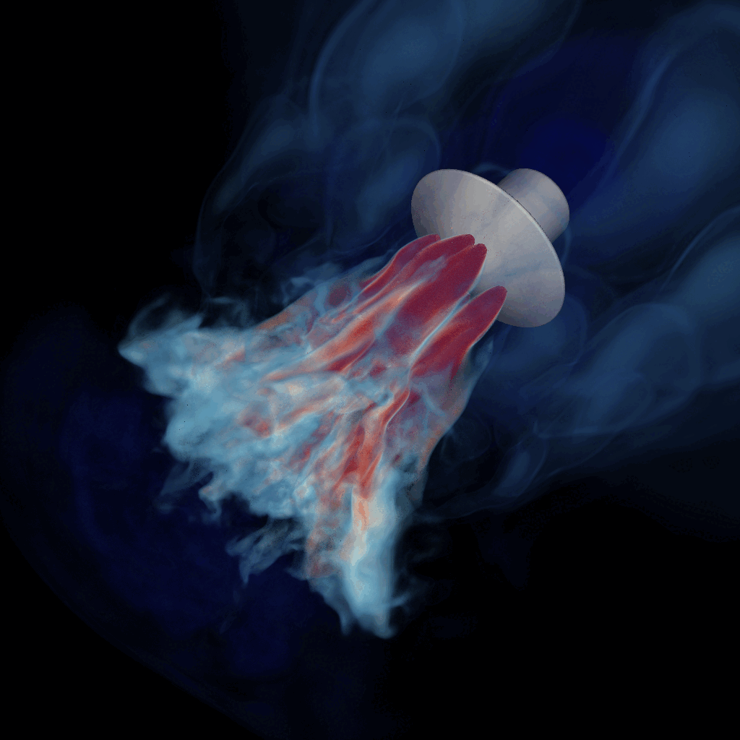
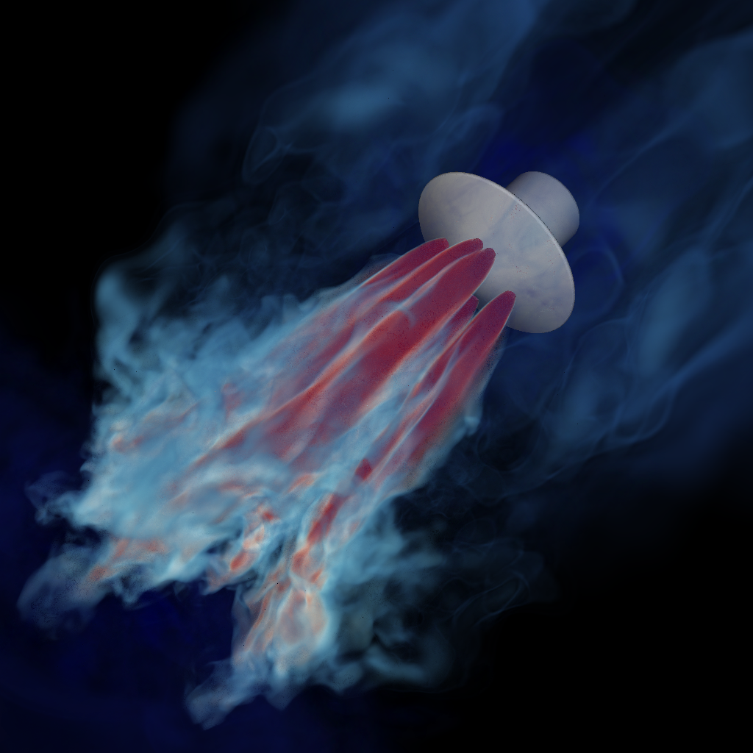
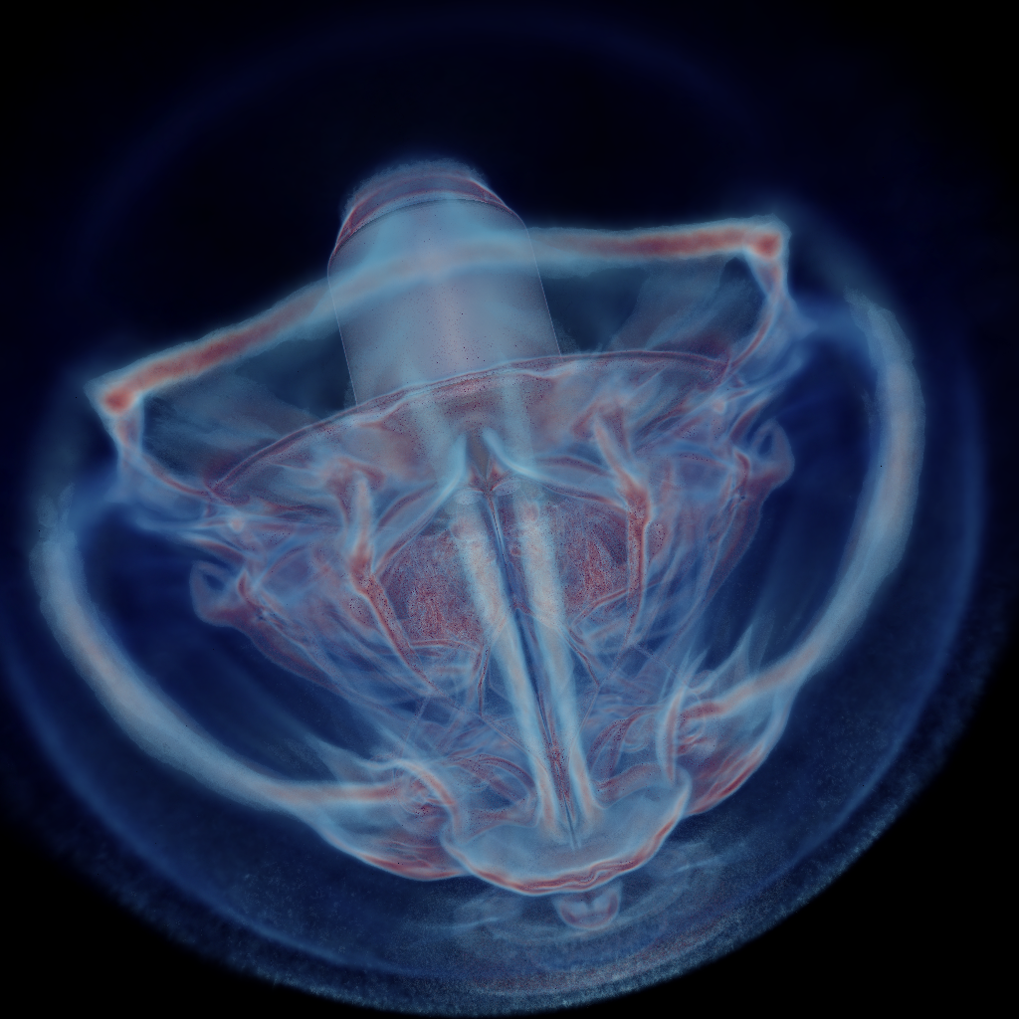
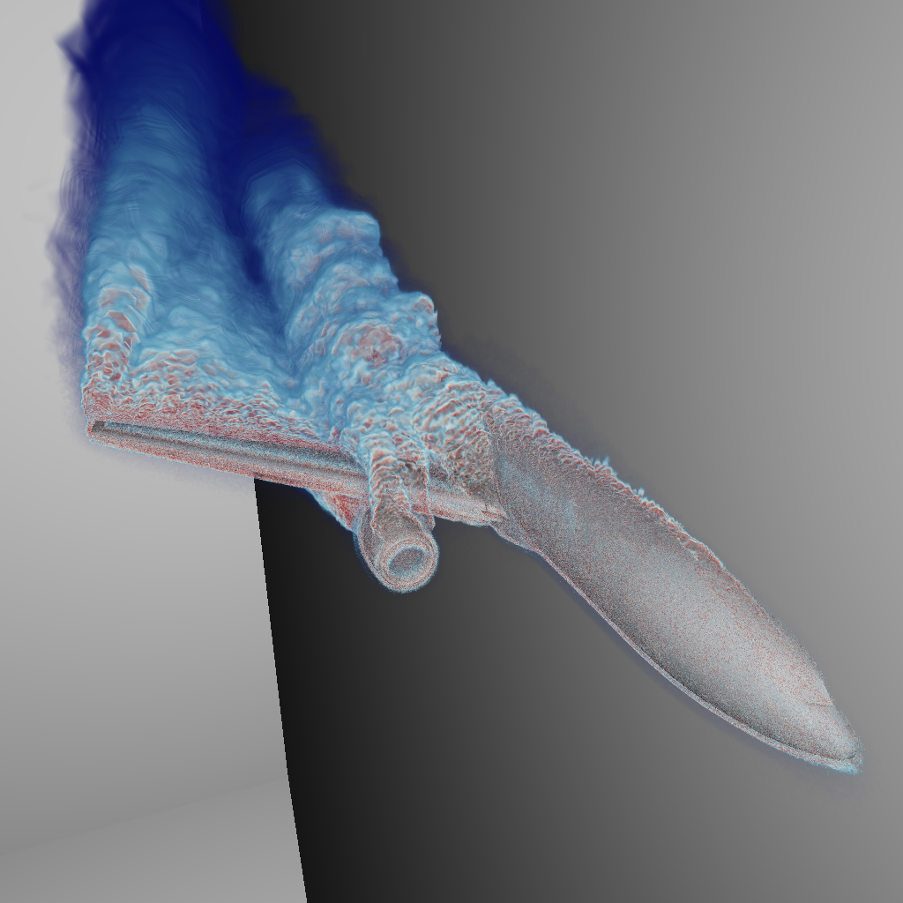
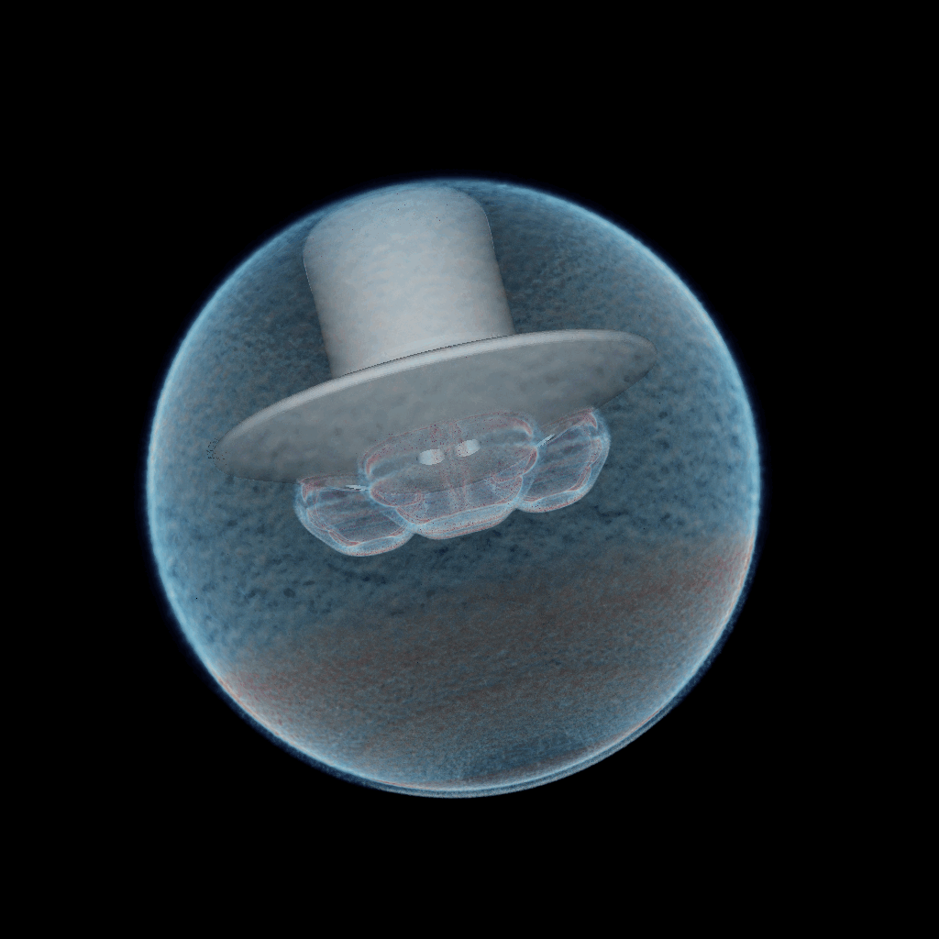
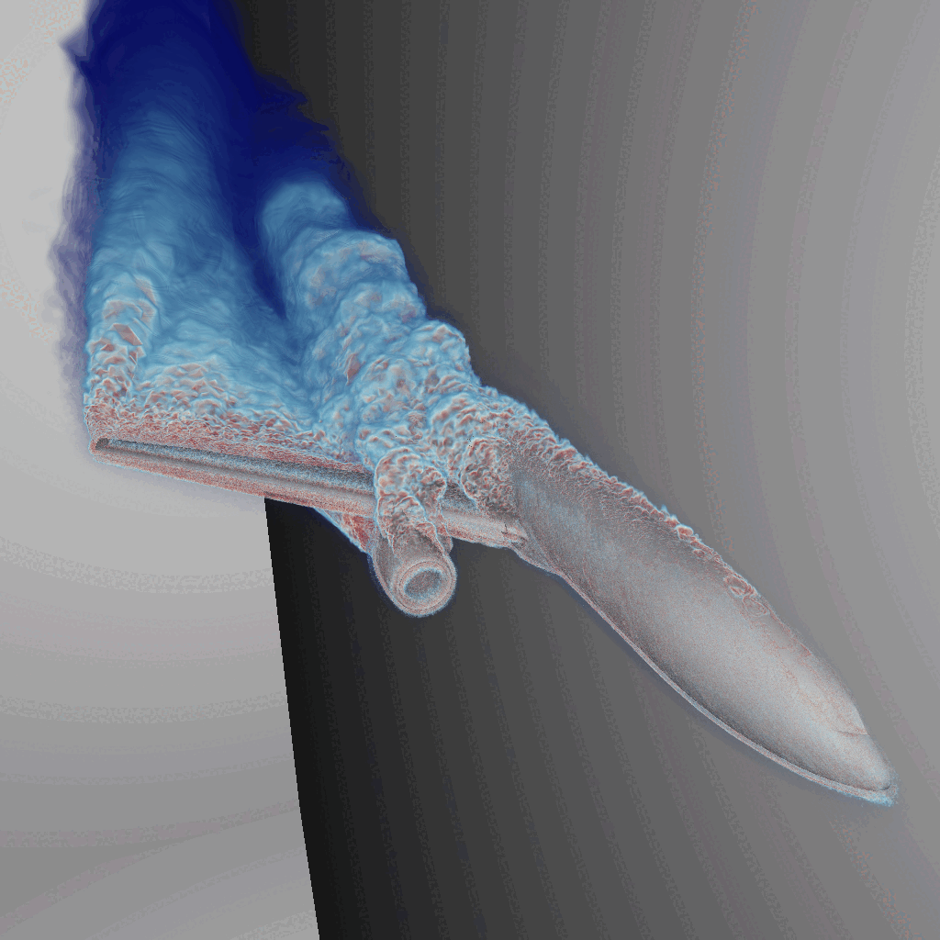
Modern CFD Simulations produce massive distributed data
Data-parallel methods are required to visualize the results
Airplane
Small lander
Huge lander
253M vertices
400 Partitions
14 GB
145M vertices
72 Partitions
14 GB
1.2G vertices
552 Partitions
112 GB

Slide 3
Data-parallel Volume Rendering
Data
Rays
Camera

Slide 4
Data-parallel Volume Rendering
Data is partitioned into different compute nodes
Trace rays into partitions at each node
Sort and composite the results from different nodes
Produce the final image
Node 0
Node 1
…
Node N

Slide 5
Data-parallel Volume Rendering
Data is partitioned into different compute nodes
Trace rays into partitions at each node
Sort and composite the results from different nodes
Produce the final image
Node 0
Node 1
…
Node N
Img 0
Img 1
Img n

Slide 6
Data-parallel Volume Rendering
Data is partitioned into different compute nodes
Trace rays into partitions at each node
Sort and composite[1] the results from different nodes
Produce the final image
Node 0
Node 1
…
Node N
Img 0
Img 1
Img n
[1] K. Moreland, “IceT Users’ Guide and Reference,” Sandia Nat’l Lab., Tech. Rep., 2011.

Slide 7
Data-parallel Volume Rendering
Data is partitioned into different compute nodes
Trace rays into partitions at each node
Sort and composite[1] the results from different nodes
Produce the final image
Img 0
Img 1
Img n
[1] K. Moreland, “IceT Users’ Guide and Reference,” Sandia Nat’l Lab., Tech. Rep., 2011.

Slide 8
Data-parallel Volume Rendering
Data is partitioned into different compute nodes
Trace rays into partitions at each node
Sort and composite [1] the results from different nodes
Produce the final image
Final image
Img 1
Img n
[1] K. Moreland, “IceT Users’ Guide and Reference,” Sandia Nat’l Lab., Tech. Rep., 2011.

Slide 9
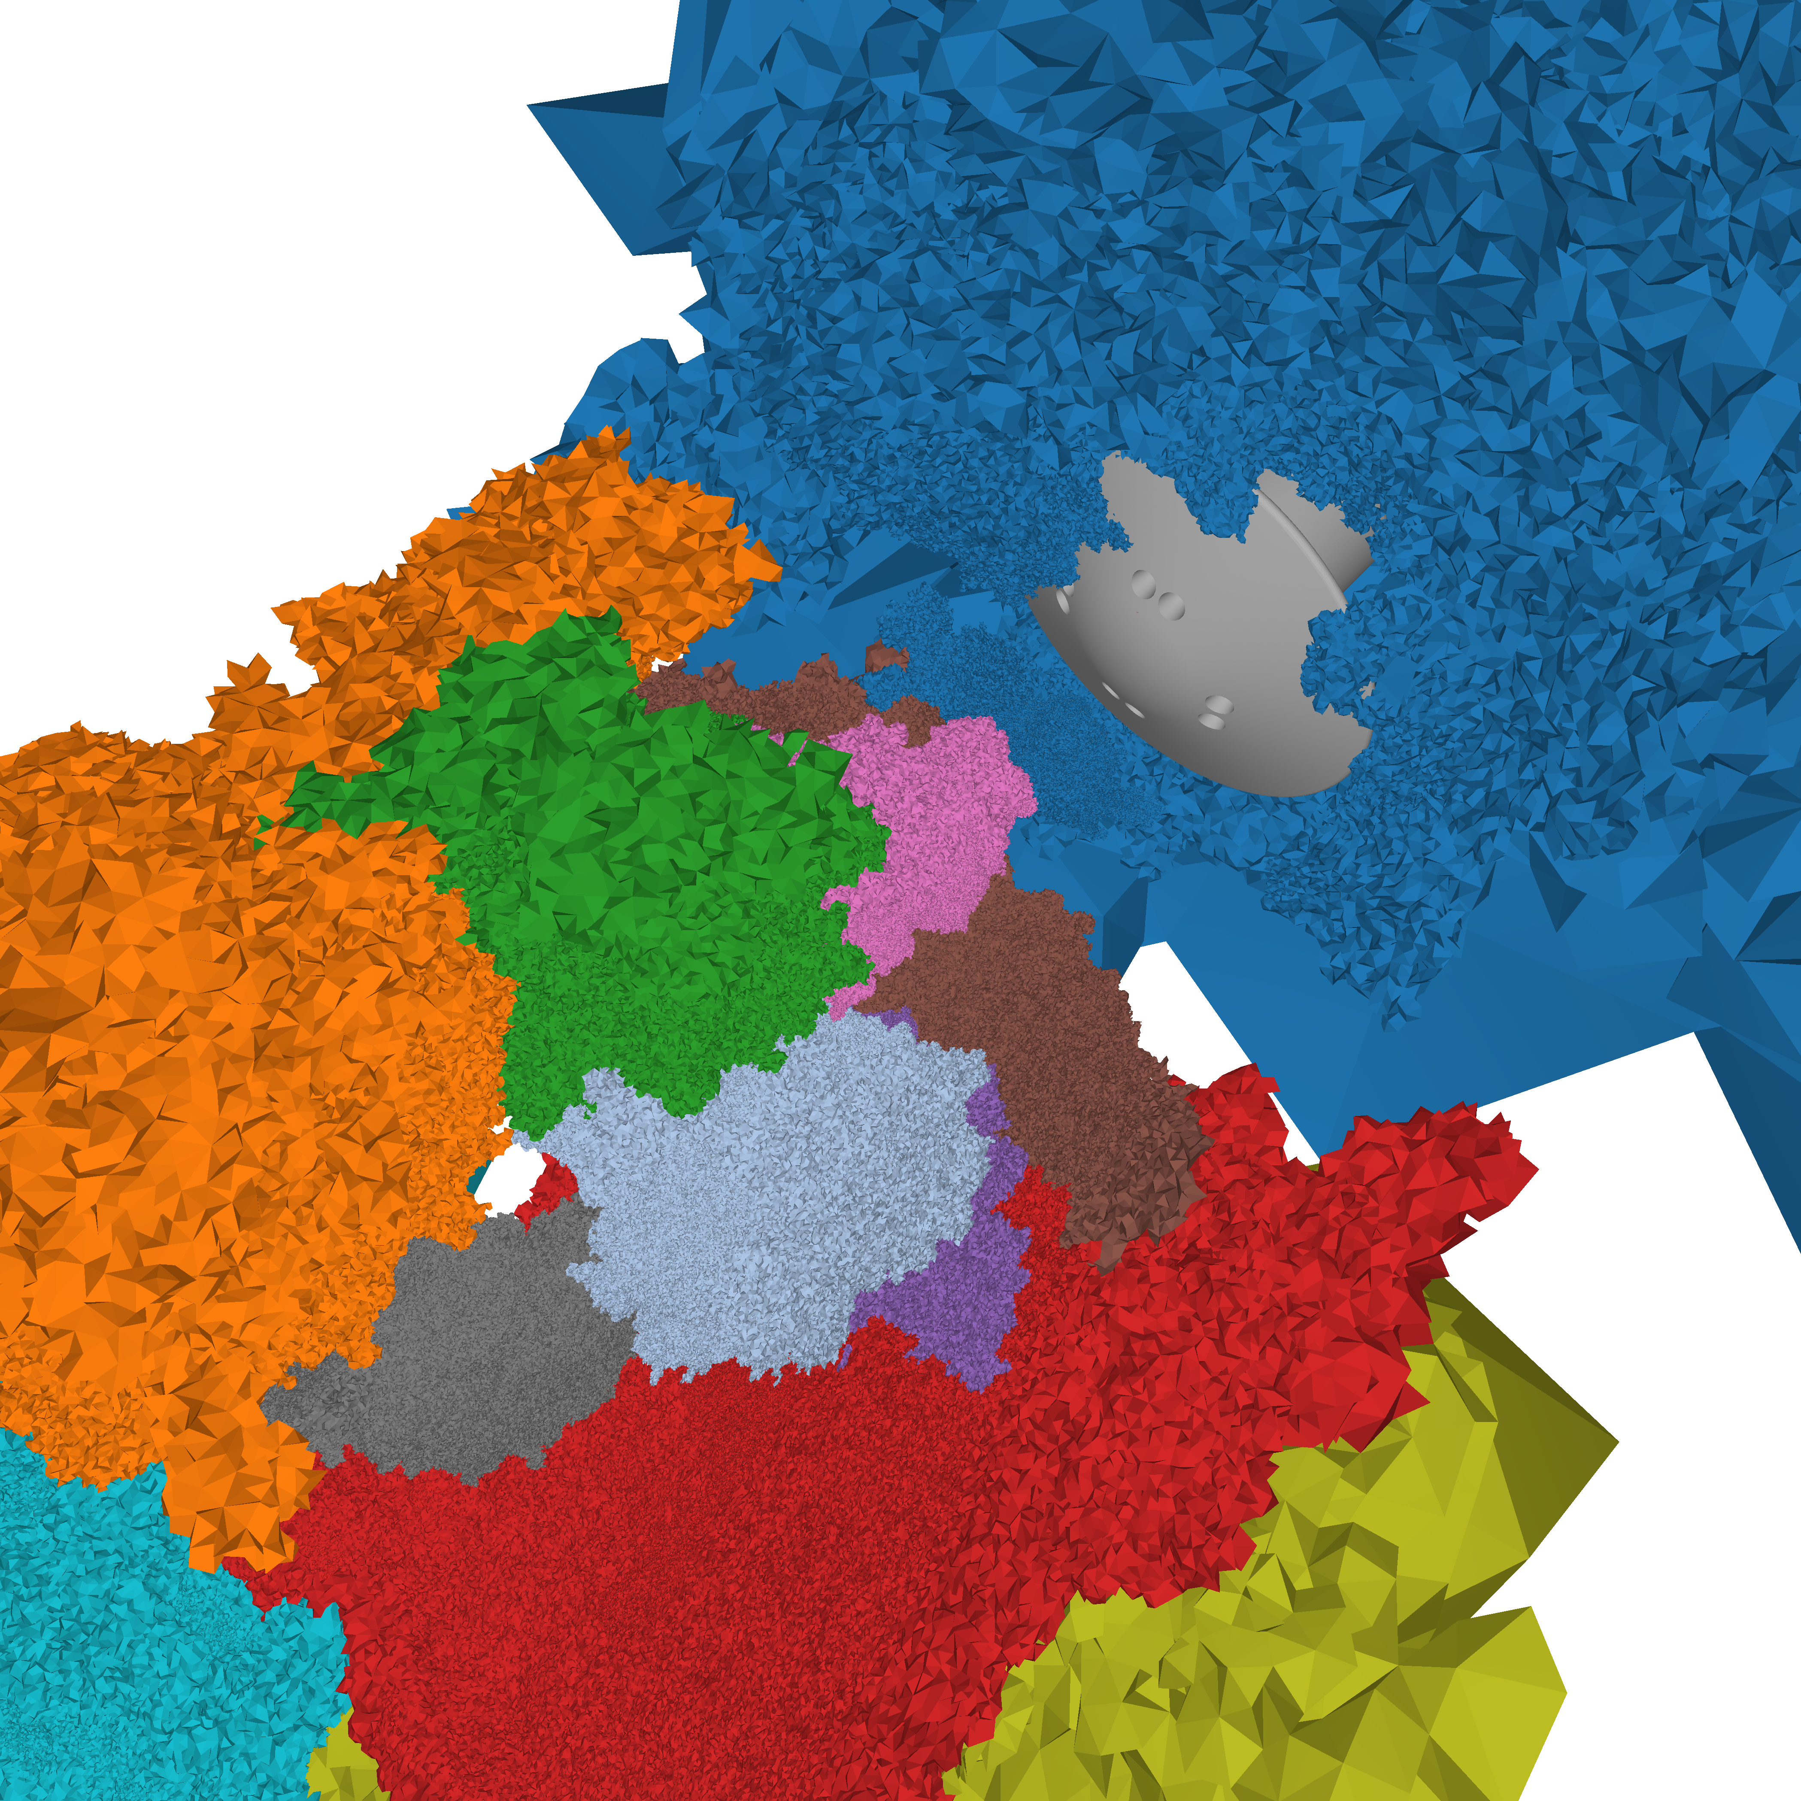
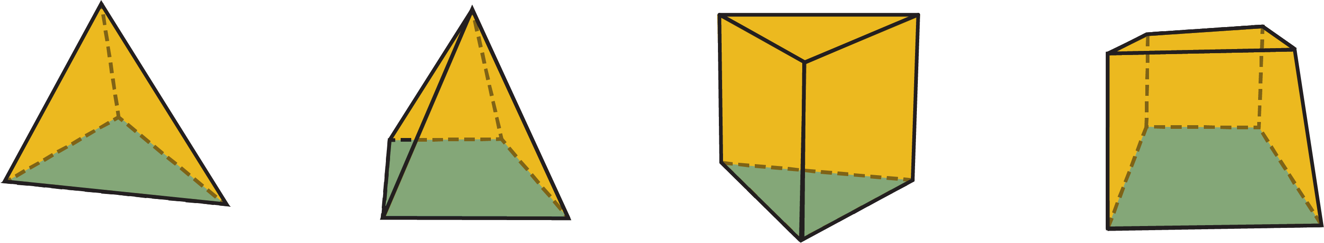
Challenges of Data-parallel Volume Rendering
Example of Fun3D [2-3]:
  Data-parallel
  Mixed unstructured mesh
  Creates non-convex non-trivial partitions: Clusters
Great for simulation performance, but challenging to render:
  Non-convex boundaries → disrupts ray traversals
  Interleaved ray paths → complicates compositing
  Redistribution is impractical → use native distribution
  Unstructured elements → costly & complicated traversal
[2] NASA, “Fun3D Manual,”available at https://fun3d.larc.nasa.gov/ , Accessed: 24 March 2022.
[3] P. J. Moran, “FUN3D Retropropulsion Data Portal - NASA,”Jul 2020, available at https://data.nas.nasa.gov/fun3d/, Accessed:27 Nov. 2023.

Slide 10
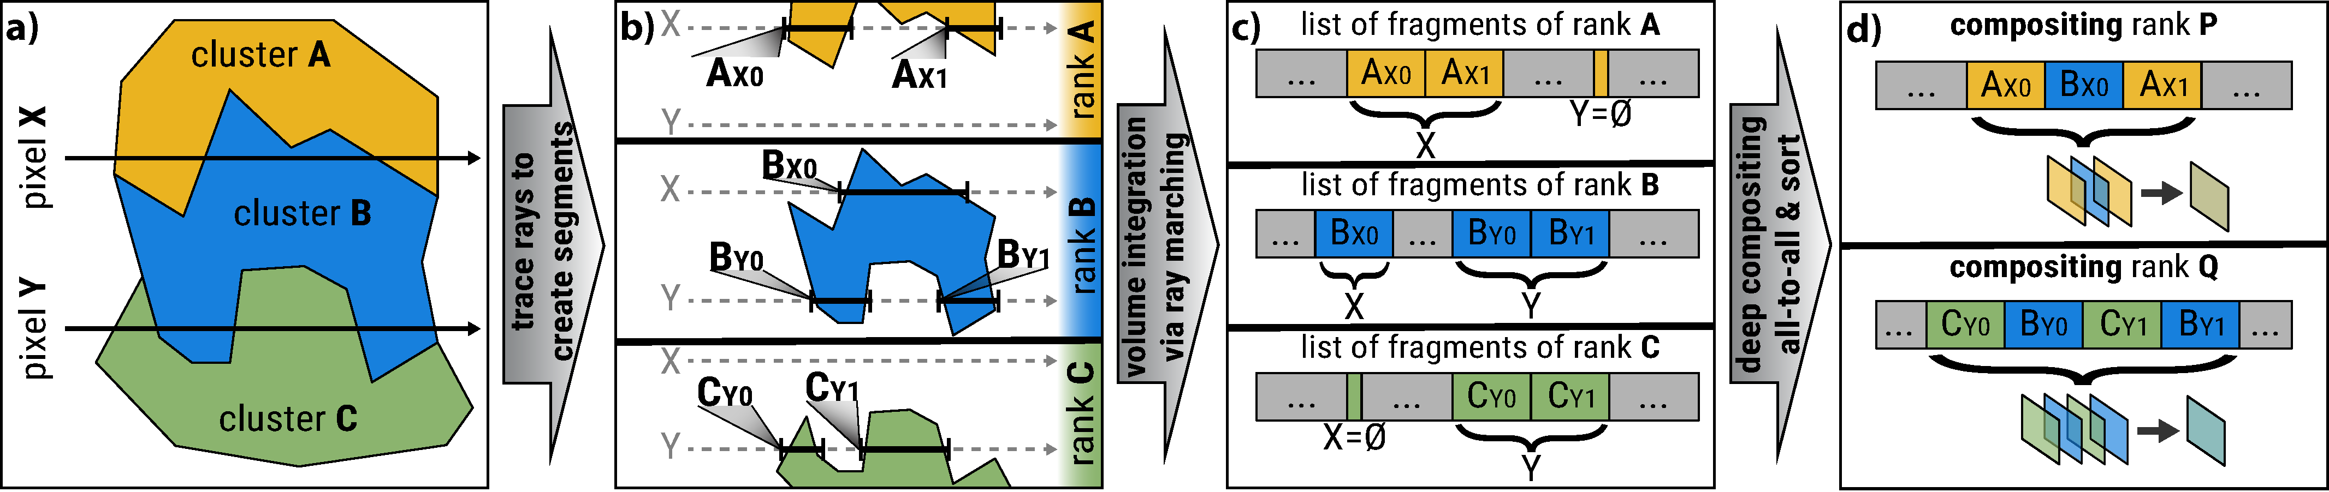
Contributions
We propose a framework:
RT-core–accelerated ray marcher with built-in compression for mixed unstructured meshes
GPU-aware MPI pipeline for efficient multi-node communication
Deep-compositing to combine the interleaved color-fragments

Slide 11
RT-core accelerated Ray segment Generation
Front-face culling: ON
Ray Segments
Camera
[4] A. Sahistan, S. Demirci, N. Morrical, S.Zellmann, A. Aman, I. Wald, and U.Güdükbay,“Ray-traced shell traversal of tetrahedral meshes for direct volume visualization,” in Proc. IEEE Vis. Conf. - Short Papers, ser. VIS’ 21, Oct 2021, pp. 91–95.

Slide 12
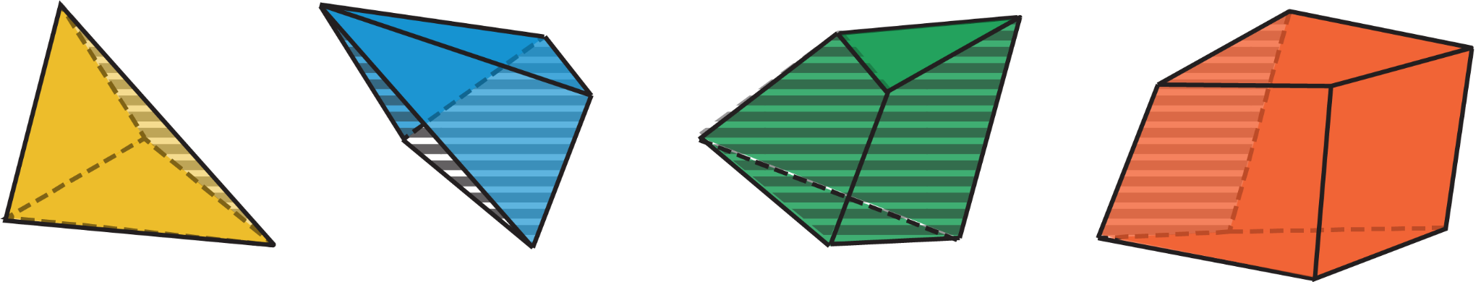
XOR-compacted Segment Volume Integration
Use element connectivity to traverse
  Most simulations store connectivity
XOR-compression [5-6]
  Exploit shared faces (3-4 vertices)
  Exclusive Or (XOR): (a ⨁ b ) ⨁ b = a
  Use precomputed XOR fields and shared faces to construct the next element
V0
?
V4
V2
V3
V1
[5] A. Aman, S. Demirci, and U. Güdükbay, “Compact tetrahedralization based acceleration structures for ray tracing,” J. Vis., vol. 25, no. 5, pp. 1103–1115, Oct 2022.
[6] A. Aman, S. Demirci, U. Güdükbay, and I. Wald, “Multi-level tetrahedralization-based accelerator for ray-tracing animated scenes,” Comp. Anim. Virt. Worlds, vol. 32, no. 3-4, pp. e2024, 11 pages, 2021.

Slide 13
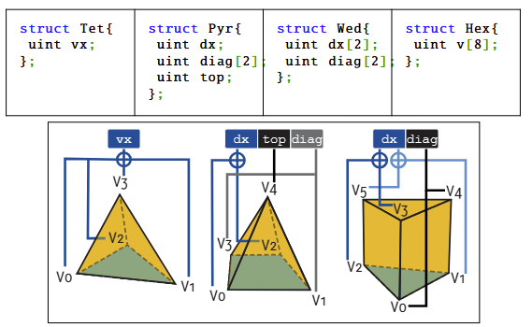
XOR-compacted Segment Volume Integration
XOR-compression
  Exploit shared faces (3-4 vertices)
  Exclusive Or (XOR): (a ⨁ b ) ⨁ b = a
  Use precomputed XOR fields and shared faces to construct the next element
V0
V0
Compression | 4x | 1.25x | 1.5x | 1x
?
=VX⨁(V0⨁V1⨁V2)
V2
V2
= (V0⨁V1⨁V2⨁V3) ⨁(V0⨁V1⨁V2) = V3
V1
V1

Slide 14
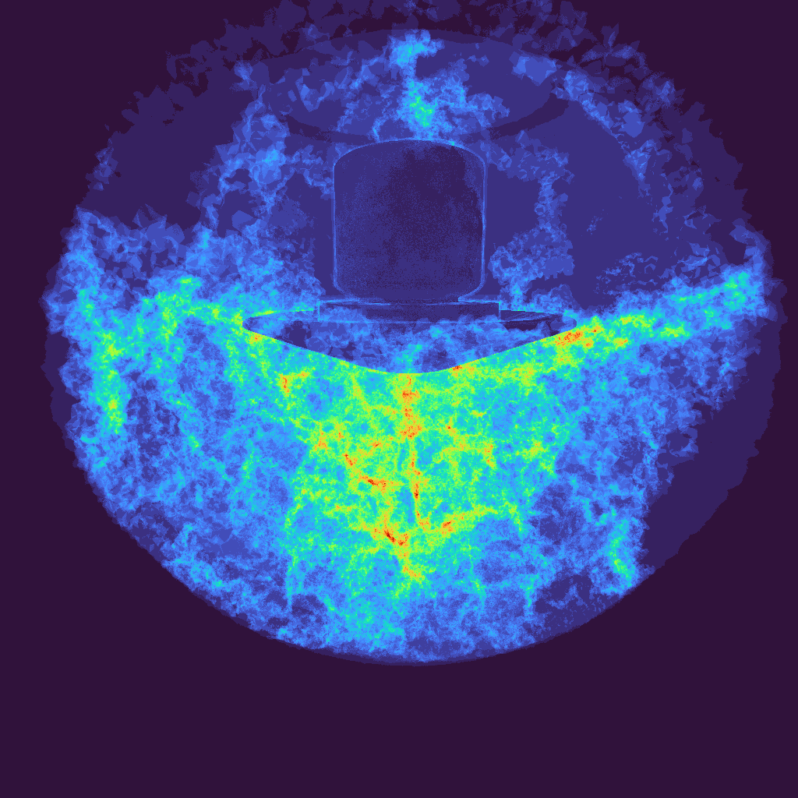
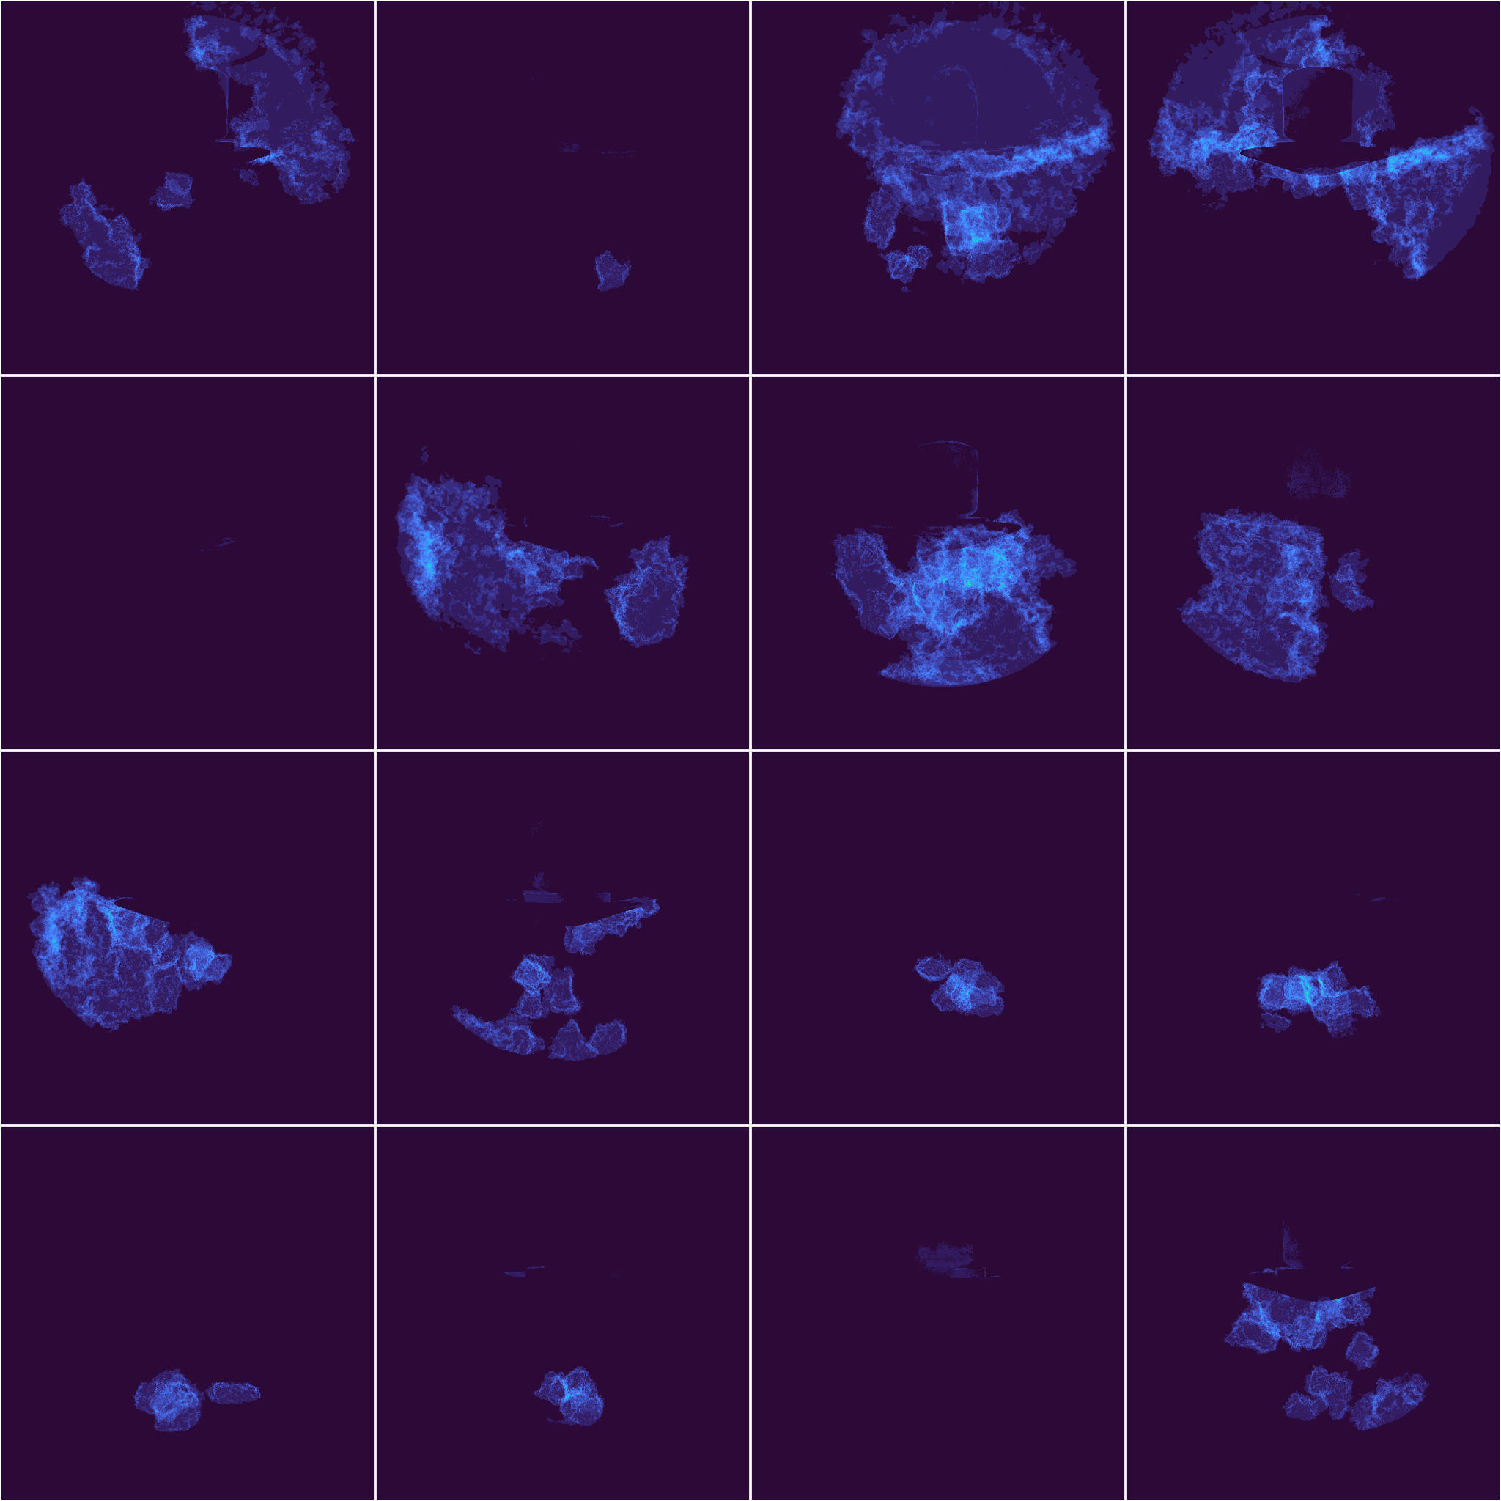
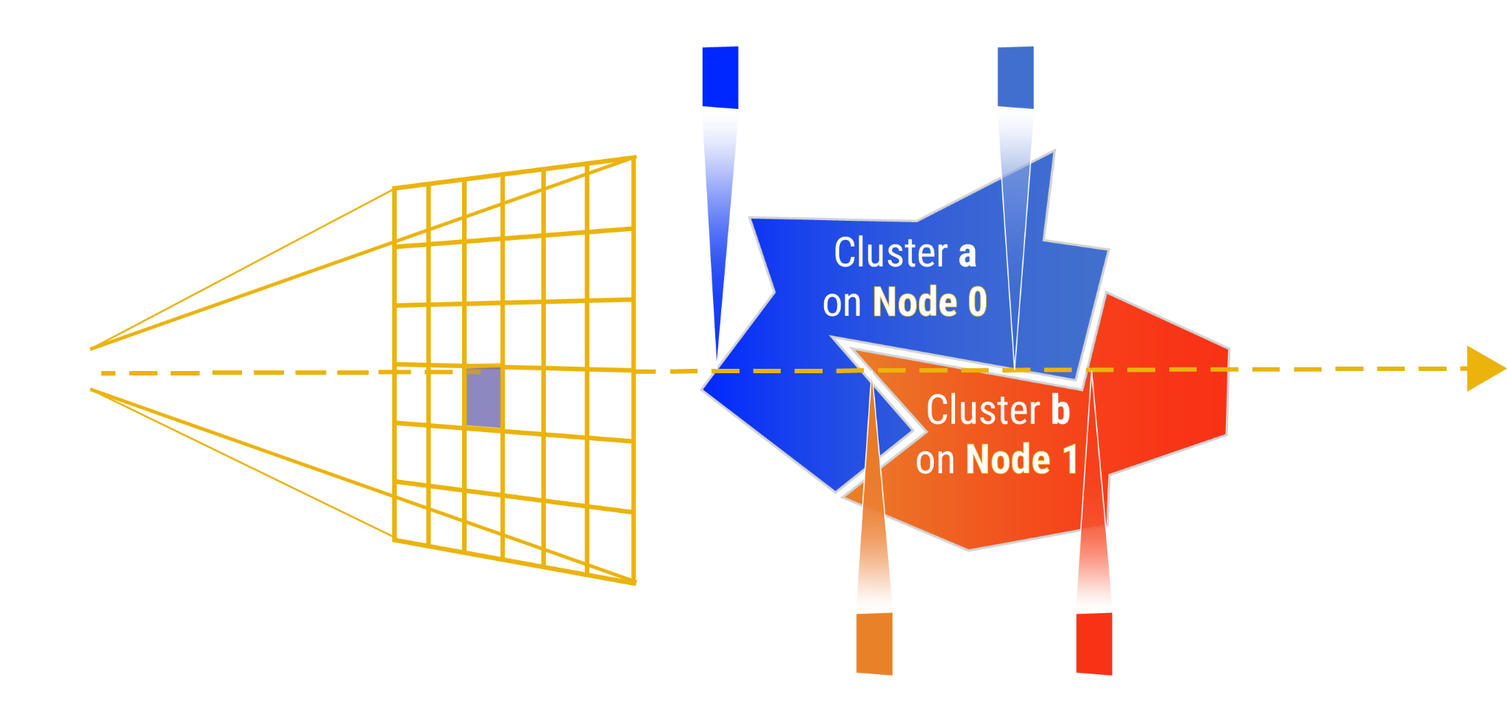
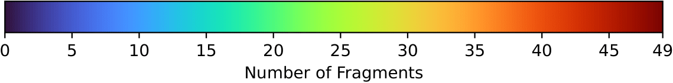
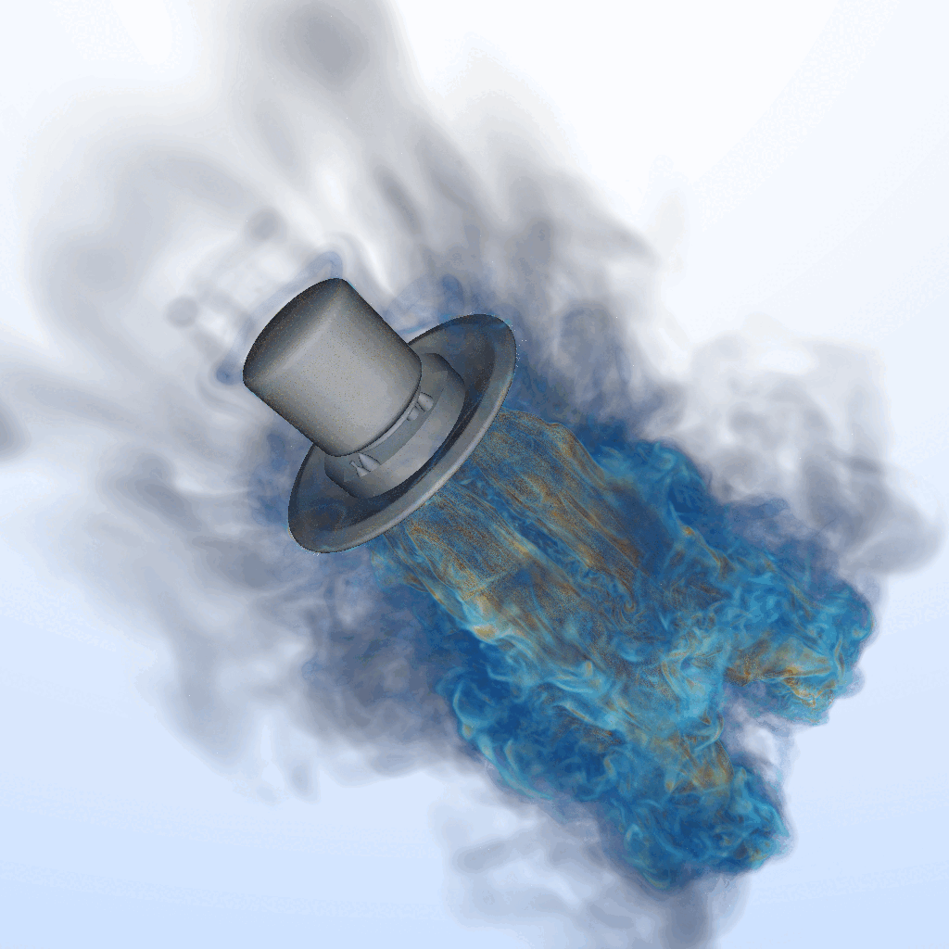
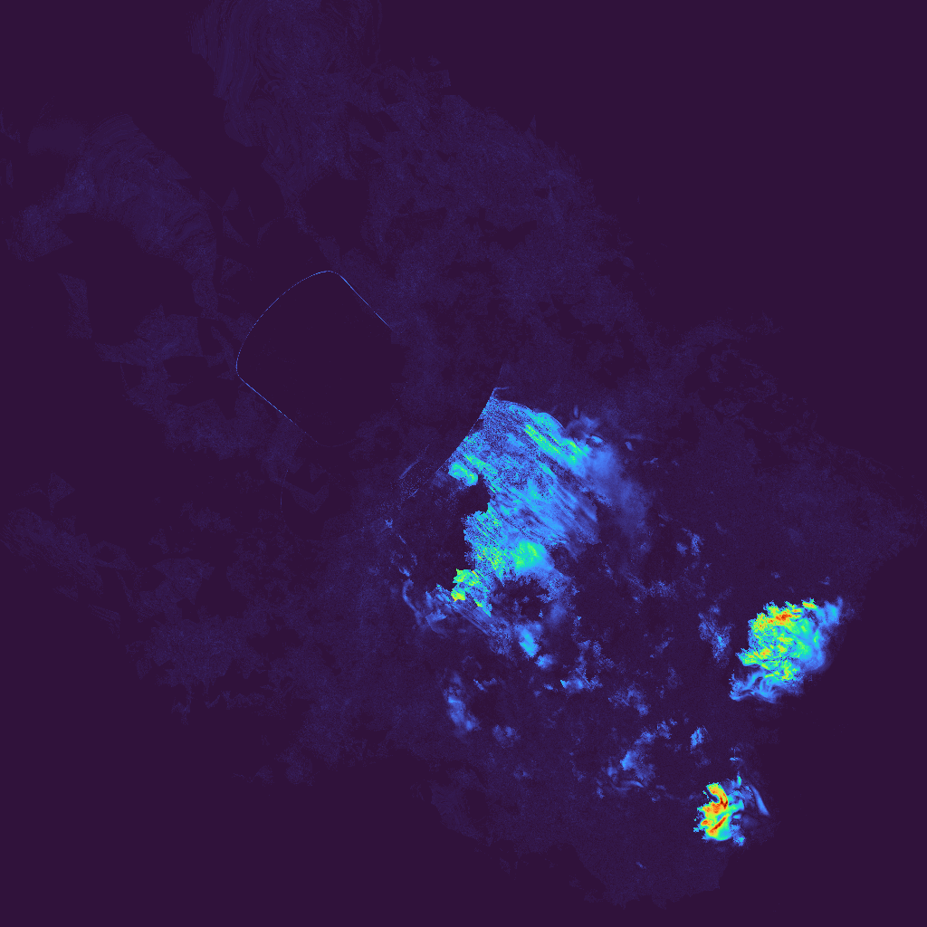
Deep-compositing
Now for every ray segment we have a fragment that stores a RGBA-Z value:
  RGBA= color and transparency information
  Z = entry depth of the shell
Ranks depth-sort local fragments, exchange pixel tiles via GPU-aware MPI, and composite them in visibility order to produce the final image
Wouldn't ICE-T work?
    Short answer: No
Camera

Slide 15
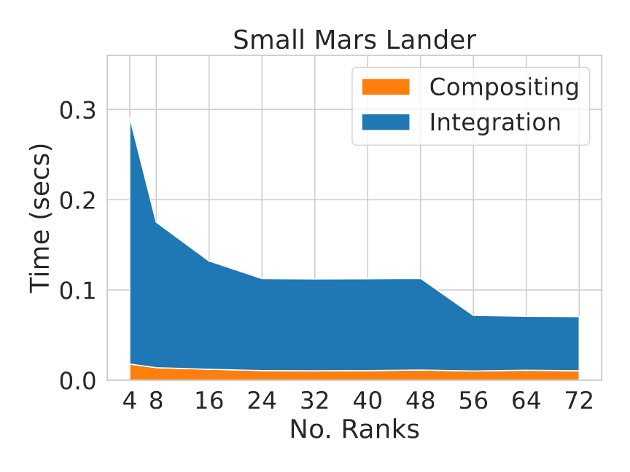
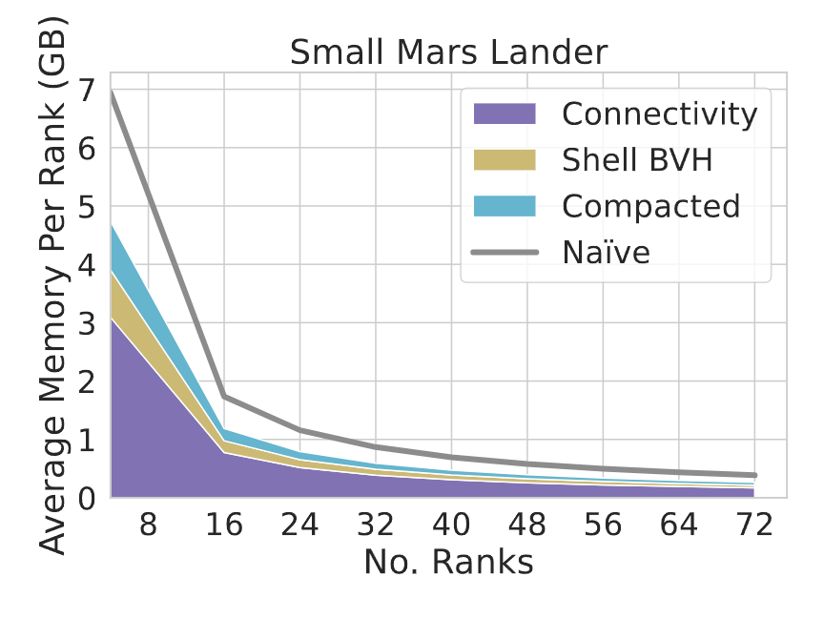
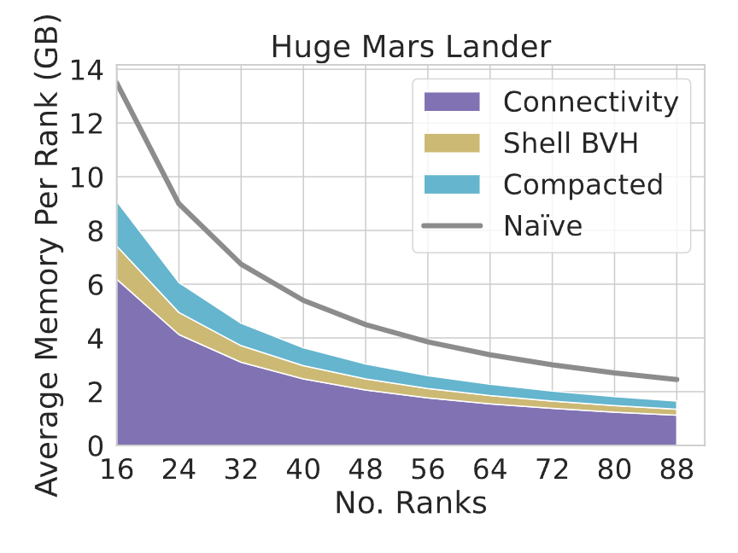
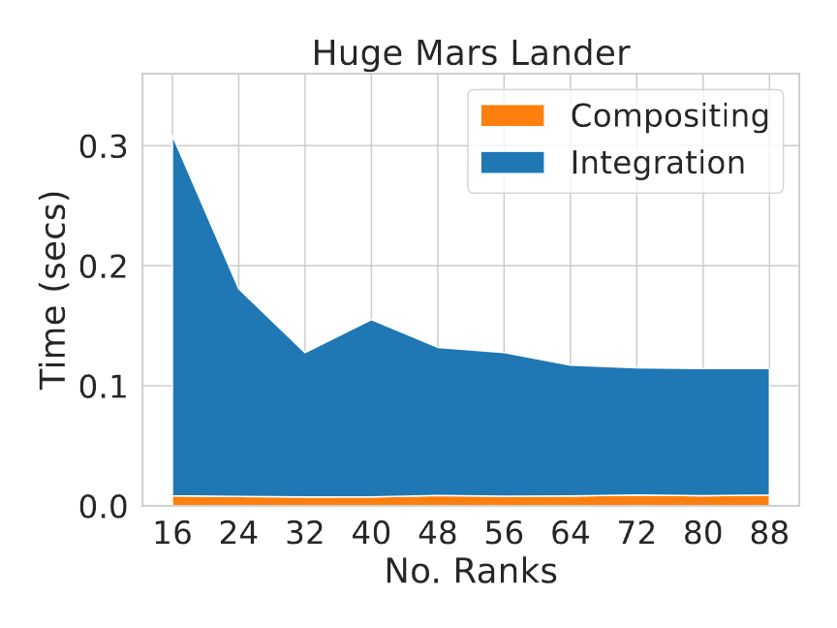
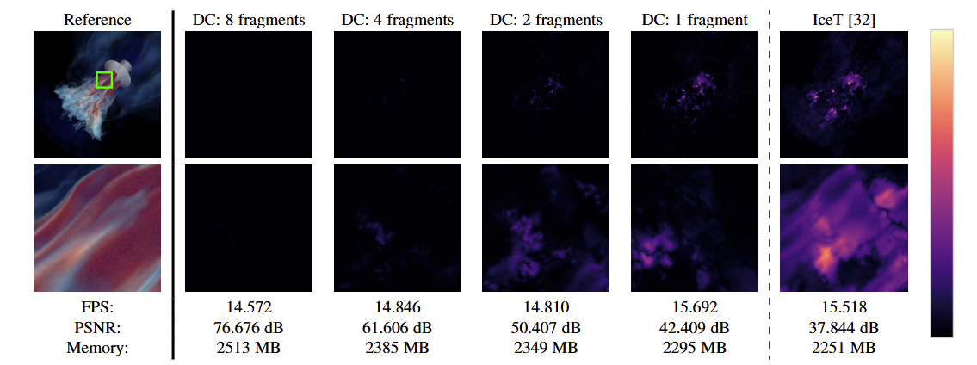
Results
We achieve 9-15 FPS while scaling up to 88 GPUs
  majority of the time is spent on volume integration (compositing scales ≈ constant)
XOR-compaction works best when there are many tets.
  Connectivity is the dominating factor
Our deep compositor provides correct visuals with minimal compromise compared to IceT
for just 6.5% performance cost, PSNR: 37.8dB→ 76.6dB

Slide 16



Scalable, Memory-Efficient Visualization for Non-trivially Distributed Meshes
Interactive and correct rendering: Renders non-convex, mixed-element meshes directly.
Memory-efficient traversal: XOR-compaction reduces storage and improves cache utilization.
Scalable & Correct compositing: GPU-aware MPI ensures correct depth ordering across nodes.
Paper on IEEE
Preprint

