Slide 1

analyzing AN ONLINE GAME’s DATA TO EVALUATE ITS SUCCESS
Basri Kahveci
Software Engineer at Peak Games

Slide 2
Outline
Goal of the project
Social game metrics
Brief description of NEW Battles
Data used in the project
Tools, methods, algorithms used
Data preparation
Modeling
Results and conclusion

Slide 3

About Peak Games
2 years old social gaming company focused on the emerging markets of Turkey, Middle East and North Africa.
One of the top 5 social gaming companies in the world.
More than 20 games on Facebook.
8 M daily active users and 24 M monthly active users.
(Up-to-date AppData stats)

Slide 4
NEW Battles
NEW Battles is Peak Games’ latest browser based strategy game running on Facebook platform.
https://apps.facebook.com/newbattles/
Beta release was in July 2012.
Commercial full release will be in January 2013.

Slide 5
Goal of the Project
Analyzing one of beta game servers’ data and gaining insights about game’s success during the beta process using common social game metrics.
Extract useful, actionable information to develop ideas for the commercial release.

Slide 6
Social Game Metrics
3 main categories:
Retention
Acquisition
Monetization

Slide 7
Retention
Retention metrics are about how much your users play and engage with your game.
Game with higher retention provides a better basis for a sustainable success.
Users typically generate more revenue after they have been in the game for a while.

Slide 8
Acquisition
Cost-effectively and profitably channeling users into the game.
Different marketing channels, ad campaigns, demographics, geography, user sources; engagement levels and revenues of the users acquired through those channels.

Slide 9
Monetization
Making money from users.
Given that 80 to 99 percent of players in a free-to-play game never pay, it’s important to understand characteristics of paying players.
Make better offers, improve virtual goods, improve purchase paths and encourage users to make purchases.
“As more free-to-play games become the norm and selling virtual goods becomes the way to make money, game companies are relying more and more on a small fraction of players (typically 1 to 3 percent) paying to level up or for that shiny new virtual sword. Finding that 1 to 3 percent of players or getting more to pay for virtual goods can have a big impact on game revenues.”
TechChrunch, April 2010

Slide 10
A Brief Description of NEW Battles
NEW Battles is an online multiplayer strategy game (similar to Travian).
Players select one of the 3 races: North, East and West.
North is the offensive race. Its units are good for attacking but disadvantaged in defense.
East is the defensive race. They are good for defending their towns but weak in attacking enemies.
West is the balanced race. West’s units are strong but expensive.
Players build towns by constructing buildings and collecting resources. They train units and make wars with other players in the game.

Slide 11
Game Terminology
Quests: Achievements in game. Quests have completion conditions and rewards. Construct foreign affairs, Build second town etc.
Tutorials: Visual guides for players to understand fundamental elements and functionalities of the game in the beginning days of a player’s game. How to use game screens to carry out various operations e.g. sending armies, trading with other players, joining to alliances, messaging.
Battles: Players train armies in their towns and send those armies to enemies’ towns to defeat them.
Alliances: Players come together, form alliances and combine their forces. In an alliance, players reinforce other alliance members to defeat enemies, trade and share resources with each other. Alliances develop war strategies, attack other players due to those strategies and make more damage.
Gold: Using gold, players can speed up operations (train armies, construct buildings faster) or buy items. Some gold is given in the beginning of the game and they can buy more gold with real money. Monetization of the game is based on selling gold to players.
Items: Items enhance different aspects of the game. Some items are used to speed up resource generation while other ones are used to increase armies’ attack / defense power. Some quests give items as reward and players use gold to buy items.

Slide 12
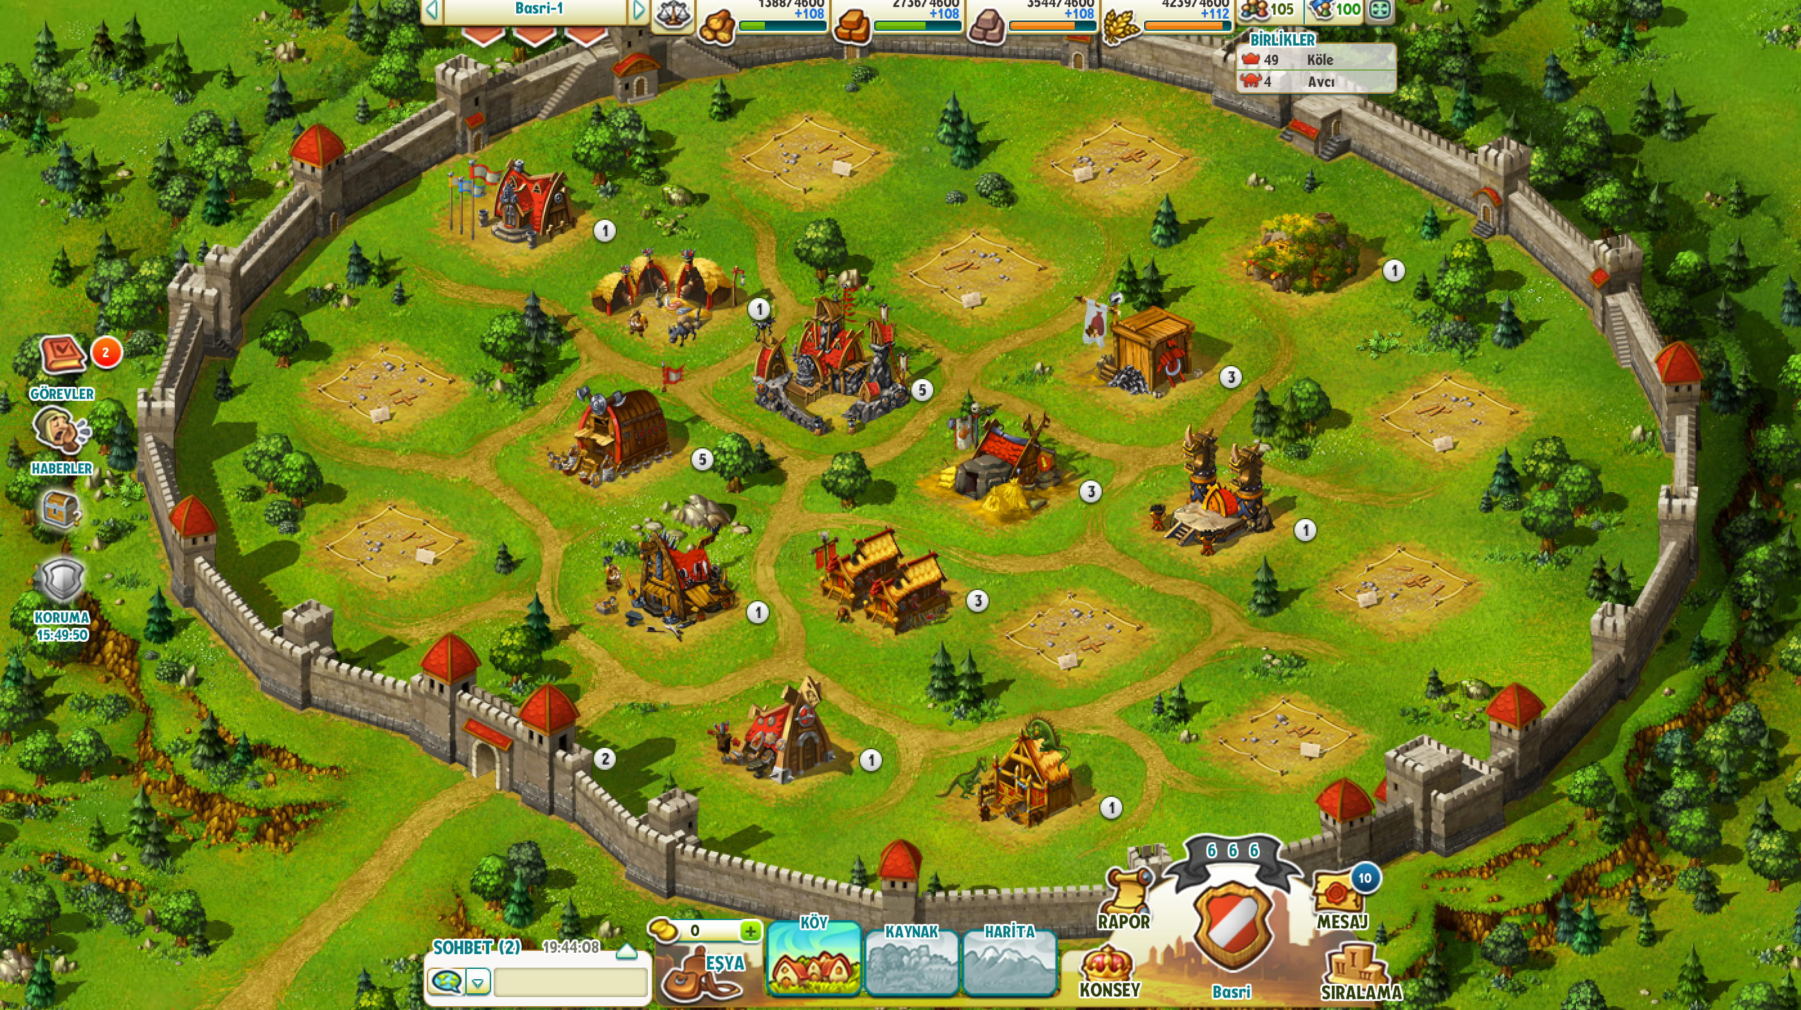
a screenshot from the game

Slide 13
Data Used in the Project
Europe Beta Server’s data is used in the project.
Game data is distributed to a bunch of different data stores.
Some portions of the data are stored in the relational manner while other portions are non-relational such as JSON documents.

Slide 14
Tools, Methods, Algorithms Used
Apache Hadoop and Apache Pig were used in data preparation process.
Data was taken from multiple databases and tables. A lot of horizontal and vertical data integration work was done for data preparation.
KNIME was used for the analysis.
k-Means was used for clustering and C4.5 decision tree was used for classifications.
Apache Hadoop: A framework that allows for the distributed processing of large data sets across clusters of computers using simple programming models.
http://hadoop.apache.org
Apache Pig: A platform for analyzing large data sets that consists of a high-level language for expressing data analysis programs.
http://pig.apache.org

Slide 15
Data Preparation
On the 52th day of the Europe beta server, database snapshots were taken to a local machine. That server’s total life time is 120 days.
Several tables were merged into 1 large table using joins, aggregations etc.
Collected data set consists 22094 rows with 23 features.
Each row represents a user.
Features are:
- taken directly from database tables,
- generated with aggregations,
- derived from generated features.
Getting meaningful and useful features is quite challenging.

Slide 16
Data Preparation - Features
nation (categorical): North, East, West
ref (categorical): ad1, ad2, ad3, bookmark, search, other
country (categorical): ctr1, ctr2, ctr3, ctr4, ctr5, ctr6, ctr7, ctr8.
is_ad (categorical): True, False
alliance_action_count (ratio scale)
is_currently_alliance_member (categorical): True, False
total_session_count, distinct_session_days, sessions_per_day, quest_count, tutorial_count, victory_count, defeat_count, total_battle_count, payment_count (ratio scale)
total_session_duration, avg_session_duration, max_session_duration, first_session_duration, total_payment (absolute scale)
latest_quest_id, latest_tutorial_id (categorical)

Slide 17
Data Preparation – Missing Features, Data Cleaning
Only advertisement sourced users’ country features are known (because of the Facebook). 15% of the users are not from advertisement sources, so their country feature is missing. These rows are ignored for one of the models.
Some rows have too much missing features because of inconsistencies in database tables. These rows are removed (1%).
latest_quest_id, latest_tutorial_id are categorical and number of values for these features are very high. Not very useful.

Slide 18
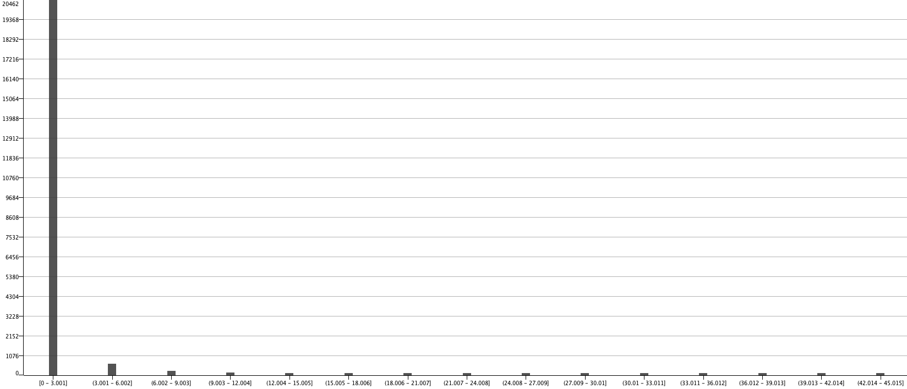
Data Visualization – # of days played
90% of players played the game for only 3 days.
Actually, 75% of players played the game for only 1 day.

Slide 19
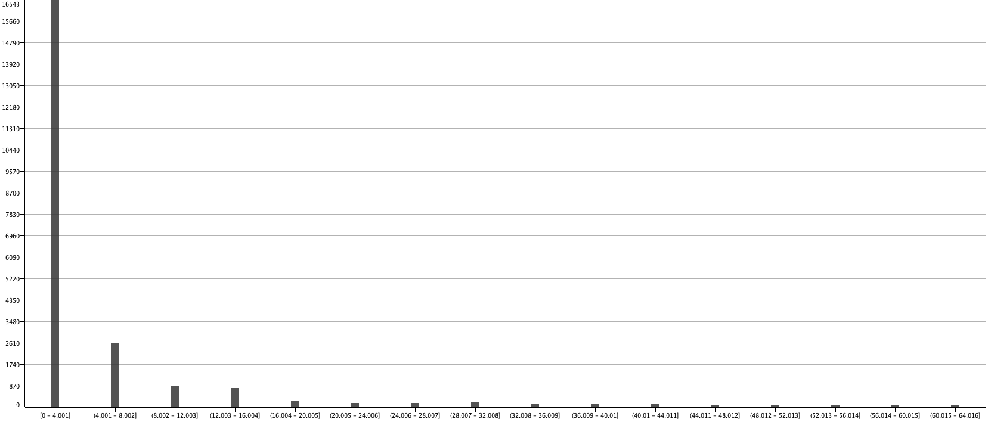
Data Visualization – Quest count
75% of players completed only 4 quests (1 day players).

Slide 20
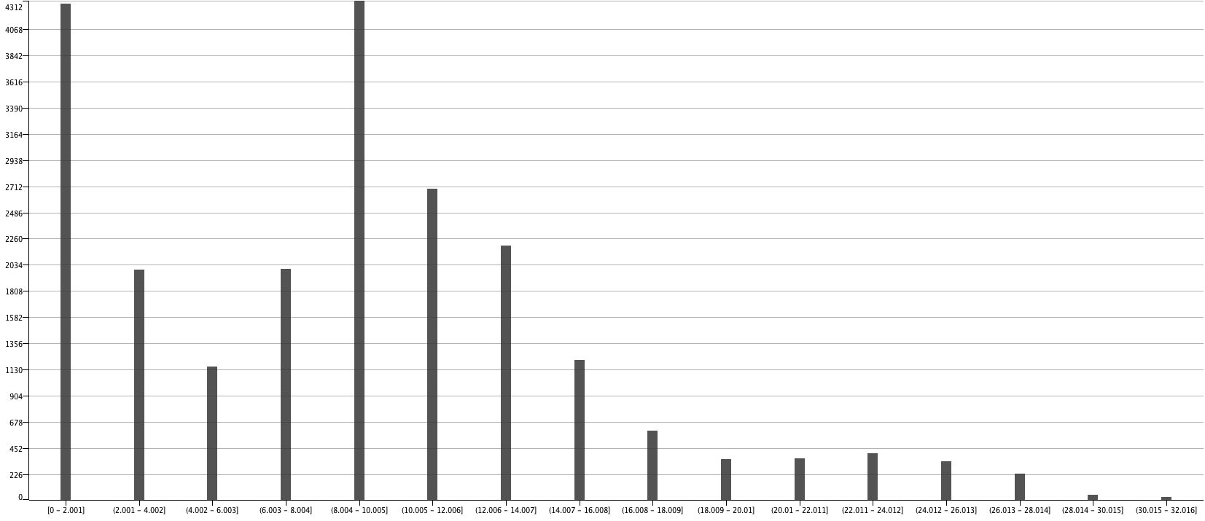
Data Visualization – Tutorial count
Players’ engagement with tutorials is good.
A lot of players completed 6-12 tutorials.
First 2 bars are probably the players already know how to play similar games.

Slide 21
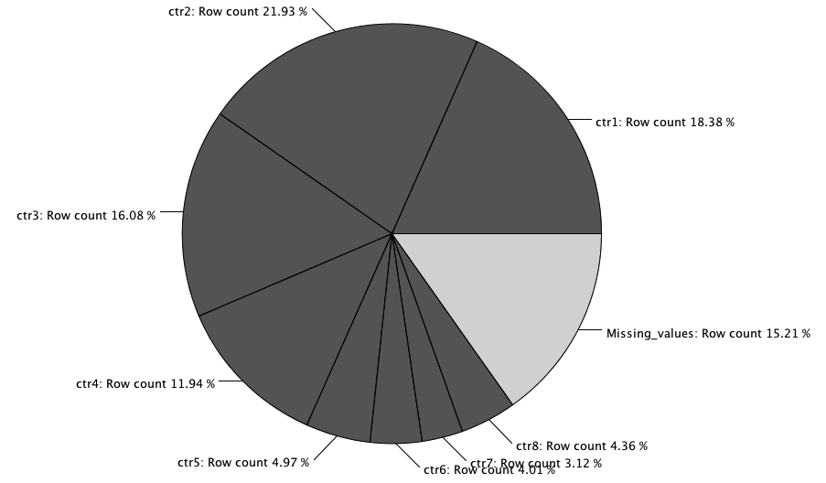
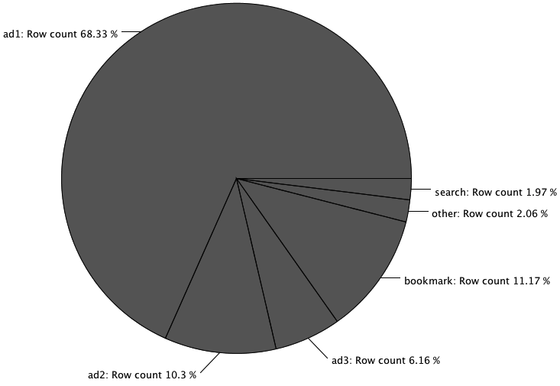
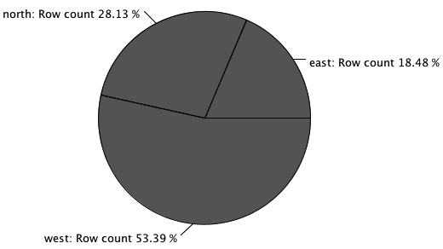
Data Visualization – ref, country, nation

Slide 22
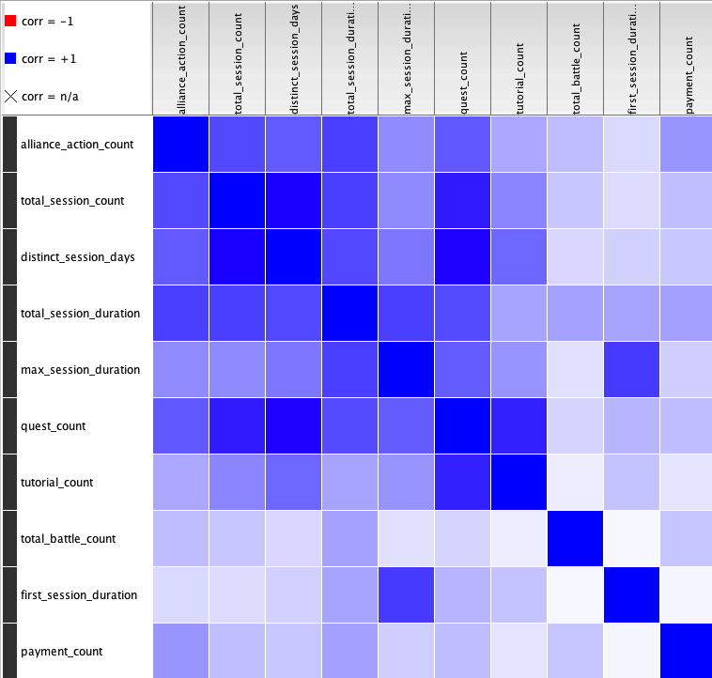
Correlation Between Features
alliance_action_count is positively correlated with total_session_count and payment_count count.
quest_count’s correlation is higher than tutorial_count’s correlation with distinct_session_days.
first_session_duration is highly correlated with max_session_duration because of the one time players.

Slide 23
Analyzing Players’ Engagement
Players’ engagement is important for retention and acquisition metrics.
Players are analyzed using number of days played, quest counts, tutorial counts, alliance action counts and total payment features.
Each feature is clustered with k-Means and a score is given to each cluster considering features’ significance on engagement.
For each player, total engagement score is calculated summing the given scores.
ref and country features are analyzed using total engagement scores.
Significance of features: total payment > alliance action count > number of days played > quest count > tutorial count.
Players with missing country feature are ignored (15%).

Slide 24
Clusters
Cluster | Coverage | # of Days Played
Cluster 0 | 2.5% | 13.3
Cluster 1 | 15.5% | 2.6
Cluster 2 | 2% | 34.5
Cluster 3 | 80% | 1
Cluster | Coverage | Quest Count
Cluster 0 | 6% | 16
Cluster 1 | 23% | 6
Cluster 2 | 3% | 40
Cluster 3 | 54% | 2
Cluster 4 | 14% | 0
Cluster | Coverage | Tutorial Count
Cluster 0 | 33% | 9
Cluster 1 | 30% | 13
Cluster 2 | 7% | 23
Cluster 3 | 30% | 3
Cluster | Coverage | Total Payment
Cluster 0 | 0.02% | 3822
Cluster 1 | 0.06% | 900
Cluster 2 | 0.2% | 177
Cluster 3 | 99.7% | 0

Slide 25
Acquisition and retention analysis for advertisements and countries
Average engagement score is 10% of max possible engagement score.
Players’ engagement scores are compared for evaluating advertisements’ performance on different countries.
3 types of advertisements: ad1, ad2, ad3
ad1 is published in 8 countries. Ad2 and ad3 are published in only ctr1, ctr2 and ctr4.
ad1’s users from ctr7 and ctr8 are 25% more engaged than ctr1 and ctr2, 13% better than other countries.
ad1’s budget could be focused on ctr7 and ctr8. Maybe a new game server could be started for ctr7 and ctr8.
ad2’s performance is very similar in ctr1, ctr2 and ctr4.
ad3’s performance is 12% lower in ctr1. Not sure to play with budgets.
Considering order of magnitude of company’s advertisement costs is $100.000, these insights are very important.

Slide 26
Importance of Paying Users
Only 0.3% of players paid for gold.
10% of players played the game more than 3 days.
0.3% ratio is not bad for a game in beta mode.
Gaining insights about paying users may help to improve gold prices, item prices and mount campaigns in game.

Slide 27
Classifying Paying Users
Paying users are clustered using 2 features: payment count and total payment with k-Means.
3, 4, 5 were tried as number of clusters. 3 provided best results.
Clusters are used as target class and a decision tree (C4.5) is constructed to investigate paying users.
Cluster | Coverage | Payment C. | Total P. | Total P. / Payment C.
Cluster 0 | 74% | 1.8 | 117.7 | 65.4
Cluster 1 | 7% | 3.8 | 3822 | 1005
Cluster 2 | 19 % | 3.9 | 875 | 222.8

Slide 28
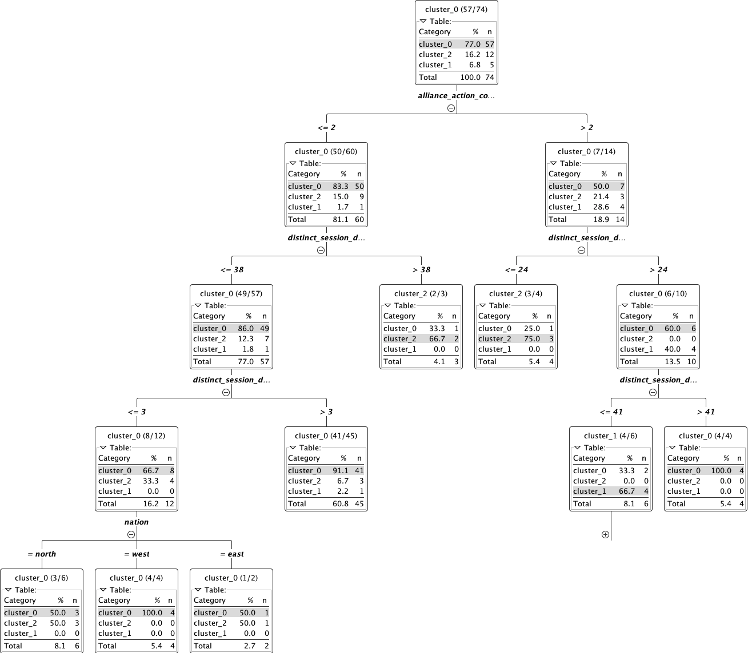
Decision tree for paying users

Slide 29
Insights about Paying Users
The offensive northern players buy gold in the first 3 days and try to be ready for attacking to enemies as early as possible. Northern players are also more likely to buy large amounts of gold in the first 3 days.
West nation’s units and buildings are expensive. They also buy gold in the first 3 days to develop their town quickly.
Cluster 2 (the middle) is higher in the branch of alliance_action_count < 2. It means, if the players play within alliances more, they will likely to be pay regularly or pay extremely high.
Players join to an alliance more than twice and play the game between 24-41 days are 40% likely to be in Cluster 1 (highest transaction rate). Cluster 1’s players probably started to play the game a little bit lately, bought large amounts of gold and spent their gold aggressively to cope with already developed players. For the late starting active users, gold campaigns can be mounted in commercial release.
Contact with Cluster 1’s and Cluster 2’s players and make them special offers for the new servers.

Slide 30
Decision tree is trained with 74 instances and tested with 10 instances.
Cross validation is done.
Classification error rate is 36%. Best: 12%, Worst: 60%.
Number of instances is low. If the classification is done with more recent data taken from the server, a better classification could be done.

Slide 31
Thank you for listening
Questions?

