Slide 1
Data Analysis of Tennis Matches
Fatih Çalışır

Slide 2
Domain of the Data
4 Types of Tennis Tournaments
  ATP World Tour 250
    ATP 250 Brisbane
    ATP 250 Sydney ...
  ATP World Tour 500
    ATP 500 Memphis
    ATP 500 Dubai

Slide 3
Domain of the Data
  ATP World Tour 1000
    ATP 1000 Paris
    ATP 1000 Shanghai ...
  Grand Slams
    Australian Open
    Roland Garros
    Wimbeldon
    US Open

Slide 4
Domain of the Data
Men’s Single
Year 2010
11 ATP 500 Tournament
9 ATP 1000 Tournament
4 Grand Slams

Slide 5
Source of Data
Internet
Official Websites of the Players
ATP(Association of Tennis Professionals) Homa Page
2010 Result Archive

Slide 6
Data Construction
From different tables
Each table from different website
Combining easily

Slide 7
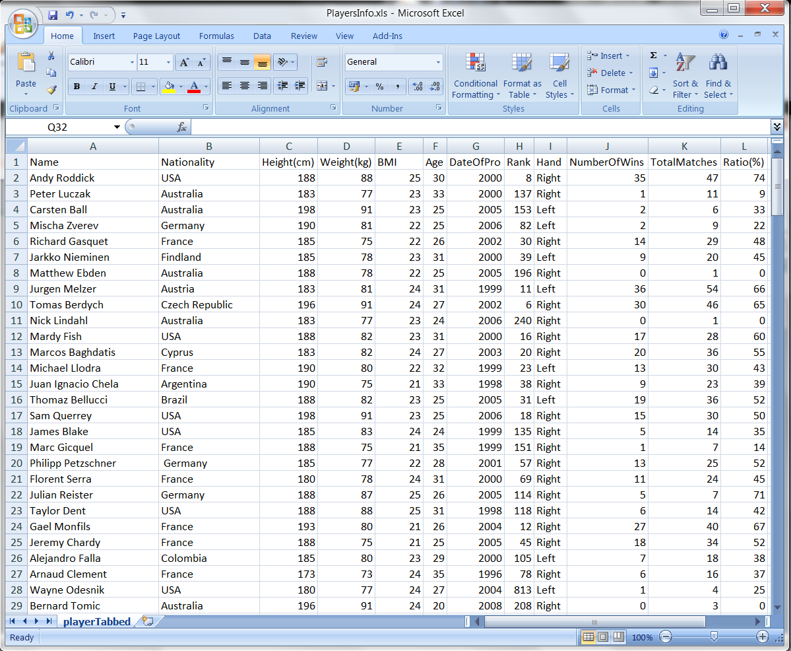
Data Construction
Players Table

Slide 8
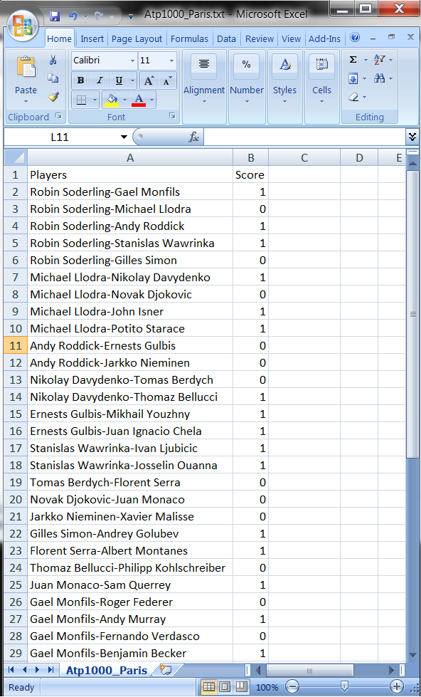
Data Construction
Tournament Results Table

Slide 9
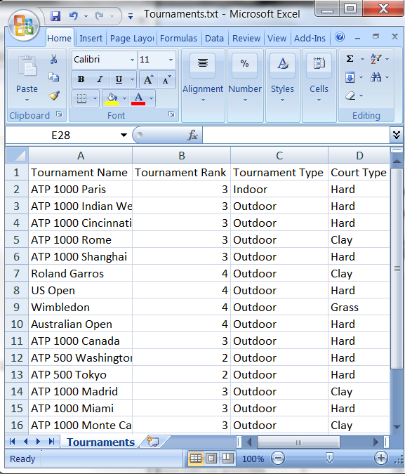
Data Construction
Tournament Info Table

Slide 10
Data Construction
Final Data Table
29 features
1453 instances

Slide 11
Aim of the Project
Classification
Finding weights for attributes

Slide 12
Missing Values
Players’ Height
Players’ Weight
Players’ BMI
Players’ Date of being Professional

Slide 13
Missing Values
Players’ Height
  Consider players with same weight
  Take the average
Players’ Weight
  Consider players with same height
  Take the average

Slide 14
Missing Values
Players’ Height and Weight
  If both of them are missing
  Remove the row
Players’ Date of beign Professional
  Consider players with same age
  Take the average

Slide 15
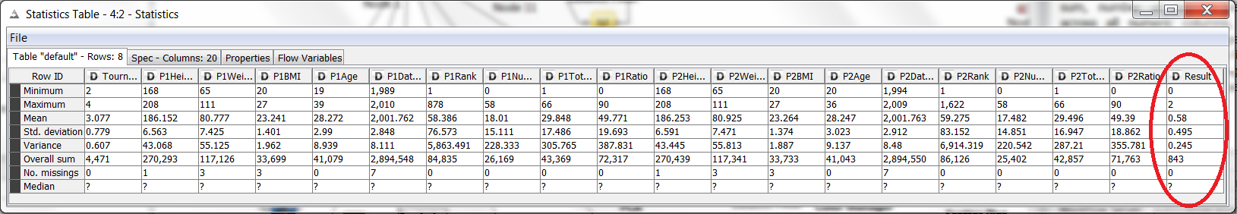
Data Understanding
Min,Max,Median,Average values for numeric attributes

Slide 16
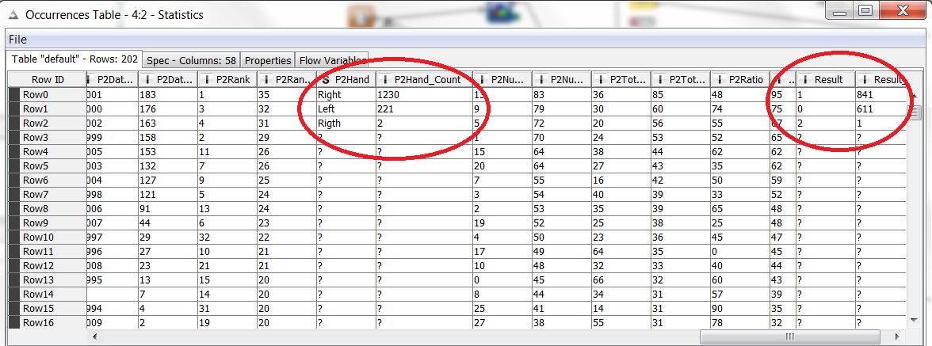
Data Understanding
Occurrence table for categorical and numeric attributes

Slide 17
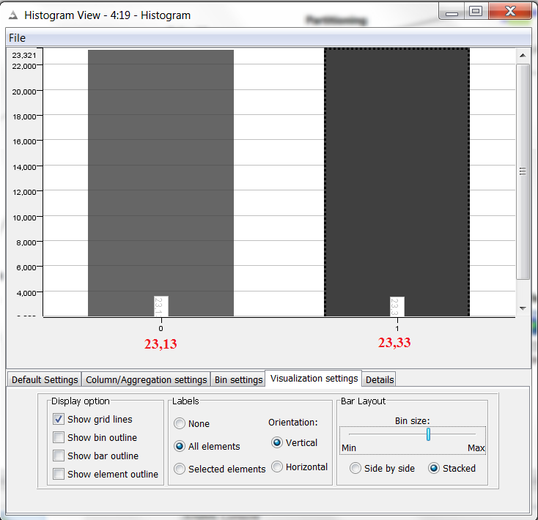
Data Understanding
Histogram for numeric attributes

Slide 18
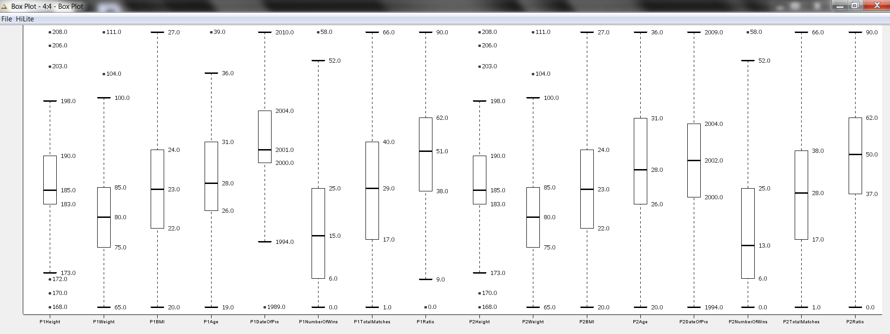
Data Understanding
Box Plot for main characteristics of numerical attributes

Slide 19
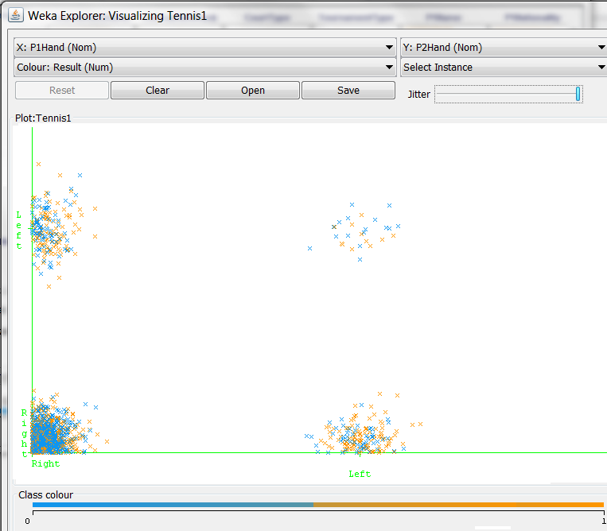
Data Understanding
Scatter Plot to relate two attributes

Slide 20
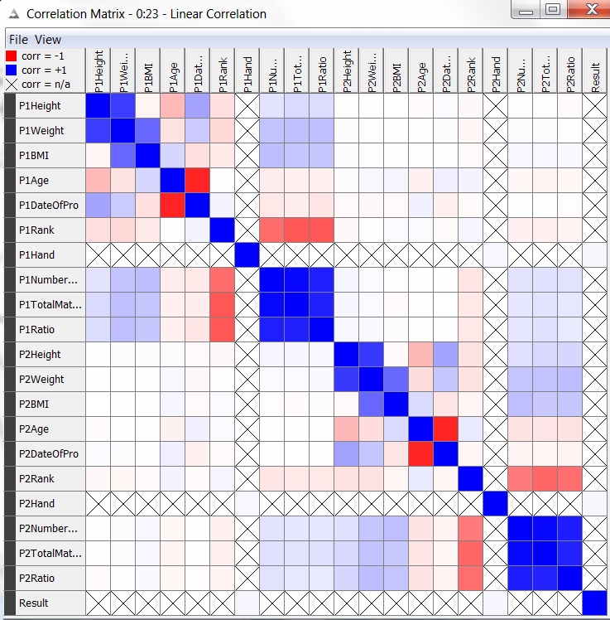
Feature Selection
Linear Correlation

Slide 21
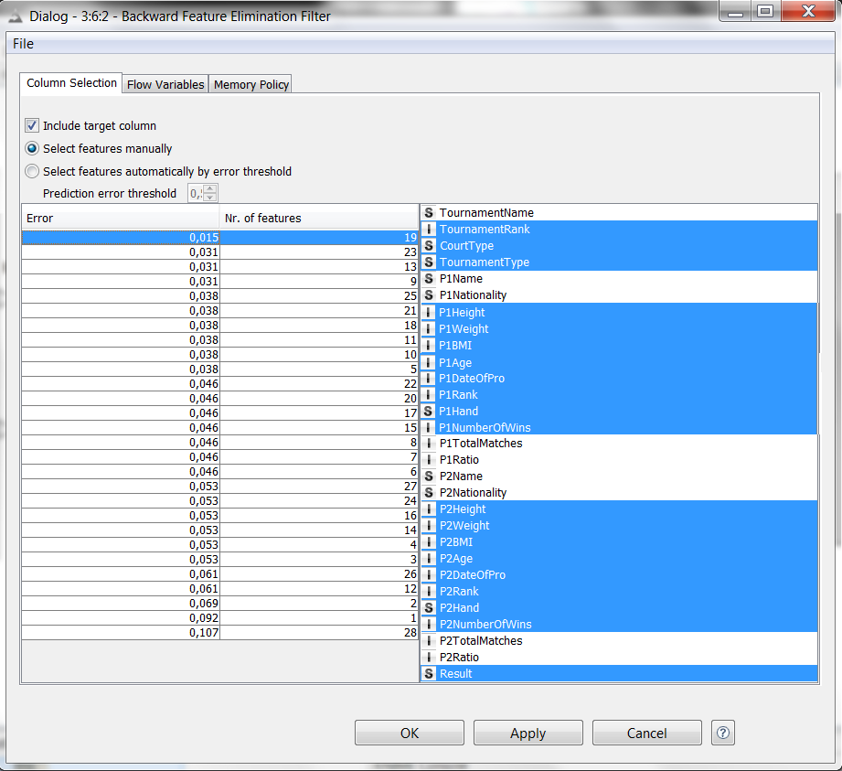
Feature Selection
Backward Elemination
Naive Bayes for Ranking

Slide 22
Feature Selection
28 attributes reduced to 19 attributes
Atrributes are meaningful

Slide 23
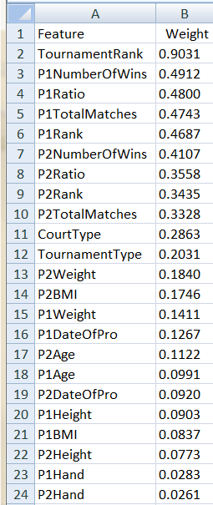
Weight of Attributes
RIMARC to find weights

Slide 24
Classification
KNIME
Decision Tree – C4.5
Gain Ratio Qualitiy Meauser

Slide 25
Classification
1017 instances for training
436 instances for testing
842 positive instances
611 negative instances
Training and test data is randomly selected

Slide 26
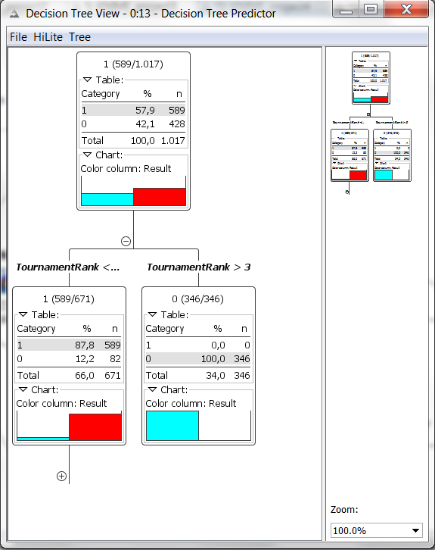
Classification
Decision Tree

Slide 27
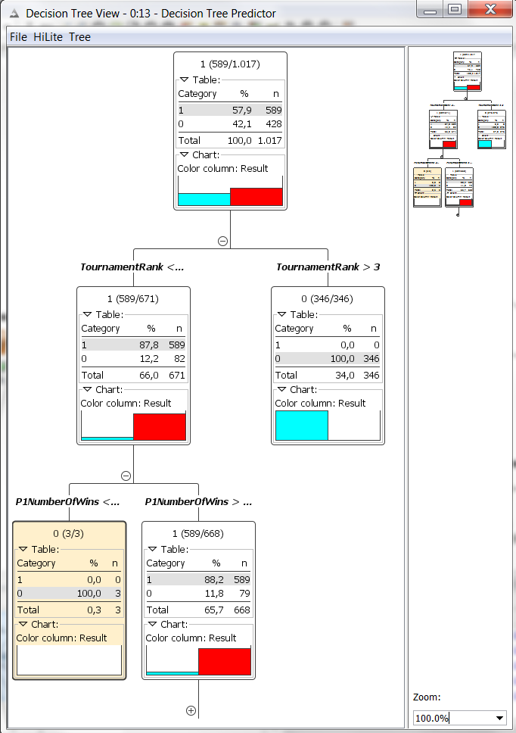
Classification

Slide 28
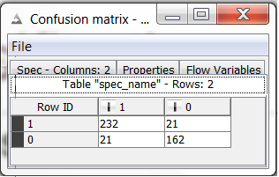
Classification
Confusion Matrix

Slide 29
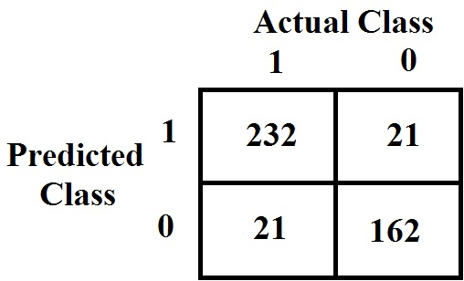
Classification
Confusion Matrix

Slide 30
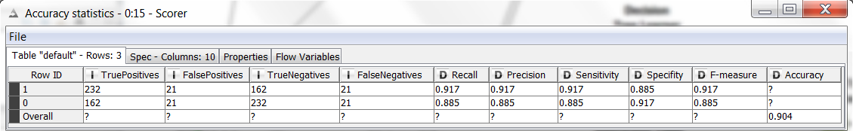
Classification
Accuracy Statistics

Slide 31
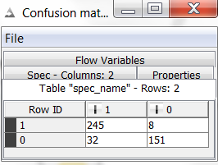
Classification
Naive Bayes Classifier
  Confusion Matrix

Slide 32
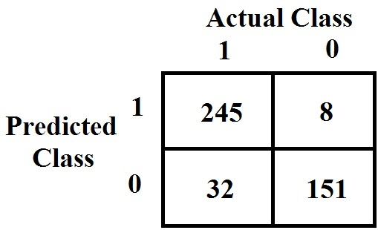
Classification
  Confusion Matrix

Slide 33

Classification
Accuracy Statistics

Slide 34
Classification
C4.5 vs Naive Bayes
Decision Tree (C4.5)
Naive Bayes

Slide 35
Classification
C4.5 vs Naive Bayes
Decision Tree (C4.5)
Naive Bayes

