Slide 1
Lecture 1: PageRank Formulation
CS425: Algorithms for Web Scale Data
Most of the slides are from the Mining of Massive Datasets book.
These slides have been modified for CS425. The original slides can be accessed at: www.mmds.org

Slide 2
Lecture Overview
Graph data overview
Problems with early search engines
PageRank Model
  Flow Formulation
  Matrix Interpretation
  Random Walk Interpretation
  Google’s Formulation
How to Compute PageRank

Slide 3
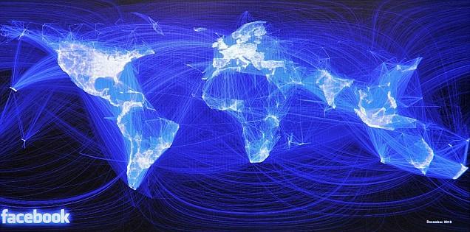
Graph Data: Social Networks
Facebook social graph
4-degrees of separation [Backstrom-Boldi-Rosa-Ugander-Vigna, 2011]

Slide 4
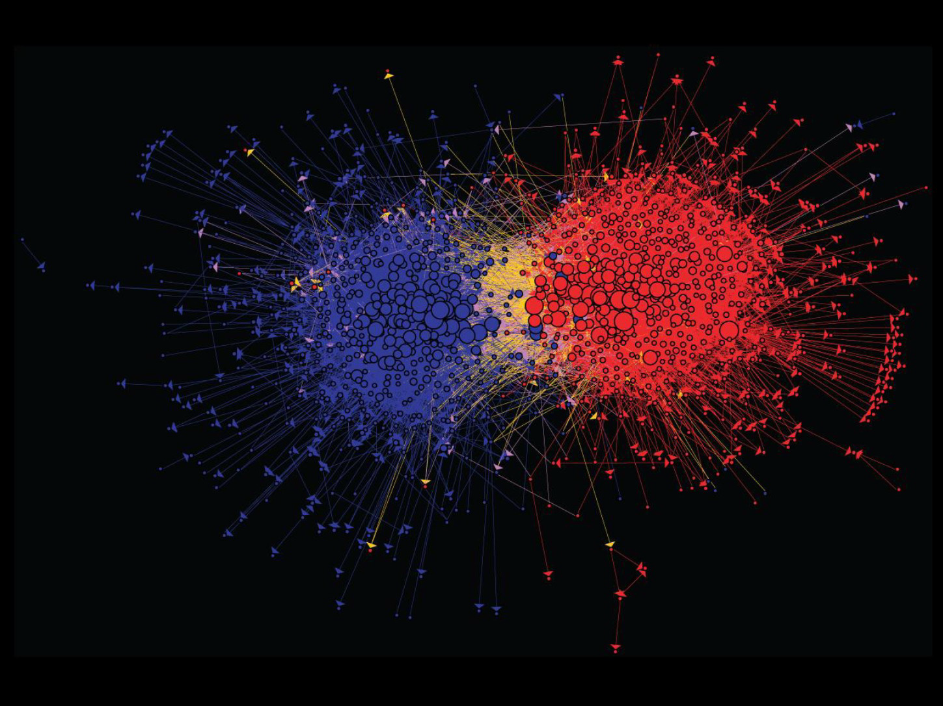
Graph Data: Media Networks
Connections between political blogs
Polarization of the network [Adamic-Glance, 2005]

Slide 5
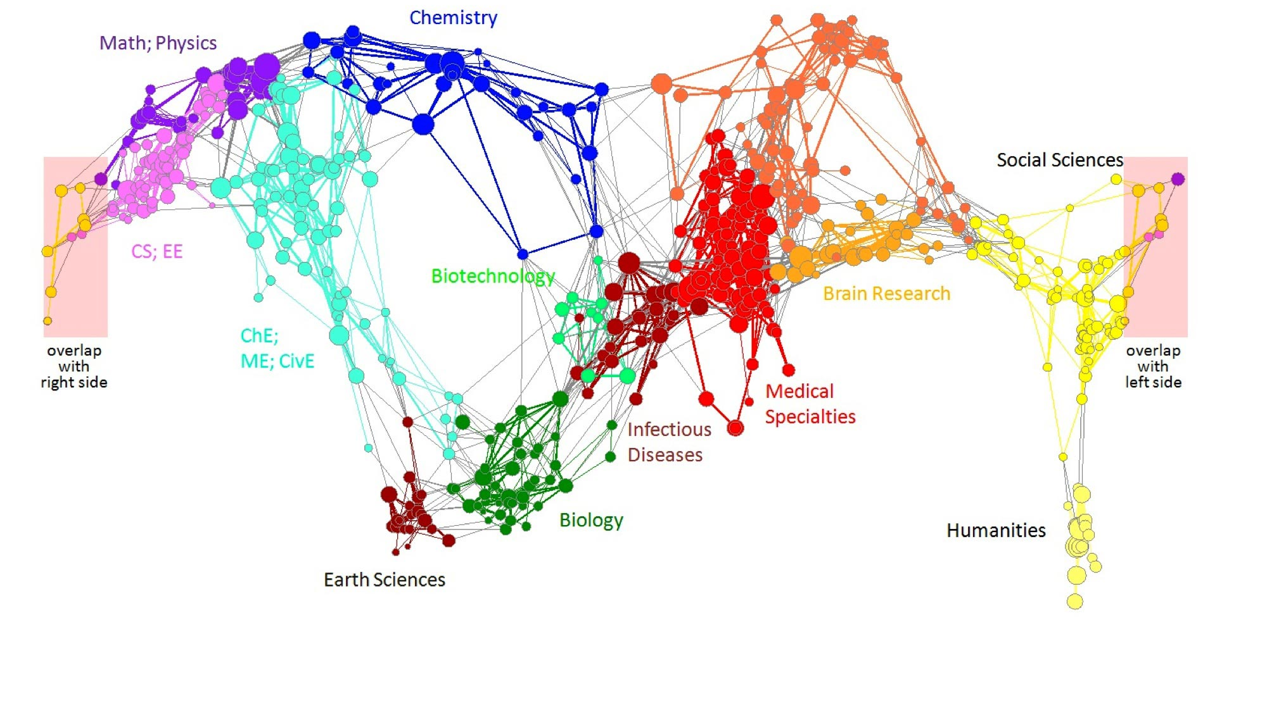
Graph Data: Information Nets
Citation networks and Maps of science
[Börner et al., 2012]

Slide 6
Graph Data: Communication Nets
domain2
domain1
router
domain3
Internet

Slide 7
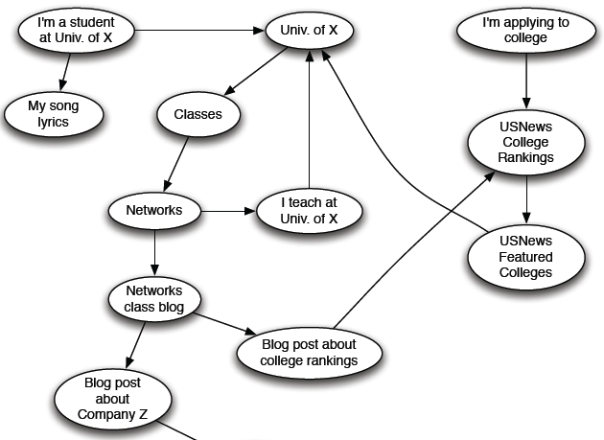
Web as a Directed Graph

Slide 8

Broad Question
How to organize the Web?
First try: Human curated
Web directories
  Yahoo, DMOZ, LookSmart
Second try: Web Search
  Information Retrieval investigates:
  Find relevant docs in a small
  and trusted set
    Newspaper articles, Patents, etc.
  But: Web is huge, full of untrusted documents, random things, web spam, etc.

Slide 9
Web Search: 2 Challenges
2 challenges of web search:
(1) Web contains many sources of information
Who to “trust”?
  Trick: Trustworthy pages may point to each other!
(2) What is the “best” answer to query “newspaper”?
  No single right answer
  Trick: Pages that actually know about newspapers might all be pointing to many newspapers

Slide 10
Early Search Engines
Inverted index
  Data structure that return pointers to all pages a term occurs
Which page to return first?
  Where do the search terms appear in the page?
  How many occurrences of the search terms in the page?
What if a spammer tries to fool the search engine?

Slide 11
Fooling Early Search Engines
Example: A spammer wants his page to be in the top search results for the term “movies”.
Approach 1:
  Add thousands of copies of the term “movies” to your page.
  Make them invisible.
Approach 2:
  Search the term “movies”.
  Copy the contents of the top page to your page.
  Make it invisible.
Problem: Ranking only based on page contents
Early search engines almost useless because of spam.

Slide 12
Google’s Innovations
Basic idea: Search engine believes what other pages say about you instead of what you say about yourself.
Main innovations:
  Define the importance of a page based on:
      How many pages point to it?
      How important are those pages?
  Judge the contents of a page based on:
      Which terms appear in the page?
      Which terms are used to link to the page?

Slide 13
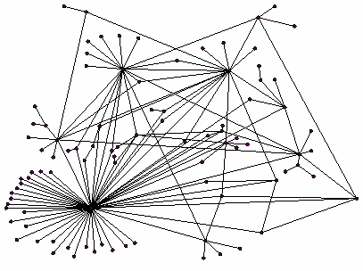
Ranking Nodes on the Graph
All web pages are not equally “important”
  www.joe-schmoe.com vs. www.stanford.edu
There is large diversity
in the web-graph
node connectivity.
Let’s rank the pages by
the link structure!

Slide 14
Link Analysis Algorithms
We will cover the following Link Analysis approaches for computing importances
of nodes in a graph:
  Page Rank
  Topic-Specific (Personalized) Page Rank
  Web Spam Detection Algorithms

Slide 15
PageRank:
The “Flow” Formulation

Slide 16
Links as Votes
Think of in-links as votes:
  www.stanford.edu has 23,400 in-links
  www.joe-schmoe.com has 1 in-link
Are all in-links are equal?
  Links from important pages count more
  Recursive question!

Slide 17
Example: PageRank Scores
B
38.4
C
34.3
A
3.3
D
3.9
E
8.1
F
3.9
1.6
1.6
1.6
1.6
1.6

Slide 18
Simple Recursive Formulation
Each link’s vote is proportional to the importance of its source page
If page j with importance r_{j} has n out-links, each link gets r_{j} / n votes
Page j’s own importance is the sum of the votes on its in-links
i
k
r_{i}/3
r_{k}/4
j
r_{j}/3
r_{j} = r_{i}/3+r_{k}/4
r_{j}/3
r_{j}/3

Slide 19

PageRank: The “Flow” Model
A “vote” from an important page is worth more
A page is important if it is pointed to by other important pages
Define a “rank” r_{j} for page j
y/2
y
a/2
y/2
m
a
m
a/2
“Flow” equations:
  r_{y} = r_{y} /2 + r_{a} /2
  r_{a} = r_{y} /2 + r_{m}
  r_{m} = r_{a} /2
$d_{i}$ … out-degree of node $i$

Slide 20
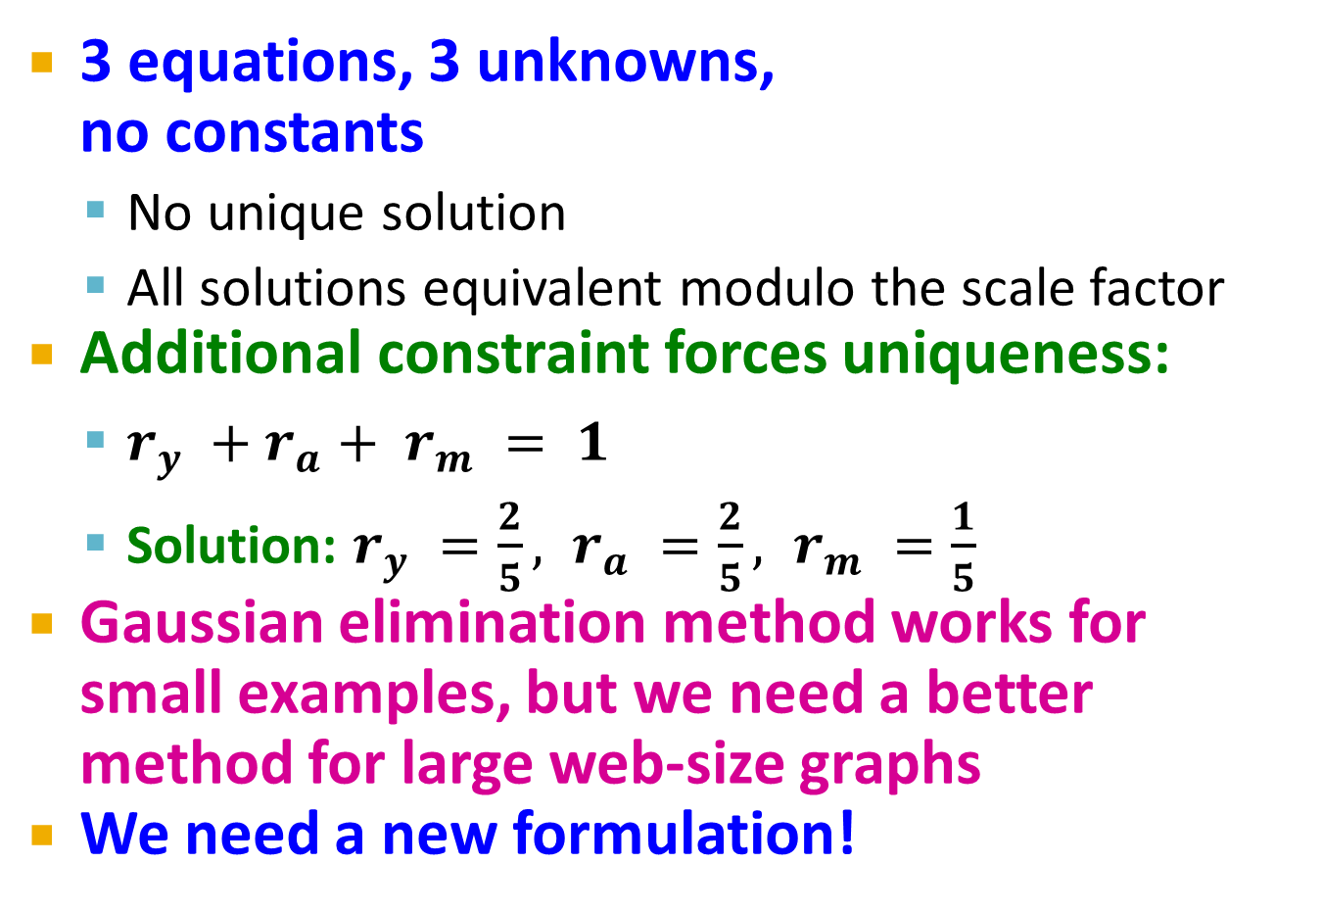
Solving the Flow Equations
Flow equations:
3 equations, 3 unknowns,
no constants
  No unique solution
  All solutions equivalent modulo the scale factor
Additional constraint forces uniqueness:
  $r_{y} +r_{a}+ r_{m} = 1$
  Solution: $r_{y} =\frac{2}{5}, r_{a} =\frac{2}{5}, r_{m} =\frac{1}{5}$
Gaussian elimination method works for
small examples, but we need a better method for large web-size graphs
We need a new formulation!
  r_{y} = r_{y} /2 + r_{a} /2
  r_{a} = r_{y} /2 + r_{m}
  r_{m} = r_{a} /2

Slide 21
PageRank:
The Matrix Formulation

Slide 22
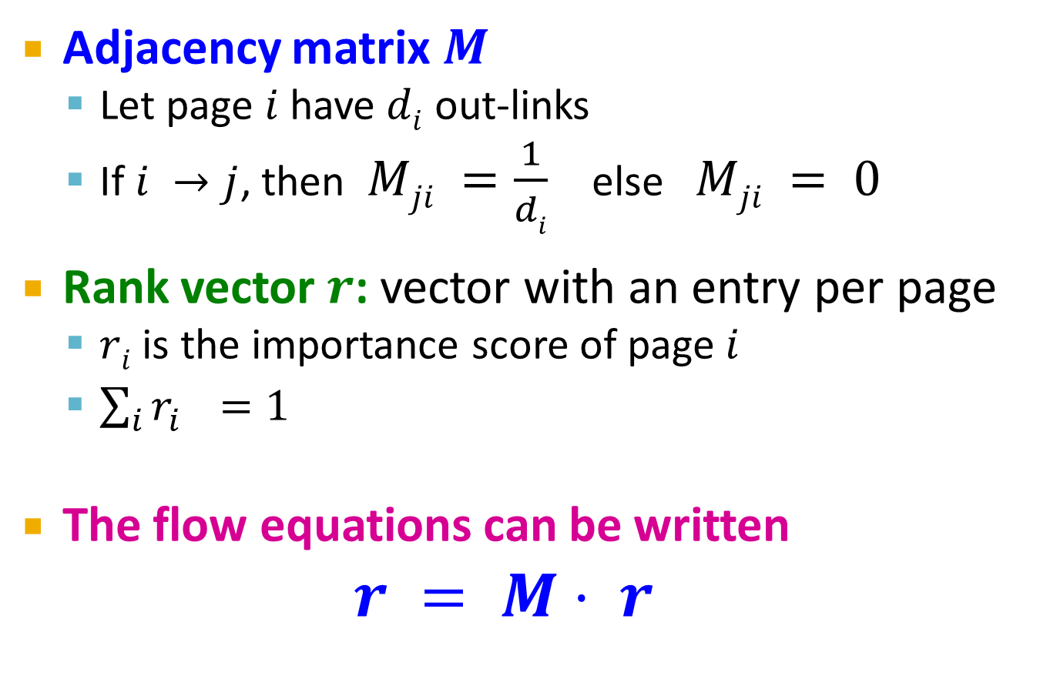
PageRank: Matrix Formulation
Adjacency matrix $M$
  Let page $i$ have $di$ out-links
  If $i →j$, then $Mji =\frac{1}{di}$ else $Mji = 0$
Rank vector $r$: vector with an entry per page
  $ri$ is the importance score of page $i$
  $\sum_{i}{r_{i}^{}=1}$
The flow equations can be written
$r = M⋅ r$

Slide 23
Example: Flow Equations & M
 | y | a | m
y | ½ | ½ | 0
a | ½ | 0 | 1
m | 0 | ½ | 0
y
a
m
r = M∙r
  r_{y} = r_{y} /2 + r_{a} /2
  r_{a} = r_{y} /2 + r_{m}
  r_{m} = r_{a} /2
y ½ ½ 0 y
a = ½ 0 1 a
m 0 ½ 0 m

Slide 24
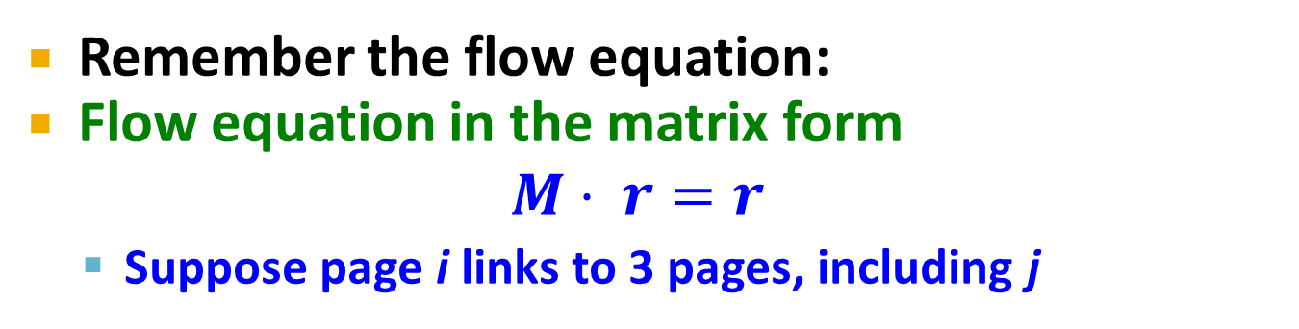
Example
Remember the flow equation:
Flow equation in the matrix form
$$M⋅ r=r$$
  Suppose page i links to 3 pages, including j
i
j
r_{j}
.
=
r_{i}
1/3
M
.
r
=
r

Slide 25
Exercise: Matrix Formulation
M
r
r
A
B
r_{A}
r_{A}
0
1/2
1
0
1/3
0
0
1/2
r_{B}
r_{B}
.
=
1/3
0
0
1/2
r_{C}
r_{C}
C
D
1/3
1/2
0
0
r_{D}
r_{D}

Slide 26
Linear Algebra Reminders
A is a column stochastic matrix iff each of its columns add up to 1 and there are no negative entries.
  Our adjacency matrix M is column stochastic. Why?
If there exist a vector x and a scalar λ such that Ax = λx, then:
  x is an eigenvector and λ is an eigenvalue of A
  The principal eigenvector is the one that corresponds to the largest eigenvalue.
The largest eigenvalue of a column stochastic matrix is 1.
Ax = x, where x is the principal eigenvector

Slide 27
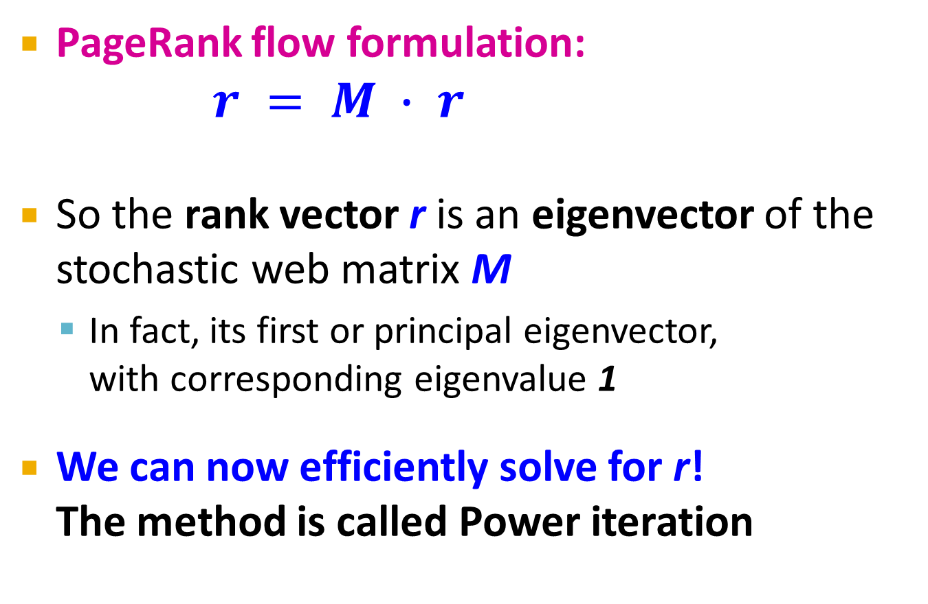

Eigenvector Formulation
PageRank flow formulation:
$r = M ∙ r$
So the rank vector r is an eigenvector of the stochastic web matrix M
  In fact, its first or principal eigenvector,
  with corresponding eigenvalue 1
We can now efficiently solve for r!
The method is called Power iteration
NOTE: x is an eigenvector with the corresponding eigenvalue λ if:
$$Ax=λx$$

Slide 28
Power Iteration Method
Given a web graph with n nodes, where the nodes are pages and edges are hyperlinks
Power iteration: a simple iterative scheme
  Suppose there are N web pages
  Initialize: r⁽⁰⁾ = [1/N,….,1/N]^{T}
  Iterate: r^{(t+1)} = M ∙ r^{(t)}
  Stop when |r^{(t+1)} – r^{(t)}|₁ < ε
d_{i} …. out-degree of node i
    |x|₁ = ∑_{1≤i≤N}|x_{i}| is the L1 norm
    Can use any other vector norm, e.g., Euclidean

Slide 29
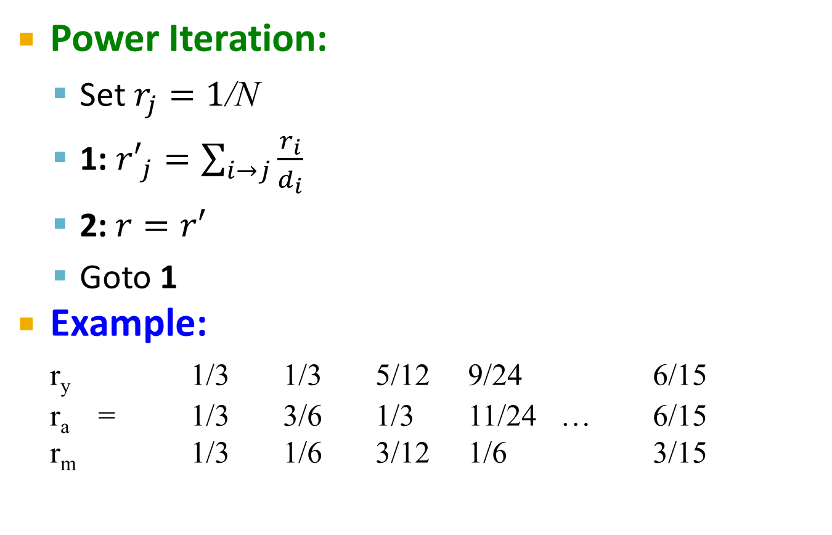
PageRank: How to solve?
Power Iteration:
  Set $r_{j}=1$/N
  1: ${r′}_{j}=\sum_{i→j}{\frac{r_{i}}{d_{i}}}$
  2:$r=r′$
  Goto 1
Example:
r_{y} 1/3 1/3 5/12 9/24 6/15
r_{a} = 1/3 3/6 1/3 11/24 … 6/15
r_{m} 1/3 1/6 3/12 1/6 3/15
y
 | y | a | m
y | ½ | ½ | 0
a | ½ | 0 | 1
m | 0 | ½ | 0
a
m
  r_{y} = r_{y} /2 + r_{a} /2
  r_{a} = r_{y} /2 + r_{m}
  r_{m} = r_{a} /2
Iteration 0, 1, 2, …

Slide 30
PageRank: How to solve?
Power Iteration:
  Set $r_{j}=1$/N
  1: ${r′}_{j}=\sum_{i→j}{\frac{r_{i}}{d_{i}}}$
  2:$r=r′$
  Goto 1
Example:
r_{y} 1/3 1/3 5/12 9/24 6/15
r_{a} = 1/3 3/6 1/3 11/24 … 6/15
r_{m} 1/3 1/6 3/12 1/6 3/15
y
 | y | a | m
y | ½ | ½ | 0
a | ½ | 0 | 1
m | 0 | ½ | 0
a
m
  r_{y} = r_{y} /2 + r_{a} /2
  r_{a} = r_{y} /2 + r_{m}
  r_{m} = r_{a} /2
Iteration 0, 1, 2, …

Slide 31
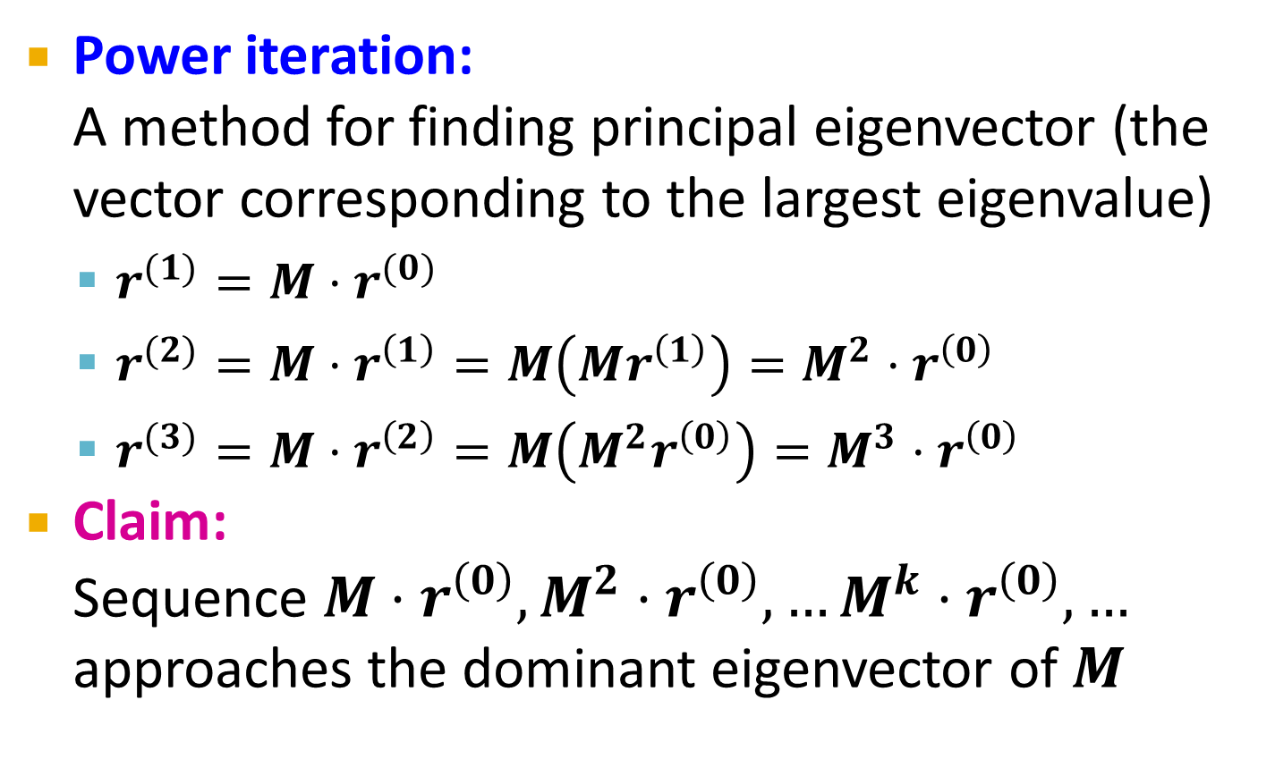
Power Iteration Convergence
Power iteration:
A method for finding principal eigenvector (the vector corresponding to the largest eigenvalue)
  $r^{(1)}=M⋅r^{(0)}$
  $r^{(2)}=M⋅r^{\left(1\right)}=M\left(Mr^{\left(1\right)}\right)=M^{2}⋅r^{\left(0\right)}$
  $r^{(3)}=M⋅r^{\left(2\right)}=M\left(M^{2}r^{\left(0\right)}\right)=M^{3}⋅r^{\left(0\right)}$
Claim:
Sequence $M⋅r^{\left(0\right)},M^{2}⋅r^{\left(0\right)},…M^{k}⋅r^{\left(0\right)},…$ approaches the dominant eigenvector of $M$

Slide 32
PageRank:
Random Walk Interpretation

Slide 33
Random Walk Interpretation of PageRank
Consider a web surfer:
  He starts at a random page
  He follows a random link at every time step
  After a sufficiently long time:
    What is the probability that he is at page j?
      This probability corresponds to the page rank of j.

Slide 34
Example: Random Walk
A
B
Time t = 0: Assume the random surfer is at A.
Time t = 1:
p(A, 1) = ?
p(B, 1) = ?
p(C, 1) = ?
p(D, 1) = ?
0
1/3
1/3
1/3
C
D

Slide 35
Example: Random Walk
Time t = 1:
p(B, 1) = 1/3
p(C, 1) = 1/3
p(D, 1) = 1/3
A
B
C
D
Time t=2:
p(A, 2) = ?
p(A, 2) = p(B, 1) . p(B→A) + p(C, 1) . p(C→A)
= 1/3 . 1/2 + 1/3 . 1 = 3/6

Slide 36
Example: Transition Matrix
M
p(t)
p(t+1)
A
B
p_{A}
p_{A}
0
1/2
1
0
1/3
0
0
1/2
p_{B}
p_{B}
.
=
1/3
0
0
1/2
p_{C}
p_{C}
C
D
1/3
1/2
0
0
p_{D}
p_{D}
p(A, t+1) = p(B, t) . p(B→A) + p(C, t) . p(C→A)
p(C, t+1) = p(A, t) . p(A→C) + p(D, t) . p(D→C)

Slide 37
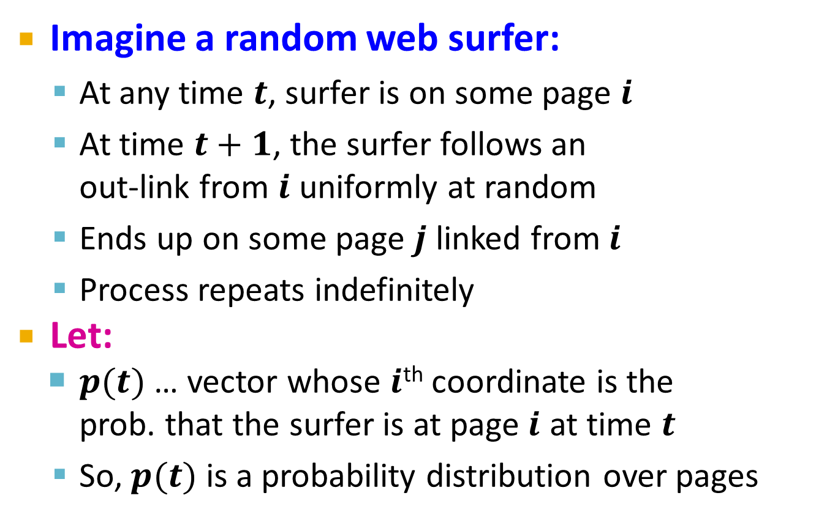
Random Walk Interpretation
Imagine a random web surfer:
  At any time $t$, surfer is on some page $i$
  At time $t+1$, the surfer follows an
  out-link from $i$ uniformly at random
  Ends up on some page $j$ linked from $i$
  Process repeats indefinitely
Let:
  $p(t)$ … vector whose $i$^{th} coordinate is the
  prob. that the surfer is at page $i$ at time $t$
  So, $p(t)$ is a probability distribution over pages
i₁
i₂
i₃
j

Slide 38
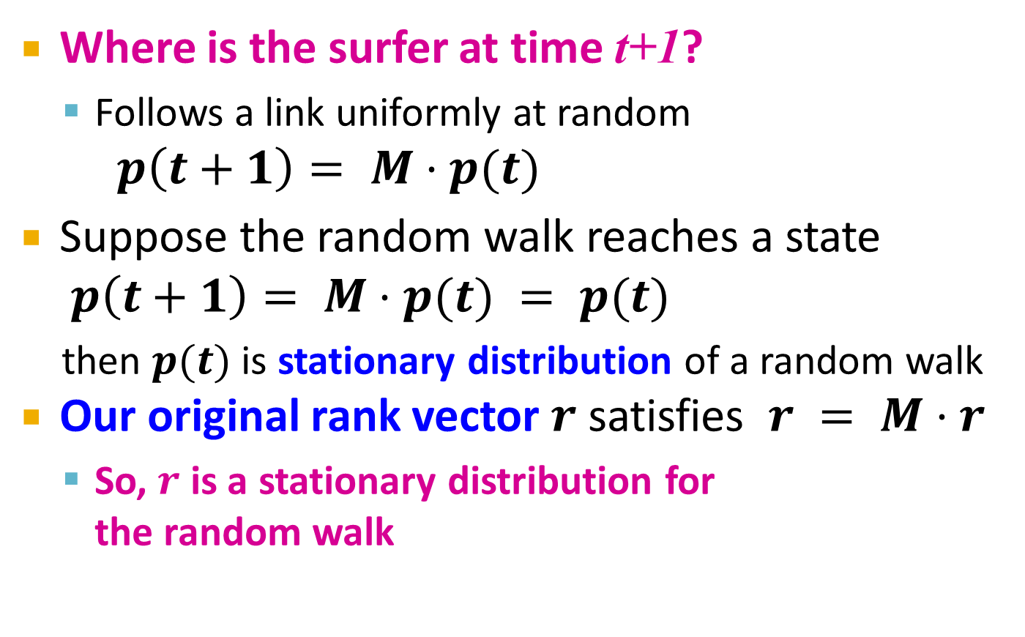
The Stationary Distribution
i₁
i₂
i₃
Where is the surfer at time t+1?
  Follows a link uniformly at random
$p\left(t+1\right)= M⋅p(t)$
Suppose the random walk reaches a state $p\left(t+1\right)= M⋅p(t) = p(t)$
  then $p(t)$ is stationary distribution of a random walk
Our original rank vector $r$ satisfies $r = M⋅r$
  So, $r$ is a stationary distribution for
  the random walk
j
Rank of page j = Probability that the surfer is at page j after a long random walk

Slide 39
Existence and Uniqueness
A central result from the theory of random walks (a.k.a. Markov processes):
For graphs that satisfy certain conditions,
the stationary distribution is unique and eventually will be reached no matter what the initial probability distribution at time t = 0

Slide 40
Summary So Far
PageRank formula:
Iterative algorithm:
  1. Initialize rank of each page to 1/N (where N is the number of pages)
  2. Compute the next page rank values using the formula above
  3. Repeat step 2 until the page rank values do not change much
Same algorithm, but different interpretations
d_{i} …. out-degree of node i

Slide 41
Summary So Far (cont’d)
Eigenvector interpretation:
  Compute the principal eigenvector of stochastic adjacency matrix M
  r = M . r
  Power iteration method
Random walk interpretation:
    Rank of page i is the probability that a surfer is at i after random walk
    p(t+1) = M . p(t)
    Guaranteed to converge to a unique solution under certain conditions

Slide 42
Convergence Conditions
To guarantee convergence to a meaningful and unique solution, the transition matrix must be:
  Column stochastic
  Irreducible
  Aperiodic

Slide 43
Column Stochastic
Column stochastic:
  All values in the matrix are non-negative
  Sum of each column is 1
 | y | a | m
y | ½ | ½ | 0
a | ½ | 0 | 1
m | 0 | ½ | 0
y
  r_{y} = r_{y} /2 + r_{a} /2
  r_{a} = r_{y} /2 + r_{m}
  r_{m} = r_{a} /2
a
m
What if we remove the edge m → a ?
No longer column stochastic

Slide 44
Irreducible
Irreducible: From any state, there is a non-zero probability of going to another.
  Equivalent to: Strongly connected graph
A
B
What if we remove the edge C → A ?
No longer irreducible.
C
D
Irreducible graph

Slide 45
Aperiodic
State i has period k if any return to state i must occur in multiples of k time steps.
If k = 1 for a state, it is called aperiodic.
  Returning to the state at irregular intervals
A Markov chain is aperiodic if all its states are aperiodic.
  If Markov chain is irreducible, one aperiodic state means all stated are aperiodic.
A
B
C
D
t₀
How to make this aperiodic?
t₀ + 4
k= 4
Add any self edge
t₀ + 8

Slide 46
PageRank:
The Google Formulation

Slide 47
PageRank: Three Questions
Does this converge?
Does it converge to what we want?
Are results reasonable?
or
equivalently

Slide 48
Does this converge?
Example:
r_{a} 1 0 1 0
r_{b} 0 1 0 1
a
b
=
Iteration 0, 1, 2, …

Slide 49
Does it converge to what we want?
Example:
r_{a} 1 0 0 0
r_{b} 0 1 0 0
a
b
=
Iteration 0, 1, 2, …

Slide 50
PageRank: Problems
Dead end
2 problems:
(1) Some pages are
dead ends (have no out-links)
  Random walk has “nowhere” to go to
  Such pages cause importance to “leak out”
(2) Spider traps:
(all out-links are within the group)
  Random walk gets “stuck” in a trap
  And eventually spider traps absorb all importance
Spider trap

Slide 51

Problem: Spider Traps
Power Iteration:
  Set $r_{j}=1$/N
  $r_{j}=\sum_{i→j}{\frac{r_{i}}{d_{i}}}$
    And iterate
Example:
r_{y} 1/3 2/6 3/12 5/24 0
r_{a} = 1/3 1/6 2/12 3/24 … 0
r_{m} 1/3 3/6 7/12 16/24 1
y
 | y | a | m
y | ½ | ½ | 0
a | ½ | 0 | 0
m | 0 | ½ | 1
a
m
m is a spider trap
  r_{y} = r_{y} /2 + r_{a} /2
  r_{a} = r_{y} /2
  r_{m} = r_{a} /2 + r_{m}
Iteration 0, 1, 2, …
All the PageRank score gets “trapped” in node m.

Slide 52
Solution: Teleports!
The Google solution for spider traps: At each time step, the random surfer has two options
  With prob. β, follow a link at random
  With prob. 1-β, jump to some random page
  Common values for β are in the range 0.8 to 0.9
Surfer will teleport out of spider trap
within a few time steps
y
y
a
m
a
m

Slide 53

Problem: Dead Ends
Power Iteration:
  Set $r_{j}=1$
  $r_{j}=\sum_{i→j}{\frac{r_{i}}{d_{i}}}$
    And iterate
Example:
r_{y} 1/3 2/6 3/12 5/24 0
r_{a} = 1/3 1/6 2/12 3/24 … 0
r_{m} 1/3 1/6 1/12 2/24 0
y
 | y | a | m
y | ½ | ½ | 0
a | ½ | 0 | 0
m | 0 | ½ | 0
a
m
  r_{y} = r_{y} /2 + r_{a} /2
  r_{a} = r_{y} /2
  r_{m} = r_{a} /2
Iteration 0, 1, 2, …
Here the PageRank “leaks” out since the matrix is not stochastic.

Slide 54
Solution: Always Teleport!
Teleports: Follow random teleport links with probability 1.0 from dead-ends
  Adjust matrix accordingly
y
y
a
m
a
m
 | y | a | m
y | ½ | ½ | 0
a | ½ | 0 | 0
m | 0 | ½ | 0
 | y | a | m
y | ½ | ½ | ⅓
a | ½ | 0 | ⅓
m | 0 | ½ | ⅓

Slide 55
Why Teleports Solve the Problem?
Why are dead-ends and spider traps a problem
and why do teleports solve the problem?
Spider-traps: PageRank scores are not what we want
  Solution: Never get stuck in a spider trap by
  teleporting out of it in a finite number of steps
Dead-ends are a problem
  The matrix is not column stochastic so our initial assumptions are not met
  Solution: Make matrix column stochastic by always teleporting when there is nowhere else to go

Slide 56
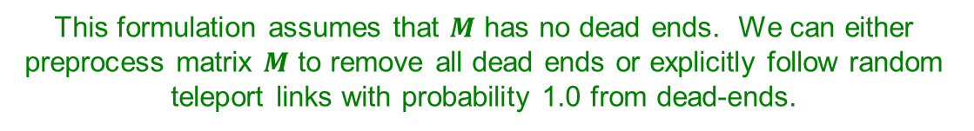
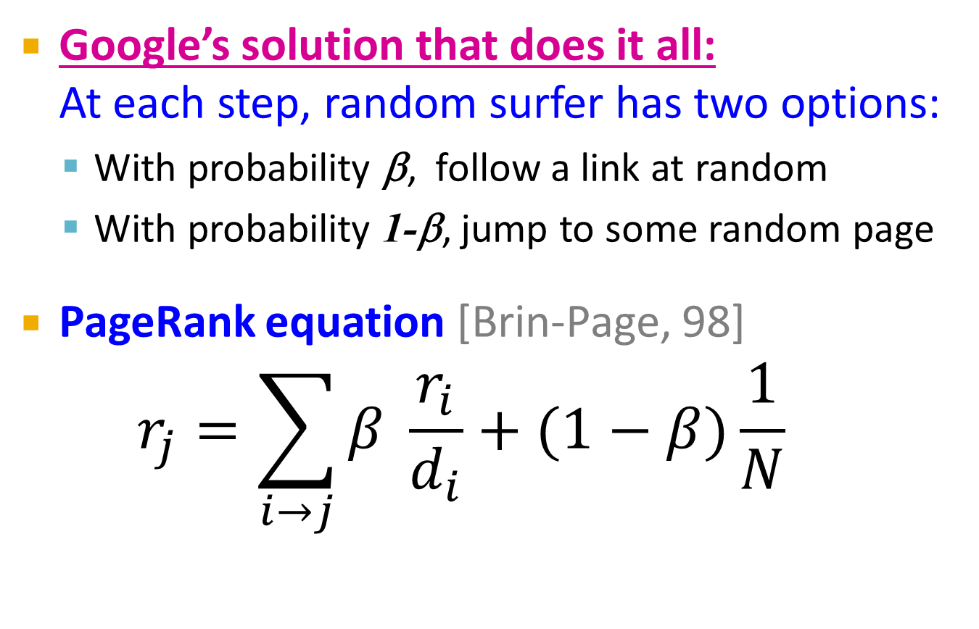
Solution: Random Teleports
Google’s solution that does it all:
At each step, random surfer has two options:
  With probability β, follow a link at random
  With probability 1-β, jump to some random page
PageRank equation [Brin-Page, 98]
$r_{j}=\sum_{i→j}{β \frac{r_{i}}{d_{i}}}+(1−β)\frac{1}{N}$
d_{i} … out-degree
of node i
This formulation assumes that $M$ has no dead ends. We can either preprocess matrix $M$ to remove all dead ends or explicitly follow random teleport links with probability 1.0 from dead-ends.

Slide 57
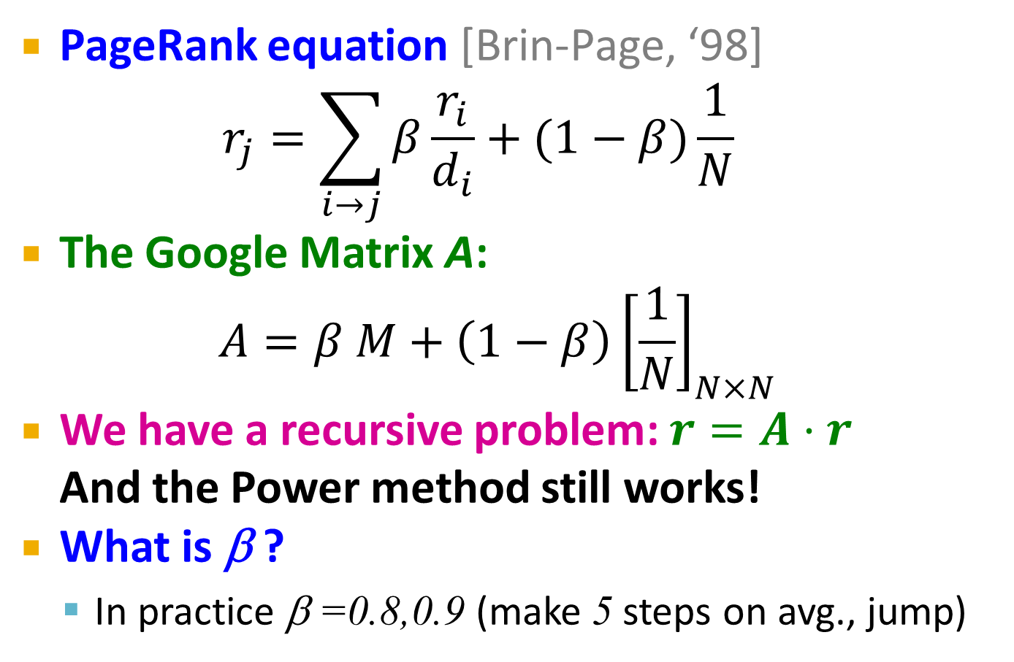
The Google Matrix
PageRank equation [Brin-Page, ‘98]
$r_{j}=\sum_{i→j}{β\frac{r_{i}}{d_{i}}}+(1−β)\frac{1}{N}$
The Google Matrix A:
$$A=β M+\left(1−β\right){\left[\frac{1}{N}\right]}_{N×N}$$
We have a recursive problem: $r=A⋅r$
And the Power method still works!
What is β ?
  In practice β =0.8,0.9 (make 5 steps on avg., jump)
[1/N]_{NxN}…N by N matrix
where all entries are 1/N

Slide 58
Random Teleports (β = 0.8)
M
  [1/N]_{NxN}
7/15
y
1/2 1/2 0
1/2 0 0
0 1/2 1
1/3 1/3 1/3
1/3 1/3 1/3
1/3 1/3 1/3
0.8
+ 0.2
7/15
1/15
7/15
1/15
y 7/15 7/15 1/15
a 7/15 1/15 1/15
m 1/15 7/15 13/15
13/15
a
7/15
m
1/15
1/15
A
y
a =
m
1/3
1/3
1/3
0.33
0.20
0.46
0.24
0.20
0.52
0.26
0.18
0.56
7/33
5/33
21/33
. . .

Slide 59
Matrix Formulation
Suppose there are N pages
Consider page i, with d_{i} out-links
We have M_{ji} = 1/|d_{i}| when i → j
and M_{ji} = 0 otherwise
The random teleport is equivalent to:
  Adding a teleport link from i to every other page and setting transition probability to (1-β)/N
  Reducing the probability of following each
  out-link from 1/|d_{i}| to β/|d_{i}|
  Equivalent: Tax each page a fraction (1-β) of its score and redistribute evenly

Slide 60
How do we actually compute the PageRank?

Slide 61
Computing Page Rank
Key step is matrix-vector multiplication
  r^{new} = A ∙ r^{old}
Easy if we have enough main memory to hold A, r^{old}, r^{new}
Say N = 1 billion pages
  We need 4 bytes for
  each entry (say)
  2 billion entries for
  vectors, approx 8GB
  Matrix A has N² entries
    10¹⁸ is a large number!
  A = β∙M + (1-β) [1/N]_{NxN}
½ ½ 0
½ 0 0
0 ½ 1
1/3 1/3 1/3
1/3 1/3 1/3
1/3 1/3 1/3
A =
0.8
+0.2
7/15 7/15 1/15
7/15 1/15 1/15
1/15 7/15 13/15
=

Slide 62
Matrix Sparseness
Reminder: Our original matrix was sparse.
  On average: ~10 out-links per vertex
  # of non-zero values in matrix M: ~10N
Teleport links make matrix M dense.
Can we convert it back to the sparse form?
Original matrix without teleports
A
B
0
1/2
1
0
1/3
0
0
1/2
1/3
0
0
1/2
C
D
1/3
1/2
0
0

Slide 63
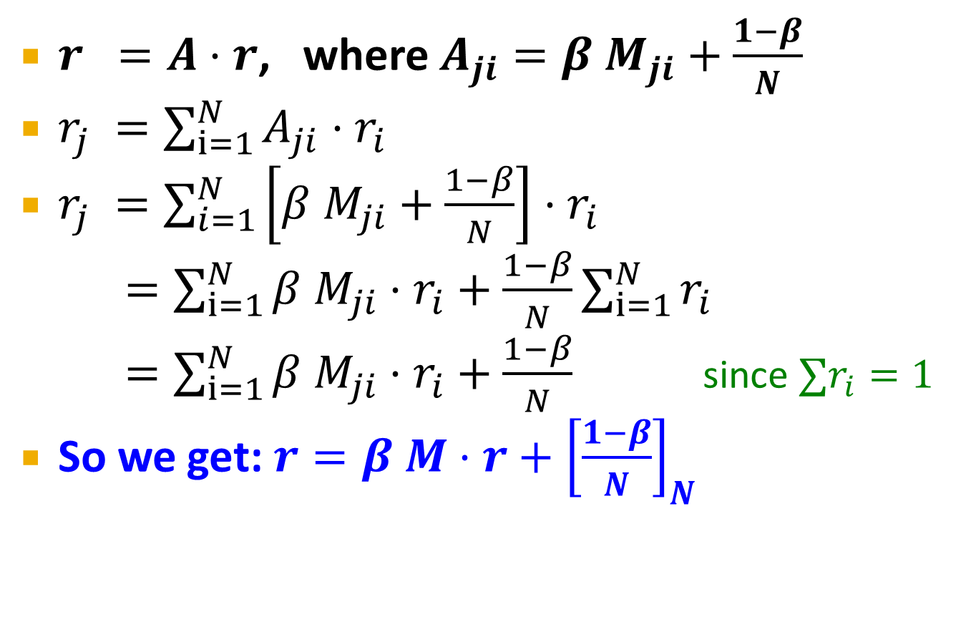
Rearranging the Equation
$r =A⋅r$, where $A_{ji}=β{ M}_{ji}+\frac{1−β}{N}$
$r_{j} =\sum_{i=1}^{N}{A_{ji}⋅r_{i}}$
$r_{j} =\sum_{i=1}^{N}{\left[β{ M}_{ji}+\frac{1−β}{N}\right]⋅r_{i}}$
$=\sum_{i=1}^{N}{β{ M}_{ji}⋅r_{i}+\frac{1−β}{N}}\sum_{i=1}^{N}{r_{i}}$
$=\sum_{i=1}^{N}{β{ M}_{ji}⋅r_{i}+\frac{1−β}{N}}$ since $∑r_{i}=1$
So we get: $r=β M⋅r+{\left[\frac{1−β}{N}\right]}_{N}$
Note: Here we assumed M has no dead-ends
[x]_{N} … a vector of length N with all entries x

Slide 64
Example: Equation with Teleports
r^{new}
M
r^{old}
A
B
r_{A}
0
1/2
1
0
r_{A}
1/4
r_{B}
1/3
0
0
1/2
r_{B}
1/4
=
β
.
+
(1-β)
r_{C}
1/3
0
0
1/2
r_{C}
1/4
C
D
r_{D}
1/3
1/2
0
0
r_{D}
1/4
Note: Here we assumed M has no dead-ends

Slide 65
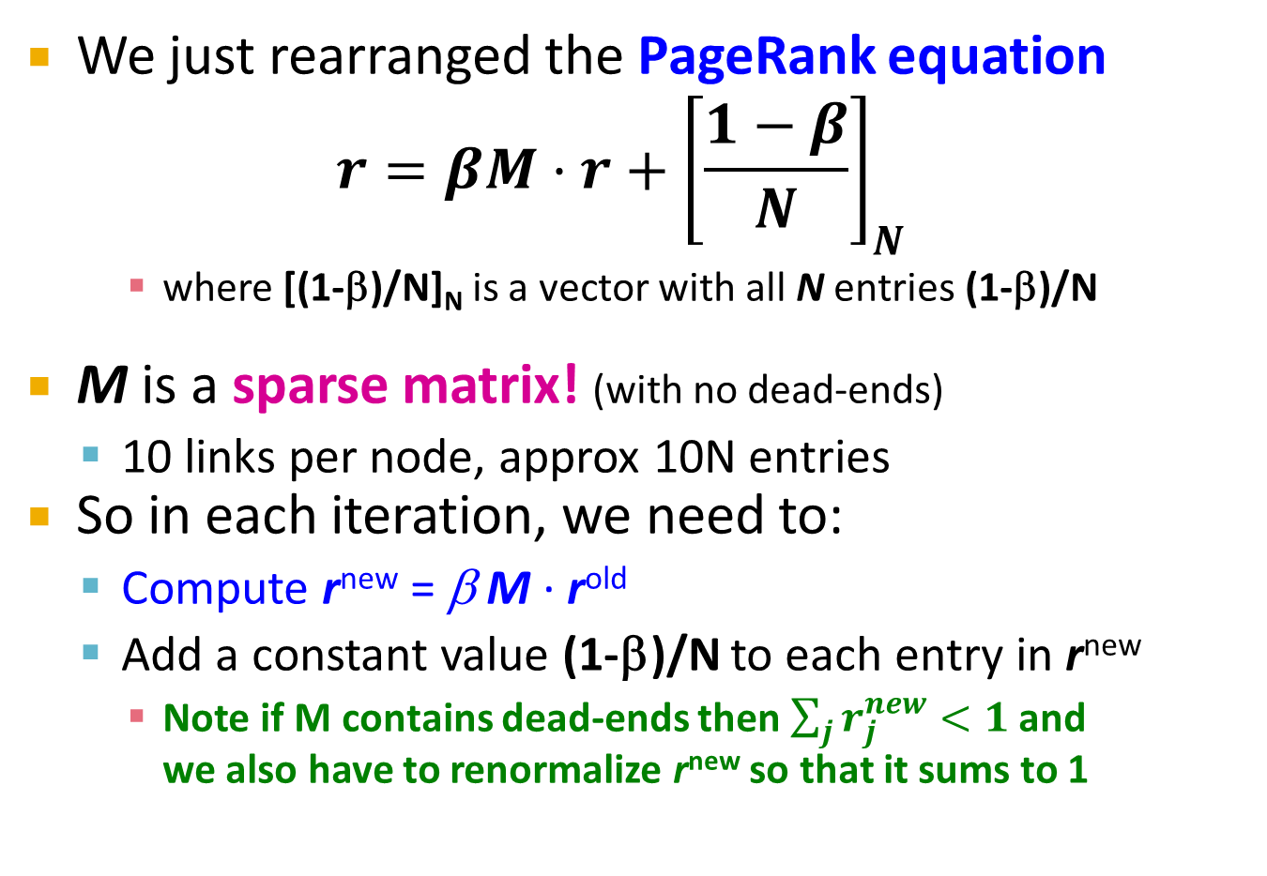
Sparse Matrix Formulation
We just rearranged the PageRank equation
$$r=βM⋅r+{\left[\frac{1−β}{N}\right]}_{N}$$
    where [(1-β)/N]_{N} is a vector with all N entries (1-β)/N
M is a sparse matrix! (with no dead-ends)
  10 links per node, approx 10N entries
So in each iteration, we need to:
  Compute r^{new} = β M ∙ r^{old}
  Add a constant value (1-β)/N to each entry in r^{new}
    Note if M contains dead-ends then $\sum_{j}{r_{j}^{new}}<1$ and
    we also have to renormalize r^{new} so that it sums to 1

Slide 66

PageRank: Without Dead Ends
Input: Graph $G$ and parameter $β$
  Directed graph $G$ (cannot have dead ends)
  Parameter $β$
Output: PageRank vector $r^{new}$
  Set: $r_{j}^{old} =\frac{1}{N}$
  repeat until convergence: $\sum_{j}{\left|r_{j}^{new}−r_{j}^{old}\right|>ε}$
    $∀j: r_{j}^{new}=\sum_{i→j}{β \frac{r_{i}^{old}}{d_{i}}}$
    $r_{j}^{new}=0$ if in-degree of $j$ is 0
    Add constant terms:
    $∀j: r_{j}^{new}=r_{j}^{new}+\frac{1−β}{N}$
    $r^{old}=r^{new}$

Slide 67
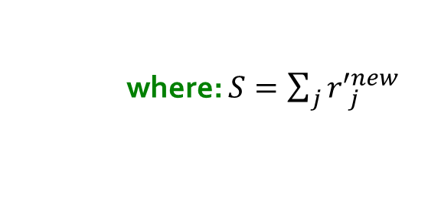

PageRank: The Complete Algorithm
Input: Graph $G$ and parameter $β$
  Directed graph $G$ (can have spider traps and dead ends)
  Parameter $β$
Output: PageRank vector $r^{new}$
  Set: $r_{j}^{old} =\frac{1}{N}$
  repeat until convergence: $\sum_{j}{\left|r_{j}^{new}−r_{j}^{old}\right|>ε}$
    $∀j: {r′}_{j}^{new}=\sum_{i→j}{β \frac{r_{i}^{old}}{d_{i}}}$
    ${r′}_{j}^{new}=0$ if in-degree of $j$ is 0
    Now re-insert the leaked PageRank:
    $∀j: r_{j}^{new}={r^{′}}_{j}^{new}+\frac{1−S}{N}$
    $r^{old}=r^{new}$
    where: $S=\sum_{j}{{r′}_{j}^{new}}$
If the graph has no dead-ends then the amount of leaked PageRank is 1-β. But since we have dead-ends the amount of leaked PageRank may be larger. We have to explicitly account for it by computing S.

Slide 68
Sparse Matrix Encoding: First Try
Store a triplet for each nonzero entry: (row, column, weight)
A
B
0
1/2
1
0
1/3
0
0
1/2
1/3
0
0
1/2
C
D
1/3
1/2
0
0
(2, 1, 1/3); (3, 1, 1/3); (4, 1, 1/3); (1, 2, 1/2); (4, 2, 1/2); (1, 3, 1); …
Assume 4 bytes per integer and 8 bytes per float: 16 bytes per entry
Inefficient: Repeating the column index and weight multiple times

Slide 69
Sparse Matrix Encoding
Store entries per source node
  Source index and degree stored once per node
  Space proportional roughly to number of links
  Say 10N, or 4*10*1 billion = 40GB
  Still won’t fit in memory, but will fit on disk
source
node
degree
destination nodes
0 | 3 | 1, 5, 7
1 | 5 | 17, 64, 113, 117, 245
2 | 2 | 13, 23

Slide 70
Basic Algorithm: Update Step
Assume enough RAM to fit r^{new} into memory
  Store r^{old} and matrix M on disk
1 step of power-iteration is:
Initialize all entries of r^{new} = (1-β) / N
For each page i (of out-degree d_{i}):
Read into memory: i, d_{i}, dest₁, …, dest_{di}, r^{old}(i)
For j = 1…d_{i}
r^{new}(dest_{j}) += β r^{old}(i) / d_{i}
0
r^{new}
source
degree
destination
r^{old}
0
1
0 | 3 | 1, 5, 6
1 | 4 | 17, 64, 113, 117
2 | 2 | 13, 23
1
2
2
3
3
4
4
5
5
6
6
Notes:
Remember to say that we first initialize r^new to 1-beta/n

Slide 71
Analysis
Assume enough RAM to fit r^{new} into memory
  Store r^{old} and matrix M on disk
In each iteration, we have to:
  Read r^{old} and M
  Write r^{new} back to disk
  Cost per iteration of Power method:
  = 2|r| + |M|
Question:
  What if we could not even fit r^{new} in memory?

Slide 72
Block-based Update Algorithm
r^{new}
src
degree
destination
r^{old}
0
0 | 4 | 0, 1, 3, 5
1 | 2 | 0, 5
2 | 2 | 3, 4
0
1
1
2
2
3
4
3
M
5
4
5
  Break r^{new} into k blocks that fit in memory
  Scan M and r^{old} once for each block

Slide 73
Block-based Update Algorithm
r^{new}
src
degree
destination
r^{old}
0
0 | 4 | 0, 1, 3, 5
1 | 2 | 0, 5
2 | 2 | 3, 4
0
1
1
2
2
3
4
3
M
5
4
5
  Break r^{new} into k blocks that fit in memory
  Scan M and r^{old} once for each block

Slide 74
Block-based Update Algorithm
r^{new}
src
degree
destination
r^{old}
0
0 | 4 | 0, 1, 3, 5
1 | 2 | 0, 5
2 | 2 | 3, 4
0
1
1
2
2
3
4
3
M
5
4
5
  Break r^{new} into k blocks that fit in memory
  Scan M and r^{old} once for each block

Slide 75
Analysis of Block Update
Similar to nested-loop join in databases
  Break r^{new} into k blocks that fit in memory
  Scan M and r^{old} once for each block
Total cost:
  k scans of M and r^{old}
  Cost per iteration of Power method:
  k(|M| + |r|) + |r| = k|M| + (k+1)|r|
Can we do better?
  Hint: M is much bigger than r (approx 10-20x), so we must avoid reading it k times per iteration

Slide 76
Block-Stripe Update Algorithm
src
degree
destination
r^{new}
0 | 4 | 0, 1
1 | 3 | 0
2 | 2 | 1
0
1
r^{old}
0
1
2
2
0 | 4 | 3
2 | 2 | 3
3
4
3
5
0 | 4 | 5
1 | 3 | 5
2 | 2 | 4
4
5
Break M into stripes! Each stripe contains only destination nodes in the corresponding block of r^{new}

Slide 77
Block-Stripe Update Algorithm
src
degree
destination
r^{new}
0 | 4 | 0, 1
1 | 3 | 0
2 | 2 | 1
0
1
r^{old}
0
1
2
2
0 | 4 | 3
2 | 2 | 3
3
4
3
5
0 | 4 | 5
1 | 3 | 5
2 | 2 | 4
4
5
Break M into stripes! Each stripe contains only destination nodes in the corresponding block of r^{new}

Slide 78
Block-Stripe Update Algorithm
src
degree
destination
r^{new}
0 | 4 | 0, 1
1 | 3 | 0
2 | 2 | 1
0
1
r^{old}
0
1
2
2
0 | 4 | 3
2 | 2 | 3
3
4
3
5
0 | 4 | 5
1 | 3 | 5
2 | 2 | 4
4
5
Break M into stripes! Each stripe contains only destination nodes in the corresponding block of r^{new}

Slide 79
Block-Stripe Analysis
Break M into stripes
  Each stripe contains only destination nodes
  in the corresponding block of r^{new}
Some additional overhead per stripe
  But it is usually worth it
Cost per iteration of Power method:
=|M|(1+ε) + (k+1)|r|

Slide 80
Some Problems with Page Rank
Measures generic popularity of a page
  Biased against topic-specific authorities
  Solution: Topic-Specific PageRank (next)
Susceptible to Link spam
  Artificial link topographies created in order to boost page rank
  Solution: TrustRank
Uses a single measure of importance
  Other models of importance
  Solution: Hubs-and-Authorities

