Slide 1
Lecture 3: Similarity Modeling
CS425: Algorithms for Web Scale Data
Most of the slides are from the Mining of Massive Datasets book.
These slides have been modified for CS425. The original slides can be accessed at: www.mmds.org

Slide 2
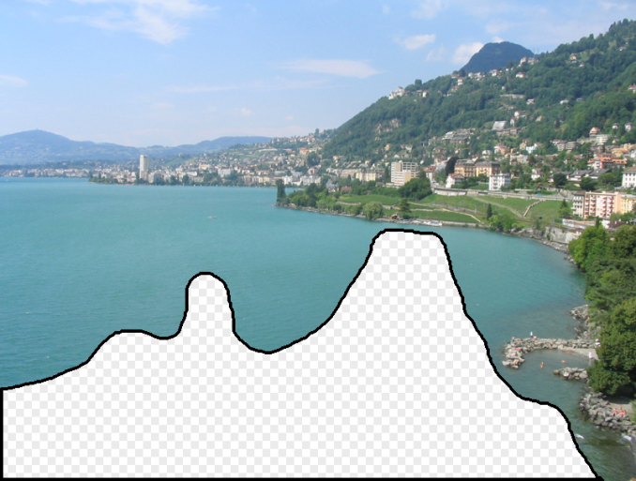

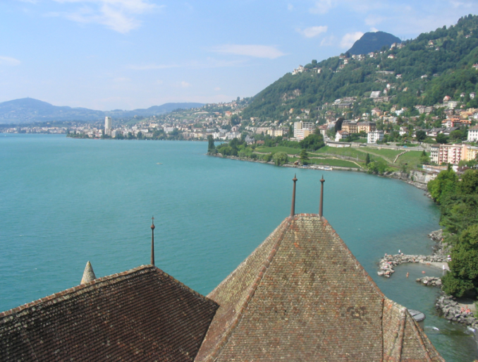
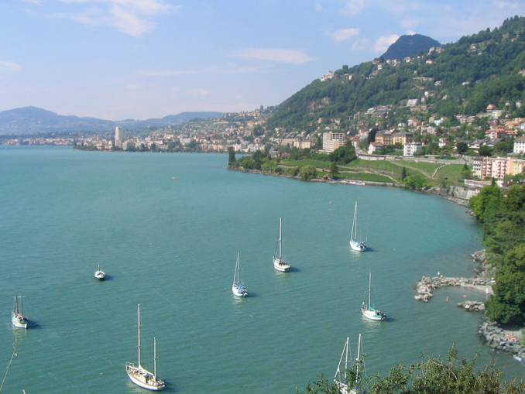
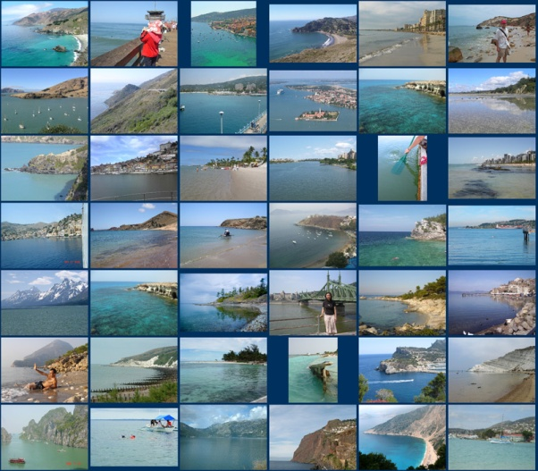
Scene Completion Problem
[Hays and Efros, SIGGRAPH 2007]

Slide 3

Scene Completion Problem
[Hays and Efros, SIGGRAPH 2007]
Notes:
10 nearest neighbors, 20,000 image database

Slide 4
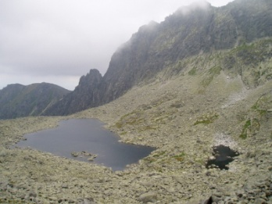
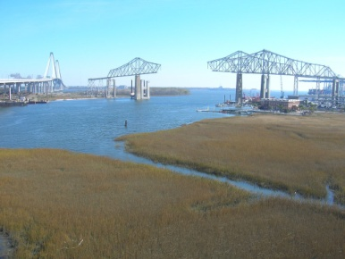

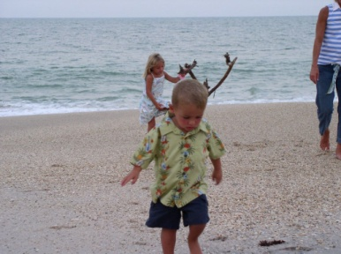
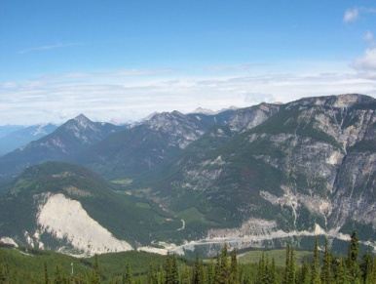
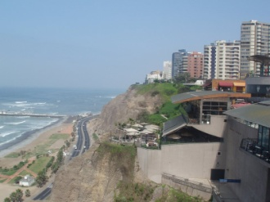
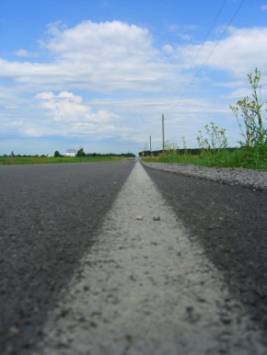
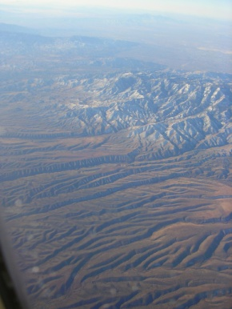
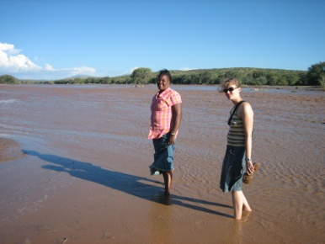

Scene Completion Problem
[Hays and Efros, SIGGRAPH 2007]
10 nearest neighbors from a collection of 20,000 images
Notes:
10 nearest neighbors, 20,000 image database

Slide 5
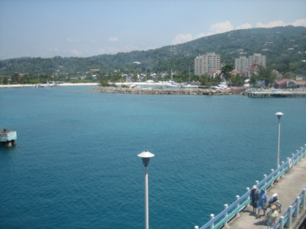
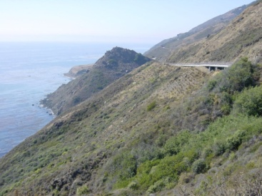
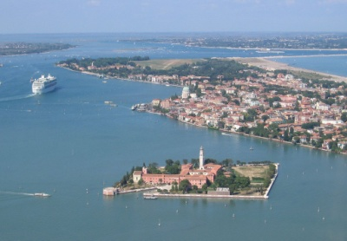
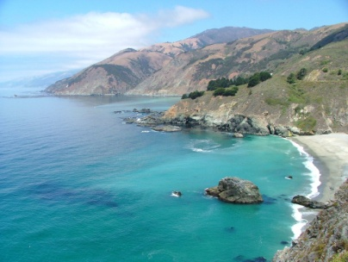

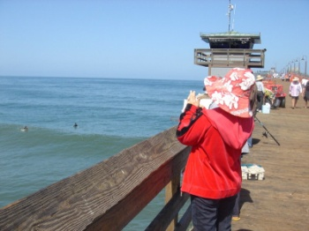
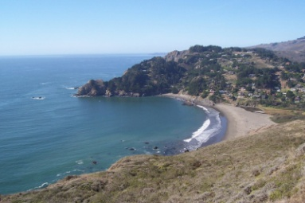
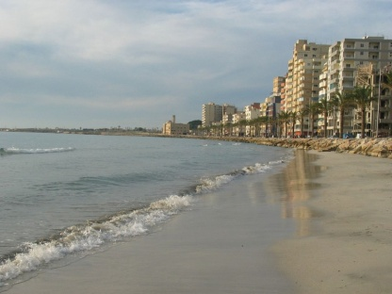

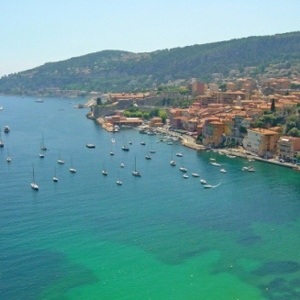
Scene Completion Problem
[Hays and Efros, SIGGRAPH 2007]
10 nearest neighbors from a collection of 2 million images
Notes:
10 nearest neighbors, 2.3 million image database

Slide 6
A Common Metaphor
Many problems can be expressed as
finding “similar” sets:
  Find near-neighbors in high-dimensional space
Examples:
  Pages with similar words
    For duplicate detection, classification by topic
  Customers who purchased similar products
    Products with similar customer sets
  Images with similar features

Slide 7
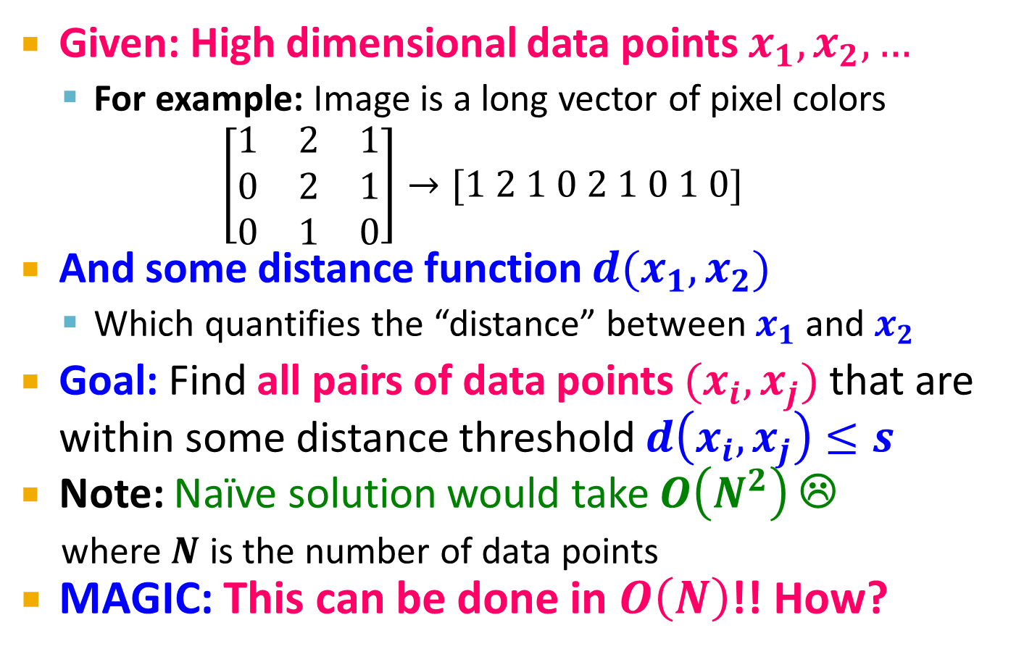
Problem for Today’s Lecture
Given: High dimensional data points $x_{1}, x_{2}, …$
  For example: Image is a long vector of pixel colors
  $$\left[\begin{matrix}1 & 2 & 1 \\ 0 & 2 & 1 \\ 0 & 1 & 0\end{matrix}\right]→[1 2 1 0 2 1 0 1 0]$$
And some distance function $d(x_{1},x_{2})$
  Which quantifies the “distance” between $x_{1}$ and $x_{2}$
Goal: Find all pairs of data points $(x_{i},x_{j})$ that are within some distance threshold $d\left(x_{i},x_{j}\right)≤s$
Note: Naïve solution would take $O\left(N^{2}\right)$ ☹
  where $N$ is the number of data points
MAGIC: This can be done in $O\left(N\right)$!! How?

Slide 8
Finding Similar Items

Slide 9
Distance Measures
  Goal: Find near-neighbors in high-dim. space
  We formally define “near neighbors” as
  points that are a “small distance” apart
For each application, we first need to define what “distance” means
Today: Jaccard distance/similarity
  The Jaccard similarity of two sets is the size of their intersection divided by the size of their union:
  sim(C₁, C₂) = |C₁∩C₂|/|C₁∪C₂|
  Jaccard distance: d(C₁, C₂) = 1 - |C₁∩C₂|/|C₁∪C₂|
3 in intersection
8 in union
Jaccard similarity= 3/8
Jaccard distance = 5/8

Slide 10
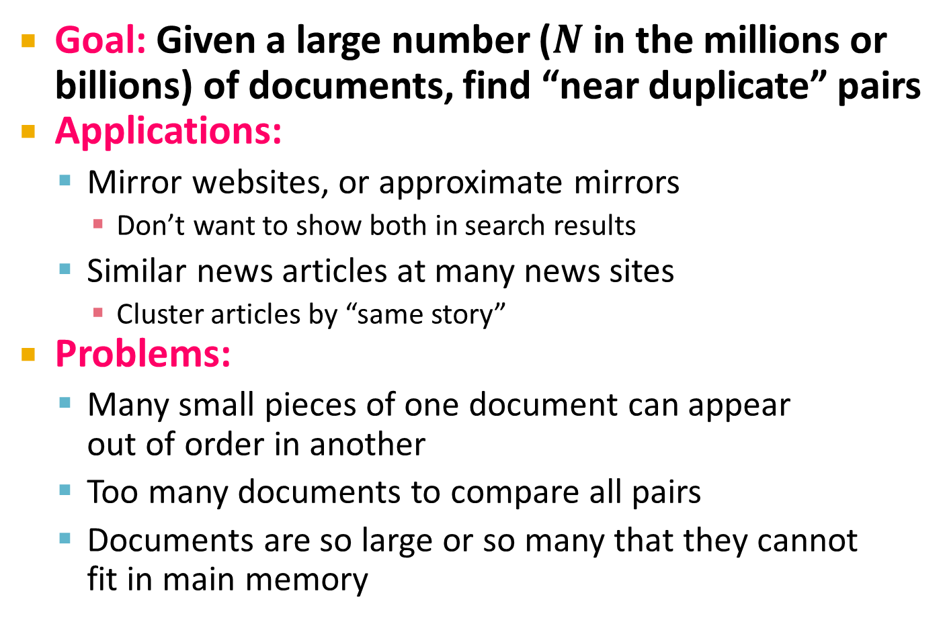
Task: Finding Similar Documents
Goal: Given a large number ($N$ in the millions or billions) of documents, find “near duplicate” pairs
Applications:
  Mirror websites, or approximate mirrors
    Don’t want to show both in search results
  Similar news articles at many news sites
    Cluster articles by “same story”
Problems:
  Many small pieces of one document can appear
  out of order in another
  Too many documents to compare all pairs
  Documents are so large or so many that they cannot
  fit in main memory

Slide 11
3 Essential Steps for Similar Docs
Shingling: Convert documents to sets
Min-Hashing: Convert large sets to short signatures, while preserving similarity
Locality-Sensitive Hashing: Focus on
pairs of signatures likely to be from
similar documents
  Candidate pairs!

Slide 12
The Big Picture
Candidate
pairs:
those pairs
of signatures
that we need
to test for
similarity
Shingling
Min
Hashing
Locality-
Sensitive
Hashing
Docu-
ment
The set
of strings
of length k
that appear
in the doc-
ument
Signatures:
short integer
vectors that
represent the
sets, and
reflect their
similarity

Slide 13
Shingling
Shingling
Docu-
ment
The set
of strings
of length k
that appear
in the doc-
ument
Step 1: Shingling: Convert documents to sets

Slide 14
Define: Shingles
A k-shingle (or k-gram) for a document is a sequence of k tokens that appears in the doc
  Tokens can be characters, words or something else, depending on the application
  Assume tokens = characters for examples
Example: k=2; document D₁ = abcab
Set of 2-shingles: S(D₁) = {ab, bc, ca}
  Option: Shingles as a bag (multiset), count ab twice: S’(D₁) = {ab, bc, ca, ab}

Slide 15
Examples
Input text:
  “The most effective way to represent documents as sets is to construct from the document the set of short strings that appear within it.”
5-shingles:
“The m”, “he mo”, “e mos”, “ most”, “ ost ”, “ost e”, “st ef”, “t eff”,
“ effe”, “effec”, “ffect”, “fecti”, “ectiv”, …
9-shingles:
“The most ”, “he most e”, “e most ef”, “ most eff”, “most effe”,
“ost effec”, “st effect”, “t effecti”, “ effectiv”, “effective”, …

Slide 16
Hashing Shingles
Storage of k-shingles: k bytes per shingle
Instead, hash each shingle to a 4-byte integer.
  E.g. “The most ” → 4320
  “he most e” → 56456
  “e most ef” → 214509
Which one is better?
  Using 4 shingles?
  Using 9-shingles, and then hashing each to 4 byte integer?
Consider the # of distinct elements represented with 4 bytes

Slide 17
Hashing Shingles
Not all characters are common.
  e.g. Unlikely to have shingles like “zy%p”
Rule of thumb: # of k-shingles is about 20^{k}
Using 4-shingles:
  # of shingles: 20⁴ = 160K
Using 9-shingles and then hashing to 4-byte values:
  # of shingles: 20⁹ = 512B
  # of buckets: 2³² = 4.3B
  512B shingles (uniformly) distributed to 4.3B buckets

Slide 18
Similarity Metric for Shingles
Document D₁ is a set of its k-shingles C₁=S(D₁)
Equivalently, each document is a
0/1 vector in the space of k-shingles
  Each unique shingle is a dimension
  Vectors are very sparse
A natural similarity measure is the
Jaccard similarity:
sim(D₁, D₂) = |C₁∩C₂|/|C₁∪C₂|

Slide 19
Working Assumption
Documents that have lots of shingles in common have similar text, even if the text appears in different order
Caveat: You must pick k large enough, or most documents will have most shingles
  k = 5 is OK for short documents
  k = 10 is better for long documents

Slide 20
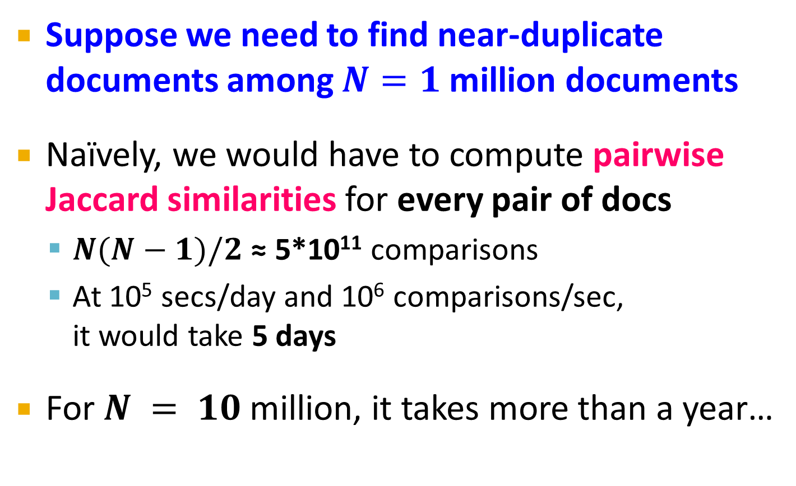
Motivation for Minhash/LSH
Suppose we need to find near-duplicate documents among $N=1$ million documents
Naïvely, we would have to compute pairwise
Jaccard similarities for every pair of docs
  $N(N−1)/2$ ≈ 5*10¹¹ comparisons
  At 10⁵ secs/day and 10⁶ comparisons/sec,
  it would take 5 days
For $N = 10$ million, it takes more than a year…

Slide 21
MinHashing
Shingling
Min-Hash-
ing
Docu-
ment
The set
of strings
of length k
that appear
in the doc-
ument
Signatures:
short integer
vectors that
represent the
sets, and
reflect their
similarity
Step 2: Minhashing: Convert large sets to short signatures, while preserving similarity

Slide 22
Encoding Sets as Bit Vectors
Many similarity problems can be
formalized as finding subsets that
have significant intersection
Encode sets using 0/1 (bit, boolean) vectors
  One dimension per element in the universal set
Interpret set intersection as bitwise AND, and
set union as bitwise OR
Example: C₁ = 10111; C₂ = 10011
  Size of intersection = 3; size of union = 4,
  Jaccard similarity (not distance) = 3/4
  Distance: d(C₁,C₂) = 1 – (Jaccard similarity) = 1/4

Slide 23
From Sets to Boolean Matrices
Rows = elements (shingles)
Columns = sets (documents)
  1 in row e and column s if and only if e is a member of s
  Column similarity is the Jaccard similarity of the corresponding sets (rows with value 1)
  Typical matrix is sparse!
Each document is a column:
  Example: sim(C₁ ,C₂) = ?
    Size of intersection = 3; size of union = 6,
    Jaccard similarity (not distance) = 3/6
    d(C₁,C₂) = 1 – (Jaccard similarity) = 3/6
Documents
1
1
1
0
1
1
0
1
0
1
0
1
0
0
0
1
Shingles
1
0
0
1
1
1
1
0
1
0
1
0

Slide 24
Outline: Finding Similar Columns
So far:
  Documents → Sets of shingles
  Represent sets as boolean vectors in a matrix
Next goal: Find similar columns while computing small signatures
  Similarity of columns == similarity of signatures

Slide 25
Hashing Columns (Signatures)
Key idea: “hash” each column C to a small signature h(C), such that:
  (1) h(C) is small enough that the signature fits in RAM
  (2) sim(C₁, C₂) is the same as the “similarity” of signatures h(C₁) and h(C₂)
Goal: Find a hash function h(·) such that:
  If sim(C₁,C₂) is high, then with high prob. h(C₁) = h(C₂)
  If sim(C₁,C₂) is low, then with high prob. h(C₁) ≠ h(C₂)
Hash docs into buckets. Expect that “most” pairs of near duplicate docs hash into the same bucket!

Slide 26
Min-Hashing
Goal: Find a hash function h(·) such that:
  if sim(C₁,C₂) is high, then with high prob. h(C₁) = h(C₂)
  if sim(C₁,C₂) is low, then with high prob. h(C₁) ≠ h(C₂)
Clearly, the hash function depends on
the similarity metric:
  Not all similarity metrics have a suitable
  hash function
There is a suitable hash function for
the Jaccard similarity: It is called Min-Hashing

Slide 27
Min-Hashing
Imagine the rows of the boolean matrix permuted under random permutation π
Define a “hash” function h_{π}(C) = the index of the first (in the permuted order π) row in which column C has value 1:
h_{π} (C) = min_{π} π(C)
Use several (e.g., 100) independent hash functions (that is, permutations) to create a signature of a column

Slide 28
Min-Hashing Example
Documents
Documents
1
0
1
0
0
1
0
0
1
0
0
1
0
1
0
1
Min-hash values
0
1
0
1
1
0
0
0
3
1
4
2
Shingles
1
0
1
0
0
1
0
0
0
1
0
1
1
0
0
1
1
0
1
0
0
1
0
1
1
0
0
0
1
0
1
0
Input Matrix
Permuted Matrix

Slide 29
Min-Hashing Example
2nd element of the permutation is the first to map to a 1
Permutation π
Input matrix (Shingles x Documents)
Signature matrix M
2
4
3
4
7
2
6
1
5
1
0
1
0
2
1
2
1
3
2
1
0
0
1
2
1
4
1
7
1
0
1
0
1
1
2
1
2
6
3
0
1
0
1
1
6
0
1
0
1
4th element of the permutation is the first to map to a 1
5
7
1
0
1
0
4
5
1
0
1
0

Slide 30
The Min-Hash Property
Choose a random permutation π
Claim: Pr[h_{π}(C_{i}) = h_{π}(C_{j})] = sim(C_{i}, C_{j})
Proof:
  Consider 3 types of rows:
type X: C_{i} and C_{j} both have 1s
type Y: only one of C_{i} and C_{j} has 1
type Z: C_{i} and C_{j} both have 0s
  After random permutation π, what if the first X-type row is before the first Y-type row?
    h_{π}(C_{i}) = h_{π}(C_{j})
C_{i}
C_{j}
X
1
1
Y
1
0
Z
0
0
Z
0
0
Z
0
0
X
1
1
Y
1
0
Input Matrix

Slide 31
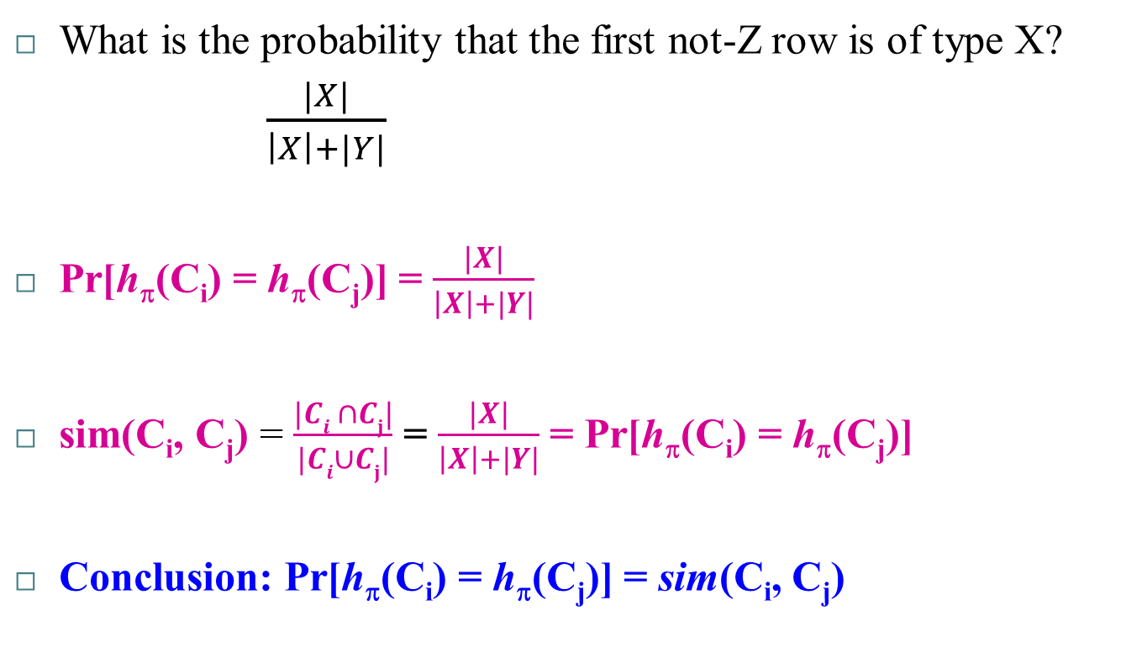
The Min-Hash Property
What is the probability that the first not-Z row is of type X?
  $\frac{|X|}{\left|X\right|+|Y|}$
    Pr[h_{π}(C_{i}) = h_{π}(C_{j})] = $\frac{|X|}{\left|X\right|+|Y|}$
sim(C_{i}, C_{j}) = $\frac{|Ci ∩Cj|}{|Ci∪Cj|}$ = $\frac{|X|}{\left|X\right|+|Y|}$ = Pr[h_{π}(C_{i}) = h_{π}(C_{j})]
Conclusion: Pr[h_{π}(C_{i}) = h_{π}(C_{j})] = sim(C_{i}, C_{j})

Slide 32
Similarity for Signatures
We know: Pr[h_{π}(C₁) = h_{π}(C₂)] = sim(C₁, C₂)
Now generalize to multiple hash functions
The similarity of two signatures is the fraction of the hash functions in which they agree
Note: Because of the Min-Hash property, the similarity of columns is the same as the expected similarity of their signatures
Notes:
Each agress with prob s.
So to estimate s we compute what fraction of hash functions agree

Slide 33
Min-Hashing Example
Permutation π
Input matrix (Shingles x Documents)
Signature matrix M
2
4
3
4
7
2
6
1
5
1
0
1
0
2
1
2
1
3
2
1
0
0
1
2
1
4
1
7
1
0
1
0
1
1
2
1
2
6
3
0
1
0
1
1
6
0
1
0
1
Similarities:
1-3 2-4 1-2 3-4
Col/Col 0.75 0.75 0 0
Sig/Sig 0.67 1.00 0 0
5
7
1
0
1
0
4
5
1
0
1
0

Slide 34
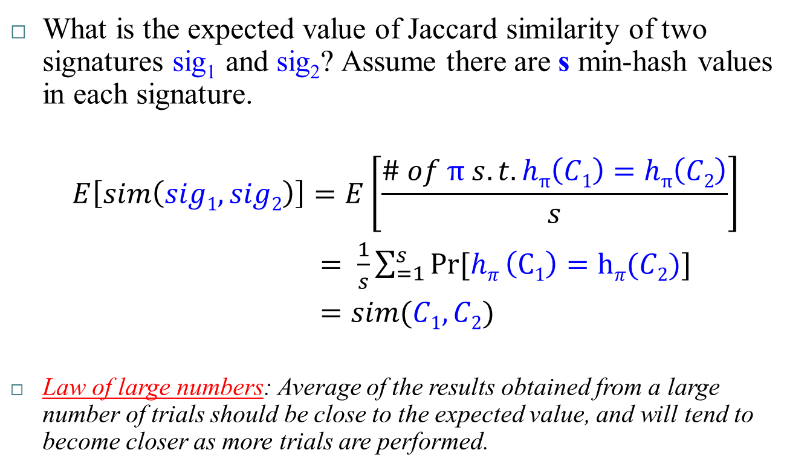
Similarity of Signatures
What is the expected value of Jaccard similarity of two signatures sig₁ and sig₂? Assume there are s min-hash values in each signature.
$$E\left[sim\left(sig1, sig2\right)\right]=E\left[\frac{\# of π s.t. hπ\left(C1\right)=hπ\left(C2\right)}{s}\right]$$
$= \frac{1}{s}\sum_{=1}^{s}{Pr⁡[hπ}\left(C1\right)=hπ(C2)]$
$=sim(C1, C2)$
Law of large numbers: Average of the results obtained from a large number of trials should be close to the expected value, and will tend to become closer as more trials are performed.

Slide 35
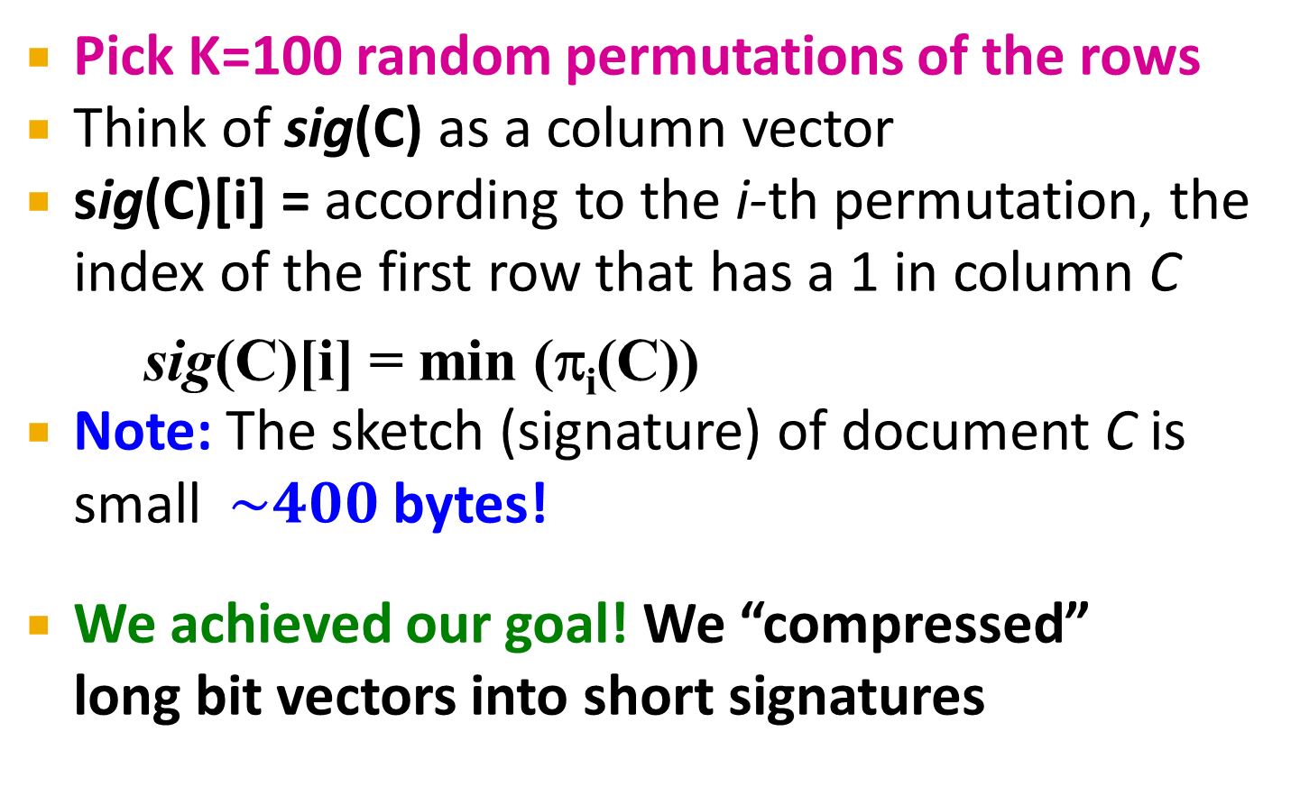
Min-Hash Signatures
Pick K=100 random permutations of the rows
Think of sig(C) as a column vector
sig(C)[i] = according to the i-th permutation, the index of the first row that has a 1 in column C
  sig(C)[i] = min (π_{i}(C))
Note: The sketch (signature) of document C is small $\sim 400$ bytes!
We achieved our goal! We “compressed”
long bit vectors into short signatures

Slide 36
Implementation Trick
Permuting rows even once is prohibitive
Row hashing!
  Pick K = 100 hash functions k_{i}
  Ordering under k_{i} gives a random row (almost) permutation!
Hash func. 1
Hash func. 2
Row
D₁
D₂
D₃
D₄
(r+1) % 5
(3r+1) % 5
0
1
0
0
1
1
1
How to pick a random
hash function h(x)?
Universal hashing:
h_{a,b}(x)=((a·x+b) mod p) mod N
where:
a,b … random integers
p … prime number (p > N)
1
0
0
1
0
2
4
2
0
1
0
1
3
2
3
1
0
1
1
4
0
4
0
0
1
0
0
3

Slide 37
Implementation Trick
One-pass implementation
  For each column C and hash-func. k_{i} keep a “slot” for the min-hash value
  Initialize all sig(C)[i] = ∞
  Scan rows looking for 1s
    Suppose row j has 1 in column C
    Then for each k_{i} :
      If k_{i}(j) < sig(C)[i], then sig(C)[i] ← k_{i}(j)

Slide 38
Example: Computing Min-Hash Signatures
Hash func. 1
Hash func. 2
Row
D₁
D₂
D₃
D₄
(r+1) % 5
(3r+1) % 5
0
1
0
0
1
1
1
1
0
0
1
0
2
4
2
0
1
0
1
3
2
Signatures
3
1
0
1
1
4
0
D₁
D₂
D₃
D₄
4
0
0
1
0
0
3
∞
∞
∞
∞
∞
∞
∞
∞

Slide 39
Example: Computing Min-Hash Signatures
Hash func. 1
Hash func. 2
Row
D₁
D₂
D₃
D₄
(r+1) % 5
(3r+1) % 5
0
1
0
0
1
1
1
1
0
0
1
0
2
4
2
0
1
0
1
3
2
Signatures
3
1
0
1
1
4
0
D₁
D₂
D₃
D₄
4
0
0
1
0
0
3
∞
∞
∞
∞
1
1
∞
∞
∞
∞
1
1

Slide 40
Example: Computing Min-Hash Signatures
Hash func. 1
Hash func. 2
Row
D₁
D₂
D₃
D₄
(r+1) % 5
(3r+1) % 5
0
1
0
0
1
1
1
1
0
0
1
0
2
4
2
0
1
0
1
3
2
Signatures
3
1
0
1
1
4
0
D₁
D₂
D₃
D₄
4
0
0
1
0
0
3
1
∞
∞
1
2
1
∞
4
1
∞

Slide 41
Example: Computing Min-Hash Signatures
Hash func. 1
Hash func. 2
Row
D₁
D₂
D₃
D₄
(r+1) % 5
(3r+1) % 5
0
1
0
0
1
1
1
1
0
0
1
0
2
4
2
0
1
0
1
3
2
Signatures
3
1
0
1
1
4
0
D₁
D₂
D₃
D₄
4
0
0
1
0
0
3
1
∞
2
1
3
1
∞
4
1
2

Slide 42
Example: Computing Min-Hash Signatures
Hash func. 1
Hash func. 2
Row
D₁
D₂
D₃
D₄
(r+1) % 5
(3r+1) % 5
0
1
0
0
1
1
1
1
0
0
1
0
2
4
2
0
1
0
1
3
2
Signatures
3
1
0
1
1
4
0
D₁
D₂
D₃
D₄
4
0
0
1
0
0
3
1
3
2
1
1
2
4
1
0
0
0

Slide 43
Example: Computing Min-Hash Signatures
Hash func. 1
Hash func. 2
Row
D₁
D₂
D₃
D₄
(r+1) % 5
(3r+1) % 5
0
1
0
0
1
1
1
1
0
0
1
0
2
4
2
0
1
0
1
3
2
Signatures
3
1
0
1
1
4
0
D₁
D₂
D₃
D₄
4
0
0
1
0
0
3
1
3
2
1
0
0
2
0
0

Slide 44
Example: Computing Min-Hash Signatures
Hash func. 1
Hash func. 2
Row
D₁
D₂
D₃
D₄
(r+1) % 5
(3r+1) % 5
0
1
0
0
1
1
1
1
0
0
1
0
2
4
2
0
1
0
1
3
2
Final signatures
3
1
0
1
1
4
0
D₁
D₂
D₃
D₄
4
0
0
1
0
0
3
1
3
0
1
0
2
0
0

Slide 45
Locality Sensitive Hashing
Candidate
pairs:
those pairs
of signatures
that we need
to test for
similarity
Shingling
Min-Hash-
ing
Locality-
Sensitive
Hashing
Docu-
ment
The set
of strings
of length k
that appear
in the doc-
ument
Signatures:
short integer
vectors that
represent the
sets, and
reflect their
similarity
Step 3: Locality-Sensitive Hashing:
Focus on pairs of signatures likely to be from similar documents

Slide 46
LSH: First Cut
2
1
4
1
1
2
1
2
2
1
2
1
Goal: Find documents with Jaccard similarity at least s (for some similarity threshold, e.g., s=0.8)
LSH – General idea: Use a function f(x,y) that tells whether x and y is a candidate pair: a pair of elements whose similarity must be evaluated
For Min-Hash matrices:
  Hash columns of signature matrix M to many buckets
  Each pair of documents that hashes into the
  same bucket is a candidate pair

Slide 47
LSH for Min-Hash
2
1
4
1
1
2
1
2
2
1
2
1
Big idea: Hash columns of
signature matrix M several times
Arrange that (only) similar columns are likely to hash to the same bucket, with high probability
Candidate pairs are those that hash to the same bucket

Slide 48
Partition M into b Bands
2
1
4
1
1
2
1
2
2
1
2
1
r rows
per band
b bands
One
signature
Signature matrix M

Slide 49
Partition M into Bands
Divide matrix M into b bands of r rows
For each band, hash its portion of each column to a hash table with k buckets
  Make k as large as possible
Candidate column pairs are those that hash to the same bucket for ≥ 1 band
Tune b and r to catch most similar pairs,
but few non-similar pairs

Slide 50
Hashing Bands
Buckets
Columns 2 and 6
are probably identical
(candidate pair)
Columns 6 and 7 are
surely different.
Matrix M
r rows
b bands

Slide 51
Banding Example
Signature Matrix
Buckets
1
3
0
0
2
1
0
1
3
0
2
1
2
2
1
4
3
0
2
2
5
4
3
5
2
4
3
2
3
1
1
4
2
2
3
1
5
5
0
2
4
3
5
4
0
5
3
0
2
5
1
1
3
2
0
2
5
1
1
2
0
2
0
2
0
1
1
2
0
0
2
5
Candidate pairs: {(2,4);

Slide 52
Banding Example
Signature Matrix
Buckets
1
3
0
0
2
1
0
1
3
0
2
1
2
2
1
4
3
0
2
2
5
4
3
5
2
4
3
2
3
1
1
4
2
2
3
1
5
5
0
2
4
3
5
4
0
5
3
0
2
5
1
1
3
2
0
2
5
1
1
2
0
2
0
2
0
1
1
2
0
0
2
5
Candidate pairs: {(2,4);

Slide 53
Banding Example
Signature Matrix
Buckets
1
3
0
0
2
1
0
1
3
0
2
1
2
2
1
4
3
0
2
2
5
4
3
5
2
4
3
2
3
1
1
4
2
2
3
1
5
5
0
2
4
3
5
4
0
5
3
0
2
5
1
1
3
2
0
2
5
1
1
2
0
2
0
2
0
1
1
2
0
0
2
5
Candidate pairs: {(2,4);
(1,6)

Slide 54
Banding Example
Signature Matrix
Buckets
1
3
0
0
2
1
0
1
3
0
2
1
2
2
1
4
3
0
2
2
5
4
3
5
2
4
3
2
3
1
1
4
2
2
3
1
5
5
0
2
4
3
5
4
0
5
3
0
2
5
1
1
3
2
0
2
5
1
1
2
0
2
0
2
0
1
1
2
0
0
2
5
Candidate pairs: {(2,4);
(1,6)
(3,8)}

Slide 55
Banding Example
Signature Matrix
Buckets
1
3
0
0
2
1
0
1
3
0
2
1
2
2
1
4
3
0
2
2
5
4
3
5
2
4
3
2
3
1
1
4
2
2
3
1
5
5
0
2
4
3
5
4
0
5
3
0
2
5
1
1
3
2
0
2
5
1
1
2
0
2
0
2
0
1
1
2
0
0
2
5
True positive
Candidate pairs: {(2,4); (1,6); (3,8)}

Slide 56
Banding Example
Signature Matrix
Buckets
1
3
0
0
2
1
0
1
3
0
2
1
2
2
1
4
3
0
2
2
5
4
3
5
2
4
3
2
3
1
1
4
2
2
3
1
5
5
0
2
4
3
5
4
0
5
3
0
2
5
1
1
3
2
0
2
5
1
1
2
0
2
0
2
0
1
1
2
0
0
2
5
True positive
Candidate pairs: {(2,4); (1,6); (3,8)}

Slide 57
Banding Example
Signature Matrix
Buckets
1
3
0
0
2
1
0
1
3
0
2
1
2
2
1
4
3
0
2
2
5
4
3
5
2
4
3
2
3
1
1
4
2
2
3
1
5
5
0
2
4
3
5
4
0
5
3
0
2
5
1
1
3
2
0
2
5
1
1
2
0
2
0
2
0
1
1
2
0
0
2
5
False positive?
Candidate pairs: {(2,4); (1,6); (3,8)}

Slide 58
Banding Example
Signature Matrix
Buckets
1
3
0
0
2
1
0
1
3
0
2
1
2
2
1
4
3
0
2
2
5
4
3
5
2
4
3
2
3
1
1
4
2
2
3
1
5
5
0
2
4
3
5
4
0
5
3
0
2
5
1
1
3
2
0
2
5
1
1
2
0
2
0
2
0
1
1
2
0
0
2
5
False negative?
Candidate pairs: {(2,4); (1,6); (3,8)}

Slide 59
Simplifying Assumption
There are enough buckets that columns are unlikely to hash to the same bucket unless they are identical in a particular band
Hereafter, we assume that “same bucket” means “identical in that band”
Assumption needed only to simplify analysis, not for correctness of algorithm

Slide 60
Example of Bands
2
1
4
1
1
2
1
2
2
1
2
1
Assume the following case:
Suppose 100,000 columns of M (100k docs)
Signatures of 100 integers (rows)
Therefore, signatures take 40Mb
Choose b = 20 bands of r = 5 integers/band
Goal: Find pairs of documents that
are at least s = 0.8 similar

Slide 61
C₁, C₂ are 80% Similar
2
1
4
1
1
2
1
2
2
1
2
1
Find pairs of ≥ s=0.8 similarity, set b=20, r=5
Assume: sim(C₁, C₂) = 0.8
  Since sim(C₁, C₂) ≥ s, we want C₁, C₂ to be a candidate pair: We want them to hash to at least 1 common bucket (at least one band is identical)
Probability C₁, C₂ identical in one particular band:
(0.8)⁵ = 0.328
Probability C₁, C₂ are different in all of the 20 bands:
(1-0.328)²⁰ = 0.00035
  i.e., about 1/3000th of the 80%-similar column pairs
  are false negatives (we miss them)
  We would find 99.965% pairs of truly similar documents

Slide 62
C₁, C₂ are 30% Similar
2
1
4
1
1
2
1
2
2
1
2
1
Find pairs of ≥ s=0.8 similarity, set b=20, r=5
Assume: sim(C₁, C₂) = 0.3
  Since sim(C₁, C₂) < s we want C₁, C₂ to hash to NO
  common buckets (all bands should be different)
Probability C₁, C₂ identical in one particular band:
(0.3)⁵ = 0.00243
Probability C₁, C₂ identical in at least 1 of 20 bands:
1 - (1 - 0.00243)²⁰ = 0.0474
  In other words, approximately 4.74% pairs of docs with similarity 0.3% end up becoming candidate pairs
    They are false positives since we will have to examine them (they are candidate pairs) but then it will turn out their similarity is below threshold s

Slide 63
LSH Involves a Tradeoff
2
1
4
1
1
2
1
2
2
1
2
1
Pick:
  The number of Min-Hashes (rows of M)
  The number of bands b, and
  The number of rows r per band
to balance false positives/negatives
Example: How would the false positives/negatives change if we had only 15 bands of 5 rows (as opposed to 20 bands of 5 rows)?
  The number of false positives would go down, but the number of false negatives would go up

Slide 64
Analysis of LSH – What We Want
Probability = 1 if t > s
Probability
of sharing
a bucket
No chance
if t < s
Similarity threshold s
Similarity t =sim(C₁, C₂) of two sets

Slide 65
What 1 Band of 1 Row Gives You
Probability
of sharing
a bucket
Remember:
Probability of
equal hash-values
= similarity
Similarity t =sim(C₁, C₂) of two sets

Slide 66
b bands, r rows/band
Columns C₁ and C₂ have similarity t
Pick any band (r rows)
  Prob. that all rows in band equal
    t^{r}
  Prob. that some row in band unequal
  1 - t^{r}
Prob. that no band identical
  (1 - t^{r})^{b}
Prob. that at least 1 band identical
  1 - (1 - t^{r})^{b}

Slide 67
What b Bands of r Rows Gives You
No bands
identical
At least
one band
identical
(
)^{b}
Probability
of sharing
a bucket
s ~ (1/b)^{1/r}
1 -
1 -
t ^{r}
All rows
of a band
are equal
Some row
of a band
unequal
Similarity t=sim(C₁, C₂) of two sets

Slide 68
Example: b = 20; r = 5
Similarity threshold s
Prob. that at least 1 band is identical:
s | 1-(1-s^{r})^{b}
.2 | .006
.3 | .047
.4 | .186
.5 | .470
.6 | .802
.7 | .975
.8 | .9996

Slide 69
Picking r and b: The S-curve
Picking r and b to get the best S-curve
  50 hash-functions (r=5, b=10)
Prob. sharing a bucket
Green area: False Positive rate
Blue area: False Negative rate
Similarity

Slide 70
LSH Summary
Tune M, b, r to get almost all pairs with similar signatures, but eliminate most pairs that do not have similar signatures
Check in main memory that candidate pairs really do have similar signatures
Optional: In another pass through data, check that the remaining candidate pairs really represent similar documents

Slide 71
Summary: 3 Steps
Shingling: Convert documents to sets
  We used hashing to assign each shingle an ID
Min-Hashing: Convert large sets to short signatures, while preserving similarity
  We used similarity preserving hashing to generate signatures with property Pr[h_{π}(C₁) = h_{π}(C₂)] = sim(C₁, C₂)
  We used hashing to get around generating random permutations
Locality-Sensitive Hashing: Focus on pairs of signatures likely to be from similar documents
  We used hashing to find candidate pairs of similarity ≥ s

