Slide 1
Lecture 5: MapReduce
CS425: Algorithms for Web Scale Data
Most of the slides are from the Mining of Massive Datasets book.
These slides have been modified for CS425. The original slides can be accessed at: www.mmds.org

Slide 2
MapReduce
Challenges of large scale computing:
How to distribute computation?
Distributed/parallel programming is hard
Need to consider parallelism, efficiency, communication, synchronization, reliability.
Map-reduce addresses all of the above
Google’s computational/data manipulation model
Elegant way to work with big data

Slide 3
Single Node Architecture
CPU
Machine Learning, Statistics
Memory
“Classical” Data Mining
Disk

Slide 4
Motivation: Google Example
20+ billion web pages x 20KB = 400+ TB
1 computer reads 80-160 MB/sec from disk
> 1 month to read the web
Many hard drives to store the web
Takes even more to do something useful with the data!
Today, a standard architecture for such problems:
Cluster of commodity Linux nodes
Commodity network (ethernet) to connect them

Slide 5
Cluster Architecture
2-10 Gbps backbone between racks
1 Gbps between
any pair of nodes
in a rack
Switch
Switch
Switch
CPU
CPU
CPU
CPU
Mem
…
Mem
Mem
…
Mem
Disk
Disk
Disk
Disk
Each rack contains 16-64 nodes
In 2011 it was guestimated that Google had 1M machines, http://bit.ly/Shh0RO

Slide 6
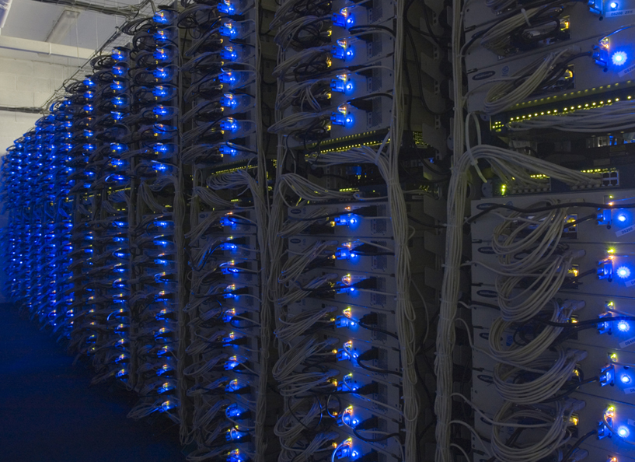

Slide 7
Large-scale Computing
Large-scale computing for data mining problems on commodity hardware
Challenges:
How do you distribute computation?
How can we make it easy to write distributed programs?
Machines fail:
One server may stay up 3 years (1,000 days)
If you have 1,000 servers, expect to loose 1/day
People estimated Google had ~1M machines in 2011
1,000 machines fail every day!

Slide 8
Idea and Solution
Issue: Copying data over a network takes time
Idea:
Bring computation close to the data
Store files multiple times for reliability
Map-reduce addresses these problems
Google’s computational/data manipulation model
Elegant way to work with big data
Storage Infrastructure – File system
Google: GFS. Hadoop: HDFS
Programming model
Map-Reduce

Slide 9
Storage Infrastructure
Problem:
If nodes fail, how to store data persistently?
Answer:
Distributed File System:
Provides global file namespace
Google GFS; Hadoop HDFS;
Typical usage pattern
Huge files (TBs)
Data is rarely updated in place
Reads and appends are common

Slide 10
Distributed File System
Chunk servers
File is split into contiguous chunks
Typically each chunk is 16-128MB
Each chunk replicated (usually 2x or 3x)
Try to keep replicas in different racks
Master node
a.k.a. Name Node in Hadoop’s HDFS
Stores metadata about where files are stored
Might be replicated
Client library for file access
Talks to master to find chunk servers
Connects directly to chunk servers to access data

Slide 11
Distributed File System
Reliable distributed file system
Data kept in “chunks” spread across machines
Each chunk replicated on different machines
Seamless recovery from disk or machine failure
C₀
C₁
D₀
C₁
C₂
C₅
C₀
C₅
…
C₅
Chunk server 1
C₂
C₅
Chunk server 2
C₃
D₀
Chunk server 3
D₁
D₀
Chunk server N
C₂
Bring computation directly to the data!
Chunk servers also serve as compute servers
Notes:
11

Slide 12
MapReduce: Overview
Map:
Extract something you care about
Group by key: Sort and Shuffle
Reduce:
Aggregate, summarize, filter or transform
Write the result
Outline stays the same, Map and Reduce change to fit the problem

Slide 13
MapReduce: The Map Step
Input
key-value pairs
Intermediate
key-value pairs
k
v
map
k
v
k
v
map
k
v
k
v
…
…
k
v
k
v

Slide 14
MapReduce: The Reduce Step
Output
key-value pairs
Intermediate
key-value pairs
Key-value groups
reduce
k
v
k
v
v
v
k
v
Group
by key
reduce
k
v
k
v
v
k
v
k
v
…
…
…
k
v
k
v
k
v

Slide 15
More Specifically
Input: a set of key-value pairs
Programmer specifies two methods:
Map(k, v) → <k’, v’>*
Takes a key-value pair and outputs a set of key-value pairs
E.g., key is the filename, value is a single line in the file
There is one Map call for every (k,v) pair
Reduce(k’, <v’>*) → <k’, v’’>
All values v’ with same key k’ are reduced together and processed in v’ order
There is one Reduce function call per unique key k’

Slide 16
Programming Model: MapReduce
Warm-up task:
We have a huge text document
Count the number of times each distinct word appears in the file
Sample application:
Analyze web server logs to find popular URLs

Slide 17
MapReduce: Word Counting
Provided by the programmer
Provided by the programmer
MAP:
Read input and produce a set of key-value pairs
Group by key:
Collect all pairs with same key
Reduce:
Collect all values belonging to the key and output
The crew of the space shuttle Endeavor recently returned to Earth as ambassadors, harbingers of a new era of space exploration. Scientists at NASA are saying that the recent assembly of the Dextre bot is the first step in a long-term space-based man/mache partnership. '"The work we're doing now -- the robotics we're doing -- is what we're going to need ……………………..
(The, 1)
(crew, 1)
(of, 1)
(the, 1)
(space, 1)
(shuttle, 1)
(Endeavor, 1)
(recently, 1)
….
(crew, 1)
(crew, 1)
(space, 1)
(the, 1)
(the, 1)
(the, 1)
(shuttle, 1)
(recently, 1)
…
(crew, 2)
(space, 1)
(the, 3)
(shuttle, 1)
(recently, 1)
…
Big document
(key, value)
(key, value)
(key, value)

Slide 18
Word Count Using MapReduce
map(key, value):
// key: document name; value: text of the document
for each word w in value:
emit(w, 1)
reduce(key, values):
// key: a word; value: an iterator over counts
result = 0
for each count v in values:
result += v
emit(key, result)

Slide 19
Map-Reduce: Environment
Map-Reduce environment takes care of:
Partitioning the input data
Scheduling the program’s execution across a set of machines
Performing the group by key step
Handling machine failures
Managing required inter-machine communication

Slide 20
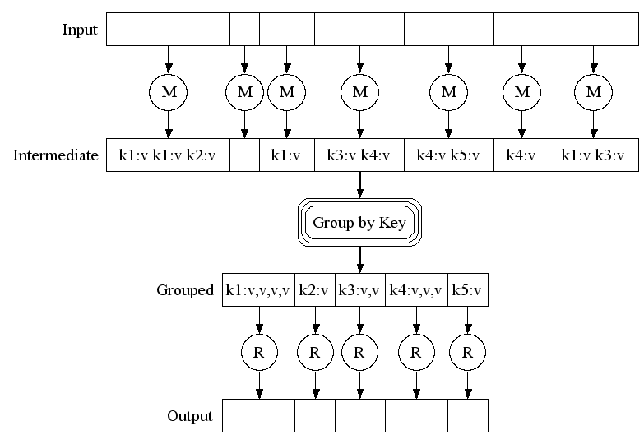
Map-Reduce: A diagram
Big document
MAP:
Read input and produce a set of key-value pairs
Group by key:
Collect all pairs with same key
(Hash merge, Shuffle, Sort, Partition)
Reduce:
Collect all values belonging to the key and output

Slide 21
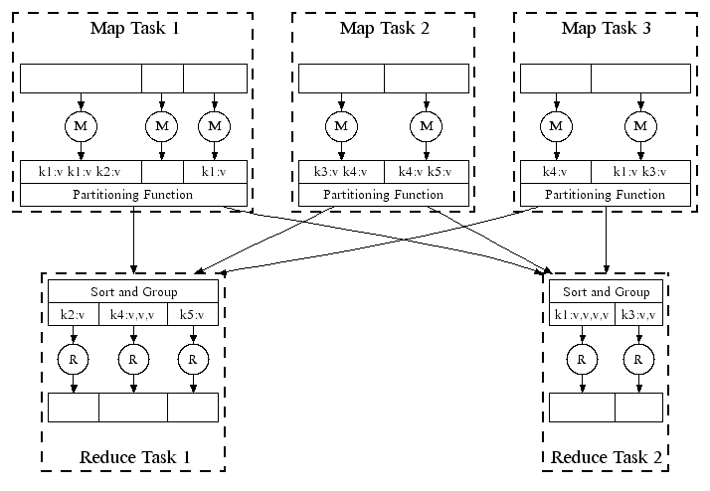
Map-Reduce: In Parallel
All phases are distributed with many tasks doing the work

Slide 22
Map-Reduce
Programmer specifies:
Map and Reduce and input files
Workflow:
Read inputs as a set of key-value-pairs
Map transforms input kv-pairs into a new set of k'v'-pairs
Sorts & Shuffles the k'v'-pairs to output nodes
All k’v’-pairs with a given k’ are sent to the same reduce
Reduce processes all k'v'-pairs grouped by key into new k''v''-pairs
Write the resulting pairs to files
All phases are distributed with many tasks doing the work
Input 0
Input 1
Input 2
Map 0
Map 1
Map 2
Shuffle
Reduce 0
Reduce 1
Out 0
Out 1

Slide 23
Data Flow
Input and final output are stored on a distributed file system (FS):
Scheduler tries to schedule map tasks “close” to physical storage location of input data
Intermediate results are stored on local FS of Map and Reduce workers
Output is often input to another MapReduce task

Slide 24
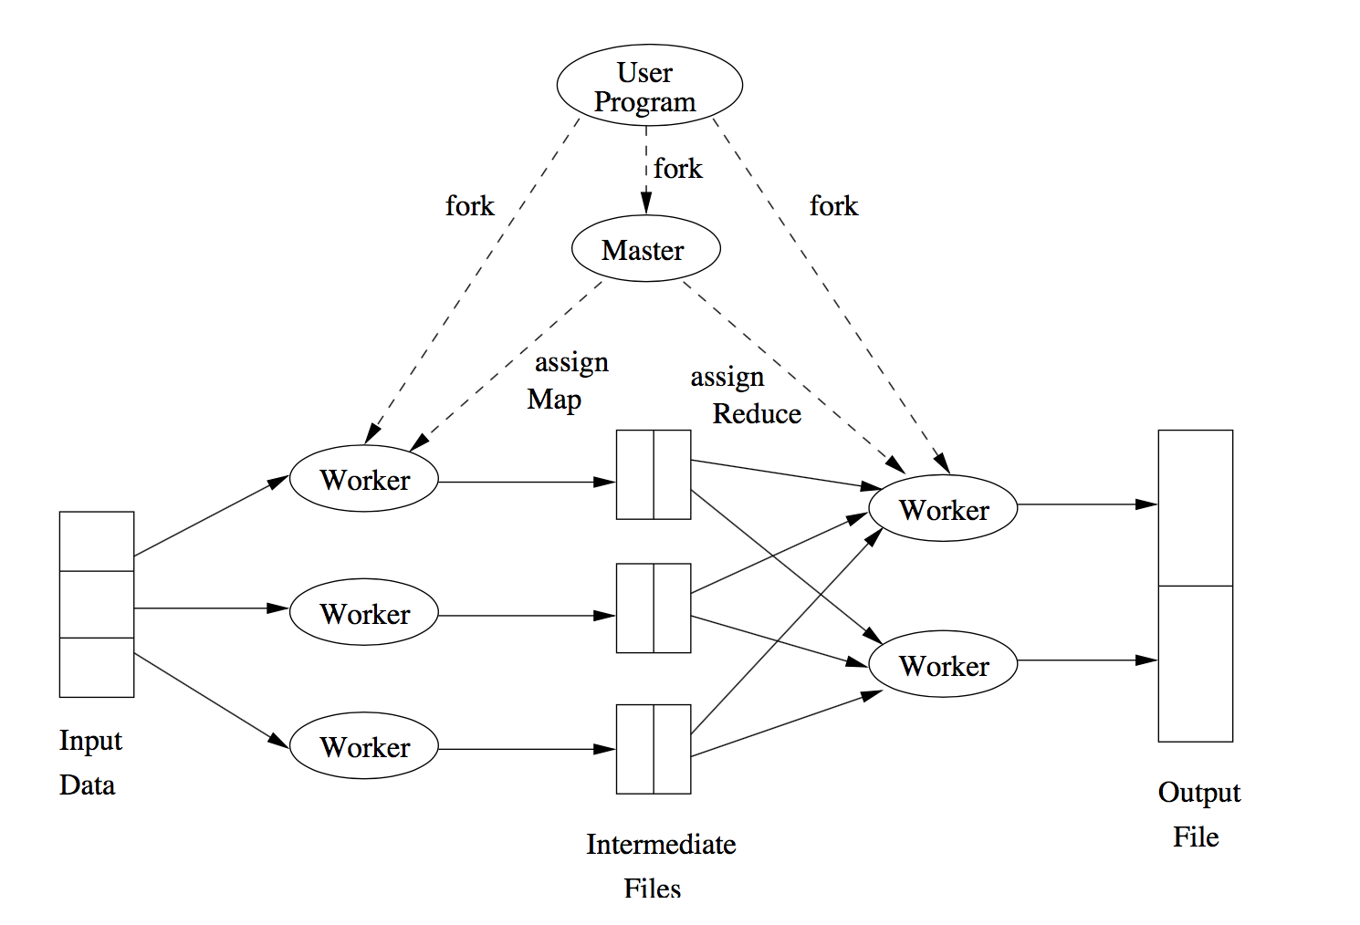
Execution Overview
Figure from Mining of Massive Datasets textbook

Slide 25
Coordination: Master
Master node takes care of coordination:
Task status: (idle, in-progress, completed)
Idle tasks get scheduled as workers become available
When a map task completes, it sends the master the location and sizes of its R intermediate files, one for each reducer
Master pushes this info to reducers
Master pings workers periodically to detect failures

Slide 26
Dealing with Failures
Map worker failure
Map tasks completed or in-progress at worker are reset to idle
Reduce workers are notified when task is rescheduled on another worker
Reduce worker failure
Only in-progress tasks are reset to idle
Reduce task is restarted
Master failure
MapReduce task is aborted and client is notified

Slide 27
How many Map and Reduce jobs?
User defines M map tasks, R reduce tasks
Rule of a thumb:
Make M much larger than the number of nodes in the cluster
One DFS chunk per map is common
Improves dynamic load balancing and speeds up recovery from worker failures
Usually R is smaller than M
Each mapper generates a file per reducer
Output is spread across R files
can use –getmerge to merge all files at the end

Slide 28
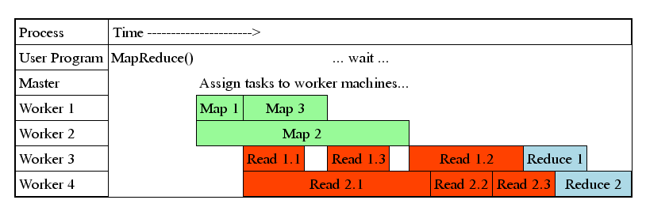
Task Granularity & Pipelining
Fine granularity tasks: map tasks >> machines
Minimizes time for fault recovery
Better dynamic load balancing

Slide 29
Refinements: Backup Tasks
Problem
Slow workers significantly lengthen the job completion time:
Other jobs on the machine
Bad disks
Weird things
Solution
Near end of phase, spawn backup copies of tasks
Whichever one finishes first “wins”
Effect
Dramatically shortens job completion time

Slide 30
Refinement: Combiners
Often a Map task will produce many pairs of the form (k,v₁), (k,v₂), … for the same key k
E.g., popular words in the word count example
Can save network time by pre-aggregating values in the mapper:
combine(k, list(v₁)) → v₂
Combiner is usually same as the reduce function
Works only if reduce function is commutative and associative

Slide 31
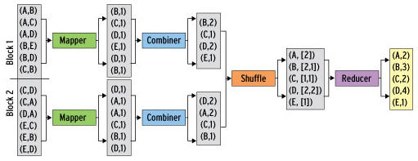
Refinement: Combiners
Back to our word counting example:
Combiner combines the values of all keys of a single mapper (single machine):
Much less data needs to be copied and shuffled!

Slide 32
Refinement: Partition Function
Want to control how keys get partitioned
Inputs to map tasks are created by contiguous splits of input file
Reduce needs to ensure that records with the same intermediate key end up at the same worker
System uses a default partition function:
hash(key) mod R
Sometimes useful to override the hash function:
E.g., hash(hostname(URL)) mod R ensures URLs from a host end up in the same output file

Slide 33
Problems Suited for Map-Reduce

Slide 34
Example: Host size
Suppose we have a large web corpus
Look at the metadata file
Lines of the form: (URL, size, date, …)
For each host, find the total number of bytes
That is, the sum of the page sizes for all URLs from that particular host
Map:
Emit <host name, size>
Reduce:
Sum up the sizes

Slide 35
Example: Language Model
Statistical machine translation:
Need to count number of times every 5-word sequence occurs in a large corpus of documents
Very easy with MapReduce:
Map:
Extract (5-word sequence, count) from document
Reduce:
Combine the counts

Slide 36
Example Application: Join

Slide 37
Join Operation
Compute the natural join R(A,B) ⋈ S(B,C)
R and S are each stored in files
Tuples are pairs (a,b) or (b,c)
A | B
a₁ | b₁
a₂ | b₁
a₃ | b₂
a₄ | b₃
B | C
b₂ | c₁
b₂ | c₂
b₃ | c₃
A | B | C
a₃ | b₂ | c₁
a₃ | b₂ | c₂
a₄ | b₃ | c₃
⋈
=
S
R

Slide 38
Join with MapReduce: Map
Map:
For each input tuple R(a, b):
Generate <key = b, value = (‘R’, a)>
For each input tuple S(b, c):
Generate <key = b, value = (‘S’, c)>
Think of ‘R’ and ‘S’ as bool variables that indicate where the pair originated from
A | B
a₁ | b₁
a₂ | b₁
a₃ | b₂
a₄ | b₃
Key-value pairs
B | C
b₂ | c₁
b₂ | c₂
b₃ | c₃
<b₁, (R, a₁)>
<b₁, (R, a₂)>
<b₂, (R, a₃)>
<b₃, (R, a₄)>
<b₂, (S, c₁)>
<b₂, (S, c₂)>
<b₃, (S, c₃)>
R
S

Slide 39
Join with MapReduce: Shuffle & Sort
Output of Map
<b₁, (R, a₁)>
<b₁, (R, a₂)>
<b₂, (R, a₃)>
<b₃, (R, a₄)>
<b₂, (S, c₁)>
<b₂, (S, c₂)>
<b₃, (S, c₃)>
Input of Reduce
<b₁, [(R, a₁); (R, a₂)]>
<b₂, [(R, a₃); (S, c₁); (S, c₂)]>
<b₃, [(R, a₄); (S, c₃)]>

Slide 40
Join with MapReduce: Reduce
Reduce:
Input: <b, value_list>
In the value list:
Pair each entry of the form (‘R’, a) with each entry (‘S’, c), and output:
<a, b, c>
Input of Reduce
Output of Reduce
<b₁, [(R, a₁); (R, a₂)]>
<b₂, [(R, a₃); (S, c₁); (S, c₂)]>
<b₃, [(R, a₄); (S, c₃)]>
<a₃, b₂, c₁>
<a₃, b₂, c₂>
<a₄, b₃, c₃>

Slide 41
Example Application: Matrix-Vector Multiplication

Slide 42
Matrix-Vector Multiplication
M
V
X
m_{ij}
.
=
x_{i}
v_{j}
$$x_{i}= \sum_{j=1}^{n}{m_{ij}v_{j}}$$

Slide 43
Simple Case: Vector fits in memory
For simplicity, assume that n is not too large and V fits into main memory of each node.
First, read V into an array accessible from Map tasks
Map:
For each m_{ij}, generate <key = i, value = m_{ij} * v_{j}>
Reduce:
Input: <key = i, values = [m_{i1} * v₁ ; m_{i2} * v₂ ; … ; m_{in} * v_{n}]
Sum up all values, and output <key = i, value = sum>
What if V does not fit into main memory?
Still works, but very slow.
$$x_{i}= \sum_{j=1}^{n}{m_{ij}v_{j}}$$

Slide 44
General Case: Vector does not fit into memory
M
V
Vertical stripes for M
Horizontal stripes for V
Each stripe stored in a file.
.
chunk
Each map task:
is assigned a chunk of one of the M files.
reads one stripe of V completely, and stores in local node’s memory.
Map and reduce function definitions same as in previous slide.

Slide 45
Example Application: Matrix-Matrix Multiplication 2 Map-Reduce Steps

Slide 46
Matrix – Matrix Multiplication
j
k
k
i
m_{ij}
i
p_{ik}
X
=
j
n_{jk}
M
N
P
$$p_{ik}= \sum_{j=1}^{n}{m_{ij}n_{jk}}$$

Slide 47
Two-Step MapReduce
Two matrices in two separate input files
Two steps of MapReduce:
Step 1: “Join” the matrix entries that need to be multiplied with each other
Similar to the Join operation we implemented using MapReduce
Step 2: Accumulate all results and compute the output matrix entries

Slide 48
First MapReduce Step
Objective: “Join” m_{ij} and n_{jk} entries
In this case, “join” corresponds to multiplication
Map:
For each m_{ij} value of matrix M
Generate <key = j, value = (“M”, i, m_{ij}) >
For each n_{jk} value of matrix N
Generate <key = j, value = (“N”, k, m_{jk}) >
$$p_{ik}= \sum_{j=1}^{n}{m_{ij}n_{jk}}$$

Slide 49
Example: Map Output
j
k
0
0
m₁₃
0
0
n₁₂
0
n₁₄
m₂₁
0
0
m₂₄
0
0
0
0
i
j
0
0
0
0
0
n₃₂
0
n₃₄
m₄₁
0
m₄₃
0
0
n₄₂
0
0
Map output:
<1, (M, 2, m₂₁)>
<1, (M, 4, m₄₁)>
<3, (M, 1, m₁₃)>
<3, (M, 4, m₄₃)>
<4, (M, 2, m₂₄)>
<1, (N, 2, n₁₂)>
<1, (N, 4, n₁₄)>
<3, (N, 2, n₃₂)>
<3, (N, 4, n₃₄)>
<4, (N, 2, n₄₂)>

Slide 50
Intuition 1: Joining entries with same j values
j
k
0
0
m₁₃
0
0
n₁₂
0
n₁₄
m₂₁
0
0
m₂₄
0
0
0
0
$$p_{ik}= \sum_{j=1}^{n}{m_{ij}n_{jk}}$$
i
j
0
0
0
0
0
n₃₂
0
n₃₄
m₄₁
0
m₄₃
0
0
n₄₂
0
0
Map output:
<1, (M, 2, m₂₁)>
<1, (M, 4, m₄₁)>
<3, (M, 1, m₁₃)>
<3, (M, 4, m₄₃)>
<4, (M, 2, m₂₄)>
<1, (N, 2, n₁₂)>
<1, (N, 4, n₁₄)>
<3, (N, 2, n₃₂)>
<3, (N, 4, n₃₄)>
<4, (N, 2, n₄₂)>

Slide 51
Intuition 1: Joining entries with same j values
j
k
0
0
m₁₃
0
0
n₁₂
0
n₁₄
m₂₁
0
0
m₂₄
0
0
0
0
$$p_{ik}= \sum_{j=1}^{n}{m_{ij}n_{jk}}$$
i
j
0
0
0
0
0
n₃₂
0
n₃₄
m₄₁
0
m₄₃
0
0
n₄₂
0
0
Map output:
<1, (M, 2, m₂₁)>
<1, (M, 4, m₄₁)>
<3, (M, 1, m₁₃)>
<3, (M, 4, m₄₃)>
<4, (M, 2, m₂₄)>
<1, (N, 2, n₁₂)>
<1, (N, 4, n₁₄)>
<3, (N, 2, n₃₂)>
<3, (N, 4, n₃₄)>
<4, (N, 2, n₄₂)>

Slide 52
Intuition 2: Partial sums
j
k
0
0
m₁₃
0
0
n₁₂
0
n₁₄
m₂₁
0
0
m₂₄
0
0
0
0
$$p_{ik}= \sum_{j=1}^{n}{m_{ij}n_{jk}}$$
i
j
0
0
0
0
0
n₃₂
0
n₃₄
m₄₁
0
m₄₃
0
0
n₄₂
0
0
<1, (M, 2, m₂₁)>
<1, (M, 4, m₄₁)>
<3, (M, 1, m₁₃)>
<3, (M, 4, m₄₃)>
<4, (M, 2, m₂₄)>
<1, (N, 2, n₁₂)>
<1, (N, 4, n₁₄)>
<3, (N, 2, n₃₂)>
<3, (N, 4, n₃₄)>
<4, (N, 2, n₄₂)>
m₂₁ . n₁₂ will contribute to the
partial sum of p₂₂

Slide 53
Intuition 2: Partial sums
j
k
0
0
m₁₃
0
0
n₁₂
0
n₁₄
m₂₁
0
0
m₂₄
0
0
0
0
$$p_{ik}= \sum_{j=1}^{n}{m_{ij}n_{jk}}$$
i
j
0
0
0
0
0
n₃₂
0
n₃₄
m₄₁
0
m₄₃
0
0
n₄₂
0
0
<1, (M, 2, m₂₁)>
<1, (M, 4, m₄₁)>
<3, (M, 1, m₁₃)>
<3, (M, 4, m₄₃)>
<4, (M, 2, m₂₄)>
<1, (N, 2, n₁₂)>
<1, (N, 4, n₁₄)>
<3, (N, 2, n₃₂)>
<3, (N, 4, n₃₄)>
<4, (N, 2, n₄₂)>
m₂₄ . n₄₂ will contribute to the
partial sum of p₂₂

Slide 54
Intuition 2: Partial sums
j
k
0
0
m₁₃
0
0
n₁₂
0
n₁₄
m₂₁
0
0
m₂₄
0
0
0
0
$$p_{ik}= \sum_{j=1}^{n}{m_{ij}n_{jk}}$$
i
j
0
0
0
0
0
n₃₂
0
n₃₄
m₄₁
0
m₄₃
0
0
n₄₂
0
0
<1, (M, 2, m₂₁)>
<1, (M, 4, m₄₁)>
<3, (M, 1, m₁₃)>
<3, (M, 4, m₄₃)>
<4, (M, 2, m₂₄)>
<1, (N, 2, n₁₂)>
<1, (N, 4, n₁₄)>
<3, (N, 2, n₃₂)>
<3, (N, 4, n₃₄)>
<4, (N, 2, n₄₂)>
m₂₁ . n₁₄ will contribute to the
partial sum of p₂₄

Slide 55
First MapReduce Step: Reduce
Reduce input:
<1, [ (M, 2, m₂₁); (M, 4, m₄₁); (N, 2, n₁₂); (N, 4, n₁₄) ] >
<3, [ (M, 1, m₁₃); (M, 4, m₄₃); (N, 2, n₃₂); (N, 4, n₃₄) ] >
<4, [ (M, 2, m₂₄); (N, 2, n₄₂) ] >
Reduce(key, value_list):
Put all entries in value_list of form (M, i, m_{i,key}) into L_{M}
Put all entries in value_list of form (N, k, n_{key,k}) into L_{N}
for each entry (M, i, m_{i,key}) in L_{M}
for each entry (N, k, n_{key,k}) in L_{N}
output <key = (i, k); value = m_{i,key} . n_{key,k} >

Slide 56
Example: Reduce Output
Reduce input:
<1, [ (M, 2, m₂₁); (M, 4, m₄₁); (N, 2, n₁₂); (N, 4, n₁₄) ] >
<3, [ (M, 1, m₁₃); (M, 4, m₄₃); (N, 2, n₃₂); (N, 4, n₃₄) ] >
<4, [ (M, 2, m₂₄); (N, 2, n₄₂) ] >
Reduce output:
< (2, 2), (m₂₁.n₁₂) >
< (2, 4), (m₂₁.n₁₄) >
< (4, 2), (m₄₁.n₁₂) >
< (4, 4), (m₄₁.n₁₄) >
< (1, 2), (m₁₃.n₃₂) >
< (1, 4), (m₁₃.n₃₄) >
< (4, 2), (m₄₃.n₃₂) >
< (4, 4), (m₄₃.n₃₄) >
< (2, 2), (m₂₄.n₄₂) >

Slide 57
Second MapReduce Step: Map
Map input:
< (2, 2), (m₂₁.n₁₂) >
< (2, 4), (m₂₁.n₁₄) >
< (4, 2), (m₄₁.n₁₂) >
< (4, 4), (m₄₁.n₁₄) >
< (1, 2), (m₁₃.n₃₂) >
< (1, 4), (m₁₃.n₃₄) >
< (4, 2), (m₄₃.n₃₂) >
< (4, 4), (m₄₃.n₃₄) >
< (2, 2), (m₂₄.n₄₂) >
Map:
for each (key, value) pair in the input
generate (key, value)
Identity function
The system will most likely assign the map tasks on the same node as the reduce that produced these outputs. Hence, no communication cost.

Slide 58
Second MapReduce Step: Reduce
Reduce input:
< (2, 2), (m₂₁.n₁₂) >
< (2, 4), (m₂₁.n₁₄) >
< (4, 2), (m₄₁.n₁₂) >
< (4, 4), (m₄₁.n₁₄) >
< (1, 2), (m₁₃.n₃₂) >
< (1, 4), (m₁₃.n₃₄) >
< (4, 2), (m₄₃.n₃₂) >
< (4, 4), (m₄₃.n₃₄) >
< (2, 2), (m₂₄.n₄₂) >
Reduce(key, value_list):
sum = 0
foreach v in value_list
sum += v
output <key, sum>

Slide 59
Example: MapReduce Step 2 - Reduce
j
k
0
0
m₁₃
0
0
n₁₂
0
n₁₄
m₂₁
0
0
m₂₄
0
0
0
0
$$p_{ik}= \sum_{j=1}^{n}{m_{ij}n_{jk}}$$
i
j
0
0
0
0
0
n₃₂
0
n₃₄
m₄₁
0
m₄₃
0
0
n₄₂
0
0
Reduce input:
< (2, 2), (m₂₁.n₁₂) >
< (2, 4), (m₂₁.n₁₄) >
< (4, 2), (m₄₁.n₁₂) >
< (4, 4), (m₄₁.n₁₄) >
< (1, 2), (m₁₃.n₃₂) >
< (1, 4), (m₁₃.n₃₄) >
< (4, 2), (m₄₃.n₃₂) >
< (4, 4), (m₄₃.n₃₄) >
< (2, 2), (m₂₄.n₄₂) >

Slide 60
Example: MapReduce Step 2 - Reduce
j
k
0
0
m₁₃
0
0
n₁₂
0
n₁₄
m₂₁
0
0
m₂₄
0
0
0
0
$$p_{ik}= \sum_{j=1}^{n}{m_{ij}n_{jk}}$$
i
j
0
0
0
0
0
n₃₂
0
n₃₄
m₄₁
0
m₄₃
0
0
n₄₂
0
0
Reduce input:
< (2, 2), (m₂₁.n₁₂) >
< (2, 4), (m₂₁.n₁₄) >
< (4, 2), (m₄₁.n₁₂) >
< (4, 4), (m₄₁.n₁₄) >
< (1, 2), (m₁₃.n₃₂) >
< (1, 4), (m₁₃.n₃₄) >
< (4, 2), (m₄₃.n₃₂) >
< (4, 4), (m₄₃.n₃₄) >
< (2, 2), (m₂₄.n₄₂) >

Slide 61
Example: MapReduce Step 2 - Reduce
j
k
0
0
m₁₃
0
0
n₁₂
0
n₁₄
m₂₁
0
0
m₂₄
0
0
0
0
$$p_{ik}= \sum_{j=1}^{n}{m_{ij}n_{jk}}$$
i
j
0
0
0
0
0
n₃₂
0
n₃₄
m₄₁
0
m₄₃
0
0
n₄₂
0
0
Reduce input:
< (2, 2), (m₂₁.n₁₂) >
< (2, 4), (m₂₁.n₁₄) >
< (4, 2), (m₄₁.n₁₂) >
< (4, 4), (m₄₁.n₁₄) >
< (1, 2), (m₁₃.n₃₂) >
< (1, 4), (m₁₃.n₃₄) >
< (4, 2), (m₄₃.n₃₂) >
< (4, 4), (m₄₃.n₃₄) >
< (2, 2), (m₂₄.n₄₂) >

Slide 62
Example: MapReduce Step 2 - Reduce
j
k
0
0
m₁₃
0
0
n₁₂
0
n₁₄
m₂₁
0
0
m₂₄
0
0
0
0
$$p_{ik}= \sum_{j=1}^{n}{m_{ij}n_{jk}}$$
i
j
0
0
0
0
0
n₃₂
0
n₃₄
m₄₁
0
m₄₃
0
0
n₄₂
0
0
Reduce input:
< (2, 2), (m₂₁.n₁₂) >
< (2, 4), (m₂₁.n₁₄) >
< (4, 2), (m₄₁.n₁₂) >
< (4, 4), (m₄₁.n₁₄) >
< (1, 2), (m₁₃.n₃₂) >
< (1, 4), (m₁₃.n₃₄) >
< (4, 2), (m₄₃.n₃₂) >
< (4, 4), (m₄₃.n₃₄) >
< (2, 2), (m₂₄.n₄₂) >

Slide 63
Summary: Two-Step MapReduce Algorithm
Step1: Map (input):
For each m_{ij} value of matrix M
generate <key = j, value = (“M”, i, m_{ij}) >
For each n_{jk} value of matrix N
generate <key = j, value = (“N”, k, m_{jk}) >
Step1: Reduce(key, value_list):
for each entry (M, i, m_{i,key}) in value_list
for each entry (N, k, n_{key,k}) in value_list
output <key = (i, k); value = m_{i,key} . n_{key,k} >
Step2: Map (key, value):
generate (key, value)
Step2: Reduce(key, value_list):
sum ← accumulate the values in value_list
output (key, sum)
$$p_{ik}= \sum_{j=1}^{n}{m_{ij}n_{jk}}$$

Slide 64
Example Application: Matrix-Matrix Multiplication Single Map-Reduce

Slide 65
Single-Step MapReduce: Intuition
$$p_{ik}= \sum_{j=1}^{n}{m_{ij}n_{jk}}$$
To compute p_{ik}, we need m_{ij} and n_{jk} values for all j.
In other words:
m_{ij} entry is needed to compute p_{ik} values for all k.
n_{jk} entry is needed to compute p_{ik} values for all i.
Intuition: Send each input matrix entry to all reducers that need it.

Slide 66
An Entry of Matrix M
j
k
i
m_{ij}
$$p_{ik}= \sum_{j=1}^{n}{m_{ij}n_{jk}}$$
X
j
n_{jk}
M
N
Each m_{ij} needs to be paired with all entries in row j of matrix N

Slide 67
An Entry of Matrix N
j
k
$$p_{ik}= \sum_{j=1}^{n}{m_{ij}n_{jk}}$$
i
m_{ij}
X
j
n_{jk}
M
N
Each n_{jk} needs to be paired with all entries in column j of matrix M

Slide 68
Map Operation
Reminder:
m_{ij} entry is needed to compute p_{ik} values for all k.
n_{jk} entry is needed to compute p_{ik} values for all i.
Map:
for each m_{ij} entry from matrix M:
for k=1 to n
generate <key = (i, k), value = (‘M’, j, m_{ij}) >
for each n_{jk} entry from matrix N:
for i=1 to n
generate <key = (i, k), value = (‘N’, j, n_{jk}) >
$$p_{ik}= \sum_{j=1}^{n}{m_{ij}n_{jk}}$$

Slide 69
Example: Map Output for Matrix M Entries
0
0
m₁₃
0
0
n₁₂
0
n₁₄
m₂₁
0
0
m₂₄
.
0
0
0
0
=
0
0
0
0
0
n₃₂
0
n₃₄
m₄₁
0
m₄₃
0
0
n₄₂
0
0
Map output:
<(1,1), (M, 3, m₁₃) >
$$p_{ik}= \sum_{j=1}^{n}{m_{ij}n_{jk}}$$

Slide 70
Example: Map Output for Matrix M Entries
0
0
m₁₃
0
0
n₁₂
0
n₁₄
m₂₁
0
0
m₂₄
.
0
0
0
0
=
0
0
0
0
0
n₃₂
0
n₃₄
m₄₁
0
m₄₃
0
0
n₄₂
0
0
Map output:
<(1,1), (M, 3, m₁₃) >
<(1,2), (M, 3, m₁₃) >
$$p_{ik}= \sum_{j=1}^{n}{m_{ij}n_{jk}}$$

Slide 71
Example: Map Output for Matrix M Entries
0
0
m₁₃
0
0
n₁₂
0
n₁₄
m₂₁
0
0
m₂₄
.
0
0
0
0
=
0
0
0
0
0
n₃₂
0
n₃₄
m₄₁
0
m₄₃
0
0
n₄₂
0
0
Map output:
<(1,1), (M, 3, m₁₃) >
<(1,2), (M, 3, m₁₃) >
<(1,3), (M, 3, m₁₃) >
<(1,4), (M, 3, m₁₃) >
$$p_{ik}= \sum_{j=1}^{n}{m_{ij}n_{jk}}$$

Slide 72
Example: Map Output for Matrix M Entries
0
0
m₁₃
0
0
n₁₂
0
n₁₄
m₂₁
0
0
m₂₄
.
0
0
0
0
=
0
0
0
0
0
n₃₂
0
n₃₄
m₄₁
0
m₄₃
0
0
n₄₂
0
0
Map output:
<(1,1), (M, 3, m₁₃) >
<(1,2), (M, 3, m₁₃) >
<(1,3), (M, 3, m₁₃) >
<(1,4), (M, 3, m₁₃) >
<(2,1), (M, 1, m₂₁) >
<(2,2), (M, 1, m₂₁) >
<(2,3), (M, 1, m₂₁) >
<(2,4), (M, 1, m₂₁) >
$$p_{ik}= \sum_{j=1}^{n}{m_{ij}n_{jk}}$$

Slide 73
Example: Map Output for Matrix M Entries
0
0
m₁₃
0
0
n₁₂
0
n₁₄
m₂₁
0
0
m₂₄
.
0
0
0
0
=
0
0
0
0
0
n₃₂
0
n₃₄
m₄₁
0
m₄₃
0
0
n₄₂
0
0
Map output:
<(1,1), (M, 3, m₁₃) >
<(1,2), (M, 3, m₁₃) >
<(1,3), (M, 3, m₁₃) >
<(1,4), (M, 3, m₁₃) >
<(2,1), (M, 1, m₂₁) >
<(2,2), (M, 1, m₂₁) >
<(2,3), (M, 1, m₂₁) >
<(2,4), (M, 1, m₂₁) >
<(2,1), (M, 4, m₂₄) >
<(2,2), (M, 4, m₂₄) >
<(2,3), (M, 4, m₂₄) >
<(2,4), (M, 4, m₂₄) >
…
$$p_{ik}= \sum_{j=1}^{n}{m_{ij}n_{jk}}$$

Slide 74
Example: Map Output for Matrix N Entries
0
0
m₁₃
0
0
n₁₂
0
n₁₄
m₂₁
0
0
m₂₄
.
0
0
0
0
=
0
0
0
0
0
n₃₂
0
n₃₄
m₄₁
0
m₄₃
0
0
n₄₂
0
0
Map output:
<(1,2), (N, 1, n₁₂) >
$$p_{ik}= \sum_{j=1}^{n}{m_{ij}n_{jk}}$$

Slide 75
Example: Map Output for Matrix N Entries
0
0
m₁₃
0
0
n₁₂
0
n₁₄
m₂₁
0
0
m₂₄
.
0
0
0
0
=
0
0
0
0
0
n₃₂
0
n₃₄
m₄₁
0
m₄₃
0
0
n₄₂
0
0
Map output:
<(1,2), (N, 1, n₁₂) >
<(2,2), (N, 1, n₁₂) >
<(3,2), (N, 1, n₁₂) >
<(4,2), (N, 1, n₁₂) >
$$p_{ik}= \sum_{j=1}^{n}{m_{ij}n_{jk}}$$

Slide 76
Example: Map Output for Matrix N Entries
0
0
m₁₃
0
0
n₁₂
0
n₁₄
m₂₁
0
0
m₂₄
.
0
0
0
0
=
0
0
0
0
0
n₃₂
0
n₃₄
m₄₁
0
m₄₃
0
0
n₄₂
0
0
Map output:
<(1,2), (N, 1, n₁₂) >
<(2,2), (N, 1, n₁₂) >
<(3,2), (N, 1, n₁₂) >
<(4,2), (N, 1, n₁₂) >
<(1,4), (N, 1, n₁₄) >
<(2,4), (N, 1, n₁₄) >
<(3,4), (N, 1, n₁₄) >
<(4,4), (N, 1, n₁₄) >
$$p_{ik}= \sum_{j=1}^{n}{m_{ij}n_{jk}}$$

Slide 77
Example: Map Output for Matrix N Entries
0
0
m₁₃
0
0
n₁₂
0
n₁₄
m₂₁
0
0
m₂₄
.
0
0
0
0
=
0
0
0
0
0
n₃₂
0
n₃₄
m₄₁
0
m₄₃
0
0
n₄₂
0
0
Map output:
<(1,2), (N, 1, n₁₂) >
<(2,2), (N, 1, n₁₂) >
<(3,2), (N, 1, n₁₂) >
<(4,2), (N, 1, n₁₂) >
<(1,4), (N, 1, n₁₄) >
<(2,4), (N, 1, n₁₄) >
<(3,4), (N, 1, n₁₄) >
<(4,4), (N, 1, n₁₄) >
<(1,2), (N, 3, n₃₂) >
<(2,2), (N, 3, n₃₂) >
<(3,2), (N, 3, n₃₂) >
<(4,2), (N, 3, n₃₂) >
…
$$p_{ik}= \sum_{j=1}^{n}{m_{ij}n_{jk}}$$

Slide 78
Summary: Map Operation
<key=(i,1), value = (M, j, m_{ij})>
m_{ij}
…
<key=(i,n), value = (M, j, m_{ij})>
<key=(1,k), value = (N, j, n_{jk})>
n_{jk}
…
<key=(n,k), value = (N, j, n_{jk})>

Slide 79
Reduce Operation
Input:
key = (i,k), value_list = [ … (M, j, m_{ij}); … (N, j, n_{jk}) … ]
an entry exists for any non-zero m_{ij} or n_{jk}
Objective: Multiply m_{ij} and n_{jk} values with matching j values, and sum up all products to compute p_{ik}
Reduce(key, value_list)
put all entries of form (M, j, m_{ij}) into L_{M}
sort entries in L_{M} based on j values
put all entries of form (N, j, n_{jk}) into L_{N}
sort entries in L_{N} based on j values
sum ← 0
for each pair (M, j, m_{ij}) in L_{M} and (N, j, n_{jk}) in L_{N}
sum += m_{ij} . n_{jk}
output (key, sum)
$$p_{ik}= \sum_{j=1}^{n}{m_{ij}n_{jk}}$$

Slide 80
Example: Reduce
0
0
m₁₃
0
0
n₁₂
0
n₁₄
m₂₁
0
0
m₂₄
.
0
0
0
0
=
0
0
0
0
0
n₃₂
0
n₃₄
m₄₁
0
m₄₃
0
0
n₄₂
0
0
Reduce input: key = (4, 2), value_list = { (M, m₄₁, 1); (M, m₄₃, 3);
(N, n₁₂, 1); (N, n₃₂, 3); (N, n₄₂, 4) }
Reduce output: key = (4, 2), value = m₄₁. n₁₂ + m₄₃. n₃₂

Slide 81
Summary: Single-Step MapReduce Algorithm
Map(input):
for each m_{ij} entry from matrix M:
for k=1 to n
generate <key = (i, k), value = (‘M’, j, m_{ij}) >
for each n_{jk} entry from matrix N:
for i=1 to n
generate <key = (i, k), value = (‘N’, j, n_{jk}) >
Reduce(key, value_list)
sum ← 0
for each pair (M, j, m_{ij}) and (N, j, n_{jk}) in value_list
sum += m_{ij} . n_{jk}
output (key, sum)
$$p_{ik}= \sum_{j=1}^{n}{m_{ij}n_{jk}}$$

Slide 82
Next Lecture
No analysis of communication costs and computation costs so far.
Next lecture:
Complexity Analysis
Improved Algorithms

