Slide 1
Lecture 7: Web Advertising
CS425: Algorithms for Web Scale Data
Most of the slides are from the Mining of Massive Datasets book.
These slides have been modified for CS425. The original slides can be accessed at: www.mmds.org

Slide 2
Online Algorithms
Classic model of algorithms
You get to see the entire input, then compute some function of it
In this context, “offline algorithm”
Online Algorithms
You get to see the input one piece at a time, and need to make irrevocable decisions along the way

Slide 3
Online Bipartite Matching

Slide 4
Bipartite Graphs
Bipartite graph:
Two sets of nodes: A and B
There are no edges between nodes that belong to the same set.
Edges are only between nodes in different sets.
1
a
2
b
3
c
A
4
d
B

Slide 5
Bipartite Matching
Maximum Bipartite Matching: Choose a subset of edges E_{M} such that:
Each vertex is connected to at most one edge in E_{M}
The size of E_{M} is as large as possible
Example: Matching projects to groups
1
a
2
b
M = {(1,a),(2,b),(3,d)} is a matching
Cardinality of matching = |M| = 3
3
c
4
d
Projects
Groups

Slide 6
Bipartite Matching
Maximum Bipartite Matching: Choose a subset of edges E_{M} such that:
Each vertex is connected to at most one edge in E_{M}
The size of E_{M} is as large as possible
Example: Matching projects to groups
1
a
2
b
M = {(1,c),(2,b),(3,d),(4,a)} is a
maximum matching
Cardinality of matching = |M| = 4
3
c
4
d
Projects
Groups

Slide 7
Example: Bipartite Matching
1
a
2
b
3
c
4
d
Projects
Groups
M = {(1,c),(2,b),(3,d),(4,a)} is a perfect matching
Perfect matching … all vertices of the graph are matched
Maximum matching … a matching that contains the largest possible number of matches

Slide 8
Matching Algorithm
Problem: Find a maximum matching for a given bipartite graph
A perfect one if it exists
There is a polynomial-time offline algorithm based on augmenting paths (Hopcroft & Karp 1973, see http://en.wikipedia.org/wiki/Hopcroft-Karp_algorithm)
But what if we do not know the entire graph upfront?

Slide 9
Online Bipartite Matching Problem
Initially, we are given the set of projects
The TA receives an email indicating the preferences of one group.
The TA must decide at that point to either:
assign a prefered project to this group, or
not assign any projects to this group
Objective is to maximize the number of preferred assignments
Note: This is not how your projects were assigned ☺

Slide 10
Greedy Online Bipartite Matching
Greedy algorithm
For each group g
Let P_{g} be the set of projects group g prefers
if there is a p ∈ P_{g} that is not already assigned to another group
assign project p to group g
else
do not assign any project to g

Slide 11
Greedy Online Graph Matching: Example
1
a
(1,a)
2
b
(2,b)
(3,d)
3
c
4
d

Slide 12
Competitive Ratio
For input I, suppose greedy produces matching M_{greedy} while an optimal matching is M_{opt}
Competitive ratio =
min_{all possible inputs I} (|M_{greedy}|/|M_{opt}|)
(what is greedy’s worst performance over all possible inputs I)

Slide 13
Analysis of the Greedy Algorithm
Step 1: Find a lower bound for the competitive ratio
A
B
Definitions:
M_{o}: The optimal matching
M_{g}: The greedy matching
L: The set of vertices from A that are in M_{o}, but not in M_{g}
R: The set of vertices from B that are connected to at least one vertex in L
R
L

Slide 14
Analysis of the Greedy Algorithm (cont’d)
Claim: All vertices in R must be in M_{g}
Proof:
By contradiction, assume there is a vertex v ∈ R that is not in M_{g}.
There must be another vertex u ∈ L that is connected to v.
By definition u is not in M_{g} either.
When the greedy algorithm processed edge (u, v), both vertices u and v were available, but it matched none of them. This is a contradiction!
Fact: |M_{o}| ≤ |M_{g}| + |L|
Adding the missing elements to Mg will make its size to be at least the size of the optimal matching.
Fact: |L| ≤ |R|
Each vertex in L was matched to another vertex in M_{o}

Slide 15
Analysis of the Greedy Algorithm (cont’d)
Fact: |R| ≤ |M_{g}|
All vertices in R are in M_{g}
Summary:
|M_{o}| ≤ |M_{g}| + |L|
|L| ≤ |R|
|R| ≤ |M_{g}|
Combine:
|M_{o}| ≤ |M_{g}| + |L|
≤ |M_{g}| + |R|
≤ 2 |M_{g}|
Lower-bound for competitive ratio:
$$\frac{|M_{g}|}{|M_{o}|}≥ \frac{1}{2}$$

Slide 16
Analysis of the Greedy Algorithm (cont’d)
We have shown that the competitive ratio is at least 1/2. However, can it be better than 1/2?
Step 2: Find an upper bound for competitive ratio:
Typical approach: Find an example.
If there is at least one example that has competitive ratio of r,
it must mean that competitive ratio cannot be greater than r.
1
a
Greedy matching:
(1,a),
(2,b)
2
b
c
The optimal matching is: (4, a), (3,b), (1,c), (2, d)
3
Competitive ratio = ½ for this example
4
d
So, competitive ratio <= ½

Slide 17
Greedy Matching Algorithm
We have shown that competitive ratio for the greedy algorithm is 1/2.
We proved that both lower bound and upper bound is 1/2
Conclusion: The online greedy algorithm can result in a matching solution that has half the size of an optimal offline algorithm in the worst case.

Slide 18
Web Advertising

Slide 19
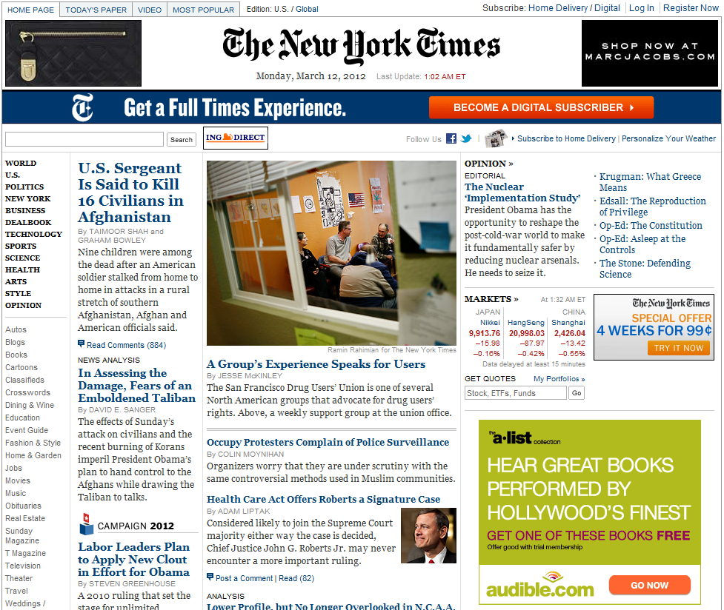
History of Web Advertising
Banner ads (1995-2001)
Initial form of web advertising
Popular websites charged X$ for every 1,000 “impressions” of the ad
Called “CPM” rate (Cost per thousand impressions)
Modeled similar to TV, magazine ads
From untargeted to demographically targeted
Low click-through rates
Low ROI for advertisers
CPM…cost per mille
Mille…thousand in Latin

Slide 20
Performance-based Advertising
Introduced by Overture around 2000
Advertisers bid on search keywords
When someone searches for that keyword, the highest bidder’s ad is shown
Advertiser is charged only if the ad is clicked on
Similar model adopted by Google with some changes around 2002
Called Adwords

Slide 21
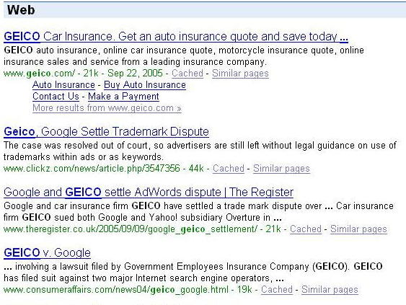
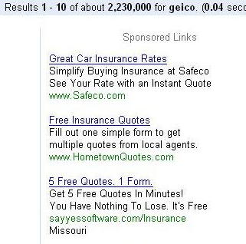
Ads vs. Search Results

Slide 22
Web 2.0
Performance-based advertising works!
Multi-billion-dollar industry
Interesting problem: What ads to show for a given query?
(This lecture)
If I am an advertiser, which search terms should I bid on and how much should I bid?
(Not focus of this lecture)

Slide 23
Adwords Problem
Given:
1. A set of bids by advertisers for search queries
2. A click-through rate for each advertiser-query pair
3. A budget for each advertiser (say for 1 month)
4. A limit on the number of ads to be displayed with each search query
Respond to each search query with a set of advertisers such that:
1. The size of the set is no larger than the limit on the number of ads per query
2. Each advertiser has bid on the search query
3. Each advertiser has enough budget left to pay for the ad if it is clicked upon

Slide 24
Adwords Problem
A stream of queries arrives at the search engine: q₁, q₂, …
Several advertisers bid on each query
When query q_{i} arrives, search engine must pick a subset of advertisers whose ads are shown
Goal: Maximize search engine’s revenues
Simplification: Instead of raw bids, use the “expected revenue per click” (i.e., Bid*CTR)
Clearly we need an online algorithm!

Slide 25
The Adwords Innovation
Advertiser
Bid
CTR
Bid * CTR
A
$1.00
1%
1 cent
B
$0.75
2%
1.5 cents
C
$0.50
2.5%
1.125 cents
Click through rate
Expected revenue

Slide 26
The Adwords Innovation
Advertiser
Bid
CTR
Bid * CTR
B
$0.75
2%
1.5 cents
C
$0.50
2.5%
1.125 cents
A
$1.00
1%
1 cent

Slide 27
Complications: Budget
Two complications:
Budget
CTR of an ad is unknown
Each advertiser has a limited budget
Search engine guarantees that the advertiser will not be charged more than their daily budget

Slide 28
Complications: CTR
CTR: Each ad has a different likelihood of being clicked
Advertiser 1 bids $2, click probability = 0.1
Advertiser 2 bids $1, click probability = 0.5
Clickthrough rate (CTR) is measured historically
Very hard problem: Exploration vs. exploitation Exploit: Should we keep showing an ad for which we have good estimates of click-through rate or Explore: Shall we show a brand new ad to get a better sense of its click-through rate

Slide 29
Simplified Problem
We will start with the following simple version of Adwords:
One ad shown for each query
All advertisers have the same budget B
All bids are $1
All ads are equally likely to be clicked and CTR = 1
We will generalize it later.

Slide 30
Greedy Algorithm
Simple greedy algorithm:
For the current query q, pick any advertiser who:
has bid 1 on q
has remaining budget
What is the competitive ratio of this greedy algorithm?
Can we model this problem as bipartite matching?

Slide 31
Bipartite Matching Model
Online algorithm:
For each new query q
assign a bid if available
B nodes
for each
advertiser
Equivalent to the online greedy bipartitite matching algorithm, which had competitive ratio = 1/2.
bids
queries
So, the competitive ratio
of this algorithm is also ½.

Slide 32
Example: Bad Scenario for Greedy
Two advertisers A and B
A bids on query x, B bids on x and y
Both have budgets of $4
Query stream: x x x x y y y y
Worst case greedy choice: B B B B _ _ _ _
Optimal: A A A A B B B B
Competitive ratio = ½
This is the worst case!
Note: Greedy algorithm is deterministic – it always resolves draws in the same way
Notes:
Is greedy deterministic or randomized (it is deterministic!!)

Slide 33
BALANCE Algorithm [MSVV]
BALANCE Algorithm by Mehta, Saberi, Vazirani, and Vazirani
For each query, pick the advertiser with the largest unspent budget
Break ties arbitrarily (but in a deterministic way)

Slide 34
Example: BALANCE
Two advertisers A and B
A bids on query x, B bids on x and y
Both have budgets of $4
Query stream: x x x x y y y y
BALANCE choice: A B A B B B _ _
Optimal: A A A A B B B B
Competitive ratio ≤ ¾

Slide 35
Analyzing BALANCE: Simple Case
Try to prove a lower bound for the competitive ratio
i.e. Consider the worst-case behavior of BALANCE algorithm
Start with the simple case:
2 advertisers A₁ and A₂ with equal budgets B
Optimal solution exhausts both budgets
All queries assigned to at least one advertiser in the optimal solution
Remove the queries that are not assigned by the optimal algorithm
This only makes things worse for BALANCE
Queries allocated to A₁ in the optimal solution
B
Queries allocated to A₂ in the optimal solution
A₁
A₂

Slide 36
Analysis of BALANCE: Simple Case
Claim: BALANCE must exhaust the budget of at least one advertiser
Proof by contradiction: Assume both advertisers have left over budgets
Consider query q that is assigned in the optimal solution, but not in BALANCE.
Contradiction: q should have been assigned to at least the same advertiser because both advertisers have available budget.
Goal: Find a lower bound for: $\frac{|S_{balance}|}{|S_{optimal}|}$

Slide 37
Analysis of BALANCE: Simple Case
Optimal solution
BALANCE solution
x
B
B
y
z
x
A₁
A₂
A₁
A₂
Without loss of generality, assume the whole budget of A₂ is exhausted.
Claim: All blue queries (the ones assigned to A₁ in the optimal solution) must be assigned to A₁ and/or A₂ in the BALANCE solution.
Proof by contradiction: Assume a blue query q not assigned to either A₁ or A₂. Since budget of A₁ is not exhausted, it should have been assigned to A₁.

Slide 38
Analysis of BALANCE: Simple Case
Optimal solution
BALANCE solution
x
B
B
y
z
x
A₁
A₂
A₁
A₂
Some of the green queries (the ones assigned to A₂ in the optimal solution) are not assigned to either A₁ or A₂. Let x be the # of such queries.
Prove an upper bound for x
Worst case for the BALANCE algorithm.

Slide 39
Analysis of BALANCE: Simple Case
Optimal solution
BALANCE solution
x
B
B
y
z
x
A₁
A₂
A₁
A₂
Consider two cases for z:
Case 1: z ≥ B/2
size (A₁) = y + z ≥ B/2
size (A₁ + A₂) = B + y + z ≥ 3B/2

Slide 40
Analysis of BALANCE: Simple Case
Optimal solution
BALANCE solution
x
B
B
y
z
x
A₁
A₂
A₁
A₂
Case 2: z < B/2
Consider the time when last
blue query was assigned to A₂:
≥ B/2
≥ B/2
A₁
A₂
A₂ has remaining budget of ≤ B/2
For A₂ to be chosen, A₁ must also have remaining budget of ≤ B/2

Slide 41
Analysis of BALANCE: Simple Case
Optimal solution
BALANCE solution
x
B
B
y
z
x
A₁
A₂
A₁
A₂
Case 2: z < B/2
size (A₁) ≥ B/2
size (A₁ + A₂) = B + size(A₁) ≥ 3B/2

Slide 42
Analysis of BALANCE: Simple Case
Conclusion:
$\frac{|S_{balance}|}{|S_{optimal}|}≥ \frac{\frac{3B}{2}}{2B}= \frac{3}{4}$
Assumption: Both advertisers have the same budget B
Can we generalize this result to any 2-advertiser problem?
The textbook claims we can.
Exercise: Find a counter-example to disprove textbook’s claim.
Hint: Consider two advertisers with budgets B and B/2.

Slide 43
BALANCE: Multiple Advertisers
For multiple advertisers, worst competitive ratio of BALANCE is 1–1/e = approx. 0.63
Interestingly, no online algorithm has a better competitive ratio!
See textbook for the worst-case analysis.

Slide 44
General Version of the Problem
Arbitrary bids and arbitrary budgets!
In a general setting BALANCE can be terrible
Consider two advertisers A₁ and A₂
A₁: x₁ = 1, b₁ = 110
A₂: x₂ = 10, b₂ = 100
Assume we see 10 instances of q
BALANCE always selects A₁ and earns 10
Optimal earns 100

Slide 45
Generalized BALANCE
Arbitrary bids: consider query q, bidder i
Bid = x_{i}
Budget = b_{i}
Amount spent so far = m_{i}
Fraction of budget left over f_{i} = 1-m_{i}/b_{i}
Define ψ_{i}(q) = x_{i}(1-e^{-fi})
Allocate query q to bidder i with largest value of ψ_{i}(q)
Same competitive ratio (1-1/e)

Slide 46
Conclusions
Web Advertising: Try to maximize ad revenue from a stream of queries
Online algorithms: Make decisions without seeing the whole input set
Approximation algorithms: Theoretically prove upper and lower bounds w.r.t. the optimal solutions.

