Slide 1
Advantages of Query Biased Summaries in Information Retrieval
Presenters:
Başak Çakar
Şadiye Kaptanoğlu

Slide 2
Introduction & Motivation
Typical output of an IR system – static predefined summary
  Title
  First few sentences
Not a clear view of the relation between document and the query
Hard for user to extract relevant information
Aim of the proposed approach
  Minimize need of referring to full text
  Provide enough information to support retrieval decisions

Slide 3
Summarization System
Based on sentence extraction methods:
  Title method
  Location method
  Term occurrence information
  Biasing summaries towards queries

Slide 4
Experimental Setup
50 randomly selected articles (TREC)
2 groups, each containing 10 people
Two types of ranked document list
  Query biased summary
  Static pre-defined summary
5 minutes to identify relevant documents

Slide 5
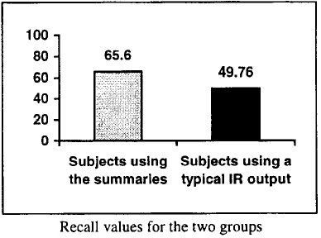
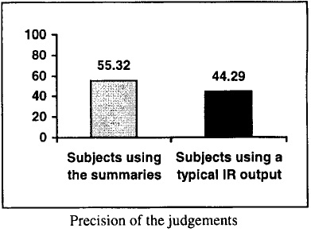
Experimental Results

Slide 6
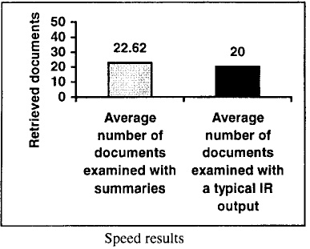
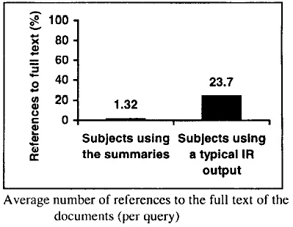
Experimental Results

Slide 7
Conclusion
Performing relevance judgments more accurately
Increasing the speed of user relevance judgments
Avoid the need of referring to full text

