Slide 1
DivText
Bahaeddin ERAVCI,
Emre YILMAZ,
Izzeddin GUR
Mehmet GUVERCIN

Slide 2
Description
Recommendation systems
are used to find relevant
data based on current data
(amazon,last.fm)
Common method is to choose a metric and according to it give top-k similar results given the current data as the query
BUT giving the top-k similar data (NN) will not satisfy the user needs

Slide 3
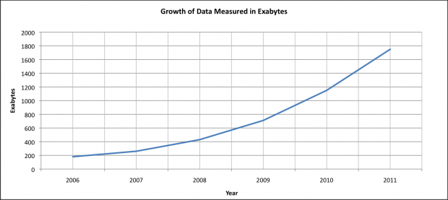
Motivation
Massive data
The fastest increasing quantity on this planet is the amount of information we are generating
Large availability
Partial knowledge about data
if you don’t know the alternatives you don’t know to search for exactly

Slide 4
Motivation
So, we need results that are both similar to the query yet different from each other i.e. diversity
This gives a chance
to do exploratory search
see different perspective of the query
for better user satisfaction

Slide 5
Methodology
Given a query most common ways to diversify search results
Selecting from similar items
Find top-m similar results for the query (m>>k)
Cluster m items into k clusters
Pick k representative point and present it to the user
Mathematically define diversity
Define a cost function that both includes a similarity metric and a diversity measure

Slide 6
Application and Expected Results
We will start by building a document set
Explore the chance for popular Turkish columnists
Use an already established document set
Build a recommendation system based on diversity of results with the aim of:
Tunable diversity-similarity parameter
More user satisfaction with respect to traditional recommendation systems
Incorporate user feedback to the proposed framework.

Slide 9
Q & A

