Slide 1
Exploring the Similarity Space
M. Yağmur Şahin
Çağlar Terzi
Arif Usta

Slide 2
Introduction
What similarity calculations should be used?
  For each type of queries
  For each or type of documents
  Type of desired performance
Is there a “silver bullet” for measurement?
To find the answer
  Q-expression (8-position string)
  Test by extending database system mg
  Experiments on TREC environment

Slide 3
Similarity Measure
Recall – Precision
TREC Conference
Range of sources are used
  Van Rijsbergen [1979]
  Salton and McGill [1983]
  Salton [1989]
  Frakes and Baeza-Yates [1992]
Extension of previous work of Salton and Buckley [1988] *sonraki cumleler

Slide 4
Combining functions
Combining functions correspond to
  importance of each term in the document,
  importance of that term in the query,
  length or weight of the document,
  length of the query

Slide 5
Term Weight
Inverse Document Frequency (IDF)
Salton and Buckley [1988]’s three different term weighting rules
Document-term and query-term weight
  Only one of them, both of them or none of them can be used

Slide 6
Relative Term Frequency
TF
TF-IDF
  w_{d,t} = r_{d,t} * w_{t}
Salton and Buckley [1988] described three different RTF formulations

Slide 7
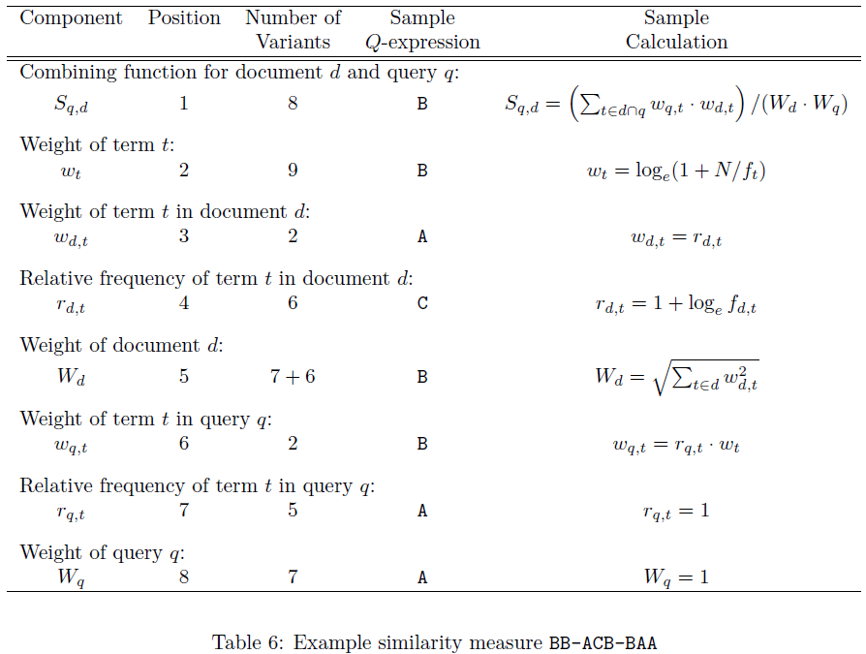
Q-Expression
8-position string
  BB-ACB-BAA

Slide 8
Experiments
Aim is the best combination
Exhaustive enumeration
  [AB][BDI]-[AB][CEF][BDIK]-[AB][ACE]A
  720 possibilites
5-10 minutes CPU time per mechanism
2-4 seconds per query per collection
Total: 4 weeks

Slide 9
Experiments
6 experimental domains
  3 sets of queries
    Title, narrative, full
  2 sets of collections
    Ap2wsj2 (Newspaper articles)
    Fr2ziff2 (Non-newspaper articles)
3 effectiveness measures
  average 11-point recall-precision average over the query set,
  average precision-at-20 value for the query set
  average reciprocal rank of the first relevant document retrieved

Slide 10
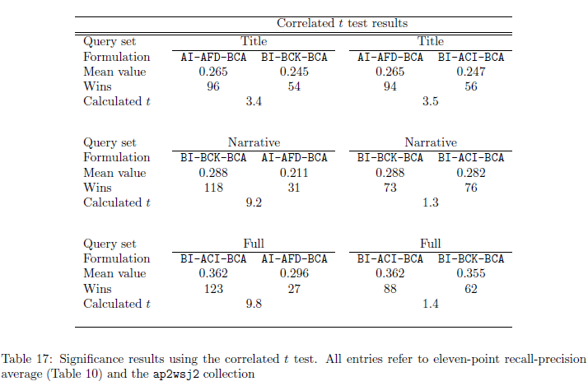
Experiments

Slide 11
Conclusion
They failed to find any particular measure that really stood out but discovered that no measure consistently worked well across all of the queries in a query set
No component or weighting scheme was shown to be consistently valuable across all of the experimental domains
Better performance can be obtained - by choosing a similarity measure to suit each query on an individual basis
  IMPLAUSIBLE!

