Slide 1
Distributed Information Retrieval Jamie Callan
Amir Rahimzadeh Ilkhechi
Yağız Salor
Mustafa İlker Saraç
Hakan Sözer

Slide 2
Motivation
The single database model can be successful if most of the important or valuable information on a network can be copied easily. However information that cannot be copied is not accessible under the single database model. Information that is proprietary that costs money or that a publisher wishes to control carefully is essentially invisible to the single database model.

Slide 3
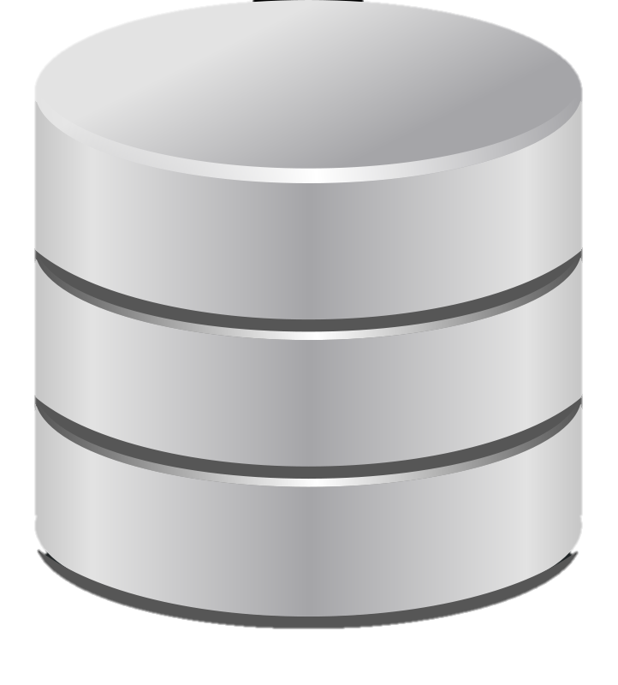
Solution
The alternative to the single database model is a multi-database model in which the existence of multiple text databases is modeled explicitly
Central DB
Holds Descriptions of the Private DBs
Private DB 1
Private DB 2
Single-DB Model
Multi-DB Model

Slide 4
Multi-Database Model
Resource Description:
The contents of each text database must be described
Resource Selection:
Given an information need and a set of resource descriptions a decision must be made about which database(s) to search
Resource Merging:
Integrating the ranked lists returned by each database into a single coherent ranked list
???, ???, ???
aaa, bbb, ccc
aaa, bbb, ccc
aaa, bbb, ccc
???, ???, ???
bbb, ddd, eee
bbb, ddd, eee
bbb, ddd, eee
???, ???, ???
aaa, ccc, ddd
aaa, ccc, ddd

Slide 5
Resource Description
Approach: A simple and robust solution is to represent each database by a description consisting of the words that occur in the database and their frequencies of occurrence or statistics derived from frequencies of occurrence which called unigram language model
???, ???, ???
aaa, bbb, ccc
???, ???, ???
bbb, ddd, eee
???, ???, ???
aaa, ccc, ddd

Slide 6
Resource Selection
The major part of this resource selection problem is ranking resources by how likely they are to satisfy the information need
Approach is to apply the techniques of document ranking to the problem of resource ranking using variants of tf .idf approaches. One advantage is that the same query can be used to rank resources and to rank documents
aaa, bbb, ccc
aaa, bbb, ccc
bbb, ddd, eee
bbb, ddd, eee
aaa, ccc, ddd

Slide 7
Resource Merging
Solutions include:
computing normalized scores
estimating normalized scores
merging based on unnormalized scores.
aaa, bbb, ccc
bbb, ddd, eee

Slide 8
Results
Accuracy
of unigram language models
of resource rankings
of document rankings
Testbeds
Summary statistics for three distributed IR testbeds

Slide 9
Conclusion & Summary
unigram language model
tf .idf
Computing normalized scores
???, ???, ???
aaa, bbb, ccc
aaa, bbb, ccc
aaa, bbb, ccc
???, ???, ???
bbb, ddd, eee
bbb, ddd, eee
bbb, ddd, eee
???, ???, ???
aaa, ccc, ddd
aaa, ccc, ddd

