Slide 1
Movie Recommendation System
Basri Kahveci, Burak Kocuroğlu, Christina Kirchner
/ 17

Slide 2
Outline
Introduction
Methodology
Dataset
Experiments & Results
Future Work
Questions

Slide 3
Introduction
We tend to like things that are similar to other things we like
We tend to like things that similar people like
These patterns can be used to make predictions to offer new things

Slide 4
Introduction Cont.
Recommendation systems involve predicting user preferences for unseen items
  such as movies, songs or books
Recommendation systems have become very popular with the increasing availability of millions of products online
Recommending relevant products increases the sales

Slide 5
Methodology
Collaborative
  Recommend items those are preferred by similar users
Content-based
  Recommend items based on similarity between items and user's preferences
Hybrid
  Combines both

Slide 6
Dataset
MovieLens 100K dataset
100,000 ratings (1-5) from 943 users on 1682 movies
At least 20 movies for each user

Slide 7
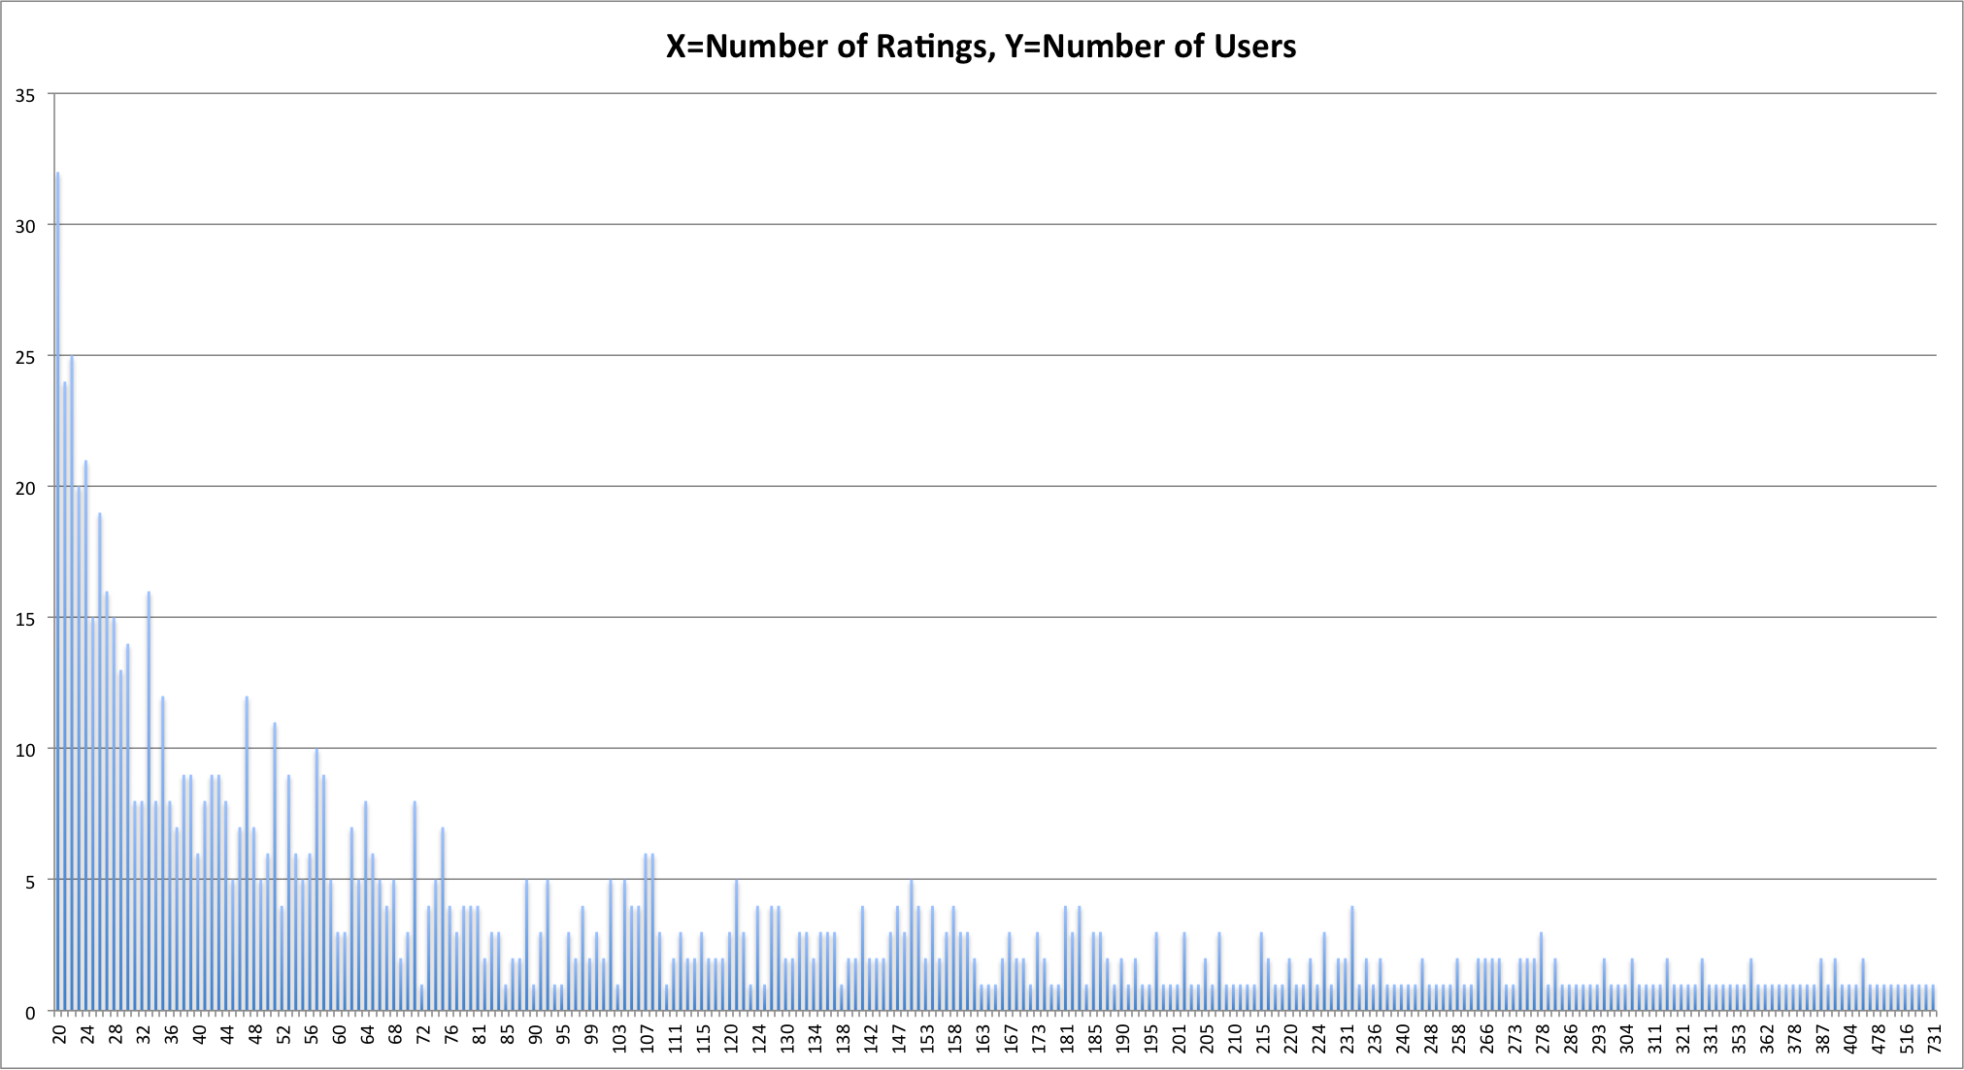
Dataset Cont.

Slide 8
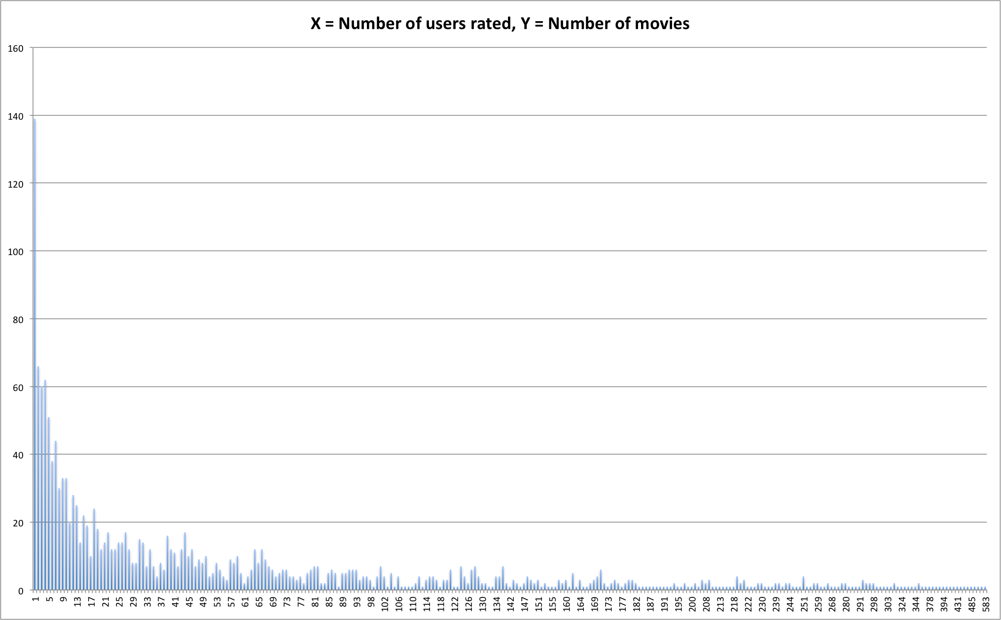
Dataset Cont.

Slide 9
Experiments and Results
* Collaborative Filtering Algorithm
for every other user w
compute a similarity s between u and w
retain the top users, ranked by similarity, as a neighborhood n
for every item i that some user in n has a preference for,
but that u has no preference for yet
for every other user v in n that has a preference for i
compute a similarity s between u and v
incorporate v's preference for i, weighted by s, into a running average

Slide 10
Experiments and Results
* Collaborative Filtering
Average Absolute Difference Values

Slide 11
Experiments and Results
* Collaborative Filtering
Performance Evaluation (CPU time in ms)

Slide 12
Experiments and Results
* Content-Based Filtering Algorithm
for every user u
create a user profile based on preferences for user u
for every user u
for every item i unseen by user u
calculate similarity of i to the profile of user u
retain top n items i for user u

Slide 13
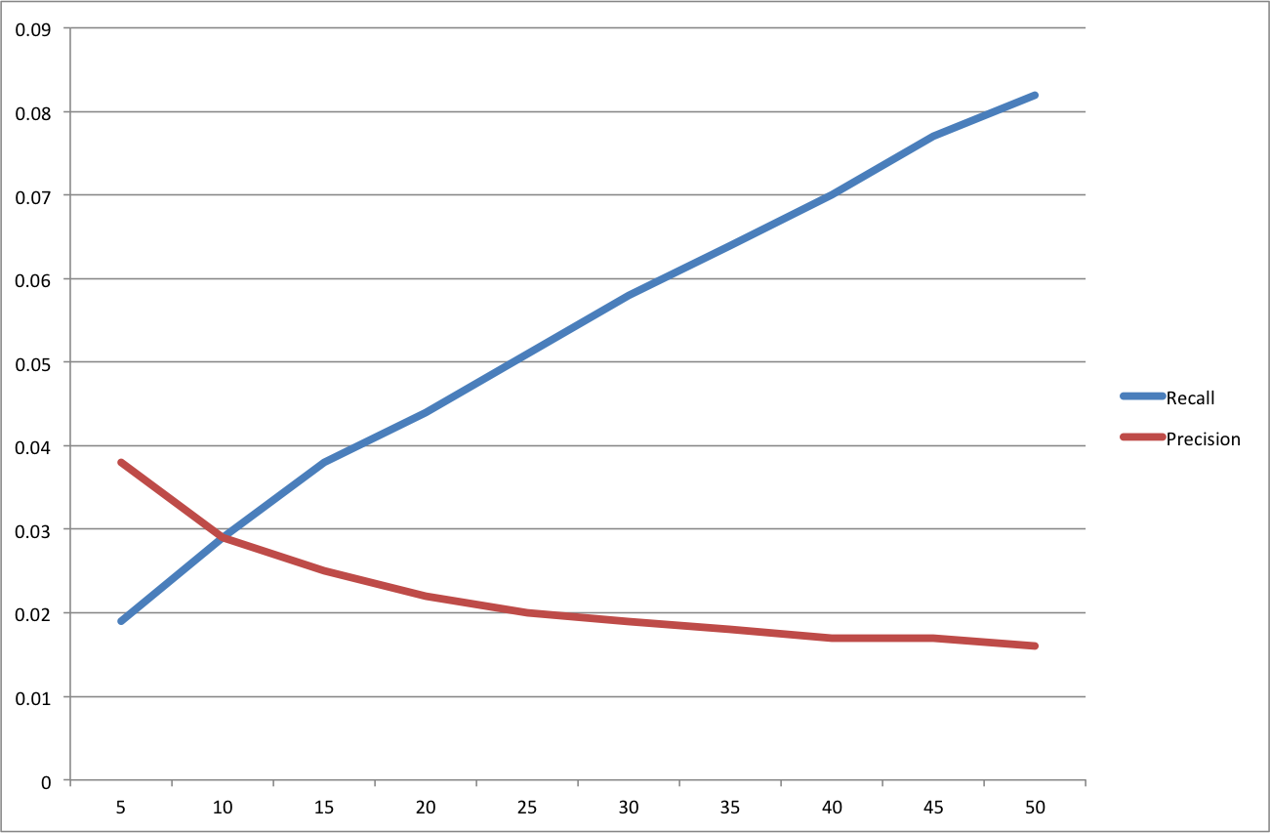
Experiments and Results
* Content-Based Filtering

Slide 14
Experiments and Results
* Hybrid Algorithm
Finds items with content-based filtering
Predicts ratings with collaborative filtering
for every user u
compute similarity for each unseen item based on user's preferences
retain top n items, ranked by similarity
for every user u
for every unseen item i of the user u
find every other user v that has a preference for i
retain users v by similarity to the user u
retain rankings given to the item i by users v
predict the ranking for i of u as average rankings of users v for i

Slide 15
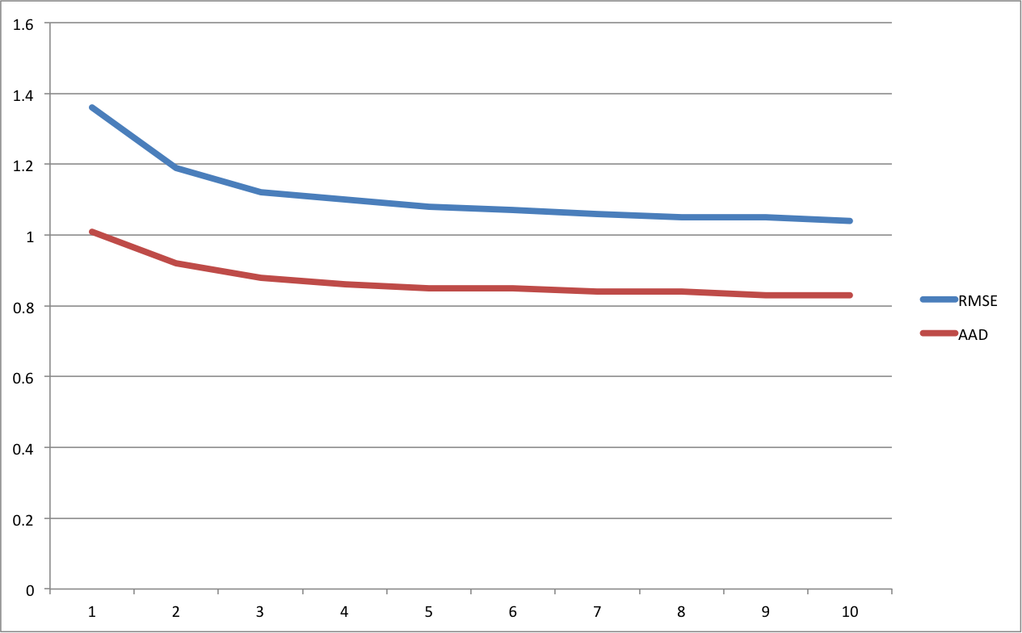
Experiments and Results
* Hybrid

Slide 16
Future Work
Introducing more features
  Year of the movie, user’s age, occupation etc.
Using larger datasets
  MovieLens 1M dataset
  MovieLens 10M dataset
Defining different weights to features for every user

Slide 17
Questions

