Slide 1
Topic Extraction From Turkish News Articles
Anıl Armağan Fuat Basık Fatih Çalışır Arif Usta

Slide 2
Agenda
Introduction
Motivation and Goal
Topic Extraction and Extraction Based Summarization
Defining the Most Important Sentence
Work Done
Future Work
Conclusion

Slide 3
Introduction
Increasing Volume of Online Data
To be Up to Date
Turkish News

Slide 4
Motivation and Goal
Topic Extraction, News Summarization, Text Mining
Getting Familiar with Text Mining Tools
Turkish , as an Agglutinative language
A novel system that summarizes Turkish News on daily basis

Slide 5
Topic Extraction and Extraction Based Summarization
Summarization Techniques
  Extraction-Based
  Abstraction-Based
  Maximum Entropy Based Summarization
  Aided Summarization
Extraction Based Summarization
  Topic Extraction
    LDA
      Top K Words

Slide 6
Defining Most Important Sentence
In extraction based summarization:
  Combining the extracted topics as summary requires NLP.
  Therefore, we select the sentence, that represents the document best.
Which one is the best?

Slide 7
Defining Most Important Sentence
First Step: Find term based importance
  If the tf-idf value of a term represents importance of a term.
  Sum tf-idf values of terms in a sentence:
  Higher the summation, more important the sentence is.
Second Step: More attack on sentences
  Sentences that are at the begining and at the end of documents,
  Sentences that contains numerical attributes,
    Are tend to be more important.

Slide 8
Defining Most Important Sentence
Third Step: Eliminating junk terms
  Applying just first and second step, might return a sentence which is too long and all terms contained are junk.
  Therefore, we will find Top-K words. Eliminate words with respect to them.
  Apply first and second step after elimination.
To find Top-K words:
  We applied LDA(Latent Dirichlet Allocation), found 100 topics
  For each topic we selected top 5 words
  In total we have top 500 words

Slide 9
Work Done
Parse the data.
Preprocess the data, apply stemming, stop word removal, typo fixing.
  Used Zemberek.
Apply LDA and define top 500 words.
  Used MALLET.

Slide 10
Future Work
Eliminate terms w.r.t top 500 words.
Find tf-idf value of each term in the dataset.
Find total sum of tf-idf values of terms for each sentence in each document.
Define most important sentence in each document.
Create a user interface.

Slide 11
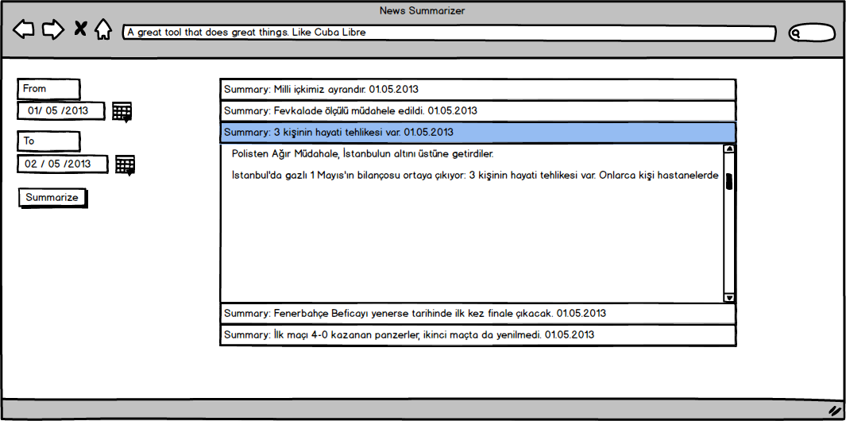
Future Work

Slide 12
Conlusion
Develop a Novel Summarization System of News
Work on Turkish Data

