Slide 1
IR Evaluation Methods for Retrieving
Highly Relevant Documents
CS 533 Presentation
Hamed Rezanejad
Emre Nevayeshirazi

Slide 2
Outline
Introduction
Evaluation Method
P – R curves
Cumulative gain based measurement
Case Study
Test queries and evaluation measures
P- R curves
Cumulative gain based measurement
Conclusion

Slide 3
Introduction
Some problem with assessment of relevance
Binary relevance cannot reflect the possibility
We want to use multiple degree assessment
P-R curves
Cumulative Gain
Query structure
Query expansion

Slide 4
Evaluation Method
Precision over recall levels and P-R curves are the typical ways of evaluating IR method performance
Original P-R curves use dichotomical relevance assessment
Seeing the difference in performance better:
We use separate recall bases for each relevance level
Computing P-R curve in this way

Slide 5
Evaluation Method
Cumulated gain-based measurement
Highly relevant documents are more valuable than marginally relevant document
The greater the ranked position of a relevant document the less valuable it is for the user
Cumulated gain vector:
Discount cumulated gain vector:

Slide 6
Case Study
Query Expansion and Query Structures
Query has a structure based on conjunctions(AND) and disjunctions(OR) of search keys.
We can change the “natural language” queries to Boolean structure
Test environment
A text database containing newspaper articles operated under InQuery system
We have four relevance categories
Relevance assessment
Two experienced journalists + two information specialists

Slide 7
Case Study
Facet structure: (a1 and a2 ..) or ( … ) …
The best performance overall was achieved with expanded, facet structured queries.
Sum: average of the weights of keys
SSYN-C: sum of synonym groups query based on concepts
WSYN: sum of synonym groups query based on facets
Adding semantically related words to original search concepts (Query Expansion) gave Unexpanded (u) and Expanded (e) query versions.

Slide 8
Case Study
Test Queries and Application of the Evaluation Measures
Analysis Presented In Two Forms
P – R Curves
CG and DCG Curves
SUM, WSYN, SSYN-C queries are used in tests.
These queries are also expanded.

Slide 9
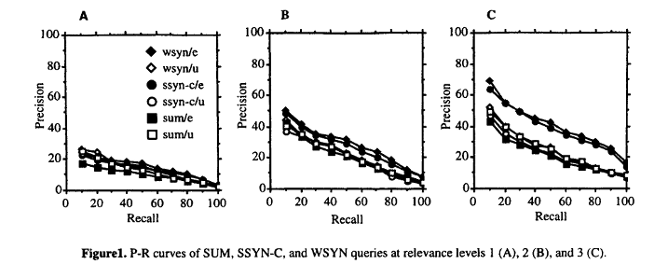
Case Study
P – R Curves
Average precision is calculated

Slide 10
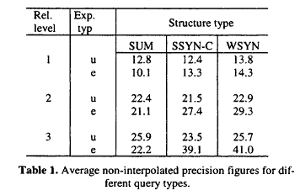
Case Study
P – R Curves Continues …
SUM not effected by query expansion
Strongly structured queries are enchanted by query expansion
Expended WYSN queries perform best
SUM vs. WYSN difference is huge
Expended queries with strong
structure are effective for most
relevant documents

Slide 11
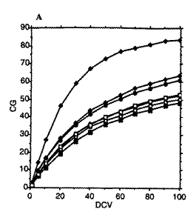
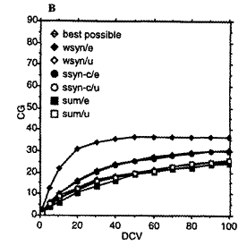
Case Study
Cumulative Gain
Relevance level 2 & 3 is used in A
Relevance level 3 is used in B
CG Vector curve for ranks 1 – 100
Best possible horizontal at rank 100
When only relevance level 3 is used (2B)
Absolute difference is smaller
Proportional differences are larger

Slide 12
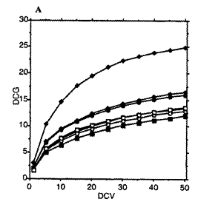
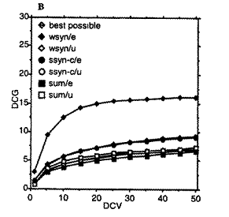
Case Study
Discounted Cumulative Gain
Log₂ is used as discount factor
Relevance level 2 & 3 is used in A
Relevance level 3 is used in B
DCG Vector curve for ranks 1 – 50
Best possible still grows at rank 50
When only relevance level 3 is used (2B)
Absolute difference is smaller
Proportional differences are larger

Slide 13
Conclusion
Two evaluation methods proposed
P – R Curve
CG and DCG
These evaluation methods are used with
Document set with 3 relevance level
Different query types
Results
In P-R curves performance difference varies with relevance level
Strongly structured queries present better effectiveness
Expended queries based on strong structures cumulate higher CG and DCG values

