Slide 1

Visualizing (Big) Data using t-SNE
Laurens van der Maaten
Joint work with Geoffrey Hinton (University of Toronto / Google).

Slide 2
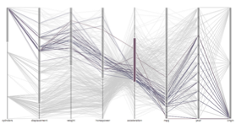
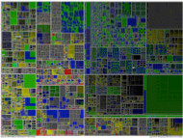
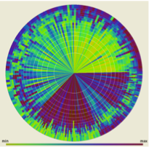

Introduction
Visualization is extremely useful for extracting knowledge from data

Slide 3
Introduction
Visualization is extremely useful for extracting knowledge from data
How can we visualize Big Data
that contains many variables?

Slide 4
Introduction
Compute dissimilarity of all pairs of database records:
Ams | 800 | 1 | 1 | 0
Rot | 700 | 3 | 0 | 1
Gro | 200 | 1 | 0 | 0
Maa | 100 | 0 | 0 | 1
Zwo | 100 | 1 | 0 | 1

Slide 5
Introduction
Compute dissimilarity of all pairs of database records:
Ams | 800 | 1 | 1 | 0
Rot | 700 | 3 | 0 | 1
Gro | 200 | 1 | 0 | 0
Maa | 100 | 0 | 0 | 1
Zwo | 100 | 1 | 0 | 1
 | Ams | Rot | Gro | Maa | Zwo
Ams | 0 | 58 | 147 | 178 | 82
Rot |  | 0 | 202 | 146 | 128
Gro |  |  | 0 | 270 | 85
Maa |  |  |  | 0 | 187
Zwo |  |  |  |  | 0

Slide 6
Introduction
Compute dissimilarity of all pairs of database records:
Exact way in which dissimilarities are computed depends on problem at hand
Ams | 800 | 1 | 1 | 0
Rot | 700 | 3 | 0 | 1
Gro | 200 | 1 | 0 | 0
Maa | 100 | 0 | 0 | 1
Zwo | 100 | 1 | 0 | 1
 | Ams | Rot | Gro | Maa | Zwo
Ams | 0 | 58 | 147 | 178 | 82
Rot |  | 0 | 202 | 146 | 128
Gro |  |  | 0 | 270 | 85
Maa |  |  |  | 0 | 187
Zwo |  |  |  |  | 0

Slide 7
Introduction
Build map in which each point represents a database record, and distances between points reflect similarities in the data:
 | Ams | Rot | Gro | Maa | Zwo
Ams | 0 | 58 | 147 | 178 | 82
Rot |  | 0 | 202 | 146 | 128
Gro |  |  | 0 | 270 | 85
Maa |  |  |  | 0 | 187
Zwo |  |  |  |  | 0

Slide 8
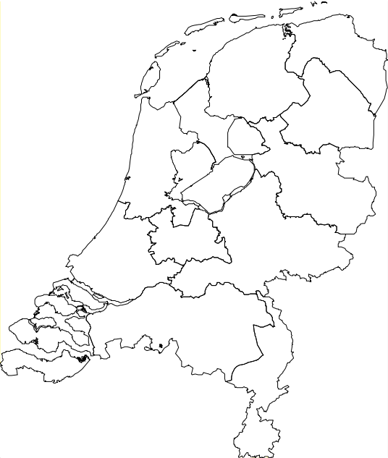
Introduction
Build map in which each point represents a database record, and distances between points reflect similarities in the data:
Groningen
 | Ams | Rot | Gro | Maa | Zwo
Ams | 0 | 58 | 147 | 178 | 82
Rot |  | 0 | 202 | 146 | 128
Gro |  |  | 0 | 270 | 85
Maa |  |  |  | 0 | 187
Zwo |  |  |  |  | 0
Zwolle
Amsterdam
Rotterdam
Maastricht

Slide 9
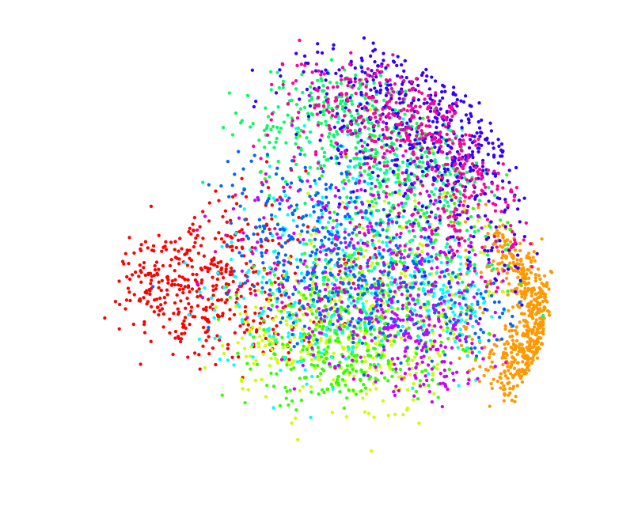
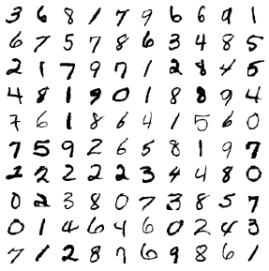

Principal Components Analysis

Slide 10
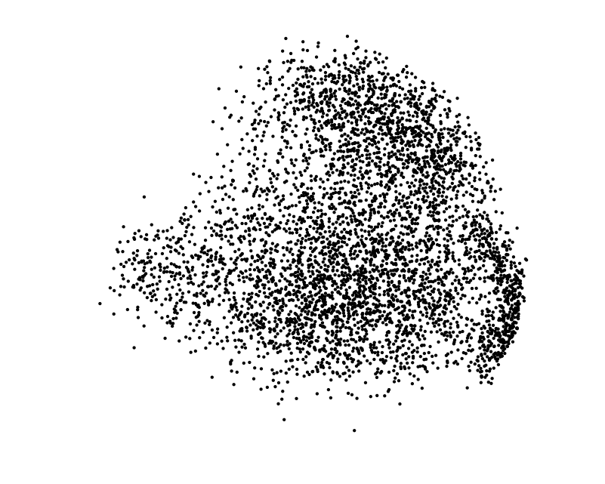
Principal Components Analysis

Slide 11
What distances to preserve?
PCA is mainly concerned with preserving large pairwise distances in the map

Slide 12
What distances to preserve?
PCA is mainly concerned with preserving large pairwise distances in the map
Large pairwise distances, however, are relatively unimportant in visualizations
  Do we really care exactly how dissimilar zeros and ones are?

Slide 13



t-Distributed Stochastic Neighbor Embedding
Compute “local” pairwise similarities based on pairwise distances:
Data

Slide 14
t-Distributed Stochastic Neighbor Embedding
Compute “local” pairwise similarities based on pairwise distances:
Data

Slide 15
t-Distributed Stochastic Neighbor Embedding
Compute “local” pairwise similarities based on pairwise distances:
Data

Slide 16
t-Distributed Stochastic Neighbor Embedding
Compute “local” pairwise similarities based on pairwise distances:
Data

Slide 17
t-Distributed Stochastic Neighbor Embedding
Compute “local” pairwise similarities based on pairwise distances:
Data

Slide 18

t-Distributed Stochastic Neighbor Embedding
Measure pairwise similarities between corresponding points in the map:
Map

Slide 19
t-Distributed Stochastic Neighbor Embedding
Measure pairwise similarities between corresponding points in the map:
Map

Slide 20
t-Distributed Stochastic Neighbor Embedding
Measure pairwise similarities between corresponding points in the map:
Map

Slide 21
t-Distributed Stochastic Neighbor Embedding
Measure pairwise similarities between corresponding points in the map:
Map

Slide 22
t-Distributed Stochastic Neighbor Embedding
Measure pairwise similarities between corresponding points in the map:
Map

Slide 23

t-Distributed Stochastic Neighbor Embedding
Move points around to minimize:
Map

Slide 24


Slide 26
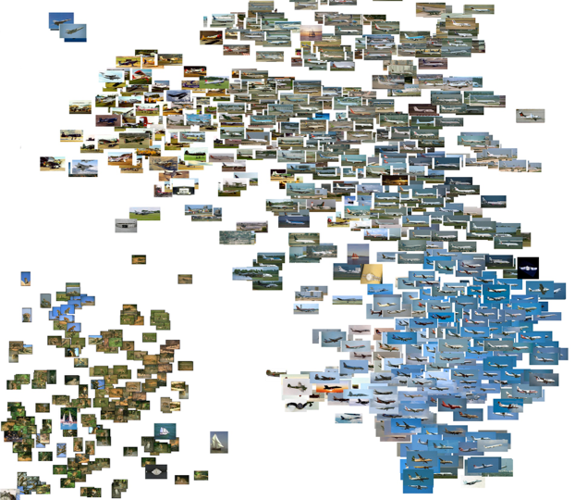
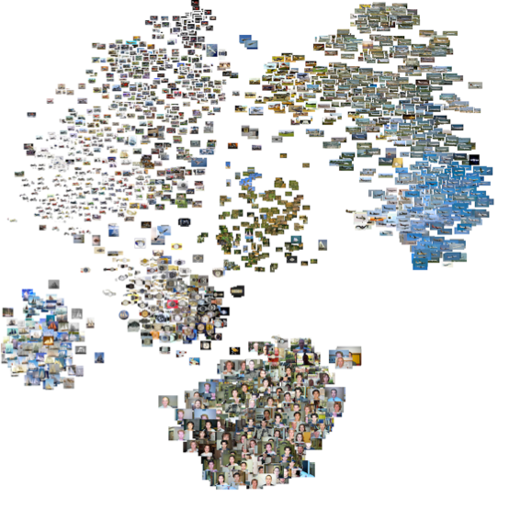
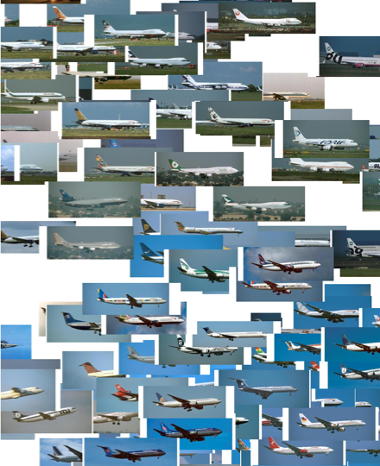
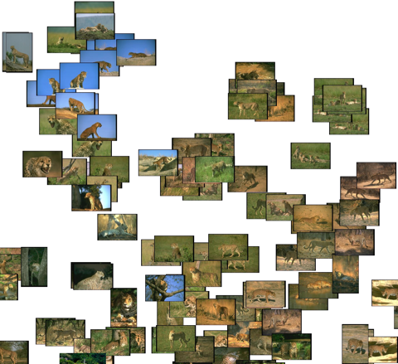

Slide 27
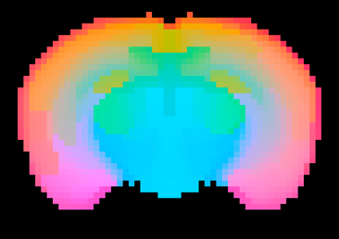
Visualizing gene expression data
Visualization of gene expression similarities in rat brain slice:

Slide 28


Visualizing mass spectrometry data
PCA
t-SNE
* Figure adopted from: J. Fonville et al., Anal. Chem. 85(3), 2013.

Slide 29
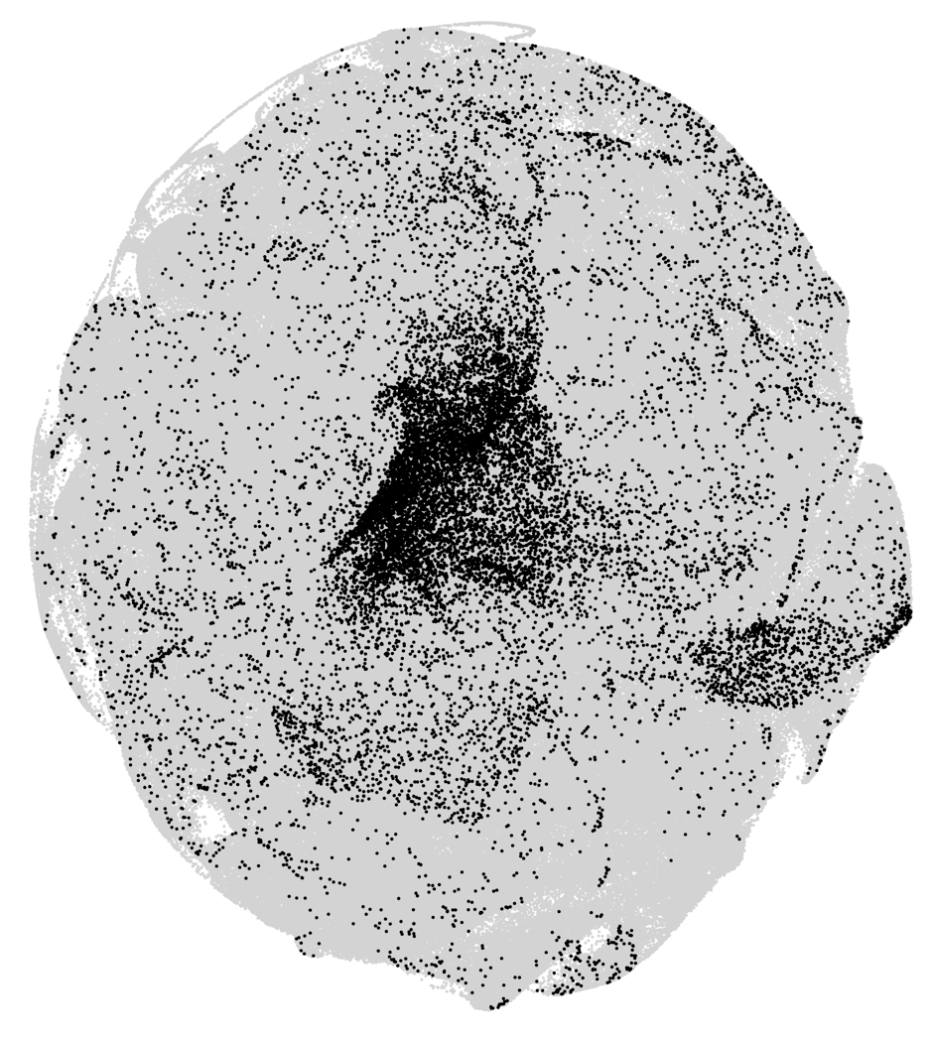
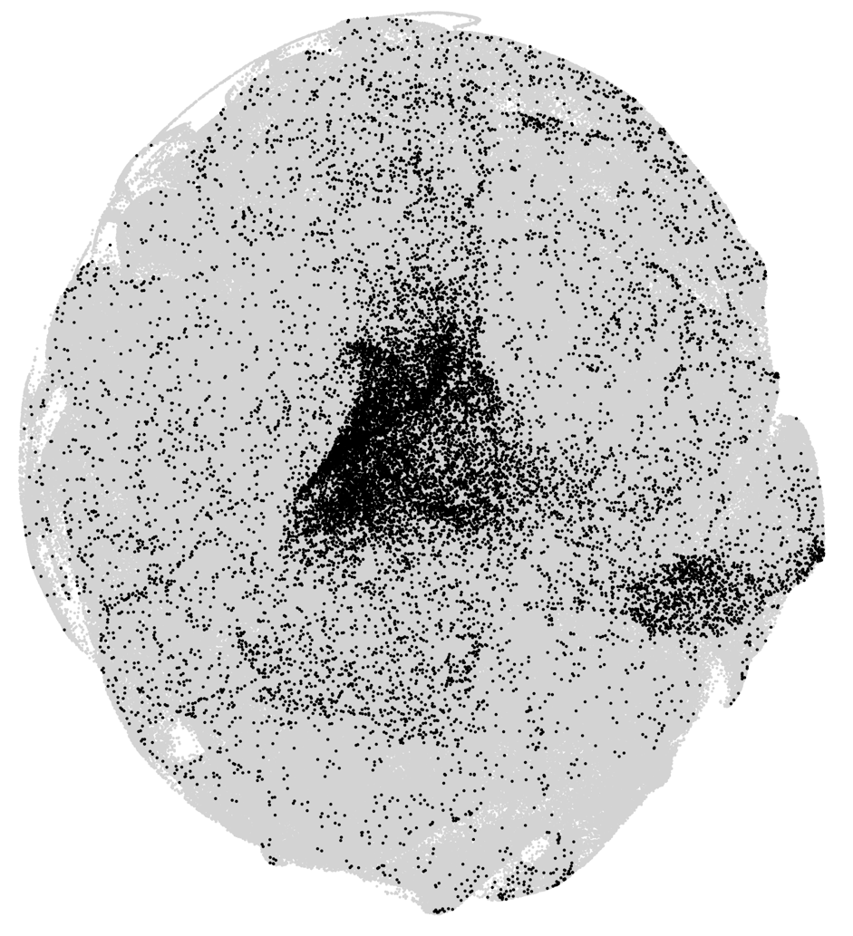
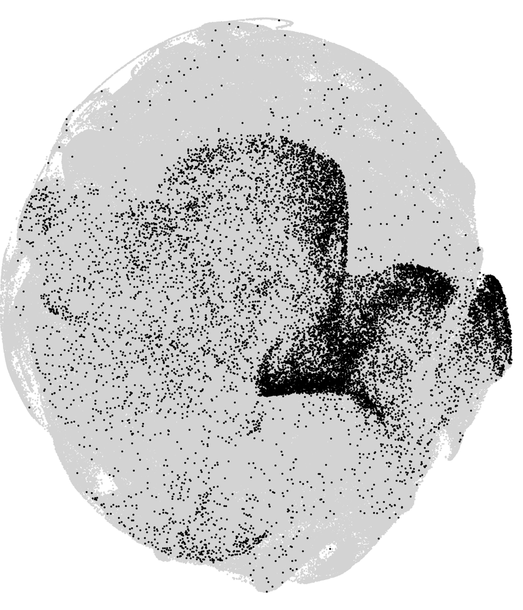
Visualizing flowcytometry data
Flowcytometry data (= blood cell measurements) of leukemic and healthy kids:
Healthy
Healthy
Leukemia
* Joint work with Stevan Lauriault & Cynthia Guidos, SickKids Hospital Toronto.

Slide 30
Visualizing movies
Netflix has a large collection of user-movie ratings stored in a rating matrix
movies
users

Slide 31
Visualizing movies
Netflix has a large collection of user-movie ratings stored in a rating matrix
Decompose the rating matrix to obtain user features and movie features:
movies
movies
users
=
x
users

Slide 32
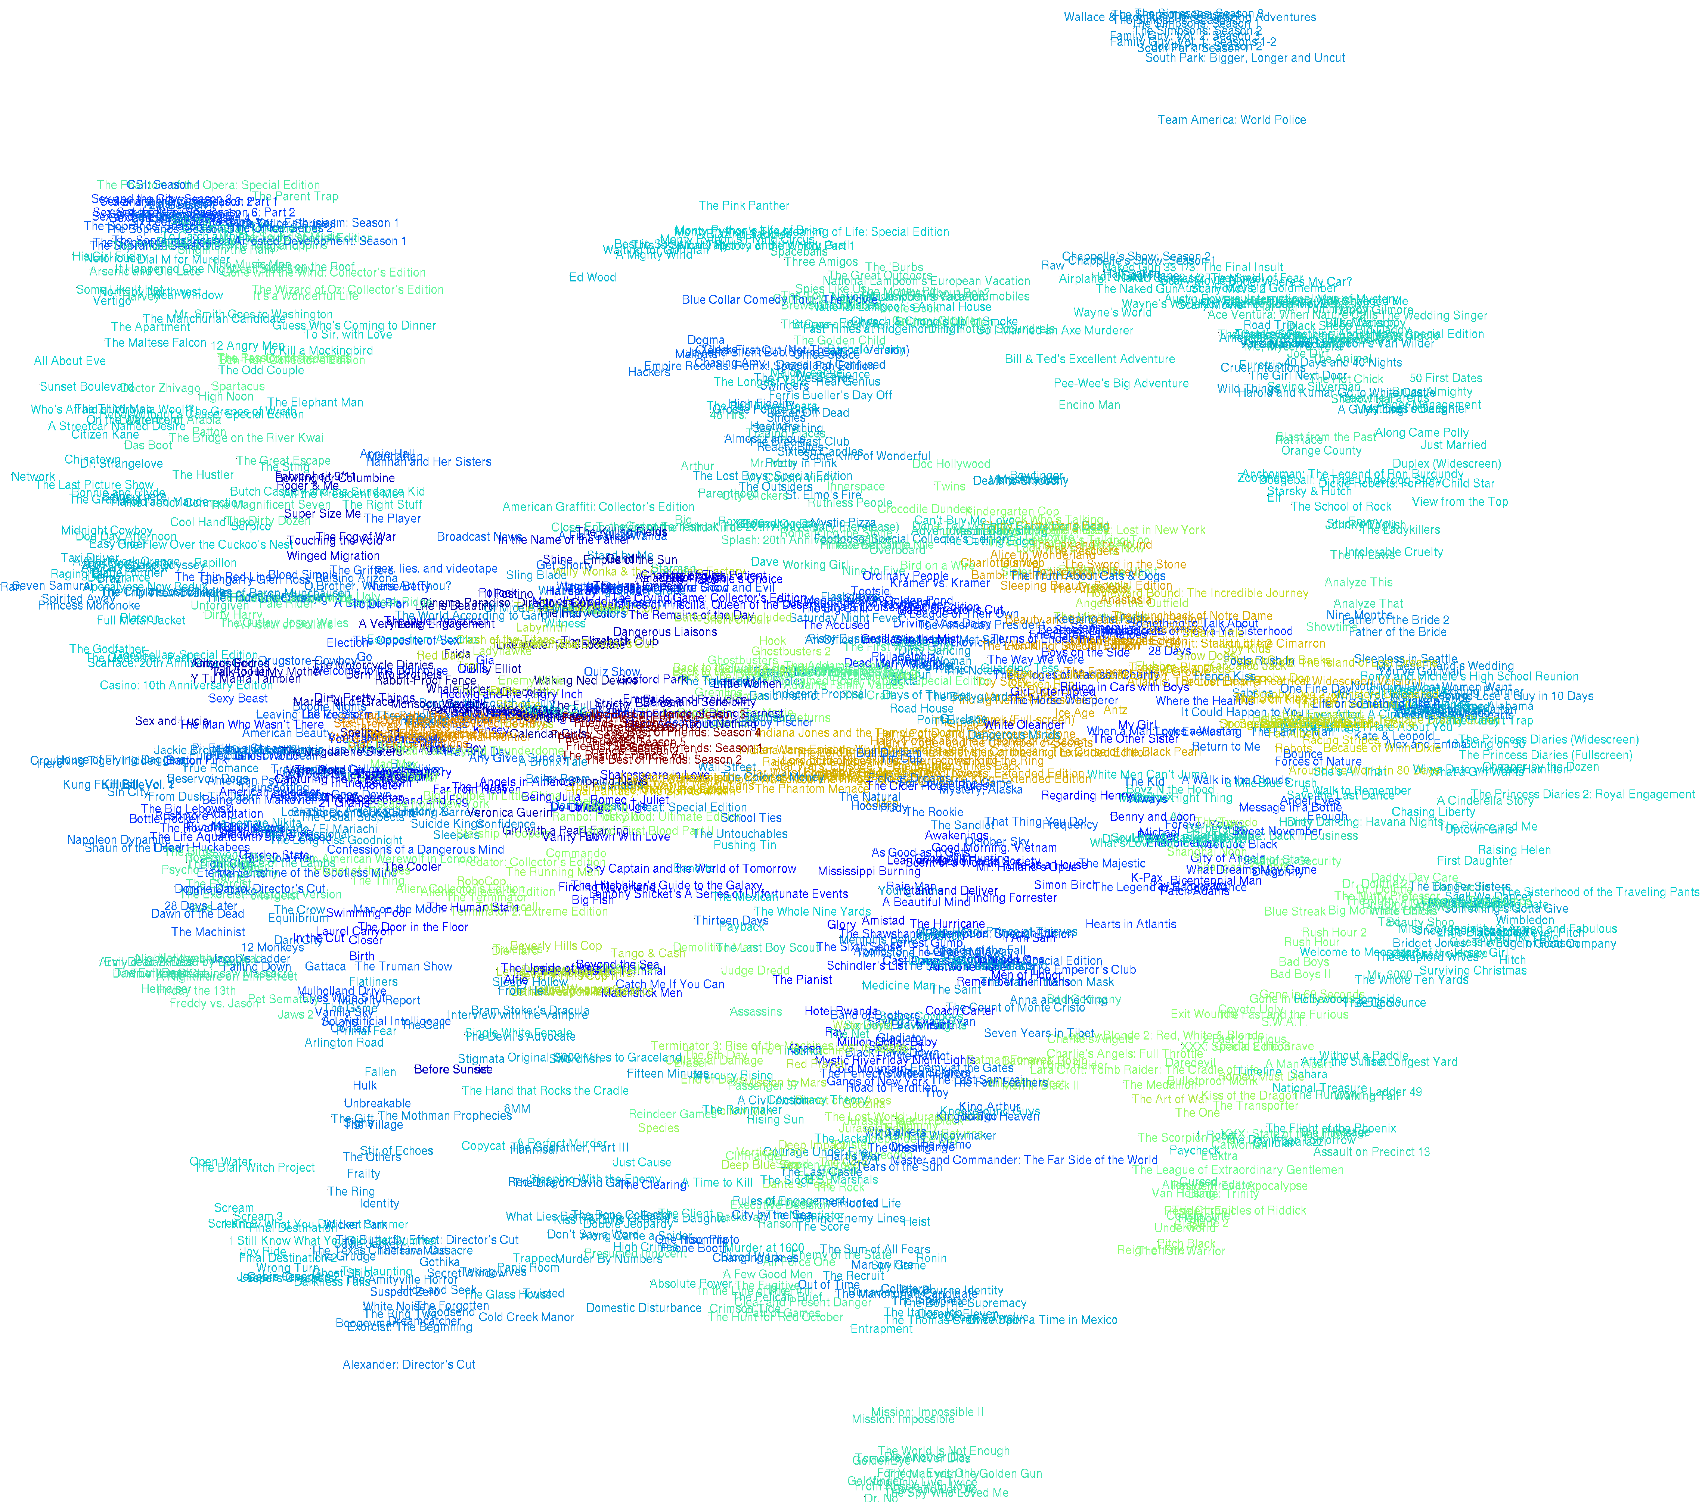


Indiana Jones, Final Fantasy,
Raiders of the Lost Ark, Star Wars
Star Trek
Friends

Slide 33
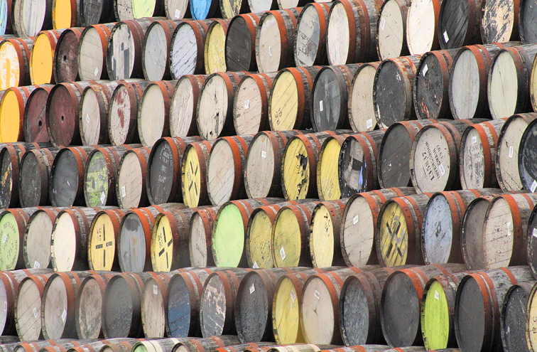
Whisky flavor map
Gather data on whisky: smokiness, body, fruity, sweetness, etc.

Slide 34
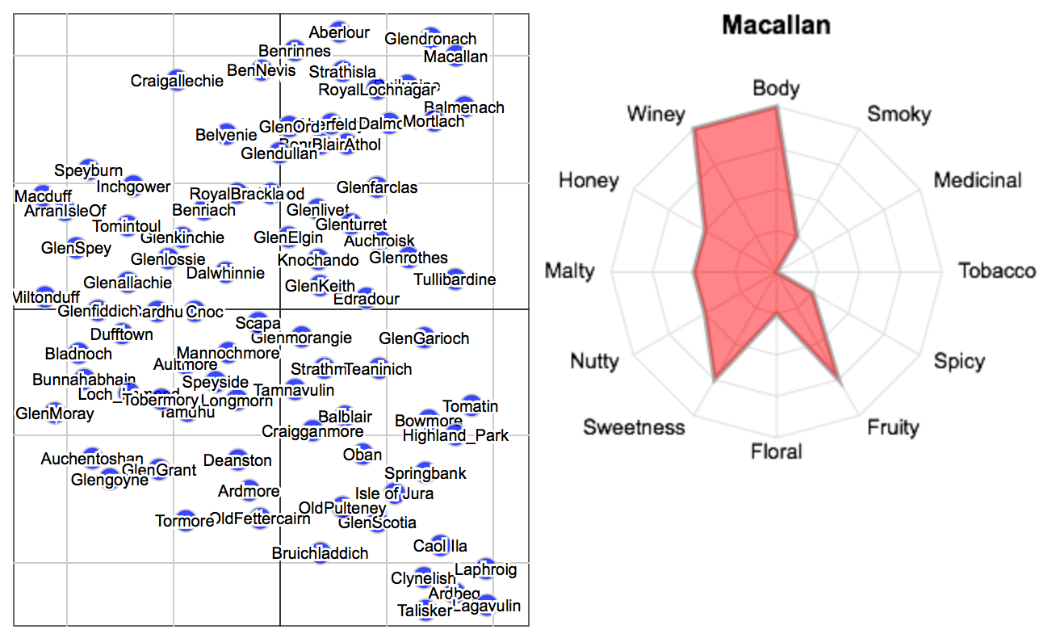
Whisky flavor map
Use this data to produce a “whisky flavor” map:
* Whisky map made by Brian Scannell at Nanigans Boston.

Slide 35

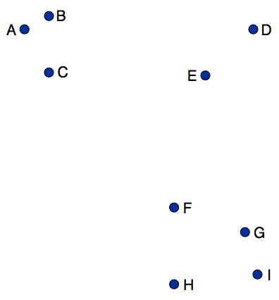
Gradient interpretation
We can interpret building a t-SNE map as a simulation of an N-body system:

Slide 36
Gradient interpretation
We can interpret building a t-SNE map as a simulation of an N-body system:
spring

Slide 37
Gradient interpretation
We can interpret building a t-SNE map as a simulation of an N-body system:
exertion / compression

Slide 38
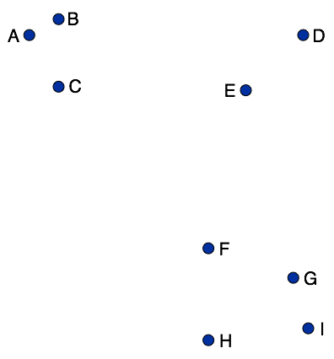
Gradient interpretation
We can interpret building a t-SNE map as a simulation of an N-body system:

Slide 39
Barnes-Hut approximation
Many of the pairwise interactions between points are very similar:

Slide 40
Barnes-Hut approximation
Approximate such similar interactions by a single interaction:

Slide 41
Barnes-Hut approximation
Approximate such similar interactions by a single interaction:
3x

Slide 42
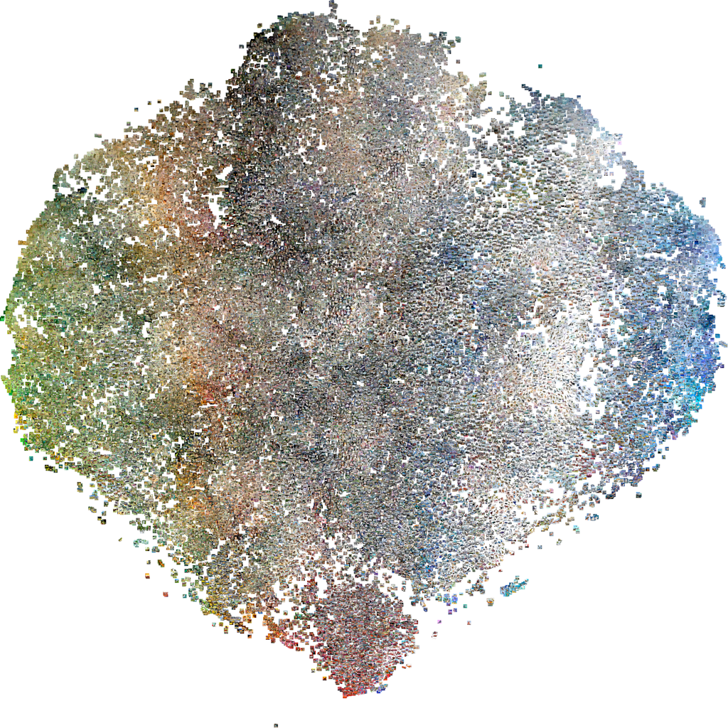
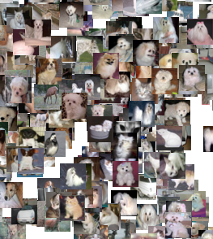
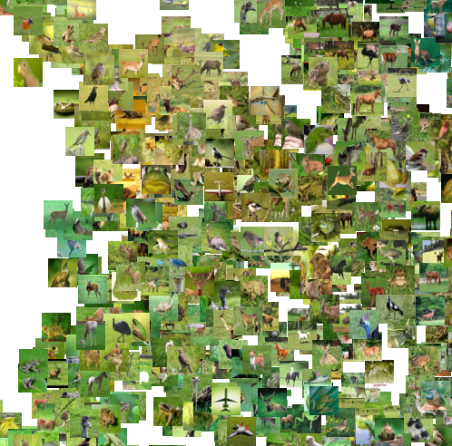
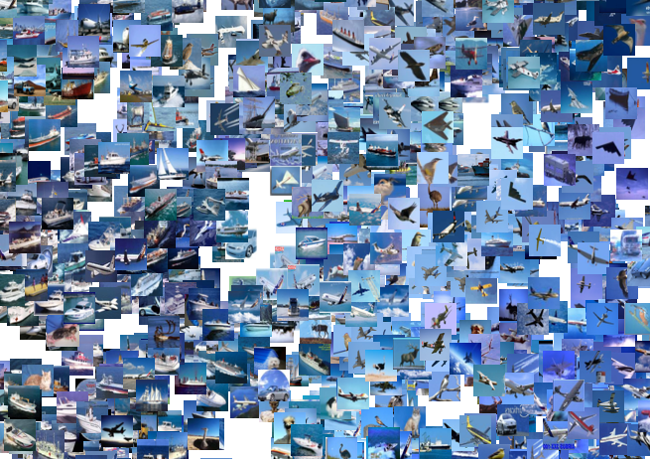
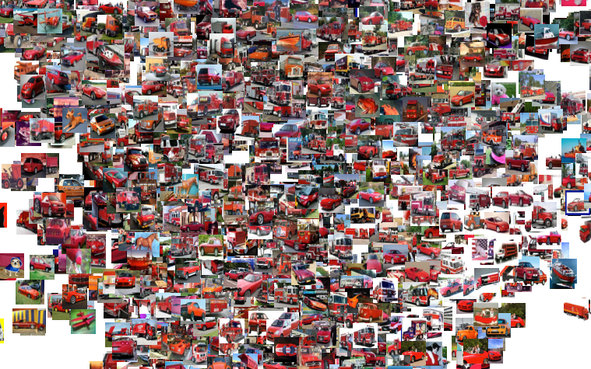

Slide 43
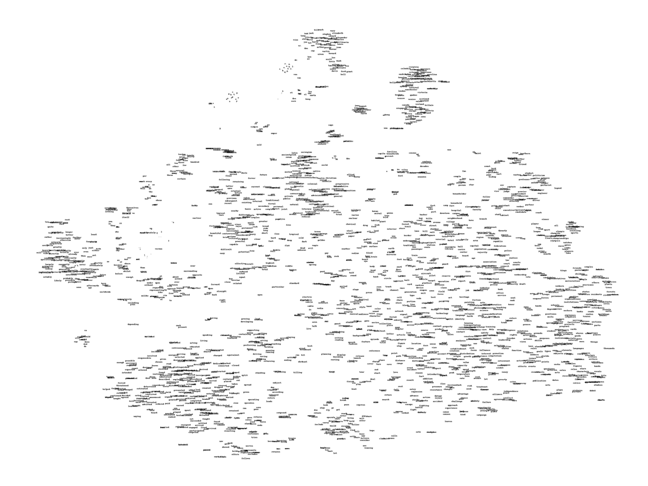
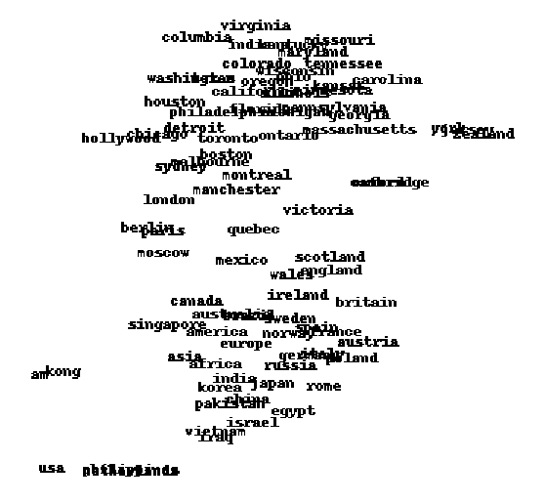
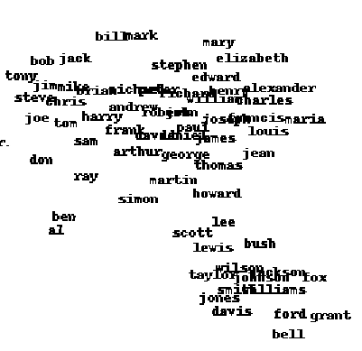

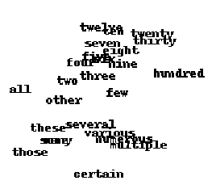
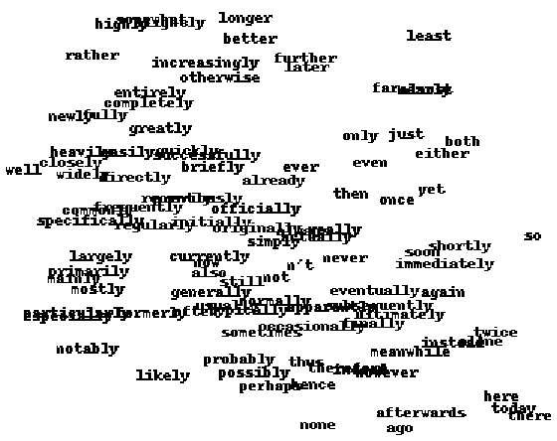
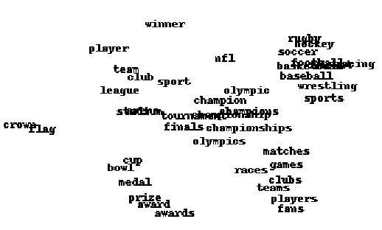
* Word map made by Joseph Turian at University of Montreal.

Slide 44
Limitations of using a single map
Suppose we are visualizing words based on association data, or authors based on co-authorships, or products based on Facebook likes, etc.

Slide 45

Limitations of using a single map
Suppose we are visualizing words based on association data, or authors based on co-authorships, or products based on Facebook likes, etc.
How can we model the words “river”, “bank”, and “bailout” in a single map?

Slide 46
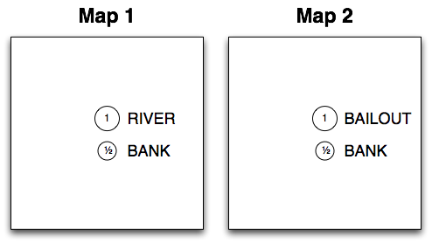
Multiple maps t-SNE
Construct multiple maps, and give each object a point in each map
Assign an importance weight to each point
Define the similarity between two points under the multiple maps model as a weighted sum over the similarities in the individual maps

Slide 47
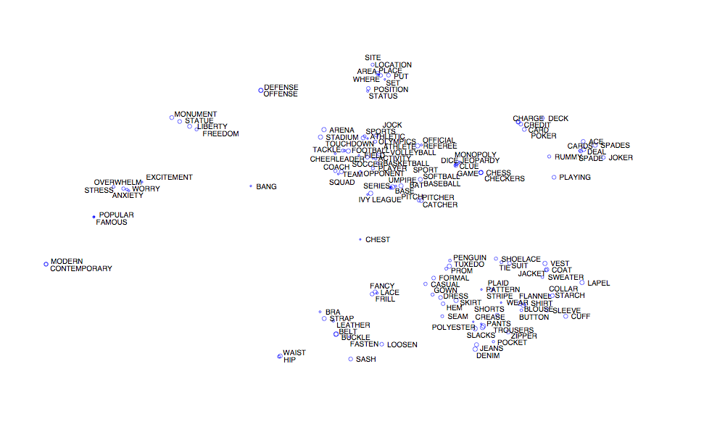
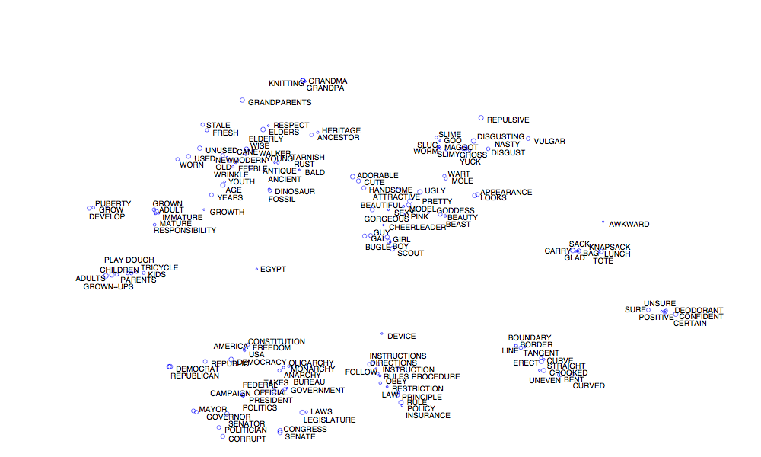

Slide 50
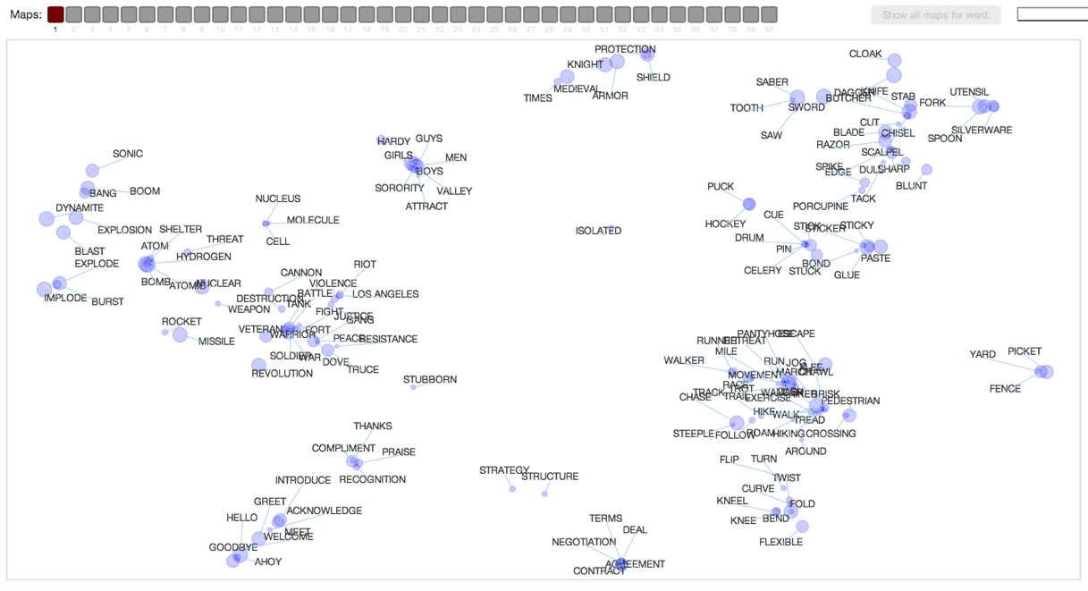
http://homepage.tudelft.nl/19j49/multiplemaps/

Slide 51
Conclusions
Visualizing high-dimensional data in maps may lead to insight in the data

Slide 52
Conclusions
Visualizing high-dimensional data in maps may lead to insight in the data
t-SNE is an effective and efficient algorithm to make such maps

Slide 53
Conclusions
Visualizing high-dimensional data in maps may lead to insight in the data
t-SNE is an effective and efficient algorithm to make such maps
t-SNE has already been successfully applied in a range of domains:
  Bioinformatics, computer security, climate research, cancer research, etc.

Slide 54
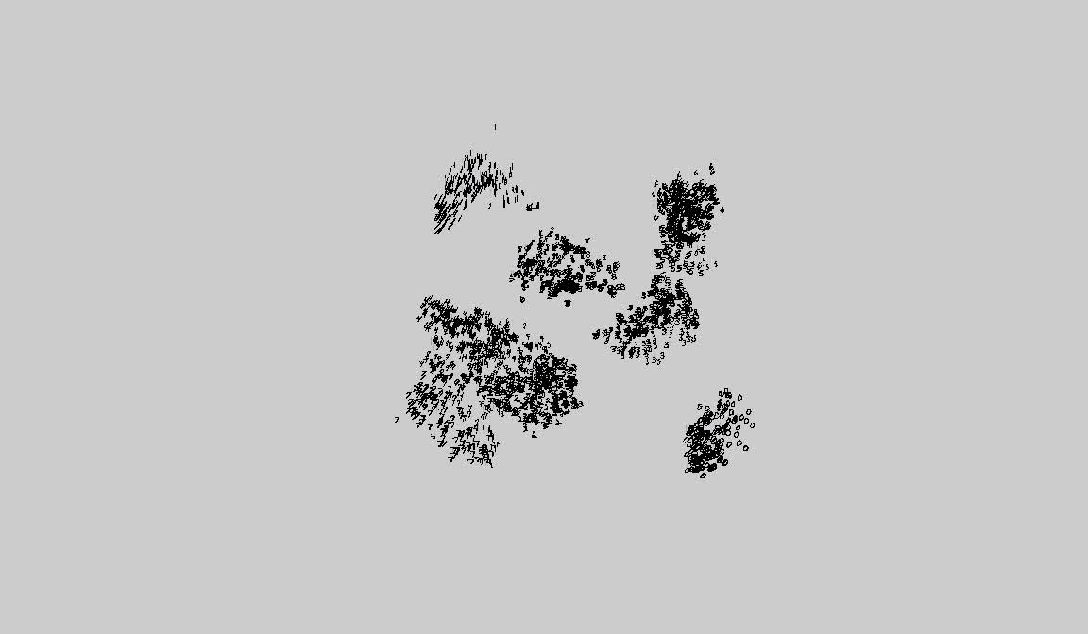


QUESTIONS?
  Laurens van der Maaten
  Geoffrey Hinton
Try it out yourself! Code is available on http://homepage.tudelft.nl/19j49/tsne
Talk with more details: http://www.youtube.com/user/GoogleTechTalks/videos

