Slide 1
Being Entrepreneur After Experiencing a Large Scale Company
Barış Erdemir
CS 2009
Siliconmade Ar-Ge, Founder
Technology Entrepreneur

Slide 2
Being Entrepreneur After Experiencing a Large Scale Company
Yapı Kredi Bank
Entrepreneurship
Turkey Information Foundation
Search For a Job

Slide 3
Being Entrepreneur After Experiencing a Large Scale Company
Yapı Kredi Bank
Entrepreneurship
Turkey Information Foundation
Search For a Job

Slide 4
Being Entrepreneur After Experiencing a Large Scale Company
Which Country/City I Would Like To Live?
Ankara
İstanbul
Europe
U.K.
U.S.A.
Other?

Slide 5
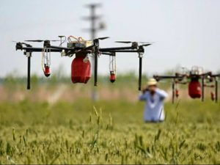
Being Entrepreneur After Experiencing a Large Scale Company
Which Industry I Would Like to Work?
High Technology
Healtcare
Education
Energy
Agriculture
Defence
Finance
Other?

Slide 6
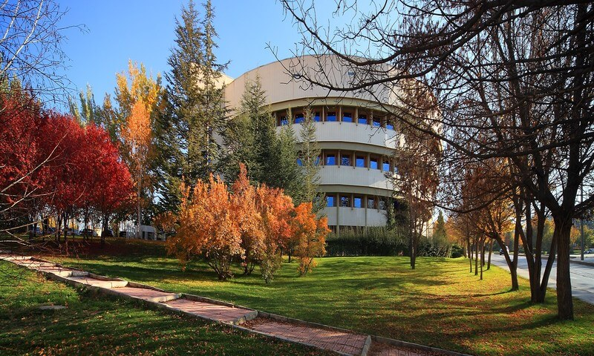
Being Entrepreneur After Experiencing a Large Scale Company
Which Environment I Would Like to Work?
Academy / Research Center
Large Scale Enterprise
Small Enterprise
Entrepreneurship
Other?

Slide 7
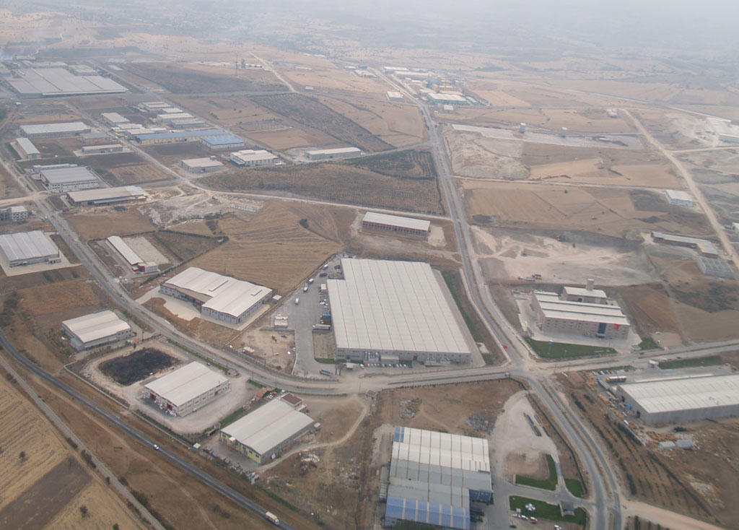
Being Entrepreneur After Experiencing a Large Scale Company
Search For a Job
Eskişehir – Savunma Sanayisi
T.A.V. – İstanbul - Havalimanı Yönetimi

Slide 8
Being Entrepreneur After Experiencing a Large Scale Company
Search For a Job
Search For a Job Criteria
İstanbul
Finance
Large Scale Enterprise

Slide 9
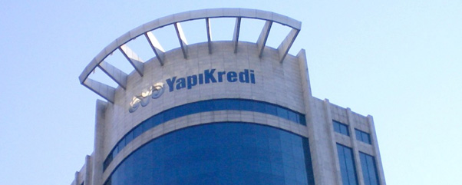
Being Entrepreneur After Experiencing a Large Scale Company
Search For a Job
BT Mimari ve Güvenlik Yönetimi Grubu Yazılım Geliştirmeci

Slide 10
Being Entrepreneur After Experiencing a Large Scale Company
Yapı Kredi Bank
Entrepreneurship
Turkey Information Foundation
Search For a Job

Slide 11
Being Entrepreneur After Experiencing a Large Scale Company
Yapı Kredi Bank
Day #1 – Task #1 : Develop a Maven Plug-in That Checks Thread Safety
Develope a Hello World Maven Plug-in
Top Down Design
Implementation
Analysis
Test
4
3
What is Maven Plug-in?
What is Thread Safety?
2
What is Maven?
What is Plug-in?
What is Thread?
1
Develop a Maven Plug-in That Checks Thread Safety

Slide 12
Being Entrepreneur After Experiencing a Large Scale Company
Yapı Kredi Bank
Task Diversity
Develop a Maven Plug-in That Checks Thread Safety
Authorization System Design & Implementation
Business Rule Manager Decision & Entegration
Configuration Management Operation Improvement
Source Control Methodology & Toole Improvement
SDLC Improvement & Trainings

Slide 13
Being Entrepreneur After Experiencing a Large Scale Company
Yapı Kredi Bank
Pros & Cons of A Large Scale Enterprise
Training Opportunities
Focusing small piece of a whole
Variety of tasks without taking the risk of job change
Specializing for a spesific need of the enterprise may lead to improve specialization that is valuable outside of the enterprise.
Secure job
When the specialization is taken out of the whole, you may be worthless
Teamwork projects improve communication skills

Slide 14
Being Entrepreneur After Experiencing a Large Scale Company
Yapı Kredi Bank
Enterprise Organisation Scheme (Non-Tech)
Board of Directors
General Manager
Marketing
Human Resources
Operation
Information Tech.
Operation

Slide 15
Being Entrepreneur After Experiencing a Large Scale Company
Yapı Kredi Bank
Enterprise IT Organisation Scheme (Non-Tech)
Task Diversity
Information Tech. (CIO)
Architecture
Technical Architecture
Data Architecture
Application Architecture
Project Management
Software Development
Analysis | Imp. | Test
Credit Cards
Internet Banking
Document Man.
Payments
Risk Scoring
Personel Loans
...
Infrastructure And Operations
Database Man.
Application Servers
Security Management
Network Management
Change Management
Problem Management
Helpdesk

Slide 16
Being Entrepreneur After Experiencing a Large Scale Company
Yapı Kredi Bank
Promotion System
Entrance / Expert 1
Level Promotion
Expert 2
Open Data
Expert 3
Defined Salary Interval
Manager
Defined & Objective Criteria
Director

Slide 17
Being Entrepreneur After Experiencing a Large Scale Company
Yapi Kredi Bank
Quitting Yapi Kredi Bank
Turiska
Koç Inovation Program Application
«Turiska» or «Bank Job» Response
Given Decision

Slide 18
Being Entrepreneur After Experiencing a Large Scale Company
Yapı Kredi Bank
Entrepreneurship
Turkey Information Foundation
Search For a Job

Slide 19
Being Entrepreneur After Experiencing a Large Scale Company
Entrepreneurship
Undergraduate Period
Siliconmade Ar-Ge
IT Management Consultency
Software Development
Ekoelektrik
Turiska
Trial Period
Turiska
Ekoelektrik

Slide 20
Being Entrepreneur After Experiencing a Large Scale Company
Yapı Kredi Bank
Entrepreneurship
Turkey Information Foundation
Search For a Job

Slide 21
Being Entrepreneur After Experiencing a Large Scale Company
Turkey Information Foundation
The pace of change is increasing day by day.
Internet makes old values invalid and the valid values still do not exist.
Internet Generation is defining new values and current establisment is resisting by promoting old values.
«Daha Yeni Başlıyor» is a philosofy for new model development that will be valid in our age.
«Başlangıç Noktası» is a platform to discuss valid models for our information age.
We missed «industrial revolution».
We missed internet base services revolution. Composit services & blockchain are opportunuties.

Slide 22
Being Entrepreneur After Experiencing a Large Scale Company
Türkiye Bilişim Vakfı
Daha Yeni Başlıyor ve Başlangıç Noktası

Slide 23
Being Entrepreneur After Experiencing a Large Scale Company
Discussion
Entrepreneurship Ideas
Global Challenges
World Economic Forum - Toplink
Singularity University – Singularity Hub
Başlangıç Noktası

Slide 24
Being Entrepreneur After Experiencing a Large Scale Company
Thank you For Listening

