Slide 1
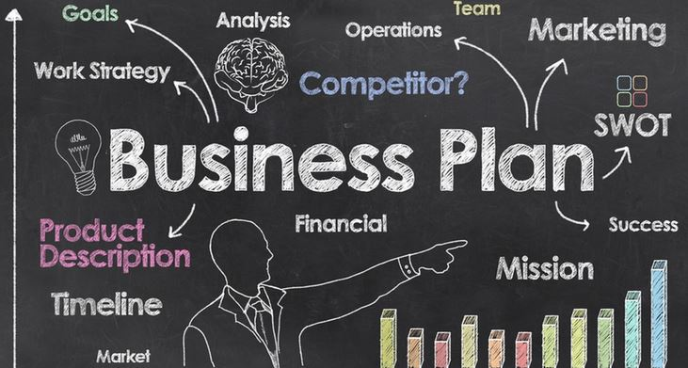
BUSINESS PLAN & ALTERNATIVES TO BUSINESS PLANS (CANVAS MODELS)

Slide 2
Who am I?
Instructor at Bilkent since 2002...
Major : Computer Science...
Spent 10 years at CTP and CTE departments...
Programming courses combined with business activities...
Member of FBA (Faculty of Business Administration) since 2011...

Slide 3
New Idea → Innovation...
Ex: We are having trouble while keeping our smartphones charged throughout the day...
→ Different approaches on battery life of Smart Phones...
A new idea, device or process...
Application of better solutions that meet new requirements, inarticulated (uncertain, ambigious etc.) needs, or existing market needs...
More effective products , processes, services, technologies, or ideas that are readily available to markets, governments and society...
Disposable Mobile Phone Charger
- Tiny charging unit in case of emergency for one use...
- Consumers will keep it at their wallets/pockets...
Innovation or NOT?

Slide 4
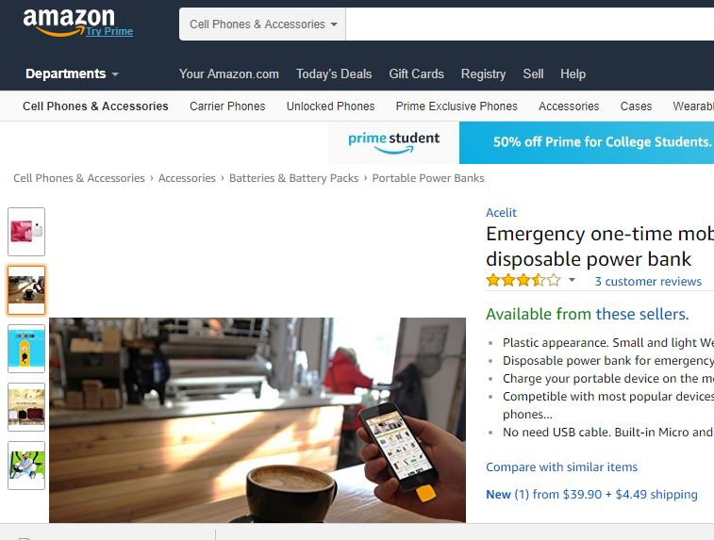
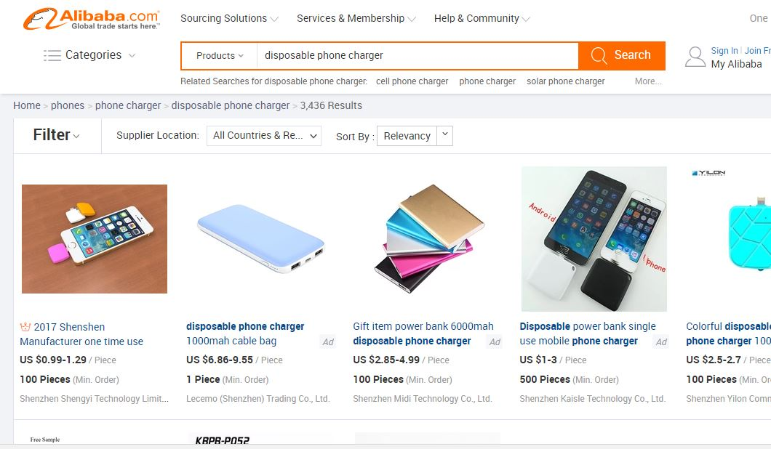
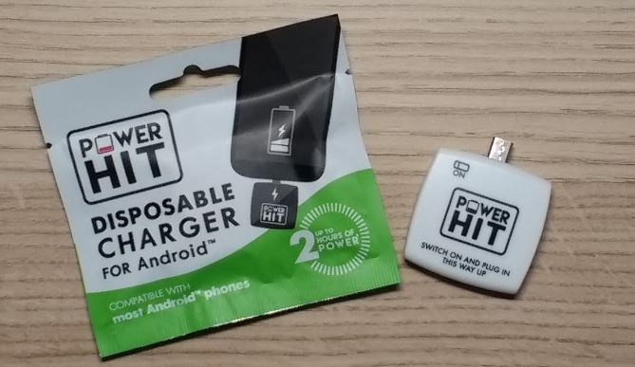
New Idea or Not? How to understand?

Slide 5
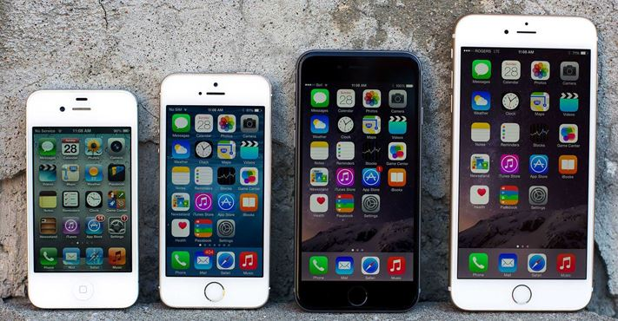
Incremental Innovation...
A series of small improvements to an existing product or product line that usually helps maintain or improve its competitive position over time.
This process is regularly used within the high technology business by companies that need to continue to improve their products to include new features increasingly desired by consumers.
new versions of iPhone
evolution of Samsung Galaxy S Series

Slide 6
Incremental Innovation... of Disposable Emergency Mobile Phone Charger
* Environmental issues ... (Social Responsibility)
Recycling of plastic packs & Li - ion battery.
* Durations...
How to extend?
* User Interface issues...

Slide 7
A Business Plan...
Assume that you have an innovative idea (ex: developing a new application for androids), what are your concerns & expectations?
- Who are my customers and how can I reach them?
- Is there a need for it?
- Is it something new (innovation) or an improvement of an existing product/service ? (incremental innovation)
- How can I form the supply-chain process?
- Incorporation! Do I need an organization? What type?
- Is it possible to make a profit in short run? How much time (weeks, months or years) do I need to reach the break-even?
- What will be the correct price?
In order to find the answers of these quesitons you need a BUSINESS PLAN!

Slide 8
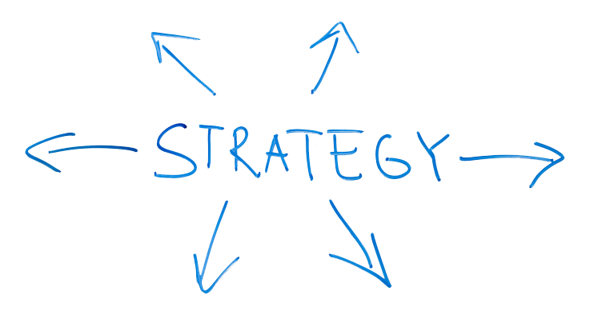
MARKETPLACE
Ind. B
Ind. A
x x x x x
x x
x x x
x
x
x
Ind. C
x
x x
x x x
x
X : Product or Service
Customer
Company
Industry

Slide 9
What is a Business Plan?
A formal statement of :
A set of business goals & objectives...
Reasons (why you believe that they are attainable)...
Action Plan for reaching those goals...
Background information about the organization or team attempting to reach those goals...
A decision making tool so, NO fixed content! The content is determined by the goals and audience...

Slide 10
Who is responsible (stakeholders) for this Plan?
Company owners...
People who make inventions, entrepreneurs, founders...
New partners
Merger Process (Not having enough capital so, offering a partnership to a company)
Professionals, consultants may need for the development phase.
Why? – Not an easy process! Especially some further marketing and financial skills may be necessary...

Slide 11
Why do we need this Plan?
As soon as there is no finished product in hand, this is simply a written brainstorming issue...
The value lies in the process of researching and thinking about the business in a systematic way...
This process helps to avoid potential future unplanned costs and unsolvable problems...

Slide 12
When do we need this Plan?
Starting up a new business with a new product/service...
From innovators perpective of view, in order to explain the necessity of an invention...
A major change process in the existing business...
Selling/Buying a division or a product line
Adding a new item to the product range
Outsourcing (Transfer of manufacturing or other tasks to countries where labor and supplies are less expensive)
Money is needed! / Raising capital
Bankers
Investors (a 3 to 5 year financial plan is required, since investors will look for their annual return in that timeframe...)

Slide 13
A Business Plan Report (15-30 pages)
How ?
Executive Summary (2-3 pages)
Summarizing everything in 2 pages!
Organizational Plan (3-7 pages)
Goals & Objectives, Mission / Vision, Business Type, Corporate Identity, Management, Organizational Chart etc.
Marketing Plan (5-10 pages)
By applying SWOT; Marketplace, Industry, Product/Service, Customer, Competitor etc. ANALYSIS → Develop a STRATEGY on them + Operations: bringing the product to market + Development: how to make future goals real
Financial Plan (5-10 pages)
5 year Income Statement, Balance Sheet and Cash Flow Projection.

Slide 14
Alternatives of Business Plan
It is too long! I just want to reflect and validate my innovative idea. Is there an alternative to first verify my idea?

Slide 15
Business Model Canvas vs Lean Business Model
Visual, Dynamic, Action oriented and Focus on Key Activities...
Business Model Canvas :
- Outlines several prescriptions which form the building blocks for the activities...
- A strategic management and lean startup template for developing new or documenting existing business models... - A visual chart with elements describing a firm's or product's value proposition, infrastructure, customers, and finances.
Alex Osterwalder
Lean Canvas : - Outlines a more problem focused approach and it majorly targets entrepreneurs and startup businesses...
- Adaptation of Business Model Canvas which Ash Maurya created in the Lean Startup spirit (Fast, Concise and Effective startup). - Lean Canvas promises an actionable and entrepreneur-focused business plan... - Focuses on problems, solutions, key metrics and competitive advantages.
Ash Maurya

Slide 16
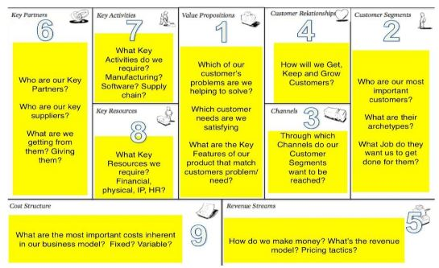
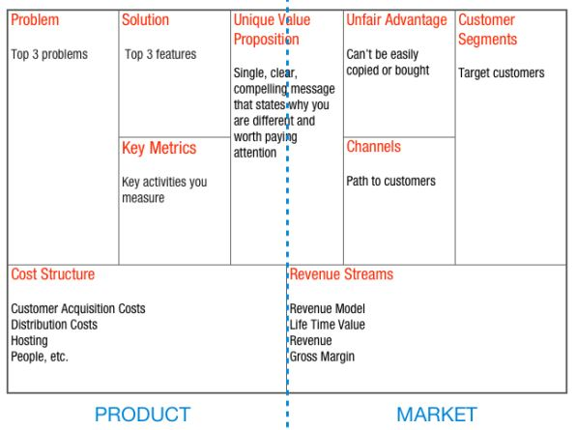
OSTERWALDER (Business Model Canvas)
2
9
1
4
3
5
MAURYA (Lean Business Model)
8
7
6

Slide 17
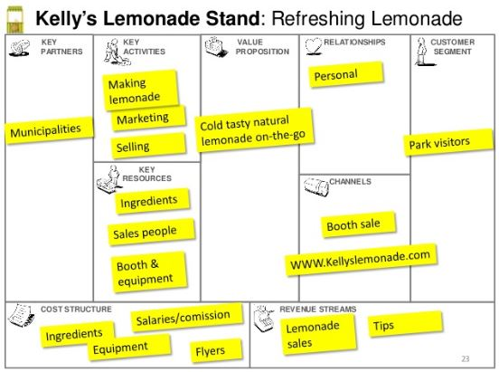
Business Model Canvas Example

Slide 18
Business Model Canvas vs Lean Canvas (Summary)
Element | Business Model Canvas | Lean Canvas
Target | New and existing businesses | Startup businesses purely
Focus | Customers, Investors, Entrepreneurs, Consultants, Advisors | Entrepreneurs purely
Customers | Lays emphasis on customer segments, channels and customer relationships for all businesses | Does not lay much emphasis on customer segments because startups have no known or tested products to sell
Approach | It lays down the infrastructure, lists the nature and sources of financing and the anticipated revenue streams of the business | It begins with the problem, a proposed solution, the channels to achieve the solution, costs involved and the anticipated revenue streams
Competition | It focuses on value proposition in quantitative and qualitative terms as way to stay smart in the market | It assesses whether the business has an unfair advantage over the rest and how to capitalize on it for improvement
Application | It fosters creativity, discussion and constructive analysis | It is a simple problem-solution oriented approach which enables the entrepreneur to develop step-by-step

Slide 19
Canvas or Business Plan?
Canvas Model :
Visual, Strategic, Dynamic, Action oriented and focuses on Key Activities based on an idea, innovation, entrepreneur facility etc.
Business Plan :
Reflects the financial structure in detail.
Conveys the organizational structure of your business, including titles of directors or officers and their individual duties.
Acts as a management tool that can be referred regularly to ensure the business is on course with meeting goals, sales targets or operational milestones.
Daily business operations and decisions should be aligned to long term company objectives and strategies, which are emphasized in a detailed business plan.

Slide 20
Assume that you are generating a mobile application that helps the students to find an empty space at parking lots. Please form a suitable ‘LEAN CANVAS’ to test and reflect your idea.

