Slide 1
the Relation Of Female genital organs’ Cancers with race and geographical factors
Marzie E. Rasekh
Fall 2012

Slide 2
Outline
Step 1: Project understanding
Step 2: Data understanding
Step 3: Data preparation
Step 4: Modeling
Step 5: Results and conclusion
Step 6: Future work

Slide 3
PROJECT UNDERSTANDING
STEP 1

Slide 4
Project Definition
Female genital organs’ cancers include 4 categories of cancers:
Cervical, Endometrioses, Uterus, and Ovary cancer
Discover rules about the effect of geographical factors and race
On different races inside Iran
Persian, Azeri, Kurd, Lor, Arab, Gilaki, Mani, Balooch, Afghani migrants, etc.
Using patient profiles at oncology hospitals and their pathology tests
Classification and Association Analysis

Slide 5
Motivation
Developed countries have annually reports on cancer incidences.
We know environment and lifestyle are related to cancer risk.
Based on recent discoveries, some race are found to be vulnerable to specific cancer.
Iran is a multicultural country with many races but no studies have been carried out in Iran.
There is a lot of Iranian migrants in other countries.
Some cancers have been completely cured and others are on the way.
Results lead to new cures (example: Human Variome Project)
Social awareness towards women cancer can be improved.
Doctors and women especially those exposed to higher risk benefit from this study.
Learn Intelligent Data Analysis

Slide 6
People of the Project
Project Owner
Prof. H. Altay Güvenir
Department of Computer Engineering; Bilkent University, Ankara, Turkey
Expert
Dr. Pouran Golbang
Gynecological Oncologist, Beheshti Hospital of Women; Esfahan, Iran
Analyst
Marzie E. Rasekh
Masters Student in Computer Science

Slide 7
The Domain
Gynecology: the branch of medicine dealing with diseases of the genital tract in women
Oncology: the branch of medicine that studies cancers and tumors
Cancer
Ovarian Cancer
Cervical Cancer
Endometrioses Cancer
Uterus Cancer
Tumor
Autoimmune diseases
Women care
Treatment (Surgery, Medicine, Radiotherapy, Chemotherapy)
Pathology test

Slide 8
Healthcare in Iran
Ministry of Health and Medical Education
University of Medical Sciences
Hospitals
Oncology centers
In the 20th century stressed the importance of regular check-ups such as the Pap smear, mammography, and blood tests.
In the early 2000s the main natural causes of death in Iran have been cardiovascular disease and cancer.

Slide 9
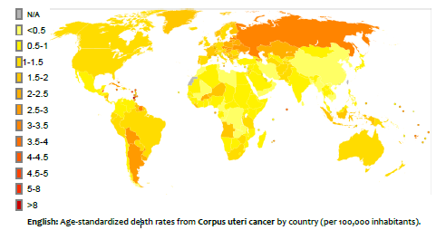
Case Study - World

Slide 10
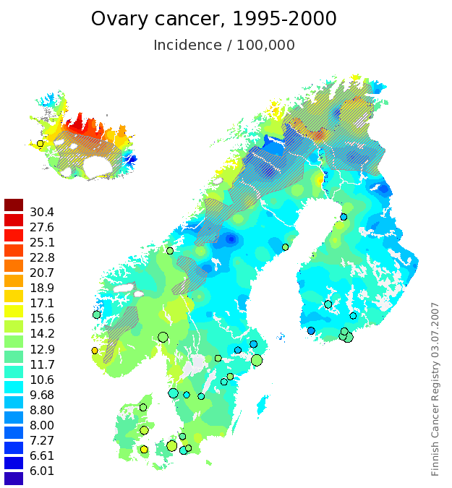
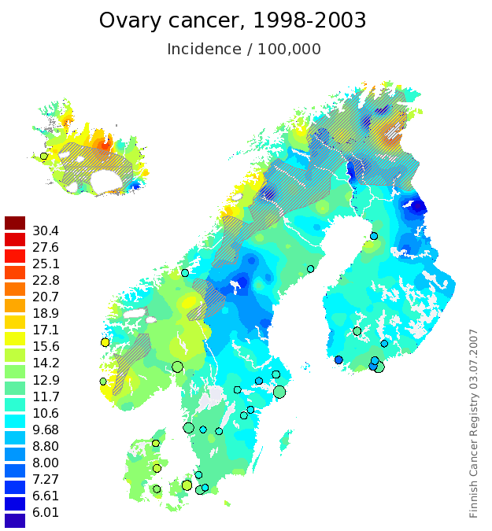
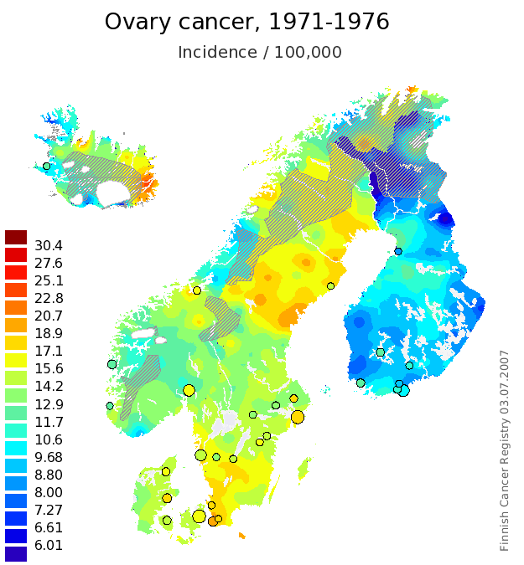
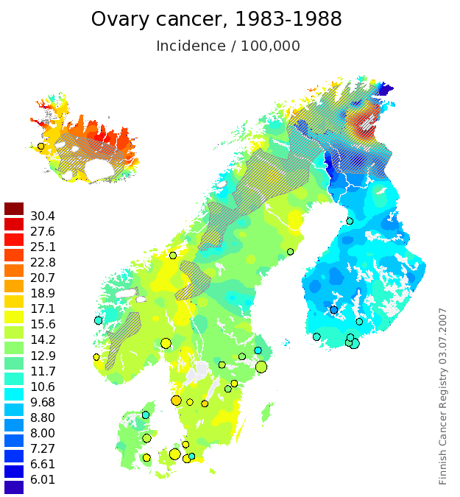
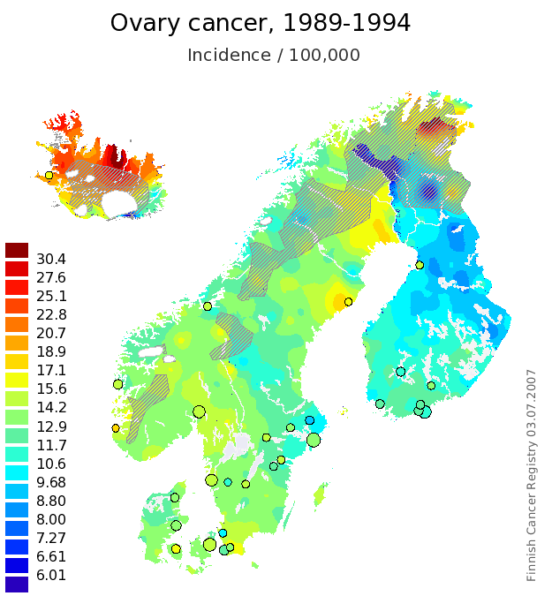
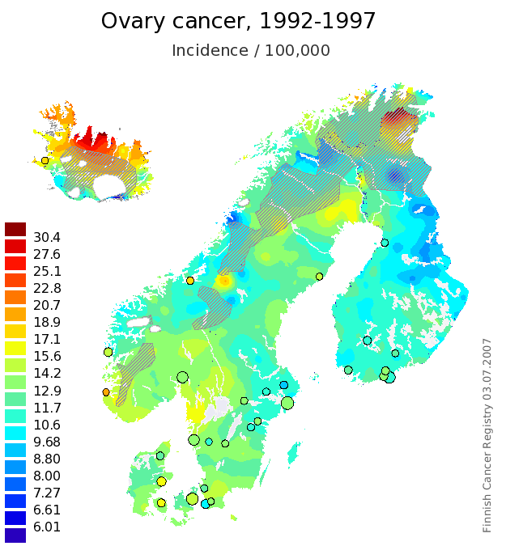
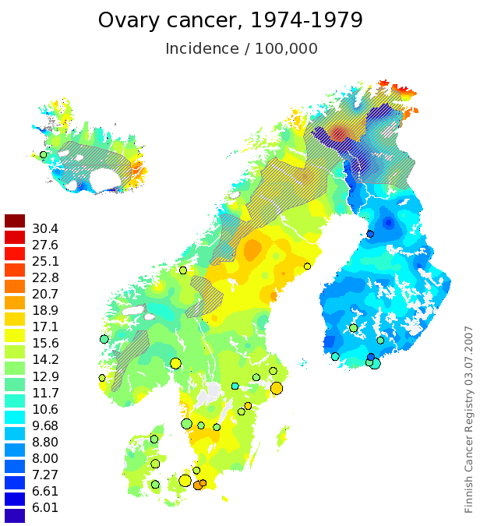
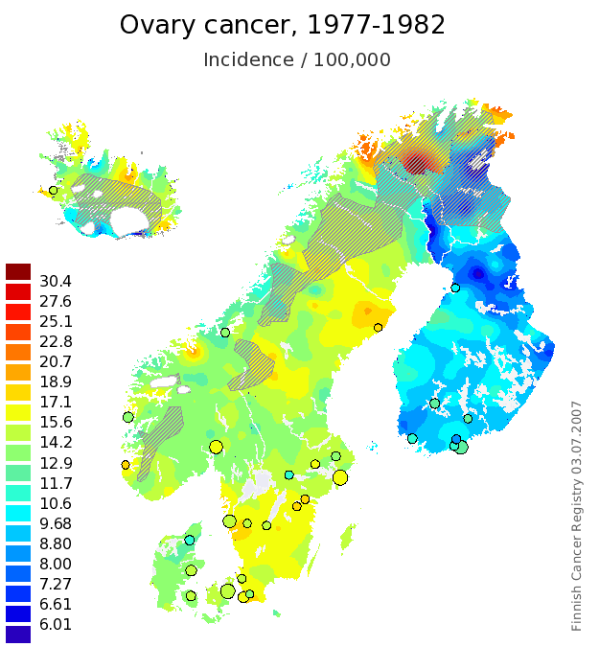
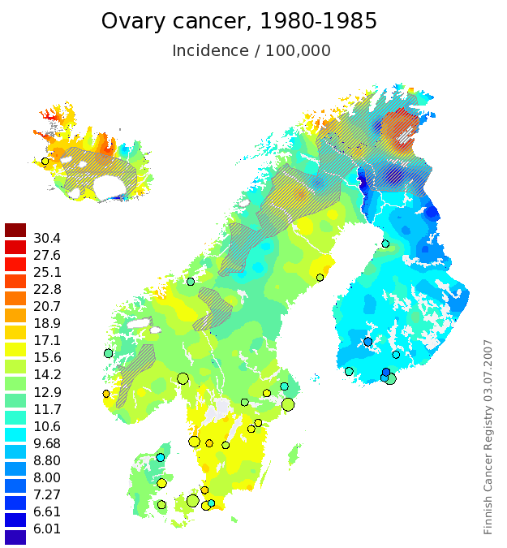
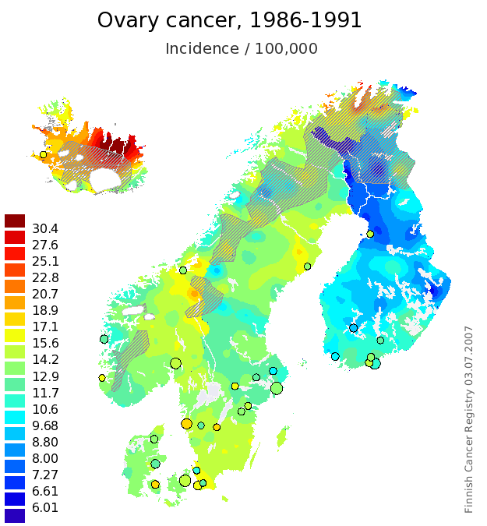
Case Study – Finland

Slide 11
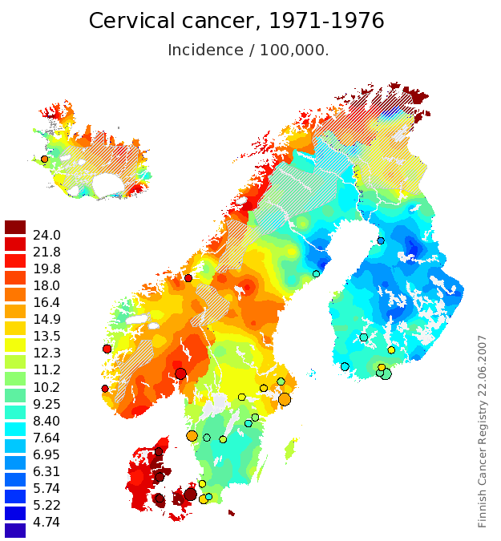
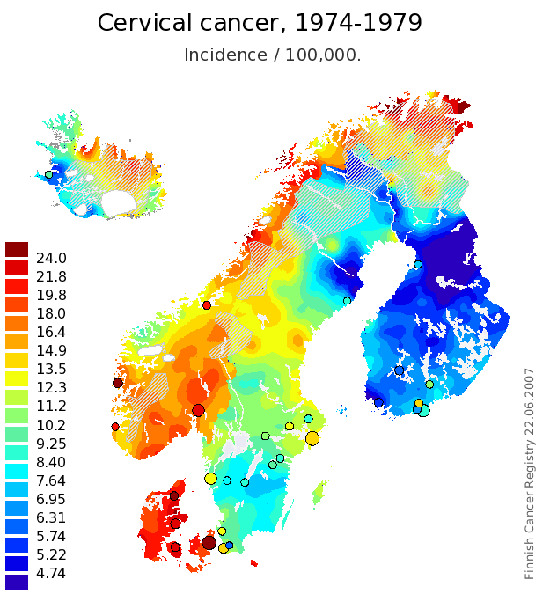
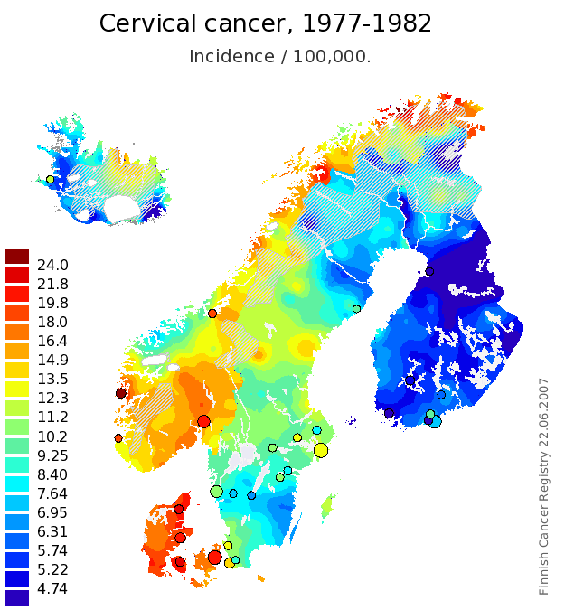
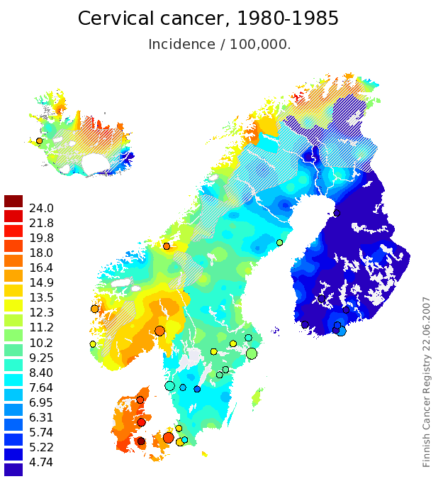
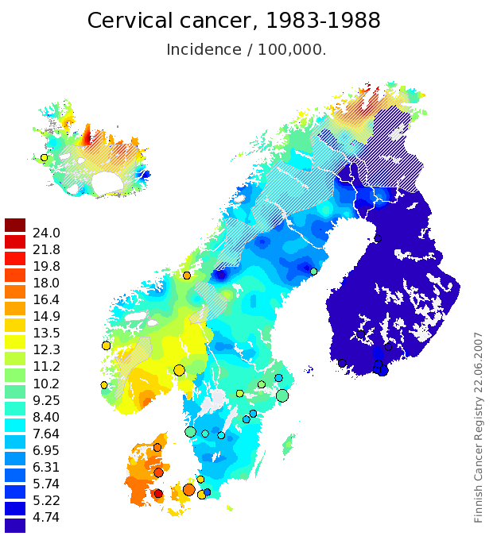
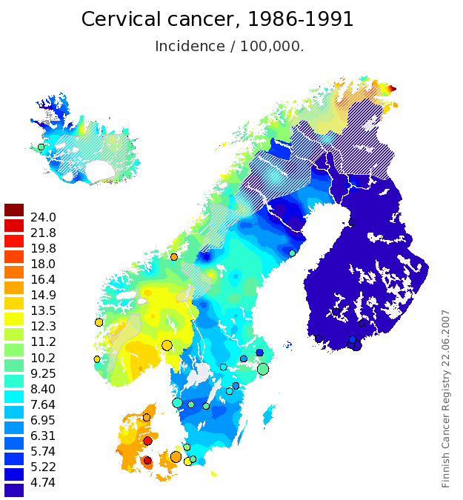
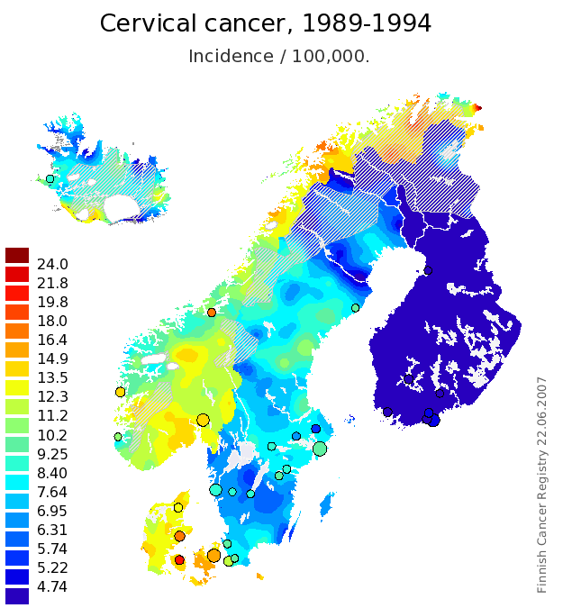
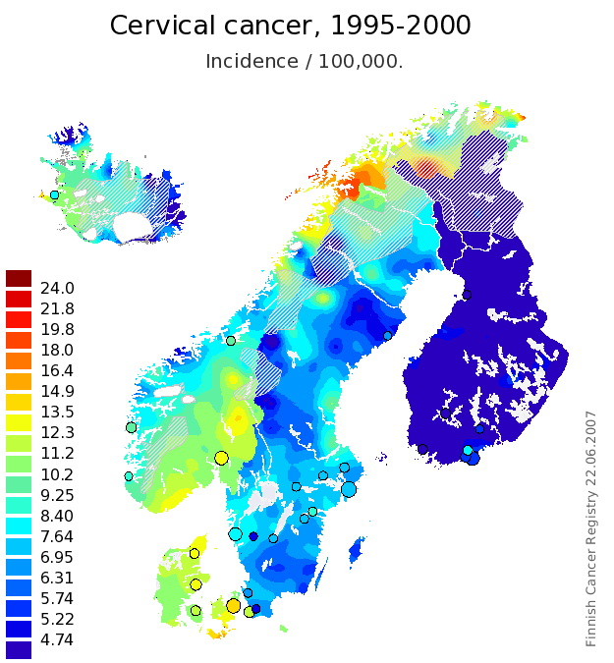
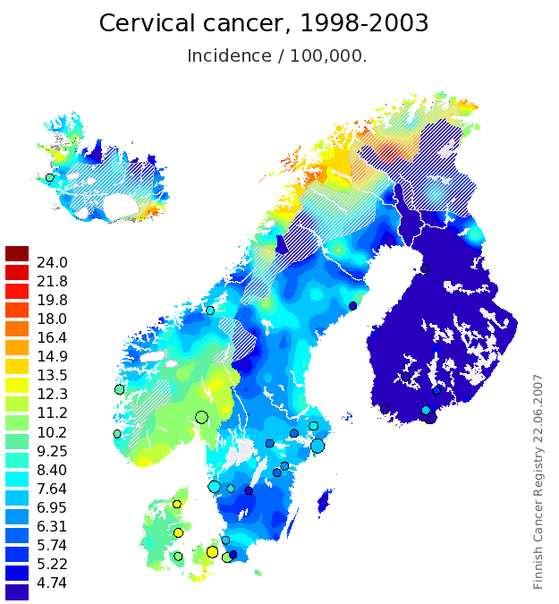
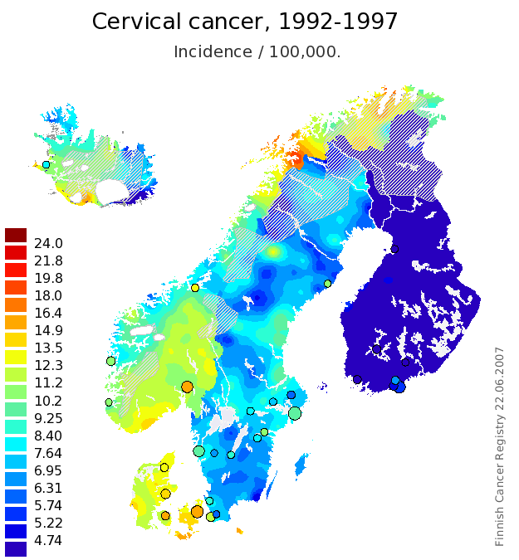
Case Study - Finland

Slide 12
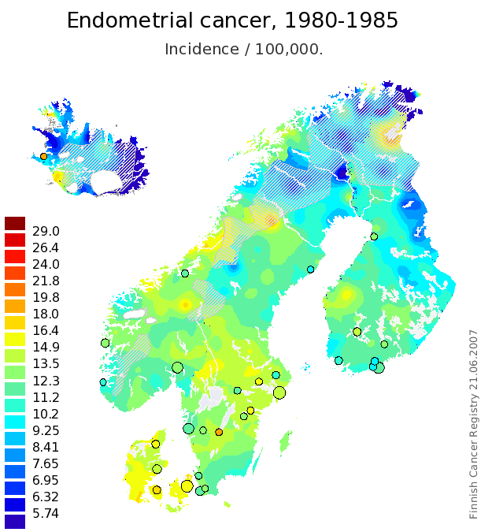
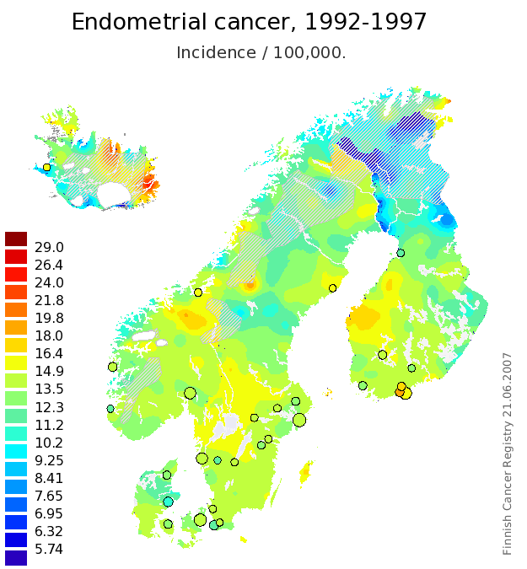
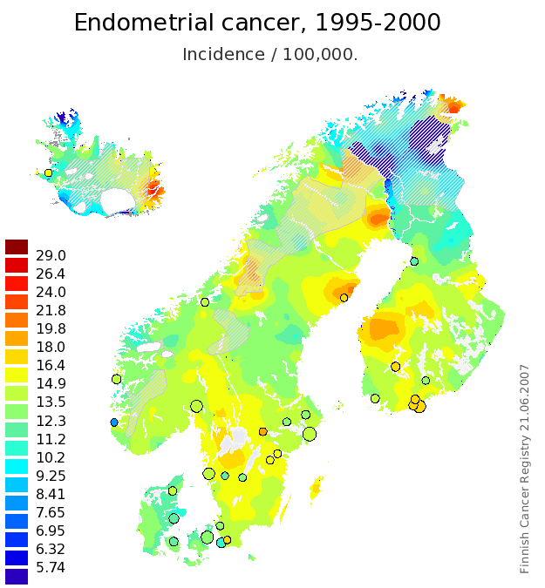
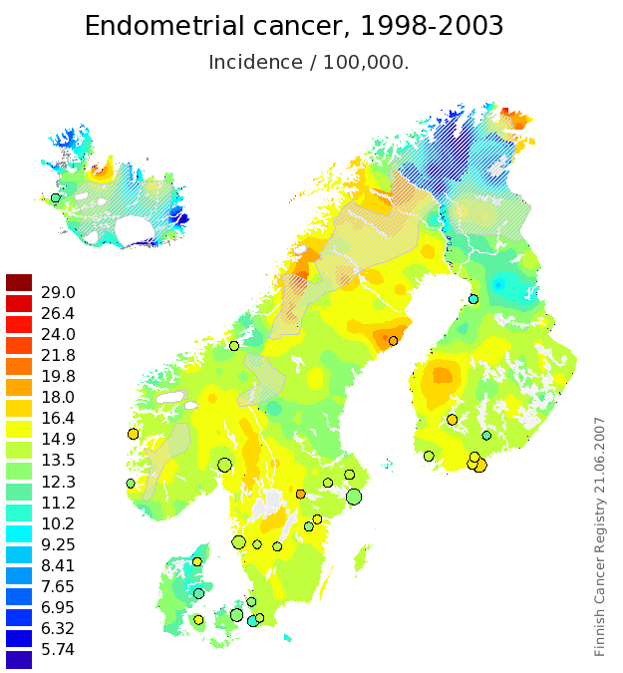
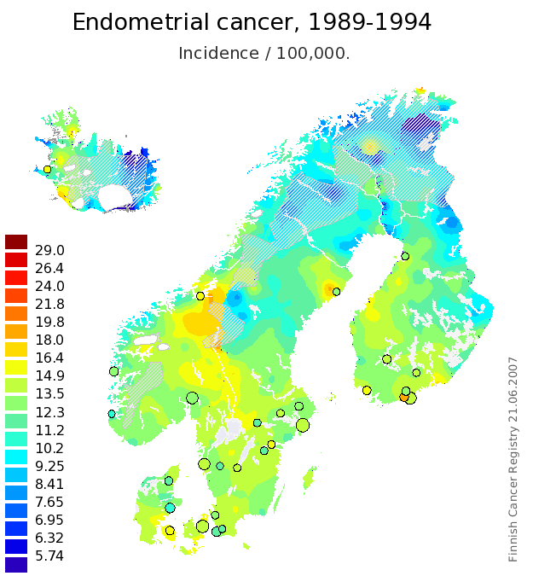
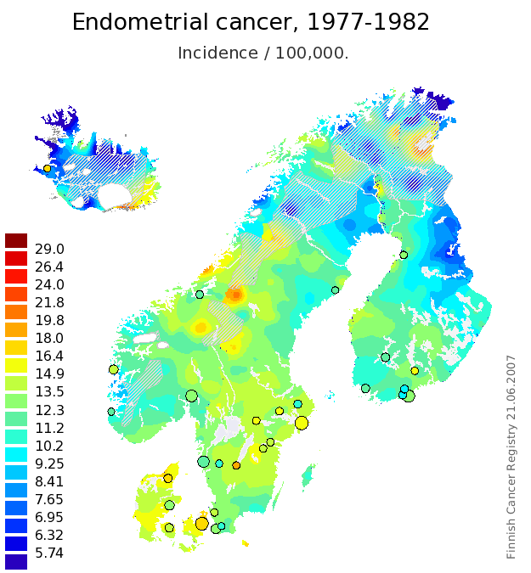
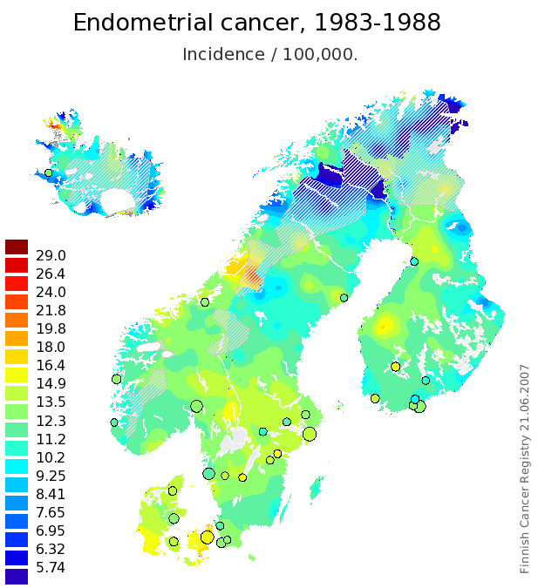
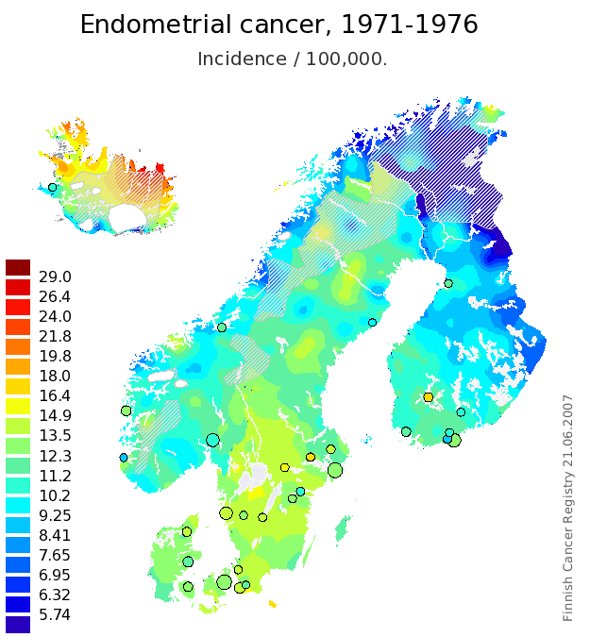
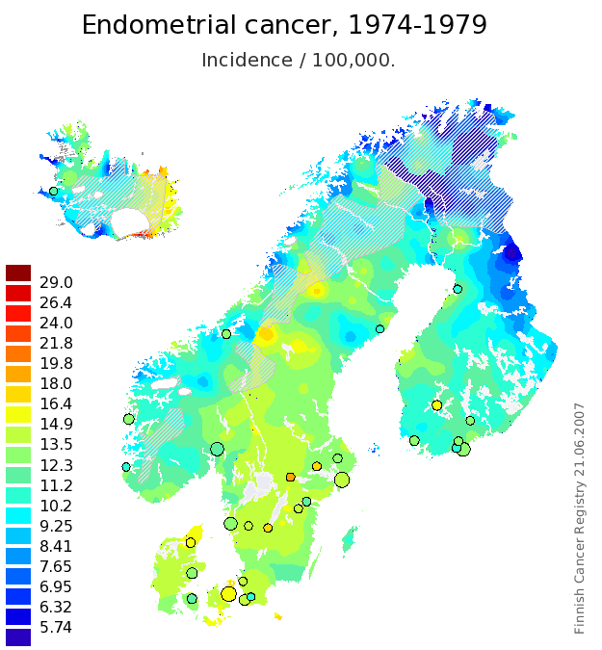
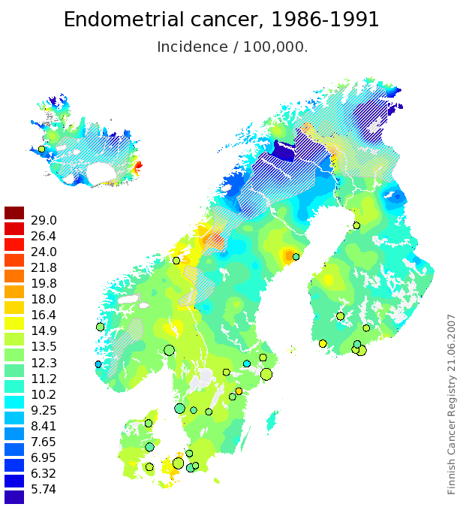
Case Study - Finland

Slide 13
Case Study - USA
Age adjusted incidence rate out of 100000 people per year based on races in USA, 2005-2009 from 18 SEER regions

Slide 14
Case Study - USA
Age adjusted mortality rate out of 100000 people per year based on races in USA, 2005-2009 from 18 SEER regions

Slide 15
Case Study - USA

Slide 16
Case Study - USA
Death rate of cervix uteri for black Americans is twice the amount of white Americans.
White women have a higher chance in Corpus and Uterus cancer in compare to black Americans but their mortality risk is less that black women.
Based on the rate from 2007-2009, 41.24% of men and women born today in America will be diagnosed with cancer at some time during their lifetime (given by seer).

Slide 17
Success Criteria
“If some set of rules prove the validity of the dataset by showing pre-known statistical facts, achieving secondary rules that show a relation between race or lifestyle with some type of women’s cancer, indicate the success of the ongoing project”

Slide 18
Application
Understanding more about the effective factors on women cancer in Iran
Understand the relation between race and lifestyle factors with given cancer
Race | Origin | Destination | Description | Case
- | 1 | - | Vulnerability of all races in a specific environment to specific cancer | Environment (childhood)
- | - | 1 | Vulnerability of all races in a specific environment to specific cancer | Environment (adulthood)
1 | - | n | Vulnerability of specific race in all environment to specific cancer | Immigration
1 | - | - | Vulnerability of one race to specific cancer | Genetics
Any thing else |  |  | No relation found. | Project failed

Slide 19
Challenges
Little automation, everything hand written
Bureaucracy and paperwork
Afraid of giving data to foreign countries
Finding devoted friends to collect data.
No official statistics available in Iran
No access to early cases
Translation
Communication between analyst and expert

Slide 20
Data understanding
STEP 2

Slide 21
What is the Data?
Information comes from hospitals
Patient profiles
pathology tests
Each record is about one patient
Patient is a woman diagnosed by gynecological cancer
Information about the patient
Information on the cancer
Information on the treatment

Slide 22
Cancer Categories
Cervical Cancer | Uterus Cancer | Ovarian Cancer
Adenocarcinoma (butrioid) Clear cell Melanoma Squamous cell carcinoma Rabdomiosarcoma | Leiomyoma Leiomyosarcoma Endometrial adenocarcinoma Sarcoma post-menopausal AUB squamous cell carcinoma | Follicular cyst Luteal cyst Granulose cell tumor Thecaluteal cyst Serous cyst adenoma Serous cyst adenocarcinoma Mucinous cyst adenoma ucinous cyst adenocarcinoma Borderline tumor of ovary Serous Papillary Adenofibroma hemorrhagic luteal cyst stromal hyperplasia of ovary Peduncular Fibroid Tumor
Endometriosis Cancer

Slide 23
Feature groups
Data groups | Description
Personal Data | Information about the race, the place of birth and residence, and education and income.
Basic Medical Record | Data about general health condition and health stability
Family History | The occurrence of auto-immune diseases or cancer in relatives and family members
Past History | The occurrence of considerable diseases in the past history of the patient himself
Tumor Description | The tumor description comes from the pathology test as said before, and includes information about the size and shape of the tumor, the staging level, whether it’s benign o malignant, the consolidation, …
Women Issues | Healthcare procedures and tests that women should regularly take
Diagnosis | The information about the diagnosis of the cancer, the details of the tumor, and the treatment procedure

Slide 24
Features - Personal Data
# | Feature | Type
14 | Age | Numeric
15 | Height | Numeric
16 | Weight | Numeric
17 | BMI | Numeric
18 | Country of birth | Nominal
19 | City of birth | Nominal
20 | Country of residence | Nominal
21 | City of residence | Nominal
22 | Race (Origin) | Nominal
23 | Occupation | Nominal

Slide 25
Features - Basic Medical Record
# | Feature | Type
1 | Blood Group | Nominal
2 | Blood Pressure at the first visit | Numeric
3 | Blood Pressure in between treatment | Numeric
4 | Blood Pressure after treatment | Numeric
5 | Diabetes | Nominal
6 | Blood Sugar Concentration | Numeric
7 | Smoking or not | Nominal

Slide 26
Features - History
# | Feature | Type
14 | Family history of cancer | Nominal
15 | Family history of autoimmune diseases | Nominal
16 | Patient history of cancer | Nominal
17 | Patient history of autoimmune diseases | Nominal
18 | Previous medicine of patient | Nominal

Slide 27
Features – Women Issues
# | Feature | Type
26 | Marriage Status | Nominal
27 | Start of Sex | Numeric
28 | Start of Menstruation | Numeric
29 | End of Menstruation | Numeric
30 | No. of childbirth | Numeric
31 | No. of marriage | Numeric
32 | No. of pregnancy | Numeric
33 | No of sex partners | Numeric
34 | Has had women care | Nominal

Slide 28
Features - Pathology (Tumor Description)
# | Feature | Type
19 | Adherence | Ordinal
20 | Cell Differentiation | Ordinal
21 | Consolidation | Nominal
22 | Cystic/Solid | Nominal
23 | Shape of tumour | Nominal
24 | Size of tumour | Numeric
25 | Staging | Ordinal

Slide 29
Features - Diagnosis
# | Feature | Type
8 | Benign or Malignant | Nominal
9 | Count | Numeric
10 | Diagnosis | Nominal
11 | Result (success or not) | Ordinal
12 | Type of treatment | Nominal
13 | Medicine for treatment | Nominal
The colored ones are candidates for the label

Slide 30
Data Resources
Tabriz
Shahid Ghazi Tabatabai (done)
Mashhad
Imam Reza Hospital
Omid Hospital
Ghaem (A.J.) Hospital
Khoozestan
Golestan Hospital
Fars
Namazi Hospital
Esfahan
Shahid Beheshti (done)
Seyyed-al-Shohada (in process)
Imam Khomeini of Falavarjan (done)
Tehran
Hazrat-e-Rasool-e-Akram (in process)
Doctor Shariati (in process)
Ayatollah Taleghani
Imam Khomeini
Imam Hossein
Shahid Chamran
Shohada
I was supposed to get data for Turkey too, but the hospital did not give the data so I excluded Ankara and Turkey and made the project inclusive to Iran.

Slide 31
Validation of Sample Population
These 6 states have 50.77% of the total population of Iran (70M).
They are the biggest states and the remainder of the cities either don’t have oncology centers or their facilities is very limited
In practice (seen in our database), most people travel to these centers for treatment.
The other hospitals would probably have no available data.
Private hospitals are almost impossible to convince.
I have to prove this.

Slide 32
Data Collection Effort
Esfahan hospitals done by my mother (the expert).
Letter from Bilkent University by Dr. Guvenir.
Needs paper work and takes months to be approved
Enough for Tabriz by the help of Dr. Ghasemi Parvin (father of my friend)
Work done by friend of friend (Armin)
Letter from Iranian state university or any organization under the ministry of Science and Technology
Got letter by Sahand Khakaabi (PHD Student in Bioinformatics @ Tehran University and friend of friend)
Worked for 2 hospitals at Tehran by friend (Hossein Mahmoodi)
Others required the exact person to be present
Defined the whole project at the Institution of Research for Fundamental Sciences (IPM)
Supervisor is Dr. Mehdi Sadeghi (Uncle of a friend, Maziar Booali)
Started the work for others hospitals at Tehran and Mashhad
No result yet.

Slide 33
Cognitive Map – Part of
Occupation
G
Known rules
Used for validating results.
OC
P
Age
AB
Malignant
CC
D
AC
wCare
Success
MS
BP2
UC
BP3
Partners
PrevSur
PrevC
Smoking
Date
tSize
Staging
AD
PrevAI
PrevMed
BP1
Sur
FamilyC
BMI
FamilyD
Height
Weight

Slide 34
Missing Values
Up to now, 13.09%
Two different types of missing value.
Really missing
Missing because they did not exist.
Example: missing history means no history.
Each hospital has different policies.
In Falavarjan all cell differentiation is missing.
In Tabriz all BMI and blood group is missing.
Due to nature of treatment.
When radiotherapy, the tumor is likely to be unknown.
When uterus, there might be no tumor.
Tumors might be torn and so the size is missing.
Missing because I could not read the hand writing.

Slide 35
Noise
Doctors record what they think is valuable.
Entering by hand.
Error of measuring equipment.
Noise of measuring scale.
Too much data on unsuccessful treatments and less on easy ones because of the sensitive nature.
Incorrect data given by patient
Lying because of legal issues
Lying because of cultural issues
Cannot remember (Example: start of menstruation was given as 13-16 or normal).

Slide 36
Data Visualization - FamilyD and Race

Slide 37
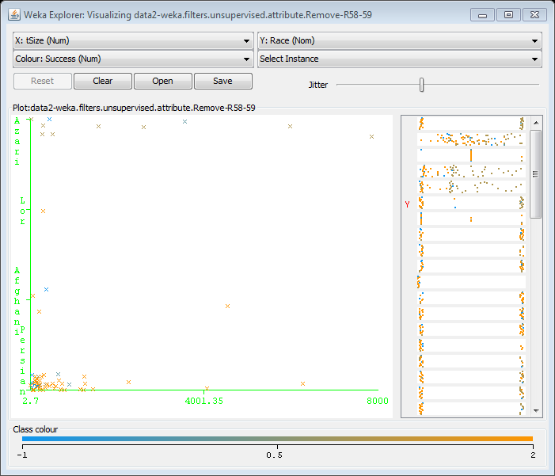
Data Visualization – tSize and Race

Slide 38
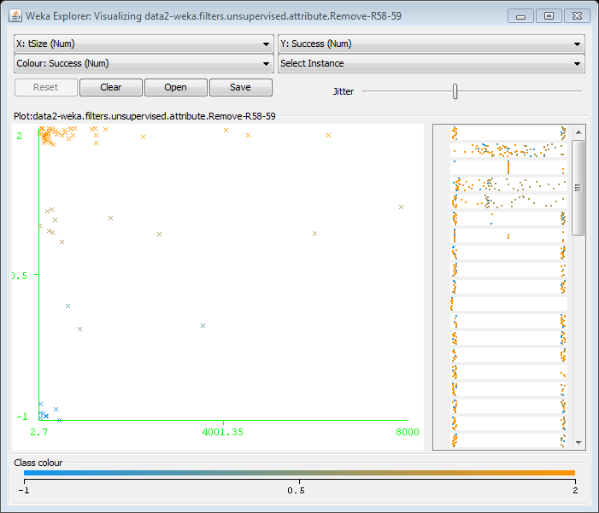
Data Visualization – tSize and Success

Slide 39
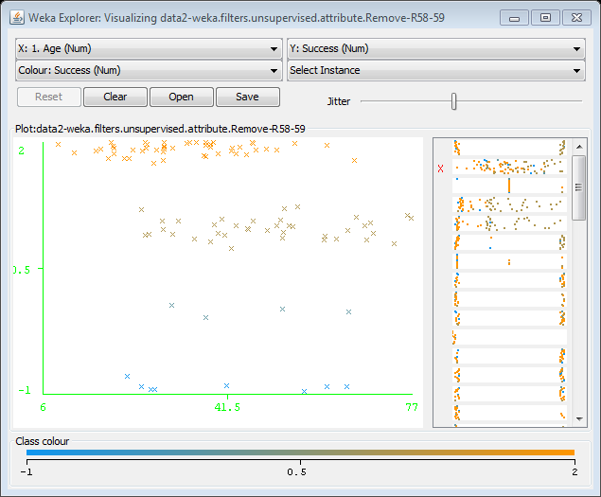
Data Visualization – Age and Success

Slide 40
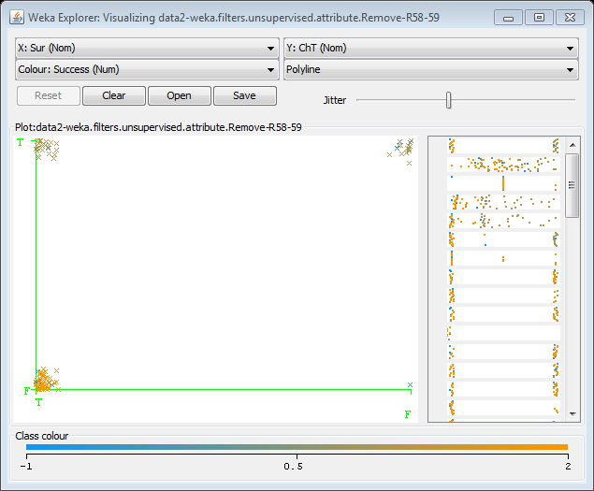
Data Visualization – Sur and ChT

Slide 41
Data Visualization - Age

Slide 42
Data Visualization - Year

Slide 43
Data Visualization - tSize

Slide 44
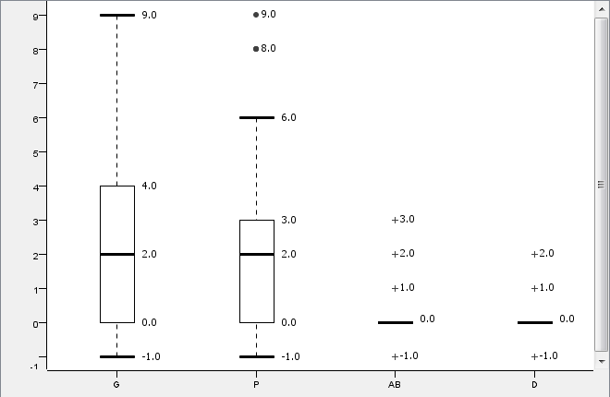
Data Visualization - Pregnancies

Slide 45
Correlation KNIME – T&F

Slide 46
Correlation Analysis - F

Slide 47
Correlation RapidMiner – T&F

Slide 48
Difficulties
Some hospitals are surgery ones and don’t perform other treatments.
Repetitive cases from different hospitals.
Different policies in each hospital (all values of one feature missing for one hospital).
Each hospital has a different period of data.
Lack of info for patients when the treatment was straight forward
Low number of cases.
The subject, legal and cultural issues.
Collecting data is very time consuming
Problems with reading handwritings
Entering the data by hand
The people who collect the data are not familiar with the domain.
Translation problem
Too many features and not enough records

Slide 49
Data preparation
STEP 3

Slide 50
1. Deleted Features
Some features were deleted because mostly missing.
Weight, Height, Shape of tumor, Start of Menstruation, Start of sex, Blood Sugar Concentration, Cell differentiation
Some were deleted because almost all were the same
Smoking (all negative)
Country of birth (all Iran except few Afghanistan)
Some were deleted because of repetitiveness
No. of partners, No. of marriages

Slide 51
2. Added Features
When going through the data some additional features were found.
No. of dead/live children (first 4 years) → Numeric
No. of abortions → Numeric
Site of cancer → Nominal
Abdomen, Right ovary, Left ovary, Pelvis, Uterus
Bleeding tissue (yes or no) → Nominal
Previous Surgeries → Numeric
Date of visit was broken to two features, month and year and day was excluded.
I added a state feature to indicate which hospital the data comes from to be able to study possible biased conclusions.

Slide 52
3. Changed types
BMI was changed from numeric to nominal. The values were replaced by low (0), normal (1), and high (2).
Adherence was changed to low (0), medium (1), and high (2) with loss of location.
Occupation was changed to stress level (SL)
sexStart was changed to low (<18), normal(18-30), high (>30)
Some features were broken into several true/false because one category or several might happen.
Diagnoses (OC, UC, EC, CC)
Benign/malignant (Benign, Malignant)
Treatment (Sur, Rat, ChT, Med)
Type of medicine for treatment (MedD, MedOC, …)
Solid/Cystic (Solid, Cystic)

Slide 53
4. Changed values
Where something was N/A and not missing, I places -1 to indicate its not applicable. Example: MenstruationE for a women who has not become menopause
Blood pressure was changes to 5 categories in order to reduce complexity and meanwhile keep details.
When there was several tumors I added up the volumes.
Category | High | Low
Hypotension | < 90 | < 60
Desired | 90–119 | 60–79
Prehypertension | 120–139 | 80–89
Stage 1 Hypertension | 140–159 | 90–99
Stage 2 Hypertension | 160–179 | 100–109
Hypertensive Crisis | ≥ 180 | ≥ 110

Slide 54
Checks to make
1. Check the logic of ages
If age < 40 then MenstruationE = -1
If age < 13 then MenstruationS = -1
Relation between true and false
If OC=T then leftOvary=T or rightOvary=T
If Med=F then MedD=F and MedOC=F

Slide 55
Strange values
Fix1: Tumor size was sometimes less than 10 and in some cases more than 10,000. I realized the measuring scale was not the same and went through all and corrected by the help of expert.
One patient has age of 6. But it was correct (germ cancer).
nTreat was less than 2 for Esfahan and about 5 and 6 for Ghazi Tabatabai. The explanation was that those who had surgery have 1-2 (Falavarjan is a surgery center) and those with radiotherapy or chemotherapy undergo treatment many times for a long time.
The success was -1 for many cases. That is radiotherapy and chemotherapy take several years to complete and our data is on the recent 5 years.
Fix2: Some menopause ages were less than 40. They meant i-years ago.

Slide 56
Strange values - Date
I wanted to delete month but then thought it might be interesting.
The months. But too soon to conclude. 100 records is not that much.

Slide 57
Strange values - Age
When comparing hospitals and case study results, Falavarjan has low age averages.

Slide 58
Summary
Several features very added.
Some were deleted.
Some were changed.
Starting with 42 features, we end up with 54.
I spent all my time to collect and prepare data.
Time consuming.
Need to go back to expert every time.
You can never understand the domain completely.

Slide 59
Modeling
STEP 4

Slide 60
Classification
First I will try to classify the data with three different targets.
Target = Cancer type
Target = Success
Target = Treatment
I will use a decision tree for this.
Each time I will use different columns (feature selecting).
With and without geographical features (state, race, birth, geo)
With and without site of cancer
With and without success

Slide 61
Association Rules
Create Association Rules
Check for pre-known rules
Check for new rules with race on one side
Found?
no
yes
Conf and support is high
yes
is conf and support high?
no
no
Success
Report to the expert
Fail

Slide 62
KNIME Model

Slide 63
Rapid Miner Model

Slide 64
RESULTS & Conclusion
STEP 5

Slide 65
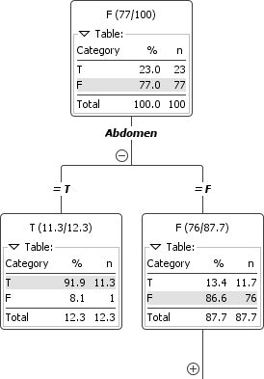
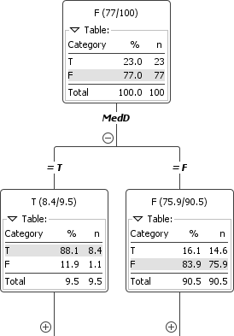
DT KNIME – Endometrioses Cancer
With site of cancer
Without site of cancer

Slide 66
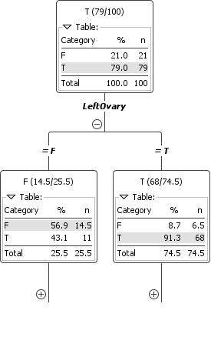
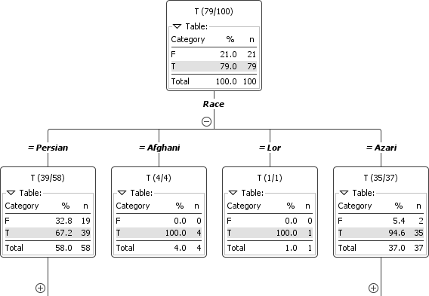
DT KNIME – Ovarian Cancer
With site of cancer
With race

Slide 67
DT KNIME – Success

Slide 68
DT Success – Rapid Miner

Slide 69
DT Success 3 levels Conf=0.25

Slide 70
DT Success 4 levels Conf=0.25

Slide 71
DT Success 5 levels Conf=0.50

Slide 72
Association Rules - KNIME
Then I will try to get some association rules.
KNIME:
Some meaningful rules:
Others were obvious.
Rule224 | 0.55 | 0.98 | 1.51 | PrevSur | <--- | [D, tSize, G]
Rule104 | 0.52 | 0.95 | 1.41 | tSize | <--- | [D, PrevSur, G, BP1H]
Rule122 | 0.53 | 0.85 | 1.32 | PrevSur | <--- | [tSize, SL]

Slide 73
Association Rules – Rapid Miner
Almost the same.
Other rules are the same.
INTERESTING:
Not useful!
Rule 165 | Race = Persian | D = 0 | 0.5 | 0.86 | 1.44 | 2.9
Rule 127 | PrevC = F, MS = M, Part = 1, Abdomen | RightOvary | 0.57 | 0.83 | 1.725

Slide 74
Conclusions
Not enough data.
Not reliable.
I need to collect more data.
Rapid Miner and KNIME show the same results so far.
Need to try other software.

Slide 75
FUTURE WORK
STEP 6

Slide 76
TO-DOs
I shall get more data and complete my dataset.
I should further understand the data and the outliers.
Complete the work as given in the model and look for some useful results.
Compare results to other countries
Try again for data from Istanbul.

Slide 77
Conclusion

Slide 78
Barriers and Tackles
“We are drowning in information and lacking knowledge.”
“Data is easy to collect.”
I think the longest and hardest work is the useful data collection.
Data is so unclean and hard to interpret. And after cleaning you see its not useful.
When using available datasets, acknowledge the effort one has gone through to collect it and now you have it for free.
Data is usually biased. People collect not everything but just what they need.
Communication is very important.
They don’t know what you need and you don’t know what they have.
You never know what you have! Never!
Get used to hearing “that’s not important” and ending up with lots of missing values.

Slide 79
Lessons Learnt
Medical information is very risky.
Do not choose medical cases.
If so, avoid middle eastern countries.
If so, make sure you have plenty of time and lots of friends.
If you have limited time, do not start ambitious big projects.
Never continue work when you are tired because you’ll end up re-doing.
Every change you make, keep a backup of previous version and write done the change.
Improve communication. Learn as much as you can before starting the work.
Having connections in the organization is very important.

Slide 80
Special thanks
Mohammad Siami
Hossein Mahmoodi
Armin
Behnam Ghasemi Parvin
Dr. Mehdi Sadeghi
Sahand Khakaabi
Maziar Booali
Maryam E. Rasekh
My mother
Dr. Guvenir

Slide 81
QUESTIONS

