Slide 1

Chapter 11
File Systems: Implementation
Bilkent University
Department of Computer Engineering
CS342 Operating Systems
Last Update: April 20, 2017

Slide 2
Objectives and Outline
Objectives
To describe the details of implementing local file systems and directory structures
To describe the implementation of remote file systems
To discuss block allocation and free-block algorithms and trade-offs
Outline
File-System Structure
File-System Implementation
Directory Implementation
Allocation Methods
Free-Space Management
Efficiency and Performance
Recovery
NFS
Example: WAFL File System

Slide 3
File System Design
File System Design Involves
  1) Defining File System Interface
    How file system looks to the user
    What is a file and its attributes
    What are the operations
    (logical) directory structure that can be used to organize files
  2) How that file system can be implemented
    Design algorithms
    Design data structures (in-memory and on-disk data structures)
    Map logical file system to physical storage device (disk, tape, etc.)

Slide 4
File System Structure - Overview
File
  Logical storage unit
  Collection of related information
File system organized into layers
File system structures and data reside on secondary storage (disks)
  Provides efficient and convenient access to disk by allowing data to be stored, located and retrieved easily
  Can also sit on another media (USB disk, CD-ROM, etc.). Usually need a different file system
File control block – storage structure consisting of information about a file
  File attributes are here
Device driver controls the physical device

Slide 5
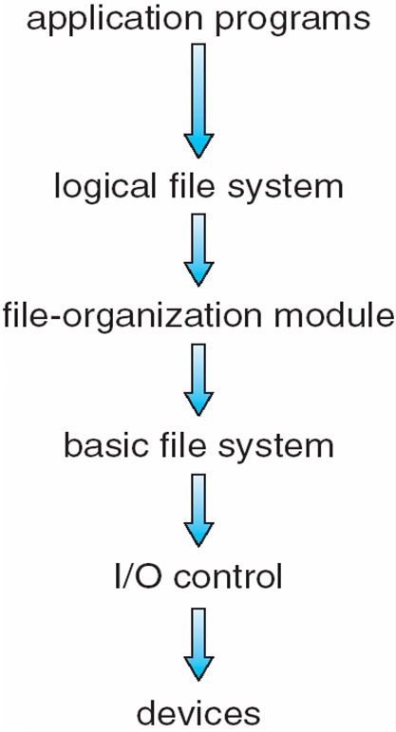
Layered File System
File System
device drivers
device controller
device (e.g., hard disk)

Slide 6
Layering File System
Processes
fd = open (f, ..)
read (fd, buf, n);
write (fd, buf, n);
close (fd);
…
Logical File
System
Layer
search directory; find file location
on disk; access file
attributes; access check; …
file offset (p) and bytes (n) to read/write
file_start block on disk
File
Organization
Layer
map requested file bytes
(logical addresses)
to disk blocks (physical blocks)
Mapping from logical to physical
physical (disk) blocks number's
Basic File
System
Layer
issuing block requests;
buffering of currently
accessed data;
caching of disk blocks
Buffer
Cache
(can we satisfy from cache?)
If not, request block
Disk Driver

Slide 7
Layered Software
Processes
read file f, write file f, ..
File System Calls
(operation will be at offset p, n bytes)
File System
find file info for f
(f, p, n) → disk block numbers
Kernel
Mode
Software
write disk block x, ..
read disk block x, …
Disk Driver
[cylinder#, track#, sector#], operation code: R,W
Disk Controller
Hardware
Disk
cylinders, tracks, sectors

Slide 8
Layered Software
Processes
User’s (process’s) view of files
File System Calls
File 1
File 2
File System
map files to disk blocks …
0
1
2
3
4
5
map disk block number
to physical
disk address
(cyl#,track#,
sector#, etc)
file system’s view of the disk
Disk Driver
disk driver will know the disk geometry
and map the disk blocks to disk sectors with a
quite simple mapping
Disk Controller
cylinders,
tracks,
sectors
0
1
2
3
4
5
Disk
Sectors
6
7
8
9
10
11

Slide 9
Disk Driver: Mapping disk blocks to physical disk sectors
Block size is a multiple of sector size.
Example: sector size can be 512 bytes; block size can be 1024 bytes,
or 4096 bytes.
disk blocks (physical blocks)
0
1
2
3
4
5
file system’s view of the disk
Disk Driver
Disk Controller
cylinders,
tracks,
sectors
0
0
1
2
3
4
2
1
5
Sectors
Disk
6
3
7
8
4
9
10
5
11

Slide 10
Example mapping files to blocks and sectors
Processes
User’s (process’s) view of files
File System Calls
File 1
File 2
File System
map files to blocks + …
0
1
2
3
4
5
file system’s view of the disk
Disk Driver
Disk Controller
cylinders,
tracks,
sectors
0
1
2
3
4
5
Disk
Sectors
6
7
8
9
10
11

Slide 11
File System Implementation
Major On-disk Structures and Information
  Boot control block contains info needed by system to boot OS from that volume
  Volume control block contains volume details (superblock)
  Directory structure organizes the files
  Per-file File Control Block (FCB) contains many details about the file
info about a file and its location on disk
partition (volume) starts
Pointers to FCBs
Boot
Control
Block
Volume
Control
Block
Directory
Structure
File Control Blocks
(FCBs)
(filename to FCB mapping)
(i.e. superblock)

Slide 12
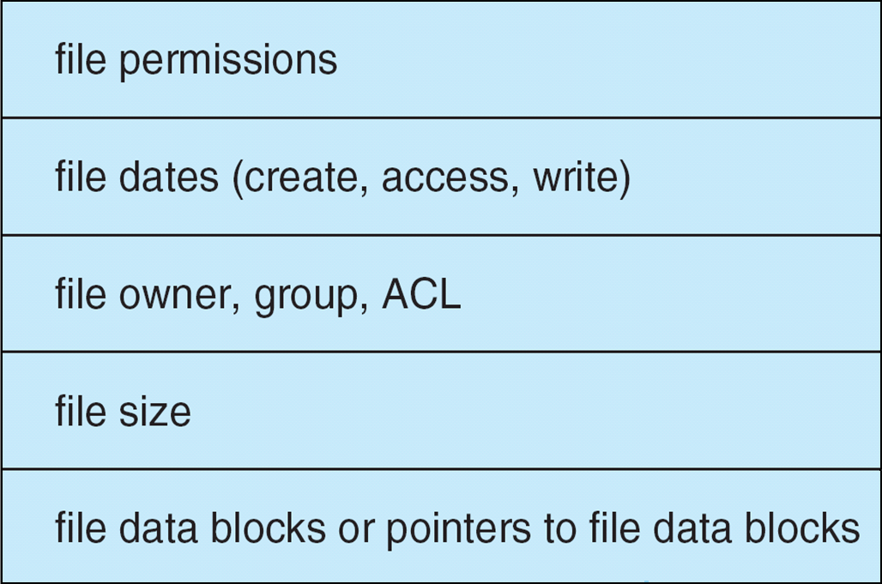
A Typical File Control Block
Filename=X
info about locating the FCB
directory entry
File Control Block of a file with filename X
File Data Blocks of X

Slide 13
File Types
Various things can be considered as files:
  Regular files
    The ascii files (text files) we use, binary files, .doc files, .pdf files, executable files, etc.
    Some programs can look to them and understand what they are. They store content
  Directories
    A file can store directory information. Hence directories can be considered as special files (in some systems like Linux).
    We will have a file control block for such a file as well.
  Device files
    We can refer to devices in the system with files.
    Device file “/dev/sda5” may refer to a hard disk partition.
    “/dev/fd0” may refer to floppy disk. “/dev/cdrom0” may refer to CDROM.
  …

Slide 14
In Memory File System Structures
There are also in-memory structures used by the file system
While files are opened and used, file system (kernel) keeps information in memory
  Information about file is brought from disk into memory
  They are put into in-memory (data) structures
Some of these structures are:
  Directory entry
  FCB
  Per process open file table entry (file descriptor points to this)
    fd = open(filename, …)
  Data blocks cached
    In “buffer cache” in memory
File entry
File entry
fd
File entry
per process open file table

Slide 15
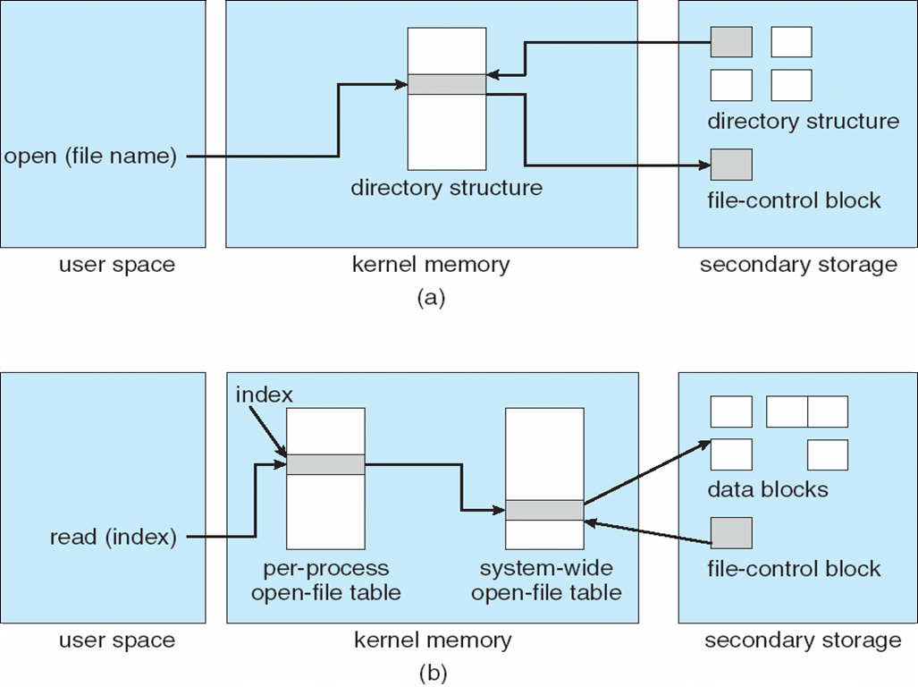
In-Memory File System Structures
opening a file
with filename
reading a file
file file descriptor
(file handle)

Slide 16
Virtual File System
Virtual File System (VFS) provides an object-oriented way of implementing file systems.
Many many files systems exist
  NTFS, Linux FS (ext3), CDROM fs, FAT32 …
VFS allows the same system call interface (the API) to be used for different types of file systems.
The API is to the VFS interface, rather than any specific type of file system.
  This can be a POSIX system call interface
User Programs
VFS Interface to Users
VFS
VFS Interface to FSs
FS1
FS2
FS3
Disk

Slide 17
Virtual File System
VFS has also an interface to file systems (concrete file systems)
  This is called VFS interface
  To local (e.g., NTFS) or remote file systems (e.g., NFS)
A concrete file system should provide functions developed according to the VFS interface (i.e., it should support functions defined in the VFS interface so that VFS layer can call those functions)
VFS implements the common file system operations that are independent of any specific/concrete file system

Slide 18
Virtual File System
Processes
POSIX system call interface for files
Virtual File System
a concrete
file system
VFS interface
File System
Type 1
File System
Type 2
File System
Type 3
(a remote FS)
disk
disk
Network

Slide 19
Directory Implementation
How a directory (i.e., subdirectory, or folder) is implemented (stored in disk)?
  Some alternatives: 1) linear list; 2) hash table
Linear list of file names with pointers to data blocks
(i.e, linear list of entries).
  simple to program
  time-consuming to execute
  (search takes time)
Hash Table – linear list with hash data structure.
  decreases directory search time
  collisions – situations where two file names hash to the same location
  fixed size

Slide 20
Directory Implementation: directory entries
games
attributes
games
mail
attributes
mail
news
attributes
news
work
attributes
work
a directory with fixed sized entries
attributes include location
info for data blocks
of the file
FCB containing attributes
Using fixed sized names

Slide 21
Directory Implementation: handling long filenames
File 1 entry length
Point to File1 name
entry
for
one
file
File 1 attributes
File 1 attributes
p
r
o
j
Point to File3 name
e
c
t
-
File 1 attributes
file 1 name
b
u
d
g
e
t
\0
Point to File3 name
File 2 entry length
File 1 attributes
File 2 attributes
p
r
o
j
p
e
r
s
e
c
t
-
o
n
n
e
b
u
d
g
l
\0
e
t
\0
p
…..
e
r
s
o
File 3 entry length
File 3 attributes
n
n
e
l
\0
f
o
o
f
o
o
\0

Slide 22
Allocation Methods
An allocation method refers to how disk blocks are allocated for files:
  Allocation of disk space to files
    Deciding where the file content will sit on disk
  Keeping track the disk blocks allocated to files
FILE CONTENT
A file is viewed as a sequence of logical blocks (data blocks)
Mapping ???
A disk is viewed as a sequence of physical blocks
DISK

Slide 23
Allocation methods
There are 3 general methods.
  Contiguous allocation
  Linked allocation
  Indexed allocation

Slide 24
Contiguous Allocation
Each file occupies a set of contiguous blocks on the disk
Simple – only starting location (block #) and length (number of blocks) are required to find out the disk data blocks of file
Random access is fast
Wasteful of space (dynamic storage-allocation problem) (external frag.)
Files cannot grow
file data
Start address = 6
Number of blocks = 4
disk blocks (physical blocks)
0
1
2
3
4
5
6
7
8
9
10
11
0
Notes:
24

Slide 25
Example
offset
0
File X
offset
File X: start=6, size_in_disk_blocks=4
0
File Y: start=2, size_in_disk_blocks=3
File Y
disk blocks (physical blocks)
0
1
2
3
4
5
6
7
8
9
10
11

Slide 26
Contiguous Allocation
LA: logical address into a file: file offset (i.e. address of a byte in file)
(first byte has address 0)
Mapping from logical (file) address to physical (disk) address (mapping algorithm):
Q = LA div DiskBlockSize
LA/DiskBlockSize
R = LA mod DiskBlockSize
  Disk Block to be accessed = Q + starting disk block number (address)
  Displacement into disk block = R
Notes:
26

Slide 27
Example
Assume block size = 1024 bytes
Which disk block contains the byte 0 of file X (LA = 0)? What is the displacement inside that block?
  Answer : disk block = 6, displacement (disk block offset) = 0
Which disk block contains the byte at LA (at file offset) 2500? In other words,
where is LA 2500 mapped in disk?
Answer: 2500 / 1024 = 2; 2500 % 1024 = 452
disk block = start address + 2 = 6 + 2 = 8
displacement in block = 452
0
2500
File X
disk blocks (physical blocks)
0
1
2
3
4
5
6
7
8
9
10
11

Slide 28
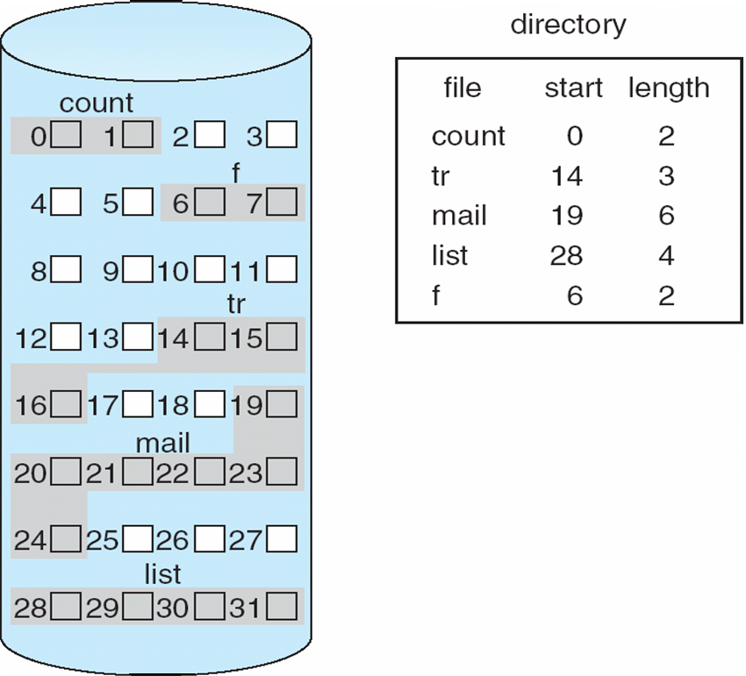
Contiguous Allocation of Disk Space
Notes:
28

Slide 29
Extent-Based Systems
Many newer file systems (i.e, Veritas File System) use a modified contiguous allocation scheme
Extent-based file systems allocate disk blocks in extents
An extent is a contiguous blocks of disk
  Extents are allocated for a file
  A file consists of one or more extents
  A file may start with a single extent.
Linux ext4 filesystem is also using extents.
Notes:
29

Slide 30
Linked Allocation
Each file is a linked list of disk blocks: blocks may be scattered anywhere on the disk.
pointer
(to the next block
allocated to the
file X)
block structure
Pointer
data
DiskBlockSize
(power of 2)
DataSize
file data
File data size in a disk block is no longer a power of 2
Notes:
30

Slide 31
Linked Allocation
File X
File starts at disk block 5
pointer
disk blocks (physical blocks)
0
1
2
3
4
5
6
7
8
9
10
11
8
3
10
data

Slide 32
Linked Allocation (Cont.)
Simple – need only starting address
Disk space is used efficiently- no waste of space (no external fragmentation)
No random access (random access is not easy)
Mapping Algorithm:
Q (integer division result: quotient)
Logical Address (LA) / (BlockSize-PointerSize)
R (remainder)
  Block to be accessed = the Qth disk block in the linked chain of
  disk blocks representing the file.
  Displacement into disk block = R + PointerSize
Notes:
32

Slide 33
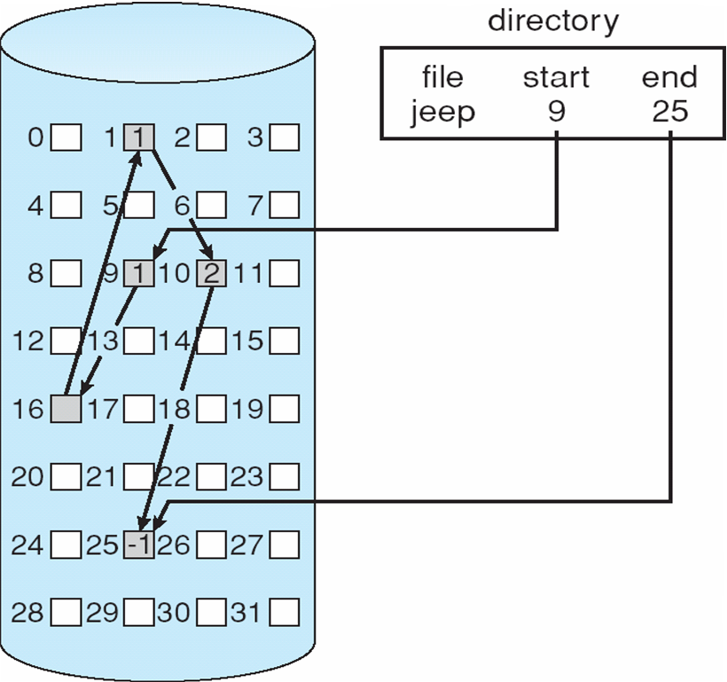
Linked Allocation
Notes:
33

Slide 34
Linked Allocation: Example
Assume block size = 1024 bytes
Pointer size if 4 bytes
Assume we have a file that is 4000 bytes.
File data is place as below to the disk blocks; file starts at disk block 5
0
1
2
3
4
5
6
7
8
9
10
11
8
3
10
1
0
2
3
Find out the disk location corresponding to file offset (LA) 2900?
Go to the 2nd block in the chain
2900 / (1024-4) = 2
2900 % 1020 = 860
Second block in chain is disk block 8
Displacement is 860+4 = 864

Slide 35
Linked Allocation: Another Example
We have a file that is 3000 bytes long.
Disk block size = 512 bytes; pointer size = 4 bytes.
We want to access bytes 1000 through 2500 of the file.
Which disk blocks should be retrieved?
file
0
1000
2500
2999
1000/508=1; 1000%508=492
2500/508=4; 2500%508=468
Logical(relative) blocks to access: 1, 2, 3, 4
access this region
File starts here
0
1
2
3
4
5
6
7
8
9
10
11
5
9
-
10
3
1
4
Disk
3
1
6
4
0
2
5
Answer: Disk Blocks 3, 9, 1, 5

Slide 36
File Allocation Table
File-allocation table (FAT) – disk-space allocation used by MS-DOS and OS/2 operating systems
Pointers (i.e., disk data blocks numbers) are kept in a table (FAT)
Data Block does not hold a pointer; hence data size in a disk block is a power of 2.
FAT16, FAT32 file systems are using this.
FAT is also used for free space information.

Slide 37
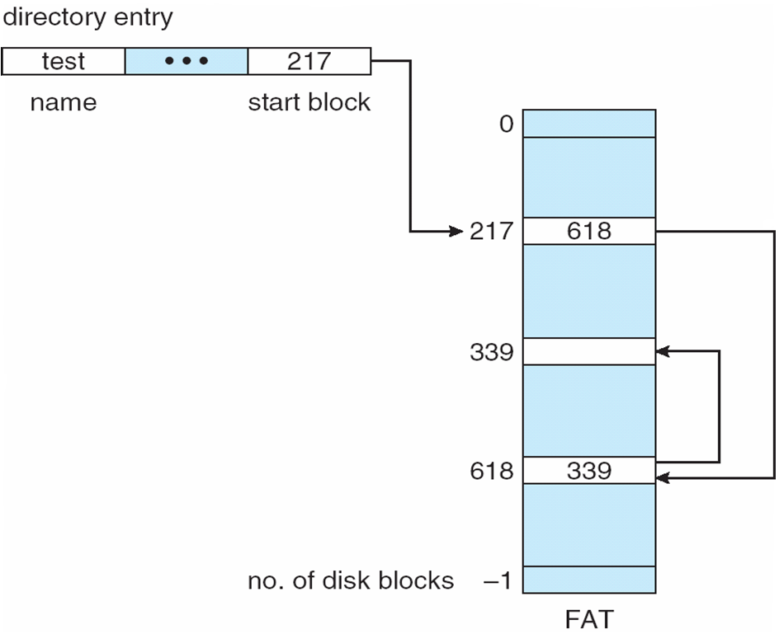
File-Allocation Table
Notes:
37

Slide 38
Linked Allocation: an enhancement
A set of contiguous blocks can be considered together
  Called Cluster
Allocation unit is now a cluster
Less space wasted due to pointer in a block (in a cluster)
Faster random access (more efficient)
Beginning of a cluster has information about the next cluster
Two clusters de not have to be next to each other.

Slide 39
Indexed Allocation
Brings all disk pointers (pointing to data blocks) together into the index block
Logical view
Disk Block Number
(physical block number)
0
1
2
Hence this is the
address (number) of block
3
index table
Disk
Data
Blocks
Index of blocks allocated to file
(logical block number)
Notes:
39

Slide 40
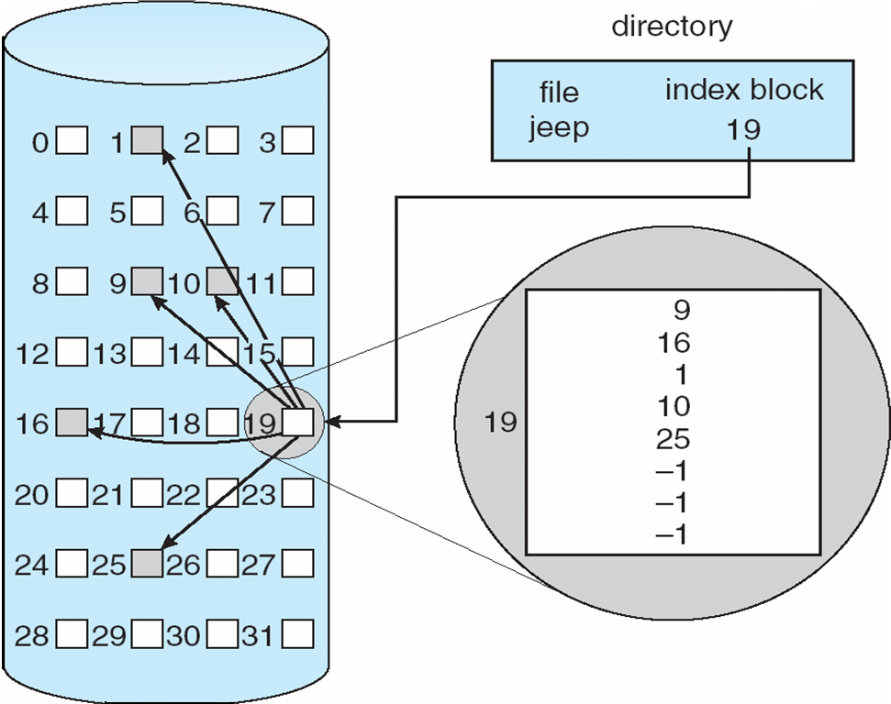
Example of Indexed Allocation
Notes:
40

Slide 41
Indexed Allocation (Cont.)
Need index table to be stored in disk
  in one or more disk blocks that can be called as index blocks
Random access can be fast
No external fragmentation, but have overhead of index block
Mapping Algorithm:
Q
LA/BlockSize
One block = 512
words
R
Q = displacement into index table (logical block number)
R = displacement into block (offset)
pointer size is 1 word
For larger files, we need other index blocks
Notes:
41

Slide 42
Indexed Allocation (Cont.)
The index table size depends on:
  How many disk blocks are allocated for the data (contents) of the file (file size)
  The size of a disk block number (disk block address)
    i.e. the size of a pointer
Example:
  Assume block size is 4 KB.
  Assume pointer size if 4 Bytes. (that means each disk block address/number is 4 bytes)
  Then a disk block can store an index table of size at most: 4 KB / 4 B = 1024 entries.
  Such a disk block containing an index table (or portion of the table) can be called as index block (not data block).

Slide 43
Indexed Allocation (Cont.)
If index table can not fit into a single block, we can use multiple index blocks and chain them together.
Linked scheme – Link blocks of index table (no limit on file size)
one index block
pointers to
data blocks
pointers to
data blocks
…
…
…
pointer to (address/number of) the
next index block
Index block 0
Index block 1
Index block n-1

Slide 44
Indexed Allocation – Mapping (Cont.)
Mapping from logical addresses to physical addresses in a file of unbounded length?
Assuming: block size is 512 words and 1 pointer occupies 1 word).
Mapping algorithm:
Q₁
LA / (512 x 511)
R₁
  Q₁ = index block relative place
  R₁ is used as follows:
Q₂
R₁ / 512
R₂
  Q₂ = displacement into the index block
  R₂ displacement into block of file:
Notes:
44

Slide 45
Indexed Allocation – Mapping (Cont.)
one index block
512 addresses
pointers to
data blocks
pointers to
data blocks
…
…
…
pointer to (address of) the
next index block
In an index block, 511 addresses are for data blocks.
Each data block is 512 words.
Hence, an index block can be used to map (511x512) words of a file

Slide 46
Index allocation
Hierarchical index allocation
  Use a hierarchy of index blocks.
  Two-level, three-level hierarchies possible
  Two level index; three-level index

Slide 47
Indexed Allocation – Mapping (Cont.)
Two-level index
inner index table
Data
block
….
pointer to
outer index table
(keep in FCB
for the file)
Data
block
inner index table

….
Data
block
inner index table
….
outer-index
index table
file
Notes:
47

Slide 48
Indexed Allocation – Mapping (Cont.)
Two-level index (maximum file size is 512³ words assuming a block is 512 words and a pointer is 1 word).
Mapping algorithm (assuming a block contains 512 pointers):
Q₁
LA / (512 x 512)
R₁
  Q₁ = displacement into outer-index
  R₁ is used as follows:
Q₂
R₁ / 512
R₂
  Q₂ = displacement into block of index table
  R₂ displacement into block of file:
Notes:
48

Slide 49
Example
Index table for a file is given below.
Block size is 4KB.
Disk pointer (address size) is 4 bytes.
data block
0
340
Block
340
1
121
…
0
77
Block
121
1
89
1023
156
inner index block
(block 77)
Block
156
1023
outer
index
block
0
432
…..
1
610
….
1023
inner index block
(block 89)

Slide 50
Example
Where is file offset (logical address) 5000?
  5000 / (1024 x 4096) = 0
  5000 % (1024 x 4096) = 5000
  5000 / 4096 = 1
  5000 % 4096 = 904
  So it is on disk block 121 (follow outer table entry 0 and then inner table entry 1) and in that block displacement is 904.

Slide 51
Example
Where is file offset 4198620?
  4198620 / (1024 x 4096) = 1.
  Go to index 1 of outer table. That gives inner index table address: 89;
  Go to that inner index table (block).
  4198620 % (1024 x 4096) = 4316.
  4316 / 4096 = 1
  Go to index 1 in the inner table. There is the data block address: 610.
  Get that data block.
  4316 % 4096 = 220. displacement is 220

Slide 52
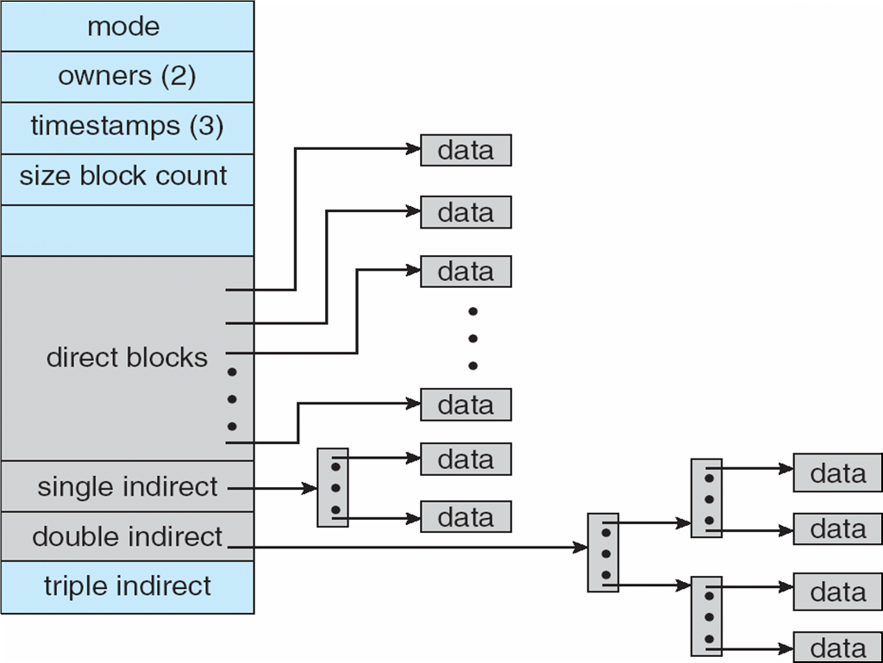
Combined Scheme: UNIX UFS (4K bytes per block)
Index allocation scheme combining many levels
One level index
Two-level index
Three-level index
Notes:
52

Slide 53
Free Space Management
How can we keep track of free blocks of the disk?
  Which blocks are free?
We need this information when we want to allocate a new block to a file:
  allocate a block that is free.
There are several methods to keep track of free blocks:
  Bit vector (bitmap) method
  Linked list method
  Grouping
  Counting
FAT can itself show free blocks.

Slide 54
Free-Space Management:
Bit Vector (Bit map)
We have a bit vector (bitmap) where we have one bit per block indicating if the block is used or free.
If the block is free the corresponding bit can be 1, else it can be 0 (or vice versa).
Example:
Disk Blocks
0
1
2
3
4
5
6
7
8
9
10
11
0000
1101
0110
BitMap
Used
1: free
0: used
free

Slide 55
Free-Space Management:
Bit Vector (Bit map)
Bit vector (n blocks in disk)
0
1
2
n-1
…
0 ⇒ block[i] used
1 ⇒ block[i] free
bit[i] =
(or vice versa)
0000000000000000
0000000000000000
0000000000000000
0000000010000000
0000000000000000
0000000000011000
0001100010000000
0000000011110000
Finding a free block (i.e. its number)
Start searching from the beginning of the bitmap:
Search for the first 1
First Free Block Number =
(number of 0-value words) * (number of bits per word)
+ offset of first 1-valued-bit
3x16+8 = 56
Notes:
55

Slide 56
Free-Space Management:
Bit Vector (Bit map)
Bit map requires extra space
  Example:
block size = 2¹² bytes
disk size = 2³⁰ bytes (1 gigabyte)
n = 2³⁰/2¹² = 2¹⁸ blocks exist on disk;
Hence we need 2¹⁸ bits in the bitmap.
That makes 2¹⁸ / 8 / 1024 = 32 Kbytes.
32 KB space required to store the bitmap
Easy to get contiguous files
Blocks of a file can be kept close to each other.
Notes:
56

Slide 57
Free-Space Management:
Linked List
Each free block has pointer to the next free block
We keep a pointer to the first free block somewhere (like superblock)
Features:
4
first free
0
1
2
3
4
5
6
7
8
9
10
11
7
9
5
10
-
used
Free blocks: 4, 7, 5, 9, 10

Slide 58
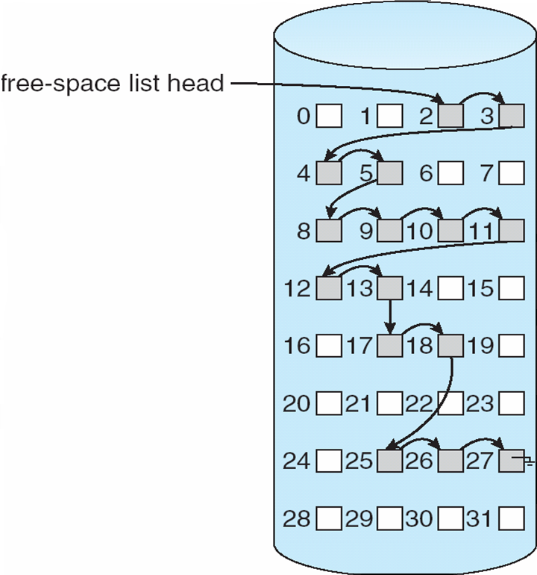
Free-Space Management:
Linked List
Linked list (free list) features:
  Cannot get contiguous
  space easily
  - No waste of space
Notes:
58

Slide 59
Free-Space Management:
Grouping
a disk block contains addresses of many free blocks
17
first free
82
53
276
127
251
362
215
25
23
26
130
300
-
Block 17
Block 130
Block 300
Free blocks are:
82 127 53 251 215 23 276 361 25 26
a block containing free block pointers will be free when those blocks are used.

Slide 60
Free-Space Management:
Counting
Besides the free block pointer, keep a counter saying how many block are free contiguously after that free block
contiguous chunk start address
count
[3, 2]
[7,3]
[11,1]
0
1
2
3
4
5
6
7
8
9
10
11
12
13
used
free

Slide 61
Free-Space Management (Cont.)
Need to protect:
  Pointer to free list
  Bit map
    Must be kept on disk
    Copy in memory and disk may differ
    Cannot allow for block[i] to have a situation where bit[i] = 0 (allocated) in memory and bit[i] = 1 (free) on disk
  Solution:
    Set bit[i] = 0 in disk
    Allocate block[i]
    Set bit[i] = 0 in memory
Notes:
61

Slide 62
Efficiency and Performance
Efficiency dependent on:
  disk allocation and directory organization and algorithms
Performance
  disk cache – separate section of main memory for frequently used blocks
  free-behind and read-ahead – techniques to optimize sequential access
  improve performance by dedicating section of memory as virtual disk, or RAM disk
Notes:
62

Slide 63
Page Cache
A page cache caches pages rather than disk blocks using virtual memory techniques
Memory-mapped I/O uses a page cache
Routine I/O through the file system uses the buffer (disk) cache
This leads to the following figure
Notes:
63

Slide 64
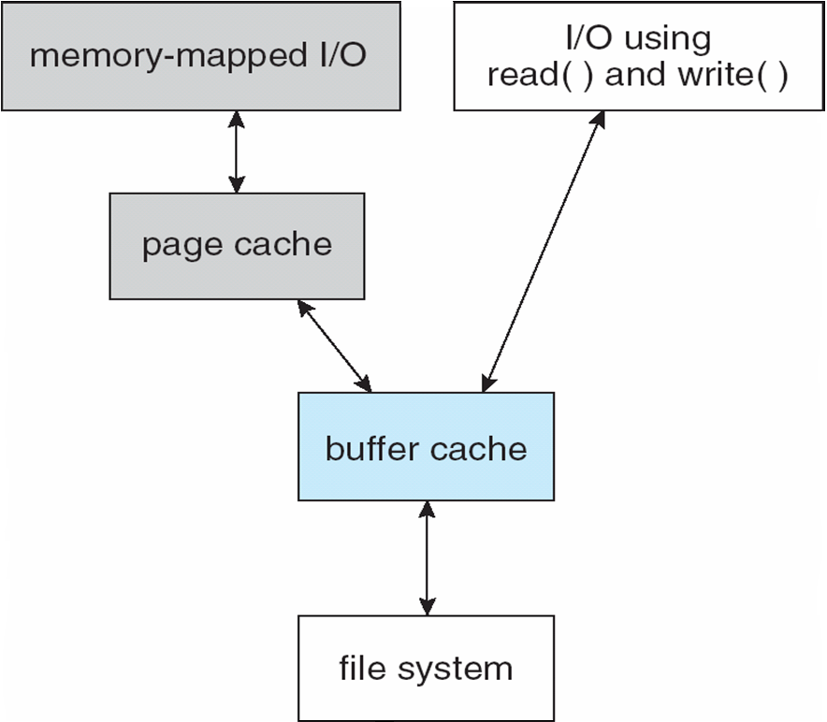
I/O Without a Unified Buffer Cache
Notes:
64

Slide 65
Unified Buffer Cache
A unified buffer cache uses the same cache to cache both memory-mapped pages and ordinary file system I/O blocks
Notes:
65

Slide 66
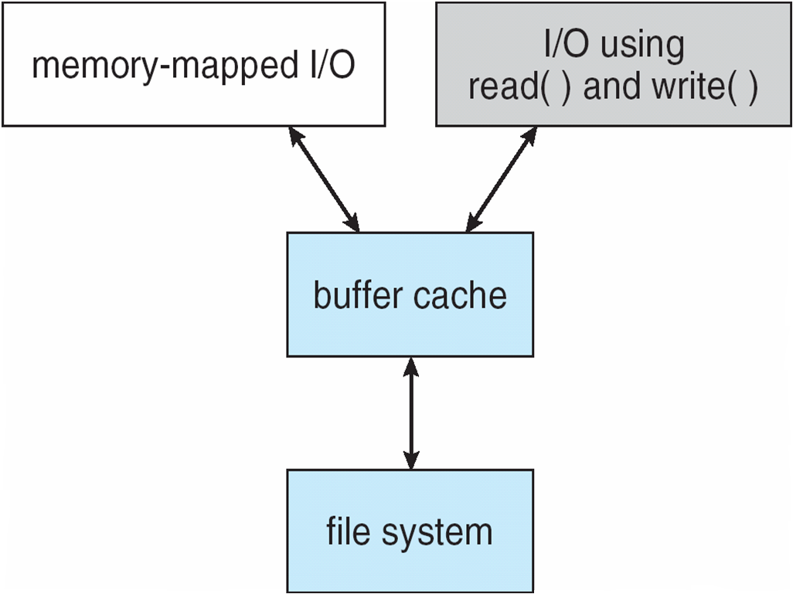
I/O Using a Unified Buffer Cache
Page cache
Notes:
66

Slide 67
Recovery
Power failure can happen ➔ inconsistency in disk (i.e., file system metadata on disk)
  Consistency checking – compares data in directory structure with data blocks on disk, and tries to fix inconsistencies
    is invoked after a power failure
Permanent file/disk failure ➔ disk lost
  Use system programs to back up data from disk to another storage device (magnetic tape, other magnetic disk, optical)
    Recover lost file or disk by restoring data from backup
      For example after a crash
Notes:
67

Slide 68
Journaling File Systems
Main Memory
Cached File System Metadata
File System Metadata
(inodes, directory entries, free list or bitmap,
Disk
Power failure or abrupt shutdown may happen at any time

Slide 69
Journaling File Systems
Example for a modification we can perform on the file system
We will remove a file; following operations (updates have to be made)
    1) Directory entry should be removed (or marked unused)
      Update directory entry on disk
    2) Inode must be marked as free (or removed)
      Update inode (or inode map) on disk
    3) Blocks pointed by inode must be de-allocated
      Added to the free list or bitmap
      Update bitmap on disk (or free list).
    While doing these sequence of operations, a power failure may happen and leave the disk structures in an inconsistent state. We need to recover from this kind of failures.
Solution: consider these operations as a transaction.

Slide 70
Journaling File Systems
A journaling file system records each file operation (modifying to file system metadata) as a transaction ( a sequence of operations to be done atomically: all or none)
All transactions are written to a log (on disk)
  A transaction is considered committed once it is written to the log
  However, the file system may not yet be updated
The transactions in the log are asynchronously executed on the file system
  When the file system is modified, the transaction is removed from the log
If the file system crashes, all remaining transactions in the log must still be performed
Notes:
70

Slide 71
The Sun Network File System (NFS)
A specification and an implementation of a software system for accessing remote files across a network
The implementation is part of the Solaris and SunOS operating systems running on Sun workstations using an unreliable datagram protocol (UDP/IP protocol and Ethernet)
Notes:
71

Slide 72
NFS (Cont.)
Interconnected workstations viewed as a set of independent machines with independent file systems, which allows sharing among these file systems in a transparent manner
  A remote directory is mounted over a local file system directory
    The mounted directory looks like an integral subtree of the local file system, replacing the subtree descending from the local directory
  Specification of the remote directory for the mount operation is nontransparent; the host name of the remote directory has to be provided
    Files in the remote directory can then be accessed in a transparent manner
  Subject to access-rights accreditation, potentially any file system (or directory within a file system), can be mounted remotely on top of any local directory
Notes:
72

Slide 73
NFS (Cont.)
NFS is designed to operate in a heterogeneous environment of different machines, operating systems, and network architectures; the NFS specifications independent of these media
This independence is achieved through the use of RPC primitives built on top of an External Data Representation (XDR) protocol used between two implementation-independent interfaces
The NFS specification distinguishes between the services provided by
  a mount mechanism, and
  the actual remote-file-access services
Notes:
73

Slide 74
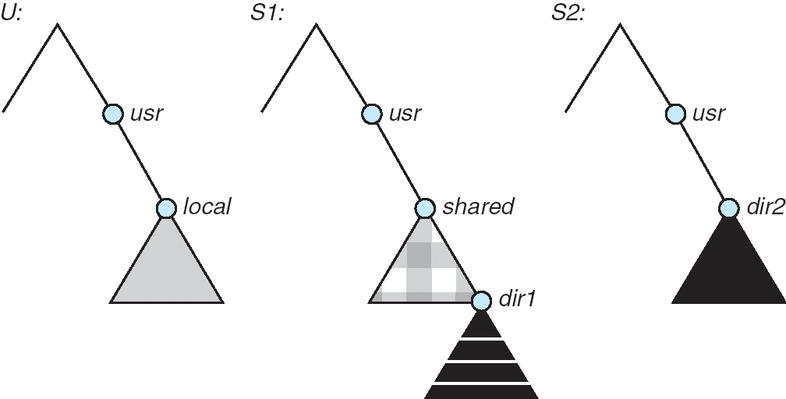
Three Independent File Systems
Notes:
74

Slide 75
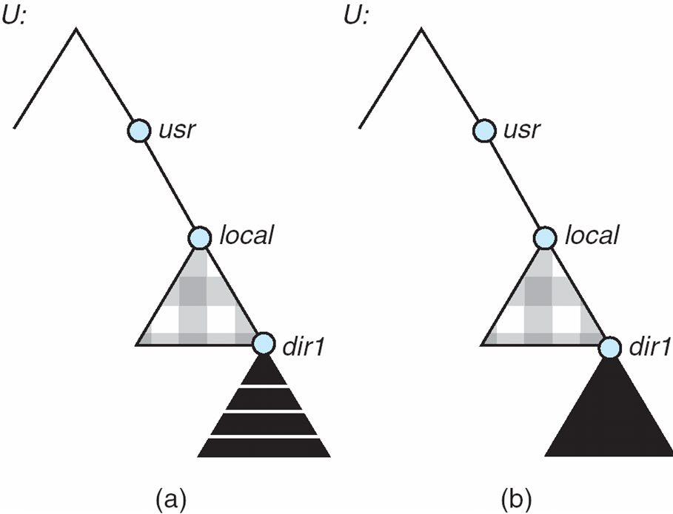
Mounting in NFS
Mounts
Cascading mounts
Notes:
75

Slide 76
NFS Mount Protocol
Establishes initial logical connection between server and client
Mount operation includes name of remote directory to be mounted and name of server machine storing it
  Mount request is mapped to corresponding RPC and forwarded to mount server running on server machine
  Export list – specifies local file systems that server exports for mounting, along with names of machines that are permitted to mount them
Following a mount request that conforms to its export list, the server returns a file handle—a key for further accesses
File handle – [<a file-system identifier>, and <an inode number>] to identify the mounted directory within the exported file system
The mount operation changes only the user’s view and does not affect the server side
Notes:
76

Slide 77
NFS Protocol
Provides a set of remote procedure calls for remote file operations. The procedures support the following operations:
  searching for a file within a directory
  reading a set of directory entries
  manipulating links and directories
  accessing file attributes
  reading and writing files
NFS servers are stateless; each request has to provide a full set of arguments
(however, NFS V4 is stateful)
Modified data must be committed to the server’s disk before results are returned to the client (lose advantages of caching)
The NFS protocol does not provide concurrency-control mechanisms
Notes:
77

Slide 78
Three Major Layers of NFS Architecture
UNIX file-system interface (based on the open, read, write, and close calls, and file descriptors)
Virtual File System (VFS) layer – distinguishes local files from remote ones, and local files are further distinguished according to their file-system types
  The VFS activates file-system-specific operations to handle local requests according to their file-system types
  Calls the NFS protocol procedures for remote requests
NFS service layer – bottom layer of the architecture
  Implements the NFS protocol
Notes:
78

Slide 79
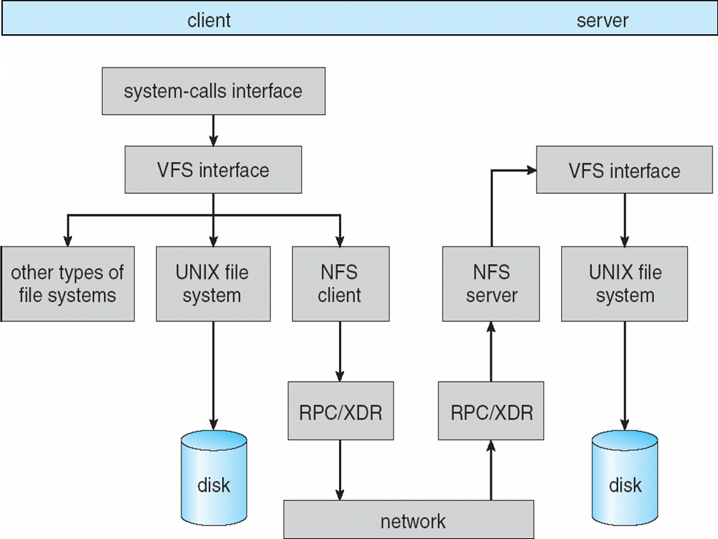
Schematic View of NFS Architecture
Notes:
79

Slide 80
NFS Path-Name Translation
Performed by breaking the path into component names and performing a separate NFS lookup call for every pair of component name and directory vnode
To make lookup faster, a directory name lookup cache on the client’s side holds the vnodes for remote directory names
Notes:
80

Slide 81
NFS Remote Operations
Nearly one-to-one correspondence between regular UNIX system calls and the NFS protocol RPCs (except opening and closing files)
NFS adheres to the remote-service paradigm, but employs buffering and caching techniques for the sake of performance
File-blocks cache – when a file is opened, the kernel checks with the remote server whether to fetch or revalidate the cached attributes
  Cached file blocks are used only if the corresponding cached attributes are up to date
File-attribute cache – the attribute cache is updated whenever new attributes arrive from the server
Clients do not free delayed-write blocks until the server confirms that the data have been written to disk
Notes:
81

Slide 82
Example: WAFL File System
Used on Network Appliance “Filers” – distributed file system appliances
“Write-anywhere file layout”
Serves up NFS, CIFS, http, ftp
Random I/O optimized, write optimized
  NVRAM for write caching
Similar to Berkeley Fast File System, with extensive modifications
Notes:
82

Slide 83
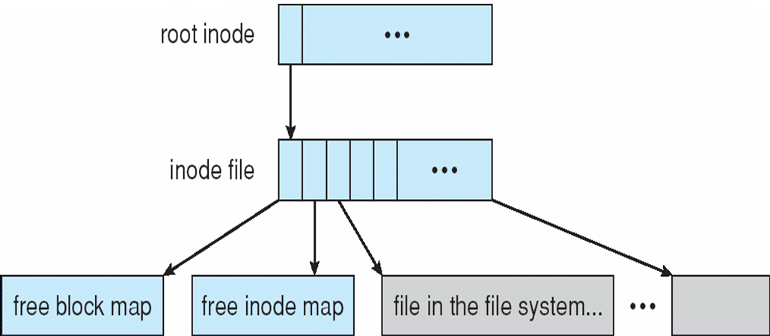
The WAFL File Layout
Notes:
83

Slide 84
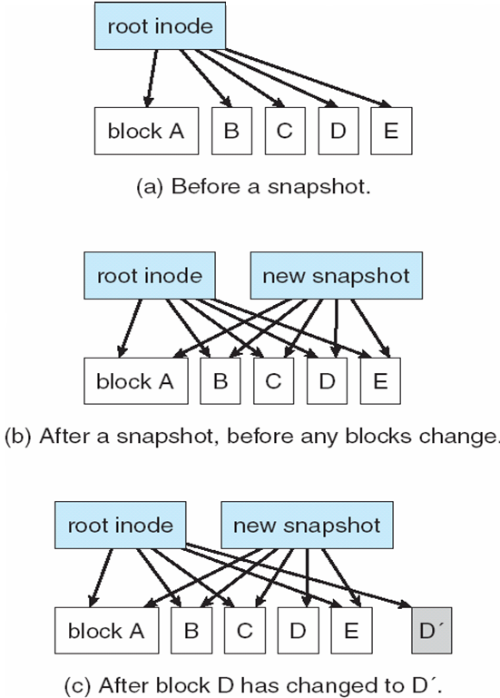
Snapshots in WAFL
Notes:
84

Slide 85
Example File System:
Linux ext2/ext3 file system
Linux ext2 file system is extended file system 2. Derived initially from Minix operating system. Linux is derived from Minix, an educational OS developed by A. Tanenbaum.
The ext3 file system is fully compatible with ext2. The added new feature is Journaling. So it can recover better from failures.
The disk data structures used by ext2 and ext3 is the same.

Slide 86
Partition Layout of ext3 (also ext2)
Block 0
a disk partition before installing ext3 file system: just a sequence of blocks
Block 0
Block 2M
Block M-1
Block M
Group 0
Group 1
Group N-1
Ext3 considers the partition to be divided into logical groups.
Each group has equal number of blocks; lets say M blocks/group

Slide 87
Ext3 file system
What do we have in a group:
  Assume block is size if 4 KB.
  The first block of each group contains a superblock (i.e. superblock info) that is 1024 bytes long.
    In group 0, superblock info starts at offset 1024 of the first block of the group (i.e. block 0 of the disk)
    In all other groups, superblock info starts at offset 0 of the first block of the group.
  Superblock keeps some general info about the filesystem
  After the first block in a group, a few blocks keeps info about all groups. It means a few blocks store group descriptors table (GDT). Some of these block may be empty and reserved.

Slide 88
Ext3 file system
What do we have in a group (continued)
  After that comes bitmap that occupies one block. It is a bitmap for the group. Each group has it own bitmap.
  Then comes an inode bitmap; showing which inodes are free.
  After that comes the inodes (inode table). Each group stores a set of nodes. The number of inodes stored in a group is the same for all groups. So the inode table of the partition is divided into groups: each group stores a portion of the table.

Slide 89
Ext3 file system: group structure
One group content
sup
GDT
bitmap
Inode
bitmap
inode table
Data blocks
Last block of the group
First block of the group
One group Block View
blocks storing inode table
…
…
…
rest of the blocks store directory and
file data information
superblock
info
bitmap
Inode-bitmap
blocks storing GDT+ reserved blocks

Slide 90
Ext3 file system: all groups and their structure
inode table
Group 0
…
…
…
Group 1
…
…
…
Group 2
…
…
…
….
Group
N-2
…
…
…
Group
N-1
…
…
…

Slide 91
Ext3 file system: structure of the 1st block of each group
boot info(first 512 bytes)
Superblock info (1K)
Superblock info (1K)
1KB
1KB
1KB
1KB
1KB
1KB
1KB
1KB
Group 0
…
…
…
Group 1
…
…
…
Group 2
…
…
…
….
Group
N-2
…
…
…
Group
N-1
…
…
…

Slide 92
Ext3 file system: root inode and root directory
root inode (inode#=2)
root directory (/)
Group 0
…
…
…
Group 1
…
…
…
Group 2
…
…
…
….
Group
N-2
…
…
…
Group
N-1
…
…
…

Slide 93
Ext3 file system: root inode
one
inode
block
…
root inode
1
2
3
..
one inode block (assume 4 KB)
(stores 32 inodes)

Slide 94
Ext3 file system: a real partition example
superblock info
…
Filesystem OS type: Linux
Inode count: 3662848
Block count: 7323624
Reserved block count: 366181
Free blocks: 4903592
Free inodes: 3288736
First block: 0
Block size: 4096
Fragment size: 4096
Reserved GDT blocks: 1024
Blocks per group: 32768
Fragments per group: 32768
Inodes per group: 16352
Inode blocks per group: 511
….
We have a ~28 GB harddisk partition
number_of_groups =
block count / blocks_per_group
= 7323624 / 32768
= 223.49 => 224 groups
Groups from 0 to 223
Inode size = 128 KB (can be 256 as well!)
Each block can contain 32 inodes
(4 KB / 128 bytes = 32)
There are 16352 inodes per group
16352/32 = 511 blocks required
to keep that many inodes in a group

Slide 95
Ext3 file system: a real partition example
32768 block per group
511 inode-blocks per group
Group 0
1
2
…
…
…
Group 1
…
…
…
Group 2
…
…
…
….
Group
222
…
…
…
Group
223
…
…
…

Slide 96
Ext3 file system: superblock structure
/usr/include/linux/ext3_fs.h
/*
* Structure of the super block
*/
struct ext3_super_block {
/*00*/ __le32 s_inodes_count; /* Inodes count */
__le32 s_blocks_count; /* Blocks count */
__le32 s_r_blocks_count; /* Reserved blocks count */
__le32 s_free_blocks_count; /* Free blocks count */
/*10*/ __le32 s_free_inodes_count; /* Free inodes count */
__le32 s_first_data_block; /* First Data Block */
__le32 s_log_block_size; /* Block size */
__le32 s_log_frag_size; /* Fragment size */
/*20*/ __le32 s_blocks_per_group; /* # Blocks per group */
__le32 s_frags_per_group; /* # Fragments per group */
__le32 s_inodes_per_group; /* # Inodes per group */
__le32 s_mtime; /* Mount time */
…
…
}

Slide 97
Ext3 file system group descriptors
The number of blocks allocated for GDT table and reserved blocks may no be the name for each group. Therefore, the group decscriptor for a group tells where the inode bitmap and inode table starts.
struct ext3_group_desc
{
__le32 bg_block_bitmap; /* Blocks bitmap block */
__le32 bg_inode_bitmap; /* Inodes bitmap block */
__le32 bg_inode_table; /* Inodes table block */
__le16 bg_free_blocks_count; /* Free blocks count */
__le16 bg_free_inodes_count; /* Free inodes count */
__le16 bg_used_dirs_count; /* Directories count */
__u16 bg_pad;
__le32 bg_reserved[3];
};
Gives info about a group
Size of group descriptor is 32 bytes

Slide 98
Ext3 file system group descriptors
Group descriptor table
Group 0 info
Group 128 info
…..
Group 127 info
First block
second block
third block
blocks in a group

Slide 99
inodes
Each inode keeps info about a file or directory
Inode 2 is the inode for the root directory
Inode numbers start with 1.
Given inode number, it is east to compute on which group it is located.

Slide 100
inode structure
struct ext3_inode {
__le16 i_mode; /* File mode */
__le16 i_uid; /* Low 16 bits of Owner Uid */
__le32 i_size; /* Size in bytes */
…
…
__le16 i_gid; /* Low 16 bits of Group Id */
__le16 i_links_count; /* Links count */
__le32 i_blocks; /* Blocks count */
__le32 i_flags; /* File flags */
…..
__le32 i_block[EXT3_N_BLOCKS];/* Pointers to blocks */
__le32 i_generation; /* File version (for NFS) */
__le32 i_file_acl; /* File ACL */
__le32 i_dir_acl; /* Directory ACL */
__le32 i_faddr; /* Fragment address */
…..
}

Slide 101
Directory entries
A directory is a file that can occupies one or mode blocks.
For example, root directory occupies one block.
Directory is a sequence of entries.
There is one entry per file
  The entry points to the inode of the file. Namely it stores
  the inode number.
  From the inode number (which is an index to the inode table), it is easy to compute the group# and index into the inode table in that group. The group descriptor also tells where the inode table in that group starts (disk blocks address). In this way we can reach to the disk block containing the inode.
When we have the inode of a file, we can get further information about the file, like it data block addresses, attributed, etc.

Slide 102
Directory entry structure
/usr/iinclude/linux/ext3_fs.h
struct ext3_dir_entry_2 {
__le32 inode; /* Inode number */
__le16 rec_len; /* Directory entry length */
__u8 name_len; /* Name length */
__u8 file_type;
char name[EXT3_NAME_LEN]; /* File name */
};

Slide 103
Directory entry structure: file types
#define EXT3_FT_REG_FILE 1 /* regular file */
#define EXT3_FT_DIR 2 /* directory */
#define EXT3_FT_CHRDEV 3 /* char device file */
#define EXT3_FT_BLKDEV 4 /* block device file */
#define EXT3_FT_FIFO 5 /* fifo file */
#define EXT3_FT_SOCK 6 /* socket */
#define EXT3_FT_SYMLINK 7 /* symbolic link */
some file types have nothing to do with disk. They
correspond to some other objects, like network connections, IPC
objects, hardware devices, etc.

Slide 104
Example directory content
root directory (/) content
type=2 inode=2 name = .
type=2 inode=2 name = ..
type=2 inode=11 name = lost+found
type=2 inode=915713 name = etc
type=2 inode=1945889 name = proc
type=2 inode=2959713 name = sys
type=2 inode=2534561 name = dev
type=2 inode=1373569 name = var
type=2 inode=3008769 name = usr
type=2 inode=1586145 name = opt
type=2 inode=3270401 name = bin
type=2 inode=1177345 name = boot
type=2 inode=3482977 name = home
type=2 inode=130817 name = lib
type=2 inode=3057825 name = media
type=2 inode=2665377 name = mnt
…

Slide 105
Example directory content
file_type
name_len
name
(variable length up 255 chars)
inode
rec_len
0
21
12
1
2
.
\0
\0
\0
12
22
12
2
2
.
.
\0
\0
padding
24
53
16
5
2
h
o
m
e
1
\0
\0
\0
40
67
28
3
2
u
s
r
\0
52
0
16
7
1
o
l
d
f
i
l
e
\0
68
34
12
4
2
s
b
i
n
block offset
(a multiple of four)
There are 6 entries in this directory. Each entry starts at an offset that is multiple of 4.

Slide 106
Searching for a file
Given a filename, /usr/home/ahmet/project.txt, how can we locate it? For example while opening the file and then reading/writing the file.
The filesystem may do the following steps:
  Parse the pathname and divide into subdirectory names and file name:
    /
    usr
    home
    ahmet
    project.txt
  From root inode to go to the block that contains the root directory (hence go to the root directory).
  Search there for an entry “usr”. That entry will tell us the inode number of subdirectory usr (which is also considered a file; therefore has an inode number),
  Access the inode for “usr” (we can compute the block number containing the inode quite easily).

Slide 107
Searching for a file
  The inode for “usr” will tell us which block(s) contains the “usr” directory.
  Go to that (those blocks) and access the “usr” directory information (a sequence of directory entries).
  There search for entry “home”. That entry will give us inode info for “home”.
  Access inode for “home” and obtain the block numbers containing the “home” directory information.
  Go to those blocks (i.e. to “home” directory).
  Search home directory entries for “ahmet”. The corresponding entry will tell the inode number for directory “ahmet”.
  Access inode for “ahmet” and then access directory information.
  In directory info “ahmet”, search for entry “project.txt”. The entry will tell where the inode for “project.txt” is.
  Access the inode for “project.txt”. It will tell the data block number for the file. Access those block to read/write the file.

Slide 108
Searching for a file
accessing /usr/home/ahmet/project.txt:
superblock
inode
/
directory
/
(cache it)
(some inodes and
directory entries
may be cached)
inode
usr
directory
usr
GDT
(cache it)
inode
home
directory
home
inode
ahmet
directory
ahmet
(cache entry)
inode
project.txt
file
project.txt
(cache it)
Disk

Slide 109
References
The slides here are adapted/modified from the textbook and its slides: Operating System Concepts, Silberschatz et al., 7th & 8th editions, Wiley.
Operating System Concepts, 7th and 8th editions, Silberschatz et al. Wiley.
Modern Operating Systems, Andrew S. Tanenbaum, 3rd edition, 2009.

