Slide 1
Chapter 10 File Systems: Interface
Bilkent University Department of Computer Engineering
CS342 Operating Systems
Last Update: April 10, 2017

Slide 2
Objectives and Outline
OBJECTIVES
To explain the function of file systems
To describe the interfaces to file systems
To discuss file-system design tradeoffs, including access methods, file sharing, file locking, and directory structures
To explore file-system protection
OUTLINE
File Concept
Access Methods
Directory Structure
File-System Mounting
File Sharing
Protection

Slide 3
File Concept
We just think and use
files when we
want to store
something
(logical storage unit)
Users
Applications/Processes
file
file
file
file
file
file
Operating System and its
File System component
floppy disk
Hard Disk
Mobile
disk
USB Disk
CD
tape

Slide 4
File Concept
Processes
Files
File System Interface
File System
Sub-System
mapping
Blocks
Disk
Driver
OS
Hard Disk
Sectors, etc.

Slide 5
File Concept
0
Contiguous logical address space (a storage)
Content:
Data
numeric
character
binary
Program
file
offset (address)
sequence of bytes
or records
size-1
User’s (processes’) view of a file

Slide 6
File Structure
None - sequence of words, bytes
Simple record structure
Lines
Fixed length records
Variable length records
Complex Structures
Formatted document
Relocatable executable file
Can simulate last two with first method by inserting appropriate control characters
Who decides:
Operating system
Program

Slide 7
File Attributes
Name – only information kept in human-readable form
Identifier – unique tag (number) identifies file within file system
Type – needed for systems that support different types
Location – pointer to file location on device
Size – current file size
Protection – controls who can do reading, writing, executing
Time, date, and user identification – data for protection, security, and usage monitoring
Information about files are kept in the directory structure, which is maintained on the disk

Slide 8
Files and Directories
There are two basic things that are stored on disk as part of the area controlled by the file system
- files (store content)
- directory information: keeps info about files, their attributes or locations; help user to organize files
Disk
Directory
attrs
file
attrs
file
filename
filename
filename
attrs
File (content)

Slide 9
File Operations
File is an abstract data type
Common Operations that are supported by the Operating System:
Create
Write
Read
Reposition within file
Delete
Truncate
Open(F_{i}) – search the directory structure on disk for entry for F_{i}, and move the content of the entry to memory
Close (F_{i}) – move the content of entry for F_{i} in memory to directory structure on disk

Slide 10
Open File
Process
OS
Open file table
RAM
X
Loc/attr
Disk
open
Directory
structure
File
X
X
Loc/attr

Slide 11
Open Files
Several pieces of data are needed to manage open files:
File position pointer: pointer to last read/write location, per process that has the file open
File-open count: number of times a file is open – to allow removal of data from open-file table when last process closes it
Disk location of the file: cache of data access information
Access mode: per-process access mode information (in which mode the process opened the file).

Slide 12
Open file information
Process
Process
Process
File pointer
File pointer
File pointer
File pointer
File pointer
File pointer
File pos. pointer
File pos. pointer
File pos. pointer
Access Rights
Access Rights
Access Rights
Access Rights
Access Rights
Access Rights
Access Mode
Access Mode
Access Mode
…
…
…
…
…
…
…
…
…
Per process
Open file table
Per process
Open file table
File Location
File Location
File Location
File Location
File-Open count
File-Open count
File-Open count
File-Open count
…
…
Main memory
…
…
System wide open file table
File on Disk (user’s view)
Byte 0

Slide 13
File Locking
Provided by some operating systems and file systems
Mediates access to a file
Mandatory or advisory:
Mandatory – access is denied depending on locks held and requested
Advisory – processes can find status of locks and decide what to do

Slide 14
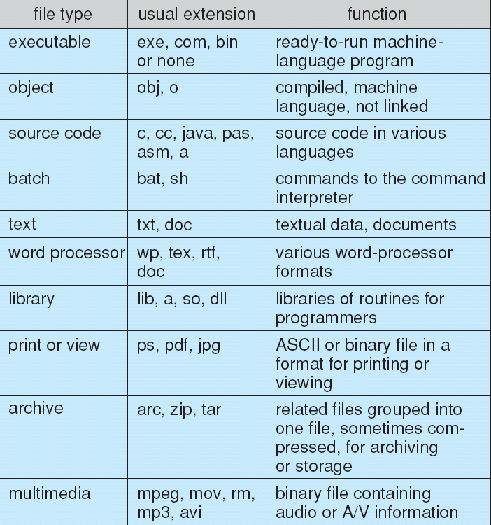
File Content Types

Slide 15
Access Methods
Sequential Access
read next
write next
reset
no read after last write
(rewrite)
Direct Access
read n
write n
position to n
read next
write next
rewrite n
n = relative block number

Slide 16
Sequential-access File

Slide 17
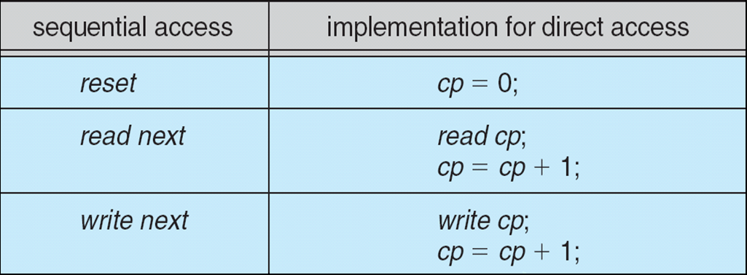
Simulation of Sequential Access on Direct-access File

Slide 18
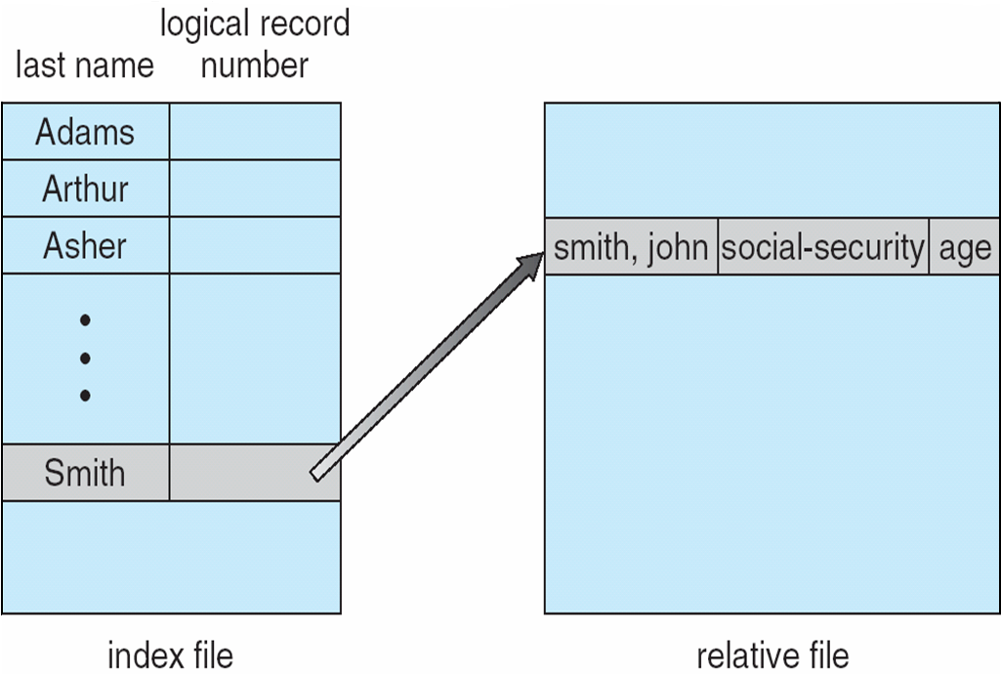
Example of Index and Relative Files

Slide 19
Disk Structure
Disk can be subdivided into partitions
Partitions also known as minidisks, slices
Disks or partitions can be RAID protected against failure
Disk or partition can be used raw – without a file system, or formatted with a file system.
Entity (partition or disk or multiple disks) containing a file system is known as a Volume.
Each volume has a Directory or Volume Table of Contents, that keeps track of and organizes files.
There may be many general-purpose file systems (e.g., NTFS) and also many special-purpose file systems (e.g., /procfs) all within the same operating system or computer.

Slide 20
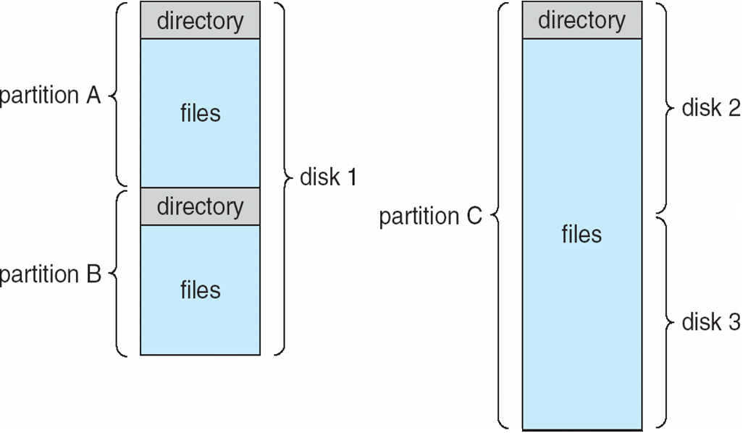
A Typical File-system Organization

Slide 21
Directory Structure
A collection of entries containing information about files and organizing the files.
Directory
filename
Files
file content (data)
F 1
F 2
F 3
F 4
F n
Both the directory structure and the files reside on disk
Backups of these two structures are kept on tapes

Slide 22
Operations Performed on Directory
Search for a file
Given filename, find out the corresponding directory entry
Create a file (add a new entry into the directory)
Delete a file (remove the related entry from directory)
Rename a file (change the name in the respective directory entry)
List a directory
List the names of all files in that directory. For each file, more information may be printed out.
Traverse the file system
Starting from root directory, go though all directory entries, including the subdirectories and their entries, recursively.

Slide 23
Organize the Directory (Logically) to Obtain
Goals:
Efficiency – locating a file quickly
Convenient Naming – convenient to users
Two users can have same name for different files
The same file can have several different names
Enabling Grouping – logical grouping of files by properties, (e.g., all Java programs, all games, …)

Slide 24
Single-Level Directory
A single directory for all users
Naming problem
Grouping problem

Slide 25
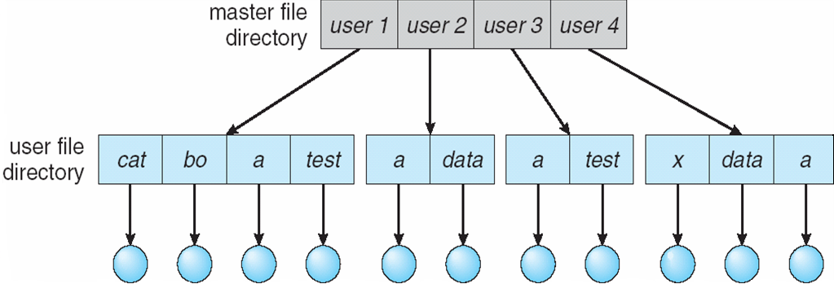
Two-Level Directory
Separate directory for each user
Path name
Can have the same file name for different user
Efficient searching
No grouping capability

Slide 26
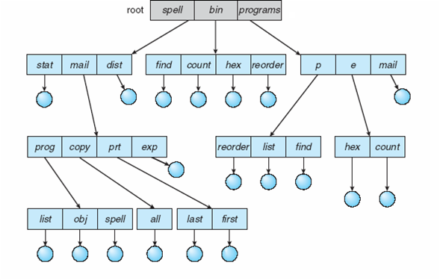
Tree-Structured Directories

Slide 27
Tree-Structured Directories (Cont)
Efficient searching
A pathname indicates where a file is. Parse the pathname and follow
those subdirectories indicated in the pathname
“/usr/home/ali/projects/cs342/file.txt”
Grouping Capability
Current directory (working directory)
cd /spell/mail/prog
type list

Slide 28
Tree-Structured Directories (Cont)
Absolute or relative path name
Creating a new file is done in current directory
Delete a file
rm <file-name>
Creating a new subdirectory is done in current directory
mkdir <dir-name>
Example: if in current directory /mail
mkdir count
mail
prog
copy
prt
exp
count
Deleting “mail” ⇒ deleting the entire subtree rooted by “mail”

Slide 29
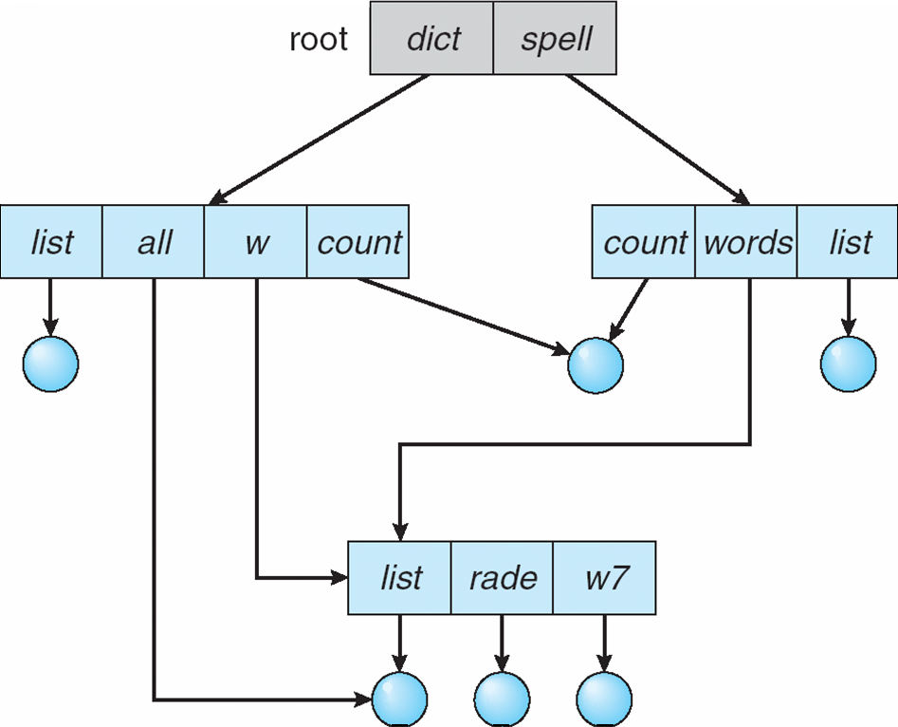
Acyclic-Graph Directories
Have shared subdirectories and files
shared file
shared subdirectory

Slide 30
Acyclic-Graph Directories (Cont.)
Y
Two different names (aliasing)
If one deletes ⇒ dangling pointer
Solutions:
Backpointers (reference list), so we can delete all pointers Variable size records a problem
Use reference count
New directory entry type
Link – another name (pointer) to an existing file
Resolve the link – follow pointer to locate the file
X
Z
W
Shared dir or file
a sequence of entries
a directory
dir
dir
file
file
file
link
file

Slide 31
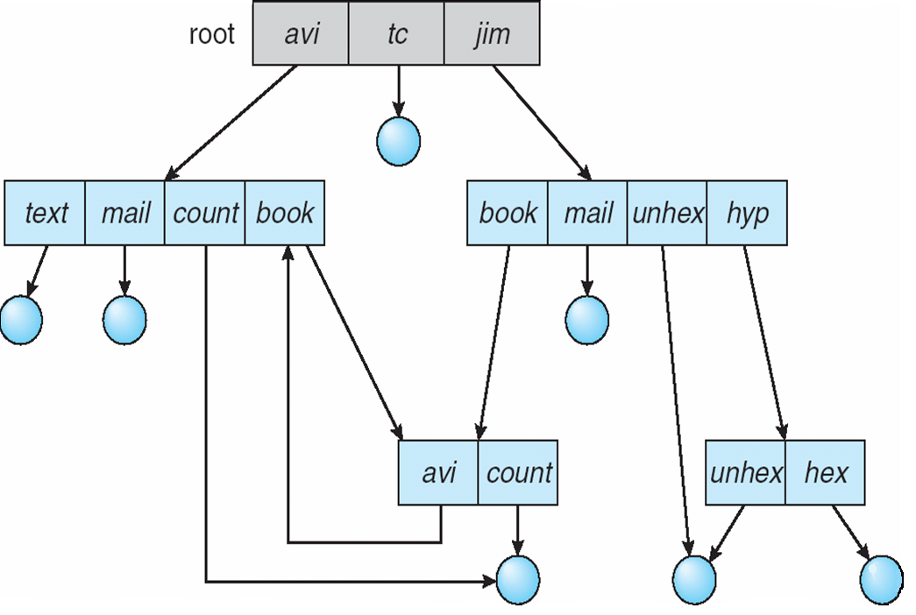
General Graph Directory

Slide 32
General Graph Directory (Cont.)
How do we guarantee no cycles?
Allow only links to files not subdirectories
Every time a new link is added use a cycle detection algorithm to determine whether it is OK (will not close loop)
Costly (especially for disk)

Slide 33
File System Mounting
A file system must be mounted before it can be accessed
(like opening a file to be read)
Mounting a new file system means placing (attaching – connecting) the new file system into a location in the local directory tree (local file system) that becomes accessible at system boot time.
An unmounted file system is mounted at a mount point
Mount point: the place in the local directory tree where the new file system is placed. The root of that file system will be that place in the local file system

Slide 34
(a) Existing. (b) Unmounted Partition
Local file system
New file system
to be mounted

Slide 35
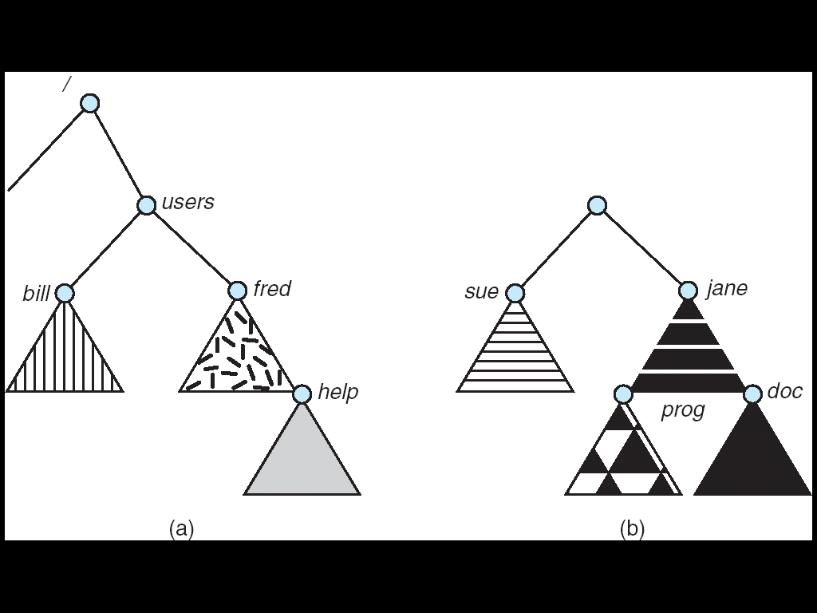
Mount Point
mount point

Slide 36
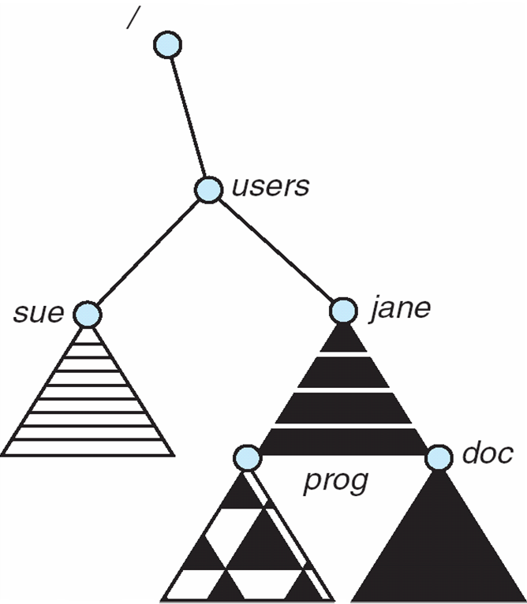
Local file system appearance after mounting

Slide 37
File Sharing
Sharing of files on multi-user systems is desirable
Sharing may be done through a protection scheme
On distributed systems, files may be shared across a network
Network File System (NFS) is a common distributed file-sharing method

Slide 38
File Sharing
Each user that has an account in the computer has a username and a unique
user ID (UID)
The administrator can create groups. A group may have a set of
usernames (users) associated with it. Each group has a unique group ID (GID)
Example: group os_team: ali, veli, selcuk, ….
File attributes for a file
…
UID (user ID)
GID (group ID)
User (owner) permissions
Group permissions
Other people permissions
……

Slide 39
File Sharing – Multiple Users Protection
Protection is based on the use of UIDs and GIDs.
Each file has associated protection bits (permissions) for UID and GID.
User ID: read, write, execute?
Group ID: read, write, execute?
UIDs identify users, allowing permissions and protections to be per-user
GIDs allow users to be in groups, permitting group access rights

Slide 40
File Sharing – Remote File Systems
Uses networking to allow file system access between systems
Manually via programs like FTP
Automatically, seamlessly using distributed file systems (DFS)
Semi automatically via the world wide web
DFS: Client-server model allows clients to mount remote file systems from servers
Server can serve multiple clients. Client can mount multiple servers.
Client and user-on-client identification is insecure or complicated (**)
NFS is standard UNIX client-server file sharing protocol
CIFS is standard Windows protocol
Standard operating system file calls are translated into remote calls
(**) Distributed Information Systems (distributed naming services) such as LDAP, DNS, NIS, Active Directory implement unified access to information needed for remote/distributed computing

Slide 41
Distributed File System
Computer B
processes
VFS
Computer A
Computer C
localFS
NFS
processes
File
System B
processes
VFS
VFS
localFS
NFS
localFS
NFS
File
System A
File
System C
Network

Slide 42
Distributed File System
File System view at computer A after remote file systems are mounted
Computer A
processes
File
System A
mount point
File
System B
File
System C

Slide 43
File Sharing – Failure Modes
Remote file systems add new failure modes, due to network failure, server failure
How to recover from failures?
Recovery from failure can involve state information (to be maintained at server) about status of each remote request
State information: what files are opened; what is the file position pointer, etc.

Slide 44
File Sharing – Consistency Semantics
Consistency semantics specify how multiple users are to access a shared file simultaneously
Unix file system (UFS) implements:
Writes to an open file visible immediately to other users of the same open file
A single file image accessed by all users
AFS has session semantics
Writes only visible to sessions starting after the file is closed
Multiple file images accessed by all users

Slide 45
Protection
File owner/creator should be able to control:
what can be done (read, write, execute….)
by whom (owner, others, group member…)
Types of access (what can be done)
Read (a file)
Write (a file)
Execute (a file)
Append (a file)
Delete ( a file)
List (a file)
For directories:
Reading means listing
Writing means being able to create a file
Executing means being able to change into the directory

Slide 46
Access Lists and Groups
Mode of access: read, write, execute
Three classes of users
RWX
a) owner access 7 ⇒ 1 1 1 RWX
b) group access 6 ⇒ 1 1 0
RWX
c) public access 1 ⇒ 0 0 1
Ask manager to create a group (unique name), say G, and add some users to the group.
For a particular file (say game) or subdirectory, define an appropriate access.
owner
group
public
chmod
761
game
Attach a group to a file chgrp G game

Slide 47
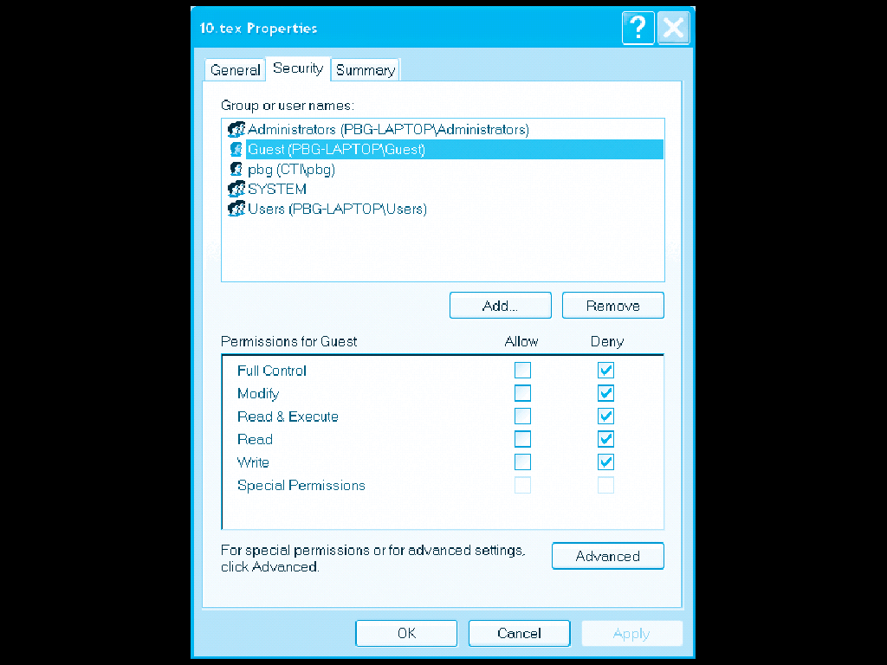
Windows XP Access-control List Management

Slide 48
A Sample UNIX Directory Listing

Slide 49
References
The slides here are adapted/modified from the textbook and its slides: Operating System Concepts, Silberschatz et al., 7th & 8th editions, Wiley.
Operating System Concepts,, Silberschatz et al. Wiley.
Modern Operating Systems, Andrew S. Tanenbaum, 3rd edition, 2009.

