Slide 1
Bilkent University Department of Computer Engineering
CS342 Operating Systems
Chapter 13 Input/Output (I/O) Systems
Last Update: May 3, 2016
1
Notes:
1

Slide 2
Objectives and Outline
Objectives
Explore the structure of an operating system’s I/O subsystem
Discuss the principles of I/O hardware and its complexity
Provide details of the performance aspects of I/O hardware and software
Outline
I/O Hardware
Application I/O Interface
Kernel I/O Subsystem
Transforming I/O Requests to Hardware Operations
STREAMS
Performance
2
Notes:
2

Slide 3
I/O Hardware
Incredible variety of I/O devices
Common concepts
Port ( a connection point through which computer accesses a device)
Bus (daisy chain or shared direct access)
Medium over which signals are sent/received
Controller (host adapter)
Chip that can be accessed by CPU and that controls the device/port/bus
PCI controller, Serial Port controller, keyboard controller, …
I/O instructions control devices
Devices have addresses, used by
Direct I/O instructions (in, out, etc)
Memory-mapped I/O (move, load, store)..
3
Notes:
3

Slide 4
I/O hardware concepts
CPU
Memory
I/O instructions
(bits/bytes/data)
Serial Port controller
SCSI (host)
controller
Graphics controller
Serial port
Screen
I/O hardware
SCSI bus
cable
Disk Controller
Disk
4
Notes:
4

Slide 5
I/O hardware concepts: direct I/O
max
mov…
or
load, store…
Main Memory address Space
0
max
I/O port address Space
in, out
0
5
Notes:
5

Slide 6
I/O hardware concepts: direct I/O
in [address], Rx
CPU
Memory
out [address], Rx
registers/buffers (addresses)
registers/buffers (addresses)
registers/buffers (addresses)
Serial Port controller
SCSI (host)
controller
Graphics controller
Serial port
SCSI bus
Screen
cable
Disk Controller
Disk
6
Notes:
6

Slide 7
I/O hardware concepts: memory mapped I/O
max
mov…
or
load, store…
Main Memory
Physical Address Space
0
I/O port address range
7
Notes:
7

Slide 8
I/O hardware concepts: memory mapped I/O
CPU
mov [address], Rx
Memory
mov Rx, [address]
registers/buffers (addresses)
registers/buffers (addresses)
registers/buffers (addresses)
Serial Port controller
SCSI (host)
controller
Graphics controller
Serial port
SCSI bus
Screen
cable
Disk Controller
Disk
8
Notes:
8

Slide 9
I/O port concept
I/O instructions use those addresses to access the controller
I/O port to access
the device
address range: I/O port addresses
Device controller
control and data registers
9
Notes:
9

Slide 10
I/O port addresses
000
Device X
Device Y
Device Z
I/O port address space
….
…
10
Notes:
10

Slide 11
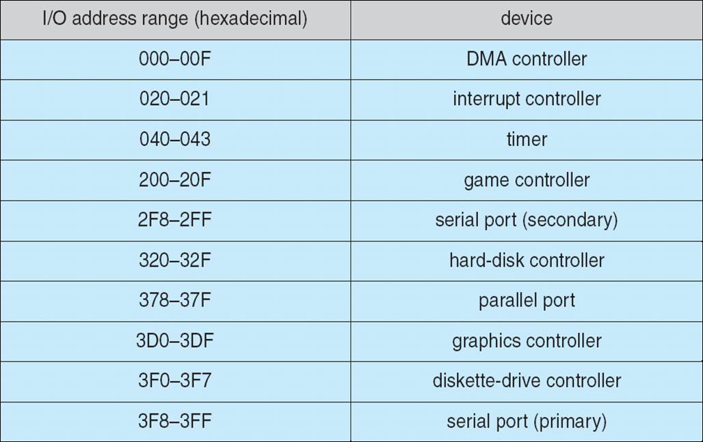
Device I/O Port Locations on PCs (partial)
11
Notes:
11

Slide 12
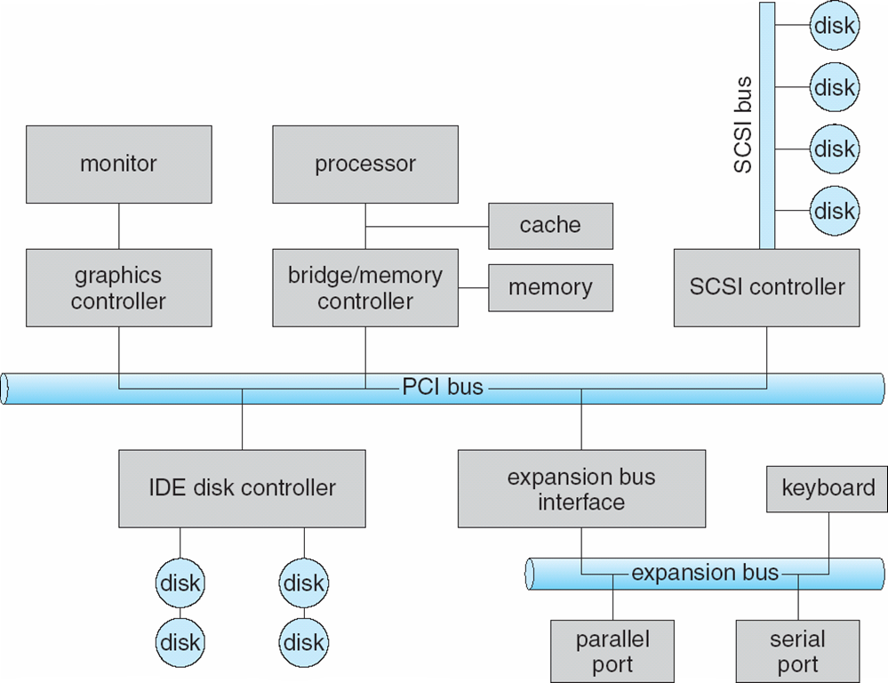
A Typical PC Bus Structure
12
Notes:
12

Slide 13
A typical I/O port
I/O instructions move bytes/words
Device Controller
command ready bit
command bit
control register
data-in register
status register
data-out register
busy bit
I/O port
13
Notes:
13

Slide 14
Interacting with the Device controller
Host (CPU+Memory) and Device Controller interaction (data transfers and control) can be in one of 3 ways:
Polling
Interrupt driven I/O
Interrupt driven with help of DMA
14
Notes:
14

Slide 15
Example: polling based writing
CPU
Memory
system bus
check the busy bit
write byte
set command ready bit
set the write bit (write command)
Device
Controller
command/control register
data-in register
set the busy bit
data-out register
status register
clear the busy bit,
clear the command ready bit
Device/Port/Cable…
Perform write operation
15
Notes:
15

Slide 16
Example: polling based writing
CPU
Controller
1. read and check the busy bit
2. if busy go to 1.
3. set the write bit in command register
4. Write byte (word) into data out register
5. Set the command ready bit
6. Go to 1(maybe after doing something else)
notices command ready bit set
set the busy bit
controller reads the command (it is write command), gets byte from data out register and write the byte out (this may take time)
clears the busy bit
clears the command ready bit
clears the error bit
16
Notes:
16

Slide 17
Transferring Data between host and device: Polling
Determines state of device
command-ready
busy
error
Busy-wait cycle to wait for I/O from device
17
Notes:
17

Slide 18
Transferring Data between host and device: Interrupts
CPU Interrupt-request line triggered by I/O device
Interrupt handler receives interrupts
Maskable to ignore or delay some interrupts
Interrupt vector to dispatch interrupt to the correct handler
Based on priority
Some nonmaskable
Interrupt mechanism also used for exceptions
18
Notes:
18

Slide 19
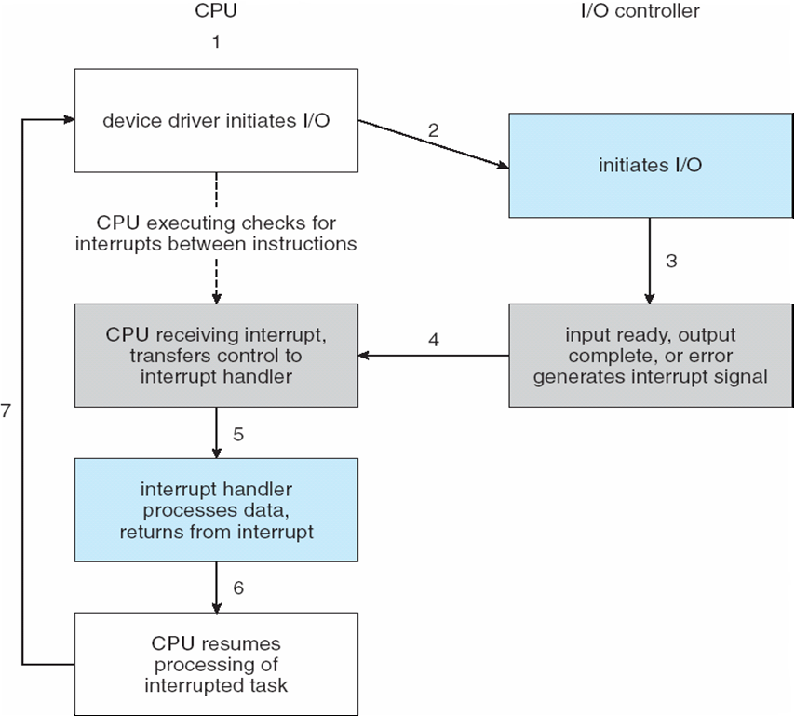
Interrupt-Driven I/O Cycle
19
Notes:
19

Slide 20
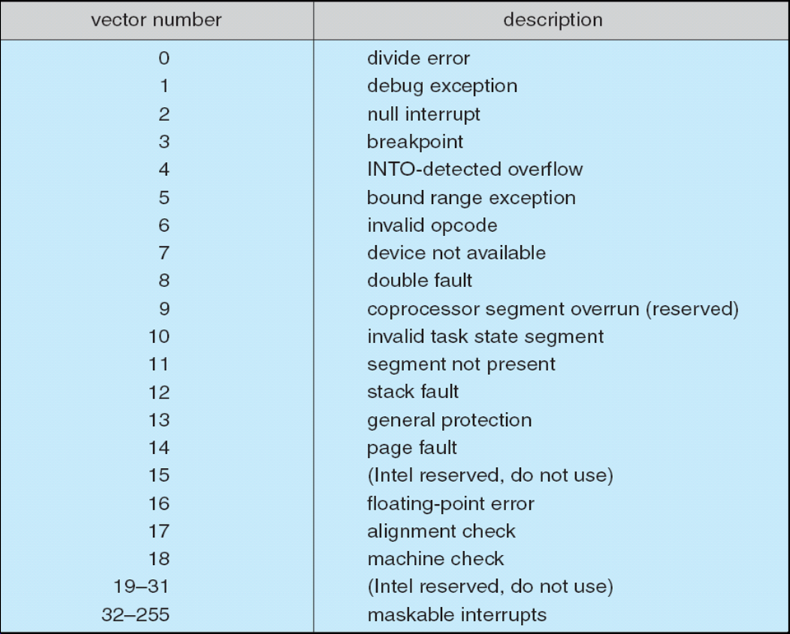
Intel Pentium Processor Event-Vector Table
20
Notes:
20

Slide 21
Direct Memory Access
Used to avoid programmed I/O for large data movement
Requires DMA controller
Bypasses CPU to transfer data directly between I/O device and memory
21
Notes:
21

Slide 22
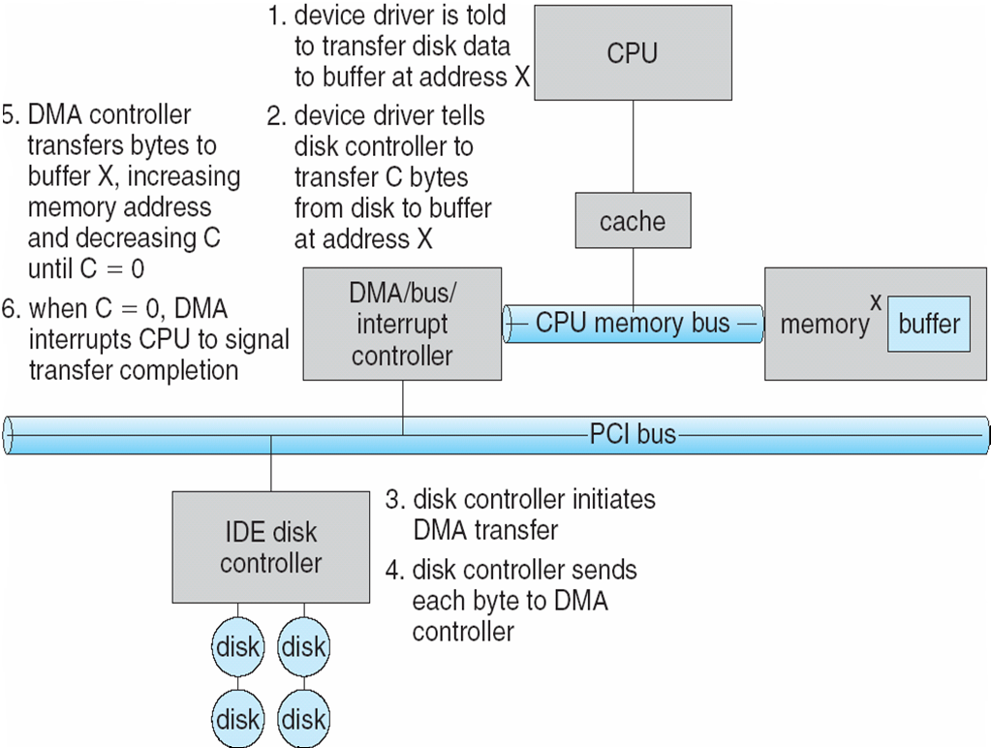
Six Step Process to Perform DMA Transfer
22
Notes:
22

Slide 23
Application I/O Interface
Devices vary in many dimensions
Character-stream or block
Sequential or random-access
Sharable or dedicated
Speed of operation
read-write, read only, or write only
Device-driver layer hides differences among I/O controllers from kernel
I/O system calls encapsulate device behaviors in generic classes
(Application I/O Interface)
23
Notes:
23

Slide 24
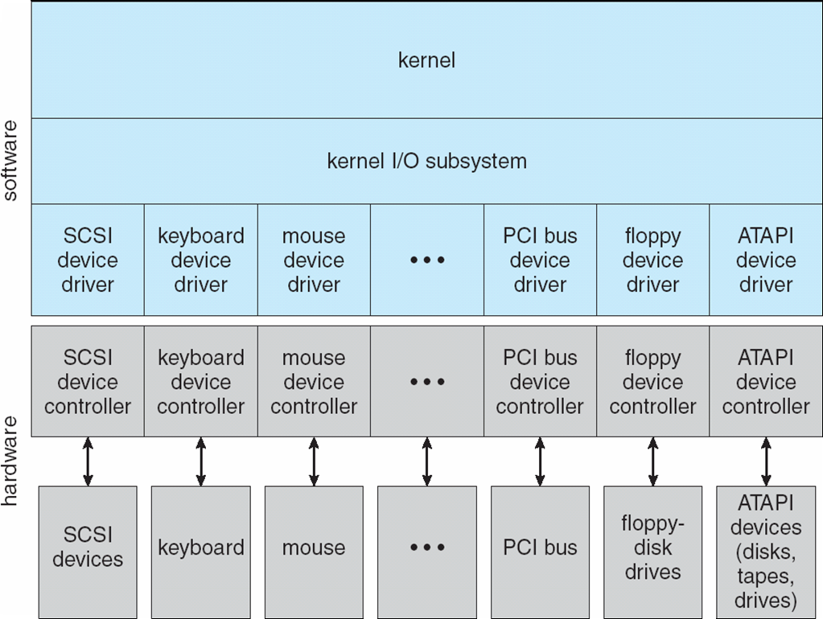
A Kernel I/O Structure
24
Notes:
24

Slide 25
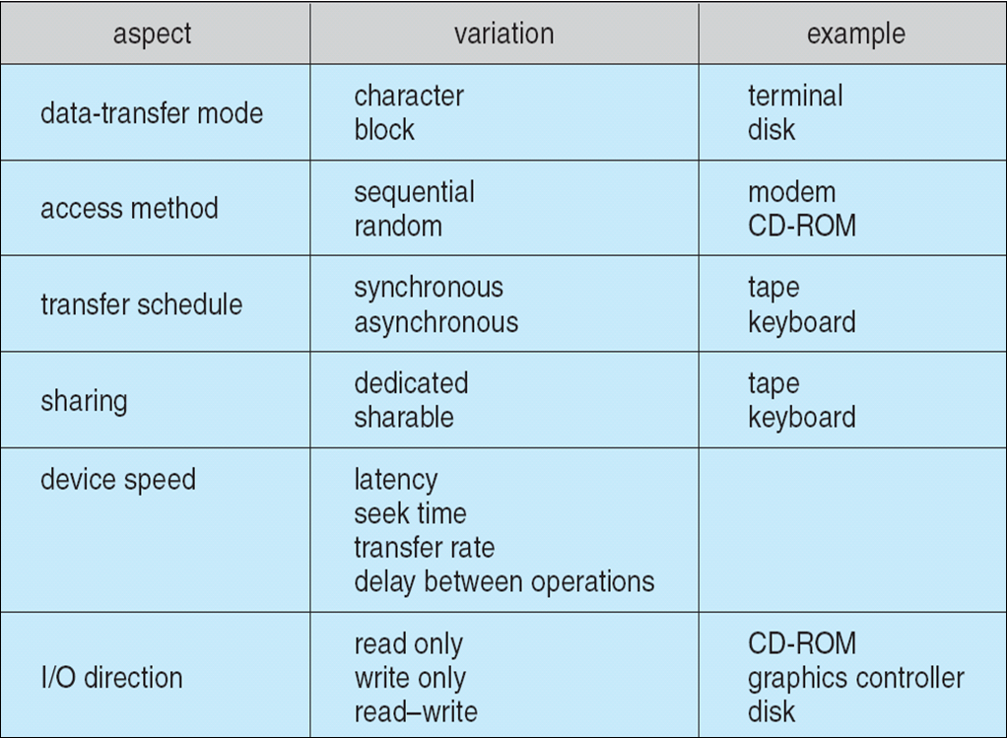
Characteristics of I/O Devices
25
Notes:
25

Slide 26
Block and Character Devices
Block devices include disk drives
Commands include read, write, seek
Raw I/O or file-system access
Memory-mapped file access possible
Character devices include keyboards, mice, serial ports
Commands include get(), put()
Libraries layered on top allow line editing
26
Notes:
26

Slide 27
Network Devices
Varying enough from block and character to have own interface
Unix and Windows NT/9x/2000 include socket interface
Separates network protocol from network operation
Includes select() functionality
Approaches vary widely (pipes, FIFOs, streams, queues, mailboxes)
27
Notes:
27

Slide 28
Clocks and Timers
Provide current time, elapsed time, timer
Programmable interval timer (PIT) used for timings, periodic interrupts
ioctl() (on UNIX) covers odd aspects of I/O such as clocks and timers
28
Notes:
28

Slide 29
Blocking and Non-blocking I/O
Blocking - process suspended until I/O completed
Easy to use and understand
Insufficient for some needs
Non-blocking - I/O call returns with as much as available
User interface, data copy (buffered I/O)
Implemented via multi-threading
Returns quickly with count of bytes read or written
Asynchronous - process runs while I/O executes
Difficult to use
I/O subsystem signals process when I/O completed
29
Notes:
29

Slide 30
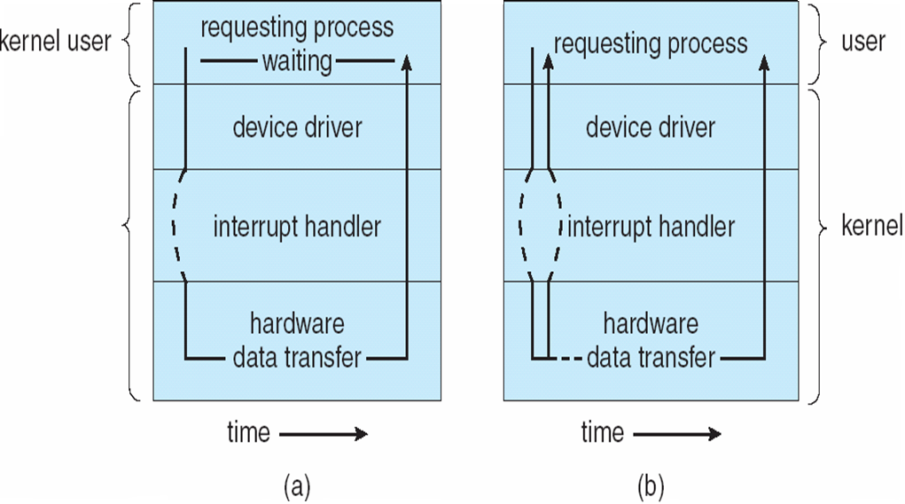
Two I/O Methods
Blocking/Synchronous I/O
Asynchronous I/O
30
Notes:
30

Slide 31
Kernel I/O Subsystem
applications
I/O system calls
Uniform naming
Scheduling
Buffering
Caching
Error handling
Spooling
Device Reservation
I/O Protection
Kernel I/O subsystem
Device drivers
Devices
31
Notes:
31

Slide 32
Kernel I/O Subsystem
Scheduling
Some I/O request ordering via per-device queue
Some OSs try fairness
32
Notes:
32

Slide 33
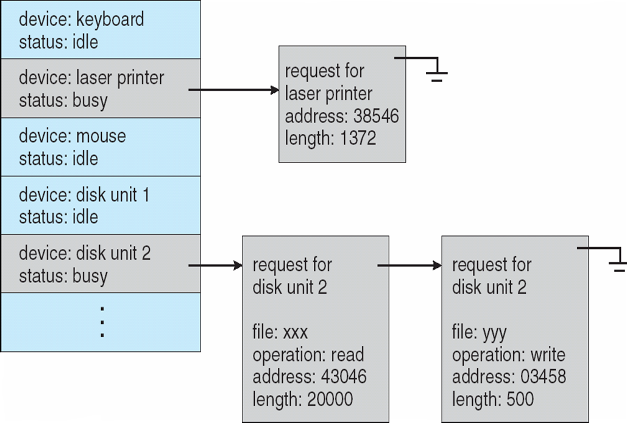
Device-status Table
33
Notes:
33

Slide 34
Kernel I/O Subsystem
Buffering - store data in memory while transferring between devices
To cope with device speed mismatch
To cope with device transfer size mismatch
To maintain “copy semantics”
34
Notes:
34

Slide 35
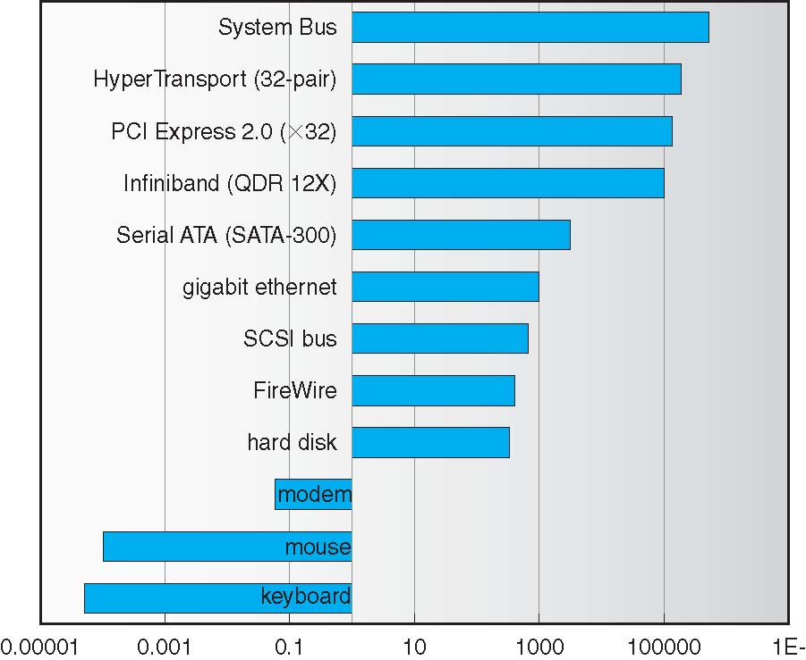
Sun Enterprise 6000 Device-Transfer Rates
35
Notes:
35

Slide 36
Kernel I/O Subsystem
Caching - fast memory that is holding copy of data
Always just a copy
Key to performance
For example, “disk cache” is caching the frequently accessed disk blocks in memory
36
Notes:
36

Slide 37
Kernel I/O Subsystem
Spooling - hold output for a device
If device can serve only one request at a time
i.e., printing
Many processes can send output to the spooler at the same time
Spooler sends the outputs to the device one at a time.
37
Notes:
37

Slide 38
Kernel I/O Subsystem
Device reservation - provides exclusive access to a device
System calls for allocation and de-allocation
Watch out for deadlock
38
Notes:
38

Slide 39
Error Handling
OS can recover from disk read, device unavailable, transient write failures
Most return an error number or code when I/O request fails
System error logs hold problem reports
39
Notes:
39

Slide 40
I/O Protection
User process may accidentally or purposefully attempt to disrupt normal operation via illegal I/O instructions
All I/O instructions defined to be privileged
Kernel can execute I/O instructions (not the processes)
I/O must be performed via system calls
Memory-mapped and I/O port memory locations must be protected too
40
Notes:
40

Slide 41
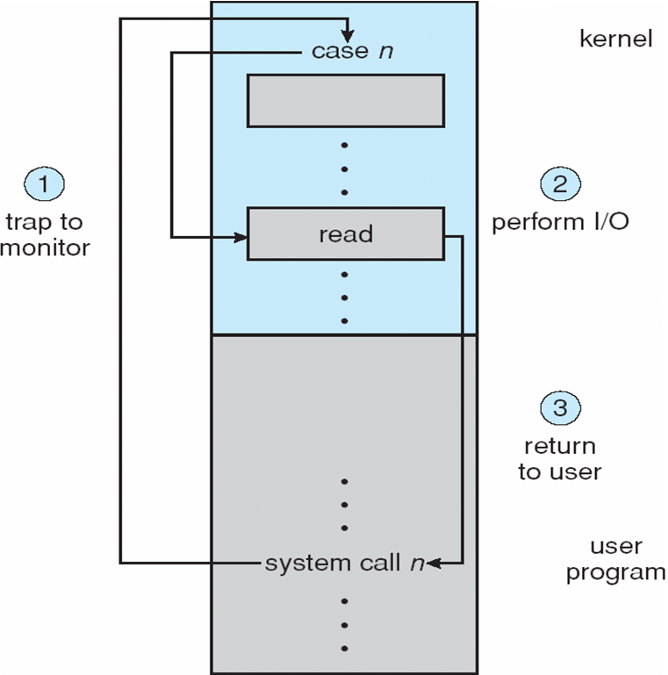
Use of a System Call to Perform I/O
41
Notes:
41

Slide 42
Kernel Data Structures
Kernel keeps state info for I/O components, including open file tables, network connections, character device state
Many, many complex data structures to track buffers, memory allocation, “dirty” blocks
Some use object-oriented methods and message passing to implement I/O
42
Notes:
42

Slide 43
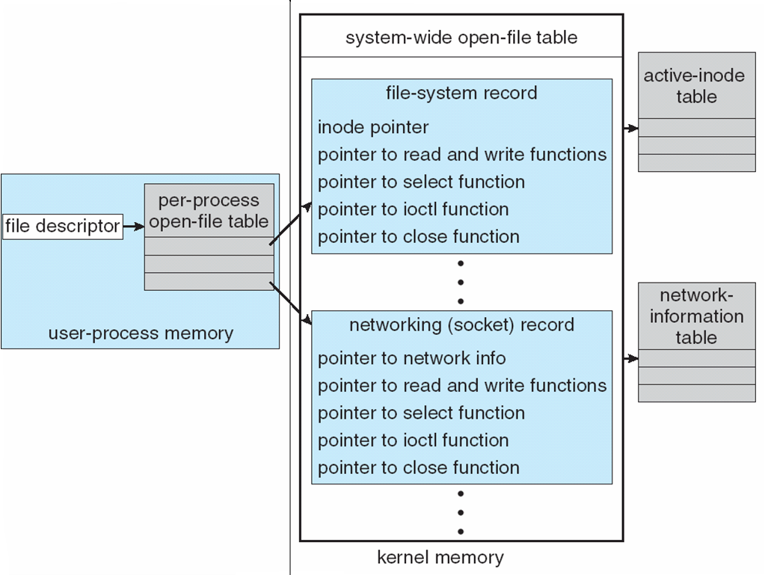
UNIX I/O Kernel Structure
43
Notes:
43

Slide 44
I/O Requests to Hardware Operations
Consider reading a file from disk for a process. A process makes systems calls like
fd = open(X, ..) where X is a filename (pathname)
read(fd, buf, N)
We are given a filename X, and N (number of bytes to read)
Determine device holding file (done by open() )
Disk? Partition? CD? Virtual Disk?
Translate name to device representation (done by open())
Find out the inode for the file
Physically read data from disk into kernel buffer (done by read () )
Using inode and index table we can reach the related blocks of the file
Make data available to requesting process (done by read() )
Copy requested data to the buffer of the user application
Return control to process
Resume the execution of the process
44
Notes:
44

Slide 45
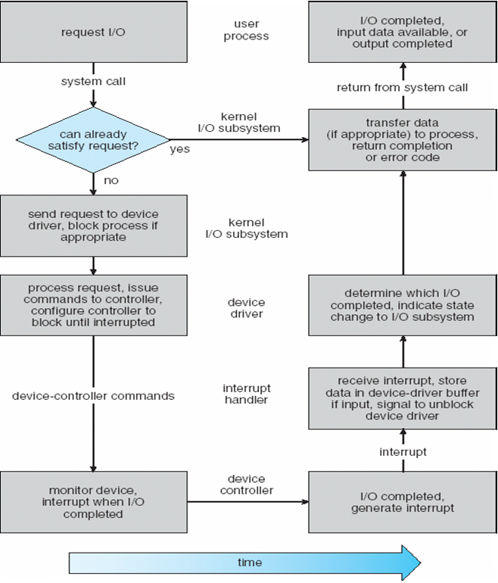
Life Cycle of An I/O Request
45
Notes:
45

Slide 46
STEAMS
STREAM – a full-duplex communication channel between a user-level process and a device in Unix System V and beyond
A STREAM consists of:
- STREAM head interfaces with the user process
- driver end interfaces with the device - zero or more STREAM modules between them.
Each module contains
a read queue and
a write queue
Message passing is used to communicate between queues (i.e., modules)
Process
Stream head
a stream
module
module
driver
Device
46
Notes:
46

Slide 47
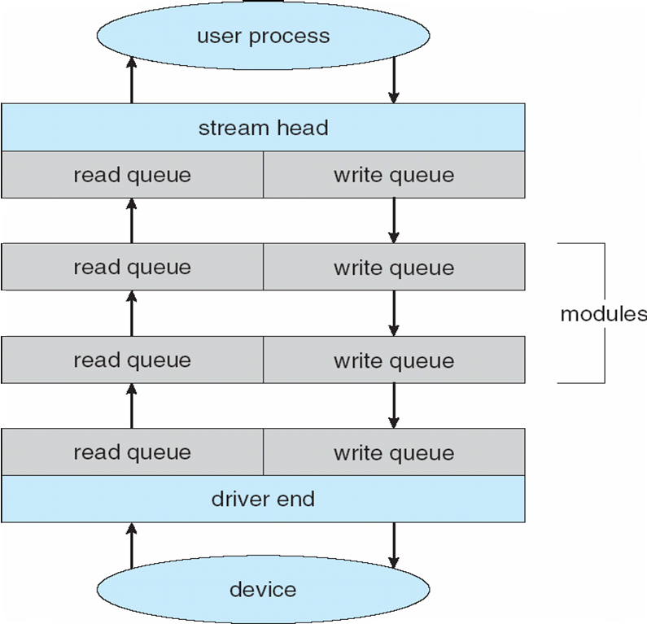
The STREAMS Structure
47
Notes:
47

Slide 48
Performance
I/O a major factor in system performance:
Demands CPU to execute device driver, kernel I/O code
Context switches due to interrupts
Software or hardware interrupts
Data copying
From device to device-driver/kernel, to application (vice versa)
Network traffic especially stressful
48
Notes:
48

Slide 49
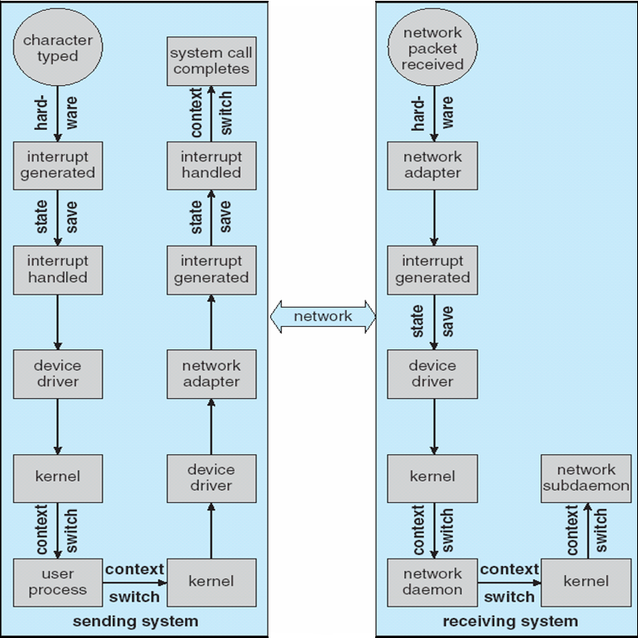
Intercomputer Communications
We are sending just
one character from one
machine to another
machine
49
Notes:
49

Slide 50
Improving Performance
Reduce number of context switches
Reduce data copying
Reduce interrupts by using large transfers, smart controllers, polling
Use DMA
Balance CPU, memory, bus, and I/O performance for highest throughput
50
Notes:
50

Slide 51
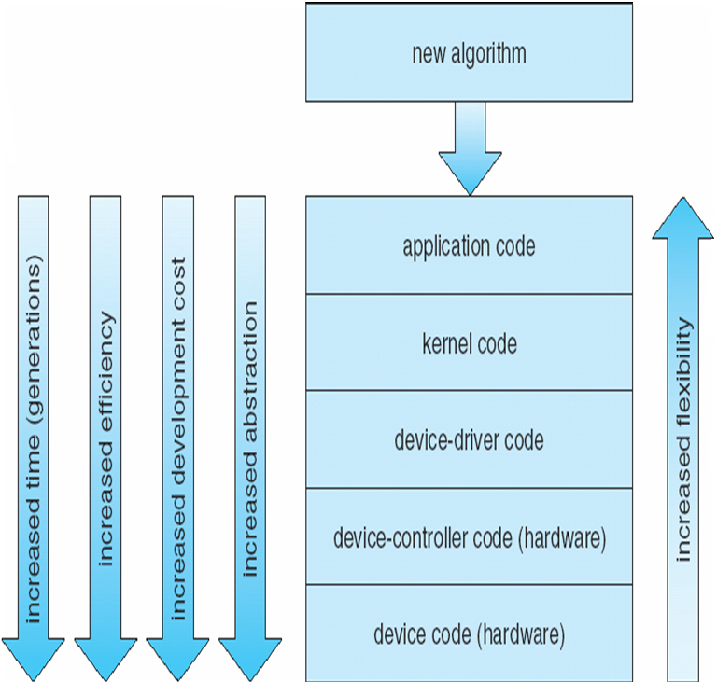
Device-Functionality Progression
-
+
-
+
-
+
51
Notes:
51

Slide 52
References
The slides here are adapted/modified from the textbook and its slides: Operating System Concepts, Silberschatz et al., 7th & 8th editions, Wiley.
Operating System Concepts, 7th and 8th editions, Silberschatz et al. Wiley.
Modern Operating Systems, Andrew S. Tanenbaum, 3rd edition, 2009.
52

