Slide 1
Chapter 12 Mass Storage
Bilkent University Department of Computer Engineering
CS342 Operating Systems
Last Update: Dec 14, 2017

Slide 2
Objectives and Outline
Objectives
Describe the physical structure of secondary and tertiary storage devices and the resulting effects on the uses of the devices
Explain the performance characteristics of mass-storage devices
Discuss operating-system services provided for mass storage, including RAID and HSM
Outline
Overview of Mass Storage Structure
Disk Structure
Disk Attachment
Disk Scheduling
Disk Management
Swap-Space Management
RAID Structure
Disk Attachment
Stable-Storage Implementation
Tertiary Storage Devices
Operating System Issues
Performance Issues

Slide 3
Mass Storage
Mass Storage : permanent storage; large volume of data can be stored permanently (powering off will not cause loss of data)
Secondary storage: always online; hard disk
Tertiary storage; tapes, etc.

Slide 4
Overview of Mass Storage Systems: Magnetic Disks
Magnetic disks provide bulk of secondary storage of modern computers
Drives rotate at 60 to 200 times per second
Transfer rate is rate at which data flow between drive and computer
Positioning time (random-access time) is time to move disk arm to desired cylinder (seek time) and time for desired sector to rotate under the disk head (rotational latency)
Head crash results from disk head making contact with the disk surface
That’s bad
Disks can be removable

Slide 5
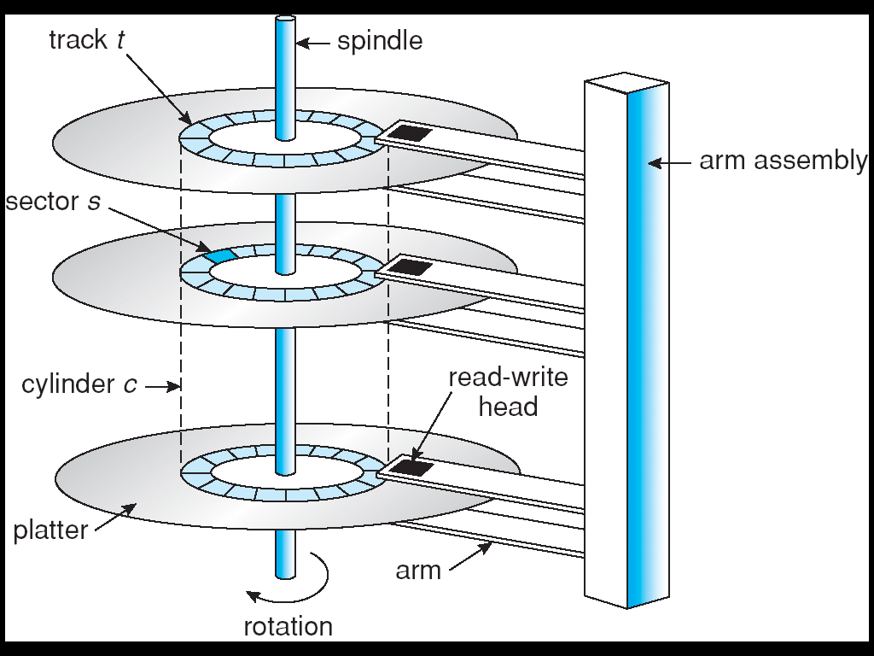
Moving-head Disk Mechanism

Slide 6
Overview of Mass Storage Systems: Magnetic Tapes
Magnetic tape
Was early secondary-storage medium
Relatively permanent and holds large quantities of data
20-200GB typical storage
Mainly used for backup, storage of infrequently-used data, transfer medium between systems
Access time slow
Random access ~1000 times slower than disk
Once data under head, transfer rates comparable to disk
Common technologies are 4mm, 8mm, 19mm, LTO-2 and SDLT

Slide 7
Disk Structure
A disk drive is addressed as a large 1-dimensional array of blocks, where the logical block is the smallest unit of transfer.
The 1-dimensional array of blocks is mapped into the sectors of the disk sequentially.
Sector 0 is the first sector of the first track on the outermost cylinder.
Mapping proceeds in order through that track, then the rest of the tracks in that cylinder, and then through the rest of the cylinders from outermost to innermost.
Sector 0

Slide 8
Disk Attachment
Host-attached storage accessed through I/O ports talking to disk I/O busses
Attachment technologies and protocols (various disk I/O buses)
IDE, EIDE, ATA, SATA
USB
SCSI
Fiber Channel
Host controller in computer uses bus to talk to disk controller built into drive or storage array
CPU
RAM
Computer I/O Bus
Host controller
Disk I/O Bus (SCSI, IDE, SATA, etc.)
messages
Disk Controller
Disk

Slide 9
Disk Attachment Example: SCSI and Fiber Channel
SCSI itself is a bus, up to 16 devices on one cable, SCSI initiator requests operation and SCSI targets perform tasks
Each target can have up to 8 logical units (disks attached to device controller
FC (fiber channel) is high-speed serial architecture
Can be switched fabric with 24-bit address space – the basis of storage area networks (SANs) in which many hosts attach to many storage units
Can be arbitrated loop (FC-AL) of 126 devices

Slide 10
Disk Attachment Example: SCSI
CPU
RAM
PCI Bus
SCSI Host
Adapter
SCSI initiator
(up to 16 devices
can be connected)
SCSI Bus
SCSI
controller
SCSI
controller
SCSI target
Disk
Disk

Slide 11
Network Attached Storage
Network-attached storage (NAS) is storage made available over a network rather than over a local connection (such as a bus)
NFS and CIFS are common distributed file system protocols used for network attached storage
We use those protocols to access remote storage that is connected to a network.
Implemented via remote procedure calls (RPCs) between host and storage
New iSCSI protocol uses IP network to carry the SCSI protocol
SCSI – SCSI bus/cable (local/host attached)
iSCSI – TCP/IP network (network attached)

Slide 12
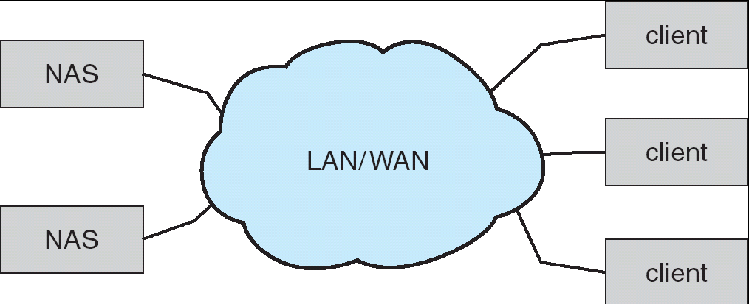
Network Attached Storage
TCP/IP Network
NFS or CIFS Protocol

Slide 13
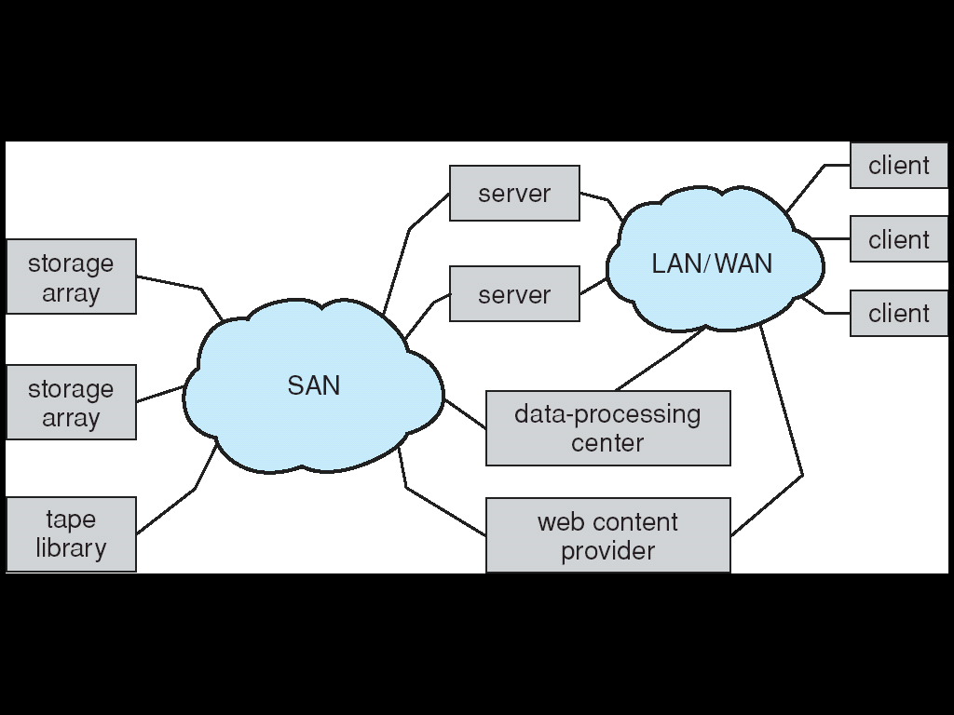
Storage Area Network
Common in large storage environments (and becoming more common)
Multiple hosts attached to multiple storage arrays – flexible
Uses a different communication infrastructure (SAN) than the common networking infrastructure

Slide 14
Disk Scheduling
The operating system is responsible for using hardware efficiently — for the disk drives, this means having a fast access time and large disk bandwidth.
Disk access time has two major components
Seek time is the time for the disk to move the head to the cylinder containing the desired sector (block).
Rotational latency is the additional waiting time for the disk to rotate the desired sector under the disk head.
Minimize seek time
Seek time ≈ seek distance (between cylinders)
Disk bandwidth is the total number of bytes transferred, divided by the total time between the first request for service and the completion of the last transfer.

Slide 15
Disk I/O queue
Process
1
Process
2
Process
3
file requests
Kernel
disk request
queue
block requests
disk
controller
request for block x (x is on cylinder y)
Disk

Slide 16
Disk Scheduling
Several algorithms exist to schedule the servicing of disk I/O requests.
Assume disk has cylinders from 0 to 199.
We illustrate them with a request queue. In the queue we have requests for blocks sitting in various cylinders. We just focus on the cylinder numbers.
98, 183, 37, 122, 14, 124, 65, 67 (these are cylinder numbers)
Head pointer: 53 (the head is currently on cylinder 53)
We have 8 requests queued. They are for blocks sitting on cylinders 98, 183, …

Slide 17
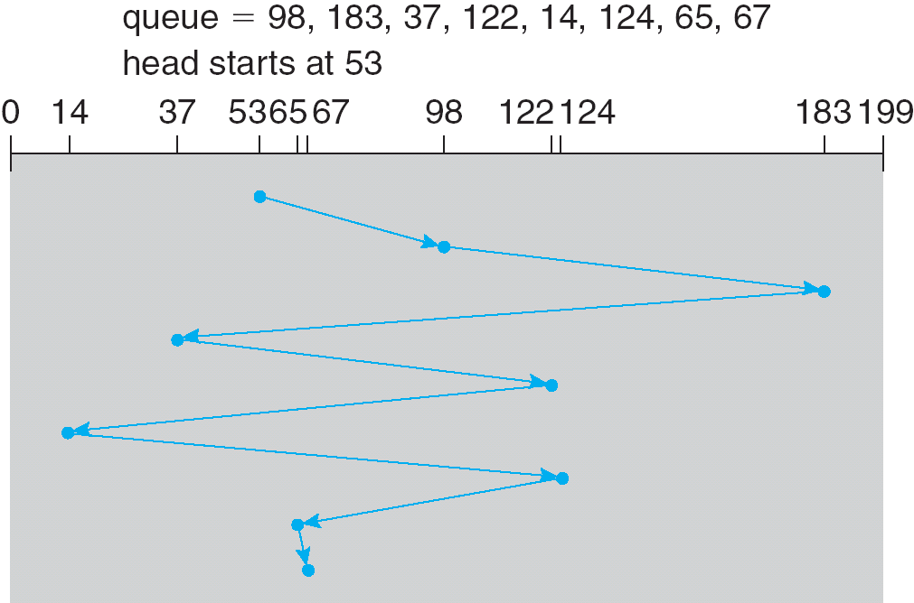
FCFS Algorithm First Come First Served
total head movement = 640 cylinders

Slide 18
SSTF Algorithm Shortest Seek Time First
Selects the request with the minimum seek time from the current head position.
SSTF scheduling is a form of SJF scheduling; may cause starvation of some requests.

Slide 19
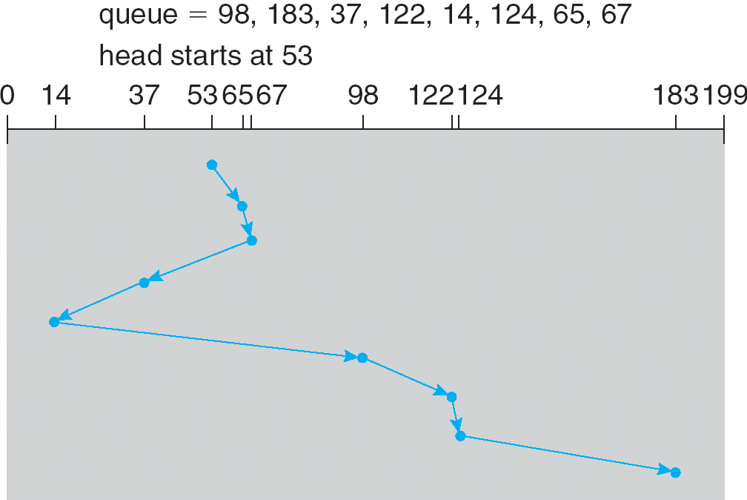
SSTF
Assume initially head direction is towards right
total head movement = 236 cylinders

Slide 20
SCAN/ELEVATOR Algorithm
The disk arm starts at one end of the disk, and moves toward the other end, servicing requests until it gets to the other end of the disk, where the head movement is reversed and servicing continues.
Sometimes called the elevator algorithm.
Several variations of the algorithm exist:
C-SCAN
LOOK
C-LOOK

Slide 21
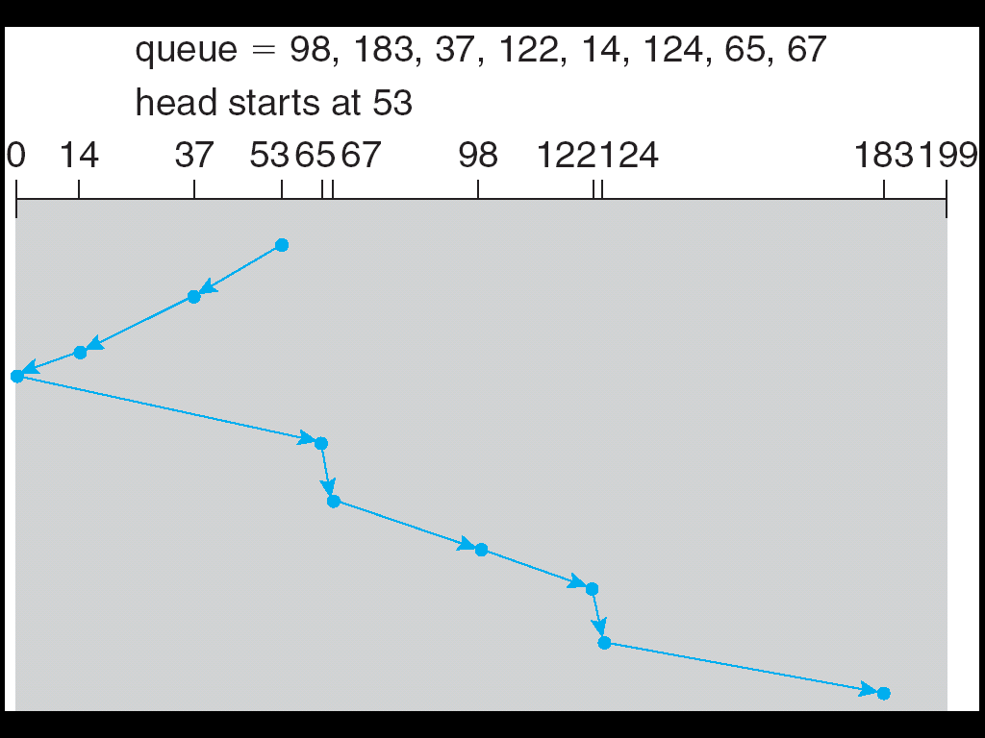
SCAN
total head movement = 236 cylinders
Assume initially head direction is towards left

Slide 22
C-SCAN
C-SCAN: Circular SCAN
Provides a more uniform wait time than SCAN.
Wait time for request: time between arrival of request to the queue and completion of handling the request.
The head moves from one end of the disk to the other; servicing requests as it goes. When it reaches the other end, however, it immediately returns to the beginning of the disk, without servicing any requests on the return trip.
Treats the cylinders as a circular list that wraps around from the last cylinder to the first one.

Slide 23
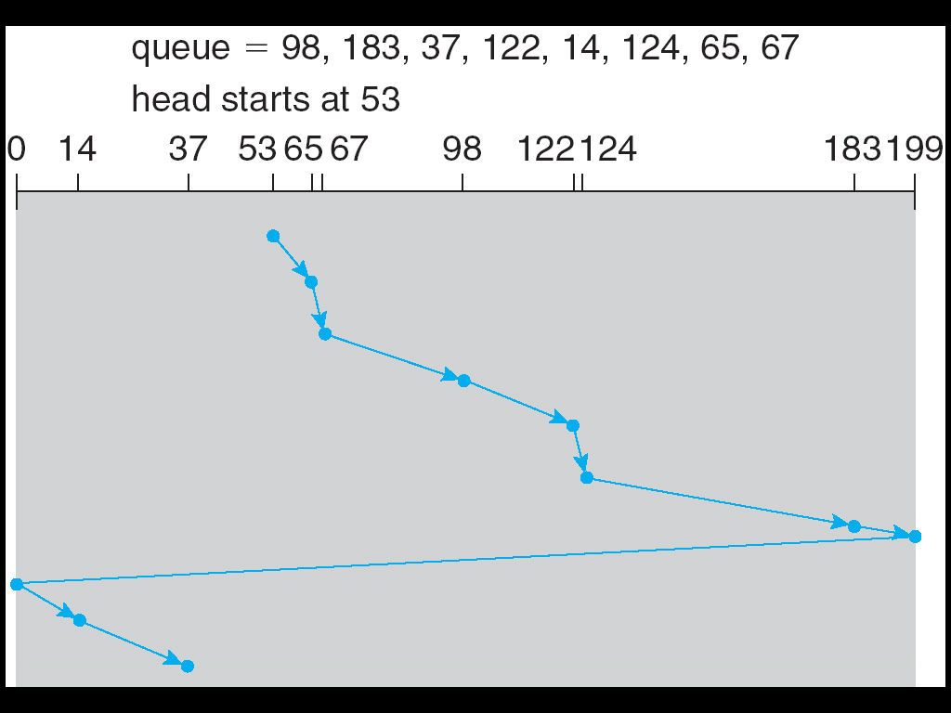
C-SCAN
Assume initially head direction is towards right
Total movement: 382

Slide 24
C-LOOK
Version of C-SCAN
Arm only goes as far as the last request in each direction, then reverses direction immediately (without first going all the way to the end of the disk); and goes to the first request in the other end of the disk.

Slide 25
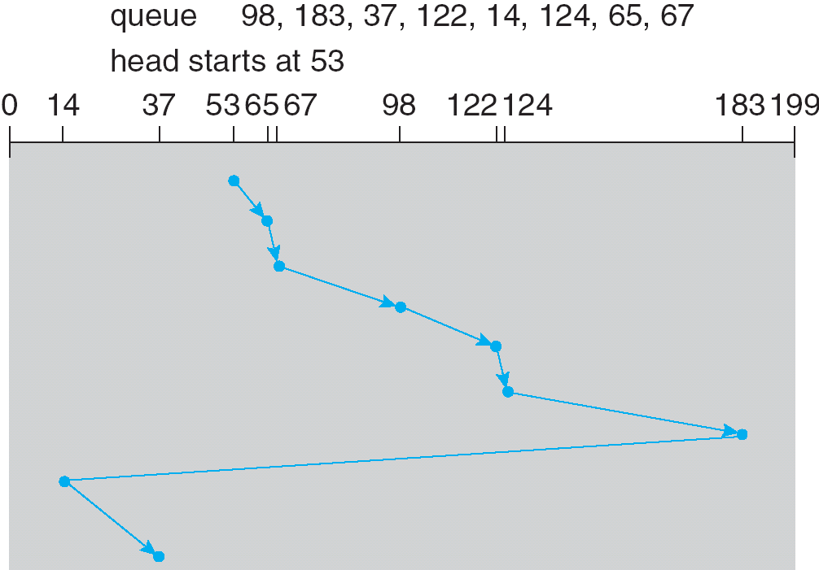
C-LOOK
Assume initially head direction is towards right
Total movement: 322

Slide 26
LOOK
From 53 to 183 (sweep meanwhile)
From 183 to 14 (sweep meanwhile)
Total = 299

Slide 27
Selecting a Disk-Scheduling Algorithm
SSTF is common and has a natural appeal
SCAN and C-SCAN perform better for systems that place a heavy load on the disk.
Performance depends on the number and types of requests.
Requests for disk service can be influenced by the file-allocation method.
The disk-scheduling algorithm should be written as a separate module of the operating system, allowing it to be replaced with a different algorithm if necessary.
Either SSTF or LOOK is a reasonable choice for the default algorithm.

Slide 28
Disk Management
Low-level formatting, or physical formatting — Dividing a disk into sectors that the disk controller can read and write.
To use a disk to hold files, the operating system still needs to record its own data structures on the disk.
Partition the disk into one or more groups of cylinders (volumes).
Logical formatting or “making a file system”.

Slide 29
Low Level Formatting
sector number
error correcting code
HDR
Data (512 bytes)
ECC
Sector
Sector
Sector
….
Disk after low level formatting
magnetic material that can store bits
Disk before low level formatting

Slide 30
Boot Process
Power ON
boot code
partition table
Boot code in ROM is run; it brings MBR into memory and starts MBR boot code
MBR boot code runs; looks to partition table; learns about the boot partition; brings and starts the boot code in the boot partition
Boot code in boot partition loads the kernel sitting in that partition
ROM
MBR
Tiny
Boot
program
partition1
CPU
Boot Block
partition2
kernel
partition3
RAM
Disk

Slide 31
Bad Blocks
Disk sectors (blocks) may become defective. Can no longer store data.
Hardware defect
System should not put data there.
Possible Strategy:
A bad block X can be remapped to a good block Y
Whenever OS tries to access X, disk controller accesses Y.
Some sectors (blocks) of disk can be reserved for this mapping.
This is called sector sparing.

Slide 32
Bad Blocks
block (sector) request
x
y
Disk Controller
z
w
bad block mapping table
bad sector
x
z
Table stored
on disk
y
w
Disk
spare sectors

Slide 33
Swap Space Management
Swap-space — Virtual memory uses disk space as an extension of main memory.
Swap-space can be carved out of the normal file system, or, more commonly, it can be in a separate disk partition.
Swap-space management
Kernel uses swap maps to track swap-space use.
Example: 4.3BSD OS allocates swap space when process starts; holds text segment (the program) and data segment.
Example: Solaris 2 OS allocates swap space only when a page is forced out of physical memory, not when the virtual memory page is first created.

Slide 34
Data Structures for Swapping on Linux Systems
free slot

Slide 35
RAID Structure
RAID: Redundant Array of Independent Disks
Multiple disk drives provides reliability via redundancy.
Multiple disks can be organized in different ways for Reliability and Performance (RAID is arranged into different levels/schemes)
If you have many disks: The probability of one of them failing becomes higher. The probability of all of them failing (at the same time) becomes lower.

Slide 36
RAID
RAID schemes improve performance and improve the reliability of the storage system by storing redundant data.
Redundancy → improves reliability (and also performance to some extend)
Disk striping → improves performance
Disk striping uses a group of disks as one storage unit and distributes (stripes) the data over those disks
Redundancy by:
Mirroring or shadowing keeps duplicate of each disk.
Use of parity bits or ECC (error correction codes) causes much less redundancy.

Slide 37
RAID Striping example: improves performance
Operating Systems Software
Give me blocks (n, n+1, …, n+k) of the disk (k contiguous disk blocks)
RAID Controller
Striping
give block n
give block n+3
give block n+1
give block n+2
Disk Controller
Disk Controller
Disk Controller
Disk Controller
Disk
n
Disk
n+1
Disk
n+2
Disk
n+3

Slide 38
Different RAID Organizations/Schemes (also called Levels)
RAID Level 0: block level striping (no redundancy)
RAID Level 1: mirroring
RAID Level 2: bit level striping + error correcting codes
RAID Level 3: bit level striping + parity
RAID Level 4: block level striping + parity
RAID Level 5: block level striping + distributed parity
….

Slide 39
RAID 0: Block Level Striping
data: in blocks; adjacent blocks go into different disks
one block can be k sectors
file system considers all disks as a single large disk
Block 0
Block 1
Block 2
Block 3
Block 4
Block 5
Block 6
Block 7
…
Block 9
Block10
Block11
Block 8
Disk 1
Disk 2
Disk 3
Disk 4
No redundancy;
parallel read for large data transfers (larger than block size)

Slide 40
RAID 0
file X
Assume a file is allocated a contiguous set of blocks
file Y
Block 0
Block 1
Block 2
Block 3
Block 4
Block 5
Block 6
Block 7
…
Block 9
Block10
Block11
Block 8
Disk 1
Disk 2
Disk 3
Disk 4
This is called Striping

Slide 41
RAID 1: Mirroring
No striping
…
Disk 1
Mirror
Mirrored copy
Disk 2

Slide 42
RAID 1
We are just mirroring the disks (copying one disk to another one).
Without striping: no performance gain, except for reads (doubled read-rate)
Reliability provided. If one disk fails, data can be recovered from the other disk.
If there are originally N (N >= 1) disks; we need N more disks to mirror
Quite costly in terms of disks required. This cost is for reliability. We can express the cost as:
overhead/data = 1/1

Slide 43
RAID 2
Bit level striping.
Error correcting codes (ECC) used.
For example every 4 data bit is protected with 3 redundant bits. If one of these 4 bits is in error, we can understand which one it is and correct it using 3 other code bits.
Hamming codes can be used.
data bits
error correction bits
bit
bit
bit
bit
bit
bit
bit
bit
bit
bit
bit
bit
bit
bit
can be bits of one byte
overhead/data = 3/4

Slide 44
RAID 2 organization
b0
b1
b2
b3
c0
c1
c2
b4
b5
b6
b7
c0
c0
c0
….
….
….
….
Disk 1
Disk 2
Disk 3
Disk 4
Disk 5
Disk 6
Disk 7
bx: data bits
cx: control bits

Slide 45
RAID 2
dddddddd dddddddd dddddddd
dddddddd dddddddd dddddddd
dddddddd dddddddd dddddddd
dddddddd dddddddd dddddddd
cccccccc cccccccc cccccccc
cccccccc cccccccc cccccccc
cccccccc cccccccc cccccccc
Disk 1
Disk 2
Disk 3
Disk 4
Disk 5
Disk 6
Disk 7
d: data bit c: control bit

Slide 46
RAID 3
Improved on RAID 2 in terms of space efficiency
Only one control bit is used for k data bits
That control bit is a parity bit
compute the parity of k bits and store it in the parity bit.
k can be 4, 8, …
This is enough to detect and correct one bit errors
even parity
P
b
b
b
b
p
1
0
1
1
1
example
b
b
b
b
p
0
1
0
1
0
overhead/data = 1/4

Slide 47
RAID 3: example
b0
b1
b2
b3
p
b4
b5
b6
b7
p
…
….
….
…
….
Disk 1
Disk 2
Disk 3
Disk 4
Disk 5

Slide 48
RAID 3: example
1
0
1
1
1
0
1
0
1
0
…
….
….
…
….
Disk 1
Disk 2
Disk 3
Disk 4
Disk 5
Even parity is used here

Slide 49
RAID 3: example
Let one disk fail! How can we recover its data
1
0
1
1
1
0
1
0
1
0
…
….
….
…
….
Disk 1
Disk 2
Disk 3
Disk 4
Disk 5
Look to disks 1, 2, 4, and 5. compute the parity and according to that
generate the content of disk 3.

Slide 50
RAID 3: example
1
1
0
0
1
1
1
1
1
0
1
1
0
1
0
1
0
0
…
….
….
…
….
Disk 1
Disk 2
Disk 3
Disk 4
Disk 5

Slide 51
RAID 4
Uses block level striping (like RAID 0)
But uses an additional disk to store the parity block
Error recovery as in RAID 3
Block 0
Block 1
Block 2
Block 3
Parity
Block
Block 4
Block 5
Block 6
Block 7
Parity
Block
Block 8
Block 9
Block 10
Block 11
Parity
Block
….
Disk 1
Disk 2
Disk 3
Disk 4
Disk 5

Slide 52
RAID 5
Parity blocks are distributed on other disks. Similar to RAID 4.
Load on parity disk is distributed in this way
Block 0
Block 1
Block 2
Block 3
Parity
Block
Block 4
Block 5
Block 6
Parity
Block
Block 7
Block 8
Block 9
Parity
Block
Block 10
Block 11
….
Disk 1
Disk 2
Disk 3
Disk 4
Disk 5

Slide 53
RAID 6
Similar to RAID level 5 but uses not only a single parity bit, but multiple ECC bits to guards against multiple disk failures
Called also as: P+Q scheme.
Reed-Solomon codes are used as ECC code.
Example: 2-bits ECC code can be used for every 4-bits data.

Slide 54
RAID Levels (0 through 6) Summary

Slide 55
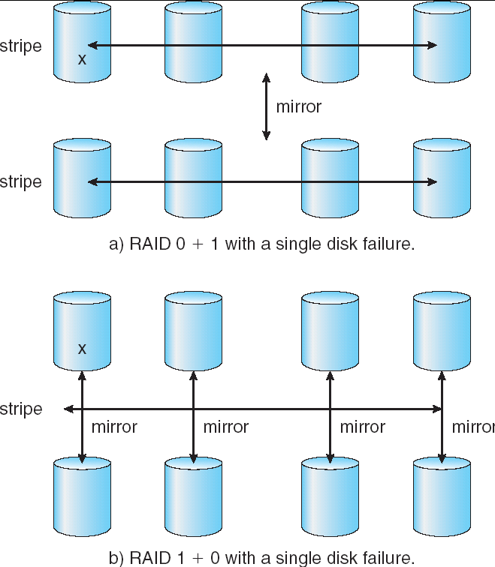
RAID Levels 0+1 and 1+0
First stripe, then mirror
RAID 0+1
RAID 1+0
First mirror, then stripe
(stripe of mirrors)

Slide 56
RAID 0+1
Mirror of stripes: first a set of disks striped, then the set is mirrored.
Minimum 3-4 disks required.
Two groups are created. In a group (set of disks) data is striped. Across groups, data is mirrored.
Group 1
Group 2
Disk1
Disk2
Disk3
Disk4
Disk5
Disk6
Block0
Block1
Block2
Block0
Block1
Block2
Block3
Block4
Block5
Block3
Block4
Block5
Block6
Block7
Block8
Block6
Block7
Block8

Slide 57
RAID 1+0
Striped of mirrored pairs: first mirror disk in pairs, then stripe them.
Minimum 4 disk s required. Both reliability and performance.
Disks are groups. A group has 2 disks (for mirrors). In a group, data is mirrored.
Across groups, data is striped.
Group 1
Group 2
Group 3
Disk1
Disk2
Disk3
Disk4
Disk5
Disk6
Block0
Block0
Block1
Block1
Block2
Block2
Block3
Block3
Block4
Block4
Block5
Block5
Block6
Block6
Block7
Block7
Block8
Block8

Slide 58
RAID 1+0 has better reliability than RAID 0+1
Advantage of 1+0 over 0+1:
In 0+1, if a single disk fails, the entire stripe will not be available any more. The other stripe will be used.
In 1+0, if a single disk fails, the mirror of it is available, hence both of the stripes.

Slide 59
Stable Storage Implementation
Write-ahead log scheme requires stable storage.
Stable storage definition: information residing in stable storage is never lost. A write to a block is either fully successful, or non-reflected and did not corrupt the existing data (previous data is intact).
To implement stable storage:
Replicate information on more than one nonvolatile storage media with independent failure modes.
Update information in a controlled manner to ensure that we can recover the stable data after any failure during data transfer or recovery.

Slide 60
Tertiary Storage Devices
Low cost is the defining characteristic of tertiary storage.
Generally, tertiary storage is built using removable media
Common examples of removable media are
floppy disks and
CD-ROMs;

Slide 61
Removable Disks
Floppy disk — thin flexible disk coated with magnetic material, enclosed in a protective plastic case.
Most floppies hold about 1 MB; similar technology is used for removable disks that hold more than 1 GB.
Removable magnetic disks can be nearly as fast as hard disks, but they are at a greater risk of damage from exposure.

Slide 62
Removable Disks
A magneto-optic disk records data on a rigid platter coated with magnetic material.
Optical disks do not use magnetism; they employ special materials that are altered by laser light.

Slide 63
WORM Disks
The data on read-write disks can be modified over and over.
WORM (“Write Once, Read Many Times”) disks can be written only once.
Thin aluminum film sandwiched between two glass or plastic platters.
To write a bit, the drive uses a laser light to burn a small hole through the aluminum; information can be destroyed but not altered.
Very durable and reliable.
Read Only disks, such ad CD-ROM and DVD, come from the factory with the data pre-recorded.

Slide 64
Tapes
Compared to a disk, a tape is less expensive and holds more data, but random access is much slower.
Tape is an economical medium for purposes that do not require fast random access, e.g., backup copies of disk data, holding huge volumes of data.
Large tape installations typically use robotic tape changers that move tapes between tape drives and storage slots in a tape library.
stacker – library that holds a few tapes
silo – library that holds thousands of tapes
A disk-resident file can be archived to tape for low cost storage; the computer can stage it back into disk storage for active use.

Slide 65
Operating System Issues
Major OS jobs are to manage physical devices and to present a virtual machine abstraction to applications
For hard disks, the OS provides two abstraction:
Raw device – an array of data blocks.
File system – the OS queues and schedules the interleaved requests from several applications.

Slide 66
Application Interface
Most OSs handle removable disks almost exactly like fixed disks — a new cartridge is formatted and an empty file system is generated on the disk.
Tapes are presented as a raw storage medium, i.e., and application does not not open a file on the tape, it opens the whole tape drive as a raw device.
Usually the tape drive is reserved for the exclusive use of that application.
Since the OS does not provide file system services, the application must decide how to use the array of blocks.
Since every application makes up its own rules for how to organize a tape, a tape full of data can generally only be used by the program that created it.

Slide 67
Tape drives
The basic operations for a tape drive differ from those of a disk drive.
locate positions the tape to a specific block (corresponds to seek).
The read position operation returns the block number where the tape head is.
Tape drives are “append-only” devices; updating a block in the middle of the tape also effectively erases everything beyond that block.
An EOT mark is placed after a block that is written.

Slide 68
File Naming
The issue of naming files on removable media is especially difficult when we want to write data on a removable cartridge on one computer, and then use the cartridge in another computer.
Contemporary OSs generally leave the name space problem unsolved for removable media, and it depends on applications and users to figure out how to access and interpret the data.
Some kinds of removable media (e.g., CDs) are so well standardized that all computers use them the same way.

Slide 69
Hierarchical Storage Management (HSM)
A hierarchical storage system extends the storage hierarchy beyond primary memory and secondary storage to incorporate tertiary storage — usually implemented as a jukebox of tapes or removable disks.
Usually incorporate tertiary storage by extending the file system.
Small and frequently used files remain on disk.
Large, old, inactive files are archived to the jukebox.
HSM is usually found in supercomputing centers and other large installations that have enormous volumes of data.

Slide 70
Speed
Two aspects of speed in tertiary storage are bandwidth and latency.
Bandwidth is measured in bytes per second.
Sustained bandwidth – average data rate during a large transfer; # of bytes/transfer time. Data rate when the data stream is actually flowing.
Effective bandwidth – average over the entire I/O time, including seek or locate, and cartridge switching. Drive’s overall data rate.
Effective bandwidth <= sustained bandwidth

Slide 71
Speed
Access latency – amount of time needed to locate data.
Access time for a disk – move the arm to the selected cylinder and wait for the rotational latency; < 35 milliseconds.
Access on tape requires winding the tape reels until the selected block reaches the tape head; tens or hundreds of seconds.
Generally say that random access within a tape cartridge is about a thousand times slower than random access on disk.
The low cost of tertiary storage is a result of having many cheap cartridges share a few expensive drives.
A removable library is best devoted to the storage of infrequently used data, because the library can only satisfy a relatively small number of I/O requests per hour.

Slide 72
Reliability
A fixed disk drive is likely to be more reliable than a removable disk or tape drive.
An optical cartridge is likely to be more reliable than a magnetic disk or tape.
A head crash in a fixed hard disk generally destroys the data, whereas the failure of a tape drive or optical disk drive often leaves the data cartridge unharmed.

Slide 73
Cost
Main memory is much more expensive than disk storage
The cost per megabyte of hard disk storage is competitive with magnetic tape if only one tape is used per drive.
The cheapest tape drives and the cheapest disk drives have had about the same storage capacity over the years.
Tertiary storage gives a cost savings only when the number of cartridges is considerably larger than the number of drives.

Slide 74
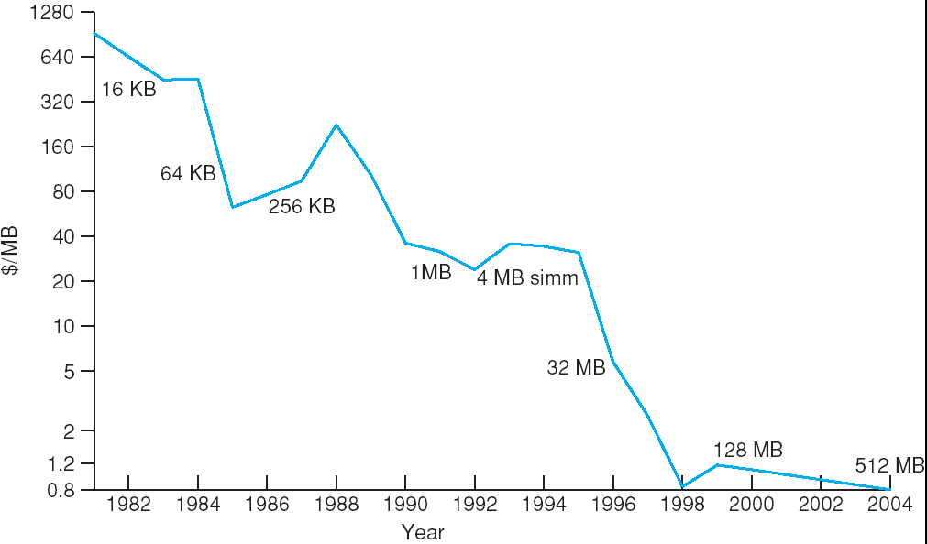
Price per Megabyte of DRAM, From 1981 to 2004

Slide 75
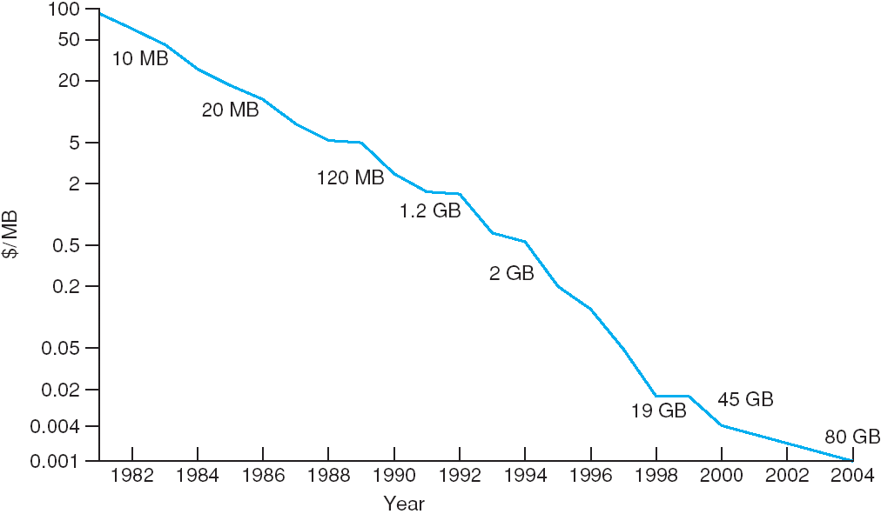
Price per Megabyte of Magnetic Hard Disk, From 1981 to 2004

Slide 76
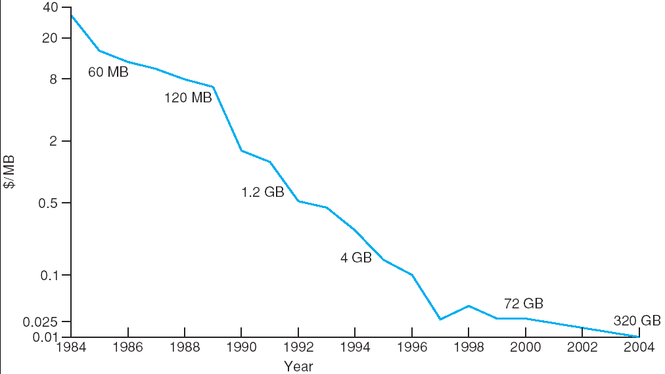
Price per Megabyte of a Tape Drive, From 1984-2000

Slide 77
References
The slides here are adapted/modified from the textbook and its slides: Operating System Concepts, Silberschatz et al., 7th & 8th editions, Wiley. Operating System Concepts, 7th and 8th editions, Silberschatz et al. Wiley.
Modern Operating Systems, Andrew S. Tanenbaum, 3rd edition, 2009.

