Slide 1

Chapter 8
Memory Management Strategies
Bilkent University
Department of Computer Engineering
CS342 Operating Systems
Ibrahim Korpeoglu
Last Update: April 11, 2018

Slide 2
Objectives and Outline
Objectives
Describe ways of organizing memory hardware
discuss various memory-management techniques, including paging and segmentation
Description of the Intel Pentium, which supports both pure segmentation and segmentation with paging
Outline
Background
  Address space
  Logical address space
  MMU
Contiguous Memory Allocation
Paging
  Structure of the Page Table
Segmentation
Example: The Intel Pentium

Slide 3
Background
Program must be brought (from disk) into memory and placed within a process for it to be run
Main memory and registers are only storage CPU can access directly
Register access in one CPU clock (or less)
Main memory can take many cycles
Cache sits between main memory and CPU registers
Protection of memory required to ensure correct operation

Slide 4
Background
Main Memory
CPU
cache
instructions
Registers
Process
data
program image
in memory
Operating
System
Disk

Slide 5
Multiple programs
Multiple programs may share memory. We need protection.
  Programs should not access each other's memory and OS memory
  OS can access everything.
  A program is allowed to touch a portion of physical memory.
  Each program should touch its own physical memory.
  Hardware support needed for protection (ensure process is accessing OK places)
Base and limit registers at CPU (hw support) can be used for that purpose.
  Base register: contains the start phy address of the program running.
  Limit register: contains the size of the program.
Hardware checks every address to be in the range.
If program relocated, base value changed.

Slide 6
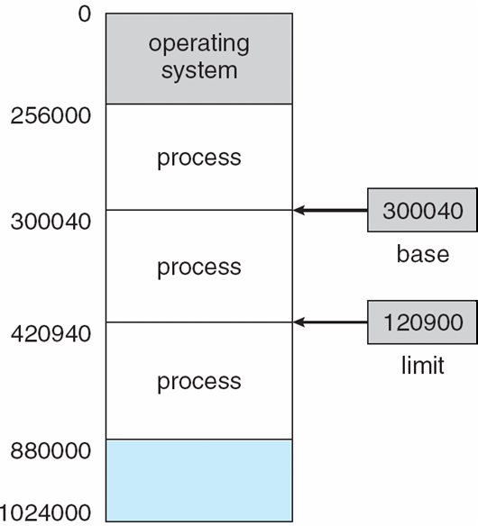
Protection: Base and Limit Registers
A pair of base and limit registers define the physical address space of a process
A process should be accessing
and using that range.
Protection can be
provided in this way.
Each physical address should be in
range [base, base+limit]

Slide 7
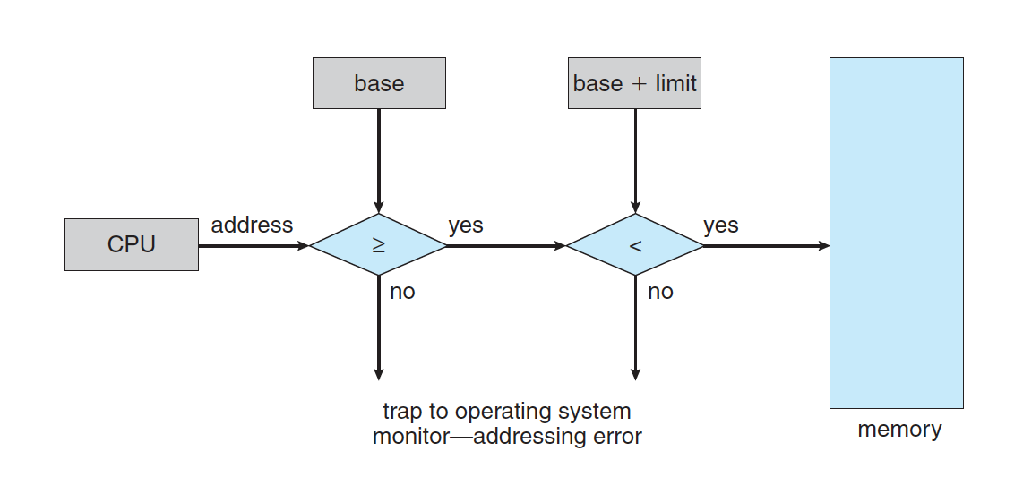
Protection
Hardware address protection with base and limit registers

Slide 8
Binding of Instructions and Data to Memory
Address binding of instructions and data to (physical) memory addresses can happen at three different stages
  Compile time: If memory location known a priori, absolute code can be generated; must recompile code if starting location changes
  Load time: Must generate relocatable code if memory location is not known at compile time.
  Execution time: Binding delayed until run time if the process can be moved during its execution from one memory segment to another. Need hardware support for address maps (e.g., base and limit registers)
RAM
Program
a program
?
data
instructions

Slide 9
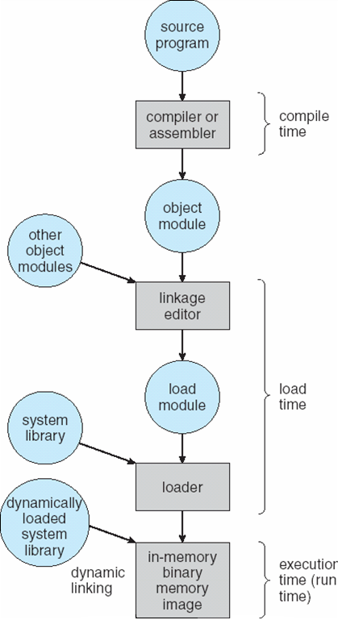
Multistep Processing of a User Program
Addresses may be represented in different
ways during these steps

Slide 10
Program addresses and memory
When code is generated (or assembly program is written) we use memory addresses for variables, functions and branching/jumping.
Those addresses can be physical or logical memory addresses.
In very early systems they are just physical memory addresses.
  A program has to be loaded to that address to run.
  No relocation
func
variable
func
variable
func
variable
main
program

Slide 11
Program addresses and memory
RAM
physical addresses
of RAM
Assume they are physical addresses
44
40
Program
36
32
Add
12
28
Mov
8
24
…
4
20
Jump 8
0
16
Add
12
Mov
8
…
4
Jump 8
0

Slide 12
Program addresses and memory
RAM
physical addresses
of RAM
44
40
36
32
Cmp
28
Program 2
Sub
24
Program 1
Program 2
…
20
Add
12
Cmp
12
Jump 12
16
Add
12
Mov
8
Sub
8
Program 1
Mov
8
…
4
…
4
…
4
Jump 8
0
Jump 12
0
Jump 8
0

Slide 13
Logical address space concept
We need logical address space concept, that is different that the physical RAM (main memory) addresses.
A program uses logical addresses.
Set of logical addresses used by the program is its logical address space
  Logical address space can be, for example, [0, max_address]
Logical address space has to be mapped somewhere in physical memory
RAM
phy_max
Program
logic_max
limit
Program
logical
address
space
base
0
0

Slide 14
Logical vs. Physical Address Space
The concept of a logical address space that is bound to a separate physical address space is central to proper memory management
  Logical address – generated by the CPU; also referred to as virtual address
  Physical address – address seen by the memory unit
Logical and physical addresses are the same in compile-time and load-time address-binding schemes;
Logical (virtual) and physical addresses differ in execution-time address-binding scheme

Slide 15
Logical and physical addresses
CPU
Main Memory (RAM)
base limit
60
56
52
48
44
40
36
32
28
24
20
16
12
08
04
00
24
32
int x
int y;
cmp ..
mov r1, M[28]
mov r2, M[24]
add r1, r2, r3
jmp 16
mov ..
PC
M[28+base]
IR
mov r1, M[28]
M[28+24]
M[52]
physical addresses
a relocatable program
28
24
20
16
12
08
04
00
int x
int y;
cmp ..
mov r1, M[28]
mov r2, M[24]
add r1, r2, r3
jmp 16
mov ..
logical addresses

Slide 16
Memory-Management Unit (MMU)
Hardware device that maps logical (virtual) to physical address
In MMU scheme, the value in the relocation register (i.e., base register) is added to every address generated by a user process at the time it is sent to memory
The user program deals with logical addresses; it never sees the real physical addresses

Slide 17
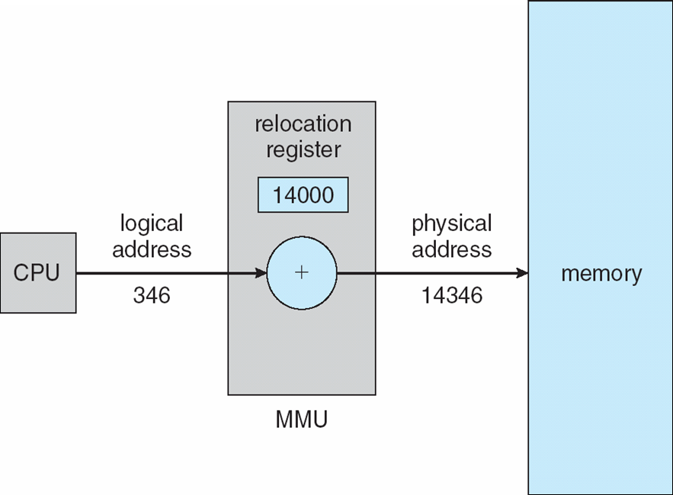
Dynamic relocation using a relocation register

Slide 18
Dynamic Loading
Routine is not loaded until it is called
Better memory-space utilization; unused routine is never loaded
  Useful when large amounts of code are needed to handle infrequently occurring cases
No special support from the operating system is required,
  implemented through program design

Slide 19
Dynamic Linking
Linking postponed until execution time
Small piece of code, stub, used to locate the appropriate memory-resident library routine
Stub replaces itself with the address of the routine, and executes the routine
Operating system needed to check if routine is in processes’ memory address
Dynamic linking is particularly useful for libraries
  Standard C library is shared library that is dynamically linked, not statically linked.
  You can link statically if you want.
System also known as shared libraries

Slide 20
Contiguous Memory Allocation
(Dynamic Memory Allocation Problem)

Slide 21
Contiguous Allocation
Main memory is partitioned usually into two partitions:
  Resident operating system, usually held in low memory with interrupt vector
  User processes then held in high memory
Relocation registers used to protect user processes from each other, and from changing operating-system code and data
  Base register contains value of smallest physical address
  Limit register contains range of logical addresses – each logical address must be less than the limit register
  MMU maps logical addresses dynamically

Slide 22
Basic Memory Allocation Strategies
In this chapter, we will cover 3 basic main memory allocation strategies to processes
  1) Contiguous allocation
  2) Paging
  3) Segmentation

Slide 23
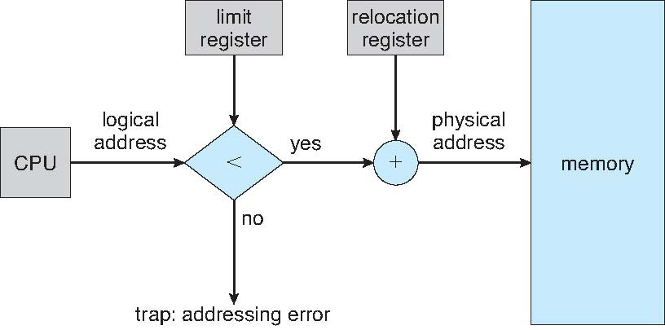
Hardware Support for Relocation and Limit Registers

Slide 24
Contiguous Allocation (Cont)
Multiple-partition allocation
  Hole – block of available memory; holes of various size are scattered throughout memory
  When a process arrives, it is allocated memory from a hole large enough to accommodate it
  Operating system maintains information about:
  a) allocated partitions b) free partitions (hole)
OS
OS
OS
OS
process 5
process 5
process 5
process 5
process 9
process 9
process 8
process 10
process 2
process 2
process 2
process 2

Slide 25
Dynamic Storage-Allocation Problem
How to satisfy a request of size n from a list of free holes
First-fit: Allocate the first hole that is big enough
Best-fit: Allocate the smallest hole that is big enough; must search entire list, unless ordered by size
  Produces the smallest leftover hole
Worst-fit: Allocate the largest hole; must also search entire list
  Produces the largest leftover hole
First-fit and best-fit better than worst-fit in terms of speed and storage utilization

Slide 26
Fragmentation
External Fragmentation – total memory space exists to satisfy a request, but it is not contiguous
Internal Fragmentation – allocated memory may be slightly larger than requested memory; this size difference is memory internal to a partition (allocation), but not being used
Reduce external fragmentation by compaction
  Shuffle memory contents to place all free memory together in one large block
  Compaction is possible only if relocation is dynamic, and is done at execution time
  I/O problem
    Latch job in memory while it is involved in I/O
    Do I/O only into OS buffers

Slide 27
Paging

Slide 28
Paging
Physical address space of a process can be noncontiguous; process is allocated physical memory whenever the latter is available
  Physical address space will also be noncontiguous.
Divide physical memory into fixed-sized blocks called frames (size is power of 2, between 512 bytes and 8,192 bytes)
Divide logical memory into blocks of same size called pages
Keep track of all free frames
To run a program of size n pages, need to find n free frames and load program
Set up a page table to translate logical to physical addresses
Internal fragmentation

Slide 29
Paging
RAM (Physical Memory)
a program
0
0
1
a frame
(size = 2^{x})
1
2
2
logical address space
3
3
4
physical memory:
set of fixed sized
frames
4
5
5
7
program: set of pages
6
8
Page size = Frame size
9

Slide 30
Paging
RAM
a program
0
0
0
1
1
2
2
2
3
3
load
1
4
4
5
5
0 mapped_to 1
1 mapped_to 4
3
7
2 mapped_to 2
5
6
3 mapped_to 7
4 mapped_to 9
8
5 mapped_to 6
4
9
page table

Slide 31
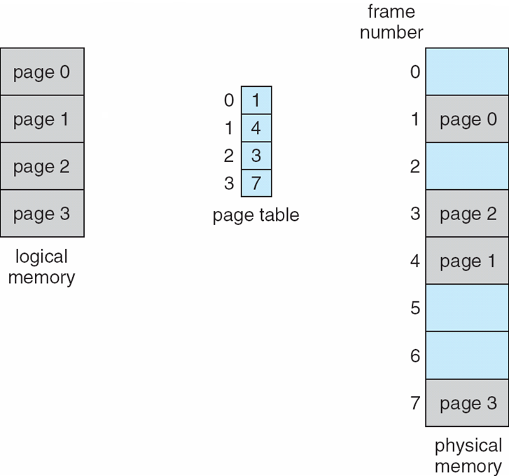
Example

Slide 32
Address Translation Scheme
  Assume Logical Addresses are m bits. Then logical address space is 2^{m} bytes.
  Assume page size is 2^{n} bytes.
Logical Address generated by CPU is divided into:
  Page number (p) – used as an index into a page table which contains base address of each page in physical memory
  Page offset (d) – combined with base address to define the physical memory address that is sent to the memory unit
page number
page offset
p
d
(m – n) bits
n bits
m bits

Slide 33
Simple example
Assume m is 3 and n is 2
Logical addresses
000
001
010
011
100
101
110
111
000
001
010
011
100
101
110
111
page0
page1

Slide 34
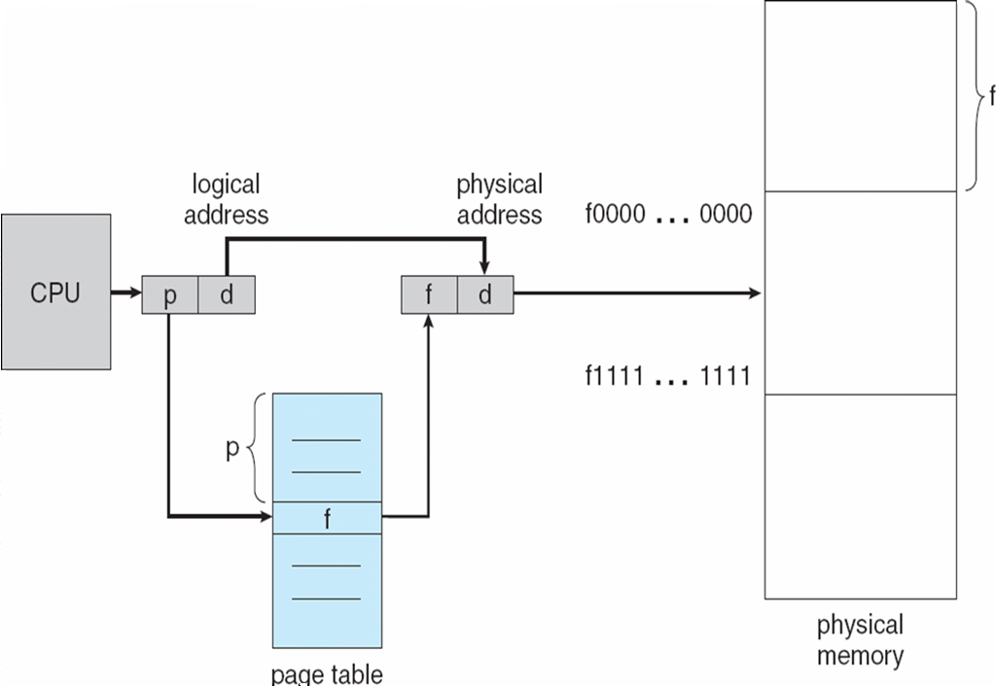
Paging Hardware: address translation

Slide 35
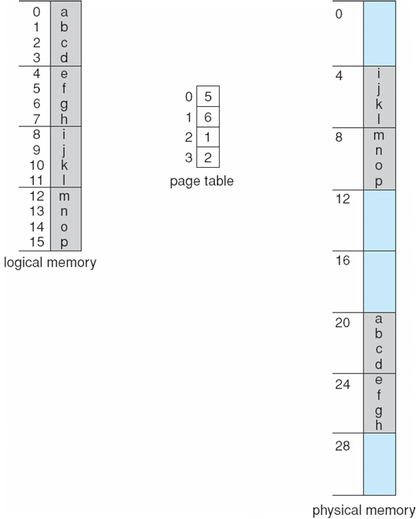
Paging Example
page size = 4 bytes
= 2²
LA = 5
PA = ?
5 is 0101
PA = 11001
4 bit logical address
LA = 11
PA = ?
32 byte memory
11 is 1011
PA = 00111
offset
(dispacement)
inside
page
page
number
LA = 13
PA = ?
13 is 1101
PA = 01001

Slide 36
Address translation example 1
15
000
0
16 bit logical address
14
000
0
0010000000000100
13
000
0
page size = 4096 bytes
(offset is 12 bits)
12
000
0
p#
offset
11
111
1
10
000
0
9
101
1
8
000
0
mapping
7
000
0
6
000
0
5
011
1
frame number
4
100
1
valid/invalid bit
f#
offset
3
000
1
2
110
1
110
000000000100
1
001
1
15 bit physical address
0
010
1
page table

Slide 37
Address translation example 2
m=3; 2³ ⁼ 8 logical addresses
2 bits for offset
0000
0001
0010
0011
0100
0101
0110
0111
1000
1001
1010
1011
1100
1101
1110
1111
n=2; page size = 2² = 4
frame 00
000
001
010
011
100
101
110
111
A
B
C
D
page 0
frame 01
E
F
G
H
1 bit for page#
page 1
E
F
G
H
frame 10
Logical Memory
page table
A
B
C
D
0
11
frame 11
1
10
each entry is used to map
4 addresses (page size addresses)
2 bits for frame#
Physical Memory

Slide 38
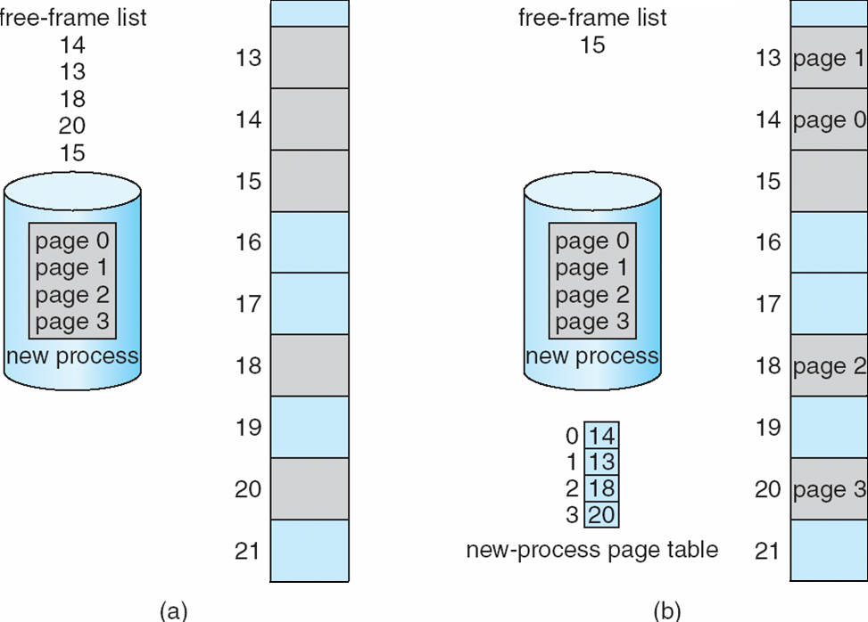
Free Frames
OS keeps info
about the frames
in its frame table
Before allocation
After allocation

Slide 39
Implementation of Page Table
Page table is kept in main memory
Page-table base register (PTBR) points to the page table
Page-table length register (PTLR) indicates size of the page table
In this scheme every data/instruction access requires two memory accesses. One for the page table and one for the data/instruction.
The two memory access problem can be solved by the use of a special fast-lookup hardware cache called associative memory or translation look-aside buffers (TLBs)
Some TLBs store address-space identifiers (ASIDs) in each TLB entry – uniquely identifies each process to provide address-space protection for that process

Slide 40
Implementation of Page Table
RAM
Program
P1
Program
P2
CPU
PC
PT1
PT2
Kernel
Memory
Page
Table
of
P1
Page
Table
of
P2
PTBR
PTLR
Currently running
process is process 1 (P1)
PCB1
PCB2

Slide 41
TLB
In this scheme every data/instruction access requires two memory accesses.
    One for the page table
    One for the data/instruction.
The two memory access problem can be solved by the use of a special fast-lookup hardware cache called associative memory or translation look-aside buffers (TLBs)
Learned (p#, f#) mappings can be cached in TLB.
  TLB: a set of entries (limited size); each entry storing a different mapping
  Can be accessed very fast

Slide 42
TLB Associative Memory
Associative memory – parallel search
Address translation (p, d)
  If p is in TLB, get frame # out
  Otherwise get frame # from page table in memory
Page #
Frame #
Some TLBs store address-space identifiers (ASIDs) in each
TLB entry – uniquely identifies each process to
provide address-space protection for that process

Slide 43
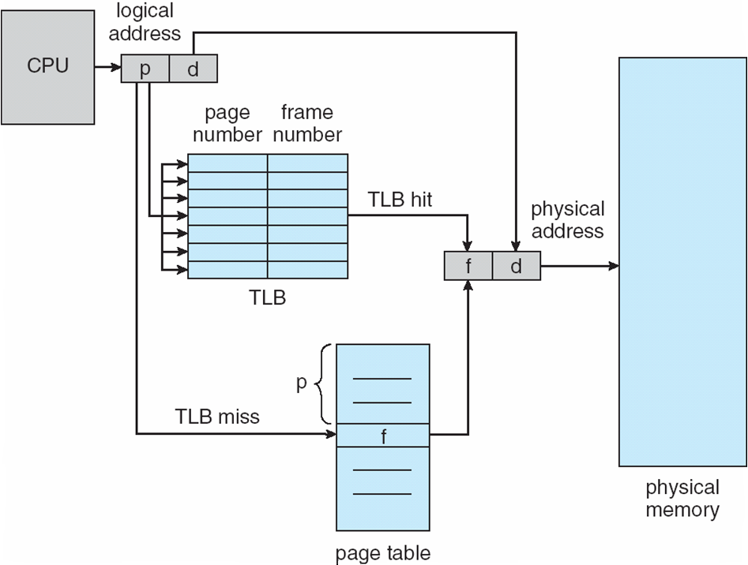
Paging Hardware With TLB

Slide 44
Effective Memory Access Time
TLB (associative registers) Lookup = ε time unit
Assume memory cycle time is 1 microsecond
Hit ratio – percentage of times that a page number is found in the TLB; ratio related to the TLB size
Hit ratio = α
Effective Access Time (EAT)
EAT = (1 + ε) α + (2 + ε)(1 – α)
= 2 + ε – α

Slide 45
Memory Protection
Memory protection implemented by associating a protection bit with each page
  Read only page
  Executable page
  Read-write page
Valid-invalid bit attached to each entry in the page table:
  “valid” indicates that the page is in the process’ logical address space, and is thus a legal page
  “invalid” indicates that the page is not in the process’ logical address space

Slide 46
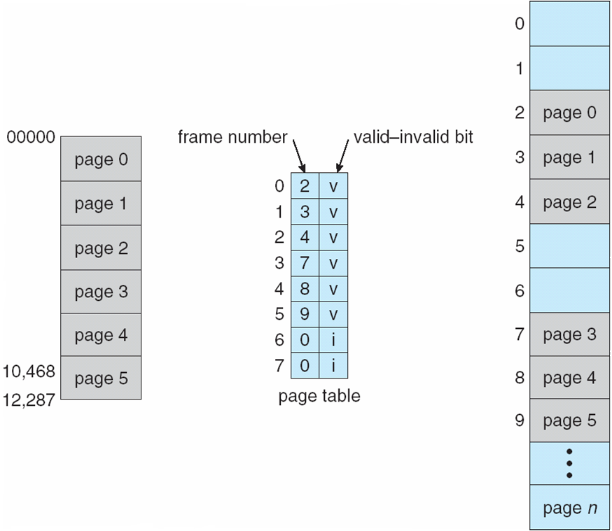
Valid (v) or Invalid (i) Bit In A Page Table

Slide 47
Page Table Entry Structure
A typical size of a page table entry can be 32 bits. Depends on the architecture
Typically we have the following fields in a page table entry.
Referenced
bit
Protection bits
(read, read-write, execute)
Reserved
Page Frame Number
Caching
Disabled
bit
Modified
(Dirty)
bit
Valid/Invalid
(Present/Absent)
bit

Slide 48
Shared Pages
A program can be started multiple times (same program executed by multiple process)
  Code pages can be shared
  Shared code
    One copy of read-only (reentrant) code shared among processes (i.e., text editors, compilers, window systems).
    Shared code must appear in same location in the logical address space of all processes
  Private code and data
    Each process keeps a separate copy of the code and data
    The pages for the private code and data can appear anywhere in the logical address space

Slide 49
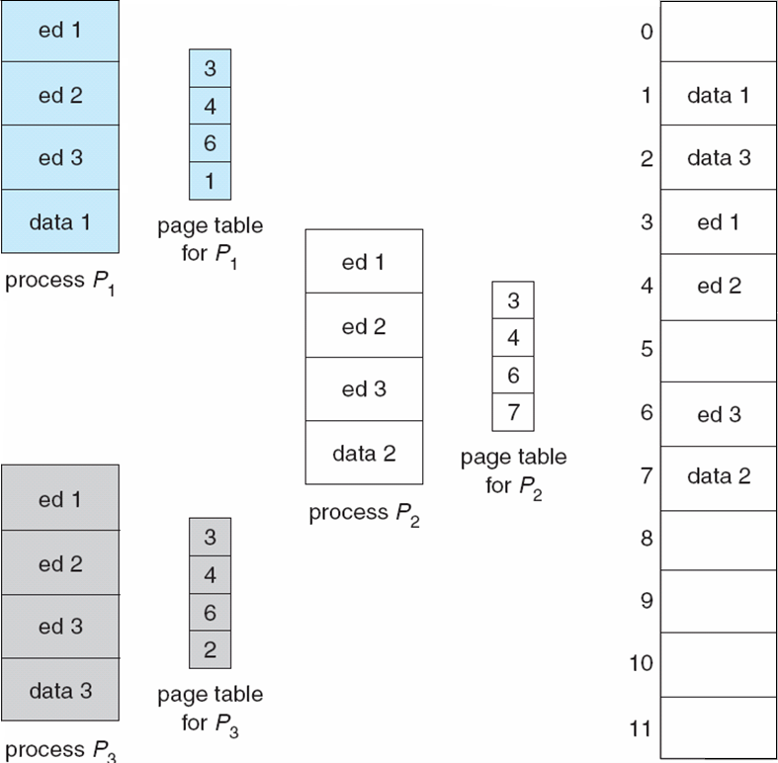
Shared Pages Example

Slide 50
Structure of the Page Table

Slide 51
Structure of the Page Table
Hierarchical Paging
Hashed Page Tables
Inverted Page Tables

Slide 52
Hierarchical Page Tables
Break up the logical address space into subspaces; multiple page tables
  Breaking the page table into sub-tables
A simple technique is a two-level page table
00
01
00
01
10
10
11
PT
11
PT
Log Mem
Log Mem

Slide 53
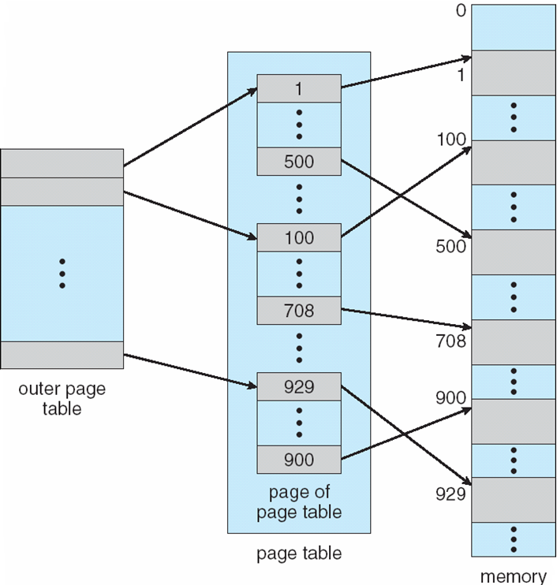
Two-Level Paging Scheme

Slide 54
Two-Level Paging Scheme
logical address
logical address
offset
offset
00
01
10
11
0000
0001
0010
0011
0100
0101
0110
0111
00
01
10
11
00
01
10
11
1000
1001
1010
1011
00
01
10
11
1100
1101
1110
1111
two-level
page table
00
01
10
11
single level
Page table

Slide 55
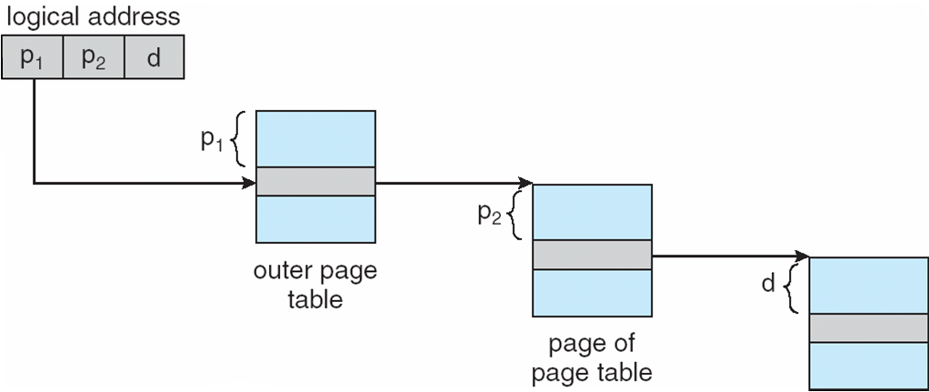
Address-Translation Scheme
A logical address is divided into 3 parts:
page
number
part 1
page
number
part 2
page offset
p₁
p₂
d
p₁ is an index into the outer page table, and p₂ is the index into the inner page table

Slide 56
Example: two level page table
Assume:
  32 bit virtual (logical addresses) used
  2 level paging
  Address split scheme: [10, 10, 12]
    10 bits page number part 1
    10 bits for page number part 2
    12 bits for offset
  Page size = 2^12 = 4096 bytes = 4 KB
  An outer (top level) page table will have 2^10 entries = 1024 entries
  An innner (second level) page table will have 2^10 = 1024 entries

Slide 57
Example: two level page table need
logical address length = 32 bits
pagesize = 4096 bytes
logical address division: 10, 10, 12
used
8 MB
unused
What is total size of two
level page
table if entry size
is 4 bytes?
2³² bytes = 4 GB
logical address space size
(only partially used)
used
12 MB

Slide 58
Example: two level page table need
Each entry of a second
level page table translates
a page# to a frame#;
i.e. each entry maps a page
which is 4096 bytes
There are 1024 entries
In a second level page table
Hence, a second level
page table can map
2¹⁰ * 2¹² = 2²² = 4 MB
of logical address space
10
10
12
2¹⁰
entries
2¹⁰
entries
……
2¹⁰
entries
Top level
page table
a second level page
table

Slide 59
Example: two level page table need
8 MB
8 MB / 4 MB = 2 second level page
tables required to map
8 MB of logical memory
Total = 3 + 2 = 5 second level
page tables required
2³² bytes = 4 GB
12 MB / 4 MB = 3 second level page
tables required to map 12 MB
of logical memory
12 MB

Slide 60
Example: two level page table need
2nd level page tables
8 MB
2¹⁰
entries
2¹⁰
entries
1K * 4Bytes +
5 * 1K * 4Bytes
= 24 KB
space needed
to hold
the page
tables of the
process
….
unused
2¹⁰
entries
2³² bytes
= 4 GB
2¹⁰
entries
top level
page table
2¹⁰
entries
12 MB
2¹⁰
entries

Slide 61
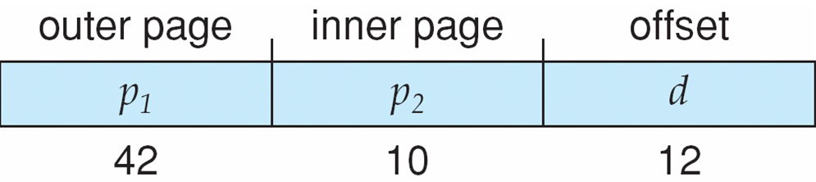
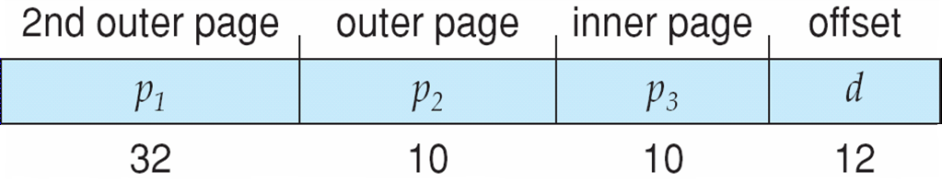
Three-level Paging Scheme
64 bit addresses

Slide 62
Hashed Page Tables
Common in address spaces > 32 bits
  Large address spaces
Page table is a hash table
A virtual page number is hashed into a page table entry
A page table entry contains a chain of elements hashing to the same location
  each element = <a virtual page number, frame number>
Virtual page numbers are compared in this chain searching for a match
  If a match is found, the corresponding physical frame is extracted
We can limit the hash table size per process, no matter how large the address is (smaller the hash table, more collisions we have)

Slide 63
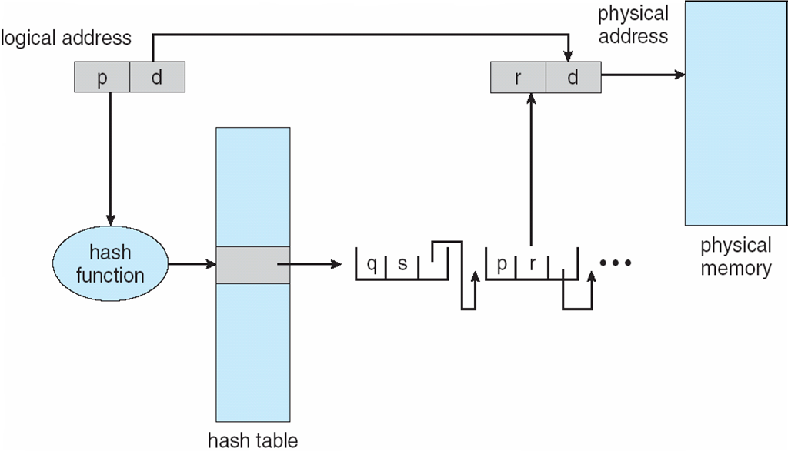
Hashed Page Table
frame number
virtual page number

Slide 64
Inverted Page Table
One entry for each real page frame of physical memory
Entry consists of the page number of the virtual page stored in that real memory location (frame), with information about the process that owns that page
  Entry content: <pid, virtual page number>
Decreases memory needed to store each page table, but increases time needed to search the table when a page reference occurs
All processes shared the same inverted table
  One inverted table in the system.

Slide 65
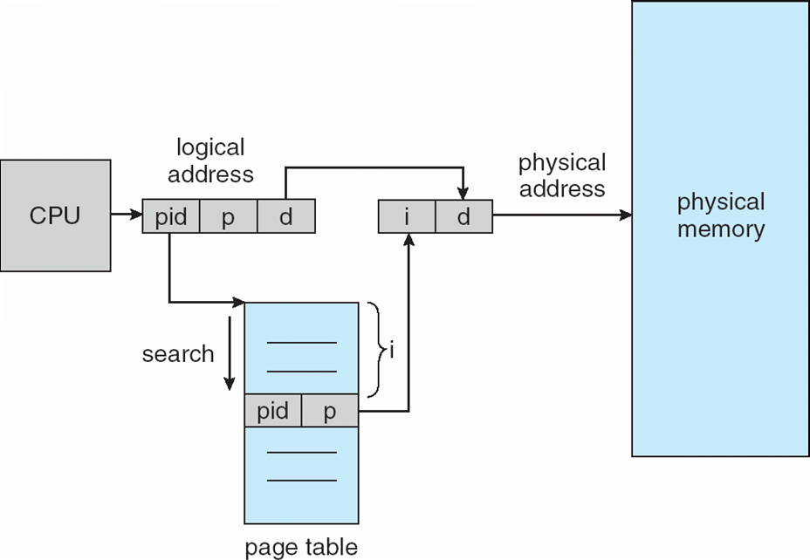
Inverted Page Table Architecture

Slide 66
Segmentation

Slide 67
Segmentation
Memory-management scheme that supports user view of memory
A program is a collection of segments (logical contiguous units)
  A segment is a logical unit such as:
main program
procedure
function
method
object
local variables, global variables
common block
stack
symbol table
arrays

Slide 68
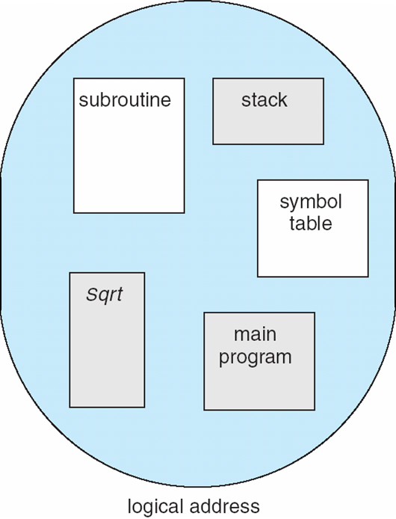
User’s View of a Program

Slide 69
Logical View of Segmentation
segment
1
1
4
2
3
4
2
3
user space
physical memory space

Slide 70
Segmentation Architecture
Logical address consists of a two tuple:
<segment-number, offset>
Segment table – maps two-dimensional logical addresses; each table entry has:
  base – contains the starting physical address where the segments reside in memory
  limit – specifies the length of the segment
Segment-table base register (STBR) points to the segment table’s location in memory
Segment-table length register (STLR) indicates number of segments used by a program;
segment number s is legal if s < STLR

Slide 71
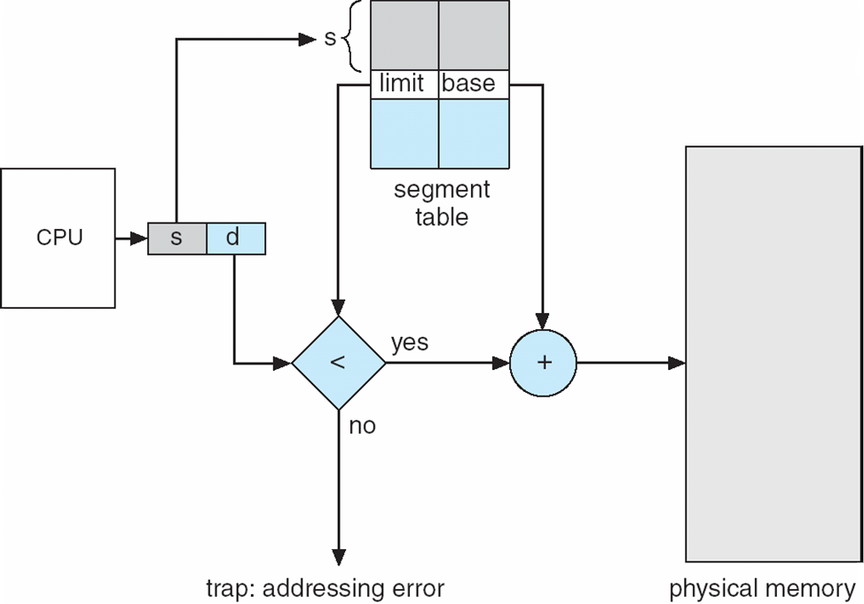
Segmentation Hardware

Slide 72
Segmentation Architecture (Cont.)
Protection
  With each entry in segment table associate:
    validation bit = 0 ⇒ illegal segment
    read/write/execute privileges
Protection bits associated with segments; code sharing occurs at segment level
  Code segment: READONLY; sharable; …
  Data segment: RED-WRITE; not-sharable
Since segments vary in length, memory allocation is a dynamic storage-allocation problem

Slide 73
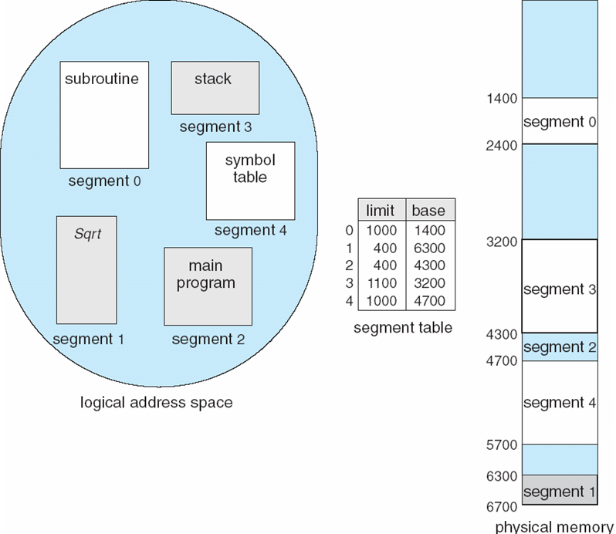
Example of Segmentation

Slide 74
Intel Pentium

Slide 75
Example: The Intel Pentium
Supports both segmentation and segmentation with paging
CPU generates logical address (<segment#, offset> pairs)
  Given to segmentation unit
    Which produces linear addresses
  Linear address given to paging unit
    Which generates physical address in main memory
    Paging unit forms equivalent of MMU

Slide 76
Logical to Physical Address Translation in Pentium
SEGMENTATION
UNIT
PAGING
UNIT
segment s
d
s
Logical
Memory
segment
table
page
table
Linear Logical Memory
Physical Memory

Slide 77
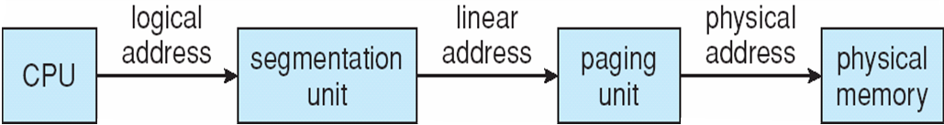
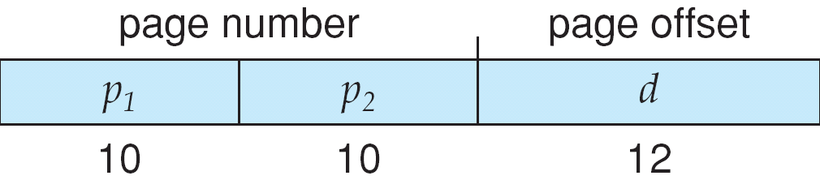
Logical to Physical Address Translation in Pentium

Slide 78
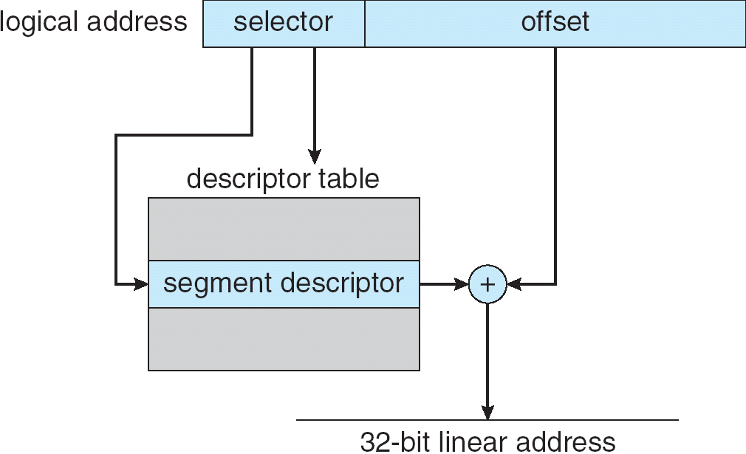
Intel Pentium Segmentation
base
base+offset
base address
limit

Slide 79
Pentium Paging Architecture
Pentium architecture allows a page size of either 4 KB or 4 MB.
For 4 KB pages, two-level paging scheme is used in a 32 bit machine
  Address division: <10, 10, 12> bits
For 4 MB pages, we can skip the inner page tables (secondary page table). A top level page table entry will point directly to a 4 MB page.

Slide 80
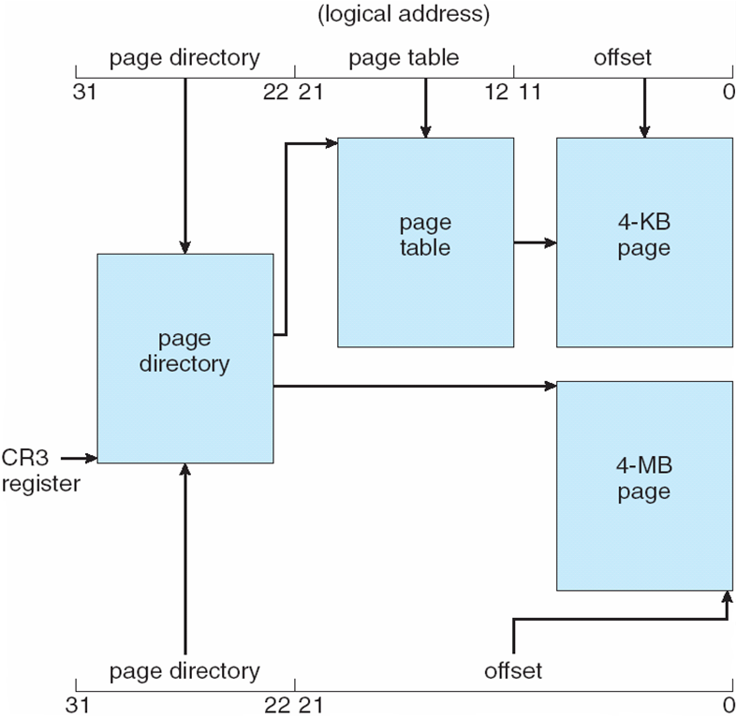
Pentium Paging Architecture

Slide 81
Linux on Pentium: Segmentation
Linux is designed to run on a lot of hardware platforms: Pentium, Arm, Motorola, Sparc, MIPS, …
Therefore it does not rely on segmentation and makes minimal use of segmentation in Pentium.

Slide 82
Linux on Pentium: Paging
Linux uses two level paging for 32 bit machines.
Linux can use three level paging as well for some bigger address space architectures.
A linear address in Linux is broken into 4 parts in 3-level paging.
  P1: global directory
  P2: middle directory
  P3: page table
  P4: offset
Number of bits in each part depends on the architecture

Slide 83

Linear Address in Linux
Broken into four parts:
In a 64 bit machine (very large address space), we use all 4 parts
In a 32 bit Intel machine, that uses two-level paging, we ignore the middle directory (its size is 0), and use 3 parts.

Slide 84
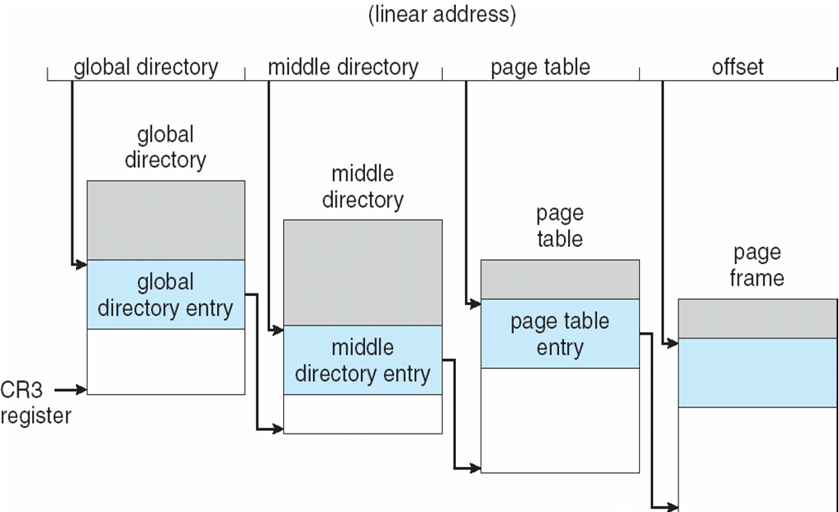
Three-level Paging in Linux

Slide 85
4 level paging
Linux also supports 4 level paging. Intel 64 bit architecture supports for level paging and Linux can run on that.
Intel 64 bit architecture uses 48 bit virtual addresses. Address division scheme is: [9,9,9,9,12]
9 bits
9 bits
9 bits
9 bits
12 bits
offset
48 bit virtual address
Intel x86_64 architecture virtual addresses

Slide 86
Linux Paging: some kernel structures
struct task_struct
{
…
…
struct mm_struct *mm;
}
struct mm_struct
{
…
pgd_t *pgd;
….
}
the PCB object
of a process X
top level
page table
of process X
(called
page
global
directory)
mm object
of process X
(keeps memory
management
related
information)

Slide 87
References
The slides here are adapted/modified from the textbook and its slides: Operating System Concepts, Silberschatz et al., 7th & 8th editions, Wiley.
Operating System Concepts, 7th and 8th editions, Silberschatz et al. Wiley.
Modern Operating Systems, Andrew S. Tanenbaum, 3rd edition, 2009.

Slide 88
Additional Study Material

Slide 89
Swapping
A process can be swapped temporarily out of memory to a backing store, and then brought back into memory for continued execution
Backing store – fast disk large enough to accommodate copies of all memory images for all users; must provide direct access to these memory images
Roll out, roll in – swapping variant used for priority-based scheduling algorithms; lower-priority process is swapped out so higher-priority process can be loaded and executed
Major part of swap time is transfer time; total transfer time is directly proportional to the amount of memory swapped
Modified versions of swapping are found on many systems (i.e., UNIX, Linux, and Windows)
System maintains a ready queue of ready-to-run processes which have memory images on disk

Slide 90
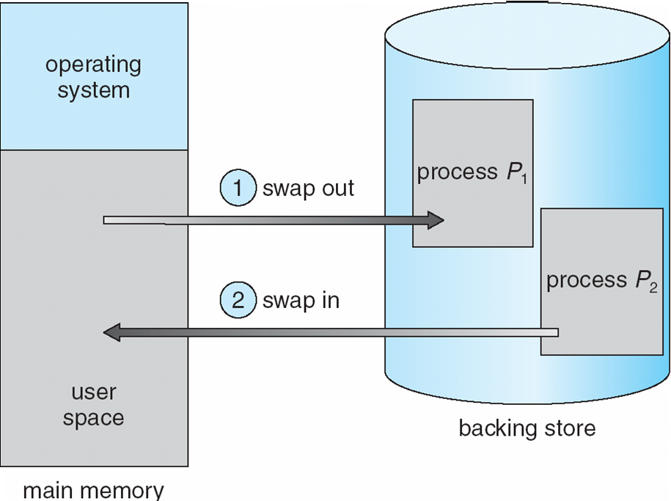
Schematic View of Swapping

