Slide 1
Chapter 14 Protection
Bilkent University Department of Computer Engineering
CS342 Operating Systems
Dr. İbrahim Körpeoğlu
http://www.cs.bilkent.edu.tr/~korpe
Last Update: Nov 11, 2011

Slide 2
Objectives and Outline
Discuss the goals and principles of protection in a modern computer system
Explain how protection domains combined with an access matrix are used to specify the resources a process may access
Examine capability and language-based protection systems
Goals of Protection
Principles of Protection
Domain of Protection
Access Matrix
Implementation of Access Matrix
Access Control
Revocation of Access Rights
Capability-Based Systems
Language-Based Protection

Slide 3
Goals of Protection
Operating system manages and controls of a collection of objects (hardware or software)
Each object has a unique name and can be accessed through a well-defined set of operation
Protection problem - ensure that each object is accessed correctly and only by those processes that are allowed to do so
Users
Systems
Processes
Access rights?
operations
Objects (hardware / software)

Slide 4
Principles of Protection
Guiding principle – principle of least privilege
Programs, users and systems should be given just enough privileges to perform their tasks

Slide 5
Domain of Protection
Protection requirement:
1. a process should be allowed to access only those resources for which it has authorization
2. a process should be able to access only those resources that it currently requires to complete its task (need to know principle)
To do these, a process operates within a protection domain.
A protection domain specifies which resources/objects can be accessed in which way by the processes operating in that domain.

Slide 6
Domain of Protection
We need
Associating processes with domains
Static association
Dynamic association
Defining domains and changing their content.
No change is allowed (static domain)
Can be changed (dynamic domain)

Slide 7
Domain Structure
Access-right = <object-name, a_set_of_rights> where a_set_of_rights is a subset of all valid operations that can be performed on the object.
Domain = set of access-rights

Slide 8
Domain Implementation (Unix)
System consists of 2 domains:
User
Supervisor
UNIX
Domain = user-id (i.e. domain determined from user-id)
The domain of a process is defined by its UID and GID.
Files (objects) also have associated UID and GUI.
Then: we can make a list of files (includes file corresponding to devices) that can be accessed (and how) by the process.

Slide 9
Domain Implementation (Unix)
A user loges in. All processes created by that user operate in the same domain.
What should happen when a process tries to execute a file which is created by another user?
File has user ID as well.
Which user ID should be used by the running process?
The creator of the process?
The owner of the executable file?

Slide 10
Domain switch accomplished via file system
Each file has associated with it a domain bit (setuid bit)
When file is executed and setuid = on, then user-id (domain) is set to owner of the file being executed. When execution completes user-id is reset
Executable
File
owner: a user ID
setuid bit: 0 or 1

Slide 11
Domain Implementation (Unix)
User A creates
User B creates
Process
X
Process
Y
Started with UID = B
Hence normally
runs with UID = B
Runs with UID = A
When file F is to be executed,
UID becomes A (since
setuid is ON).
Hence process
runs with UID A while executing file F.
Executable
File
F
owner: user ID A
setuid bit: 1 (ON)

Slide 12
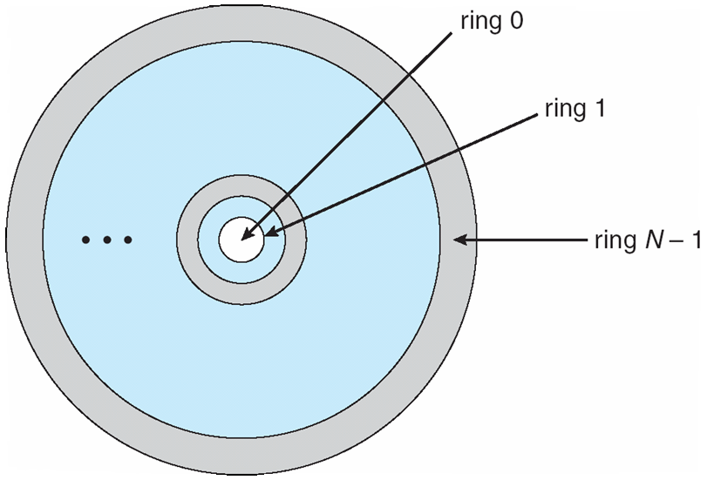
Domain Implementation (MULTICS)
Let D_{i} and D_{j} be any two domain rings
If j < i ⇒ D_{i} ⊆ D_{j} (Dj has more privileges than Di)
Consider
domains
as rings;
Hierarchical
organization

Slide 13
Access Matrix
Modeling protection
View protection as a matrix (access matrix): protection rules are expressed using a matrix
Rows represent domains
Columns represent objects
Access(i, j) contains the set of operations that a process executing in Domain_{i} can invoke on Object_{j}
A general method and mechanism
Can be implemented in various ways.

Slide 14
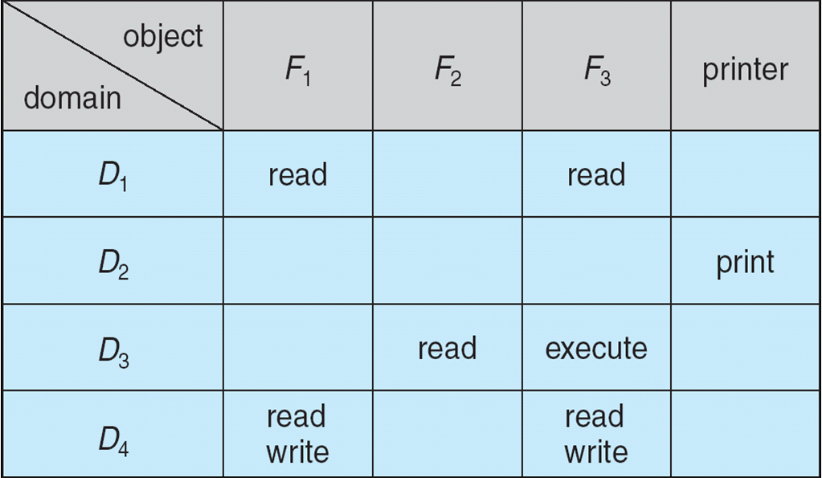
Access Matrix

Slide 15
Use of Access Matrix
If a process in Domain D_{i} tries to do “op” on object O_{j}, then “op” must be in the access matrix
Can be expanded to dynamic protection
Operations to add, delete access rights to/from the Matrix
Special access rights for a domain:
owner of O_{i}
copy op from O_{i} to O_{j}
control – D_{i} can modify D_{j} access rights
transfer – switch from domain D_{i} to D_{j}

Slide 16
Use of Access Matrix
Access matrix design separates mechanism from policy
Mechanism
Operating system provides access-matrix + rules
It ensures that the matrix is only manipulated by authorized agents and that rules are strictly enforced
Policy
User dictates policy
Who can access what object and in what mode

Slide 17
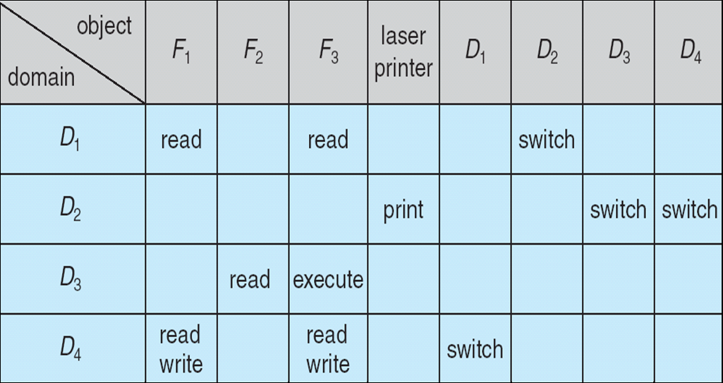
Access Matrix With Domains as Objects
Switch is applicable to only domain objects. A process can switch to that domain.

Slide 18
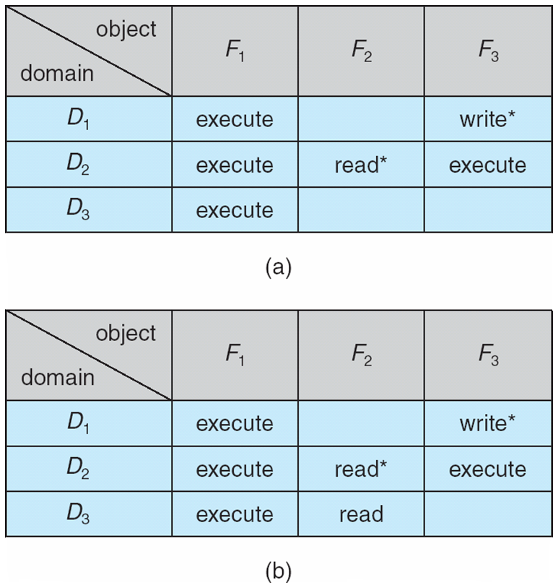
Access Matrix with Copy Rights
Has copy right for object F2
copied
access right
If a domain has a copy right, then it can copy the right to another domain.

Slide 19
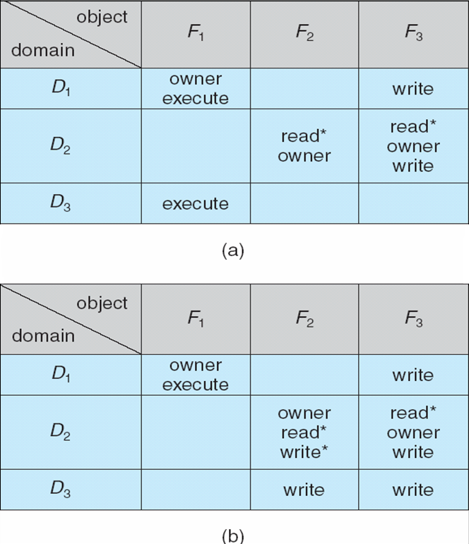
Access Matrix With Owner Rights
D2 is owner for F2 and F3
added
access right
added
access right
If a domain has owner right for an object, it can add / remove access right entries for the object

Slide 20
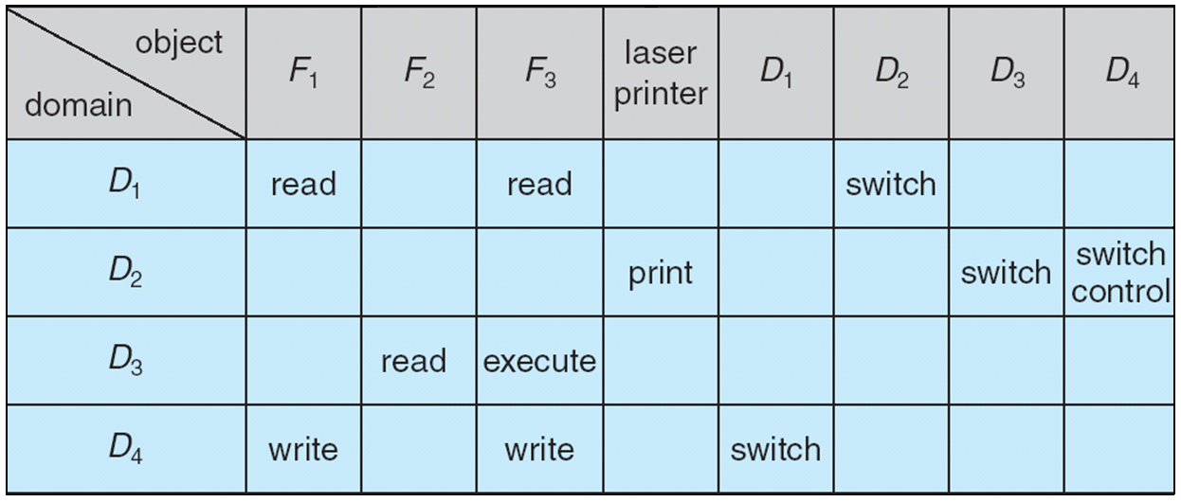
Modified Access Matrix
Control is applicable to only domain objects. Di can control Dj (any access right can be removed/added from/to Dj by Di)

Slide 21
Implementation of Access Matrix
Each Column = Access-Control List for one object Defines who can perform what operation. Domain 1 = Read, Write Domain 2 = Read Domain 3 = Read
Access Control List associated with an object

Slide 22
Implementation of Access Matrix
Each Row = Capability List (like a key) Fore each domain, what operations allowed on which objects.
Object 1 – Read
Object 4 – Read, Write, Execute
Object 5 – Read, Write, Delete, Copy
Access Rights of a Domain
(i.e. capabilities of a domain: what a domain can do)

Slide 23
Access Control
Protection can be applied to non-file resources
Solaris 10 provides role-based access control (RBAC) to implement least privilege
Privilege is right to execute system call or use an option within a system call
Can be assigned to processes
Users assigned roles granting access to privileges and programs

Slide 24
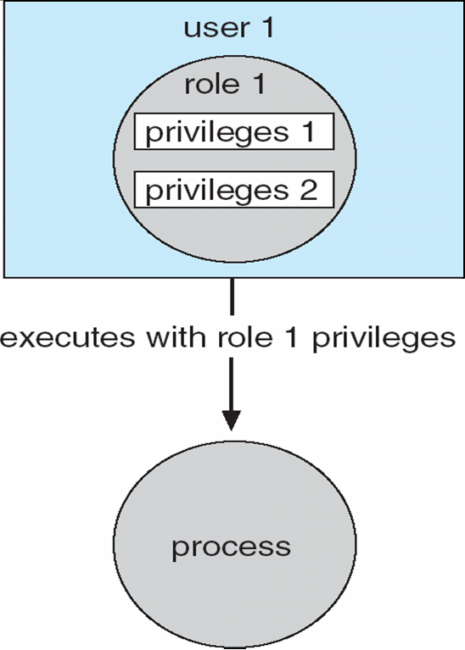
Role Based Access Control
Users
can take roles if they know the corresponding
passwords

Slide 25
Revocation of Access Rights
Assume want to remove (revoke) an access right from an object
How we will revoke and whether it is easy or difficult to revoke depends on the implementation of Access Matrix.
Access List – Delete access rights from access list
Simple
Immediate
Capability List – Scheme required to locate capability in the system before capability can be revoked
Reacquisition
Back-pointers
Indirection
Keys

Slide 26
Capability Based Systems
Hydra
Fixed set of access rights known to and interpreted by the system
Interpretation of user-defined rights performed solely by user's program; system provides access protection for use of these rights
Cambridge CAP System
Data capability - provides standard read, write, execute of individual storage segments associated with object
Software capability -interpretation left to the subsystem, through its protected procedures

Slide 27
Language Based Protection
Specification of protection in a programming language allows the high-level description of policies for the allocation and use of resources
Language implementation can provide software for protection enforcement when automatic hardware-supported checking is unavailable
Interpret protection specifications to generate calls on whatever protection system is provided by the hardware and the operating system

Slide 28
Protection in Java 2
Protection is handled by the Java Virtual Machine (JVM)
A class is assigned a protection domain when it is loaded by the JVM
The protection domain indicates what operations the class can (and cannot) perform
If a library method is invoked that performs a privileged operation, the stack is inspected to ensure the operation can be performed by the library

Slide 29
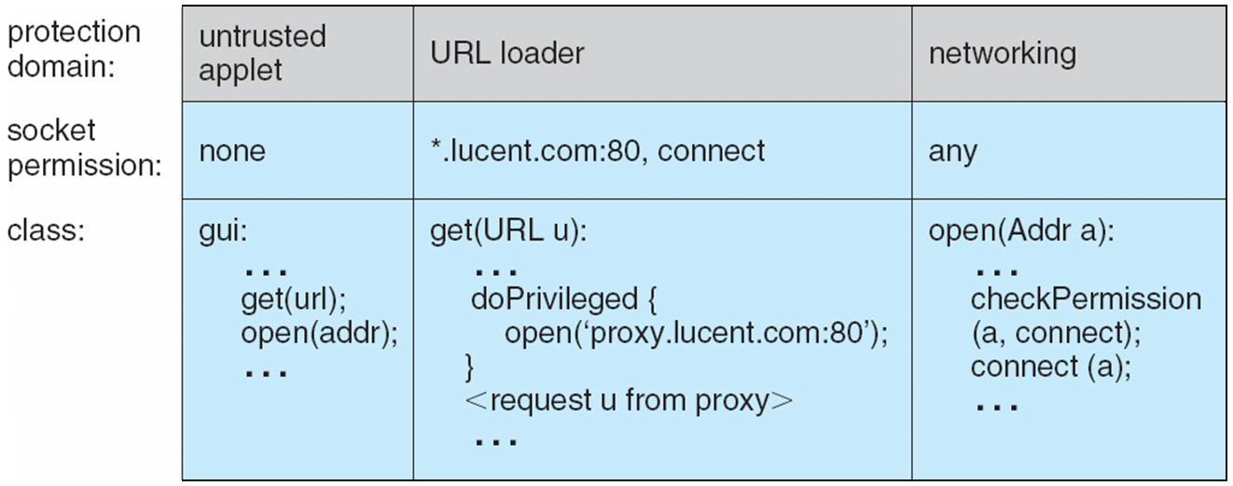
Stack Inspection

Slide 30
References
The slides here are adapted/modified from the textbook and its slides: Operating System Concepts, Silberschatz et al., 7th & 8th editions, Wiley.
Operating System Concepts, 7th and 8th editions, Silberschatz et al. Wiley.
Modern Operating Systems, Andrew S. Tanenbaum, 3rd edition, 2009.

