Slide 1
Chapter 9 Virtual Memory
Bilkent University Department of Computer Engineering
CS342 Operating Systems
Last Update: April 12, 2018

Slide 2
Objectives and Outline
Objectives
To describe the benefits of a virtual memory system
To explain the concepts of demand paging,
page-replacement algorithms, and
allocation of page frames
To discuss the principle of the working-set model
Outline
Background
Demand Paging
Copy-on-Write
Page Replacement
Allocation of Frames
Thrashing
Memory-Mapped Files
Allocating Kernel Memory
Other Considerations
Operating-System Examples

Slide 3
Background
Virtual memory – program uses virtual memory which can be partially loaded into physical memory
Benefits:
Only part of the program needs to be in memory for execution
more concurrent programs
Logical address space can therefore be much larger than physical address space
execute programs larger than RAM size
Easy sharing of address spaces by several processes
Library or a memory segment can be shared
Allows for more efficient process creation

Slide 4
Virtual Memory That is Larger Than Physical Memory
Page 0
0
Page 1
1
2
Page 2
Page 2
3
Page 0
Page 1
4
unavail
Page 3
Page 2
Page 3
…
Page 0
move pages
…
Page 4
unavail
Page 4
Page 3
n-2
Page 1
page n-2
Page n-1
n-1
page table
Physical memory
page n-2
page n-1
all pages of program sitting on physical Disk
Virtual memory

Slide 5
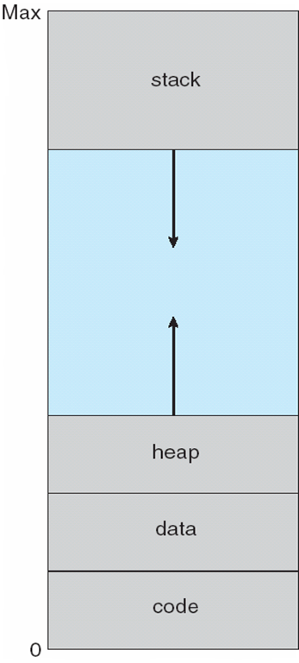
A typical virtual-address space layout of a process
function parameters;
local variables;
return addresses
unused address space
will be used whenever
needed
malloc() allocates
space from here
(dynamic memory allocation)
global data (variables)

Slide 6
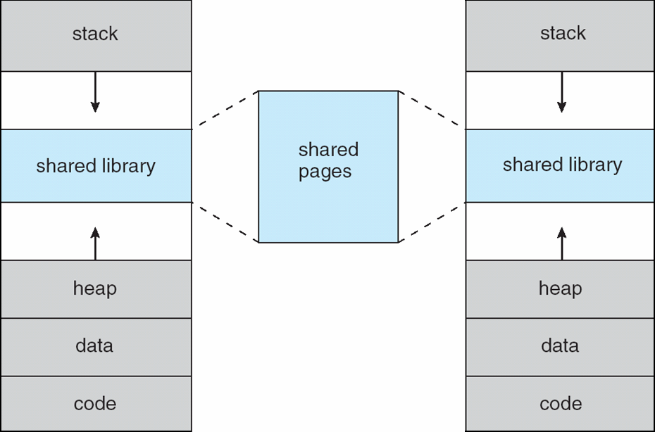
Shared Library Using Virtual Memory
Virtual memory of process A
Virtual memory of process B
only one copy of
a page needs to
be in memory

Slide 7
Implementing Virtual Memory
Virtual memory can be implemented via:
Demand paging
Bring pages into memory when they are used, i.e., allocate memory for pages when they are used (accessed/references/needed).
Demand segmentation
Bring segments into memory when they are used, i.e., allocate memory for segments when they are used.

Slide 8
Demand Paging
Bring a page into memory only when it is needed
Less I/O needed
Less memory needed
Faster response
More users
Page is needed ⇒ reference to it
invalid reference (page is not in used portion of address space) ⇒ abort
not-in-memory ⇒ bring to memory
Pager never brings a page into memory unless page will be needed

Slide 9
Valid-Invalid Bit
With each page table entry a valid–invalid bit (validation bit) is associated (v ⇒ in-memory, i ⇒ not-in-memory)
Initially valid–invalid bit is set to i on all entries
Example of a page table snapshot:
During address translation, if valid–invalid bit in page table entry
is i ⇒ page fault
Frame #
valid-invalid bit
v
v
v
v
i
….
i
i
page table

Slide 10
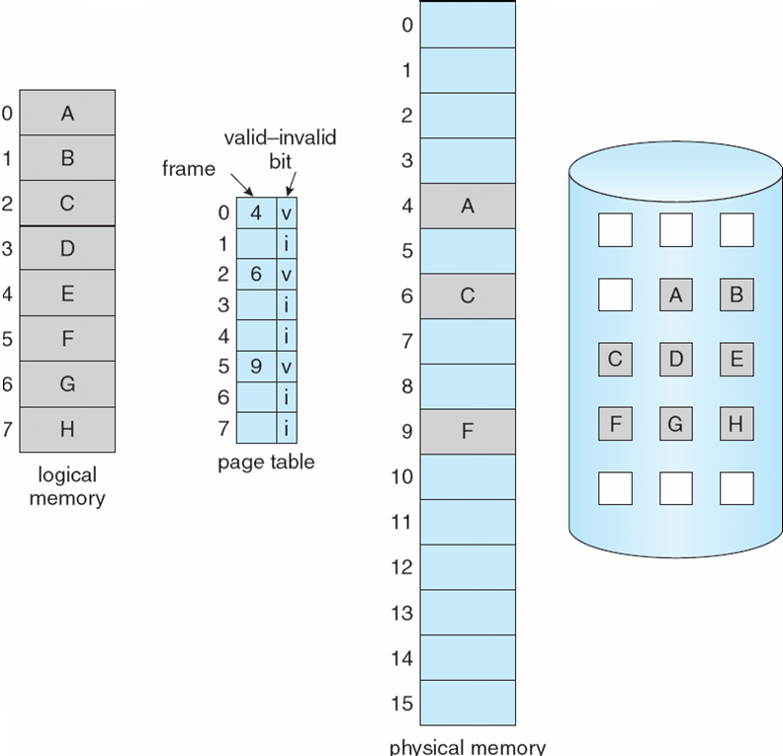
Page Table When Some Pages Are Not in Main Memory

Slide 11
Page Fault
When CPU makes a memory reference (i.e. page reference), HW consults the page table. If entry is invalid, then exception occurs and kernel gets executed.
Kernel handles such a case as follows:
Kernel looks at another table to decide (that table: virtual memory regions of the process):
Invalid reference (page is in unused portion of address space) → Abort
Just not in memory → PAGE FAULT
(page is in used portion, but not in RAM)
Get empty frame (we may need to remove a page; if removed page is modified, we need disk I/O to swap it out)
Swap page into frame (we need disk I/O)
Reset tables (install mapping into page table)
Set validation bit = v
Restart the instruction that caused the page fault

Slide 12
Page Fault (Cont.)
If page fault occurs when trying to fetch an instruction, fetch the instruction again after bringing the page in.
If page fault occurs while we are executing an instruction: Restart the instruction after bringing the page in.
For most instructions, restarting the instruction is no problem.
But for some, we need to be careful.

Slide 13
Steps in Handling a Page Fault
swap
space

Slide 14
Performance of Demand Paging
Page Fault Rate (p): 0 ≤ p ≤ 1.0
if p = 0 no page faults
if p = 1, every reference is a fault
Effective Access Time to Memory (EAT)
EAT = (1 – p) x memory_access_time
+ p x (page fault overhead time
+ time to swap page out (sometimes)
+ time swap page in
+ restart overhead time)
page fault
service time

Slide 15
Demand Paging Example
Memory access time = 200 nanoseconds
Average page-fault service time = 8 milliseconds
EAT = (1 – p) x 200 + p (8 milliseconds)
= (1 – p) x 200 + p x 8,000,000
= 200 + p x 7,999,800
If one access out of 1,000 causes a page fault (p = 1/1000), then
EAT = 8.2 microseconds.
This is a slowdown by a factor of 40!!
(200 ns / 8.2 microsec ~= 1/40)

Slide 16
Process Creation
Virtual memory allows other benefits during process creation:
- Copy-on-Write
- Memory-Mapped Files (later)

Slide 17
Copy-on-Write
Copy-on-Write (COW) allows both parent and child processes to initially share the same pages in memory If either process modifies a shared page, only then is the page copied
COW allows more efficient process creation as only modified pages are copied

Slide 18
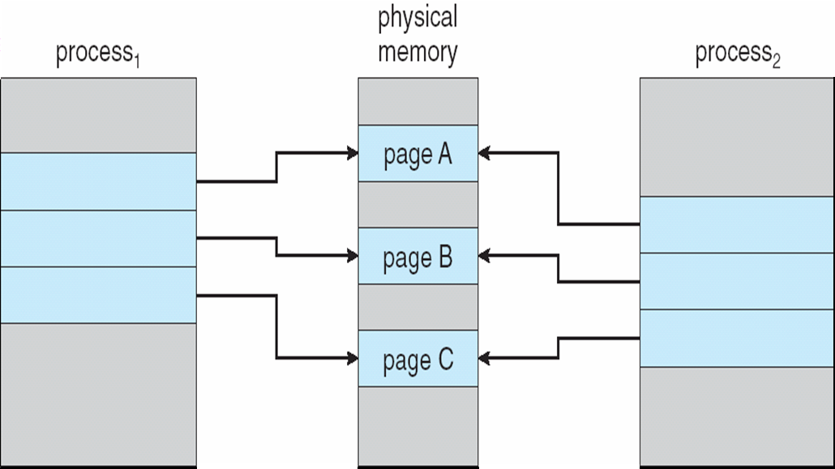
Before Process 1 Modifies Page C

Slide 19
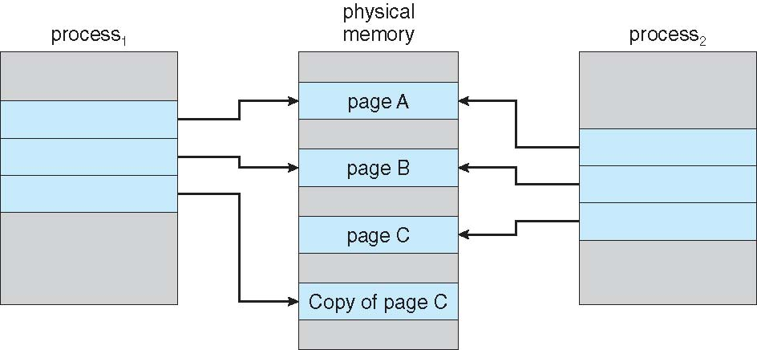
After Process 1 Modifies Page C

Slide 20
Page Replacement

Slide 21
What happens if there is no free frame?
Page replacement – find some page in memory, but not really in use, swap it out
Algorithm ? Which page should be remove?
performance – want an algorithm which will result in minimum number of page faults
With page replacement, same page may be brought into memory several times
Prevent over-allocation of memory by modifying page-fault service routine to include page replacement

Slide 22
Page Replacement
Use modify (dirty) bit to reduce overhead of page transfers – only modified pages are written to disk while removing/replacing a page.
Page replacement completes separation between logical memory and physical memory
large virtual memory can be provided on a smaller physical memory

Slide 23
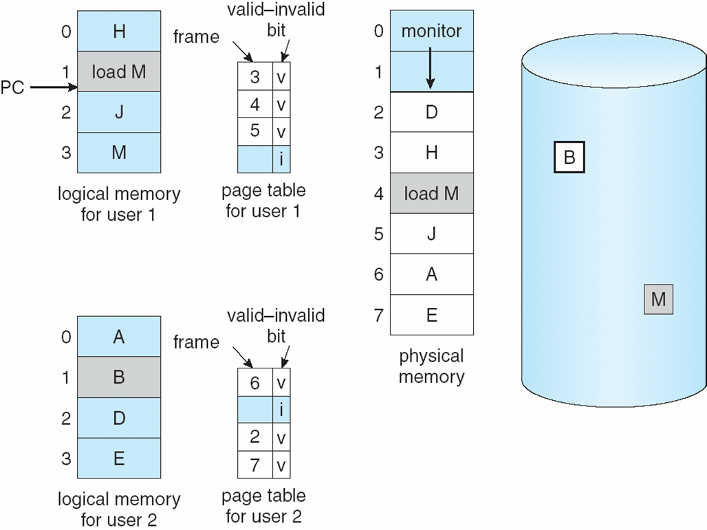
Need For Page Replacement
While executing “load M”
we will have a page fault and we need
page replacement.

Slide 24
Basic Page Replacement
Steps performed by OS while replacing a page upon a page fault:
Find the location of the desired page on disk
Find a free frame: - If there is a free frame, use it - If there is no free frame, use a page replacement algorithm to select a victim frame; if the victim page is modified, write it back to disk.
Bring the desired page into the (new) free frame; update the page and frame tables
Restart the process

Slide 25
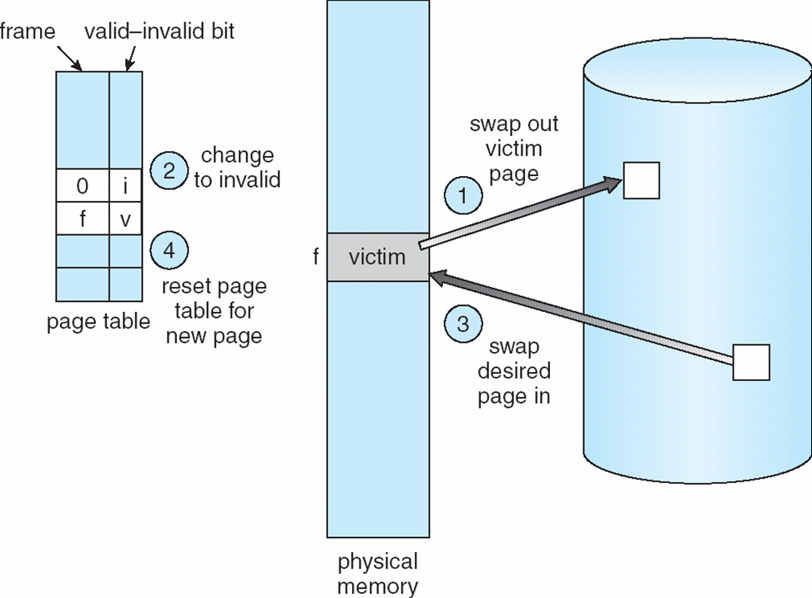
Page Replacement

Slide 26
Page Replacement Algorithms
Want lowest page-fault rate
Evaluate algorithm by running it on a particular string of page (memory) references (reference string) and computing the number of page faults on that string
In all our examples, the page reference string is
1, 2, 3, 4, 1, 2, 5, 1, 2, 3, 4, 5

Slide 27
Driving reference string
Assume process makes the following memory references (in decimal) in a system with 100 bytes per page:
0100 0432 0101 0612 0102 0103 0104 0101 0611 0102 0103 0104 0101 0610 0102 0103 0104 0609 0102 0105
Example: Bytes (addresses) 0…99 will be in page 0
Page referenced with each memory reference
1, 4, 1, 6, 1, 1, 1, 1, 6, 1, 1, 1, 1, 6, 1, 1, 6, 1, 1
Corresponding page reference string
1, 4, 1, 6, 1, 6, 1, 6, 1, 6, 1

Slide 28
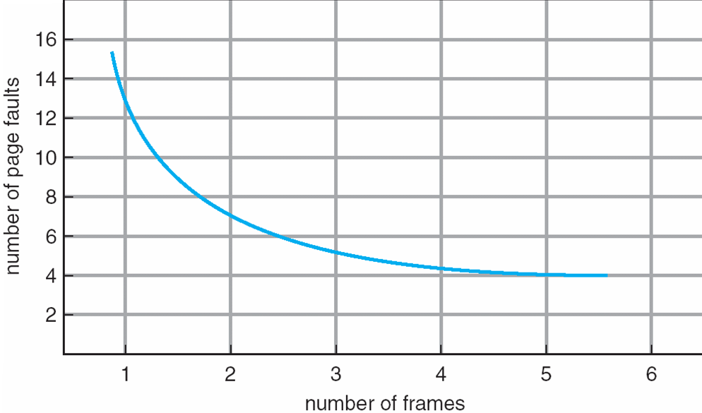
Graph of Page Faults Versus The Number of Frames

Slide 29
First-In-First-Out (FIFO) Algorithm
Reference string: 1, 2, 3, 4, 1, 2, 5, 1, 2, 3, 4, 5
3 frames (3 pages can be in memory at a time per process)
4 frames
Belady’s Anomaly: more frames ⇒ more page faults
1
1
4
5
2
2
1
3
9 page faults
3
3
2
4
1
1
5
4
2
2
1
5
10 page faults
3
3
2
4
4
3

Slide 30
FIFO Page Replacement

Slide 31
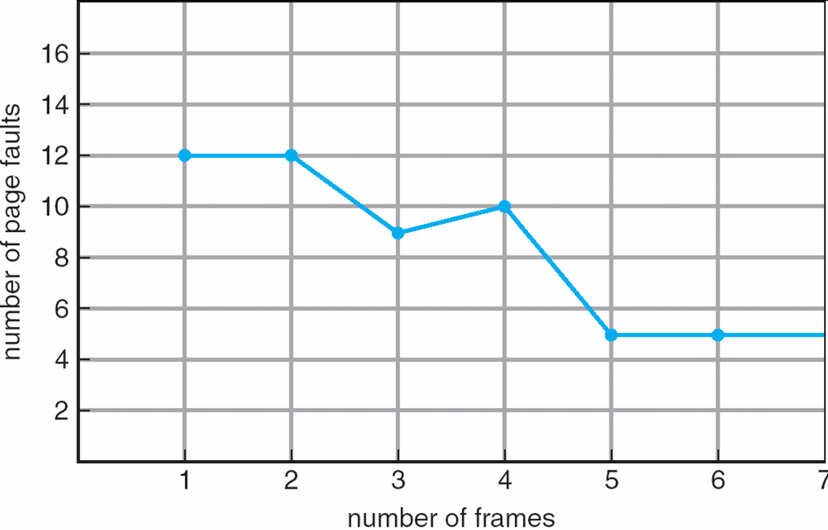
FIFO Illustrating Belady’s Anomaly

Slide 32
Optimal Algorithm
Replace page that will not be used for longest period of time
4 frames example
1, 2, 3, 4, 1, 2, 5, 1, 2, 3, 4, 5
How do you know this?
Used for measuring how well your algorithm performs
1
4
2
6 page faults
3
4
5

Slide 33
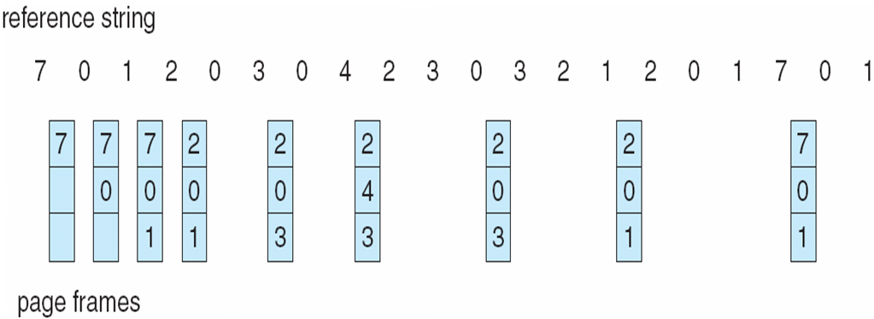
Optimal Page Replacement

Slide 34
Least Recently Used (LRU) Algorithm
Reference string: 1, 2, 3, 4, 1, 2, 5, 1, 2, 3, 4, 5
1
1
1
1
5
2
2
2
2
2
3
5
5
4
4
4
4
3
3
3
8 page faults

Slide 35
LRU Page Replacement

Slide 36
LRU Algorithm Implementation
Counter implementation
Every page entry has a counter field; every time page is referenced through this entry, copy the clock into the counter field
When a page needs to be replaced, look at the counters to determine which one to replace
The one with the smallest counter value will be replaced
…
…
frame#
counter
frame#
counter
PTE
clock
frame#
counter
…
…
Page Table

Slide 37
LRU Algorithm Implementation
Stack implementation – keep a stack of page numbers in a double link form:
Page referenced:
move it to the top
requires 6 pointers to be changed (with every memory reference; costly)
No search for replacement (replacement fast)

Slide 38
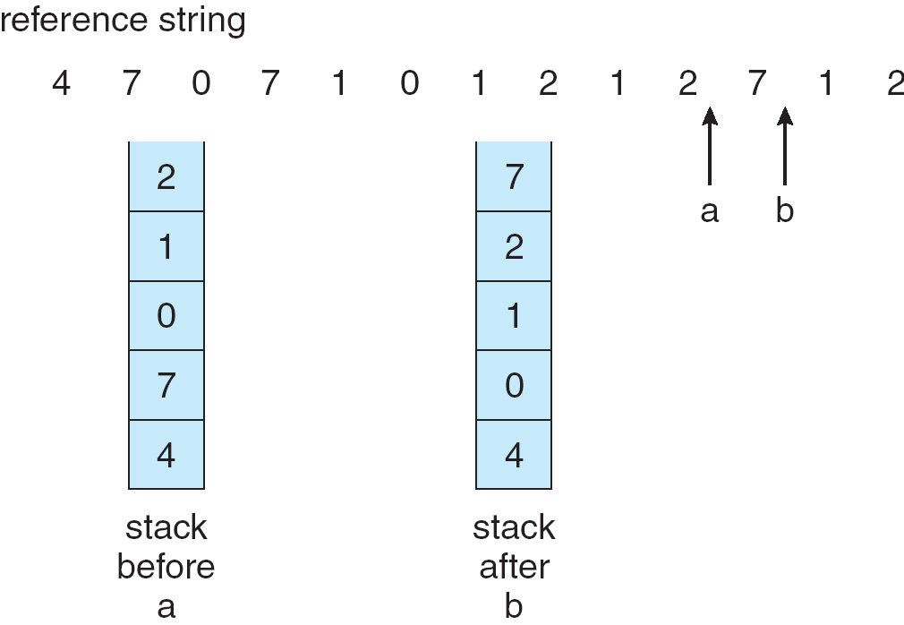
Use of a Stack to Record The Most Recent Page References

Slide 39
LRU Approximation Algorithms
Reference bit
Additional Reference bits
Second Chance 1
Second Chance 1 (clock)
Enhanced Second Chance

Slide 40
Reference Bit
Use of reference bit (R bit)
With each page associate a bit, initially = 0 (not referenced/used)
When page is referenced, bit set to 1
Replace the page which R bit 0 (if one exists)
We do not know the order, however (several pages may have 0 value)
Reference bits are cleared periodically
(with every timer interrupt, for example)
For example: every 10 ms.

Slide 41
Additional Reference Bits
Besides the reference bit (R bit) for each page, we can keep an Additional Reference Bits (calle it as ARB) field associated with each page. For example, an 8-bit field that can store 8 reference bits.
At each timer interrupt (or periodically), the reference bit of a page is shifted from left into ARB field of the page. All other bits of ARB field is shifted to the right as well.
The value in the ARB field indicates when the page is accessed approximately.
When a page is to be replaced, select the page with least ARB field value.
R bit
ARB field for a page

Slide 42
Additional Reference Bits Example
At tick 1: R: 0, ARB: 0000000
R is set (R:1)
At tick 2: R:0, ARB: 1000000
R is not set
At tick 3: R:0, ARB: 0100000tt
R is set (R:1)
At tick 4: R:0, ARB: 1010000
….
t

Slide 43
Second-Chance Algorithm 1
FIFO that is checking if page is referenced or not; Need R bit
If page to be replaced, look to the FIFO list; remove the page close to head of the list and that has reference bit 0.
If the head has R bit 1, move it to the back of the list (i.e. set the load time to the current time) after clearing the R bit.
Then try to find another page that has 0 as R bit.
May require to change all 1’s to 0’s and then come back to the beginning of the queue.
Add a newly loaded page to the tail with R = 1.
R=1
R=1
R=0
R=0
R=1
R=1
Head
Tail
(Youngest)
(oldest)

Slide 44
Second-Chance Algorithm 1
Head
Example:
1
1
0
0
1
Before page removal
C
A
B
E
D
Access page H
0
1
0
0
1
After page removal
E
D
C
A
H
B is removed

Slide 45
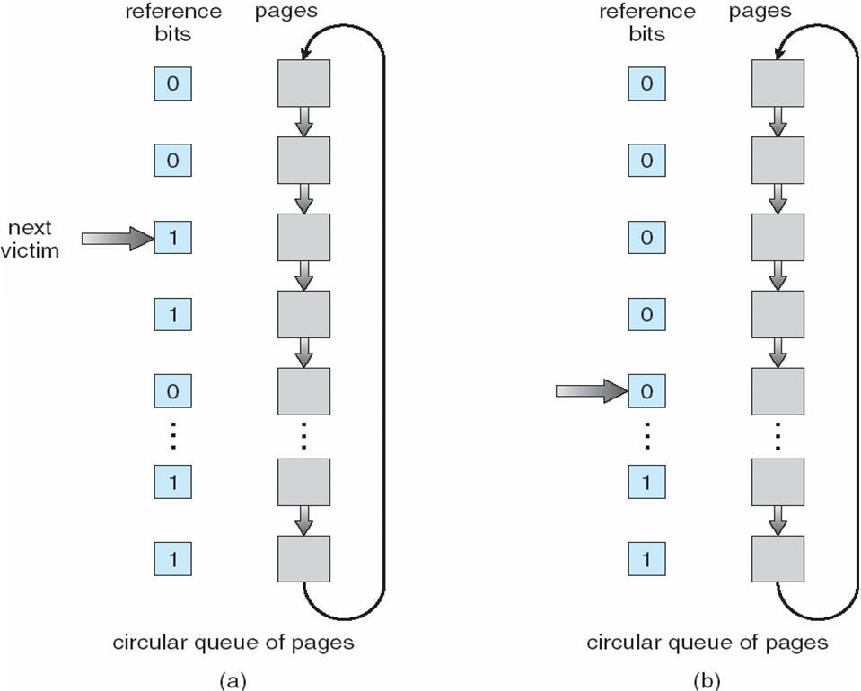
Second-Chance Algorithm 2 (Clock Algorithm)
Second chance can
be implemented using
a circular list of pages;
Then it is also called
Clock algorithm
Next victim pointer

Slide 46
Enhanced Second-Change Algorithm
Consider also the reference bits and the modified bits (dirty bit) of pages
Reference (R) bit: page is referenced in the last interval
Modified (M) bit: page is modified after being loaded into memory
Four possible cases (R,M):
0,0: neither recently used nor modified
0,1: not recently used but modified
1,0: recently used but clean
1,1: recently used and modified
We replace the first page encountered in the lowest non-empty class.
Rest is the same with second-chance algorithm
We may need to scan the list several times until we find the page to replace

Slide 47
Counting Algorithms
Keep a counter of the number of references that have been made to each page
LFU Algorithm: replaces page with smallest count
MFU Algorithm: based on the argument that the page with the smallest count was probably just brought in and has yet to be used

Slide 48
Allocation of Frames
Each process needs minimum number of pages
Example: IBM 370 – 6 pages to handle SS MOVE instruction:
instruction is 6 bytes, might span 2 pages
2 pages to handle from
2 pages to handle to
Various allocation approaches
fixed allocation (this is a kind of local allocation)
Equal allocation
Proportional allocation (proportional to the size)
priority allocation (this is a kind of global allocation)
global allocation
local allocation

Slide 49
Fixed Allocation
Equal allocation – For example, if there are 100 frames and 5 processes, give each process 20 frames.
Proportional allocation – Allocate according to the size of process
Example:

Slide 50
Priority Allocation
Use a proportional allocation scheme using priorities rather than size
If process P_{i} generates a page fault,
select for replacement one of its frames
select for replacement a frame from a process with lower priority number

Slide 51
Global versus Local Allocation
When a page fault occurs for a process and we need page replacement, there are two general approaches:
Global replacement – select a victim frame from the set of all frames;
one process can take a frame from another
Local replacement – select a victim frame only from the frames allocated to the process.
A process uses always its allocated frames

Slide 52
Thrashing
If a process does not have “enough” pages, the page-fault rate is very high. This leads to:
low CPU utilization
operating system thinks that it needs to increase the degree of multiprogramming
another process added to the system
Thrashing ≡ a process is busy swapping pages in and out

Slide 53
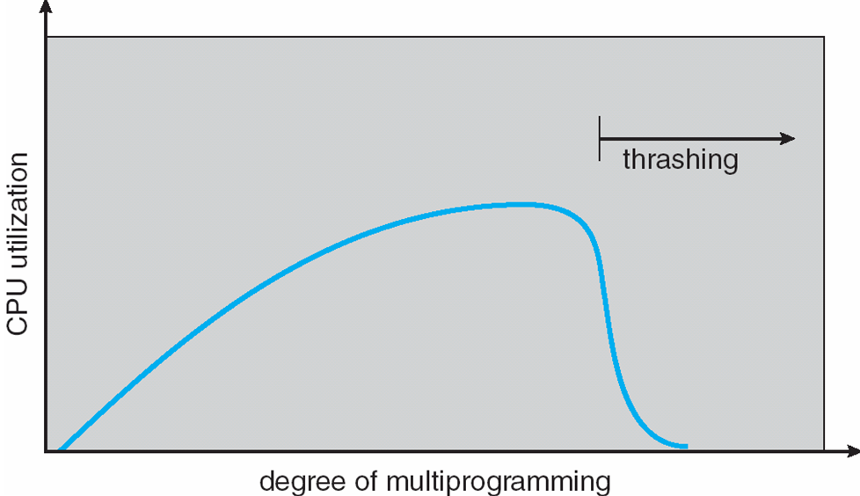
Thrashing (Cont.)

Slide 54
Demand Paging and Thrashing
Why does demand paging work? Locality model (locality of reference)
Process migrates from one locality to another
Localities may overlap
Why does thrashing occur? Σ size of locality > total physical memory size

Slide 55
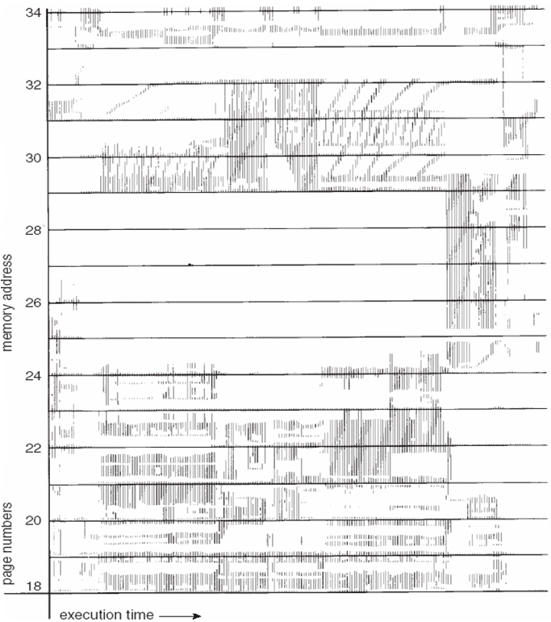
Locality In A Memory-Reference Pattern

Slide 56
Working-Set Model
A method for deciding a) how many frames to allocate to a process, and also b) for selecting which page to replace.
Maintain a Working Set (WS) for each process.
Look to the past Δ page references
Δ ≡ working-set window ≡ a fixed number of page references
WSS_{i} (working set size of Process P_{i}) = total number of distinct pages referenced in the most recent Δ
WSS varies in time
Value of Δ is important
if Δ too small, will not encompass entire locality
if Δ too large, will encompass several localities
if Δ = ∞ ⇒ will encompass entire program

Slide 57
Working-Set Model

Slide 58
Working-Set Model
D = Σ WSS_{i} ≡ total demand for frames
if D > m ⇒ Thrashing (m: #frames in memory)
A possible policy: if D > m, then suspend one of the processes.

Slide 59
Keeping Track of Working-Set a method
Approximate with interval timer + a reference bit
Example: Δ = 10,000 (time units)
Timer interrupts after every 5000 time units
Keep 2 reference bits for each page
Whenever timer interrupts, for a page, shift the R bit to right into ARB and clear R bit.
If ARB has at least one 1 ⇒ page in working set
you can increase granularity by increasing the size of ARB and decreasing the timer interrupt interval

Slide 60
Keeping Track of Working-Set a method
additional
ref_bits (ARB)
Physical Memory
R_bit
page x
frame 0
x
0
x
0
0
y
0
y
0
0
Page y
frame 1
z
0
z
0
0
w
0
w
0
0
Page z
frame 2
page table
Page w
frame 3
ARB is 2 bits here, but could be more (like 8 bits)

Slide 61
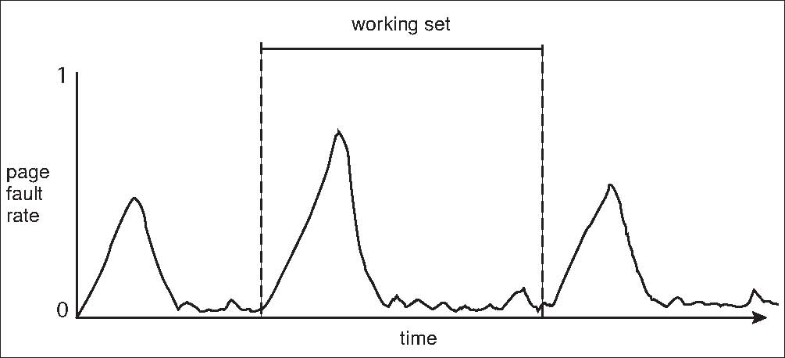
Working Sets and Page Fault Rates
transition from one working set to another

Slide 62
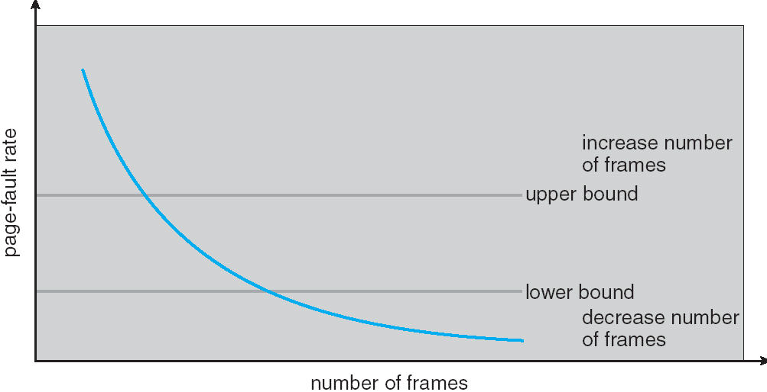
Page-Fault Frequency (PFF) Scheme
Establish “acceptable” page-fault rate
If actual rate too low, process loses frame
If actual rate too high, process gains frame

Slide 63
Memory-Mapped Files
Memory-mapped file I/O allows file I/O to be treated as routine memory access by mapping a disk block to a page in memory
A file is initially read using demand paging. A page-sized portion of the file is read from the file system into a physical page. Subsequent reads/writes to/from the file are treated as ordinary memory accesses.
Simplifies file access by treating file I/O through memory rather than read() write() system calls
Also allows several processes to map the same file allowing the pages in memory to be shared

Slide 64
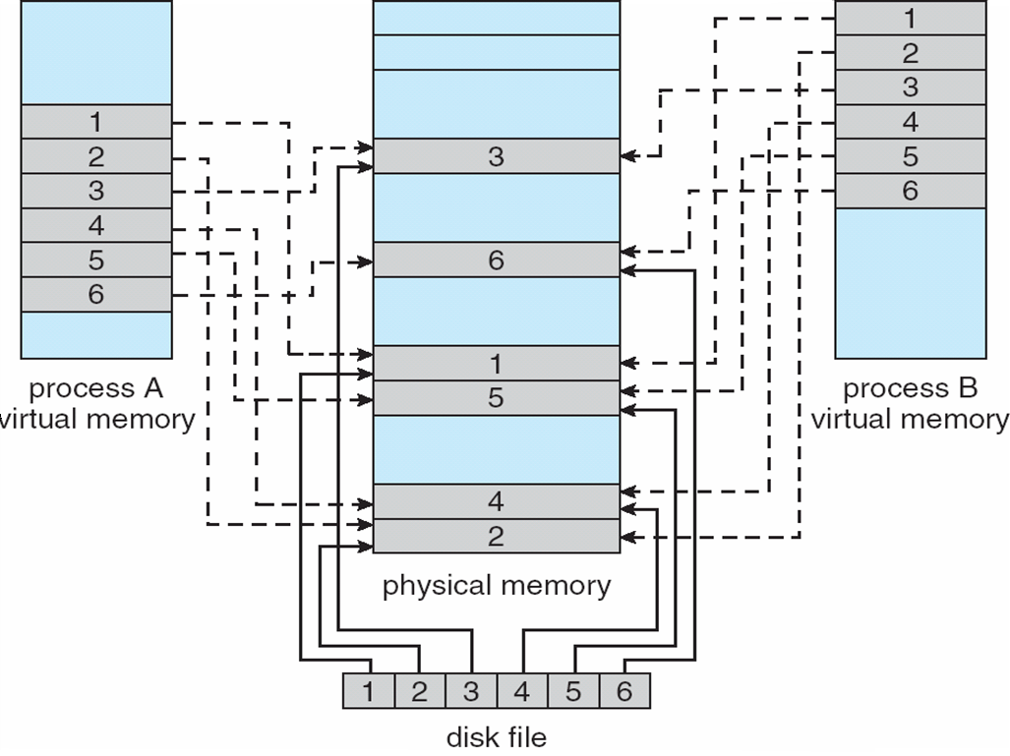
Memory Mapped Files

Slide 65
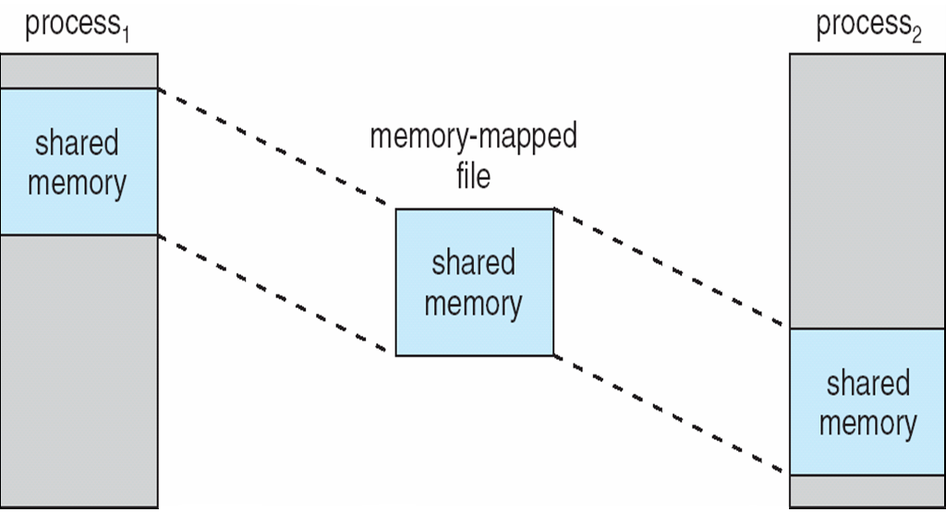
Memory-Mapped Shared Memory in Windows

Slide 66
Allocating Kernel Memory
Treated differently from user memory. Why?
Often allocated from a free-memory pool
Kernel requests memory for structures (objects) of varying sizes
Object types: process descriptors, semaphores, file objects, …
Allocation of object type size requested many times.
Those structures have sizes much less than the page size
Some kernel memory needs to be contiguous
This is dynamic memory allocation problem.
But using first-fit like strategies (heap management strategies) cause external fragmentation

Slide 67
Allocating Kernel Memory
We will see two methods
Buddy System Allocator
Slab Allocator

Slide 68
Buddy System Allocator
Allocates memory from fixed-size segment consisting of physically-contiguous pages
Memory allocated using power-of-2 allocator
Satisfies requests in units sized as power of 2
Request rounded up to next highest power of 2
When smaller allocation needed than is available, current chunk split into two buddies of next-lower power of 2
Continue until appropriate sized chunk available

Slide 69
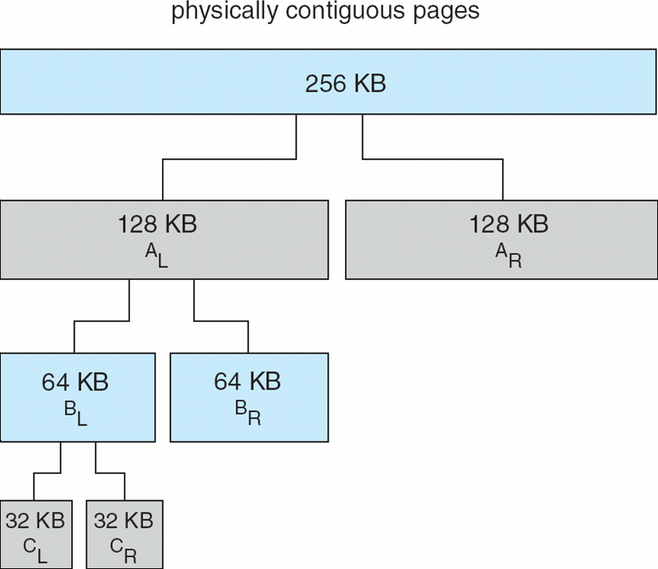
Buddy System Allocator

Slide 70
Example
Object A needs memory 45 KB in size
Object B needs memory 70 KB in size
Object C needs memory 50 KB in size
Object D needs memory 90 KB in size
Object C removed
Object A removed
Object B removed
Object D removed

Slide 71
Example
512 KB of Memory (physically contiguous area)
A
C
B
D
Alloc A 45 KB
Alloc B 70 KB
Alloc C 50 KB
Alloc D 90 KB
Free C
Free A
Free B
Free D
512
256
256
128
128(B)
128
128
128(D)
128
64(A)
64
64(C)
64

Slide 72
Slab Allocator
Alternate strategy
Within kernel, a considerable amount of memory is allocated for a finite set of object types such as process descriptors, file descriptors and other common structures
Idea:
a contiguous phy memory (slab)
(a set of page frames)
a contiguous phy memory (slab) (a set of page frames)
Obj X
Obj
X
Obj
X
Obj
X
Obj
X
Obj
X
Obj
Y
Obj Y
Obj Y
Obj Y
Obj X: object of type X Obj Y: object of type Y

Slide 73
Slab Allocator
Slab is one or more physically contiguous pages
Cache consists of one or more slabs
Single cache for each unique kernel data structure
Each cache filled with objects of same type – instantiations of the data structure
When cache created, filled with slots (objects) marked as free
When structures stored, objects marked as used
If slab is full of used objects, next object allocated from empty slab
If no empty slabs, new slab allocated
Benefits include
no fragmentation,
fast memory request satisfaction

Slide 74
Slabs and Caches
cache
structure
cache
structure
slab
structure
slab
structure
a set of
contiguous pages (a slab)
a set of
contiguous pages
(a slab)
a set of
contiguous pages
(a slab)
a set of
contiguous pages (a slab)
a set of
contiguous pages
(a slab)
set of slabs containing same type of objects (a cache)
(can store objects of type/size X)
a set of slabs (another cache)
(can store objects of type/size Y)

Slide 75
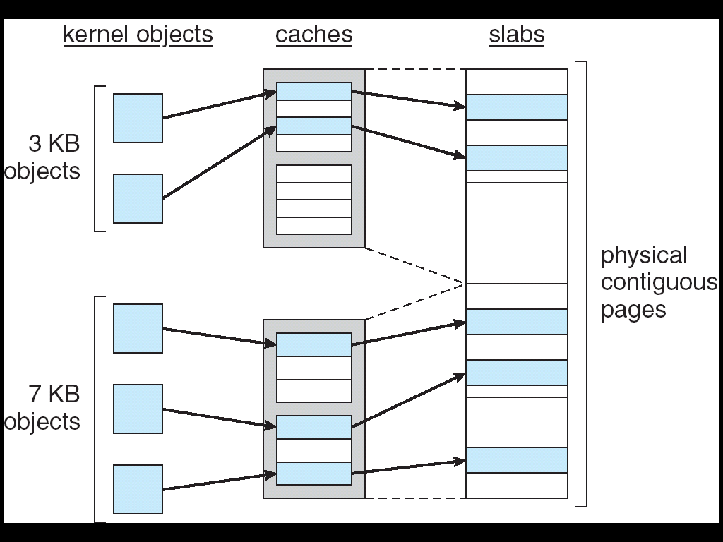
Slab Allocation

Slide 76
Prepaging
Prepaging
To reduce the large number of page faults that occurs at process startup
Prepage all or some of the pages a process will need, before they are referenced
But if prepaged pages are unused, I/O and memory was wasted
Assume s pages are prepaged and α of the pages is used
Is cost of s * α save pages faults > or < than the cost of prepaging s * (1- α) unnecessary pages?
α near zero ⇒ prepaging loses

Slide 77
Other Issues – Page Size
Page size selection must take into consideration:
Fragmentation
Small page size reduces fragmentation
table size
Large page size reduces page table size
I/O overhead
Large page size reduce I/O overhead (seek time, rotation time)
Locality
Locality is improved with smaller page size.

Slide 78
Other Issues – TLB Reach
TLB Reach - The amount of memory accessible from the TLB
TLB Reach = (TLB Size) x (Page Size)
Ideally, the working set of each process is stored in the TLB
Otherwise there is a high degree of page faults
To increase TLB reach:
Increase the Page Size
This may lead to an increase in fragmentation as not all applications require a large page size
Provide Multiple Page Sizes
This allows applications that require larger page sizes the opportunity to use them without an increase in fragmentation

Slide 79
Other Issues – Program Structure
page 0
int
int
int
int
Program structure
int[128,128] data;
Each row is stored in one page
Program 1
for (j = 0; j <128; j++) for (i = 0; i < 128; i++) data[i,j] = 0;
128 x 128 = 16,384 page faults
Program 2
for (i = 0; i < 128; i++) for (j = 0; j < 128; j++) data[i,j] = 0;
128 page faults
Page 1
int
int
int
int
assuming pagesize=512 bytes
Page 127
int
int
int
int

Slide 80
Other Issues – I/O interlock
I/O Interlock – Pages must sometimes be locked into memory
Consider I/O - Pages that are used for copying a file from a device must be locked from being selected for eviction by a page replacement algorithm
Process A
pages
Process B
pages
Process A starts I/O and then blocks.
Process B runs and needs a frame.
We should not remove A’s page

Slide 81
Additional Study Material

Slide 82
Operating System Examples
Windows XP
Solaris

Slide 83
Windows XP
Uses demand paging with clustering. Clustering brings in pages surrounding the faulting page
Processes are assigned working set minimum and working set maximum
Working set minimum is the minimum number of pages the process is guaranteed to have in memory
A process may be assigned as many pages up to its working set maximum
When the amount of free memory in the system falls below a threshold, automatic working set trimming is performed to restore the amount of free memory
Working set trimming removes pages from processes that have pages in excess of their working set minimum

Slide 84
Solaris
Maintains a list of free pages to assign faulting processes
Lotsfree – threshold parameter (amount of free memory) to begin paging
Desfree – threshold parameter to increasing paging
Minfree – threshold parameter to being swapping
Paging is performed by pageout process
Pageout scans pages using modified clock algorithm
Scanrate is the rate at which pages are scanned. This ranges from slowscan to fastscan
Pageout is called more frequently depending upon the amount of free memory available

Slide 85
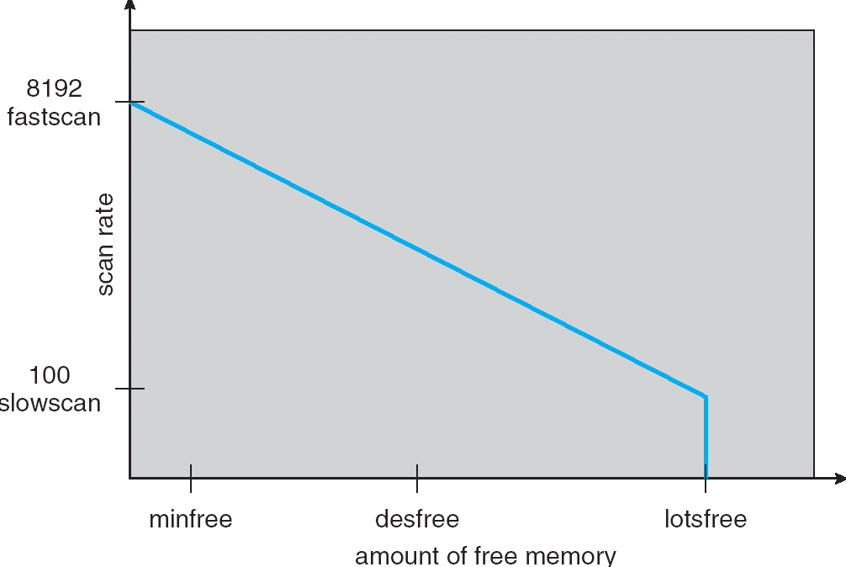
Solaris 2 Page Scanner

Slide 86
Slab Allocation in Linux Kernel

Slide 87
Cache structure
A set of slabs that contain one type of object is considered as a cache.
Cache structure is a structure that keeps information about the cache and includes pointers to the slabs.
struct kmem_cache_s {
struct list_head slabs_full; /* points to the full slabs */
struct list_head slabs_partial; /* points to the partial slabs */
struct list_head slabs_free; /* points to the free slabs */
unsigned int objsize; /* size of objects stored in this cache */
unsigned int flags;
unsigned int num;
spinlock_t spinlock;
…
…
}

Slide 88
Slab structure
A slab stucture is a data structure that points to a contiguous set of page frames (a slab) that can store some number of objects of same size.
A slab can be considered as a set of slots (slot size = object size). Each slot in a slab can hold one object.
Which slots are free are maintained in the slab structure
typedef struct slab_s {
struct list_head list;
unsigned long colouroff;
void *s_mem; /* start address of first object */
unsigned int inuse; /* number of active objects */
kmem_bufctl_t free; /* info about free objects */
} slab_t;

Slide 89
Layout of Slab Allocator
prev cache
cache
next cache
slabs_full
slabs_partial
slabs_free
slabs
slabs
slabs
pages
pages
pages
an object

Slide 90
Slab Allocator in Linux
cat /proc/slabinfo will give info about the current slabs and objects
cache names: one cache for each different object type
# name <active_objs> <num_objs> <objsize> <objperslab> <pagesperslab> : tunables <limit> <batchcount> <
sharedfactor> : slabdata <active_slabs> <num_slabs> <sharedavail>
ip_fib_alias 15 113 32 113 1 : tunables 120 60 8 : slabdata 1 1 0
ip_fib_hash 15 113 32 113 1 : tunables 120 60 8 : slabdata 1 1 0
dm_tio 0 0 16 203 1 : tunables 120 60 8 : slabdata 0 0 0
dm_io 0 0 20 169 1 : tunables 120 60 8 : slabdata 0 0 0
uhci_urb_priv 4 127 28 127 1 : tunables 120 60 8 : slabdata 1 1 0
jbd_4k 0 0 4096 1 1 : tunables 24 12 8 : slabdata 0 0 0
ext3_inode_cache 128604 128696 504 8 1 : tunables 54 27 8 : slabdata 16087 16087 0
ext3_xattr 24084 29562 48 78 1 : tunables 120 60 8 : slabdata 379 379 0
journal_handle 16 169 20 169 1 : tunables 120 60 8 : slabdata 1 1 0
journal_head 75 144 52 72 1 : tunables 120 60 8 : slabdata 2 2 0
revoke_table 2 254 12 254 1 : tunables 120 60 8 : slabdata 1 1 0
revoke_record 0 0 16 203 1 : tunables 120 60 8 : slabdata 0 0 0
scsi_cmd_cache 35 60 320 12 1 : tunables 54 27 8 : slabdata 5 5 0
….
files_cache 104 170 384 10 1 : tunables 54 27 8 : slabdata 17 17 0
signal_cache 134 144 448 9 1 : tunables 54 27 8 : slabdata 16 16 0
sighand_cache 126 126 1344 3 1 : tunables 24 12 8 : slabdata 42 42 0
task_struct 179 195 1392 5 2 : tunables 24 12 8 : slabdata 39 39 0
anon_vma 2428 2540 12 254 1 : tunables 120 60 8 : slabdata 10 10 0
pgd 89 89 4096 1 1 : tunables 24 12 8 : slabdata 89 89 0
pid 170 303 36 101 1 : tunables 120 60 8 : slabdata 3 3 0
active objects
size

Slide 91
References
The slides here are adapted/modified from the textbook and its slides: Operating System Concepts, Silberschatz et al., 7th & 8th editions, Wiley.
Operating System Concepts, 7th and 8th editions, Silberschatz et al. Wiley.
Modern Operating Systems, Andrew S. Tanenbaum, 3rd edition, 2009.

