Slide 1
Chapter 3 Processes
Bilkent University Department of Computer Engineering
CS342 Operating Systems
Last Update: Oct 2, 2019

Slide 2
Outline
OUTLINE
Process Concept
Process Scheduling
Operations on Processes
Inter-process Communication
Examples of IPC Systems
Communication in Client-Server Systems
OBJECTIVES
To introduce the notion of a process -- a program in execution, which forms the basis of all computation
To describe the various features of processes, including scheduling, creation and termination, and communication
To describe communication in client-server systems

Slide 3
Process Concept and Process Management

Slide 4
Process Concept
Process: a program in execution; process execution must progress in sequential fashion
A process includes:
text – code – section (program counter – PC)
stack section (stack pointer)
data section
set of open files currently used
set of I/O devices currently used
An operating system executes a variety of programs:
Batch systems: jobs
Time-shared systems: user programs or tasks
We will use the terms job and process almost interchangeably

Slide 5
Process: program in execution
If we have a single program running in the system, then the task of OS is easy:
load the program, start it, and program runs in CPU
(from time to time it calls OS to get some service done)
But if we want to start several processes, then the running program in CPU (current process) has to be stopped for a while and other program (process) has to run in CPU.
Process management becomes an important issue
To do process switch, we have to save the state/context (register values) of the CPU which belongs to the stopped program, so that later the stopped program can be re-started again as if nothing has happened.
Keep track of process progress

Slide 6
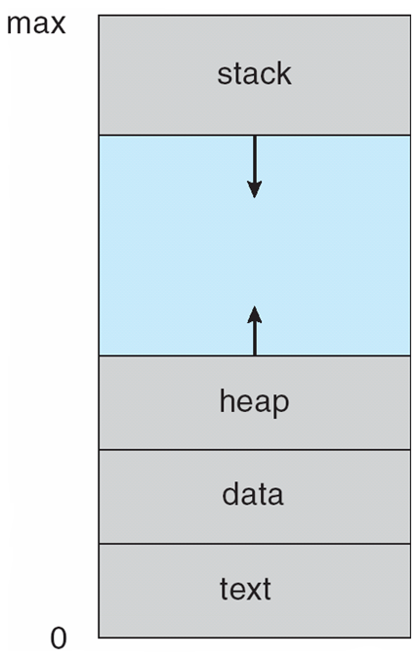
Process: program in execution
CPU
(Physical)
Main Memory
(RAM)
registers
PSW
PC
IR
CPU state of the process
(CPU context)
process address space
(currently used portion of the address space must be in memory)

Slide 7
Multiple Processes
one program counter
Process
A
processes
Three program counters
Process
B
C
Process
A
Process
B
Process
C
B
Process
C
A
time
Conceptual model
of three different processes
what is
happening physically
one process executing at a time

Slide 8
Process in Memory
Stack segment (holds the called function parameters,
local variables, return values)
Storage for dynamically created
variables
Data segment (includes global variables, arrays, etc., you use)
Text segment (code segment)
(instructions are here)
A process needs this memory content to run
(called address space; memory image)

Slide 9
Process Address Space
A process can only access its address space
Each process has its own address space
Kernel can access everything

Slide 10
Process State
As a process executes, it changes state
new: The process is being created
running: Instructions are being executed
waiting: The process is waiting for some event to occur
ready: The process is waiting to be assigned to a processor
terminated: The process has finished execution
In a single-CPU system, only one process may be in running state; many processes may be in ready and waiting states.

Slide 11
Diagram of Process State

Slide 12
Process Control Block
Process 1
Process 2
Process 3
Process N
stack
stack
stack
stack
process
address space
data
data
data
data
text
text
text
text
PCB
1
PCB
2
PCB
3
PCB N
Kernel Memory
Kernel maintains a PCB for each process. They can be linked together in various queues.

Slide 13
Process Control Block
Information associated with each process
Process state (ready, running, waiting, etc)
Program counter (PC)
CPU registers
CPU scheduling information
Priority of the process, etc.
Memory-management information
text/data/stack section pointers, sizes, etc.
pointer to page table, etc.
Accounting information
CPU usage, clock time so far, …
I/O status information
List of I/O devices allocated to the process,
Process ID (pid)
Parent process
Child processes
File management info
Root directory
Working directory
a list of open files, etc.
UID
GID

Slide 14
Process Representation in Linux
In Linux kernel source tree, the file include/linux/sched.h contains
the definition of the structure task_struct, which is the PCB for a process.
struct task_struct {
long state; /* state of the process */
….
pid_t pid; /* identifier of the process */
…
unisgned int time_slice; /* scheduling info */
…
struct files_struct *files; /* info about open files */
….
struct mm_struct *mm; /* info about the address space of this process */
…
}

Slide 15
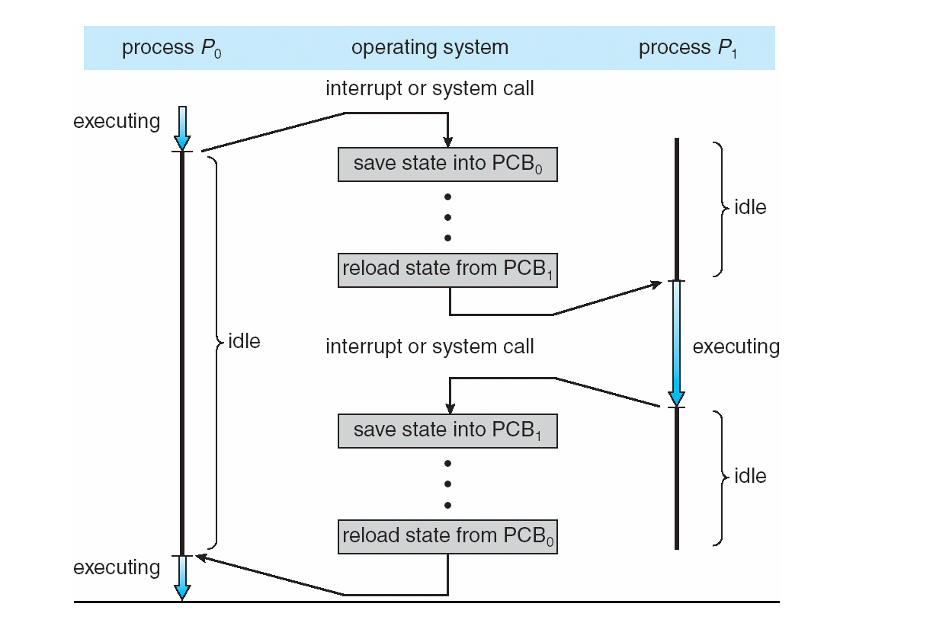
CPU Switch from Process to Process

Slide 16
Example: Processes in Linux
Use ps command to see the currently started processes in the system
Use ps aux to get more detailed information
See the manual page of the ps to get help about the ps:
Type: man ps
The man command gives info about a command, program, library function, or system call.
The /proc file system in Linux is the kernel interface to users to look to the kernel state (variables, structures, etc.).
Many subfolders
One subfolder per process (name of subfolder == pid of process)

Slide 17
Process Queues and Scheduling

Slide 18
Process Scheduling
In a multiprogramming or time-sharing system, there may be multiple processes ready to execute.
We need to select one them and give the CPU to that.
This is scheduling (decision).
There are various criteria that can be used in the scheduling decision.
The scheduling mechanism (dispatcher) than assigns the selected process to the CPU and starts execution of it.
Select
(Scheduling Algorithm)
Dispatch
(mechanism)

Slide 19
Scheduling
Ready queue is one of the many queues that a process may be added
CPU scheduling schedules from ready queue.
Other queues possible:
Job queue – set of all processes started in the system waiting for memory
Device queues – set of processes waiting for an I/O device
A process will wait in such a queue until I/O is finished or until the waited event happens
Processes migrate among the various queues
Process/CPU scheduling
CPU
Ready
queue
Device
queue
Memory
Device
Device
queue
Device
Job queue

Slide 20
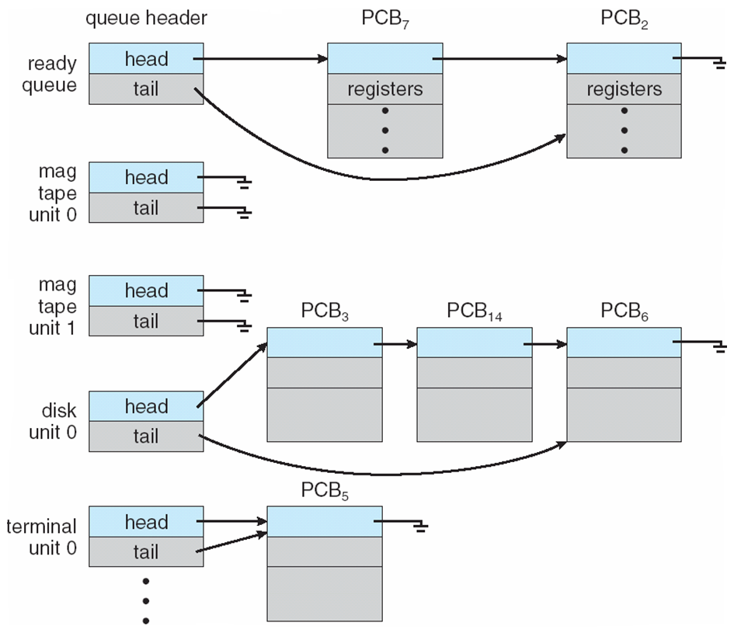
Ready Queue and Various I/O Device Queues

Slide 21
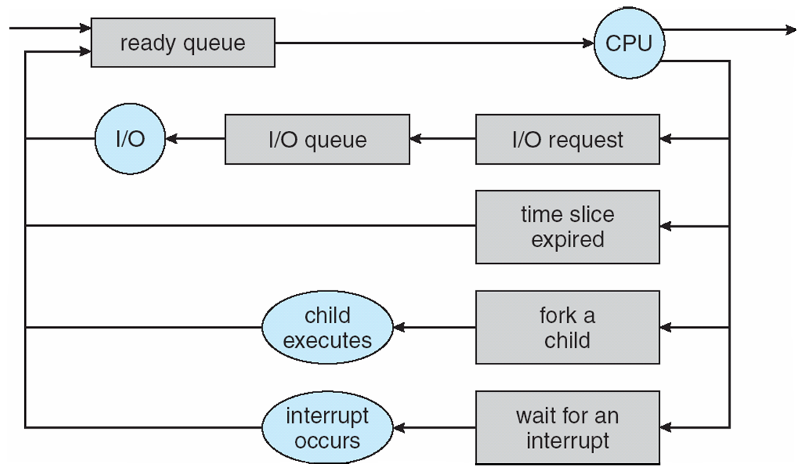
Representation of Process Scheduling
CPU Scheduler
ready queue
I/O queue

Slide 22
Schedulers
Long-term scheduler (or job scheduler) – selects which processes should be brought into the ready queue
Short-term scheduler (or CPU scheduler) – selects which process should be executed next and allocates CPU
Short-term
scheduler
CPU
ready queue
Long-term
scheduler
Main Memory
job queue

Slide 23
Schedulers
Short-term scheduler is invoked very frequently (milliseconds) ⇒ (must be fast)
Long-term scheduler is invoked very infrequently (seconds, minutes) ⇒ (may be slow)
The long-term scheduler controls the degree of multiprogramming
i.e. number of processes in memory
Can also control kind of processes in memory!
What kind of processes will be in memory?
A good mix of IO bound and CPU bound processes

Slide 24
Addition of Medium Term Scheduling
Medium term
scheduler
Medium term
scheduler
Short term
Scheduler
(CPU Scheduler)

Slide 25
Process Behavior
Processes can be described as either:
I/O-bound process – spends more time doing I/O than computations, many short CPU bursts
CPU-bound process – spends more time doing computations; few very long CPU bursts
CPU burst: the execution of the program in CPU between two I/O requests (i.e. time period during which the process wants to continuously run in the CPU without making I/O)
We may have a short or long CPU burst.
I/O bound
CPU bound
waiting
waiting

Slide 26
Context Switch
When CPU switches to another process, the system must save the state of the old process and load the saved state for the new process via a context switch
Context of a process represented in the PCB
Context-switch time is overhead; the system does no useful work while switching
Time dependent on hardware support

Slide 27
Process Creation and Termination

Slide 28
Process Creation
Parent process create children processes, which, in turn create other processes, forming a tree of processes
Generally, process identified and managed via a process identifier (pid)
Resource sharing alternatives:
Parent and children share all resources
Children share subset of parent’s resources
Parent and child share no resources
Execution alternatives:
Parent and children execute concurrently
Parent waits until children terminate
Process
Process
Process
Process
Process
Process

Slide 29
Process Creation (Cont)
Child’s address space?
Child has a new address space.
Child’s address space can contain:
1) the copy of the parent (at creation)
2) has a new program loaded into it
UNIX examples
fork system call creates new process
exec system call used after a fork to replace the process’ memory space with a new program
Parent AS
Child AS
1)
Parent AS
Child AS
2)

Slide 30
C Program Forking Separate Process in Linux
int main()
{
pid_t n; // stores process id
n = fork();
if (n < 0) {
fprintf(stderr, "Fork Failed");
exit(-1);
}
else if (n == 0) { /* child process*/
execlp("/bin/ls", "ls", NULL);
}
else { /* parent process */
wait (NULL);
printf ("Child Complete");
exit(0);
}
}
Parent
n=?
pid=x
before fork() executed
Parent
n=y
Child
n=0
pid=x
pid=y
after fork() executed
Parent
n=y
Child
pid=x
pid=y
after execlp() executed

Slide 31
Execution Trace: fork()
Process-Parent
Process-Child
stack
n
y
stack
n
0
PC
data
data
….
n=fork();
If (n == 0)
..
else if (n>0) ...
….
n=fork();
If (n == 0)
..
else if (n>0) ...
text
text
CPU
PC
PC
x
pid
y
pid
PCB-Parent
PCB-Child
sys_fork()
{….}
RAM
Kernel

Slide 32
Execution Trace: fork() with execlp()
Process-Parent
Process-Child
stack
n
y
stack
n
0
PC
data
data
….
n=fork();
If (n == 0)
…exec()
else if (n>0) ...
….
n=fork();
If (n == 0)
…exec()
else if (n>0) ...
text
text
new code
CPU
PC
PC
x
pid
y
pid
PCB-Parent
PCB-Child
sys_fork()
{….}
sys_execve()
{….}
RAM
Kernel

Slide 33
Family of exec() Functions in Unix
Program A
Program B
…
execlp(…);
…
…
execv(…);
…
Your Programs
…..
user mode
execl(...)
{…}
execlp(...)
{…}
execle(...)
{…}
execv(...)
{…}
execvp(...)
{…}
execve(...)
{…}
C Library
sys_execve(…)
{
…
}
kernel mode
Kernel

Slide 34
Examples
What is the following pseudocode doing?
main()
pid_t n=0;
for (i=0; i<10; ++i) {
n = fork();
if (n==0) {
print (“hello”);
exit (0);
}
}
for (i=0; i<10; ++i)
wait();
}
What is the following pseudocode doing?
main()
pid_t n=0;
for (i=0; i<2; ++i) {
print (i);
n = fork();
print (“hello”);
}
}

Slide 35
Examples
What is the following pseudocode doing?
main()
int x,y;
x = fork();
if (x==0) {
y = fork();
if (y==0) { print (“hello”);
}
}
}

Slide 36
Examples
What is the following pseudocode doing?
main() {
int x,y;
x = fork();
if (x==0) {
y = fork();
if (y==0) { print (“hello”);
exit(0);
}
exit(0);
}
waitpid (x);
}

Slide 37
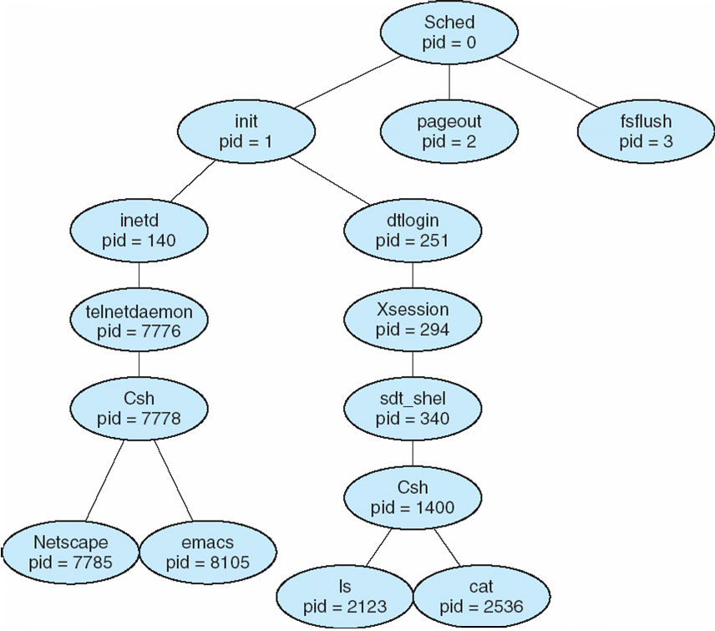
A tree of processes on a typical Solaris
the shell that a remote user is using
your local shell
your started programs

Slide 38
Process Termination
Process executes last statement and asks the operating system to delete it (can use exit system call)
Output data from child to parent (via wait)
Process’ resources are deallocated by operating system
Parent may terminate execution of children processes (abort)
Child has exceeded allocated resources
Task assigned to child is no longer required
If parent is exiting
Some operating systems do not allow child to continue if its parent terminates
All children terminated - cascading termination

Slide 39
Process Termination
Parent
Child
fork();
….
….
x = wait ();
….
….
….
exit (code);
PCB of parent
PCB of child
sys_wait()
{
…return(..)
}
sys_exit(..)
{
…
}
Kernel

Slide 40
Inter-process Communication (IPC)

Slide 41
Cooperating Processes and the need for Interprocess Communication
Processes within a system may be independent or cooperating
Independent process cannot affect or be affected by the execution of another process
Cooperating process can affect or be affected by the execution of another process
Reasons for process cooperation
Information sharing
Computation speed-up
Modularity (application will be divided into modules/sub-tasks)
Convenience (may be better to work with multiple processes)
Application
Process
Process
Process
cooperating process
The overall application is designed to consist of cooperating processes

Slide 42
IPC Mechanisms
Cooperating processes require a facility/mechanism for inter-process communication (IPC)
There are two basic IPC models provided by most systems:
1) Shared memory model
processes use a shared memory to exchange data
2) Message passing model
processes send messages to each other through the kernel

Slide 43
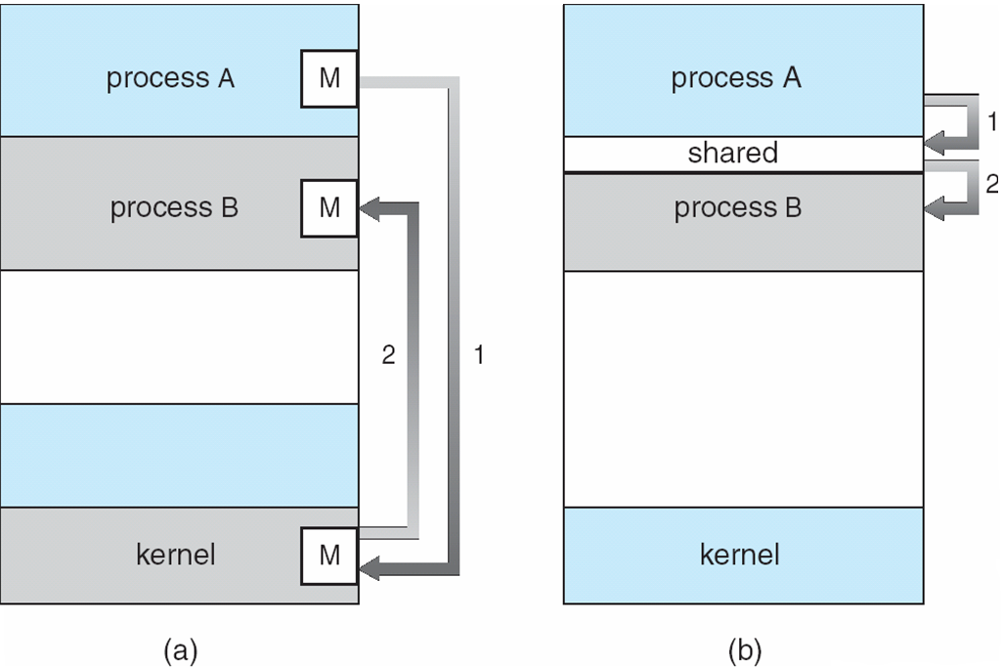
Communication Models
message passing approach
shared memory approach

Slide 44
Shared Memory IPC Mechanism
A region of shared memory is established between (among) two or more processes.
via the help of the operating system kernel (i.e. system calls).
Processes can read and write shared memory region (segment) directly as ordinary memory access (pointer access)
During this time, kernel is not involved.
Hence it is fast
Process A
shared region
Process B
Kernel

Slide 45
Access via pointers
char *cptr;
char c;
cptr = …open/attach shared memory region…
/* cptr points to the beginning of shared memory,
which can be considered as a sequence of bytes / characters
*/
cptr[0] = ‘A’ // write a value into byte 0 of shared memory
cptr[1] = ‘B’; // write a value into byte 1 …
c = cptr [5]; // read value at byte 5 of shared memory
// we can also read / write integers and structures
// all via pointer operations of C

Slide 46
Shared Memory IPC Mechanism
To illustrate use of an IPC mechanism, a general model problem, called producer-consumer problem, can be used. A lot of problems look like this.
We have a producer, a consumer, and data is sent from producer to consumer.
unbounded-buffer places no practical limit on the size of the buffer
bounded-buffer assumes that there is a fixed buffer size
Producer Process
Buffer
Consumer Process
Produced Items
We can solve this problem via shared memory IPC mechanism

Slide 47
Bounded-Buffer – Shared-Memory Solution
Shared data
#define BUFFER_SIZE 10
typedef struct {
. . .
} item;
item buffer[BUFFER_SIZE];
int in = 0; // next free position
int out = 0; // first full position
Solution is correct, but can only use BUFFER_SIZE-1 elements

Slide 48
Buffer State in Shared Memory
Producer
Consumer
item buffer[BUFFER_SIZE]
int out;
int in;
Shared Memory

Slide 49
Buffer State in Shared Memory
Buffer Full
in
out
((in+1) % BUFFER_SIZE == out) : considered full buffer
Buffer Empty
in
out
in == out : empty buffer

Slide 50
Bounded-Buffer – Producer and Consumer Code
while (true) { // produce an item
while ( ((in + 1) % BUFFER SIZE) == out)
; // do nothing -- no free buffers
buffer[in] = item;
in = (in + 1) % BUFFER SIZE;
}
Producer
while (true) {
while (in == out)
; // do nothing -- nothing to consume
// remove an item from the buffer
item = buffer[out];
out = (out + 1) % BUFFER SIZE;
return item;
}
Consumer
buffer (an array)
in, out integer variable
Shared Memory

Slide 51
Message Passing IPC Mechanism
Another mechanism for processes to communicate and to synchronize their actions
With message passing system, processes communicate with each other without resorting to shared variables
This IPC facility provides two operations:
send(message) – message size fixed or variable
receive(message)
If P and Q wish to communicate, they need to:
establish a (logical) communication link between them
exchange messages via send/receive
messages
passed
through
P
Q
Logical Communication Link

Slide 52
Implementation in a system
The messaging passing facility can be implemented in various ways.
That means the facility may have different features depending on the system
How are links established?
Explicitly by the process? Or implicitly by the kernel?
Can a link be associated with more than two processes?
How many links can be there between a pair of communicating processes?
What is the capacity of a link?
Is the size of a message that the link can accommodate fixed or variable?
Is a link unidirectional or bi-directional?

Slide 53
Naming: Identifying the receiver
Naming (how do we identify the receiver)
Direct naming and communication
Receiver and sender process explicitly specified
send (P, message) – send a message to process P
receive(Q, message) – receive a message from process Q
Indirect naming and communication
Messages are directed and received from mailboxes (also referred to as ports)
send (mqid, message)
receive (mqid, message)
Process
Process
send() {..
{
receive() {…
}
Mailbox (mqid)
Kernel

Slide 54
Synchronization
How does the sender/receiver behave if it can not send/receive the message immediately
Depends whether Blocking or Non-Blocking communication is used
Blocking is considered synchronous
Sender blocks until receiver or kernel receives
Receiver blocks until message available
Non-blocking is considered asynchronous
Sender sends the message really or tries later, but always returns immediately and can do something
Receiver receives a valid message or null, but always returns immediately and can do something

Slide 55
Buffering
Exact behavior depends also on the Available Buffer
Buffer: Queue of messages attached to the link. Implemented in one of three ways
1. Zero capacity – 0 messages Sender must wait for receiver (rendezvous)
2. Bounded capacity – finite length of n messages Sender must wait if link full
Unbounded capacity – infinite length Sender never waits

Slide 56
Synchronization
Sender
Receiver
Kernel
Buffer
 | Zero Buffer | Some Buffer
Blocking Send | Wait until receiver receives | Wait until kernel receives (if buffer has space no wait)
Blocking Receive | Wait until sender has a message | Wait until kernel has a message (if buffer has message no wait)
Nonblocking Send | Return with receiver received the message or error | Return with kernel received the message or error
Nonblocking Receive | Return with a message or none | Return with a message or none
What if there
would be an infinite buffer?

Slide 57
Example IPC: POSIX message queues
POSIX (Portable Operating System Interface) is the standard API for Unix-like systems.
shareddefs.h
struct item {
int id;
char astr[64];
};
#define MQNAME "/justaname"
--- We have a producer, a consumer process.
--- Producer sends messages to the consumer.
--- In the following example, run the consumer first.

Slide 58
producer.c
#include <stdlib.h>
#include <mqueue.h>
#include <stdio.h>
#include <unistd.h>
#include <errno.h>
#include <string.h>
#include "shareddefs.h"
int main()
{
mqd_t mq; struct item item; int n;
mq = mq_open(MQNAME, O_RDWR);
if (mq == -1) { perror("mq_open failed\n"); exit(1); }
int i = 0;
while (1) {
item.id = i;
strcpy(item.astr, "os is good\n");
n = mq_send(mq, (char *) &item, sizeof(struct item), 0);
if (n == -1) {perror("mq_send failed\n"); exit(1); }
i++;
sleep(1);
}
mq_close(mq);
return 0;
}

Slide 59
consumer.c
#include <stdlib.h>
#include <mqueue.h>
#include <stdio.h>
#include <unistd.h>
#include <errno.h>
#include <string.h>
#include "shareddefs.h"
int main()
{ mqd_t mq; struct mq_attr mq_attr;
struct item *itemptr;
int n, buflen; char *bufptr;
mq = mq_open(MQNAME, O_RDWR | O_CREAT, 0666, NULL);
if (mq == -1) { perror("can not create msg queue\n"); exit(1); }
mq_getattr(mq, &mq_attr);
printf("mq maximum msgsize = %d\n", (int) mq_attr.mq_msgsize);
/* allocate large enough space for the buffer */
buflen = mq_attr.mq_msgsize;
bufptr = (char *) malloc(buflen);
while (1) {
n = mq_receive(mq, (char *) bufptr, buflen, NULL);
if (n == -1) { perror("mq_receive failed\n"); exit(1); }
printf("mq_receive success, message size=%d\n", n);
itemptr = (struct item *) bufptr;
printf("item->id = %d\n", itemptr->id);
printf("item->astr = %s\n", itemptr->astr);
printf("\n");
}
free(bufptr);
mq_close(mq);
return 0;
}

Slide 60
Makefile
all: producer consumer
consumer: consumer.c
gcc -Wall -o consumer consumer.c -lrt
producer: producer.c
gcc -Wall -o producer producer.c -lrt
clean:
rm -fr *~ producer consumer
korpe@ubuntu:~/x$ ls

Slide 61
Example IPC: POSIX shared memory
The following functions are defined to create and manage shared memory in POSIX API
shm_open():
create or open a shared memory region/segment (also called shared memory object)
shm_unlink():
remove the shared memory object
ftruncate():
set the size of shared memory region
mmap():
map the shared memory into the address space of the process. With this, a process gets a pointer to the shared memory region and can use that pointer to access the shared memory.

Slide 62
Example IPC: POSIX shared memory
The following functions are defined to create and manage shared memory in POSIX API
shm_open():
create or open a shared memory region/segment (also called shared memory object)
shm_unlink():
remove the shared memory object
ftruncate():
set the size of shared memory region
mmap():
map the shared memory into the address space of the process. With this, a process gets a pointer to the shared memory region and can use that pointer to access the shared memory.

Slide 63
producer
#include <stdio.h>
#include <stdlib.h>
#include <string.h>
#include <fcntl.h>
#include <sys/shm.h>
#include <sys/stat.h>
#include <sys/mman.h>
int main()
{
const int SIZE = 4096; const char *name = "OS";
const char *message0= "Studying "; const char *message1= "Operating Systems ";
const char *message2= "Is Fun!";
int shm_fd; void *ptr;
shm_fd = shm_open(name, O_CREAT | O_RDWR, 0666);
ftruncate(shm_fd,SIZE);
ptr = mmap(0,SIZE, PROT_READ | PROT_WRITE, MAP_SHARED, shm_fd, 0);
if (ptr == MAP_FAILED) { printf("Map failed\n"); return -1; }
sprintf(ptr,"%s",message0);
ptr += strlen(message0);
sprintf(ptr,"%s",message1);
ptr += strlen(message1);
sprintf(ptr,"%s",message2);
ptr += strlen(message2);
return 0;
}
In this example, run the producer first.

Slide 64
consumer
#include <stdio.h>
#include <stdlib.h>
#include <fcntl.h>
#include <sys/shm.h>
#include <sys/stat.h>
#include <sys/mman.h>
int main()
{
const char *name = "OS";
const int SIZE = 4096;
int shm_fd;
void *ptr; int
shm_fd = shm_open(name, O_RDONLY, 0666);
if (shm_fd == -1) { printf("shared memory failed\n"); exit(-1); }
ptr = mmap(0,SIZE, PROT_READ, MAP_SHARED, shm_fd, 0);
if (ptr == MAP_FAILED) {printf("Map failed\n"); exit(-1); }
printf("%s",ptr);
if (shm_unlink(name) == -1) {printf("Error removing %s\n",name); exit(-1);
}
}

Slide 65
Other IPC methods: pipes
Unix/Linux Pipes:
A pipe enables one-way communication between a parent and child and vice versa
It is easy to use.
When process terminates, pipe is removed automatically
pipe() system call
P
C
pipe

Slide 66
#include <stdio.h>
#include <unistd.h>
#include <sys/types.h>
#include <string.h>
#define BUFFER_SIZE 25
#define READ_END 0
#define WRITE_END 1
int main(void)
{
char write_msg[BUFFER_SIZE] = "Greetings";
char read_msg[BUFFER_SIZE]; pid_t pid; int fd[2]; // an array of 2 integers fd[0] and fd[1]
if (pipe(fd) == -1) { fprintf(stderr,"Pipe failed"); return 1;}
pid = fork();
if (pid < 0) { fprintf(stderr, "Fork failed"); return 1; }
if (pid > 0) {
close(fd[READ_END]); //close read end (index 0) - it is unused here
write(fd[WRITE_END], write_msg, strlen(write_msg)+1);
close(fd[WRITE_END]);
}
else { /* child process */
close(fd[WRITE_END]); //close write end (index 1) - it is unused here
read(fd[READ_END], read_msg, BUFFER_SIZE);
printf("child read %s\n",read_msg);
close(fd[READ_END]);
}
return 0;
}
Parent is sending to Child
C
P
0(R)
1(W)

Slide 67
Other IPC methods: named-pipes (FIFOs)
A named-pipe is called FIFO.
It has a name (a filename)
Call mkfifo() to create
When processes terminate, it is not removed automatically
No need for parent-child relationship
Bidirectional
Any two processes can create and use named pipes.
P1
P2
a_filename
named pipe

Slide 68
Communication Through Network: Client-Server Communication

Slide 69
Communications in Client-Server Systems
Sockets
Remote Procedure Calls
Remote Method Invocation (Java)

Slide 70
Sockets
A socket is defined as an endpoint for communication
Concatenation of IP address and port
The socket 161.25.19.8:1625 refers to port 1625 on host 161.25.19.8
Communication happens between a pair of sockets
A communication can be identified as a pair of sockets
(IP1, Port1, IP2, Port2)
Bidirectional communication
P
Q
Network
M1
M2

Slide 71
Socket Communication

Slide 72
Sockets
Two types
TCP (STREAM)
UDP
A socket is bound to an address and port.
A network application
Two parts
Usually a server and a client

Slide 73
TCP Server and Client
Create a socket s and put to listening mode
c = Accept (s)
Read(c) and Write(c)
Close(c)
Create a socket c
Connect (c, s_address_port)
Read (c) and Write (c)
Close (c)
You will learn Socket programming in detail in Computer Networks course.

Slide 74
Remote Procedure Calls
Remote procedure call (RPC) abstracts procedure calls between processes on networked systems
Stubs – client-side proxy for the actual procedure on the server
The client-side stub locates the server and marshalls the parameters into a message and sends a message to the server
The server-side stub receives this message, unpacks the marshalled parameters, and performs (executes) the procedure on the server
The return value is put into a reply message and sent back to the client-side

Slide 75
Execution of RPC

Slide 76
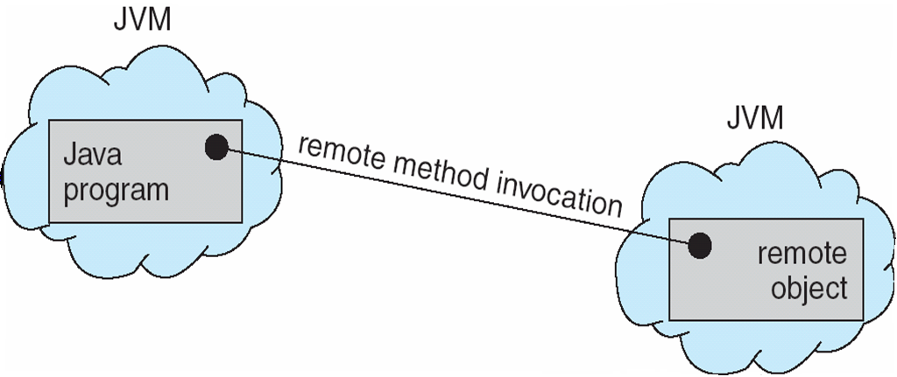
Remote Method Invocation
Remote Method Invocation (RMI) is a Java mechanism similar to RPCs
RMI allows a Java program on one machine to invoke a method on a remote object

Slide 77
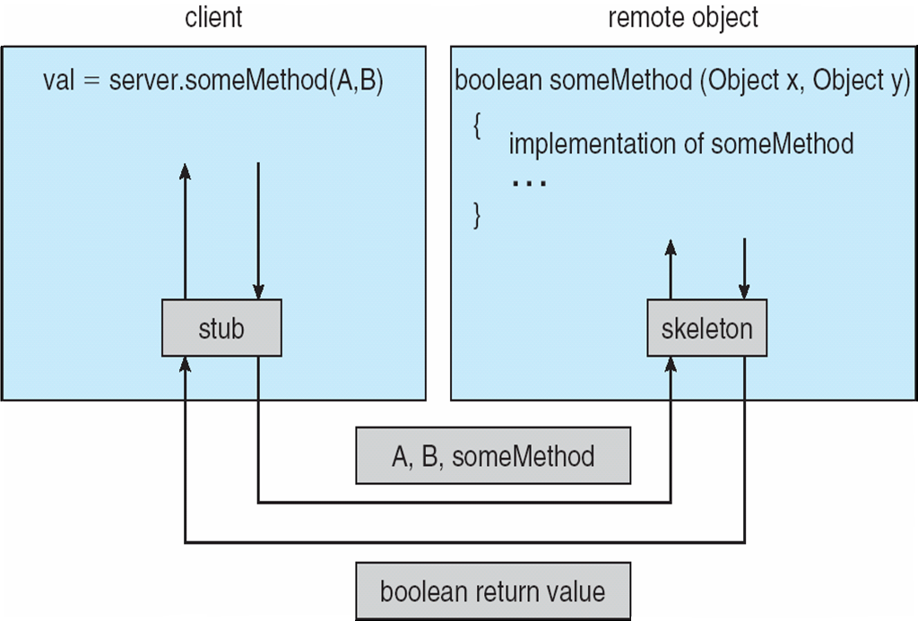
Marshalling Parameters

Slide 78
References
1. Operating System Concepts, 9th edition, Silberschatz et al. Wiley.
2. Modern Operating Systems, Andrew S. Tanenbaum, 3rd edition, 2009.
3. The slides here are adapted/modified from the textbook and its slides: Operating System Concepts, Silberschatz et al., 7, 8, 9th editions, Wiley.

Slide 79
Additional Study Material

