Slide 1

Chapter 6:
Synchronization
Bilkent University
Department of Computer Engineering
CS342 Operating Systems
Last Update: Nov 13, 2019

Slide 2
Objectives and Outline
Objectives
To introduce the critical-section problem
Critical section solutions can be used to ensure the consistency of shared data
To present both software and hardware solutions of the critical-section problem
Outline
Background
The Critical-Section Problem
Peterson’s Solution
Synchronization Hardware
Semaphores
Classic Problems of Synchronization
Monitors
Synchronization Examples from operating systems

Slide 3
Background
Concurrent access to shared data may result in data inconsistency
Maintaining data consistency requires mechanisms to ensure the orderly execution of cooperating processes
Shared Data
Can be a shared memory
variable, a global variable
in a multi-thread program or
a file; or a kernel variable
Concurrent Threads or Processes

Slide 4
Producer Consumer Problem Revisited
Below is a solution to the consumer-producer problem that fills all the slots of the shared buffer.
Use an integer count to keep track of the number of full slots.
Initially, count is set to 0. It is incremented by the producer after it puts a new item and is decremented by the consumer after it retrieves an item from the buffer.
also a shared variable
Producer
count
Consumer
Shared Buffer
at most BUFFER_SIZE items

Slide 5
Producer and Consumer Code
Producer
ConSUMER
while (true) {
/*produce an item*/
nextProduced = ….
while (count == BUFFER_SIZE)
; // do nothing
buffer [in] = nextProduced;
in = (in + 1) % BUFFER_SIZE;
count++;
}
while (true) {
while (count == 0)
; // do nothing
nextConsumed = buffer[out];
out = (out + 1) % BUFFER_SIZE;
count--;
/*consume item nextConsumed*/
}

Slide 6
a possible Problem: race condition
Assume we had 5 items in the buffer
Then:
  Assume producer has just produced a new item and put it into buffer and is about to increment the count.
  Assume the consumer has just retrieved an item from buffer and is about the decrement the count.
  Namely: Assume producer and consumer is now about to execute count++ and count-- statements.

Slide 7
Producer
Consumer
or
Producer
Consumer

Slide 8
Race Condition
count++ could be implemented as
register1 = count
register1 = register1 + 1
count = register1
count-- could be implemented as
register2 = count
register2 = register2 - 1
count = register2

Slide 9
Race Condition
register1
Count
PRODUCER (count++)
5
6
5
6
4
register1 = count
register1 = register1 + 1
count = register1
register1 = count
register1 = register1 + 1
count = register1
register2
5
4
CONSUMER (count--)
register2 = count
register2 = register2 – 1
count = register2
register2 = count
register2 = register2 – 1
count = register2
CPU
6
Main Memory

Slide 10
Interleaved Execution sequence
Consider this execution interleaving with “count = 5” initially:
  S0: producer execute register1 = count {register1 = 5}
  S1: producer execute register1 = register1 + 1 {register1 = 6}
  S2: consumer execute register2 = count {register2 = 5}
  S3: consumer execute register2 = register2 - 1 {register2 = 4}
  S4: producer execute count = register1 {count = 6 }
  S5: consumer execute count = register2 {count = 4}

Slide 11
Count value may be 4, 6, or 5 in various runs.
But it should be 5 (as a result of one increment, one decrement operation)
Interleaved access to count causes data inconsistency: 4, 5, 6.
For consistent results (5), either count++ should be executed and finished first, or count– should be executed and finished. Not interleaved.
We need to enforce non-interleaved access (atomic) in this case. This means: synchronization required.

Slide 12
Programs and critical sections
The part of the program (process) that is accessing and changing shared data is called its critical section
Process 1 Code
Process 2 Code
Process 3 Code
Change X
Change X
Change Y
Change Y
Change Y
Change X
Assuming X and Y are shared data.

Slide 13
Program lifetime and its structure
Considering a process:
  It may be executing critical section code from time to time
  It may be executing non critical section code (remainder section) other times.
We should not allow more than one process to be in their critical regions where they are manipulating the same shared data.

Slide 14
Structuring Programs
The general way to do that is:
do {
entry section
critical section
exit section
remainder
} while (TRUE)
do {
critical section
remainder section
} while (TRUE)
The general structure of a program
Entry section will allow only one process to enter and execute critical section code.

Slide 15
Solution to Critical-Section Problem
An ideal solution should have the following conditions satisfied:
Mutual Exclusion - If process P_{i} is executing in its critical section, then no other processes can be executing in their critical sections
Progress - If no process is executing in its critical section and there exist some processes that wish to enter their critical section, then the selection of the processes that will enter the critical section next cannot be postponed indefinitely // no deadlock
Bounded Waiting - A bound must exist on the number of times that other processes are allowed to enter their critical sections after a process has made a request to enter its critical section and before that request is granted // no starvation of a process
  Assume that each process executes at a nonzero speed
  No assumption concerning relative speed of the N processes

Slide 16
Applications and Kernel
Multi-process applications sharing a file or shared memory segment may face critical section problems.
Multi-threaded applications sharing global variables may also face critical section problems.
Similarly, kernel itself may face critical section problem. It is also a program. It may have critical sections.

Slide 17
Kernel Critical Sections
While kernel is executing a function x(), a hardware interrupt may arrive and interrupt handler h() can be run. Make sure that interrupt handler h() and x() do not access the same kernel global variable. Otherwise race condition may happen.
While a process is running in user mode, it may call a system call s(). Then kernel starts running function s(). CPU is executing in kernel mode now. We say the process is now running in kernel mode (even though kernel code is running).
  While a process X is running in kernel mode, it may or may not be pre-empted. In preemptive kernels, the process running in kernel mode can be preempted and a new process may start running. In non-preemptive kernels, the process running in kernel mode is not preempted unless it blocks or returns to user mode.

Slide 18
Kernel Critical Sections
  In a preemptive kernel, a process X running in kernel mode may be suspended (preempted) at an arbitrary (unsafe) time. It may be in the middle of updating a kernel variable or data structure at that moment. Then a new process Y may run and it may also call a system call. Then, process Y starts running in kernel mode and may also try update the same kernel variable or data structure (execute the critical section code of kernel). We can have a race condition if kernel is not synchronized.
Therefore, we need to solve synchronization and critical section problem for the kernel itself as well. The same problem appears there as well.

Slide 19
Peterson’s Solution
Two process solution
Assume that the LOAD and STORE instructions are atomic; that is, cannot be interrupted.
The two processes share two variables:
  int turn;
  Boolean flag[2]
The variable turn indicates whose turn it is to enter the critical section.
The flag array is used to indicate if a process is ready to enter the critical section. flag[i] = true implies that process P_{i} is ready!

Slide 20
Algorithm for Process P_{i}
do {
flag[i] = TRUE;
turn = j;
while (flag[j] && turn == j);
critical section
flag[i] = FALSE;
remainder section
} while (1)
entry section
exit section

Slide 21
Two processes executing concurrently
PROCESS i (0)
PROCESS j (1)
do {
flag[0] = TRUE;
turn = 1;
while (flag[1] && turn == 1);
critical section…..
flag[0] = FALSE;
remainder section…..
} while (1)
do {
flag[1] = TRUE;
turn = 0;
while (flag[0] && turn == 0);
critical section…..
flag[1] = FALSE;
remainder section…..
} while (1)
flag[]
turn
Shared Variables

Slide 22
Synchronization Hardware
We can use some hardware support (if available) for protecting critical section code
  1) Disable interrupts? maybe
    Sometimes only (kernel)
    Not on multi-processors
  2) Special machine instructions and lock variables
    TestandSet
    CompareAndSwap (EXCH instruction in Intel x86 arch)

Slide 23
Solution to Critical-section Problem Using Locks
Use of lock variables is a general and very common approach.
A lock variable (an integer that can have values 0 or 1) shared
A process (thread) can be structured as follows:
do {
acquire_lock (lock)
critical section
release_lock (lock)
remainder section
} while (TRUE);
Only one process can acquire lock. Others has to wait (or busy loop)

Slide 24
Synchronization Hardware
What happens if you use a lock variable without special instructions?
  Can be source of race conditions
    Example:
      int lock = 0; // global variable (shared among threads)
Thread 1
Thread 2
while (lock == 1)
; // loop
lock = 1;
// critical section
lock = 0;
while (lock == 1)
; // loop
lock = 1;
// critical section
lock = 0;
above code is NOT correct solution

Slide 25
Synchronization Hardware
Therefore we need to use special machine instructions that can do testing and setting atomically or something like that (like swapping)
Some possible atomic (non-interruptable) machine instructions:
  TestAndSet instruction (TSL):
  test memory word and set value
  CompareAndSwap instruction
They can be executed atomically in a multi-processor environment as well (one CPU at a time executes the instruction: it involves memory access; memory is shared)

Slide 26
TestAndSet Instruction
Is a machine/assembly instruction.
  But here we provide definition of it using a high level language code.
Definition of TestAndSet Instruction
boolean TestAndSet (boolean *target)
{
boolean rv = *target;
*target = TRUE;
return rv:
}
TestAndSet REGISTER, LOCK;

Slide 27
Solution using TestAndSet
To use it, we need to program in assembly language.
i.e., entry section code should be programmed in assembly
Solution
We use a shared Boolean variable lock, initialized to false.
do {
while ( TestAndSet (&lock ))
; // do nothing
// critical section
lock = FALSE;
// remainder section
} while (TRUE);
entry section
exit_section

Slide 28
In assembly
entry_section:
TestAndSet REGISTER, LOCK;
CMP REGISTER, #0
JNE entry_section;
RET
entry section code
exit_section:
move LOCK, #0
RET
exit section code
main:
..
call entry_section;
execute criticial region;
call exit_section;

Slide 29
CompareAndSwap Instruction
Again a machine instruction
It has three operands: value, expected, newvalue
Definition
void compare_and_swap (int *value, int expected, int new_value)
{
boolean temp = *value;
if (value == expected)
*value == new_value;
return temp;
}

Slide 30
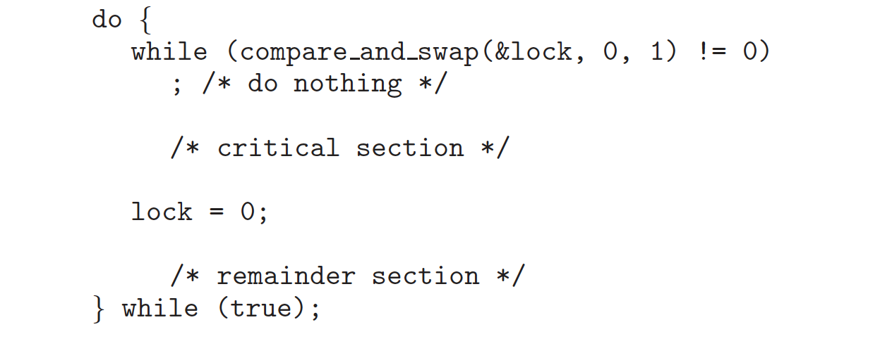
Solution using CompareAndSwap
Need to program entry_section() in assembly
Solution
We use a shared Boolean variable lock initialized to FALSE.
entry_section
exit_section

Slide 31
Comments
Use of TestAndSet and CompareAndSwap as explained provides mutual exclusion: 1st property satisfied
But, Bounded Waiting property, 3rd property, may not be satisfied.
A process X may be waiting, but we can have the other process Y going into the critical region repeatedly.

Slide 32
Bounded-waiting Mutual Exclusion with TestandSet()
do {
waiting[i] = TRUE;
key = TRUE;
while (waiting[i] && key)
key = TestAndSet(&lock);
waiting[i] = FALSE;
// critical section
j = (i + 1) % n;
while ((j != i) && !waiting[j])
j = (j + 1) % n;
if (j == i)
lock = FALSE;
else
waiting[j] = FALSE;
// remainder section
} while (TRUE);
entry section code
exit section code

Slide 33
Mutex Locks
Put these acquire_lock() and release_lock() implementations in a library/software. Such an object is called mutex_lock (mutual exclusion lock)
  mutex_lock: a primitive implemented in such a software library (or kernel) that applications can use.
  Applications will not be directly using HW instructions; instead mutex_lock implementation will use these HW instructions.
  If implementation uses busy waiting, it is called spin lock
      define-and-initiaze mutex_lock lock;
      acquire_lock (lock);
      // Critical section
      release_lock (lock);

Slide 34
Semaphore
Synchronization tool that does not require busy waiting
Semaphore S: integer variable and a wait queue
shared, and can be a kernel variable
Two standard operations modify S: wait() and signal()
    Originally called P() and V()
    Also called down() and up()
  Semaphores can only be accessed via these two indivisible (atomic/indivisable) operations;
  They can be implemented as system calls by kernel. Kernel makes sure they are indivisible.
Less complicated entry and exit sections when semaphores are used

Slide 35
Meaning (semantics) of operations
wait (S):
if S positive
S-- and return
else
block/wait (until somebody wakes you up; then return)
signal(S):
if there is a process waiting
wake it up and return
else
S++ and return

Slide 36
Comments
Wait body and signal body have to be executed atomically: one process at a time. Hence the body of wait and signal are critical sections to be protected by the kernel.
Not that when wait() causes the process to block, the operation is nearly finished (wait body critical section is done).
That means another process can execute wait body or signal body

Slide 37
Semaphore as General Synchronization Tool
Binary semaphore – integer value can range only between 0
and 1; can be simpler to implement
  Also known as mutex locks
  Binary semaphores provides mutual exclusion; can be used for the critical section problem.
Counting semaphore – integer value can range over an unrestricted domain
  Can be used for other synchronization problems; for example for resource allocation.

Slide 38
Usage
Binary semaphores (mutexes) can be used to solve critical section problem.
A semaphore variable (lets say mutex) can be shared by N processes, and initialized to 1.
Each process is structured as follows:
  do {
  wait (mutex);
  // Critical Section
  signal (mutex);
  // remainder section
  } while (TRUE);

Slide 39
usage: mutual exclusion
Process 0
Process 1
  do {
  wait (mutex);
  // Critical Section
  signal (mutex);
  // remainder section
  } while (TRUE);
  do {
  wait (mutex);
  // Critical Section
  signal (mutex);
  // remainder section
  } while (TRUE);
wait() {…}
signal() {…}
Kernel
Semaphore mutex; // initialized to 1

Slide 40
usage: other synchronization problems
P0
P1
…
S1;
….
…
S2;
….
Assume we definitely want to
have S1 executed before S2.
semaphore x = 0; // initialized to 0
P0
P1
…
S1;
signal (x);
….
…
wait (x);
S2;
….
Solution:

Slide 41
Uses of Semaphore: synchronization
Buffer is an array of BUF_SIZE Cells (at most BUF_SIZE items can be put)
Producer
Consumer
  do {
  // produce item
  …
  put item into buffer
  ..
  signal (Full_Cells);
  } while (TRUE);
  do {
  wait (Full_Cells);
  ….
  remove item from buffer
  ..
  …
  } while (TRUE);
wait() {…}
signal() {…}
Kernel
Semaphore Full_Cells = 0; // initialized to 0

Slide 42
Consumer/Producer is Synchronized
Full_Cells
BUF_SIZE
Producer
Sleeps
0
time
Consumer
Sleeps

Slide 43
Ensured by synchronization mechanisms:
* Red is always less than Blue
* (Blue – Red) can never be greater than BUF_SIZE
Pt – Ct <= BUF_SIZE
Pt – Ct >= 0
all items produced (Pt)
BUF_SIZE
times
all items consumed (Ct)

Slide 44
usage: resource allocation
Assume we have a resource that has 5 instances. A process that needs that type of resource will need to use one instance. We can allow at most 5 process concurrently using these 5 resource instances. Another process (processes) that want the resource need to block. How can we code those processes?
Solution:
one of the processes creates and initializes a semaphore to 5.
semaphore x = 5; // semaphore to access resource
wait (x);
…
….use one instance
of the resource…
…
signal (x);
Each process has to be
coded in this manner.

Slide 45
Semaphore Implementation
Must guarantee that for a semaphore, no two processes can execute wait() and signal() critical sections at the same time.
  Critical section in wait / signal: part that is updating the integer vaue
Kernel can guarantee this.
  By disabling interrupts in a single CPU system
  By use of spin locks in a multi-processor system
Semaphore data structure:
typedef struct {
int value; // semaphore value
struct process *list; // semaphore wait queue
} semaphore;

Slide 46
Semaphore Implementation
Semaphore data structure:
With each semaphore there is an associated waiting queue.
  The processes waiting for the semaphore are waited here.
typedef struct {
int value; // semaphore value
struct process *list; // semaphore wait queue
} semaphore;

Slide 47
Semaphore Implementation
Implementation of wait:
wait(semaphore *S) {
S->value--;
if (S->value < 0) {
add this process to S->list; block the process;
}
}
Implementation of signal:
signal(semaphore *S) {
S->value++;
if (S->value <= 0) {
remove a process P from S->list; wakeup the process;
}
}

Slide 48
Kernel Implementing wait and signal
The wait and signal operations must be atomic. The integer value is updated.
No two processes can execute wait() and signal() critical sections at the same time.
  Critical section in wait / signal: part that is updating the integer value
    Critical section is short
  How can the kernel ensure that? It can NOT use semaphores to implement semaphores.
Kernel can guarantee this.
  By disabling interrupts in a single CPU system
  By use of spin locks in a multi-processor system

Slide 49
Deadlock and Starvation
Deadlock – two or more processes are waiting indefinitely for an event that can be caused by only one of the waiting processes
Let S and Q be two semaphores initialized to 1
P₀ P₁
wait (S); wait (Q);
wait (Q); wait (S);
. .
. .
. .
signal (S); signal (Q);
signal (Q); signal (S);
Starvation – indefinite blocking. A process may never be removed from the semaphore queue in which it is suspended
Priority Inversion - Scheduling problem when lower-priority process holds a lock needed by higher-priority process

Slide 50
Classical Problems of Synchronization
Bounded-Buffer Problem
Readers and Writers Problem
Dining-Philosophers Problem

Slide 51
Bounded Buffer Problem
N buffers, each can hold one item
Semaphore mutex initialized to the value 1
Semaphore full initialized to the value 0
Semaphore empty initialized to the value N.
prod
cons
buffer
full = 4
empty = 6

Slide 52
Bounded Buffer Problem
The structure of the producer process
The structure of the consumer process
do {
// produce an item in nextp
wait (empty);
wait (mutex);
// add the item to the buffer
signal (mutex);
signal (full);
} while (TRUE);
do {
wait (full);
wait (mutex);
// remove an item from
// buffer to nextc
signal (mutex);
signal (empty);
// consume the item in nextc
} while (TRUE);

Slide 53
Readers-Writers Problem
A data set is shared among a number of concurrent processes
  Readers – only read the data set; they do not perform any updates
  Writers – can both read and write
Problem – allow multiple readers to read at the same time. Only one single writer can access the shared data at the same time
reader
writer
reader
Data Set
reader
writer
writer
reader

Slide 54
Readers-Writers Problem
Shared Data
  Data set
  Integer readcount initialized to 0
    Number of readers reading the data at the moment
  Semaphore mutex initialized to 1
    Protects the readcount variable
    (multiple readers may try to modify it)
  Semaphore wrt initialized to 1
    Protects the data set
    (either writer or reader(s) should access data at a time)

Slide 55
Readers-Writers Problem (Cont.)
The structure of a reader process
do {
wait (mutex) ;
readcount ++ ;
if (readcount == 1)
wait (wrt) ;
signal (mutex);
// reading is performed
wait (mutex) ;
readcount -- ;
if (readcount == 0) signal (wrt) ;
signal (mutex) ;
} while (TRUE);
The structure of a writer process
do {
wait (wrt) ;
// writing is performed
signal (wrt) ;
} while (TRUE);

Slide 56
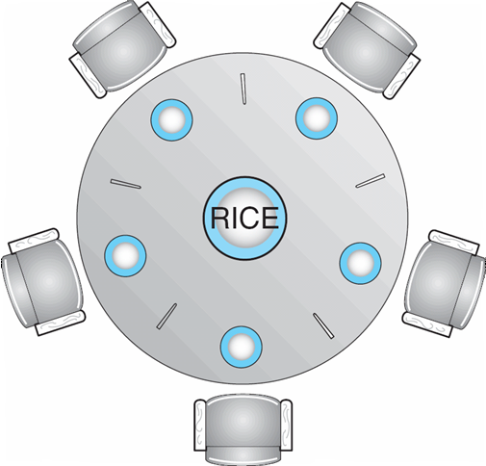
Dining-Philosophers Problem
a resource
a process
Assume a philosopher needs two forks to eat. Forks are like resources.
While a philosopher is holding a fork, another one can not have it.

Slide 57
Dining-Philosophers Problem
Is not a real problem; but lots of real resource allocation problems look like this. If we can solve this problem effectively and efficiently, we can also solve the real problems.
From a satisfactory solution:
  We want to have concurrency: two philosophers that are not sitting next to each other on the table should be able to eat concurrently.
  We don’t want deadlock: waiting for each other indefinitely.
  We don’t want starvation: no philosopher waits forever.

Slide 58
Dining-Philosophers Problem (Cont.)
  Semaphore chopstick [5] initialized to 1
    do {
    wait ( chopstick[i] );
    wait ( chopStick[ (i + 1) % 5] );
    // eat
    signal ( chopstick[i] );
    signal (chopstick[ (i + 1) % 5] );
    // think
    } while (TRUE);
This solution provides concurrency but may result in deadlock.

Slide 59
Problems with Semaphores
Incorrect use of semaphore operations:
  signal (mutex) …. wait (mutex)
  wait (mutex) … wait (mutex)
  Omitting of wait (mutex) or signal (mutex) (or both)

Slide 60
Monitors
A high-level abstraction that provides a convenient and effective mechanism for process synchronization
Only one process may be active within the monitor at a time
  Threads monitoring to enter or a condition to happen
Shared data/object put and accessed in monitor. Monitor controls access. No race condition then.
Other names: thread-safe class, thread-safe object, or thread-safe module
    monitor monitor-name
    {
    // shared variable declarations
    procedure P1 (…) { …. }
    …
    procedure Pn (…) {……}
    Initialization code ( ….) { … }
    …
    }

Slide 61
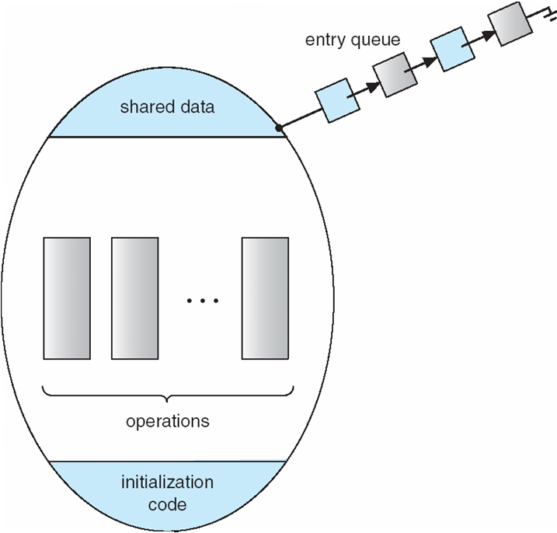
Schematic view of a Monitor

Slide 62
Condition Variables
condition x, y;
Two operations on a condition variable:
  x.wait () – a process that invokes the operation is suspended.
  x.signal () – resumes one of processes (if any) that
    invoked x.wait ()

Slide 63
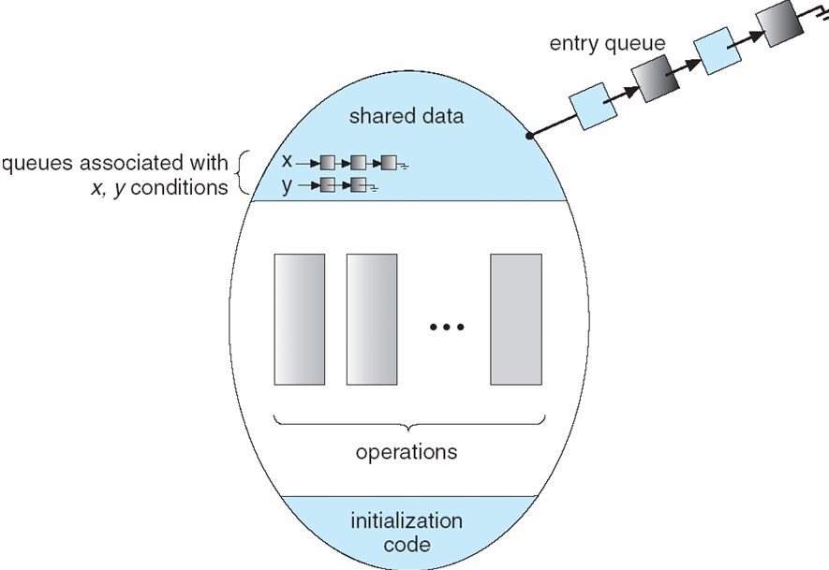
Monitor with Condition Variables

Slide 64
Condition Variables
Condition variables are not semaphores. They are different even though they look similar.
  A condition variable does not count: have no associated integer.
  A signal on a condition variable x is lost (not saved for future use) if there is no process waiting (blocked) on the condition variable x.
  The wait() operation on a condition variable x will always cause the caller of wait to block.
  The signal() operation on a condition variable will wake up a sleeping process on the condition variable, if any. It has no effect if there is nobody sleeping.

Slide 65
What happens when a process signals?
If a process P signals (a waiting process Q), there is danger of two processes to be in monitor:
  Signaling process (P).
  Waiting process (Q)
  (waiting for that signal).
Two possibilities:
  Signal and wait: Q in monitor (Hoare semantics)
  Signal and continue: P in monitor (Mesa semantics);
    This (Mesa) is most commonly used now!
To be safe, you can try to put signal() at the end of the procedure.
P
Q
procedure f1()
procedure f2()
…
x.wait()
…
…
x.signal()
…

Slide 66
Condition variables: example
Let us do an example.
Assume we have a resource to be accessed by many processes. Assume we have 5 instances of the resource. 5 processes can use the resource simultaneously.
We want to implement a monitor that will implement two functions: acquire() and release() that can be called by a process before and after using a resource.

Slide 67
Condition variables: example
monitor Allocate
{
int count = 5; // we initialize count to 5.
condition c;
void acquire () {
if (count == 0)
c.wait();
count--;
}
void release () {
count++;
c.signal();
}
}

Slide 68
Condition variables: example
A process will be coded like the following:
Allocate MA; // resource allocation monitor
….
MA.acquire();
// ….use the resource …
MA.release();
….

Slide 69
Monitor Solution to Dining Philosophers
monitor DP {
enum { THINKING;
HUNGRY, EATING) state [5] ;
condition cond [5];
void pickup (int i) {
state[i] = HUNGRY;
test(i);
if (state[i] != EATING)
cond[i].wait;
}
void putdown (int i) {
state[i] = THINKING;
// test left and right neighbors
test((i + 4) % 5)
test((i + 1) % 5);
}
void test (int i) {
if ( (state[(i + 4) % 5] != EATING) &&
(state[(i + 1) % 5] != EATING) &&
(state[i] == HUNGRY)) {
state[i] = EATING ;
cond[i].signal ();
}
}
initialization_code() {
for (int i = 0; i < 5; i++)
state[i] = THINKING;
}
} /* end of monitor */

Slide 70
Solution to Dining Philosophers (cont)
Each philosopher invokes the operations pickup() and putdown() in the following sequence:
Philosopher i
…
DP DiningPhilosophers;
….
while (1)
THINK…
DiningPhilosophters.pickup (i);
EAT /* use resource(s) */
DiningPhilosophers.putdown (i);
THINK…
}

Slide 71
Monitor Solution to Dining Philosophers
#define LEFT (i+4)%5
THINKING?
HUNGRY?
EATING?
#define RIGHT (i+1)%5
state[LEFT] = ?
state[i] = ?
state[RIGHT] = ?
Process
(i+4) % 5
Process
i
Process
(i+1) % 5
…
…
Test(i+4 %5)
Test(i)
Test(i+1 %5)

Slide 72
Broadcast operation may be useful as well
Broadcast on a condition variable: wakes up all sleeping processes
Consider an allocation problem where each thread can request and can be given (if available) multiple instances of a resource.
Consider 3 threads.
  Thread 1 wants 10 instances
  Thread 2 wants 5 instances.
  Thread 3 has 5 instances.
When thread 3 releases these 5 instances and signals on a condition variable and wakeup thread 1, it is not enough for thread 1 and thread 1 will wait again.

Slide 73
Broadcast operation may be useful as well
Instead thread 3 can use broadcast operation on the condition variable.
Assuming MESA semantics, the usage pattern is as follows:
  Always wait in a while loop (not if statement)
  That means: check the condition again after returning from wait

Slide 74
Monitor functions using broadcast on a condition variable
Request (k) // request k instances
{
while (k > avail-count)
cv.wait();
avail-count -= k;
return
}
Thread Code
.
..
..
M.Request(m);
// do something
M.Release (m);
..
..
Release (k) // release k instances
{
avail-count += k;
cv.broadcast()
}

Slide 75
Spin Locks
Kernel uses to protect short critical regions (a few instructions) on multi-processor systems.
Assume we have a process A running in CPU 1 and holding a spin lock and executing the critical region touching to some shared data.
Assume at the same, another process B running in CPU 2 would like run a critical region touching to the same shared data.
B can wait on a semaphore, but this will cause B to sleep (a context switch is needed; costly operation). However, critical section of A is short; It would be better if B would busy wait for a while; then the lock would be available.
Spin Locks are doing this. B can use a Spin Lock to wait (busy wait) until A will leave the critical region and releases the Spin Lock. Since critical region is short, B will not wait much.

Slide 76
Spin Locks
Process A running in kernel mode
(i.e. executing kernel code shown)
Process B running in kernel mode
(i.e. executing kernel code shown)
f1() {…
acquire_spin_lock_(X);
…//critical region….
…touch to SD (shared data);
release_spin_lock(X);
}
f2() {…
acquire_spin_lock_(X);
…//critical region….
…touch to SD (shared data);
release_spin_lock(X); …
}
CPU 1
CPU 2
Kernel
X
lock variable (accessed atomically)
Main
Memory
f1() {…}
f2() {…}
SD
shared data

Slide 77
Spin Locks
a spin lock can be acquired after busy waiting.
Remember the TestAndSet or Swap hardware instructions that are atomic even on multi-processor systems. They can be used to implement the busy-wait acquisition code of spin locks.
While process A is in the critical region, executing on CPU 1 and having the lock (X set to 1), process A may be spinning on a while loop on CPU 2, waiting for the lock to be become available (i.e. waiting X to become 0). As soon as process A releases the lock (sets X to 0), process B can get the lock (test and set X), and enter the critical region.

Slide 78
Synchronization Examples
Solaris
Windows XP
Linux
Pthreads

Slide 79
Solaris Synchronization
Implements a variety of locks to support multitasking, multithreading (including real-time threads), and multiprocessing
Uses adaptive mutexes for efficiency when protecting data from short code segments
Uses condition variables and readers-writers locks when longer sections of code need access to data
Uses turnstiles to order the list of threads waiting to acquire either an adaptive mutex or reader-writer lock

Slide 80
Windows XP Synchronization
Uses interrupt masks to protect access to global resources on uniprocessor systems
Uses spinlocks on multiprocessor systems
Also provides dispatcher objects which may act as either mutexes and semaphores
Dispatcher objects may also provide events
  An event acts much like a condition variable

Slide 81
Linux Synchronization
Linux:
  Prior to kernel Version 2.6, disables interrupts to implement short critical sections
  Version 2.6 and later, fully preemptive
Linux provides:
  semaphores
  spin locks

Slide 82
Pthreads Synchronization
Pthreads API is OS-independent
It provides:
  mutex locks
  condition variables
  Semaphores
Mutex locks and conditions variables together can be used like monitors. But there is no monitor construct in C and pthreads
Non-portable extensions include:
  read-write locks
  spin locks

Slide 83
Pthreads
Use of mutex locks and condition variables are very common in multithreaded Pthread programs in Linux
  Also they are recommended synchronization variables.
Usage patterns exist for use of mutex and condition variables.
  Study and use them.
Note that there is no monitor in C.
  Hence condition variables in a Pthread C program is not accessed inside a monitor.
  Therefore they are used in combination with mutex locks.
  We need explicit locking (with mutex locks) to be used in our Pthread programs (with monitor this is not required, but no monitor in C).
    Get lock at function start and release lock at function end.

Slide 84
Pthreads
#include <pthread.h>
pthread_mutex_t mutex;
pthread_mutex_init (&mutex, NULL);
pthread_mutex_lock (&mutex);
// CS
pthread_mutex_unlock (&mutex);

Slide 85
Pthreads also have broadcast call on a condition variable.
  Wakes up all sleeping / waiting processes.
Mesa semantics is used.
The wait should be done in a loop (while loop).
  check condition and wait Loop.
  Do not check condition with an “if” statement.
    Check with “while” statement

Slide 86
Usage Pattern
When there is shared state (data) to be accessed by multiple processes, encapsulate it into a shared object:
  Define a class with public/private methods and shared data and some other variables. Shared data (shared state)
  Have a lock variable associated with the object (defined in the class)
  Have one or more condition variables (defined in the class)
  When a public method will access shared state, make it first acquire the lock in the beginning and release the lock at the end.
  Wait on a condition variable when needed
    Use a while loop for this (this is safer and more modular)
  Signal or Broadcast on a condition variable when needed
    Mesa semantics

Slide 87
Example
cv: condition variable
lock: a lock variable
method1 body:
acquire (lock)
//access shared state
while (! an_expected_condition)
wait (cv, &lock);
release(lock)
return;
method2 body:
acquire (lock)
//access shared state
// change the state to make
// expected condition true
signal(cv)
// or broadcast (cv);
release(lock)
return;

Slide 88
References
The slides here are adapted/modified from the textbook and its slides: Operating System Concepts, Silberschatz et al., 7th & 8th editions, Wiley.
Operating System Concepts, 7th and 8th editions, Silberschatz et al. Wiley.
Modern Operating Systems, Andrew S. Tanenbaum, 3rd edition, 2009.

Slide 89
Additional Study Material

Slide 90
Monitor Implementation Using Semaphores
Variables
semaphore mutex; // (initially = 1); allows only one process to be active
semaphore next; // (initially = 0); causes signaler to sleep
int next-count = 0; /* num sleepers since they signalled */
Each procedure F will be replaced by
wait(mutex);
…
body of F;
…
if (next_count > 0)
signal(next)
else
signal(mutex);
Mutual exclusion within a monitor is ensured.

Slide 91
Monitor Implementation Using Semaphores
Condition variables: how do we implement them?
Assume the following strategy is implemented regarding who will run after a signal() is issued on a condition variable:
  “The process that calls signal() on a condition variable is blocked. It can not be waken up if there is somebody running inside the monitor”.
Some programming languages require the process calling signal to quit monitor by having the signal() call as the last statement of a monitor procedure.
  Such a strategy can be implemented in a more easy way.

Slide 92
Monitor Implementation Using Semaphores
For each condition variable x, we have:
semaphore x_sem; // (initially = 0); causes caller of wait to sleep
int x-count = 0; // number of sleepers on condition
The operation x.wait can be
implemented as:
x-count++;
if (next_count > 0)
signal(next);
else
signal(mutex);
wait(x_sem);
x-count--;
The operation x.signal can be
implemented as:
if (x-count > 0) {
next_count++;
signal(x_sem);
wait(next); next_count--;
}

Slide 93
Monitor Example: a monitor for priority based allocation of a resource
Monitor condition variable queue can be FIFO.
Or, it may not be FIFO: condition variable wait function can take a priority defining parameter (not very standard wait function)
  Example: We would like to apply a priority based allocation. The process that will use the resource for the shortest amount of time will get the resource first if there are other processes that want the resource.
Processes or Threads
that want to use the resource
….
Resource

Slide 94
Example continued
Assume we have condition variable implementation that can enqueue sleeping processes with respect to a priority specified as a parameter to wait() call.
  cond x;
  …
  x.wait (priority);
Queue of sleeping processes waiting on condition x
X
10
20
45
70
priority could be the time-duration to use the resource

Slide 95
Example continued
monitor ResourceAllocator
{
boolean busy;
condition x;
void acquire(int time) {
if (busy)
x.wait(time);
busy = TRUE;
}
void release() {
busy = FALSE;
x.signal();
}
initialization_code() {
busy = FALSE;
}
}

Slide 96
Example continued
Process 1
Process 2
Process N
ResourceAllocator RA;
RA.acquire(10);
…
….use resource…
….
RA.release();
ResourceAllocator RA;
RA.acquire(30);
…
….use resource…
….
RA.release();
ResourceAllocator RA;
RA.acquire(25);
…
….use resource…
….
RA.release();
…
Each process should use resource between acquire() and release() calls.

