Slide 1

Chapter 4
Threads
Bilkent University
Department of Computer Engineering
CS342 Operating Systems
Last Update: Feb 21, 2019

Slide 2
Outline and Objectives
Outline
Overview
Multithreading Models
Thread Libraries
Threading Issues
Operating System Examples
Windows XP Threads
Linux Threads
Re-entrancy
Thread specific data
Objectives
To introduce the notion of a thread — a fundamental unit of CPU utilization that forms the basis of multithreaded computer systems
To discuss the APIs for the Pthreads, Win32, and Java thread libraries
To examine issues related to multithreaded programming

Slide 3
Threading Concept

Slide 4
Threads and Thread Usage
A process has normally a single thread of control (execution sequence/flow).
  Always at least one thread exists
  If blocks, no activity can be done as part of the process
  Better: be able to run concurrent activities (tasks) as part of the same process.
  Now, a process can have multiple threads of control (multiple concurrent tasks).
Threads run in pseudo-parallel manner (concurrently), share text(code) and data

Slide 5
Benefits of using threads for an App
Responsiveness
  One thread blocks, another one runs.
  One thread may always wait for the user
Resource Sharing
  Threads can easily share resources
Economy
  Creating a thread is fast
  Context switching among threads may be faster
Scalability
  Multiprocessors can be utilized better

Slide 6
Threads and Thread Usage
data
data
CPU
blocks
blocks
blocks
code
blocks
code
run enough
single-threaded process
multi-threaded process

Slide 7
a multithreaded process’ execution flows: threads
Instructions of the Program
main()
Thread0
Thread2
Thread1
time
Lifetime of the process

Slide 8
Multithreading Concept
CPU
single-threaded process
multi-threaded process

Slide 9
Multithreading Concept
Process
Process
thread
thread
thread
thread
P1.T1
P2.T1
P2.T2
P2.T3
Schedulable Entities
We can select one of them and run

Slide 10
Multithreading Concept
thread1
thread2
thread3
thread4
function1(…)
{
….
{
function2(…)
{
….
{
main()
{ ….
thread_create (function1 ,…);
….
thread_create (function2, …);
….
thread_create (function1, …);
….
}

Slide 11
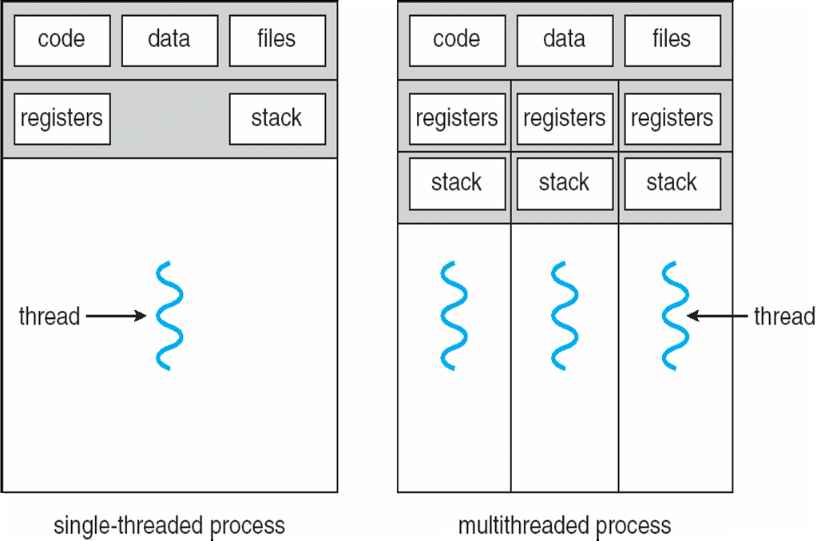
Single and Multithreaded Processes

Slide 12
Multicore programming and multithreading challenges
Multicore systems putting pressure on programmers.
  Threading can utilize Multicore systems better, but it has some challenges
Threading Challenges include
  Dividing activities
    Come up with concurrent tasks
  Balance
    Tasks should be similar importance and load
  Data splitting
    Data may need to be split as well
  Data dependency
    Data dependencies should be considered; need synchronization of activities
  Testing and debugging
    Debugging is more difficult

Slide 13
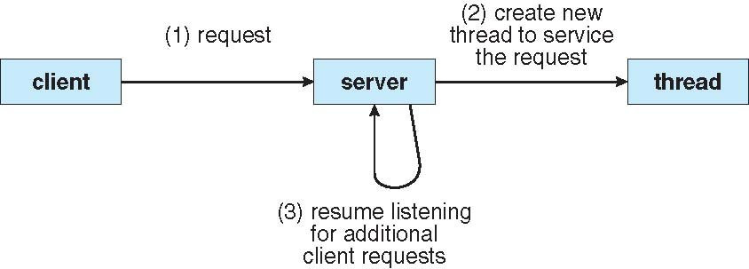
Multithreaded Server Architecture

Slide 14
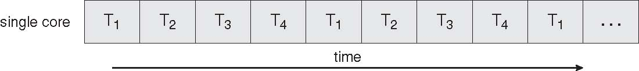
Concurrent Execution on a Single-core System

Slide 15
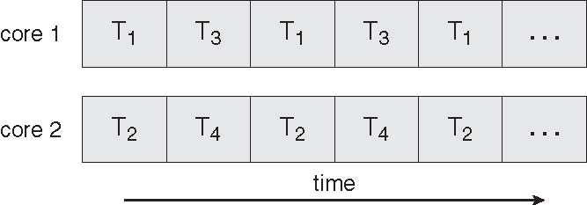
Parallel Execution on a Multicore System

Slide 16
Speedup: Amdahl’s Law
Potential performance gain (speed up) with multiple cores (CPUs)?
Program: both serial and parallel parts
Assume the program executes and finishes in 1 time unit.
  S: time to execute the serial portion (0 <= S <= 1)
  1-S: is the runtime of the portion that can be parallelized
N: number of processing cores.
  N tasks can run in parallel. Then parallelizable portion of the program will finish N times faster

Slide 17
Threading Support

Slide 18
Threading Support
Multithreading can be supported by:
  User level libraries (without Kernel being aware of it)
    Library creates and manages threads (user level implementation)
  Kernel itself
    Kernel creates and manages threads (kernel space implementation)
No matter which is implemented, threads can be created, used, and terminated via a set of functions that are part of a Thread API (a thread library)
  Three primary thread libraries: POSIX threads, Java threads, Win32 threads

Slide 19
Multithreading Models
A user process wants to create one or more threads.
  Kernel can create one or more threads for the process.
    Even a kernel does not support threading, it can create one thread per process (i.e., it can create a process which is a single thread of execution).
Finally a relationship must exist between user threads and kernel thread(s)
  Mapping user level threads to kernel level threads
Three common ways of establishing such a relationship:
  Many-to-One model
  One-to-One model
  Many-to-Many model

Slide 20
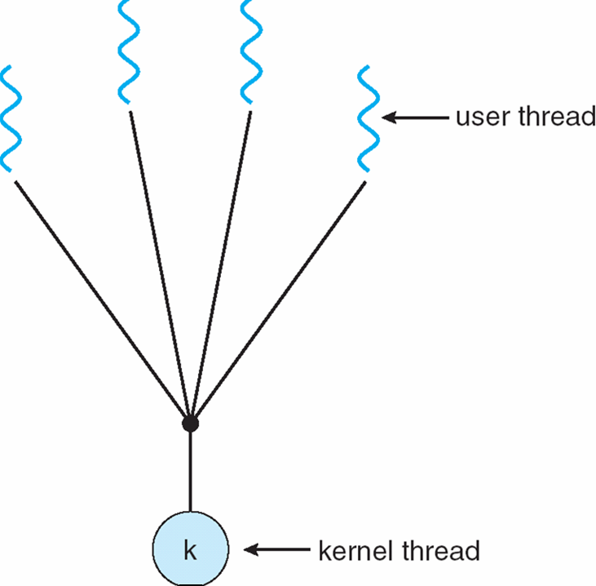
Many-to-One Model:
Implementing Threads in User Space
Many user-level threads
mapped to a single kernel thread
Examples:
  Solaris Green Threads
  GNU Portable Threads
Thread management
done at user space, by a
thread library
Kernel supports process concept;
not threading concept

Slide 21
Many-to-One Model:
Implementing Threads in User Space
No need for kernel support for multithreading (+)
Thread creation is fast (+)
Switching between threads is fast; efficient approach (+)
Blocking system calls defeat the purpose and have to be handled (-)
A thread has to explicitly call a function to voluntarily give the CPU to some other thread (-)
  example: thread_yield()
Multiple threads will run on a single processor, not utilizing multi-processor machines. (-)
Thread
Process A
Process B
Run-time
System (library)
Thread
table
PCB A
PCB B
Kernel
process table

Slide 22
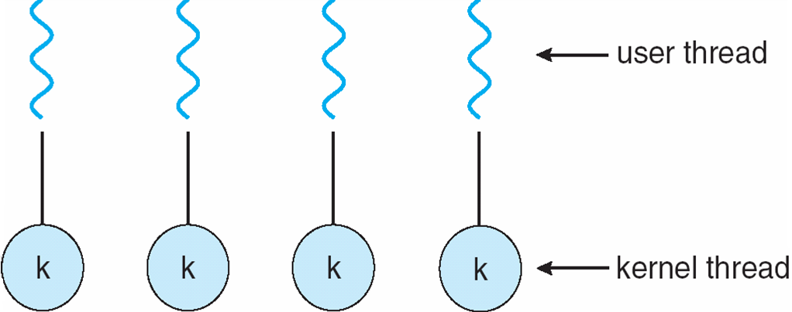
One-to-One Model:
Implementing Threads in Kernel Space
Kernel may implement threading and can manage threads, schedule threads. Kernel is aware of threads.
Examples (nearly all modern OSs): Windows, Linux, …
  All these kernels have threading support. They can schedule processes and their threads (not only processes)
Each user-level thread maps to a kernel thread

Slide 23
One-to-One Model:
Implementing Threads in Kernel Space
Provides more concurrency; when a thread blocks, another can run. Blocking system calls are not problem anymore. (+)
Multiple processors can be utilized as well. (+).
Kernel can stop a long running thread and run another thread. No need for explicit request from a thread to be stopped. (+)
Need system calls to create threads and this takes time; (-)
thread switching costly; (-)
any thread function requires a system call. (-)
Process A
Process B
PCB A
PCB B
Kernel
process table
Thread table

Slide 24
Threading API

Slide 25
Thread Libraries
Thread library provides programmer with API for creating and managing threads
  Programmer just have to know the thread library interface (API).
  Threads may be implemented in user space or kernel space.
    library may be entirely in user space or may get kernel support for threading

Slide 26
Pthreads Library
Pthreads: POSIX threads
May be provided either as user-level or kernel-level
A POSIX standard (IEEE 1003.1c) API for thread creation and synchronization
API specifies behavior of the thread library, implementation is up to development of the library
Common in UNIX-like operating systems (Solaris, Linux, Mac OS X)

Slide 27
Pthreads Example
We will show a program that creates a new thread.
  Hence a process will have two threads :
    1 - the initial/main thread that is created to execute the main() function (that thread is always created even though there is no support for multithreading);
    2 - the new thread.
    (both threads have equal power)
The program will just create a new thread to do a simple computation: will sum all integers upto a given parameter value
  sum = 1+2+…+parameter_value
The main thread will wait until sum is computed into a global variable.
Then the main thread will print the result.

Slide 28
Pthreads Example
#include <pthread.h>
#include <stdio.h>
int sum; /* shared sum by threads – global variable */
void *runner (void *param); /* thread start function */

Slide 29
Pthreads Example
int main(int argc, char *argv[]){
pthread_t tid; /* id of the created thread */
pthread_attr_t attr; /* set of thread attributes */
if (argc != 2) {
fprintf (stderr, “usage: a.out <value>\n”);
return -1;
}
if (atoi(argv[1]) < 0) {
fprintf (stderr, “%d must be >= 0\n”, atoi(argv[1]);
return -1;
}
pthread_attr_init (&attr);
pthread_create (&tid, &attr, runner, argv[1]);
pthread_join (tid, NULL);
printf (“sum = %d\n”, sum);
}

Slide 30
Pthreads Example
void *runner (void *param)
{
int i;
int upper;
upper = atoi(param);
sum = 0;
for (i = 1; i <= upper; ++i)
sum += i;
pthread_exit(0);
}

Slide 31
Pthreads Example
int main(…)
{
…
….
pthread_create(&tid,…,runner,..);
pthread_join(tid);
. printf (…, sum, …);
}
runner (…)
{
….
sum = …
pthread_exit();
{
thread1
thread2
wait

Slide 32
Compiling and running the program
You can put the above code into a .c file, say mysum.c
In order to use the Pthreads functions, we need to include pthread.h header file in our program (as shown in previous slides)
We also need to link with the pthread library (the Pthreads API functions are not implemented in the standard C library). The way to do that is using the –l option of the C compiler. After -l you can provide a library name like pthread.
Hence we can compile+link our program as follows:
  gcc -Wall -o mysum -lpthread mysum.c
Then we run it as (for example):
  ./mysum 6
It will print out 21

Slide 33
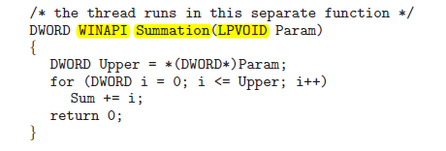
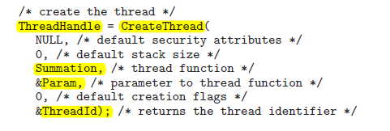
Windows Threads

Slide 34
Java Threads
Java threads are managed by the JVM
Typically implemented using the threads model provided by underlying OS
Java threads may be created by:
  Extending Thread class
  Implementing the Runnable interface
    Example given in the book

Slide 35
From Single-threaded to Multithreaded
Scope of variables:
  Normally we have: global, local
  With threads, we want: global, local, and thread-specific (thread wide)
thread-specific: global inside the thread (thread-wide global), but not global for the whole process. Other threads can not access it. But all functions of the thread can.
But we may not have language support to define such variables.
  C can not do that. Normally in C we have just global variables and local variables. We do not have thread-wide (thread-local or thread-global) variables.
Therefore thread API has special functions that can be used to create such variables – data.
  This is called thread specific data.

Slide 36
Thread Specific Data
(Thread Local Storage: TLS)
Allows each thread to have its own copy of data
  Each thread refers to the data with the same name.
Example:
  Each thread can do:
    create_global (bufptr); // create a name (i.e., key)
    allocate space for a buffer // create block of memory
      buf = malloc (BUFFERSIZE)
    set_global (bufptr, buf); // associate the pointer
    buf = (char *) get_global (bufptr); // get the pointer to access
    use pointer to buffer to access data in the buffer
  Here bufptr is the same name of the variable used in each thread. But each thread has its own copy of data.

Slide 37
Thread Specific Data
(Thread Local Storage: TLS)
Thread 1
Thread 2
Thread 3
bufptr
bufptr
bufptr
buffer
buffer
buffer
Data
Data
Data
space allocated
with malloc
space allocated
with malloc
space allocated
with malloc
Each thread is using the same variable name bufptr to get access to its own
specific data.

Slide 38
Thread Specific Data
In POSIX Pthreads Library we have the following functions to create thread specific data that has an associated name (key).
pthread_key_create
pthread_key_delete
pthread_setspecific
pthread_getspecific
key is seen by all threads; in each thread,
key is associated with thread specific data
(thread local storage)
Example:
pthread_key_t data1;
pthread_key_create (&data1, …);
// In each thread we can do the following:
char *buf = malloc(1024);
pthread_set_specific (data1, buf); // associate buf (buffer pointer) with data1
buf = pthread_get_specific (data1); // get pointer to access data

Slide 39
From Single-threaded to Multithreaded
Many programs are written as a single threaded process.
If we try to convert a single-threaded process to be a multi-threaded process, we have to be careful about the following:
  the global variables
  the library functions we use

Slide 40
From Singlethread to Multithreaded
int status; // a global variable
func1(…) {
….
status = …
do_something_based_on(status);
}
func2(…) {
…
status = …
do_something_based_on(status);
}
main() {
….
func1 (…);
func2 (…);
}
This is a
single threaded
program

Slide 41
From Singlethread to Multithreaded
int status;
func1(…) {
….
status = …
do_something_based_on(status);
}
func2(…) {
…
status = …
do_something_based_on(status);
}
main() {
….
thread_create(…, func1, …);
thread_create(…, func2, …);
}
We can have problem here.
Just after func1 of thread 1 updated status, a thread switch may occur and 2nd thread can run and update status.
Then thread 1 will run again, but will work with a different status value.
Wrong result!

Slide 42
Thread-safe / Reentrant libraries
Many library procedures may not be reentrant.
  They are not designed to have a second call to itself from the same process before it is completed (not re-entrant).
    (We are talking about non-recursive procedures.)
  They may be using global variables. Hence may not be thread-safe.
We have to be sure that we use thread-safe (reentrant) library routines in multi-threaded programs we are developing.

Slide 43
Examples from Operating Systems

Slide 44
Operating System Examples
Windows XP Threads
Linux Threads

Slide 45
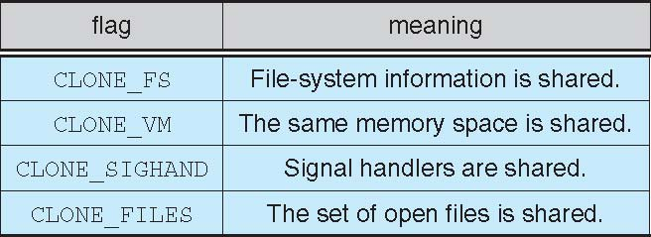
Linux Threads
Linux refers to them as tasks rather than threads
Thread creation is done through clone() system call
clone() allows a child task to share the address space of the parent task (process)

Slide 46
Clone() and fork()
user program
library
fork()
clone()
sys_fork()
{
…
}
sys_clone(){
….
}
kernel

Slide 47
References
The slides here are adapted/modified from the textbook and its slides: Operating System Concepts, Silberschatz et al., 7th & 8th editions, Wiley.
Operating System Concepts, 7th and 8th editions, Silberschatz et al. Wiley.
Modern Operating Systems, Andrew S. Tanenbaum, 3rd edition, 2009.

Slide 48
Additional Study Material

Slide 49
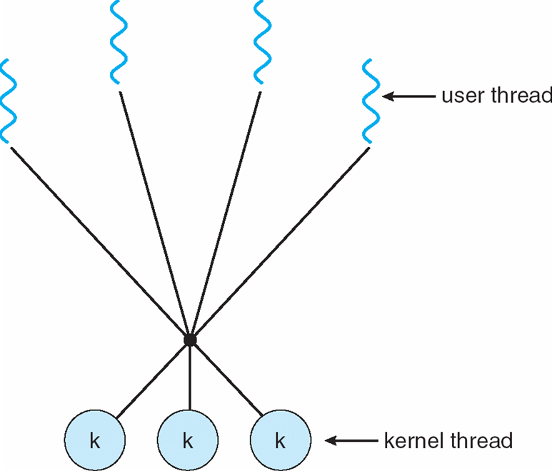
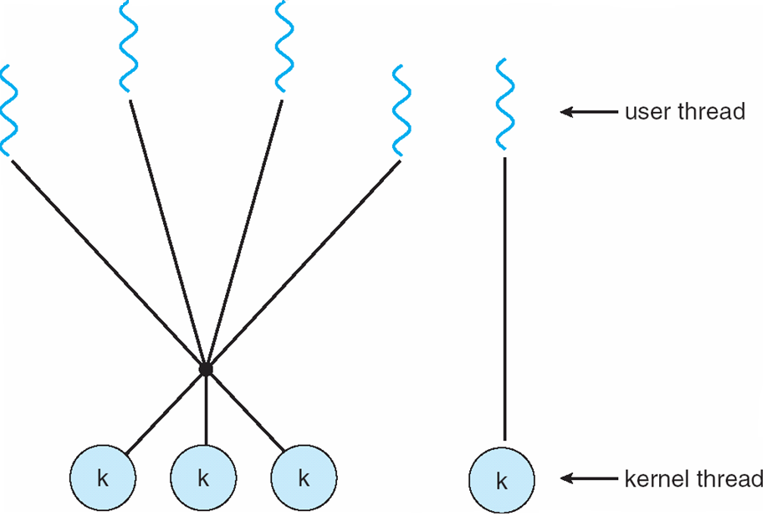
Many-to-Many Model & Two-level Model
Many-to-Many Model
Allows many user level threads to be mapped to many kernel threads
Allows the operating system to create a sufficient number of kernel threads
Solaris prior to version 9
Windows NT/2000 with the ThreadFiber package
Two-level Model
Similar to M:M, except that it allows a user thread to be bound to a kernel thread
Examples
  IRIX
  HP-UX
  Tru64 UNIX
  Solaris 8 and earlier

Slide 50
Implicit Threading

Slide 51
Implicit Threading
Applications can create hundreds or thousands of threads.
  Can be creating explicitly. (App programmer worries)
  Can be created by compiler, library, platform, etc. (easier for App programmer) - called Implicit Threading.
Some alternatives for implicit threading
  Thread Pools
  OpenMP (Compiler Supported)
  Grand Central Dispatch (in Mac OS X)

Slide 52
Thread Pools
Create a number of threads in a pool where they await for work
Advantages:
  Faster
  Limit the count of threads:
    Allows the number of threads in the application to be bound to the size of the pool

Slide 53
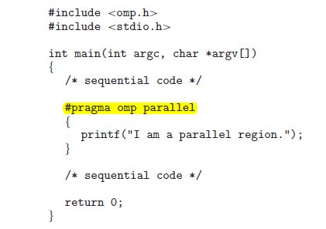

OpenMP
Is a set of compiler directives as well as an API for programs in C and C++.
Parallel programming in shared memory environments.
Parallel regions identified by programmer.
Examples:
Number of threads ==
Number of cores

Slide 54

Grand Central Dispatch (GCD)
A combination of extensions to the C language, and API, and a run-time library that allows app developers to identify sections of code to run in parallel.
Programmer identifies the region to be parallel:
GCD schedules such blocks for run-time execution by placing them in a dispatch queue (serial or concurrent).
Blocks can run in parallel in different cores.

Slide 55
Other Threading Issues

Slide 56
Threading Issues
Semantics of fork() and exec() system calls
Thread cancellation of target thread
  Asynchronous or deferred
Signal handling
Thread pools
Thread-specific data
Scheduler activations

Slide 57
Semantics of fork() and exec()
Does fork() duplicate only the calling thread or all threads?
How should we implement fork?
logical thing to do is:
  1) If exec() will be called after fork(), there is no need to duplicate the threads. They will be replaced anyway.
  2) If exec() will not be called, then it is logical to duplicate the threads as well; so that the child will have as many threads as the parent has.
So we may implement two system calls: like fork1 and fork2!

Slide 58
Thread Cancellation
Terminating a thread before it has finished
  Need at various cases
Two general approaches:
  Asynchronous cancellation terminates the target thread immediately
  Deferred cancellation allows the target thread to periodically check if it should be cancelled
    Canceller thread indicates a target thread to be cancelled.
    Target threads performs checks at cancellation points and if it is safe gets terminated.

Slide 59
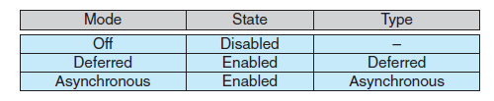
Thread Cancellation
pthread_t tid;
pthread_create (&tid, 0, worker, NULL);
…
/* cancel the thread */
pthread_cancel(tid); /* requesting cancellation */
Cancelling thread
while (1) {
/* do some work */
…
/* check if there is cancel request */
} pthread_test_cancel();
Target thread

Slide 60
Signal Handling
If a signal is sent to a Multithreaded Process, who will receive and handle that?
In a single threaded process, it is obvious.
In a multi-threaded process, there are a number of options, like delivering the signal to:
  thread to which signal applies
  all threads of the process
  a specific thread responsible for handling signals

Slide 61
Signal Handling
Signals are used in UNIX systems to notify a process that a particular event has occurred
  They are notifications
a Signal:
  Signal is generated by a particular event
  Signal is delivered to a process (same or different process)
  Signal is handled
A signal handler is used to process signals
Handled asynchronously

Slide 62
Signal Handling
Options:
  Deliver the signal to the thread to which the signal applies
  Deliver the signal to every thread in the process
  Deliver the signal to certain threads in the process
  Assign a specific thread to receive all signals for the process

Slide 63
a C program using signals
#include <stdio.h>
#include <signal.h>
#include <stdlib.h>
static void sig_int_handler() {
printf("I received SIGINT signal. bye... \n");
fflush(stdout);
exit(0);
}
int main() {
signal (SIGINT, sig_int_handler);
while (1)
;
}
While a program is running, if we press CTRL-C keys, the program will be terminated (killed). We are sending a SIGINT signal to the program
By default, SIGINT is handled by kernel. By default, kernel terminates the program.
But if we specify a handler function as here, then our program can handle it.
Kernel will notify our process with a signal when user presses the CTRL-C keys.
Program X

Slide 64
delivering signal (notifying)
Program X
signal handler run
SIGINT signal delivered
Kernel
CTRL-C
Keyboard

Slide 65
kill program
process id = 3405
kill -s SIGINT 3405
Program X
signal handler run
SIGINT signal is delivered
Kernel
SIGINT signal is stored in PCB of X
Keyboard

Slide 66
Some Signals
SIGABRT Process abort signal.
SIGALRM Alarm clock.
SIGBUS Access to an undefined portion of a memory object.
SIGCHLD Child process terminated, stopped, or continued.
SIGCONT Continue executing, if stopped.
SIGFPE Erroneous arithmetic operation.
SIGHUP Hangup.
SIGILL Illegal instruction.
SIGINT Terminal interrupt signal.
SIGKILL Kill (cannot be caught or ignored).
SIGPIPE Write on a pipe with no one to read it.
SIGQUIT Terminal quit signal.
SIGSEGV Invalid memory reference.
SIGSTOP Stop executing (cannot be caught or ignored).
SIGTERM Termination signal.

Slide 67
Scheduler Activations
Kernel threads are good, but they are slower if we create short threads too frequently, or threads wait for each other too frequently.
Is there a middle way?
  Schedule Activation
Goal is mimic kernel threads at user level with some more kernel support. But kernel will not create another thread for each user thread (M:1 or M:M model).
Avoid unnecessary transitions between user and kernel space.

Slide 68
Scheduler Activations: Upcall mechanism
upcall handler can
re-start the 1st thread
threads
Process
Run-time
System
(i.e. thread library)
upcall handler
schedules
another thread
Thread
table
library registers a handler
(upcall handler)
when
process/thread
is started
makes system call
kernel runs the upcall handler
(i.e. makes an upcall; activates
the user level scheduler)
Kernel
Kernel initiates I/O
and blocks the thread
kernel detects that I/O is finished
kernel informs the library via upcall

Slide 69
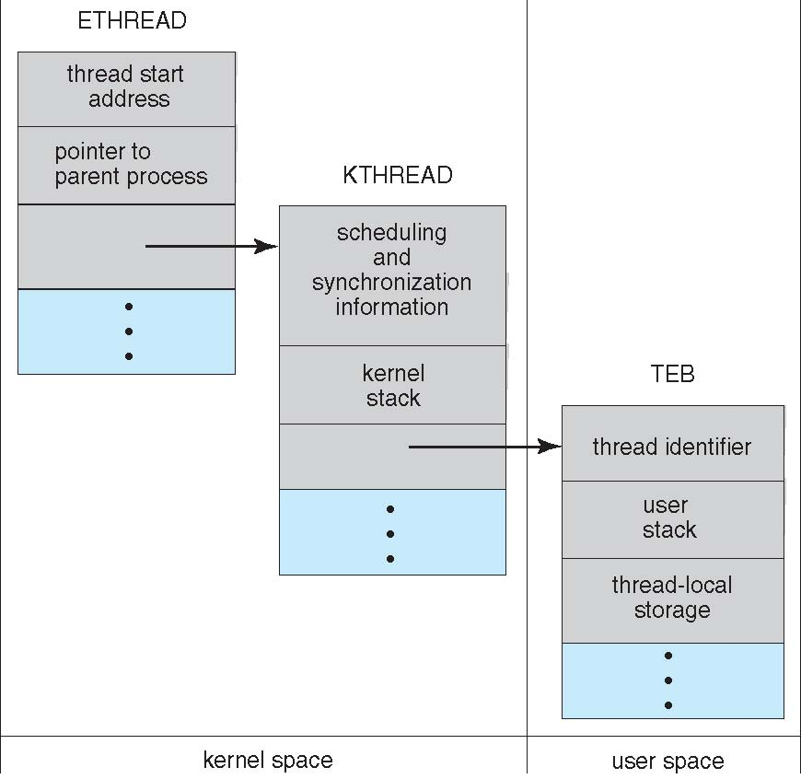
Windows XP Threads

Slide 70
Windows XP Threads
Implements the one-to-one mapping, kernel-level
Each thread contains
  A thread id
  Register set
  Separate user and kernel stacks
  Private data storage area
The register set, stacks, and private storage area are known as the context of the threads
The primary data structures of a thread include:
  ETHREAD (executive thread block)
  KTHREAD (kernel thread block)
  TEB (thread environment block)

