Slide 1
Lecture 8: Recommender Systems:
Content-Based Systems &
Collaborative Filtering
CS425: Algorithms for Web Scale Data
Most of the slides are from the Mining of Massive Datasets book.
These slides have been modified for CS425. The original slides can be accessed at: www.mmds.org

Slide 2

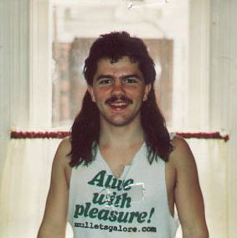
Example: Recommender Systems
Customer X
  Buys Metallica CD
  Buys Megadeth CD
Customer Y
  Does search on Metallica
  Recommender system suggests Megadeth from data collected about customer X

Slide 3










Recommendations
Examples:
Search
Recommendations
Items
Products, web sites,
blogs, news items, …

Slide 4
From Scarcity to Abundance
Shelf space is a scarce commodity for traditional retailers
  Also: TV networks, movie theaters,…
Web enables near-zero-cost dissemination
of information about products
  From scarcity to abundance
More choice necessitates better filters
  Recommendation engines
  How Into Thin Air made Touching the Void
  a bestseller: http://www.wired.com/wired/archive/12.10/tail.html
Notes:
In 1988, a British mountain climber named Joe Simpson wrote a book called Touching the Void, a harrowing account of near death in the Peruvian Andes. It got good reviews but, only a modest success, it was soon forgotten. Then, a decade later, a strange thing happened. Jon Krakauer wroteInto Thin Air, another book about a mountain-climbing tragedy, which became a publishing sensation. SuddenlyTouching the Void started to sell again.
Random House rushed out a new edition to keep up with demand. Booksellers began to promote it next to their Into Thin Air displays, and sales rose further. A revised paperback edition, which came out in January, spent 14 weeks on theNew York Times bestseller list. That same month, IFC Films released a docudrama of the story to critical acclaim. NowTouching the Void outsells Into Thin Air more than two to one.
What happened? In short, Amazon.com recommendations. The online bookseller's software noted patterns in buying behavior and suggested that readers who liked Into Thin Airwould also like Touching the Void. People took the suggestion, agreed wholeheartedly, wrote rhapsodic reviews. More sales, more algorithm-fueled recommendations, and the positive feedback loop kicked in.

Slide 5
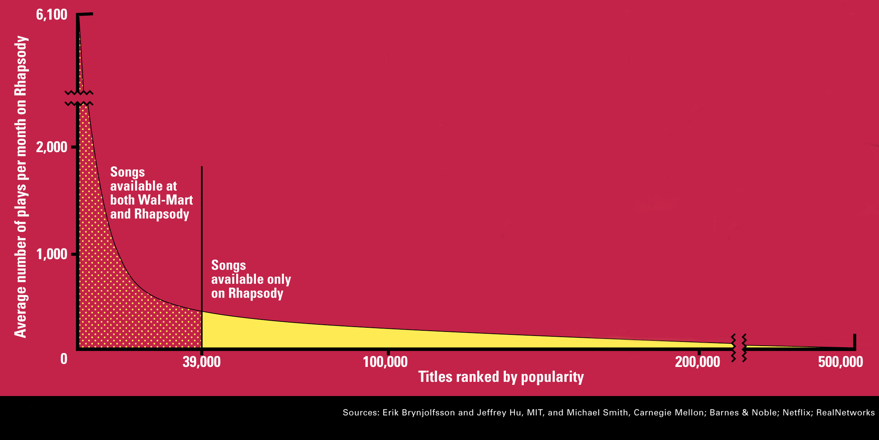
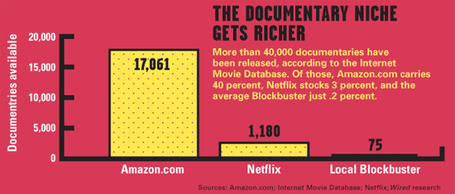
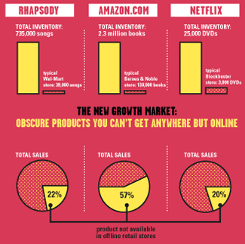
Sidenote: The Long Tail
Source: Chris Anderson (2004)

Slide 6
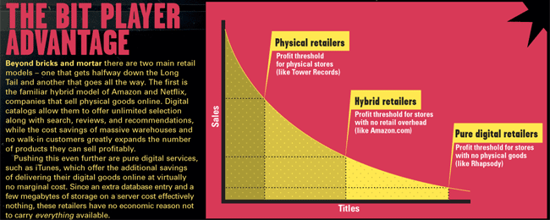
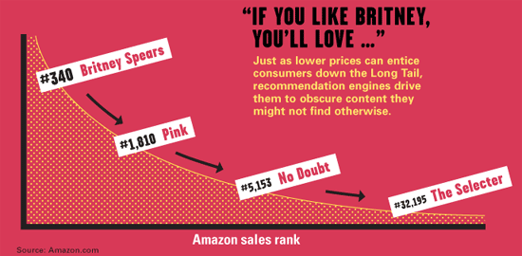
Physical vs. Online
    Read http://www.wired.com/wired/archive/12.10/tail.html to learn more!

Slide 7
Types of Recommendations
Editorial and hand curated
  List of favorites
  Lists of “essential” items
Simple aggregates
  Top 10, Most Popular, Recent Uploads
Tailored to individual users
  Amazon, Netflix, …

Slide 8
Formal Model
X = set of Customers
S = set of Items
Utility function u: X × S → R
  R = set of ratings
  R is a totally ordered set
  e.g., 0-5 stars, real number in [0,1]

Slide 9
Utility Matrix
Avatar
LOTR
Matrix
Pirates
Alice
Bob
Carol
David

Slide 10
Key Problems
(1) Gathering “known” ratings for matrix
  How to collect the data in the utility matrix
(2) Extrapolate unknown ratings from the
known ones
  Mainly interested in high unknown ratings
    We are not interested in knowing what you don’t like
    but what you like
(3) Evaluating extrapolation methods
  How to measure success/performance of
  recommendation methods

Slide 11
(1) Gathering Ratings
Explicit
  Ask people to rate items
  Doesn’t work well in practice – people
  can’t be bothered
Implicit
  Learn ratings from user actions
    E.g., purchase implies high rating
  What about low ratings?

Slide 12
(2) Extrapolating Utilities
Key problem: Utility matrix U is sparse
  Most people have not rated most items
  Cold start:
    New items have no ratings
    New users have no history
Three approaches to recommender systems:
  1) Content-based
  2) Collaborative
  3) Latent factor based
This lecture

Slide 13
Content-based
Recommender Systems

Slide 14
Content-based Recommendations
Main idea: Recommend items to customer x similar to previous items rated highly by x
Example:
Movie recommendations
  Recommend movies with same actor(s),
  director, genre, …
Websites, blogs, news
  Recommend other sites with “similar” content

Slide 15
Plan of Action
Item profiles
likes
build
recommend
match
Red
Circles
Triangles
User profile

Slide 16
Item Profiles
For each item, create an item profile
Profile is a set (vector) of features
  Movies: author, title, actor, director,…
  Text: Set of “important” words in document
How to pick important features?
  Usual heuristic from text mining is TF-IDF
  (Term frequency * Inverse Doc Frequency)
    Term … Feature
    Document … Item

Slide 17
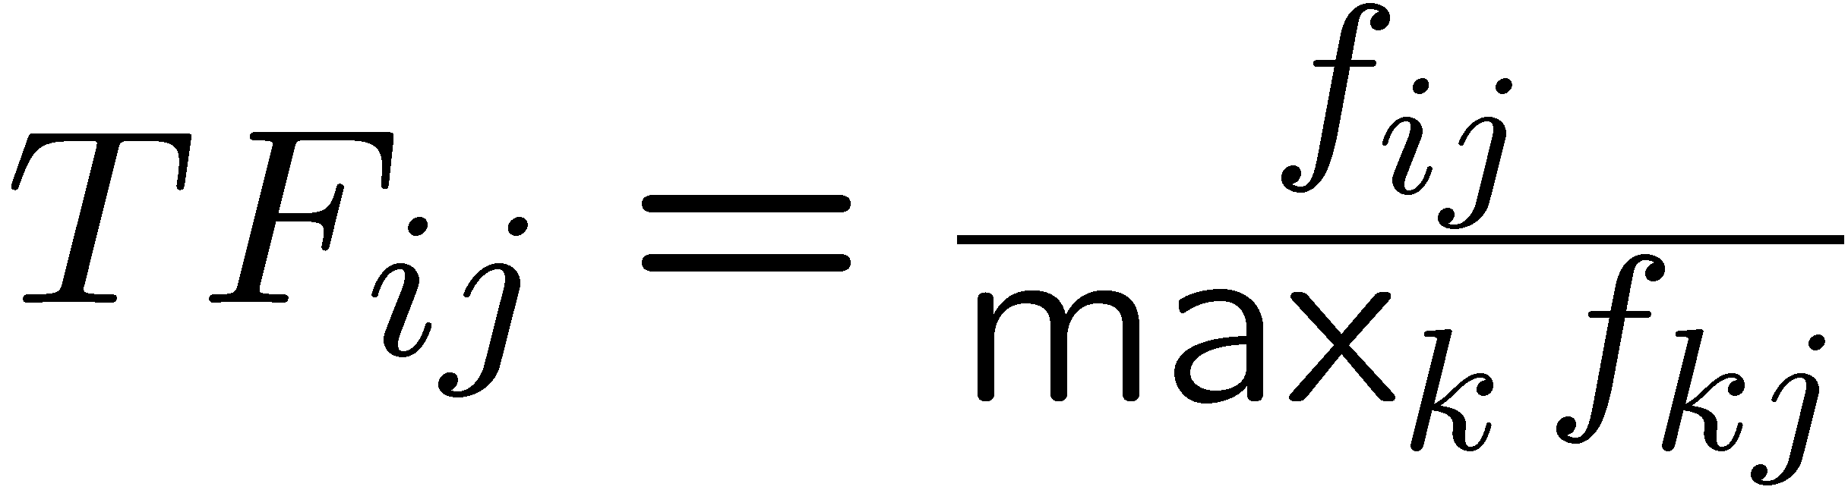
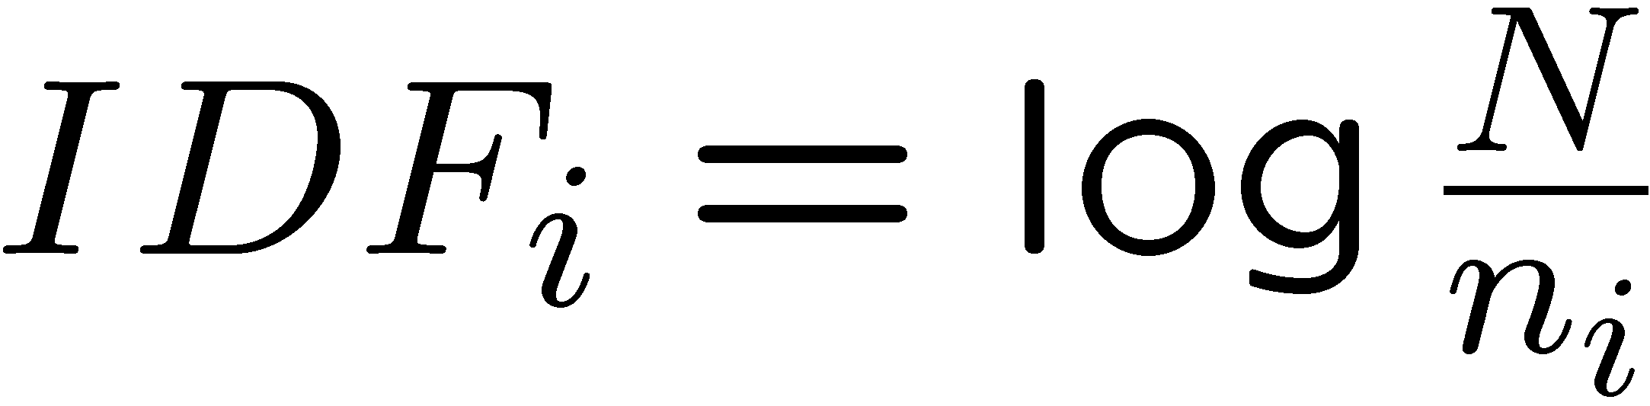
Sidenote: TF-IDF
f_{ij} = frequency of term (feature) i in doc (item) j
n_{i} = number of docs that mention term i
N = total number of docs
TF-IDF score: w_{ij} = TF_{ij} × IDF_{i}
Doc profile = set of words with highest TF-IDF scores, together with their scores
Note: we normalize TF
to discount for “longer”
documents

Slide 18
Two Types of Document Similarity
In the LSH lecture: Lexical similarity
  Large identical sequences of characters
For recommendation systems: Content similarity
  Occurrences of common important words
  TF-IDF score: If an uncommon word appears more frequently in two documents, it contributes to similarity.
Similar techniques (e.g. MinHashing and LSH) are still applicable.

Slide 19
Representing Item Profiles
A vector entry for each feature
  Boolean features
    e.g. One bool feature for every actor, director, genre, etc.
  Numeric features
  e.g. Budget of a movie, TF-IDF for a document, etc.
We may need weighting terms for normalization of features
Spielberg Scorsese Tarantino Lynch Budget
Jurassic Park 1 0 0 0 63M
Departed 0 1 0 0 90M
Eraserhead 0 0 0 1 20K
Twin Peaks 0 0 0 1 10M

Slide 20
User Profiles – Option 1
Option 1: Weighted average of rated item profiles
Utility matrix (ratings 1-5)
 | Jurassic Park | Minority Report | Schindler’s List | Departed | Aviator | Eraserhead | Twin Peaks
User 1 | 4 |  | 5 |  |  | 1 | 1
User 2 | 2 | 3 |  |  | 1 | 5 | 4
User 3 |  | 5 | 4 | 5 | 5 |  | 3
User profile(ratings 1-5)
 | Spielberg | Scorcese | Lynch
User 1 | 4.5 | 0 | 1
User 2 | 2.5 | 1 | 4.5
User 3 | 4.5 | 5 | 3
Missing scores
similar to
bad scores

Slide 21
User Profiles – Option 2 (Better)
Option 2: Subtract average values from ratings first
Utility matrix (ratings 1-5)
 | Jurassic Park | Minority Report | Schindler’s List | Departed | Aviator | Eraserhead | Twin Peaks | Avg
User 1 | 4 |  | 5 | 0 |  | 1 | 1 | 2.75
User 2 | 2 | 3 |  |  | 1 | 5 | 4 | 3
User 3 |  | 5 | 4 | 5 | 5 |  | 3 | 4.4

Slide 22
User Profiles – Option 2 (Better)
Option 2: Subtract average values from ratings first
Utility matrix (ratings 1-5)
 | Jurassic Park | Minority Report | Schindler’s List | Departed | Aviator | Eraserhead | Twin Peaks | Avg
User 1 | 1.25 |  | 2.25 |  |  | -1.75 | -1.75 | 2.75
User 2 | -1 | 0 |  |  | -2 | 3 | 1 | 3
User 3 |  | 0.6 | -0.4 | 0.6 | 0.6 |  | -1.4 | 4.4
User profile
 | Spielberg | Scorcese | Lynch
User 1 | 1.75 | 0 | -1.75
User 2 | -0.5 | -2 | 2
User 3 | -0.1 | 0.6 | -1.4

Slide 23
Prediction Heuristic
Given:
  A feature vector for user U
  A feature vector for movie M
Predict user U’s rating for movie M
Which distance metric to use?
Cosine distance is a good candidate
  Works on weighted vectors
  Only directions are important, not the magnitude
    The magnitudes of vectors may be very different in movies and users

Slide 24
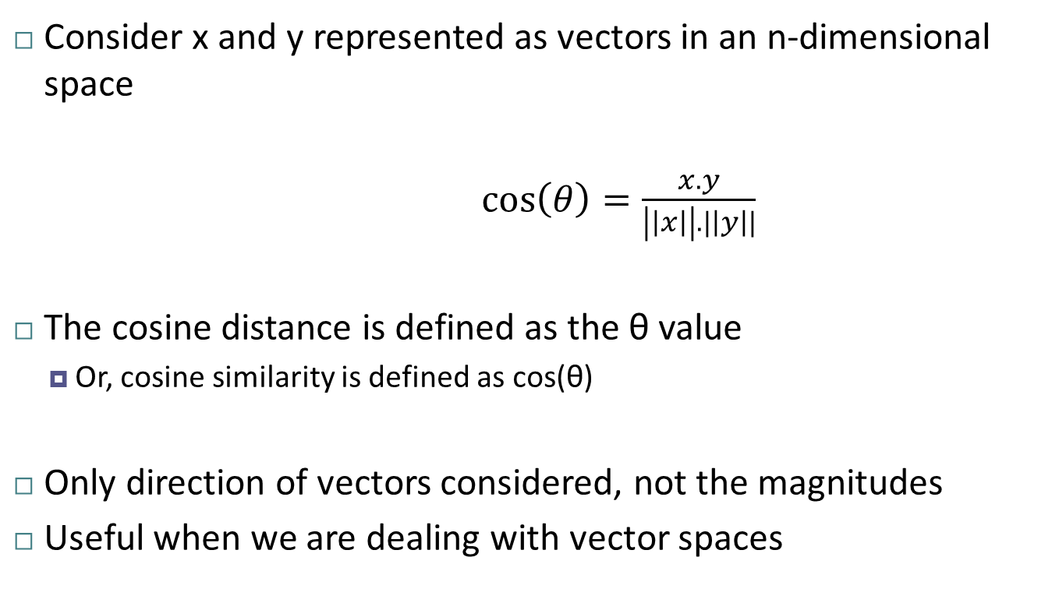
Reminder: Cosine Distance
Consider x and y represented as vectors in an n-dimensional space
$\cos\left(θ\right)=\frac{x. y}{\left|\left|x\right|\right|. |\left|y\right||}$
The cosine distance is defined as the θ value
  Or, cosine similarity is defined as cos(θ)
Only direction of vectors considered, not the magnitudes
Useful when we are dealing with vector spaces
x
y
θ

Slide 25
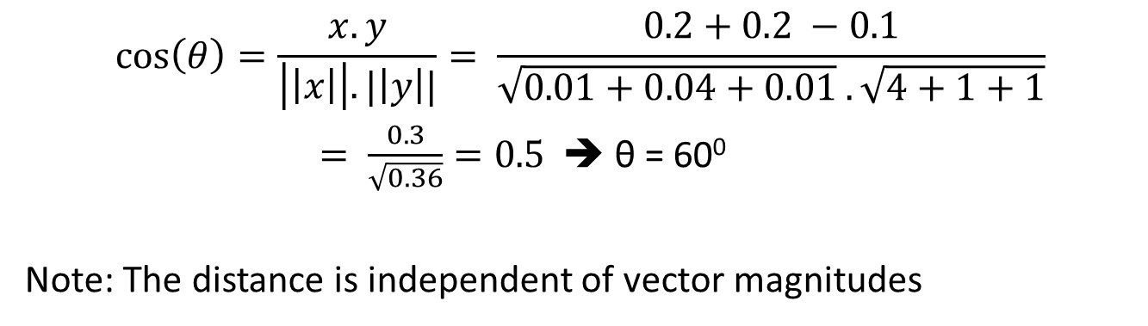
Reminder: Cosine Distance - Example
y = [2.0, 1.0, 1.0]
θ
x = [0.1, 0.2, -0.1]
$$\cos\left(θ\right)=\frac{x. y}{\left|\left|x\right|\right|. |\left|y\right||}= \frac{0.2+0.2 −0.1}{\sqrt{0.01+0.04+0.01} . \sqrt{4+1+1}}$$
$= \frac{0.3}{\sqrt{0.36}}=0.5$ ➔ θ = 60⁰
Note: The distance is independent of vector magnitudes

Slide 26
Prediction Example
Predict the rating of user U for movies 1, 2, and 3
 | Actor 1 | Actor 2 | Actor 3 | Actor 4
User U | -0.6 | 0.6 | -1.5 | 2.0
Movie 1 | 1 | 1 | 0 | 0
Movie 2 | 1 | 0 | 1 | 0
Movie 3 | 0 | 1 | 0 | 1
User and movie feature vectors

Slide 27
Prediction Example
Predict the rating of user U for movies 1, 2, and 3
 | Actor 1 | Actor 2 | Actor 3 | Actor 4 | Vector Magn.
User U | -0.6 | 0.6 | -1.5 | 2.0 | 2.6
Movie 1 | 1 | 1 | 0 | 0 | 1.4
Movie 2 | 1 | 0 | 1 | 0 | 1.4
Movie 3 | 0 | 1 | 0 | 1 | 1.4

Slide 28
Prediction Example
Predict the rating of user U for movies 1, 2, and 3
 | Actor 1 | Actor 2 | Actor 3 | Actor 4 | Vector Magn. | Cosine Sim
User U | -0.6 | 0.6 | -1.5 | 2.0 | 2.6
Movie 1 | 1 | 1 | 0 | 0 | 1.4 | 0
Movie 2 | 1 | 0 | 1 | 0 | 1.4 | -0.6
Movie 3 | 0 | 1 | 0 | 1 | 1.4 | 0.7

Slide 29
Prediction Example
Predict the rating of user U for movies 1, 2, and 3
 | Actor 1 | Actor 2 | Actor 3 | Actor 4 | Vector Magn. | Cosine Sim | Cosine Dist
User U | -0.6 | 0.6 | -1.5 | 2.0 | 2.6
Movie 1 | 1 | 1 | 0 | 0 | 1.4 | 0 | 90⁰
Movie 2 | 1 | 0 | 1 | 0 | 1.4 | -0.6 | 124⁰
Movie 3 | 0 | 1 | 0 | 1 | 1.4 | 0.7 | 46⁰

Slide 30
Prediction Example
Predict the rating of user U for movies 1, 2, and 3
 | Actor 1 | Actor 2 | Actor 3 | Actor 4 | Vector Magn. | Cosine Sim | Cosine Dist | Interpretation
User U | -0.6 | 0.6 | -1.5 | 2.0 | 2.6
Movie 1 | 1 | 1 | 0 | 0 | 1.4 | 0 | 90⁰ | ^{Neither likes nor dislikes}
Movie 2 | 1 | 0 | 1 | 0 | 1.4 | -0.6 | 124⁰ | ^{Dislikes}
Movie 3 | 0 | 1 | 0 | 1 | 1.4 | 0.7 | 46⁰ | ^{Likes}

Slide 31
Content-Based Approach: True or False?
Need data on other users
False
Can handle users with unique tastes
True – no need to have similarity with other users
Can handle new items easily
True – well-defined features for items
Can handle new users easily
False – how to construct user-profiles?
Can provide explanations for the predicted recommendations
True – know which features contributed to the ratings
Likes Metallica,
Sinatra and Bieber

Slide 32
Pros: Content-based Approach
+: No need for data on other users
  No cold-start or sparsity problems
+: Able to recommend to users with
unique tastes
+: Able to recommend new & unpopular items
  No first-rater problem
+: Able to provide explanations
  Can provide explanations of recommended items by listing content-features that caused an item to be recommended

Slide 33
Cons: Content-based Approach
–: Finding the appropriate features is hard
  E.g., images, movies, music
–: Recommendations for new users
  How to build a user profile?
–: Overspecialization
  Never recommends items outside user’s
  content profile
  People might have multiple interests
  Unable to exploit quality judgments of other users
    e.g. Users who like director X also like director Y
    User U rated X, but doesn’t know about Y

Slide 34
Collaborative Filtering
  Harnessing quality judgments of other users

Slide 35
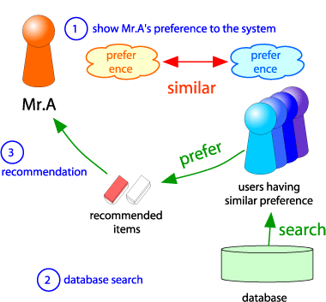
Collaborative Filtering
Consider user x
Find set N of other
users whose ratings
are “similar” to
x’s ratings
Estimate x’s ratings
based on ratings
of users in N
x
N

Slide 36
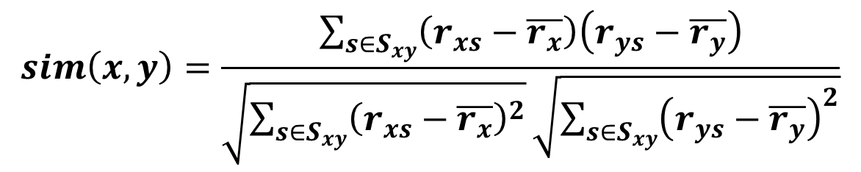
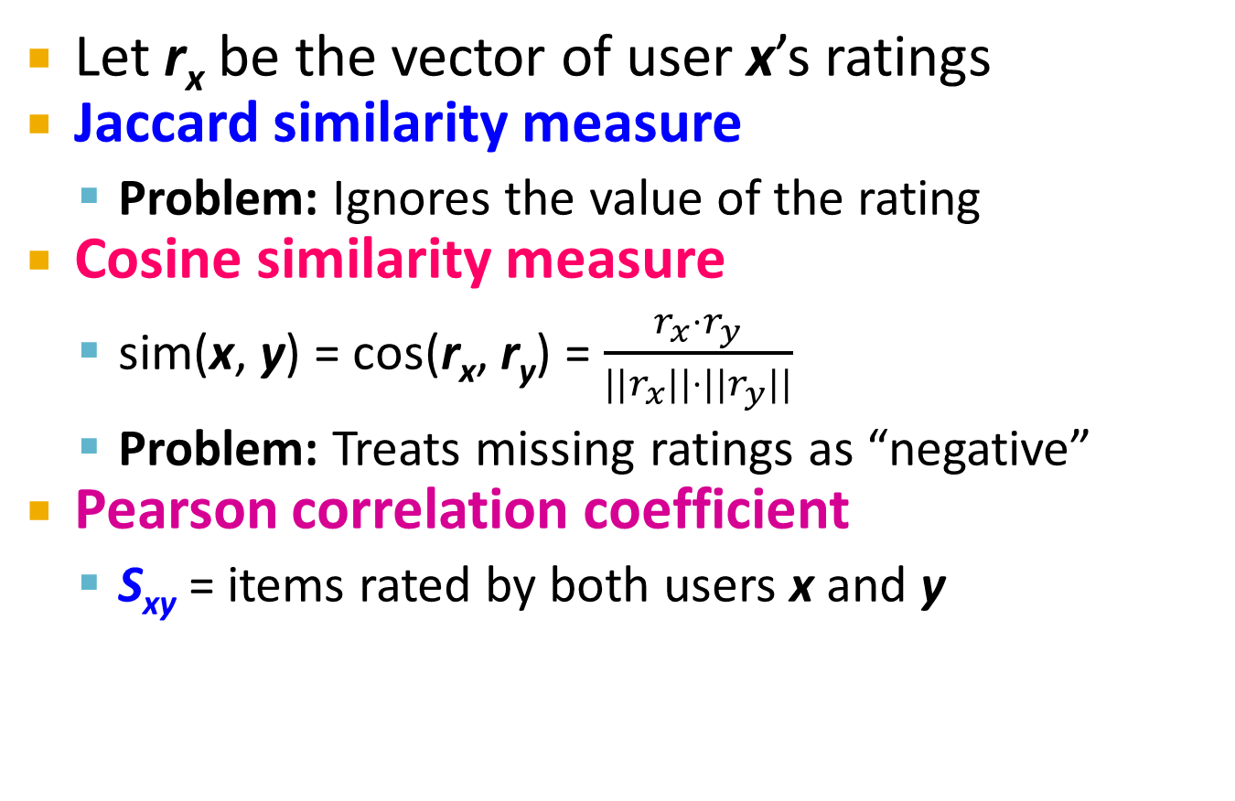
Finding “Similar” Users
r_{x} = [*, _, _, *, ***]
r_{y} = [*, _, **, **, _]
Let r_{x} be the vector of user x’s ratings
Jaccard similarity measure
  Problem: Ignores the value of the rating
Cosine similarity measure
  sim(x, y) = cos(r_{x}, r_{y}) = $\frac{r_{x}⋅r_{y}}{||r_{x}||⋅{||r}_{y}||}$
  Problem: Treats missing ratings as “negative”
Pearson correlation coefficient
  S_{xy} = items rated by both users x and y
r_{x}, r_{y} as sets:
r_{x} = {1, 4, 5}
r_{y} = {1, 3, 4}
r_{x}, r_{y} as points:
r_{x} = {1, 0, 0, 1, 3}
r_{y} = {1, 0, 2, 2, 0}
$$sim\left(x,y\right)=\frac{\sum_{s∈S_{xy}}{\left(r_{xs}−\overline{r_{x}}\right)\left(r_{ys}−\overline{r_{y}}\right)}}{\sqrt{\sum_{s∈S_{xy}}{{\left(r_{xs}−\overline{r_{x}}\right)}^{2}}}\sqrt{\sum_{s∈S_{xy}}{{\left(r_{ys}−\overline{r_{y}}\right)}^{2}}}}$$
r_{x}, r_{y} … avg.
rating of x, y
Notes:
-- Jaccard is not appropriate as we want to consider weights

Slide 37
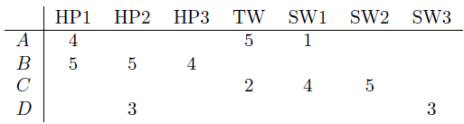
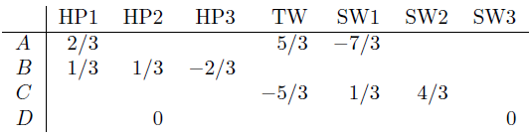

Similarity Metric
Cosine sim:
  $$sim(x, y) = \frac{\sum_{i}{r_{xi}⋅r_{yi}}}{\sqrt{\sum_{i}{r_{xi}^{2}}}⋅\sqrt{\sum_{i}{r_{yi}^{2}}}}$$
Intuitively we want: sim(A, B) > sim(A, C)
Jaccard similarity: 1/5 < 2/4
Cosine similarity: 0.386 > 0.322
  Considers missing ratings as “negative”
  Solution: subtract the (row) mean
sim A,B vs. A,C:
0.092 > -0.559
Notice cosine sim. is correlation when data is centered at 0

Slide 38
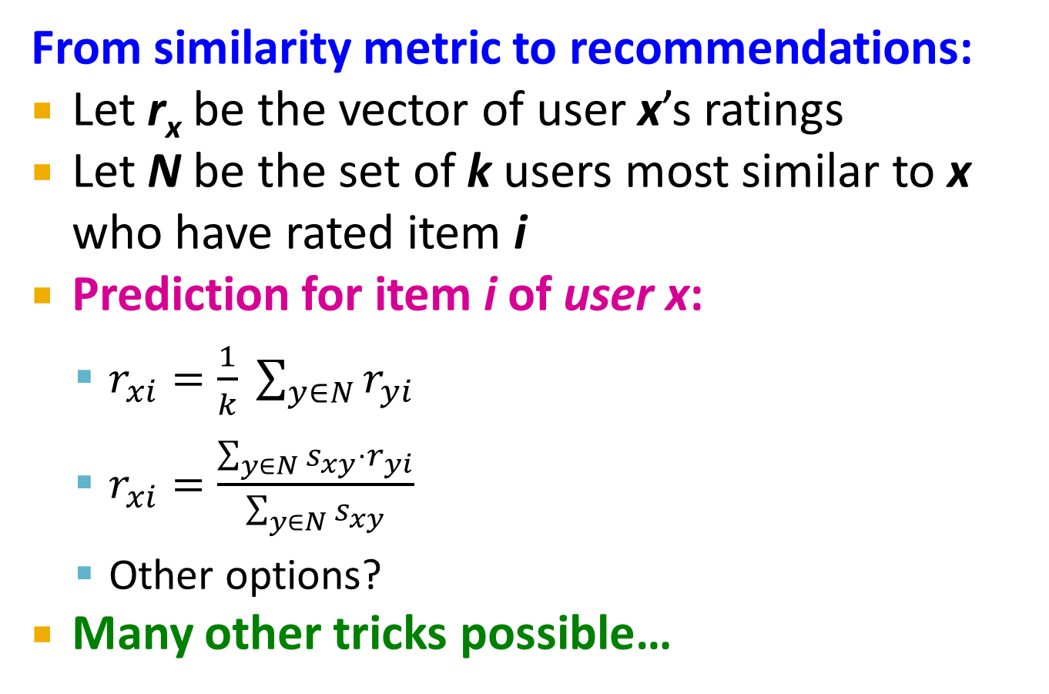
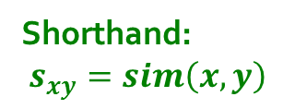
Rating Predictions
From similarity metric to recommendations:
Let r_{x} be the vector of user x’s ratings
Let N be the set of k users most similar to x who have rated item i
Prediction for item i of user x:
  $r_{xi}=\frac{1}{k} \sum_{y∈N}{r_{yi}}$
  $r_{xi}=\frac{\sum_{y∈N}{s_{xy}⋅r_{yi}}}{\sum_{y∈N}{s_{xy}}}$
  Other options?
Many other tricks possible…
Shorthand:
$s_{xy}=sim\left(x,y\right)$

Slide 39
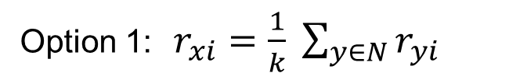
Rating Predictions
Predict the rating of A for HP2:
similarity of A
0.09
-0.56
0
Prediction based on the top 2 neighbors who have also rated HP2
Option 1: $r_{xi}=\frac{1}{k} \sum_{y∈N}{r_{yi}}$
r_{A,HP2} = (5+3) / 2 = 4

Slide 40
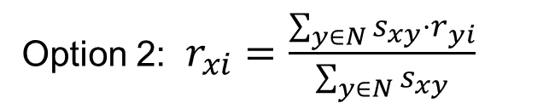
Rating Predictions
Predict the rating of A for HP2:
similarity of A
0.09
-0.56
0
Prediction based on the top 2 neighbors who have also rated HP2
Option 2: $r_{xi}=\frac{\sum_{y∈N}{s_{xy}⋅r_{yi}}}{\sum_{y∈N}{s_{xy}}}$
r_{A,HP2} = (5 x 0.09 + 3 x 0) / 0.09 = 5

Slide 41
Item-Item Collaborative Filtering
So far: User-user collaborative filtering
Another view: Item-item
  For item i, find other similar items
  Estimate rating for item i based
  on ratings for similar items
  Can use same similarity metrics and
  prediction functions as in user-user model
s_{ij}… similarity of items i and j
r_{xj}…rating of user u on item j
N(i;x)… set items rated by x similar to i

Slide 42
Item-Item CF (|N|=2)
users
12 | 11 | 10 | 9 | 8 | 7 | 6 | 5 | 4 | 3 | 2 | 1
 | 4 |  | 5 |  |  | 5 |  |  | 3 |  | 1 | 1
3 | 1 | 2 |  |  | 4 |  |  | 4 | 5 |  |  | 2
 | 5 | 3 | 4 |  | 3 |  | 2 | 1 |  | 4 | 2 | 3
 | 2 |  |  | 4 |  |  | 5 |  | 4 | 2 |  | 4
5 | 2 |  |  |  |  | 2 | 4 | 3 | 4 |  |  | 5
 | 4 |  |  | 2 |  |  | 3 |  | 3 |  | 1 | 6
movies
- unknown rating
- rating between 1 to 5

Slide 43
Item-Item CF (|N|=2)
users
12 | 11 | 10 | 9 | 8 | 7 | 6 | 5 | 4 | 3 | 2 | 1
 | 4 |  | 5 |  |  | 5 | ? |  | 3 |  | 1 | 1
3 | 1 | 2 |  |  | 4 |  |  | 4 | 5 |  |  | 2
 | 5 | 3 | 4 |  | 3 |  | 2 | 1 |  | 4 | 2 | 3
 | 2 |  |  | 4 |  |  | 5 |  | 4 | 2 |  | 4
5 | 2 |  |  |  |  | 2 | 4 | 3 | 4 |  |  | 5
 | 4 |  |  | 2 |  |  | 3 |  | 3 |  | 1 | 6
movies
- estimate rating of movie 1 by user 5

Slide 44
Item-Item CF (|N|=2)
users
12 | 11 | 10 | 9 | 8 | 7 | 6 | 5 | 4 | 3 | 2 | 1
 | 4 |  | 5 |  |  | 5 | ? |  | 3 |  | 1 | 1
3 | 1 | 2 |  |  | 4 |  |  | 4 | 5 |  |  | 2
 | 5 | 3 | 4 |  | 3 |  | 2 | 1 |  | 4 | 2 | 3
 | 2 |  |  | 4 |  |  | 5 |  | 4 | 2 |  | 4
5 | 2 |  |  |  |  | 2 | 4 | 3 | 4 |  |  | 5
 | 4 |  |  | 2 |  |  | 3 |  | 3 |  | 1 | 6
sim(1,m)
1.00
-0.18
0.41
-0.10
-0.31
0.59
movies
Neighbor selection:
Identify movies similar to
movie 1, rated by user 5
Here we use Pearson correlation as similarity:
1) Subtract mean rating m_{i} from each movie i
m₁ = (1+3+5+5+4)/5 = 3.6
row 1: [-2.6, 0, -0.6, 0, 0, 1.4, 0, 0, 1.4, 0, 0.4, 0]
2) Compute cosine similarities between rows

Slide 45
Item-Item CF (|N|=2)
users
12 | 11 | 10 | 9 | 8 | 7 | 6 | 5 | 4 | 3 | 2 | 1
 | 4 |  | 5 |  |  | 5 | ? |  | 3 |  | 1 | 1
3 | 1 | 2 |  |  | 4 |  |  | 4 | 5 |  |  | 2
 | 5 | 3 | 4 |  | 3 |  | 2 | 1 |  | 4 | 2 | 3
 | 2 |  |  | 4 |  |  | 5 |  | 4 | 2 |  | 4
5 | 2 |  |  |  |  | 2 | 4 | 3 | 4 |  |  | 5
 | 4 |  |  | 2 |  |  | 3 |  | 3 |  | 1 | 6
sim(1,m)
1.00
-0.18
0.41
-0.10
-0.31
0.59
movies
Neighbor selection:
Identify movies similar to
movie 1, rated by user 5
Here we use Pearson correlation as similarity:
1) Subtract mean rating m_{i} from each movie i
m₁ = (1+3+5+5+4)/5 = 3.6
row 1: [-2.6, 0, -0.6, 0, 0, 1.4, 0, 0, 1.4, 0, 0.4, 0]
2) Compute cosine similarities between rows

Slide 46
Item-Item CF (|N|=2)
users
12 | 11 | 10 | 9 | 8 | 7 | 6 | 5 | 4 | 3 | 2 | 1
 | 4 |  | 5 |  |  | 5 | ? |  | 3 |  | 1 | 1
3 | 1 | 2 |  |  | 4 |  |  | 4 | 5 |  |  | 2
 | 5 | 3 | 4 |  | 3 |  | 2 | 1 |  | 4 | 2 | 3
 | 2 |  |  | 4 |  |  | 5 |  | 4 | 2 |  | 4
5 | 2 |  |  |  |  | 2 | 4 | 3 | 4 |  |  | 5
 | 4 |  |  | 2 |  |  | 3 |  | 3 |  | 1 | 6
sim(1,m)
1.00
-0.18
0.41
-0.10
-0.31
0.59
movies
Compute similarity weights:
s_{1,3}=0.41, s_{1,6}=0.59

Slide 47
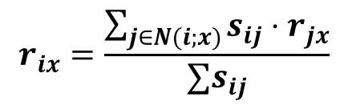
Item-Item CF (|N|=2)
users
12 | 11 | 10 | 9 | 8 | 7 | 6 | 5 | 4 | 3 | 2 | 1
 | 4 |  | 5 |  |  | 5 | 2.6 |  | 3 |  | 1 | 1
3 | 1 | 2 |  |  | 4 |  |  | 4 | 5 |  |  | 2
 | 5 | 3 | 4 |  | 3 |  | 2 | 1 |  | 4 | 2 | 3
 | 2 |  |  | 4 |  |  | 5 |  | 4 | 2 |  | 4
5 | 2 |  |  |  |  | 2 | 4 | 3 | 4 |  |  | 5
 | 4 |  |  | 2 |  |  | 3 |  | 3 |  | 1 | 6
movies
Predict by taking weighted average:
r_{1.5} = (0.41*2 + 0.59*3) / (0.41+0.59) = 2.6
$$r_{ix}=\frac{\sum_{j∈N(i;x)}{s_{ij}⋅r_{jx}}}{∑s_{ij}}$$

Slide 48

CF: Common Practice
Before:
Define similarity s_{ij} of items i and j
Select k nearest neighbors N(i; x)
  Items most similar to i, that were rated by x
Estimate rating r_{xi} as the weighted average:
baseline estimate for r_{xi}
μ = overall mean movie rating
b_{x} = rating deviation of user x
= (avg. rating of user x) – μ
b_{i} = rating deviation of movie i
$$b_{xi}=μ+b_{x}+b_{i}$$

Slide 49
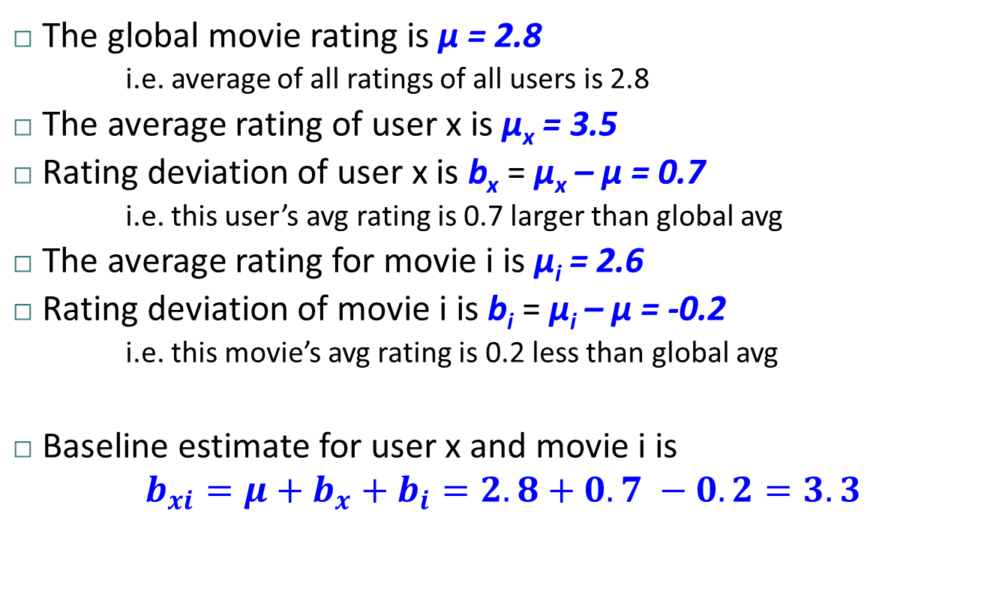
Example
The global movie rating is μ = 2.8
  i.e. average of all ratings of all users is 2.8
The average rating of user x is μ_{x} = 3.5
Rating deviation of user x is b_{x} = μ_{x} – μ = 0.7
  i.e. this user’s avg rating is 0.7 larger than global avg
The average rating for movie i is μ_{i} = 2.6
Rating deviation of movie i is b_{i} = μ_{i} – μ = -0.2
  i.e. this movie’s avg rating is 0.2 less than global avg
Baseline estimate for user x and movie i is
$$b_{xi}=μ+b_{x}+b_{i}=2.8+0.7 −0.2=3.3$$

Slide 50
Example (cont’d)
Items k and m: The most similar items to i that are also rated by x
Assume both have similarity values of 0.4
Assume:
r_{xk} = 2 and b_{xk} = 3.2 → deviation of -1.2
r_{xm} = 3 and b_{xk} = 3.8 → deviation of -0.8

Slide 51
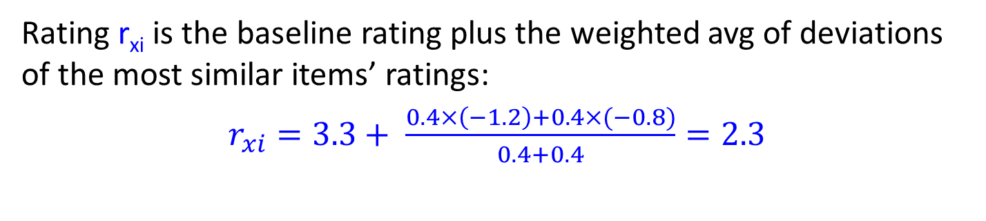
Example (cont’d)
Rating r_{xi} is the baseline rating plus the weighted avg of deviations of the most similar items’ ratings:
$r_{xi}=3.3+ \frac{0.4×\left(−1.2\right)+0.4×(−0.8)}{0.4+0.4}=2.3$

Slide 52
Item-Item vs. User-User
Avatar
LOTR
Matrix
Pirates
Alice
Bob
Carol
David
In practice, it has been observed that item-item often works better than user-user
Why? Items are simpler, users have multiple tastes
Notes:
There is a difference in the typical behavior of users and items, as it
pertains to similarity. Intuitively, items tend to be classifiable in simple
terms. For example, music tends to belong to a single genre. It is impossi-
ble, e.g., for a piece of music to be both 60’s rock and 1700’s baroque. On
the other hand, there are individuals who like both 60’s rock and 1700’s
baroque, and who buy examples of both types of music.
The consequence is that it is easier to discover items that are similar because they belong
to the same genre, than it is to detect that two users are similar because
they prefer one genre in common, while each also likes some genres that
the other doesn’t care for.

Slide 53
Collaborating Filtering: True or False?
Need data on other users
True
Effective for users with unique tastes and esoteric items
False – relies on similarity between users or items
Can handle new items easily
False – cold start problems
Can handle new users easily
False – cold start problems
Can provide explanations for the predicted recommendations
User-user: False – “because users X, Y, Z also liked it”
Item-item: True – “because you also liked items i, j, k”

Slide 54
Pros/Cons of Collaborative Filtering
+ Works for any kind of item
  No feature selection needed
- Cold Start:
  Need enough users in the system to find a match
- Sparsity:
  The user/ratings matrix is sparse
  Hard to find users that have rated the same items
- First rater:
  Cannot recommend an item that has not been
  previously rated
  New items, Esoteric items
- Popularity bias:
  Cannot recommend items to someone with
  unique taste
  Tends to recommend popular items

Slide 55
Hybrid Methods
Implement two or more different recommenders and combine predictions
  Perhaps using a linear model
Add content-based methods to
collaborative filtering
  Item profiles for new item problem
  Demographics to deal with new user problem

Slide 56
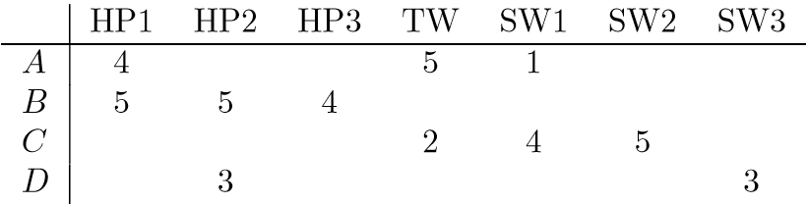
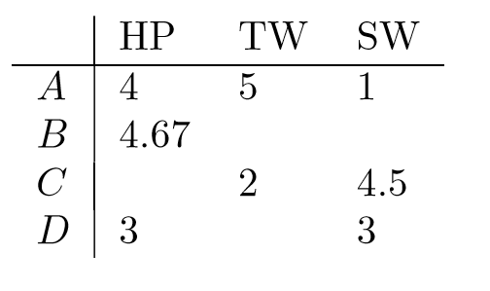
Item/User Clustering to Reduce Sparsity

Slide 57
Remarks & Practical Tips
- Evaluation
- Error metrics
- Complexity / Speed

Slide 58
Evaluation
movies
1 | 3 | 4
 | 3 | 5 |  |  | 5
 |  | 4 | 5 |  | 5
 |  | 3
 |  | 3
2 |  |  | 2 |  | 2
 |  |  |  | 5
 | 2 | 1 |  |  | 1
 | 3 |  |  | 3
1
users

Slide 59
Evaluation
movies
1 | 3 | 4
 | 3 | 5 |  |  | 5
 |  | 4 | 5 |  | 5
 |  | 3
 |  | 3
2 |  |  | ? |  | ?
 |  |  |  | ?
 | 2 | 1 |  |  | ?
 | 3 |  |  | ?
1
users
Test Data Set

Slide 60
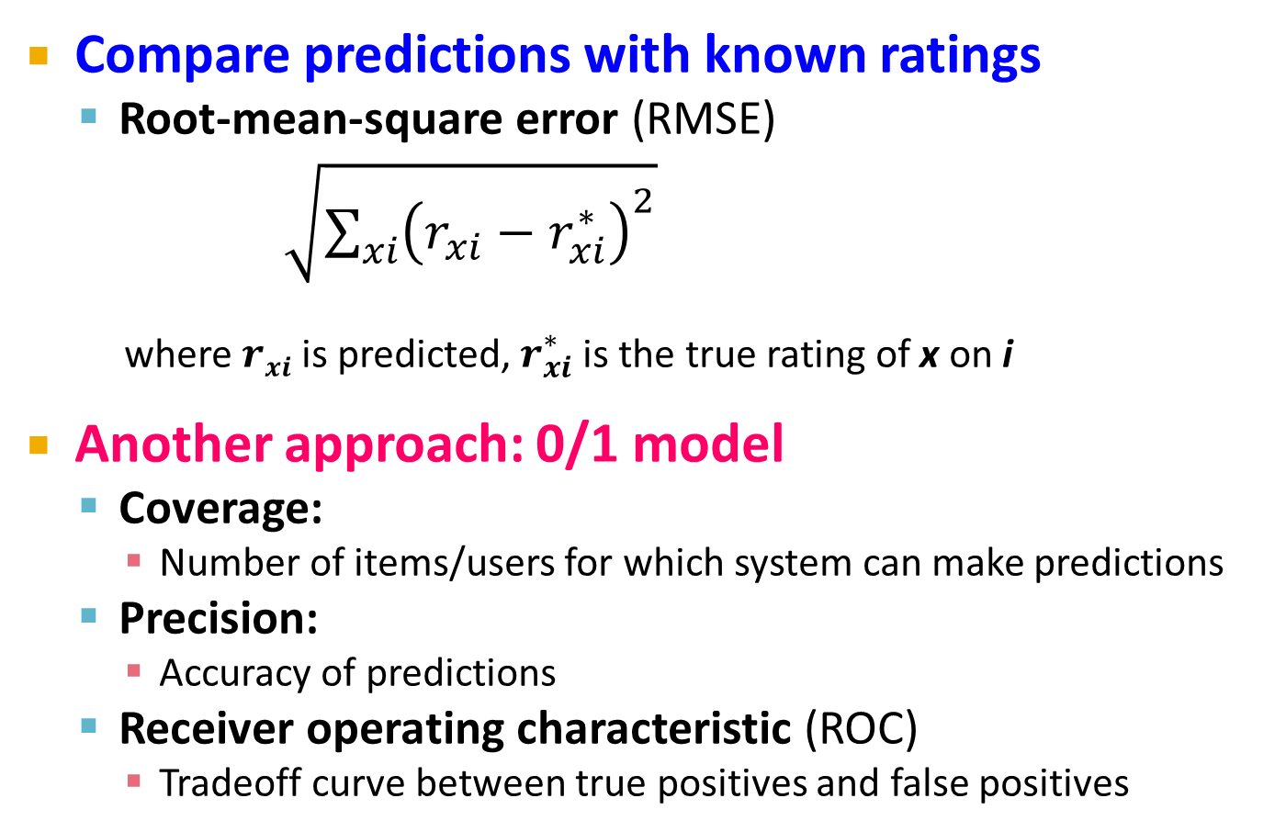
Evaluating Predictions
Compare predictions with known ratings
  Root-mean-square error (RMSE)
    $\sqrt{\sum_{xi}{{\left(r_{xi}−r_{xi}^{∗}\right)}^{2}}}$
    where $rxi$ is predicted, $r_{xi}^{∗}$ is the true rating of x on i
Another approach: 0/1 model
  Coverage:
    Number of items/users for which system can make predictions
  Precision:
    Accuracy of predictions
  Receiver operating characteristic (ROC)
    Tradeoff curve between true positives and false positives

Slide 61
Problems with Error Measures
Narrow focus on accuracy sometimes
misses the point
  Prediction Context
  Prediction Diversity

Slide 62







Prediction Diversity Problem

Slide 63
Problems with Error Measures
In practice, we care only to predict high ratings:
  RMSE might penalize a method that does well
  for high ratings and badly for others
  Alternative: Precision at top k

Slide 64
Collaborative Filtering: Complexity
Expensive step is finding k most similar customers: O(|X|)
Too expensive to do at runtime
  Could pre-compute
Naïve pre-computation takes time O(k ·|X|)
      X … set of customers
We already know how to do this!
  Near-neighbor search in high dimensions (LSH)
  Clustering
  Dimensionality reduction

Slide 65
Tip: Add Data
Leverage all the data
  Don’t try to reduce data size in an
  effort to make fancy algorithms work
  Simple methods on large data do best
Add more data
  e.g., add IMDB data on genres
More data beats better algorithms
http://anand.typepad.com/datawocky/2008/03/more-data-usual.html

