Slide 1
Floorplanning
Mustafa Ozdal

Slide 2
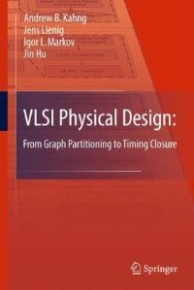
Chapter 2 – Netlist and System Partitioning
SOME SLIDES ARE FROM THE BOOK:
VLSI Physical Design: From Graph Partitioning to Timing Closure
MODIFICATIONS WERE MADE ON THE ORIGINAL SLIDES
Original Authors:
Andrew B. Kahng, Jens Lienig, Igor L. Markov, Jin Hu

Slide 3
3.1 Introduction
System Specification
Partitioning
Architectural Design
ENTITY test is
port a: in bit;
end ENTITY test;
Functional Design
and Logic Design
Chip Planning
Circuit Design
Placement
Physical Design
Clock Tree Synthesis
Physical Verification
and Signoff
DRC
LVS
ERC
Signal Routing
Fabrication
Timing Closure
Packaging and Testing
Chip

Slide 4
3.1 Introduction
I/O Pads
Floorplan
Module a
Module b
Block a
Block c
Module c
Chip
Planning
GND
Block d
VDD
Block Pins
Block
b
Module d
Block e
Module e
Supply Network
© 2011 Springer Verlag

Slide 5
Floorplanning
Circuit modules obtained through partitioning
  either automatic or manual partitioning
Floorplanning: Assign shapes and locations for all circuit modules.

Slide 6
3.1 Introduction
Example
Given: Three blocks with the following potential widths and heights
Block A: w = 1, h = 4 or w = 4, h = 1 or w = 2, h = 2
Block B: w = 1, h = 2 or w = 2, h = 1
Block C: w = 1, h = 3 or w = 3, h = 1
Task: Floorplan with minimum total area enclosed
C
A
B
B
C
A
A

Slide 7
3.1 Introduction
Example
Given: Three blocks with the following potential widths and heights
Block A: w = 1, h = 4 or w = 4, h = 1 or w = 2, h = 2
Block B: w = 1, h = 2 or w = 2, h = 1
Block C: w = 1, h = 3 or w = 3, h = 1
Task: Floorplan with minimum total area enclosed

Slide 8
3.1 Introduction
Example
Given: Three blocks with the following potential widths and heights
Block A: w = 1, h = 4 or w = 4, h = 1 or w = 2, h = 2
Block B: w = 1, h = 2 or w = 2, h = 1
Block C: w = 1, h = 3 or w = 3, h = 1
Task: Floorplan with minimum total area enclosed
Solution:
Aspect ratios
Block A with w = 2, h = 2; Block B with w = 2, h = 1; Block C with w = 1, h = 3
This floorplan has a global bounding box with minimum possible area (9 square units).

Slide 9
Optimization Objectives
Minimize the area of the global bounding box
  Aspect ratio constraints due to packaging and manufacturing limitations (e.g. a square chip)
Minimize the total wirelength between blocks
  Long connections increase signal delays (lower performance)
  More wirelength can degrade routability
  More wirelength increases power (due to wire capacitances)

Slide 10
Objective Function: Example
Combination of area(F) and total wirelength L(F) of floorplan F
  Minimize α ∙ area(F) + (1 – α) ∙ L(F)
  where the parameter 0 ≤ α ≤ 1 gives the relative importance between area(F) and L(F)

Slide 11
Floorplan Representations
A floorplan can be represented based on the locations of the blocks
  ➔ Complicates generation of new overlap-free floorplans
Typical floorplanning algorithms are iterative in nature
  Local search and iterative improvement heavily used
Topological representations based on relative block positions
  The represented floorplan guaranteed to be overlap free
  Easy to evaluate and make incremental changes

Slide 12
3.3 Terminology
A rectangular dissection is a division of the chip area into a set of blocks
or non-overlapping rectangles.
A slicing floorplan is a rectangular dissection
  Obtained by repeatedly dividing each rectangle, starting with the entire chip area, into two smaller rectangles
  Horizontal or vertical cut line.
A slicing tree or slicing floorplan tree is a binary tree with k leaves and k – 1 internal nodes
  Each leaf represents a block
  Each internal node represents a horizontal or vertical cut line.

Slide 13
3.3 Terminology
Slicing floorplan and two possible corresponding slicing trees
V
V
c
H
H
H
H
b
e
f
a
b
c
H
a
b
d
H
a
© 2011 Springer Verlag
d
d
V
c
V
e
f
e
f

Slide 14
3.3 Terminology
Polish expression
V
c
H
H
b
f
a
A
B
∗
+
C
D
E
F
∗
+
e
b
c
H
+
a
d
d
V
e
f
Bottom up: V → ∗ and H → +
Length 2n-1 (n = Number of leaves of the slicing tree)

Slide 15
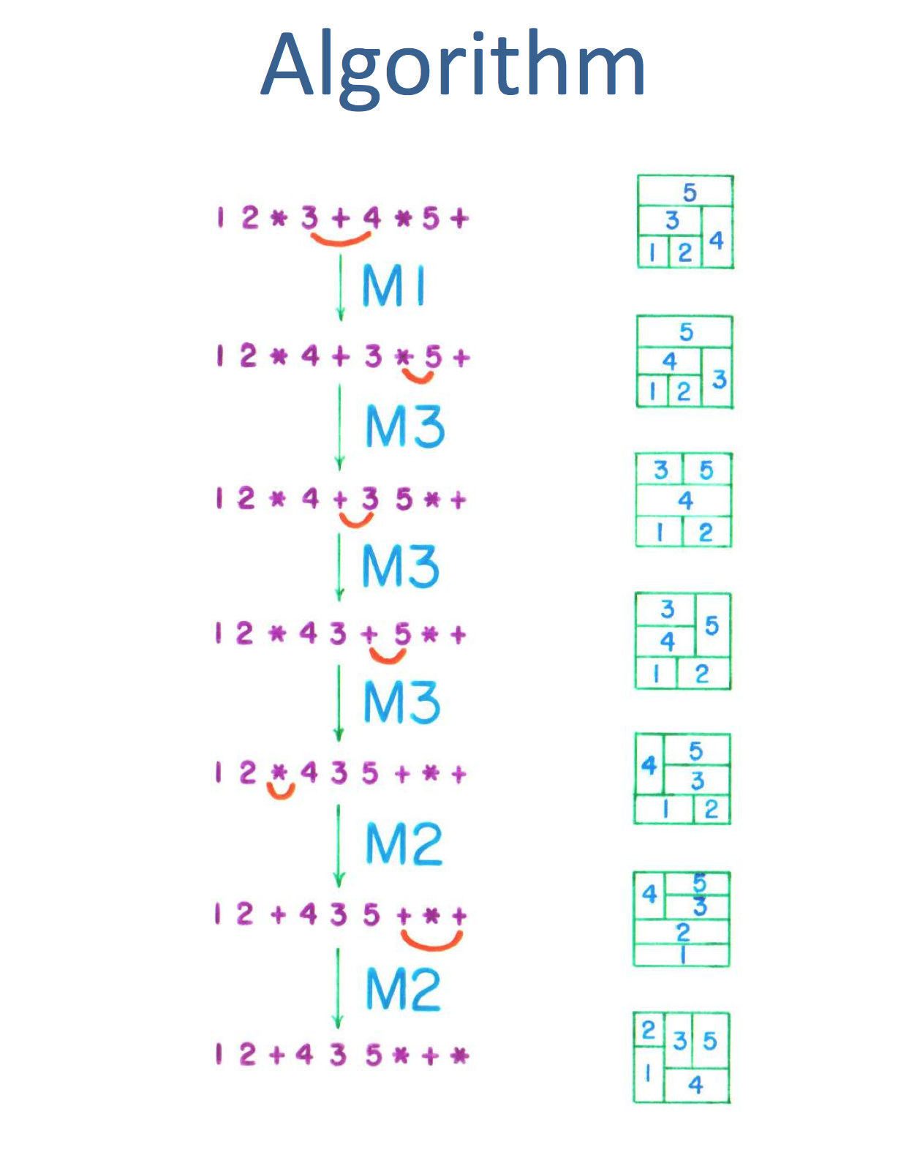
slide from M. D. F. Wong, “On Simulated Annealing in EDA”, ISPD 2012

Slide 16
3.3 Terminology
Non-slicing floorplans (wheels)
b
b
c
a
e
e
a
c
d
d
© 2011 Springer Verlag

Slide 17
3.3 Terminology
Floorplan tree: Tree that represents a hierarchical floorplan
d
H
b
e
g
V
H
c
a
f
H
W
h
i
H
h
i
a
b
c
d
e
f
g
H
Horizontal division
(objects to the top and bottom)
H
W
Wheel (4 objects cycled
around a center object)
Vertical division
(objects to the left and right)
H
© 2011 Springer Verlag
V
H

Slide 18
Terminology: Vertical Constraint Graph
In a vertical constraint graph (VCG), node weights represent the heights
of the corresponding blocks.
  Two nodes v_{i} and v_{j}, with corresponding blocks m_{i} and m_{j}, are connected
  with a directed edge from v_{i} to v_{j} if m_{i} is below m_{j}.
t
c
3
c
3
6
b
6
b
e
6
f
6
e
f
6
6
a
d
3
6
a
d
3
s

Slide 19
Terminology: Horizontal Constraint Graph
In a horizontal constraint graph (HCG), node weights represent the widths
of the corresponding blocks.
  Two nodes v_{i} and v_{j}, with corresponding blocks m_{i} and m_{j}, are connected
  with a directed edge from v_{i} to v_{j} if m_{i} is to the left of m_{j}.
3
4
3
4
c
b
c
b
2
2
e
f
s
e
f
t
2
2
a
d
a
d
3
4

Slide 20
Longest Path in a VCG
What does the longest path in the VCG correspond to?
➔ The minimum required floorplan height
t
c
3
c
3
6
b
6
b
e
6
f
6
e
f
6
6
a
d
3
6
a
d
3
s

Slide 21
Longest Path in HCG
What does the longest path in the HCG correspond to?
➔ The minimum required floorplan width
3
4
3
4
c
b
c
b
2
2
e
f
s
e
f
t
2
2
a
d
a
d
3
4

Slide 22
3.3 Terminology
In a vertical constraint graph (VCG), node weights represent the heights
of the corresponding blocks.
  Two nodes v_{i} and v_{j}, with corresponding blocks m_{i} and m_{j}, are connected
  with a directed edge from v_{i} to v_{j} if m_{i} is below m_{j}.
In a horizontal constraint graph (HCG), node weights represent the widths
of the corresponding blocks.
  Two nodes v_{i} and v_{j}, with corresponding blocks m_{i} and m_{j}, are connected
  with a directed edge from v_{i} to v_{j} if m_{i} is to the left of m_{j}.
The longest path(s) in the VCG / HCG correspond(s) to the minimum vertical / horizontal floorplan span required to pack the blocks (floorplan height / width).
A constraint-graph pair is a floorplan representation that consists of two directed graphs – vertical constraint graph and horizontal constraint graph – which capture the relations between block positions.

Slide 23
3.3 Terminology
Constraint graphs
d
t
b
e
g
b
d
e
a
c
f
g
h
a
c
f
i
h
b
d
e
Vertical
Constraint Graph
g
i
s
a
c
f
t
s
h
i
© 2011 Springer Verlag
Horizontal Constraint Graph

Slide 24
3.3 Terminology
Sequence pair
Two permutations represent geometric relations between every pair of blocks
Example: (ABDCE, CBAED)
Horizontal and vertical relations between blocks A and B:
  (… A … B … , … A … B …) → A is left of B
  (… B … A … , … A … B …) → A is below B
  (… A … B … , … B … A …) → A is above B
  (… B … A … , … B … A …) → A is right of B
A
D
B
C
E

Slide 25
3.3 Terminology
Sequence pair
Two permutations represent geometric relations between every pair of blocks
Example: (ABDCE, CBAED)
Horizontal and vertical relations between blocks A and B:
  (… A … B … , … A … B …) → A is left of B
  (… B … A … , … A … B …) → A is below B
  (… A … B … , … B … A …) → A is above B
  (… B … A … , … B … A …) → A is right of B
A
D
B
➔ A is above B
C
E

Slide 26
3.3 Terminology
Sequence pair
Two permutations represent geometric relations between every pair of blocks
Example: (ABDCE, CBAED)
Horizontal and vertical relations between blocks A and B:
  (… A … B … , … A … B …) → A is left of B
  (… A … B … , … B … A …) → A is above B
  (… B … A … , … A … B …) → A is below B
  (… B … A … , … B … A …) → A is right of B
A
D
B
➔ B is left of D
C
E

Slide 27
Sequence Pair: Intuition
A
D
D
B
A
E
C
E
Sequence 1: ABDCE
B
A
D
B
C
Sequence 2: CBAED
E
D
A
C
B
E
C

Slide 28
Sequence Pair: Intuition
blocks above B
A
D
D
B
A
blocks right of B
E
C
blocks left of B
E
Sequence 1: ABDCE
B
A
D
B
C
Sequence 2: CBAED
E
D
A
C
B
E
C
blocks below B

Slide 29
3.4 Floorplan Representations
3.1 Introduction to Floorplanning
3.2 Optimization Goals in Floorplanning
3.3 Terminology
3.4 Floorplan Representations
  3.4.1 Floorplan to a Constraint-Graph Pair
  3.4.2 Floorplan to a Sequence Pair
  3.4.3 Sequence Pair to a Floorplan
3.5 Floorplanning Algorithms
  3.5.1 Floorplan Sizing
  3.5.2 Cluster Growth
  3.5.3 Simulated Annealing
  3.5.4 Integrated Floorplanning Algorithms
3.6 Pin Assignment
3.7 Power and Ground Routing
  3.7.1 Design of a Power-Ground Distribution Network
  3.7.2 Planar Routing
  3.7.3 Mesh Routing
29

Slide 30
Horizontal and Vertical Constraints
w_{A}
w_{B}
A
h_{A}
B
h_{B}
(x_{A}, y_{A})
(x_{B}, y_{B})
If x_{A} + w_{A} ≤ x_{B} and ! (y_{A}+h_{A} ≤ y_{B} or y_{B} + h_{B} ≤ y_{A})
➔ A is left of B
B
A
B
If y_{A} + h_{A} ≤ y_{B} and ! (x_{A}+w_{A} ≤ x_{B} or x_{B} + w_{B} ≤ x_{A})
A
➔ A is below B

Slide 31
3.4.1 Floorplan to a Constraint-Graph Pair
Create nodes for every block. In addition, create a source node and a sink one.
a
b
a
b
s
t
c
d
e
c
d
e
31

Slide 32
3.4.1 Floorplan to a Constraint-Graph Pair
Create nodes for every block. In addition, create a source node and a sink one.
Add a directed edge (A,B) if Block A is to the left of Block B. (HCG)
a
b
a
b
s
t
c
d
e
c
d
e
32

Slide 33
3.4.1 Floorplan to a Constraint-Graph Pair
Create nodes for every block. In addition, create a source node and a sink one.
Add a directed edge (A,B) if Block A is to the left of Block B. (HCG)
Remove the redundant edges that cannot be derived from other edges by transitivity.
a
b
a
b
s
t
c
d
e
c
d
e
33

Slide 34
Floorplan to a Sequence Pair
Step 1: Consider the constraints related to HCG
  (… A … B … , … A … B …) → A is left of B
c
b
c
b
HCG
e
f
s
e
f
t
a
d
a
d
Constraints for SP 1
Constraints for SP 2
b
c
b
c
e
f
e
f
a
d
a
d

Slide 35
Floorplan to a Sequence Pair
Step 2: Consider the constraints related to VCG
t
  (… B … A … , … A … B …)
  → A is below B
c
c
b
b
e
f
e
f
a
d
a
d
s
Constraints for SP 1
Constraints for SP 2
b
c
b
c
e
f
e
f
a
d
a
d

Slide 36
Floorplan to a Sequence Pair
Step 3: Create the sequence pairs based on the constraints
c
  (… A … B … , … A … B …) → A is left of B
b
e
f
  (… B … A … , … A … B …) → A is below B
a
d
Constraints for SP 1
Constraints for SP 2
b
c
b
c
e
f
e
f
a
d
a
d
Sequence 1: bacefd
Sequence 2: abdefc

Slide 37
Sequence Pair to a Floorplan
Method 1 (simpler):
  1. Create constraint graphs: HCG and VCG
  2. Pack the blocks based on HCG and VCG (next slides)
  Complexity: O(n²)
Method 2
  Pack the blocks based on the sequence pair directly
  Complexity: O(nlgn)

Slide 38
Constraint Graph Pair to a Floorplan
Given an HCG and a VCG, we can compute a packing solution that satisfies all the constraints.
Basic idea:
  Compute the longest path on HCG
  The coordinate computed for each vertex will be the x-coordinate of the corresponding block in the packed floorplan.
  Compute the longest path on VCG
  The coordinate computed for each vertex will be the y-coordinate of the corresponding block in the packed floorplan.

Slide 39
Reminder: Longest Path Algorithm
LONGEST-PATH (G)
for each vertex u in G
coord[u] = 0
for each vertex u in G in topological order
for each edge (u→v) in G do
coord[v] = max (coord[v], coord[u]+wt(u))

Slide 40
Example: Sequence Pair to a Floorplan
3
c
3
d
6
a
6
b
6
e
6
f
4
4
3
3
2
2
Compute HCG and VCG for the sequence pair:
  S1 = bdcefa S2 = dbaefc
  (… A … B … , … A … B …) → A is left of B
  (… B … A … , … A … B …) → A is below B

Slide 41
Example: HCG for sequence pair
  S1 = bdcefa S2 = dbaefc
b
a
s
e
f
t
d
c

Slide 42
Example: VCG for Sequence Pair
  S1 = bdcefa S2 = dbaefc
t
c
b
e
f
d
a
s

Slide 43
Example: Longest Path in HCG
w=3
w=3
x(s) = 0
x(b) = 0
x(d) = 0
x(e) = 4
x(c) = 4
x(a) = 4
x(f) = 6
x(t) = 8
b
a
s
e
f
t
w=2
w=2
d
c
w=4
w=4

Slide 44
Example: Longest Path in VCG
t
y(s) = 0
y(a) = 0
y(d) = 0
y(b) = 3
y(e) = 6
y(f) = 6
y(c) = 12
y(t) = 15
c
h=3
h=6
b
e
h=6
f
h=6
h=3
d
a
h=6
s

Slide 45
Example: Packing
3
c
3
d
6
a
6
b
6
e
6
f
4
4
3
3
(4,12)
(0,0)
2
2
(4,0)
(0,3)
(4,6)
(6,6)
8
c
15
e
f
b
a
d

Slide 46
Example: Summary
3
c
3
d
6
a
6
b
6
e
6
f
4
4
3
3
2
2
The sequence pair:
  S1 = bdcefa S2 = dbaefc
8
c
corresponds to the packed floorplan:
12
e
f
b
a
d

Slide 47
Example: Perturbation
8
The original sequence pair:
  S1 = bdcefa S2 = dbaefc
c
12
e
f
b
a
What happens if we swap the positions
of a and d in both sequences?
d
i.e. S1 = bacefd S2 = abdefc

Slide 48
Example: Longest Path in HCG after Perturbation
w=3
w=4
x(s) = 0
x(b) = 0
x(a) = 0
x(e) = 3
x(c) = 3
x(d) = 3
x(f) = 5
x(t) = 7
b
d
s
e
f
t
w=2
w=2
a
c
w=3
w=4

Slide 49
Example: Longest Path in VCG
t
y(s) = 0
y(a) = 0
y(d) = 0
y(b) = 6
y(e) = 3
y(f) = 3
y(c) = 9
y(t) = 12
c
h=3
h=6
b
e
h=6
f
h=6
h=6
a
d
h=3
s

Slide 50
Example: Packing
3
c
3
d
6
a
6
b
6
e
6
f
4
4
3
3
(3,9)
(3,0)
2
2
(0,0)
(0,6)
(3,3)
(5,3)
7
c
b
12
e
f
a
d

Slide 51
Example: Summary
8
c
The original sequence pair:
  S1 = bdcefa S2 = dbaefc
12
e
f
b
a
d
7
Swap positions of a and d in both sequences:
c
S1 = bacefd S2 = abdefc
b
12
e
f
a
d

Slide 52
Sequence Pair to a Floorplan
Method 1 (simpler):
  1. Create constraint graphs: HCG and VCG
  2. Pack the blocks based on HCG and VCG (next slides)
  Complexity: O(n²)
Method 2
  Pack the blocks based on the sequence pair directly
  Complexity: O(nlgn)

Slide 53
Reminder: A Common Subsequence
Given two sequences X and Y:
  Z is a common subsequence of X and Y if Z is a subsequence of both X and Y.
Example:
  X = bdcefa Y = dbaefc
  Z = bef (a common subsequence of X and Y)
  because X = bdcefa Y = dbaefc

Slide 54
Reminder: Longest Common Subsequence (LCS)
Each element in the sequence can have a weight defined
Example:
  Elements: a b c d e f
  Weights: 3 3 4 4 2 2
Longest common subsequence (LCS) of two sequences is the common sequence with the maximum weight
X = bdcefa Y = dbaefc
LCS (X, Y) = def with weight = 4 + 2 + 2 = 8

Slide 55
LCS of a Sequence Pair
3
c
3
d
6
a
6
b
6
e
6
f
4
4
3
3
2
2
  (… A … B … , … A … B …) → A is left of B
Sequence pair: X = bdcefa Y = dbaefc
8
c
Let the weights defined as the block widths
What does the LCS(X, Y) correspond to?
12
e
f
b
LCS(X, Y) = def
a
➔ the maximum horizontal span of the floorplan
d

Slide 56
LCS of a Sequence Pair
3
c
3
d
6
a
6
b
6
e
6
f
4
4
3
3
2
2
  (… B … A … , … A … B …) → A is below B
Sequence pair: X = bdcefa Y = dbaefc
8
c
Let the weights defined as the block heights
What does the LCS(X^{R}, Y) correspond to?
12
e
f
b
LCS(X^{R}, Y) = aec
a
➔ the maximum vertical span of the floorplan
d

Slide 57
Sequence Pair to a Floorplan
How to find the x-coordinate of block b?
  Consider the location of b in the sequence pair (X,Y)
X = X₁ b X₂ Y = Y₁ b Y₂
  What does LCS (X₁, Y₁) correspond to?
      the max horizontal span of the blocks left of b
  x-coord (b) = LCS(X₁, Y₁)
  (… A … B … , … A … B …) → A is left of B

Slide 58
Sequence Pair to a Floorplan
How to find the y-coordinate of block b?
  Consider the location of b in the sequence pair (X,Y)
X = X₁ b X₂ Y = Y₁ b Y₂
X^{R}= X₂^{R}b X₁^{R}
  What does LCS (X₂^{R}, Y₁) correspond to?
      the max vertical span of the blocks below b
  y-coord (b) = LCS(X₂^{R}, Y₁)
  (… B … A … , … A … B …) → A is below B

Slide 59
Sequence Pair to a Floorplan using an LCS Algorithm
Find-LCS: Given two sequences X and Y consisting of n blocks, return the length of the LCS before each block b
  i.e. Return length of LCS(X₁, Y₁) for each block b for which X= X₁ b X₂ and Y = Y₁ b Y₂
Inputs:
Block a b c d e f
Weight 3 3 4 4 2 2
X = bdcefa
Y = dbaefc
Output:
LCS length
before
4 0 4 0 4 6

Slide 60
Sequence Pair to a Floorplan using an LCS Algorithm
FIND-LCS is solvable in O(nlgn) time
Tang, X. Tian, R. and Wong, D.F., “Fast Evaluations of Sequence Pair in Block Placement by Longest Common Subsequence Computations”, DATE 2000
Sequence pair (X,Y) to a packed floorplan:
x-coords = FIND-LCS (X, Y, widths)
y-coords = FIND-LCS (X^{R}, Y, heights)

Slide 61
Example: Sequence Pair to a Floorplan
3
c
3
d
6
a
6
b
6
e
6
f
4
4
3
3
2
2
Sequence pair: X = bdcefa Y = dbaefc
x-coords ← FIND-LCS (bdcefa, dbaefc, widths)
x-coords =
4 0 4 0 4 6

Slide 62
Example: Sequence Pair to a Floorplan
3
c
3
d
6
a
6
b
6
e
6
f
4
4
3
3
2
2
Sequence pair: X = bdcefa Y = dbaefc
y-coords ← FIND-LCS (afecdb, dbaefc, heights)
y-coords =
0 3 12 0 6 6

Slide 63
Example: Sequence Pair to a Floorplan
3
c
3
d
6
a
6
b
6
e
6
f
4
4
3
3
(4,12)
(0,0)
2
2
(4,0)
(0,3)
(4,6)
(6,6)
8
Sequence pair:
X = bdcefa
Y = dbaefc
c
How will the floorplan change if we swap a and d in sequence X?
15
e
f
b
a
d

Slide 64
3.5 Floorplanning Algorithms
3.1 Introduction to Floorplanning
3.2 Optimization Goals in Floorplanning
3.3 Terminology
3.4 Floorplan Representations
  3.4.1 Floorplan to a Constraint-Graph Pair
  3.4.2 Floorplan to a Sequence Pair
  3.4.3 Sequence Pair to a Floorplan
3.5 Floorplanning Algorithms
  3.5.1 Floorplan Sizing
  3.5.2 Cluster Growth
  3.5.3 Simulated Annealing
  3.5.4 Integrated Floorplanning Algorithms
3.6 Pin Assignment
3.7 Power and Ground Routing
  3.7.1 Design of a Power-Ground Distribution Network
  3.7.2 Planar Routing
  3.7.3 Mesh Routing

Slide 65
3.5 Floorplanning Algorithms
Common Goals
To minimize the total length of interconnect, subject to an upper bound on
the floorplan area
or
To simultaneously optimize both wire length and area
Otten, R.: Efficient Floorplan Optimization. Int. Conf. on Computer Design, 499-502, 1983
65

Slide 66
Floorplan Sizing
Each block has the following constraints:
  Area constraint: w_{block} . h_{block} ≥ area_{block}
  Lower bound constraints: w_{block} ≥ w_{LB} and h_{block} ≥ h_{LB}
  Discrete w_{block} and h_{block} options
Min-area floorplan: For a given slicing floorplan, compute the locations and shapes to obtain the min floorplan area.
  Is this problem NP-hard?
    No, it’s polynomial time solvable!

Slide 67
3.5.1 Floorplan Sizing
Shape functions
h
h
Legal shapes
Legal shapes
Otten, R.: Efficient Floorplan Optimization. Int. Conf. on Computer Design, 499-502, 1983
w
w
h_{a}*_{a}w ≥ A
Block with minimum width and
height restrictions

Slide 68
3.5.1 Floorplan Sizing
Shape functions
h
h
Otten, R.: Efficient Floorplan Optimization. Int. Conf. on Computer Design, 499-502, 1983
w
w
Discrete (h,w) values
Hard library block

Slide 69
3.5.1 Floorplan Sizing
Corner points
h
5
5
2
2
2
5
w
2
5

Slide 70
3.5.1 Floorplan Sizing
Algorithm
This algorithm finds the minimum floorplan area for a given slicing floorplan in
polynomial time. For non-slicing floorplans, the problem is NP-hard.
Construct the shape functions of all individual blocks
Bottom up: Determine the shape function of the top-level floorplan
from the shape functions of the individual blocks
Top down: From the corner point that corresponds to the minimum top-level floorplan area, trace back to each block’s shape function to find that block’s dimensions and location.

Slide 71
3.5.1 Floorplan Sizing – Example
Step 1: Construct the shape functions of the blocks
3
Block A:
5
5
3
Block B:
4
2
2
4

Slide 72
3.5.1 Floorplan Sizing – Example
Step 1: Construct the shape functions of the blocks
3
h
Block A:
5
5
3
6
5
Block B:
4
4
2
2
2
4
2
3
4
6
w

Slide 73
3.5.1 Floorplan Sizing – Example
Step 1: Construct the shape functions of the blocks
3
h
Block A:
5
5
3
6
Block B:
4
3
4
2
2
2
4
2
4
5
6
w

Slide 74
3.5.1 Floorplan Sizing – Example
Step 1: Construct the shape functions of the blocks
3
h
Block A:
5
5
3
6
Block B:
4
h_{A}(w)
4
2
2
2
4
2
4
6
w

Slide 75
3.5.1 Floorplan Sizing – Example
Step 1: Construct the shape functions of the blocks
3
h
Block A:
5
5
3
6
Block B:
4
h_{A}(w)
4
2
h_{B}(w)
2
2
4
2
4
6
w

Slide 76
3.5.1 Floorplan Sizing – Example
Step 2: Determine the shape function of the top-level floorplan (vertical)
h
8
6
4
h_{A}(w)
2
h_{B}(w)
2
4
6
w

Slide 77
3.5.1 Floorplan Sizing – Example
Step 2: Determine the shape function of the top-level floorplan (vertical)
h
8
6
4
h_{A}(w)
2
h_{B}(w)
2
4
6
w

Slide 78
3.5.1 Floorplan Sizing – Example
Step 2: Determine the shape function of the top-level floorplan (vertical)
h
h
8
8
6
6
h_{C}(w)
4
4
h_{A}(w)
h_{A}(w)
2
h_{B}(w)
2
h_{B}(w)
2
4
6
w
2
4
6
w

Slide 79
3.5.1 Floorplan Sizing – Example
Step 2: Determine the shape function of the top-level floorplan (vertical)
h
h
8
8
6
6
h_{C}(w)
4
4
h_{A}(w)
h_{A}(w)
2
h_{B}(w)
2
5 x 5
h_{B}(w)
2
4
6
w
2
4
6
w

Slide 80
3.5.1 Floorplan Sizing – Example
Step 2: Determine the shape function of the top-level floorplan (vertical)
3 x 9
h
h
8
8
6
6
4 x 7
h_{C}(w)
4
4
h_{A}(w)
h_{A}(w)
2
h_{B}(w)
2
5 x 5
h_{B}(w)
2
4
6
w
2
4
6
w

Slide 81
3.5.1 Floorplan Sizing – Example
Step 2: Determine the shape function of the top-level floorplan (vertical)
3 x 9
h
h
8
8
6
6
4 x 7
h_{C}(w)
4
4
h_{A}(w)
h_{A}(w)
2
h_{B}(w)
2
5 x 5
h_{B}(w)
2
4
6
w
2
4
6
w
Minimimum top-level floorplan
with vertical composition

Slide 82
3.5.1 Floorplan Sizing – Example
Step 2: Determine the shape function of the top-level floorplan (horizontal)
h_{B}(w)
h_{A}(w)
h_{B}(w)
h_{A}(w)
h_{C}(w)
h
h
5 x 5
6
6
4
4
7 x 4
2
2
2
4
6
8
w
2
4
6
8
w
9 x 3
Minimimum top-level floorplan
with horizontal composition

Slide 83
3.5.1 Floorplan Sizing – Example
Step 3: Find the individual blocks’ dimensions and locations
h
(1) Minimum area floorplan: 5 x 5
6
4
2
2
4
6
8
w
Horizontal composition

Slide 84
3.5.1 Floorplan Sizing – Example
Step 3: Find the individual blocks’ dimensions and locations
h
(1) Minimum area floorplan: 5 x 5
6
4
2
(2) Derived block dimensions : 2 x 4 and 3 x 5
2
4
6
8
w
Horizontal composition

Slide 85
3.5.1 Floorplan Sizing – Example
Step 3: Find the individual blocks’ dimensions and locations
h
(1) Minimum area floorplan: 5 x 5
6
5 x 5
4
2
(2) Derived block dimensions : 2 x 4 and 3 x 5
2
4
6
8
w
2 x 4
3 x 5
Horizontal composition

Slide 86
Floorplan Sizing
Iteratively compose nodes in the tree bottom-up.
At the root, choose the best solution.
Backtrace the compositions
V
H
H
a
b
d
H
c
V
e
f

Slide 87
3.5.2 Cluster Growth
Iteratively add blocks to the cluster until all blocks are assigned
Only the different orientations of the blocks instead of the shape / aspect ratio are taken into account
Linear ordering to minimize total wirelength of connections between blocks
h
h
h
Growth direction
b
b
6
6
c
2
a
a
a
w
w
w
4
4
4
© 2011 Springer Verlag

Slide 88
3.5.2 Cluster Growth – Linear Ordering
New nets have no pins on any block from the partially-constructed ordering
Terminating nets have no other incident blocks that are unplaced
Continuing nets have at least one pin on a block from the partially-constructed ordering and at least one pin on an unordered block
Terminating nets
New nets
…
Continuing nets

Slide 89
3.5.2 Cluster Growth – Linear Ordering
Gain of each block m is calculated:
Gain_{m} = (Number of terminating nets of m) – (New nets of m)
The block with the maximum gain is selected to be placed next
N₁
Gain_{B} = 1 – 1 = 0
A
B
N₄

Slide 90
3.5.2 Cluster Growth – Linear Ordering (Example)
N₃
N₁
N₅
A
B
C
D
E
N₂
N₆
N₄

Slide 91
N₃
N₁
N₅
A
B
C
D
E
N₂
N₆
N₄
Iteration #
Block
New Nets
Terminating Nets
Gain
Continuing Nets
0
A
N₁,N₂,N₃
--
-3
--
1
B
C
D
E
N₄
N₅
N₄,N₅,N₆
N₅,N₆
N₁
--
N₂
--
0
-1
-2
-2
--
N₃
--
N₃
Initial block
Gain_{A} = (Number of terminating nets of A) – (New nets of A)
2
C
D
E
N₅
N₅,N₆
N₅,N₆
--
N₂,N₄
--
-1
0
-2
N₃
--
N₃
3
C
E
--
--
--
N₆
0
1
N₃,N₅
N₃,N₅
N₃
4
N₁
N₄
N₅
C
--
N₃,N₅
2
--
A
B
D
E
C
N₂
N₆

Slide 92
N₃
N₁
N₅
A
B
C
D
E
N₂
N₆
N₄
Iteration #
Block
New Nets
Terminating Nets
Gain
Continuing Nets
0
A
N₁,N₂,N₃
--
-3
--
1
B
C
D
E
N₄
N₅
N₄,N₅,N₆
N₅,N₆
N₁
--
N₂
--
0
-1
-2
-2
--
N₃
--
N₃
2
C
D
E
N₅
N₅,N₆
N₅,N₆
--
N₂,N₄
--
-1
0
-2
N₃
--
N₃
3
C
E
--
--
--
N₆
0
1
N₃,N₅
N₃,N₅
N₃
4
N₁
N₄
N₅
C
--
N₃,N₅
2
--
A
B
D
E
C
N₂
N₆

Slide 93
N₃
N₁
N₅
A
B
C
D
E
N₂
N₆
N₄
Iteration #
Block
New Nets
Terminating Nets
Gain
Continuing Nets
0
A
N₁,N₂,N₃
--
-3
--
1
B
C
D
E
N₄
N₅
N₄,N₅,N₆
N₅,N₆
N₁
--
N₂
--
0
-1
-2
-2
--
N₃
--
N₃
2
C
D
E
N₅
N₅,N₆
N₅,N₆
--
N₂,N₄
--
-1
0
-2
N₃
--
N₃
3
C
E
--
--
--
N₆
0
1
N₃,N₅
N₃,N₅
N₃
4
N₁
N₄
N₅
C
--
N₃,N₅
2
--
A
B
D
E
C
N₂
N₆

Slide 94
N₃
N₁
N₅
A
B
C
D
E
N₂
N₆
N₄
Iteration #
Block
New Nets
Terminating Nets
Gain
Continuing Nets
0
A
N₁,N₂,N₃
--
-3
--
1
B
C
D
E
N₄
N₅
N₄,N₅,N₆
N₅,N₆
N₁
--
N₂
--
0
-1
-2
-2
--
N₃
--
N₃
2
C
D
E
N₅
N₅,N₆
N₅,N₆
--
N₂,N₄
--
-1
0
-2
N₃
--
N₃
3
C
E
--
--
--
N₆
0
1
N₃,N₅
N₃,N₅
4
C
--
N₃,N₅
2
--
© 2011 Springer Verlag

Slide 95
3.5.2 Cluster Growth – Linear Ordering (Example)
N₃
N₁
N₅
A
B
C
D
E
N₂
N₆
N₄
N₃
N₁
N₄
N₅
A
B
D
E
C
N₂
N₆

Slide 96
3.5.2 Cluster Growth – Algorithm
Input: set of all blocks M, cost function C
Output: optimized floorplan F based on C
F = Ø
order = LINEAR_ORDERING(M) // generate linear ordering
for (i = 1 to |order|)
curr_block = order[i]
ADD_TO_FLOORPLAN(F,curr_block,C) // find location and orientation // of curr_block that causes // smallest increase based on
// C while obeying constraints

Slide 97
3.5.2 Cluster Growth
The objective is to minimize the total wirelength of connections blocks
Though this produces mediocre solutions, the algorithm
is easy to implement and fast.
Can be used to find the initial floorplan solutions for iterative algorithms such as simulated annealing.
Analysis
97

Slide 98
3.5.3 Simulated Annealing
Simulated Annealing (SA) algorithms are iterative in nature.
Begins with an initial (arbitrary) solution and seeks to incrementally improve
the objective function.
During each iteration, a local neighborhood of the current solution is considered. A new candidate solution is formed by a small perturbation of
the current solution.
Unlike greedy algorithms, SA algorithms can accept candidate solutions with higher cost.
Introduction
98

Slide 99
3.5.3 Simulated Annealing
Cost
Initial solution
Local
optimum
Global
optimum
Solution states

Slide 100
3.5.3 Simulated Annealing
Definition (from material science): controlled cooling process of high-temperature materials to modify their properties.
Cooling changes material structure from being highly randomized (chaotic) to being structured (stable).
The way that atoms settle in low-temperature state is probabilistic in nature.
Slower cooling has a higher probability of achieving
a perfect lattice with minimum-energy
  Cooling process occurs in steps
  Atoms need enough time to try different structures
  Sometimes, atoms may move across larger distances and
  create (intermediate) higher-energy states
  Probability of the accepting higher-energy states decreases with temperature
What is annealing?
100

Slide 101
3.5.3 Simulated Annealing
Generate an initial solution S_{init}, and evaluate its cost.
Generate a new solution S_{new} by performing a random walk
S_{new} is accepted or rejected based on the temperature T
  Higher T means a higher probability to accept S_{new} if COST(S_{new}) > COST(S_{init})
  T slowly decreases to form the final solution
Boltzmann acceptance criterion, where r is a random number [0,1)
Simulated Annealing
101

Slide 102
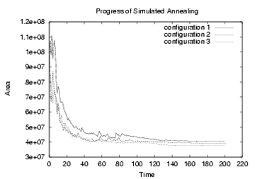
3.5.3 Simulated Annealing – Algorithm

Slide 103
3.5.3 Simulated Annealing – Algorithm
Input: initial solution init_sol
Output: optimized new solution curr_sol
T = T₀ // initialization
i = 0
curr_sol = init_sol
curr_cost = COST(curr_sol)
while (T > T_{min})
while (stopping criterion is not met)
i = i + 1
(a_{i},b_{i}) = SELECT_PAIR(curr_sol) // select two objects to perturb
trial_sol = TRY_MOVE(a_{i},b_{i}) // try small local change
trial_cost = COST(trial_sol)
Δcost = trial_cost – curr_cost
if (Δcost < 0) // if there is improvement,
curr_cost = trial_cost // update the cost and
curr_sol = MOVE(a_{i},b_{i}) // execute the move
else
r = RANDOM(0,1) // random number [0,1]
if (r < e ^{–Δcost/T}) // if it meets threshold,
curr_cost = trial_cost // update the cost and
curr_sol = MOVE(a_{i},b_{i}) // execute the move
T = α ∙ T // 0 < α < 1, T reduction
© 2011 Springer Verlag

Slide 104
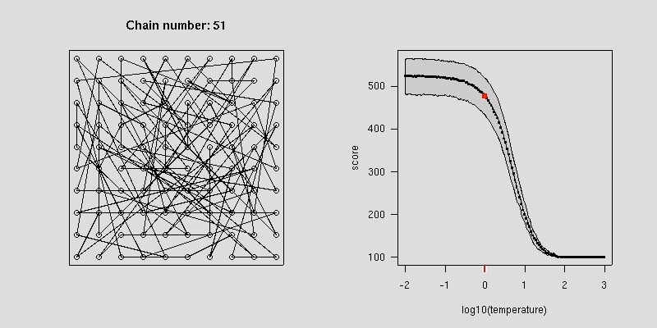
Simulated Annealing – Animation
Source: http://www.biostat.jhsph.edu/~iruczins/teaching/misc/annealing/animation.html

Slide 105
Simulated Annealing - Notes
Practical tuning needed for good results:
  How to choose the T values and how to update it?
  Should we spend more iterations with high T or low T?
    High T: More non-greedy moves accepted
    Low T: Accepts mostly greedy moves, but can get stuck
    Quality of initial solution should also be considered

Slide 106
Simulated Annealing - Notes
For floorplanning:
  Definition of move depends on the representation used
    e.g. Polish expression, sequence pair, etc.
  Cost evaluation of a move may involve:
    packing (e.g. based on horizontal/vertical constraints)
    block sizing
    wirelength estimation

