Slide 1
Image Classification and
Object Recognition
Selim Aksoy
Department of Computer Engineering
Bilkent University
saksoy@cs.bilkent.edu.tr

Slide 2
Image classification
Image (scene) classification is a fundamental problem in image understanding.
Automatic techniques for associating scenes with semantic labels have a high potential for improving the performance of other computer vision applications such as
  browsing (natural grouping of images instead of clusters based only on low-level features),
  retrieval (filtering images in archives based on content), and
  object recognition (the probability of an unknown object/region that exhibits several local features of a ship actually being a ship can be increased if the scene context is known to be a coast with high confidence but can be decreased if no water related context is dominant in that scene).

Slide 3
Image classification
The image classification problem has two critical components: representing images and learning models for semantic categories using these representations.
Early work used low-level global features extracted from the whole image or from a fixed spatial layout.
More recent approaches exploit local statistics in images using patches extracted by interest point detectors.
Other configurations that use regions and their spatial relationships are also proposed.

Slide 4
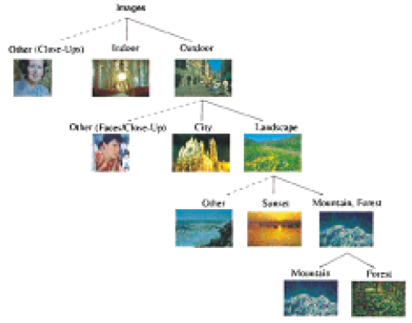
Hierarchical image classification
Images
Others (Face/close-up)
Indoor
Outdoor
Others (Face/close-up)
City
Landscape
Others
Sunset
Mountain/forest
Mountain
Forest
Hierarchy of 11 scene categories (Vailaya et al., “Image classification for content-based indexing,” IEEE Trans. Image Processing, 2001).

Slide 5
Hierarchical image classification
Image representation:
  Mean and std. dev. of LUV values in 10x10 blocks for indoor/outdoor classification.
  Edge direction histograms for city/landscape classification.
  Histograms of HSV and LUV values for sunset/mountain/forest classification.
Classification:
  Class-conditional density estimation using vector quantization.
  Bayesian classification.

Slide 6
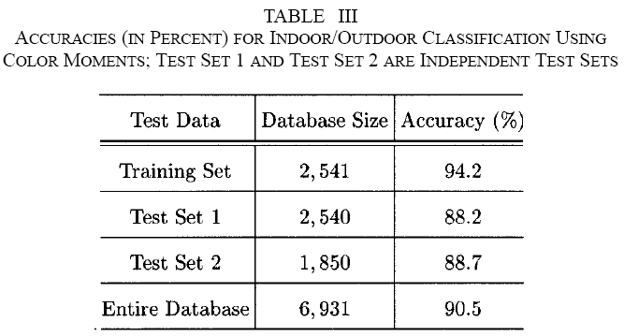
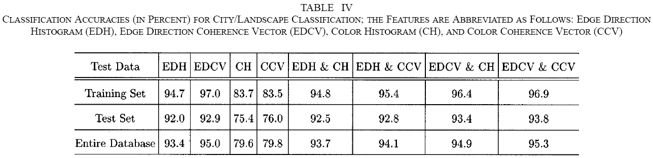
Hierarchical image classification

Slide 7
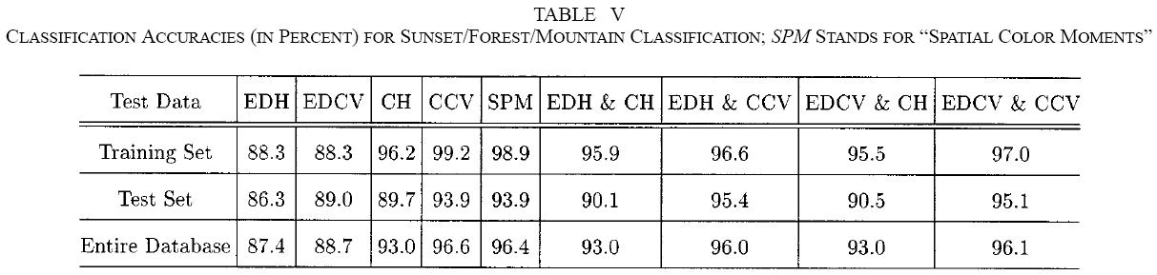
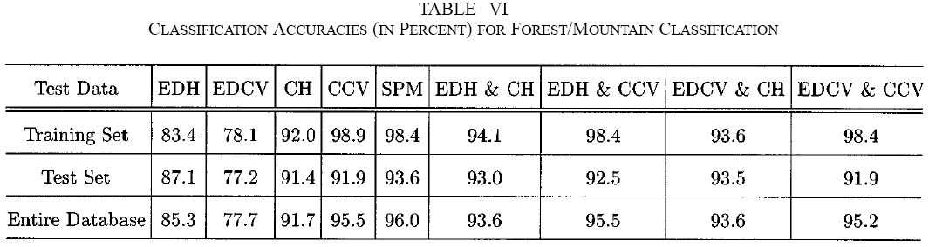
Hierarchical image classification

Slide 8
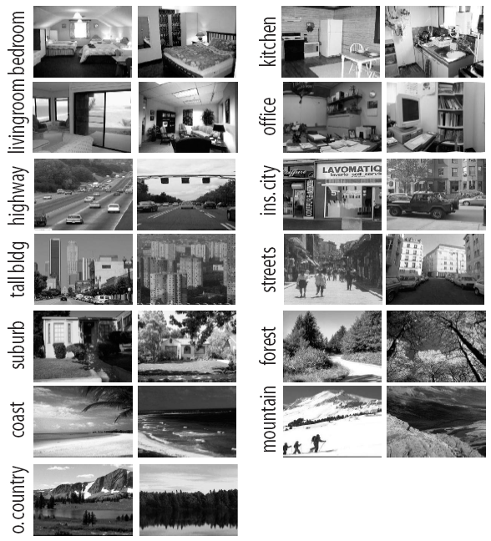
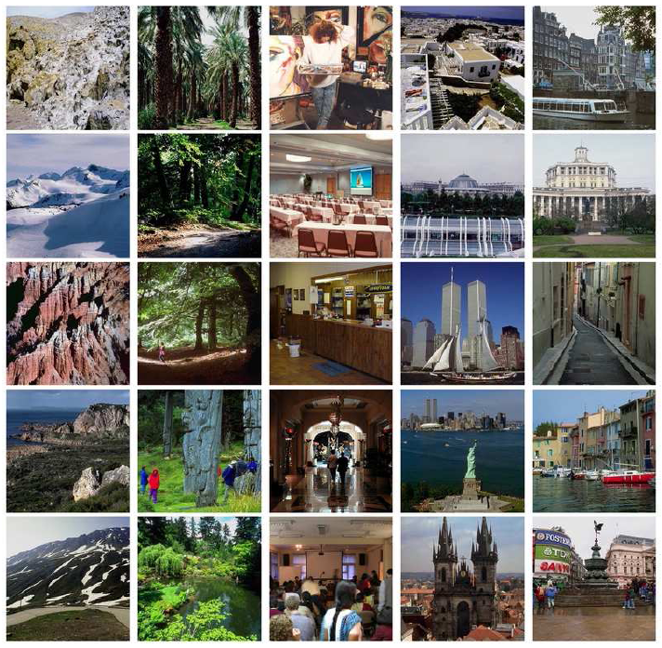
Image classification using bag-of-words
IDIAP data set (left to right): mountain, forest, indoor, city-panorama, city-street.
Caltech data set: 13 natural scene categories.

Slide 9
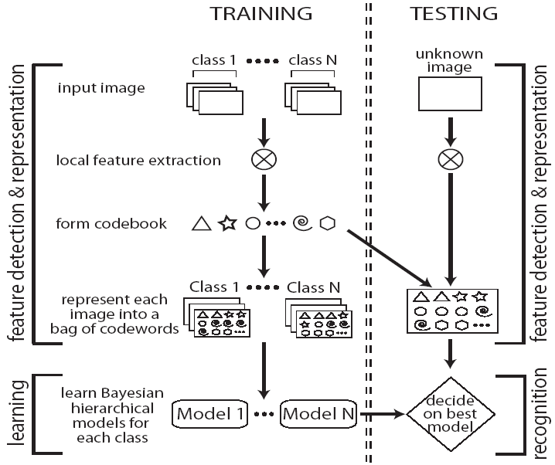
Image classification using bag-of-words
Flowchart from Fei-Fei Li, Pietro Perona, “A Bayesian hierarchical model for learning natural scene categories,” IEEE CVPR, 2005.

Slide 10

Image classification using bag-of-words
A codebook obtained from 650 training examples from 13 categories.
Image patches are detected by a sliding grid and random sampling of scales.

Slide 11
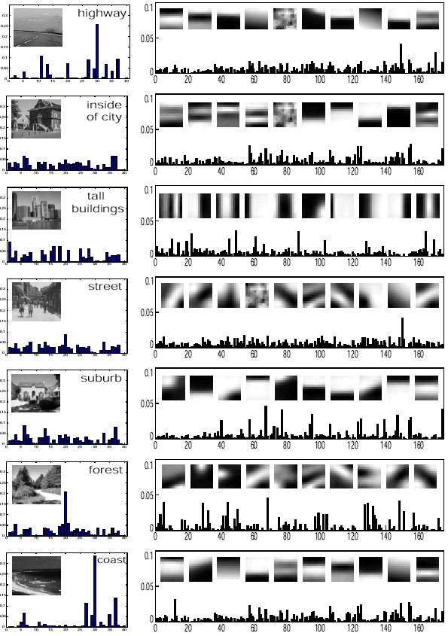
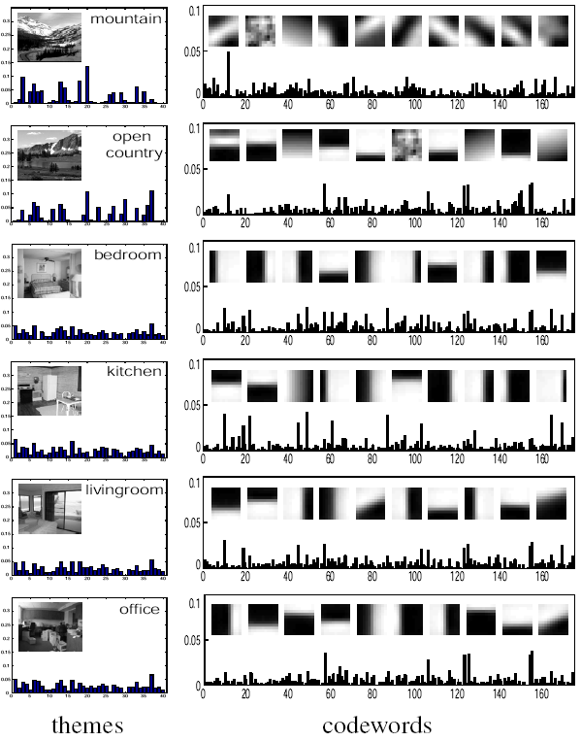
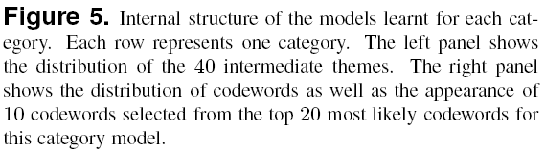

Slide 12
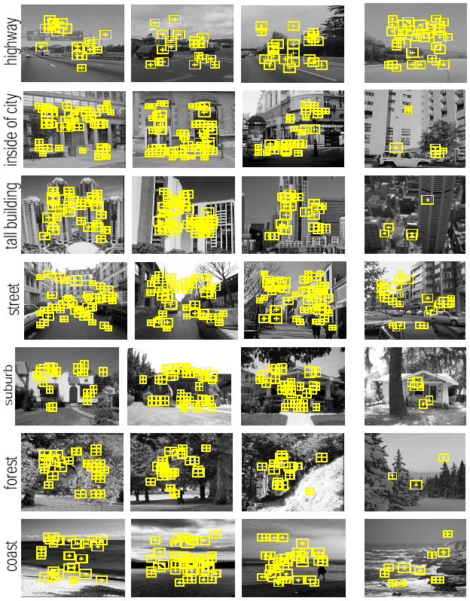
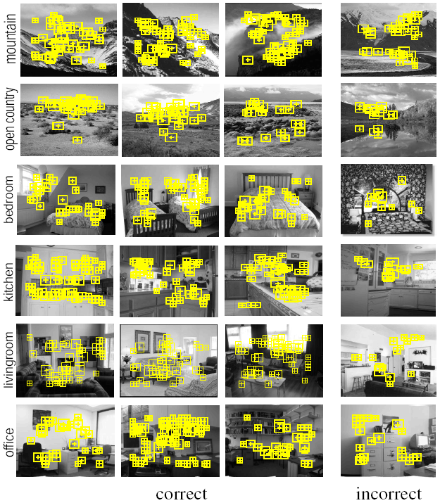
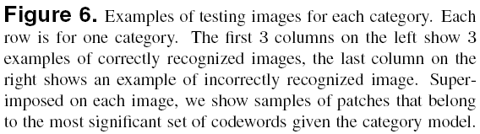

Slide 13
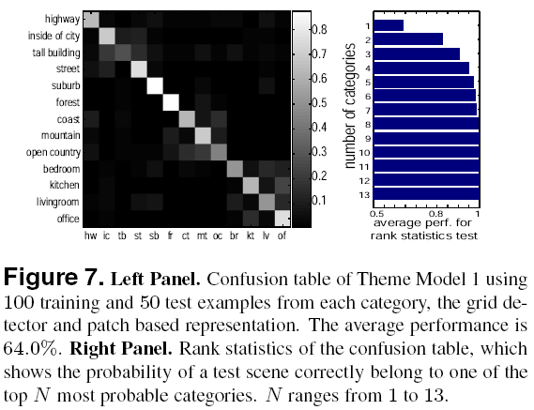
Image classification using bag-of-words

Slide 14
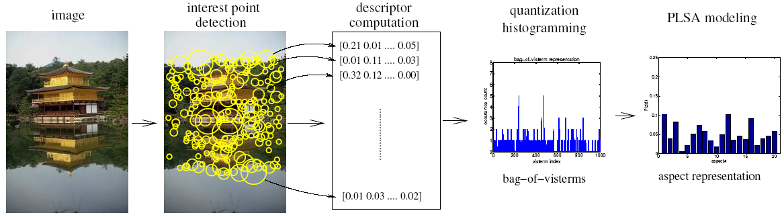
Image classification using bag-of-words
Probabilistic Latent Semantic Analysis (PLSA) is used to learn aspect models to capture co-occurrences of visterms (visual terms).
Bag-of-visterms representation or the aspect parameters are given as input to Support Vector Machines for classification.
Flowchart from Quelhas et al., “A thousand words in a scene,” IEEE Trans. PAMI, 2007.

Slide 15
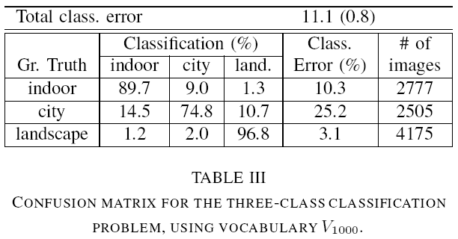
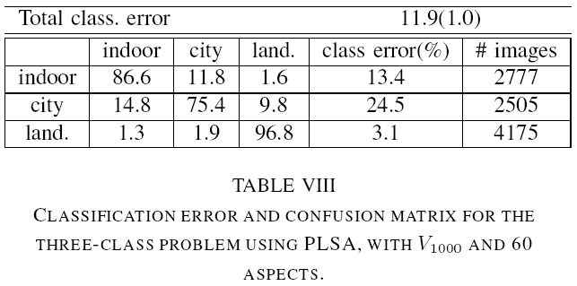
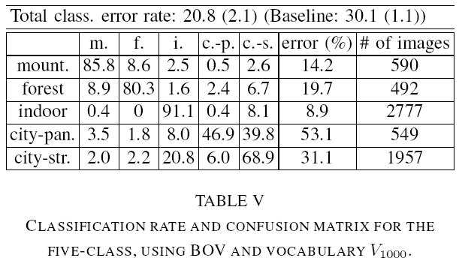
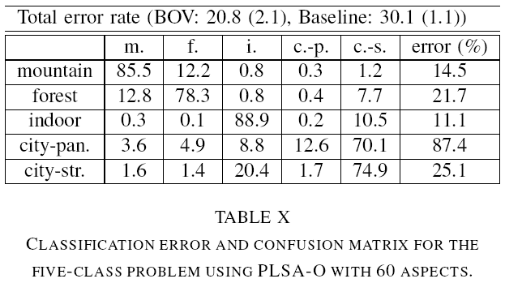
Image classification using bag-of-words

Slide 16
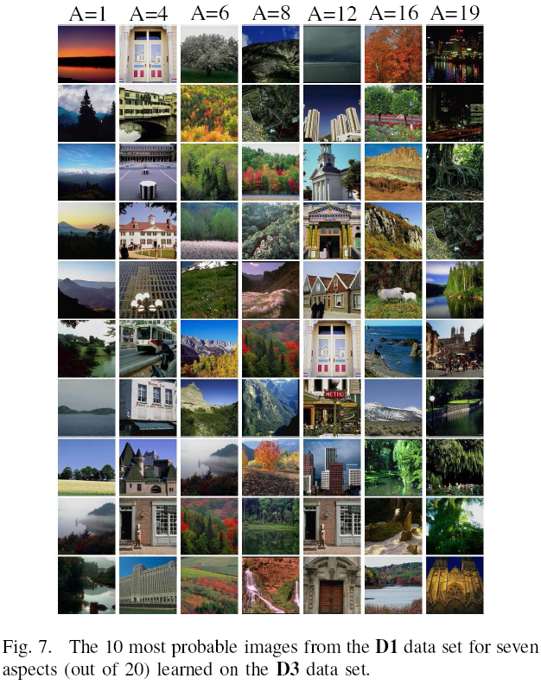

Slide 17
Image classification using bag-of-regions
D. Gökalp, S. Aksoy, “Scene classification using bag-of-regions representations,” IEEE CVPR, Beyond Patches Workshop, 2007.
  Region segmentation
  Region clustering → region codebook
  Above-below spatial relationships → region pairs
  Statistical region selection: identify region types that
    are frequently found in a particular class of scenes but rarely exist in other classes, and
    consistently occur together in the same class of scenes.
  Bayesian scene classification using
    bag of individual regions,
    bag of region pairs.

Slide 18
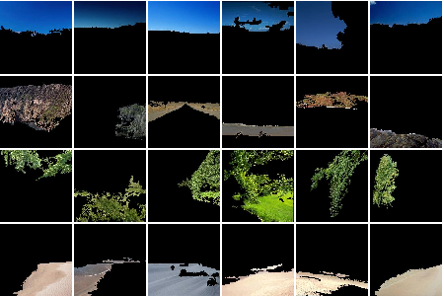
Image classification using bag-of-regions
Examples for region clusters.
Each row represents a different cluster.

Slide 19
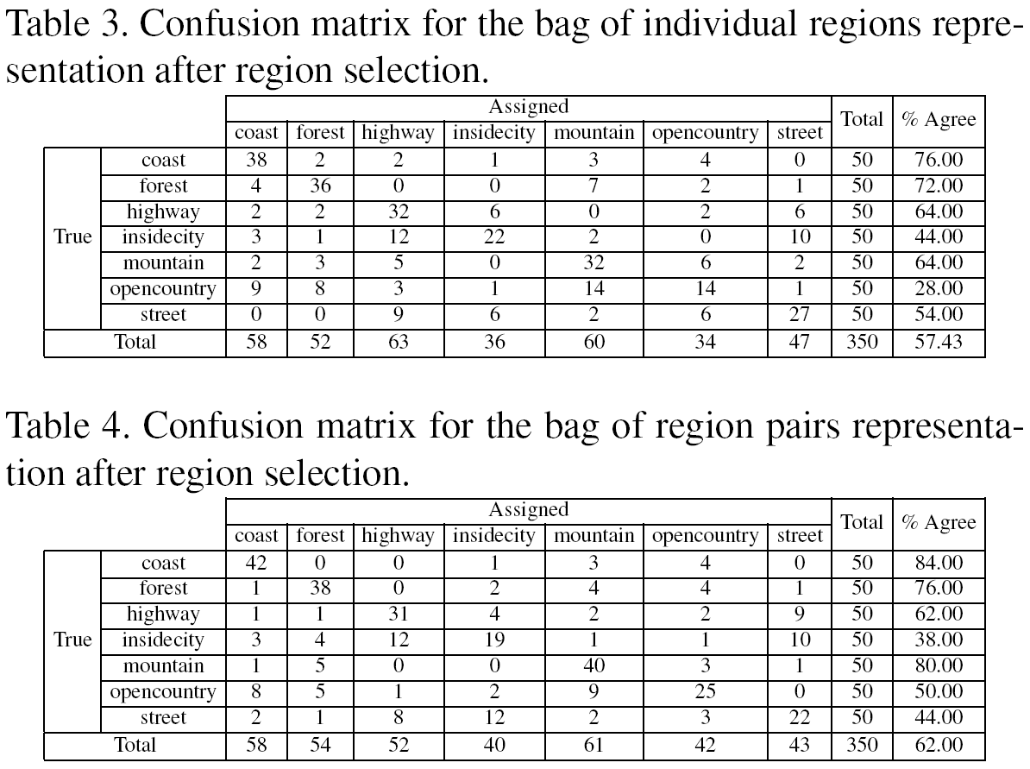
Image classification using bag-of-regions

Slide 20
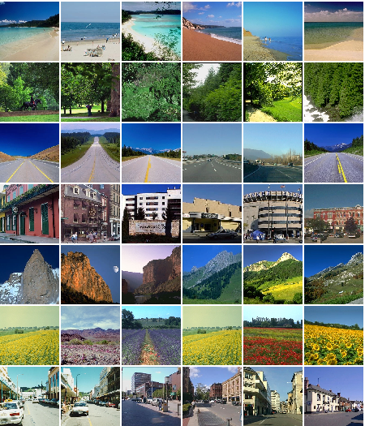
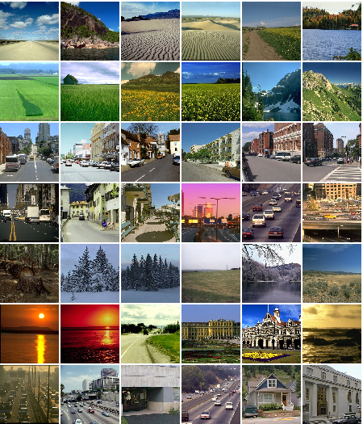
Image classification using bag-of-regions
Examples for correctly classified scenes.
Examples for wrongly classified scenes.

Slide 21
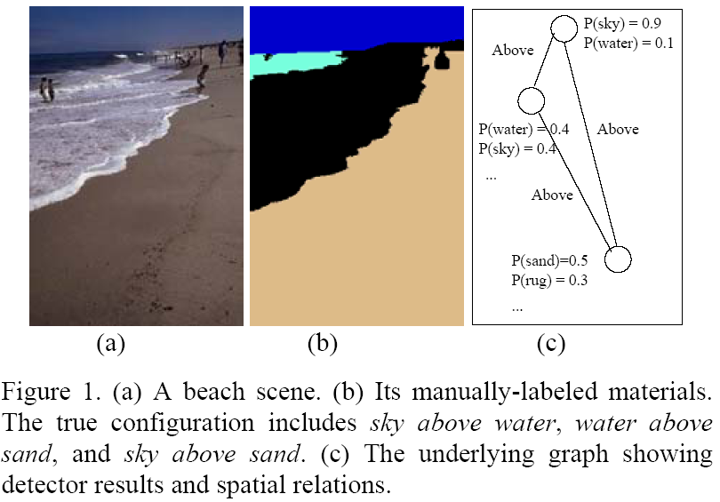
Image classification using factor graphs
Boutell et al., “Scene Parsing Using Region-Based Generative Models,” IEEE Trans. Multimedia, 2007.

Slide 22




ICCV 2009 Kyoto, Short Course, September 24
Recognizing and Learning
Object Categories: Year 2009
Li Fei-Fei, Stanford
Rob Fergus, NYU
Antonio Torralba, MIT

Slide 23

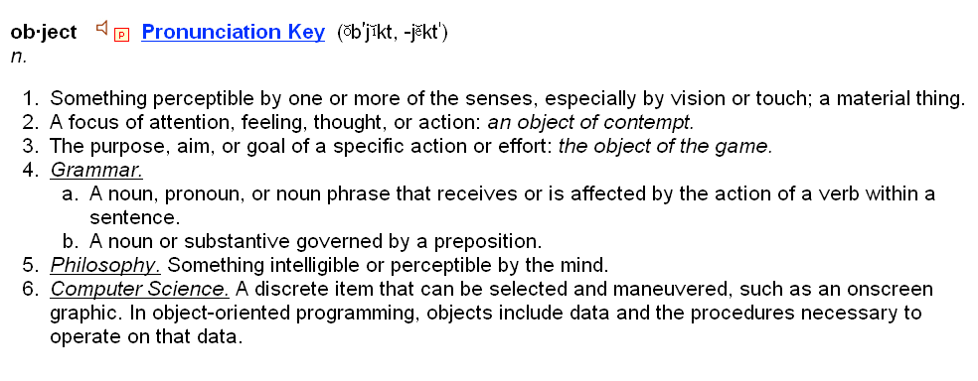

perceptible
material
thing
vision

Slide 24
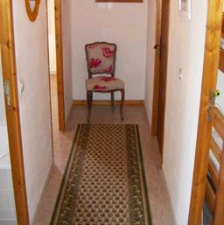

Object recognition
Is it really so hard?
Find the chair in this image
Output of normalized correlation
This is a chair

Slide 25
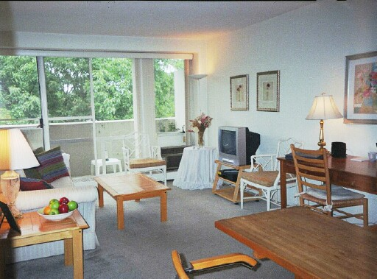

Object recognition
Is it really so hard?
Find the chair in this image
Pretty much garbage
Simple template matching is not going to make it

Slide 26
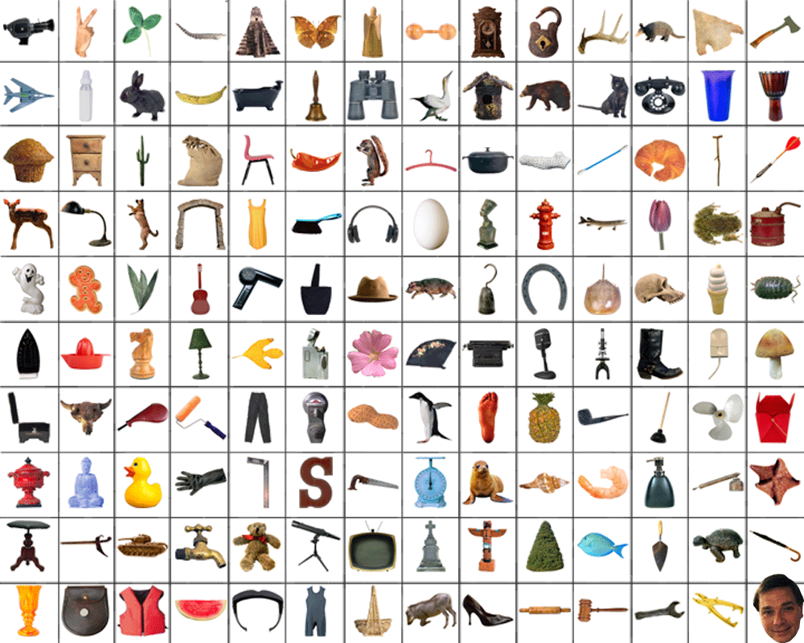
~10,000 to 30,000

Slide 27
Three main issues
Representation
  How to represent an object category
Learning
  How to form the classifier, given training data
Recognition
  How the classifier is to be used on novel data

Slide 28
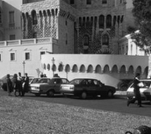
Scenes, Objects, and Parts
Scene
Objects
Parts
Features
E. Sudderth, A. Torralba, W. Freeman, A. Willsky. ICCV 2005.

Slide 29

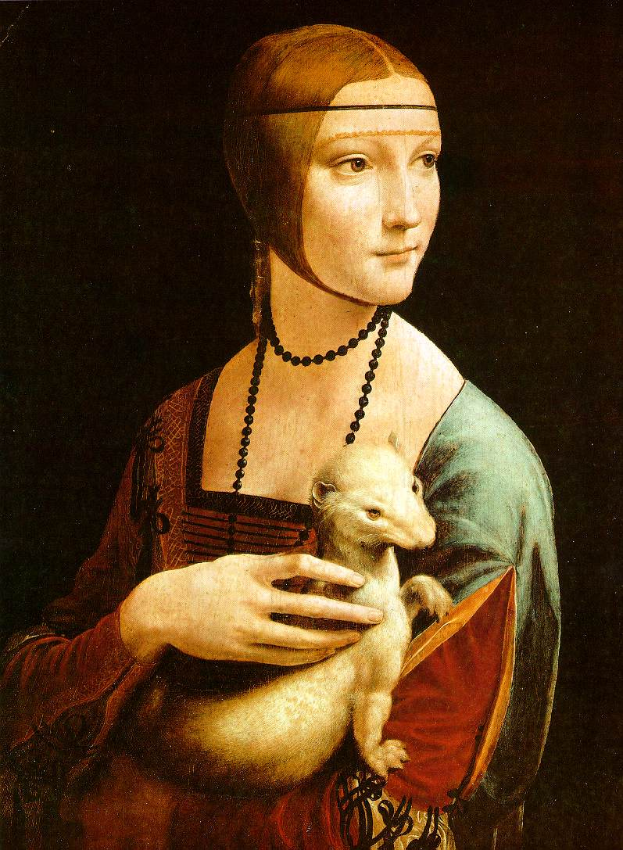
Bag of Words
Models

Slide 30
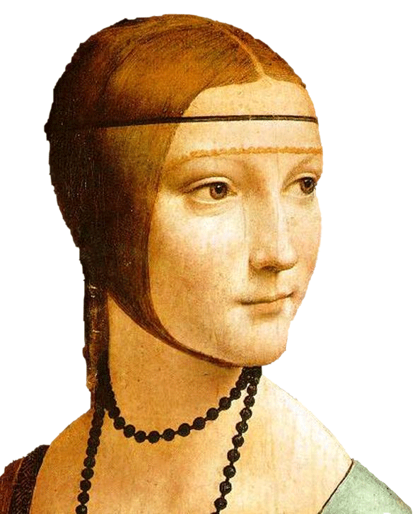
Object
Bag of ‘words’

Slide 31

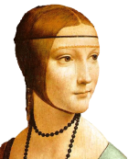
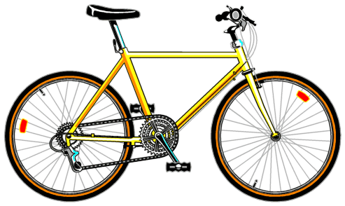
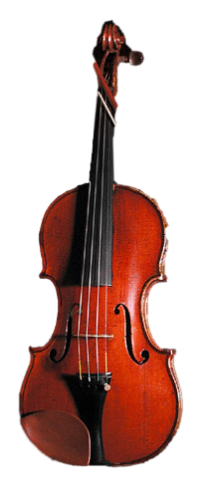
Bag of words
Independent features
Histogram representation

Slide 32




What about spatial info?
?

Slide 33
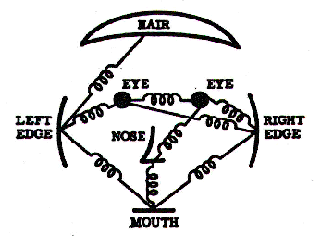
Part-based
Models

Slide 34
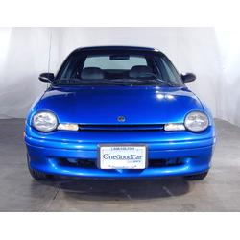
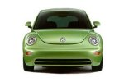
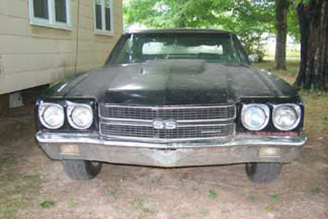
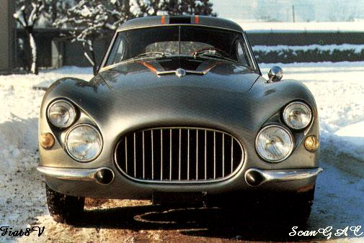
Model: Parts and Structure
Notes:
Globally different, but have portions in common

Slide 35
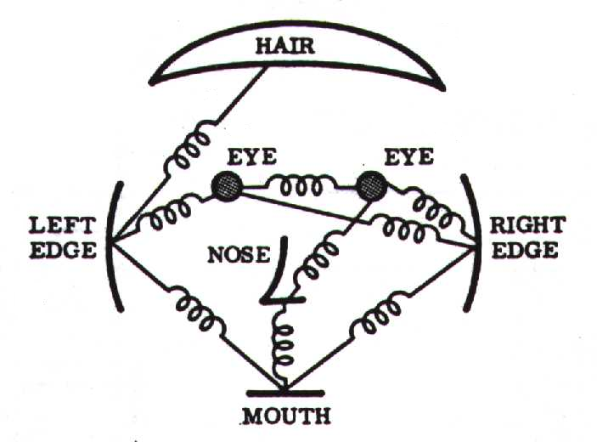
Representation
Object as set of parts
  Generative representation
Model:
  Relative locations between parts
  Appearance of part
Issues:
  How to model location
  How to represent appearance
  How to handle occlusion/clutter
Figure from [Fischler & Elschlager 73]

Slide 36
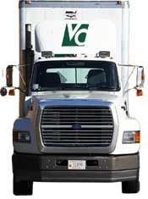
Sparse representation
  + Computationally tractable (10⁵ pixels → 10¹ -- 10² parts)
  + Generative representation of class
  + Avoid modeling global variability
  + Success in specific object recognition
  - Throw away most image information
  - Parts need to be distinctive to separate from other classes

Slide 37
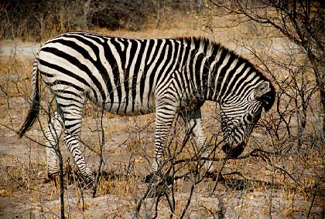
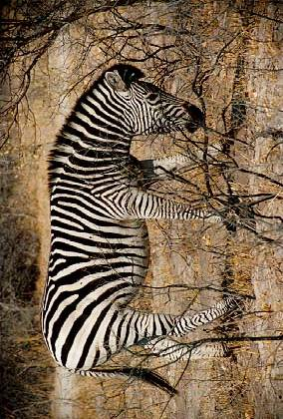
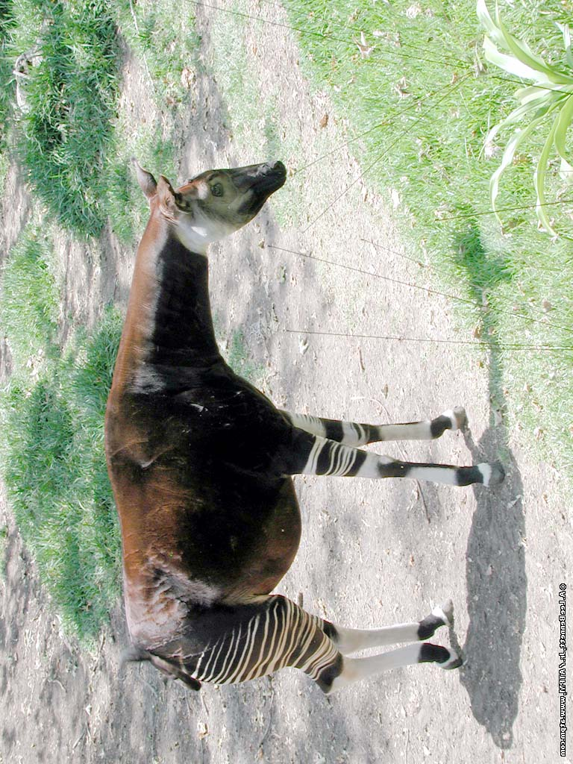
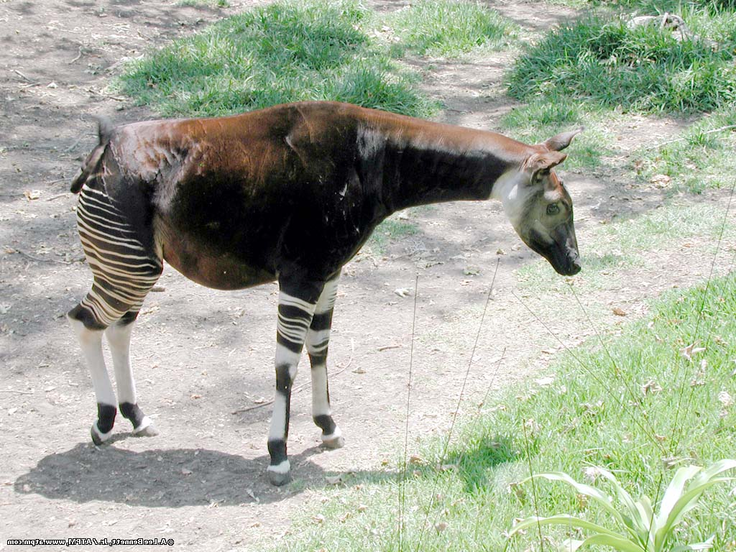
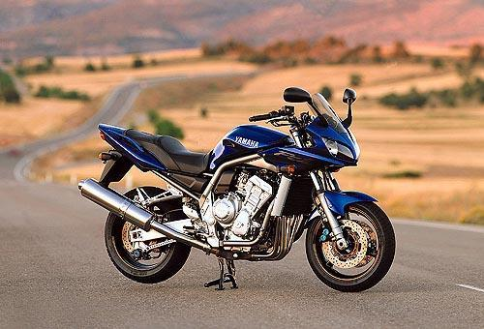








The correspondence problem
Model with P parts
Image with N possible assignments for each part
Consider mapping to be 1-1
NP combinations!!!
Notes:
Key problem with approach & motivates design choices. Assume for the moment that we have a set of regions.

Slide 38
from Sparse Flexible Models of Local Features
Gustavo Carneiro and David Lowe, ECCV 2006
Different connectivity structures
Fergus et al. ’03
Fei-Fei et al. ‘03
Crandall et al. ‘05
Fergus et al. ’05
Crandall et al. ‘05
Felzenszwalb & Huttenlocher ‘00
O(N²)
O(N⁶)
O(N²)
O(N³)
Csurka ’04
Vasconcelos ‘00
Bouchard & Triggs ‘05
Carneiro & Lowe ‘06

Slide 39
Stochastic Grammar of Images
S.C. Zhu et al. and D. Mumford

Slide 40


Context and Hierarchy in a Probabilistic Image Model
Jin & Geman (2006)
e.g. animals, trees, rocks
e.g. contours, intermediate objects
e.g. linelets, curvelets, T-junctions
e.g. discontinuities, gradient
animal head instantiated by tiger head
animal head instantiated by bear head

Slide 41
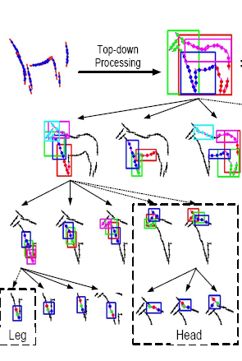
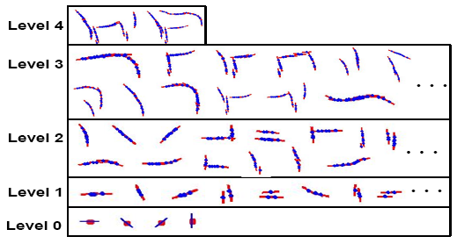
A Hierarchical Compositional System for
Rapid Object Detection
Long Zhu, Alan L. Yuille, 2007
Able to learn #parts at each level

Slide 42

Learning a Compositional Hierarchy of Object Structure
Fidler & Leonardis, CVPR’07; Fidler, Boben & Leonardis, CVPR 2008
Parts model
The architecture
Learned parts

Slide 43


Felzenszwalb, Mcallester, Ramanan, CVPR 2008
2-scale model
  Whole object
  Parts
HOG representation +
SVM training to obtain
robust part detectors
Distance
transforms allow
examination of every
location in the image

Slide 44
Shape representation in part-based models
“Star” shape model
x₁
x₆
x₂
x₅
x₃
x₄
e.g. implicit shape model
Parts mutually independent
N image features, P parts in the model

Slide 45

Implicit shape models
Visual vocabulary is used to index votes for object position [a visual word = “part”]
visual codeword with
displacement vectors
training image annotated with object localization info
B. Leibe, A. Leonardis, and B. Schiele, Combined Object Categorization and Segmentation with an Implicit Shape Model, ECCV Workshop on Statistical Learning in Computer Vision 2004

Slide 46

Implicit shape models
Visual vocabulary is used to index votes for object position [a visual word = “part”]
test image
B. Leibe, A. Leonardis, and B. Schiele, Combined Object Categorization and Segmentation with an Implicit Shape Model, ECCV Workshop on Statistical Learning in Computer Vision 2004

Slide 47
Implicit shape models: Training
Build vocabulary of patches around extracted interest points using clustering

Slide 48
Implicit shape models: Training
Build vocabulary of patches around extracted interest points using clustering
Map the patch around each interest point to closest word

Slide 49
Implicit shape models: Training
Build vocabulary of patches around extracted interest points using clustering
Map the patch around each interest point to closest word
For each word, store all positions it was found, relative to object center

Slide 50
Implicit shape models: Testing
Given new test image, extract patches, match to vocabulary words
Cast votes for possible positions of object center
Search for maxima in voting space
(Extract weighted segmentation mask based on stored masks for the codebook occurrences)
What is the dimension of the Hough space?

Slide 51

Implicit shape models: Testing

Slide 52

Example: Results on Cows
Original image
Grauman and Leibe

Slide 53

Example: Results on Cows
Interest points
Grauman and Leibe

Slide 54

Example: Results on Cows
Matched patches
Grauman and Leibe

Slide 55

Example: Results on Cows
Votes
Grauman and Leibe

Slide 56

Example: Results on Cows
1st hypothesis
Grauman and Leibe

Slide 57

Example: Results on Cows
2nd hypothesis
Grauman and Leibe

Slide 58

Example: Results on Cows
3rd hypothesis
Grauman and Leibe

Slide 59
Detection results
Qualitative Performance
  Recognizes different kinds of objects
  Robust to clutter, occlusion, noise, low contrast
Grauman and Leibe

Slide 60
Shape representation in part-based models
“Star” shape model
Fully connected constellation model
x₁
x₁
x₆
x₂
x₆
x₂
x₅
x₃
x₅
x₃
x₄
x₄
e.g. implicit shape model
Parts mutually independent
e.g. Constellation Model
Parts fully connected
N image features, P parts in the model
Slide credit: Rob Fergus

Slide 61
Probabilistic constellation model
Part
descriptors
Part
locations
h: assignment of features to parts
Candidate parts
Source: Lana Lazebnik

Slide 62
Probabilistic constellation model
h: assignment of features to parts
Part 1
Part 3
Part 2
Source: Lana Lazebnik

Slide 63
Probabilistic constellation model
h: assignment of features to parts
Part 1
Part 3
Part 2
Source: Lana Lazebnik

Slide 64
Shape representation in part-based models
“Star” shape model
Fully connected constellation model
x₁
x₁
x₆
x₂
x₆
x₂
x₅
x₃
x₅
x₃
x₄
x₄
e.g. implicit shape model
Parts mutually independent
Recognition complexity: O(NP)
Method: Gen. Hough Transform
e.g. Constellation Model
Parts fully connected
Recognition complexity: O(N^{P})
Method: Exhaustive search
N image features, P parts in the model
Slide credit: Rob Fergus

Slide 65
Parts and structure models summary
Explicit notion of correspondence between image and model
Efficient methods for large # parts and
# positions in image
With powerful part detectors, can get state-of-the-art performance
Hierarchical models allow for more parts

Slide 66

Classifier-based methods

Slide 67

























Classifier-based methods
Object detection and recognition is formulated as a classification problem.
The image is partitioned into a set of overlapping windows
… and a decision is taken at each window about if it contains a target object or not.
Decision boundary
Background
Where are the screens?
Computer screen
Bag of image patches
In some feature space

Slide 68









Discriminative vs. generative
Generative model
(The artist)
0.1
0.05
0
0
10
20
30
40
50
60
70
x = data
Discriminative model
(The lousy
painter)
1
0.5
0
0
10
20
30
40
50
60
70
x = data
Classification function
1
-1
0
10
20
30
40
50
60
70
80
x = data

Slide 69





Formulation
Formulation: binary classification
…
x₁
x₂
x₃
…
x_{N}
x_{N+1}
x_{N+2}
…
x_{N+M}
Features x =
Labels
y =
-1
+1
-1
-1
?
?
?
Training data: each image patch is labeled
as containing the object or background
Test data
Classification function
Where belongs to some family of functions
Minimize misclassification error
(Not that simple: we need some guarantees that there will be generalization)

Slide 70
Formulation
vs.
Bayes rule:
posterior ratio
likelihood ratio
prior ratio

Slide 71
Formulation
posterior ratio
likelihood ratio
prior ratio
Discriminative methods model posterior
Generative methods model likelihood and prior

Slide 72

Discriminative
Direct modeling of
Decision
boundary
Zebra
Non-zebra

Slide 73


Generative
Model and
Low | Middle
High | Middle→Low

Slide 74
Learning
Level of supervision
  Image labels
  Bounding box
  Manual segmentation
  Noisy labels
Contains a motorbike

Slide 75
Object recognition using context
The relationships between objects and the scene setting can be characterized in five ways:
  Interposition: objects interrupt their background
  Support: objects tend to rest on surfaces
  Probability: objects tend to be found in some contexts but not others
  Position: given an object is probable in a scene, it is often found in some positions and not others
  Familiar size: objects have a limited set of size relations with other objects

Slide 76

Object recognition using context
An ideal setting where the objects are perfectly segmented, the regions are classified, and the objects’ labels are refined with respect to semantic context in the image. (Rabinovich et al. “Objects in Context,” ICCV, 2007)

Slide 77

Object recognition using context
First column: segmentation results; second column: classification without contextual constraints; third column: classification with co-occurrence contextual constraints implemented using a conditional random field model. (Rabinovich et al. “Objects in Context,” ICCV, 2007)

Slide 78


Object recognition using context
better
better
Using
above
below
inside
around
relationships
as spatial constraints
better
worse
First column: input image; second column: classification with co-occurrence contextual constraints; third column: classification with spatial and co-occurrence contextual constraints. (Galleguillos et al. “Object Categorization using Co-Occurrence, Location and Appearance,” CVPR, 2008)

Slide 79

Object recognition using context
Geometric context: learn labeling of the image into geometric classes such as support/ground (green), vertical planar (green) and sky (blue). The arrows show the direction that the vertical planar surface is facing.
(Hoiem et al., “Geometric Context from a Single Image,” ICCV, 2005)

Slide 80


Object recognition using context
(a)
(b)
(c)
(d)
Putting objects in perspective: Car (a) and pedestrian (b) detection by using only local information. Car (c) and pedestrian (d) detection by using context.
(Hoiem et al. “Putting Objects in Perspective,” CVPR, 2006)

Slide 81




Object recognition using context
Contextual recognition by maximizing a scene probability function that incorporates outputs of individual object detectors (confidence values for assigned object labels) and pairwise interactions between objects (likelihood of pairwise spatial relationships). Left column: without using context; right column: with using context. (Firat Kalaycilar, “An object recognition framework using contextual interactions among objects,” M.S. Thesis, Bilkent University, 2009)

