Slide 1
Binary Image Analysis
Selim Aksoy
Department of Computer Engineering
Bilkent University
saksoy@cs.bilkent.edu.tr

Slide 2
Outline
Introduction to binary image analysis
Thresholding
Mathematical morphology
Pixels and neighborhoods
Connected components analysis

Slide 3
Binary image analysis
Binary image analysis consists of a set of operations that are used to produce or process binary images, usually images of 0’s and 1’s where
  0 represents the background,
  1 represents the foreground.
00010010001000
00011110001000
00010010001000

Slide 4

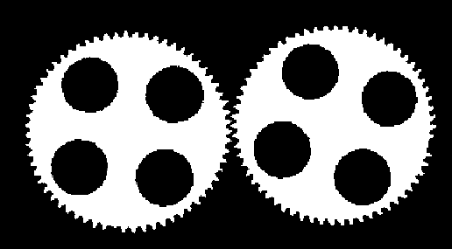
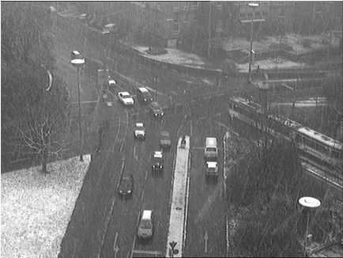
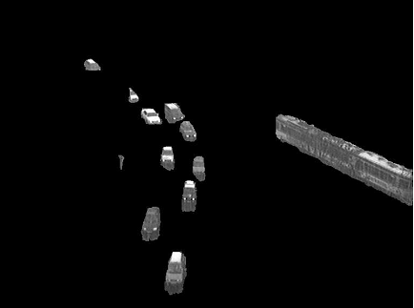
Application areas
Document analysis
Industrial inspection
Surveillance
Adapted from Shapiro and Stockman;
Cheung and Kamath

Slide 5
Operations
Separate objects from background and from one another.
Aggregate pixels for each object.
Compute features for each object.

Slide 6
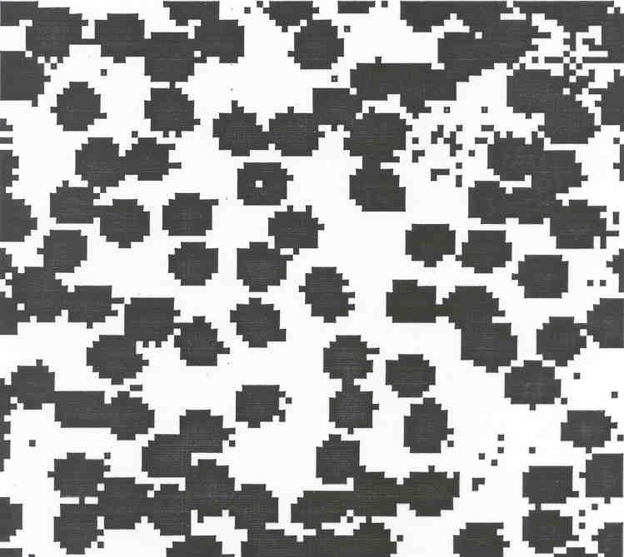
Example: red blood cell image
Many blood cells are separate objects.
Many touch each other
→ bad!
Salt and pepper noise is present.
How useful is this data?
63 separate objects are detected.
Single cells have area of about 50 pixels.
Adapted from Linda Shapiro, U of Washington

Slide 7
Thresholding
Binary images can be obtained by thresholding.
Assumptions for thresholding:
  Object region of interest has intensity distribution different from background.
  Object pixels likely to be identified by intensity alone:
    intensity > a
    intensity < b
    a < intensity < b
Works OK with flat-shaded scenes or engineered scenes.
Does not work well with natural scenes.

Slide 8
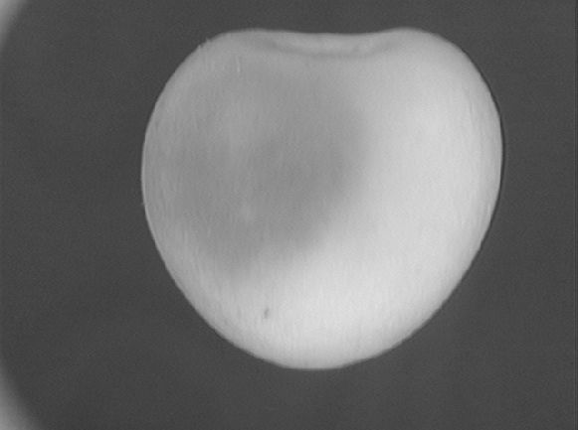
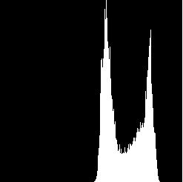
Use of histograms for thresholding
Background is black.
Healthy cherry is bright.
Bruise is medium dark.
Histogram shows two cherry regions (black background has been removed).
Adapted from Shapiro and Stockman

Slide 9
Automatic thresholding
How can we use a histogram to separate an image into 2 (or several) different regions?
Is there a single clear threshold? 2? 3?
Adapted from Shapiro and Stockman

Slide 10
Automatic thresholding: Otsu’s method
Assumption: the histogram is bimodal.
Method: find the threshold t that minimizes the weighted sum of within-group variances for the two groups that result from separating the gray levels at value t.
The best threshold t can be
determined by a simple
sequential search through
all possible values of t.
If the gray levels are strongly dependent on the location within the image, local or dynamic thresholds can also be used.
Group 1 Group 2
t

Slide 11
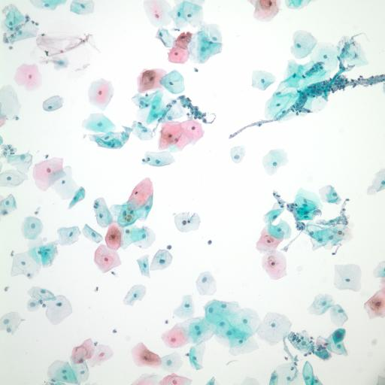
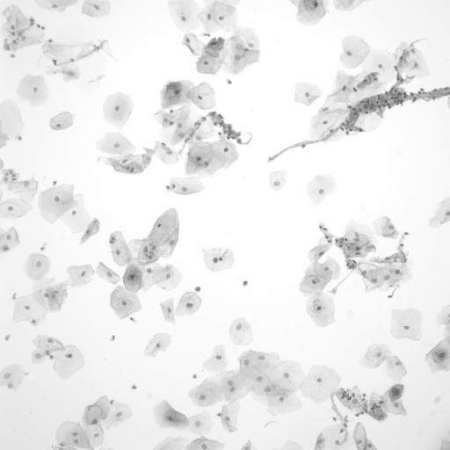
Automatic thresholding
A Pap smear image example: RGB image (left) and grayscale image (right).

Slide 12
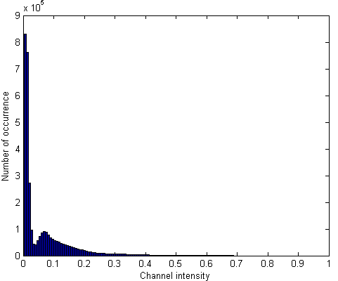
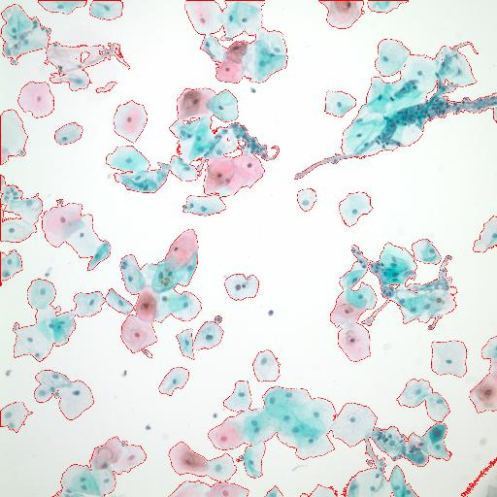
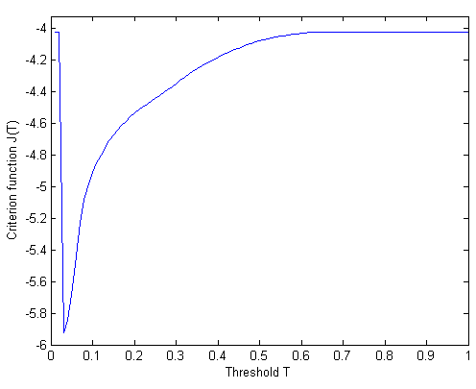
Automatic thresholding
Histogram of the negative image (top-left), sum of within-group variances versus the threshold (bottom-left), resulting mask overlayed as red on the original image (top).

Slide 13
Mathematical morphology
The word morphology refers to form and structure.
In computer vision, it is used to refer to the shape of a region.
The language of mathematical morphology is set theory where sets represent objects in an image.
We will discuss morphological operations on binary images whose components are sets in the 2D integer space Z².

Slide 14
Mathematical morphology
Mathematical morphology consists of two basic operations
  dilation
  erosion
and several composite relations
  opening
  closing
  conditional dilation
  …

Slide 15
Dilation
Dilation expands the connected sets of 1s of a binary image.
It can be used for
  growing features
  filling holes and gaps
Adapted from Linda Shapiro, U of Washington

Slide 16
Erosion
Erosion shrinks the connected sets of 1s of a binary image.
It can be used for
  shrinking features
  removing bridges, branches and small protrusions
Adapted from Linda Shapiro, U of Washington

Slide 17
Basic concepts from set theory

Slide 18
Basic concepts from set theory
Adapted from Gonzales and Woods

Slide 19
Structuring elements
Structuring elements are small binary images used as shape masks in basic morphological operations.
They can be any shape and size that is digitally representable.
One pixel of the structuring element is denoted as its origin.
Origin is often the central pixel of a symmetric structuring element but may in principle be any chosen pixel.

Slide 20
Structuring elements
Adapted from Gonzales and Woods

Slide 21
Dilation

Slide 22
Dilation
1 | 1 | 1 | 1 | 1 | 1 | 1
 |  |  | 1 | 1 | 1 | 1
 |  |  | 1 | 1 | 1 | 1
 |  | 1 | 1 | 1 | 1 | 1
 |  |  | 1 | 1 | 1 | 1
 |  | 1 | 1
1
1
1
1
1
1
1
1
1
1
1
1
1
1
1
1
1
1
1
1
1
1
1
1
0
1
1
1
1
1
1
1
0
1
1
1
1
1
1
1
0
1
1
1
1
1
1
1
0
1
1
1
1
1
1
1
1 | 1 | 1
1 | 1 | 1
1 | 1 | 1
0
1
1
1
1
0
0
0
Binary image A
Dilation result
Structuring element B
(1st definition)

Slide 23
Dilation
1 | 1 | 1 | 1 | 1 | 1 | 1
 |  |  | 1 | 1 | 1 | 1
 |  |  | 1 | 1 | 1 | 1
 |  | 1 | 1 | 1 | 1 | 1
 |  |  | 1 | 1 | 1 | 1
 |  | 1 | 1
1
1
1
1
1
1
1
1
1
1
1
1
1
1
1
1
1
1
1
1
1
1
1
1
1
1
1
1
1
1
1
1
1
1
1
1
1
1
1
1
1
1
1
1
1
1
1
1
1
1
1
1
1 | 1 | 1
1 | 1 | 1
1 | 1 | 1
1
1
1
1
Binary image A
Dilation result
Structuring element B
(2nd definition)

Slide 24

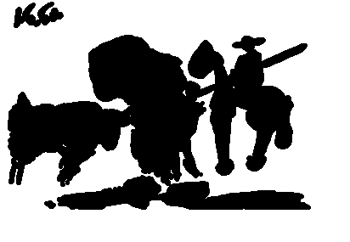


Dilation
Structuring
Element
Pablo Picasso, Pass with the Cape, 1960
Adapted from John Goutsias, Johns Hopkins Univ.

Slide 25
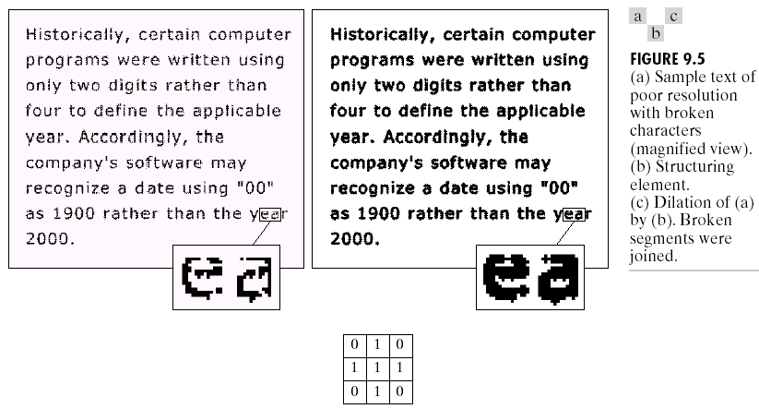
Dilation
Adapted from Gonzales and Woods

Slide 26
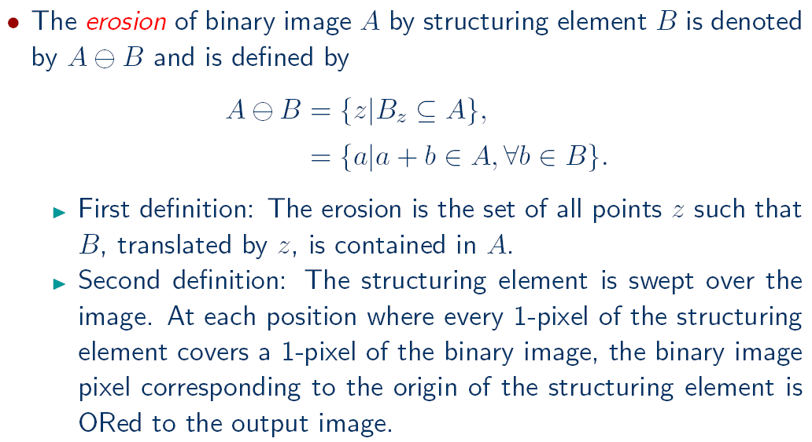
Erosion

Slide 27
Erosion
1 | 1 | 1 | 1 | 1 | 1 | 1
 |  |  | 1 | 1 | 1 | 1
 |  |  | 1 | 1 | 1 | 1
 |  | 1 | 1 | 1 | 1 | 1
 |  |  | 1 | 1 | 1 | 1
 |  | 1 | 1
0
0
0
0
0
0
0
0
0
0
0
0
0
0
0
0
0
0
0
0
1
1
0
0
0
0
0
0
1
1
0
0
0
0
0
0
1
1
0
0
0
0
0
0
0
0
0
0
0
0
0
0
0
0
0
0
1 | 1 | 1
1 | 1 | 1
1 | 1 | 1
0
0
0
0
0
0
0
0
Binary image A
Erosion result
Structuring element B
(1st definition)

Slide 28
Erosion
1 | 1 | 1 | 1 | 1 | 1 | 1
 |  |  | 1 | 1 | 1 | 1
 |  |  | 1 | 1 | 1 | 1
 |  | 1 | 1 | 1 | 1 | 1
 |  |  | 1 | 1 | 1 | 1
 |  | 1 | 1
1
1
1
1
1
1
1 | 1 | 1
1 | 1 | 1
1 | 1 | 1
Binary image A
Erosion result
Structuring element B
(2nd definition)

Slide 29


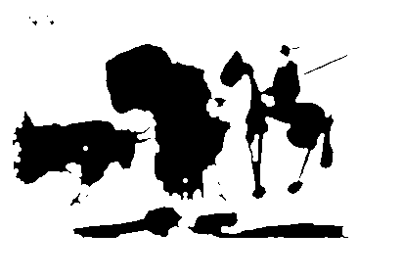
Erosion
Structuring
Element
Pablo Picasso, Pass with the Cape, 1960
Adapted from John Goutsias, Johns Hopkins Univ.

Slide 30
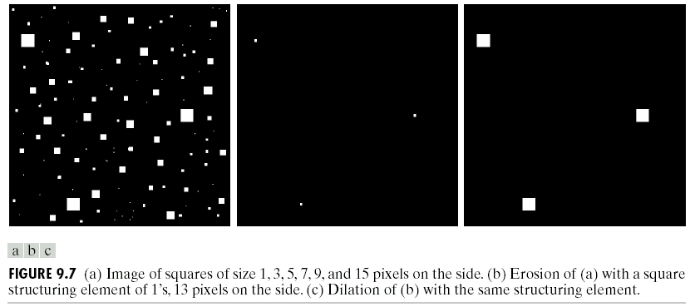
Erosion
Adapted from Gonzales and Woods

Slide 31
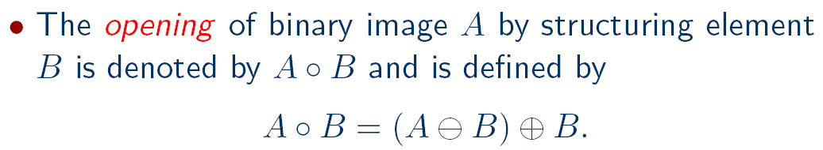
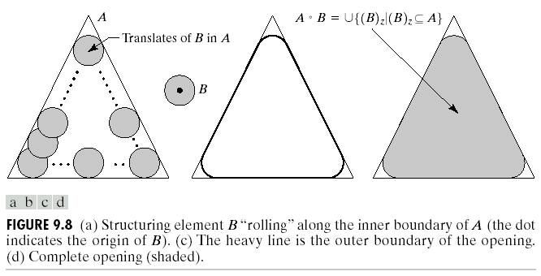
Opening

Slide 32
Opening
1 | 1 | 1 | 1 | 1 | 1 | 1
 |  |  | 1 | 1 | 1 | 1
 |  |  | 1 | 1 | 1 | 1
 |  | 1 | 1 | 1 | 1 | 1
 |  |  | 1 | 1 | 1 | 1
 |  | 1 | 1
1
1
1
1
1
1
1
1
1
1
1
1
1
1
1
1
1
1
1
1
1 | 1 | 1
1 | 1 | 1
1 | 1 | 1
Binary image A
Opening result
Structuring element B

Slide 33



Opening
Structuring
Element
Pablo Picasso, Pass with the Cape, 1960
Adapted from John Goutsias, Johns Hopkins Univ.

Slide 34
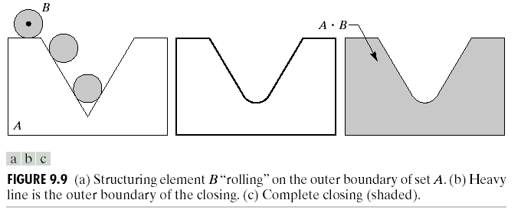
Closing

Slide 35
Closing
1 | 1 | 1 | 1 | 1 | 1 | 1
 |  |  | 1 | 1 | 1 | 1
 |  |  | 1 | 1 | 1 | 1
 |  | 1 | 1 | 1 | 1 | 1
 |  |  | 1 | 1 | 1 | 1
 |  | 1 | 1
1
1
1
1
1
1
1
1
1
1
1
1
1
1
1
1
1
1
1
1
1
1
1
1
1
1
1
1
1
1 | 1 | 1
1 | 1 | 1
1 | 1 | 1
Binary image A
Closing result
Structuring element B

Slide 36
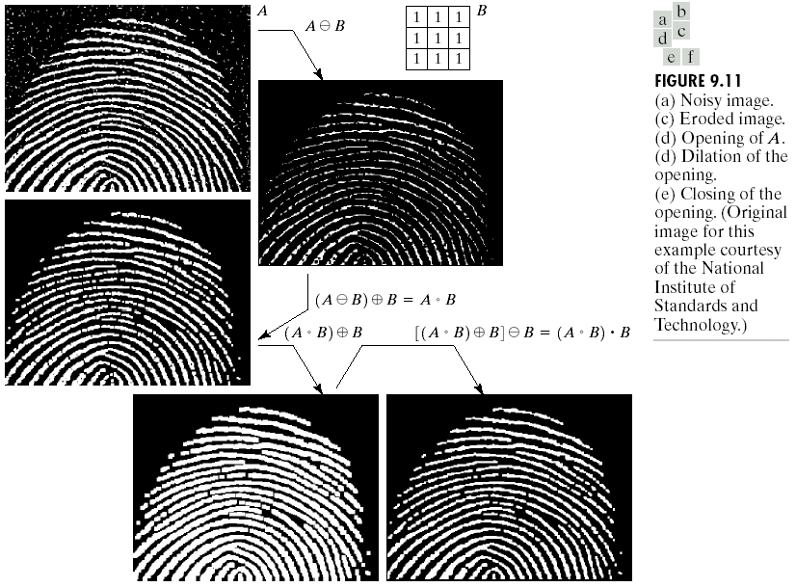
Examples
Adapted from Gonzales and Woods

Slide 37
Properties

Slide 38
Properties

Slide 39
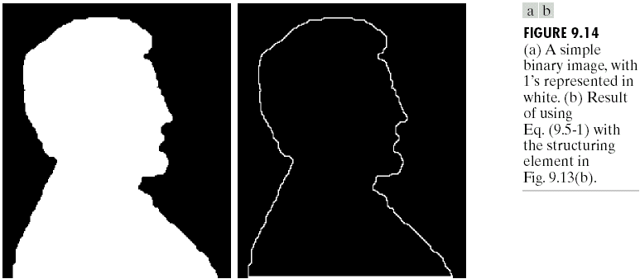
Boundary extraction

Slide 40
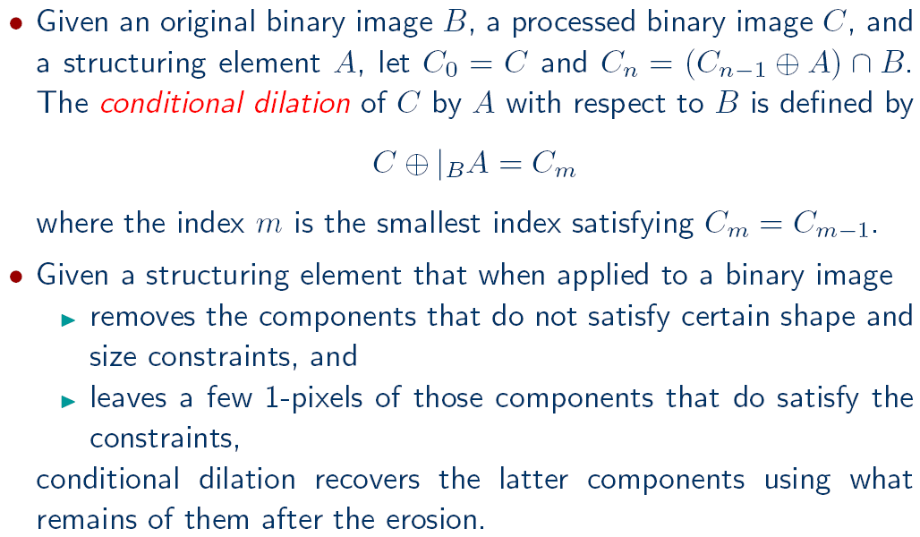
Conditional dilation

Slide 41
Region filling

Slide 42
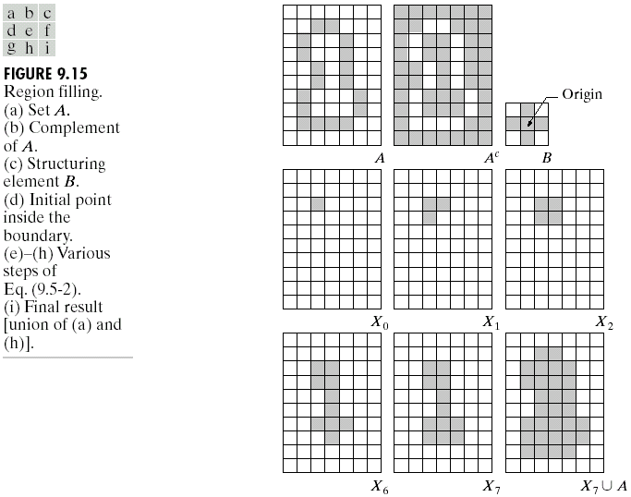
Region filling
Adapted from Gonzales and Woods

Slide 43
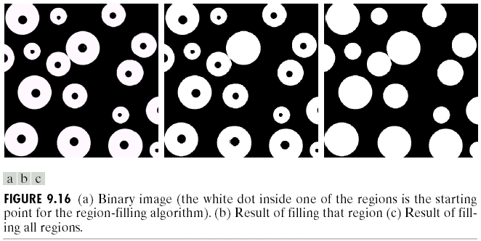
Region filling
Adapted from Gonzales and Woods

Slide 44
Hit-or-miss transform

Slide 45
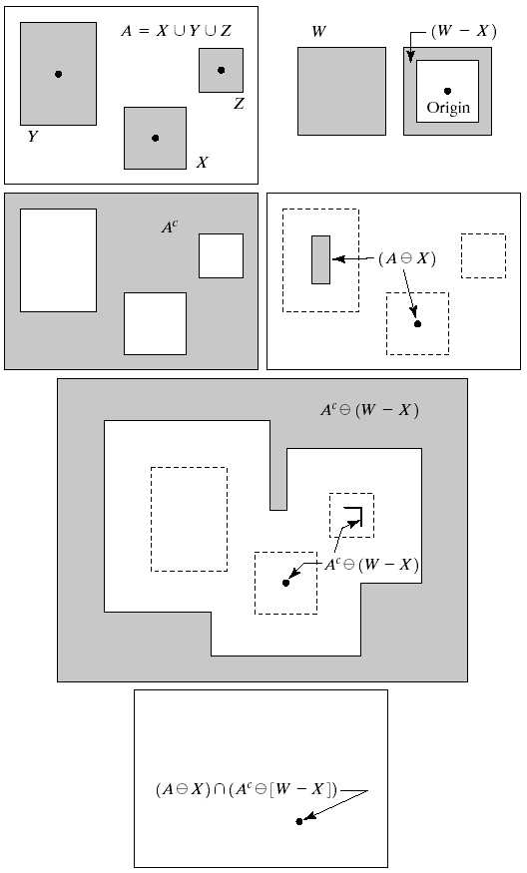
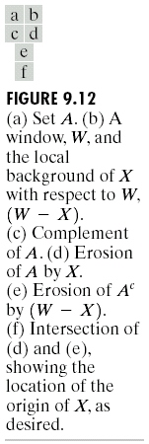
Hit-or-miss transform
Adapted from Gonzales and Woods

Slide 46
Thinning

Slide 47
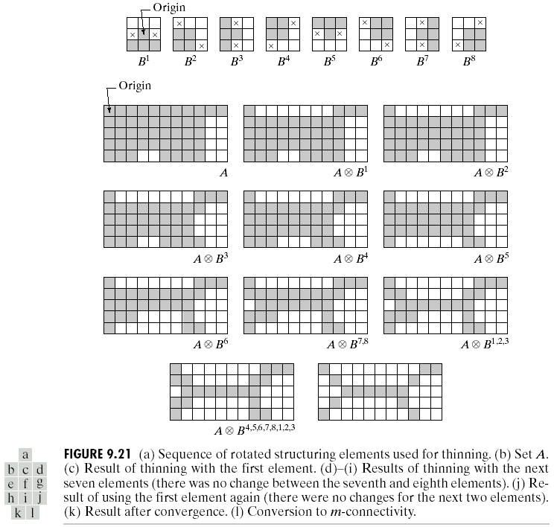
Thinning

Slide 48
Thickening

Slide 49
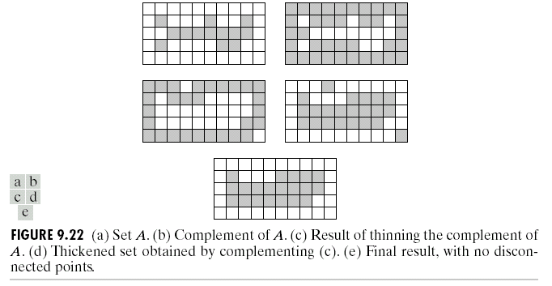
Thickening
Adapted from Gonzales and Woods

Slide 50
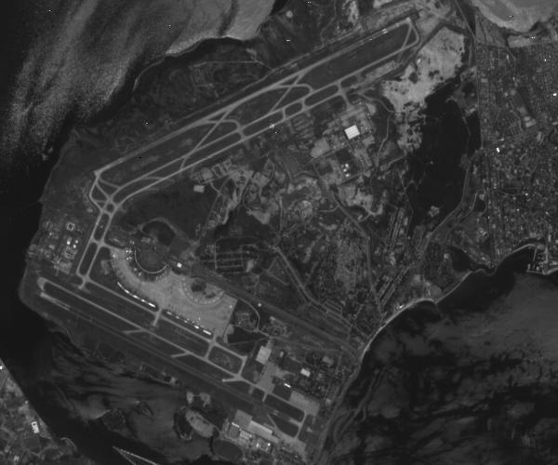
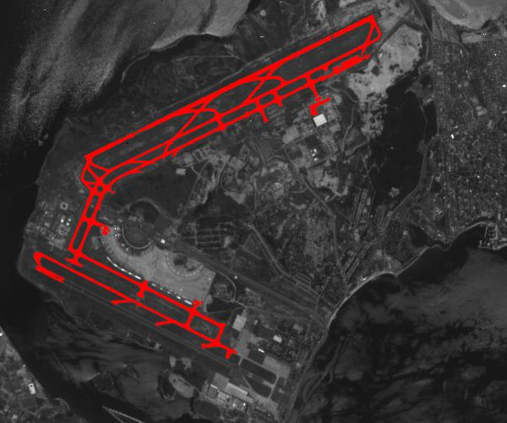
Examples
Detecting runways in satellite airport imagery
http://www.mmorph.com/mxmorph/html/mmdemos/mmdairport.html

Slide 51
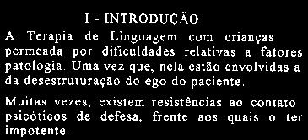
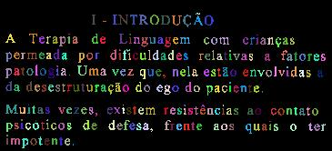
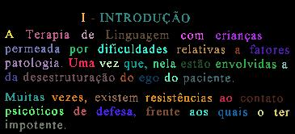
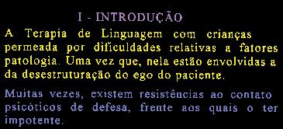
Examples
Segmenting letters, words and paragraphs
http://www.mmorph.com/mxmorph/html/mmdemos/mmdlabeltext.html

Slide 52
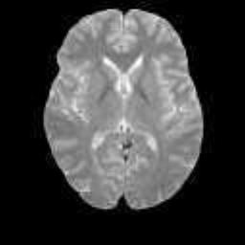
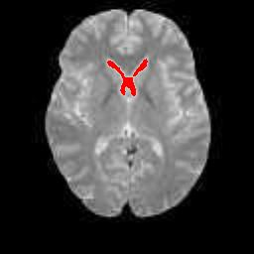
Examples
Extracting the lateral ventricle from an MRI image of the brain
http://www.mmorph.com/mxmorph/html/mmdemos/mmdbrain.html

Slide 53
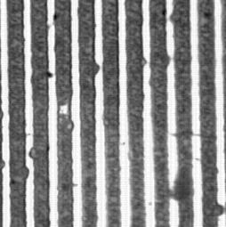
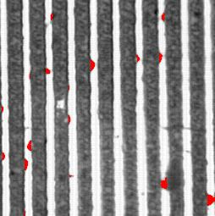
Examples
Detecting defects in a microelectronic circuit
http://www.mmorph.com/mxmorph/html/mmdemos/mmdlith.html

Slide 54
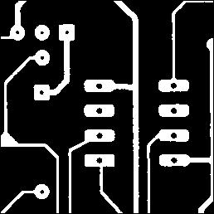
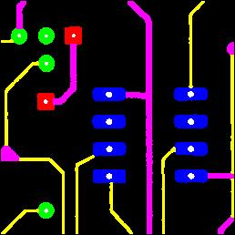
Examples
Decomposing a printed circuit board in its main parts
http://www.mmorph.com/mxmorph/html/mmdemos/mmdpcb.html

Slide 55
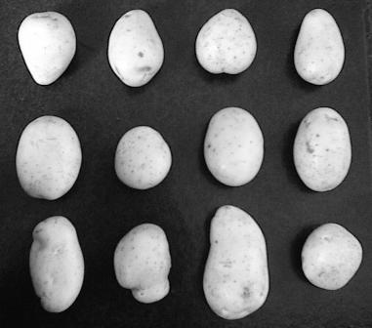
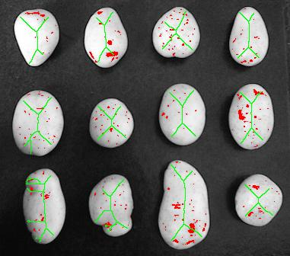
Examples
Grading potato quality by shape and skin spots
http://www.mmorph.com/mxmorph/html/mmdemos/mmdpotatoes.html

Slide 56
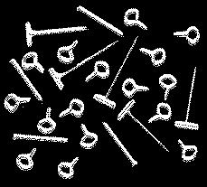
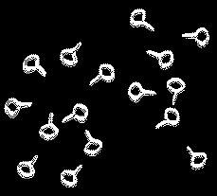
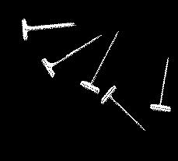

Examples
Classifying two dimensional pieces
http://www.mmorph.com/mxmorph/html/mmdemos/mmdpieces.html

Slide 57
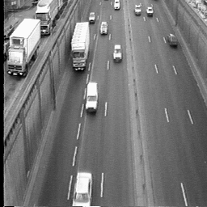
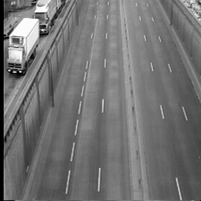
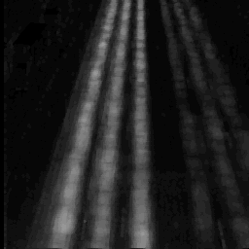
Examples
Traffic scene
Temporal average
Average of differences
Lane detection example
Adapted from CMM/ENSMP/ARMINES

Slide 58
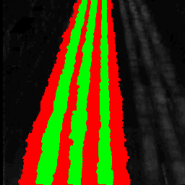
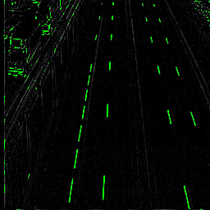

Examples
Threshold and dilation to detect lane markers
White line detection
(top hat)
Detected lanes
Lane detection example
Adapted from CMM/ENSMP/ARMINES

Slide 59

Pixels and neighborhoods
In many algorithms, not only the value of a particular pixel, but also the values of its neighbors are used when processing that pixel.
The two most common definitions for neighbors are the 4-neighbors and the 8-neighbors of a pixel.

Slide 60




Connected components analysis
Once you have a binary image, you can identify and then analyze each connected set of pixels.
The connected components operation takes in a binary image and produces a labeled image in which each pixel has the integer label of either the background (0) or a component.
Original image Thresholded image After morphology Connected components

Slide 61
Connected components analysis
Methods for connected components analysis:
  Recursive tracking (almost never used)
  Parallel growing (needs parallel hardware)
  Row-by-row (most common)
    Classical algorithm
    Run-length algorithm
    (see Shapiro-Stockman)
Adapted from Shapiro and Stockman

Slide 62
Connected components analysis
Recursive labeling algorithm:
  Negate the binary image so that all 1s become -1s.
  Find a pixel whose value is -1, assign it a new label, call procedure search to find its neighbors that have values -1, and recursively repeat the process for these neighbors.

Slide 63
Adapted from Shapiro and Stockman

Slide 64
Connected components analysis
Row-by-row labeling algorithm:
  The first pass propagates a pixel’s label to its neighbors to the right and below it.
  (Whenever two different labels can propagate to the same pixel, these labels are recorded as an equivalence class.)
  The second pass performs a translation, assigning to each pixel the label of its equivalence class.
A union-find data structure is used for efficient construction and manipulation of equivalence classes represented by tree structures.

Slide 65
Connected components analysis
Adapted from Shapiro and Stockman

Slide 66
Connected components analysis
Adapted from Shapiro and Stockman

Slide 67

Connected components analysis
Adapted from Shapiro and Stockman

Slide 69




Connected components analysis

Slide 70



Connected components analysis

