Slide 1
Representation and
Description
Selim Aksoy
Department of Computer Engineering
Bilkent University
saksoy@cs.bilkent.edu.tr

Slide 2
Representation and description
Images and segmented regions must be represented and described in a form suitable for further processing.
The representations and the corresponding descriptions are selected according to the computational and semantic requirements of the image analysis task.
We will study:
  Region representations and descriptors.
  Image representations and descriptors.

Slide 3
Region representations
Representing a region involves two choices:
  External characteristics (boundary).
  Internal characteristics (pixels comprising the region).
An external representation is chosen when the primary focus is on shape characteristics.
An internal representation is selected when the primary focus is on regional properties, such as color and texture.

Slide 4
Labeled images and overlays
Labeled images are good intermediate representations for regions.
The idea is to assign each detected region a unique identifier (an integer) and create an image where all pixels of a region will have its unique identifier as their pixel value.
A labeled image can be used as a kind of mask to identify pixels of a region.
Region boundaries can be computed from the labeled image and can be overlaid on top of the original image.

Slide 5
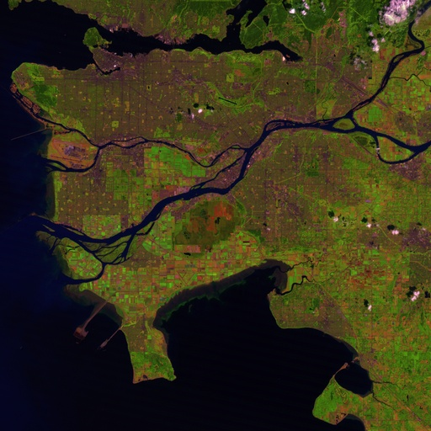
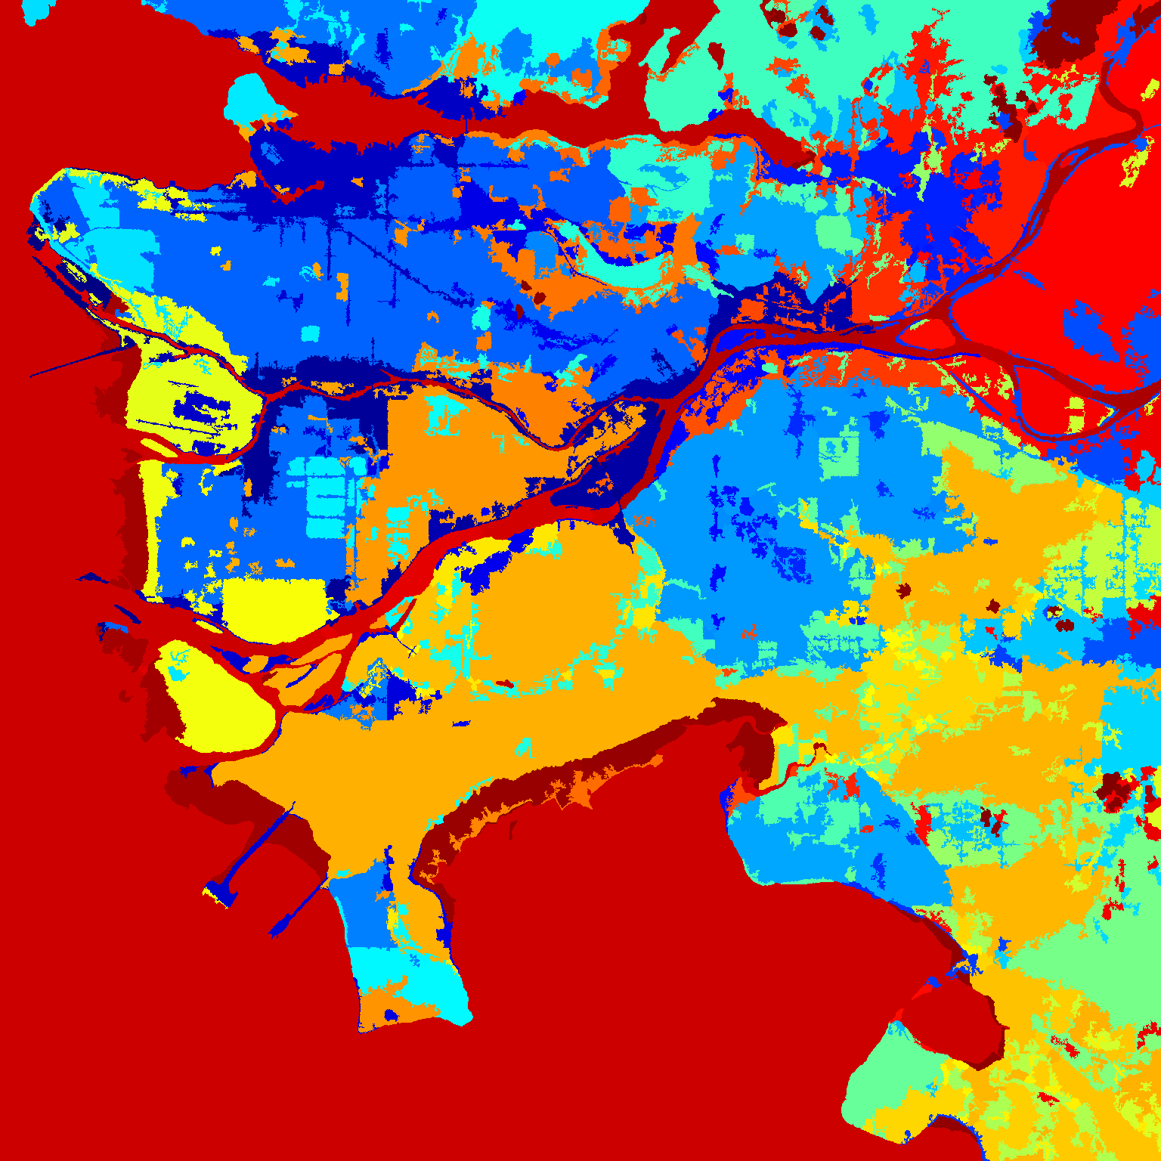
Labeled images and overlays
A satellite image and the corresponding labeled image after segmentation
(displayed in pseudo-color).

Slide 6
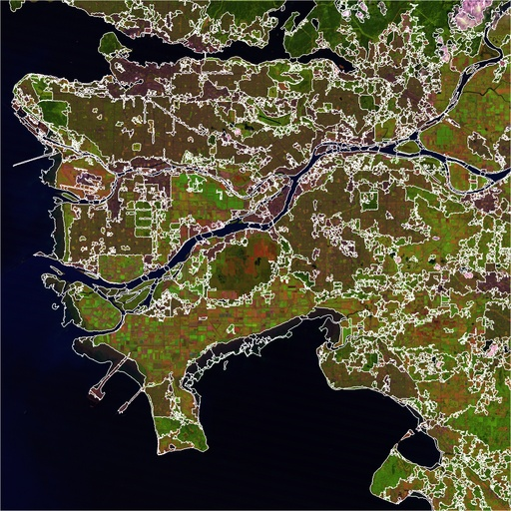
Labeled images and overlays
A satellite image and the corresponding segmentation overlay.

Slide 7
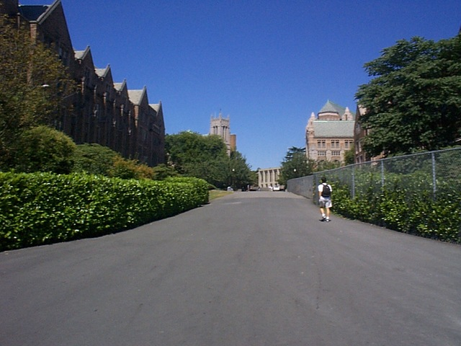
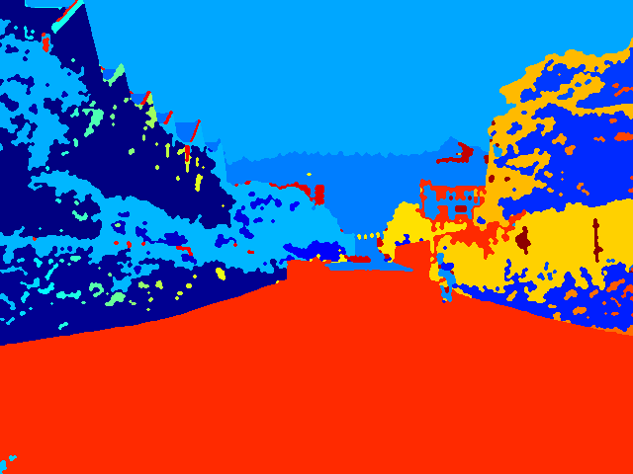
Labeled images and overlays
An image and the corresponding labeled image after segmentation
(displayed in pseudo-color).

Slide 8
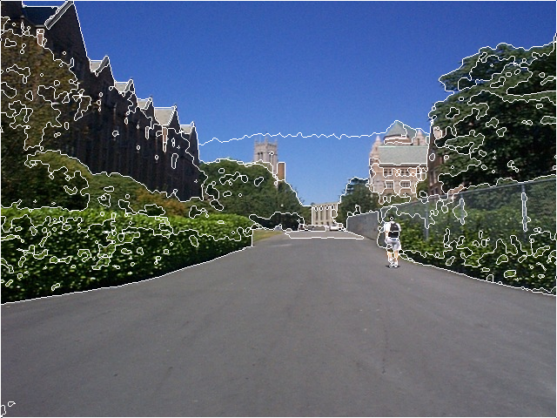
Labeled images and overlays
An image and the corresponding segmentation overlay.

Slide 9
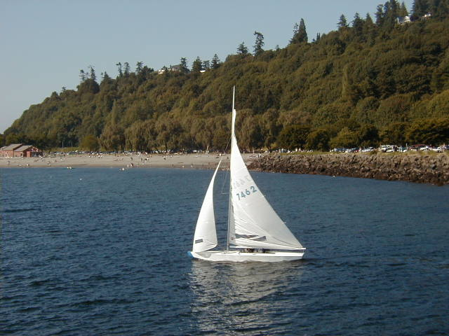
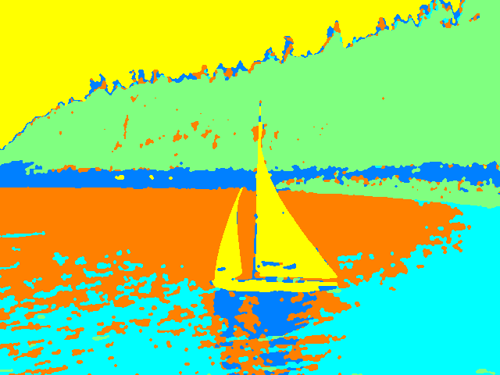
Labeled images and overlays
An image and the corresponding labeled image after segmentation
(displayed in pseudo-color).

Slide 10
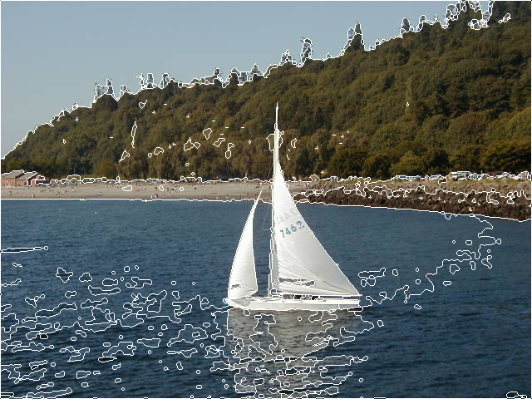
Labeled images and overlays
An image and the corresponding segmentation overlay.

Slide 11
Chain codes
Regions can be represented by their boundaries in a data structure instead of an image.
The simplest form is just a linear list of the boundary points of each region.
This method generally is unacceptable because:
  The resulting list tends to be quite long.
  Any small disturbances along the boundary cause changes in the list that may not be related to the shape of the boundary.
A variation of the list of points is the chain code, which encodes the information from the list of points at any desired quantization.

Slide 12
Chain codes
Conceptually, a boundary to be encoded is overlaid on a square grid whose side length determines the resolution of the encoding.
Starting at the beginning of the curve, the grid intersection points that come closest to it are used to define small line segments that join each grid point to one of its neighbors.
The directions of these line segments are then encoded as small integers from zero to the number of neighbors used in encoding.

Slide 13
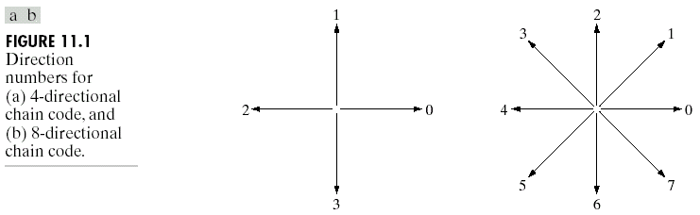
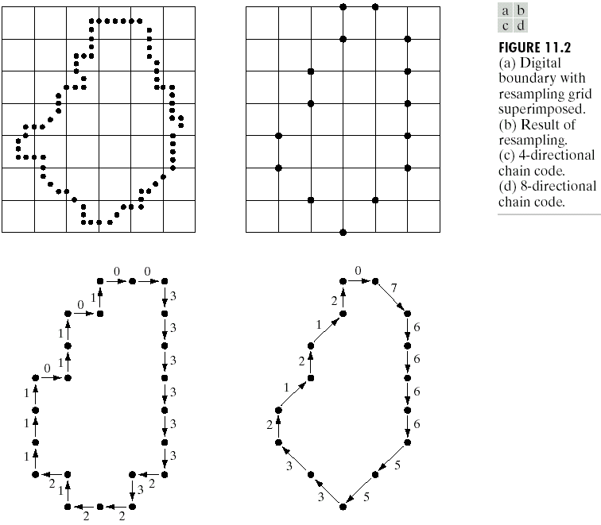
Chain codes

Slide 14
Chain codes
The chain code of a boundary depends on the starting point.
However, the code can be normalized by treating it as a circular sequence.
Size (scale) normalization can be achieved by altering the size of the sampling grid.
Rotation normalization can be achieved by using the first difference of the chain code instead of the code itself.
  Count the number of direction changes (in counter-clockwise direction) that separate two adjacent elements of the code (e.g., 10103322 → 3133030).

Slide 15
Chain codes

Slide 16
Polygonal approximations
When the boundary does not have to be exact, the boundary pixels can be approximated by straight line segments, forming a polygonal approximation to the boundary.
The goal of polygonal approximations is to capture the “essence” of the boundary shape with the fewest possible polygonal segments.
This representation can save space and simplify algorithms that process the boundary.

Slide 17
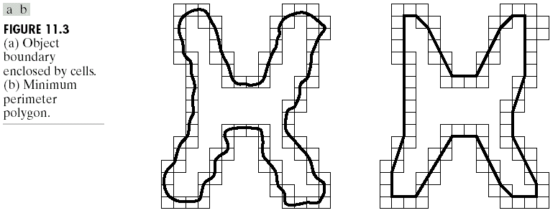
Polygonal approximations
Minimum perimeter polygons:
  Enclose the boundary by a set of concatenated cells.
  Produce a polygon of minimum perimeter that fits the geometry established by the cell strip.

Slide 18
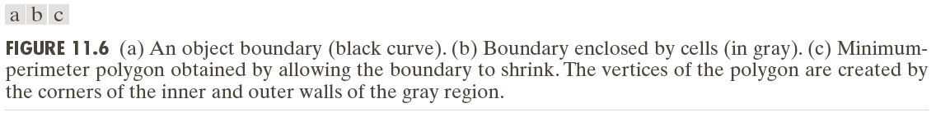
Polygonal approximations

Slide 19
Polygonal approximations

Slide 20
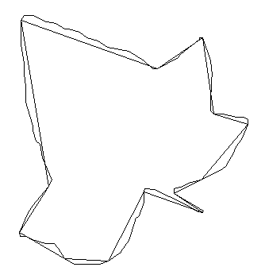
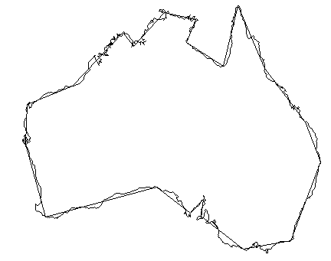
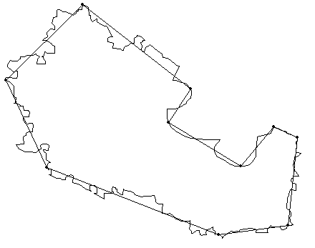
Polygonal approximations
Merging techniques:
  Points along a boundary can be merged until the least square error line fit of the points merged so far exceeds a preset threshold.
  At the end of the procedure, the intersections of adjacent line segments form the vertices of the polygon.

Slide 21
Polygonal approximations
Splitting techniques:
  One approach is to subdivide a segment successively into two parts until a specified criterion is satisfied.
  For instance, a requirement might be that the maximum perpendicular distance from a boundary segment to the line joining its two end points not exceed a preset threshold.
  If it does, the farthest point from the line becomes a vertex, thus subdividing the initial segment into two.
  The procedure terminates when no point in the new boundary segments has a perpendicular distances that exceeds the threshold.

Slide 22
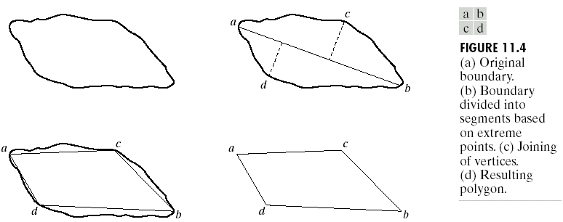
Polygonal approximations

Slide 23
Scale space
The scale space representation of a shape is created by tracking the position of inflection points on a shape boundary filtered by low-pass Gaussian filters of variable widths.
As the width (σ) of Gaussian filter increases, insignificant inflections are eliminated from the boundary and the shape becomes smoother.
The inflection points that remain present in the representation are expected to be “significant” object characteristics.

Slide 24
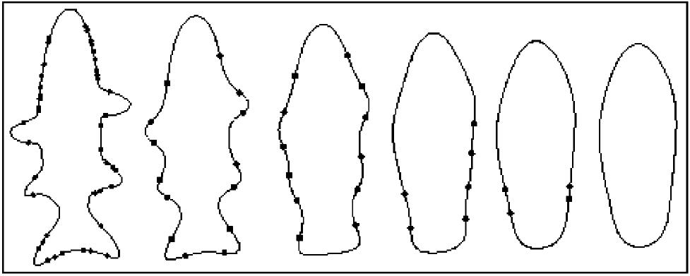
Scale space
The evolution of shape boundary as scale increases.
From left to right: σ = 1, 4, 7, 10, 12, 14.

Slide 25
Signatures
A signature is a 1-D functional representation of a boundary.
A simple method is to plot the distance from the centroid to the boundary as a function of angle.
  Normalization with respect to rotation and scaling are needed.
Another method is to traverse the boundary and, corresponding to each point on the boundary, plot the angle between the line tangent to the boundary at that point and a reference line.
A variation is to use the histogram of tangent angle values.

Slide 26
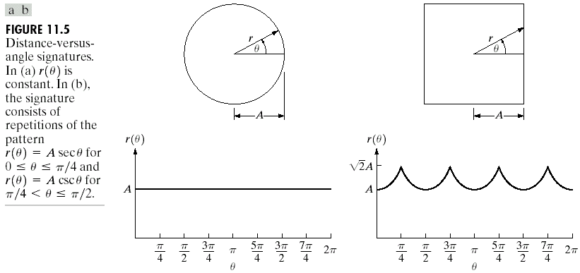
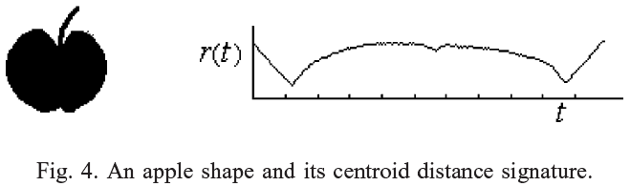
Signatures

Slide 27
Boundary segments
Decomposing a boundary into segments can reduce the boundary’s complexity and simplify the description process.
The convex hull H of an arbitrary set S is the smallest convex set containing S.
The set difference H – S is called the convex deficiency of the set.
The region boundary can be partitioned by following the contour of S and marking the points at which a transition is made into and out of a component of the convex deficiency.

Slide 28

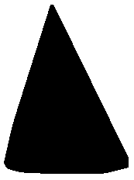
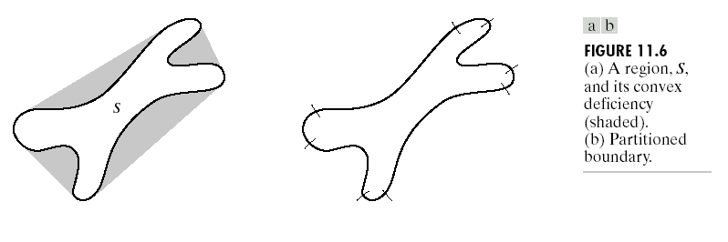
Boundary segments
A region and its convex hull.

Slide 29
Skeletons
An important approach to representing the structural shape of a plane region is to reduce it to a graph.
This reduction may be accomplished by obtaining the skeleton of the region.
The medial axis transformation (MAT) can be used to compute the skeleton.
The MAT of a region R with border B is as follows:
  For each point p in R, we find its closest neighbor in B.
  If p has more than one such neighbor, it is said to belong to the medial axis of R.

Slide 30
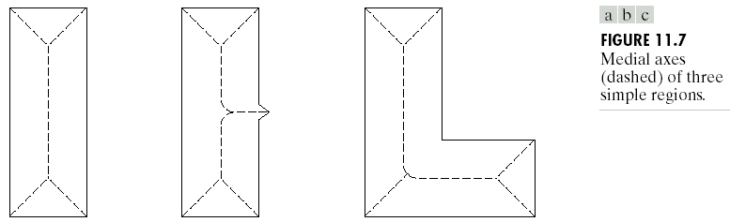
Skeletons
The MAT can be computed using thinning algorithms that iteratively delete edge points of a region subject to the constraints that deletion of these points
  does not remove end points,
  does not break connectivity, and
  does not cause excessive erosion of the region.

Slide 31
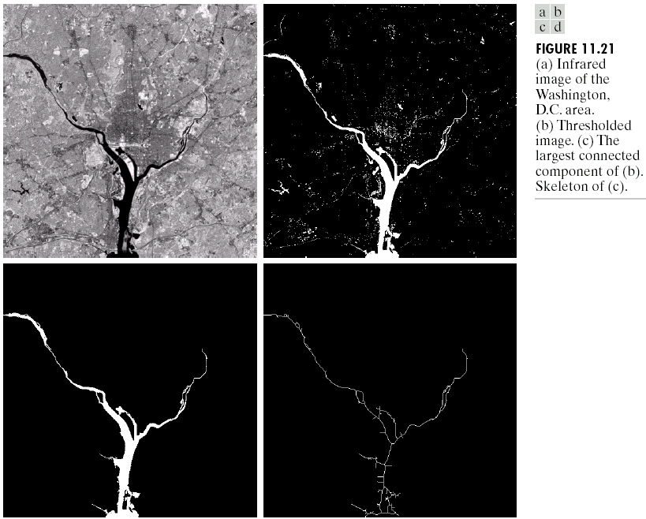
Skeletons

Slide 32
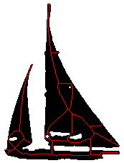
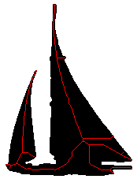
Skeletons
A region, its skeleton, and the skeleton after
filling the holes in the region.

Slide 33
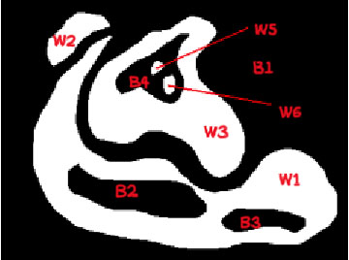
Composite regions
Some regions can have holes and also multiple parts that are not contiguous.
A tree structure can be used to represent such regions.
Image
(W1)
(W2)
(W3)
(B2)
(B3)
(B4)
(W5)
(W6)

Slide 34
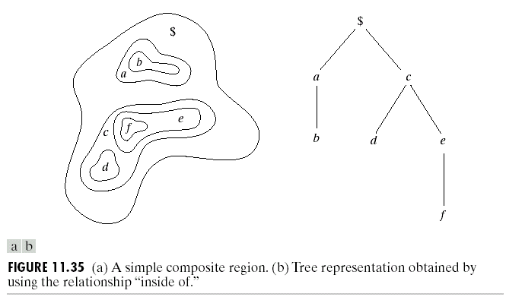
Composite regions

Slide 35

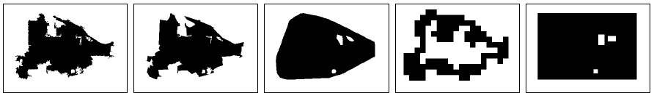
Examples
Region representation examples. Rows show representations for two different regions. Columns represent, from left to right: original boundary, smoothed polygon, convex hull, grid representation, and minimum bounding rectangle.

Slide 36
Region descriptors
Boundary descriptors use external representations to model the shape characteristics of regions.
Regional descriptors use internal representations to model the internal content of regions.
Examples:
  Shape properties (both internal and external)
  Fourier descriptors (external)
  Statistics and histograms (internal)

Slide 37
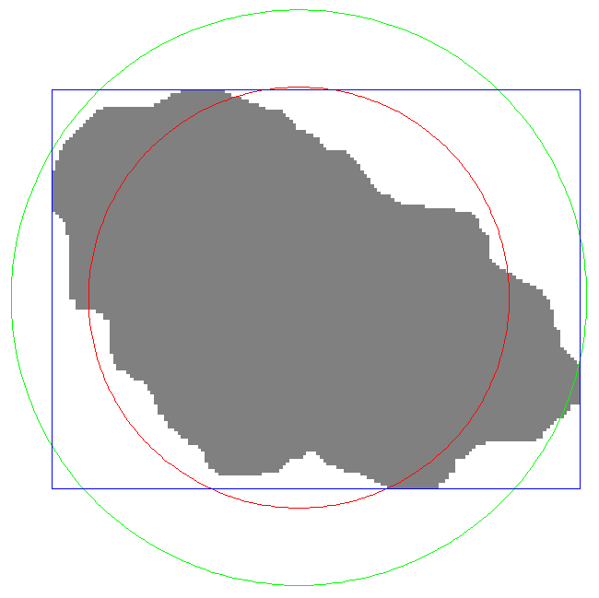
Shape properties
Area
  Number of pixels in the region
Perimeter
  Number of pixels on the boundary
  Number of vertical and horizontal components plus √2 times the number of diagonal components
Bounding box
Diameter
  Maximum distance between
  boundary points
Equivalent diameter
  Diameter of a circle with the same area as the region

Slide 38
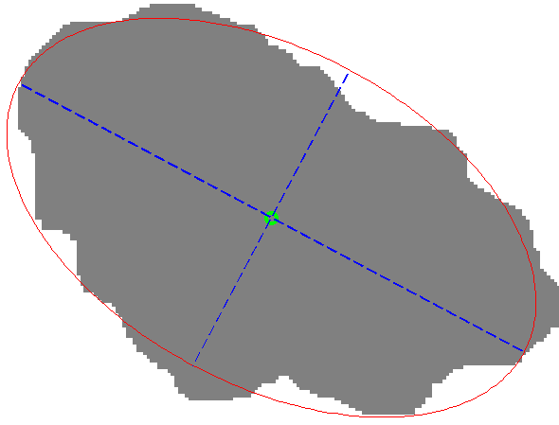
Shape properties
Principal axes of inertia
  Compute the mean of pixel coordinates (centroid)
  Compute the covariance matrix of pixel coordinates
  Major axis is the eigenvector of the covariance matrix corresponding to the larger eigenvalue
  Minor axis is the eigenvector
  of the covariance matrix
  corresponding to the smaller
  eigenvalue

Slide 39
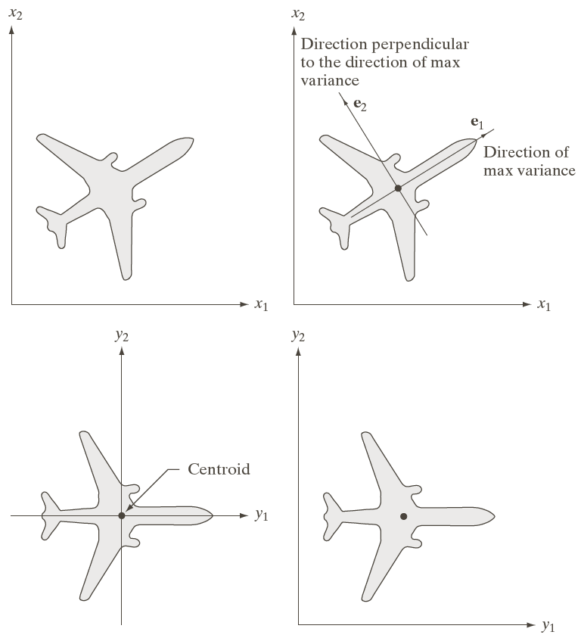
Shape properties

Slide 40
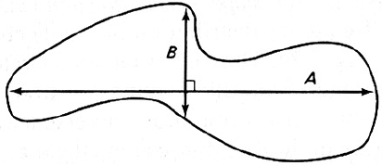
Shape properties
Orientation
  Orientation of the major axis with respect to the horizontal axis
Eccentricity (elongation)
  Ratio of the length of maximum chord A
  to maximum chord B perpendicular to A
  Ratio of the principal axes of inertia
Compactness
  Perimeter² / area (minimized by a disk)
Extent
  Area of region / area of its bounding box
Solidity
  Area of region / area of its convex hull

Slide 41

Shape properties
Spatial variances
  Variance of pixel coordinates along the principal axes of inertia
Euler number
  Number of connected regions – number of holes
  (actually a topological property that describes the connectedness of a region, not its shape)
Moments

Slide 42
Fourier descriptors
Given the list of K boundary points, start at an arbitrary point and traverse the boundary in a particular direction.
The coordinates can be expressed in the form
x(k) = x_{k} and y(k) = y_{k} where k = 0, 1, …, K-1 shows the order of traversal.
Each coordinate pair can be treated as a complex number s(k) = x(k) + j y(k) for k = 0, 1, …, K-1.
The complex coefficients of the discrete Fourier transform of s(k) are called the Fourier descriptors of the boundary.

Slide 43
Fourier descriptors
The inverse Fourier transform reconstructs s(k), i.e., the boundary.
If only the first P coefficients are used in the reconstruction, we obtain an approximation to the boundary.
Note that only P terms are used to obtain each component of s(k), but k still ranges from 0 to K-1.
Since the high-frequency components of the Fourier transform account for fine detail, the smaller P becomes, the more detail is lost on the boundary.

Slide 44
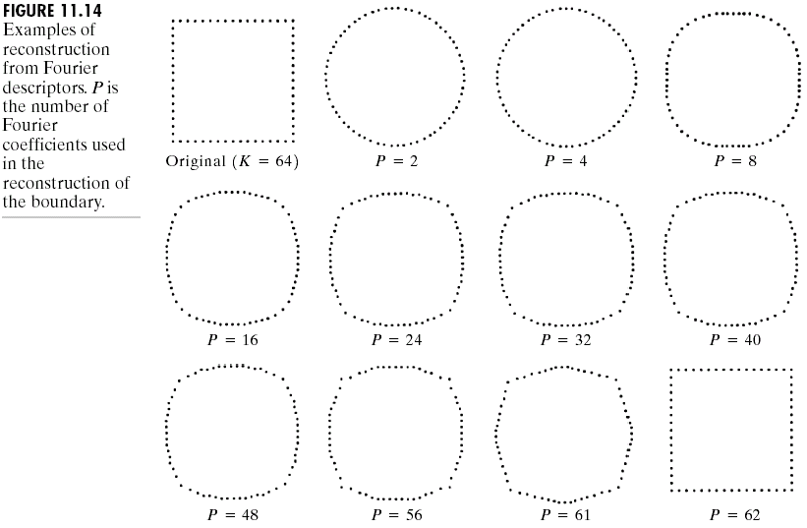
Fourier descriptors

Slide 45
Fourier descriptors

Slide 46
Statistics and histograms
Contents of regions can be summarized using statistics (e.g., mean, standard deviation) and histograms of pixel features.
Commonly used pixel features include
  Gray tone,
  Color (RGB, HSV, …),
  Texture,
  Motion.
Then, the resulting region level features can be used for clustering, retrieval, classification, etc.

Slide 47
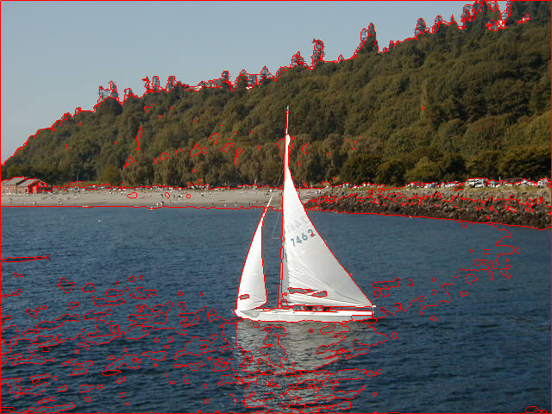
Statistics and histograms

Slide 48
Statistics and histograms
Region RGB histogram RGB mean and std.dev.

Slide 49
Statistics and histograms
Region RGB histogram RGB mean and std.dev.

Slide 50
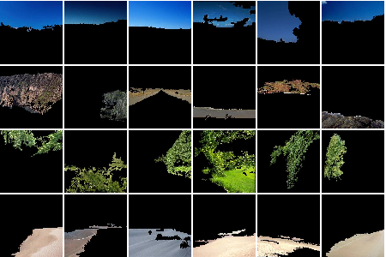
Statistics and histograms
Region clusters obtained using the histograms of the HSV values of their pixels. Each row represents the clusters corresponding to sky, rock, tree, road.

Slide 51
Image representations and descriptors
Popular image representations (in increasing order of complexity) include:
  Global representation
  Tiled representations
  Quadtrees
  Region adjacency graphs
  Attributed relational graphs

Slide 52




































Tiled representations
Images can be divided into fixed size or variable size grids that are overlapping or non-overlapping.
Dividing an image into 5x7 fixed size non-overlapping grid cells.

Slide 53
Tiled representations

Slide 54
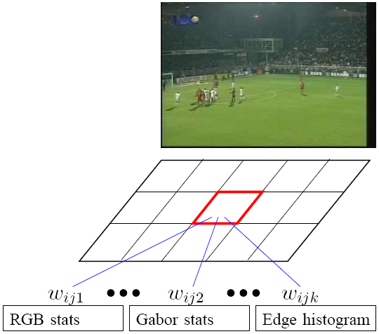
Tiled representations
Example application: learning the importance of different features in different grid cells using user feedback.

Slide 55
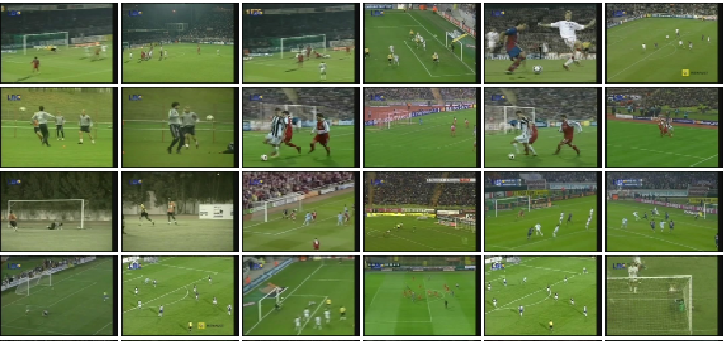
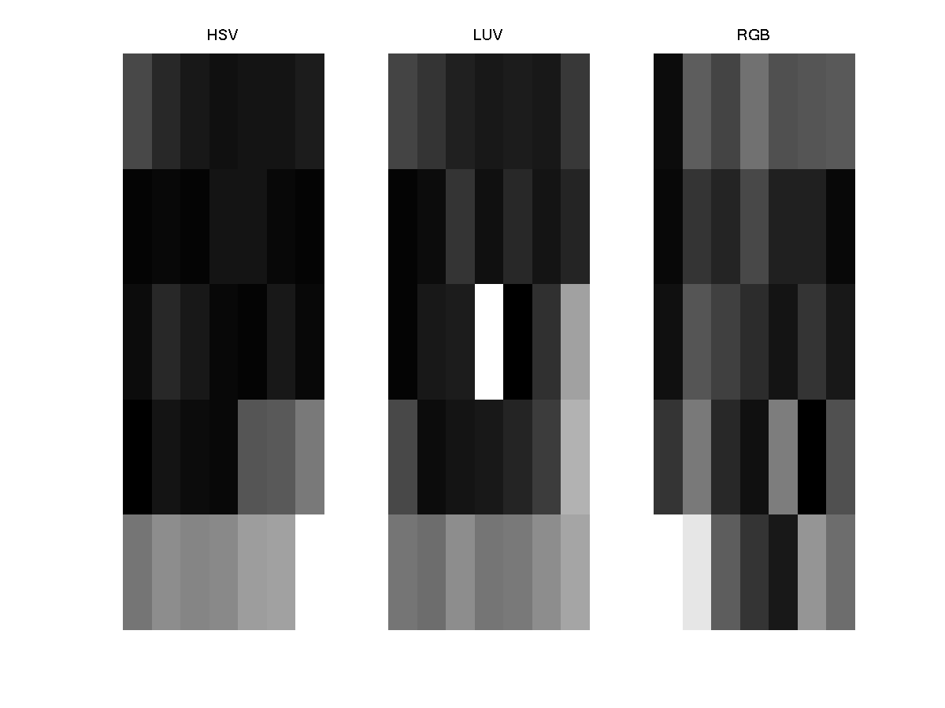
Tiled representations
Results of a football query.
Weights for different features (left to right: HSV, LUV, RGB) and grid cells for the football query. Brighter colors represent higher weights.

Slide 56
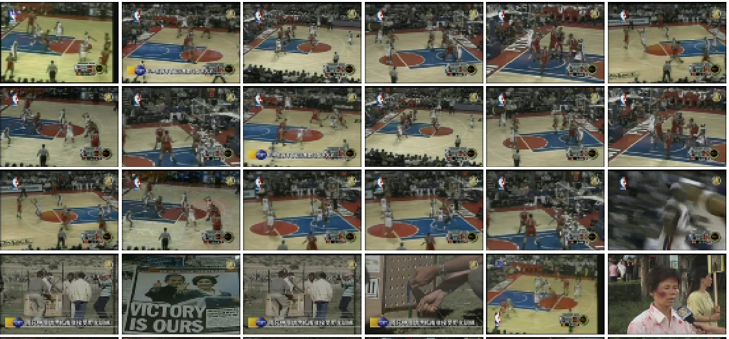
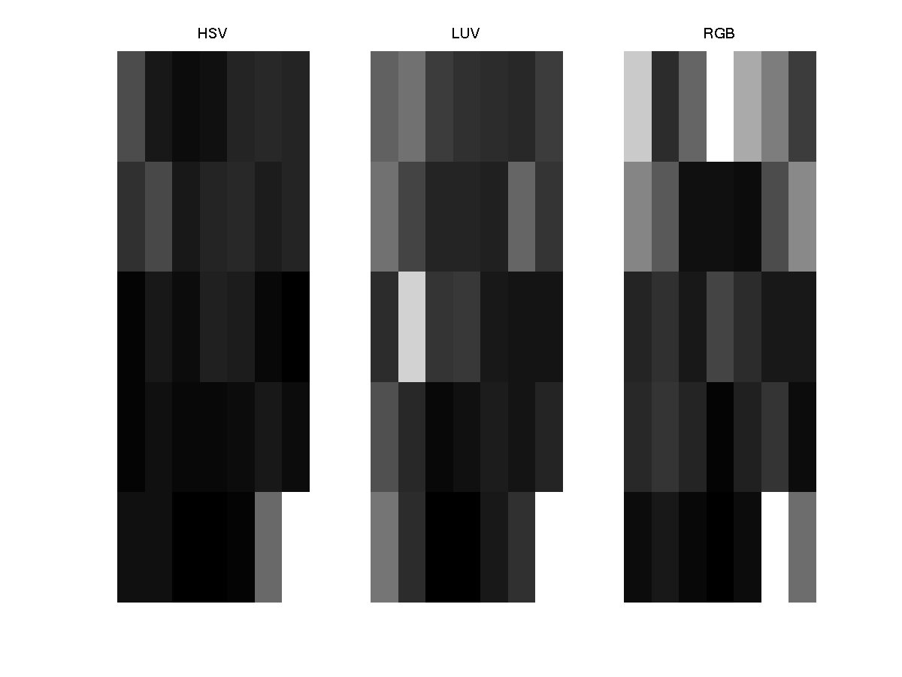
Tiled representations
Results of a basketball query.
Weights for different features (left to right: HSV, LUV, RGB) and grid cells for the basketball query. Brighter colors represent higher weights.

Slide 57
Quadtrees
Quadtrees:
  Trees where nodes have 4 children.
Building a quadtree:
  Nodes represent regions.
  Every time a region is split, its node gives birth to 4 children.
  Leaves are nodes for uniform regions.
Merging:
  Siblings that are “similar” can be merged.

Slide 58
Quadtrees
1
1
1
2
3
2
3
2
3
4
4
4
Not uniform
uniform

Slide 59
Quadtrees
1
1
1
2
3
2
3
2
3
4
4
4
1
1
2
3
2
3
4
4
Splitting…

Slide 60
Quadtrees
1
1
1
2
3
2
3
2
3
4
4
4
Merging…

Slide 61
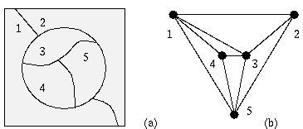
Region adjacency graphs
A region adjacency graph (RAG) is a graph in which each node represents a region of the image and an edge connects two nodes if the regions are adjacent.
1
2
3
4

Slide 62
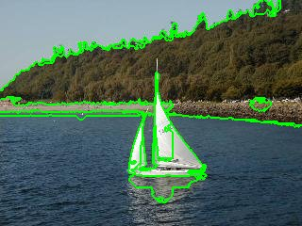
Region adjacency graphs
1
2
1
2
3
4
4
3

Slide 63
Attributed relational graphs
Attributed relational graphs (ARG) generalize ordinary graphs by attaching discrete or continuous features (attributes) to the vertices and edges.
Formally, an attributed relational graph G is a
4-tuple G=(N,E,μ,ν) where
  N is the set of nodes,
  E ⊆ N ×N is the set of edges,
  μ : N →L_{N} is a function assigning labels to the nodes,
  ν : E →L_{E} is a function assigning labels to the edges.

Slide 64
Attributed relational graphs
Many real-world entities can be represented as an ARG.
For example, visual scenes can be modeled as the composition of the objects with specific spatial/attribute relationships.
Molecular compounds can be represented as an ARG with atoms as vertices and bonds as edges.
A web site can be represented as an ARG with web pages as vertices and URL links as edges.

Slide 65
Attributed relational graphs
Example application: modeling remote sensing image content using ARGs.
  Nodes in the ARG represent the regions and edges represent the spatial relationships between these regions.
  Nodes are labeled with the class (land cover/use) names and the corresponding confidence values for these class assignments.
  Edges are labeled with the spatial relationship classes and the corresponding degrees for these relationships.

Slide 66
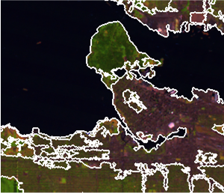
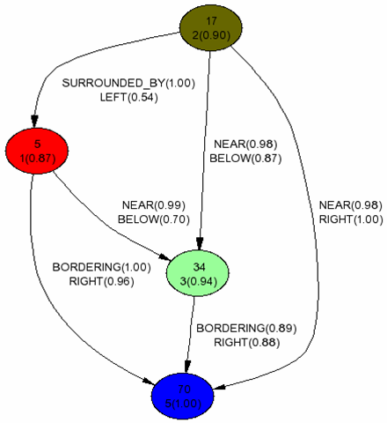
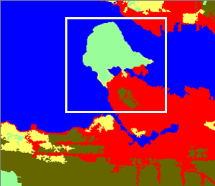
Attributed relational graphs
ARG for an example scene (marked with a white rectangle) containing regions classified as water (blue), city center (red), residential area (brown) and park (green). Nodes are labeled using region id, class id, class probability (in parenthesis) and edges are labeled using relationship names and membership values (in parenthesis).

Slide 67
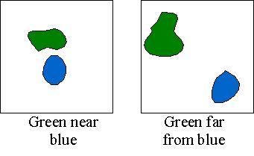
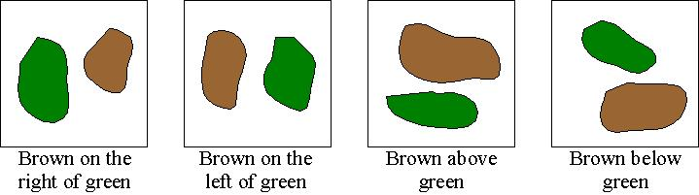
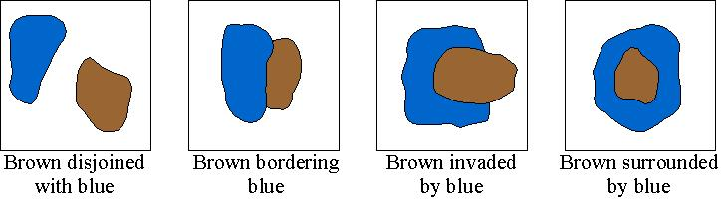
Attributed relational graphs
Pairwise spatial relationships
Perimeter-class relationships
Distance-class relationships
Orientation-class relationships

Slide 68
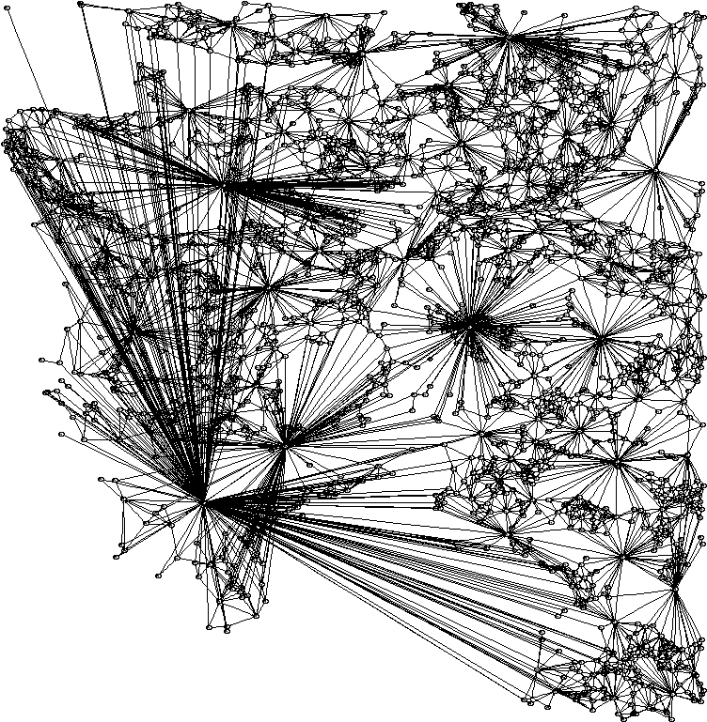
Attributed relational graphs
ARG of a LANDSAT scene. Nodes are located at the centroids of the corresponding regions. Edges are drawn only for pairs that are within 10 pixels of each other to keep the graph simple.

Slide 69
Attributed relational graphs
An important problem is how similarities between two scenes represented using ARGs can be found.
Relational matching has been extensively studied in structural pattern recognition.
One possible solution is the “editing distance” between two ARGs that is defined as the minimum cost taken over all sequences of operations (error corrections such as substitution, insertion and deletion) that transform one ARG to the other.

Slide 70


Attributed relational graphs
Find the ARG of the area of interest (query).

Slide 71

Attributed relational graphs
Search the graph for the whole scene …

Slide 72

Attributed relational graphs
… by first finding the nodes (regions) with similar attributes

Slide 73

Attributed relational graphs
… and then finding the subgraphs with similar edges (relationships).

