Slide 1
Color Image Processing
Selim Aksoy
Department of Computer Engineering
Bilkent University
saksoy@cs.bilkent.edu.tr

Slide 2
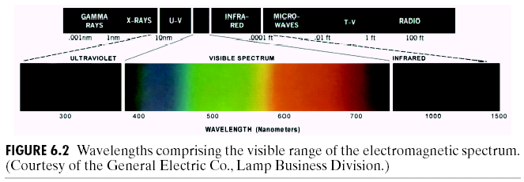
Color
Used heavily in human vision.
Visible spectrum for humans is 400 nm (blue) to 700 nm (red).
Machines can “see” much more; e.g., X-rays, infrared, radio waves.
Adapted from Gonzales and Woods

Slide 3
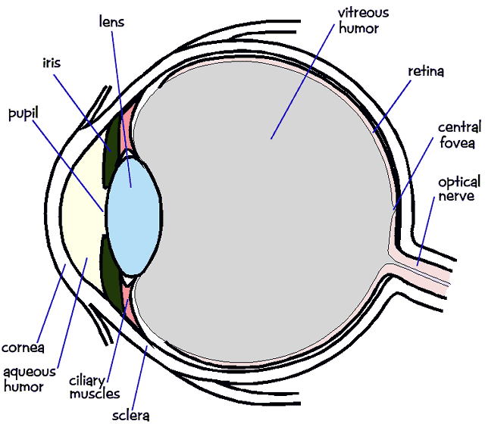
Human visual system
Color perception
  Light hits the retina, which contains photosensitive cells.
  These cells convert the spectrum into a few discrete values.
Adapted from Steve Seitz, U of Washington

Slide 4
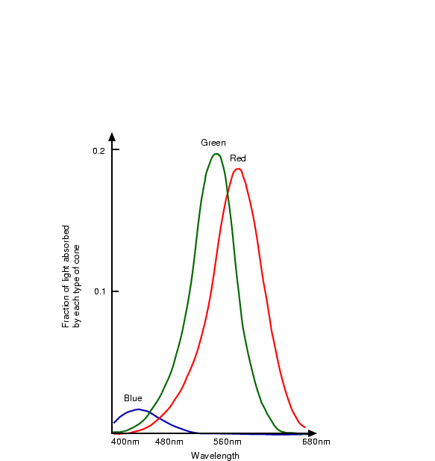
Human visual system
There are two types of photosensitive cells:
  Cones
    Sensitive to colored light, but not very sensitive to dim light.
  Rods
    Sensitive to achromatic light.
We perceive color using three
different types of cones.
  Each one is sensitive in a different
  region of the spectrum.
    440 nm (BLUE)
    545 nm (GREEN)
    580 nm (RED)
  They have different sensitivities
  (we are more sensitive to green than red).
Adapted from Octavia Camps, Penn State

Slide 5
Factors that affect perception
Light: the spectrum of energy that illuminates the object surface.
Reflectance: ratio of reflected light to incoming light.
Specularity: highly specular (shiny) vs. matte surface.
Distance: distance to the light source.
Angle: angle between surface normal and light source.
Sensitivity: how sensitive is the sensor.
Adapted from Linda Shapiro, U of Washington

Slide 6
Color models
They provide a standard way of specifying a particular color using a 3D coordinate system.
Hardware oriented
  RGB: additive system (add colors to black) used for displays.
  CMY: subtractive system used for printing.
  YIQ: used for TV and is good for compression.
Image processing oriented
  HSV: good for perceptual space for art, psychology and recognition.
Adapted from Octavia Camps, Penn State

Slide 7
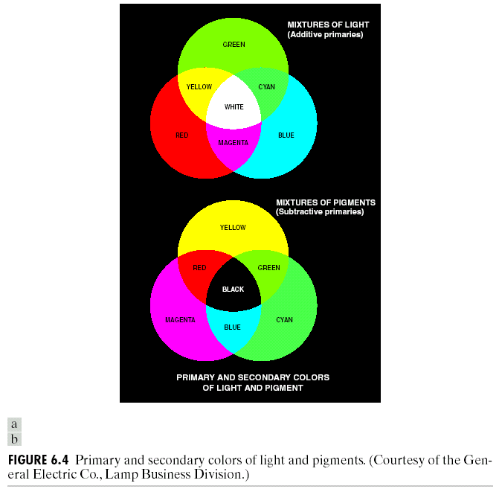
Additive and subtractive colors
Adapted from Gonzales and Woods

Slide 8
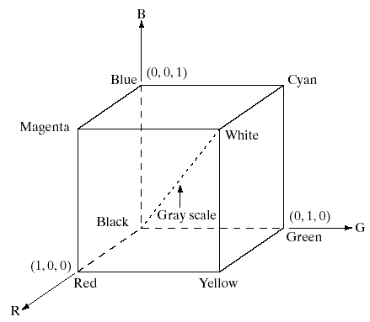
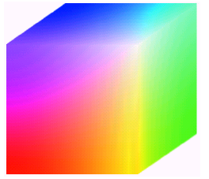
RGB model
Additive model.
An image consists of 3 bands, one for each primary color.
Appropriate for image displays.
Adapted from Gonzales and Woods

Slide 9
CMY model
Cyan-Magenta-Yellow is a subtractive model which is good to model absorption of colors.
Appropriate for paper printing.
Adapted from Octavia Camps, Penn State

Slide 10
CIE chromaticity model
The Commission Internationale de l’Eclairage defined 3 standard primaries: X, Y, Z that can be added to form all visible colors.
Y was chosen so that its color matching function matches the sum of the 3 human cone responses.
Adapted from Octavia Camps, Penn State

Slide 11
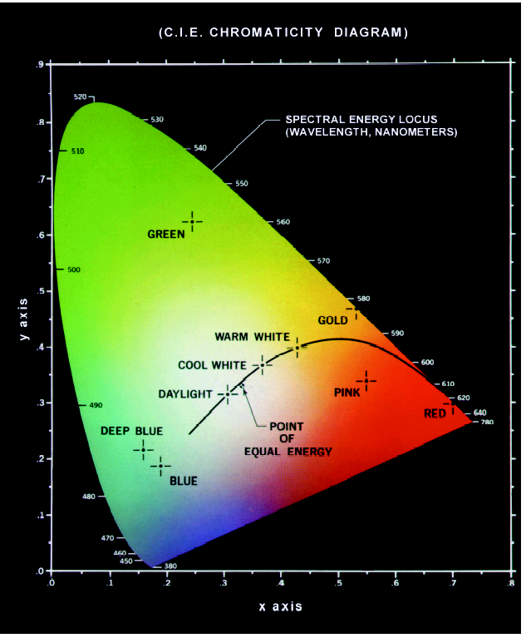
CIE chromaticity model
x, y, z normalize X, Y, Z such that
x + y + z = 1.
Actually only x and y are needed because
z = 1 - x - y.
Pure colors are at the curved boundary.
White is (1/3, 1/3, 1/3).
Adapted from Octavia Camps, Penn State

Slide 12
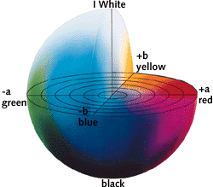
CIE Lab (L*a*b) model
One luminance channel (L) and two color channels (a and b).
In this model, the color differences which you perceive correspond to Euclidian distances in CIE Lab.
The a axis extends from green (-a) to red (+a) and the b axis from blue (-b) to yellow (+b). The brightness (L) increases from the bottom to the top of the 3D model.
http://en.wikipedia.org/wiki/Lab_color_space
Adapted from Linda Shapiro, U of Washington

Slide 13
YIQ model
Have better compression properties.
Luminance Y is encoded using more bits than chrominance values I and Q (humans are more sensitive to Y than I and Q).
Luminance used by black/white TVs.
All 3 values used by color TVs.
Adapted from Octavia Camps, Penn State

Slide 14
HSV model
HSV: Hue, saturation, value are non-linear functions of RGB.
Hue relations are naturally expressed in a circle.
Adapted from Octavia Camps, Penn State

Slide 15
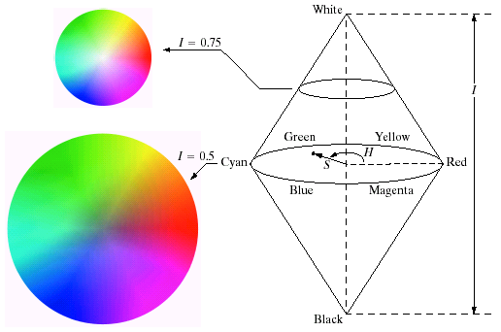
HSV model
Uniform: equal (small) steps give the same perceived color changes.
Hue is encoded as an angle (0 to 2π).
Saturation is the distance to the vertical axis (0 to 1).
Intensity is the height along the vertical axis (0 to 1).
Adapted from Gonzales and Woods

Slide 16
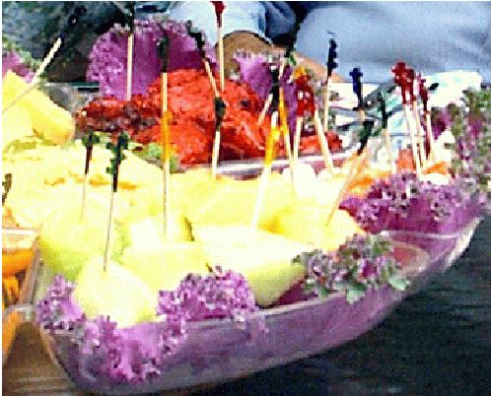
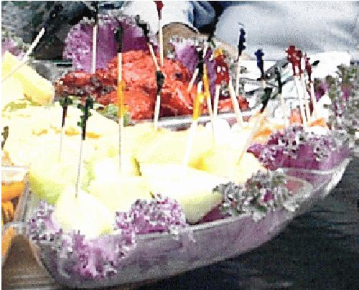
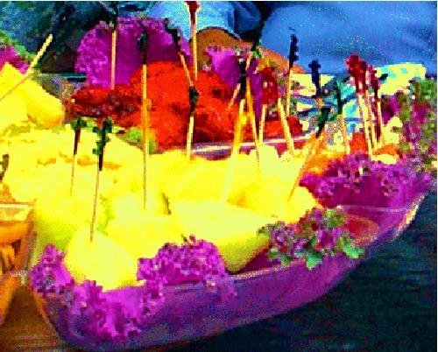
HSV model
(Left) Image of food originating from a digital camera.
(Center) Saturation value of each pixel decreased 20%.
(Right) Saturation value of each pixel increased 40%.
Adapted from Linda Shapiro, U of Washington

Slide 17
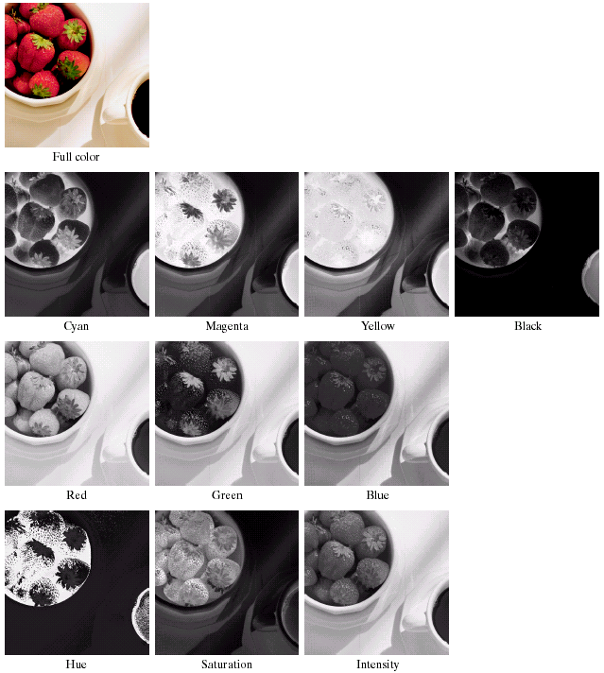
Color models
CMYK
RGB
HSV
Adapted from Gonzales and Woods

Slide 18
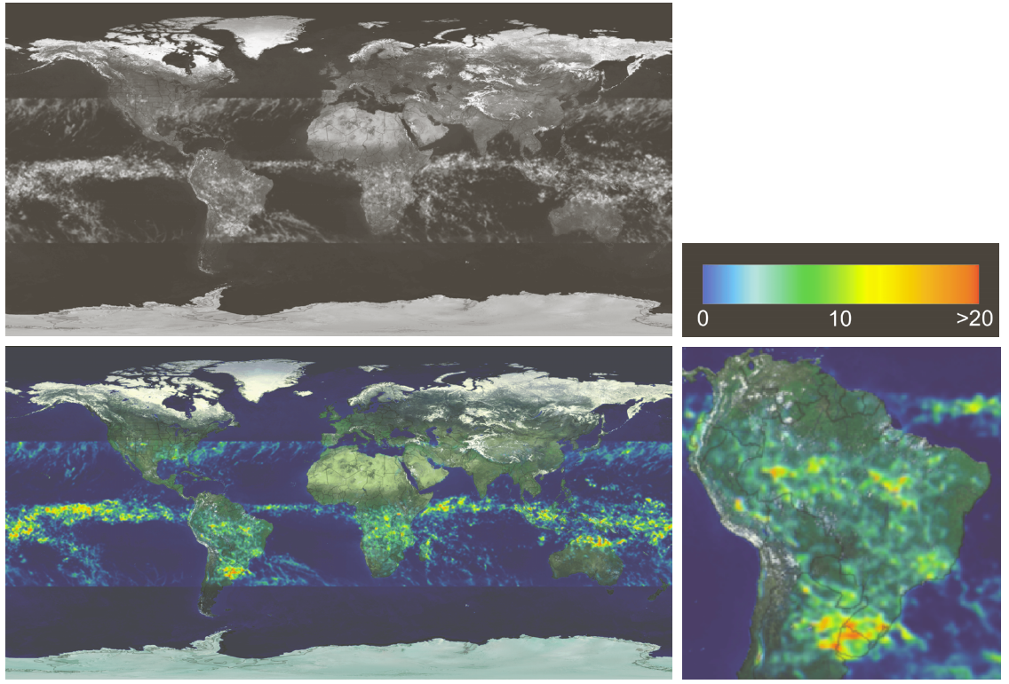
Examples: pseudocolor

Slide 19
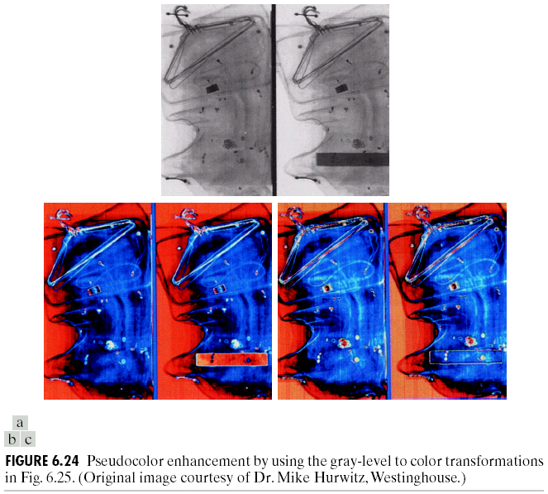
Examples: pseudocolor

Slide 20
Examples: pseudocolor

Slide 21
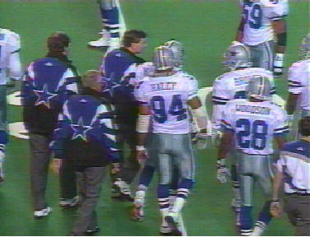
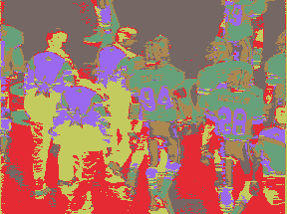
Examples: segmentation
Can cluster on color values and pixel locations.
Can use connected components and an approximate color criteria to find regions.
Can train an algorithm to look for certain colored regions – for example, skin color.
Original RGB image
Color clusters by k-means
Adapted from Linda Shapiro, U of Washington

Slide 22
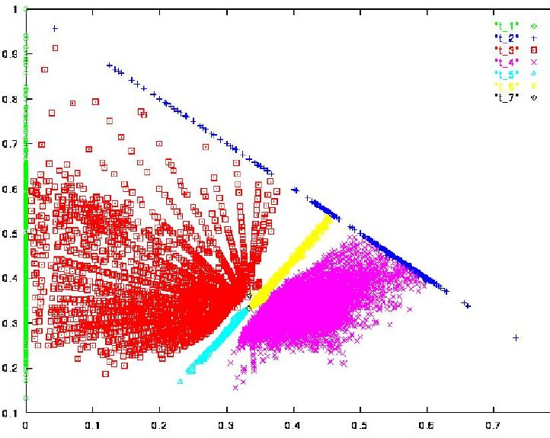
Examples: segmentation
Skin color in RGB space:
Purple region shows skin color samples from several people. Blue and yellow regions show skin in shadow or behind a beard.
Adapted from Linda Shapiro, U of Washington

Slide 23
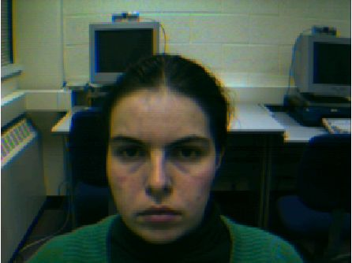
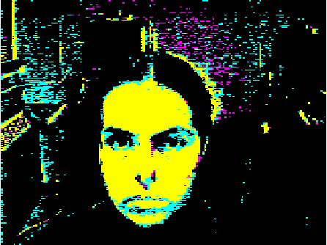
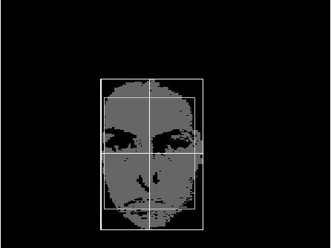
Examples: segmentation
(Left) Input video frame.
(Center) Pixels classified according to RGB space.
(Right) Largest connected component with aspect similar to a face.
Adapted from Linda Shapiro, U of Washington

Slide 24
Examples: histogram
Histogram is fast and easy to compute.
Size can easily be normalized so that different image histograms can be compared.
Can match color histograms for database query or classification.
Adapted from Linda Shapiro, U of Washington

Slide 25
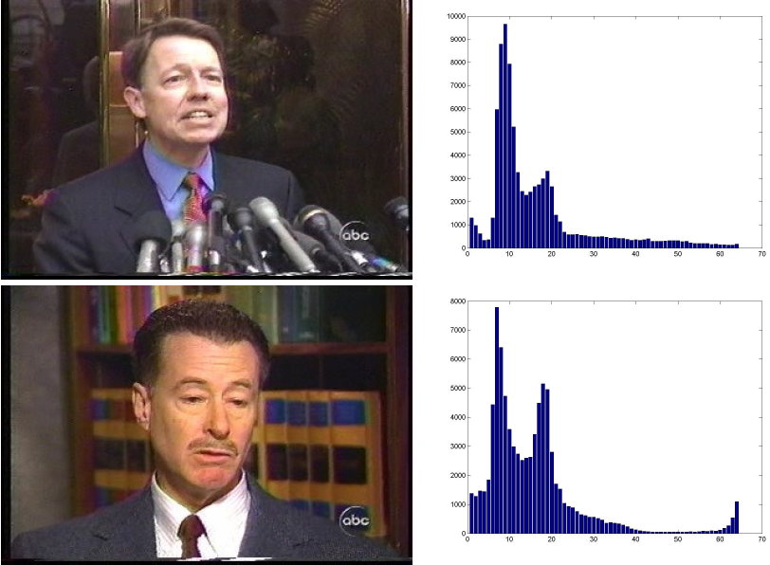
Examples: histogram

Slide 26
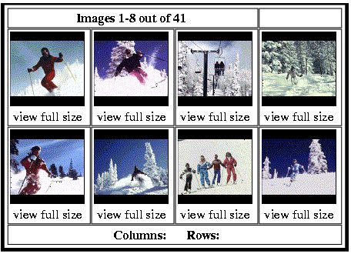
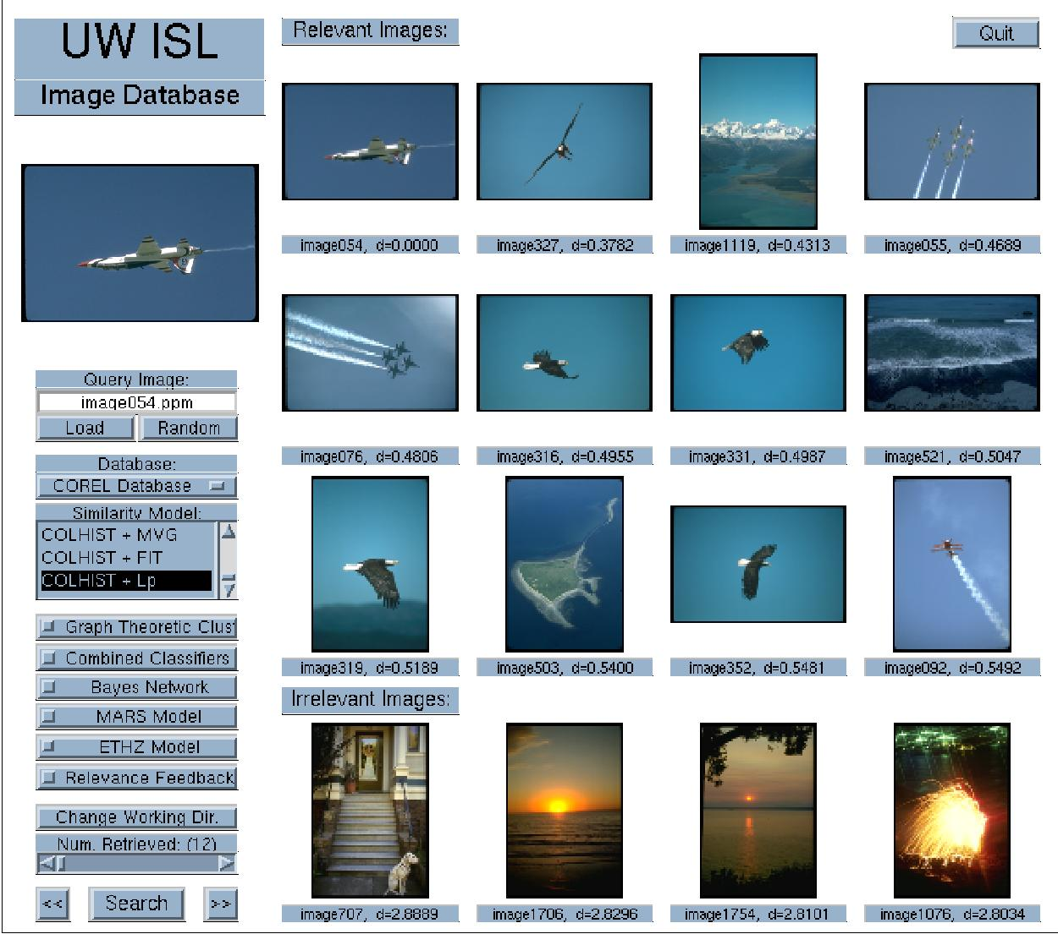
Examples: image retrieval
Adapted from Linda Shapiro, U of Washington

Slide 27
Summary
To print (RGB → CMY or grayscale)
To compress images (RGB → YUV)
  Color information (U,V) can be compressed 4 times without significant degradation in perceptual quality.
To compare images (RGB → CIE Lab)
  CIE Lab space is more perceptually uniform.
  Euclidean distance in Lab space hence meaningful.
http://www.couleur.org/index.php?page=transformations

