Slide 1
Filtering – Part I
Selim Aksoy
Department of Computer Engineering
Bilkent University
saksoy@cs.bilkent.edu.tr

Slide 2
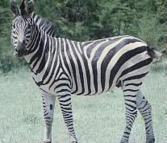
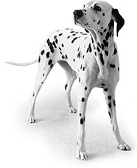
Importance of neighborhood
Both zebras and dalmatians have black and white pixels in similar numbers.
The difference between the two is the characteristic appearance of small group of pixels rather than individual pixel values.
Adapted from Pinar Duygulu, Bilkent University

Slide 3
Outline
We will discuss neighborhood operations that work with the values of the image pixels in the neighborhood.
Spatial domain filtering
Frequency domain filtering
Image enhancement
Finding patterns

Slide 4
Spatial domain filtering
3 | 3 | 3
3 | ? | 3
3 | 3 | 3
What is the value of the center pixel?
What assumptions are you making to infer the center value?
3
3 | 4 | 3
2 | ? | 3
3 | 4 | 2
3

Slide 5
Spatial domain filtering
Some neighborhood operations work with
  the values of the image pixels in the neighborhood, and
  the corresponding values of a subimage that has the same dimensions as the neighborhood.
The subimage is called a filter (or mask, kernel, template, window).
The values in a filter subimage are referred to as coefficients, rather than pixels.

Slide 6
Spatial domain filtering
Operation: modify the pixels in an image based on some function of the pixels in their neighborhood.
Simplest: linear filtering (replace each pixel by a linear combination of its neighbors).
Linear spatial filtering is often referred to as “convolving an image with a filter”.

Slide 7


Linear filtering
g [m,n]
f [m,n]
For a linear spatially invariant system
m=0 1 2 …
111 | 115 | 113 | 111 | 112 | 111 | 112 | 111
135 | 138 | 137 | 139 | 145 | 146 | 149 | 147
163 | 168 | 188 | 196 | 206 | 202 | 206 | 207
180 | 184 | 206 | 219 | 202 | 200 | 195 | 193
189 | 193 | 214 | 216 | 104 | 79 | 83 | 77
191 | 201 | 217 | 220 | 103 | 59 | 60 | 68
195 | 205 | 216 | 222 | 113 | 68 | 69 | 83
199 | 203 | 223 | 228 | 108 | 68 | 71 | 77
? | ? | ? | ? | ? | ? | ? | ?
? | -5 | 9 | -9 | 21 | -12 | 10 | ?
? | -29 | 18 | 24 | 4 | -7 | 5 | ?
? | -50 | 40 | 142 | -88 | -34 | 10 | ?
? | -41 | 41 | 264 | -175 | -71 | 0 | ?
? | -24 | 37 | 349 | -224 | -120 | -10 | ?
? | -23 | 33 | 360 | -217 | -134 | -23 | ?
? | ? | ? | ? | ? | ? | ? | ?
-1 | 2 | -1
-1 | 2 | -1
-1 | 2 | -1
=
g[m,n]
h[m,n]
f[m,n]

Slide 8


Convolution vs correlation
Convolution:
Correlation:
Reference: http://www.cs.umd.edu/~djacobs/CMSC426/Convolution.pdf

Slide 9
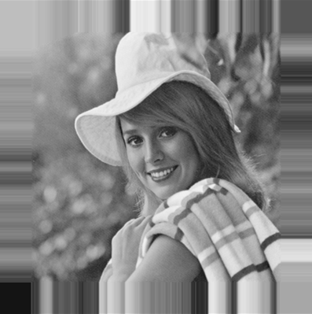
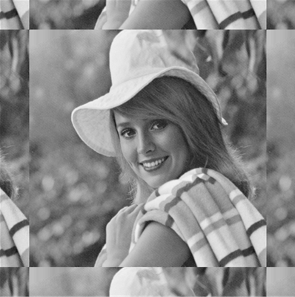
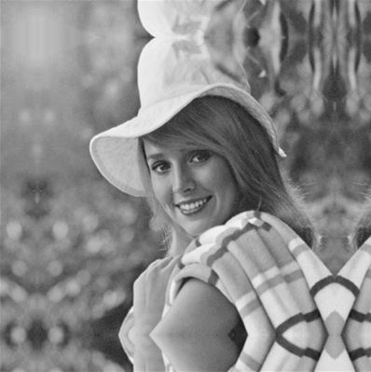
Spatial domain filtering
Be careful about indices, image borders and padding during implementation.
zero
fixed/clamp
periodic/wrap
reflected/mirror
Border padding examples.
Adapted from CSE 455, U of Washington

Slide 10
Smoothing spatial filters
Often, an image is composed of
  some underlying ideal structure, which we want to detect and describe,
  together with some random noise or artifact, which we would like to remove.
Smoothing filters are used for blurring and for noise reduction.
Linear smoothing filters are also called averaging filters.

Slide 11
Smoothing spatial filters
10
11
10
0
0
1
X
X
X
X
X
X
9
10
11
1
0
1
X
10
X
I
10
9
10
0
2
1
O
X
X
11
10
9
10
9
11
X
X
9
10
11
9
99
11
F
X
X
10
9
9
11
10
10
X
X
X
X
X
X
1
1
1
1/9
1
1
1
1
1
1
1/9.(10x1 + 11x1 + 10x1 + 9x1 + 10x1 + 11x1 + 10x1 + 9x1 + 10x1) =
1/9.( 90) = 10
Adapted from Octavia Camps, Penn State

Slide 12
Smoothing spatial filters
10
11
10
0
0
1
X
X
X
X
X
X
9
10
11
1
0
1
X
X
I
10
9
10
0
2
1
O
X
X
11
10
9
10
9
11
X
X
9
10
11
9
99
11
F
X
20
X
10
9
9
11
10
10
X
X
X
X
X
X
1
1
1
1/9
1
1
1
1
1
1
1/9.(10x1 + 9x1 + 11x1 + 9x1 + 99x1 + 11x1 + 11x1 + 10x1 + 10x1) =
1/9.( 180) = 20
Adapted from Octavia Camps, Penn State

Slide 13
Smoothing spatial filters
Common types of noise:
  Salt-and-pepper noise: contains random occurrences of black and white pixels.
  Impulse noise: contains random occurrences of white pixels.
  Gaussian noise: variations in intensity drawn from a Gaussian normal distribution.
Adapted from Linda Shapiro, U of Washington

Slide 14
Adapted from Linda Shapiro,
U of Washington

Slide 15
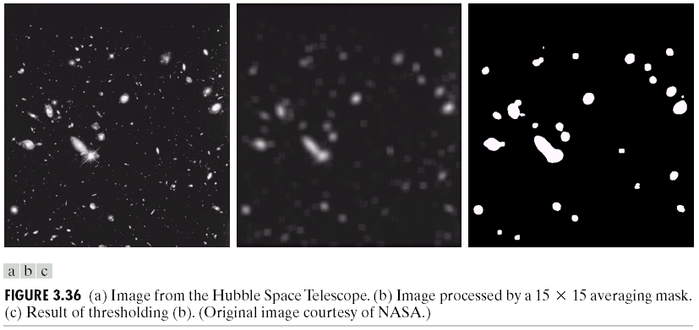
Smoothing spatial filters
Adapted from Gonzales and Woods

Slide 16
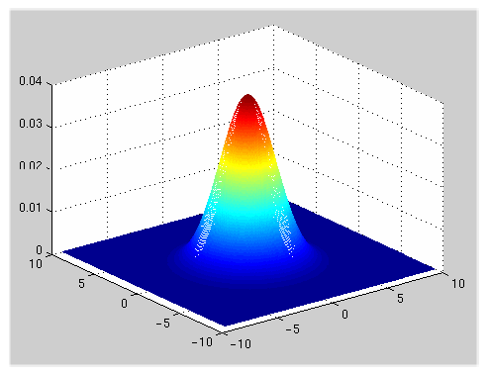

Smoothing spatial filters
A weighted average that weighs pixels at its center much more strongly than its boundaries.
2D Gaussian filter
Adapted from Martial Hebert, CMU

Slide 17
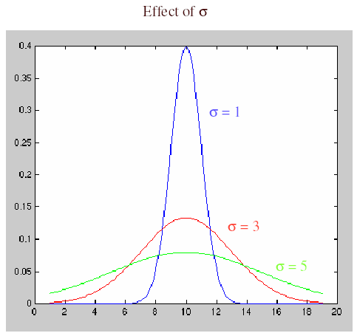
Smoothing spatial filters
If σ is small: smoothing will have little effect.
If σ is larger: neighboring pixels will have larger weights resulting in consensus of the neighbors.
If σ is very large: details will disappear along with the noise.
Adapted from Martial Hebert, CMU

Slide 18
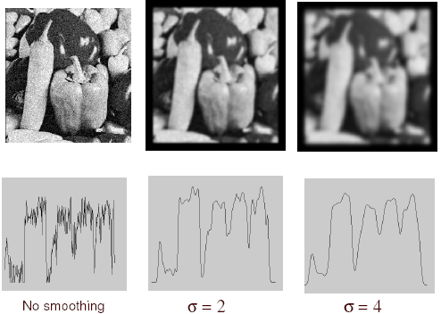
Smoothing spatial filters
Adapted from Martial Hebert, CMU

Slide 19
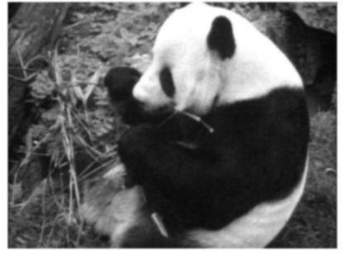
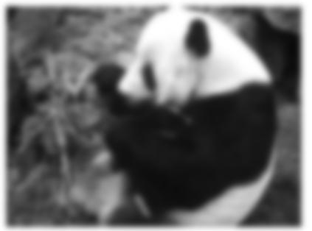
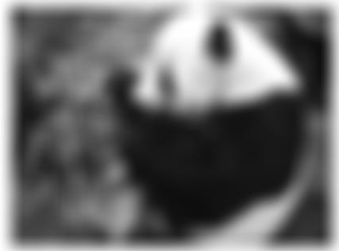
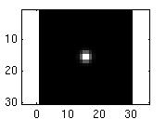
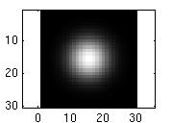
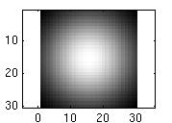
Smoothing spatial filters
…
Width of the Gaussian kernel controls the amount of smoothing.
Adapted from K. Grauman

Slide 20
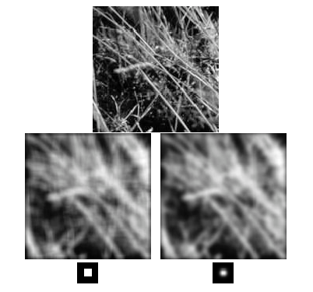
Smoothing spatial filters
Result of blurring using a uniform local model.
Produces a set of narrow horizontal and vertical bars – ringing effect.
Result of blurring using a Gaussian filter.
Adapted from David Forsyth, UC Berkeley

Slide 21
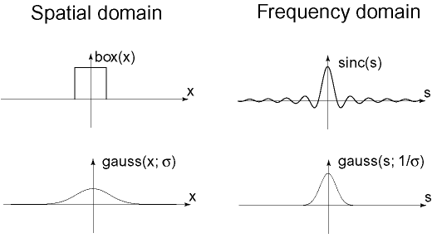

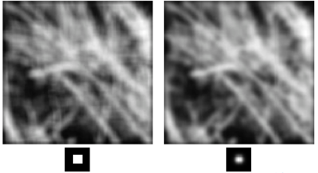
Ringing artifact
We will revisit
this discussion
later in the Fourier
transform topic
Result of blurring using a uniform local model.
Produces a set of narrow horizontal and vertical bars – ringing effect.
Result of blurring using a Gaussian filter.
Adapted from David Forsyth, UC Berkeley

Slide 22
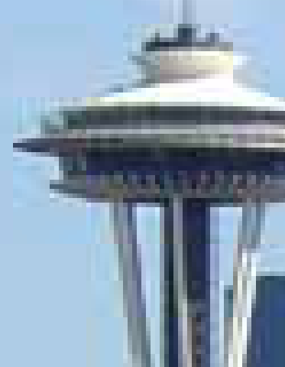




Smoothing spatial filters
Gaussian versus mean filters
Adapted from CSE 455, U of Washington

Slide 23
Order-statistic filters
Order-statistic filters are nonlinear spatial filters whose response is based on
  ordering (ranking) the pixels contained in the image area encompassed by the filter, and then
  replacing the value of the center pixel with the value determined by the ranking result.
The best-known example is the median filter.
It is particularly effective in the presence of impulse or salt-and-pepper noise, with considerably less blurring than linear smoothing filters.

Slide 24
Order-statistic filters
10
11
10
0
0
1
X
X
X
X
X
X
9
10
11
1
0
1
X
10
X
I
10
9
10
0
2
1
O
X
X
11
10
9
10
9
11
X
X
9
10
11
9
99
11
X
X
10
9
9
11
10
10
X
X
X
X
X
X
median
sort
10,11,10,9,10,11,10,9,10
9,9,10,10,10,10,10,11,11
Adapted from Octavia Camps, Penn State

Slide 25
Order-statistic filters
10
11
10
0
0
1
X
X
X
X
X
X
9
10
11
1
0
1
X
X
I
10
9
10
0
2
1
O
X
X
11
10
9
10
9
11
X
X
9
10
11
9
99
11
X
10
X
10
9
9
11
10
10
X
X
X
X
X
X
median
sort
10,9,11,9,99,11,11,10,10
9,9,10,10,10,11,11,11,99
Adapted from Octavia Camps, Penn State

Slide 26
Salt-and-pepper noise
Adapted from Linda Shapiro,
U of Washington

Slide 27
Gaussian noise
Adapted from Linda Shapiro,
U of Washington

Slide 28
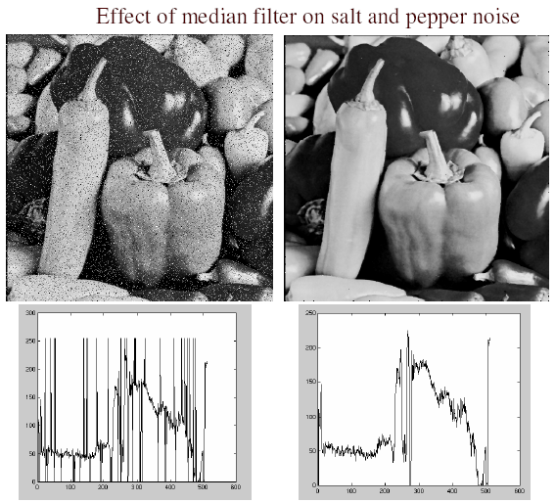
Order-statistic filters
Adapted from Martial Hebert, CMU

Slide 29


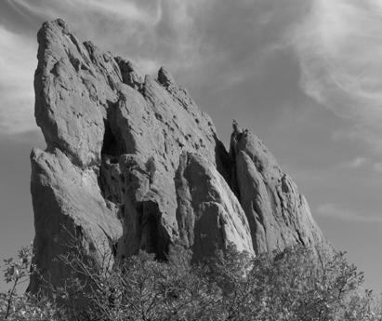
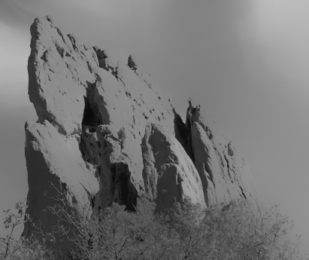




Spatially varying filters
*
input
output
*
*
Bilateral filter: kernel depends on the local image content.
See the Szeliski book for the math.
Adapted from Sylvian Paris

Slide 30

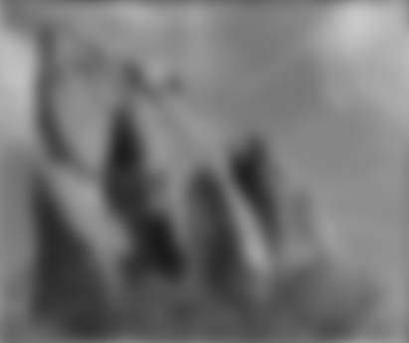
Spatially varying filters
*
input
output
*
*
Compare to the result of using the same Gaussian kernel everywhere
Adapted from Sylvian Paris

Slide 31
Sharpening spatial filters
Objective of sharpening is to highlight or enhance fine detail in an image.
Since smoothing (averaging) is analogous to integration, sharpening can be accomplished by spatial differentiation.
First-order derivative of 1D function f(x)
f(x+1) – f(x).
Second-order derivative of 1D function f(x)
f(x+1) – 2f(x) + f(x-1).

Slide 32
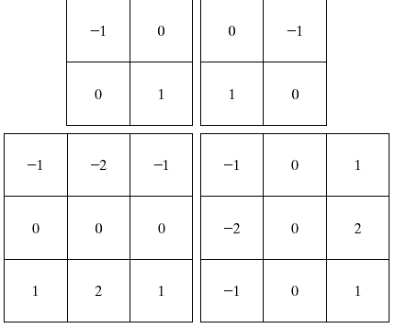
Sharpening spatial filters
Robert’s cross-gradient operators
Sobel gradient operators

Slide 33
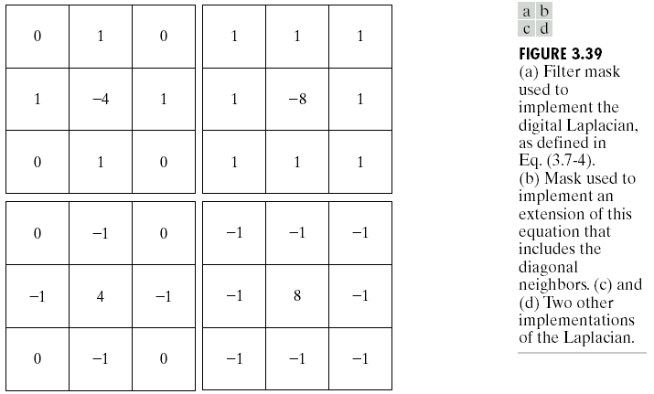
Sharpening spatial filters

Slide 34
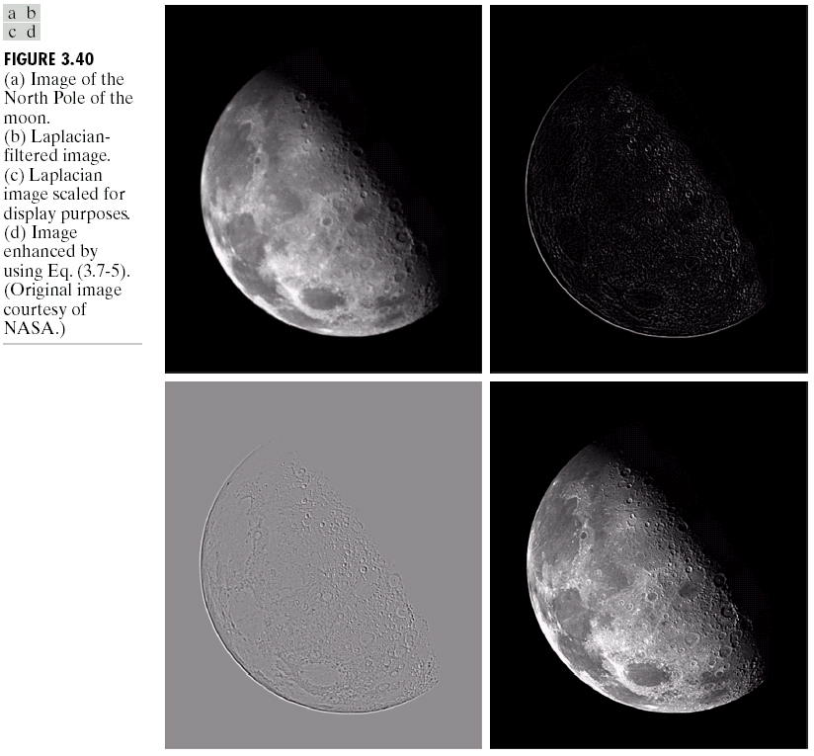
Sharpening spatial filters
Adapted from Gonzales and Woods

Slide 35
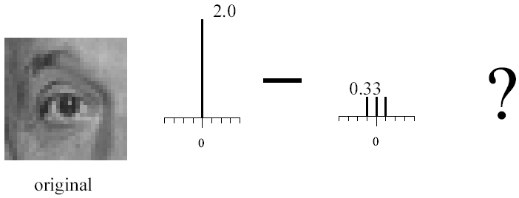
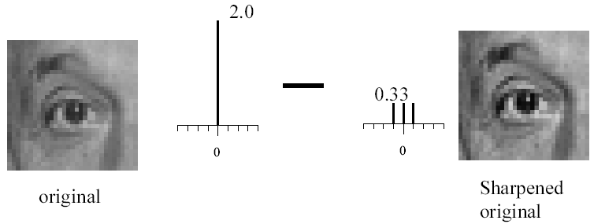
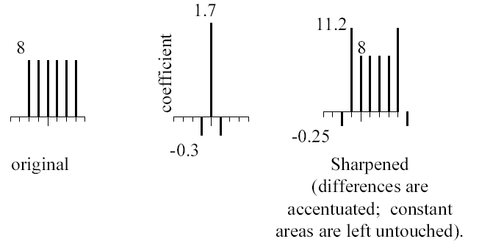
Sharpening spatial filters
High-boost filtering
Adapted from Darrell and Freeman, MIT

Slide 36
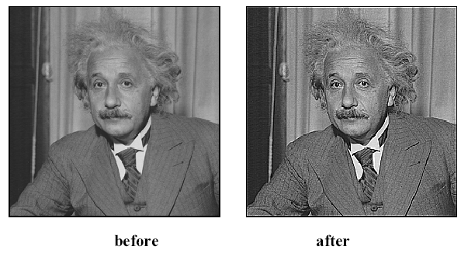
Sharpening spatial filters
Adapted from Darrell and Freeman, MIT

Slide 37
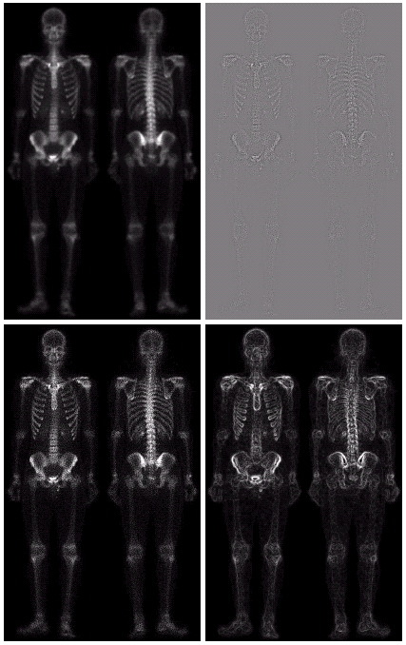
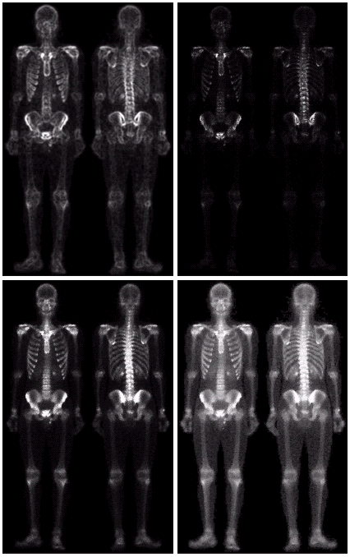
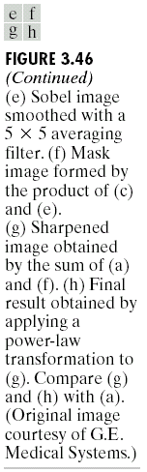
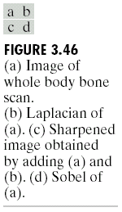
Combining spatial enhancement methods

