Slide 1
Filtering – Part II
Selim Aksoy
Department of Computer Engineering
Bilkent University
saksoy@cs.bilkent.edu.tr

Slide 2
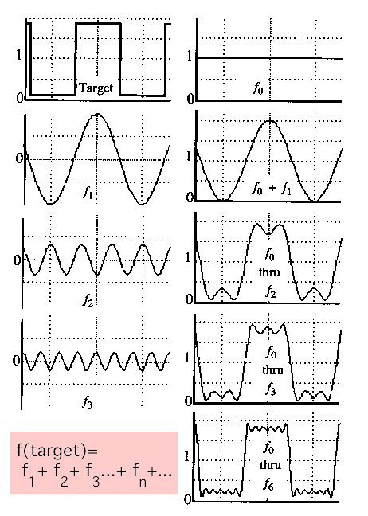
Fourier theory
The Fourier theory shows how most real functions can be represented in terms of a basis of sinusoids.
The building block:
  A sin( ωx + Φ )
Add enough of them to get any signal you want.
Adapted from Alexei Efros, CMU

Slide 3
Fourier transform

Slide 4
Fourier transform

Slide 5
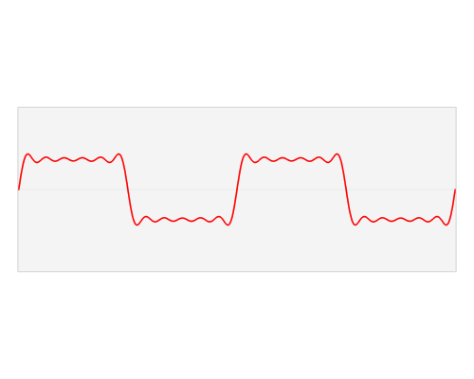
An illustration
By Lucas V. Barbosa - Own work, Public Domain, https://commons.wikimedia.org/w/index.php?curid=24822617

Slide 6
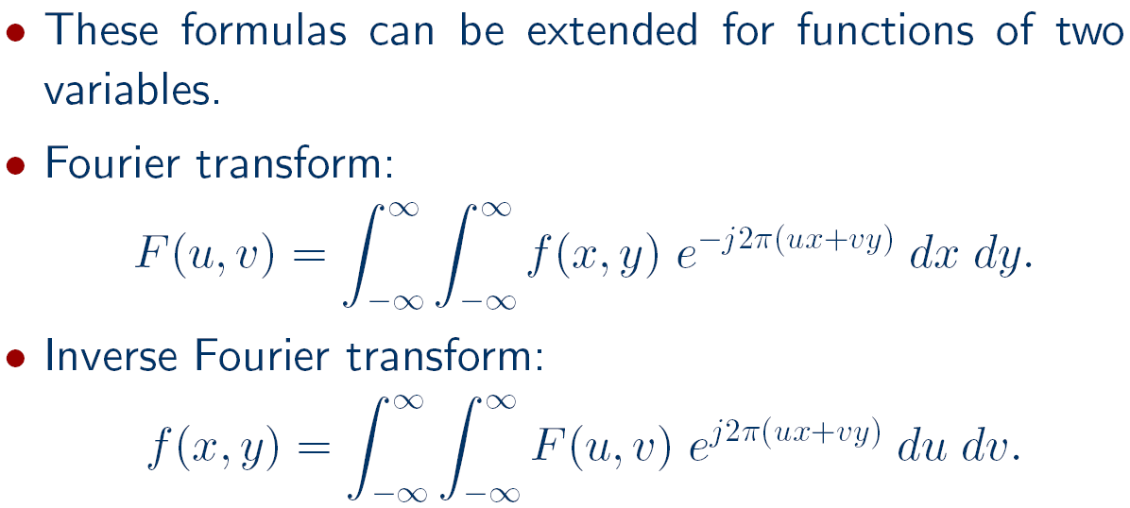
Fourier transform

Slide 7
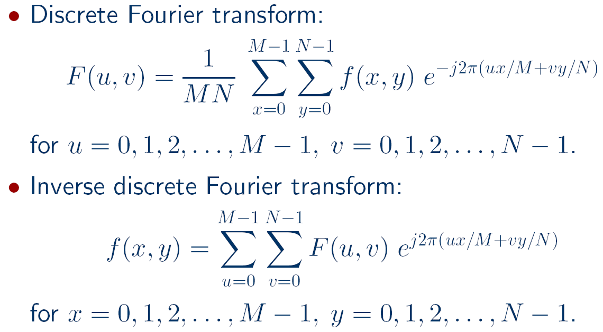
Fourier transform

Slide 8
Fourier transform

Slide 9
Fourier transform

Slide 10

Fourier transform
To get some sense of what basis elements look like, we plot a basis element --- or rather, its real part ---
as a function of x,y for some fixed u, v. We get a function that is constant when (ux+vy) is constant. The magnitude of the vector (u, v) gives a frequency, and its direction gives an orientation. The function is a sinusoid with this frequency along the direction, and constant perpendicular to the direction.
v
u
Adapted from Antonio Torralba

Slide 11

Fourier transform
Here u and v are larger than in the previous slide.
v
u
Adapted from Antonio Torralba

Slide 12

Fourier transform
And larger still...
v
u
Adapted from Antonio Torralba

Slide 13
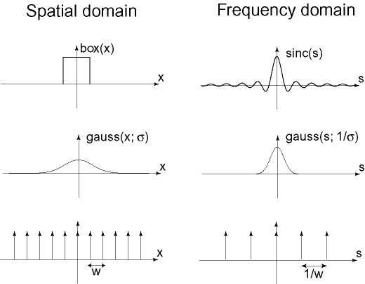

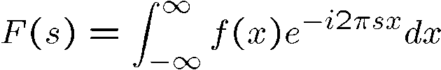
Fourier transform
Adapted from Alexei Efros, CMU

Slide 14
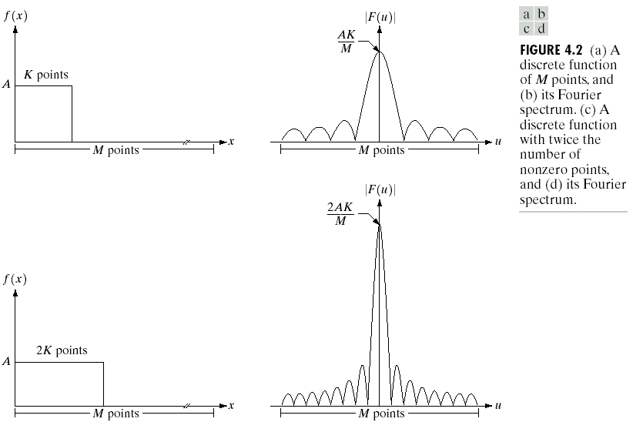
Fourier transform
Adapted from Gonzales and Woods

Slide 15
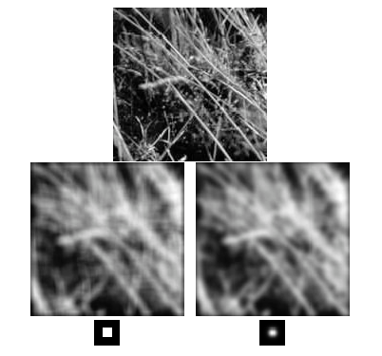
Ringing artifact revisited
Adapted from Gonzales and Woods

Slide 16
Fourier transform - matlab
A=1; K=10; M=100;
t=[ones(1,K)*A zeros(1,M-K)];
subplot(3,1,1); bar(t); ylim([0 2*A])
subplot(3,1,2); bar(abs(fftshift(fft(t)))); ylim([0 A*K+1])
% Matlab uses DFT formulation without normalization by M.
subplot(3,1,3); bar(real(fftshift(fft(t)))); ylim([-A*K+1 A*K+1])
Adapted from Gonzales and Woods

Slide 17
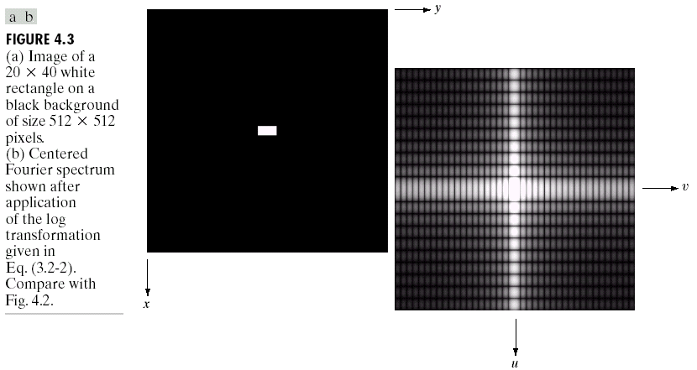
Fourier transform
Adapted from Gonzales and Woods

Slide 18
Fourier transform

Slide 19
Fourier transform

Slide 20
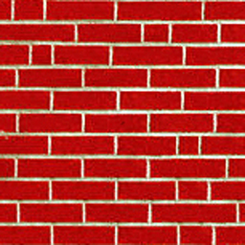
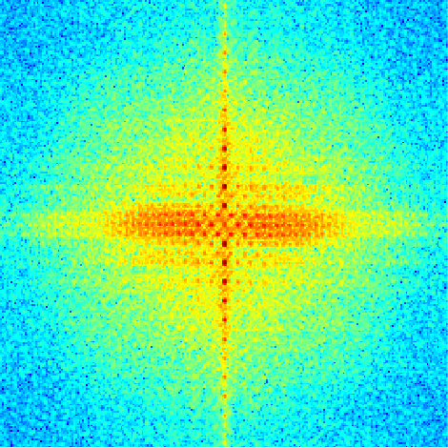
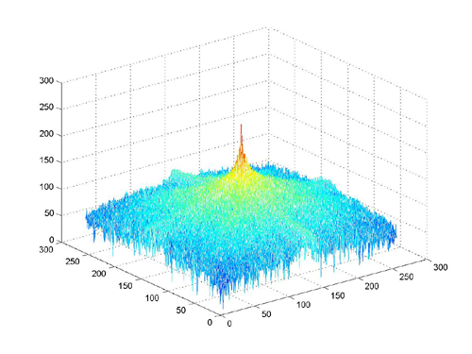
Fourier transform
How to interpret a Fourier spectrum:
Vertical orientation
Low spatial frequencies
45 deg.
0
Horizontal
orientation
0
fmax
High
spatial
frequencies
fx in cycles/image
Log power spectrum
Adapted from Antonio Torralba

Slide 21
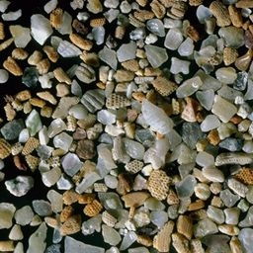
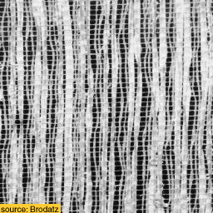
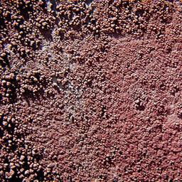
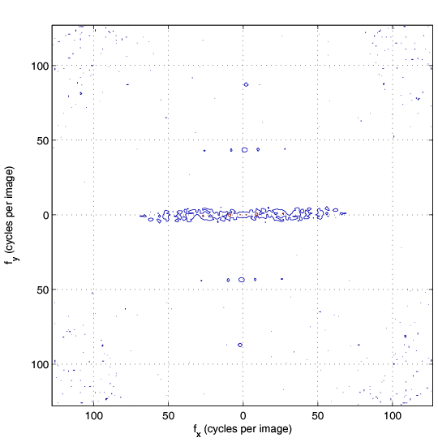
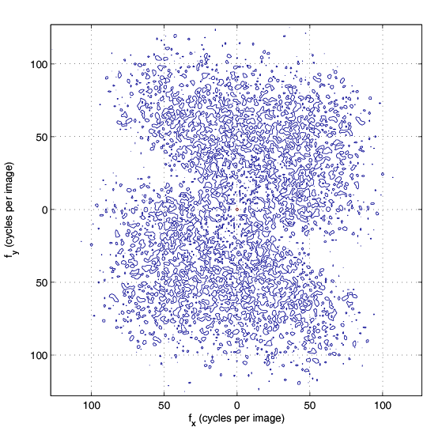
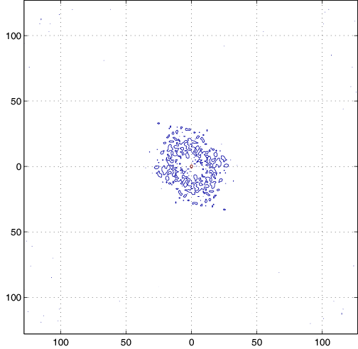
Fourier transform
A
B
C
1
2
3
Adapted from Antonio Torralba

Slide 22
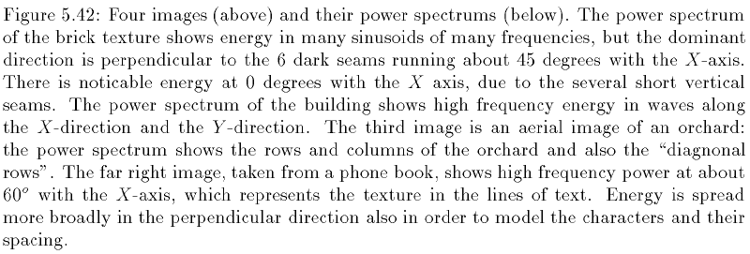
Fourier transform
Adapted from Shapiro and Stockman

Slide 23
Convolution theorem

Slide 24
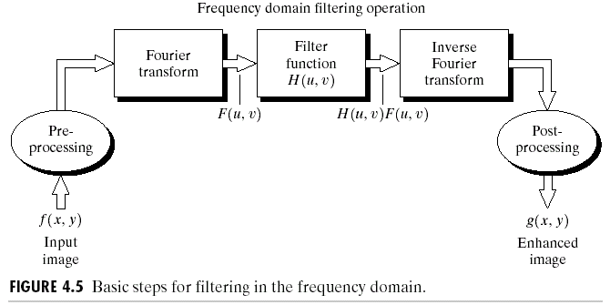
Frequency domain filtering
Adapted from Shapiro and Stockman,
and Gonzales and Woods

Slide 25
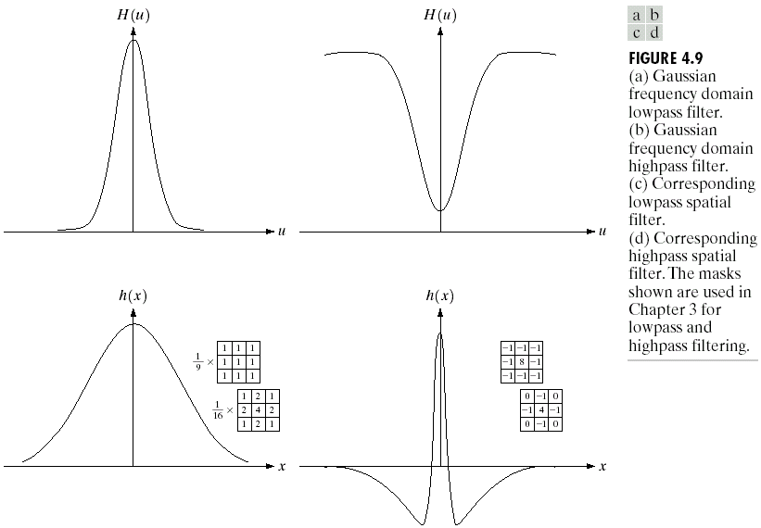
Frequency domain filtering

Slide 26

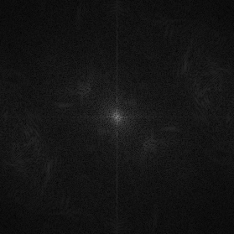


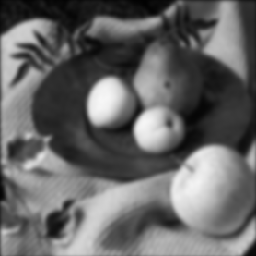

Frequency domain filtering
f(x,y)
|F(u,v)|
★
×
h(x,y)
|H(u,v)|
⇓
⇓
g(x,y)
|G(u,v)|
Adapted from Alexei Efros, CMU

Slide 27
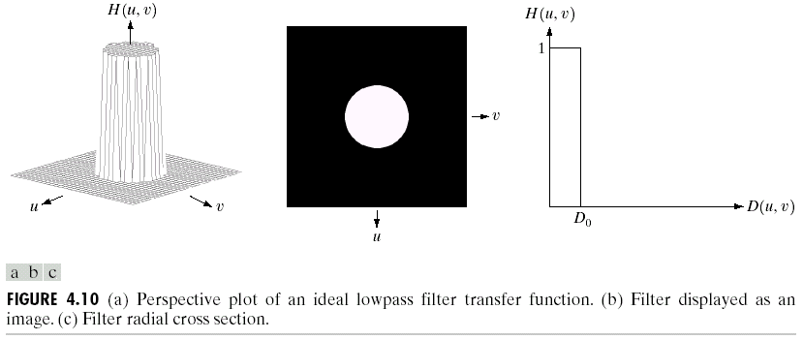
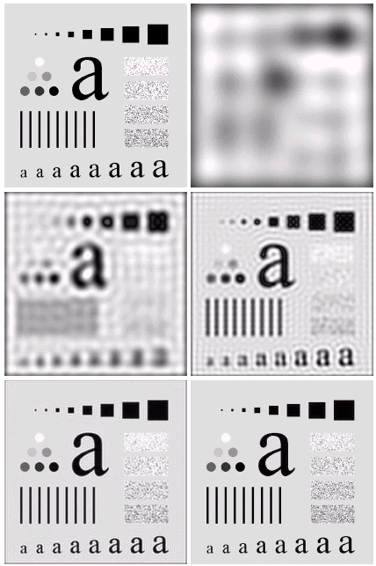

Smoothing frequency domain filters

Slide 28
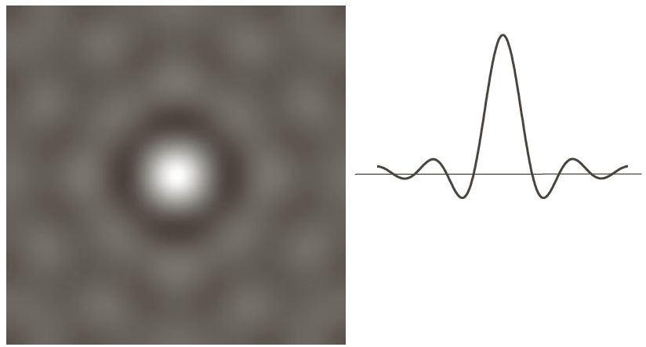
Smoothing frequency domain filters
The blurring and ringing caused by the ideal low-pass filter can be explained using the convolution theorem where the spatial representation of a filter is given below.

Slide 29
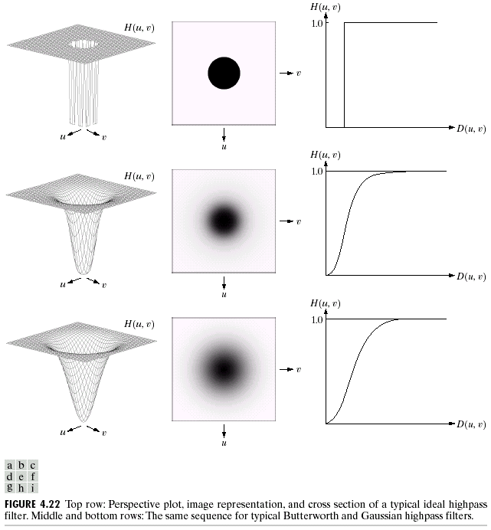
Sharpening frequency domain filters

Slide 30
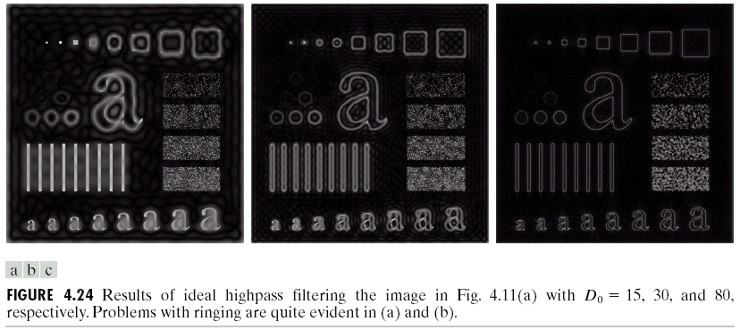
Sharpening frequency domain filters
Adapted from Gonzales and Woods

Slide 31
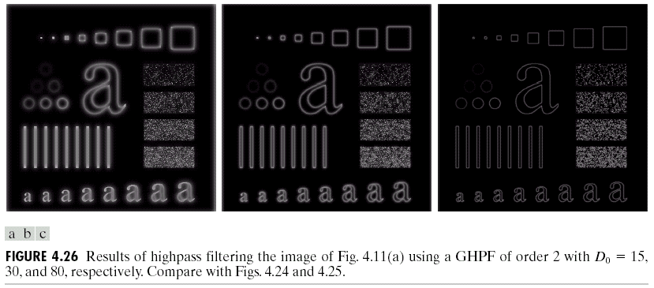
Sharpening frequency domain filters
Adapted from Gonzales and Woods

Slide 32
Template matching
Correlation can also be used for matching.
If we want to determine whether an image f contains a particular object, we let h be that object (also called a template) and compute the correlation between f and h.
If there is a match, the correlation will be maximum at the location where h finds a correspondence in f.
Preprocessing such as scaling and alignment is necessary in most practical applications.

Slide 33
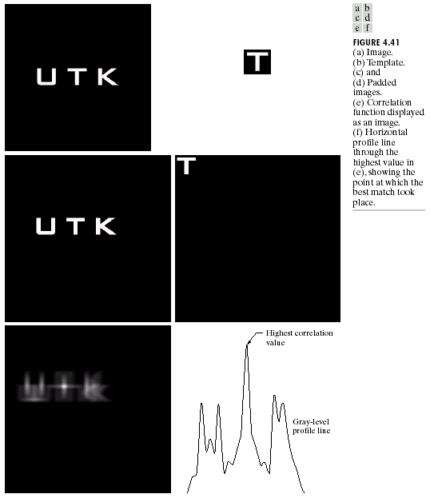
Template matching
Adapted from Gonzales and Woods

Slide 34
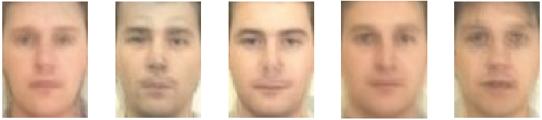
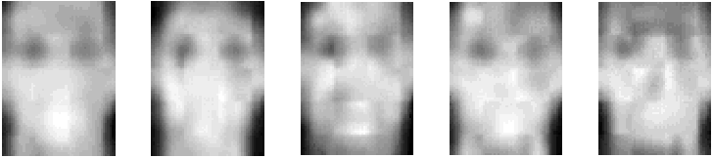
Template matching
Face detection using template matching: face templates.

Slide 35
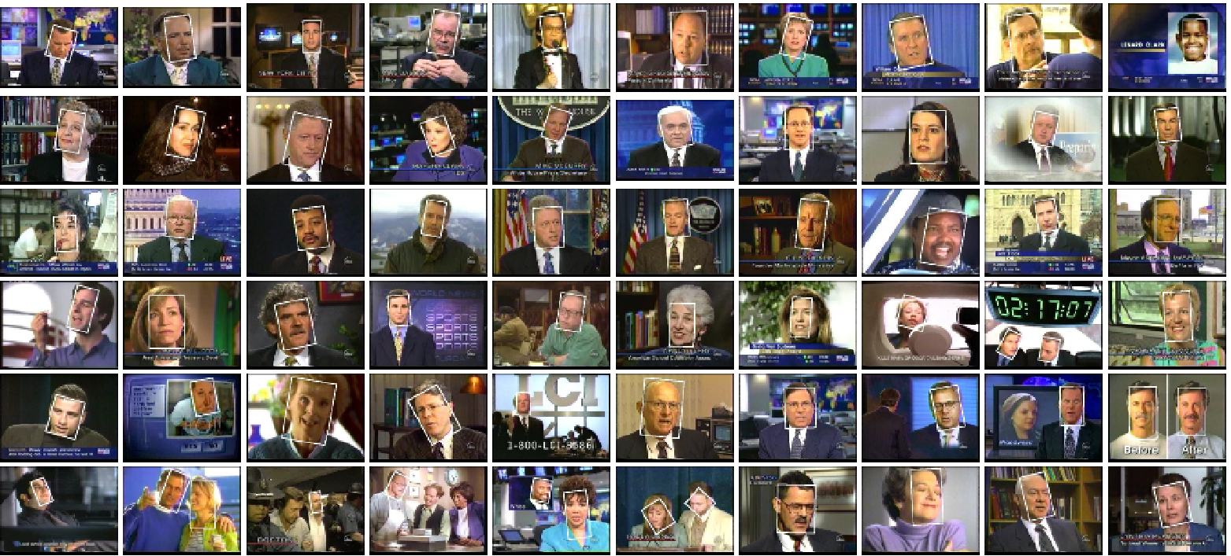
Template matching
Face detection using template matching: detected faces.

Slide 36
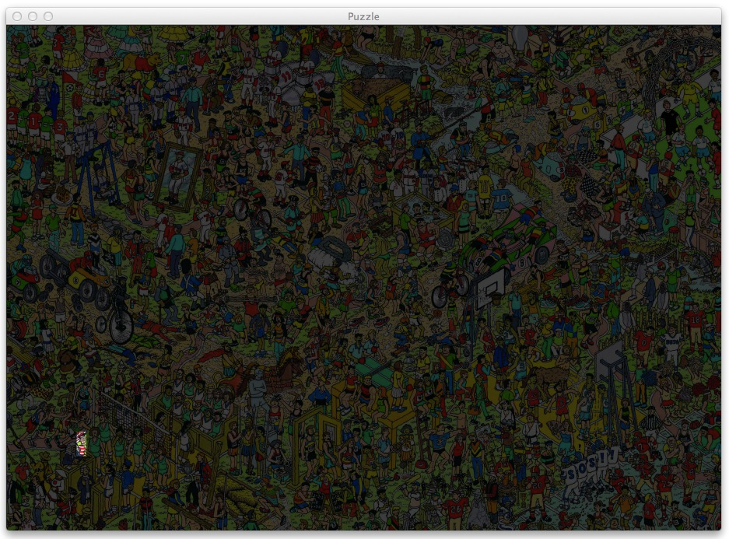
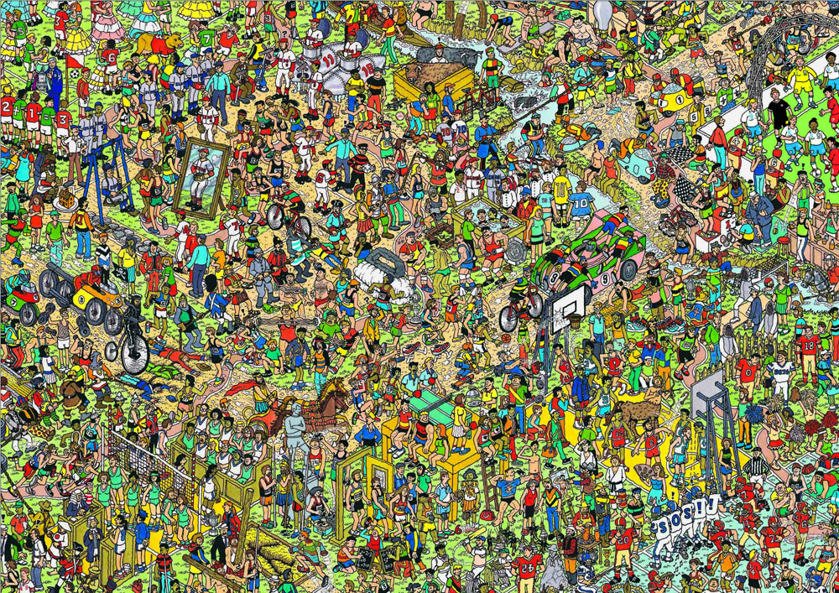
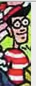
Template matching
Where is Waldo?
http://machinelearningmastery.com/using-opencv-python-and-template-matching-to-play-wheres-waldo/

Slide 37
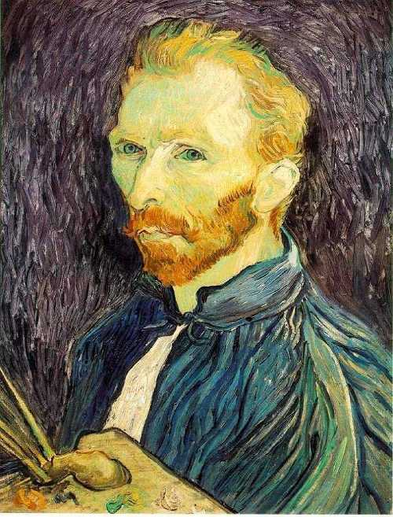
Resizing images
How can we generate a half-sized version of a large image?
Adapted from Steve Seitz, U of Washington

Slide 38

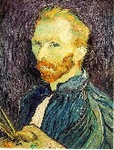

Resizing images
1/8
1/4
Throw away every other row and column to create a 1/2 size image (also called sub-sampling).
Adapted from Steve Seitz, U of Washington

Slide 39
Resizing images
1/2
1/4 (2x zoom)
1/8 (4x zoom)
Does this look nice?
Adapted from Steve Seitz, U of Washington

Slide 40



Resizing images
We cannot shrink an image by simply taking every k’th pixel.
Solution: smooth the image, then sub-sample.
Gaussian 1/8
Gaussian 1/4
Gaussian 1/2
Adapted from Steve Seitz, U of Washington

Slide 41
Resizing images
Gaussian 1/2
Gaussian 1/4 (2x zoom)
Gaussian 1/8 (4x zoom)
Adapted from Steve Seitz, U of Washington

Slide 42
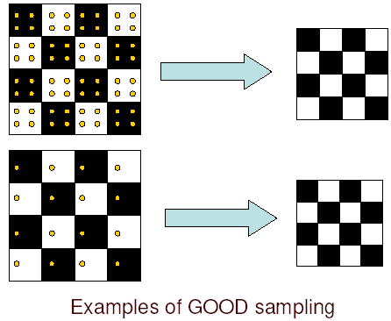
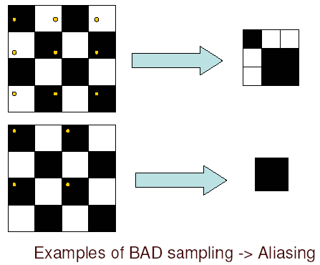
Sampling and aliasing
Adapted from Steve Seitz, U of Washington

Slide 43
Sampling and aliasing
Errors appear if we do not sample properly.
Common phenomenon:
  High spatial frequency components of the image appear as low spatial frequency components.
Examples:
  Wagon wheels rolling the wrong way in movies.
  Checkerboards misrepresented in ray tracing.
  Striped shirts look funny on color television.

Slide 44
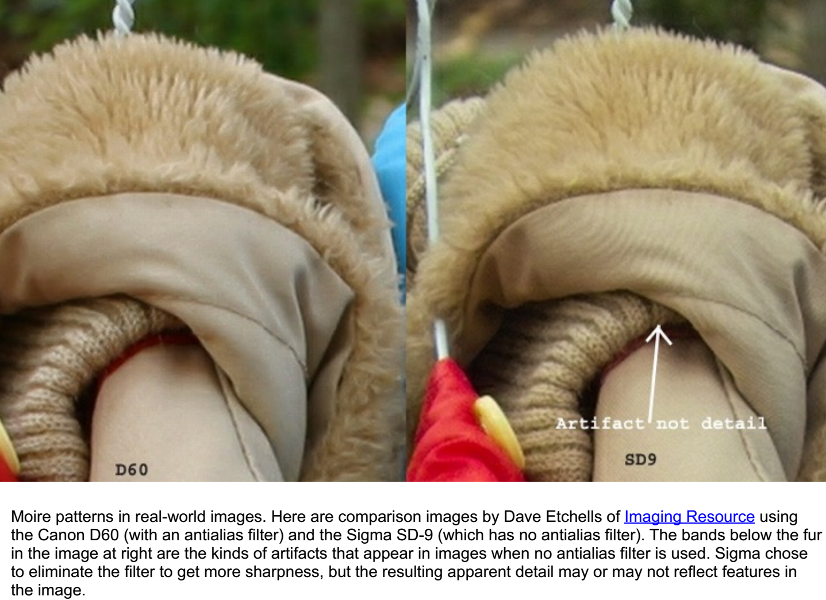
Sampling and aliasing
Adapted from Ali Farhadi

Slide 45
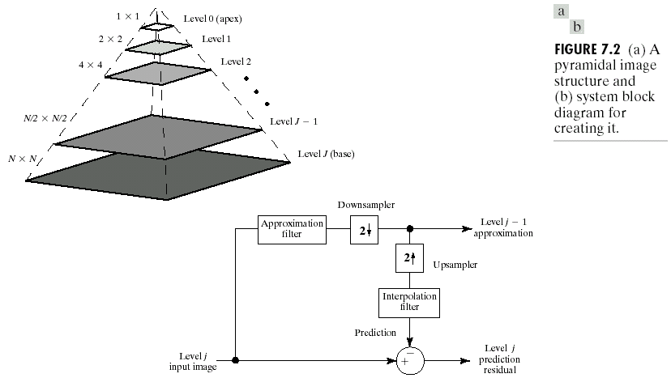
Gaussian pyramids
Adapted from Gonzales and Woods

Slide 46
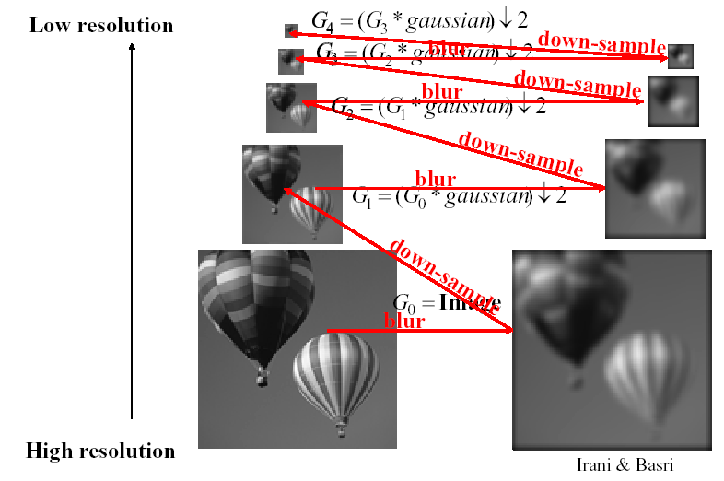
Gaussian pyramids
Adapted from Michael Black, Brown University

Slide 47
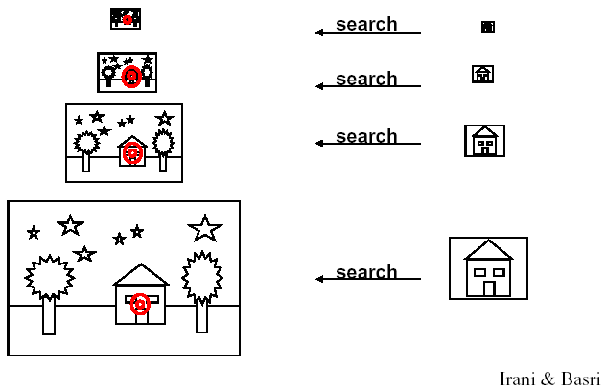
Gaussian pyramids
Adapted from Michael Black, Brown University

