Slide 1
Content-Based Image Retrieval
Selim Aksoy
Department of Computer Engineering
Bilkent University
saksoy@cs.bilkent.edu.tr

Slide 2
Image retrieval
Searching a large database for images that match a query:
  What kind of databases?
  What kind of queries?
  What constitutes a match?
  How do we make such searches efficient?

Slide 3
Applications
Art Collections
  Fine Arts Museum of San Francisco
Medical Image Databases
  CT, MRI, Ultrasound, The Visible Human
Scientific Databases
  Earth Sciences
General Image Collections for Licensing
  Corbis, Getty Images
The World Wide Web
  Google, Microsoft, Flickr

Slide 4

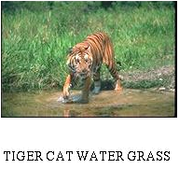


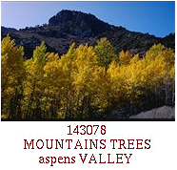
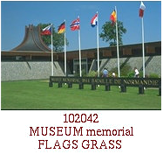
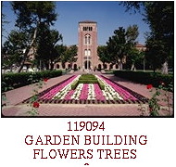
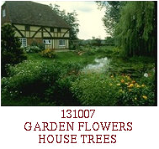
Corel data set
60,000 images with annotated keywords

Slide 5
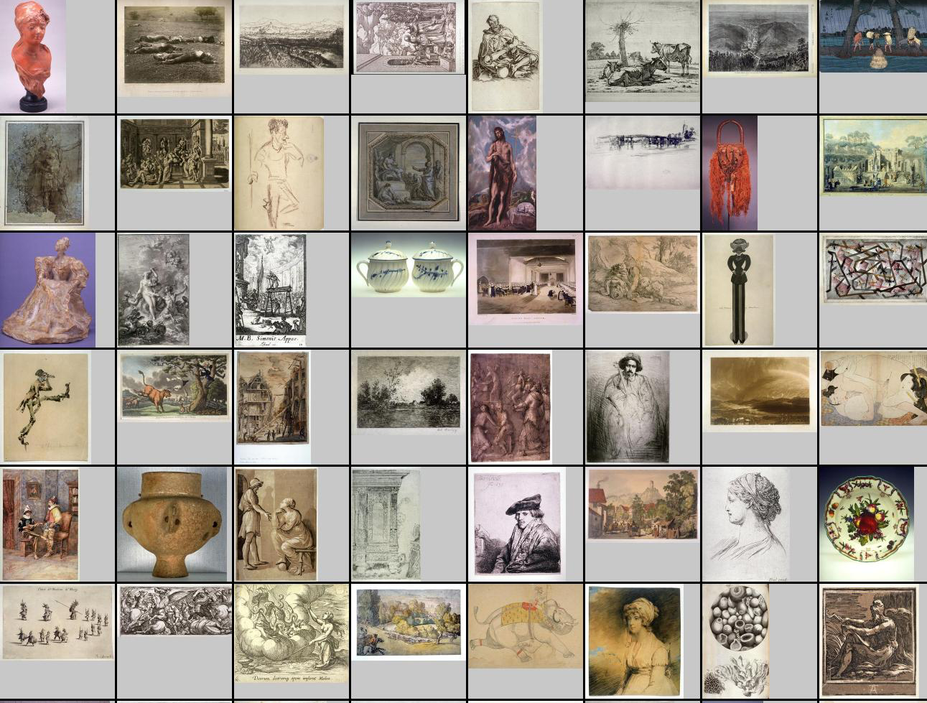
Fine Arts Museum of San Francisco
80,000 images

Slide 6
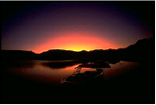
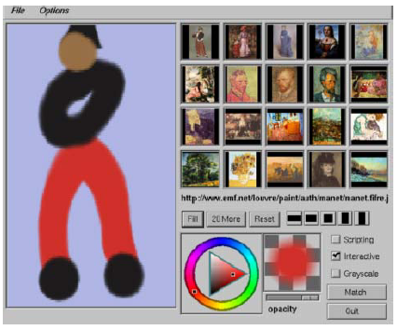
Query formulation
Text description (keywords)
Query by example
Query by sketch
Symbolic description (man and woman on a beach)
Relevance feedback

Slide 7
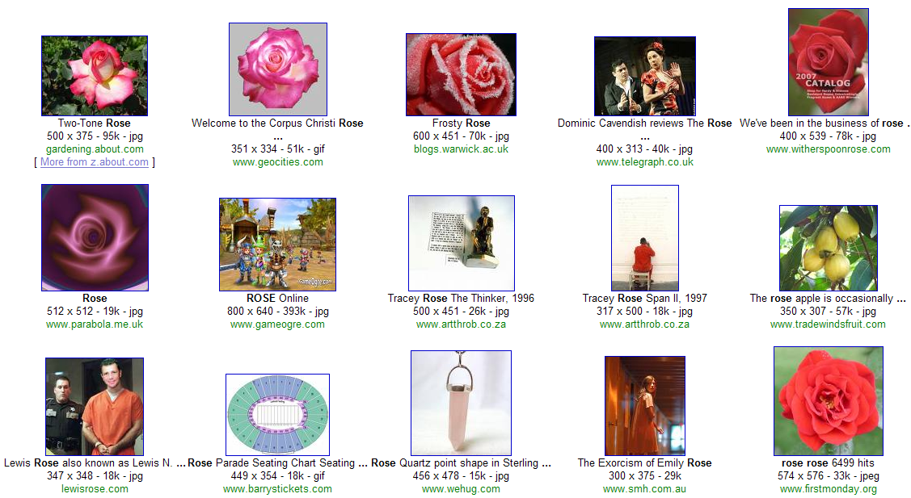
Google query on “rose”

Slide 8
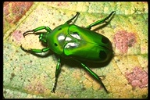
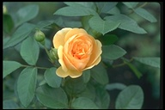
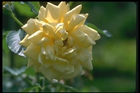
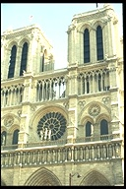
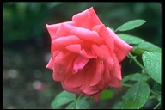
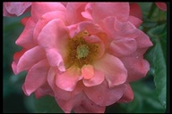
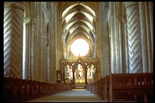
Corel query on “rose”

Slide 9
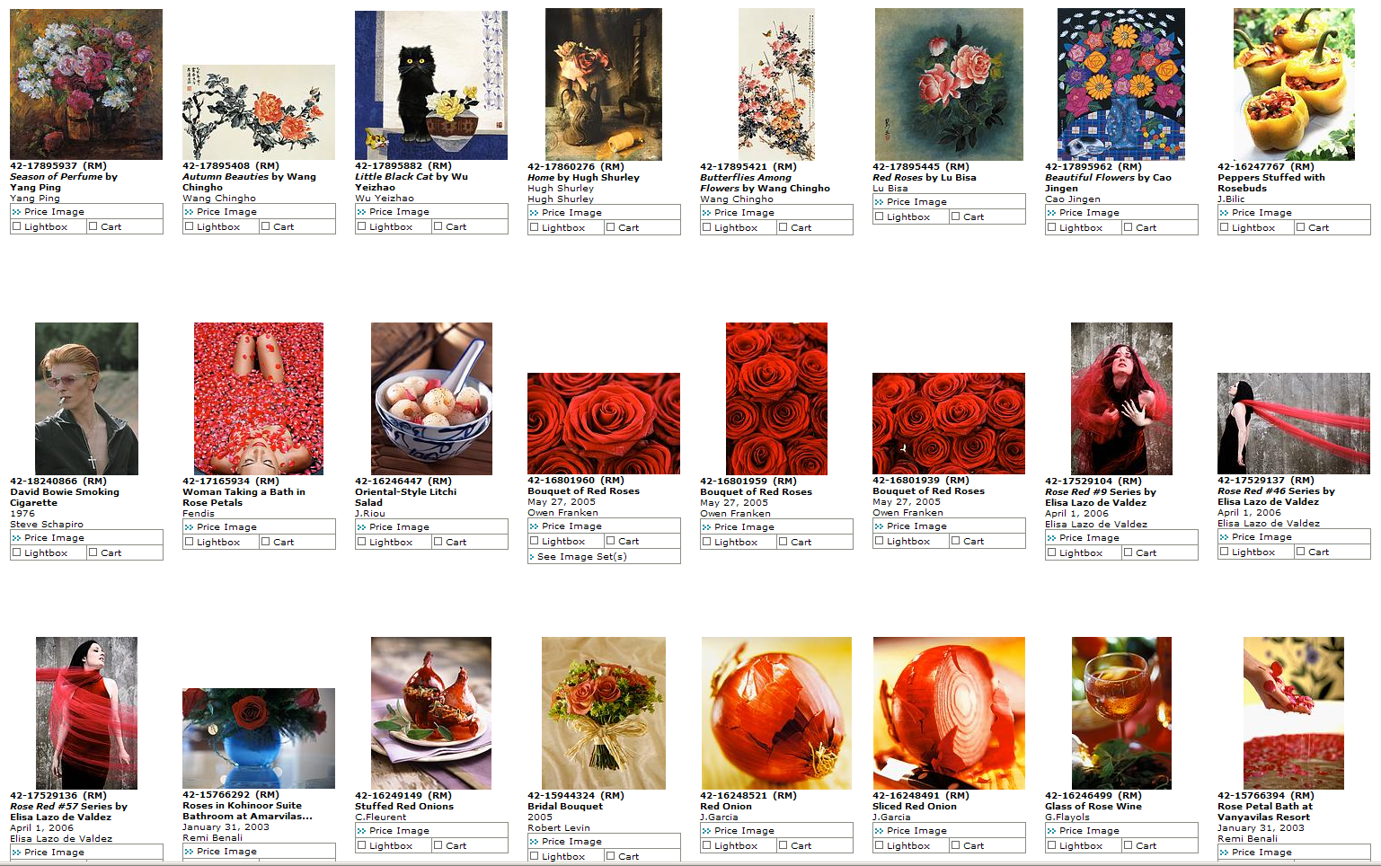
Corbis query on “rose”

Slide 10
Difficulties with keywords
Images may not have keywords.
  (An image is worth … how many key-words?)
Query is not easily satisfied by keywords.
  “A casually dressed couple gazing into each others eyes lovingly with dramatic clouds in the background.”
  “Pretty girl doing something active, sporty in a summery setting, beach - not wearing lycra, exercise clothes - more relaxed in tee-shirt. Feature is about deodorant so girl should look active - not sweaty but happy, healthy, carefree - nothing too posed or set up - nice and natural looking.”
Content-based image retrieval (CBIR)

Slide 11
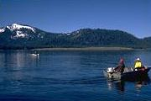

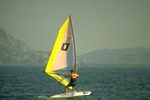
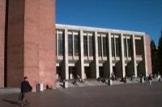
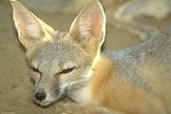
Content-based image retrieval
Query Image
Retrieved Images
User
Image Database
Distance Measure
Images
Image Feature Extraction
Feature Space

Slide 12
Image representations and features
Image representations:
  Iconic
  Global
  Region-based
  Object-based
Image features:
  Color
  Texture
  Shape
  Objects and their relationships
  (this is the most powerful, but you have to be able to recognize the objects!)

Slide 13
Image similarity
Distance measures:
  Euclidean distance
  Other L_{p} metrics
  Histogram intersection
  Cosine distance
  Earth mover’s distance
Probabilistic similarity measures:
  P( relevance | two images )
  P( relevance | two images ) / P( irrelevance | two images)

Slide 14
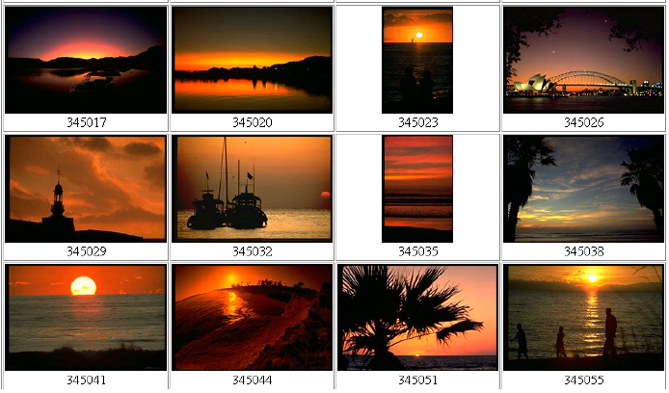
Global histograms
Searching using global color histograms

Slide 15
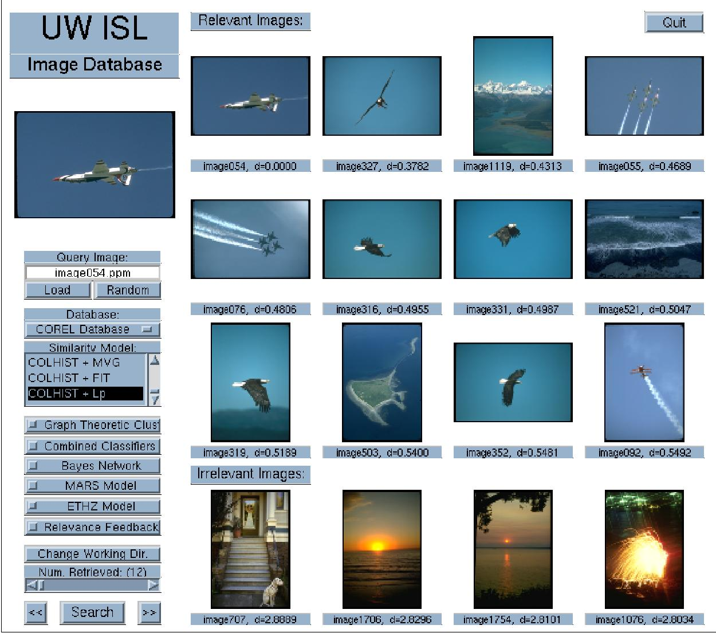
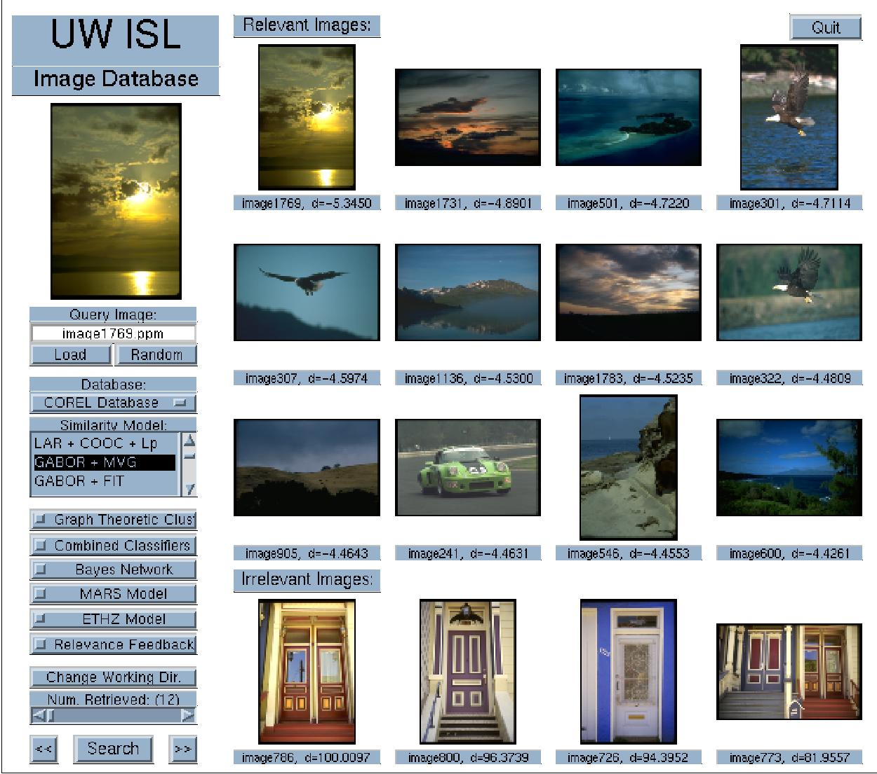
Global histograms
“Airplanes” using color histograms (4/12)
“Sunsets” using Gabor texture (3/12)

Slide 16
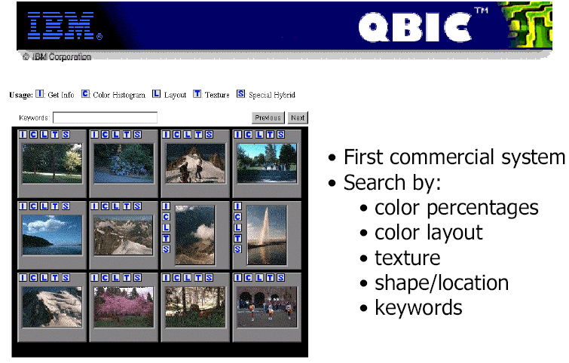
Query by image content (QBIC)

Slide 17
Color histograms in QBIC
The QBIC color histogram distance is:
d_{hist}(I,Q) = (h(I) - h(Q))^{T} A (h(I) - h(Q)).
h(I) is a K-bin histogram of a database image.
h(Q) is a K-bin histogram of the query image.
A is a K x K similarity matrix.
R G B Y C V
1 0 0 .5 0 .5
0 1 0 .5 .5 0
0 0 1
1
1
1
R
G
B
Y
C
V
?
How similar is blue to cyan?
?

Slide 18
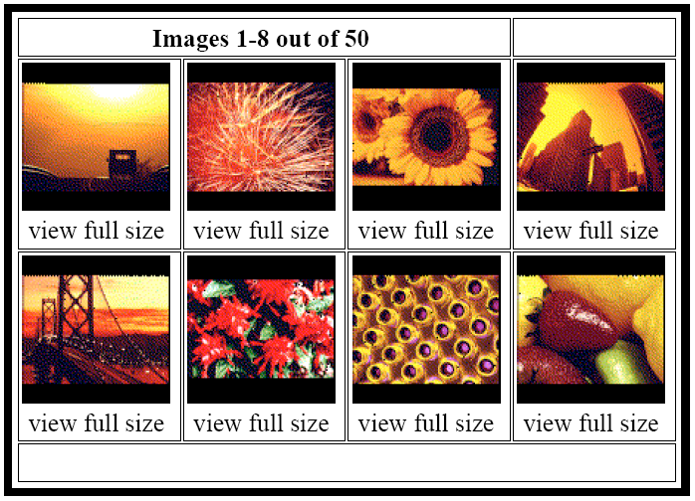
Color percentages in QBIC
%40 red, %30 yellow, %10 black

Slide 19
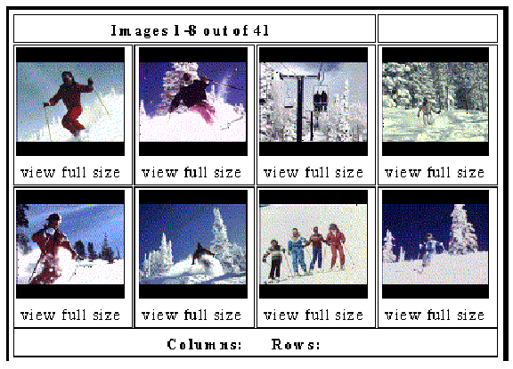
Color layout in QBIC

Slide 20
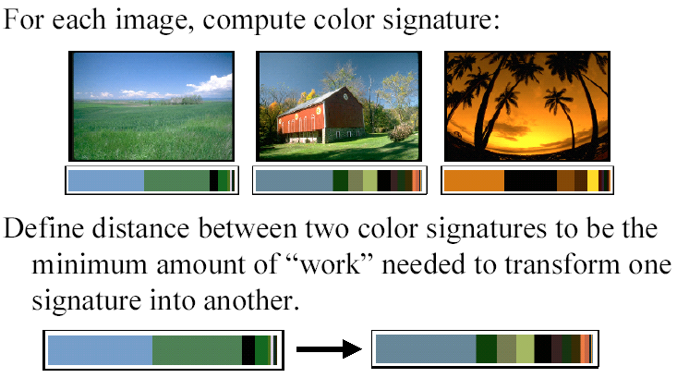
Earth mover’s distance

Slide 21
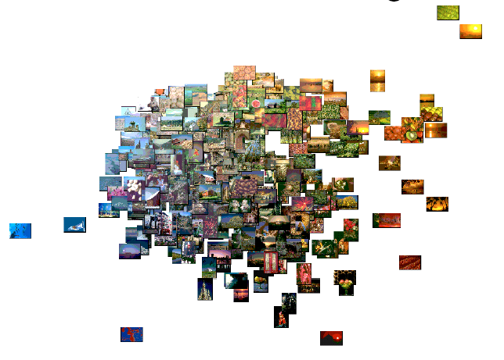
Earth mover’s distance
Visualization using EMD and multidimensional scaling

Slide 22
Probabilistic similarity measures
Two classes:
  Relevance class A
  Irrelevance class B
Bayes classifier
  Assign (ξ_{i},ξ_{j}) to
Discriminant function for classification
Rank images according to posterior ratio values based on feature differences.

Slide 23
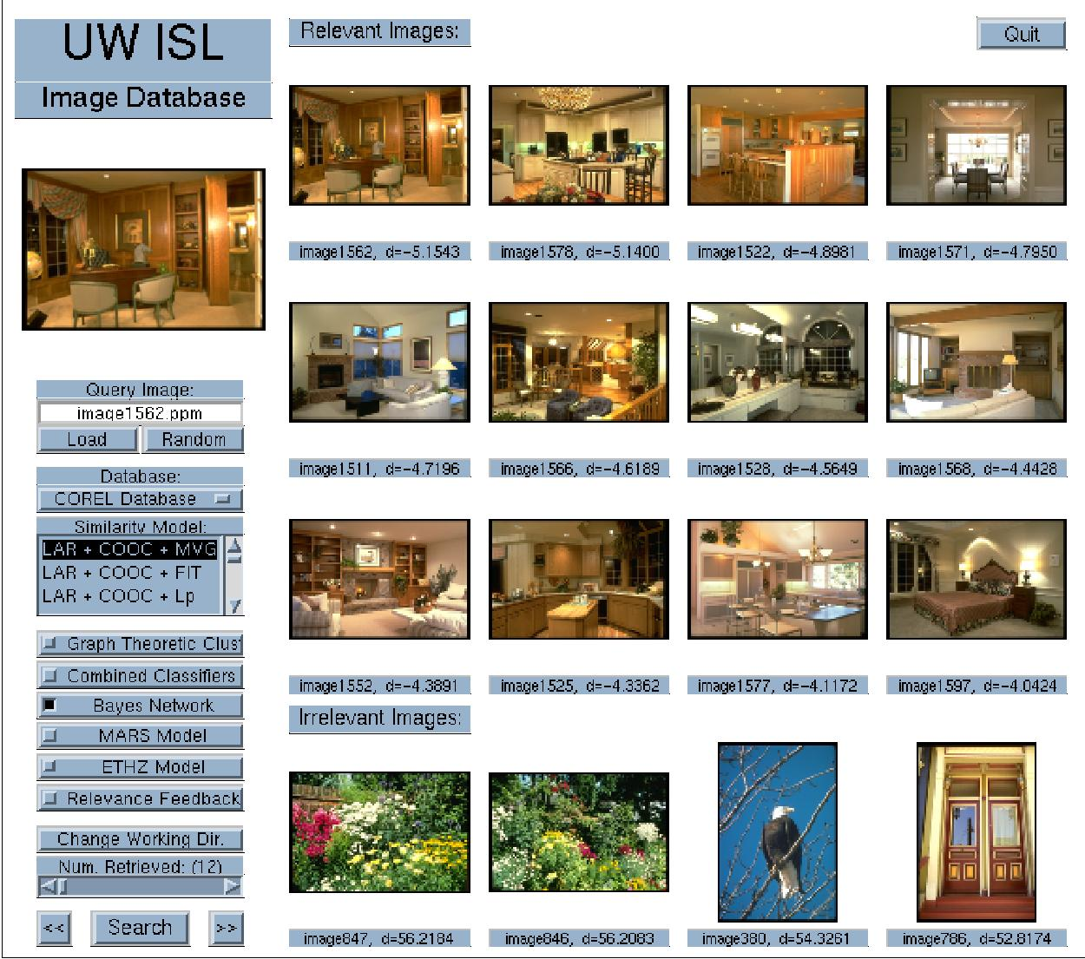
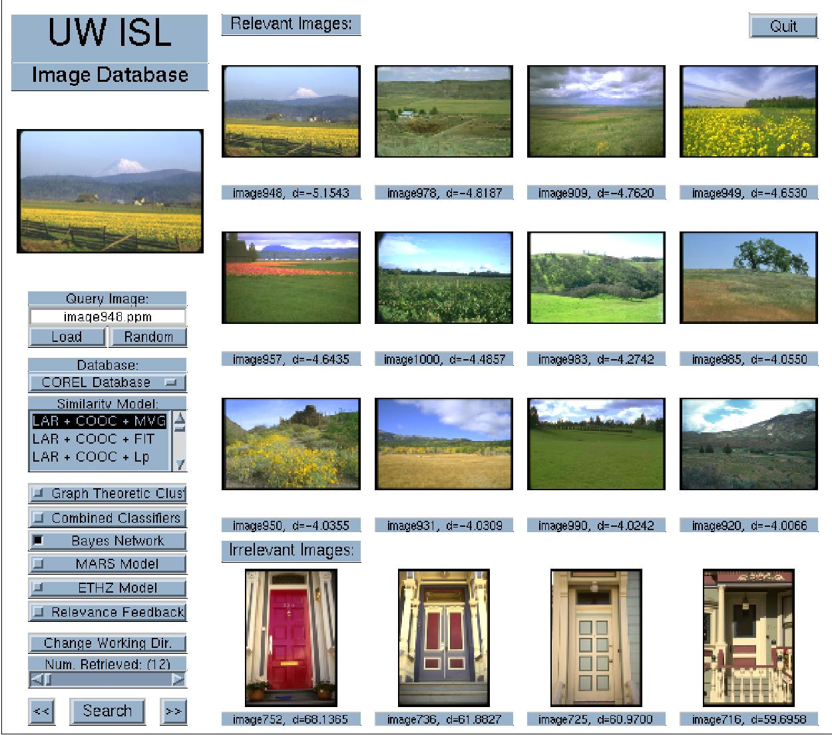
Probabilistic similarity measures
“Residential interiors” (12/12)
“Fields” (12/12)

Slide 24
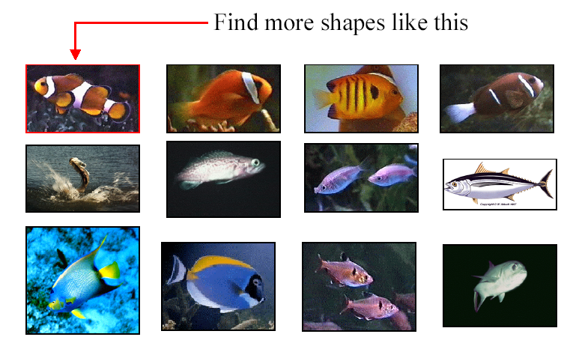
Shape-based retrieval

Slide 25
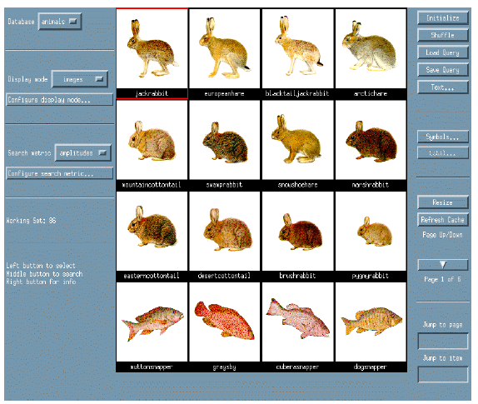
Shape-based retrieval

Slide 26
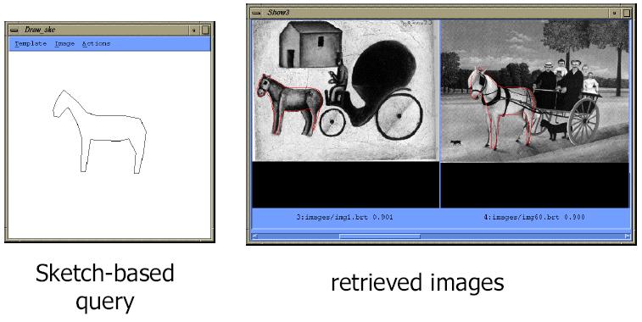
Elastic shape matching

Slide 27
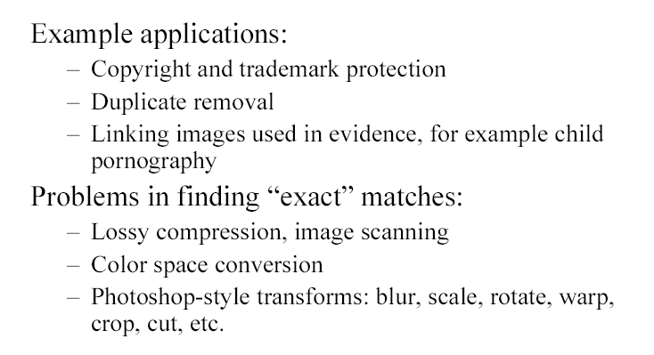
Iconic matching

Slide 28
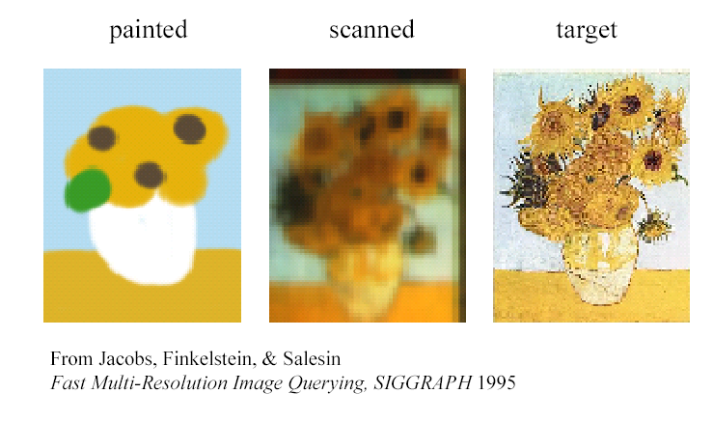
Iconic matching
Wavelet-based image compression
Quantization of coefficients

Slide 29
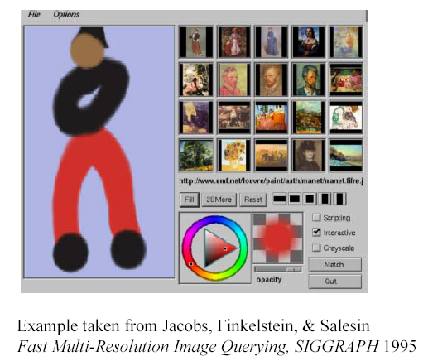
Iconic matching

Slide 30
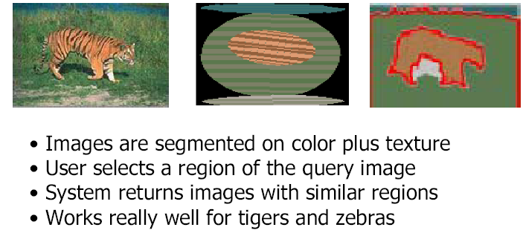
Region-based retrieval: Blobworld

Slide 31
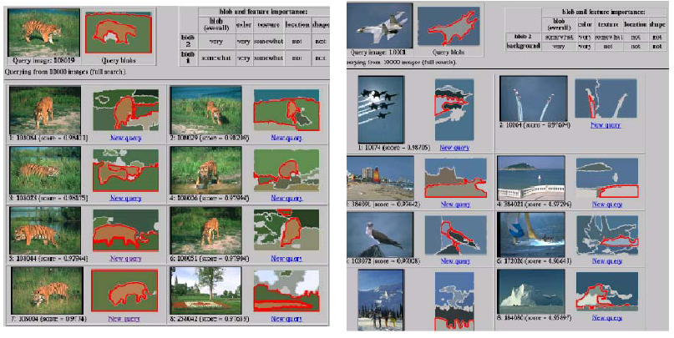
Region-based retrieval: Blobworld

Slide 32
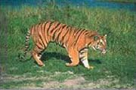
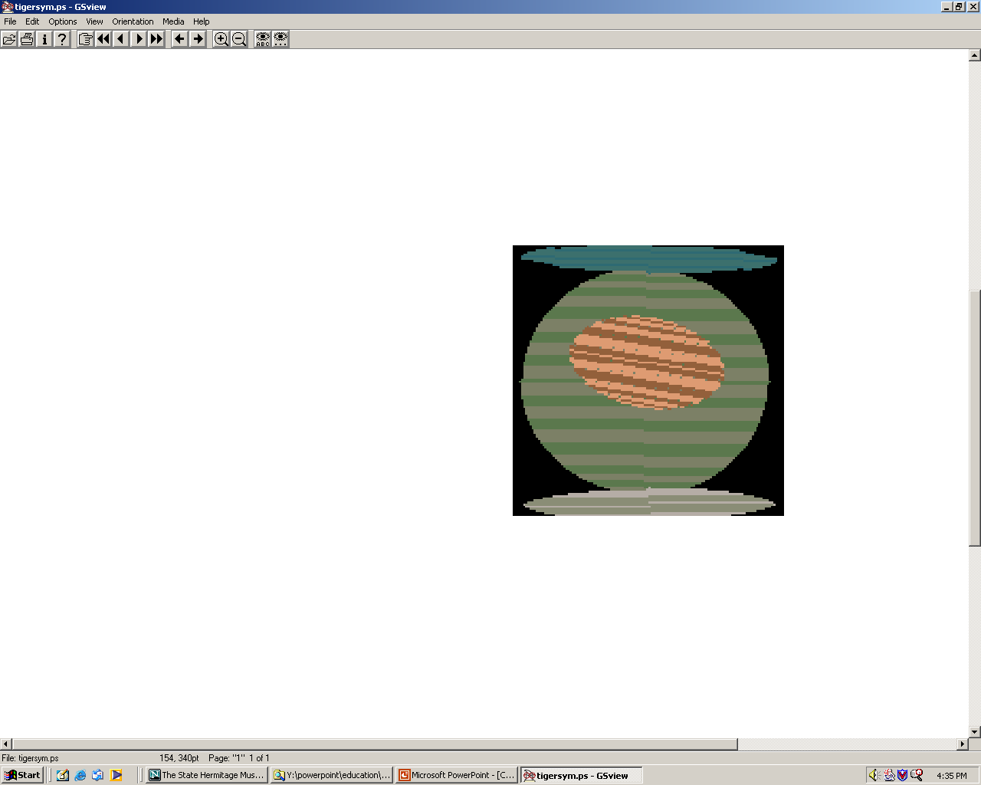
Retrieval using spatial relationships
Build graph using regions and their spatial relationships.
Similarity is computed using graph matching.
image
sky
above
above
adjacent
inside
tiger
grass
above
above
adjacent
abstract regions
sand

Slide 33
Combining multiple features
Text query
on
“rose”

Slide 34
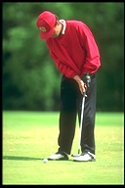
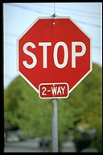

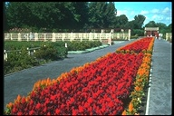
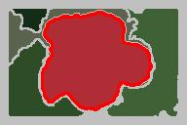
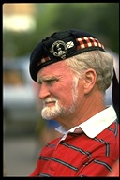

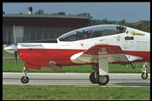
Combining multiple features
Visual query
on

Slide 35


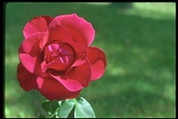

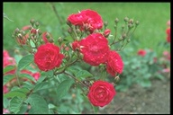
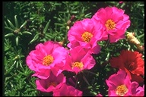
Combining multiple features
Text query
on
“rose”
and visual query
on

Slide 36




Video Google: object matching

Slide 37


Video Google
Viewpoint invariant descriptors
Visual vocabulary

Slide 38
Video Google
Document 1
Inverted index
Now is the time
for all good men
to come to the aid
of their country.
Word | Document
aid | 1
all | 1
and | 2
can | 2
come | 1, 2
country | 1
for | 1
good | 1
… | …
the | 1, 1, 2
… | …
Document 2
Summer has come
and passed. The innocent
can never last.

Slide 39

Video skimming

Slide 40

Event detection, indexing, retrieval

Slide 41


Informedia Digital Video Library
IDVL interface returned for "El Nino" query along with different multimedia abstractions from certain documents.

Slide 42

Informedia Digital Video Library
IDVL interface returned for “bin ladin" query.
The results can be tuned using many classifiers.

Slide 43


Relevance feedback
In real interactive CBIR systems, the user should be allowed to interact with the system to “refine” the results of a query until he/she is satisfied.

Slide 44
Relevance feedback
Example methods:
  Query point movement
    Query point is moved toward positive examples and moved away from negative examples.
  Weighting features
    The CBIR system should automatically adjust the weight that were given by the user for the relevance of previously retrieved documents.
  Weighting similarity measures
  Feature density estimation
  Probabilistic relevance feedback

Slide 45
Relevance feedback
Positive feedback
Negative feedback

Slide 46



Relevance feedback
“Sunsets” using color histograms (1/12)
Using combined features (6/12)
After 1st feedback (12/12)

Slide 47



Relevance feedback
“Auto racing” using color histograms (3/12)
Using combined features (9/12)
After 1st feedback (12/12)

Slide 48

Indexing for fast retrieval
Use of key images and the triangle inequality for efficient retrieval.

Slide 49
Indexing for fast retrieval
Offline
  Choose a small set of key images.
  Store distances from database images to keys.
Online (given query Q)
  Compute the distance from Q to each key.
  Obtain lower bounds on distances to database images.
  Threshold or return all images in order of lower bounds.

Slide 50

Indexing for fast retrieval
Hierarchical cellular tree

Slide 51

Indexing for fast retrieval

Slide 52
Performance evaluation
Two traditional measures for retrieval performance in the information retrieval literature are precision and recall.
Given a particular number of images retrieved,
  precision is defined as the percentage of retrieved images that are actually relevant, and
  recall is defined as the percentage of relevant images that are retrieved.

Slide 53
Current research objective
Query Image
Retrieved Images
User
boat
Image Database
…
Animals
Buildings
  Office Buildings
  Houses
Transportation
  Boats
  Vehicles
…
Images
Object-oriented
Feature Extraction
Categories

Slide 54
Demos
Google Image Search (http://images.google.com/)
Microsoft Image Search (https://www.bing.com/images)
Yahoo Image Search (http://images.search.yahoo.com/)
Vitalas (http://vitalas.ercim.eu/)
FIDS (http://www.cs.washington.edu/research/
imagedatabase/demo/fids/)
Like Visual Shopping (http://www.like.com/)
  Now Google shopping (http://www.google.com/shopping)
Google Similar Images
  http://googleblog.blogspot.com/2009/10/similar-images-graduates-from-google.html
Google Image Swirl
  http://googleresearch.blogspot.com/2009/11/explore-images-with-google-image-swirl.html

