Slide 1
Edge Detection
Selim Aksoy
Department of Computer Engineering
Bilkent University
saksoy@cs.bilkent.edu.tr

Slide 2
Edge detection
Edge detection is the process of finding meaningful transitions in an image.
The points where sharp changes in the brightness occur typically form the border between different objects or scene parts.
Further processing of edges into lines, curves and circular arcs result in useful features for matching and recognition.
Initial stages of mammalian vision systems also involve detection of edges and local features.

Slide 3
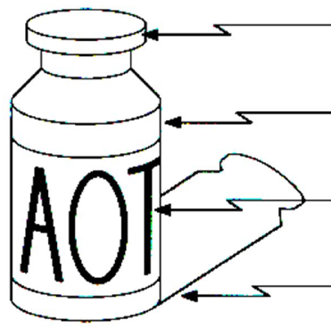
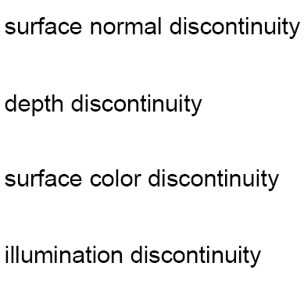
Edge detection
Sharp changes in the image brightness occur at:
  Object boundaries
    A light object may lie on a dark background or a dark object may lie on a light background.
  Reflectance changes
    May have quite different
    characteristics – zebras
    have stripes, and leopards
    have spots.
  Cast shadows
  Sharp changes in surface
  orientation

Slide 4

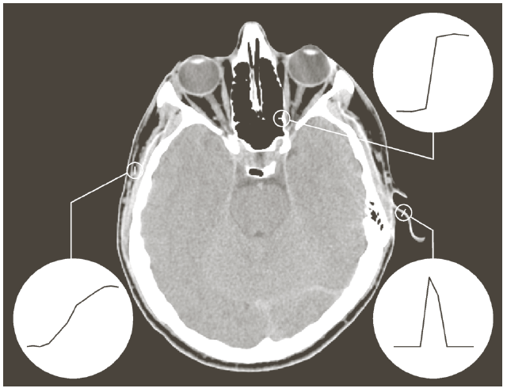
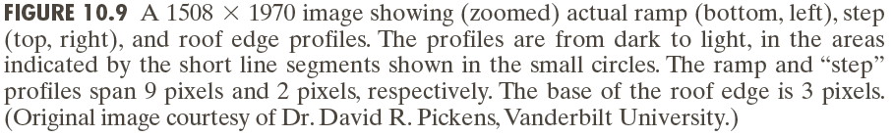
Edge models

Slide 5
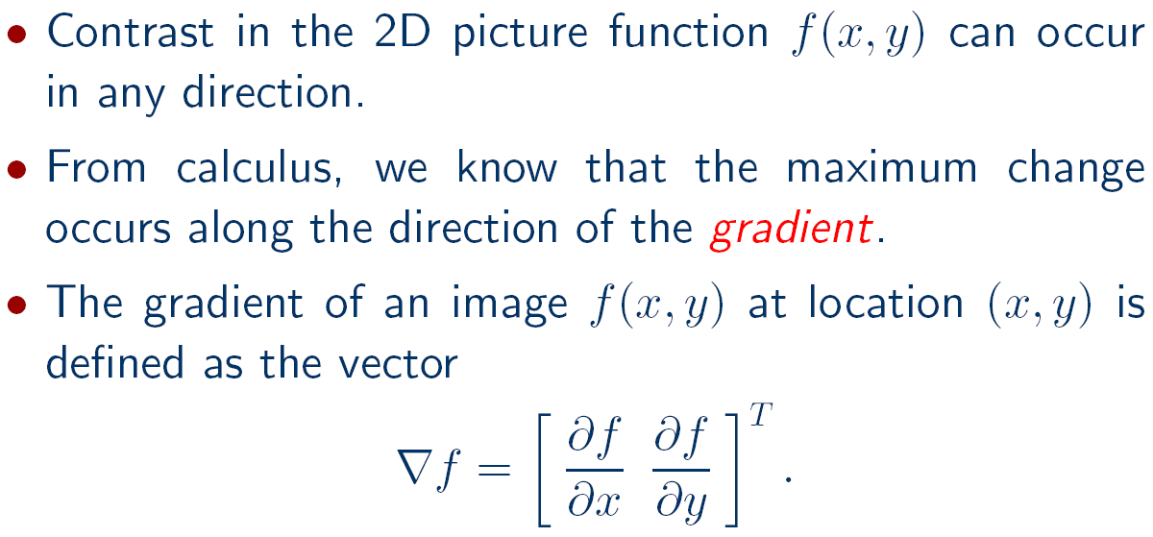



Difference operators for 2D

Slide 6
Difference operators for 2D

Slide 7
Difference operators for 2D
Adapted from Gonzales and Woods

Slide 8
Difference operators for 2D

Slide 9



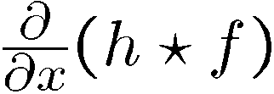
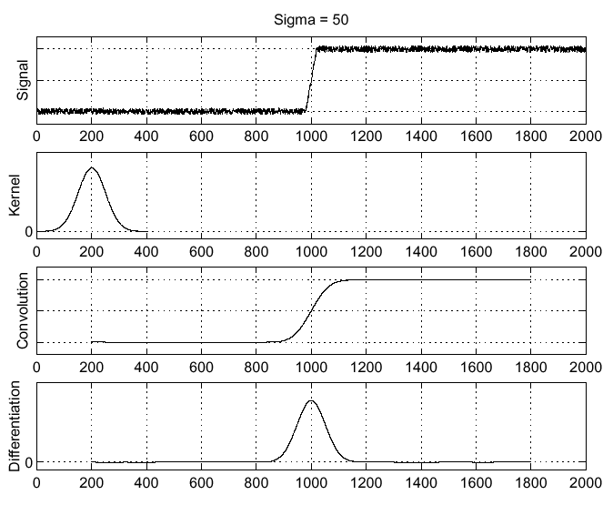
Difference operators under noise
Solution is to smooth first:
Adapted from Steve Seitz

Slide 10
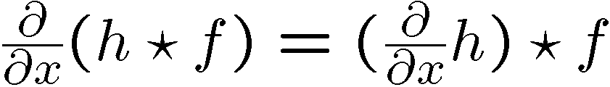
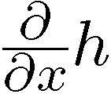
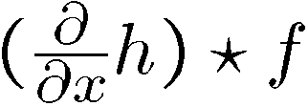
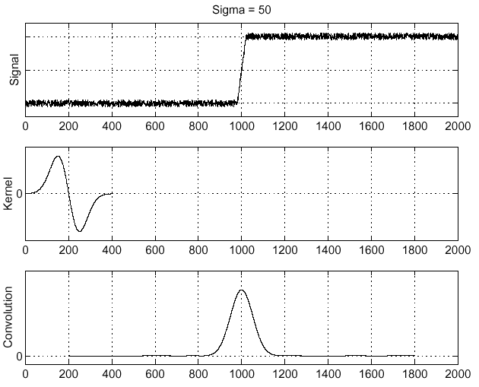
Difference operators under noise
Differentiation property of convolution:
Adapted from Steve Seitz

Slide 11
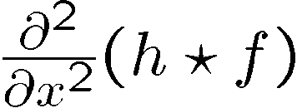
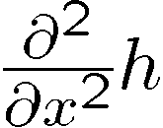
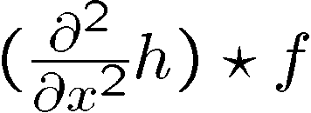
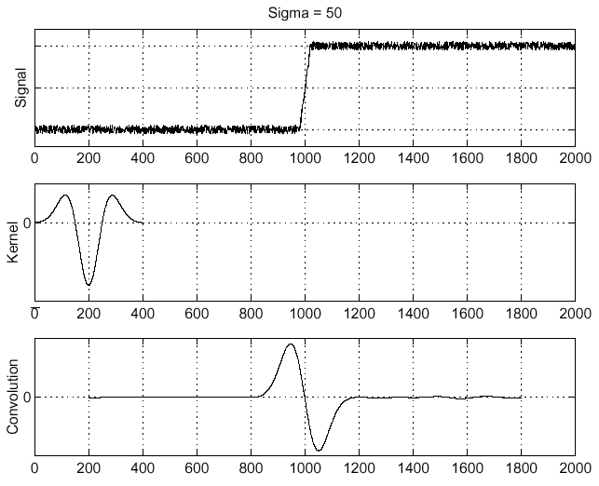
Difference operators under noise
Consider:
Laplacian of Gaussian
operator
Adapted from Steve Seitz

Slide 12
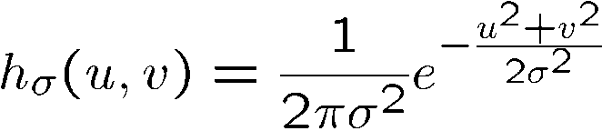
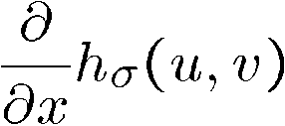

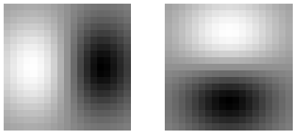
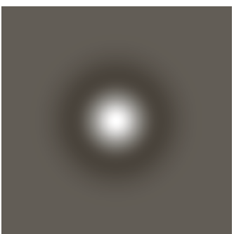
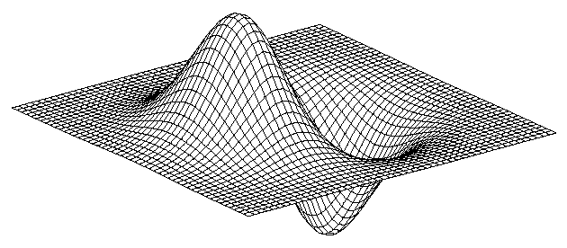
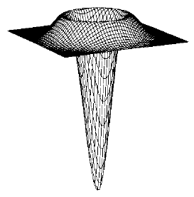
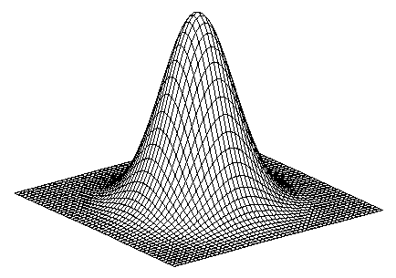
Edge detection filters for 2D
Laplacian of Gaussian
Gaussian
derivative of Gaussian
Adapted from Steve Seitz, U of Washington

Slide 13
Difference operators for 2D

Slide 14
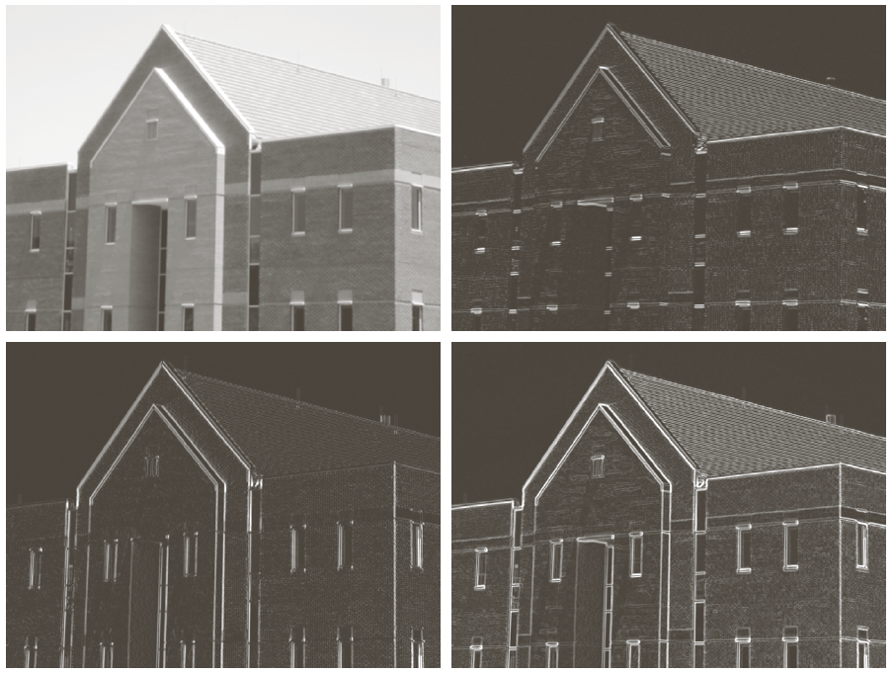
Difference operators for 2D

Slide 15
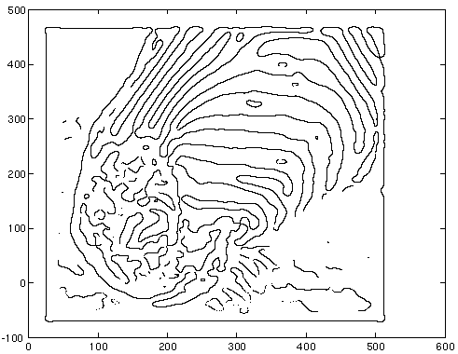
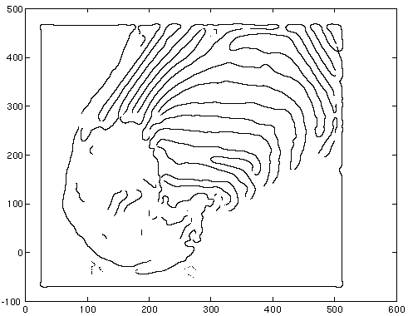
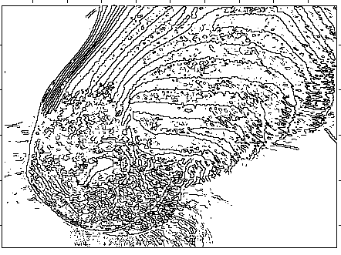
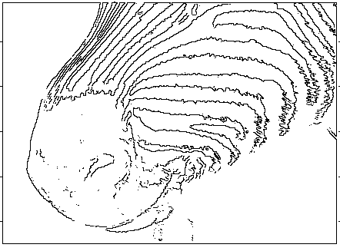
Difference operators for 2D
sigma=4
Laplacian of Gaussian
zero crossings
Threshold=1
Threshold=4
sigma=2
Adapted from David Forsyth, UC Berkeley

Slide 16
Edge detection
Three fundamental steps in edge detection:
  Image smoothing: to reduce the effects of noise.
  Detection of edge points: to find all image points that are potential candidates to become edge points.
  Edge localization: to select from the candidate edge points only the points that are true members of an edge.

Slide 17
Canny edge detector
Smooth the image with a Gaussian filter with spread σ.
Compute gradient magnitude and direction at each pixel of the smoothed image.
Zero out any pixel response less than or equal to the two neighboring pixels on either side of it, along the direction of the gradient (non-maxima suppression).
Track high-magnitude contours using thresholding (hysteresis thresholding).
Keep only pixels along these contours, so weak little segments go away.

Slide 18

Canny edge detector
Original image (Lena)
Adapted from Steve Seitz, U of Washington

Slide 19
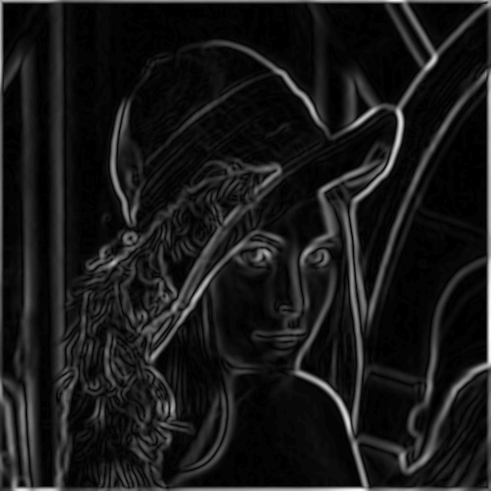
Canny edge detector
Magnitude of the gradient
Adapted from Steve Seitz, U of Washington

Slide 20
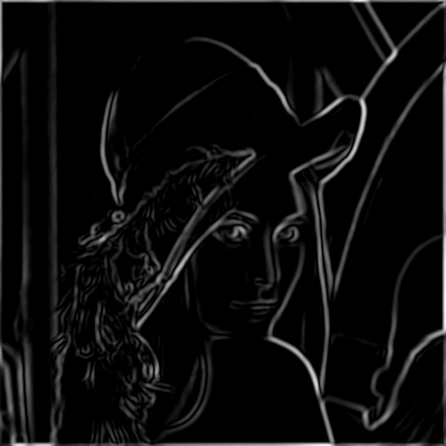
Canny edge detector
Thresholding
Adapted from Steve Seitz, U of Washington

Slide 21

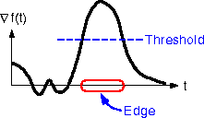
Canny edge detector
How to turn these thick regions of the gradient into curves?
Adapted from Steve Seitz, U of Washington

Slide 22

Canny edge detector
Non-maxima suppression:
  Check if pixel is local maximum along gradient direction.
  Select single max across width of the edge.
  Requires checking interpolated pixels p and r.
  This operation can be used with any edge operator when thin boundaries are wanted.

Slide 23
Canny edge detector
Problem: pixels along this edge did not survive the thresholding
Adapted from Steve Seitz, U of Washington

Slide 24
Canny edge detector
Hysteresis thresholding:
  Use a high threshold to start edge curves, and a low threshold to continue them.

Slide 25
Canny edge detector
Adapted from Martial Hebert, CMU

Slide 26
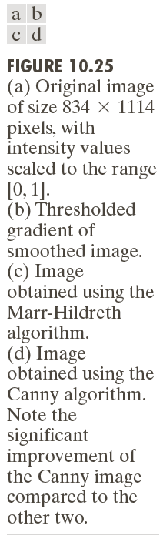
Canny edge detector

Slide 27
Canny edge detector

Slide 28
Canny edge detector
The Canny operator gives single-pixel-wide images with good continuation between adjacent pixels.
It is the most widely used edge operator today; no one has done better since it came out in the late 80s. Many implementations are available.
It is very sensitive to its parameters, which need to be adjusted for different application domains.

Slide 29
Edge linking
Hough transform
  Finding line segments
  Finding circles
Model fitting
  Fitting line segments
  Fitting ellipses
Edge tracking

Slide 30
Fitting: main idea
Choose a parametric model to represent a set of features
Membership criterion is not local
  Cannot tell whether a point belongs to a given model just by looking at that point
Three main questions:
  What model represents this set of features best?
  Which of several model instances gets which feature?
  How many model instances are there?
Computational complexity is important
  It is infeasible to examine every possible set of parameters and every possible combination of features
Adapted from Kristen Grauman

Slide 31
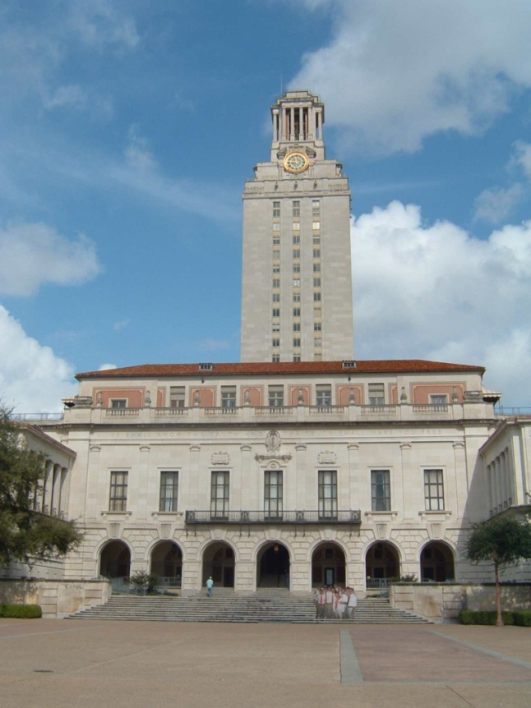
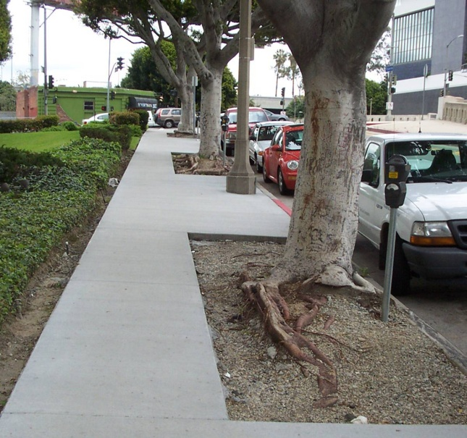
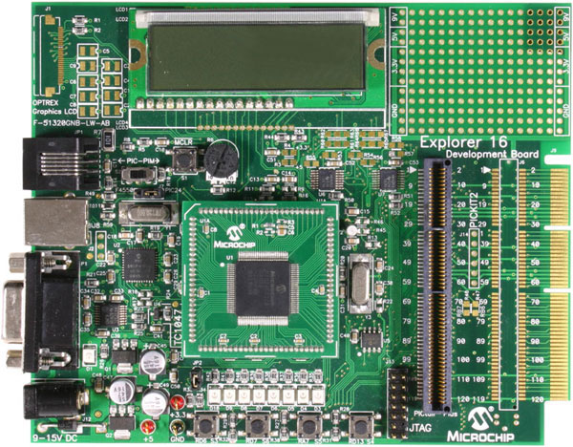
Example: line fitting
Why fit lines?
  Many objects characterized by presence of straight lines
Adapted from Kristen Grauman

Slide 32
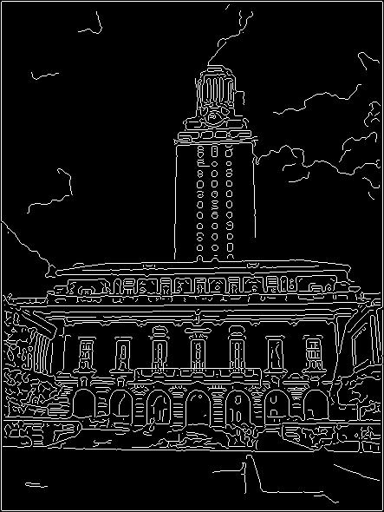
Difficulty of line fitting
Extra edge points (clutter), multiple models:
  which points go with which line, if any?
Only some parts of each line detected, and some parts are missing:
  how to find a line that bridges missing evidence?
Noise in measured edge points, orientations:
  how to detect true underlying parameters?
Adapted from Kristen Grauman

Slide 33
Voting
It is not feasible to check all combinations of features by fitting a model to each possible subset.
Voting is a general technique where we let each feature vote for all models that are compatible with it.
  Cycle through features, cast votes for model parameters.
  Look for model parameters that receive a lot of votes.
Noise and clutter features will cast votes too, but typically their votes should be inconsistent with the majority of “good” features.
Adapted from Kristen Grauman

Slide 34
Hough transform
The Hough transform is a method for detecting lines or curves specified by a parametric function.
If the parameters are p₁, p₂, … p_{n}, then the Hough procedure uses an n-dimensional accumulator array in which it accumulates votes for the correct parameters of the lines or curves found on the image.
b
image
m
accumulator
y = mx + b
Adapted from Linda Shapiro, U of Washington

Slide 35

Hough transform: line segments
y
b
b₀
x
m₀
m
Image space
Hough (parameter) space
Connection between image (x,y) and Hough (m,b) spaces
  A line in the image corresponds to a point in Hough space
  To go from image space to Hough space:
    given a set of points (x,y), find all (m,b) such that y = mx + b
Adapted from Steve Seitz, U of Washington

Slide 36

Hough transform: line segments
y
b
y₀
x₀
x
m
Image space
Hough (parameter) space
Connection between image (x,y) and Hough (m,b) spaces
  A line in the image corresponds to a point in Hough space
  To go from image space to Hough space:
    given a set of points (x,y), find all (m,b) such that y = mx + b
  What does a point (x₀, y₀) in the image space map to?
    Answer: the solutions of b = -x₀m + y₀
    This is a line in Hough space
Adapted from Steve Seitz, U of Washington

Slide 37
Hough transform: line segments
y
b
(x₁, y₁)
y₀
(x₀, y₀)
b = –x₁m + y₁
x₀
x
m
Image space
Hough (parameter) space
What are the line parameters for the line that contains both (x₀, y₀) and (x₁, y₁)?
  It is the intersection of the lines b = –x₀m + y₀ and
  b = –x₁m + y₁
Adapted from Steve Seitz, U of Washington

Slide 38
Hough transform: line segments
y = mx + b is not suitable (why?)
The equation generally used is:
d = r sin(θ) + c cos(θ).
c
θ
d is the distance from the line to origin.
θ is the angle the perpendicular makes
with the column axis.
d
r
Adapted from Linda Shapiro, U of Washington

Slide 39
Hough transform: line segments
Adapted from Shapiro and Stockman

Slide 40
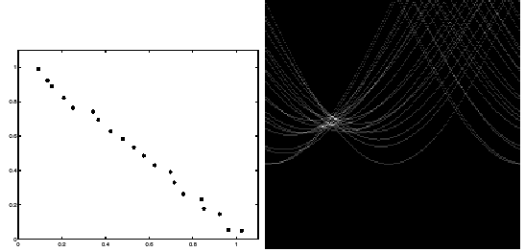
Hough transform: line segments

Slide 41
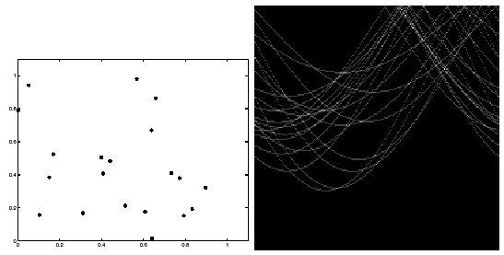
Hough transform: line segments

Slide 42
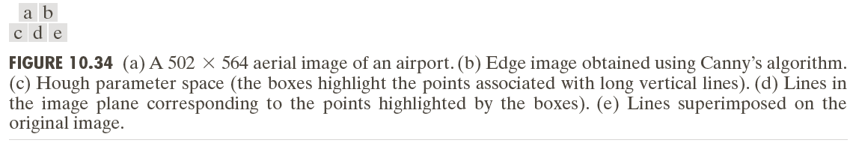
Hough transform: line segments

Slide 43
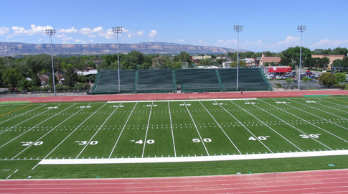
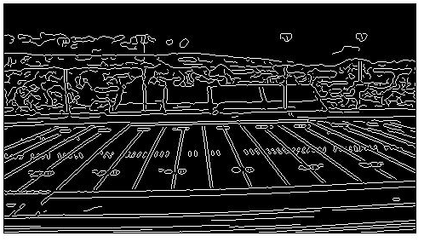
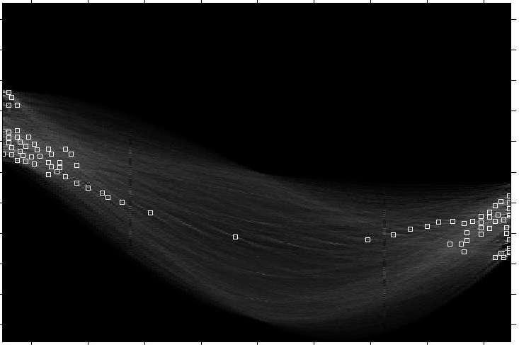
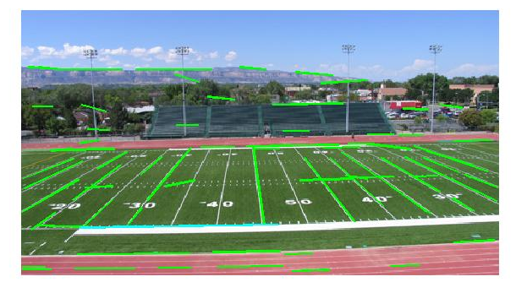
Hough transform: line segments
Adapted from Kristen Grauman

Slide 44
Hough transform: circles
Main idea: The gradient vector at an edge pixel points the center of the circle.
Circle equations:
  r = r₀ + d sin(θ) r₀, c₀, d are parameters
  c = c₀ + d cos(θ)
d
*(r,c)
Adapted from Linda Shapiro, U of Washington

Slide 45
Hough transform: circles
Adapted from Shapiro and Stockman

Slide 46
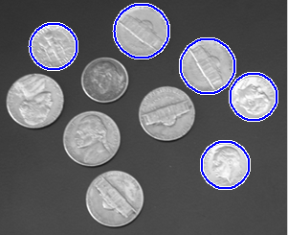
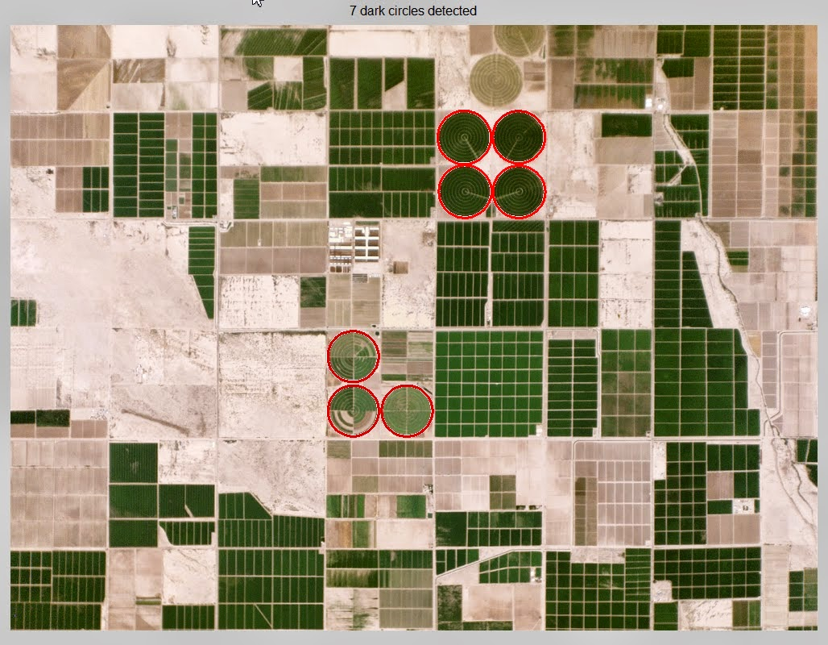
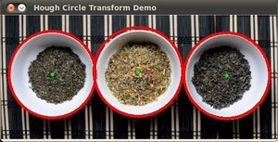
Hough transform: circles
https://www.mathworks.com/help/images/ref/imfindcircles.html
http://shreshai.blogspot.com.tr/2015/01/matlab-tutorial-finding-center-pivot.html
http://docs.opencv.org/2.4/doc/tutorials/imgproc/imgtrans/hough_circle/hough_circle.html

Slide 47
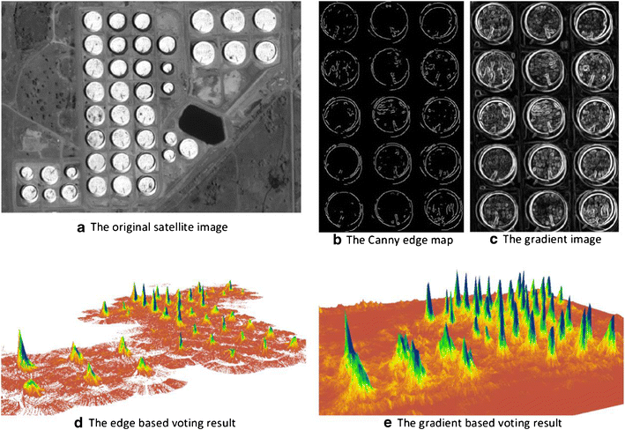
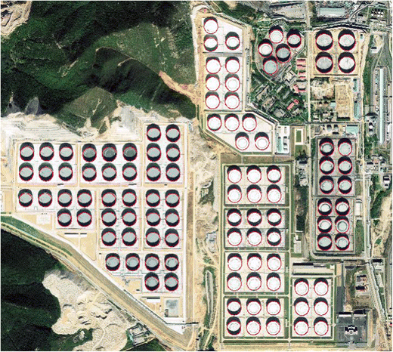
Hough transform: circles
Zhao et al., “Oil Tanks Extraction from High Resolution Imagery Using a Directional and Weighted Hough Voting Method”, Journal of the Indian Society of Remote Sensing, September 2015

Slide 48
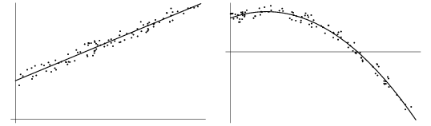
Model fitting
Mathematical models that fit data not only reveal important structure in the data, but also can provide efficient representations for further analysis.
Mathematical models exist for lines, circles, cylinders, and many other shapes.
We can use the method of least squares for determining the parameters of the best mathematical model fitting the observed data.

Slide 49
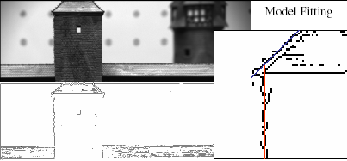
Model fitting: line segments
Adapted from Martial Hebert, CMU

Slide 50
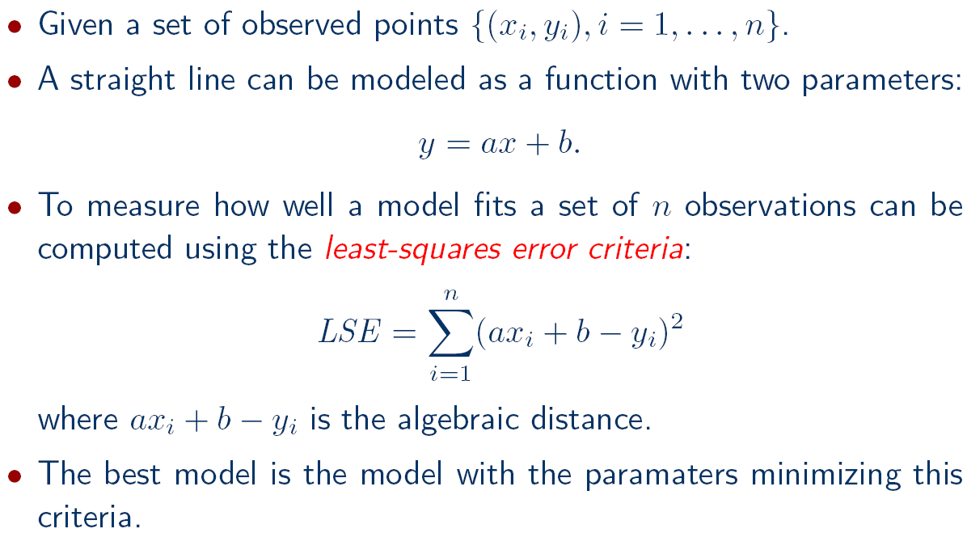
Model fitting: line segments

Slide 51

Model fitting: line segments

Slide 52


Model fitting: line segments

Slide 53
Model fitting: line segments
Problems in fitting:
  Outliers
  Error definition (algebraic vs. geometric distance)
  Statistical interpretation of the error (hypothesis testing)
  Nonlinear optimization
  High dimensionality (of the data and/or the number of model parameters)
  Additional fit constraints

Slide 54

Model fitting: ellipses

Slide 55

Model fitting: ellipses
Adapted from Andrew Fitzgibbon, PAMI 1999

Slide 56
Model fitting: ellipses
Adapted from Andrew Fitzgibbon, PAMI 1999

Slide 57
Edge tracking
Mask-based approach uses masks to identify the following events:
  start of a new segment,
  interior point continuing a segment,
  end of a segment,
  junction between multiple segments,
  corner that breaks a segment into two.
junction
corner
Adapted from Linda Shapiro, U of Washington

Slide 58
Edge tracking: ORT Toolkit
The algorithm is called Strider and is like a spider moving along pixel chains of an image, looking for junctions and corners.
It identifies them by a measure of local asymmetry.
  When it is moving along a straight or curved segment with no interruptions, its legs are symmetric about its body.
  When it encounters an obstacle (i.e., a corner or junction) its legs are no longer symmetric.
  If the obstacle is small (compared to the spider), it soon becomes symmetrical.
  If the obstacle is large, it will take longer.
The accuracy depends on the length of the spider and the size of its stride.
  The larger they are, the less sensitive it becomes.

Slide 59

Edge tracking: ORT Toolkit
The measure of asymmetry is the angle
between two line segments.
L1: the line segment from pixel 1 of the spider
to pixel N-2 of the spider
L2: the line segment from pixel 1 of the spider
to pixel N of the spider
The angle must be <= arctan(2/length(L2))
angle 0
here
Longer spiders allow less of an angle.
Adapted from Linda Shapiro, U of Washington

Slide 60
Edge tracking: ORT Toolkit
The parameters are the length of the spider and the number of pixels per step.
These parameters can be changed to allow for less sensitivity, so that we get longer line segments.
The algorithm has a final phase in which adjacent segments whose angle differs by less than a given threshold are joined.
Advantages:
  Works on pixel chains of arbitrary complexity.
  Can be implemented in parallel.
  Parameters are well understood.

Slide 61

Example: building detection
by Yi Li @ University of Washington

Slide 62

Example: building detection

Slide 63
Example: object extraction
by Serkan Kiranyaz
Tampere University of Technology

Slide 64

Example: object extraction

Slide 65
Example: object extraction

Slide 66


Example: object extraction

Slide 67
Example: object recognition
Mauro Costa’s dissertation at the University of Washington for recognizing 3D objects having planar, cylindrical, and threaded surfaces:
  Detects edges from two intensity images.
  From the edge image, finds a set of high-level features and their relationships.
  Hypothesizes a 3D model using relational indexing.
  Estimates the pose of the object using point pairs, line segment pairs, and ellipse/circle pairs.
  Verifies the model after projecting to 2D.

Slide 68
Example: object recognition
Example scenes used. The labels “left” and “right” indicate the direction of the light source.

Slide 70
Example: object recognition

Slide 71
Example: object recognition

Slide 72

Example: object recognition
1 coaxials-
multi
encloses
1 1 2 3
2 3 3 2
encloses
2 ellipse
encloses
e e e c
3 parallel
lines
coaxial
Relationship graph and the corresponding 2-graphs.

Slide 73

Example: object recognition
Learning phase: relational indexing by encoding each 2-graph and storing in a hash table.
Matching phase: voting by each 2-graph observed in the image.

Slide 74

Example: object recognition
Incorrect hypothesis
The matched features of the hypothesized object are used to determine its pose.
The 3D mesh of the object is used to project all its features onto the image.
A verification procedure checks how well the object features line up with edges on the image.

