Slide 1

Slides used by permission from
Joseph Redmon, CSE 455, Spring 2018
University of Washington, Seattle
Paul G. Allen School of Computer Science & Engineering
https://courses.cs.washington.edu/courses/cse455/18sp/

Slide 2


Slide 3
What is machine learning?
Algorithms to approximate functions
  Usually use lots of statistics
  Usually minimize some form of loss function
Supervised learning
  Given inputs to a function, try to predict the output
  Have lots of labelled examples
Semi-supervised learning
  Same but number of labelled examples < number of examples
Unsupervised learning
  Want to model unlabelled data
  Find similarities and differences between subgroups of data
  Learn functions to generate new data

Slide 4
Supervised Learning (typically)
Have data with labels, want to take new data and predict correct label
Pick a model
Do you know anything a priori about your data? Is it linear, polynomial, etc?
Pick a loss function
Easy to calculate function of model parameters given training data
Should give an approximation of how “good” your model is
E.g. Sum squared error (L₂ loss), sum absolute differences (L₁ loss), etc…
Pick model parameters to minimize loss
Find local or global minimum of loss.
How? Set derivative = 0, closed form solution, gradient descent, etc

Slide 5
Gradient descent
For some loss function L_{data}(w), gradient ∇L_{data}(w) points towards in direction of steepest ascent.
In 1d, either points left or right

Slide 6
Gradient descent
For some loss function L_{data}(w), gradient ∇L_{data}(w) points towards in direction of steepest ascent.
In 1d, either points left or right
Algorithm:
Take derivative
Move slightly in other
direction
Repeat

Slide 7
Gradient descent
For some loss function L_{data}(w), gradient ∇L_{data}(w) points towards in direction of steepest ascent.
In 1d, either points left or right
Algorithm:
Take derivative
Move slightly in other
direction
Repeat

Slide 8
Gradient descent
Algorithm:
Take derivative
Move slightly in other
direction
Repeat
End up at local optima

Slide 9
Gradient descent
Formally:
w_{t+1}= w_{t} - η ∇L(w)
Where η is step size, how far to step relative to the gradient

Slide 10
Gradient descent
Calculating ∇L(w) can be hard, especially for big data, |data| very large.
What if we estimate it it instead?
How do we estimate things?

Slide 11
Stochastic gradient descent (SGD)
Estimate ∇L_{data}(w) with only some of the data
Before:
w_{t+1} = w_{t} - η Σ_{i}∇L_{i}(w), for all i in data
Now:
w_{t+1} = w_{t} - η Σ_{j}∇L_{j}(w), for some subset j
Maybe even:
w_{t+1} = w_{t} - η ∇L_{k}(w), for some random k
# of points used for update is called batch size

Slide 12


Slide 13
Case study: Image classification
https://lear.inrialpes.fr/~verbeek/mlcr.slides.11.12/sanchez11cvpr.pdf
Given an image, what’s in it?
Old state-of-the-art:
Extract features from image
SIFT and Fisher Vectors
Train Linear SVM
On 1000 different classes, 54% accurate

Slide 14
What’s wrong with this?
Machine learning needs features!!
What are the right features?
HOG?
SIFT?
FV?

Slide 15
What’s wrong with this?
Machine learning needs features!!
What are the right features?
HOG?
SIFT?
FV?
Why not let the algorithm decide

Slide 16
What’s wrong with this?
Machine learning needs features!!
What are the right features?
HOG?
SIFT?
FV?
Why not let the algorithm decide
Neural networks: Feature extraction + linear model

Slide 17
Success of Neural Networks
Image classification:
54% -> 80% accuracy on 1000 classes
Object detection:
33% mAP (DPM) -> 88% mAP on 20 classes

Slide 18
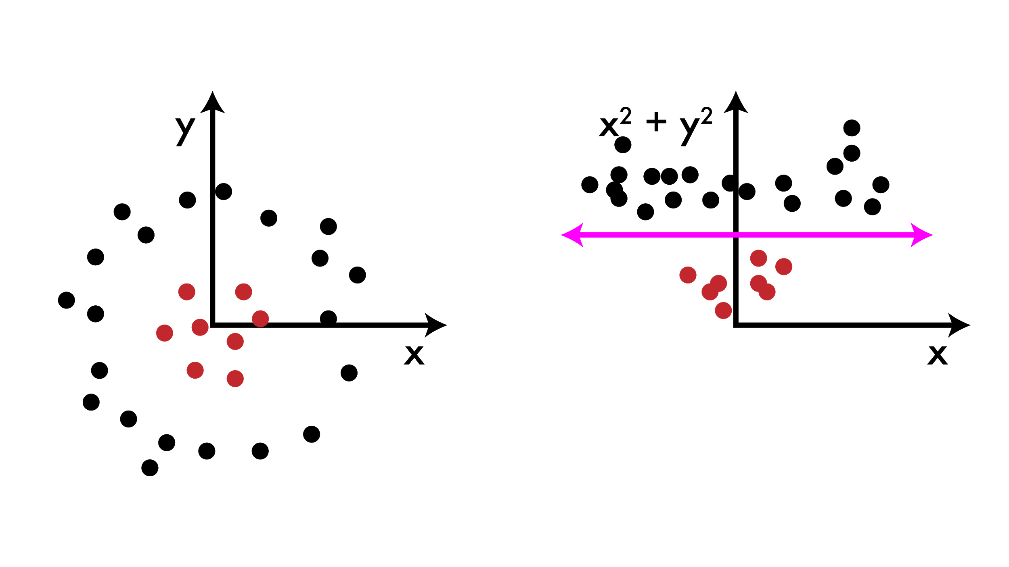
What is feature engineering?
Arguably the core problem of machine learning (especially in practice)
ML models work well if there is a clear relationship between the inputs and outputs of the function you are trying to model

Slide 19
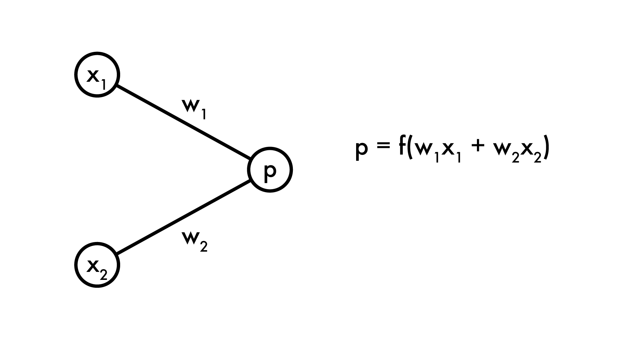
Linear model can’t do this
Cannot learn transformations of features, only use existing features. Human must create good features

Slide 20
What if we added more processing?
Generally, feature engineering is just coming up with combinations of the features we already have

Slide 21
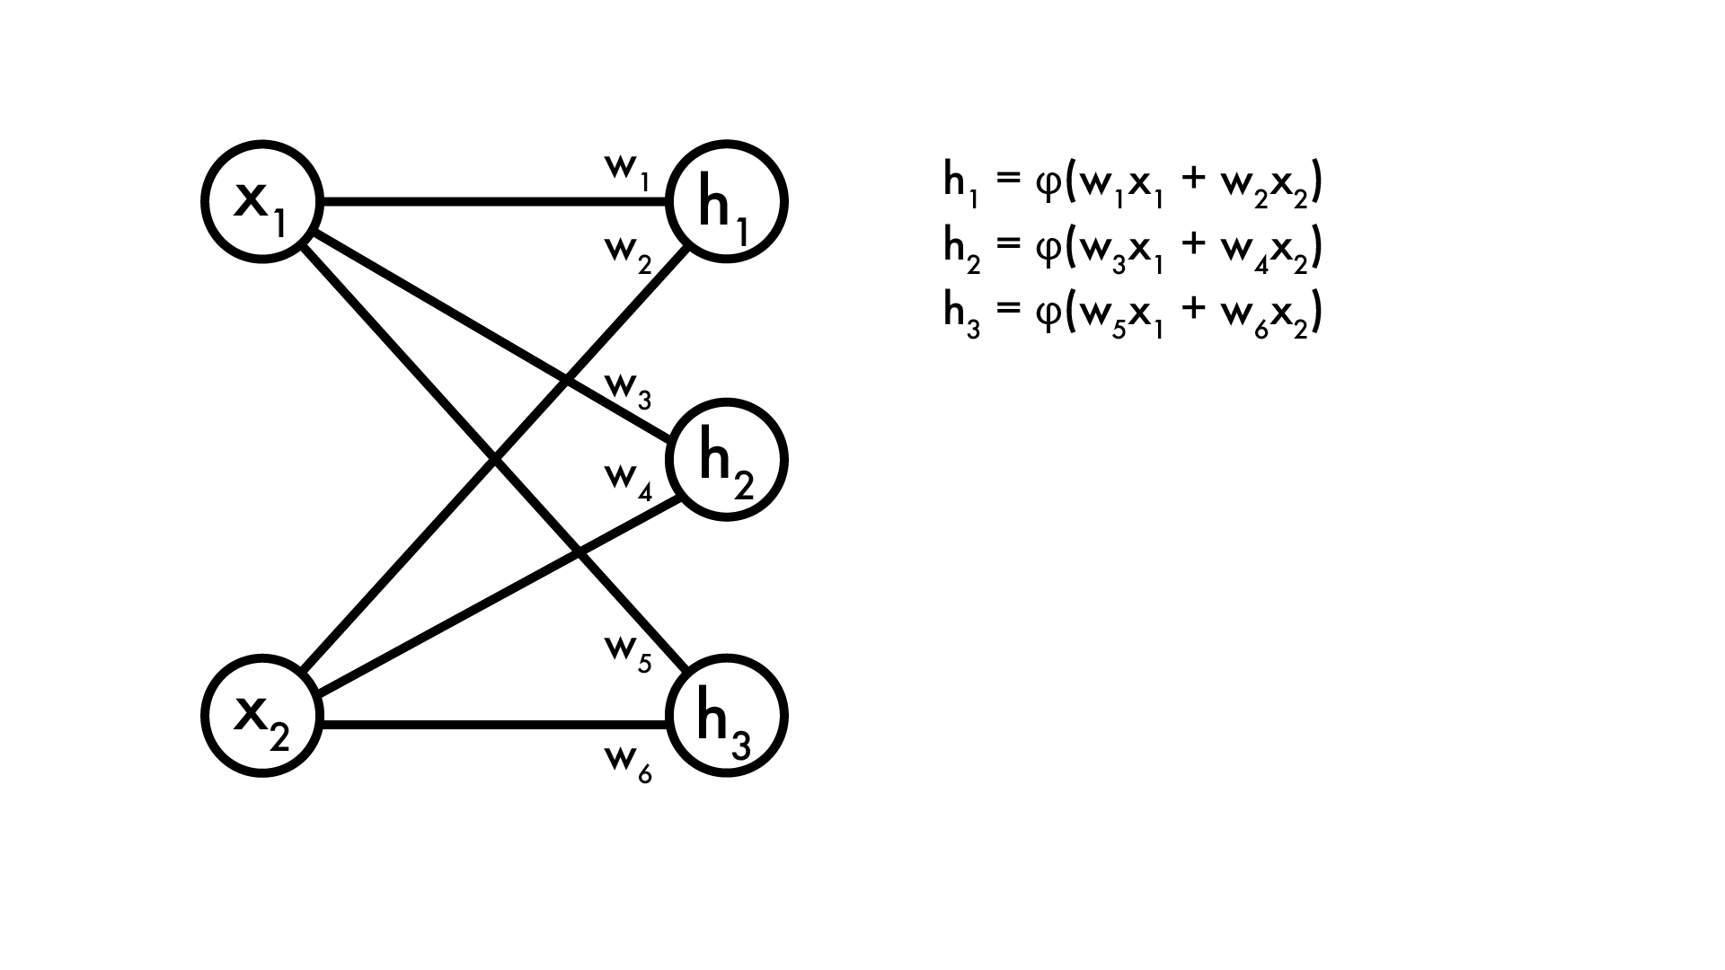
What if we added more processing?
Create “new” features using old ones. We’ll call H our hidden layer

Slide 22
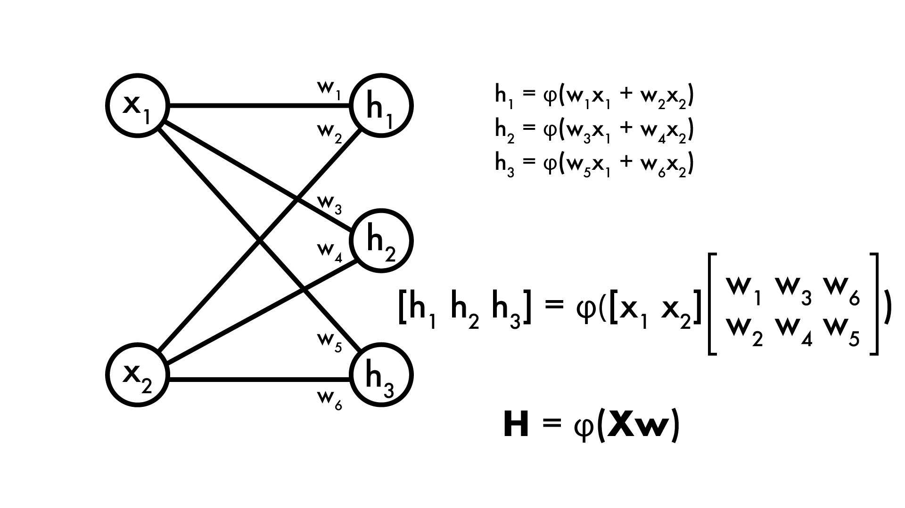
What if we added more processing?
As with linear model, H can be expressed in matrix operations

Slide 23
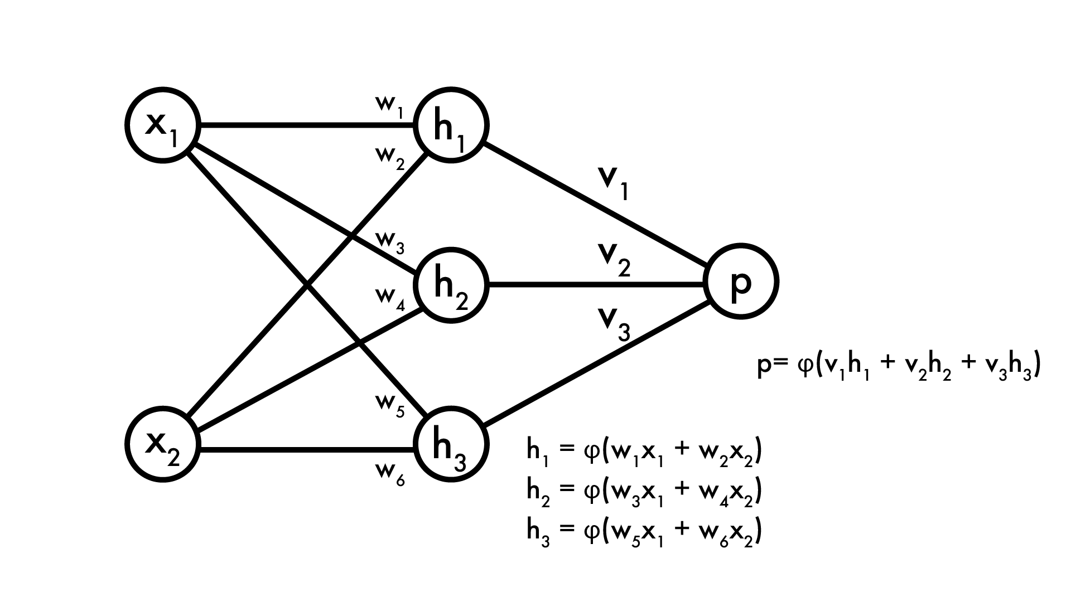
What if we added more processing?
Now our prediction p is a function of our hidden layer

Slide 24
What if we added more processing?
Now our prediction p is a function of our hidden layer
Feature extractor

Slide 25
What if we added more processing?
Now our prediction p is a function of our hidden layer
Feature extractor
Linear model

Slide 26
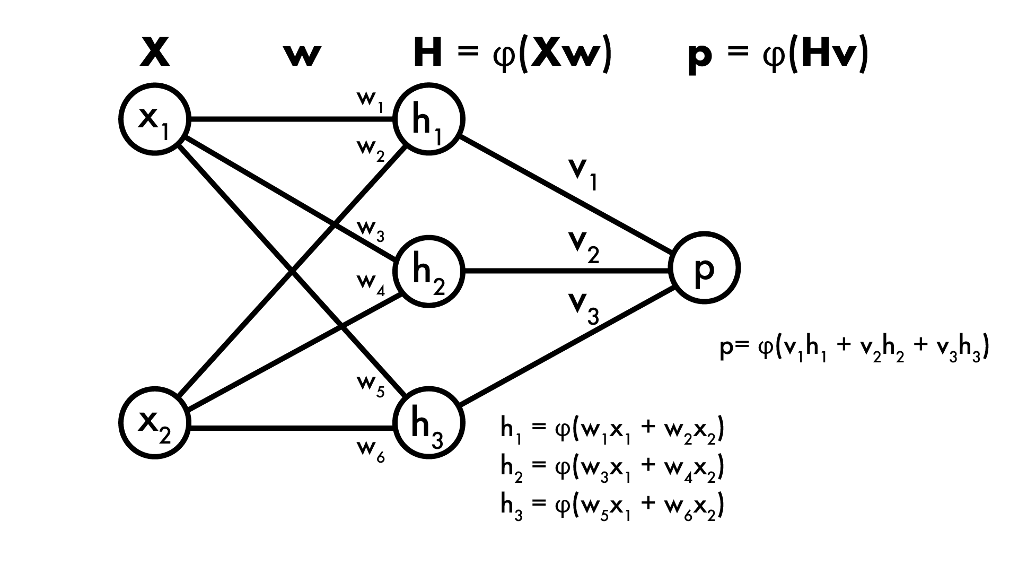
What if we added more processing?
Can still express the whole process in matrix notation! Nice because matrix ops are fast

Slide 27
This is a neural network!
This one has 1 hidden layer, but can have way more
Each layer is just some function φ applied to linear combination of the previous layer

Slide 28
φ is our activation function
Want to apply some extra processing at each layer. Why?
Imagine φ(x) = x, linear activation

Slide 29
φ is our activation function
Want to apply some extra processing at each layer. Why?
Imagine φ(x) = x, linear activation
p = v₁h₁ + v₂h₂ + v₃h₃
But h₁ = x₁w₁ + x₂w₂, h₂ = … etc
So
p = v₁w₁x₁ + v₁w₂x₂ + v₂w₃x₁ + v₂w₄x₂ + v₃w₅x₁ + v₃w₆x₂
= (v₁w₁+v₂w₃+v₃w₅)x₁ + (v₁w₂+v₂w₄+v₃w₆)x₂
= u₁x₁ + u₂x₂

Slide 30
Universal approximation theorem
https://en.wikipedia.org/wiki/Universal_approximation_theorem
What if φ not linear?
Universal approximation theorem (Cybenko 89, Hornik 91)
φ: any nonconstant, bounded, monotonically increasing function
I_{m}: m-dimensional unit hypercube (interval [0-1] in m-d)
Then 1-layer neural network with φ as activation can model any continuous function f: I_{m} -> R
(no bound on size of hidden layer)
By extension, works on f: bounded R^{m} -> R
What can we learn? What can’t we?
UAT just says it’s possible to model, not how.

Slide 31
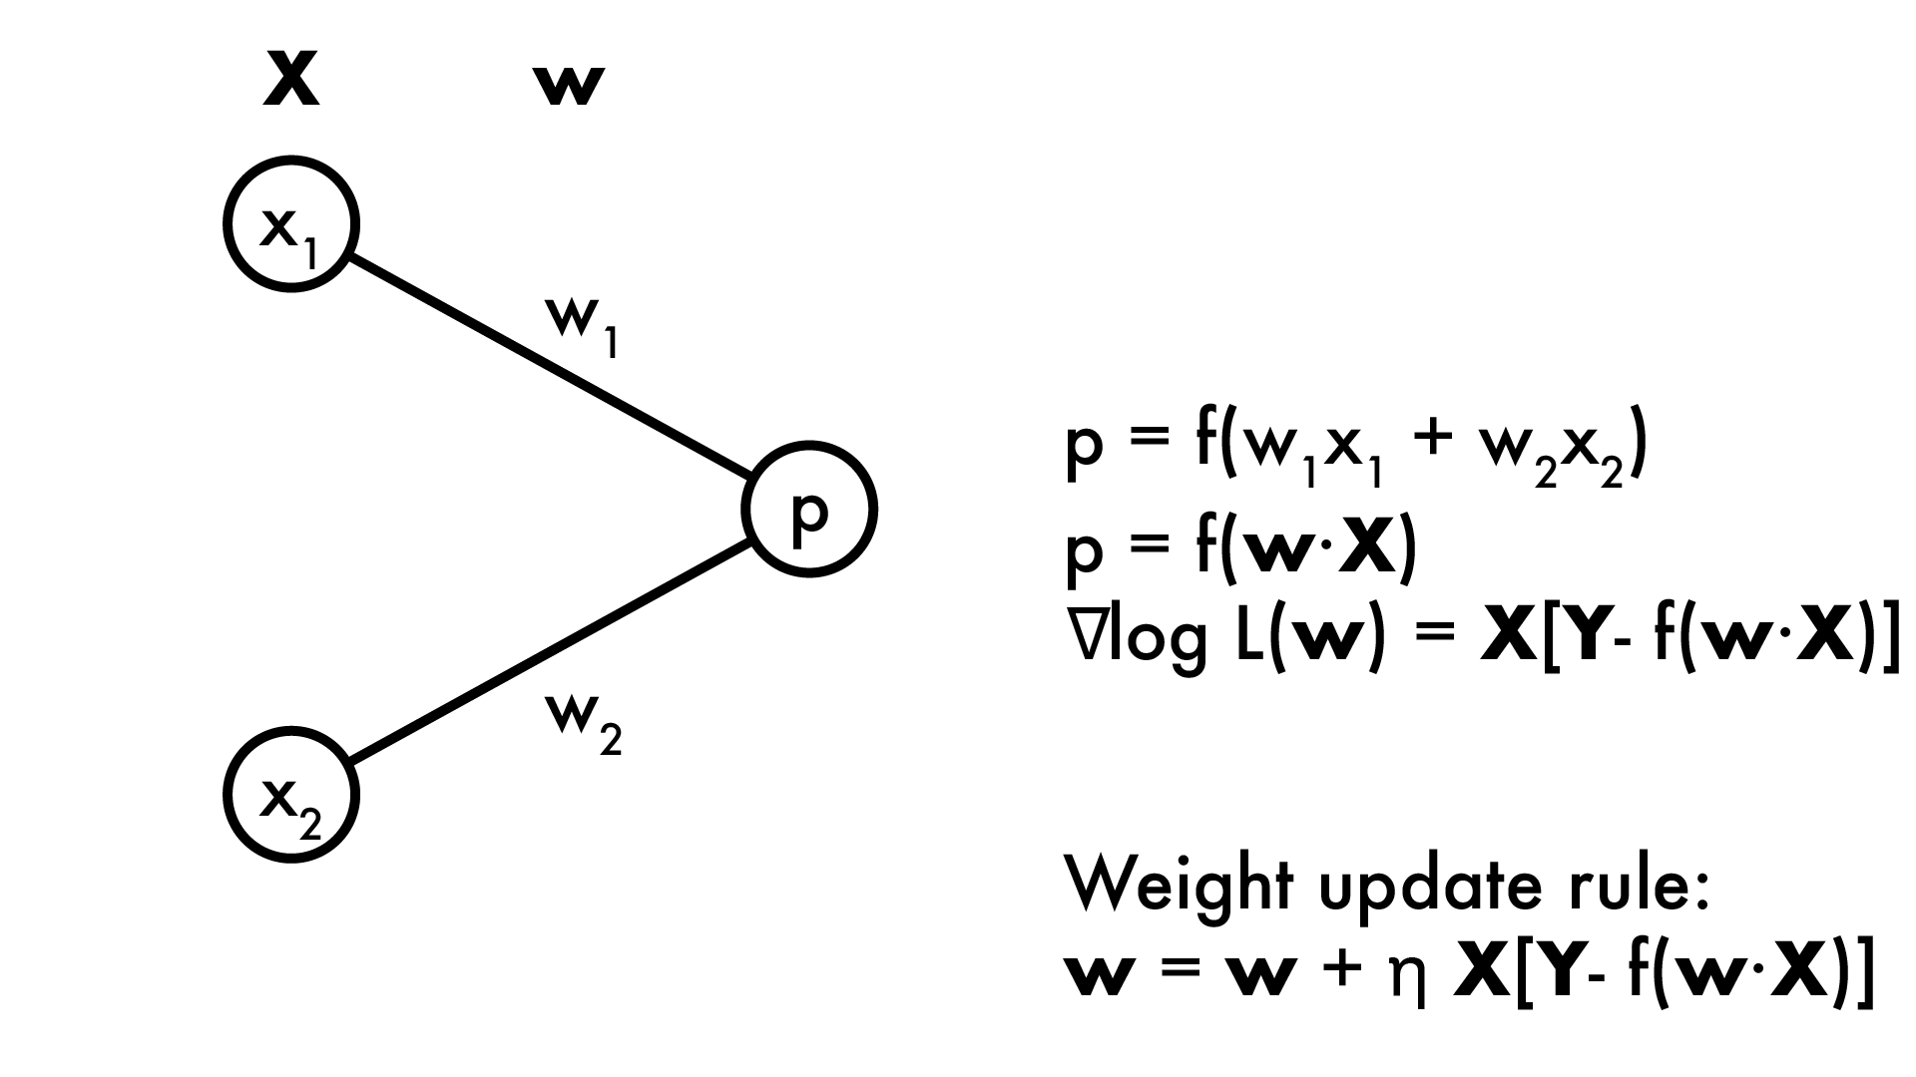
How do we learn it?
Neural networks are non-convex with no closed form solution (can’t take derivative and set = 0)
Gradient descent! Recall for linear model:

Slide 32
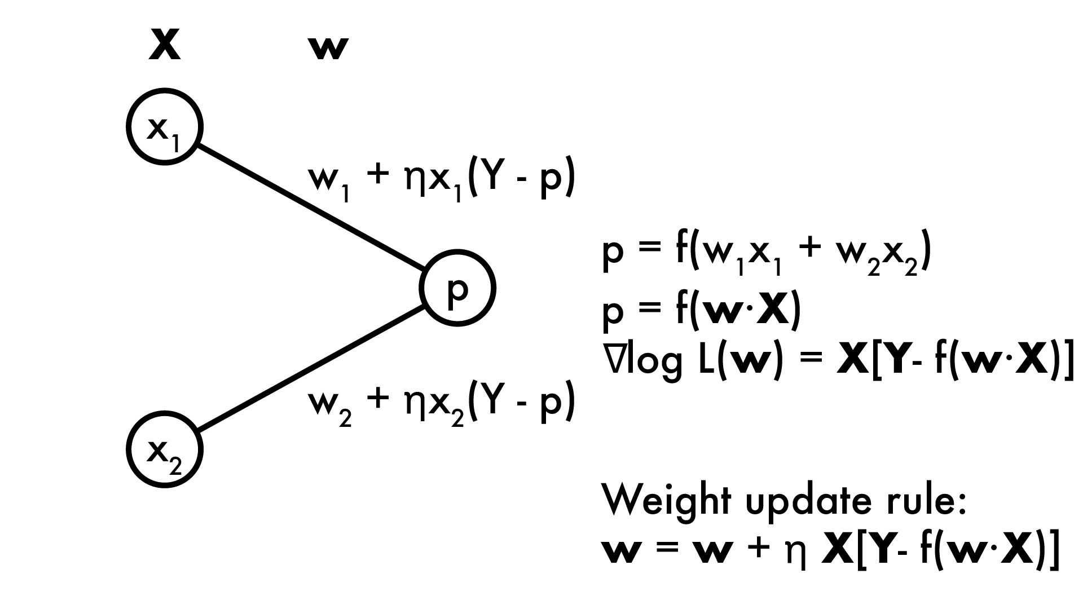
How do we learn it?
With gradient descent we calculate the partial derivatives of the loss (or likelihood) function for every weight: ∂/∂w_{i} log L(w)
Then do gradient descent (or ascent) by adding gradient to weight

Slide 33


Slide 34
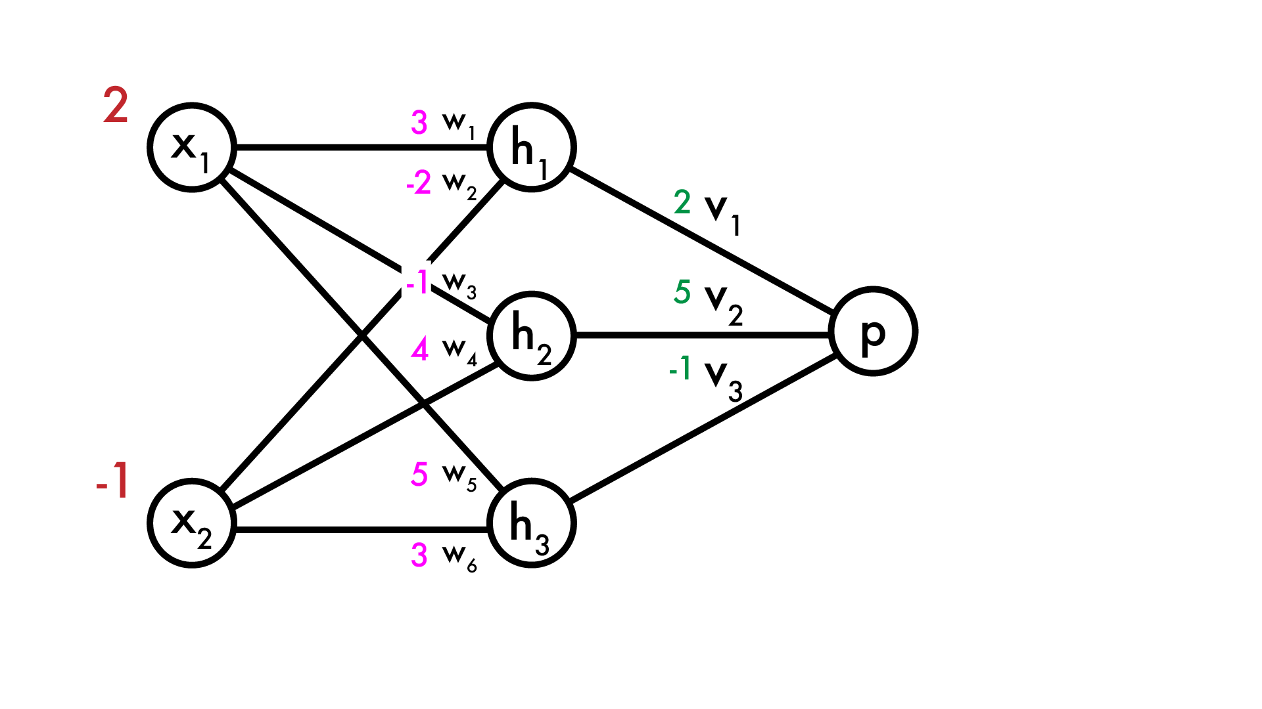
How do we learn it?
Now we have a “real” neural network (using linear activation for simplicity). How do we predict p?

Slide 35
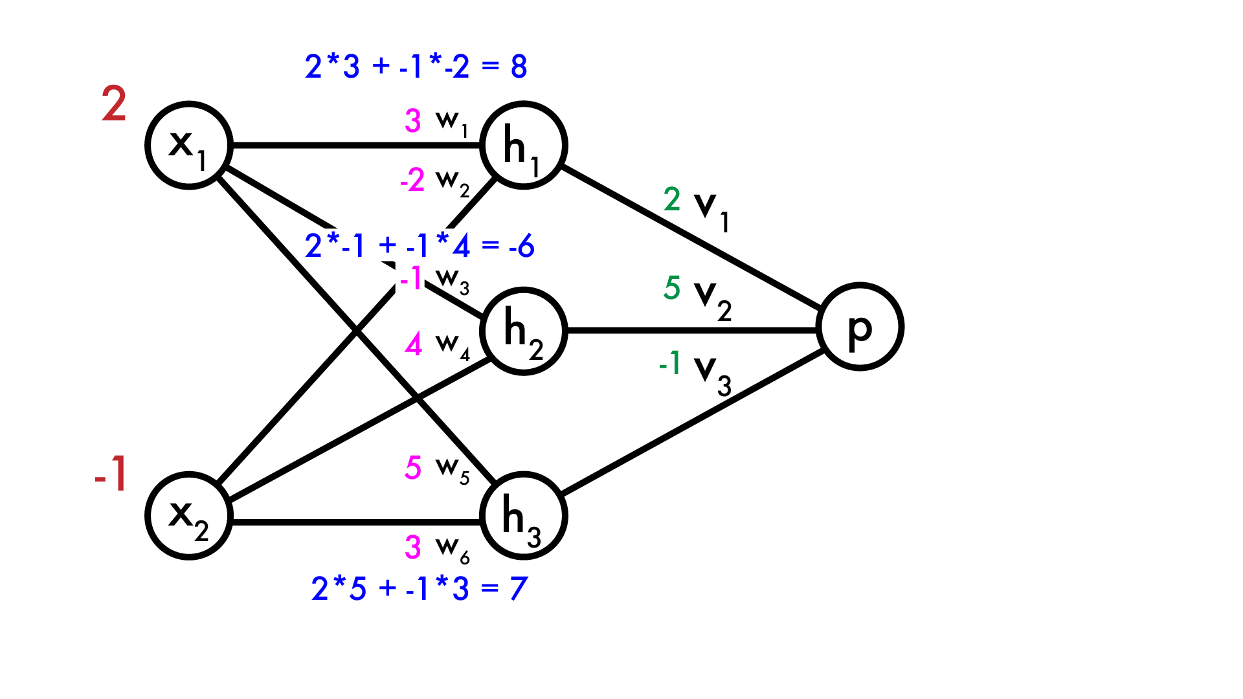
How do we learn it?
Now we have a “real” neural network (using linear activation for simplicity). How do we predict p?
Calculate hidden layer neurons

Slide 36
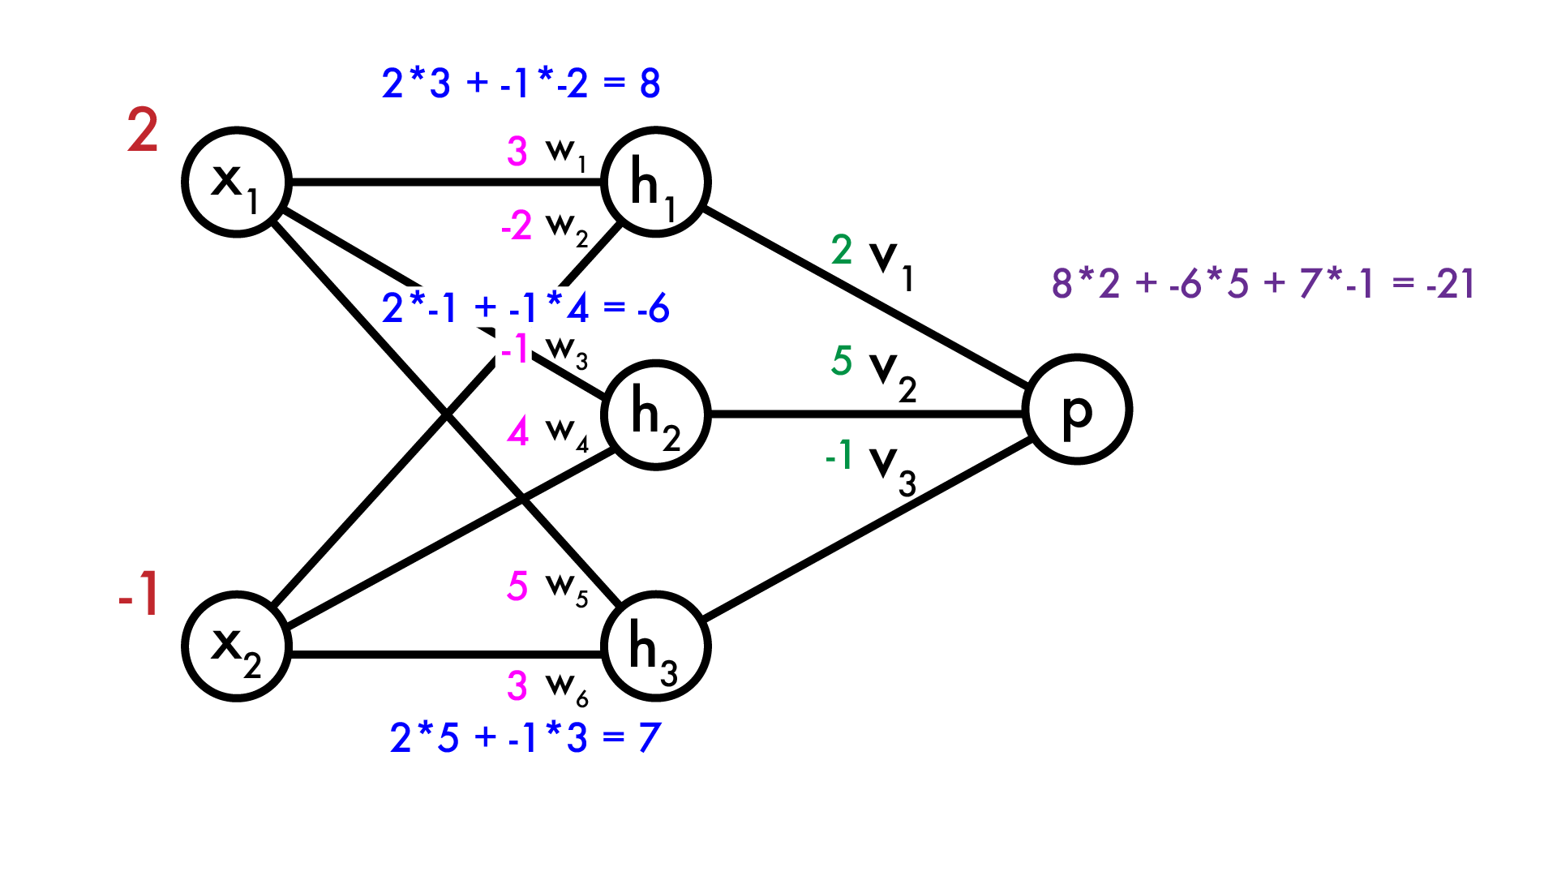
How do we learn it?
Now we have a “real” neural network (using linear activation for simplicity). How do we predict p?
Calculate hidden layer neurons
Calculate output p

Slide 37
How do we learn it?
Say we want to make p larger. How do we modify the weights? The first layer is easy, same as normal linear model:

Slide 38
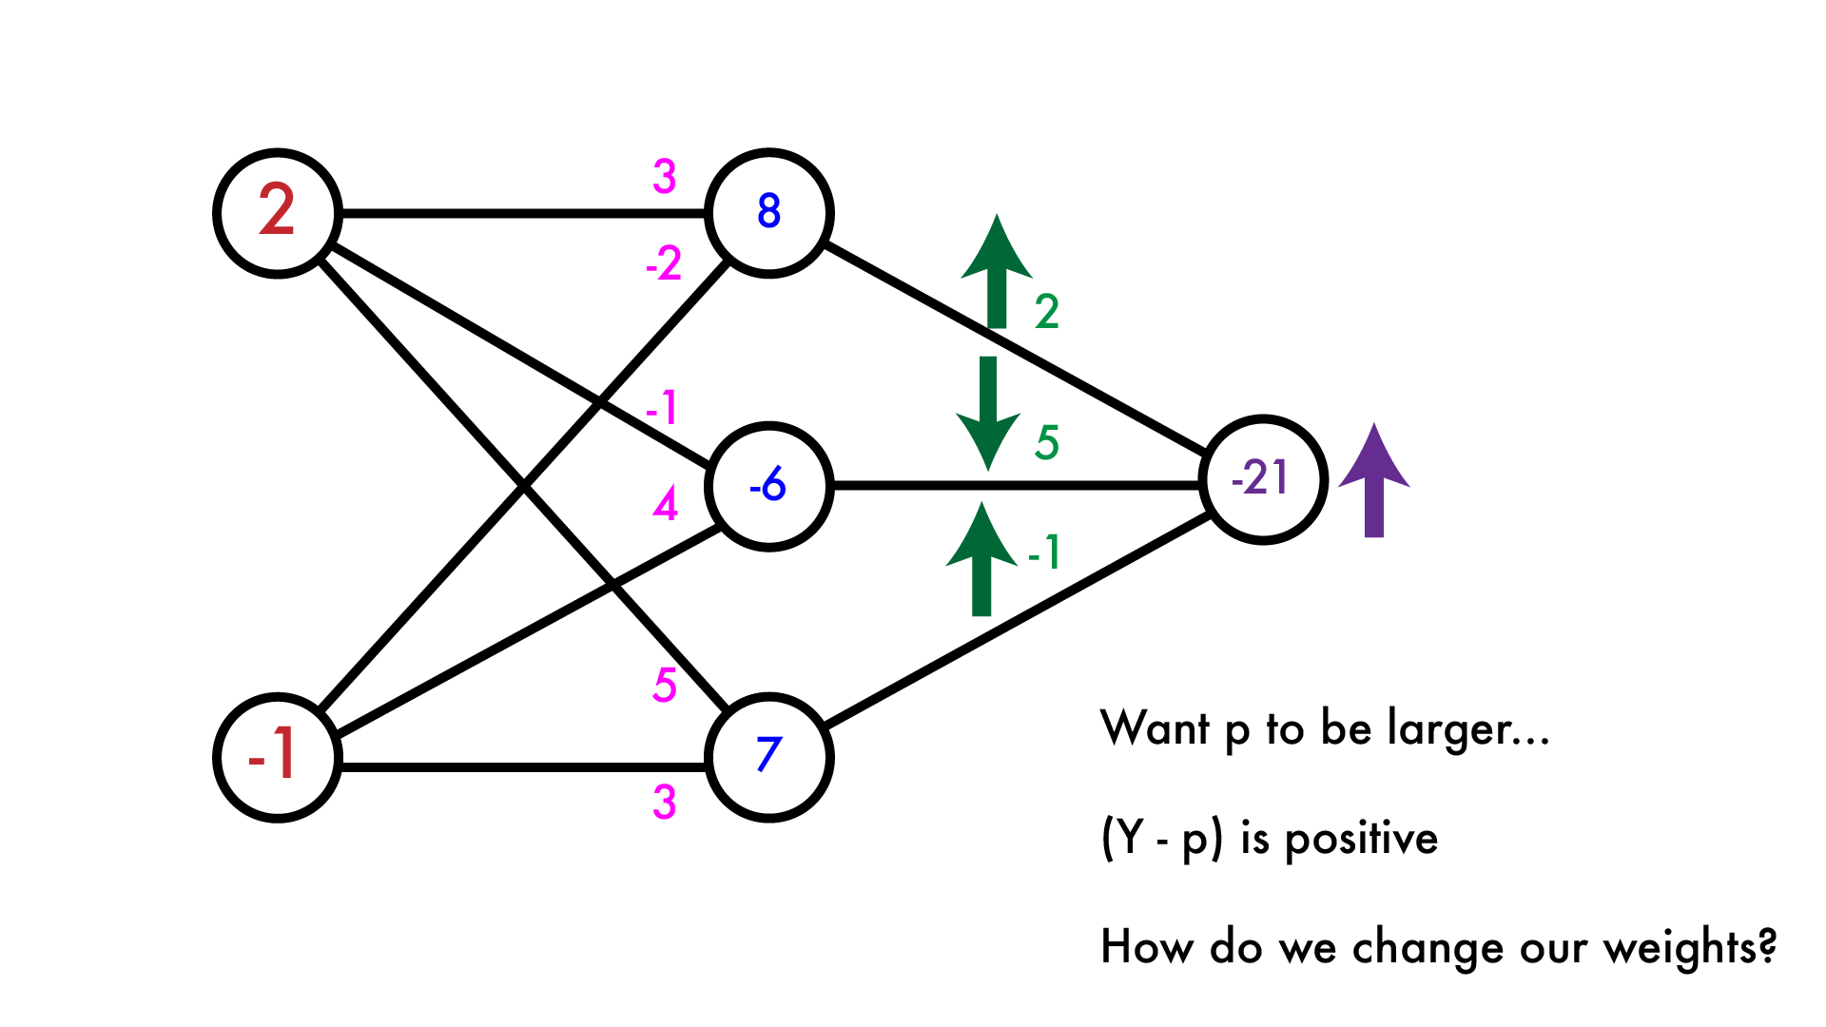
How do we learn it?
Say we want to make p larger. How do we modify the weights? The first layer is easy, same as normal linear model:

Slide 39
How do we learn it?
Now what? Let’s calculate the “error” that the hidden layer makes. We want p to be larger, given current weights how should we adjust the hidden layer output to do that?

Slide 40
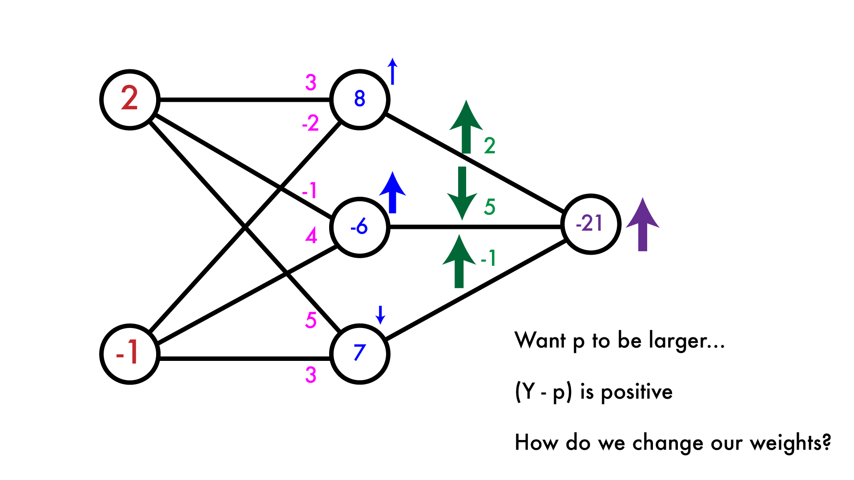
How do we learn it?
Now what? Let’s calculate the “error” that the hidden layer makes. We want p to be larger, given current weights how should we adjust the hidden layer output to do that?

Slide 41
How do we learn it?
Now that we have an “error” in our hidden layer, want to modify the previous weights. Easy again, just like our linear model.

Slide 42
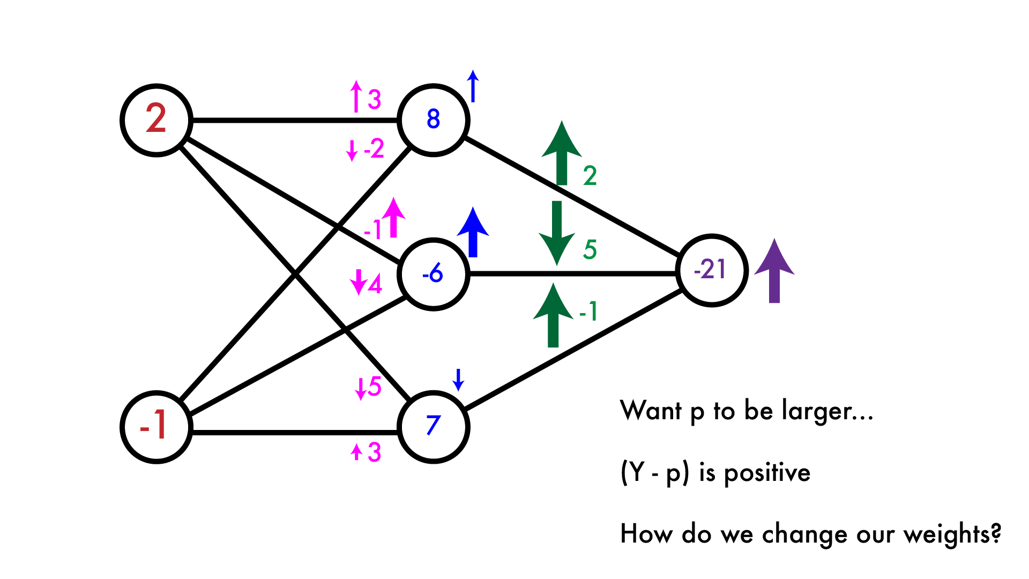
How do we learn it?
Now that we have an “error” in our hidden layer, want to modify the previous weights. Easy again, just like our linear model.

Slide 43
Backpropagation: just taking derivatives
This is the backpropagation algorithm. It’s really just an easy way to calculate partial derivatives in a neural network. We forward-propagate information through the network, calculate our error, then backpropagate that error through network to calculate weight updates.

Slide 44
Backpropagation: just taking derivatives
This was with linear activations but the process is the same for any φ, just have to calculate φ’(x) for that neuron as well.

Slide 45
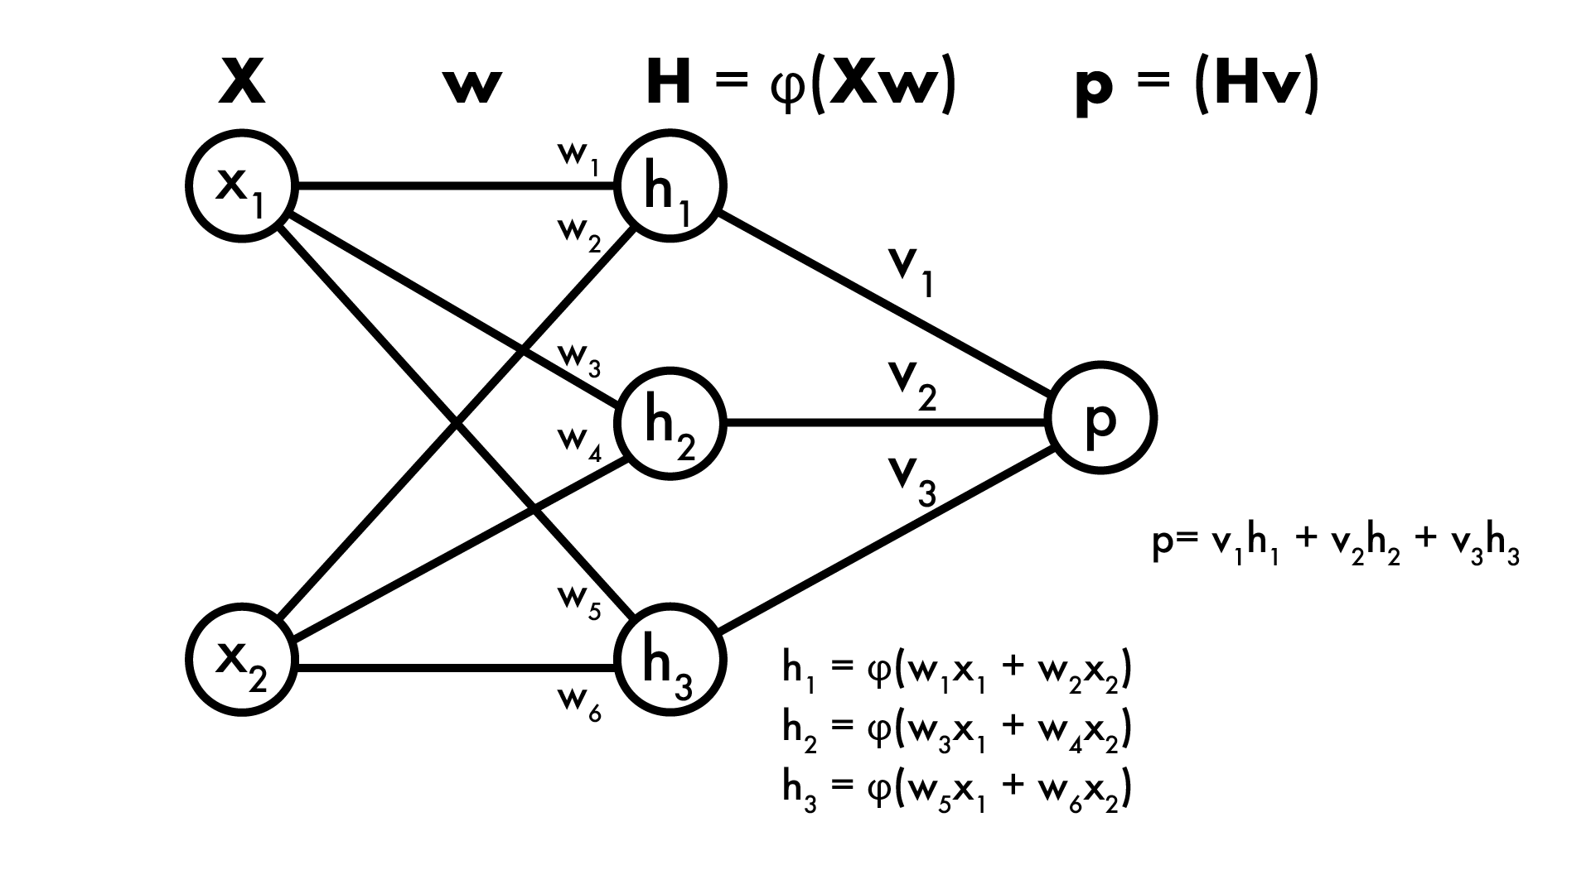
Backpropagation: the math
1-layer NN, sigmoid activation at hidden layer, linear output:
F(X) = φ(Xw)v
F(X) = φ(x₁w₁ + x₂w₂)v₁ + φ(x₁w₃ + x₂w₄)v₂ + φ(x₁w₅ + x₂w₆)v₃

Slide 46
Backpropagation: the math
1-layer NN, sigmoid activation at hidden layer, linear output:
F(X) = φ(Xw)v
F(X) = φ(x₁w₁ + x₂w₂)v₁ + φ(x₁w₃ + x₂w₄)v₂ + φ(x₁w₅ + x₂w₆)v₃
Say regression, Loss function is ½ L₂ norm, expected output is Y:
L_{X,Y}(w,v) = ½(Y - F(X))² = ½(Y - φ(Xw)v)²

Slide 47
Backpropagation: the math
1-layer NN, sigmoid activation at hidden layer, linear output:
F(X) = φ(Xw)v
F(X) = φ(x₁w₁ + x₂w₂)v₁ + φ(x₁w₃ + x₂w₄)v₂ + φ(x₁w₅ + x₂w₆)v₃
Say regression, Loss function is ½ L₂ norm, expected output is Y:
L_{X,Y}(w,v) = ½(Y - F(X))² = ½(Y - φ(Xw)v)²
Want partial derivative of Loss w.r.t. weights, say v₂:
∂/∂v₂ L_{X,Y}(w,v) = ∂/∂v₂ ½(Y - φ(Xw)v)²

Slide 48
Backpropagation: the math
1-layer NN, sigmoid activation at hidden layer, linear output:
F(X) = φ(Xw)v
F(X) = φ(x₁w₁ + x₂w₂)v₁ + φ(x₁w₃ + x₂w₄)v₂ + φ(x₁w₅ + x₂w₆)v₃
Say regression, Loss function is ½ L₂ norm, expected output is Y:
L_{X,Y}(w,v) = ½(Y - F(X))² = ½(Y - φ(Xw)v)²
Want partial derivative of Loss w.r.t. weights, say v₂:
∂/∂v₂ L_{X,Y}(w,v) = ∂/∂v₂ ½(Y - φ(Xw)v)²
= (Y - φ(Xw)v) * -[∂/∂v₂φ(Xw)v]

Slide 49
Backpropagation: the math
1-layer NN, sigmoid activation at hidden layer, linear output:
F(X) = φ(Xw)v
F(X) = φ(x₁w₁ + x₂w₂)v₁ + φ(x₁w₃ + x₂w₄)v₂ + φ(x₁w₅ + x₂w₆)v₃
Say regression, Loss function is ½ L₂ norm, expected output is Y:
L_{X,Y}(w,v) = ½(Y - F(X))² = ½(Y - φ(Xw)v)²
Want partial derivative of Loss w.r.t. weights, say v₂:
∂/∂v₂ L_{X,Y}(w,v) = ∂/∂v₂ ½(Y - φ(Xw)v)²
= (Y - φ(Xw)v) * -[∂/∂v₂φ(Xw)v]
= (Y - φ(Xw)v) * -[∂/∂v₂ φ(x₁w₃ + x₂w₄)v₂]

Slide 50
Backpropagation: the math
1-layer NN, sigmoid activation at hidden layer, linear output:
F(X) = φ(Xw)v
F(X) = φ(x₁w₁ + x₂w₂)v₁ + φ(x₁w₃ + x₂w₄)v₂ + φ(x₁w₅ + x₂w₆)v₃
Say regression, Loss function is ½ L₂ norm, expected output is Y:
L_{X,Y}(w,v) = ½(Y - F(X))² = ½(Y - φ(Xw)v)²
Want partial derivative of Loss w.r.t. weights, say v₂:
∂/∂v₂ L_{X,Y}(w,v) = ∂/∂v₂ ½(Y - φ(Xw)v)²
= (Y - φ(Xw)v) * -[∂/∂v₂φ(Xw)v]
= (Y - φ(Xw)v) * -[∂/∂v₂ φ(x₁w₃ + x₂w₄)v₂]
= (Y - φ(Xw)v) * -φ(x₁w₃ + x₂w₄)

Slide 51
Backpropagation: the math
Want partial derivative of Loss w.r.t. weights, say v₂:
∂/∂v₂ L_{X,Y}(w,v) = (Y - φ(Xw)v) * -φ(x₁w₃ + x₂w₄)

Slide 52
Backpropagation: the math
Want partial derivative of Loss w.r.t. weights, say v₂:
∂/∂v₂ L_{X,Y}(w,v) = -(Y - φ(Xw)v)*h₂

Slide 53
Backpropagation: the math
Want partial derivative of Loss w.r.t. weights, say v₂:
∂/∂v₂ L_{X,Y}(w,v) = -(Y - φ(Xw)v)*h₂
Weight update rule (remember descend on loss):
v₂ = v₂ + η(Y - φ(Xw)v)*h₂

Slide 54
Backpropagation: the math
1-layer NN, sigmoid activation at hidden layer, linear output:
F(X) = φ(Xw)v
F(X) = φ(x₁w₁ + x₂w₂)v₁ + φ(x₁w₃ + x₂w₄)v₂ + φ(x₁w₅ + x₂w₆)v₃
Say regression, Loss function is ½ L₂ norm, expected output is Y:
L_{X,Y}(w,v) = ½(Y - F(X))² = ½(Y - φ(Xw)v)²
Want partial derivative of Loss w.r.t. weights, say w₂:
∂/∂w₂ L_{X,Y}(w,v) = ∂/∂w₂ ½(Y - φ(Xw)v)²
= (Y - φ(Xw)v) * -[∂/∂w₂ φ(Xw)v]

Slide 55
Backpropagation: the math
1-layer NN, sigmoid activation at hidden layer, linear output:
F(X) = φ(Xw)v
F(X) = φ(x₁w₁ + x₂w₂)v₁ + φ(x₁w₃ + x₂w₄)v₂ + φ(x₁w₅ + x₂w₆)v₃
Say regression, Loss function is ½ L₂ norm, expected output is Y:
L_{X,Y}(w,v) = ½(Y - F(X))² = ½(Y - φ(Xw)v)²
Want partial derivative of Loss w.r.t. weights, say w₂:
∂/∂w₂ L_{X,Y}(w,v) = ∂/∂w₂ ½(Y - φ(Xw)v)²
= (Y - φ(Xw)v) * -[∂/∂w₂ φ(Xw)v]
= (Y - φ(Xw)v) * -[∂/∂w₂ φ(x₁w₁ + x₂w₂)v₁]

Slide 56
Backpropagation: the math
1-layer NN, sigmoid activation at hidden layer, linear output:
F(X) = φ(Xw)v
F(X) = φ(x₁w₁ + x₂w₂)v₁ + φ(x₁w₃ + x₂w₄)v₂ + φ(x₁w₅ + x₂w₆)v₃
Say regression, Loss function is ½ L₂ norm, expected output is Y:
L_{X,Y}(w,v) = ½(Y - F(X))² = ½(Y - φ(Xw)v)²
Want partial derivative of Loss w.r.t. weights, say w₂:
∂/∂w₂ L_{X,Y}(w,v) = ∂/∂w₂ ½(Y - φ(Xw)v)²
= (Y - φ(Xw)v) * -[∂/∂w₂ φ(Xw)v]
= (Y - φ(Xw)v) * -v₁[∂/∂w₂ φ(x₁w₁ + x₂w₂)]

Slide 57
Backpropagation: the math
1-layer NN, sigmoid activation at hidden layer, linear output:
F(X) = φ(Xw)v
F(X) = φ(x₁w₁ + x₂w₂)v₁ + φ(x₁w₃ + x₂w₄)v₂ + φ(x₁w₅ + x₂w₆)v₃
Say regression, Loss function is ½ L₂ norm, expected output is Y:
L_{X,Y}(w,v) = ½(Y - F(X))² = ½(Y - φ(Xw)v)²
Want partial derivative of Loss w.r.t. weights, say w₂:
∂/∂w₂ L_{X,Y}(w,v) = ∂/∂w₂ ½(Y - φ(Xw)v)²
= (Y - φ(Xw)v) * -[∂/∂w₂ φ(Xw)v]
= (Y - φ(Xw)v) * -v₁[∂/∂w₂ φ(x₁w₁ + x₂w₂)]
= (Y - φ(Xw)v) * -v₁φ’(x₁w₁+x₂w₂)[∂/∂w₂ (x₁w₁ + x₂w₂)]
Chain rule!
If F(x) = f(g(x))
F’(x) = f’(g(x))g’(x)

Slide 58
Backpropagation: the math
1-layer NN, sigmoid activation at hidden layer, linear output:
F(X) = φ(Xw)v
F(X) = φ(x₁w₁ + x₂w₂)v₁ + φ(x₁w₃ + x₂w₄)v₂ + φ(x₁w₅ + x₂w₆)v₃
Say regression, Loss function is ½ L₂ norm, expected output is Y:
L_{X,Y}(w,v) = ½(Y - F(X))² = ½(Y - φ(Xw)v)²
Want partial derivative of Loss w.r.t. weights, say w₂:
∂/∂w₂ L_{X,Y}(w,v) = ∂/∂w₂ ½(Y - φ(Xw)v)²
= (Y - φ(Xw)v) * -[∂/∂w₂ φ(Xw)v]
= (Y - φ(Xw)v) * -v₁[∂/∂w₂ φ(x₁w₁ + x₂w₂)]
= (Y - φ(Xw)v) * -v₁φ’(x₁w₁+x₂w₂)[∂/∂w₂ (x₁w₁ + x₂w₂)]
= (Y - φ(Xw)v) * -v₁φ’(x₁w₁+x₂w₂) * x₂

Slide 59
Backpropagation: the math
Want partial derivative of Loss w.r.t. weights, say w₂:
∂/∂w₂ L_{X,Y}(w,v) = (Y - φ(Xw)v) * -v₁φ’(x₁w₁+x₂w₂) * x₂

Slide 60
Backpropagation: the math
Want partial derivative of Loss w.r.t. weights, say w₂:
∂/∂w₂ L_{X,Y}(w,v) = (Y - φ(Xw)v) * -v₁φ’(x₁w₁+x₂w₂) * x₂
Model error at p

Slide 61
Backpropagation: the math
Want partial derivative of Loss w.r.t. weights, say w₂:
∂/∂w₂ L_{X,Y}(w,v) = (Y - φ(Xw)v) * -v₁φ’(x₁w₁+x₂w₂) * x₂
Model error at p
Backpropagate through v₁

Slide 62
Backpropagation: the math
Want partial derivative of Loss w.r.t. weights, say w₂:
∂/∂w₂ L_{X,Y}(w,v) = (Y - φ(Xw)v) * -v₁φ’(x₁w₁+x₂w₂) * x₂
Model error at p
Model error at h₁
Backpropagate through v₁

Slide 63
Backpropagation: the math
Want partial derivative of Loss w.r.t. weights, say w₂:
∂/∂w₂ L_{X,Y}(w,v) = (Y - φ(Xw)v) * -v₁φ’(x₁w₁+x₂w₂) * x₂
Model error at p
Model error at h₁
Multiply by x₂: gradient w.r.t. w₂
Backpropagate through v₁

Slide 64
Backpropagation: the math
∂h₁/∂(w₁x₁ + w₂x₂)
∂p/∂h₁
∂p/∂v₁
∂(w₁x₁ + w₂x₂)/∂w₂
∂L/∂p

Slide 65
Backpropagation: the math
∂(w₁x₁ + w₂x₂)/∂w₂ = x₂

Slide 66
Backpropagation: the math
∂h₁/∂(w₁x₁ + w₂x₂) = φ’(x₁w₁+x₂w₂)
∂(w₁x₁ + w₂x₂)/∂w₂ = x₂

Slide 67
Backpropagation: the math
∂h₁/∂(w₁x₁ + w₂x₂) = φ’(x₁w₁+x₂w₂)
∂p/∂h₁ = v₁
∂(w₁x₁ + w₂x₂)/∂w₂ = x₂

Slide 68
Backpropagation: the math
∂h₁/∂(w₁x₁ + w₂x₂) = φ’(x₁w₁+x₂w₂)
∂p/∂h₁ = v₁
∂p/∂v₁ = h₁
∂(w₁x₁ + w₂x₂)/∂w₂ = x₂

Slide 69
Backpropagation: the math
∂h₁/∂(w₁x₁ + w₂x₂) = φ’(x₁w₁+x₂w₂)
∂p/∂h₁ = v₁
∂p/∂v₁ = h₁
∂(w₁x₁ + w₂x₂)/∂w₂ = x₂
∂L/∂p = (Y - φ(Xw)v)

Slide 70
Backpropagation: the math
∂h₁/∂(w₁x₁ + w₂x₂) = φ’(x₁w₁+x₂w₂)
∂p/∂h₁ = v₁
∂p/∂v₁ = h₁
∂(w₁x₁ + w₂x₂)/∂w₂ = x₂
∂L/∂p = (Y - φ(Xw)v)
How do we update v₁?
∂L/∂v₁

Slide 71
Backpropagation: the math
∂h₁/∂(w₁x₁ + w₂x₂) = φ’(x₁w₁+x₂w₂)
∂p/∂h₁ = v₁
∂p/∂v₁ = h₁
∂(w₁x₁ + w₂x₂)/∂w₂ = x₂
∂L/∂p = (Y - φ(Xw)v)
How do we update v₁?
∂L/∂v₁ = ∂p/∂v₁ * ∂L/∂p

Slide 72
Backpropagation: the math
∂h₁/∂(w₁x₁ + w₂x₂) = φ’(x₁w₁+x₂w₂)
∂p/∂h₁ = v₁
∂p/∂v₁ = h₁
∂(w₁x₁ + w₂x₂)/∂w₂ = x₂
∂L/∂p = (Y - φ(Xw)v)
How do we update v₁?
∂L/∂v₁ = ∂p/∂v₁ * ∂L/∂p =
H₁

Slide 73
Backpropagation: the math
∂h₁/∂(w₁x₁ + w₂x₂) = φ’(x₁w₁+x₂w₂)
∂p/∂h₁ = v₁
∂p/∂v₁ = h₁
∂(w₁x₁ + w₂x₂)/∂w₂ = x₂
∂L/∂p = (Y - φ(Xw)v)
How do we update v₁?
∂L/∂v₁ = ∂p/∂v₁ * ∂L/∂p =
H₁ * (Y - φ(Xw)v)

Slide 74
Backpropagation: the math
∂h₁/∂(w₁x₁ + w₂x₂) = φ’(x₁w₁+x₂w₂)
∂p/∂h₁ = v₁
∂p/∂v₁ = h₁
∂(w₁x₁ + w₂x₂)/∂w₂ = x₂
∂L/∂p = (Y - φ(Xw)v)
How do we update w₂?
∂L/∂w₂

Slide 75
Backpropagation: the math
∂h₁/∂(w₁x₁ + w₂x₂) = φ’(x₁w₁+x₂w₂)
∂p/∂h₁ = v₁
∂p/∂v₁ = h₁
∂(w₁x₁ + w₂x₂)/∂w₂ = x₂
∂L/∂p = (Y - φ(Xw)v)
How do we update w₂?
∂L/∂w₂ =
∂(w₁x₁ + w₂x₂)/∂w₂ * ∂h₁/∂(w₁x₁ + w₂x₂) * ∂p/∂h₁ * ∂L/∂p

Slide 76
Backpropagation: the math
∂h₁/∂(w₁x₁ + w₂x₂) = φ’(x₁w₁+x₂w₂)
∂p/∂h₁ = v₁
∂p/∂v₁ = h₁
∂(w₁x₁ + w₂x₂)/∂w₂ = x₂
∂L/∂p = (Y - φ(Xw)v)
How do we update w₂?
∂L/∂w₂ =
∂(w₁x₁ + w₂x₂)/∂w₂ * ∂h₁/∂(w₁x₁ + w₂x₂) * ∂p/∂h₁ * ∂L/∂p = x₂

Slide 77
Backpropagation: the math
∂h₁/∂(w₁x₁ + w₂x₂) = φ’(x₁w₁+x₂w₂)
∂p/∂h₁ = v₁
∂p/∂v₁ = h₁
∂(w₁x₁ + w₂x₂)/∂w₂ = x₂
∂L/∂p = (Y - φ(Xw)v)
How do we update w₂?
∂L/∂w₂ =
∂(w₁x₁ + w₂x₂)/∂w₂ * ∂h₁/∂(w₁x₁ + w₂x₂) * ∂p/∂h₁ * ∂L/∂p = x₂ * φ’(x₁w₁+x₂w₂)

Slide 78
Backpropagation: the math
∂h₁/∂(w₁x₁ + w₂x₂) = φ’(x₁w₁+x₂w₂)
∂p/∂h₁ = v₁
∂p/∂v₁ = h₁
∂(w₁x₁ + w₂x₂)/∂w₂ = x₂
∂L/∂p = (Y - φ(Xw)v)
How do we update w₂?
∂L/∂w₂ =
∂(w₁x₁ + w₂x₂)/∂w₂ * ∂h₁/∂(w₁x₁ + w₂x₂) * ∂p/∂h₁ * ∂L/∂p = x₂ * φ’(x₁w₁+x₂w₂) * v₁

Slide 79
Backpropagation: the math
∂h₁/∂(w₁x₁ + w₂x₂) = φ’(x₁w₁+x₂w₂)
∂p/∂h₁ = v₁
∂p/∂v₁ = h₁
∂(w₁x₁ + w₂x₂)/∂w₂ = x₂
∂L/∂p = (Y - φ(Xw)v)
How do we update w₂?
∂L/∂w₂ =
∂(w₁x₁ + w₂x₂)/∂w₂ * ∂h₁/∂(w₁x₁ + w₂x₂) * ∂p/∂h₁ * ∂L/∂p = x₂ * φ’(x₁w₁+x₂w₂) * v₁ * (Y - φ(Xw)v)

Slide 80
Backpropagation: the math
∂L/∂v₁
∂L/∂p

Slide 81
Backpropagation: the math
∂L/∂h₁
∂L/∂p

Slide 82
Backpropagation: the math
∂L/∂(w₁x₁ + w₂x₂)
∂L/∂h₁
φ’(x₁w₁+x₂w₂)

Slide 83
Backpropagation: the math
∂L/∂(w₁x₁ + w₂x₂)
∂L/∂w₂

Slide 84
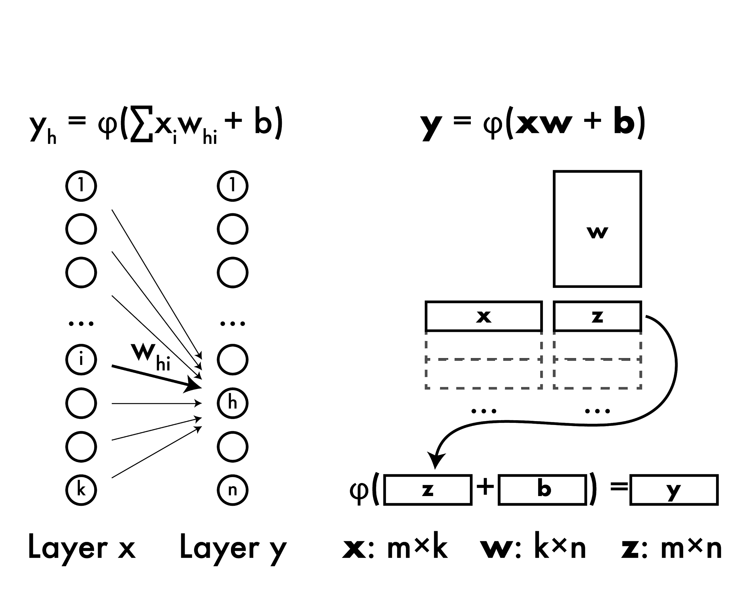
Forward propagation

Slide 85
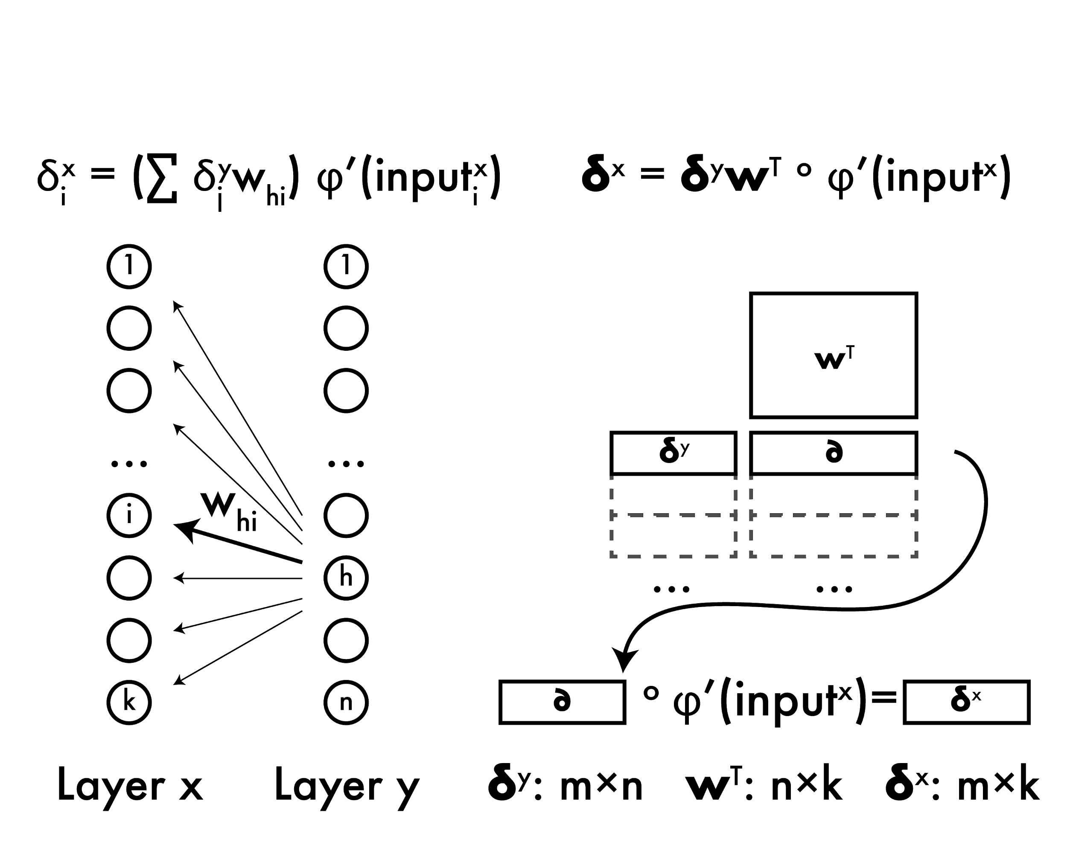
Backward propagation

Slide 86
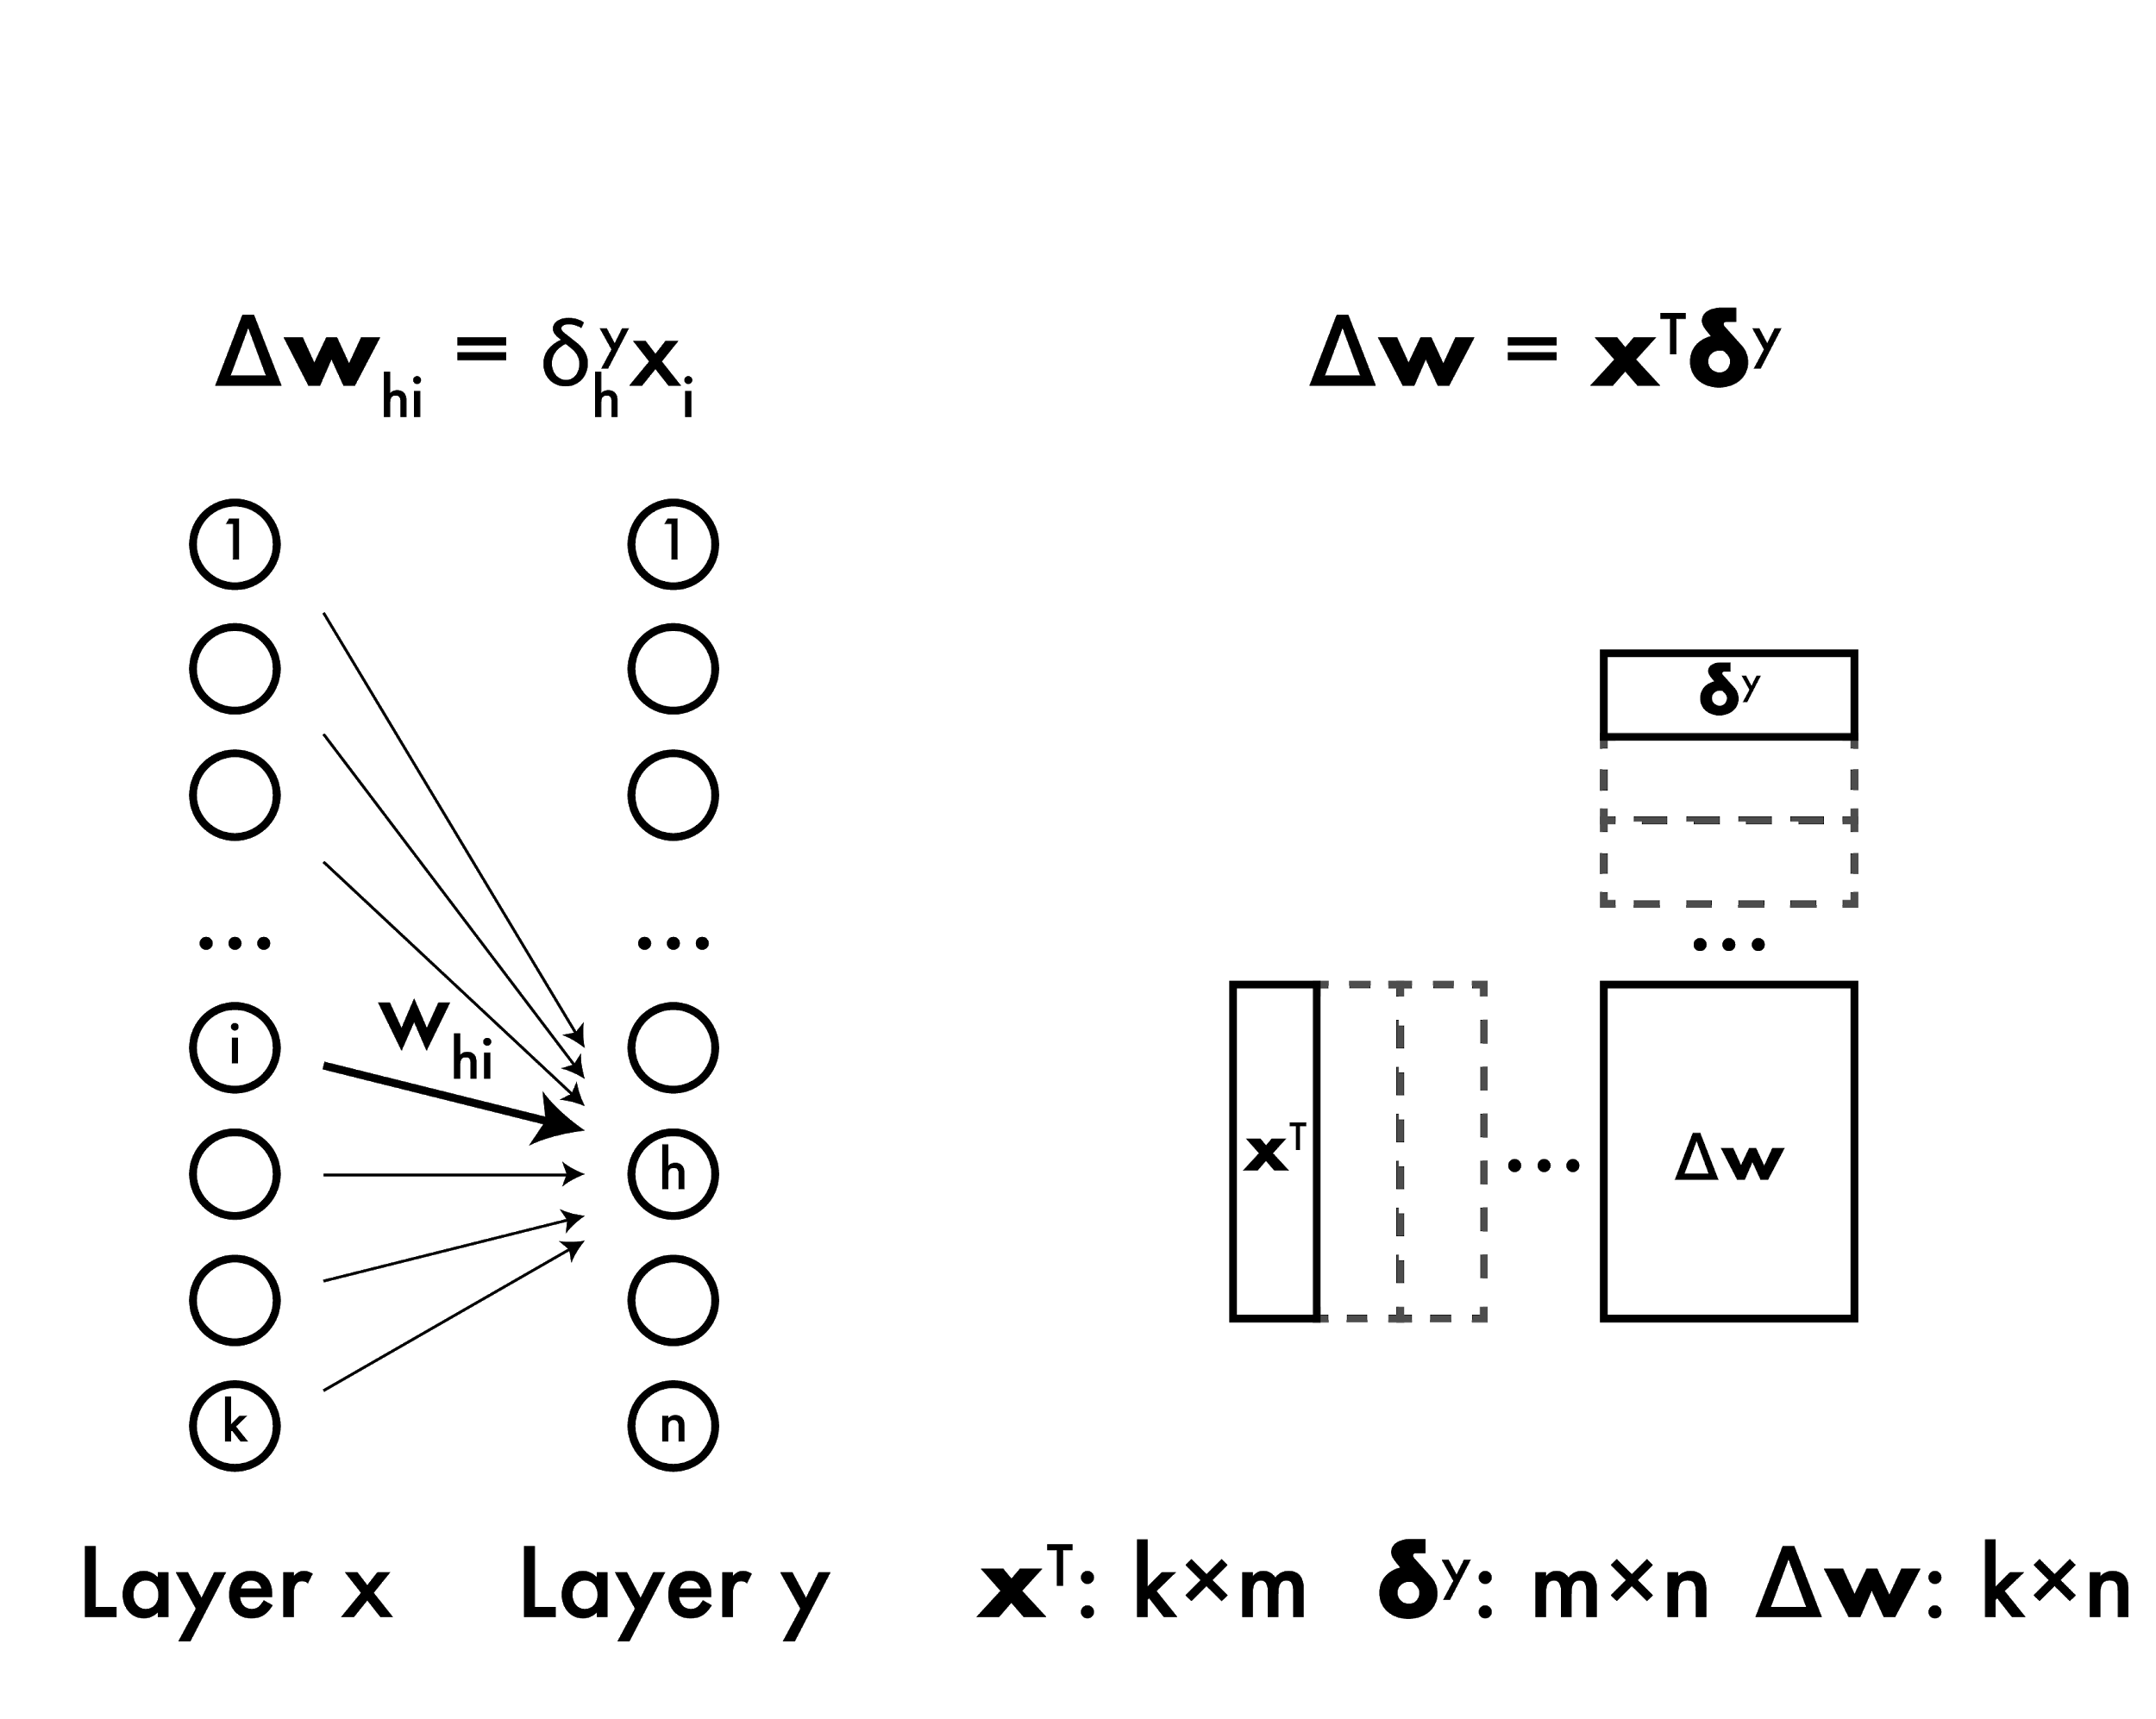
Weight updates

Slide 87
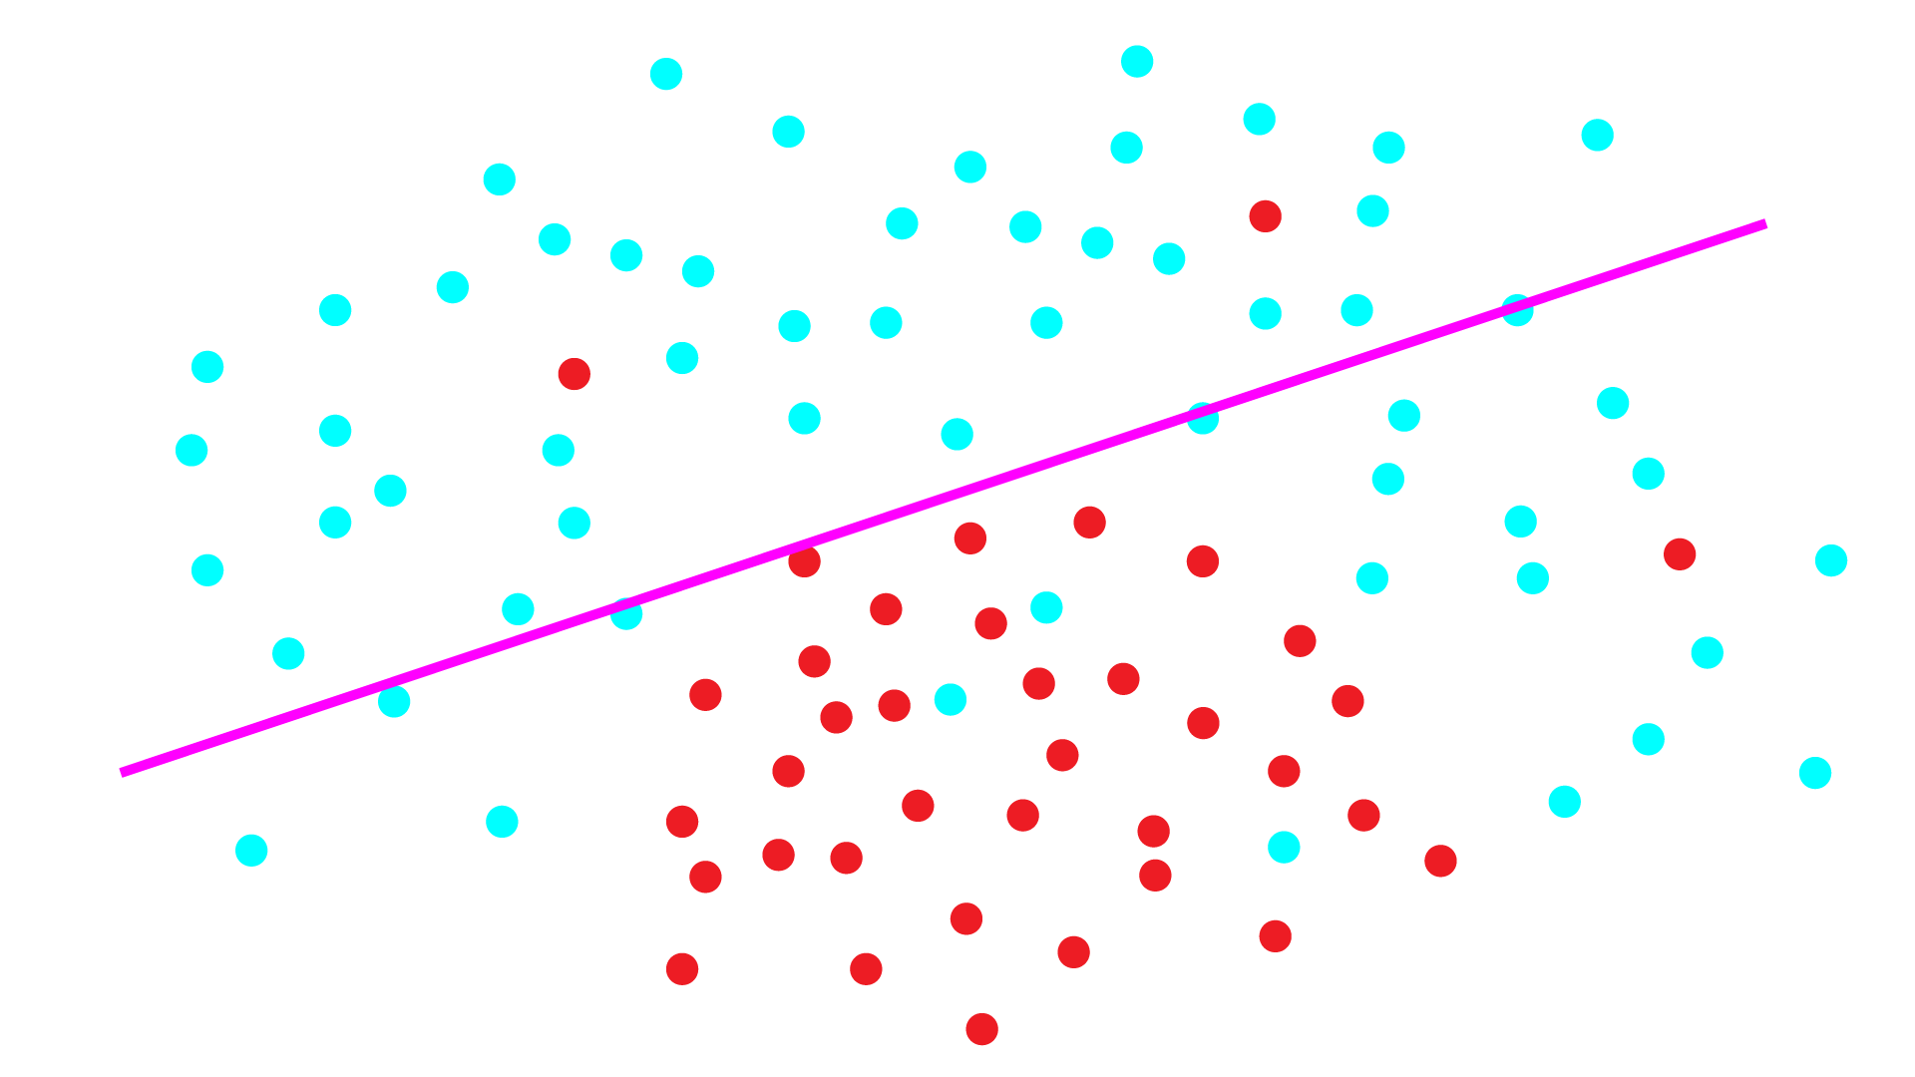
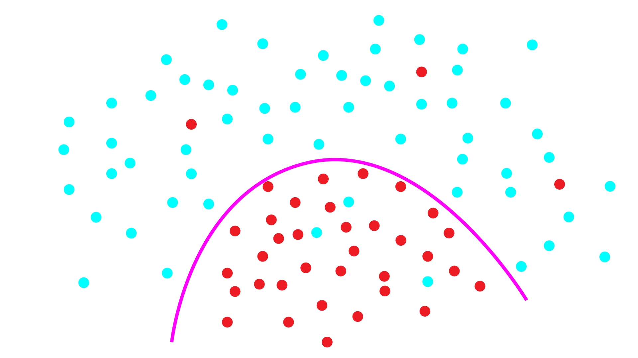
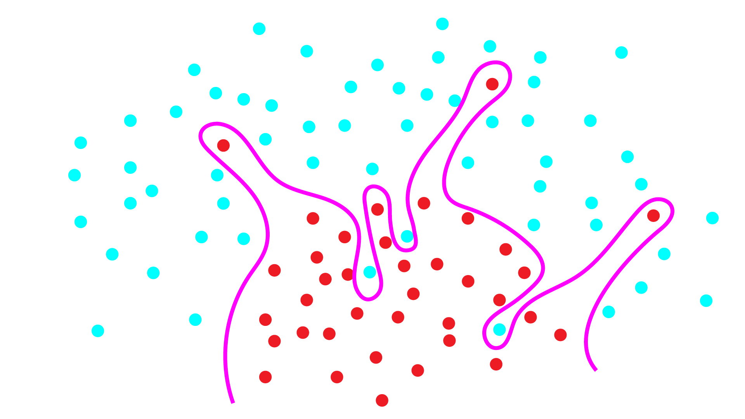
Under and Overfitting
Underfitting: model not powerful enough, too much bias
Overfitting: model too powerful, fits to noise, doesn’t generalize well
Want the happy medium, how?

Slide 88
Under and Overfitting
Want the happy medium, how?
Pick the right model, but very hard to know a priori
Make weak model more powerful: boosting! (or other ways)
Make strong model less likely to overfit: regularization

Slide 89
With great power comes great overfitting
Neural networks are (sort of) all powerful! Which is not necessarily a good thing.

Slide 90
With great power comes great overfitting
Like SVMs, put limits on model that make it generalize better!
SVM:
min ||w||₂
s.t. y_{n}(w·x_{n} - b) ≥ 1, n = 1, 2 ..
Neural net:
Minimize loss function and weight magnitude
Before: argmin_{w} L_{X}(w)
Now: argmin_{w} L_{X}(w) + λ ||w||₂

Slide 91
Weight decay: neural network regularization
argmin_{w} L_{X}(w) + λ ||w||₂
λ: regularization parameter
Higher: more penalty for large weights, less powerful model
Lower: less penalty, more overfitting
Commonly use L₂ norm to regularize, weight decay
Gradient descent update rule:
w_{t+1} = w_{t} - η[∂/∂w_{t} L(w_{t}) + λw_{t}]
= w_{t} - η∂/∂w_{t} L(w_{t}) - ηλw_{t}
Subtract a little bit of weight every iteration

Slide 92
Sometimes training is SLOW
With SGD we make LOTS of little steps along the gradient
Sometimes we move in the same direction for a long time…
Maybe we should speed up in that direction!

Slide 93
Momentum: speeding up SGD
If we keep moving in same direction we should move further every round
Before:
Δw_{t} = -∂/∂w_{t} L(w_{t})
Now:
Δw_{t} = -∂/∂w_{t} L(w_{t}) + mΔw_{t-1}
w_{t+1} = w_{t} + ηΔw_{t}
Side effect: smooths out updates if gradient is in different directions

Slide 94
NN updates with weight decay and momentum
Δw_{t} = -∂/∂w_{t} L(w_{t}) - λw_{t} + mΔw_{t-1}
w_{t+1} = w_{t} + ηΔw_{t}

Slide 95
NN updates with weight decay and momentum
Δw_{t} = -∂/∂w_{t} L(w_{t}) - λw_{t} + mΔw_{t-1}
w_{t+1} = w_{t} + ηΔw_{t}
Gradient of loss

Slide 96
NN updates with weight decay and momentum
Δw_{t} = -∂/∂w_{t} L(w_{t}) - λw_{t} + mΔw_{t-1}
w_{t+1} = w_{t} + ηΔw_{t}
Gradient of loss
Weight decay

Slide 97
NN updates with weight decay and momentum
Δw_{t} = -∂/∂w_{t} L(w_{t}) - λw_{t} + mΔw_{t-1}
w_{t+1} = w_{t} + ηΔw_{t}
Gradient of loss
Weight decay
Momentum

Slide 98
NN updates with weight decay and momentum
Δw_{t} = -∂/∂w_{t} L(w_{t}) - λw_{t} + mΔw_{t-1}
w_{t+1} = w_{t} + ηΔw_{t}
Gradient of loss
Weight decay
Momentum
Learning rate

Slide 99
What about our activation functions φ
Many options, want them to be easy to take derivative
UAT holds when bounded, in practice bounds can be problematic

Slide 100
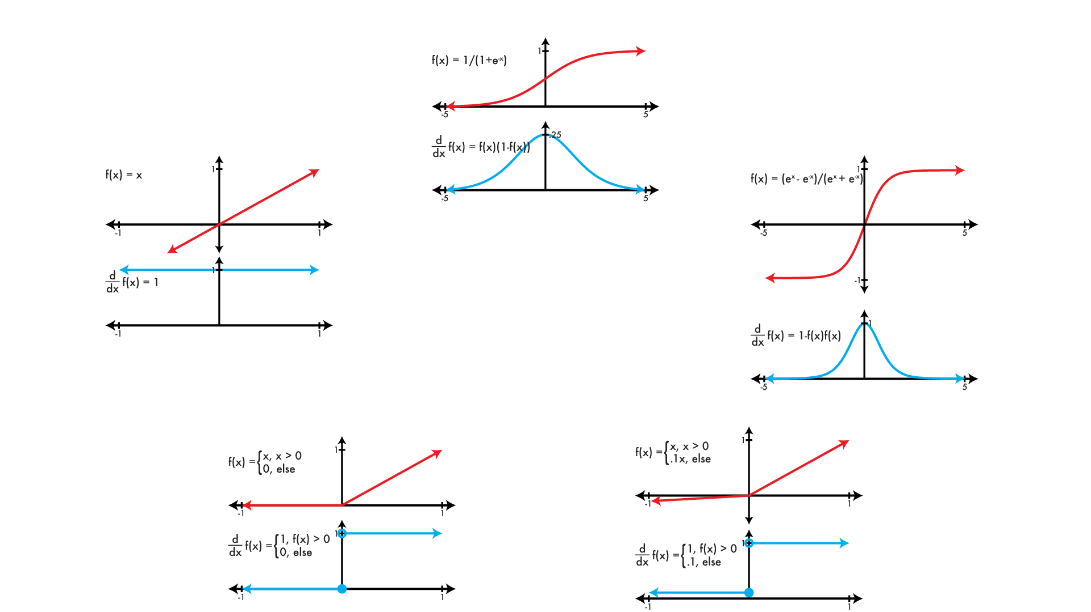
Common activation functions φ
logistic
linear
tanh
REctified Linear Unit (RELU)
Leaky RELU

Slide 101
So many hyper parameters!!
How do we know what to use??

Slide 102
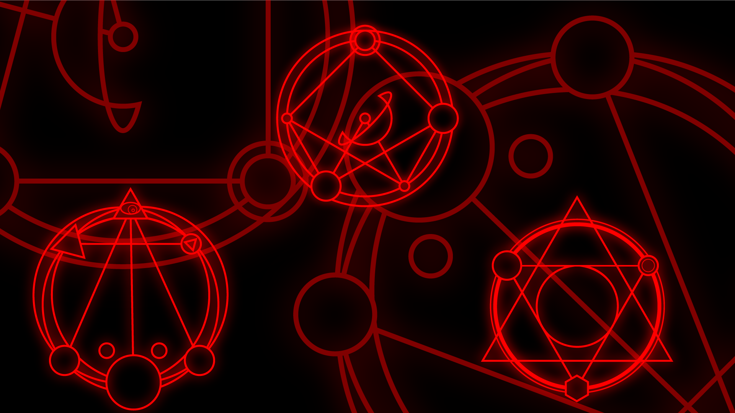
Hyper Parameter Dark Magic
What follows are the one, true, correct, and only set of hyperparameters.
Praise be the NetLord!
η = [.0001 - .01]
λ = .0005
m = .9
φ = leaky relu

Slide 103


Slide 104
Neural networks and images
Neural networks are densely connected
Each neuron in layer i connected to every neuron in layer i+1
HOG features: 36 features / 8 x 8 patch
Say we want to process images:
Input : 256 x 256 x 3 RGB image
Hidden : 32 x 32 x 36 feature map?
Output : 1000 classes
Input -> hidden is 7.2 billion connections!

Slide 105
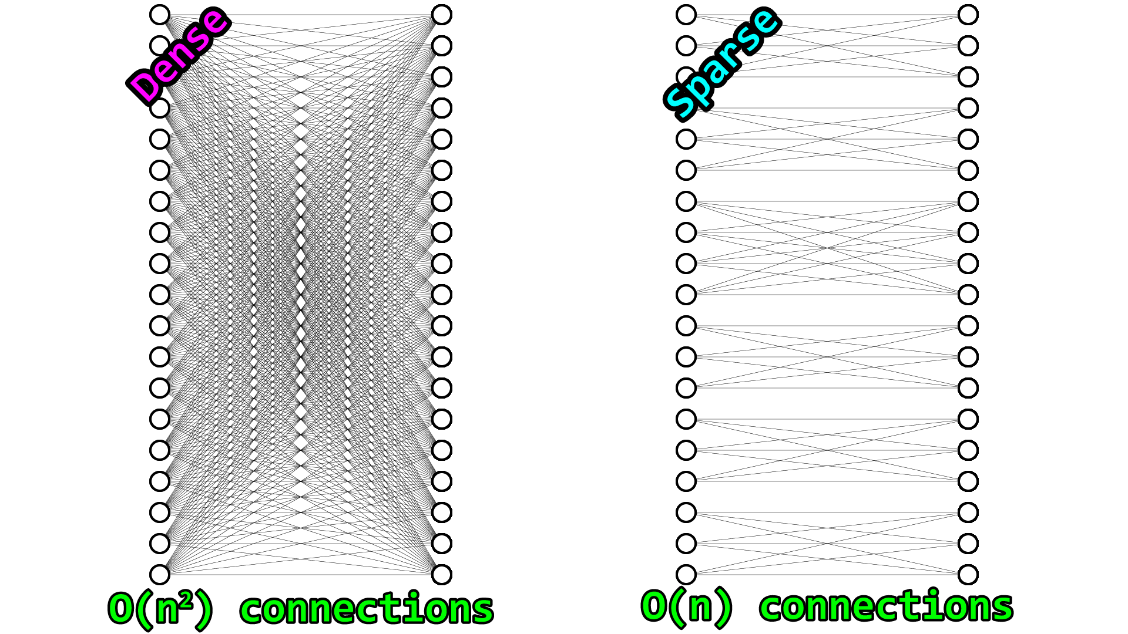
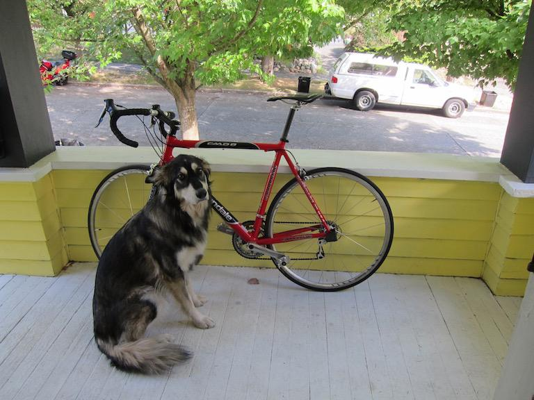
Too many weights!
Neural networks are densely connected
But is this really what we want when
processing images?

Slide 106
Too many weights!
Would rather have sparse connections
Fewer weights
Nearby regions - related
Far apart - not related
How can we do this?

Slide 107
Too many weights!
Would rather have sparse connections
Fewer weights
Nearby regions - related
Far apart - not related
Convolutions!
Just weighted sums of
small areas in image
Weight sharing in different
locations in image

Slide 108
Convolutional neural networks
Use convolutions instead of dense connections to process images
Takes advantage of structure in our data!
Imposes an assumption on our model:
Nearby pixels are related, far apart ones are less related.
What does this do to our bias/variance??

Slide 109
Convolutional Layer
Input: an image
Processing: convolution with multiple filters
Output: an image, # channels = # filters
Output still weighted sum of input (w/ activation)

Slide 110
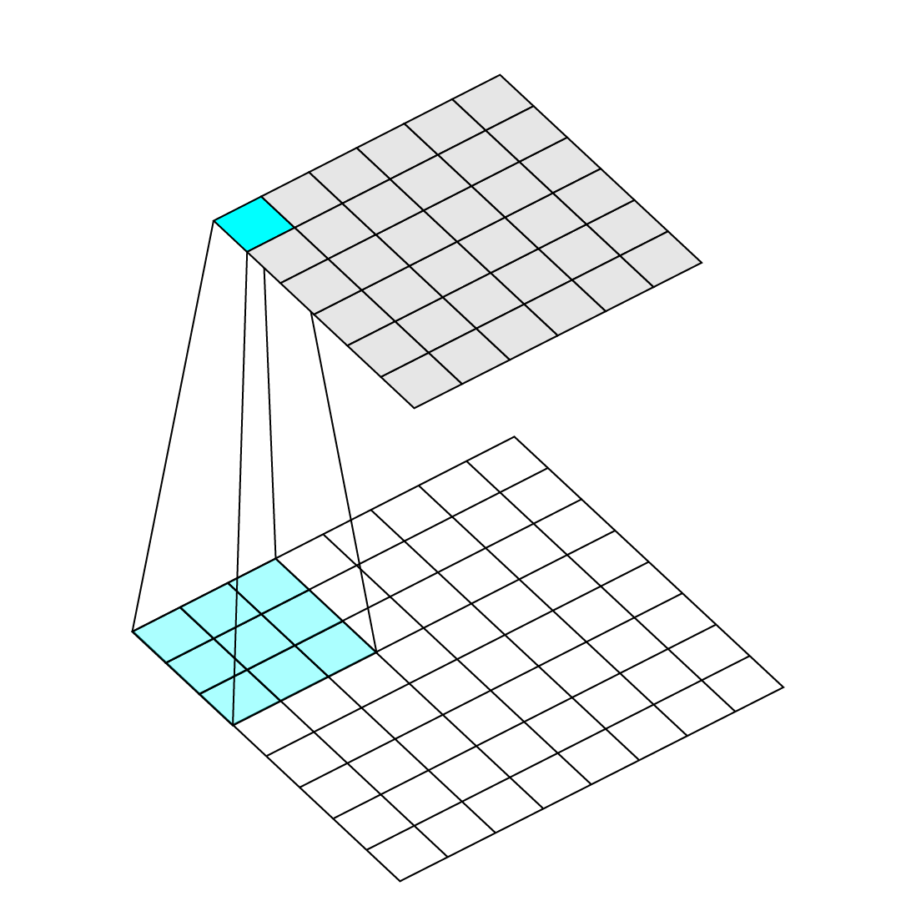
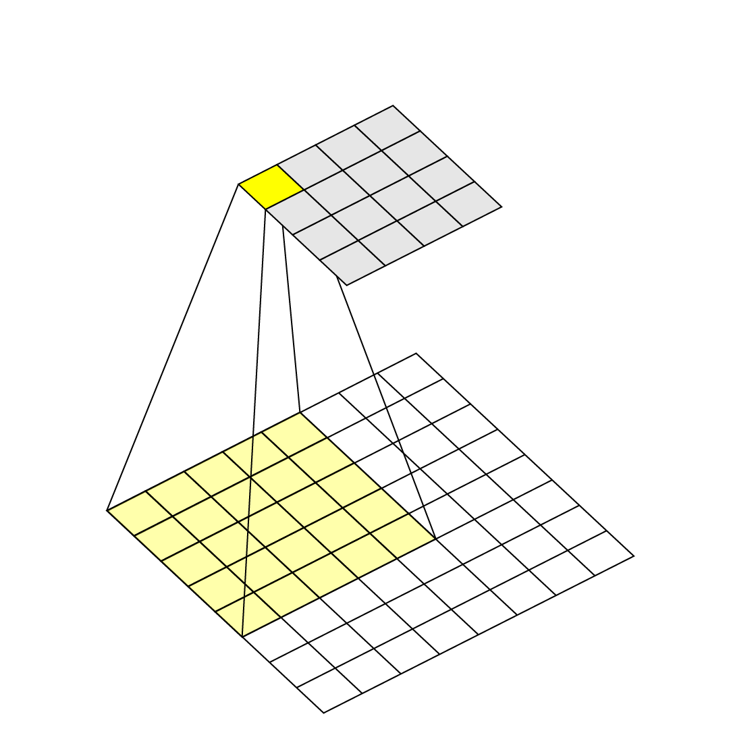
Kernel size
How big the filter for a layer is
Typically 1 x 1 <-> 11 x 11
1 x 1 is just linear combination of channels in previous image (no spatial processing)
Filters usually have same
number of channels as
input image.

Slide 111
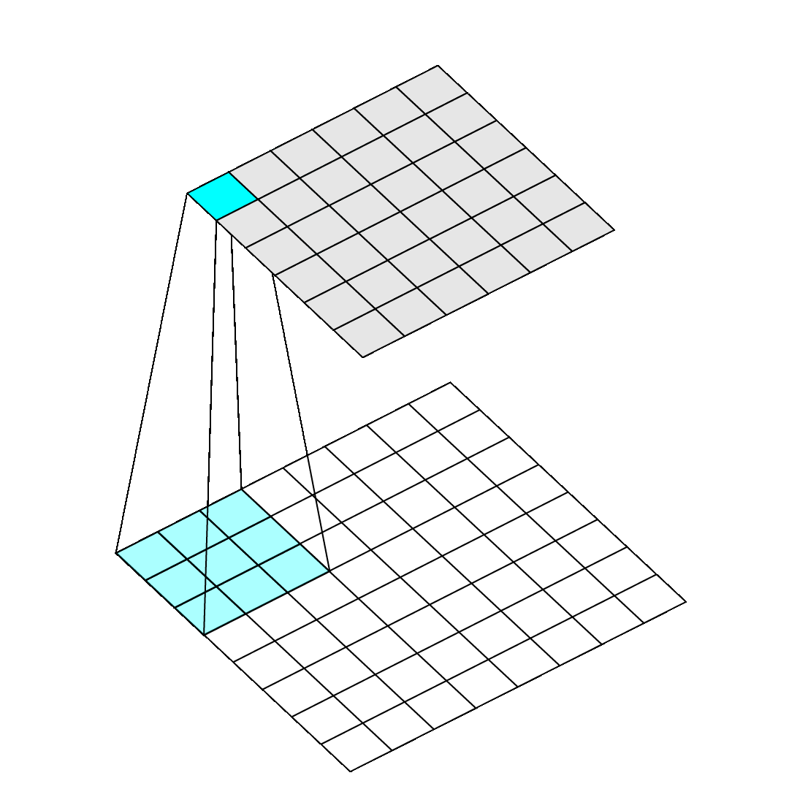
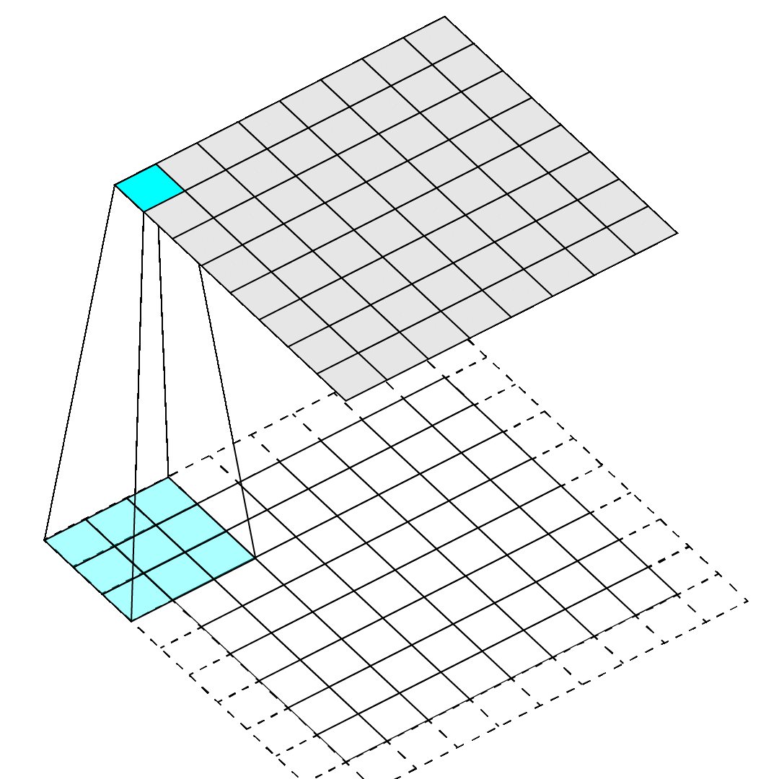
Padding
Convolutions have problems on edges
Do nothing: output a little smaller than input
Pad: add extra pixels on edge

Slide 112
Stride
How far to move filter between applications
We’ve done stride 1 convolutions up until now, approximately preserves image size
Could move filter further, downsample image

Slide 113
Implement using matrices!
We want convolution to be matrix operations because matrices are fast. How?

Slide 114
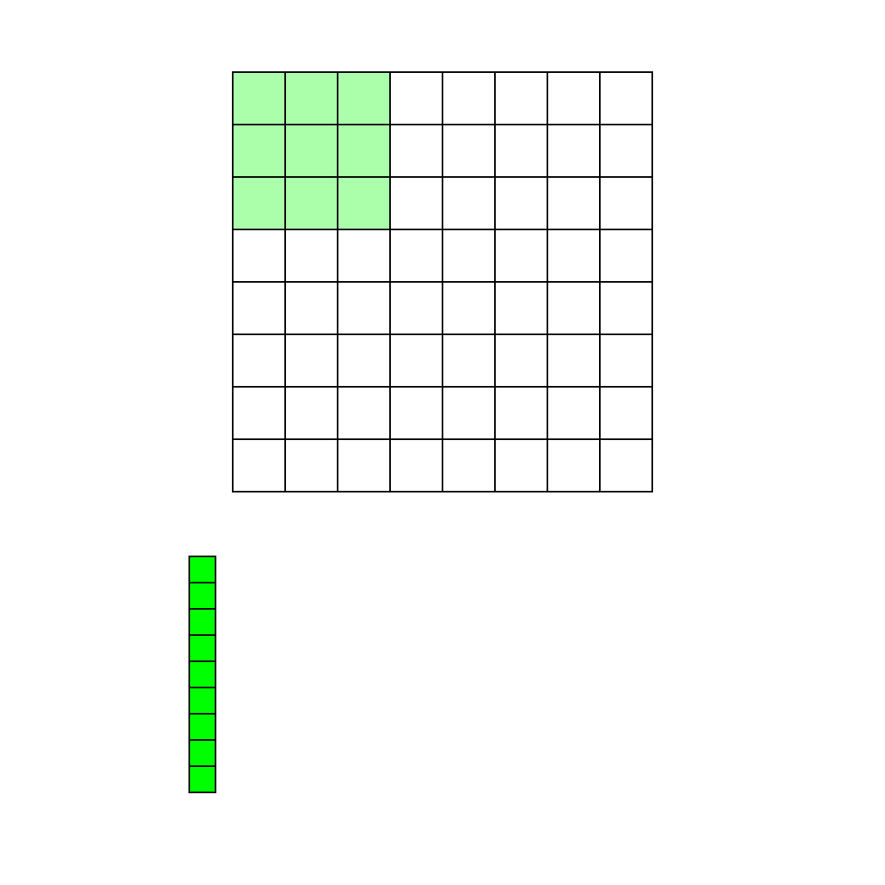
Im2col: rearrange image
Take spatial blocks of image and put them into columns of a matrix.
Im2col handles kernel size, stride,
padding, etc.
Makes matrix with all relevant
pixels in the image.

Slide 115
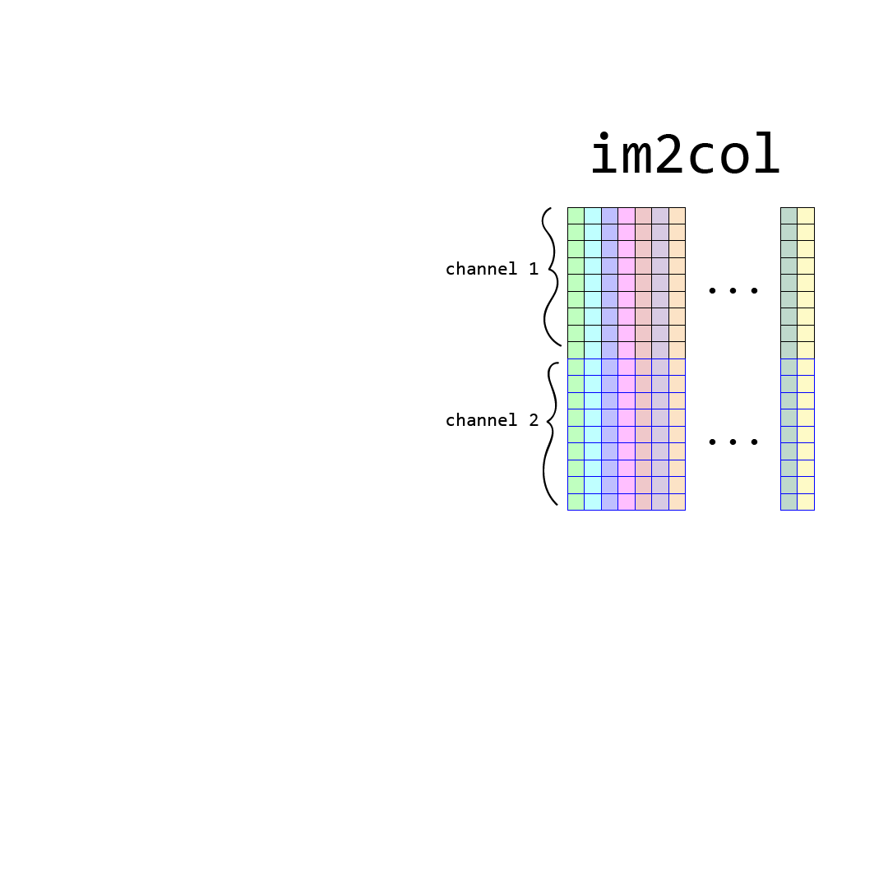
Im2col: rearrange image
Take spatial blocks of image and put them into columns of a matrix.
Im2col handles kernel size, stride,
padding, etc.
Makes matrix with all relevant
pixels in the image.
Multiple channel image stacked by channel.

Slide 116
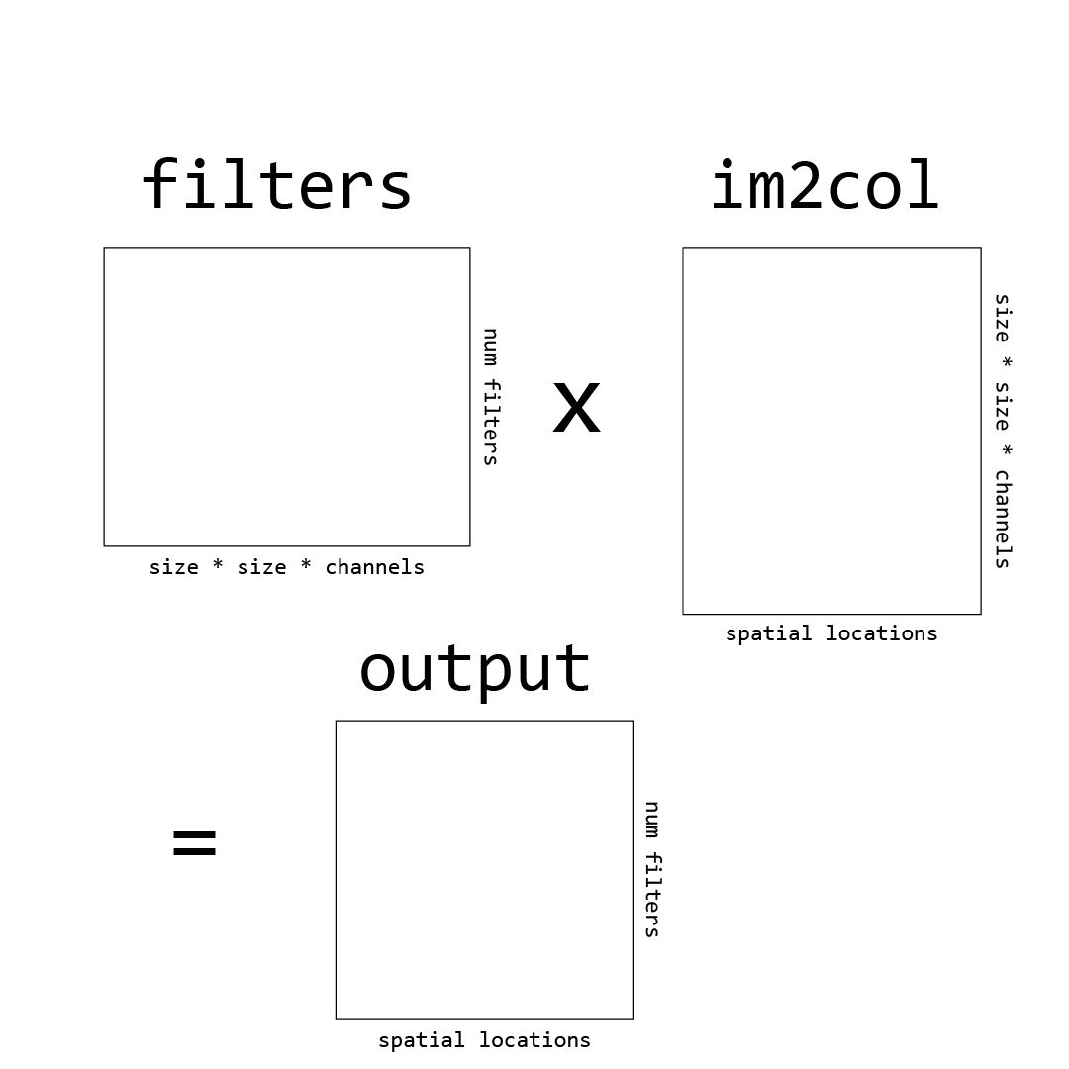
Im2col: rearrange image
Now we just multiply by
our filter matrix to do
convolutions.

Slide 117
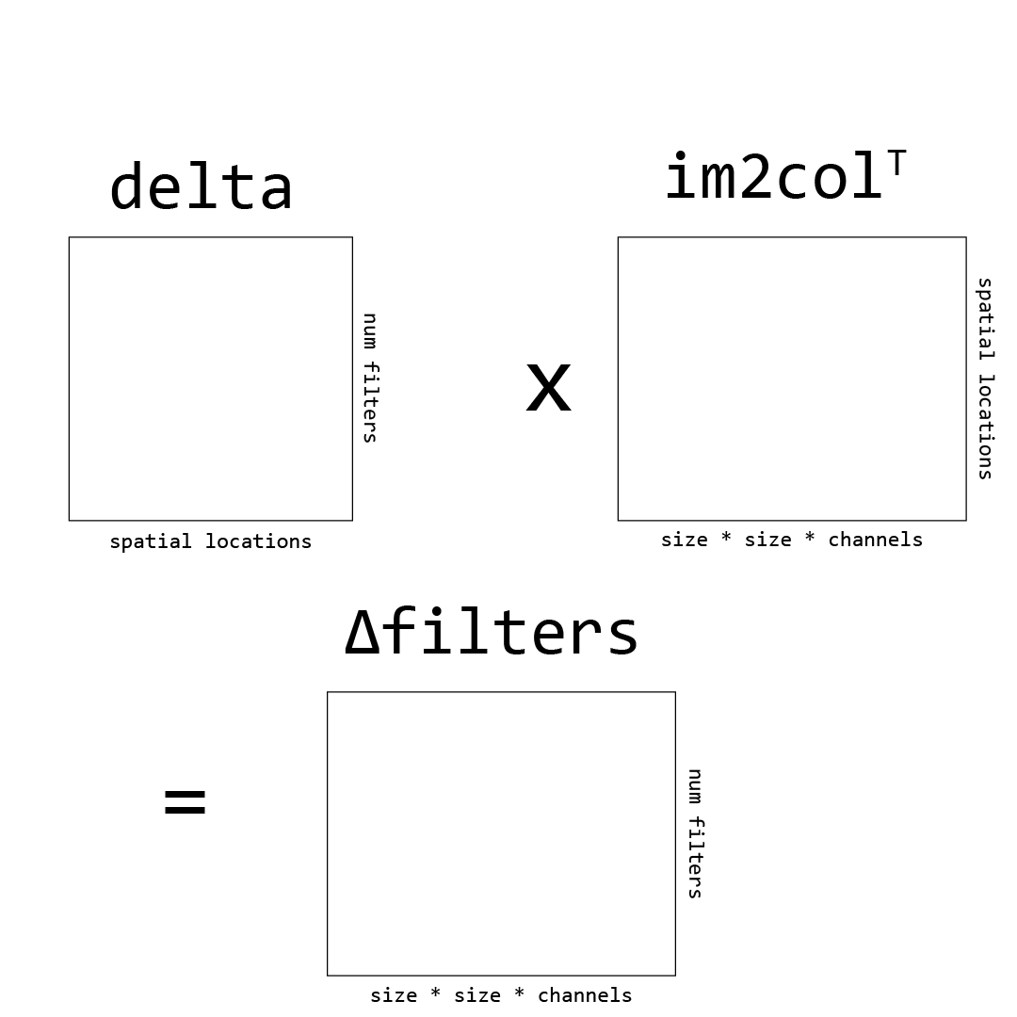
Im2col: rearrange image
Can calculate our weight
updates as well by
multiplying the delta of
a layer by the input.

Slide 118
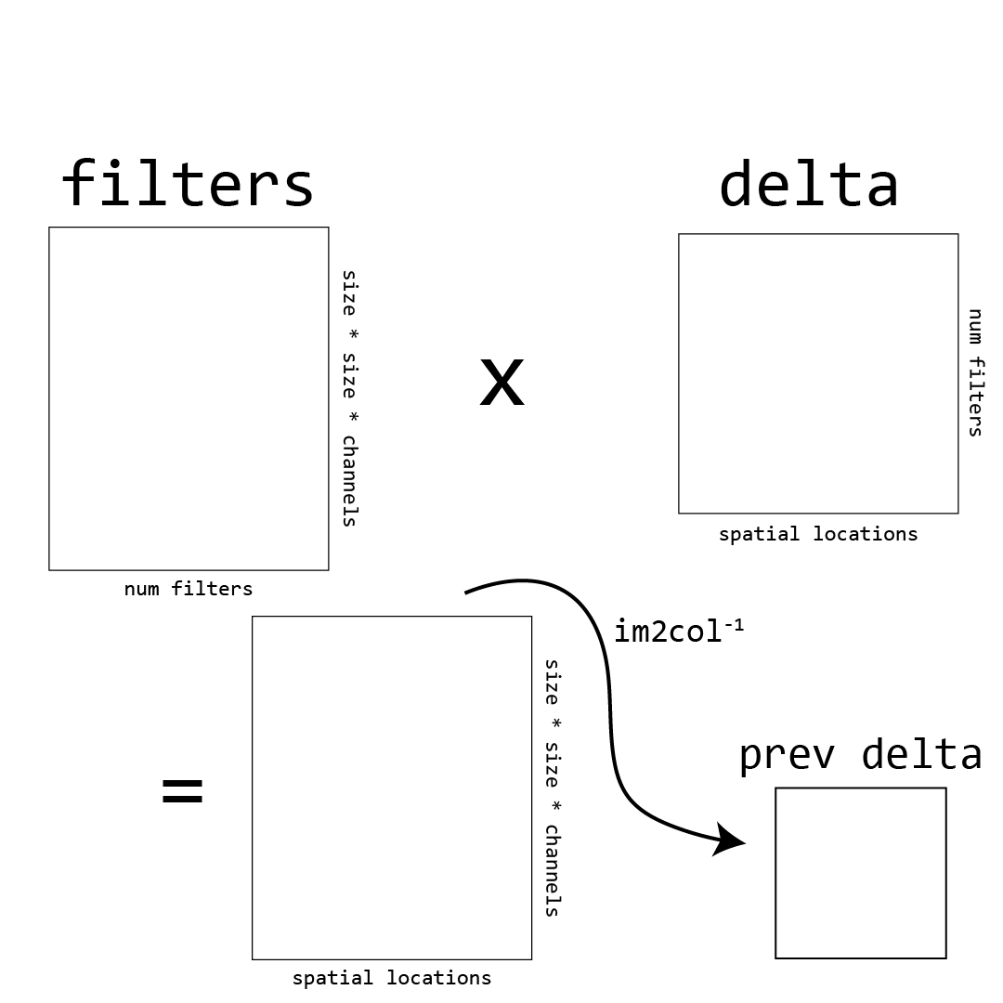
Im2col: rearrange image
Finally, can calculate
backpropagated delta by
multiplying the current
delta by weights and
doing the reverse of
im2col.

Slide 119
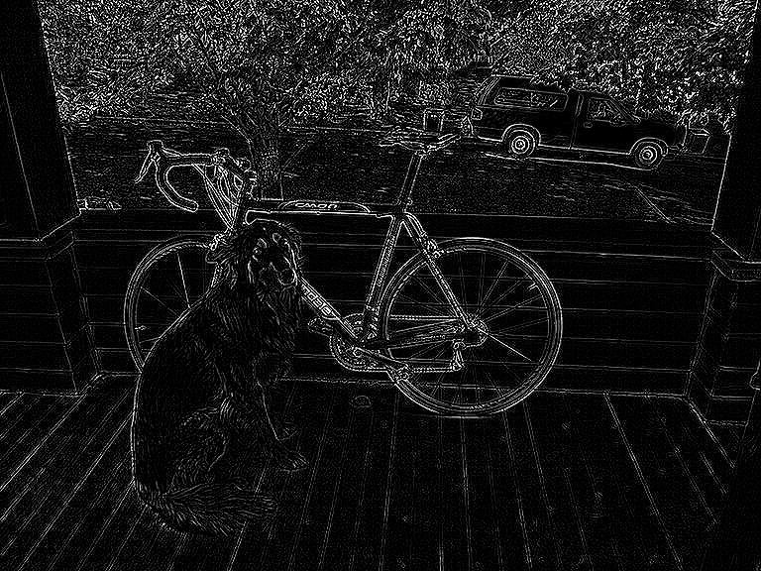
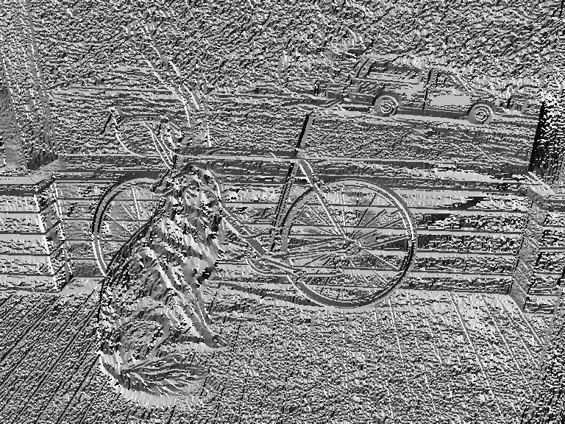
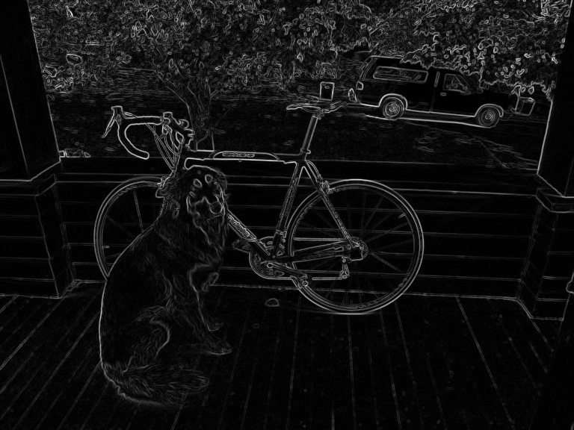
Images are BIG
Even a 256 x 256 images has hundreds of thousands of pixels and that’s considered a small image!
Convolution:
Aggregate information, maybe we don’t need all of the image, can subsample without throwing away useful information

Slide 120
Pooling Layer
Input: an image
Processing: pool pixel values over region
Output: an image, shrunk by a factor of the stride
Hyperparameters:
What kind of pooling? Average, mean, max, min
How big of stride? Controls downsampling
How big of region? Usually not much bigger than stride
Most common: 2x2 or 3x3 maxpooling, stride of 2

Slide 121
Maxpooling Layer, 2x2 stride 2
-7 | 6 | -1 | 3 | 9 | 9 | 6 | -9
3 | -8 | 0 | 7 | 10 | 8 | -3 | 10
-4 | 2 | -6 | 4 | -7 | 5 | 5 | 7
-3 | -9 | 1 | 8 | -8 | 9 | -1 | -5
-7 | 10 | -9 | -5 | 9 | -8 | -7 | 10
-5 | 5 | 9 | 4 | 10 | -8 | 7 | 6
-3 | 8 | 0 | 2 | 2 | -3 | -2 | 5
4 | -6 | 7 | -3 | 1 | 4 | 10 | 0

Slide 122
Maxpooling Layer, 2x2 stride 2
-7 | 6 | -1 | 3 | 9 | 9 | 6 | -9
3 | -8 | 0 | 7 | 10 | 8 | -3 | 10
-4 | 2 | -6 | 4 | -7 | 5 | 5 | 7
-3 | -9 | 1 | 8 | -8 | 9 | -1 | -5
-7 | 10 | -9 | -5 | 9 | -8 | -7 | 10
-5 | 5 | 9 | 4 | 10 | -8 | 7 | 6
-3 | 8 | 0 | 2 | 2 | -3 | -2 | 5
4 | -6 | 7 | -3 | 1 | 4 | 10 | 0
6

Slide 123
Maxpooling Layer, 2x2 stride 2
-7 | 6 | -1 | 3 | 9 | 9 | 6 | -9
3 | -8 | 0 | 7 | 10 | 8 | -3 | 10
-4 | 2 | -6 | 4 | -7 | 5 | 5 | 7
-3 | -9 | 1 | 8 | -8 | 9 | -1 | -5
-7 | 10 | -9 | -5 | 9 | -8 | -7 | 10
-5 | 5 | 9 | 4 | 10 | -8 | 7 | 6
-3 | 8 | 0 | 2 | 2 | -3 | -2 | 5
4 | -6 | 7 | -3 | 1 | 4 | 10 | 0
6

Slide 124
Maxpooling Layer, 2x2 stride 2
-7 | 6 | -1 | 3 | 9 | 9 | 6 | -9
3 | -8 | 0 | 7 | 10 | 8 | -3 | 10
-4 | 2 | -6 | 4 | -7 | 5 | 5 | 7
-3 | -9 | 1 | 8 | -8 | 9 | -1 | -5
-7 | 10 | -9 | -5 | 9 | -8 | -7 | 10
-5 | 5 | 9 | 4 | 10 | -8 | 7 | 6
-3 | 8 | 0 | 2 | 2 | -3 | -2 | 5
4 | -6 | 7 | -3 | 1 | 4 | 10 | 0
6 | 7

Slide 125
Maxpooling Layer, 2x2 stride 2
-7 | 6 | -1 | 3 | 9 | 9 | 6 | -9
3 | -8 | 0 | 7 | 10 | 8 | -3 | 10
-4 | 2 | -6 | 4 | -7 | 5 | 5 | 7
-3 | -9 | 1 | 8 | -8 | 9 | -1 | -5
-7 | 10 | -9 | -5 | 9 | -8 | -7 | 10
-5 | 5 | 9 | 4 | 10 | -8 | 7 | 6
-3 | 8 | 0 | 2 | 2 | -3 | -2 | 5
4 | -6 | 7 | -3 | 1 | 4 | 10 | 0
6 | 7

Slide 126
Maxpooling Layer, 2x2 stride 2
-7 | 6 | -1 | 3 | 9 | 9 | 6 | -9
3 | -8 | 0 | 7 | 10 | 8 | -3 | 10
-4 | 2 | -6 | 4 | -7 | 5 | 5 | 7
-3 | -9 | 1 | 8 | -8 | 9 | -1 | -5
-7 | 10 | -9 | -5 | 9 | -8 | -7 | 10
-5 | 5 | 9 | 4 | 10 | -8 | 7 | 6
-3 | 8 | 0 | 2 | 2 | -3 | -2 | 5
4 | -6 | 7 | -3 | 1 | 4 | 10 | 0
6 | 7 | 10

Slide 127
Maxpooling Layer, 2x2 stride 2
-7 | 6 | -1 | 3 | 9 | 9 | 6 | -9
3 | -8 | 0 | 7 | 10 | 8 | -3 | 10
-4 | 2 | -6 | 4 | -7 | 5 | 5 | 7
-3 | -9 | 1 | 8 | -8 | 9 | -1 | -5
-7 | 10 | -9 | -5 | 9 | -8 | -7 | 10
-5 | 5 | 9 | 4 | 10 | -8 | 7 | 6
-3 | 8 | 0 | 2 | 2 | -3 | -2 | 5
4 | -6 | 7 | -3 | 1 | 4 | 10 | 0
6 | 7 | 10 | 10

Slide 128
Maxpooling Layer, 2x2 stride 2
-7 | 6 | -1 | 3 | 9 | 9 | 6 | -9
3 | -8 | 0 | 7 | 10 | 8 | -3 | 10
-4 | 2 | -6 | 4 | -7 | 5 | 5 | 7
-3 | -9 | 1 | 8 | -8 | 9 | -1 | -5
-7 | 10 | -9 | -5 | 9 | -8 | -7 | 10
-5 | 5 | 9 | 4 | 10 | -8 | 7 | 6
-3 | 8 | 0 | 2 | 2 | -3 | -2 | 5
4 | -6 | 7 | -3 | 1 | 4 | 10 | 0
6 | 7 | 10 | 10
2

Slide 129
Maxpooling Layer, 2x2 stride 2
-7 | 6 | -1 | 3 | 9 | 9 | 6 | -9
3 | -8 | 0 | 7 | 10 | 8 | -3 | 10
-4 | 2 | -6 | 4 | -7 | 5 | 5 | 7
-3 | -9 | 1 | 8 | -8 | 9 | -1 | -5
-7 | 10 | -9 | -5 | 9 | -8 | -7 | 10
-5 | 5 | 9 | 4 | 10 | -8 | 7 | 6
-3 | 8 | 0 | 2 | 2 | -3 | -2 | 5
4 | -6 | 7 | -3 | 1 | 4 | 10 | 0
6 | 7 | 10 | 10
2 | 8

Slide 130
Maxpooling Layer, 2x2 stride 2
-7 | 6 | -1 | 3 | 9 | 9 | 6 | -9
3 | -8 | 0 | 7 | 10 | 8 | -3 | 10
-4 | 2 | -6 | 4 | -7 | 5 | 5 | 7
-3 | -9 | 1 | 8 | -8 | 9 | -1 | -5
-7 | 10 | -9 | -5 | 9 | -8 | -7 | 10
-5 | 5 | 9 | 4 | 10 | -8 | 7 | 6
-3 | 8 | 0 | 2 | 2 | -3 | -2 | 5
4 | -6 | 7 | -3 | 1 | 4 | 10 | 0
6 | 7 | 10 | 10
2 | 8 | 9 | 7
10 | 9 | 10 | 10
8 | 7 | 4 | 10

Slide 131
(Fully) Connected Layer
The standard neural network layer where every input neuron connects to every output neuron
Often used to go from image feature map -> final output or map image features to a single vector
Eliminates spatial information

Slide 132
Convnet Building Blocks
Convolutional layers:
Connections are convolutions
Used to extract features
Pooling layers:
Used to downsample feature maps, make processing more efficient
Most common: maxpool, avgpool sometimes used at end
Connected layers:
Often used as last layer, to map image features -> prediction
No spatial information
Inefficient: lots of weights, no weight sharing

Slide 133


Slide 134
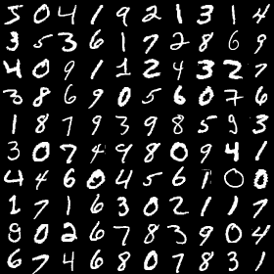
MNIST: Handwriting recognition
50,000 images of handwriting
28 x 28 x 1 (grayscale)
Numbers 0-9

Slide 135
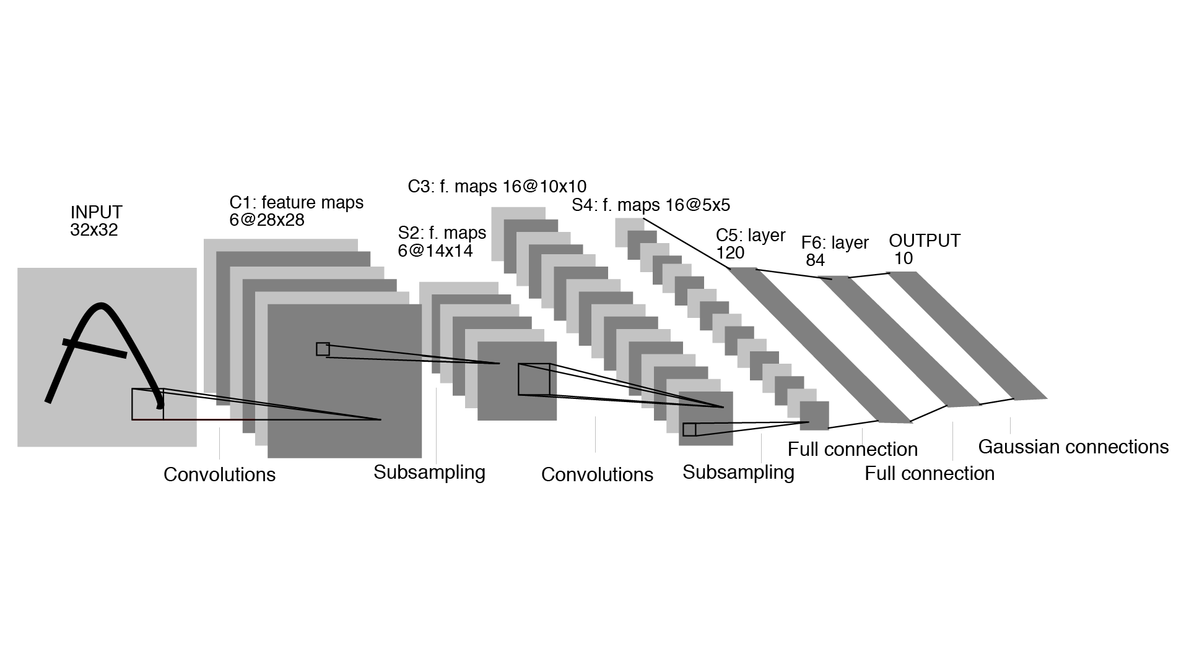
LeNet: First Convnet for Images*
*probably? Maybe neocognitron but not trained w/ backprop Fukushima, Kunihiko (1980). "Neocognitron: A Self-organizing Neural Network Model for a Mechanism of Pattern Recognition Unaffected by Shift in Position" (PDF). Biological Cybernetics. 36 (4): 193–202.
99% accuracy on MNIST (Yann LeCun 1998)
Has all elements of modern convnet
Convolutions, maxpooling, fully connected layers
Logistic activations after pooling layers (nowadays use RELU)
Weight updates through backpropagation

Slide 136
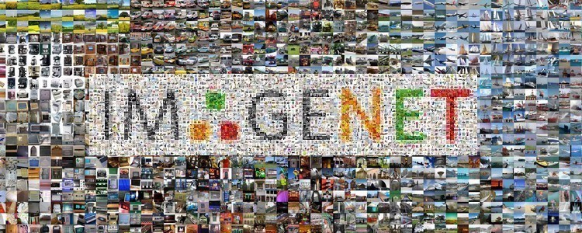
ImageNet: Really big image dataset
Dataset of images and labels from Princeton
14 million images, 22k categories
Challenge subset (most used):
1.2 million images, 1000 categories

Slide 137
ImageNet: Really big image dataset
Labels taken from WordNet, a lexical database of english words and how they relate
Paid workers on AMT to label images with WordNet label or synset (group of words)

Slide 138
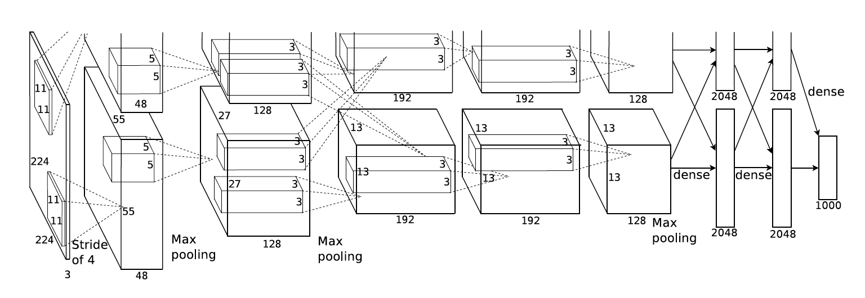
AlexNet: first good network
https://papers.nips.cc/paper/4824-imagenet-classification-with-deep-convolutional-neural-networks.pdf
Entry for ImageNet challenge

Slide 139
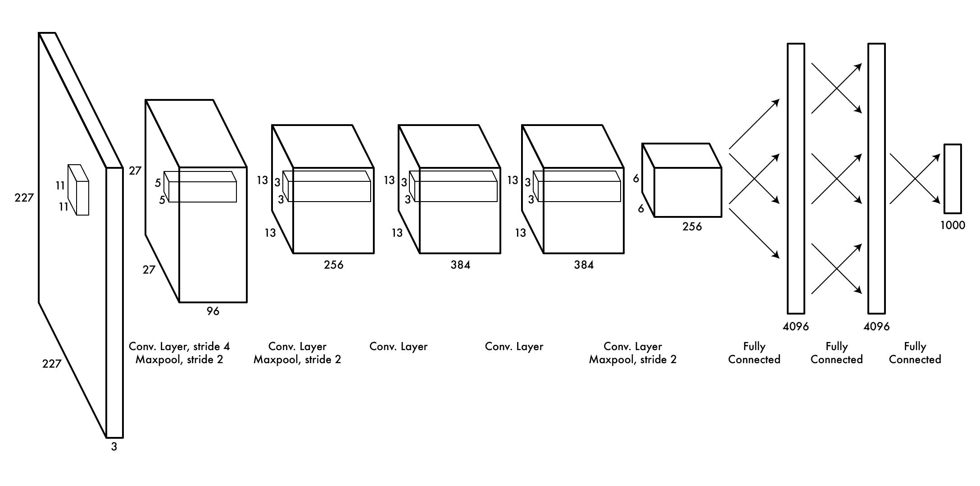
AlexNet: first good network
https://papers.nips.cc/paper/4824-imagenet-classification-with-deep-convolutional-neural-networks.pdf
Entry for ImageNet challenge

Slide 140
AlexNet: first good network
https://papers.nips.cc/paper/4824-imagenet-classification-with-deep-convolutional-neural-networks.pdf
Entry for ImageNet challenge
Much higher accuracy than “traditional” methods (SVM on SIFT)
Why did it take so long?

Slide 141

GPUs: How modern CNNs are possible
Alex spent a long time implementing the components of a CNN on a GPU, his software Cudaconvnet was the first “modern” neural network framework
GPUs allow >100x speedup compared to CPU, training still took weeks on ImageNet
This idea, CNNs + GPUs started revolution
in computer vision just 5 years ago
(check NVIDIAs stock in last 5 years)

Slide 142
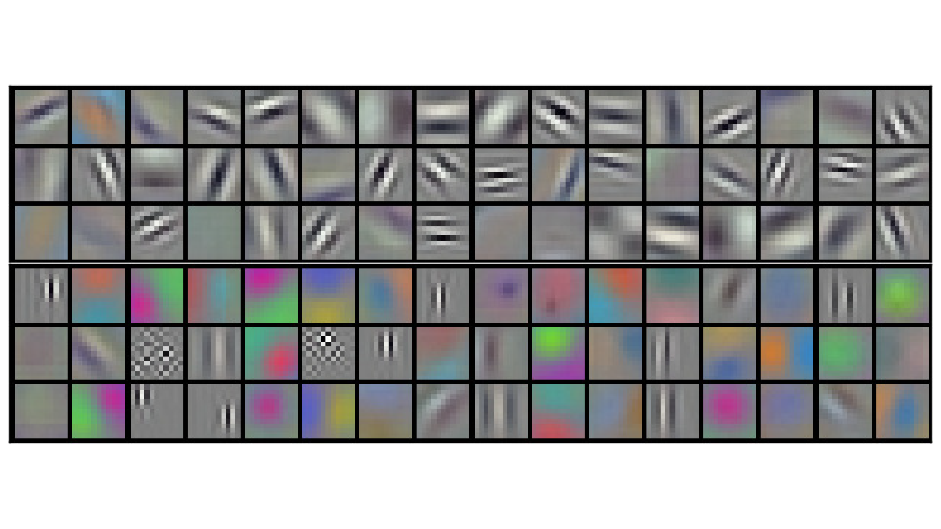
What are these networks learning?
Features! Here’s 1st layer of AlexNet

Slide 143
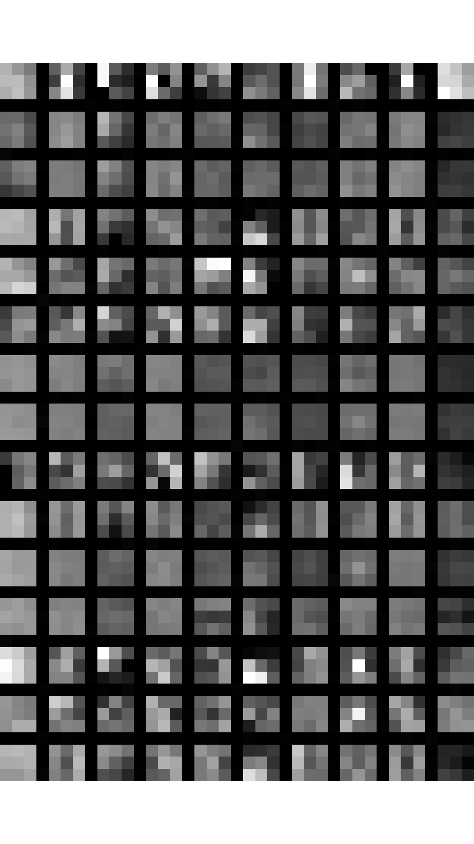
Later layers harder to visualize
Combinations of lower-level
features, not much meaning by
themselves
We can try other methods to
visualize them, information flow

Slide 144
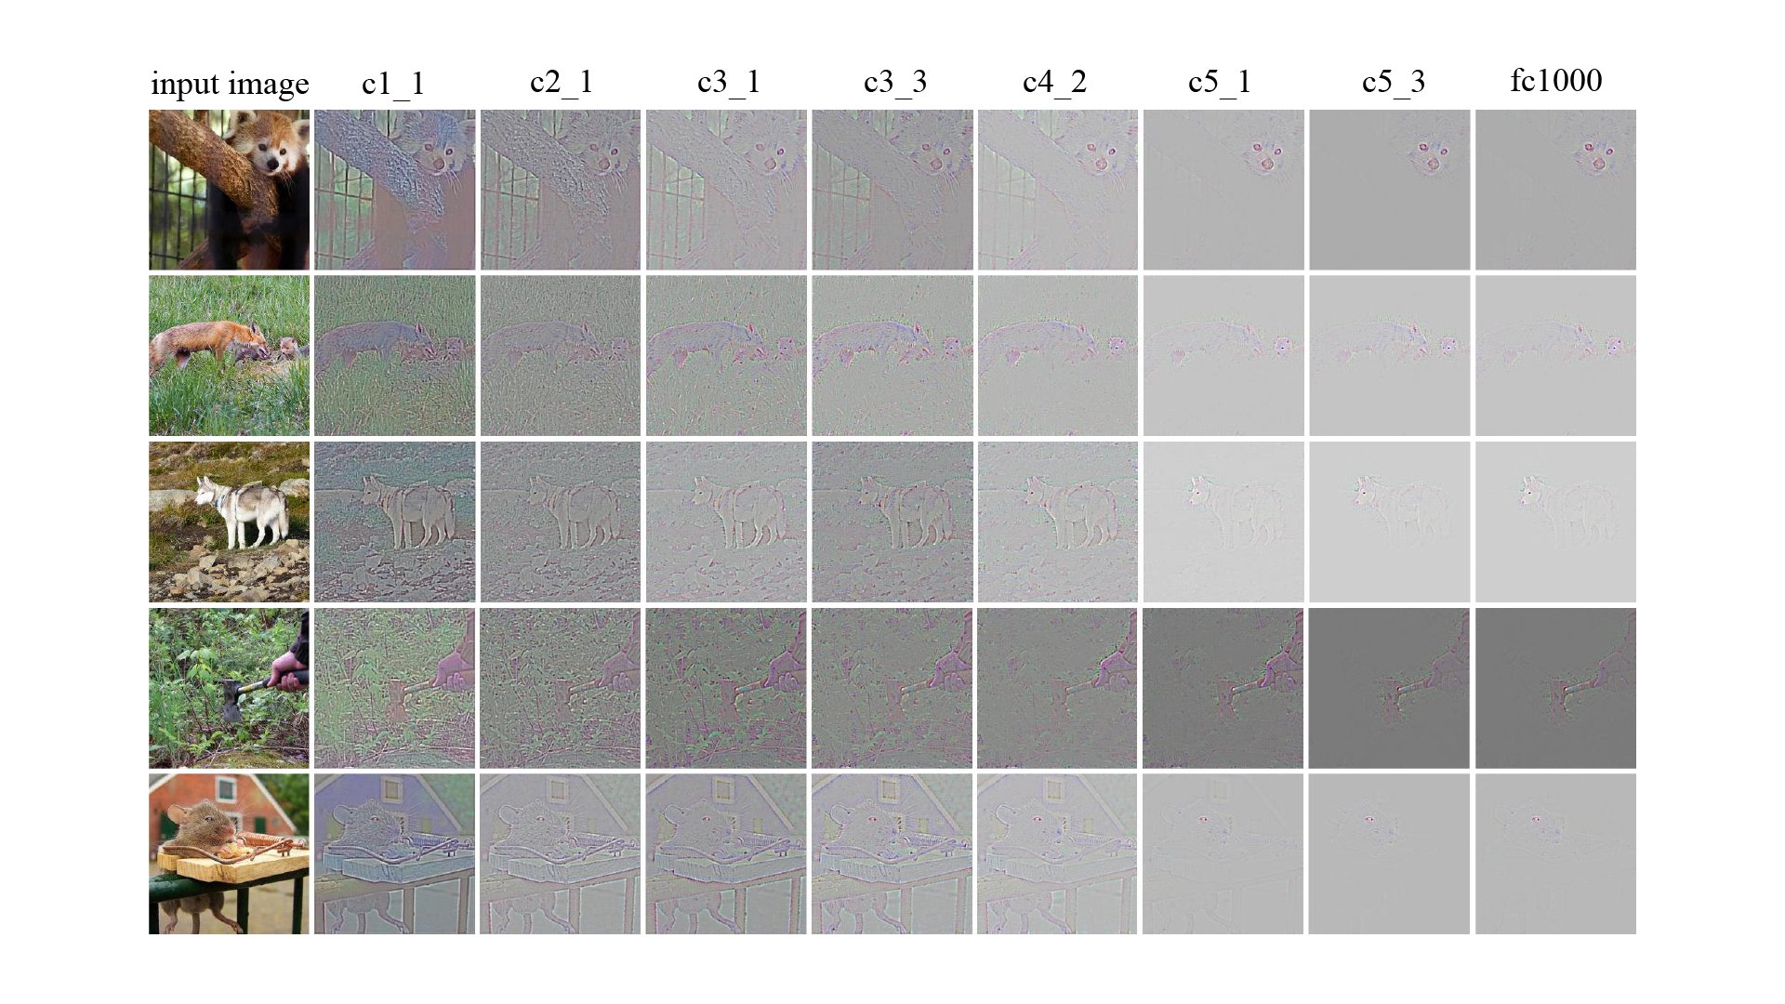
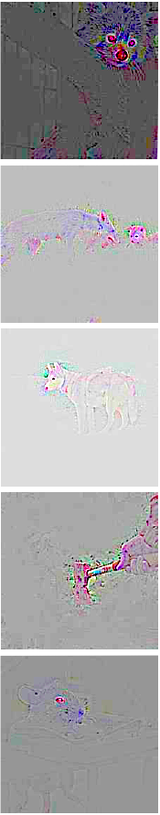
What info goes through the network
https://icmlviz.github.io/icmlviz2016/assets/papers/4.pdf

Slide 145
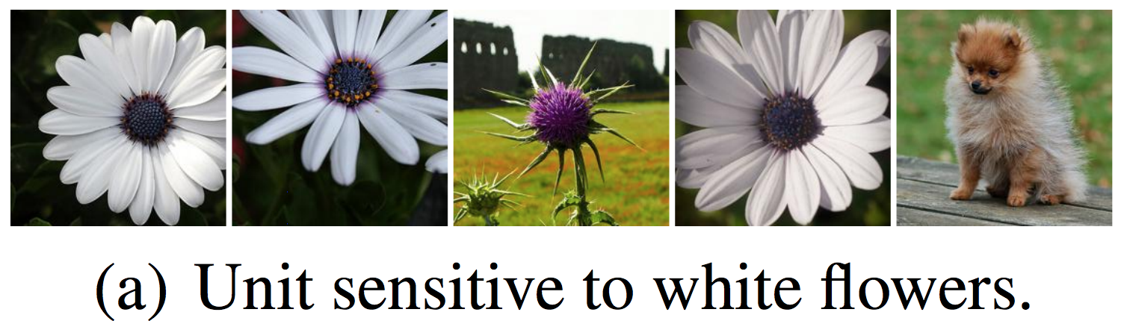
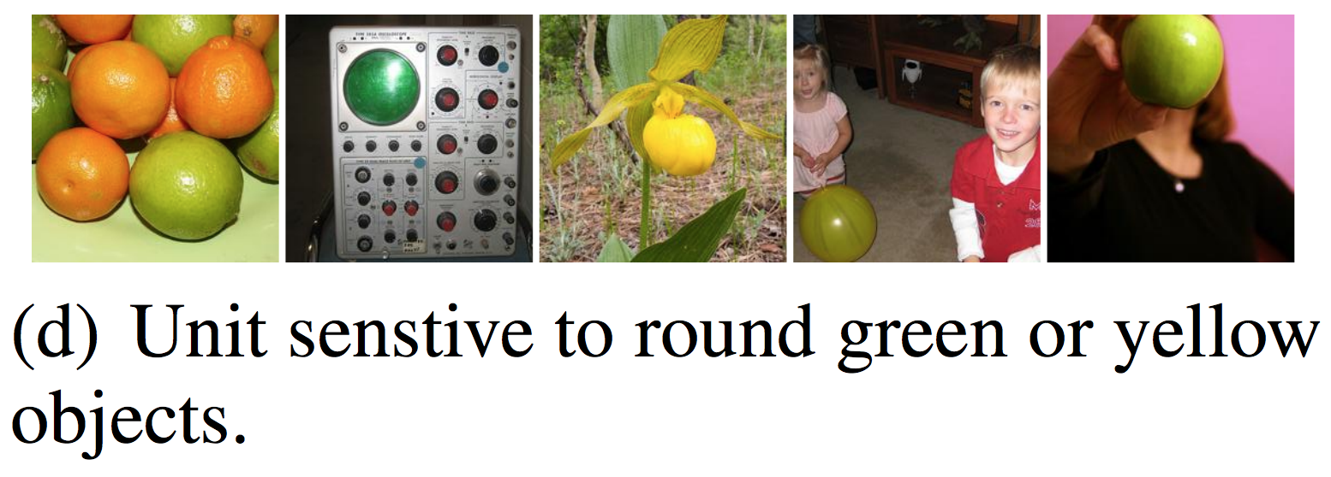
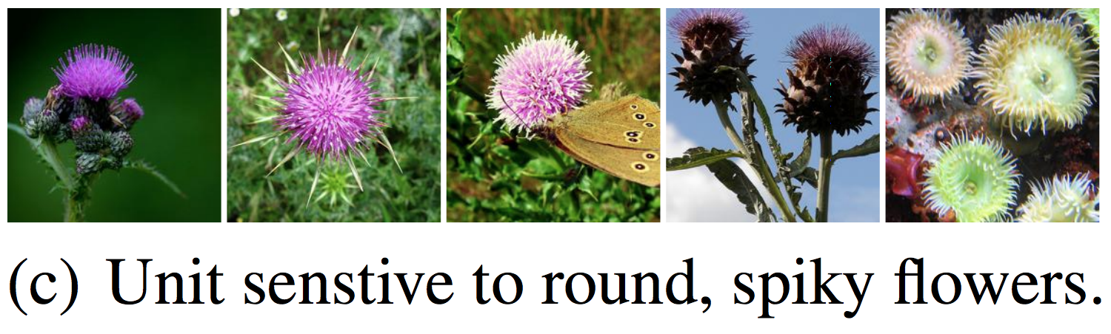
Idea: find interesting images
https://arxiv.org/pdf/1312.6199.pdf
We can feed images into our network and see which ones activate certain neurons

Slide 146
Idea: make interesting images
Instead of optimizing network, we can do gradient descent on the image too
Optimize the image to activate certain neurons or certain layers, then we can learn what those layers or neurons do!
You may have seen this under the name deep dream

Slide 147
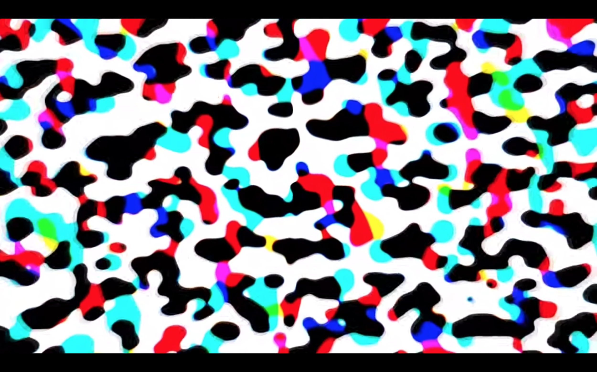
Early layers: blobs
https://www.youtube.com/watch?v=SCE-QeDfXtA
Neurons respond strongly to high contrast

Slide 148

Middle layers: edges, curves, eyes
https://www.youtube.com/watch?v=SCE-QeDfXtA
Neurons respond to simple features and shapes

Slide 149

Middle layers: edges, curves, eyes
https://www.youtube.com/watch?v=SCE-QeDfXtA
Neurons respond to simple features and shapes

Slide 150

Middle layers: edges, curves, eyes
https://www.youtube.com/watch?v=SCE-QeDfXtA
Neurons respond to simple features and shapes

Slide 151

Later layers: eyes, objects, dogs
https://www.youtube.com/watch?v=SCE-QeDfXtA
Neurons respond to arrangements of features

Slide 152

Later layers: eyes, objects, dogs
https://www.youtube.com/watch?v=SCE-QeDfXtA
Neurons respond to arrangements of features

Slide 153

Later layers: eyes, objects, dogs
https://www.youtube.com/watch?v=SCE-QeDfXtA
Neurons respond to arrangements of features

Slide 154
Neural networks work!
At least, seem to do what we want them to
Low-level features
Lines, oriented edges
Predictor
Process features and predict output
Mid-level features
Combine edges: curves, shapes
High-level features
Combine shapes: objects, scenes

Slide 155

VGG: networks getting bigger
From the Visual Geometry Group at Oxford
Considered “very deep” at the time, 16 - 19 layers
VGG-16 is still commonly used as a feature extractor
Although really it shouldn’t be, much better alternatives

Slide 156


VGG: networks getting bigger

Slide 157

VGG is inefficient
https://arxiv.org/pdf/1312.4400.pdf
Just stringing together a bunch of 3x3 convolutions in general, is pretty inefficient.
Network in network idea from Lin et al.:
Use 3x3 convolutions to process spatial information
Use 1x1 convolutions to reduce # of channels
E.g.

Slide 158

GoogleNet: networks getting weird
https://www.cs.unc.edu/~wliu/papers/GoogLeNet.pdf
Another way to efficiency:
Split layers
Not just one size, but many
1x1, 3x3, 5x5
Also use 1x1 convs to compress feature maps
Can make large networks that are still efficient, better than VGG yet smaller and faster.

Slide 159

GoogleNet: networks getting weird
Like… really big
And this is sort of all we do now, try to make networks bigger without making them too expensive

Slide 160
GoogleNet: networks getting weird
Like… really big
And this is sort of all we do now, try to make networks bigger without making them too expensive
Multiple outputs

Slide 161
Gradient explosion / vanishing
With very deep networks, the gradients flow through many layers of weights on their way back
With saturating activation functions like logistic or with small weights gradients can “vanish”
With non-saturating activations or large weights gradients can EXPLODE!
Learning doesn’t scale, what works at 2 levels doesn’t at 20

Slide 162
Batch normalization
https://arxiv.org/pdf/1502.03167.pdf
One way to deal with gradient vanishing:
Normalize activations of filters spatially / over the mini-batch
During training, the distribution of network activations changes over time because the parameters (weights) change
Learning is more stable if this change (or internal covariate shift) is reduced
If output is 32 x 32 x 16 image, batch size of 64, normalize activations for each filter across all images in batch:
I.e. calculate 16 means and variances
Subtract mean, divide by variance both across spatial dimensions and images in the batch

Slide 163
Batch normalization
https://arxiv.org/pdf/1502.03167.pdf
Other benefits:
Output is normalized before activation, mean 0 var 1 means it’s in the “good” domain of most activation functions
Each image is seen relative to others in a batch, introduces a form of regularization because we don’t ever “see” same image twice
Stabilizes training so much larger learning rates can be used

Slide 164

GoogleNetv2 or Inception Net?
https://arxiv.org/pdf/1502.03167.pdf
Or something, GoogleNet + batch norm

Slide 165

Residual connections
Normally, output of two layers is: f(w*f(vx))
Residual connections: f(w*f(vx) + x)
Learning how to modify x, add some transformed amount
Gives delta another path, less vanishing gradient

Slide 166

ResNet

Slide 167
ResNet
3x3 conv blocks or 3x3 and 1x1 conv blocks
Residual connections
VERY deep, 100+ layers

Slide 168
Grouped convolutions
Most filters look at every channel in input
Very expensive
Maybe not needed? Might only pull info from a few of them
Grouped convolutions:
Split up input feature map intro groups
Run convs on groups independently
Recombine

Slide 169
Grouped convolutions
Grouped convolutions:
Split up input feature map intro groups
Run convs on groups independently
Recombine
E.g. 3x3 conv layer 32 x 32 x 256 input, 128 filters, 32 groups:
Split input into 32 different feature maps
Each is 32 x 32 x 8
Run 4 filters, 3x3x8 on each group
Merge 4*32 channels back together, get 32 x 32 x 128 output
Input, output stays same dimensions, less computation

Slide 170

ResNeXt
https://arxiv.org/pdf/1611.05431.pdf
Replace 3x3 blocks with larger grouped convs
“Larger” network but same computational complexity

Slide 171

What’s NeXt?
Starting to saturate ImageNet, fighting over 1-2%

Slide 172
What’s NeXt?
Starting to saturate ImageNet, fighting over 1-2%
But now vision really works, other tasks
Segmentation
Object detection
Captioning
…

Slide 173


Slide 174

Semantic Segmentation

Slide 175

Semantic Segmentation
https://arxiv.org/pdf/1505.04366.pdf

Slide 176

Semantic Segmentation
https://arxiv.org/pdf/1505.04366.pdf

Slide 177
Semantic Segmentation
https://arxiv.org/pdf/1505.04366.pdf
Encoder

Slide 178
Semantic Segmentation
https://arxiv.org/pdf/1505.04366.pdf
Encoder
Decoder

Slide 179
Semantic Segmentation
https://arxiv.org/pdf/1505.04366.pdf
Coarse features

Slide 180
Semantic Segmentation
https://arxiv.org/pdf/1505.04366.pdf
Fine-grained predictions
Coarse features

Slide 181

U-net/Segnet
https://arxiv.org/pdf/1511.00561.pdf, https://arxiv.org/pdf/1505.04597.pdf

Slide 182

Spatial pyramid pooling
https://arxiv.org/pdf/1612.01105.pdf

Slide 183

Spatial pyramid pooling

Slide 184


DeepLabv3+
https://arxiv.org/pdf/1802.02611.pdf
Atrous convolutions
Spaced inputs

Slide 185
DeepLabv3+
https://arxiv.org/pdf/1802.02611.pdf
Atrous convolutions
Spaced inputs
Pre-train on ImageNet

Slide 186
DeepLabv3+
https://arxiv.org/pdf/1802.02611.pdf
Atrous convolutions
Spaced inputs
Fine-tune on segmentation
Pre-train on ImageNet

Slide 187


Slide 188


Slide 189

Object detection

Slide 190

Deformable parts models

Slide 191
Scoring object detection
Multiple classes, multiple objects per images
Can’t just use accuracy
“Correct” bounding box:
Intersection / Union > 0.5
Intersection: Ground truth ∩ prediction
Union: Ground truth ∪ prediction

Slide 192
Scoring object detection
“Correct” bounding box:
Intersection / Union > 0.5
Recall:
Correct bounding boxes / total ground-truth boxes
Precision:
Correct bounding boxes / total predicted boxes
Only the most confident predictions: High precision, low recall
All the predictions: Low precision, high recall

Slide 193

Scoring object detection
Precision-Recall curve: vary threshold, plot precision and recall
Average precision:
Area under PR curve
Only for a single class
Take mean of AP across classes:
Mean AP (mAP)
Standard detection metric
Sometimes at particular IOU
I.e. mAP@.5 or mAP@.75

Slide 194
PASCAL VOC
One of the first large detection datasets:
20 classes
11,530 training images
27,450 annotated objects
DPM: 33.6% mAP
DPM is pre-neural network, how do we use CNNs for detection?

Slide 195

R-CNN: Regions with CNN features

Slide 196


Selective search: fewer proposals

Slide 197

Lots of post processing, 20 sec/im
Pascal VOC:
AlexNet
53.3% mAP
VGG-16
62.4% mAP

Slide 198


Slide 199


YOLO

Slide 200
 | Pascal 2007 mAP | Speed
DPM v5 | 33.7 | .07 FPS | 14 s/img
R-CNN | 66.0 | .05 FPS | 20 s/img

Slide 201
 | Pascal 2007 mAP | Speed
DPM v5 | 33.7 | .07 FPS | 14 s/img
R-CNN | 66.0 | .05 FPS | 20 s/img
YOLO | 63.4 | 45 FPS | 22 ms/img

Slide 202


Slide 203

Say you have an image...

Slide 204

Split it into a grid

Slide 205
For each cell predicts P(obj)

Slide 206
Also predict a bounding box

Slide 207

Also predict a bounding box

Slide 208

Also class probabilities
Bicycle
Car
Dog
Dining Table

Slide 209

Also class probabilities

Slide 210

Threshold and non-max suppression

Slide 211

Tensor encoding detection

Slide 212
Tensor encoding detection
Can predict multiple boxes, just stack this tensor multiple times

Slide 213

Multiple bounding boxes per cell
Going to predict 5 boxes per cell
Want spatial diversity between boxes
Some small, medium, large
Don’t predict boxes directly
Predict offsets from priors
Priors should be sensible
YOLO uses k-means clustering of
training data bounding box (w,h)

Slide 214

Bounding box encoding (YOLOv2 and v3)
Given cell offset c_{x} and c_{y}
Prior box p_{w} and p_{h}
Our predicted bounding box
is given by:

Slide 215
YOLO loss function
L(YOLO) = α₁L(confidence) + α₂L(localization) +
α₃L(classification)
Can tune all the alphas
L(confidence): binary cross-entropy
L(localization): RMSE
L(classification): multi-class cross-entropy or 1 v all binary cross-entropy

Slide 216
 | Pascal 2007 mAP | Speed
DPM v5 | 33.7 | .07 FPS | 14 s/img
R-CNN | 66.0 | .05 FPS | 20 s/img
YOLO | 63.4 | 45 FPS | 22 ms/img
YOLOv2 | 78.6 | 40 FPS | 25 ms/img
YOLOv3 | 83.1 | 30 FPS | 33 ms/img

Slide 217
 | Pascal 2007 mAP | Speed
DPM v5 | 33.7 | .07 FPS | 14 s/img
R-CNN | 66.0 | .05 FPS | 20 s/img
YOLO | 63.4 | 45 FPS | 22 ms/img
YOLOv2 | 78.6 | 40 FPS | 25 ms/img
YOLOv3 | 83.1 | 30 FPS | 33 ms/img
Fast R-CNN | 70.0 | .5 FPS | 2 s/img
Faster R-CNN | 73.2 | 7 FPS | 140 ms/img
Resnet FRCNN | 76.4 | ?? | ??
ResNet + COCO data | 83.8 | ?? | ??
R-FCN | 83.6 | 6 FPS | 170 ms/img

Slide 218

R-CNN is slow
https://dl.dropboxusercontent.com/s/vlyrkgd8nz8gy5l/fast-rcnn.pdf?dl=0
Run convnet independently over every ROI

Slide 219

Fast R-CNN
https://dl.dropboxusercontent.com/s/vlyrkgd8nz8gy5l/fast-rcnn.pdf?dl=0
Run convnet once, extract features using ROI pooling
ROI Pool:
Convert variable sized
ROI to fixed size output

Slide 220

ROI Align
https://arxiv.org/pdf/1703.06870.pdf
Better than ROI Pool so we’ll talk
about it instead
Split ROI into fixed size (say 2x2)
Sample image at multiple points for
each cell in ROI (bilinear interp.)
Pool over these samples (max, avg…)

Slide 221
Fast R-CNN
https://dl.dropboxusercontent.com/s/vlyrkgd8nz8gy5l/fast-rcnn.pdf?dl=0
Run convnet once, extract features using ROI pooling
ROI Pool:
Convert variable sized
ROI to fixed size output
Much faster, no independent
network evals (except last
linear layer)
Still slow region proposer,
selective search takes ~2 sec

Slide 222

Faster R-CNN
https://dl.dropboxusercontent.com/s/vlyrkgd8nz8gy5l/fast-rcnn.pdf?dl=0
Use Convnet to propose regions and generate features
ROI Pool to fix size of ROI features
Additional layers to classify and predict
bbox for ROIs

Slide 223

Saturating PASCAL VOC, need new data

Slide 224

Common Objects in COntext (COCO)
http://cocodataset.org/#home
80 objects
117,261 train/val images
902,435 object instances
New detection metric, mAP averaged over IOU [.5 - .95]
Segmentation masks for each instance
Originally by Microsoft but they were scared of copyright something something so they spun it off

Slide 225

Performance on COCO
These are Faster R-CNN with new loss

Slide 226
Segmentation vs Detection
Pixel-level labels
Category only
Bounding box labels
Category + instance

Slide 227


Instance Segmentation
Given an image produce instance-level segmentation
Which class does each pixel belong to
Also which instance

Slide 228

Mask R-CNN
https://arxiv.org/pdf/1703.06870.pdf
Similar to R-CNN but predict mask instead of box

Slide 229

Mask R-CNN
https://arxiv.org/pdf/1703.06870.pdf
Similar to R-CNN but predict mask as well as box

Slide 230
Mask R-CNN
https://arxiv.org/pdf/1703.06870.pdf
Similar to R-CNN but predict mask as well as box
Faster R-CNN

Slide 231
Mask R-CNN
https://arxiv.org/pdf/1703.06870.pdf
Similar to R-CNN but predict mask as well as box
Faster R-CNN
Mask Prediction

Slide 232
Mask R-CNN on COCO: 41 mAP
Mask R-CNN is over here somewhere

