Slide 1
Digital Image Fundamentals
Selim Aksoy
Department of Computer Engineering
Bilkent University
saksoy@cs.bilkent.edu.tr

Slide 2
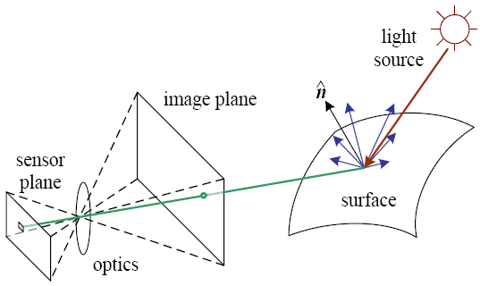
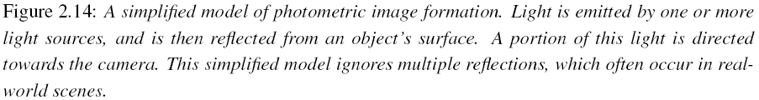
Imaging process
Light reaches surfaces in 3D.
Surfaces reflect.
Sensor element receives light energy.
Intensity is important.
Angles are important.
Material is important.
Adapted from Rick Szeliski

Slide 3
Physical parameters
Geometric
  Type of projection
  Camera pose
Optical
  Sensor’s lens type
  Focal length, field of view, aperture
Photometric
  Type, direction, intensity of light reaching sensor
  Surfaces’ reflectance properties
Sensor
  Sampling, etc.
Adapted from Trevor Darrell, UC Berkeley

Slide 4
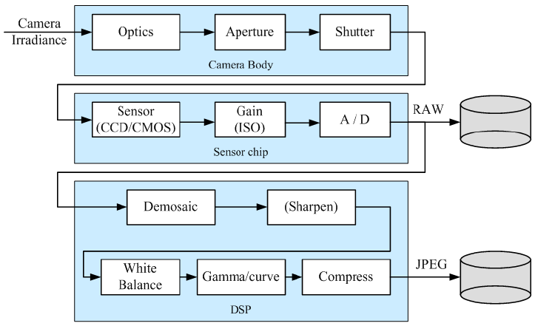
Image acquisition
Adapted from Rick Szeliski

Slide 5
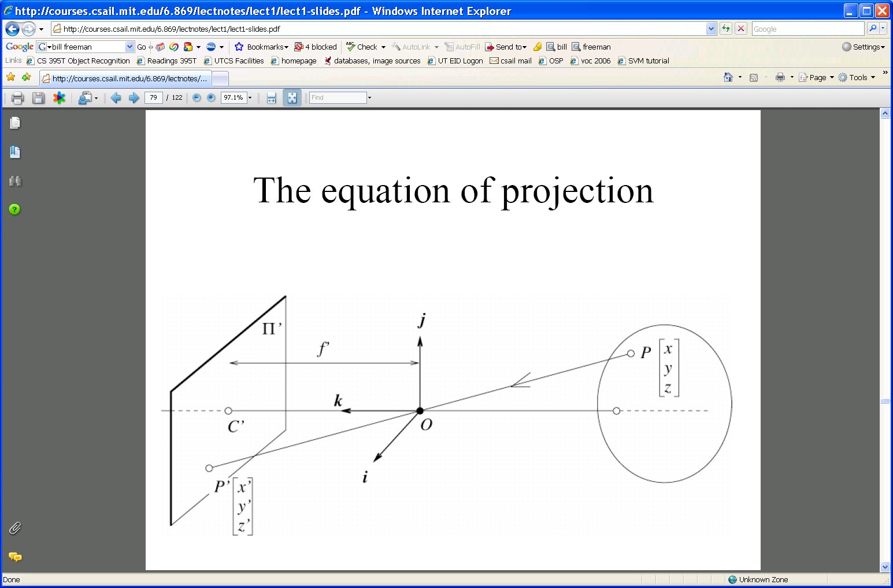
Camera calibration
World frame
Camera frame
Camera’s extrinsic and intrinsic parameters are needed to calibrate the geometry.
Extrinsic: camera frame ↔ world frame
Intrinsic: image coordinates relative to camera ↔ pixel coordinates
Adapted from Trevor Darrell, UC Berkeley

Slide 6
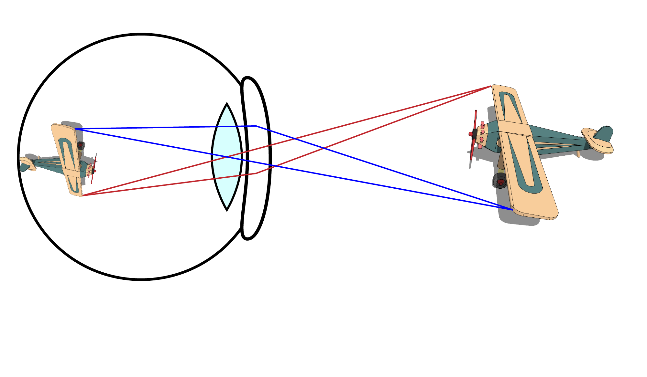
Eyes: projection onto retina
Adapted from Joseph Redmon, U of Washington

Slide 7
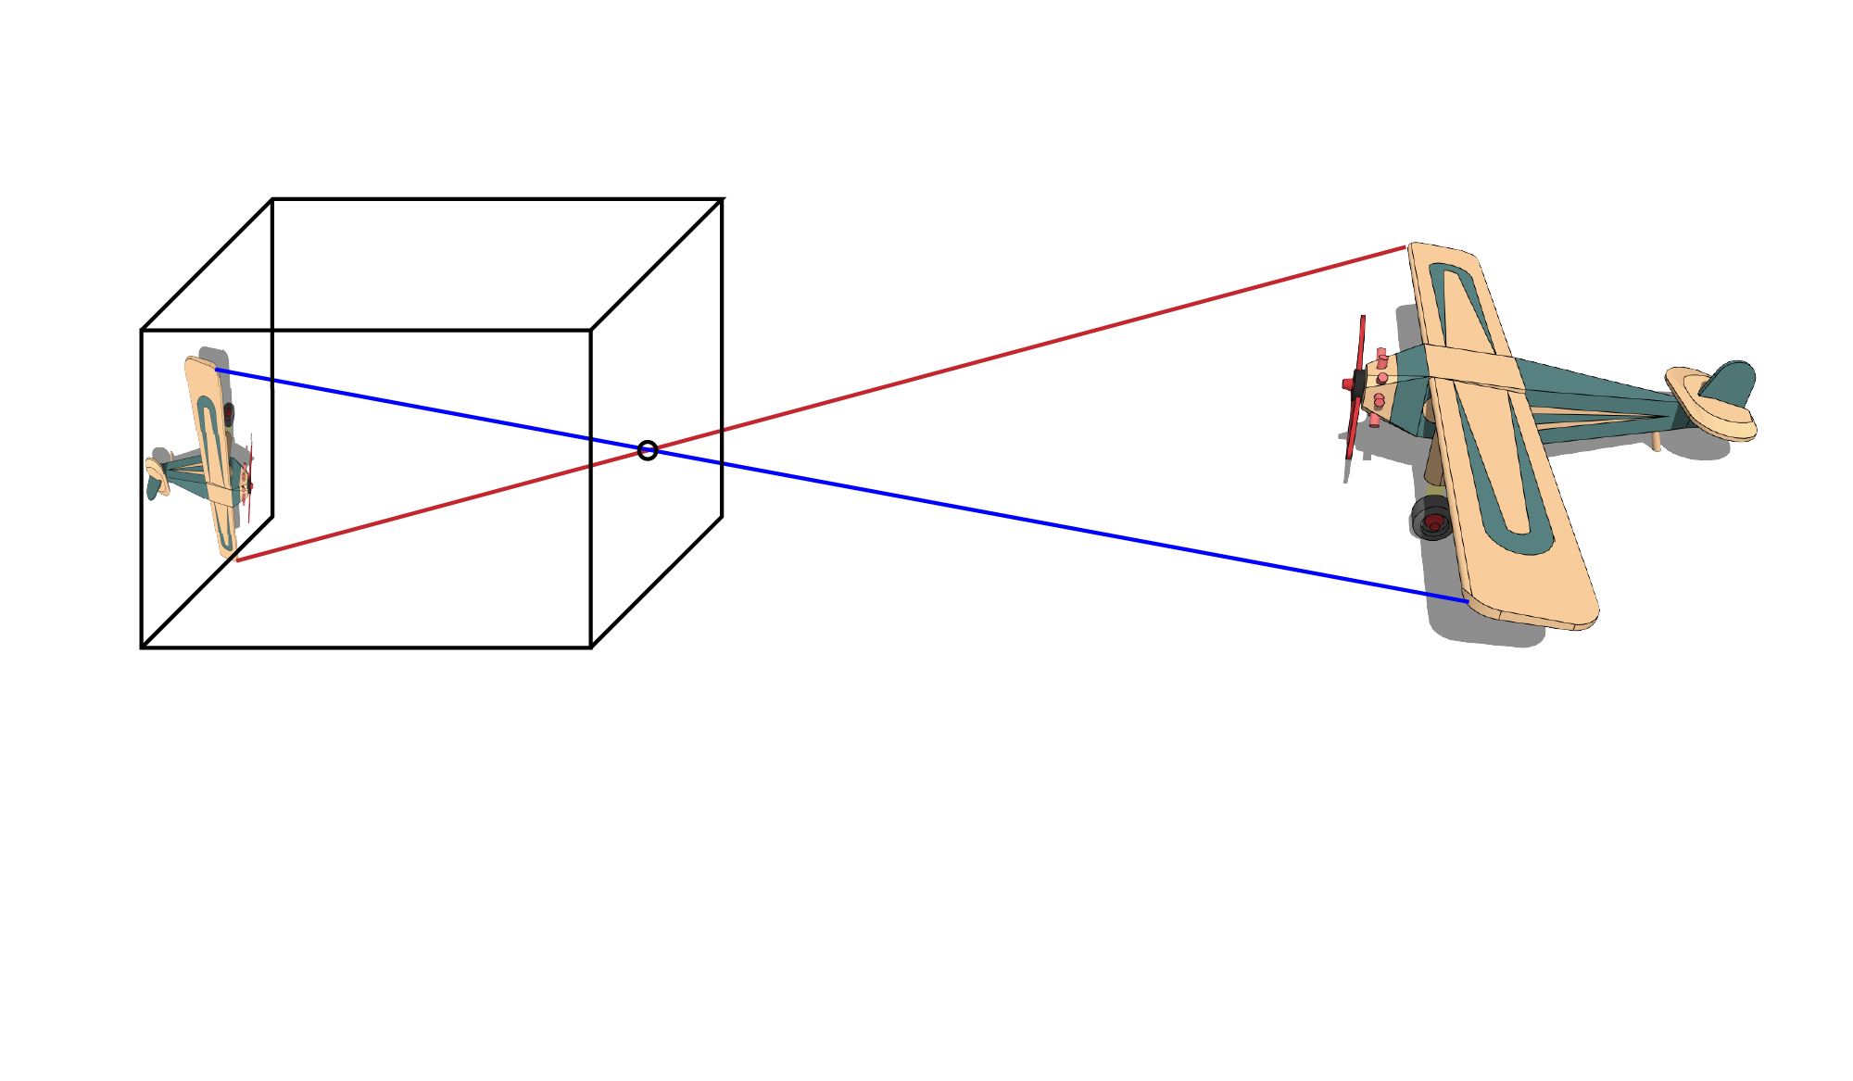
Model: pinhole camera
Adapted from Joseph Redmon, U of Washington

Slide 8
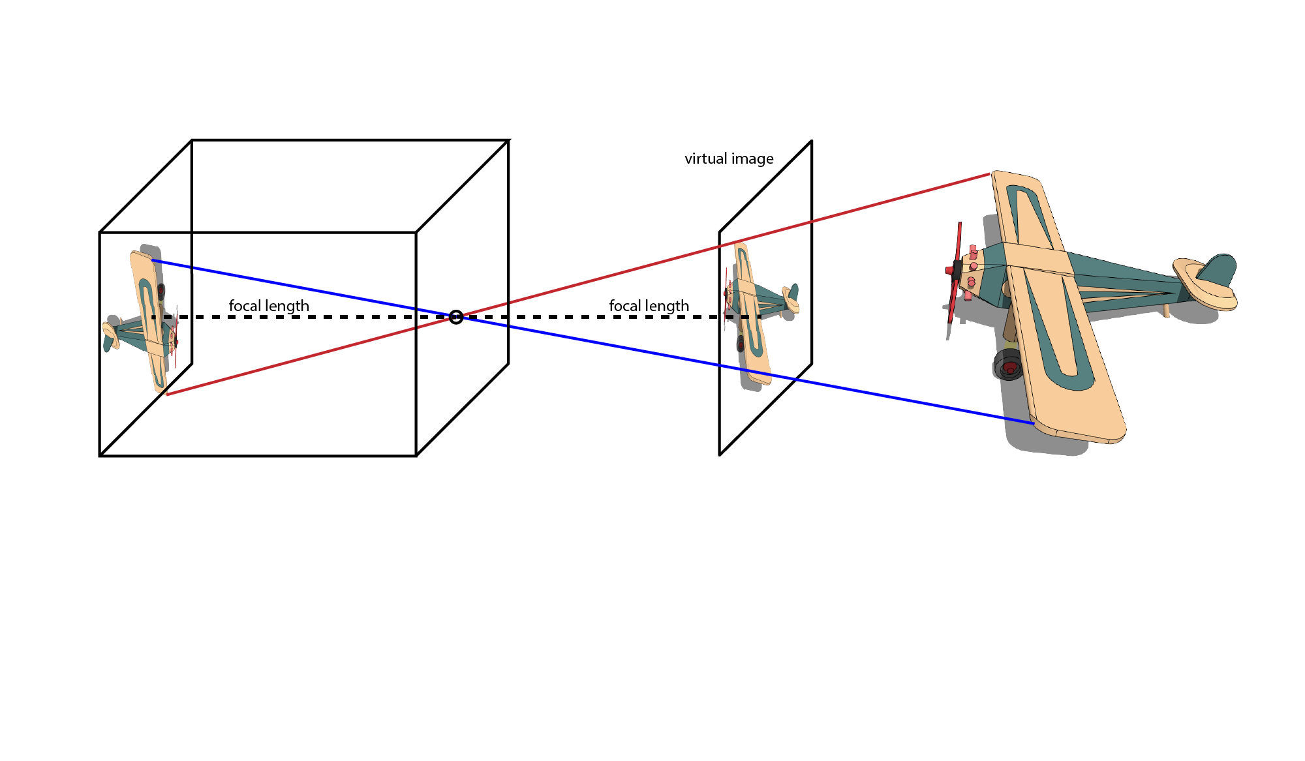
Model: pinhole camera
Adapted from Joseph Redmon, U of Washington

Slide 9
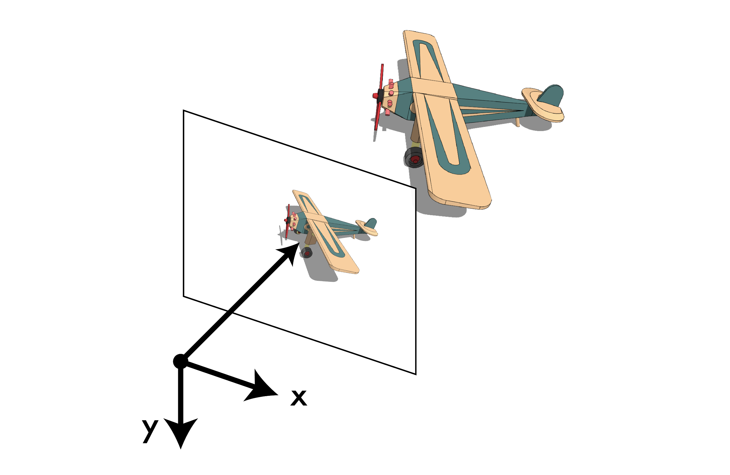
Image: 3d->2d projection of the world
Adapted from Joseph Redmon, U of Washington

Slide 10

Image: 3d->2d projection of the world
Adapted from Joseph Redmon, U of Washington

Slide 11
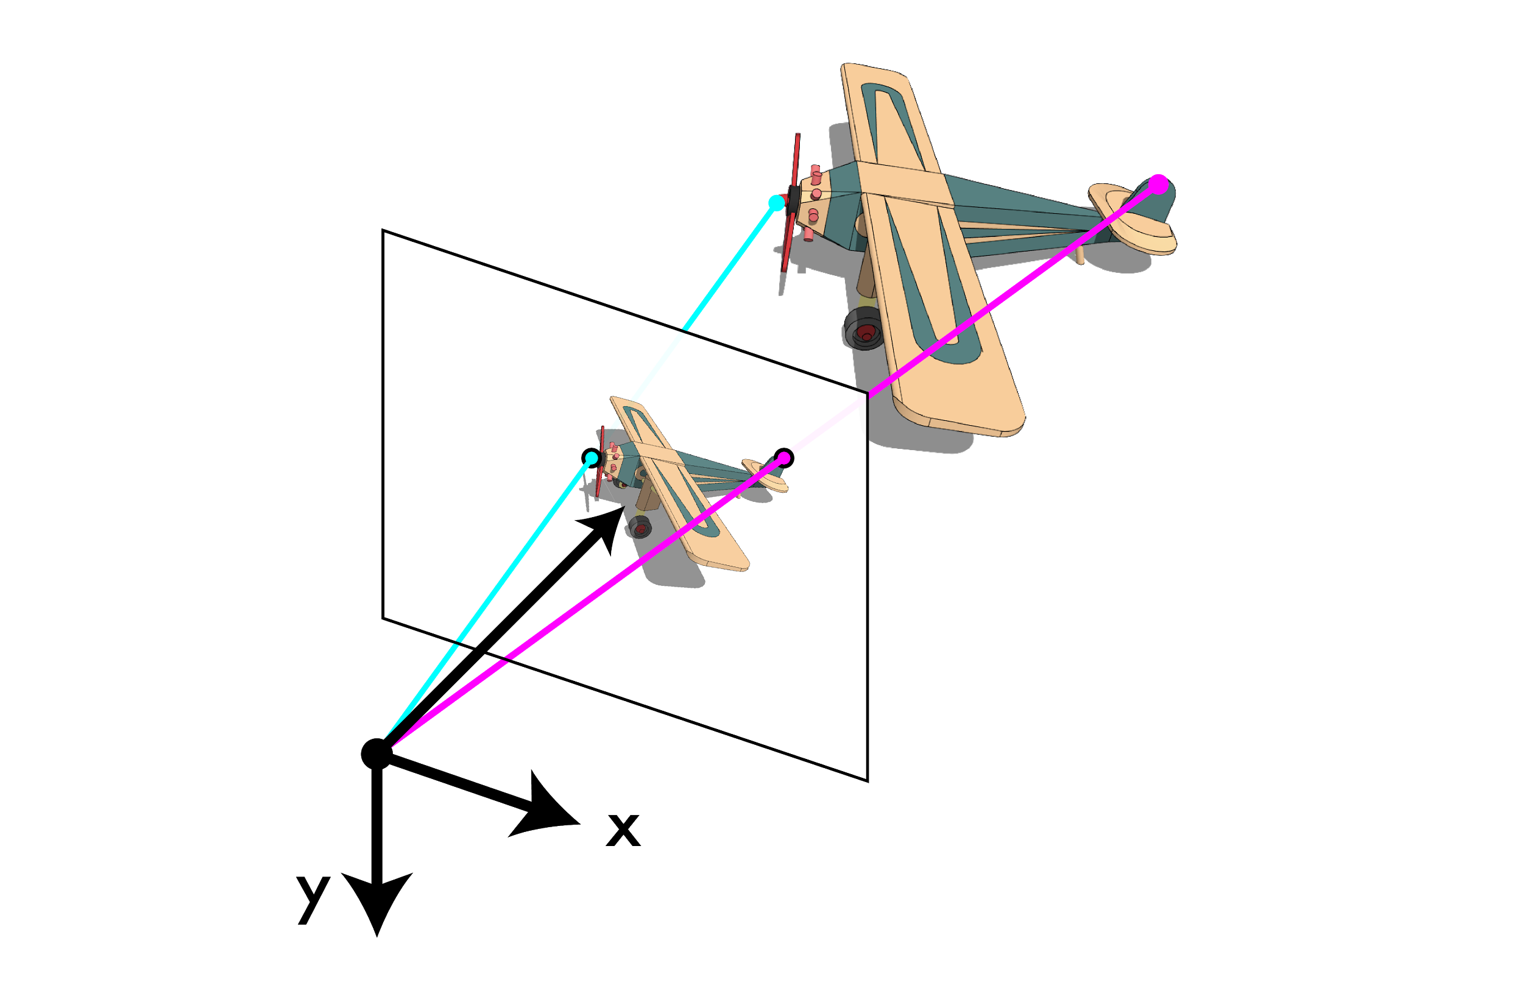
Image: 3d->2d projection of the world
Adapted from Joseph Redmon, U of Washington

Slide 12
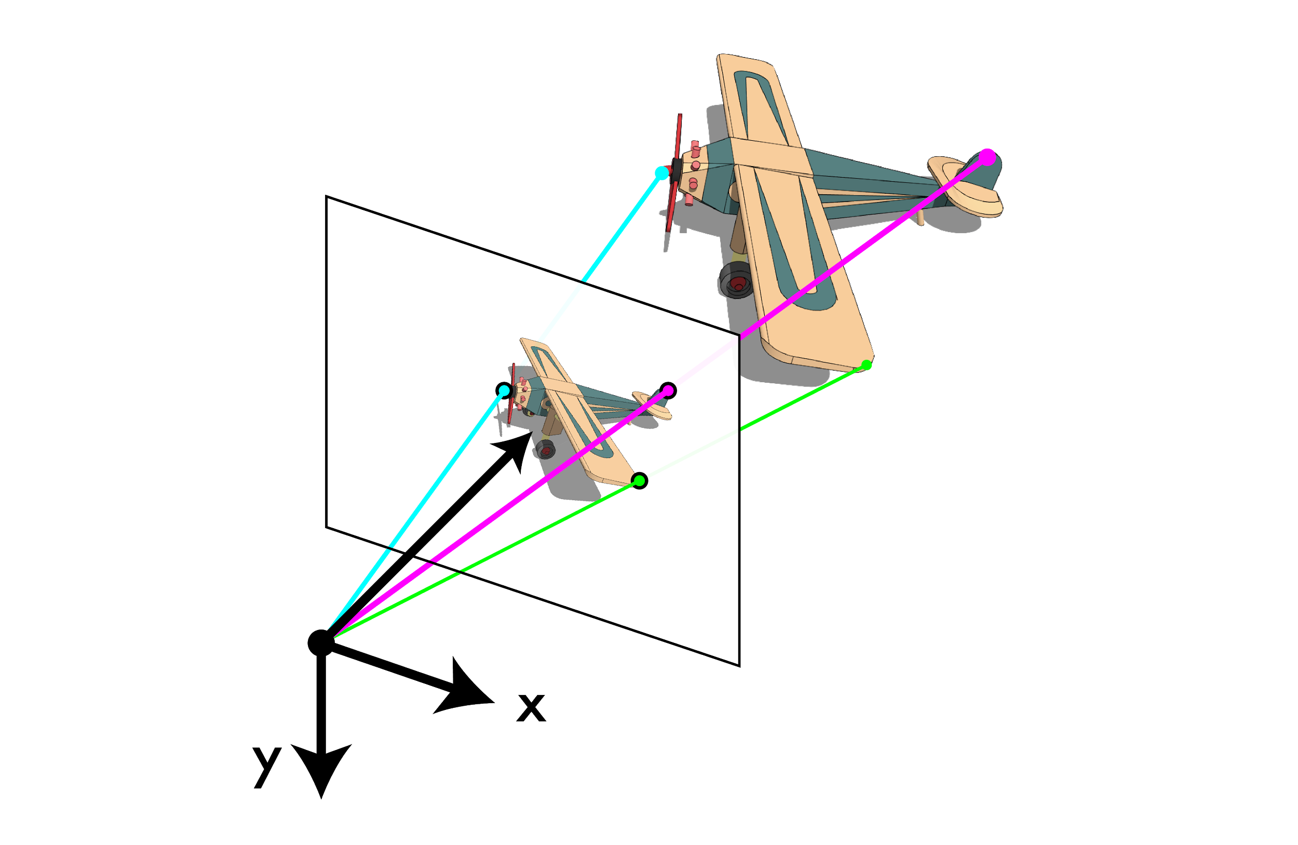
Image: 3d->2d projection of the world
Adapted from Joseph Redmon, U of Washington

Slide 13

Image: 3d->2d projection of the world
Adapted from Joseph Redmon, U of Washington

Slide 14
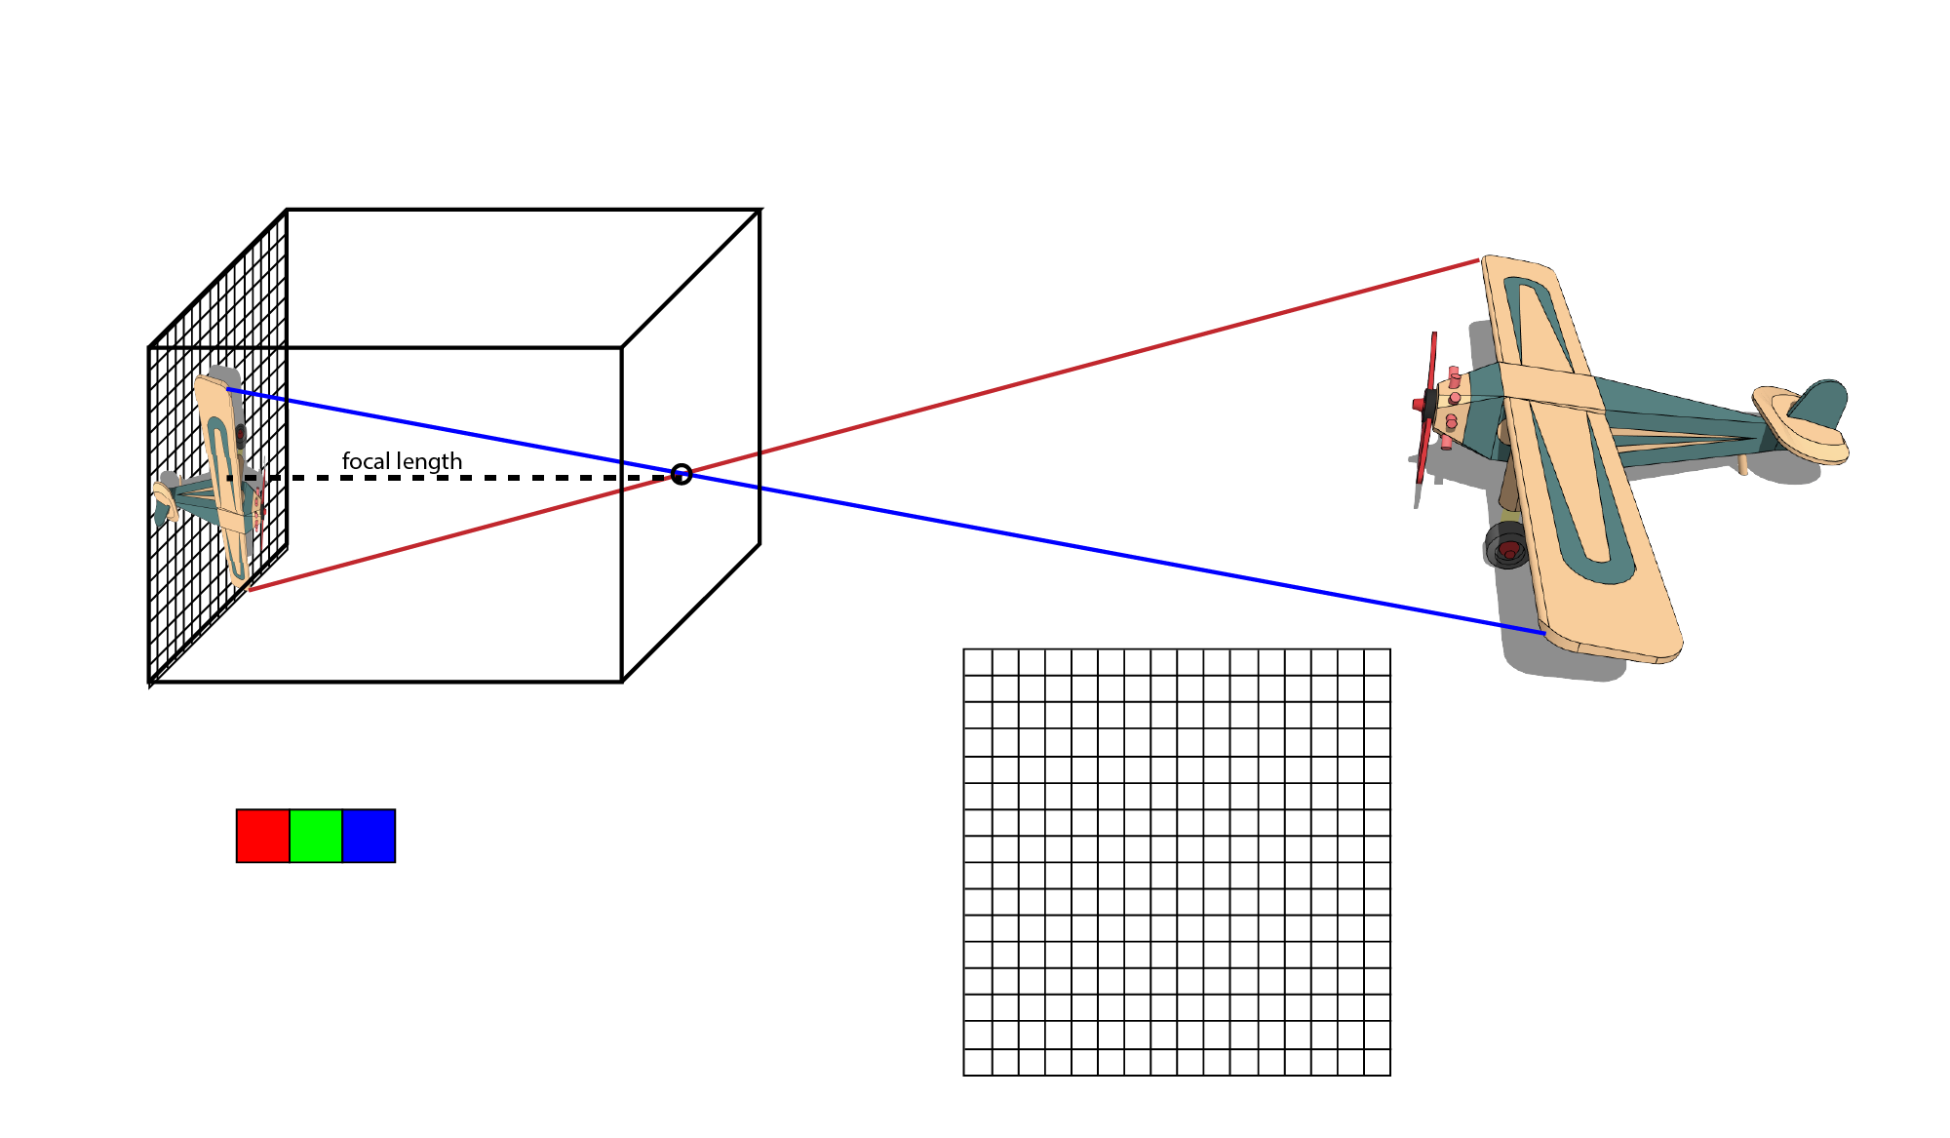
How do we record color?
At each point we record incident light
Adapted from Joseph Redmon, U of Washington

Slide 15
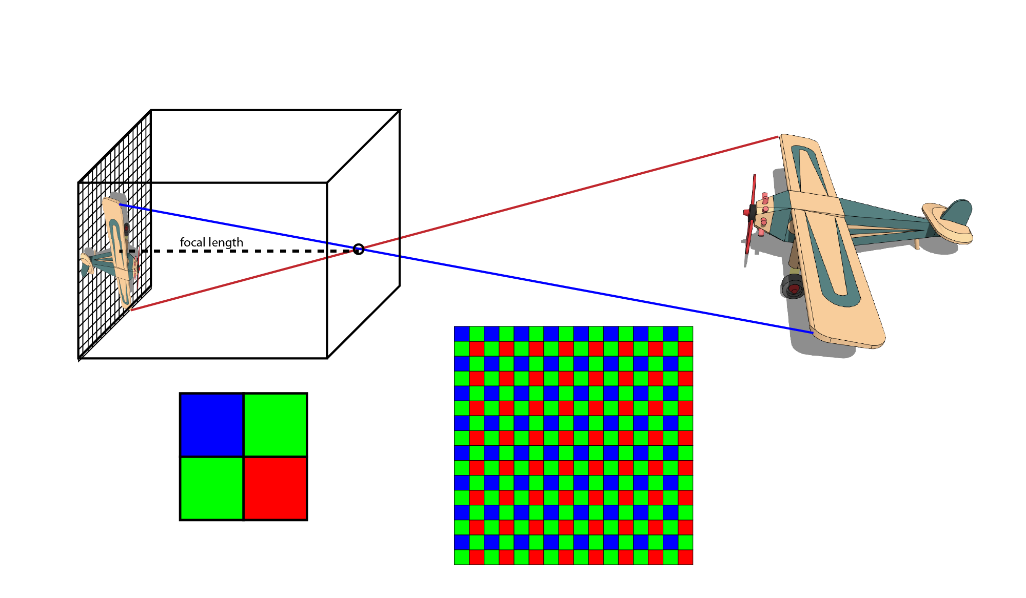
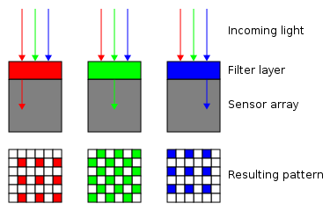
How do we record color?
Bayer pattern for CMOS sensors
Adapted from Joseph Redmon, U of Washington

Slide 16
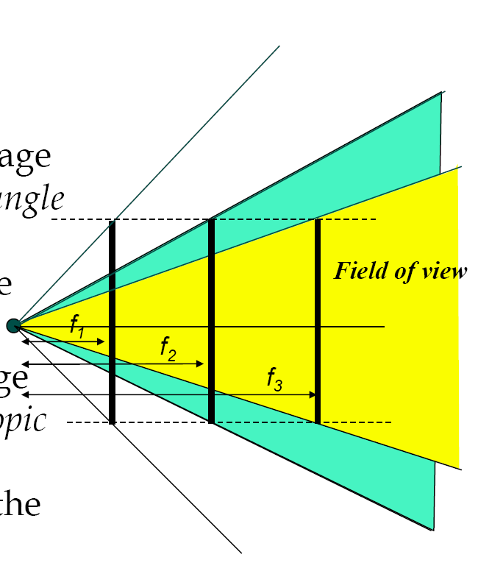
Focal length
Field of view depends on focal length.
As f gets smaller, image becomes more wide angle
  more world points project onto the finite image plane
As f gets larger, image becomes more telescopic
  smaller part of the world projects onto the finite image plane
Adapted from Trevor Darrell, UC Berkeley

Slide 17
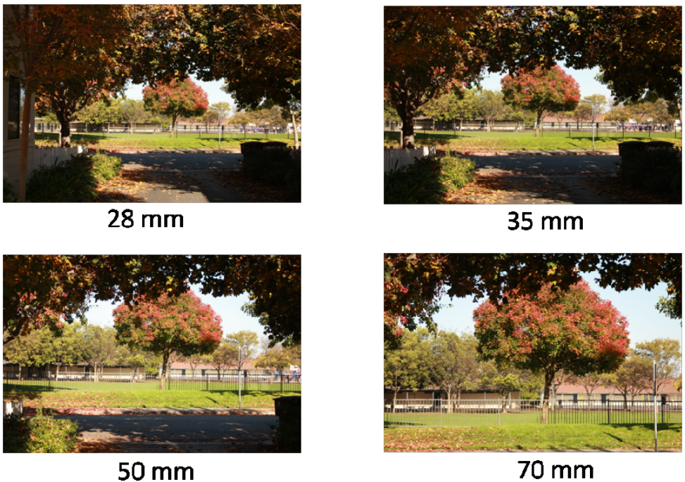
Focal length
Adapted from Matthew Brown, U of Washington

Slide 18
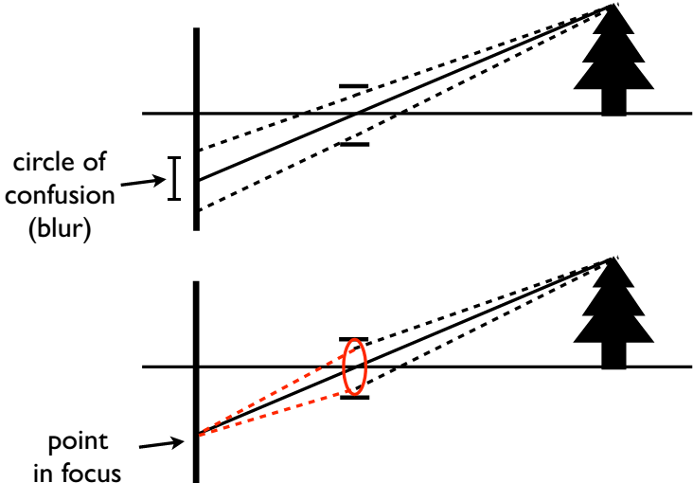
Aperture
A real camera must have a finite aperture to get enough light, but this causes blur in the image
Solution: use a lens to focus light onto the image plane
Adapted from Matthew Brown, U of Washington

Slide 19
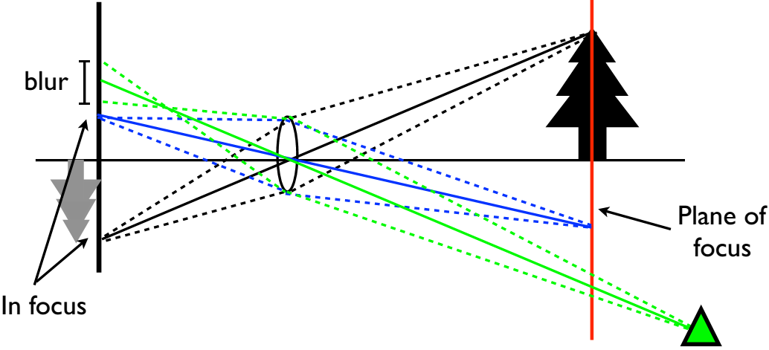
Aperture
Note that lenses focus all rays from a plane in the world
Objects off the plane are blurred depending on distance
Adapted from Matthew Brown, U of Washington

Slide 20
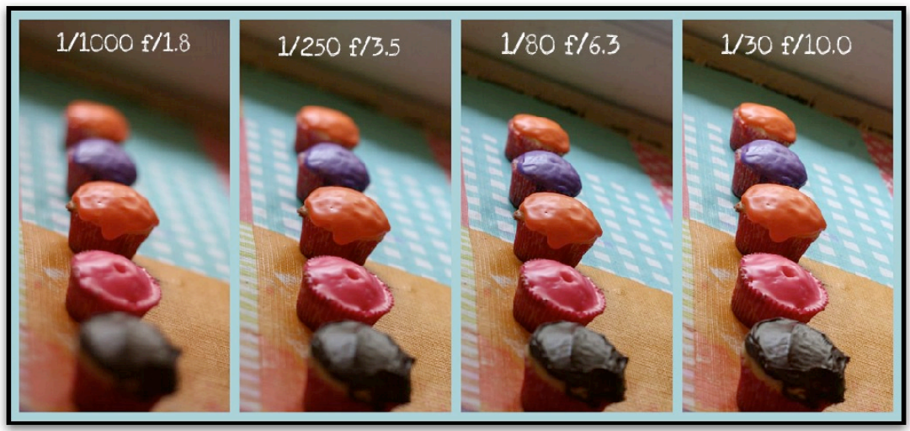
Aperture
Smaller aperture -> smaller blur, larger depth of field
Adapted from Matthew Brown, U of Washington

Slide 21
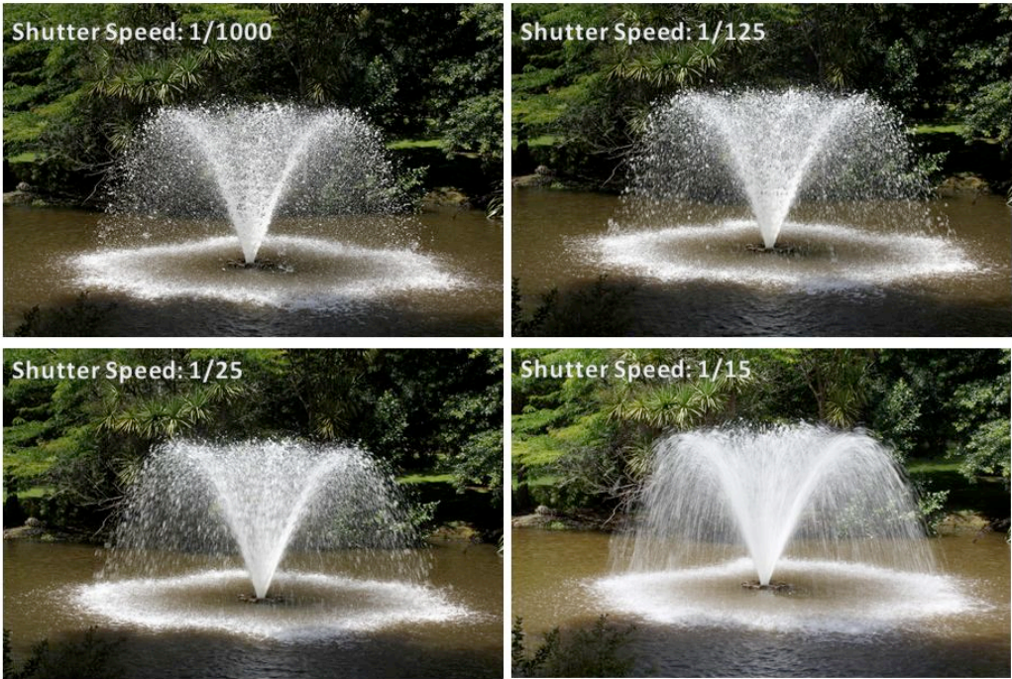
Shutter speed
Adapted from Matthew Brown, U of Washington

Slide 22
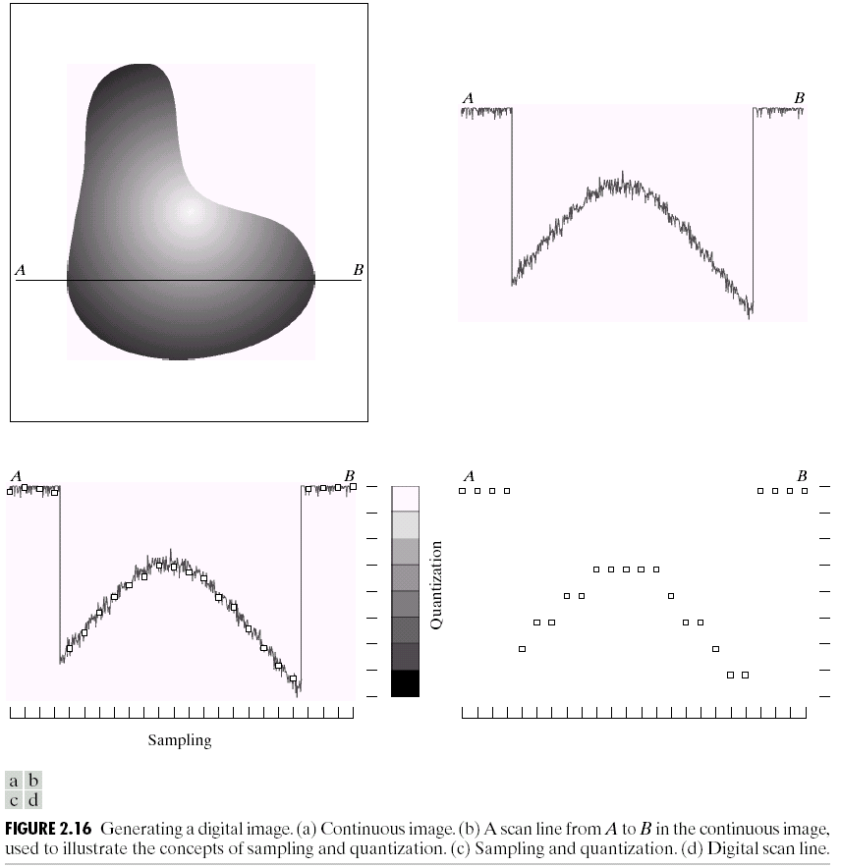
Sampling and quantization

Slide 23
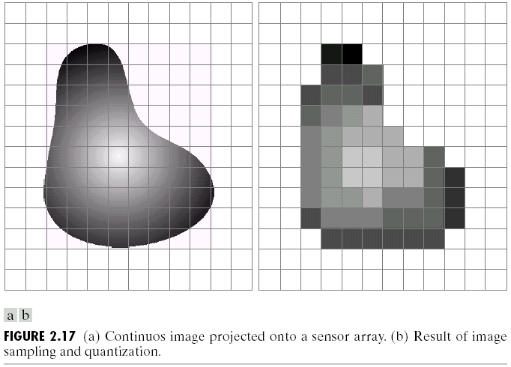
Sampling and quantization

Slide 24
Image representation
Images can be represented by 2D functions of the form f(x,y).
The physical meaning of the value of f at spatial coordinates (x,y) is determined by the source of the image.
Adapted from Shapiro and Stockman

Slide 25


Image representation
In a digital image, both the coordinates and the image value become discrete quantities.
Images can now be represented as 2D arrays (matrices) of integer values: I[i,j] (or I[r,c]).
The term gray level is used to describe monochromatic intensity.

Slide 26
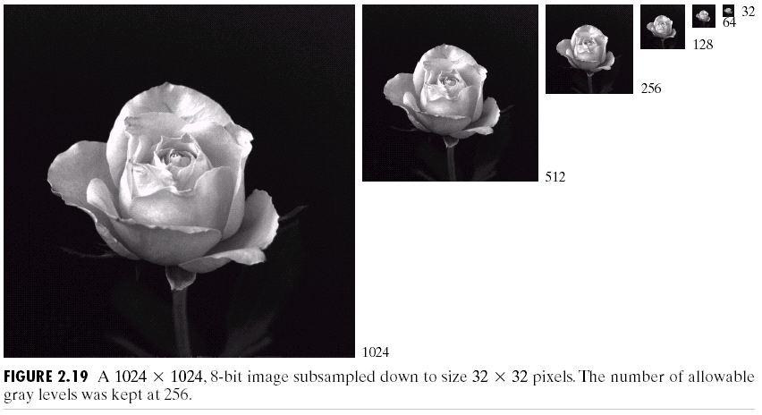
Spatial resolution
Spatial resolution is the smallest discernible detail in an image.
Sampling is the principal factor determining spatial resolution.

Slide 27
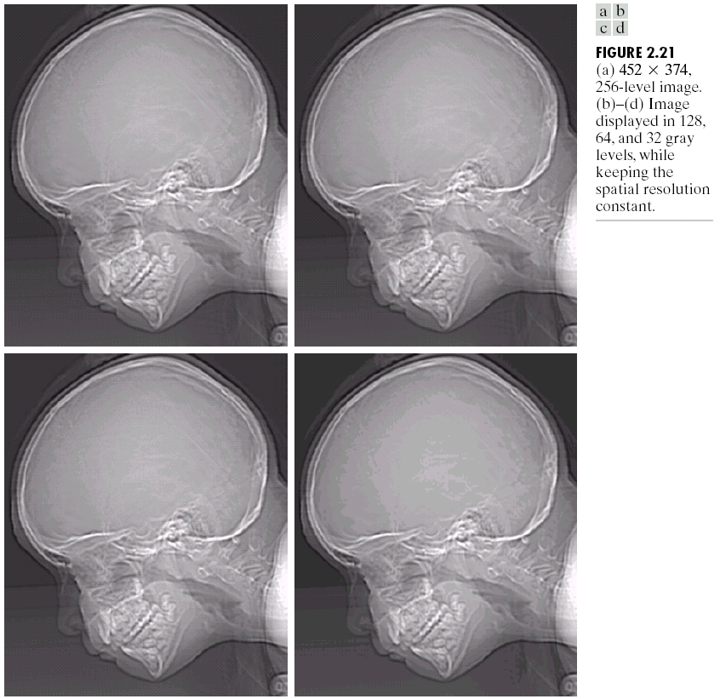
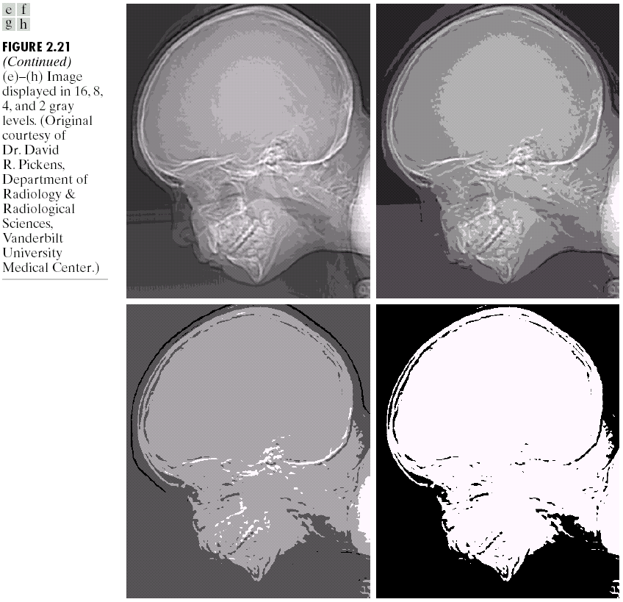
Gray level resolution
Gray level resolution refers to the smallest discernible change in gray level (often power of 2).

Slide 28
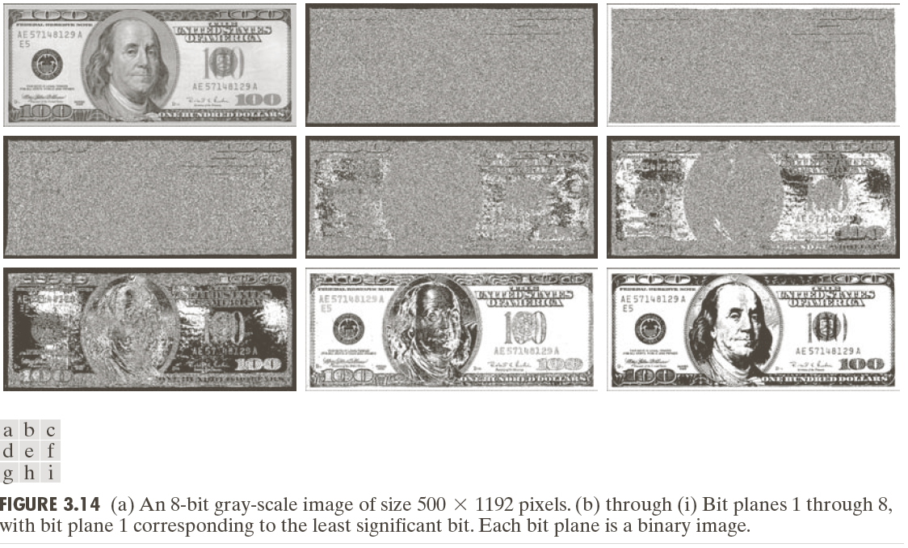
Bit planes

Slide 29
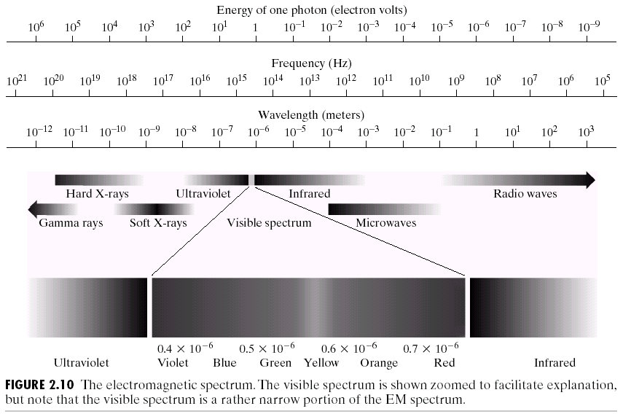
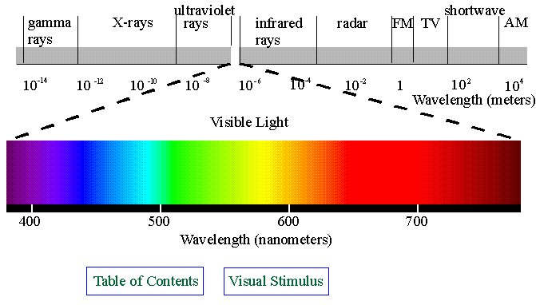
Electromagnetic (EM) spectrum

Slide 30
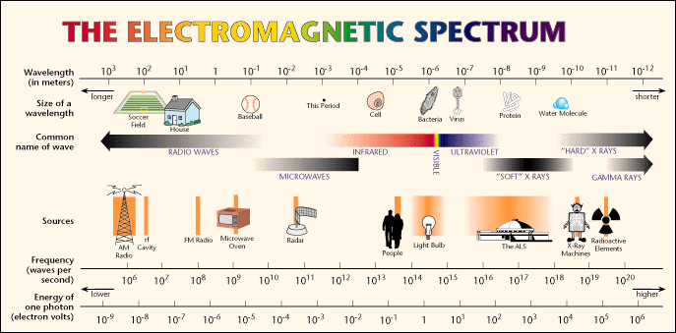
Electromagnetic (EM) spectrum
The wavelength of an EM wave required to “see” an object must be of the same size as or smaller than the object.

Slide 31
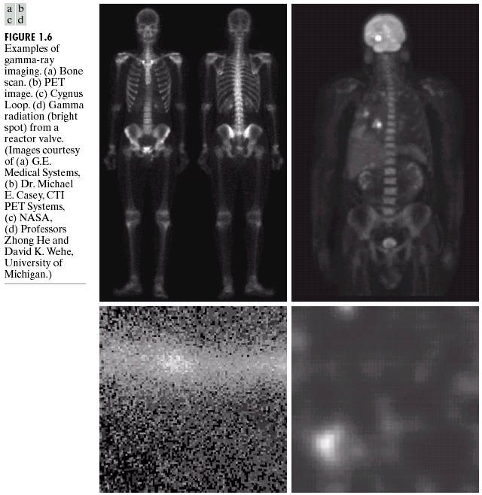
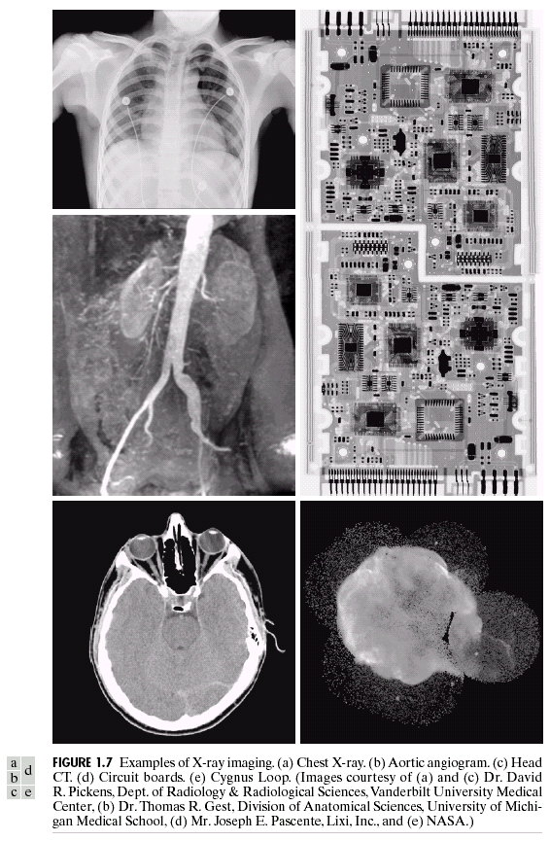
Other types of sensors

Slide 32
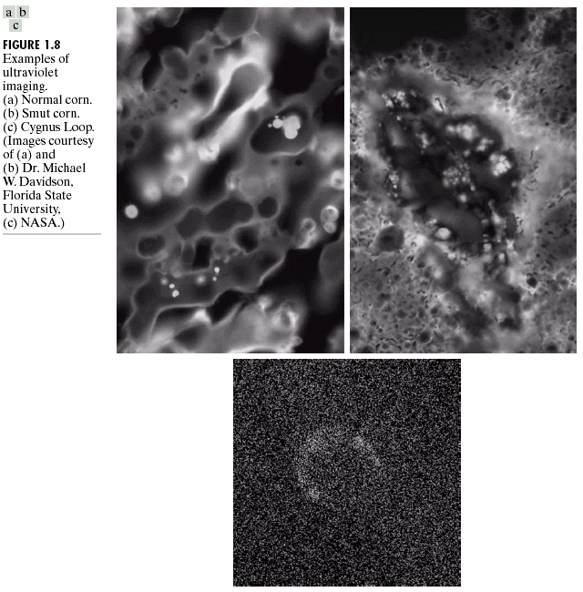
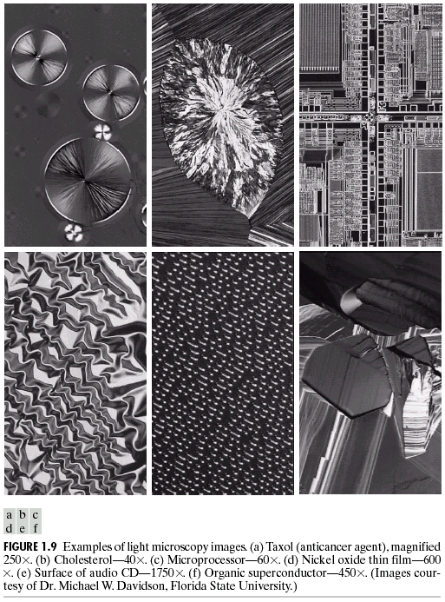
Other types of sensors

Slide 33
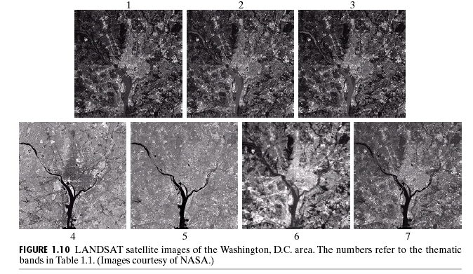
Other types of sensors
blue green red
near ir middle ir thermal ir middle ir

Slide 34
Other types of sensors
©IEEE

Slide 35
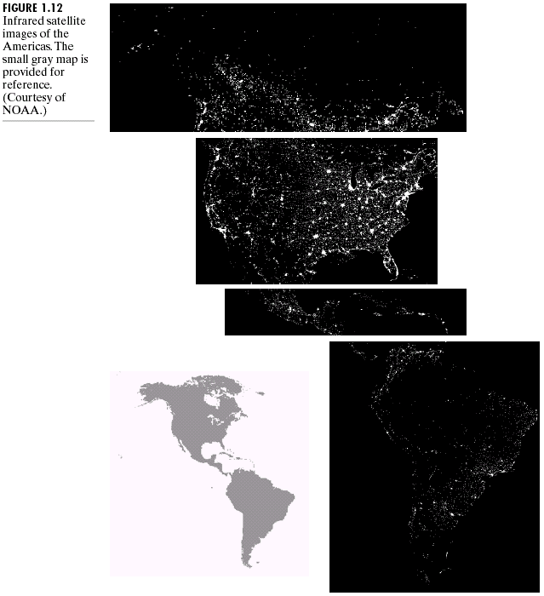
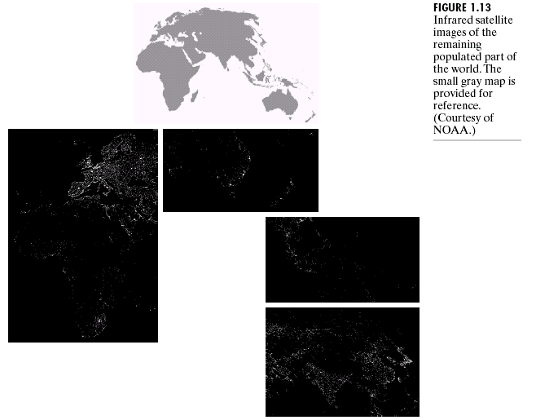
Other types of sensors

Slide 36
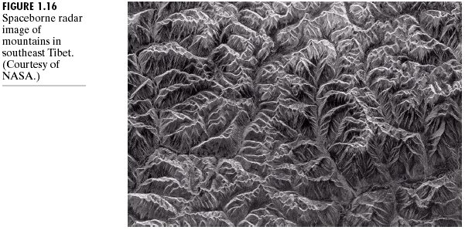
Other types of sensors

Slide 37
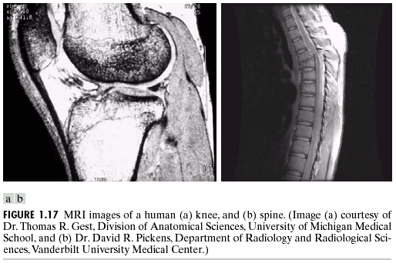
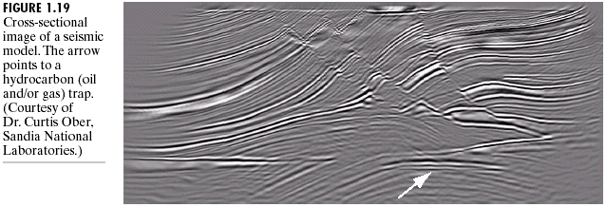
Other types of sensors

Slide 38
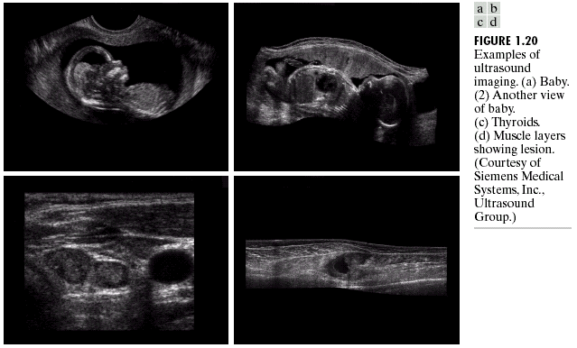
Other types of sensors

Slide 39
Image enhancement
The principal objective of enhancement is to process an image so that the result is more suitable than the original for a specific application.
Enhancement can be done in
  Spatial domain,
  Frequency domain.
Common reasons for enhancement include
  Improving visual quality,
  Improving machine recognition accuracy.

Slide 40
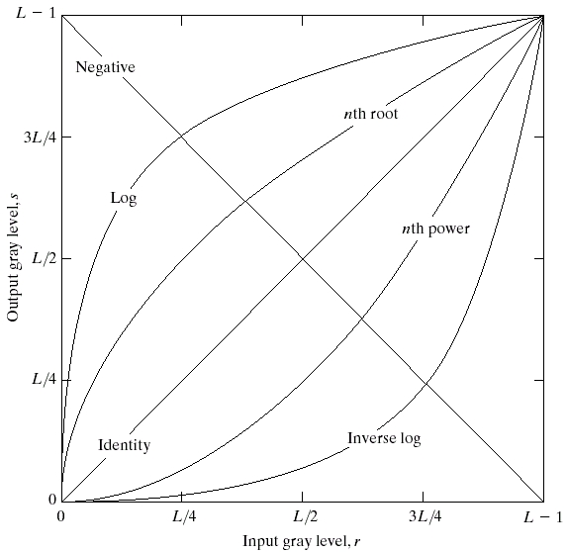
Image enhancement
Transformation function of the form
s = T(r)
where “r” is the original pixel value and “s” is the new value after enhancement.

Slide 41
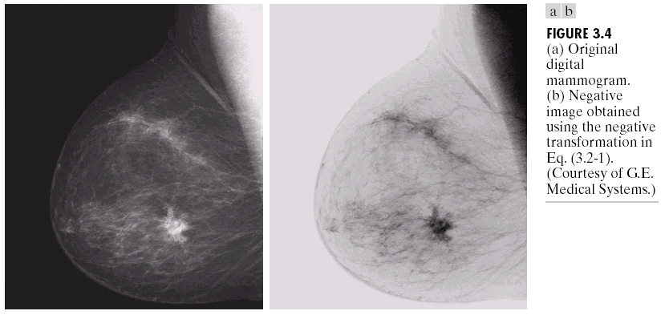
Image enhancement

Slide 42
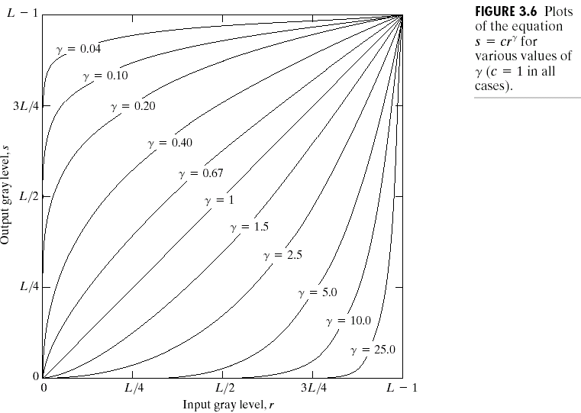
Image enhancement

Slide 43
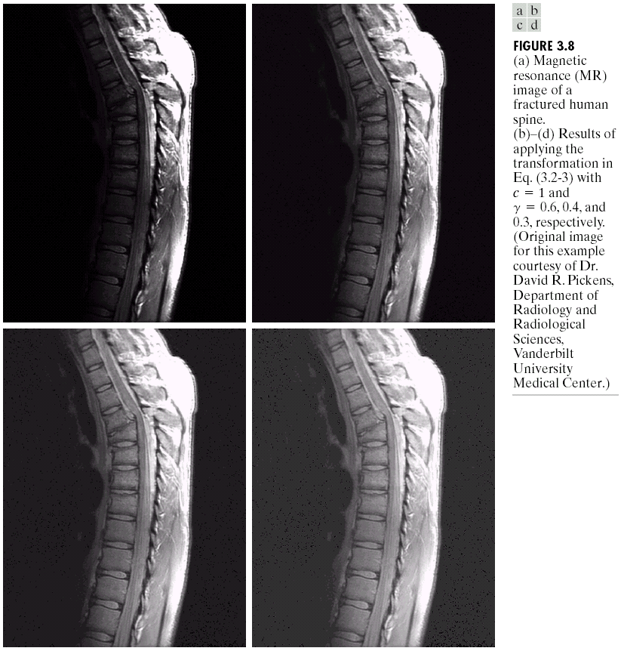
Image enhancement

Slide 44
Image enhancement
Contrast stretching:

Slide 45
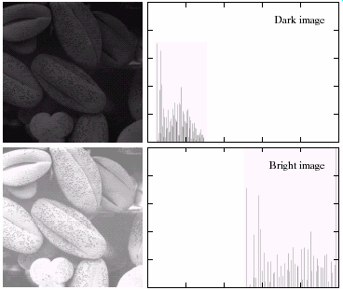
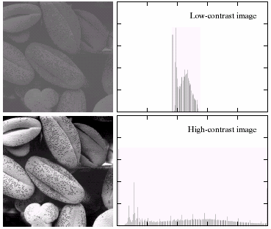
Histogram processing

Slide 46
Histogram processing
Intuitively, we expect that an image whose pixels
  tend to occupy the entire range of possible gray levels,
  tend to be distributed uniformly
will have a high contrast and show a great deal of gray level detail.
It is possible to develop a transformation function that can achieve this effect using histograms.

Slide 47
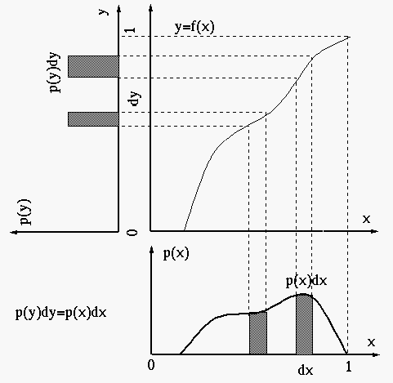
Histogram equalization
http://fourier.eng.hmc.edu/e161/lectures/contrast_transform/node3.html

Slide 48
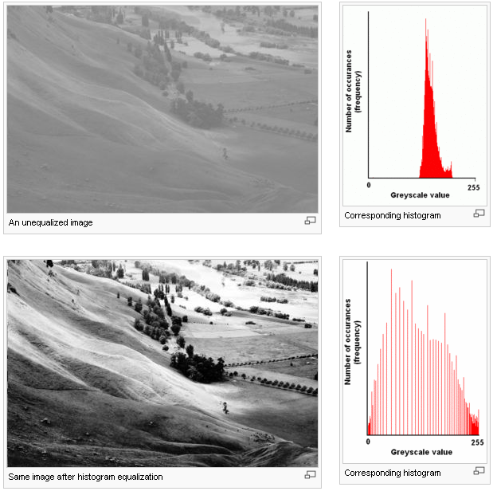
Histogram equalization
Adapted from Wikipedia

Slide 49
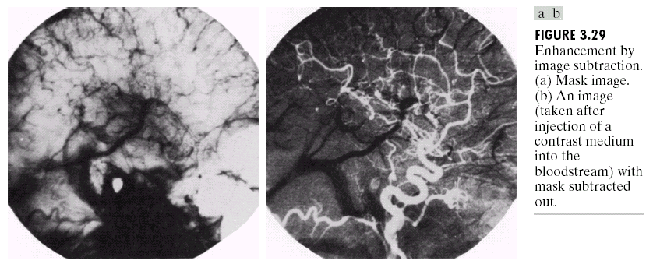
Enhancement using arithmetic operations

Slide 50


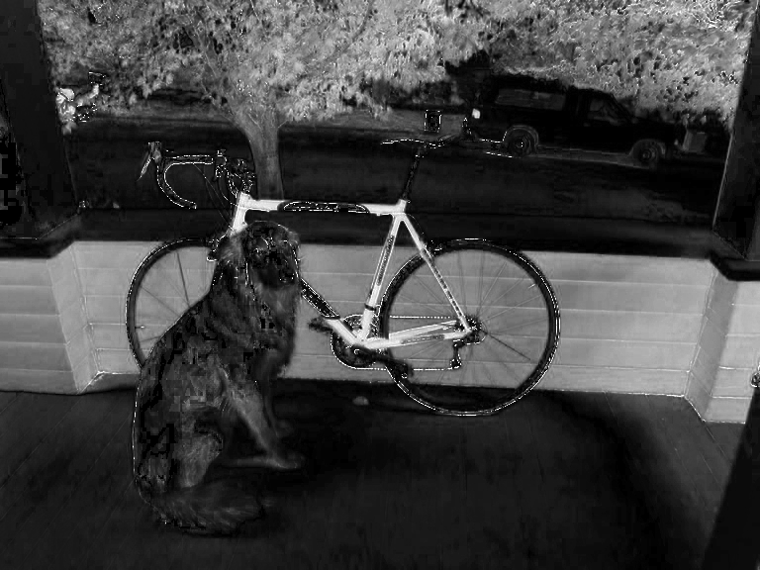
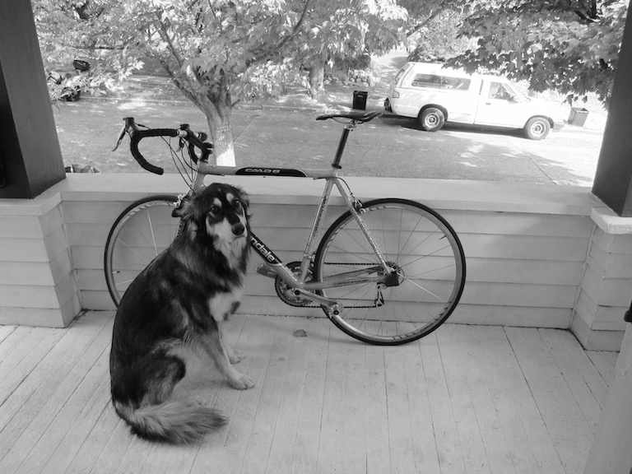
Enhancement using color channels
RGB
Hue
Saturation
Value
Adapted from Joseph Redmon, U of Washington

Slide 51


Enhancement using color channels
2x
More saturation -> intense colors
Adapted from Joseph Redmon, U of Washington

Slide 52


Enhancement using color channels
2x
More value -> lighter image
Adapted from Joseph Redmon, U of Washington

Slide 53


Enhancement using color channels
-.2
Shift hue -> shift colors
Adapted from Joseph Redmon, U of Washington

Slide 54


Enhancement using color channels
Set hue to your favorite color
Adapted from Joseph Redmon, U of Washington

Slide 55


Enhancement using color channels
… or patterns
Adapted from Joseph Redmon, U of Washington

Slide 56


Enhancement using color channels
Increase and threshold saturation
Adapted from Joseph Redmon, U of Washington

Slide 57
Image formats
Popular formats:
  BMP Microsoft Windows bitmap image
  EPS Adobe Encapsulated PostScript
  GIF CompuServe graphics interchange format
  JPEG Joint Photographic Experts Group
  PBM Portable bitmap format (black and white)
  PGM Portable graymap format (gray scale)
  PPM Portable pixmap format (color)
  PNG Portable Network Graphics
  PS Adobe PostScript
  TIFF Tagged Image File Format

Slide 58
Image formats
ASCII or binary
Number of bits per pixel (color depth)
Number of bands
Support for compression (lossless, lossy)
Support for metadata
Support for transparency
Format conversion
…
http://en.wikipedia.org/wiki/Comparison_of_graphics_file_formats

