Slide 1
Representation and
Description
Selim Aksoy
Department of Computer Engineering
Bilkent University
saksoy@cs.bilkent.edu.tr

Slide 2
Representation and description
Images and segmented regions must be represented and described in a form suitable for further processing.
The representations and the corresponding descriptions are selected according to the computational and semantic requirements of the image analysis task.
We will study:
  Region representations and descriptors.
  Image representations and descriptors.

Slide 3
Region representations
Representing a region involves two choices:
  External characteristics (boundary).
  Internal characteristics (pixels comprising the region).
An external representation is chosen when the primary focus is on shape characteristics.
An internal representation is selected when the primary focus is on regional properties, such as color and texture.

Slide 4
Labeled images and overlays
Labeled images are good intermediate representations for regions.
The idea is to assign each detected region a unique identifier (an integer) and create an image where all pixels of a region will have its unique identifier as their pixel value.
A labeled image can be used as a kind of mask to identify pixels of a region.
Region boundaries can be computed from the labeled image and can be overlaid on top of the original image.

Slide 5
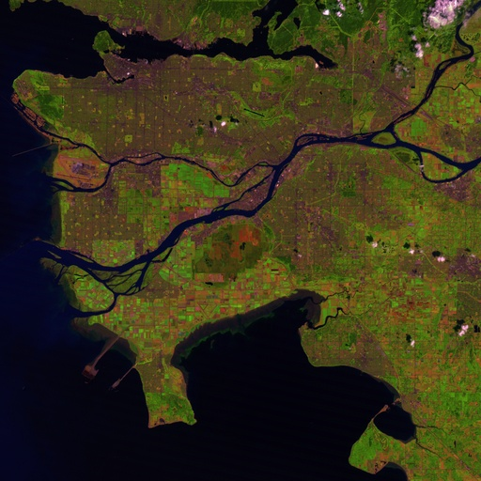
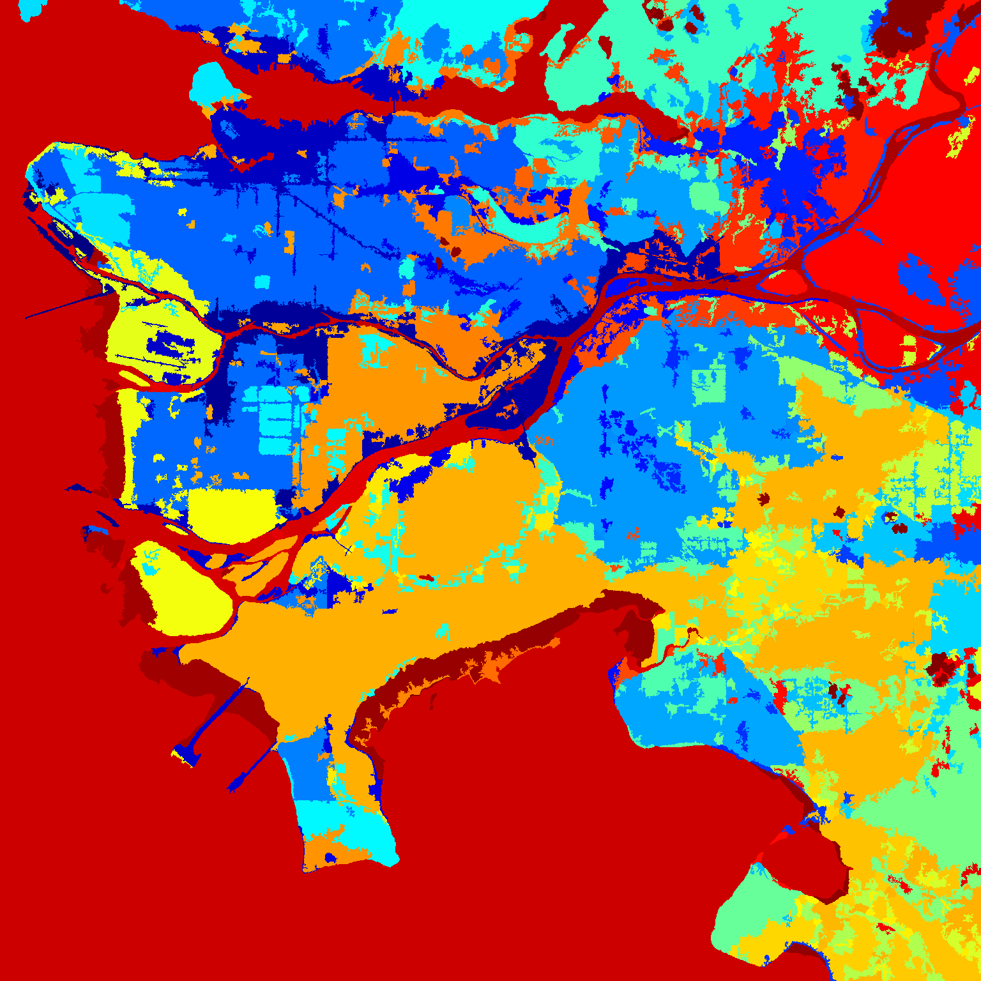
Labeled images and overlays
A satellite image and the corresponding labeled image after segmentation
(displayed in pseudo-color).

Slide 6
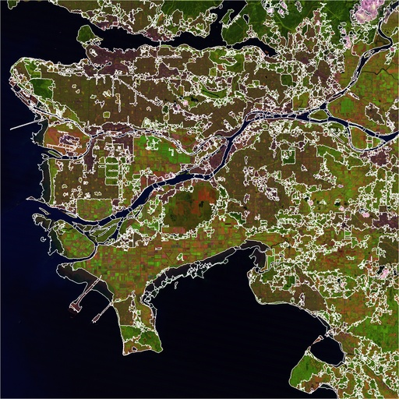
Labeled images and overlays
A satellite image and the corresponding segmentation overlay.

Slide 7
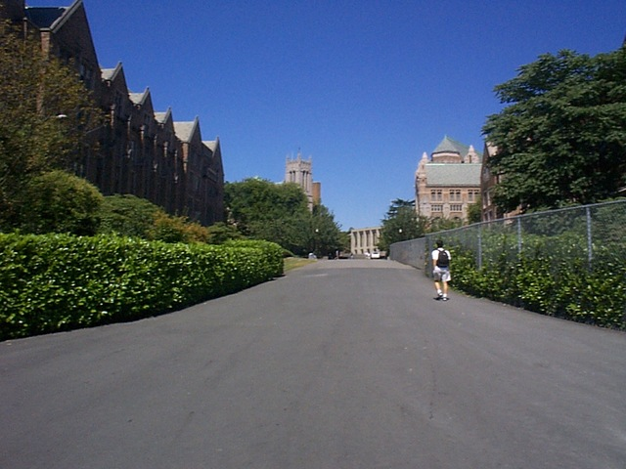
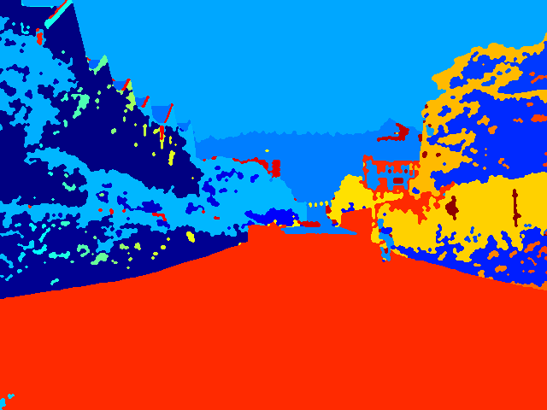
Labeled images and overlays
An image and the corresponding labeled image after segmentation
(displayed in pseudo-color).

Slide 8
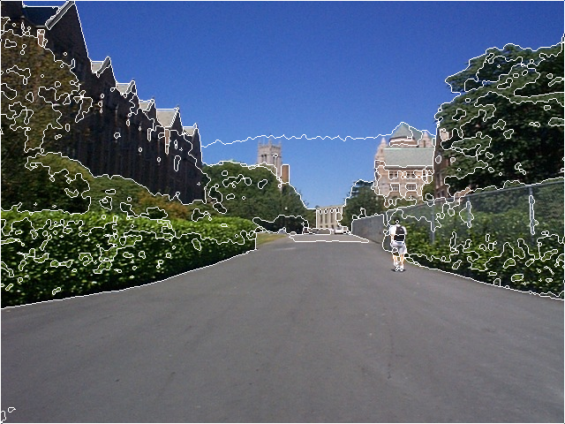
Labeled images and overlays
An image and the corresponding segmentation overlay.

Slide 9
Chain codes
Regions can be represented by their boundaries in a data structure instead of an image.
A linear list of the boundary points of each region is generally unacceptable. Why?
A variation is the chain code, which encodes the information from the list of points at any desired quantization.

Slide 10
Chain codes
Conceptually, a boundary to be encoded is overlaid on a square grid whose side length determines the resolution of the encoding.
Starting at the beginning of the curve, the grid intersection points that come closest to it are used to define small line segments that join each grid point to one of its neighbors.
The directions of these line segments are then encoded as small integers from zero to the number of neighbors used in encoding.

Slide 11
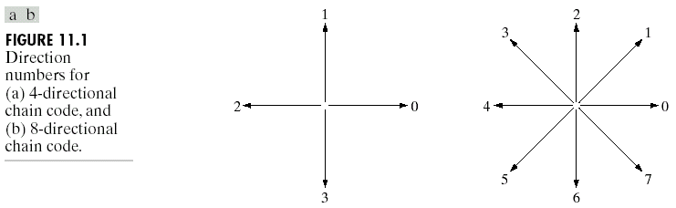
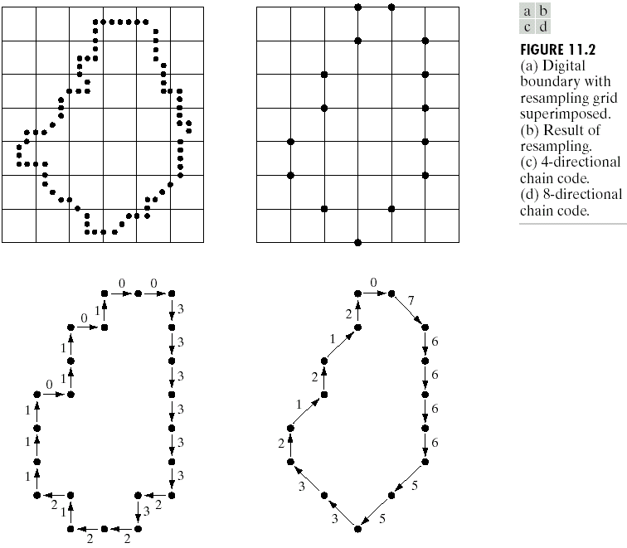
Chain codes

Slide 12
Chain codes
The chain code of a boundary depends on the starting point.
However, the code can be normalized by treating it as a circular sequence.
Size (scale) normalization can be achieved by altering the size of the sampling grid.
Rotation normalization can be achieved by using the first difference of the chain code instead of the code itself.
  Count the number of direction changes (in counter-clockwise direction) that separate two adjacent elements of the code (e.g., 10103322 → 3133030).

Slide 13
Chain codes

Slide 14
Polygonal approximations
When the boundary does not have to be exact, the boundary pixels can be approximated by straight line segments, forming a polygonal approximation to the boundary.
The goal of polygonal approximations is to capture the “essence” of the boundary shape with the fewest possible polygonal segments.
This representation can save space and simplify algorithms that process the boundary.

Slide 15
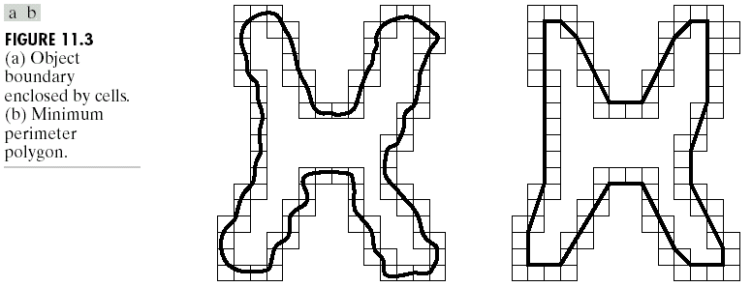
Polygonal approximations
Minimum perimeter polygons:
  Enclose the boundary by a set of concatenated cells.
  Produce a polygon of minimum perimeter that fits the geometry established by the cell strip.

Slide 16
Polygonal approximations

Slide 17
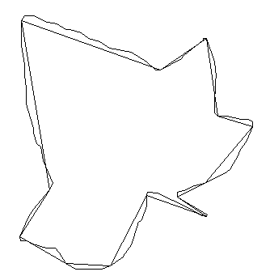
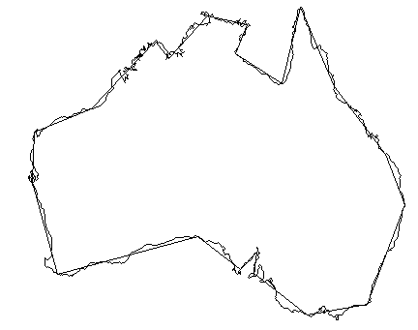
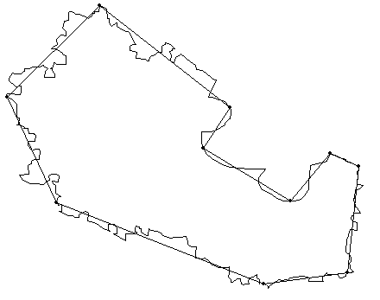
Polygonal approximations
Merging techniques:
  Points along a boundary can be merged until the least square error line fit of the points merged so far exceeds a preset threshold.
  At the end of the procedure, the intersections of adjacent line segments form the vertices of the polygon.

Slide 18
Polygonal approximations
Splitting techniques:
  One approach is to subdivide a segment successively into two parts until a specified criterion is satisfied.
  For instance, a requirement might be that the maximum perpendicular distance from a boundary segment to the line joining its two end points not exceed a preset threshold.
  If it does, the farthest point from the line becomes a vertex, thus subdividing the initial segment into two.
  The procedure terminates when no point in the new boundary segments has a perpendicular distances that exceeds the threshold.

Slide 19
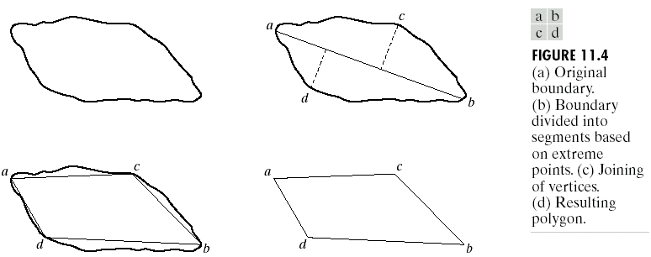
Polygonal approximations

Slide 20
Scale space
The scale space representation of a shape is created by tracking the position of inflection points on a shape boundary filtered by low-pass Gaussian filters of variable widths.
As the width (σ) of Gaussian filter increases, insignificant inflections are eliminated from the boundary and the shape becomes smoother.
The inflection points that remain present in the representation are expected to be “significant” object characteristics.

Slide 21
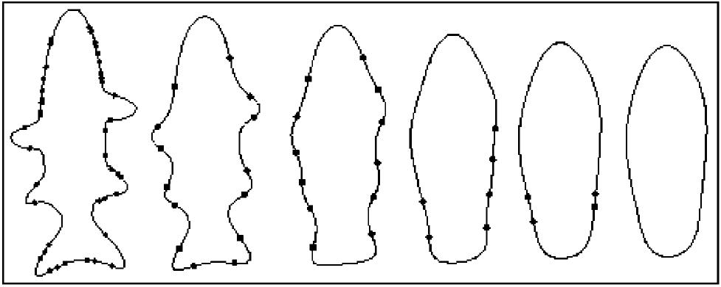
Scale space
The evolution of shape boundary as scale increases.
From left to right: σ = 1, 4, 7, 10, 12, 14.

Slide 22
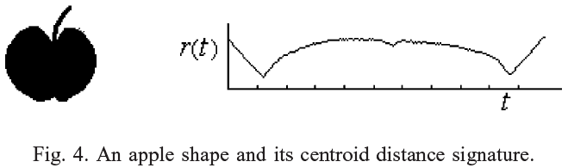
Signatures
A signature is a 1-D functional representation of a boundary.
A simple method is to plot the distance from the centroid to the boundary as a function of angle.
  Normalization with respect to rotation and scaling are needed.
Another method is to traverse the boundary, and plot the angle between the line tangent to the boundary at each point and a reference line.

Slide 23

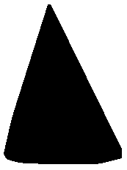
Boundary segments
Decomposing a boundary into segments can reduce the boundary’s complexity and simplify the description process.
The convex hull H of an arbitrary set S is the smallest convex set containing S.
A region and its convex hull.

Slide 24
Skeletons
An important approach to representing the structural shape of a plane region is to reduce it to a graph.
This reduction may be accomplished by obtaining the skeleton of the region.
The medial axis transformation (MAT) can be used to compute the skeleton.
The MAT of a region R with border B is as follows:
  For each point p in R, we find its closest neighbor in B.
  If p has more than one such neighbor, it is said to belong to the medial axis of R.

Slide 25
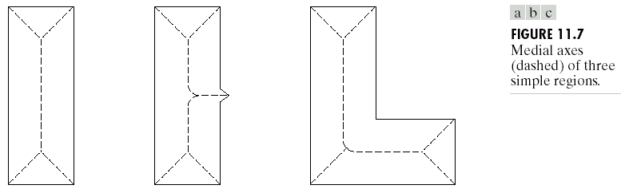
Skeletons
The MAT can be computed using thinning algorithms that iteratively delete edge points of a region subject to the constraints that deletion of these points
  does not remove end points,
  does not break connectivity, and
  does not cause excessive erosion of the region.

Slide 26
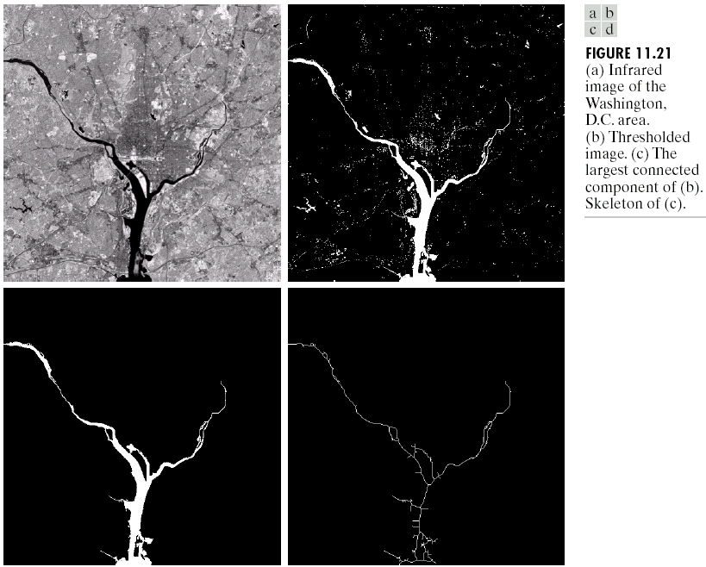
Skeletons

Slide 27
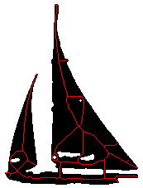
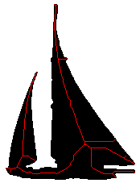
Skeletons
A region, its skeleton, and the skeleton after
filling the holes in the region.

Slide 28

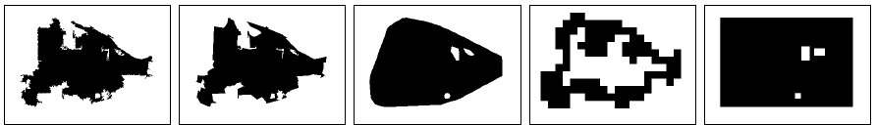
Examples
Region representation examples. Rows show representations for two different regions. Columns represent, from left to right: original boundary, smoothed polygon, convex hull, grid representation, and minimum bounding rectangle.

Slide 29
Region descriptors
Boundary descriptors use external representations to model the shape characteristics of regions.
Regional descriptors use internal representations to model the internal content of regions.
Examples:
  Shape properties (both internal and external)
  Statistics and histograms (internal)

Slide 30
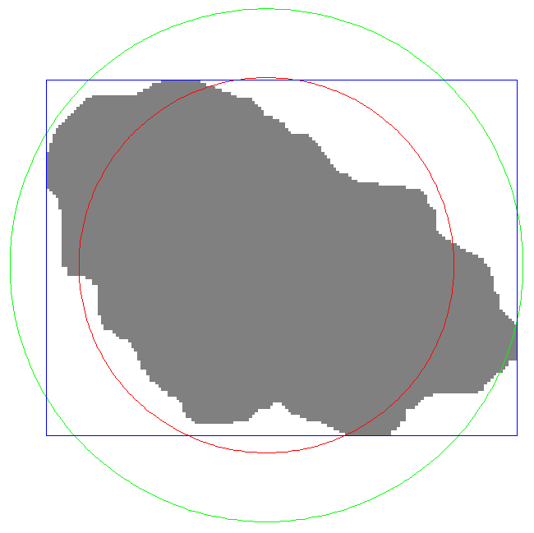
Shape properties
Area
  Number of pixels in the region
Perimeter
  Number of pixels on the boundary
  Number of vertical and horizontal components plus √2 times the number of diagonal components
Bounding box
Diameter
  Maximum distance between
  boundary points
Equivalent diameter
  Diameter of a circle with the same area as the region

Slide 31
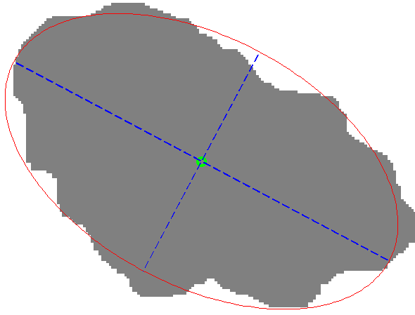
Shape properties
Principal axes of inertia
  Compute the mean of pixel coordinates (centroid)
  Compute the covariance matrix of pixel coordinates
  Major axis is the eigenvector of the covariance matrix corresponding to the larger eigenvalue
  Minor axis is the eigenvector
  of the covariance matrix
  corresponding to the smaller
  eigenvalue

Slide 32
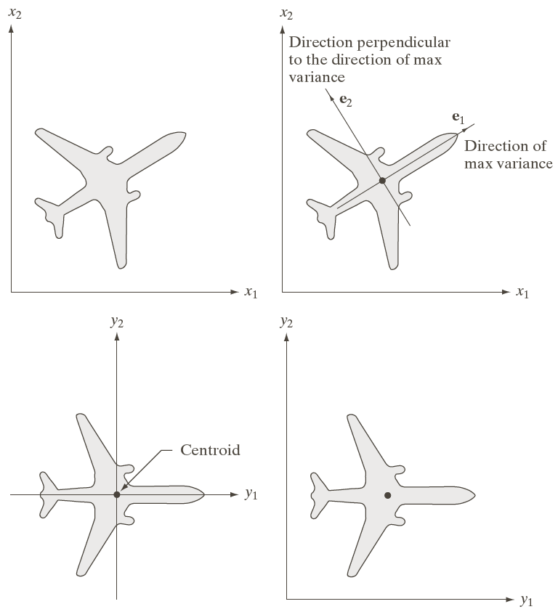
Shape properties

Slide 33
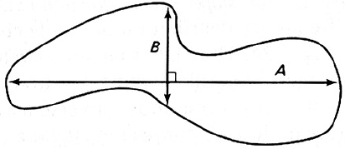
Shape properties
Orientation
  Orientation of the major axis with respect to the horizontal axis
Eccentricity (elongation)
  Ratio of the length of maximum chord A
  to maximum chord B perpendicular to A
  Ratio of the principal axes of inertia
Compactness
  Perimeter² / area (minimized by a disk)
Extent
  Area of region / area of its bounding box
Solidity
  Area of region / area of its convex hull

Slide 34

Shape properties
Spatial variances
  Variance of pixel coordinates along the principal axes of inertia
Moments

Slide 35
Statistics and histograms
Contents of regions can be summarized using statistics (e.g., mean, standard deviation) and histograms of pixel features.
Commonly used pixel features include
  Gray tone,
  Color (RGB, HSV, …),
  Texture,
  Motion.
Then, the resulting region level features can be used for clustering, retrieval, classification, etc.

Slide 36
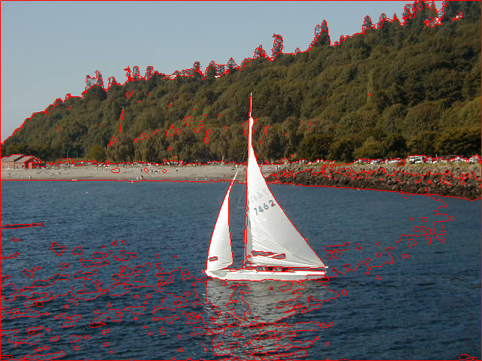
Statistics and histograms

Slide 37
Statistics and histograms
Region RGB histogram RGB mean and std.dev.

Slide 38
Statistics and histograms
Region RGB histogram RGB mean and std.dev.

Slide 39
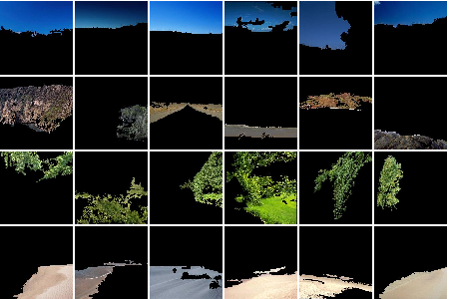
Statistics and histograms
Region clusters obtained using the histograms of the HSV values of their pixels. Each row represents the clusters corresponding to sky, rock, tree, road.

Slide 40
Image representations and descriptors
Popular image representations (in increasing order of complexity) include:
  Global representation
  Tiled representations
  Quadtrees
  Region adjacency graphs
  Attributed relational graphs

Slide 41




































Tiled representations
Images can be divided into fixed size or variable size grids that are overlapping or non-overlapping.
Dividing an image into 5x7 fixed size non-overlapping grid cells.

Slide 42
Tiled representations

Slide 43
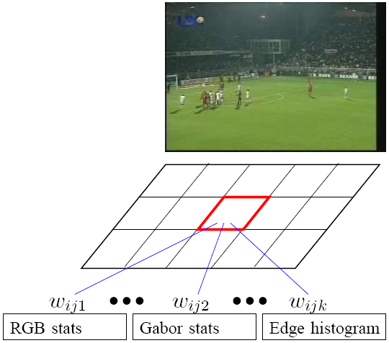
Tiled representations
Example application: learning the importance of different features in different grid cells using user feedback.

Slide 44
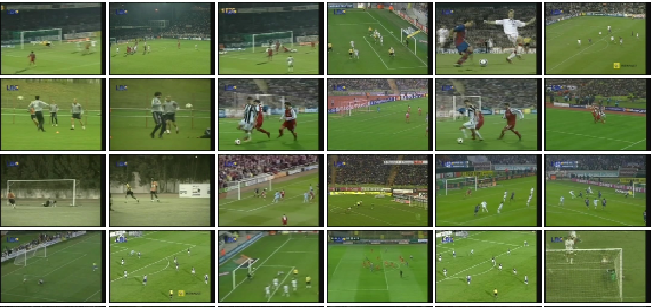
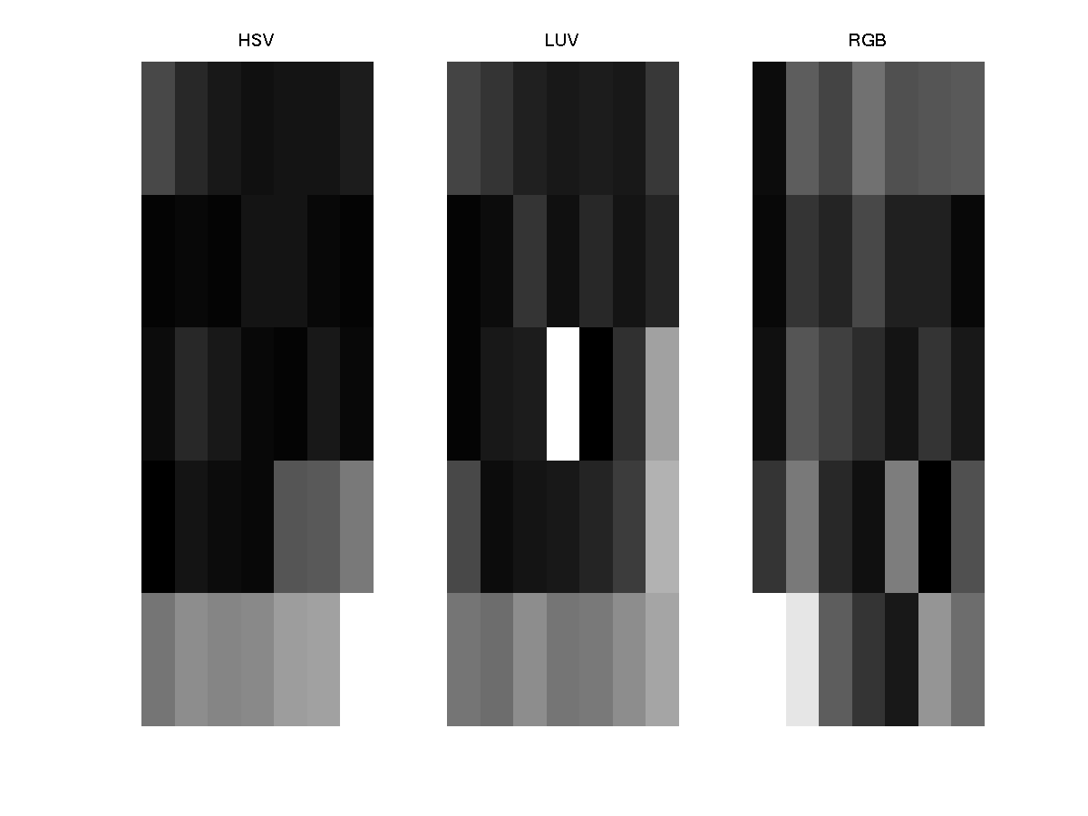
Tiled representations
Results of a football query.
Weights for different features (left to right: HSV, LUV, RGB) and grid cells for the football query. Brighter colors represent higher weights.

Slide 45
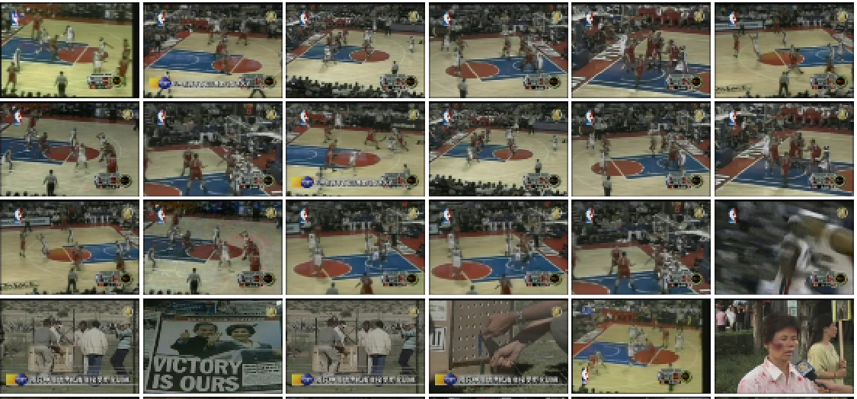
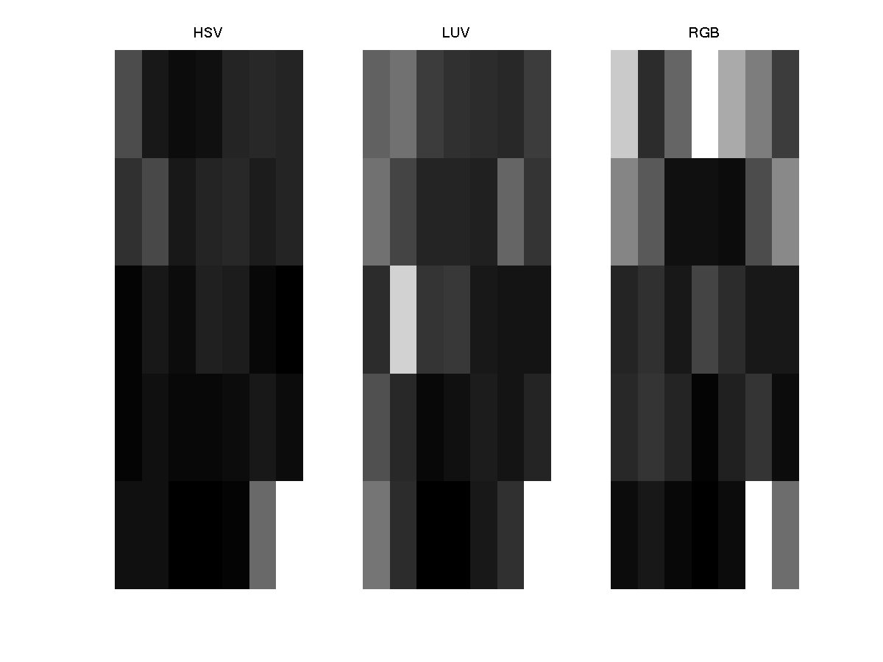
Tiled representations
Results of a basketball query.
Weights for different features (left to right: HSV, LUV, RGB) and grid cells for the basketball query. Brighter colors represent higher weights.

Slide 46
Quadtrees
Quadtrees:
  Trees where nodes have 4 children.
Building a quadtree:
  Nodes represent regions.
  Every time a region is split, its node gives birth to 4 children.
  Leaves are nodes for uniform regions.
Merging:
  Siblings that are “similar” can be merged.

Slide 47
Quadtrees
1
1
1
2
3
2
3
2
3
4
4
4
Not uniform
uniform

Slide 48
Quadtrees
1
1
1
2
3
2
3
2
3
4
4
4
1
1
2
3
2
3
4
4
Splitting…

Slide 49
Quadtrees
1
1
1
2
3
2
3
2
3
4
4
4
Merging…

Slide 50
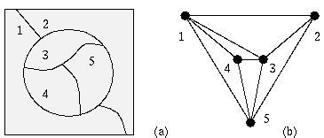
Region adjacency graphs
A region adjacency graph (RAG) is a graph in which each node represents a region of the image and an edge connects two nodes if the regions are adjacent.
1
2
3
4

Slide 51
Attributed relational graphs
Attributed relational graphs (ARG) generalize ordinary graphs by attaching discrete or continuous features (attributes) to the vertices and edges.
Formally, an attributed relational graph G is a
4-tuple G=(N,E,μ,ν) where
  N is the set of nodes,
  E ⊆ N ×N is the set of edges,
  μ : N →L_{N} is a function assigning labels to the nodes,
  ν : E →L_{E} is a function assigning labels to the edges.

Slide 52
Attributed relational graphs
Example application: modeling remote sensing image content using ARGs.
  Nodes in the ARG represent the regions and edges represent the spatial relationships between these regions.
  Nodes are labeled with the class (land cover/use) names and the corresponding confidence values for these class assignments.
  Edges are labeled with the spatial relationship classes and the corresponding degrees for these relationships.

Slide 53
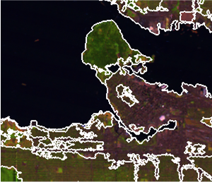
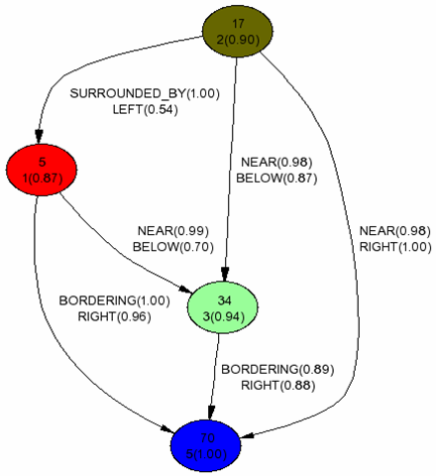
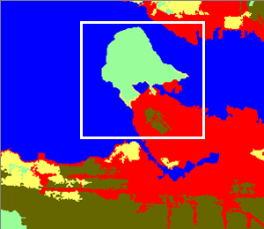
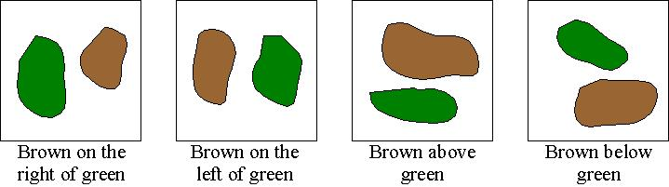
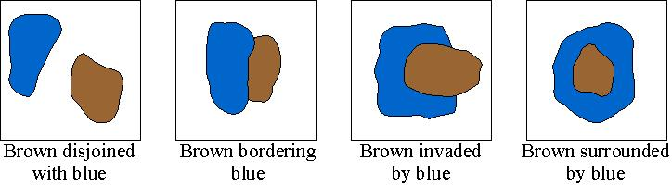
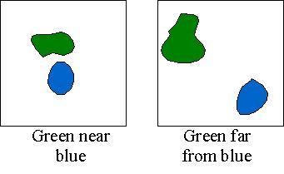
Attributed relational graphs
ARG for an example scene (marked with a white rectangle) containing regions classified as water (blue), city center (red), residential area (brown) and park (green). Nodes are labeled using region id, class id, class probability (in parenthesis) and edges are labeled using relationship names and membership values (in parenthesis).

Slide 54
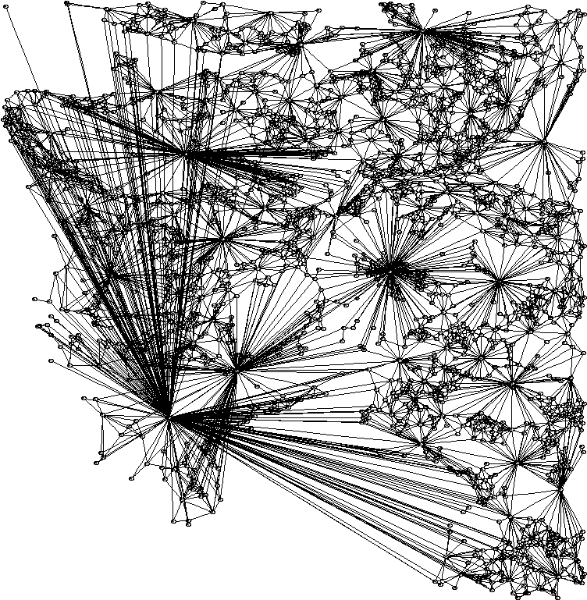
Attributed relational graphs
ARG of a LANDSAT scene. Nodes are located at the centroids of the corresponding regions. Edges are drawn only for pairs that are within 10 pixels of each other to keep the graph simple.

Slide 55
Attributed relational graphs
An important problem is how similarities between two scenes represented using ARGs can be found.
Relational matching has been extensively studied in structural pattern recognition.
One possible solution is the “editing distance” between two ARGs that is defined as the minimum cost taken over all sequences of operations (error corrections such as substitution, insertion and deletion) that transform one ARG to the other.

Slide 56
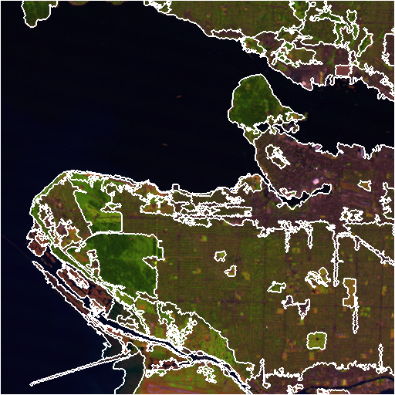
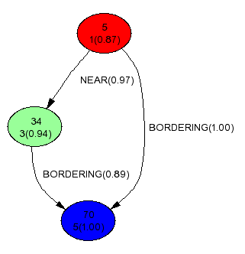
Attributed relational graphs
Find the ARG of the area of interest (query).

Slide 57
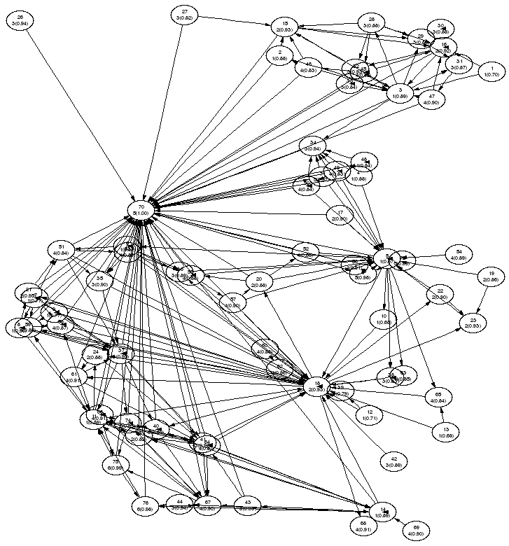
Attributed relational graphs
Search the graph for the whole scene …

Slide 58
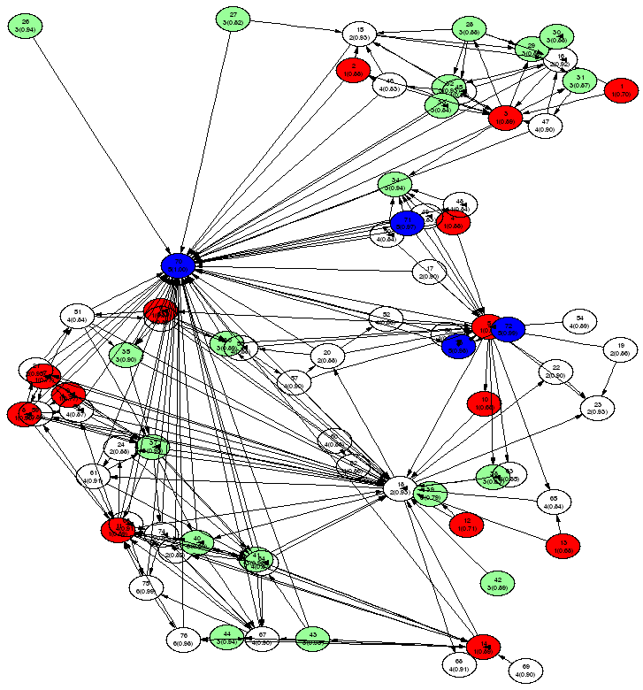
Attributed relational graphs
… by first finding the nodes (regions) with similar attributes

Slide 59
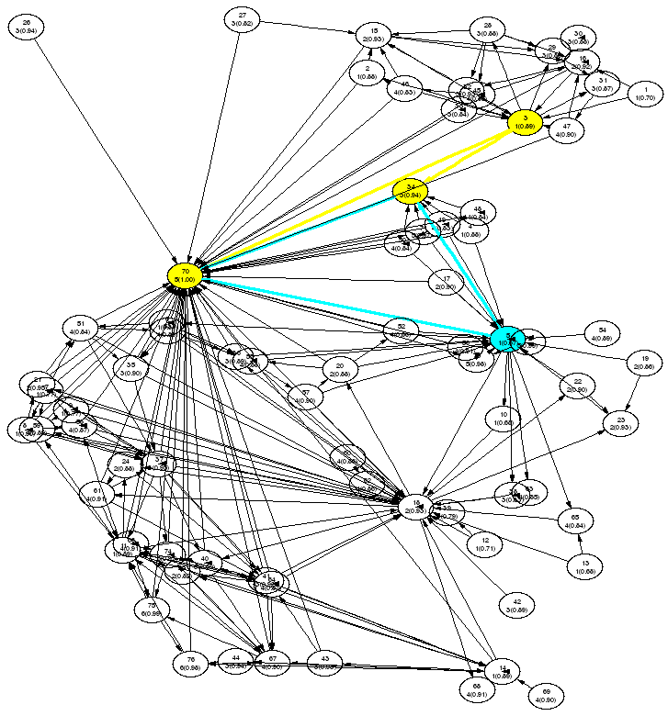
Attributed relational graphs
… and then finding the subgraphs with similar edges (relationships).

