Slide 1
Linear Filtering – Part II
Selim Aksoy
Department of Computer Engineering
Bilkent University
saksoy@cs.bilkent.edu.tr

Slide 2
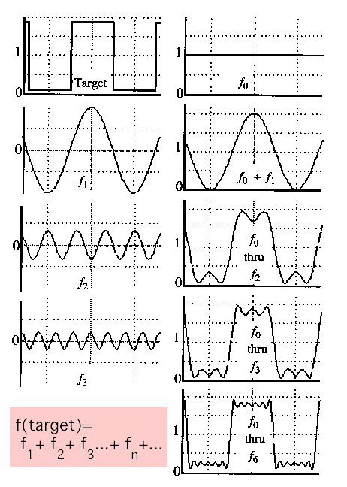
Fourier theory
The Fourier theory shows how most real functions can be represented in terms of a basis of sinusoids.
The building block:
  A sin( ωx + Φ )
Add enough of them to get any signal you want.
Adapted from Alexei Efros, CMU

Slide 3
Fourier transform

Slide 4
Fourier transform

Slide 5
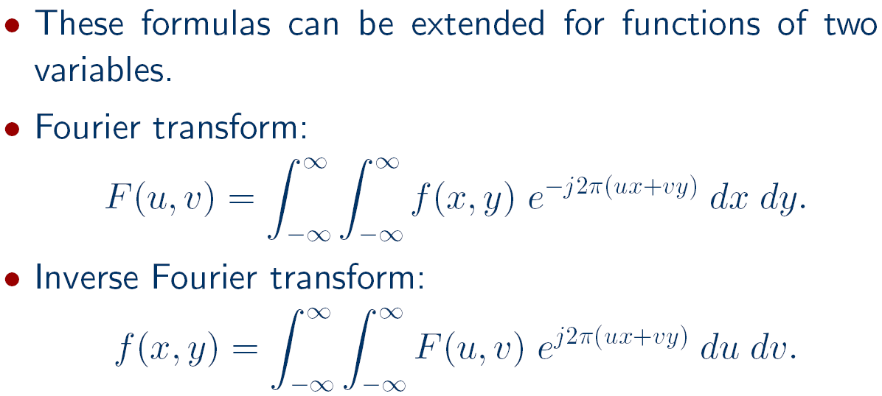
Fourier transform

Slide 6
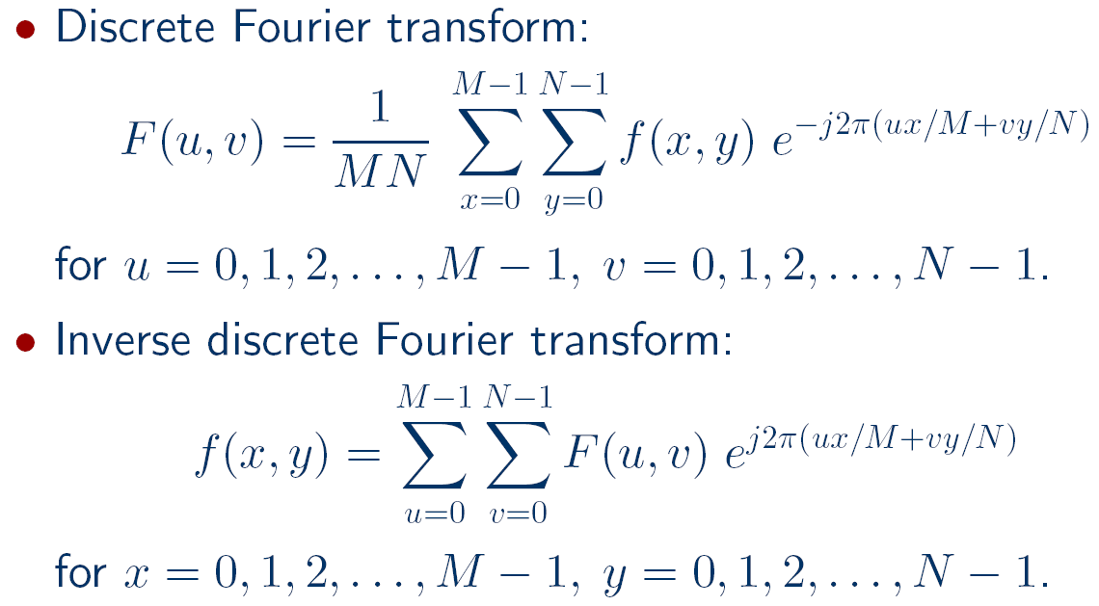
Fourier transform

Slide 7
Fourier transform

Slide 8
Fourier transform

Slide 9

Fourier transform
To get some sense of what basis elements look like, we plot a basis element --- or rather, its real part ---
as a function of x,y for some fixed u, v. We get a function that is constant when (ux+vy) is constant. The magnitude of the vector (u, v) gives a frequency, and its direction gives an orientation. The function is a sinusoid with this frequency along the direction, and constant perpendicular to the direction.
v
u
Adapted from Antonio Torralba

Slide 10

Fourier transform
Here u and v are larger than in the previous slide.
v
u
Adapted from Antonio Torralba

Slide 11

Fourier transform
And larger still...
v
u
Adapted from Antonio Torralba

Slide 12
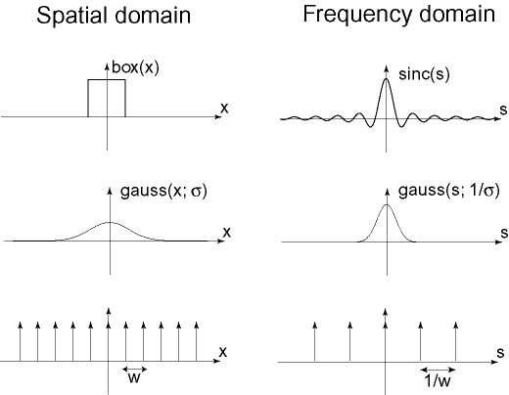

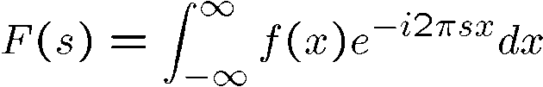
Fourier transform
Adapted from Alexei Efros, CMU

Slide 13
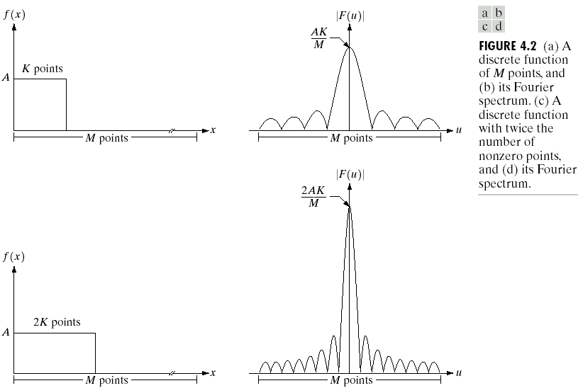
Fourier transform
Adapted from Gonzales and Woods

Slide 14
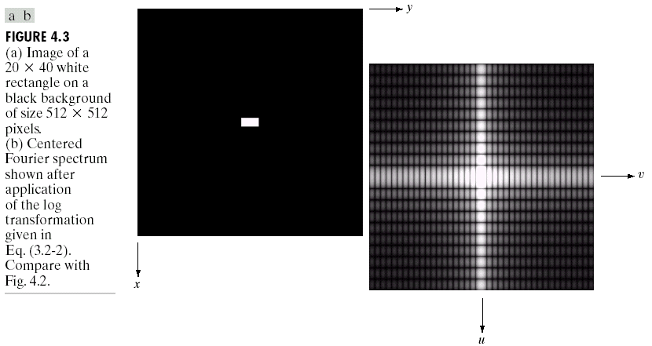
Fourier transform
Adapted from Gonzales and Woods

Slide 15
Fourier transform

Slide 16
Fourier transform

Slide 17
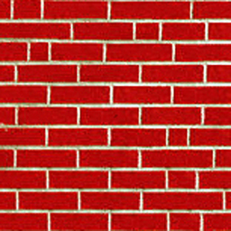
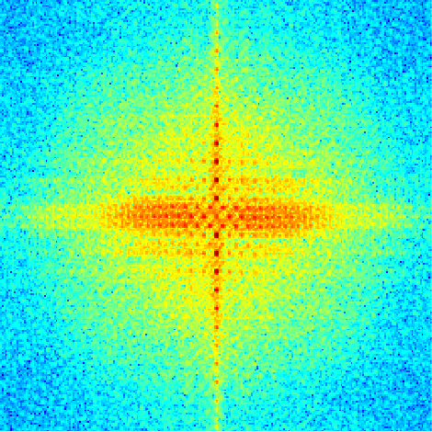
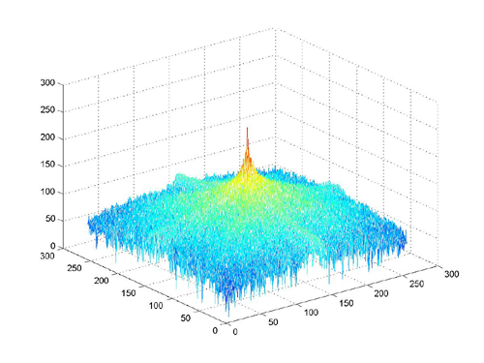
Fourier transform
How to interpret a Fourier spectrum:
Vertical orientation
Low spatial frequencies
45 deg.
0
Horizontal
orientation
0
fmax
High
spatial
frequencies
fx in cycles/image
Log power spectrum
Adapted from Antonio Torralba

Slide 18

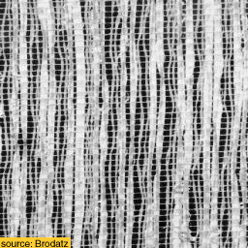
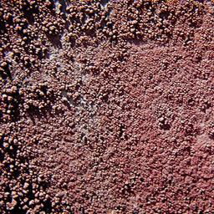
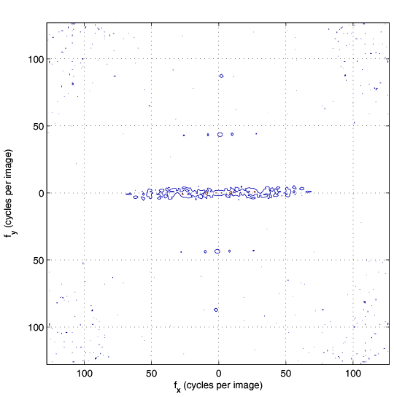
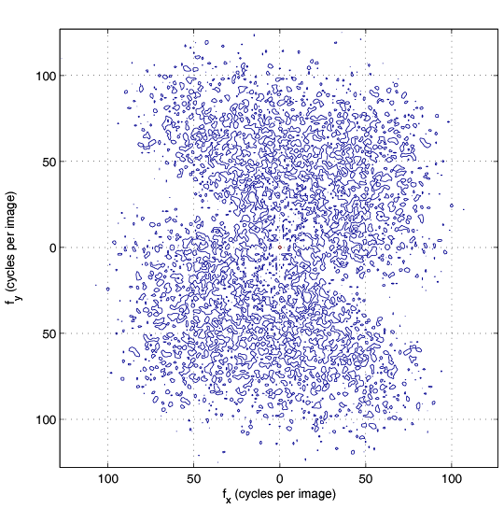
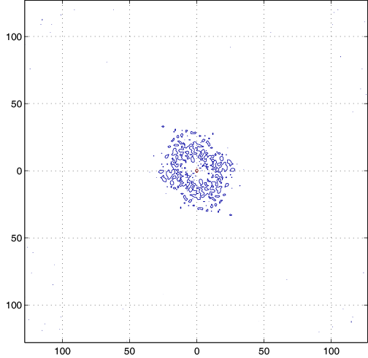
Fourier transform
A
B
C
1
2
3
Adapted from Antonio Torralba

Slide 19
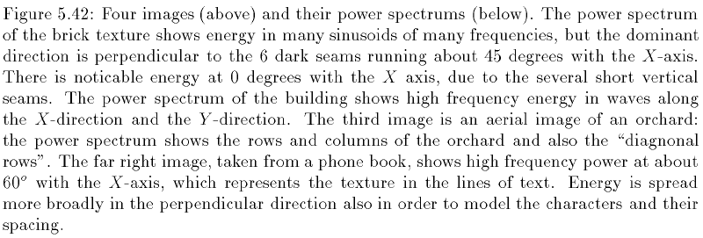
Fourier transform
Adapted from Shapiro and Stockman

Slide 20
Convolution theorem

Slide 21
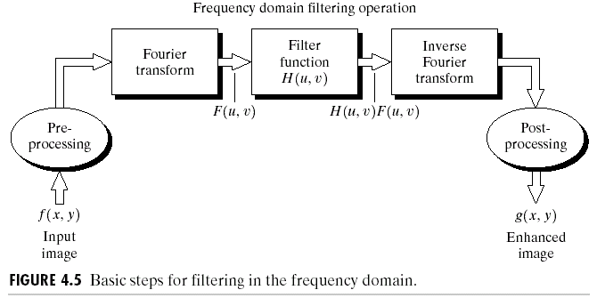
Frequency domain filtering
Adapted from Shapiro and Stockman,
and Gonzales and Woods

Slide 22
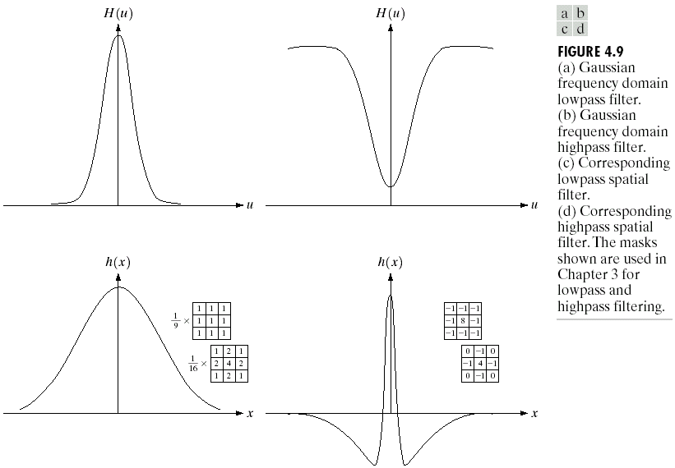
Frequency domain filtering
Since the discrete Fourier transform is periodic, padding is needed in the implementation to avoid aliasing (see section 4.6 in the Gonzales-Woods book for implementation details).

Slide 23

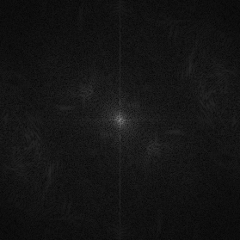


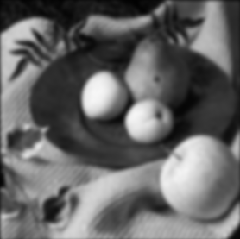

Frequency domain filtering
f(x,y)
|F(u,v)|
★
×
h(x,y)
|H(u,v)|
⇓
⇓
g(x,y)
|G(u,v)|
Adapted from Alexei Efros, CMU

Slide 24
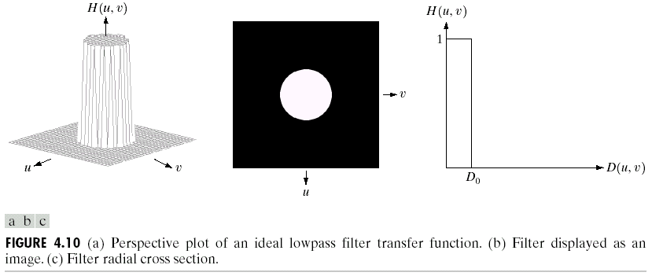
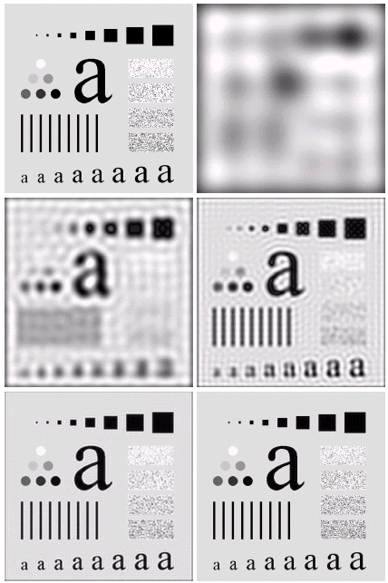

Smoothing frequency domain filters

Slide 25
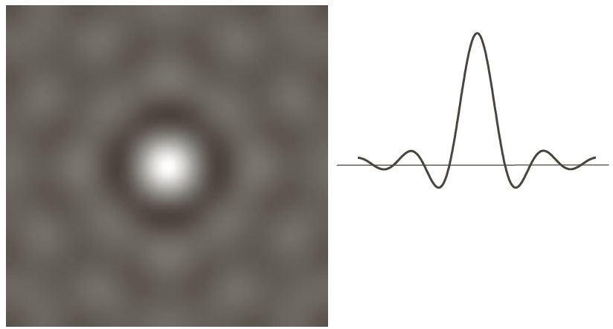
Smoothing frequency domain filters
The blurring and ringing caused by the ideal low-pass filter can be explained using the convolution theorem where the spatial representation of a filter is given below.

Slide 26
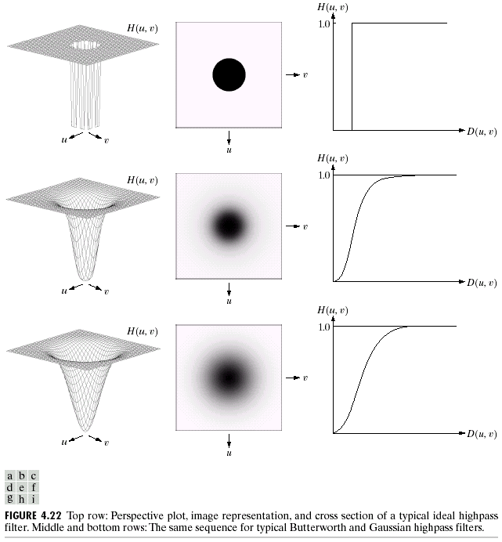
Sharpening frequency domain filters

Slide 27
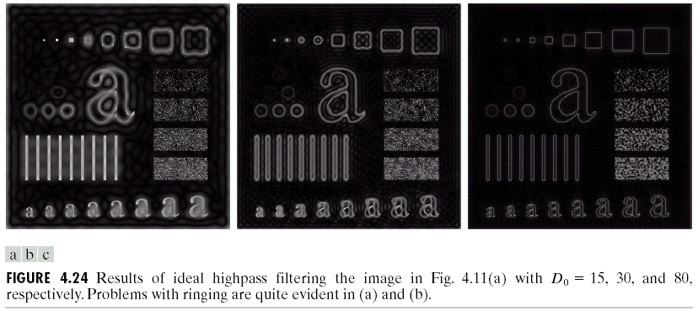
Sharpening frequency domain filters
Adapted from Gonzales and Woods

Slide 28
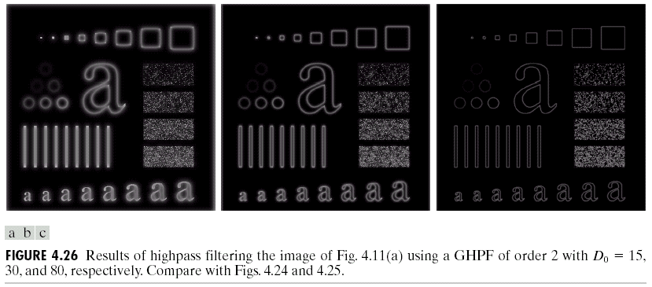
Sharpening frequency domain filters
Adapted from Gonzales and Woods

Slide 29
Template matching
Correlation can also be used for matching.
If we want to determine whether an image f contains a particular object, we let h be that object (also called a template) and compute the correlation between f and h.
If there is a match, the correlation will be maximum at the location where h finds a correspondence in f.
Preprocessing such as scaling and alignment is necessary in most practical applications.

Slide 30
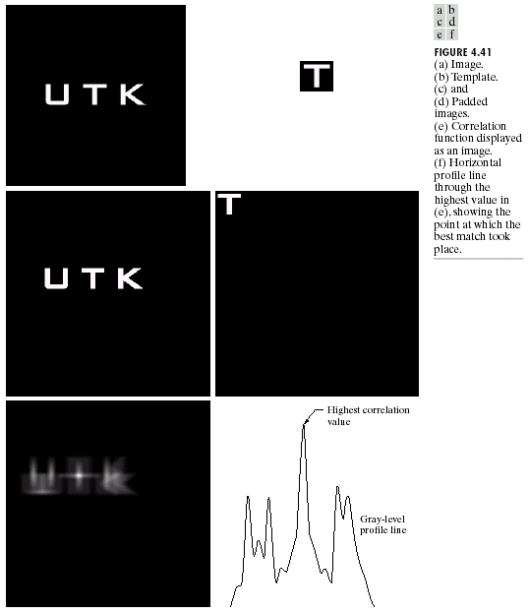
Template matching
Adapted from Gonzales and Woods

Slide 31
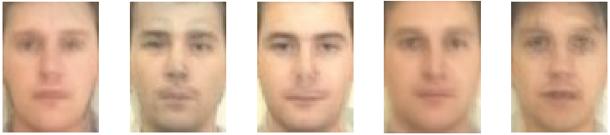
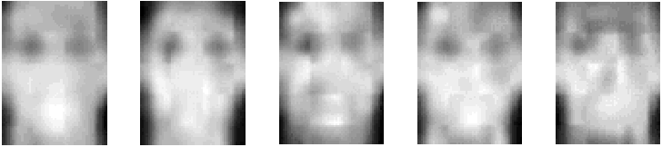
Template matching
Face detection using template matching: face templates.

Slide 32
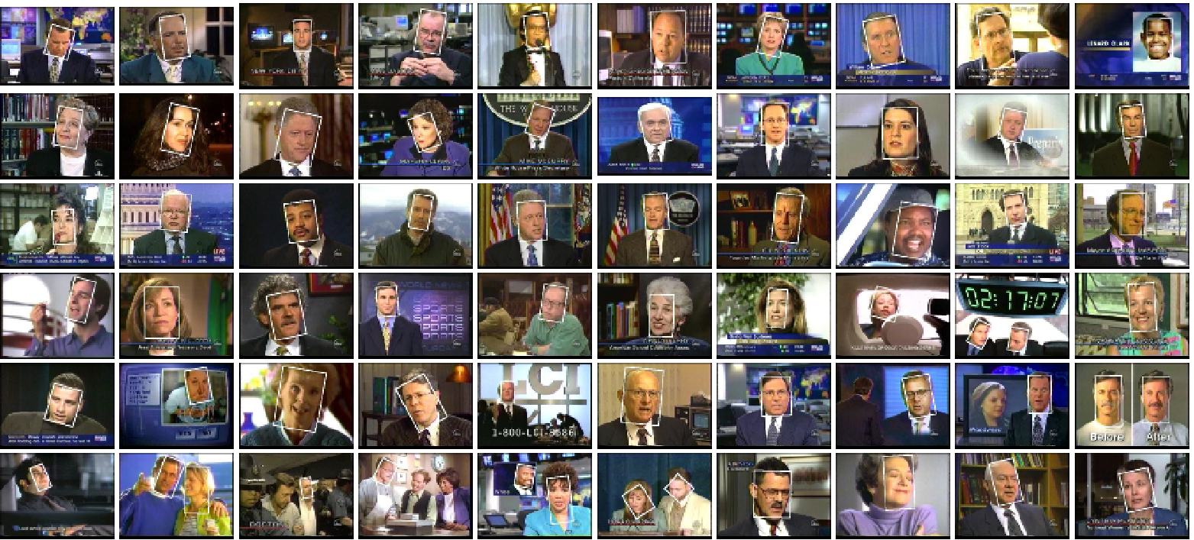
Template matching
Face detection using template matching: detected faces.

Slide 33
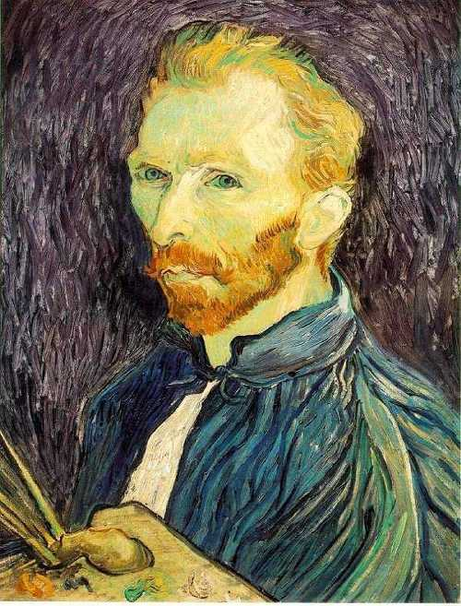
Resizing images
How can we generate a half-sized version of a large image?
Adapted from Steve Seitz, U of Washington

Slide 34

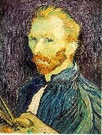

Resizing images
1/8
1/4
Throw away every other row and column to create a 1/2 size image (also called sub-sampling).
Adapted from Steve Seitz, U of Washington

Slide 35
Resizing images
1/2
1/4 (2x zoom)
1/8 (4x zoom)
Does this look nice?
Adapted from Steve Seitz, U of Washington

Slide 36



Resizing images
We cannot shrink an image by simply taking every k’th pixel.
Solution: smooth the image, then sub-sample.
Gaussian 1/8
Gaussian 1/4
Gaussian 1/2
Adapted from Steve Seitz, U of Washington

Slide 37
Resizing images
Gaussian 1/2
Gaussian 1/4 (2x zoom)
Gaussian 1/8 (4x zoom)
Adapted from Steve Seitz, U of Washington

Slide 38
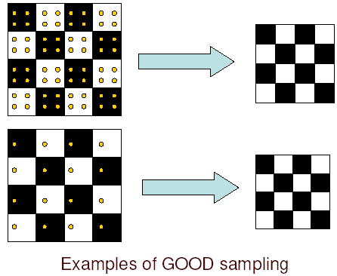
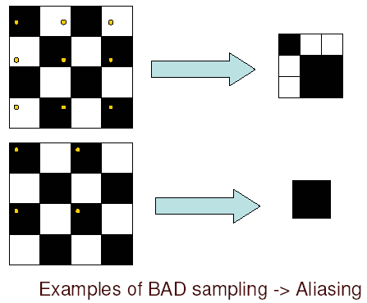
Sampling and aliasing
Adapted from Steve Seitz, U of Washington

Slide 39
Sampling and aliasing
Errors appear if we do not sample properly.
Common phenomenon:
  High spatial frequency components of the image appear as low spatial frequency components.
Examples:
  Wagon wheels rolling the wrong way in movies.
  Checkerboards misrepresented in ray tracing.
  Striped shirts look funny on color television.

Slide 40
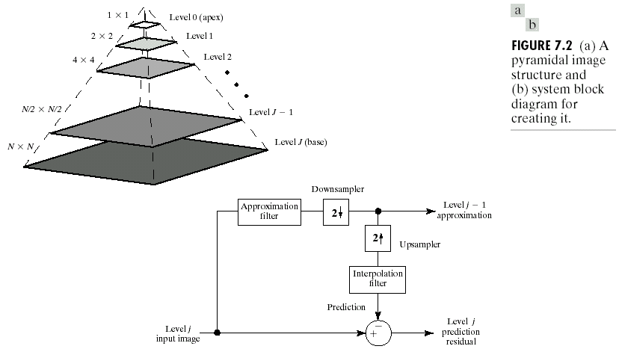
Gaussian pyramids
Adapted from Gonzales and Woods

Slide 41
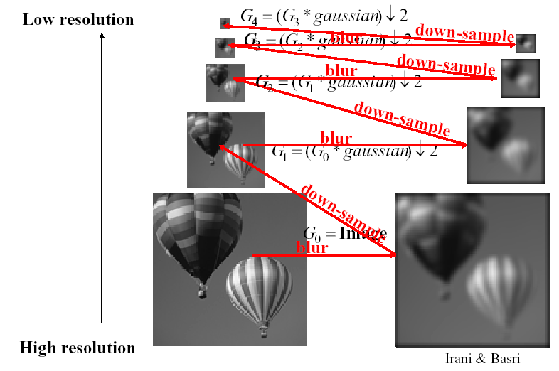
Gaussian pyramids
Adapted from Michael Black, Brown University

Slide 42
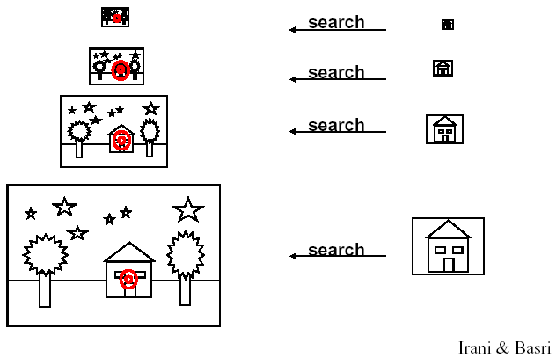
Gaussian pyramids
Adapted from Michael Black, Brown University

