Slide 1
Digital Image Fundamentals
Selim Aksoy
Department of Computer Engineering
Bilkent University
saksoy@cs.bilkent.edu.tr

Slide 2
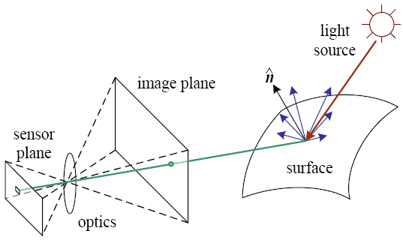
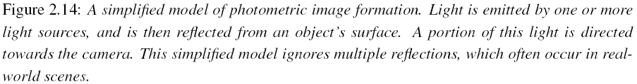
Imaging process
Light reaches surfaces in 3D.
Surfaces reflect.
Sensor element receives light energy.
Intensity is important.
Angles are important.
Material is important.
Adapted from Rick Szeliski

Slide 3
Physical parameters
Geometric
  Type of projection
  Camera pose
Optical
  Sensor’s lens type
  Focal length, field of view, aperture
Photometric
  Type, direction, intensity of light reaching sensor
  Surfaces’ reflectance properties
Sensor
  Sampling, etc.
Adapted from Trevor Darrell, UC Berkeley

Slide 4
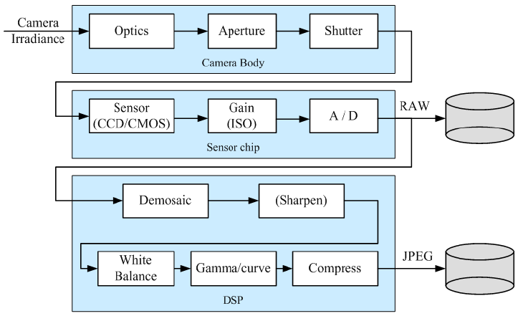
Image acquisition
Adapted from Rick Szeliski

Slide 5
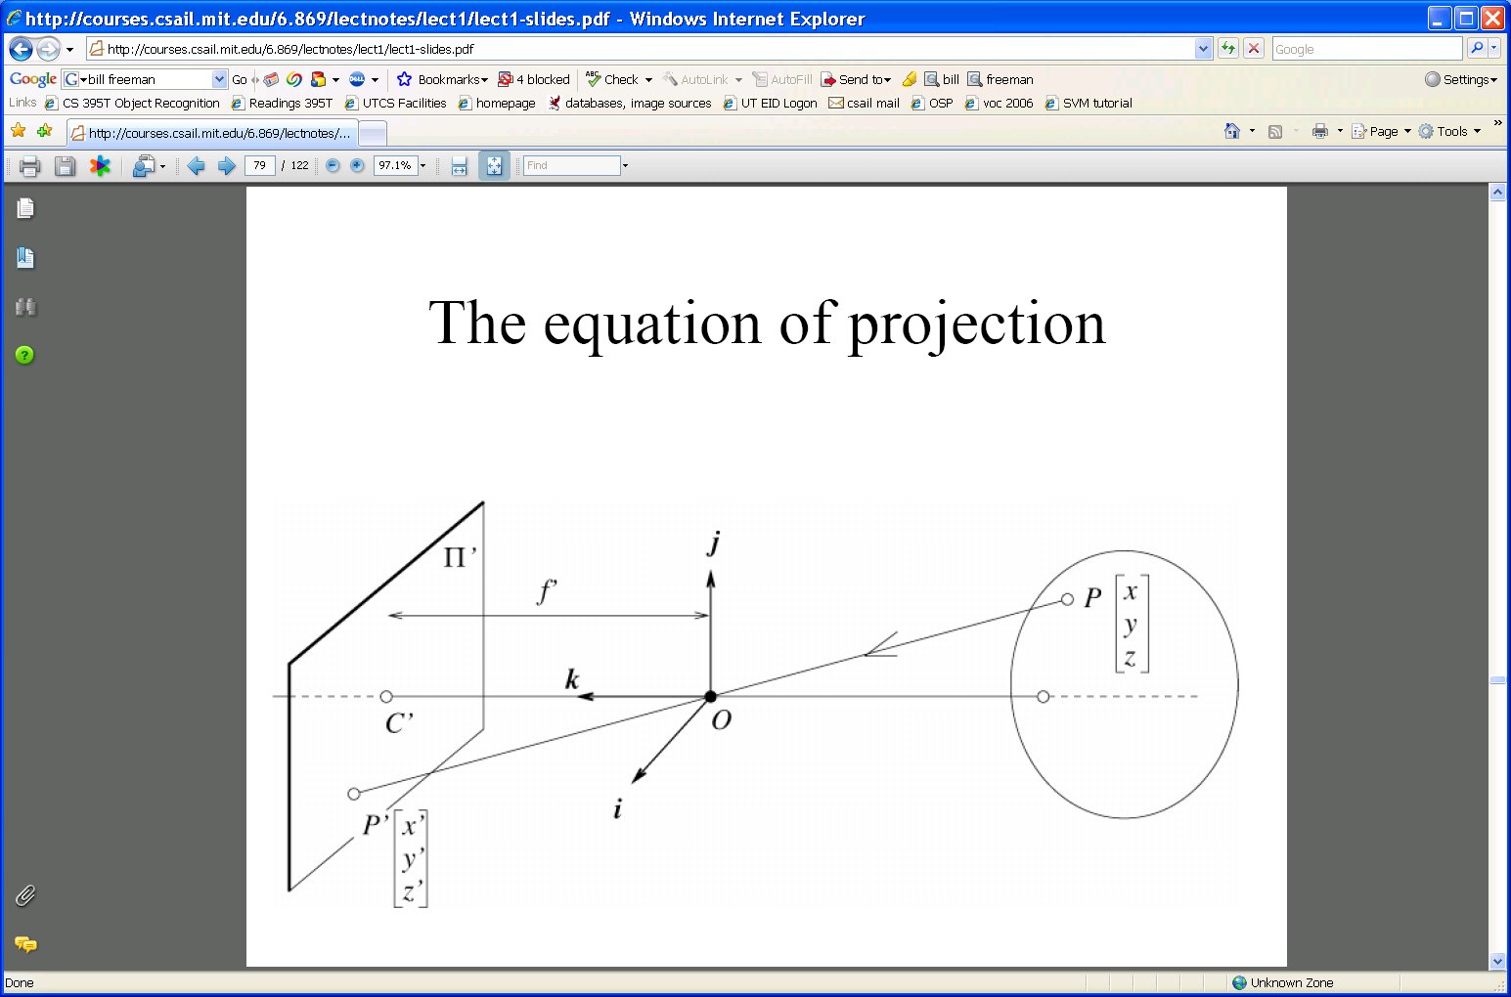
Camera calibration
World frame
Camera frame
Camera’s extrinsic and intrinsic parameters are needed to calibrate the geometry.
Extrinsic: camera frame ↔ world frame
Intrinsic: image coordinates relative to camera ↔ pixel coordinates
Adapted from Trevor Darrell, UC Berkeley

Slide 6
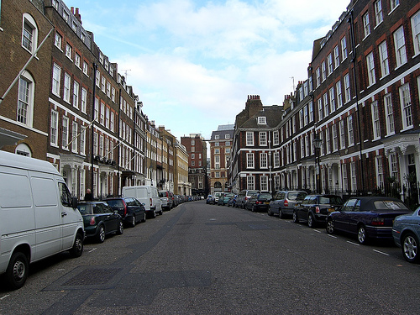
Perspective effects
Adapted from Trevor Darrell, UC Berkeley

Slide 7
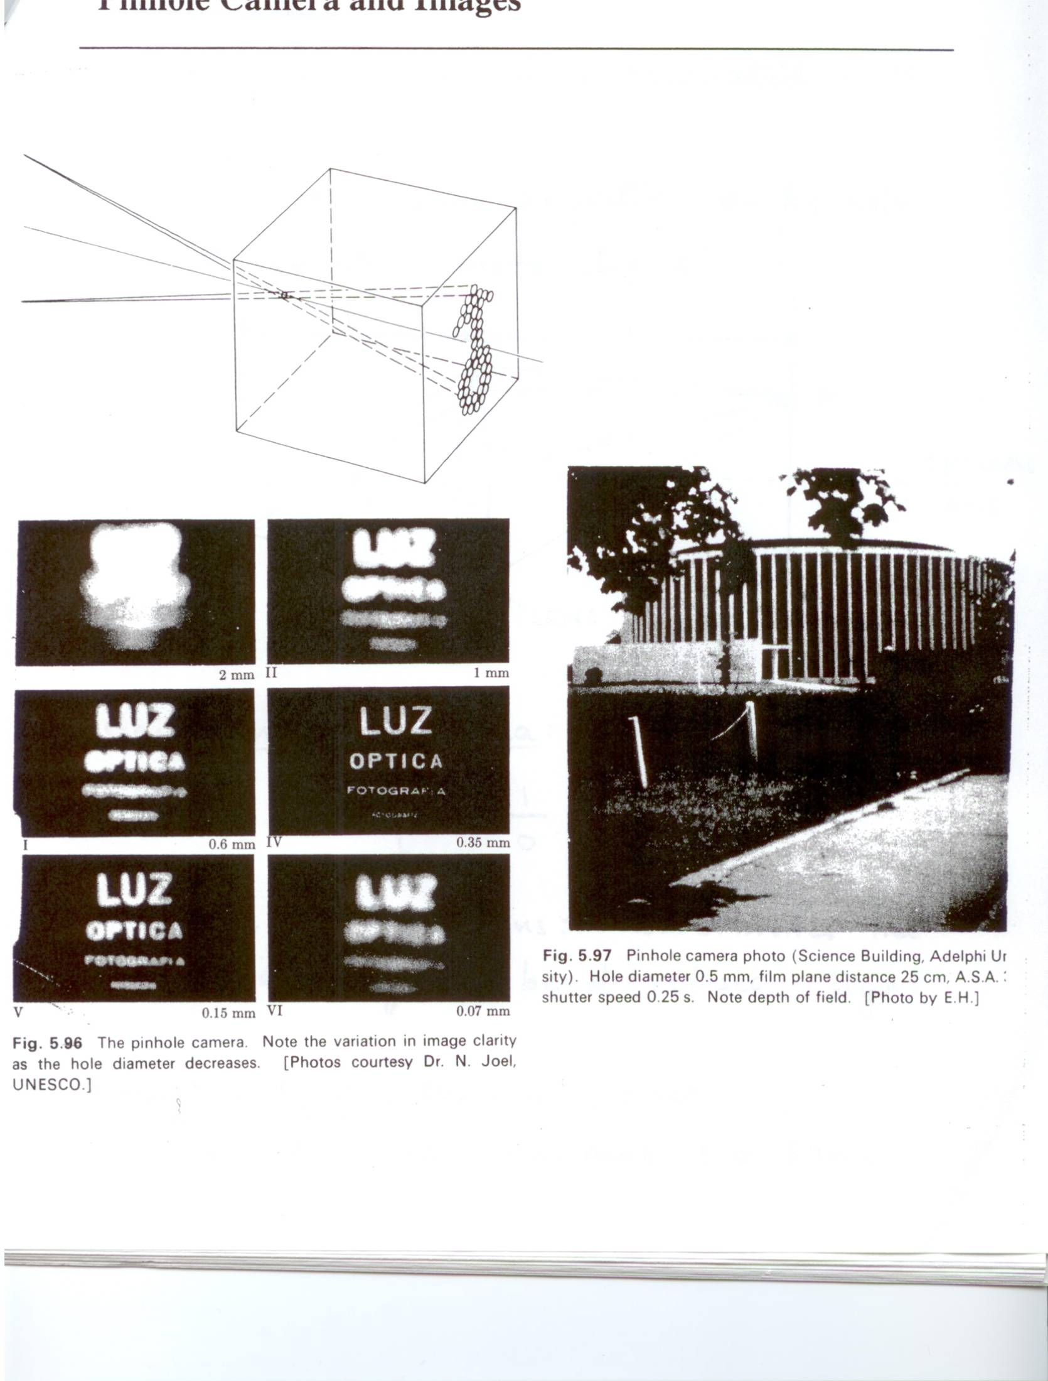
Aperture
Aperture size affects the image we would get.
Larger
Smaller
Adapted from Trevor Darrell, UC Berkeley

Slide 8
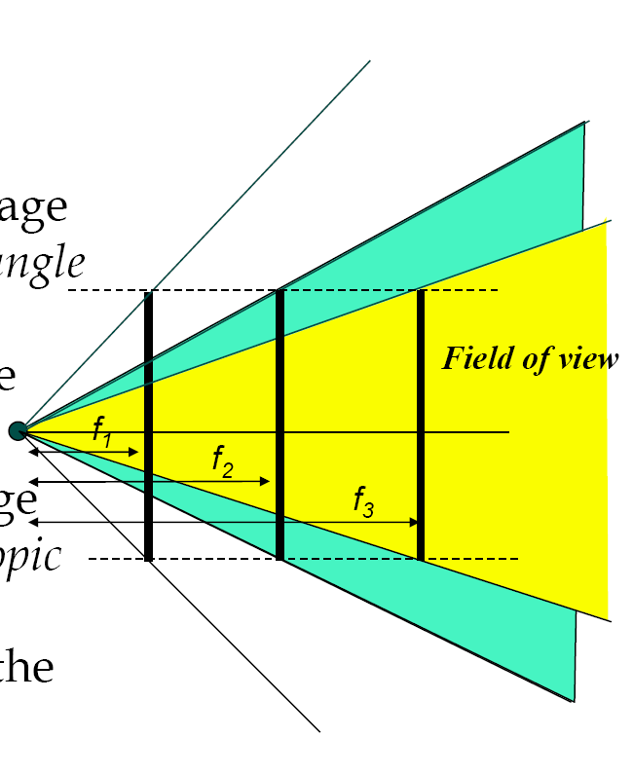
Focal length
Field of view depends on focal length.
As f gets smaller, image becomes more wide angle
  more world points project onto the finite image plane
As f gets larger, image becomes more telescopic
  smaller part of the world projects onto the finite image plane
Adapted from Trevor Darrell, UC Berkeley

Slide 9
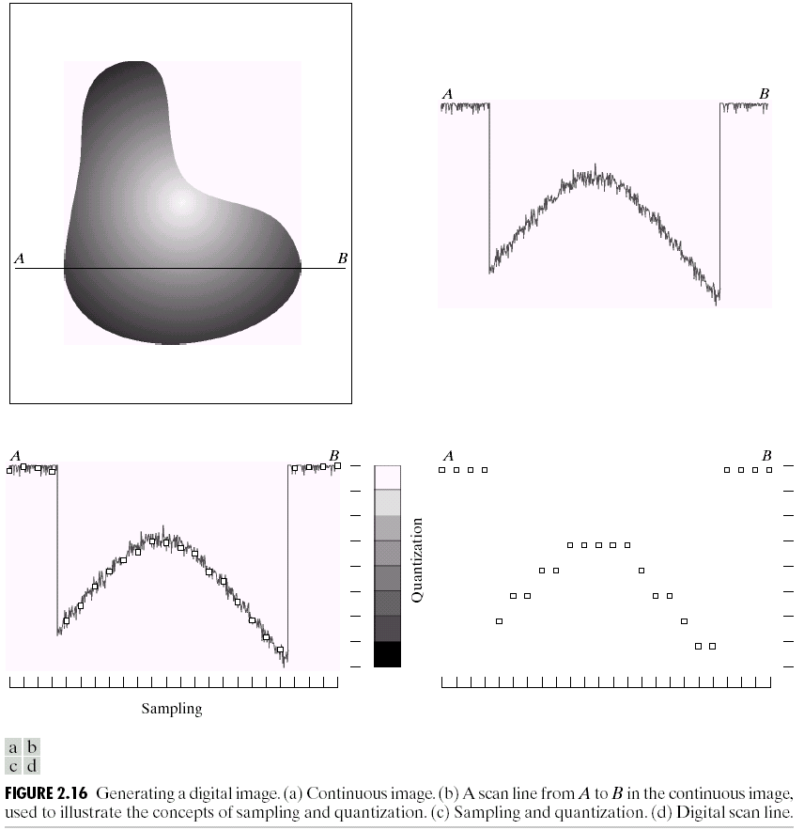
Sampling and quantization

Slide 10
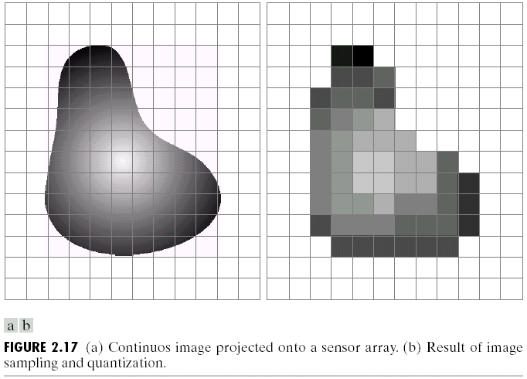
Sampling and quantization

Slide 11
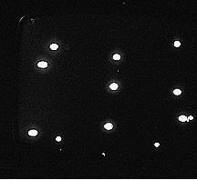
Problems with arrays
Blooming: difficult to insulate adjacent sensing elements.
Charge often leaks from hot cells to neighbors, making bright regions larger.
Adapted from Shapiro and Stockman

Slide 12
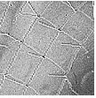
Problems with arrays
Clipping: dark grid intersections at left were actually brightest of scene.
In A/D conversion the bright values were clipped to lower values.
Adapted from Shapiro and Stockman

Slide 13
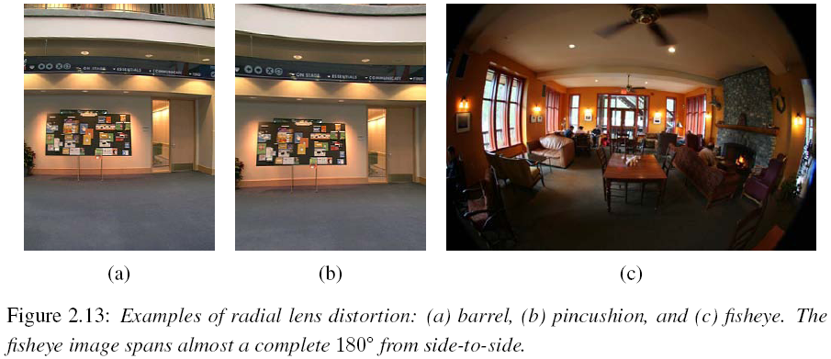
Problems with lenses
Adapted from Rick Szeliski

Slide 14
Image representation
Images can be represented by 2D functions of the form f(x,y).
The physical meaning of the value of f at spatial coordinates (x,y) is determined by the source of the image.
Adapted from Shapiro and Stockman

Slide 15


Image representation
In a digital image, both the coordinates and the image value become discrete quantities.
Images can now be represented as 2D arrays (matrices) of integer values: I[i,j] (or I[r,c]).
The term gray level is used to describe monochromatic intensity.

Slide 16
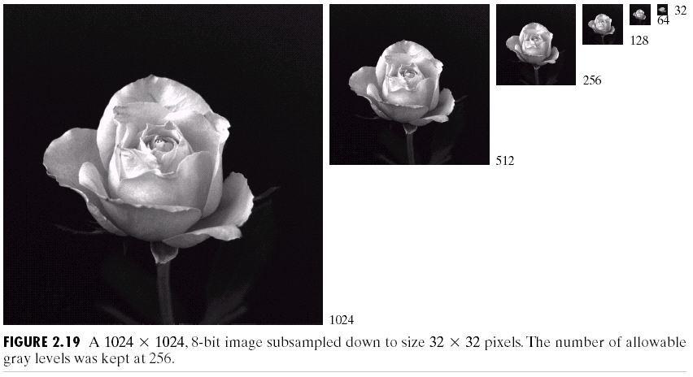
Spatial resolution
Spatial resolution is the smallest discernible detail in an image.
Sampling is the principal factor determining spatial resolution.

Slide 17
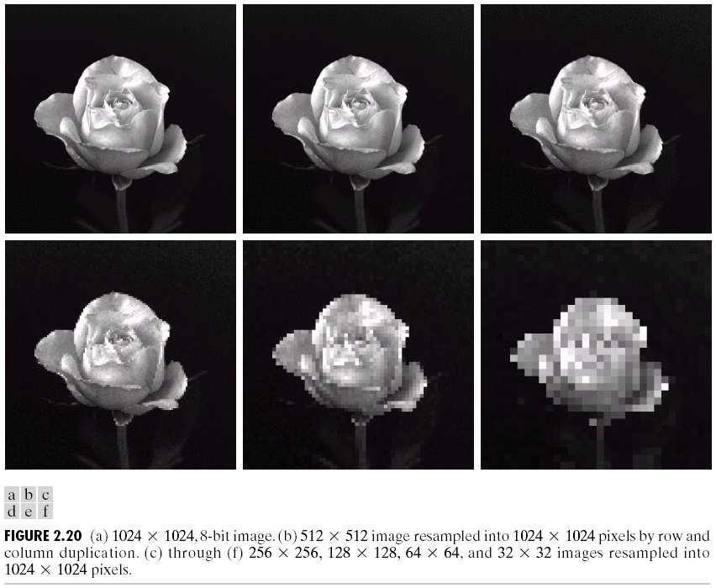
Spatial resolution

Slide 18
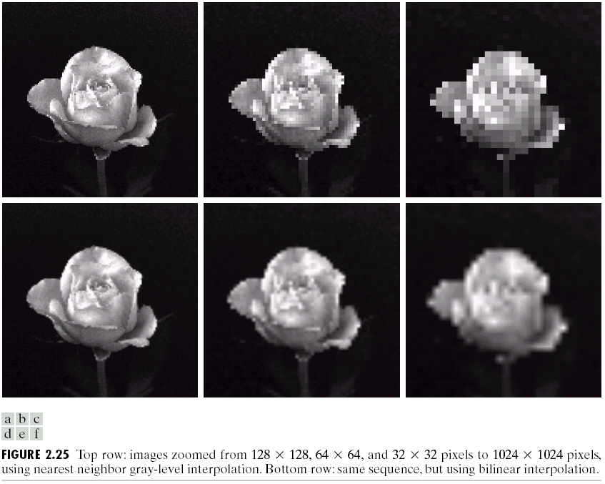
Spatial resolution

Slide 19
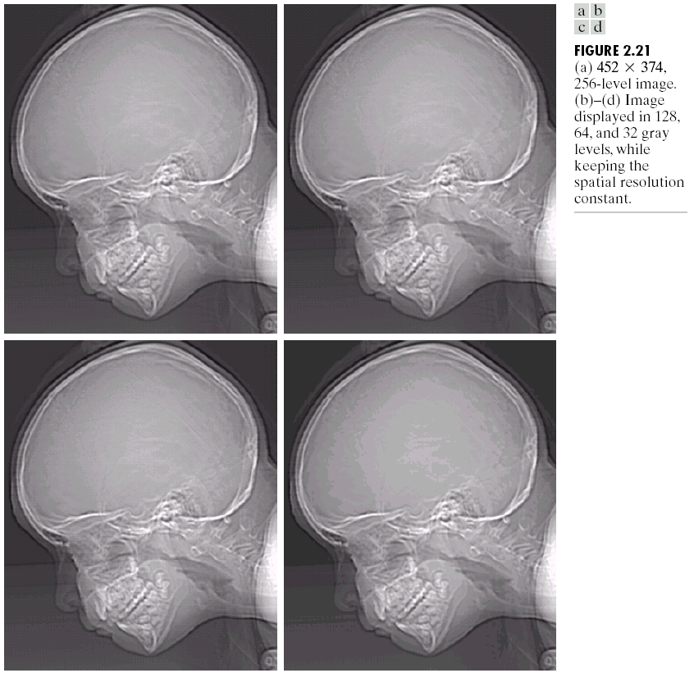
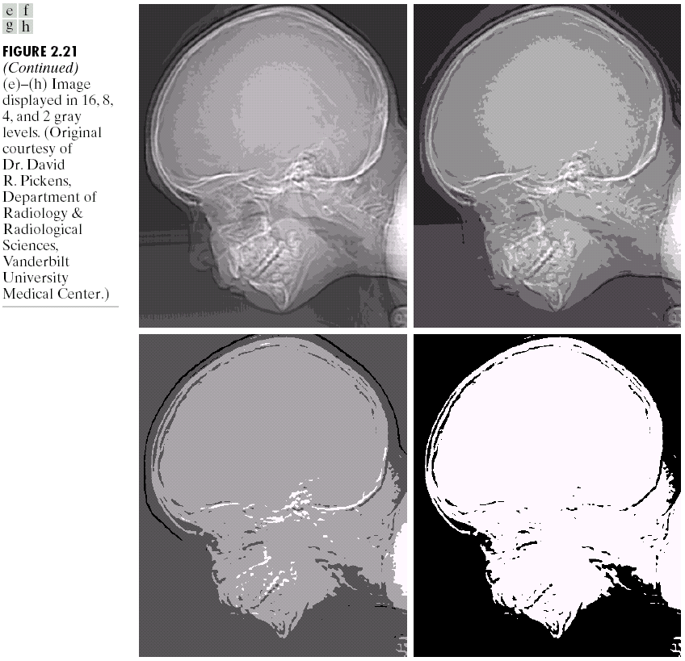
Gray level resolution
Gray level resolution refers to the smallest discernible change in gray level (often power of 2).

Slide 20
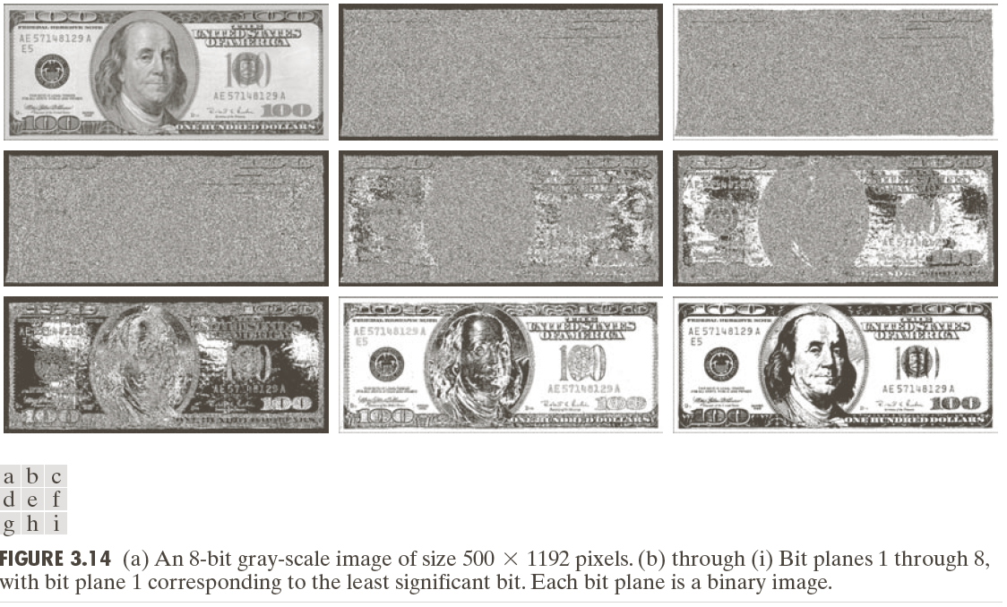
Bit planes

Slide 21
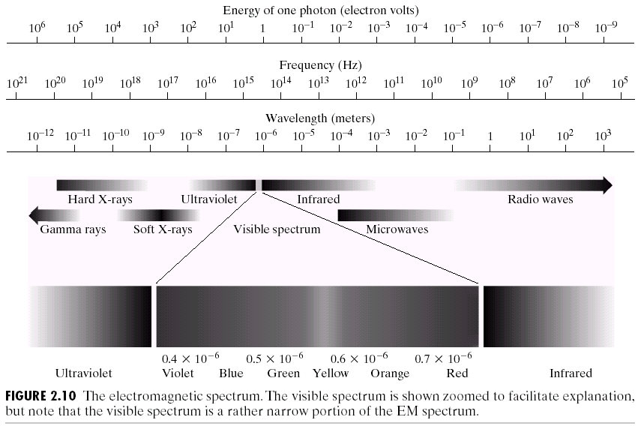
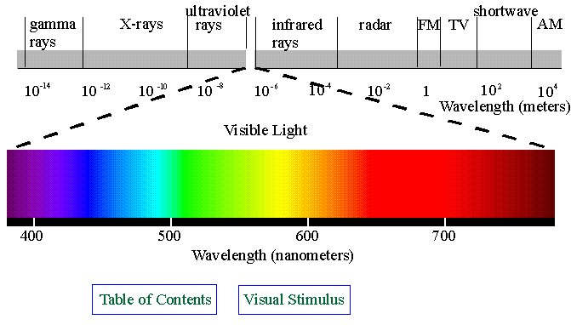
Electromagnetic (EM) spectrum

Slide 22
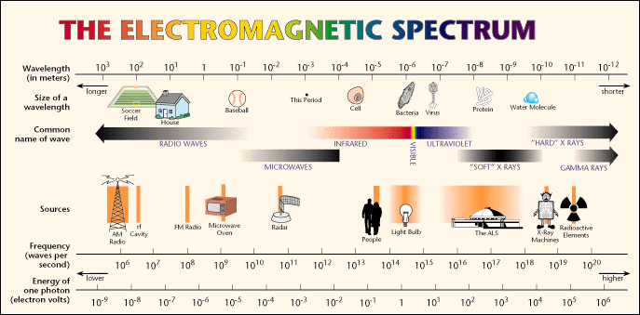
Electromagnetic (EM) spectrum
The wavelength of an EM wave required to “see” an object must be of the same size as or smaller than the object.

Slide 23
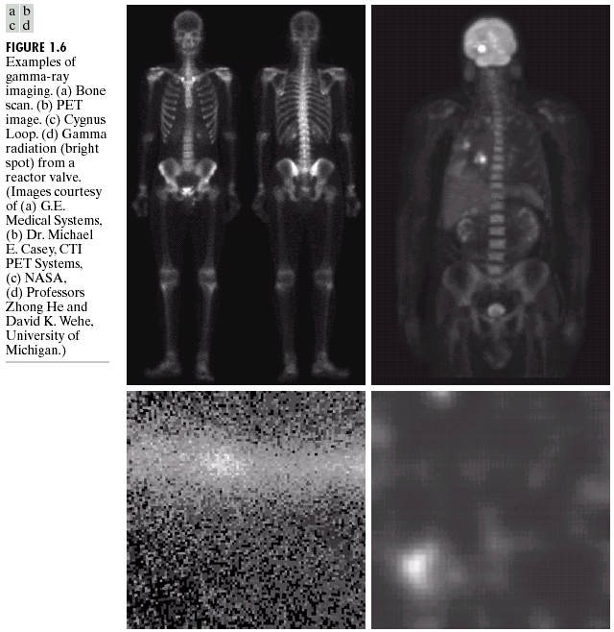
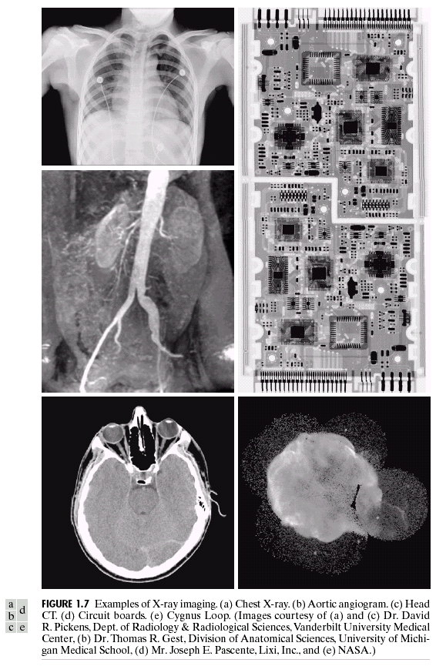
Other types of sensors

Slide 24
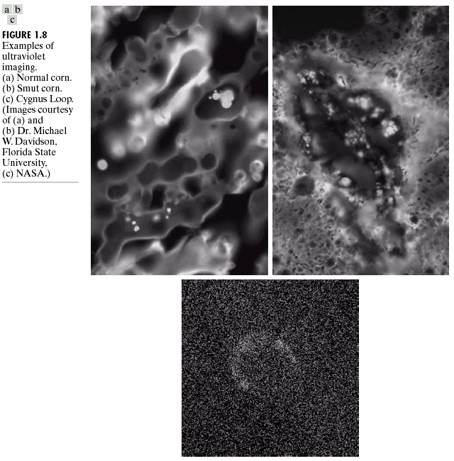
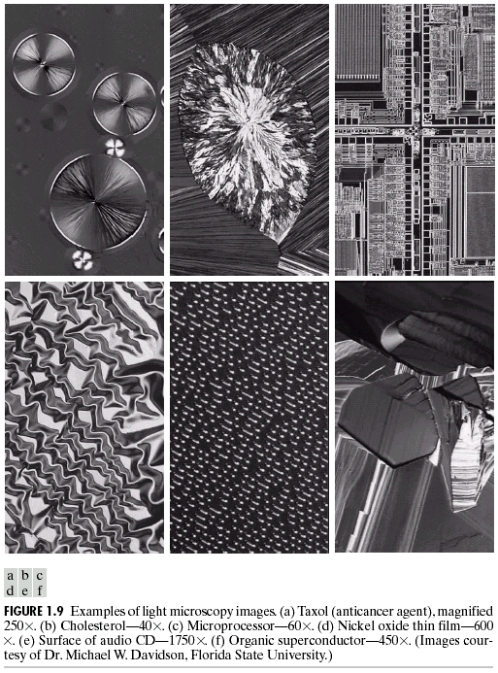
Other types of sensors

Slide 25
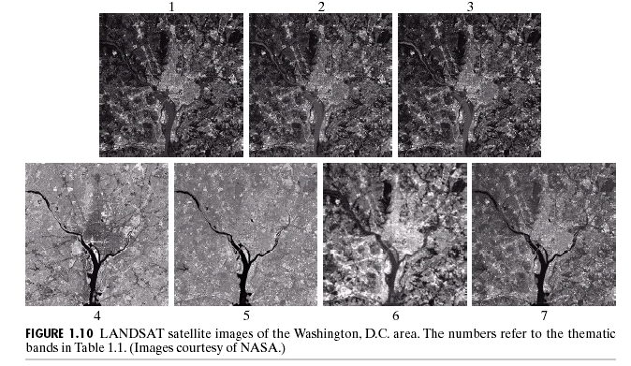
Other types of sensors
blue green red
near ir middle ir thermal ir middle ir

Slide 26
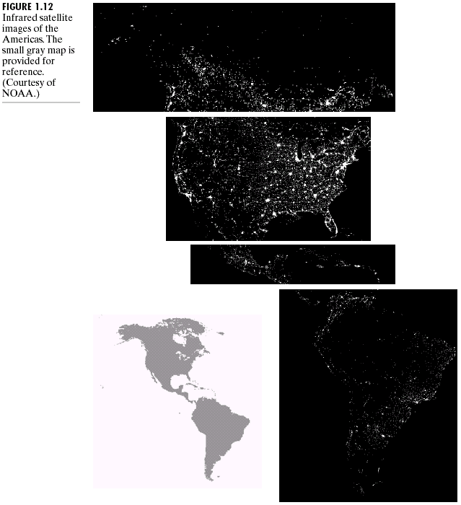
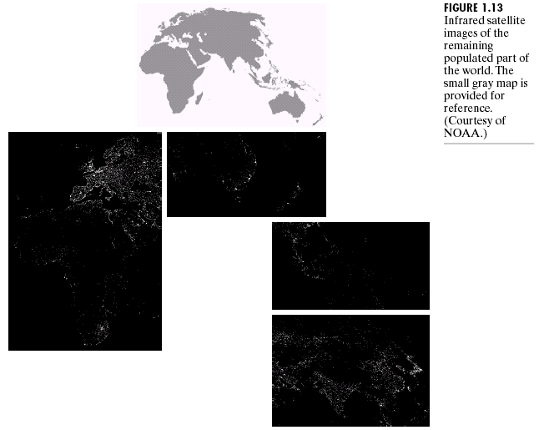
Other types of sensors

Slide 27
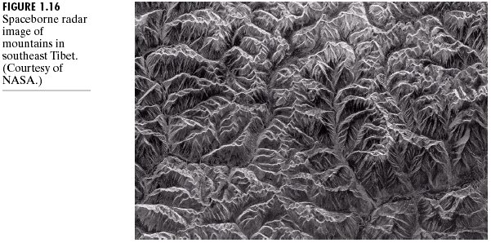
Other types of sensors

Slide 28
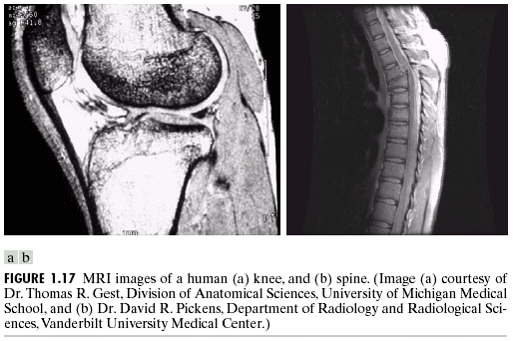
Other types of sensors

Slide 29
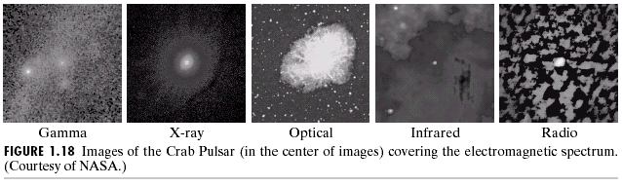
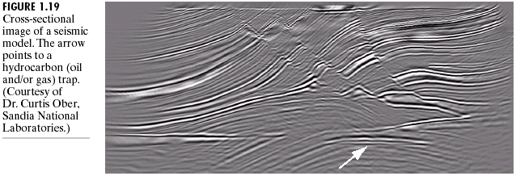
Other types of sensors

Slide 30
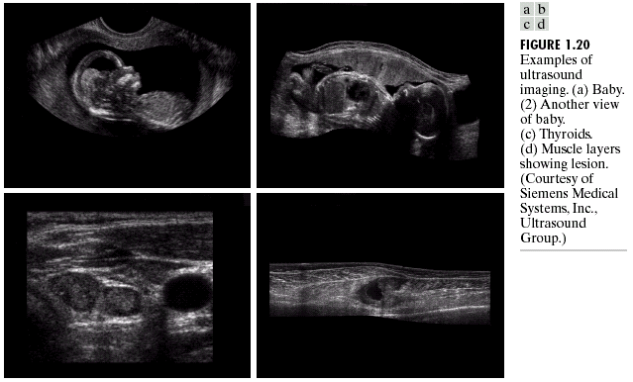
Other types of sensors

Slide 31
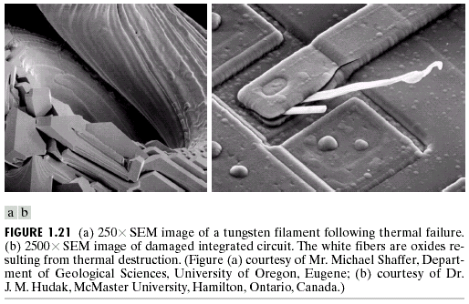
Other types of sensors

Slide 32
Other types of sensors
©IEEE

Slide 33
Image enhancement
The principal objective of enhancement is to process an image so that the result is more suitable than the original for a specific application.
Enhancement can be done in
  Spatial domain,
  Frequency domain.
Common reasons for enhancement include
  Improving visual quality,
  Improving machine recognition accuracy.

Slide 34
Image enhancement
First, we will consider point processing where enhancement at any point depends only on the image value at that point.
For gray level images, we will use a transformation function of the form
s = T(r)
where “r” is the original pixel value and “s” is the new value after enhancement.

Slide 35
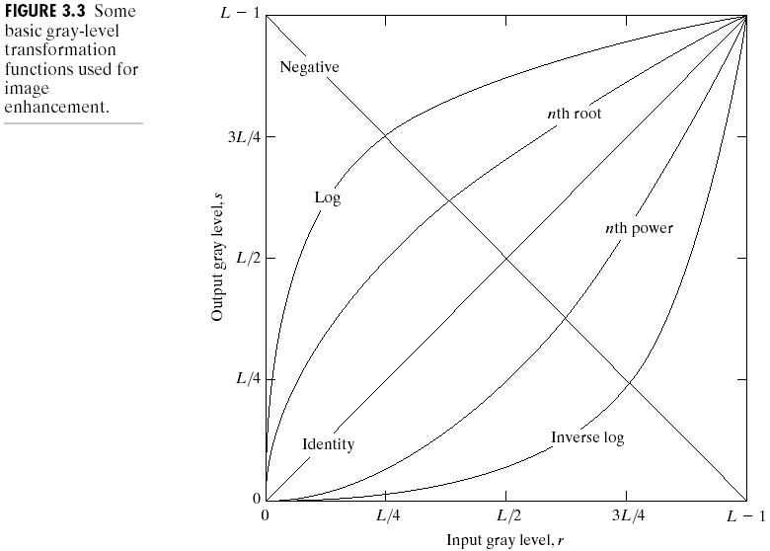
Image enhancement

Slide 36
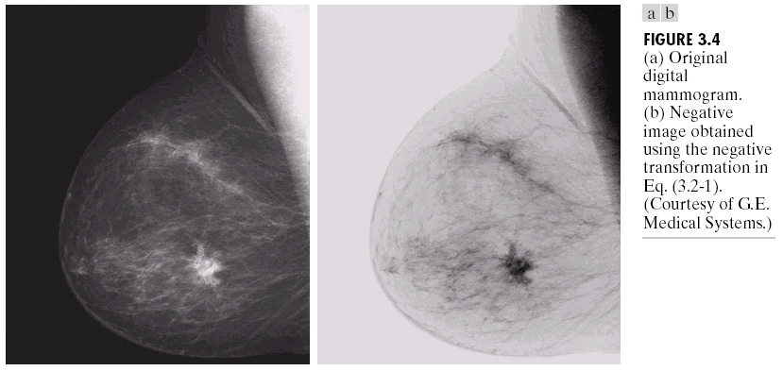
Image enhancement

Slide 37
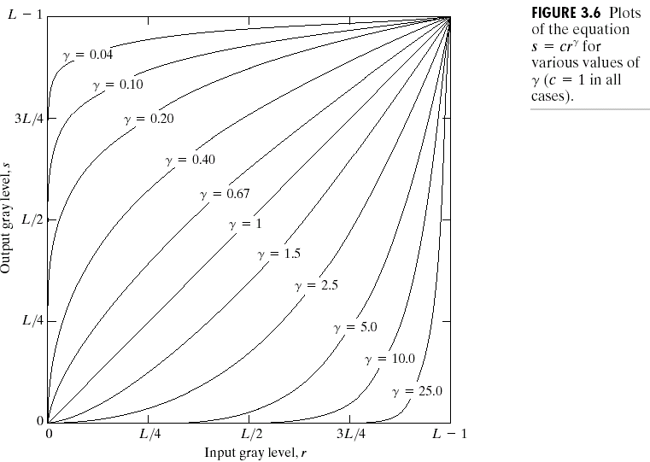
Image enhancement

Slide 38
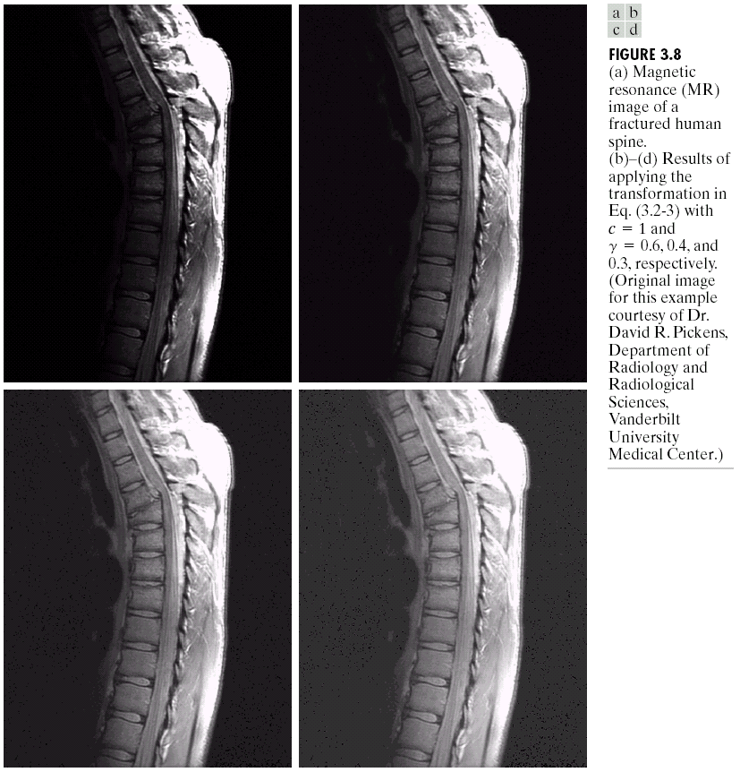
Image enhancement

Slide 39
Image enhancement
Contrast stretching:

Slide 40
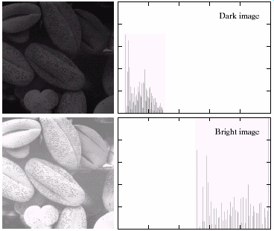
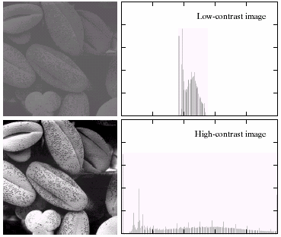
Histogram processing

Slide 41
Histogram processing
Intuitively, we expect that an image whose pixels
  tend to occupy the entire range of possible gray levels,
  tend to be distributed uniformly
will have a high contrast and show a great deal of gray level detail.
It is possible to develop a transformation function that can achieve this effect using histograms.

Slide 42
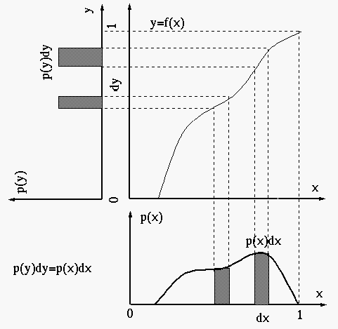
Histogram equalization
http://fourier.eng.hmc.edu/e161/lectures/contrast_transform/node3.html

Slide 43
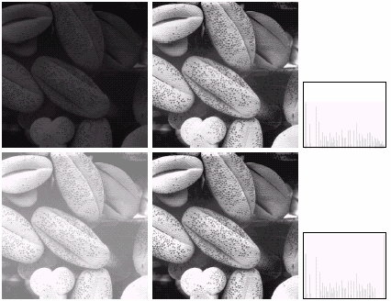
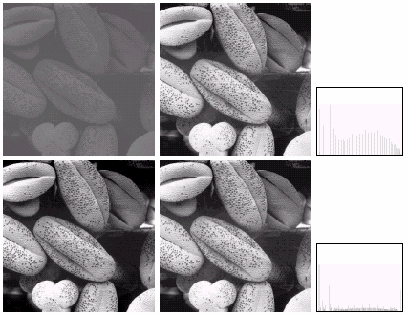
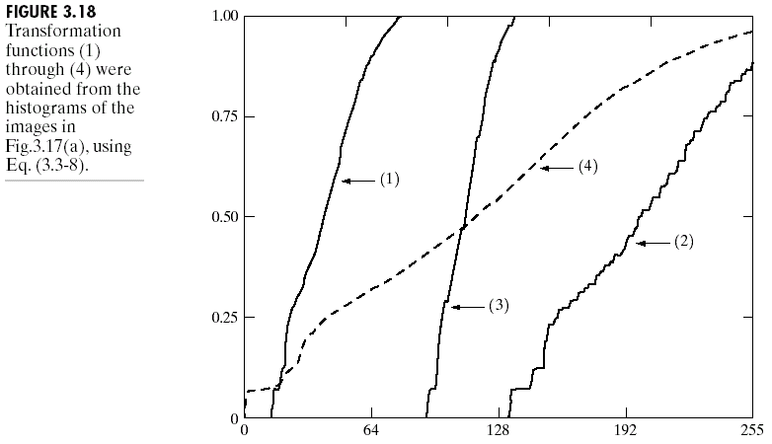
Histogram equalization

Slide 44
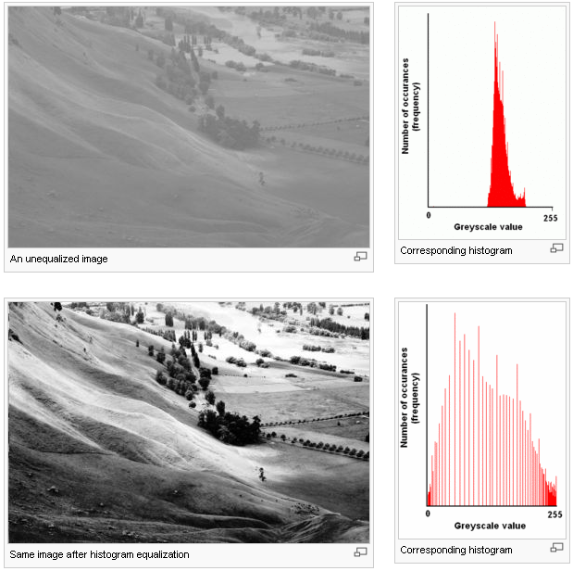
Histogram equalization
Adapted from Wikipedia

Slide 45
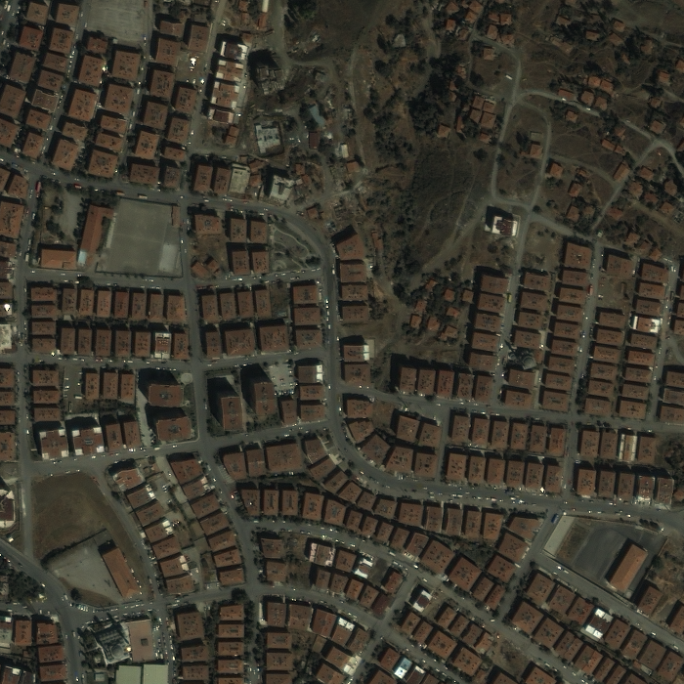
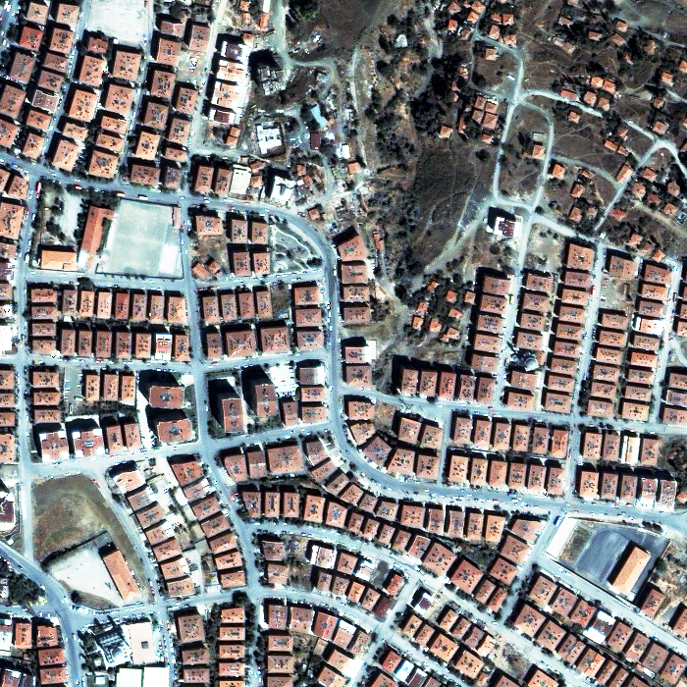
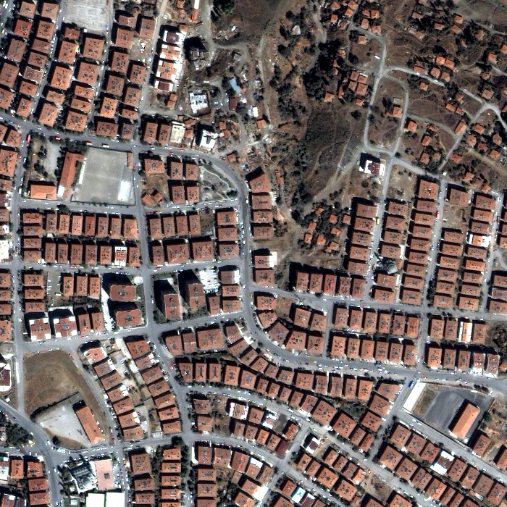
Histogram equalization
Original RGB image
Histogram equalization of each individual band/channel
Histogram stretching by removing 2% percentile from each individual band/channel

Slide 46
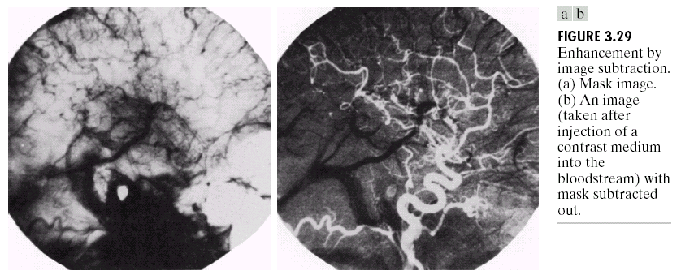
Enhancement using arithmetic operations

Slide 47
Image formats
Popular formats:
  BMP Microsoft Windows bitmap image
  EPS Adobe Encapsulated PostScript
  GIF CompuServe graphics interchange format
  JPEG Joint Photographic Experts Group
  PBM Portable bitmap format (black and white)
  PGM Portable graymap format (gray scale)
  PPM Portable pixmap format (color)
  PNG Portable Network Graphics
  PS Adobe PostScript
  TIFF Tagged Image File Format

Slide 48
Image formats
ASCII or binary
Number of bits per pixel (color depth)
Number of bands
Support for compression (lossless, lossy)
Support for metadata
Support for transparency
Format conversion
…
http://en.wikipedia.org/wiki/Comparison_of_graphics_file_formats

