Slide 1
Introduction
Selim Aksoy
Department of Computer Engineering
Bilkent University
saksoy@cs.bilkent.edu.tr

Slide 2
What is computer vision?
“What does it mean, to see? The plain man's answer (and Aristotle's, too) would be, to know what is where by looking.”
-- David Marr, Vision (1982)
Automatic understanding of images and video
  Computing properties of the 3D world from visual data (measurement).
  Algorithms and representations to allow a machine to recognize objects, people, scenes, and activities (perception and interpretation).
Adapted from Trevor Darrell, UC Berkeley, Alyosha Efros, Carnegie Mellon

Slide 3
Why study computer vision?
As image sources multiply, so do applications
  Relieve humans of boring, easy tasks
  Enhance human abilities: human-computer interaction, visualization
  Perception for robotics / autonomous agents
  Organize and give access to visual content
Goals of vision research:
  Give machines the ability to understand scenes
  Aid understanding and modeling of human vision
  Automate visual operations
Adapted from Trevor Darrell, UC Berkeley

Slide 4
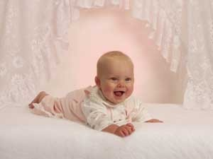
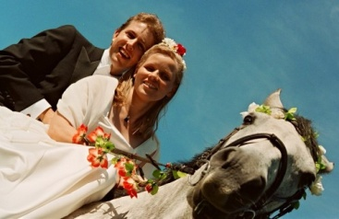
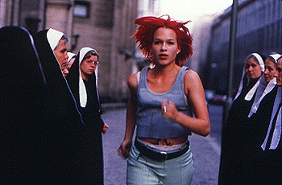
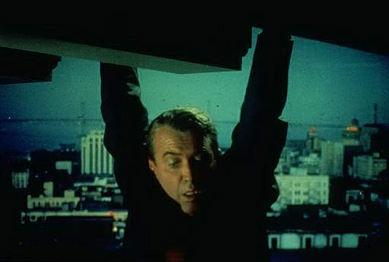
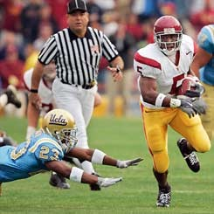


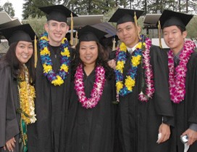
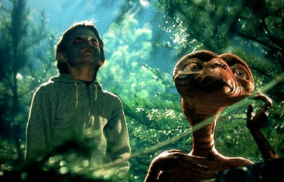
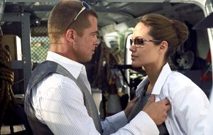
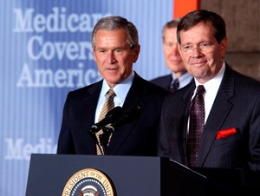
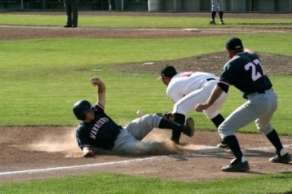






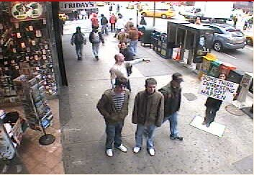
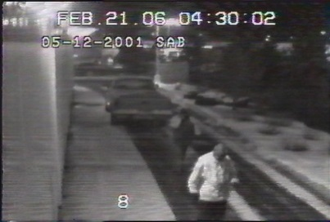
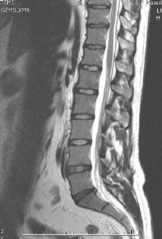
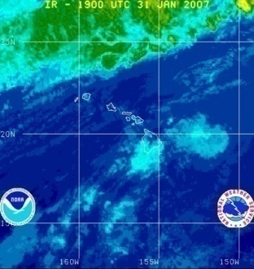
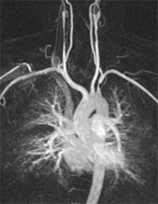
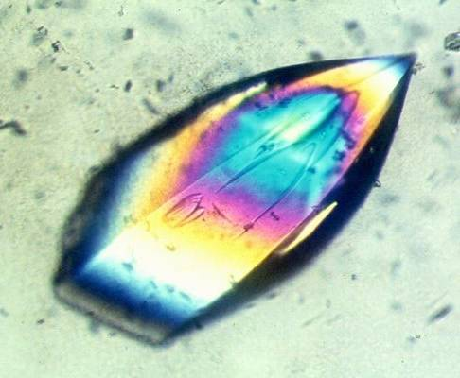
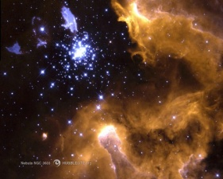
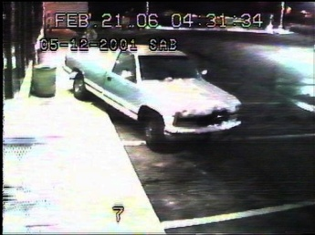
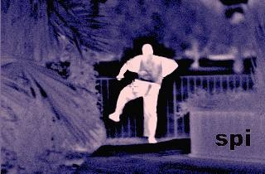
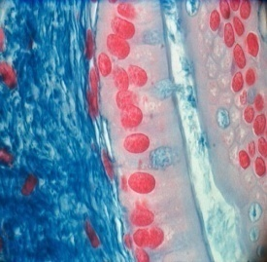
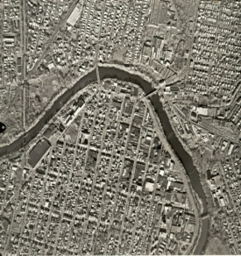
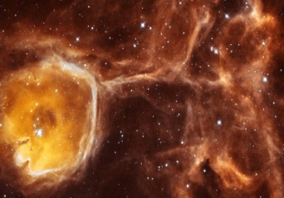
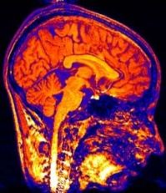
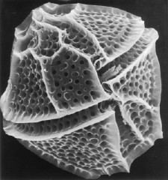
Why study computer vision?
Personal photo albums
Movies, news, sports
Surveillance and security
Medical and scientific images

Slide 5
Applications
Medical image analysis
Security
  Biometrics
  Surveillance
  Tracking
  Target recognition
Remote sensing
Robotics
Industrial inspection, quality control
Document analysis
Multimedia
Assisted living
Human-computer interfaces
…

Slide 6
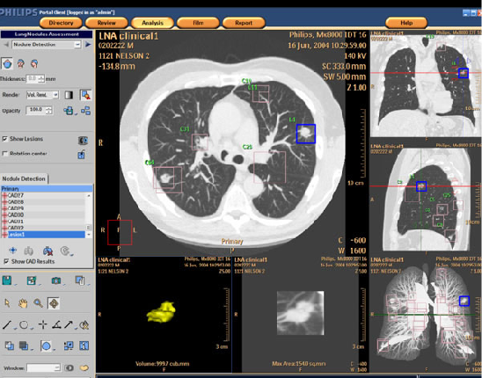
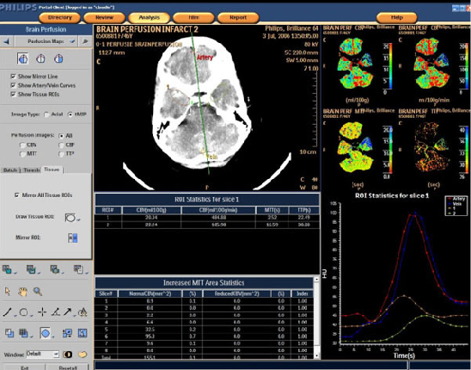
Medical image analysis
http://www.clarontech.com

Slide 7
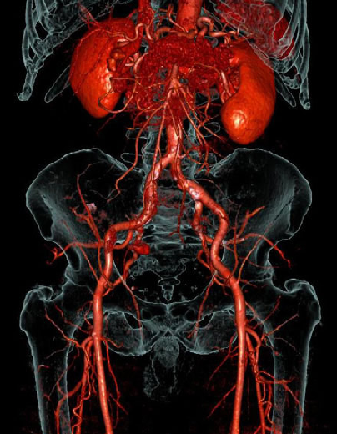
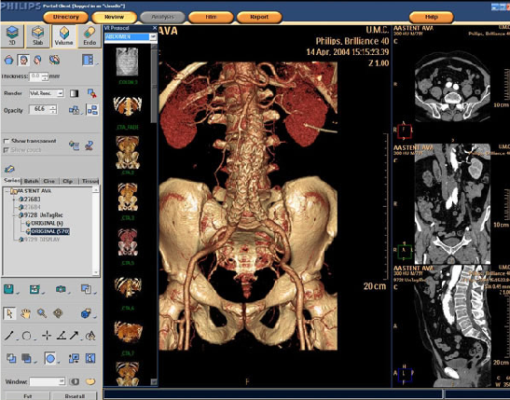
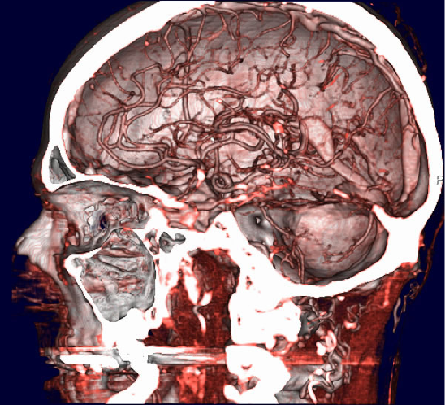
Medical image analysis
http://www.clarontech.com

Slide 8
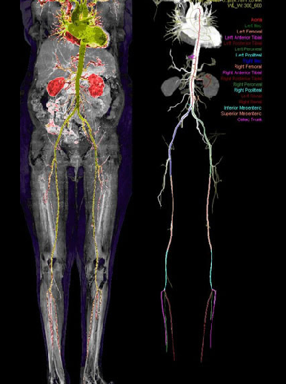
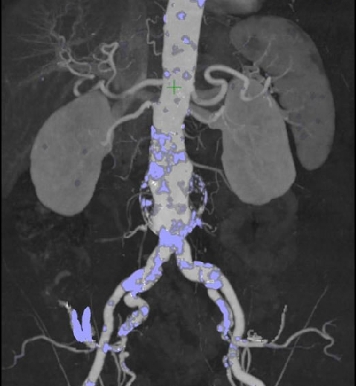
Medical image analysis
http://www.clarontech.com

Slide 9
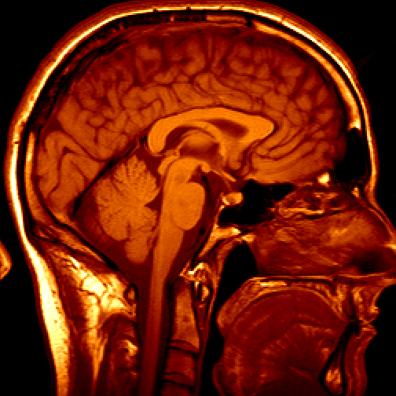
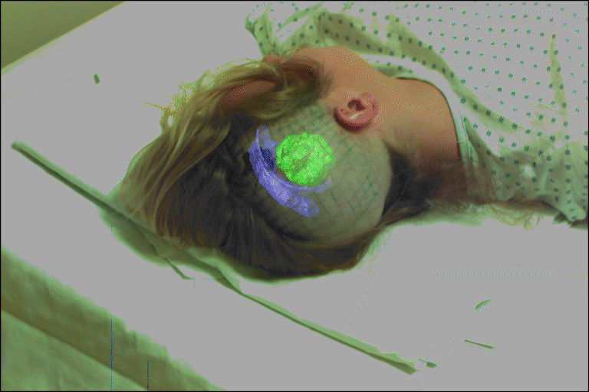
Medical image analysis
Image guided surgery
Grimson et al., MIT
3D imaging: MRI, CT
Adapted from CSE 455, U of Washington

Slide 10
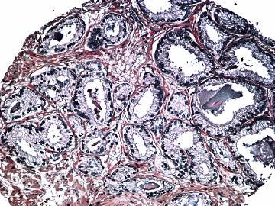
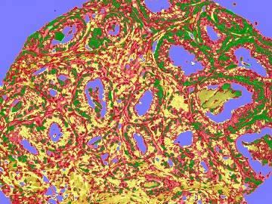
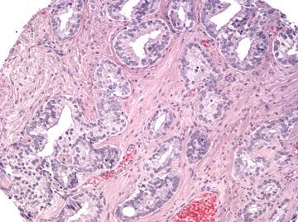
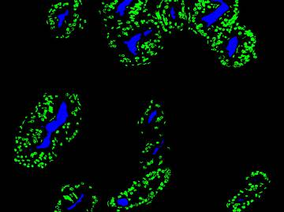
Medical image analysis
Cancer detection and grading

Slide 11
Medical image analysis
Breast biopsy images: detecting regions of interest
Adapted from Linda Shapiro, U of Washington

Slide 12
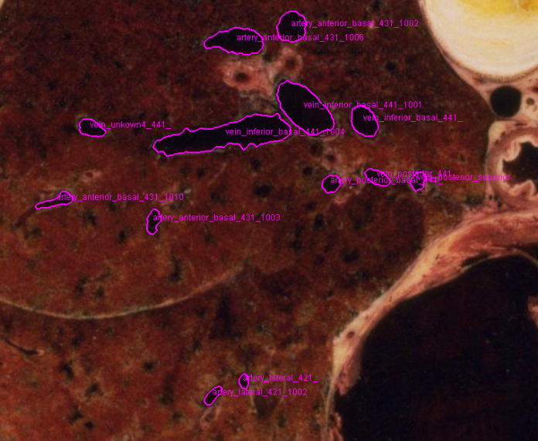
Medical image analysis
Slice of lung
Adapted from Linda Shapiro, U of Washington

Slide 13
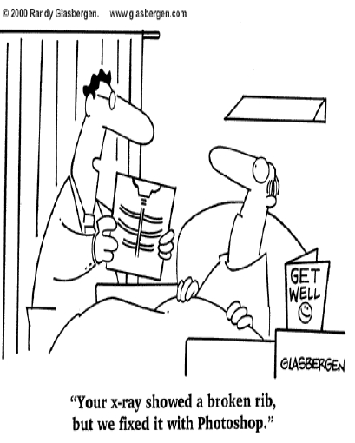
Medical image analysis

Slide 14
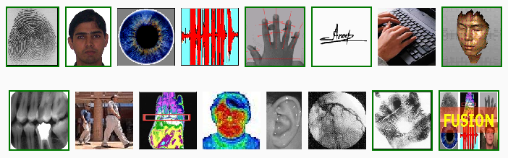
Biometrics
Adapted from Anil Jain, Michigan State

Slide 15
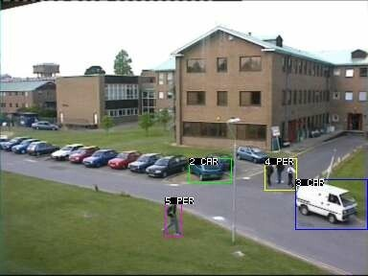
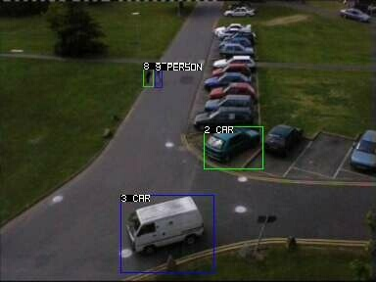
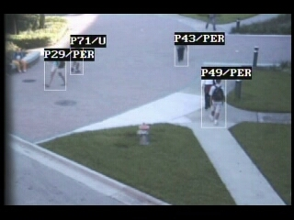
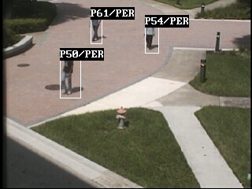
Surveillance and tracking
University of Central Florida, Computer Vision Lab

Slide 16
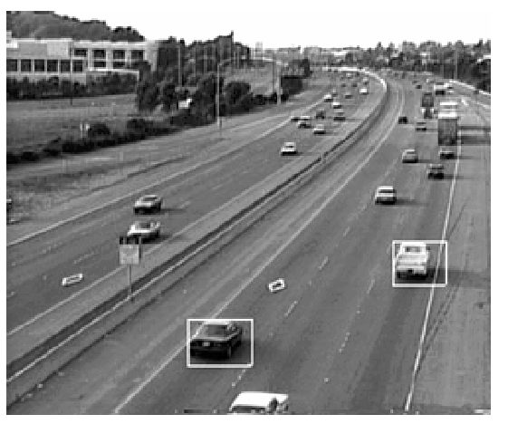
Surveillance and tracking
Adapted from Martial Hebert, CMU

Slide 17
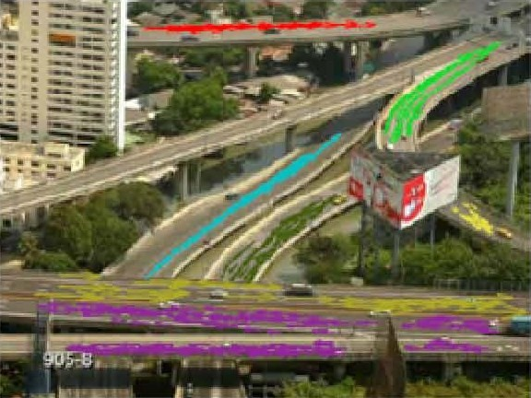
Surveillance and tracking
Generating traffic patterns
University of Central Florida, Computer Vision Lab

Slide 18
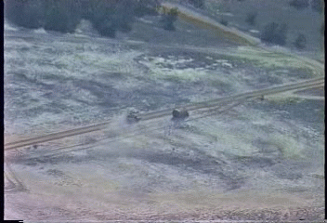

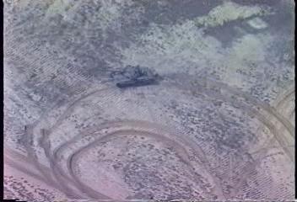
Surveillance and tracking
Tracking in UAV videos
Adapted from Martial Hebert, CMU, and
Masaharu Kobashi, U of Washington

Slide 19
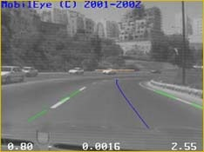
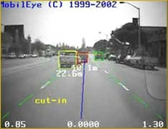




Vehicle and pedestrian protection
Lane departure warning, collision warning, traffic sign recognition,
pedestrian recognition, blind spot warning
http://www.mobileye-vision.com

Slide 20

Smart cars
Adapted from CSE 455, U of Washington

Slide 21




Self-driving cars
http://www.darpa.mil/grandchallenge/index.asp
http://en.wikipedia.org/wiki/DARPA_Grand_Challenge

Slide 22

Self-driving cars
Adapted from CSE 455, U of Washington

Slide 23

Self-driving cars
“Our self-driving cars have now traveled nearly 200,000 miles on public highways in California and Nevada, 100 percent safely. They have driven from San Francisco to Los Angeles and around Lake Tahoe, and have even descended crooked Lombard Street in San Francisco. They drive anywhere a car can legally drive.”
- Sebastian Thrun, Google
Adapted from CSE 455, U of Washington

Slide 24





Autonomous navigation
Michigan State University
General Dynamics Robotics Systems
http://www.gdrs.com

Slide 25


Forest fire monitoring system
Early warning of forest fires
Adapted from Enis Cetin, Bilkent University

Slide 26



Robotics
Adapted from CSE 455, U of Washington

Slide 27

Robotics
Adapted from Steven Seitz, U of Washington

Slide 28


Face detection
Adapted from CSE 455, U of Washington

Slide 29

Face recognition
Adapted from CSE 455, U of Washington

Slide 30



Industrial automation
Automatic fruit sorting
Color Vision Systems
http://www.cvs.com.au

Slide 31

Industrial automation
Industrial robotics;
bin picking
http://www.braintech.com

Slide 32


Postal service automation
General Dynamics Robotics Systems
http://www.gdrs.com

Slide 33


Optical character recognition
Digit recognition, AT&T labs
http://www.research.att.com/~yann
License place recognition
Adapted from Steven Seitz, U of Washington

Slide 34
Document analysis
Adapted from Shapiro and Stockman

Slide 35


Document analysis
Adapted from Linda Shapiro, U of Washington

Slide 36




Sports video analysis
Tennis review system
http://www.hawkeyeinnovations.co.uk

Slide 37

Scene classification

Slide 38





Object recognition
Lincoln, Microsoft Research
kooaba
Situated search
Yeh et al., MIT
Google Goggles
Bing Vision

Slide 39

Augmented reality
Adapted from CSE 455, U of Washington

Slide 40

Land cover classification

Slide 41




Land cover classification

Slide 42


Object recognition
Recognition of buildings and building groups

Slide 43


Photo tourism: exploring photo collections
Building 3D scene models from individual photos
Adapted from Steven Seitz, U of Washington

Slide 44


Photosynth

Slide 45



Content-based retrieval
Online shopping catalog search
http://www.like.com

Slide 46



3D scanning and reconstruction
Adapted from Linda Shapiro, U of Washington

Slide 47



3D modeling

Slide 48

Earth viewers

Slide 49

Earth viewers

Slide 50

Earth viewers
Apple’s 3D maps

Slide 51

Motion capture
Adapted from Linda Shapiro, U of Washington

Slide 52





Visual effects
Adapted from CSE 455, U of Washington

Slide 53

Motion capture
Microsoft’s XBox Kinect
Adapted from CSE 455, U of Washington

Slide 54


Mozaic
Adapted from David Forsyth, UC Berkeley

Slide 55


Mozaic
Adapted from David Forsyth, UC Berkeley

Slide 56
Why is vision so hard?
Ill-posed problem
[Sinha and Adelson 1993]
Adapted from Ali Farhadi, U of Washington

Slide 57



Challenges 1: view point variation
Michelangelo 1475-1564
Adapted from L. Fei-Fei,
R. Fergus, A. Torralba

Slide 58

Challenges 2: illumination
Adapted from Fei-Fei Li

Slide 59

Challenges 3: occlusion
Magritte, 1957
Adapted from L. Fei-Fei,
R. Fergus, A. Torralba

Slide 60

Challenges 4: scale
Adapted from L. Fei-Fei,
R. Fergus, A. Torralba

Slide 61

Challenges 5: deformation
Xu, Beihong 1943
Adapted from L. Fei-Fei, R. Fergus, A. Torralba

Slide 62

Challenges 6: background clutter
Adapted from Fei-Fei Li

Slide 63






Challenges 7: intra-class variation
Adapted from L. Fei-Fei, R. Fergus, A. Torralba

Slide 64

Perception and grouping
Subjective contours

Slide 65

Perception and grouping
Occlusion
Adapted from Michael Black, Brown University

Slide 66

Perception and grouping
Müller-Lyer Illusion
Adapted from Alyosha Efros, Carnegie Mellon

Slide 67


Slide 68
Critical issues
What information should be extracted?
How can it be extracted?
How should it be represented?
How can it be used to aid analysis and understanding?

Slide 69



What do computers see?

Slide 70

Sky
The car is in front of the pole
Person
White
Horse
Car
Road
Shadow
1m
Wheel
Adapted from Ali Farhadi, U of Washington

Slide 71
Recognition
How can different cues such as color, texture, shape, motion, etc., can be used for recognition?
  Which parts of image should be recognized together?
  How can objects be recognized without focusing on detail?
  How can objects with many free parameters be recognized?
  How do we structure very large model bases?

Slide 72


Color
Adapted from Martial Hebert, CMU

Slide 73

Texture
Adapted from David Forsyth, UC Berkeley

Slide 74

Color, texture, and proximity
Adapted from Fei-Fei Li

Slide 75












Segmentation
Original Images | Color Regions | Texture Regions | Line Clusters
Adapted from Linda Shapiro, U of Washington

Slide 76
Shape
Recognized objects
Model database
Adapted from Enis Cetin, Bilkent University

Slide 77

Motion
Adapted from Michael Black, Brown University

Slide 78

Detection and recognition
Adapted from Michael Black, Brown University

Slide 79

Parts and relations
Adapted from Michael Black, Brown University

Slide 80

Parts and relations
Adapted from Michael Black, Brown University

Slide 81


Context
Adapted from Antonio Torralba, MIT

Slide 82


Context
Adapted from Derek Hoiem, CMU

Slide 83
Context
Adapted from
Derek Hoiem, CMU

Slide 84
Stages of computer vision
Low-level
    image → image
Mid-level
    image → features / attributes
High-level
    features → “making sense”, recognition

Slide 85


Low-level
sharpening
blurring
Adapted from Linda Shapiro, U of Washington

Slide 86



Low-level
Canny
original image
edge image
Mid-level
ORT
data
structure
edge image
circular arcs and line segments
Adapted from Linda Shapiro, U of Washington

Slide 87


Mid-level
K-means
clustering
(followed by
connected
component
analysis)
original color image
regions of homogeneous color
data
structure
Adapted from Linda Shapiro, U of Washington

Slide 88


Low-level to high-level
low-level
edge image
mid-level
consistent
line clusters
high-level
Adapted from Linda Shapiro, U of Washington

Slide 89
Visual recognition
Verification
Is this a car?

Slide 90
Visual recognition
Classification:
Is there a car in this picture?

Slide 91
Visual recognition
Detection:
Where is the car in this picture?

Slide 92
Visual recognition
Pose Estimation:

Slide 93
Visual recognition
Activity Recognition:
What is he doing?
What is he doing?

Slide 94
Visual recognition
Object Categorization:
Sky
Person
Tree
Horse
Car
Person
Bicycle
Road

Slide 95
Visual recognition
Segmentation
Sky
Tree
Car
Person

