Slide 1
Local Feature Detectors
Selim Aksoy
Department of Computer Engineering
Bilkent University
saksoy@cs.bilkent.edu.tr
Slides adapted from Cordelia Schmid and David Lowe, CVPR 2003 Tutorial,
Matthew Brown, Microsoft Research, and Steve Seitz, U of Washington.

Slide 2
Image matching
Image matching is a fundamental aspect of many problems in computer vision.
  Object or scene recognition
  Solving for 3D structure from multiple images
  Stereo correspondence
  Image alignment & stitching
  Image indexing and search
  Motion tracking
Find “interesting” pieces of the image.
  Focus attention of algorithms
  Speed up computation

Slide 3
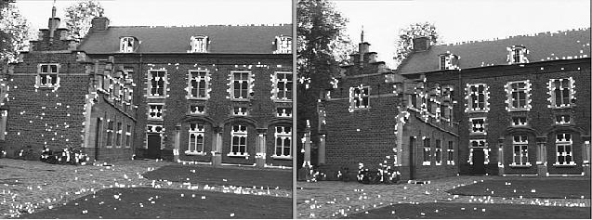
Image matching applications
Stereo correspondence and 3D reconstruction

Slide 4
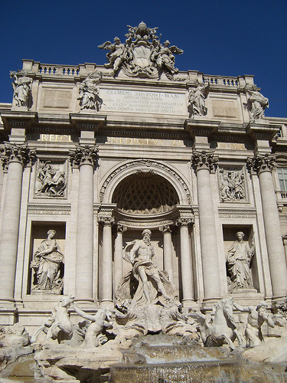
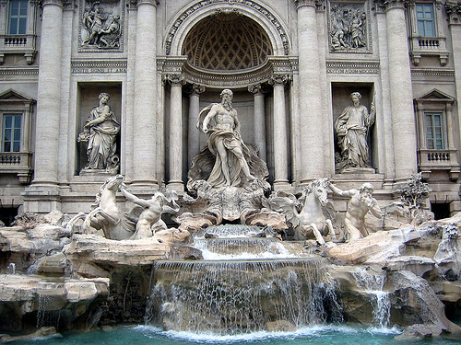
Image matching applications
Two images of Rome from Flickr

Slide 5
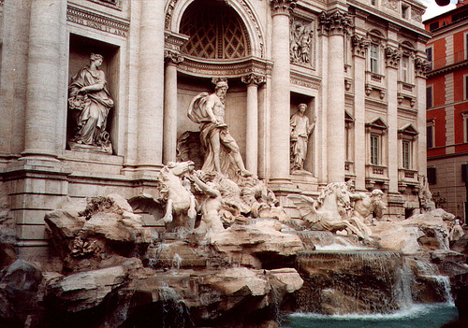
Image matching applications
Two images of Rome from Flickr: harder case

Slide 6
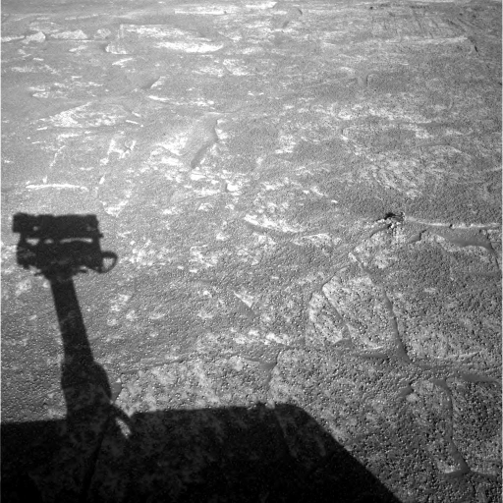
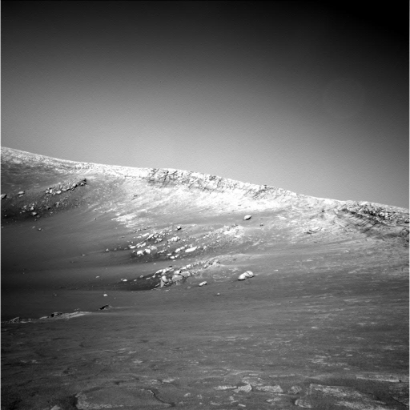
Image matching applications
Two images from NASA Mars Rover: even harder case

Slide 7
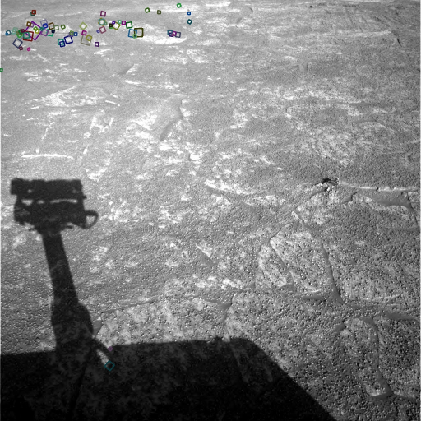
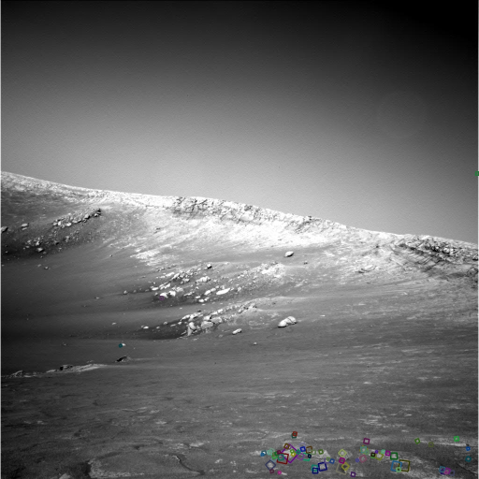
Image matching applications
Two images from NASA Mars Rover: matching using local features

Slide 8
Advantages of local features
Locality
  features are local, so robust to occlusion and clutter
Distinctiveness
  can differentiate a large database of objects
Quantity
  hundreds or thousands in a single image
Efficiency
  real-time performance achievable
Generality
  exploit different types of features in different situations

Slide 9
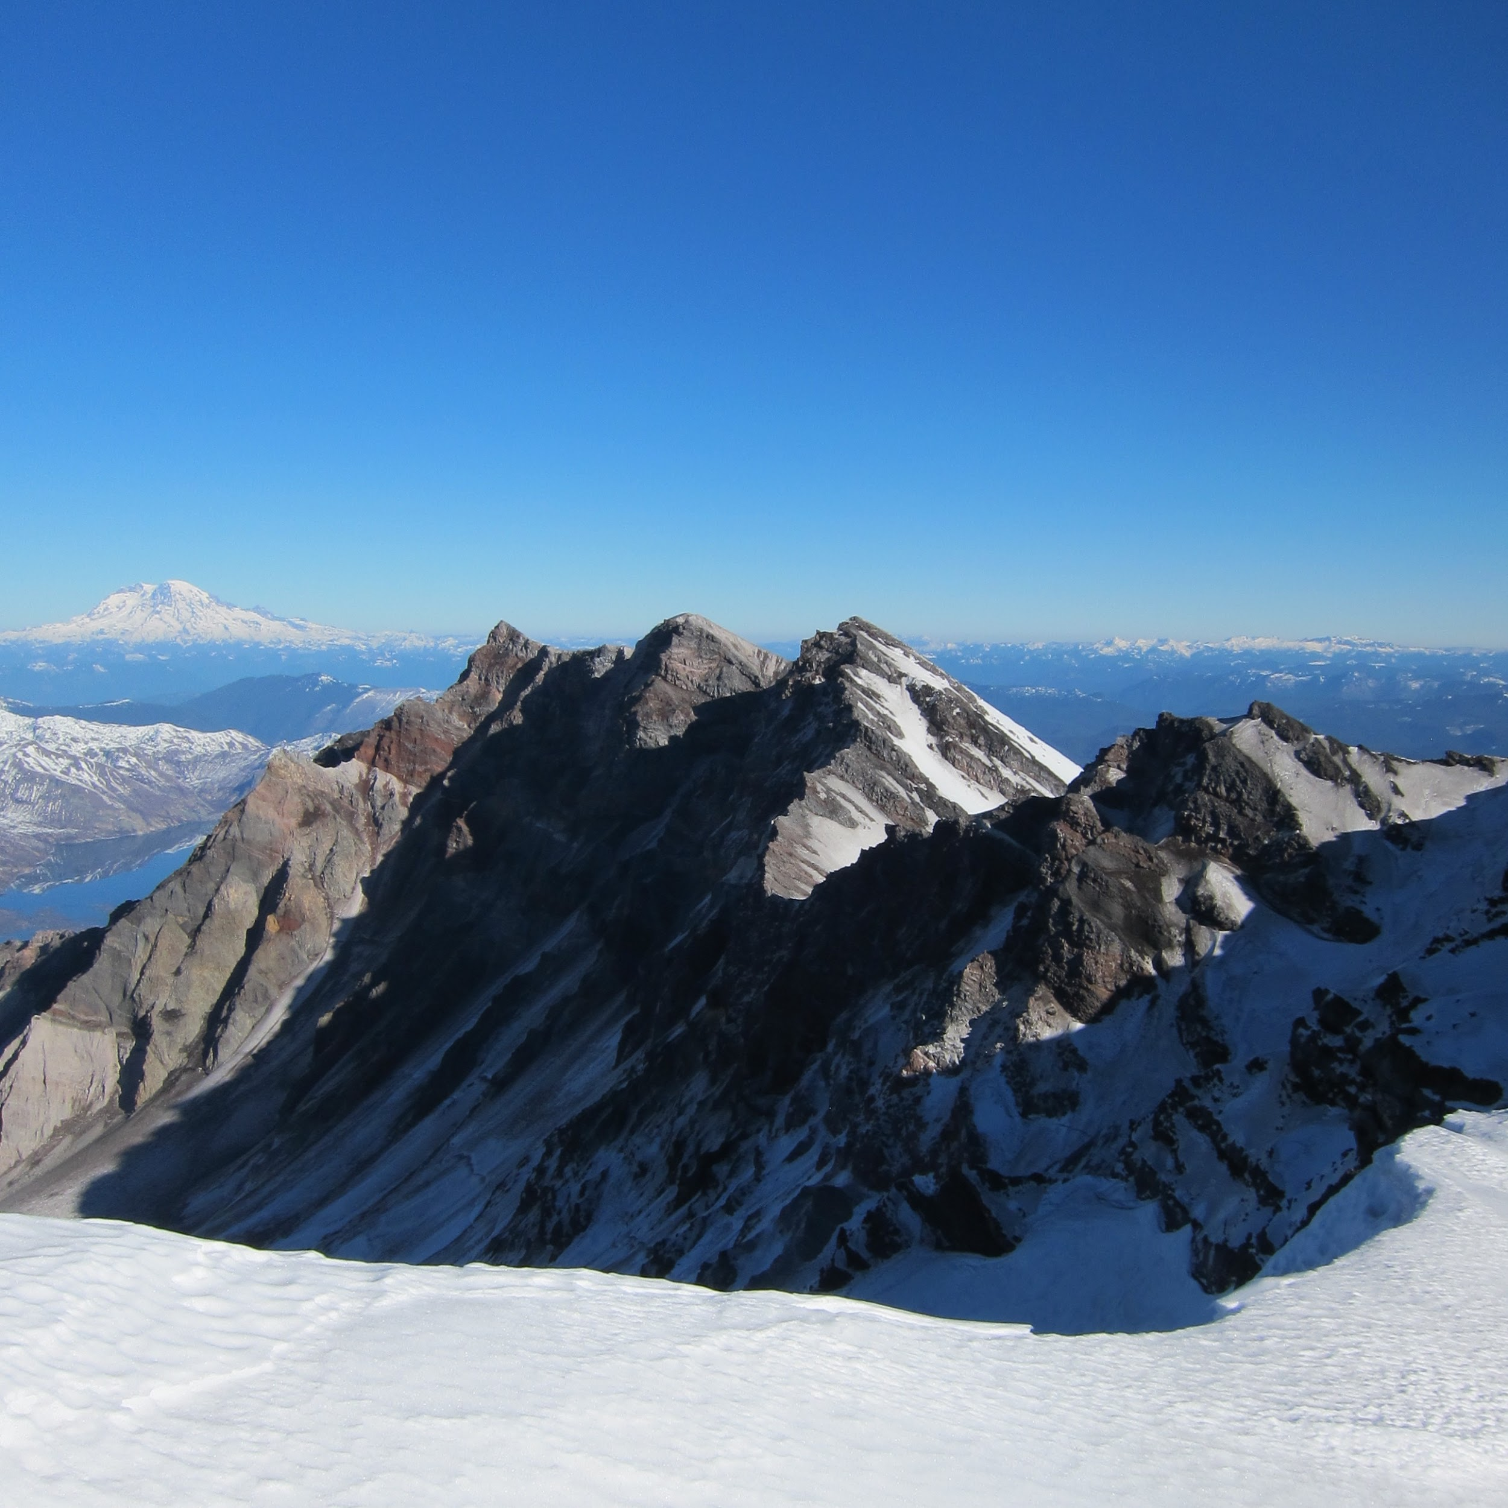
Local features
What makes a good feature?
We want uniqueness.
  Look for image regions that are unusual.
  Lead to unambiguous matches in other images.
How to define “unusual”?
0D structure
not useful for matching
1D structure
edge, can be localized in 1D, subject to the aperture problem
2D structure
corner, can be localized in 2D,
good for matching

Slide 10
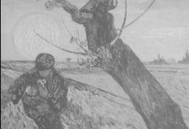
Overview of the approach
Extraction of interest points (characteristic locations).
Computation of local descriptors.
Determining correspondences.
Using these correspondences for matching/recognition/etc.
interest points
( )
local descriptor

Slide 11
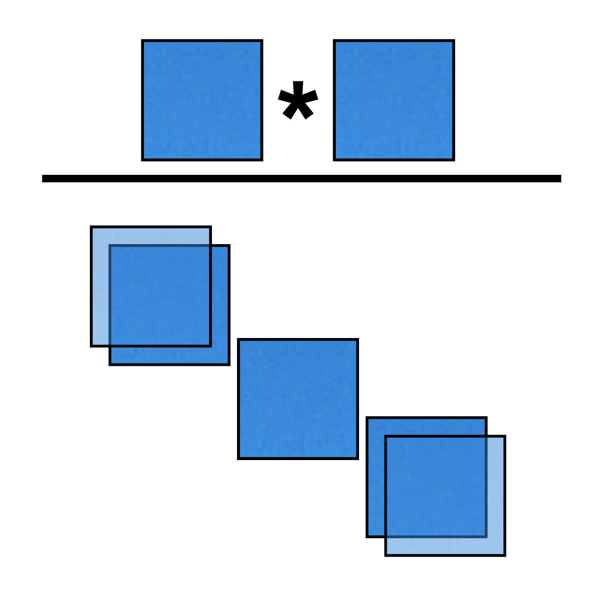
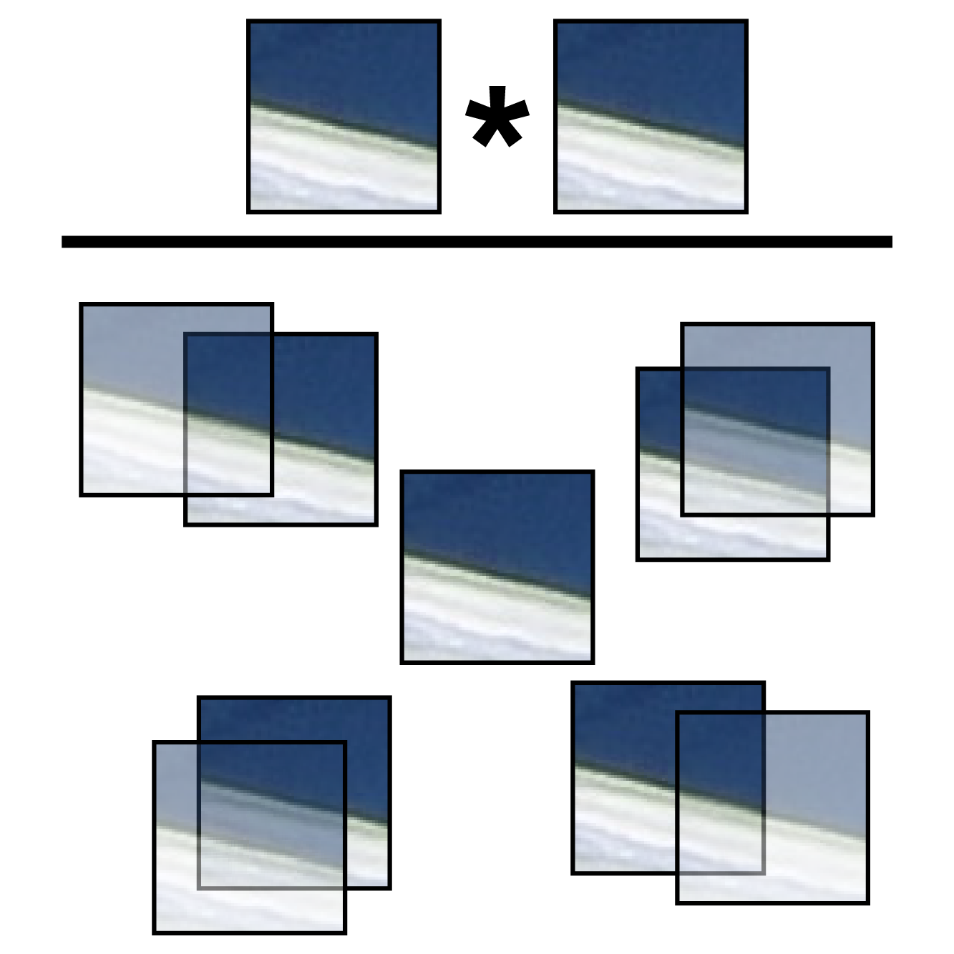
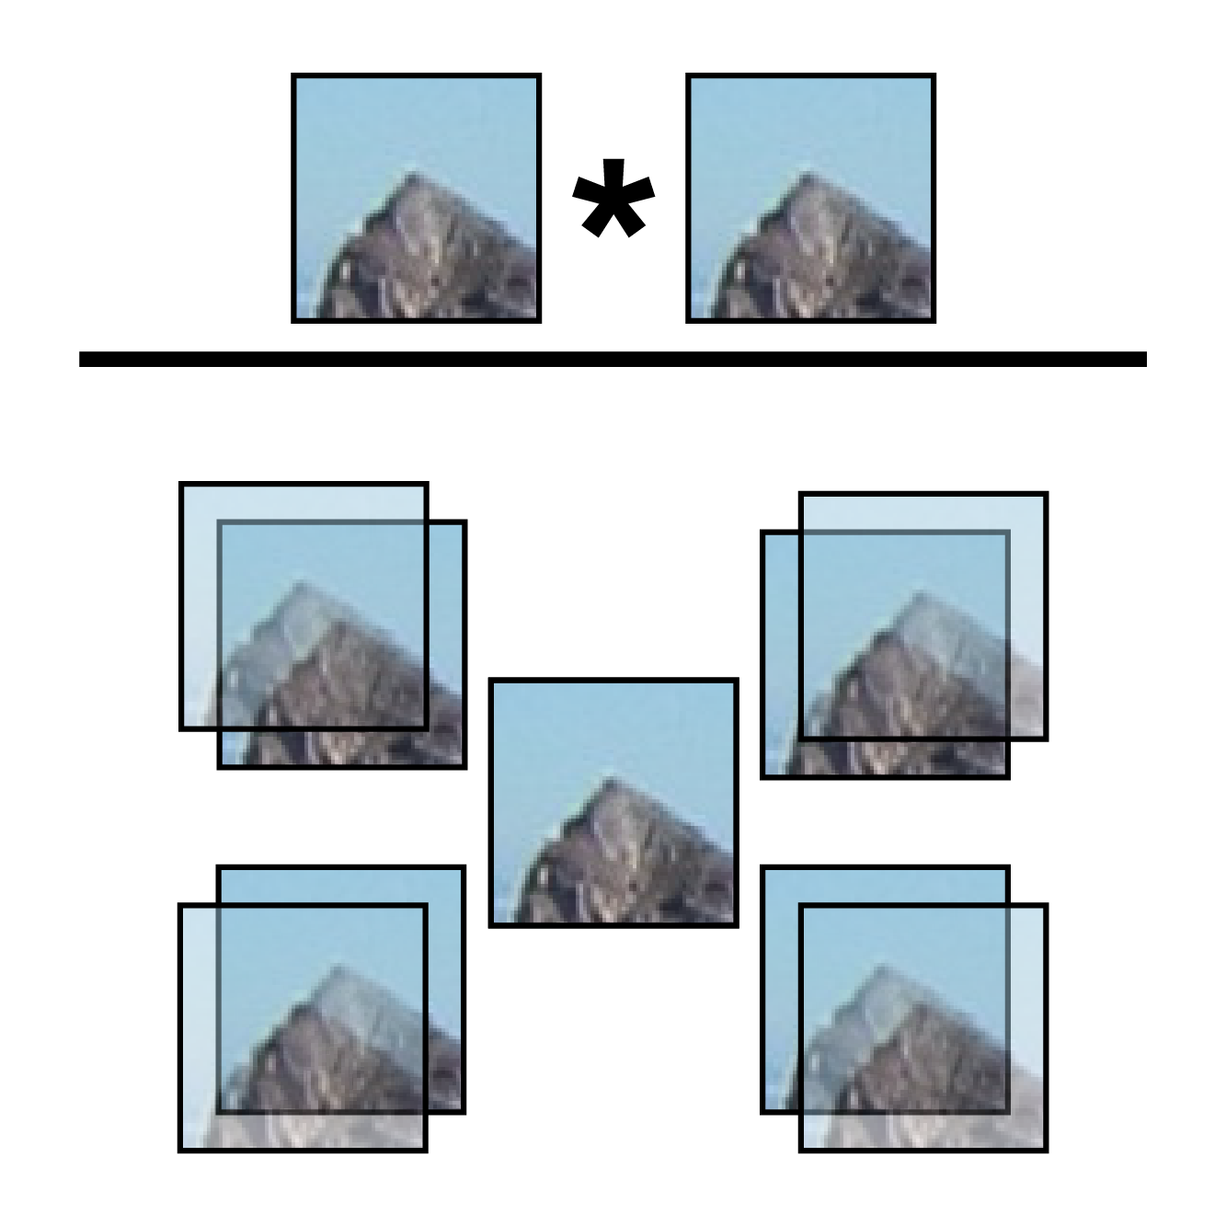
Local features: detection
Idea: find regions that are dissimilar to its neighbors (self-difference).
“flat” region:
no change in all directions
“edge”:
no change along the edge direction
“corner”:
significant change in all directions

Slide 12
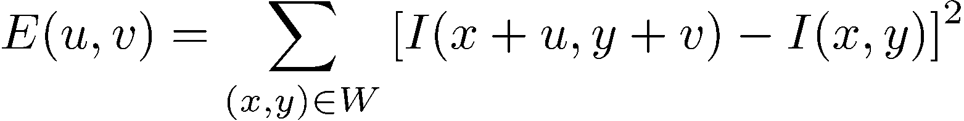
Local features: detection
Consider shifting the window W by (u,v):
  How do the pixels in W change?
  Auto-correlation function measures
  the self similarity of a signal and is
  related to the sum-of-squared
  difference.
  Compare each pixel before and
  after the shift by summing up the
  squared differences (SSD).
  This defines an SSD “error” of E(u,v):
W

Slide 13
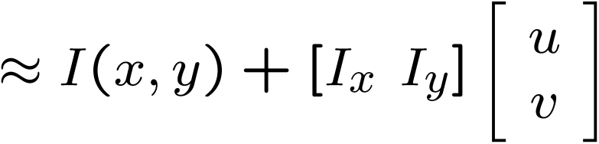
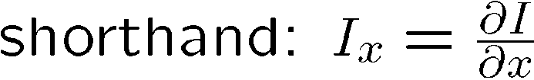
Local features: detection
Taylor Series expansion of I:
If the motion (u,v) is assumed to be small, then first order approximation is good.
Plugging this into the formula on the previous slide...

Slide 14
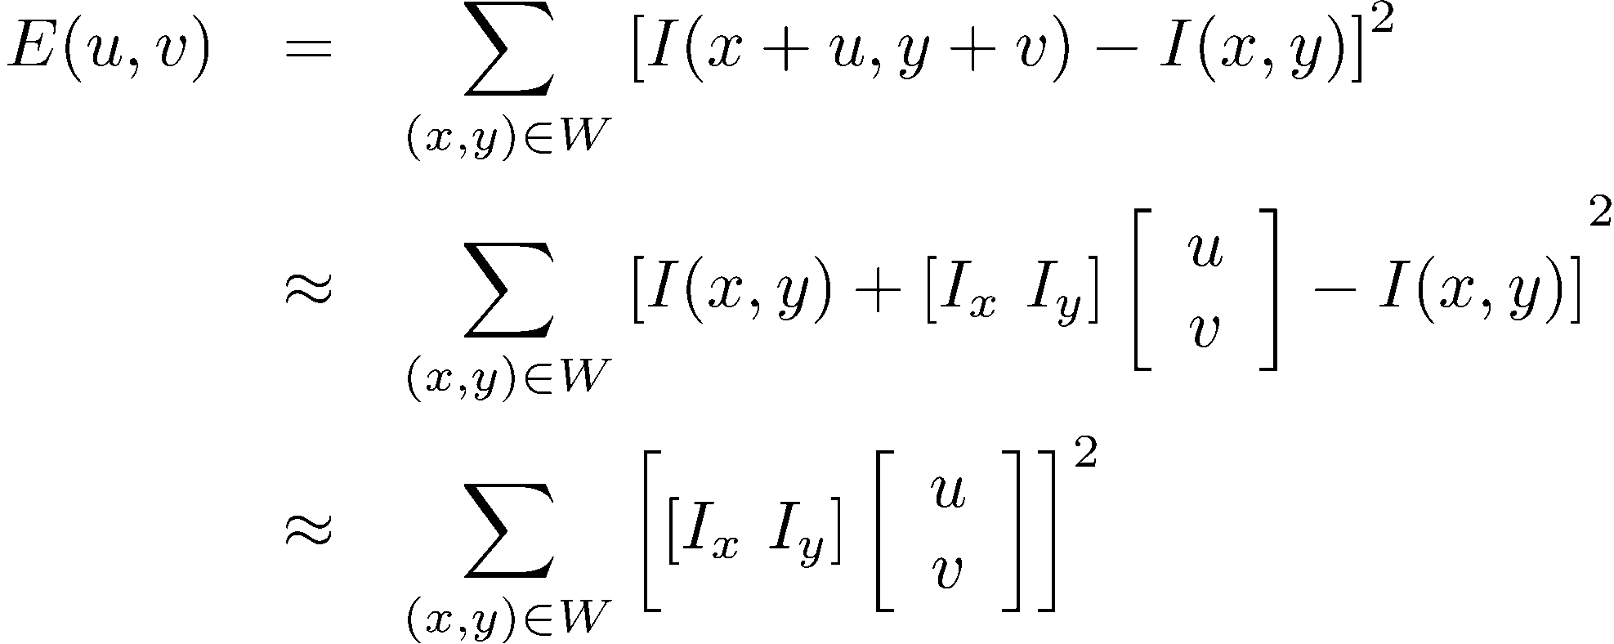
Local features: detection
Sum-of-squared differences error E(u,v):

Slide 15
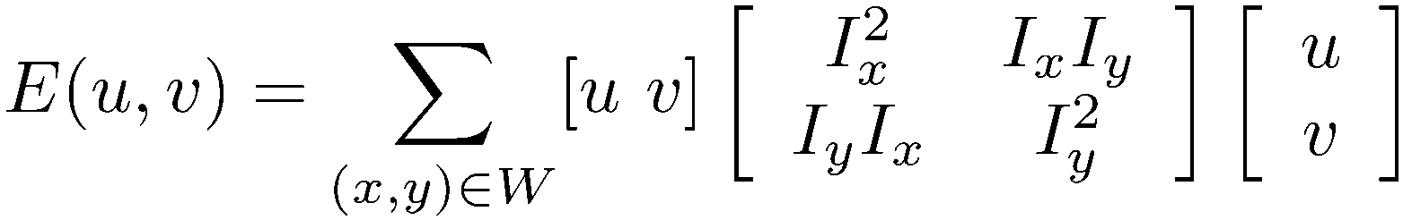

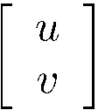
Local features: detection
This can be rewritten:
Which directions will result in the largest and smallest E values?
[after sum over all (x,y)]

Slide 16
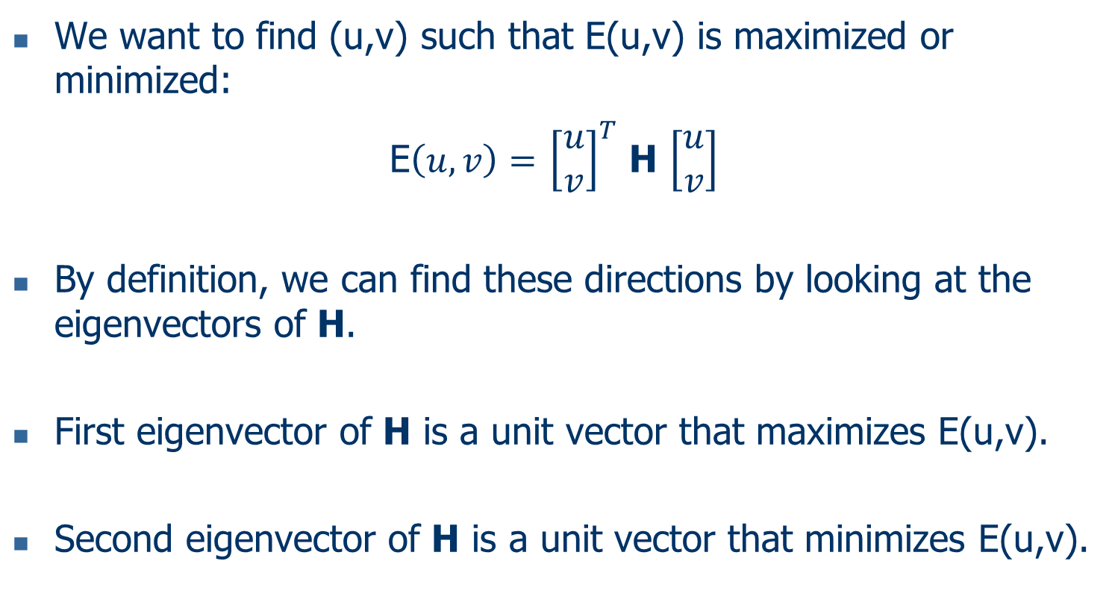
Local features: detection
We want to find (u,v) such that E(u,v) is maximized or minimized:
E$\left(u,v\right)=$ ${\left[\begin{matrix}u \\ v\end{matrix}\right]}^{T}$ H $\left[\begin{matrix}u \\ v\end{matrix}\right]$
  By definition, we can find these directions by looking at the eigenvectors of H.
  First eigenvector of H is a unit vector that maximizes E(u,v).
  Second eigenvector of H is a unit vector that minimizes E(u,v).

Slide 17
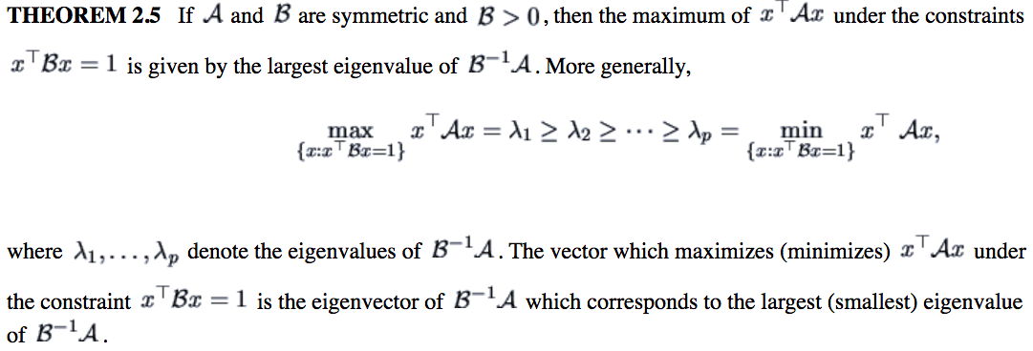
Quick eigenvector/eigenvalue review
Relevant theorem:
http://fedc.wiwi.hu-berlin.de/xplore/tutorials/mvahtmlnode16.html

Slide 18


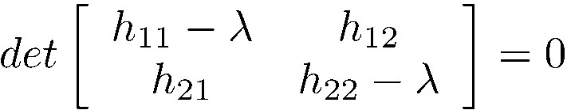
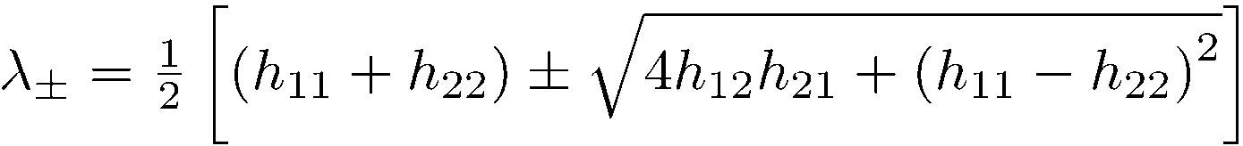
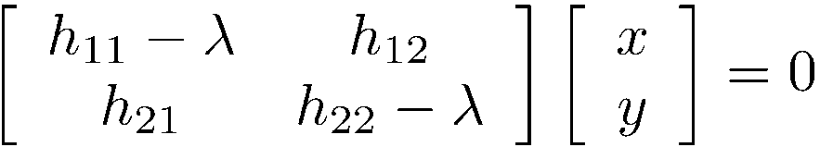
Quick eigenvector/eigenvalue review
The eigenvectors of a matrix A are the vectors x that satisfy:
The scalar λ is the eigenvalue corresponding to x
  The eigenvalues are found by solving:
  In our case, A = H is a 2x2 matrix, so we have
  The solution:
Once you know λ, you find x by solving

Slide 19
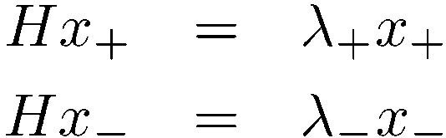
Local features: detection
This can be rewritten:
Eigenvalues and eigenvectors of H:
  Define shifts with the smallest and largest change (E value).
  x₊ = direction of largest increase in E.
  λ₊ = amount of increase in direction x₊.
  x₋ = direction of smallest increase in E.
  λ₋ = amount of increase in direction x₋.
x₋
[sum over all (x,y)]
x₊

Slide 20
Harris detector
To measure the strength:
R = det(H) – k(trace(H))²
where
trace(H) = λ₁ + λ₂
det(H) = λ₁ x λ₂
(λ₁ and λ₂ are the eigenvalues of H).
R is positive for corners, negative in edge regions, and small in flat regions.
Very similar to λ₋ but less expensive (no square root).
Also called the “Harris Corner Detector” or “Harris Operator”.
Lots of other detectors, this is one of the most popular.

Slide 21
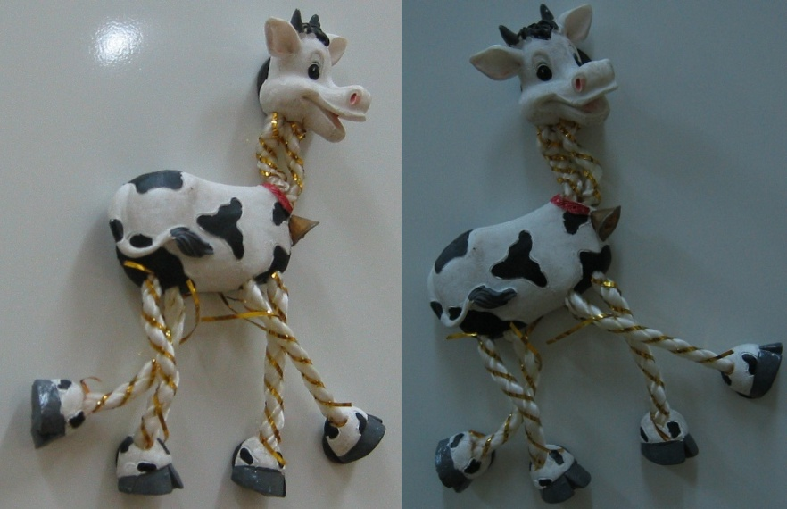
Harris detector example

Slide 22
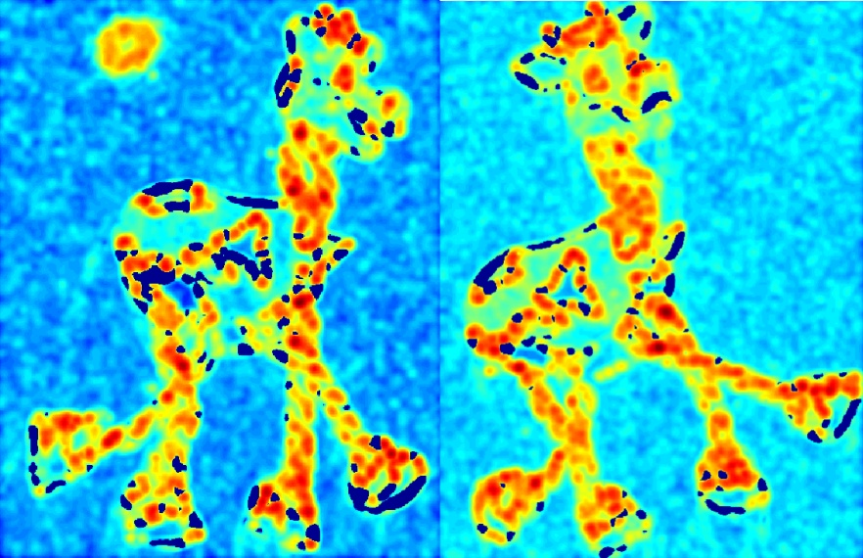
Harris detector example
R values (red high, blue low)

Slide 23
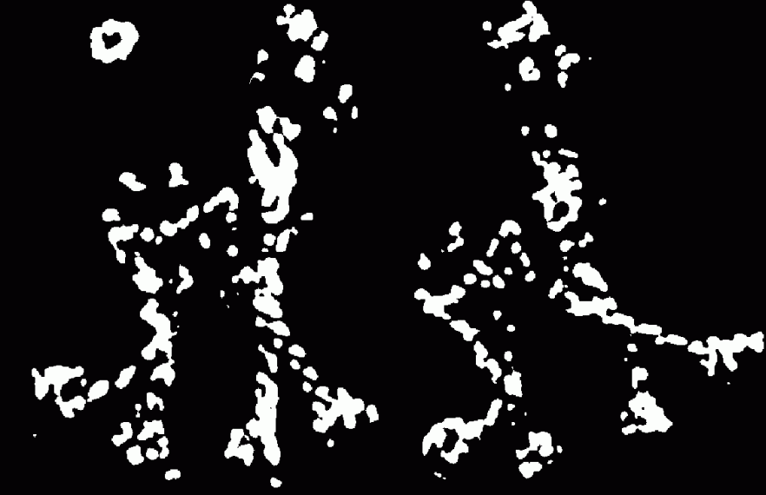
Harris detector example
Threshold (R > value)

Slide 24

Harris detector example
Local maxima of R (nonmaxima suppression)

Slide 25

Harris detector example
Harris features (red)

Slide 26
Local features: descriptors
( )
local descriptor
Describe points so that they can be compared.
Descriptors characterize the local neighborhood of a point.

Slide 27
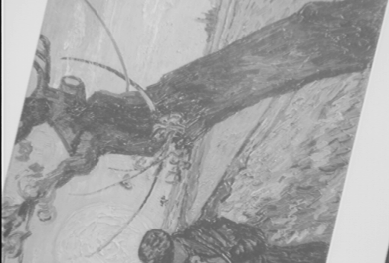
Local features: matching
We know how to detect good features.
Next question: how to match them?
Vector comparison using a distance measure can be used.
( )
?
( )
=

Slide 28
Local features: matching
Given a feature in I₁, how to find the best match in I₂?
  Define a distance function that compares two descriptors.
  Test all the features in I₂, find the one with minimum distance.
50
75
200
feature distance

Slide 29
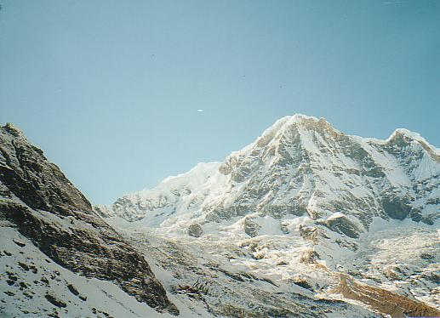
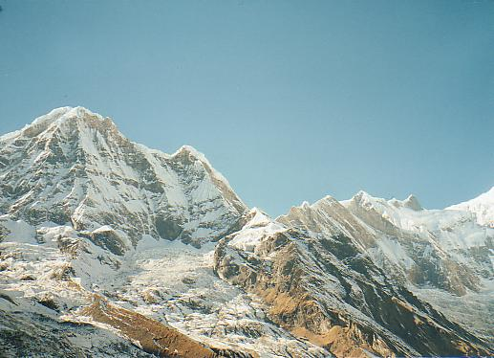
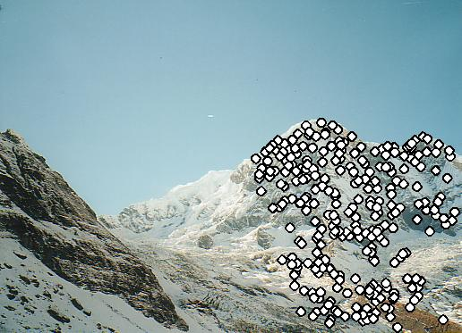
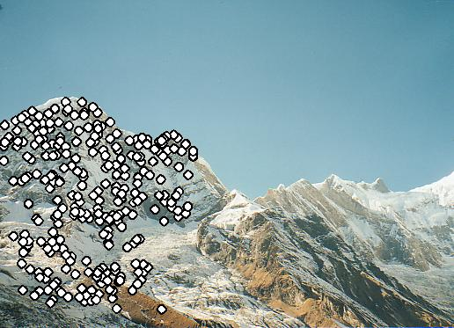
Matching examples

Slide 30
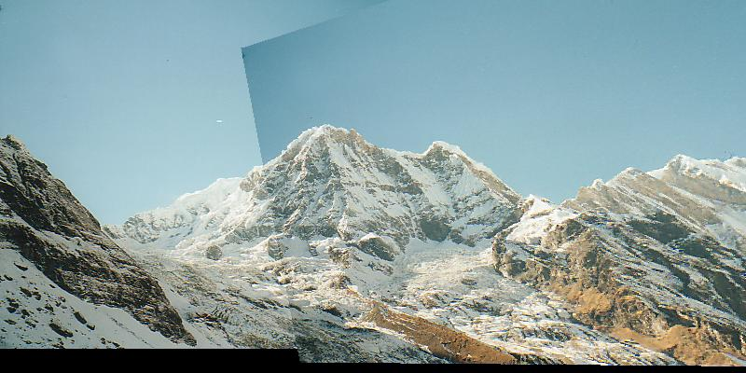
Matching examples

Slide 31
Local features: matching
Matches can be improved using local constraints
  neighboring points should match
  angles, length ratios should be similar
1
1
2
2
3

Slide 32
Local features: invariance
Suppose you rotate the image by some angle.
  Will you still pick up the same features?
What if you change the brightness?
What about scale?
We’d like to find the same features regardless of the transformation.
  This is called transformational invariance.
  Most feature methods are designed to be invariant to
    Translation, 2D rotation, scale.
  They can usually also handle
    Limited 3D rotations.
    Limited affine transformations (some are fully affine invariant).
    Limited illumination/contrast changes.

Slide 33
How to achieve invariance?
Need both of the following:
Make sure your detector is invariant.
  Harris is invariant to translation and rotation.
  Scale is trickier.
    Common approach is to detect features at many scales using a Gaussian pyramid (e.g., MOPS).
    More sophisticated methods find “the best scale” to represent each feature (e.g., SIFT).
Design an invariant feature descriptor.
  A descriptor captures the information in a region around the detected feature point.
  The simplest descriptor: a square window of pixels.
  Let’s look at some better approaches…

Slide 34
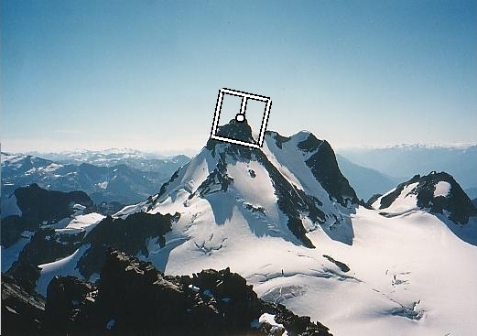
Rotation invariance for descriptors
Find dominant orientation of the image patch.
  This is given by x₊, the eigenvector of H corresponding to λ₊ (larger eigenvalue).
  Rotate the patch according to this angle.

Slide 35
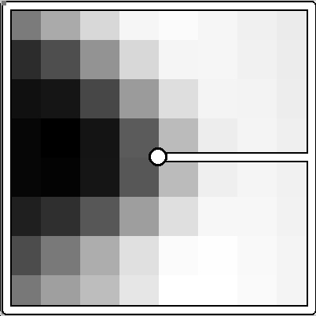
Multi-scale Oriented Patches (MOPS)
Take 40x40 square window around detected feature.
  Scale to 1/5 size (using prefiltering).
  Rotate to horizontal.
  Sample 8x8 square window centered at feature.
  Intensity normalize the window by subtracting the mean, dividing by the standard deviation in the window.
40 pixels
8 pixels

Slide 36

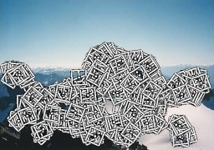
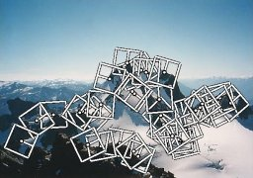
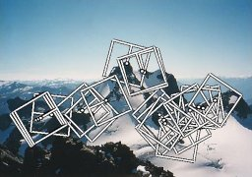
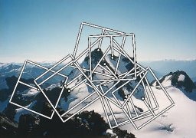
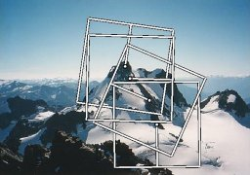
Multi-scale Oriented Patches (MOPS)
Extract oriented patches at multiple scales of the Gaussian pyramid.

Slide 37
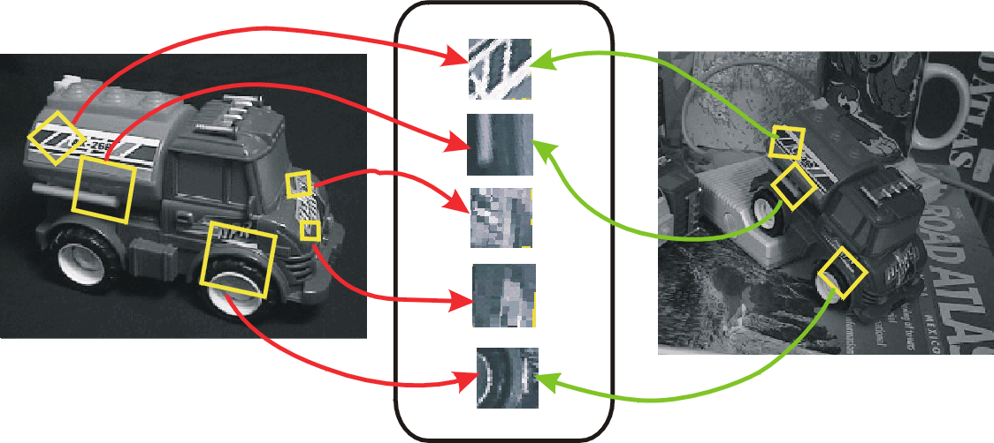
Scale Invariant Feature Transform (SIFT)
The SIFT operator developed by David Lowe is both a detector and a descriptor that are invariant to translation, rotation, scale, and other imaging parameters.

Slide 38
Overall approach for SIFT
Scale space extrema detection
  Search over multiple scales and image locations.
Interest point localization
  Fit a model to determine location and scale.
  Select interest points based on a measure of stability.
Orientation assignment
  Compute best orientation(s) for each interest point region.
Interest point description
  Use local image gradients at selected scale and rotation to describe each interest point region.

Slide 39

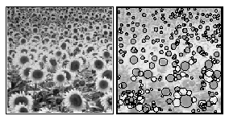
Scale space extrema detection
The scale space of an image is a function L(x,y,σ) that is produced from the convolution of the input image with a Gaussian kernel (at different scales).
Scale space detection
  Find local maxima across scale space

Slide 40
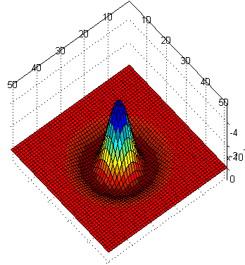
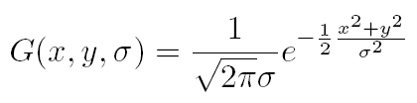
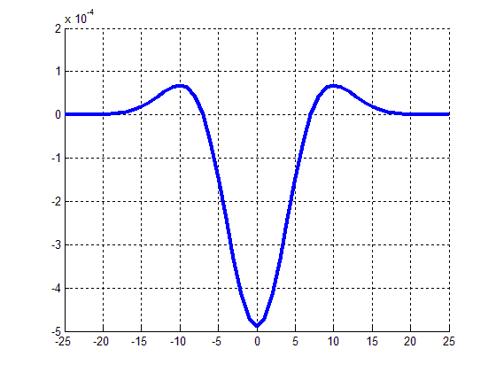
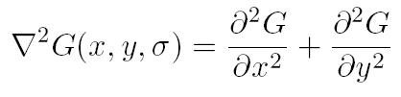
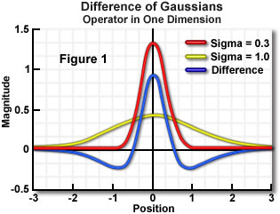

Scale space interest points
Laplacian of Gaussian (LoG) kernel
Difference of Gaussian kernel is a close approximation to scale-normalized LoG.

Slide 41
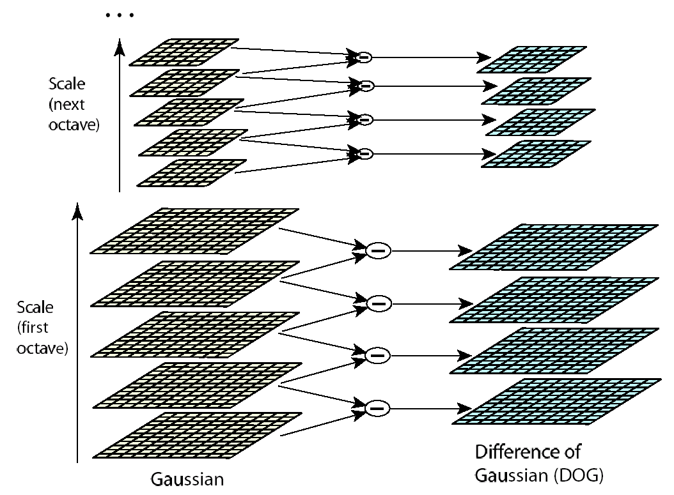
Lowe’s pyramid scheme
For each octave of scale space, the initial image is repeatedly convolved with Gaussian to produce the set of scale space images (left). Adjacent Gaussian images are subtracted to produce difference of Gaussian images (right). After each octave Gaussian image is downsampled by a factor of 2.

Slide 42
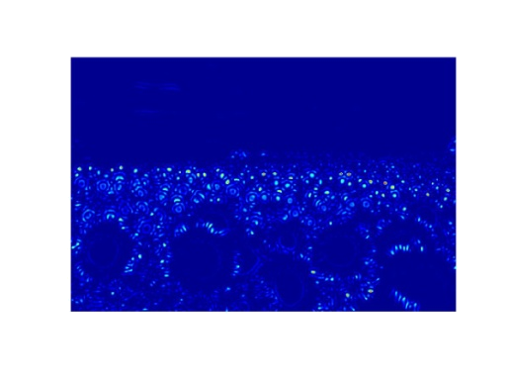






Interest point localization
Look for extrema.
For each max or min found, output is the location and the scale.
σ5
scale
σ4
σ3
σ2
σ1

Slide 43
Orientation assignment
Create histogram of local gradient directions computed at selected scale.
Assign canonical orientation at peak of smoothed histogram.
Each key specifies stable 2D coordinates (x, y, scale, orientation).

Slide 44
Interest point descriptors
At this point, each interest point has
  location,
  scale,
  orientation.
Next step is to compute a descriptor for the local image region about each interest point that is
  highly distinctive,
  invariant as possible to variations such as changes in viewpoint and illumination.

Slide 45
Lowe’s interest point descriptor
Use the normalized circular region about the interest point.
  Rotate the window to standard orientation.
  Scale the window size based on the scale at which the point was found.
Compute gradient magnitude and orientation at each point in the region.
Weight them by a Gaussian window overlaid on the circle.
Create an orientation histogram over the 4x4 subregions of the window.
4x4 descriptors over 16x16 sample array were used in practice. 4x4 times 8 directions gives a vector of 128 values.

Slide 46



Lowe’s interest point descriptor
An input image
Overlayed descriptors
Adapted from www.vlfeat.org

Slide 47
Example applications
Object and scene recognition
Stereo correspondence
3D reconstruction
Image alignment & stitching
Image indexing and search
Motion tracking
Robot navigation

Slide 48




Examples: 3D recognition

Slide 49

Examples: location recognition

Slide 50



Examples: robot localization

Slide 51

Examples: robot localization
Map continuously built over time

Slide 52

Examples: panaromas
Recognize overlap from an unordered set of images and automatically stitch together.
SIFT features provide initial feature matching.
Image blending at multiple scales hides the seams.
Panorama of Lowe’s lab automatically assembled from 143 images

Slide 53

Examples: panaromas
Image registration and blending

Slide 54

Sony Aibo
SIFT usage:
  Recognize
  charging
  station
  Communicate
  with visual
  cards
  Teach object
  recognition

Slide 55


Photo tourism: exploring photo collections
Detect features using SIFT.
Joint work by University of Washington and Microsoft Research
http://phototour.cs.washington.edu/

Slide 56
















Photo tourism: exploring photo collections
Detect features using SIFT.

Slide 57
Photo tourism: exploring photo collections
Detect features using SIFT.

Slide 58
Photo tourism: exploring photo collections
Match features between each pair of images.

Slide 59




Photo tourism: exploring photo collections
Link up pairwise matches to form connected components of matches across several images.
Image 1
Image 2
Image 3
Image 4

Slide 60

Photo tourism: exploring photo collections

Slide 61

Photo tourism: exploring photo collections
Photos are automatically placed inside a sketchy 3D model of the scene;
an optional overhead map also shows each photo's location.

Slide 62

Photo tourism: exploring photo collections
An info pane on the left shows information about the current image and navigation buttons for moving around the collection; the filmstrip view on the bottom shows related images; mousing over these images brings them up as a registered overlay.

Slide 63

Photo tourism: exploring photo collections
Photographs can also be taken in outdoor natural environments. The photos are correctly placed in 3-D, and more free-form geometric models can be used for inter-image transitions.

Slide 64

Photo tourism: exploring photo collections
Annotations entered in one image (upper left) are automatically transferred to all other related images.

Slide 65


Scene summarization for online collections
http://grail.cs.washington.edu/projects/canonview
Scene summary browsing
Enhanced 3D browsing

