Slide 1
Image Segmentation
Selim Aksoy
Department of Computer Engineering
Bilkent University
saksoy@cs.bilkent.edu.tr

Slide 2
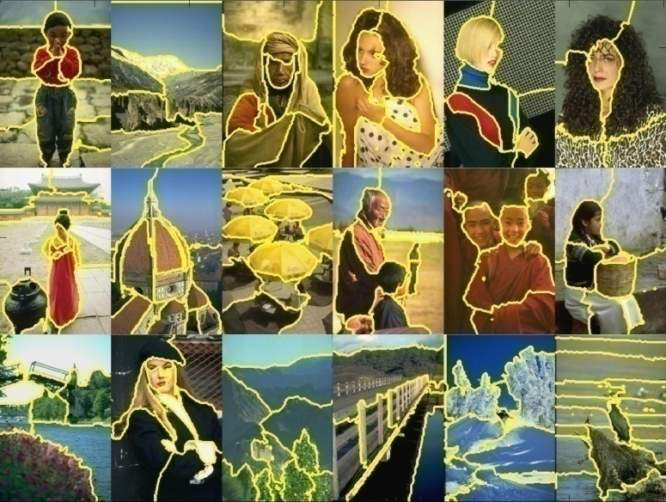
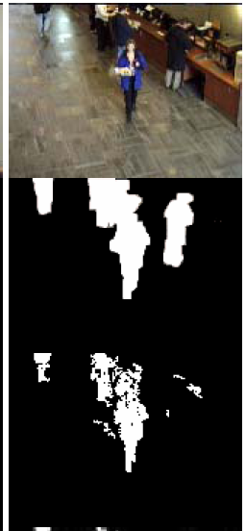
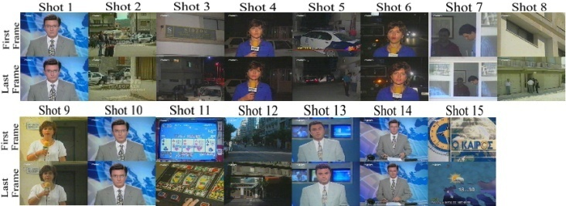
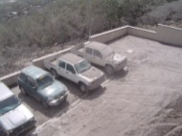
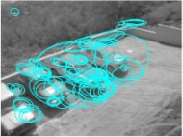
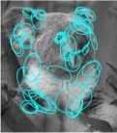
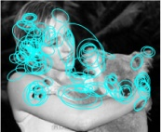
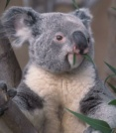
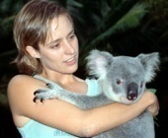
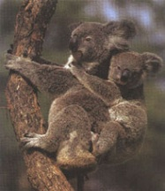
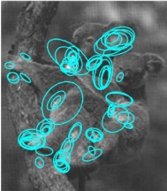
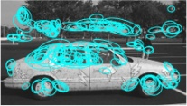

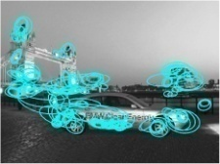




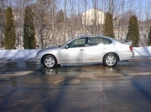
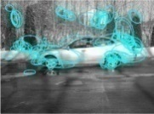
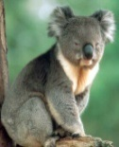
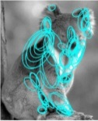

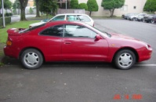
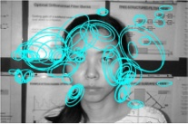
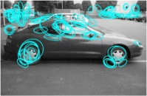
Examples of grouping in vision
[http://poseidon.csd.auth.gr/LAB_RESEARCH/Latest/imgs/SpeakDepVidIndex_img2.jpg]
Group video frames into shots
[Figure by J. Shi]
Determine image regions
[Figure by Wang & Suter]
Figure-ground separation
[Figure by Grauman & Darrell]
Object-level grouping

Slide 3
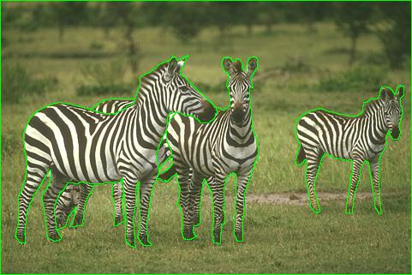
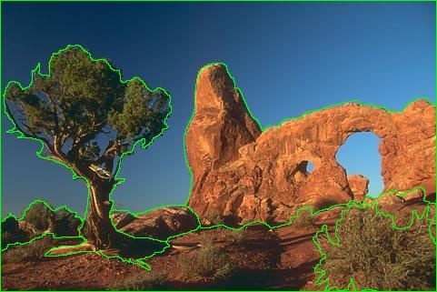
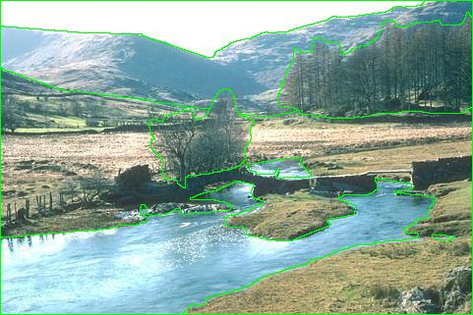
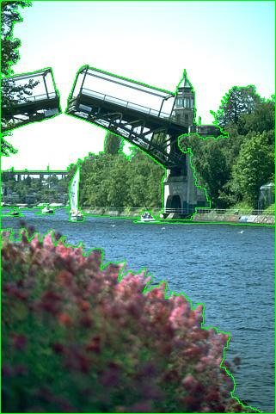
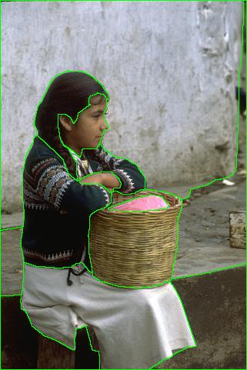
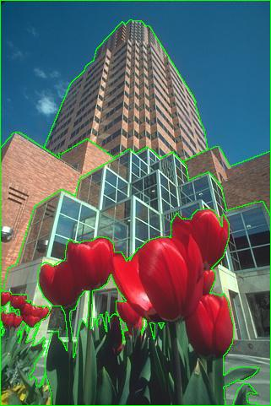
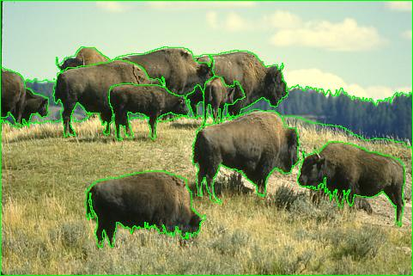
Image segmentation

Slide 4
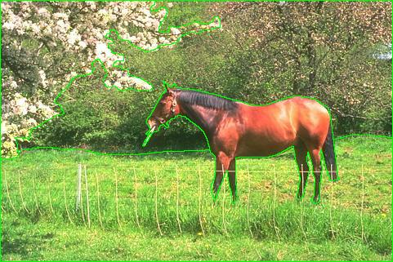
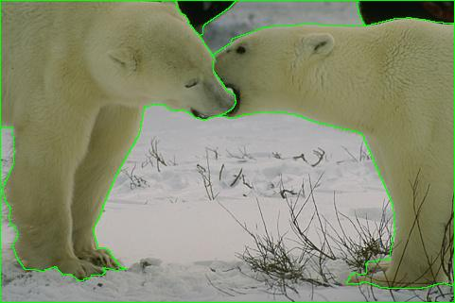
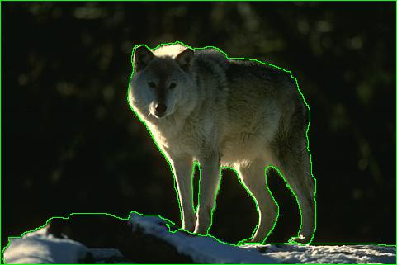
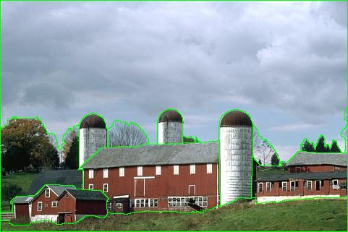
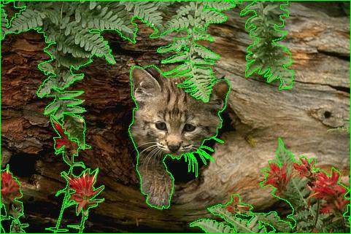
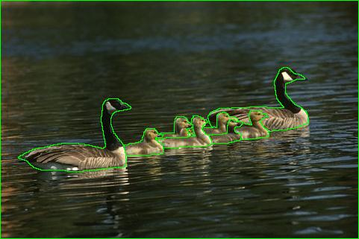
Image segmentation

Slide 5
From images to objects
What defines an object?
  Subjective problem, but has been well-studied.
  Gestalt laws seek to formalize this.
  “What is interesting and what is not” depends on the application.
  There is no single solution to this problem.

Slide 6
Gestalt laws
A series of factors affect whether elements should be grouped together.
  Proximity: tokens that are nearby tend to be grouped.
  Similarity: similar tokens tend to be grouped together.
  Common fate: tokens that have coherent motion tend to be grouped together.
  Common region: tokens that lie inside the same closed region tend to be grouped together.
  Parallelism: parallel curves or tokens tend to be grouped together.
  Closure: tokens or curves that tend to lead to closed curves tend to be grouped together.
  Symmetry: curves that lead to symmetric groups are grouped together.
  Continuity: tokens that lead to “continuous” curves tend to be grouped.
  Familiar configuration: tokens that, when grouped, lead to a familiar object, tend to be grouped together.

Slide 7
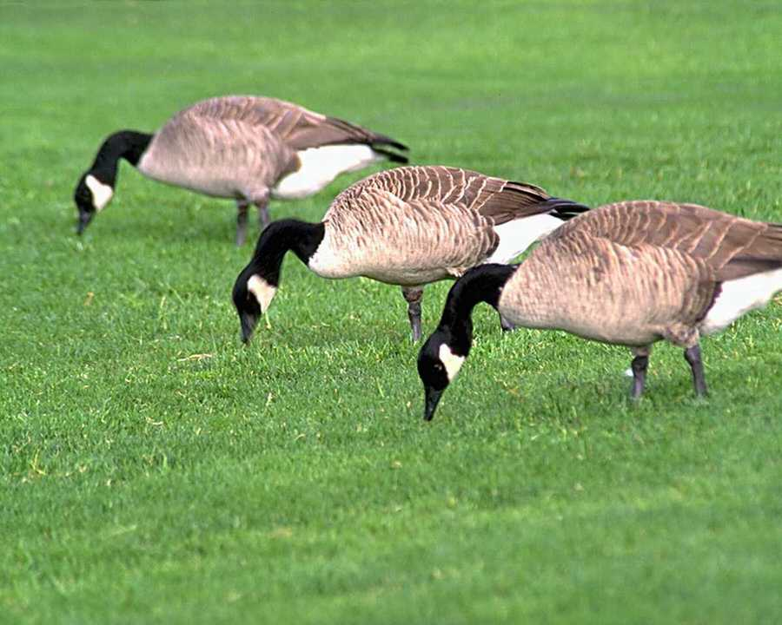
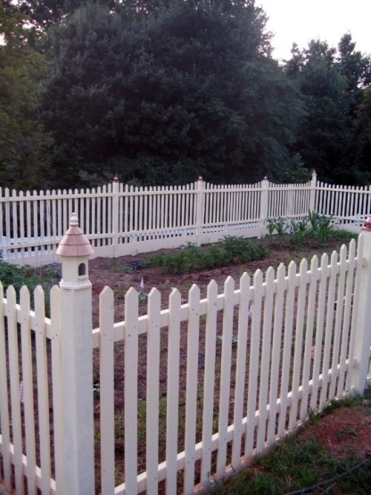
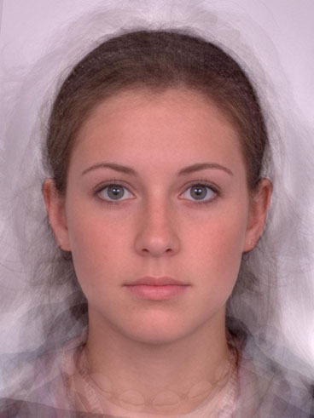
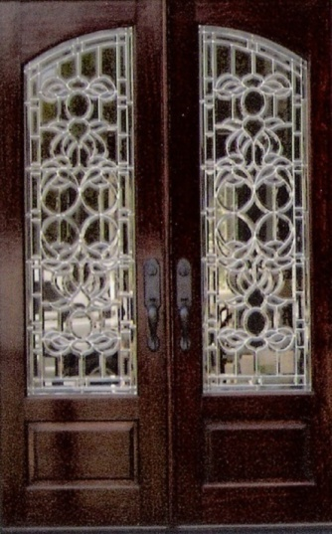
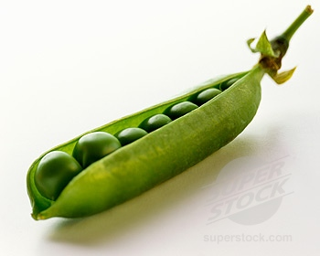
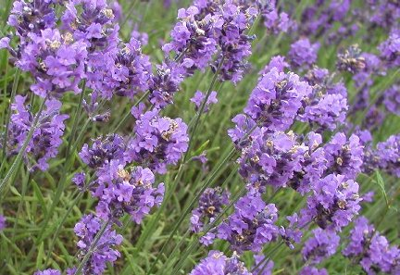
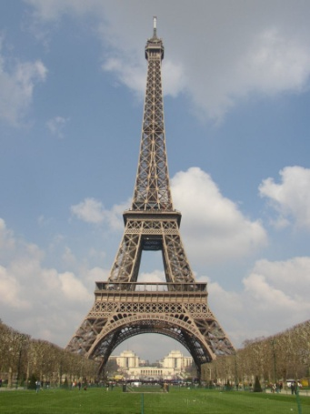
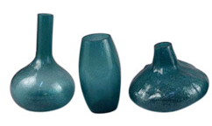
Gestalt laws
Symmetry
Similarity
Adapted from Kristen Grauman

Slide 8
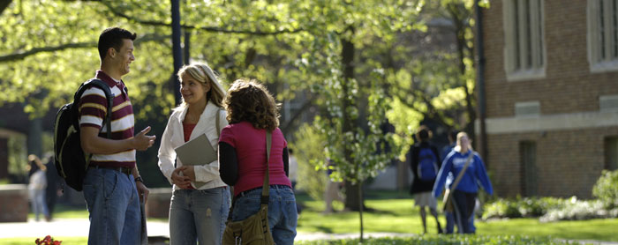
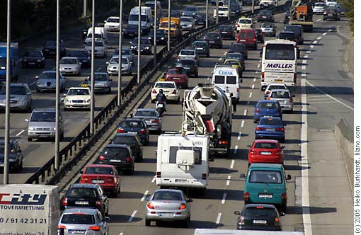
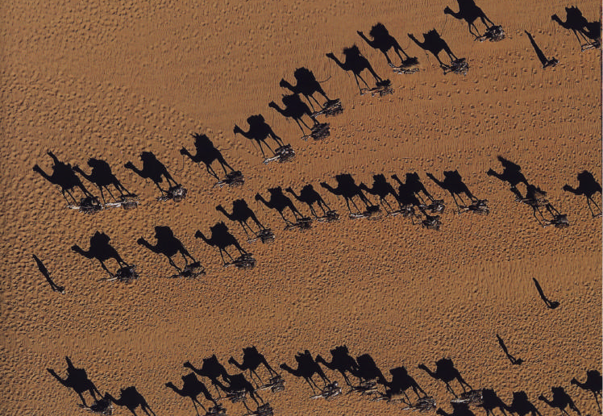

Gestalt laws
Proximity
Common fate
Adapted from Kristen Grauman

Slide 9
Image segmentation
Image segmentation is the operation of partitioning an image into a collection of connected sets of pixels.
Segmentation criteria: a segmentation is a partition of an image I into a set of regions S satisfying:
  ∪ S_{i} = S Partition covers the whole image.
  S_{i} ∩ S_{j} = ∅, i ≠ j No regions intersect.
  ∀ S_{i}, P(S_{i}) = true Homogeneity predicate is satisfied by
  each region.
  P(S_{i} ∪ S_{j}) = false, Union of adjacent regions
  i ≠ j, S_{i} adjacent S_{j} does not satisfy it.

Slide 10
Image segmentation
So, all we have to do is to define and implement the similarity predicate.
  But, what do we want to be similar in each region?
  Is there any property that will cause the regions to be meaningful objects?
Example approaches:
  Histogram-based
  Clustering-based
  Region growing
  Split-and-merge
  Morphological
  Graph-based
  Superpixels

Slide 11
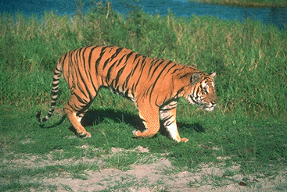
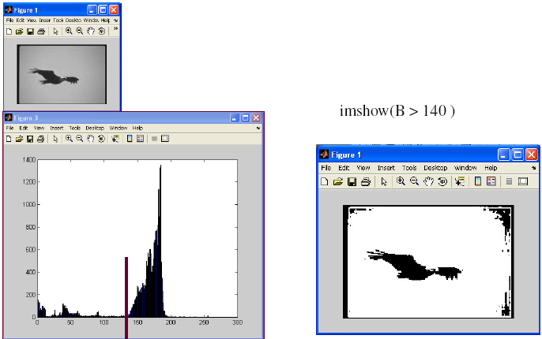
Histogram-based segmentation
How many “orange” pixels are
in this image?
This type of question can be answered
by looking at the histogram.

Slide 12



Clustering-based segmentation
How to choose the representative colors?
  This is a clustering problem!
K-means algorithm can be used for clustering.
  http://home.dei.polimi.it/matteucc/Clustering/tutorial_html/AppletKM.html
  http://www.math.le.ac.uk/people/ag153/homepage/KmeansKmedoids/Kmeans_Kmedoids.html

Slide 13
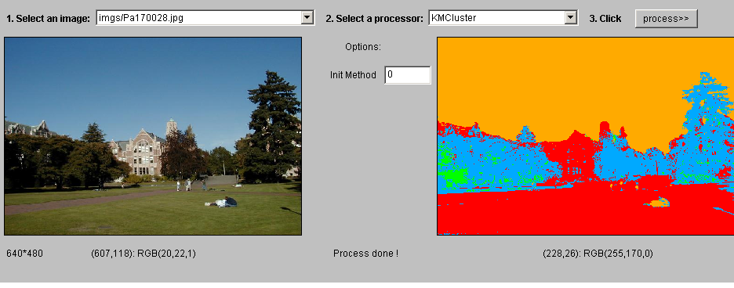
Clustering-based segmentation
K-means clustering of color.

Slide 14
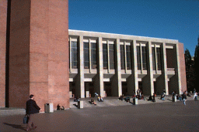
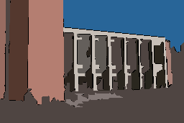
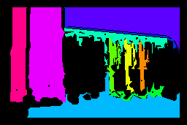






Clustering-based segmentation
Clustering can also be used with other features (e.g., texture) in addition to color.
Original Images
Color Regions
Texture Regions

Slide 15


Clustering-based segmentation
Pros (of k-means):
  Simple, fast to compute
  Converges to local minimum of within-cluster squared error
Cons (of k-means):
  Setting K?
  Sensitive to initial centers
  Sensitive to outliers
  Detects spherical clusters
Adapted from Kristen Grauman

Slide 16
Clustering-based segmentation
K-means variants:
  Different ways to initialize the means.
  Different stopping criteria.
  Dynamic methods for determining the right number of clusters (K) for a given image.
Problem: histogram-based and clustering-based segmentation using color/texture/etc can produce messy/noisy regions. (Why?)
How can these be fixed?

Slide 17

Mean shift algorithm
The mean shift algorithm seeks modes or local maxima of density in the feature space.
Image
Feature space
(L*u*v* color values)
Adapted from Kristen Grauman

Slide 18
Mean shift algorithm
Search
window
Center of
mass
Mean Shift
vector

Slide 19
Mean shift algorithm
Search
window
Center of
mass
Mean Shift
vector

Slide 20
Mean shift algorithm
Search
window
Center of
mass
Mean Shift
vector

Slide 21
Mean shift algorithm
Search
window
Center of
mass
Mean Shift
vector

Slide 22
Mean shift algorithm
Search
window
Center of
mass
Mean Shift
vector

Slide 23
Mean shift algorithm
Search
window
Center of
mass
Mean Shift
vector

Slide 24
Mean shift algorithm
Search
window
Center of
mass

Slide 25

Mean shift clustering/segmentation
Find features (color, gradients, texture, etc)
Initialize windows at individual feature points
Perform mean shift for each window until convergence
Merge windows that end up near the same “peak” or mode

Slide 26




Mean shift segmentation

Slide 27
Mean shift segmentation
Pros:
  Does not assume shape on clusters
  One parameter choice (window size)
  Generic technique
  Find multiple modes
Cons:
  Selection of window size
  Does not scale well with dimension of feature space
Adapted from Kristen Grauman

Slide 28
Region growing
Region growing starts with one pixel (seed) of a potential region and tries to grow it by adding adjacent pixels till the pixels being compared are too dissimilar.
We need to define a measure of similarity between a pixel and a set of pixels as well as a rule that makes a decision for growing.
Usually a statistical test is used to decide which pixels can be added to a region.
  Region is a population with similar statistics.
  Use statistical test to see if neighbor on border fits into the region population.

Slide 29
Region growing
Example: Let R be the N pixel region obtained so far and p be a neighboring pixel with gray tone y.
Define the mean X and scatter S² (sample variance) by
The T statistic is defined by

Slide 30
Region growing
It has a T_{N-1} distribution if all the pixels in R and the test pixel p are independent and identically distributed Gaussians (i.i.d. assumption).
For the T distribution, compute the probability Pr(T ≤ t) for a given degrees of freedom and a confidence level. Pick a suitable threshold t.
If T ≤ t for desired confidence level, add p to region R and update the mean and scatter.
If T is too high, the value p is not likely to have arisen from the population of pixels in R. Start a new region.

Slide 31




Region growing
http://www.bigr.nl/website/static/research/regrow.html
http://www.mathworks.com/matlabcentral/fileexchange/
32532-region-growing-2d3d-grayscale
http://www.mathworks.com/matlabcentral/fileexchange/
19084-region-growing
http://www.creatis.insa-lyon.fr/~grenier/?p=172

Slide 32

Split-and-merge
Start with the whole image.
If the variance is too high, break into quadrants.
Merge any adjacent regions that are similar enough.
Repeat steps 2 and 3, iteratively until no more splitting or merging occur.
→ Idea: good
Results: blocky

Slide 33

Split-and-merge

Slide 34


Watershed segmentation
The image can be interpreted as a topographic surface, with both valleys and mountains.
Three types of points can be considered:
  Points belonging to a regional minimum.
  Points at which a drop of water, if placed at the location of any of those points, would fall to a single minimum.
  → catchment basins
  Points at which water would be equally likely to fall to more than one such minimum.
  → watershed lines

Slide 35
Watershed segmentation
Assume that there is a hole in each minima and the surface is immersed into a lake.
The water will enter through the holes at the minima and flood the surface.
To avoid the water coming from two different minima to meet, a dam is build whenever there would be a merge of the water.
Finally, the only thing visible of the surface would be the dams. These dam walls are called the watershed lines.

Slide 36

Watershed segmentation

Slide 37

Watershed segmentation

Slide 38








Watershed segmentation
A multi-scale segmentation can be obtained by iteratively smoothing the topographic surface.

Slide 39
Watershed segmentation
The key behind using the watershed transform for segmentation is this: change your image into another image whose catchment basins are the objects you want to identify.
Examples:
  Distance transform can be used with binary images where the catchment basins correspond to the foreground components of interest.
  Gradient can be used with grayscale images where the catchment basins should theoretically correspond to the homogeneous grey level regions of the image.

Slide 40
Watershed segmentation
Binary image.
Distance transform of the complement of the binary image.
Watershed transform after complementing the distance transform, and forcing pixels that do not belong to the objects to be at –Inf.

Slide 41


Watershed segmentation
A cell image.
Gradient of the cell image.

Slide 42






Watershed segmentation
Multi-scale watershed segmentation of the cell image.

Slide 43
Graph-based segmentation
An image is represented by a graph whose nodes are pixels or small groups of pixels.
The goal is to partition the nodes into disjoint sets so that the similarity within each set is high and across different sets is low.

Slide 44
Graph-based segmentation
Let G = (V,E) be a graph. Each edge (u,v) has a weight w(u,v) that represents the similarity between u and v.
Graph G can be broken into 2 disjoint graphs with node sets A and B by removing edges that connect these sets.
Let cut(A,B) = Σ w(u,v).
One way to segment G is to find the minimum cut.
u∈A, v∈B

Slide 45

Graph-based segmentation
Problem with minimum cut: weight of cut proportional to number of edges in the cut; tends to produce small, isolated components.

Slide 46
Graph-based segmentation
Shi and Malik proposed the normalized cut.
cut(A,B) cut(A,B)
Ncut(A,B) = --------------- + ---------------
assoc(A,V) assoc(B,V)
Normalized
cut
assoc(A,V) = Σ w(u,t)
u∈A, t∈V
How much is A connected
to the graph as a whole

Slide 47
Graph-based segmentation
A
B
2
2
2
2
2
2
2
2
1
4
3
1
2
2
2
3
3 3
Ncut(A,B) = ------- + ------
21 16

Slide 48
Graph-based segmentation
Shi and Malik turned graph cuts into an eigenvector/eigenvalue problem.
Set up a weighted graph G=(V,E).
  V is the set of (N) pixels.
  E is a set of weighted edges (weight w_{ij} gives the similarity between nodes i and j).
  Length N vector d: d_{i} is the sum of the weights from node i to all other nodes.
  N x N matrix D: D is a diagonal matrix with d on its diagonal.
  N x N symmetric matrix W: W_{ij} = w_{ij}.

Slide 49

Graph-based segmentation
Let x be a characteristic vector of a set A of nodes.
  x_{i} = 1 if node i is in a set A
  x_{i} = -1 otherwise
Let y be a continuous approximation to x
Solve the system of equations
(D – W) y = λ D y
for the eigenvectors y and eigenvalues λ.
Use the eigenvector y with second smallest eigenvalue to bipartition the graph (y → x → A).
If further subdivision is merited, repeat recursively.

Slide 50
Graph-based segmentation
Edge weights w(i,j) can be defined by
w(i,j) = e *
where
  X(i) is the spatial location of node I
  F(i) is the feature vector for node I
  which can be intensity, color, texture, motion…
The formula is set up so that w(i,j) is 0 for nodes that are too far apart.
-||X(i)-X(j)||² / σ_{X}²
-||F(i)-F(j)||² / σ_{I}²
e if ||X(i)-X(j)||² < r
0 otherwise

Slide 51

Graph-based segmentation

Slide 52
Graph-based segmentation
Pros:
  Generic framework, flexible to choice of function that computes weights (“affinities”) between nodes
  Does not require model of the data distribution
Cons:
  Time complexity can be high
  Dense, highly connected graphs → many affinity computations
  Solving eigenvalue problem
Adapted from Kristen Grauman

Slide 53
Superpixels
Goal is to divide the image into a large number of regions, such that each region lies within object boundaries.
Desirable properties:
  Good adherence to object boundaries
  Regular shape and similar size
  Fast to compute and simple to use
Popular methods:
  Graph-based superpixel methods
    Ncut
  Gradient-based superpixel methods
    Waterpixel
    SLIC
Adapted from Derek Hoiem and Hsuan-Yi Ko

Slide 54
Superpixels
Start from rough initial clusters and iteratively refine them until some convergence criterion is met.
Simple linear iterative clustering (SLIC):
  Initialize cluster centers on pixel grid in steps S.
    Features: Lab color, x-y position
  Move centers to position in 3x3 window with smallest gradient.
  Compare each pixel to cluster center within 2S pixel distance and assign to nearest.
  Recompute cluster centers as mean color/position of pixels belonging to each cluster.
  Stop when residual error is small.
Adapted from Derek Hoiem

Slide 55



Superpixels
http://ivrl.epfl.ch/research/superpixels

Slide 56

Superpixels
Multi-scale superpixel segmentation of a breast biopsy image.
B. E. Bejnordi, G. Litjens, M. Hermsen, N. Karssemeijer, and J. A. van der Laak, “A multi-scale superpixel classification approach to the detection of regions of interest in whole slide histopathology images,” SPIE Medical Imaging Symposium, 2015.

