Slide 1
Texture Analysis
Selim Aksoy
Department of Computer Engineering
Bilkent University
saksoy@cs.bilkent.edu.tr

Slide 2
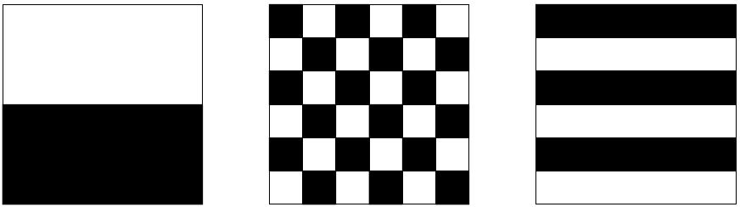
Texture
An important approach to image description is to quantify its texture content.
Texture gives us information about the spatial arrangement of the colors or intensities in an image.

Slide 3
Texture
Although no formal definition of texture exists, intuitively it can be defined as the uniformity, density, coarseness, roughness, regularity, intensity and directionality of discrete tonal features and their spatial relationships.
Texture is commonly found in natural scenes, particularly in outdoor scenes containing both natural and man-made objects.

Slide 4
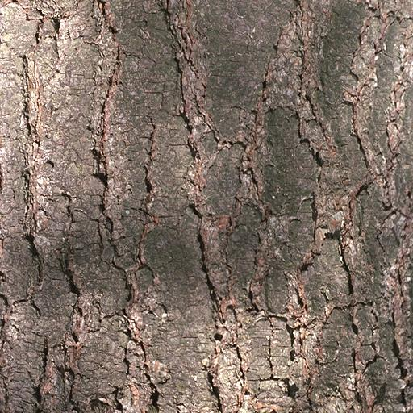
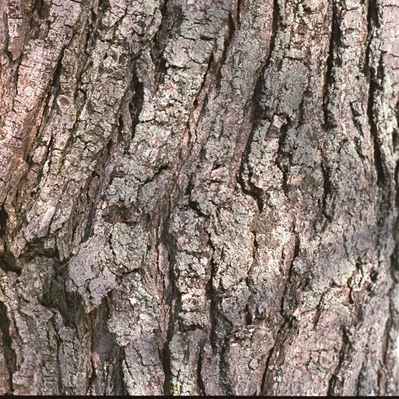
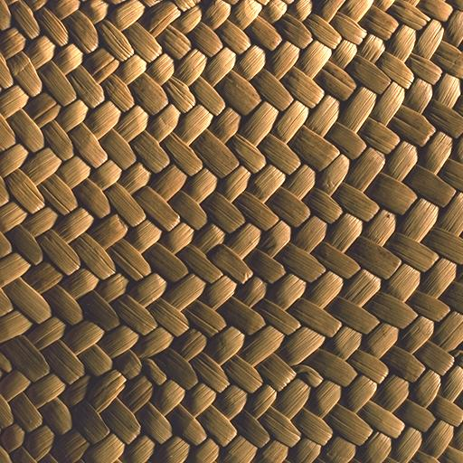
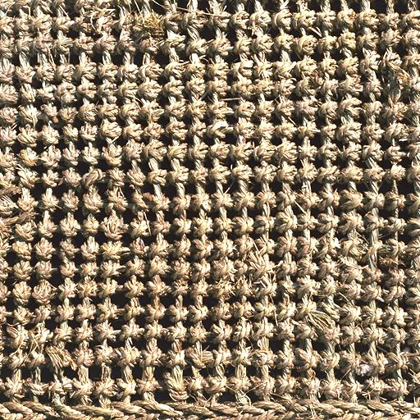
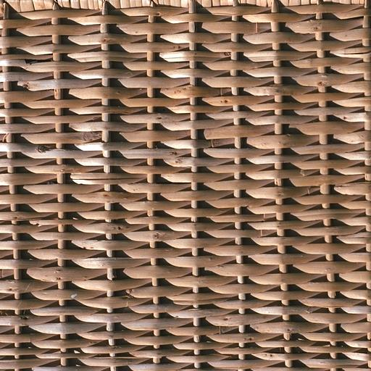
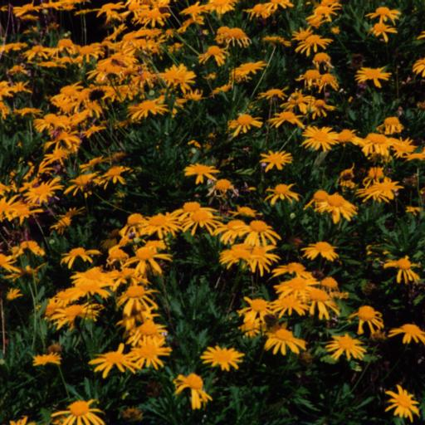
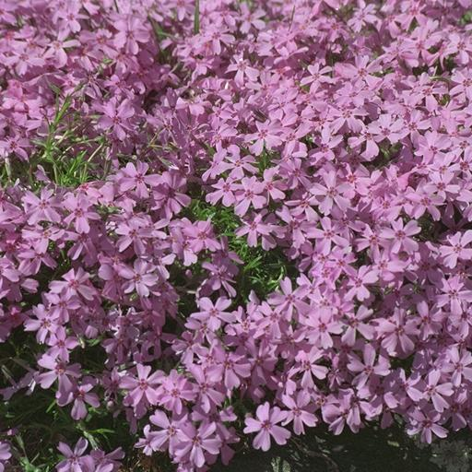
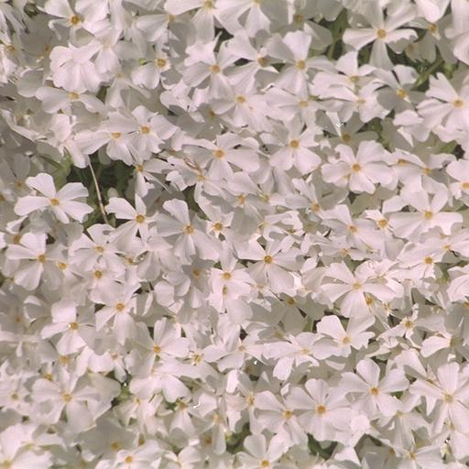
Texture
Bark Bark Fabric Fabric
Fabric Flowers Flowers Flowers

Slide 5
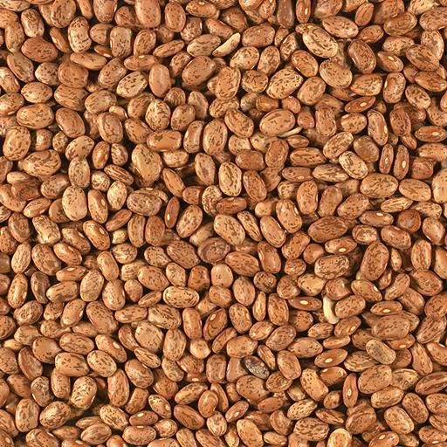
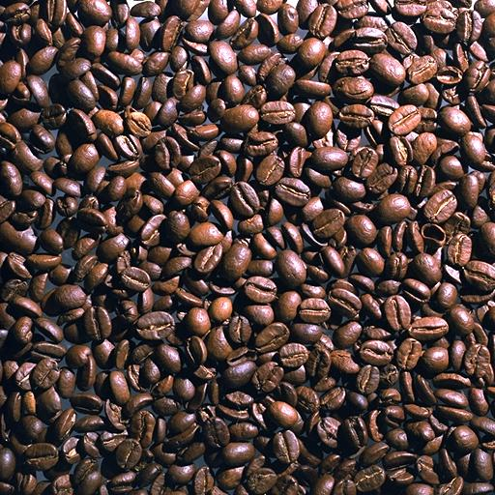
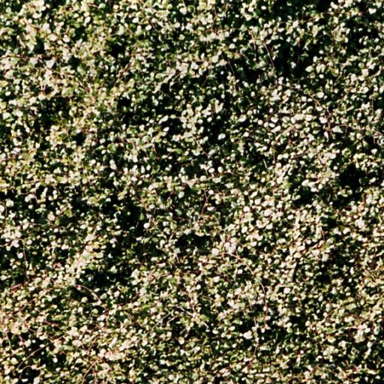
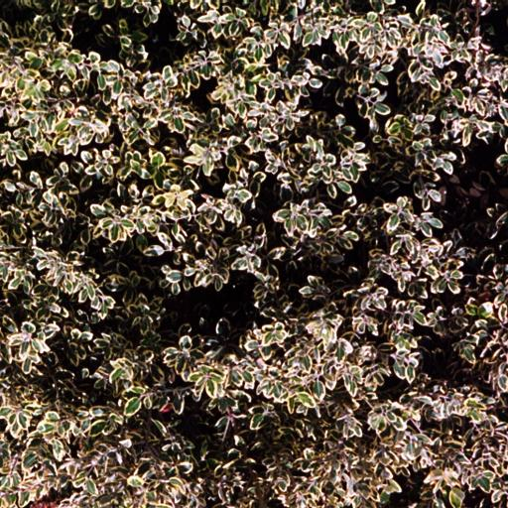
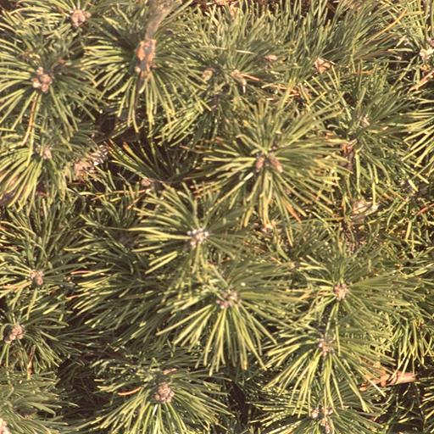
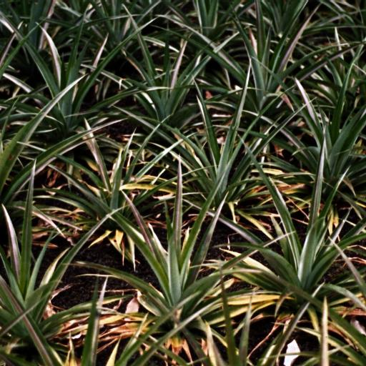
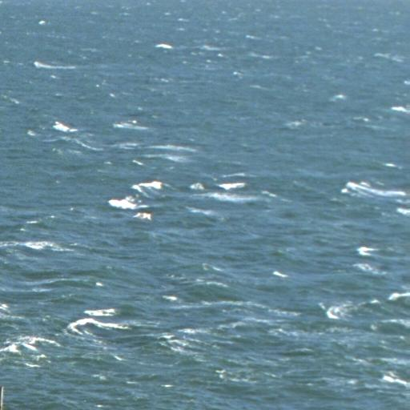
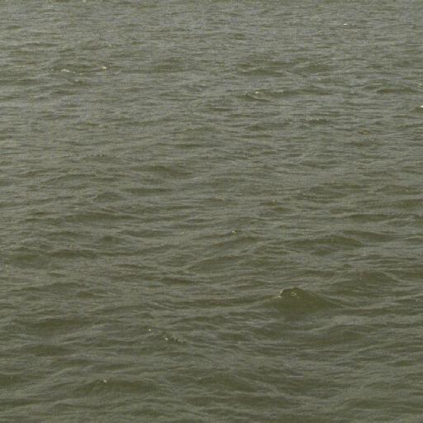
Texture
Food Food Leaves Leaves
Leaves Leaves Water Water

Slide 6

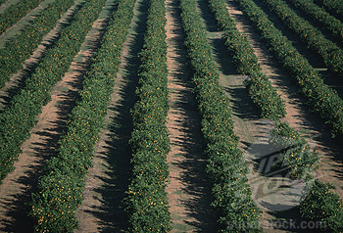
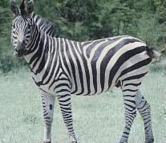

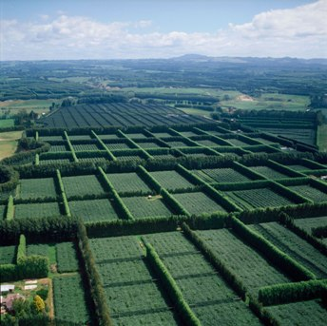
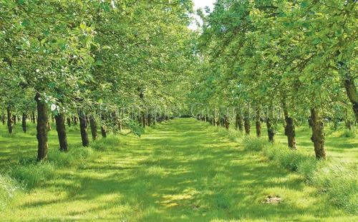
Texture
Whether an effect is a texture or not depends on the scale at which it is viewed.

Slide 7
Texture
The approaches for characterizing and measuring texture can be grouped as:
  structural approaches that use the idea that textures are made up of primitives appearing in a near-regular repetitive arrangement,
  statistical approaches that yield a quantitative measure of the arrangement of intensities.
While the first approach is appealing and can work well for man-made, regular patterns, the second approach is more general and easier to compute, and is used more often in practice.

Slide 8
Structural approaches
Structural approaches model texture as a set of texture primitives (also called texels (texture elements) or textons) in a particular spatial relationship (also called lattice or grid layout).
A structural description of a texture includes a description of the primitives and a specification of their placement patterns.
Of course, the primitives must be identifiable and their relationships must be efficiently computable.

Slide 9
Structural approaches
  Examples of periodic patterns that are extended in two linearly independent directions to cover the 2D plane. These patterns are also known as wallpaper patterns.
Y. Liu, et al., “A Computational Model for Periodic Pattern Perception Based on Frieze and Wallpaper Groups”, IEEE Trans. On Pattern Analysis and Machine Intelligence, 2004

Slide 10
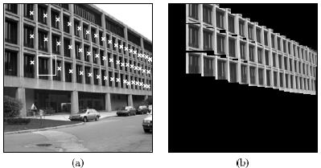
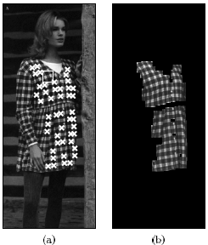
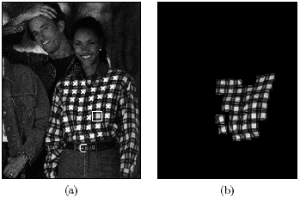
Structural approaches
  A structural texture analysis method that involves detecting interesting elements in the image, matching elements with their neighbors, and grouping the elements.
T. Leung, J. Malik, “Detecting, Localizing and Grouping Repeated Scene Elements from an Image”, ECCV 2004

Slide 11
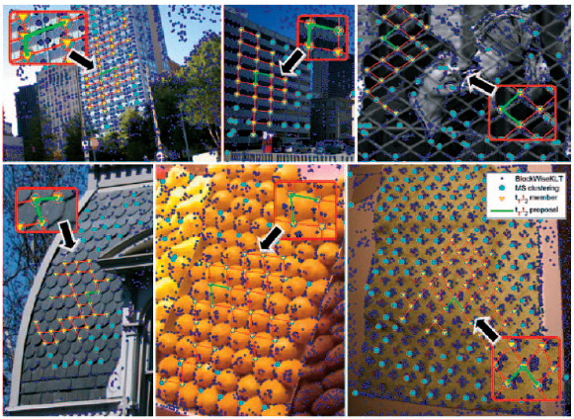
Structural approaches
A method that involves the detection of interest points, clustering of these points, voting for consistent lattice unit proposals, and iterative fitting of a lattice structure.
M. Park, et al., “Deformed Lattice Detection in Real-World Images Using Mean-Shift Belief Propagation”, IEEE Trans. On Pattern Analysis and Machine Intelligence, 2009

Slide 12
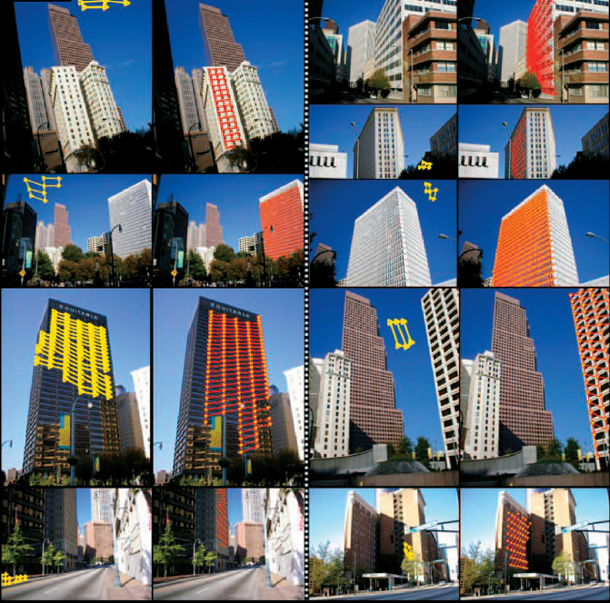
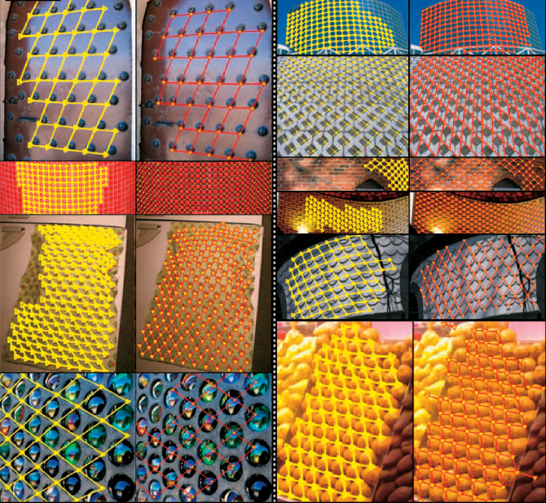
Structural approaches
Examples from two different structural texture analysis methods.
M. Park, et al., “Deformed Lattice Detection in Real-World Images Using Mean-Shift Belief Propagation”, IEEE Trans. On Pattern Analysis and Machine Intelligence, 2009

Slide 13
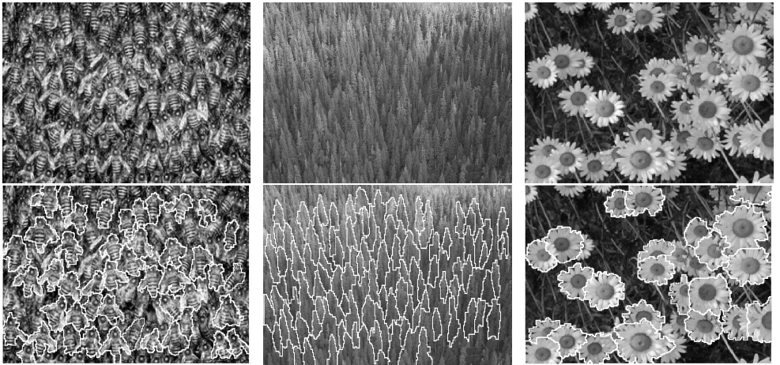
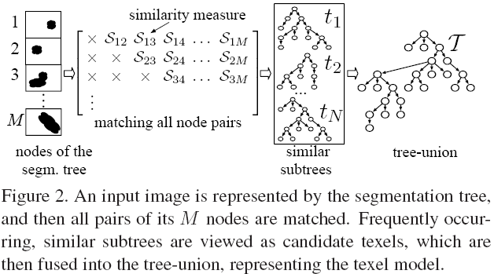
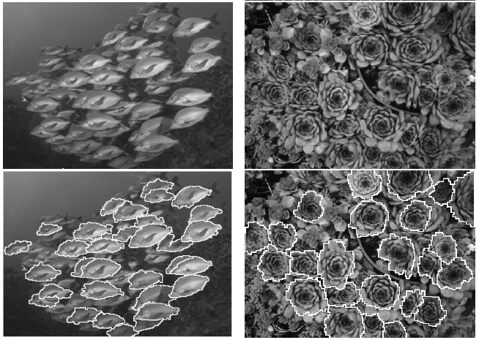
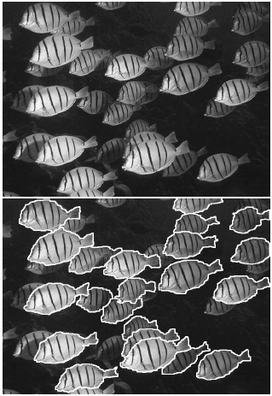
Structural approaches
A method that involves forming a hierarchical representation of the image and searching for texels within this hierarchy.
N. Ahuja, S. Todorovic, “Extracting Texels in 2.1D Natural Textures”, ICCV 2007

Slide 14
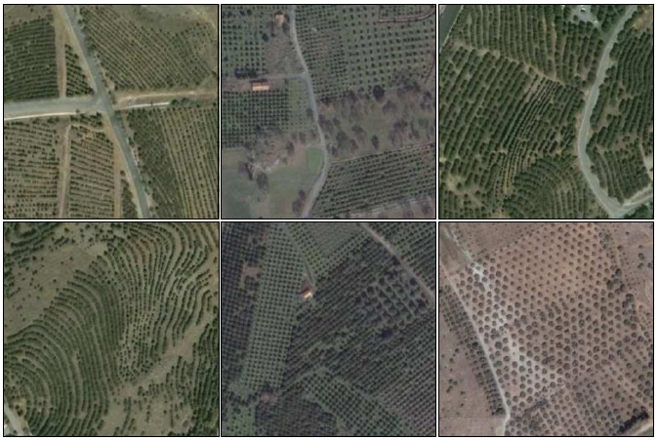
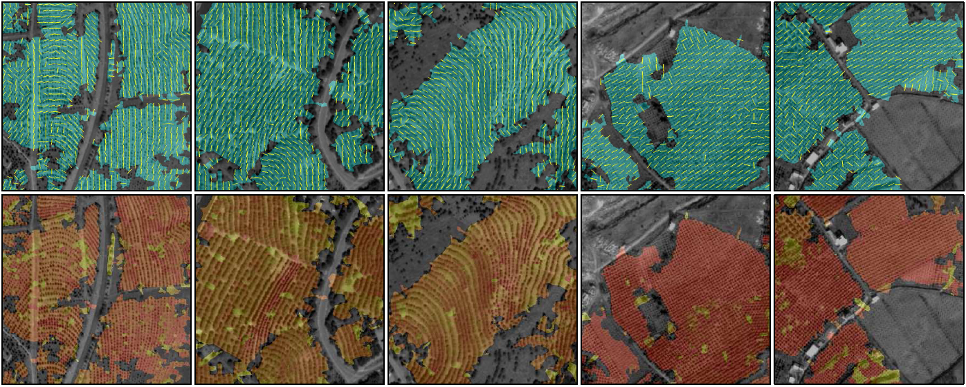
Structural approaches
A method for localization of natural structural textures using multi-orientation and multi-scale regularity analysis of textons detected using Laplacian of Gaussian filters (top: orientation estimates, bottom: scale estimates).
I. Z. Yalniz, S. Aksoy, “Unsupervised Detection and Localization of Structural Textures Using Projection Profiles”, Pattern Recognition, 2010

Slide 15
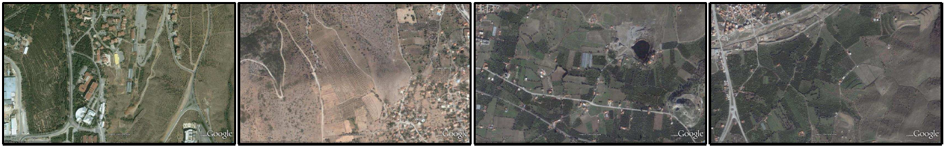
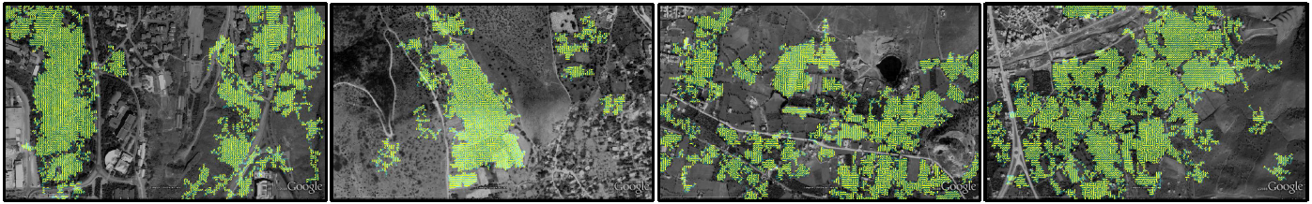
Structural approaches
Examples of natural structural texture detection in images taken from Google Earth (top: input images, bottom: localized structural textures).
I. Z. Yalniz, S. Aksoy, “Unsupervised Detection and Localization of Structural Textures Using Projection Profiles”, Pattern Recognition, 2010

Slide 16
Statistical approaches
Usually, segmenting out the texels is difficult or even impossible in real images.
Instead, numeric quantities or statistics that describe a texture can be computed from the gray tones or colors themselves.
This approach can be less intuitive, but is computationally efficient and often works well.

Slide 17
Statistical approaches
Some statistical approaches for texture:
  Edge density and direction
  Co-occurrence matrices
  Local binary patterns
  Statistical moments
  Autocorrelation
  Markov random fields
  Autoregressive models
  Mathematical morphology
  Interest points
  Fourier power spectrum
  Gabor filters

Slide 18
Edge density and direction
The number of edge pixels in a fixed-size region tells us how busy that region is.
Edge directions also help characterize the texture.
Edge-based texture measures:
  Edgeness per unit area
    F_{edgeness} = | { p | gradient_magnitude(p) ≥ threshold } | / area
  Edge magnitude and direction histograms
    F_{magdir} = ( H_{magnitude}, H_{direction} )
Two histograms can be compared by computing their L₁ or L₂ distance.

Slide 19
Edge texture
Satellite images sorted according to the amount of land development (left). Properties of the arrangements of line segments can be used to model the organization in an area (right).

Slide 20
Co-occurrence matrices
Co-occurrence, in general form, can be specified in a matrix of relative frequencies P(i, j; d, θ) with which two texture elements separated by distance d at orientation θ occur in the image, one with property i and the other with property j.
In gray level co-occurrence, as a special case, texture elements are pixels and properties are gray levels.

Slide 21
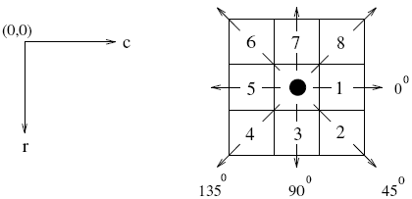
Co-occurrence matrices

Slide 22
Co-occurrence matrices
If a texture is coarse and the distance d used to compute the co-occurrence matrix is small compared to the sizes of the texture elements, pairs of pixels at separation d should usually have similar gray levels.
This means that high values in the matrix P(i, j; d, θ) should be concentrated on or near its main diagonal.
Conversely, for a fine texture, if d is comparable to the texture element size, then the gray levels of points separated by d should often be quite different, so that values in P(i, j; d, θ) should be spread out relatively uniformly.

Slide 23
Co-occurrence matrices
Similarly, if a texture is directional, i.e., coarser in one direction than another, the degree of spread of the values about the main diagonal in P(i, j; d, θ) should vary with the orientation θ.
Thus texture directionality can be analyzed by comparing spread measures of P(i, j; d, θ) for various orientations.

Slide 24
Co-occurrence matrices

Slide 25
Co-occurrence matrices
In order to use the information contained in co-occurrence matrices, Haralick et al. (SMC 1973) defined 14 statistical features that capture textural characteristics such as homogeneity, contrast, organized structure, and complexity.

Slide 26
Co-occurrence matrices

Slide 27
Co-occurrence matrices
Zucker and Terzopoulos (CGIP 1980) suggested using a chi-square statistical test to select the values of d that have the most structure for a given class of images.
N_{d}(i,j): unnormalized co-occurrence of gray level i and j for distance d.
As N gets closer to a diagonal matrix, the test gives larger values.
Notes:
Measures correlation off all I and j grayscale values.
function chi_square_test
alpha = 0;
N = 100;
X = rand(N,N);
X = X * X.' + alpha * eye(N);
c = 0;
k = sum(X,2);
for i = 1:N
for j = 1:N
c = c + X(i,j)^2 / (k(i) * k(j));
end
end
c = c - 1;
disp(c);

Slide 28
Co-occurrence matrices
Example building groups (first column), the contrast features for 0 and 67.5 degree orientations (second and third columns), and the chi-square features for 0 and 67.5 degree orientations (fourth and fifth columns). X-axes represent inter-pixel distances of 1 to 60. The features at a particular orientation exhibit a periodic structure as a function of distance if the neighborhood contains a regular arrangement of buildings along that direction. On the other hand, features are very similar for different orientations if there is no particular arrangement in the neighborhood.

Slide 29
Local binary patterns
For each pixel p, create an 8-bit number b₁ b₂ b₃ b₄ b₅ b₆ b₇ b₈, where b_{i} = 0 if neighbor i has value less than or equal to p’s value and 1 otherwise.
Represent the texture in the image (or a region) by the histogram of these numbers.
1 2 3
100 | 101 | 103
40 | 50 | 80
50 | 60 | 90
8
4
1 1 1 1 1 1 0 0
7 6 5

Slide 30
Local binary patterns
The fixed neighborhoods were later extended to multi-scale circularly symmetric neighbor sets.

Slide 31
Autocorrelation
The autocorrelation function of an image can be used to
  detect repetitive patterns of texture elements, and
  describe the fineness/coarseness of the texture.
The autocorrelation function ρ(dr,dc) for displacement d=(dr,dc) is given by

Slide 32
Autocorrelation
Interpreting autocorrelation:
  Coarse texture → function drops off slowly
  Fine texture → function drops off rapidly
  Can drop differently for r and c
  Regular textures → function will have peaks and valleys; peaks can repeat far away from [0,0]
  Random textures → only peak at [0,0]; breadth of peak gives the size of the texture

Slide 33
Fourier power spectrum
The autocorrelation function is related to the power spectrum of the Fourier transform.
The power spectrum contains texture information because
  prominent peaks in the spectrum give the principal direction of the texture patterns,
  location of the peaks gives the fundamental spatial period of the patterns.

Slide 34
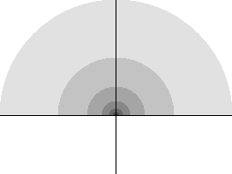
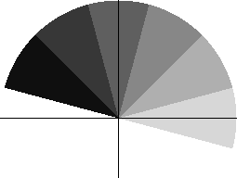
Fourier power spectrum
The power spectrum, represented in polar coordinates, can be integrated over regions bounded by circular rings (for frequency content) and wedges (for orientation content).

Slide 35
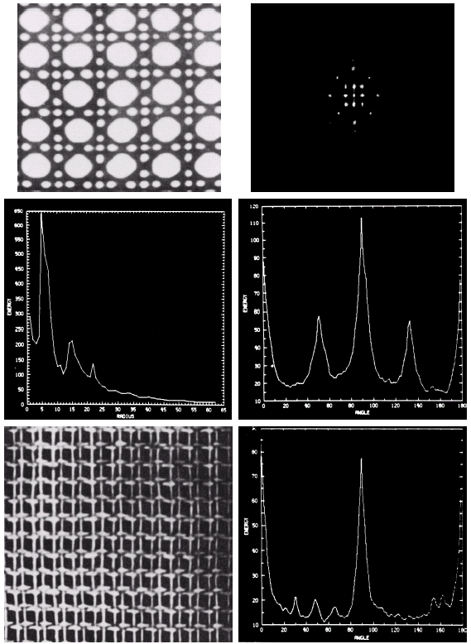

Fourier power spectrum

Slide 36


Gabor filters
Gabor filters can be considered as orientation and scale tunable edge and line detectors.
A 2D Gabor function g(x,y) and its Fourier transform G(u,v) can be written as
where and .

Slide 37
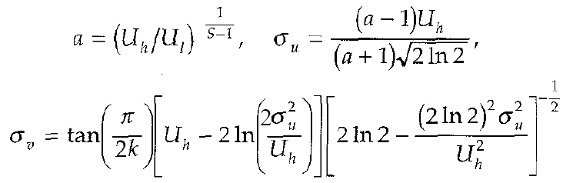
Gabor filters
Let U_{l} and U_{h} denote the lower and upper center frequencies of interest, K be the number of orientations, and S be the number of scales, the filter parameters can be selected as
where W = U_{h} and m = 0, 1, …, S-1.

Slide 38
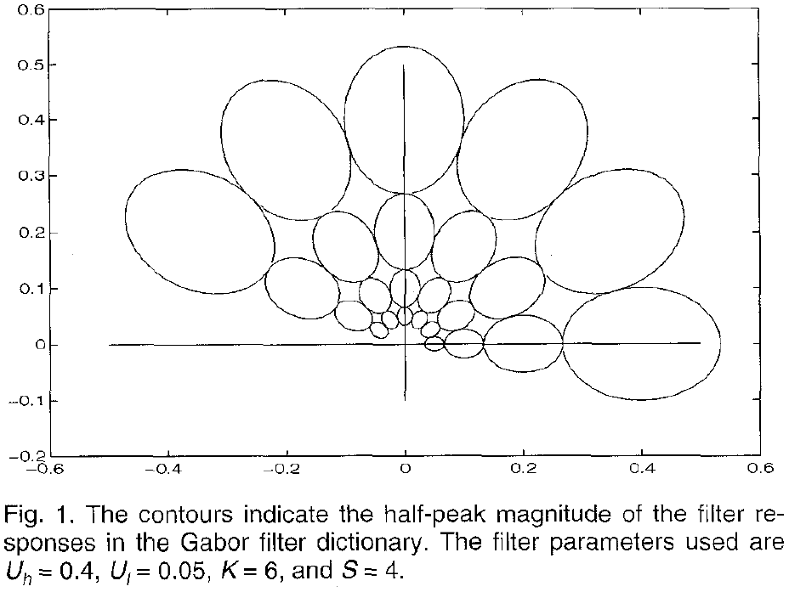
Gabor filters

Slide 39
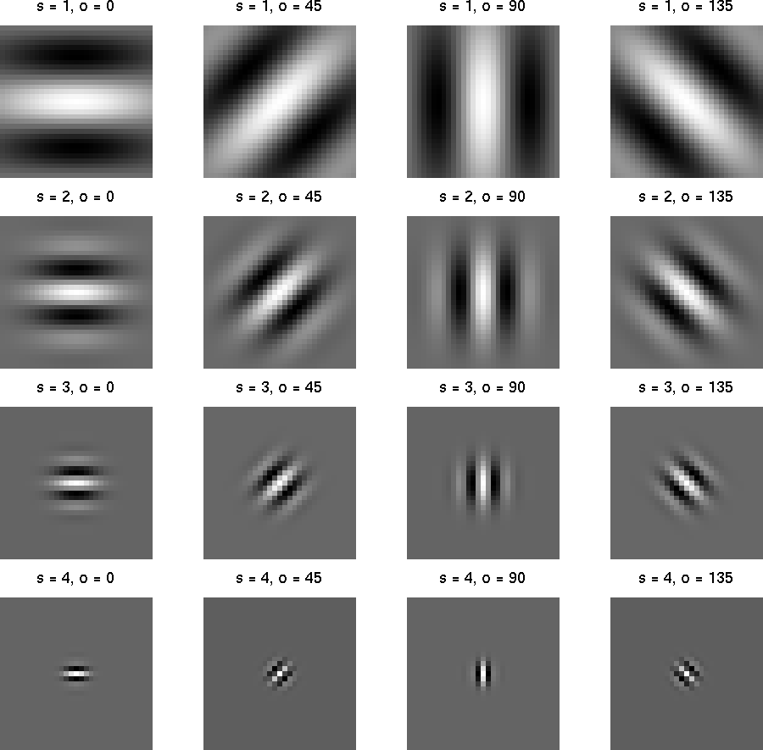
Gabor filters
Filters at multiple scales and orientations.

Slide 40
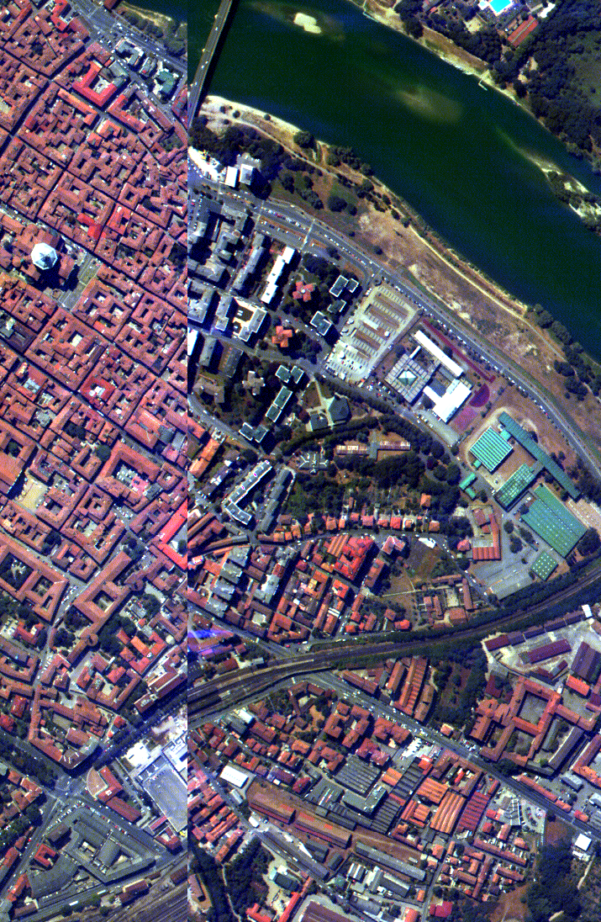
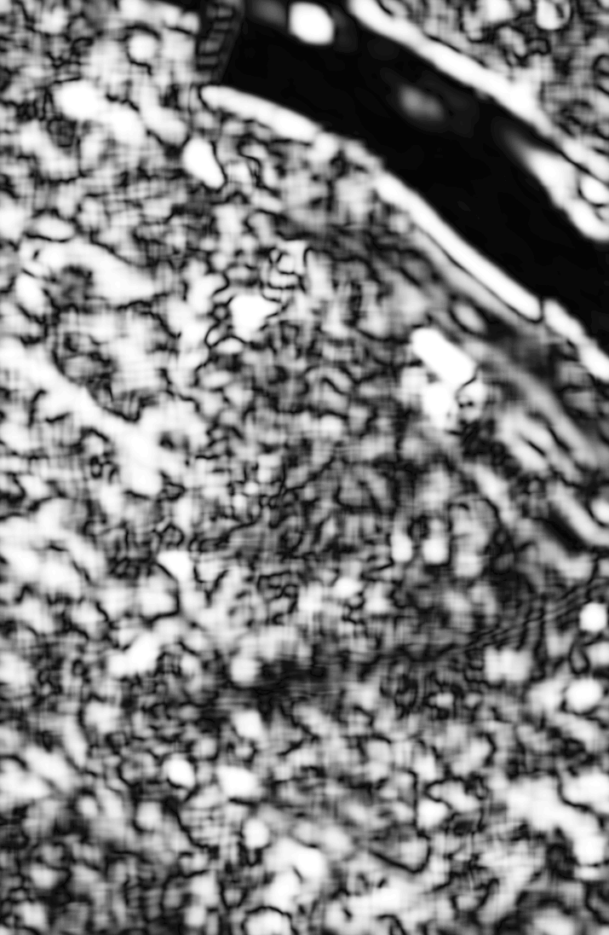
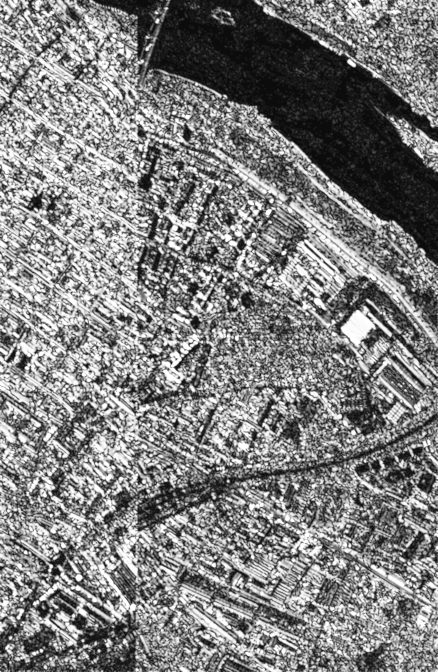
Gabor filters
Gabor filter responses for a satellite image.

Slide 41
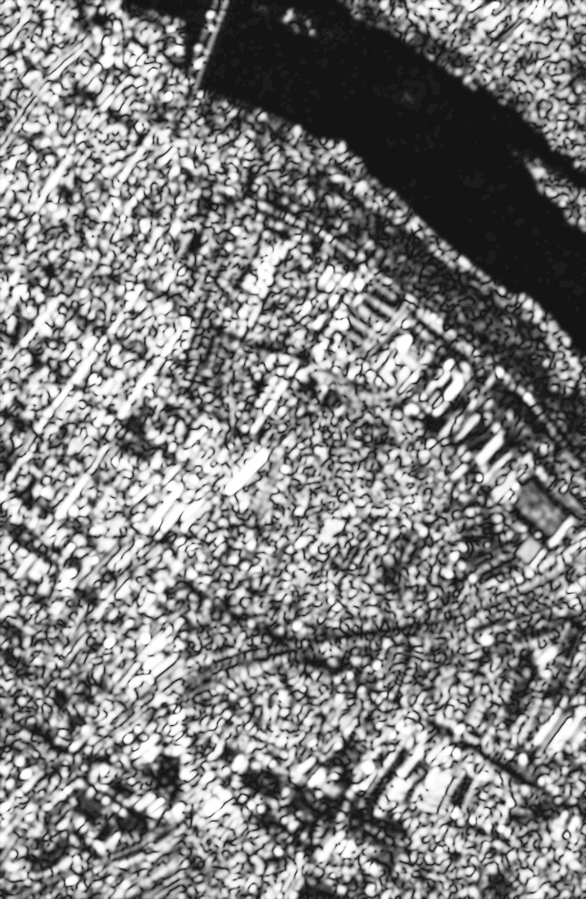
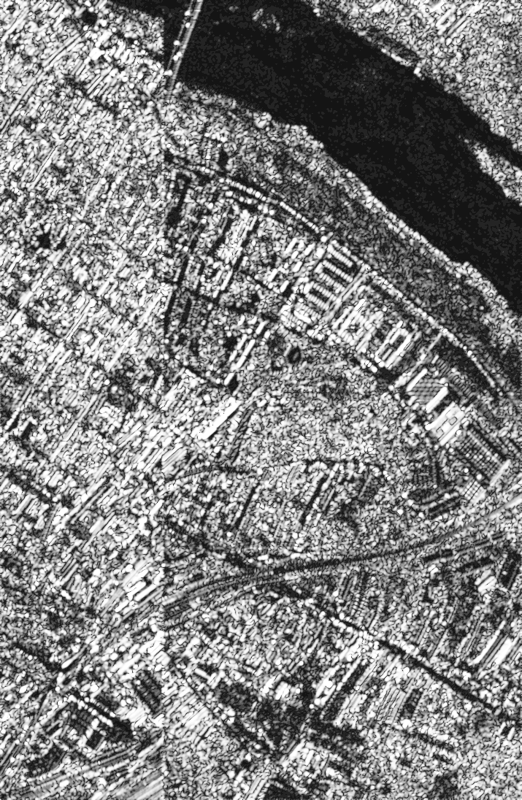
Gabor filters
Gabor filter responses for a satellite image.

Slide 42
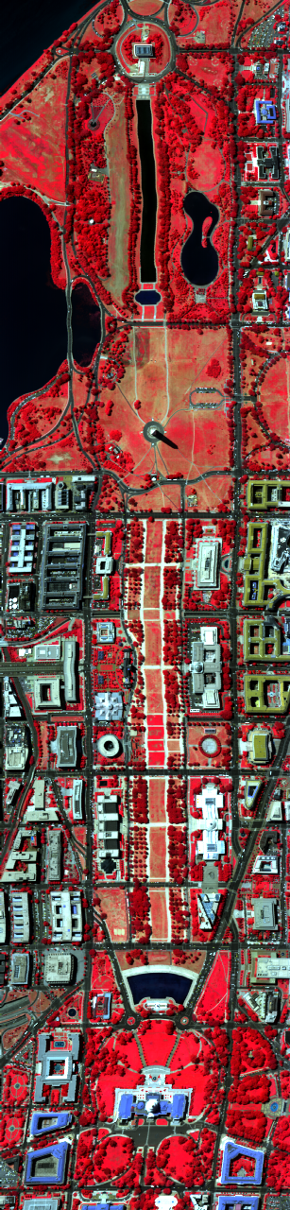
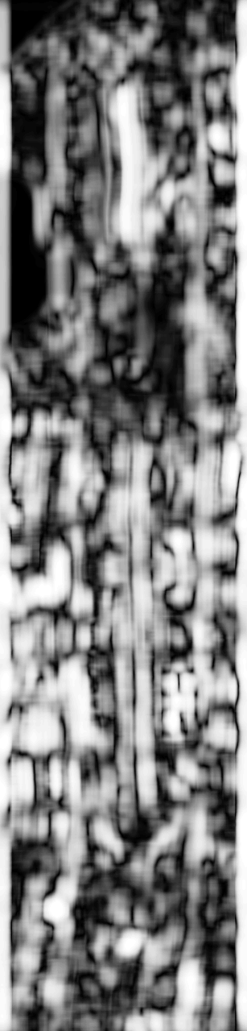
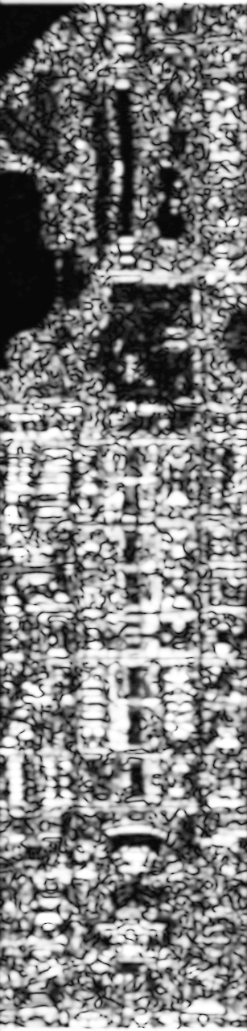

Gabor filter responses for a satellite image.

Slide 44

Gabor filters

