Slide 1
Slides used by permission from
Joseph Redmon, CSE 455, Autumn 2019
University of Washington, Seattle
Paul G. Allen School of Computer Science & Engineering
https://courses.cs.washington.edu/courses/cse455/19au/

Slide 3
What is machine learning?
Algorithms to approximate functions
Usually use lots of statistics
Usually minimize some form of loss function
Supervised learning
Given inputs to a function, try to predict the output
Have lots of labelled examples
Semi-supervised learning
Same but number of labelled examples < number of examples
Unsupervised learning
Want to model unlabelled data
Find similarities and differences between subgroups of data
Learn functions to generate new data

Slide 4
Supervised Learning (typically)
Have data with labels, want to take new data and predict correct label
Pick a model Do you know anything a priori about your data? Is it linear, polynomial, etc?
Pick a loss function Easy to calculate function of model parameters given training data Should give an approximation of how “good” your model is E.g. Sum squared error (L₂ loss), sum absolute differences (L₁ loss), etc…
Pick model parameters to minimize loss Find local or global minimum of loss. How? Set derivative = 0, closed form solution, gradient descent, etc

Slide 5
Gradient descent
For some loss function L_{data}(w), gradient ∇L_{data}(w) points towards in direction of steepest ascent.
In 1d, either points left or right

Slide 6
Gradient descent
For some loss function L_{data}(w), gradient ∇L_{data}(w) points towards in direction of steepest ascent.
In 1d, either points left or right
Algorithm:
Take derivative Move slightly in other direction Repeat

Slide 7
Gradient descent
For some loss function L_{data}(w), gradient ∇L_{data}(w) points towards in direction of steepest ascent.
In 1d, either points left or right
Algorithm:
Take derivative Move slightly in other direction Repeat

Slide 8
Gradient descent
Algorithm:
Take derivative Move slightly in other direction Repeat
End up at local optima

Slide 9
Gradient descent
Formally: w_{t+1}= w_{t} - η ∇L(w)
Where η is step size, how far to step relative to the gradient

Slide 10
Gradient descent
Calculating ∇L(w) can be hard, especially for big data, |data| very large.
What if we estimate it it instead?
How do we estimate things?

Slide 11
Stochastic gradient descent (SGD)
Estimate ∇L_{data}(w) with only some of the data
Before: w_{t+1} = w_{t} - η Σ_{i}∇L_{i}(w), for all i in data
Now: w_{t+1} = w_{t} - η Σ_{j}∇L_{j}(w), for some subset j
Maybe even: w_{t+1} = w_{t} - η ∇L_{k}(w), for some random k
# of points used for update is called batch size

Slide 12
Case study: Image classification
https://lear.inrialpes.fr/~verbeek/mlcr.slides.11.12/sanchez11cvpr.pdf
Given an image, what’s in it?
Old state-of-the-art: Extract features from image SIFT and Fisher Vectors Train Linear SVM
On 1000 different classes, 54% accurate

Slide 13
What’s wrong with this?
Machine learning needs features!!
What are the right features? HOG? SIFT? FV?

Slide 14
What’s wrong with this?
Machine learning needs features!!
What are the right features? HOG? SIFT? FV?
Why not let the algorithm decide

Slide 15
What’s wrong with this?
Machine learning needs features!!
What are the right features? HOG? SIFT? FV?
Why not let the algorithm decide
Neural networks: Feature extraction + linear model

Slide 16
Success of Neural Networks
Image classification:
54% -> 80% accuracy on 1000 classes
Object detection:
33% mAP (DPM) -> 88% mAP on 20 classes

Slide 18
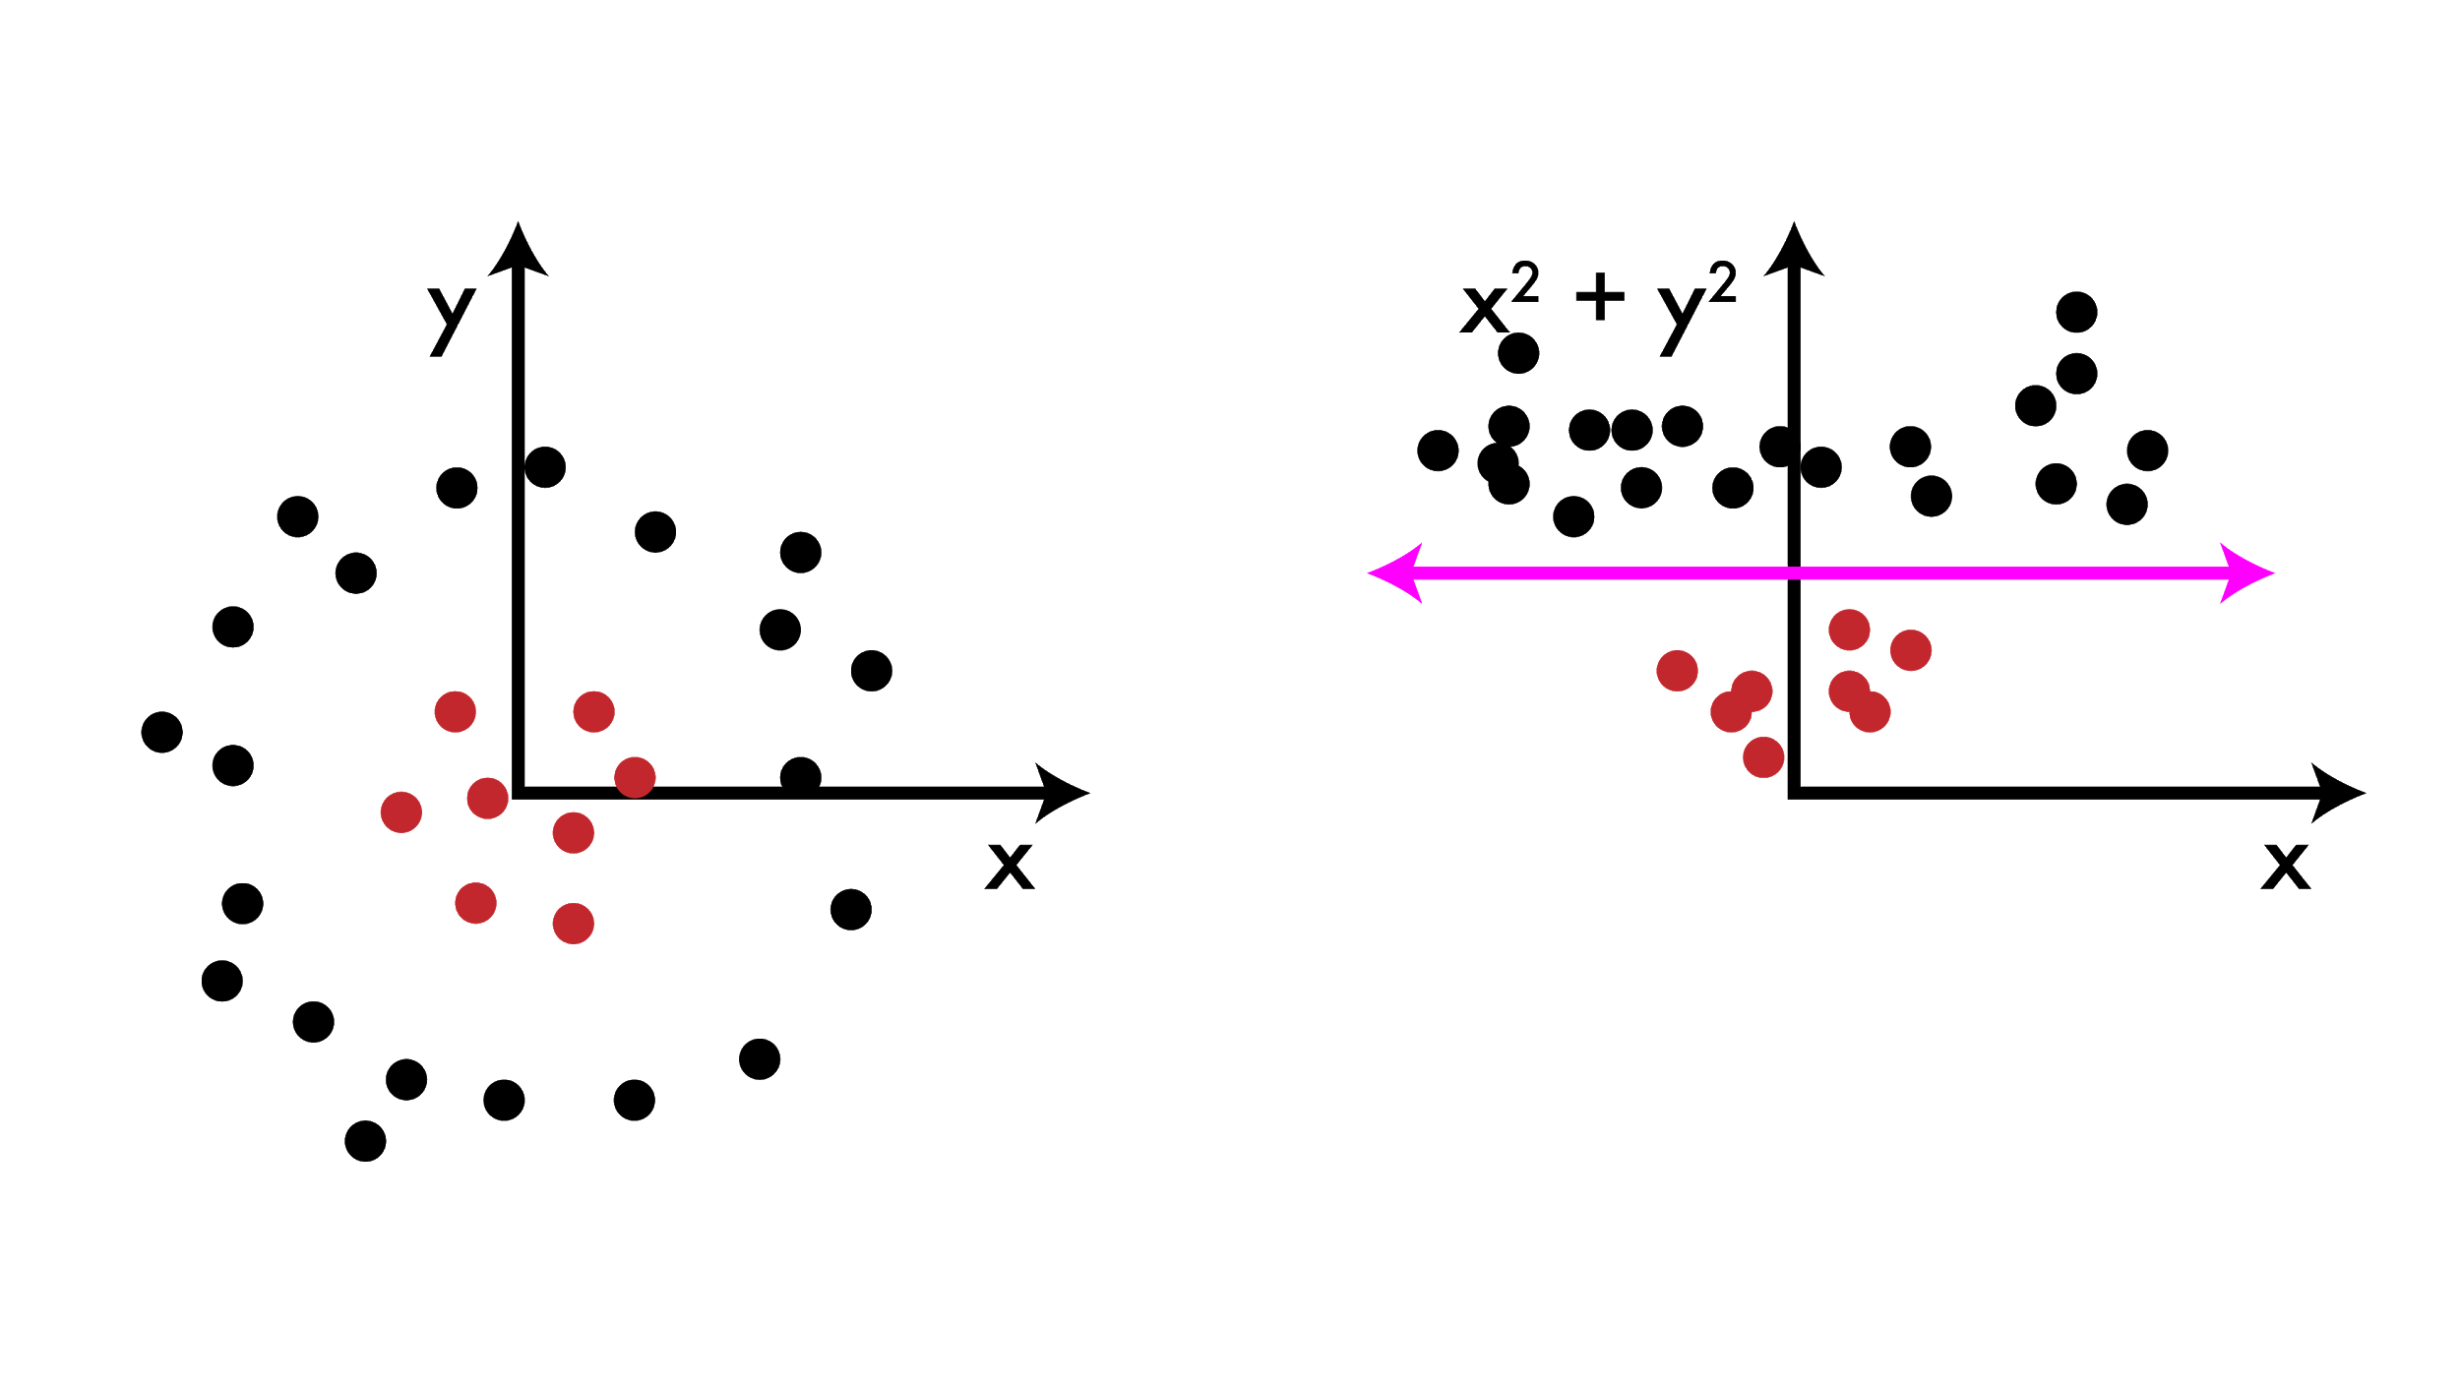
What is feature engineering?
Arguably the core problem of machine learning (especially in practice)
ML models work well if there is a clear relationship between the inputs and outputs of the function you are trying to model

Slide 19
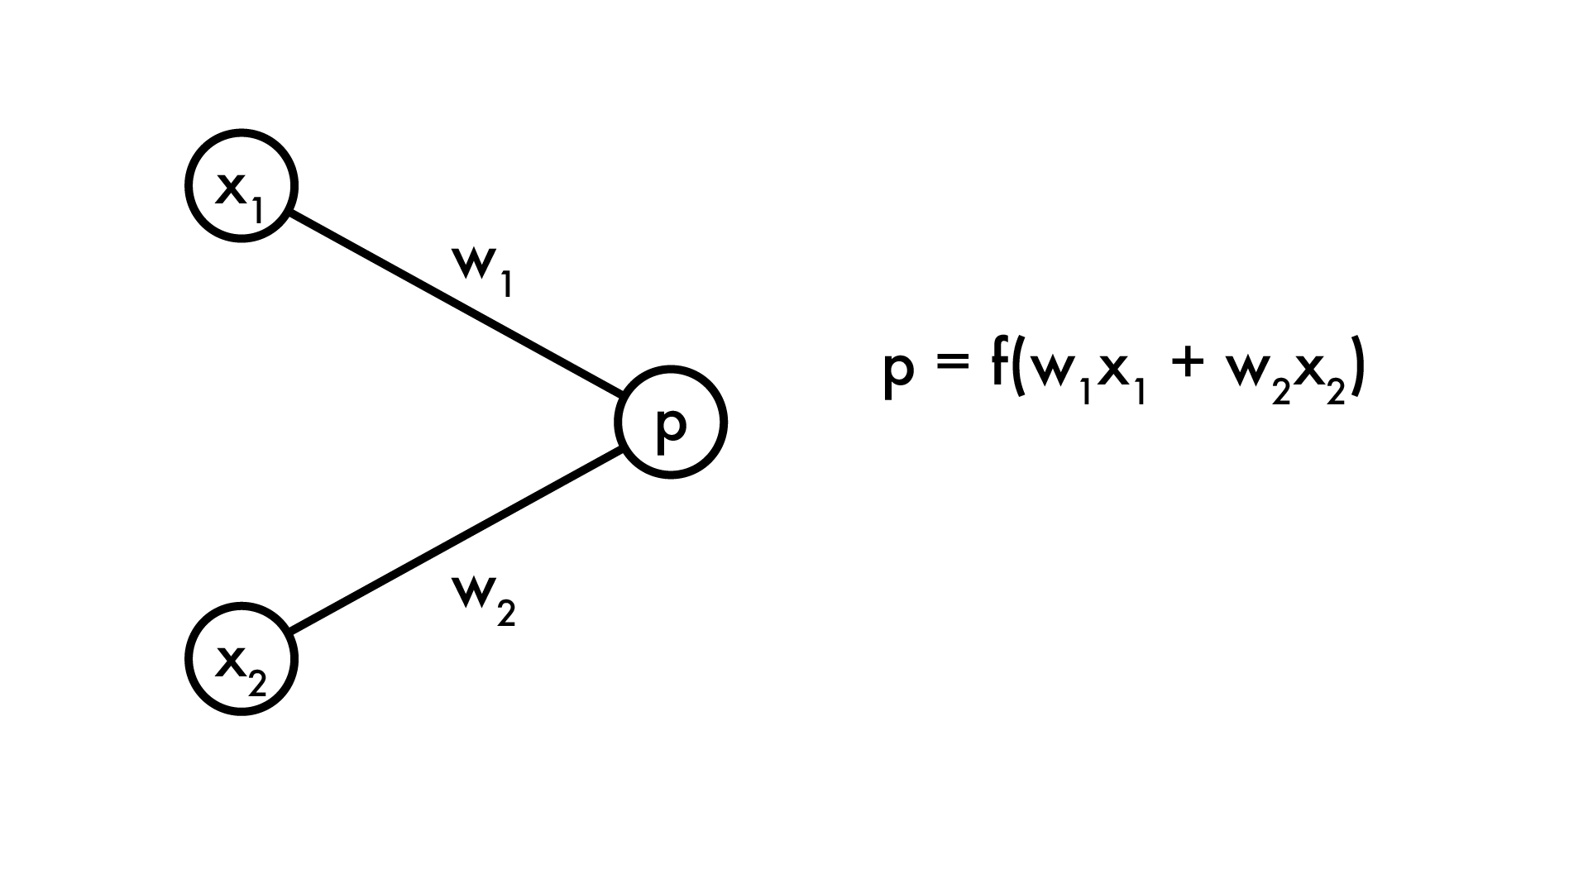
Linear model can’t do this
Cannot learn transformations of features, only use existing features. Human must create good features

Slide 20
What if we added more processing?
Generally, feature engineering is just coming up with combinations of the features we already have

Slide 21
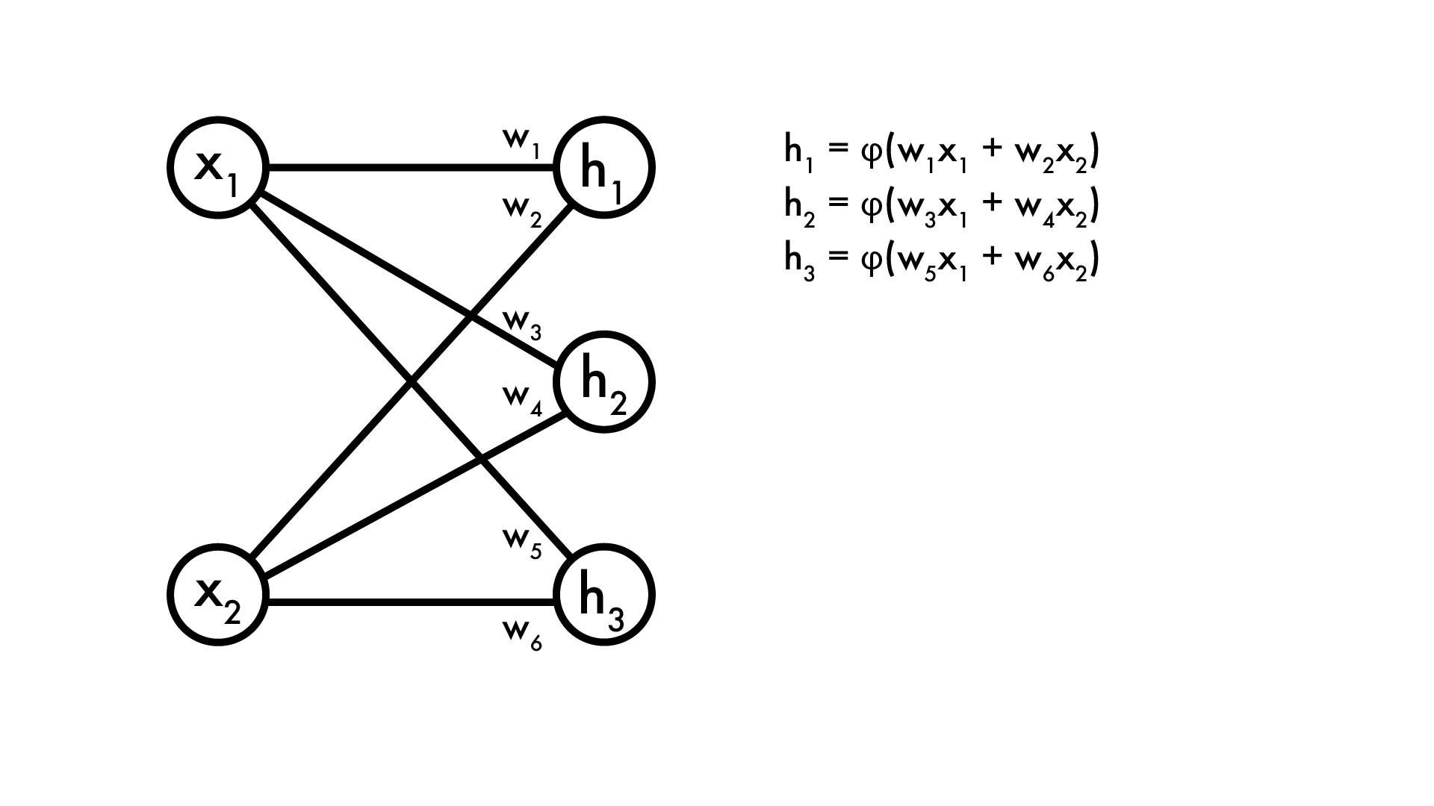
What if we added more processing?
Create “new” features using old ones. We’ll call H our hidden layer

Slide 22
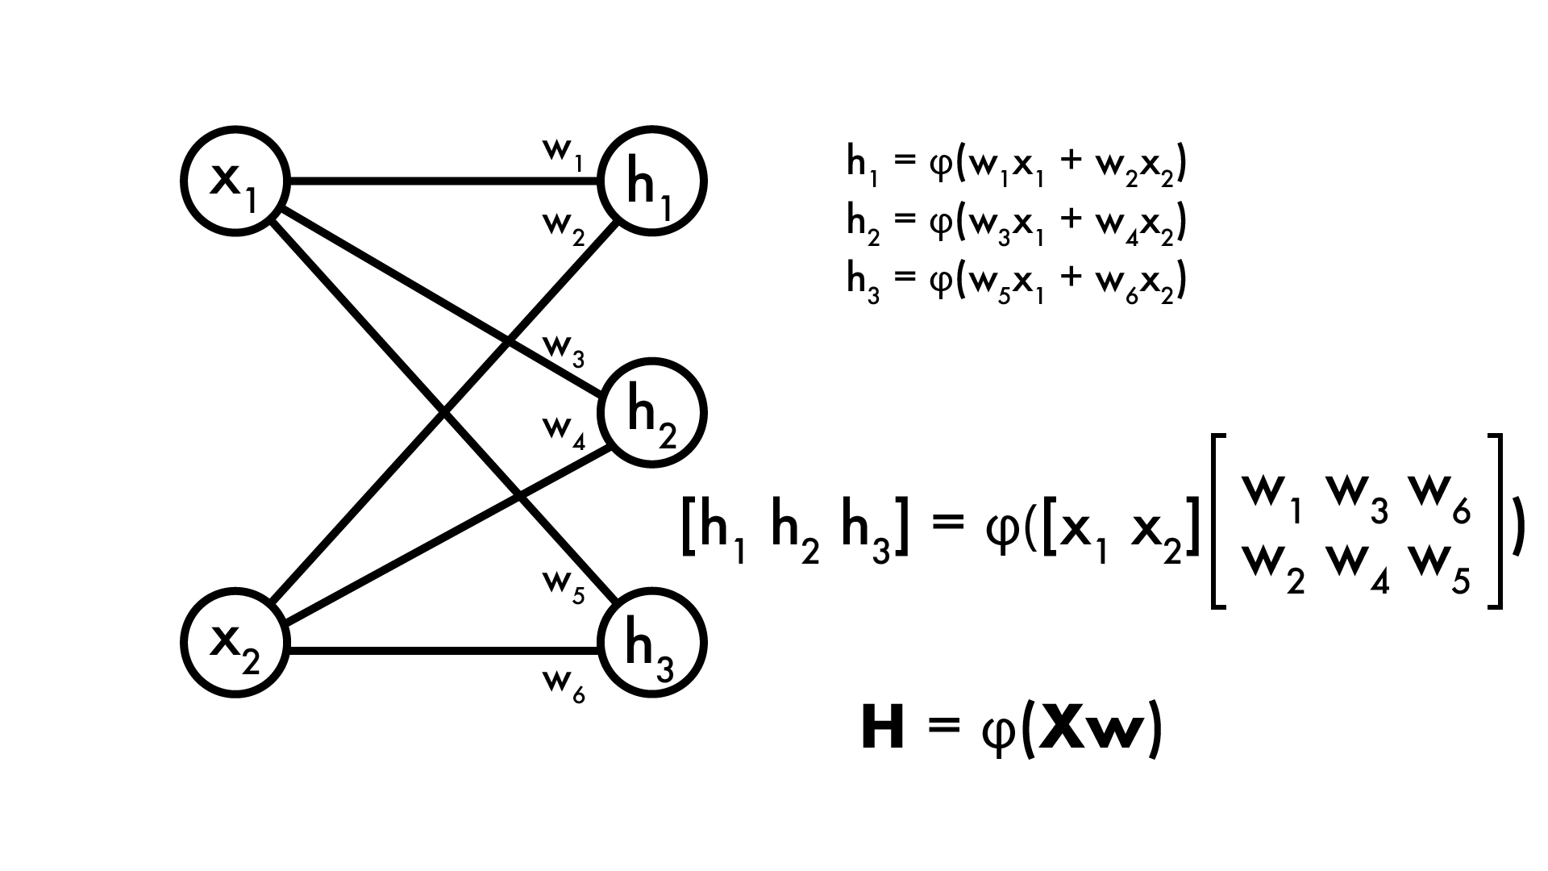
What if we added more processing?
As with linear model, H can be expressed in matrix operations

Slide 23
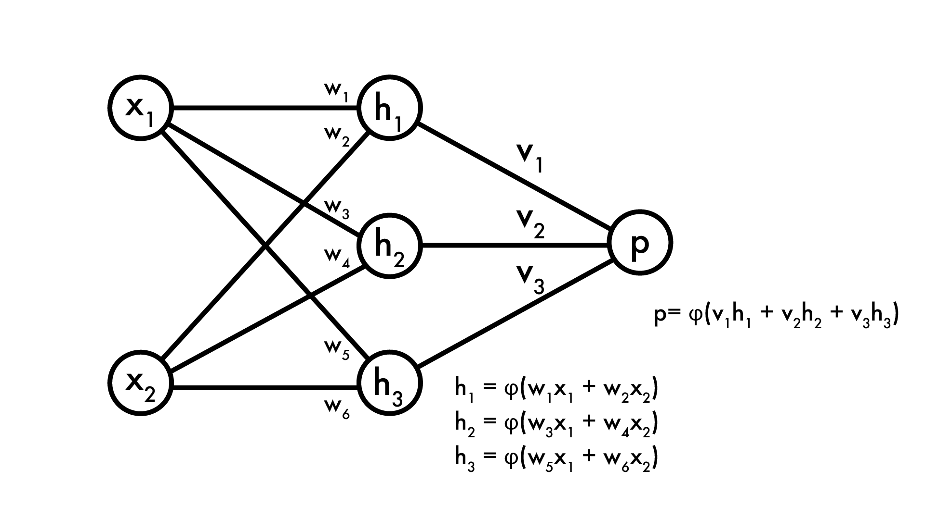
What if we added more processing?
Now our prediction p is a function of our hidden layer

Slide 24
What if we added more processing?
Now our prediction p is a function of our hidden layer
Feature extractor

Slide 25
What if we added more processing?
Now our prediction p is a function of our hidden layer
Feature extractor
Linear model

Slide 26
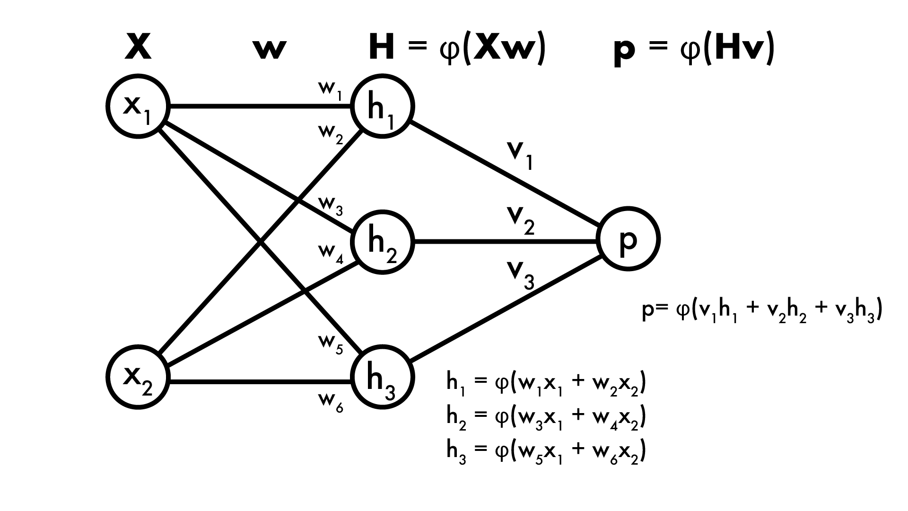
What if we added more processing?
Can still express the whole process in matrix notation! Nice because matrix ops are fast

Slide 27
This is a neural network!
This one has 1 hidden layer, but can have way more Each layer is just some function φ applied to linear combination of the previous layer

Slide 28
φ is our activation function
Want to apply some extra processing at each layer. Why? Imagine φ(x) = x, linear activation

Slide 29
φ is our activation function
Want to apply some extra processing at each layer. Why? Imagine φ(x) = x, linear activation
p = v₁h₁ + v₂h₂ + v₃h₃
But h₁ = x₁w₁ + x₂w₂, h₂ = … etc So p = v₁w₁x₁ + v₁w₂x₂ + v₂w₃x₁ + v₂w₄x₂ + v₃w₅x₁ + v₃w₆x₂ = (v₁w₁+v₂w₃+v₃w₅)x₁ + (v₁w₂+v₂w₄+v₃w₆)x₂ = u₁x₁ + u₂x₂

Slide 30
Universal approximation theorem
https://en.wikipedia.org/wiki/Universal_approximation_theorem
What if φ not linear?
Universal approximation theorem (Cybenko 89, Hornik 91) φ: any nonconstant, bounded, monotonically increasing function I_{m}: m-dimensional unit hypercube (interval [0-1] in m-d) Then 1-layer neural network with φ as activation can model any continuous function f: I_{m} -> R (no bound on size of hidden layer)
By extension, works on f: bounded R^{m} -> R
What can we learn? What can’t we?
UAT just says it’s possible to model, not how.

Slide 31
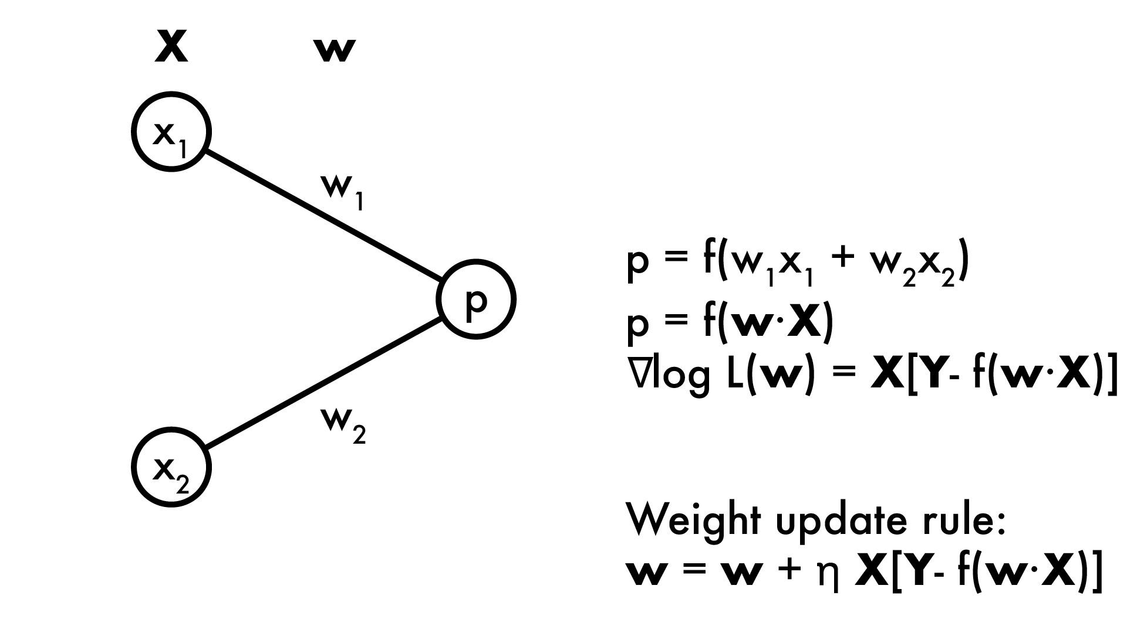
How do we learn it?
Neural networks are non-convex with no closed form solution (can’t take derivative and set = 0)
Gradient descent! Recall for linear model:

Slide 32
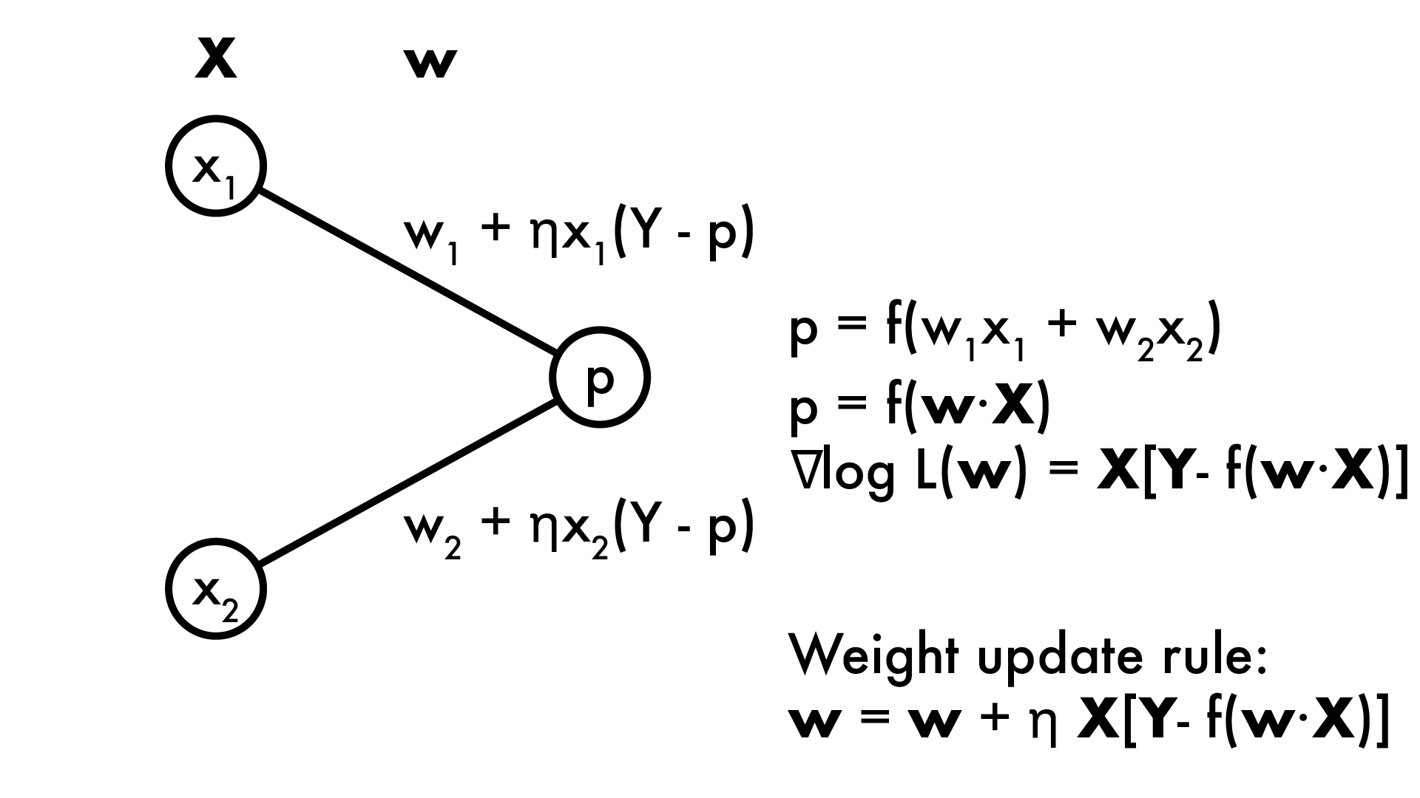
How do we learn it?
With gradient descent we calculate the partial derivatives of the loss (or likelihood) function for every weight: ∂/∂w_{i} log L(w)
Then do gradient descent (or ascent) by adding gradient to weight

Slide 33
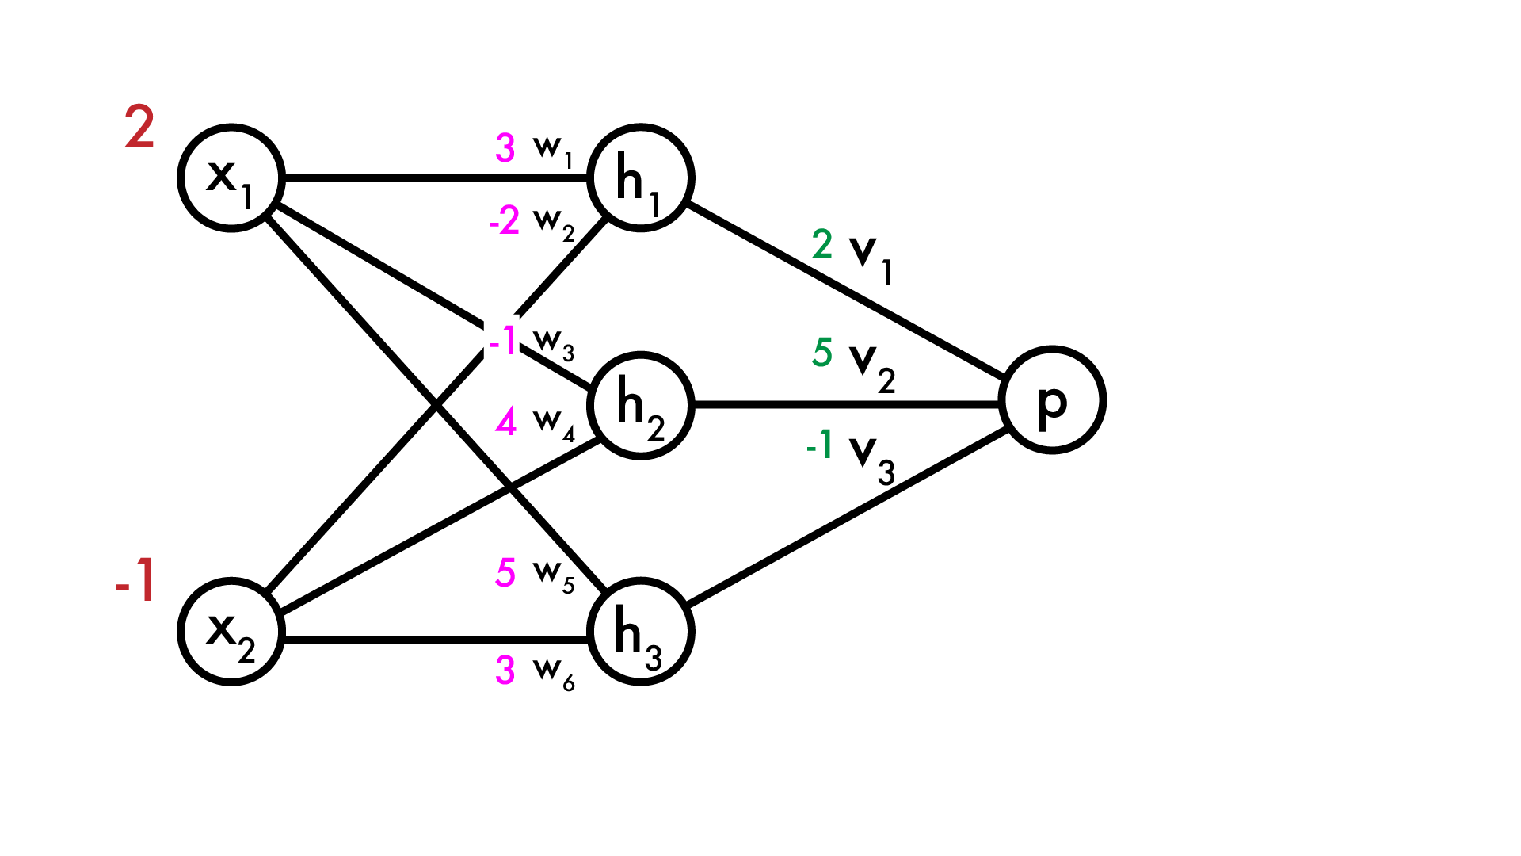
How do we learn it?
Now we have a “real” neural network (using linear activation for simplicity). How do we predict p?

Slide 34
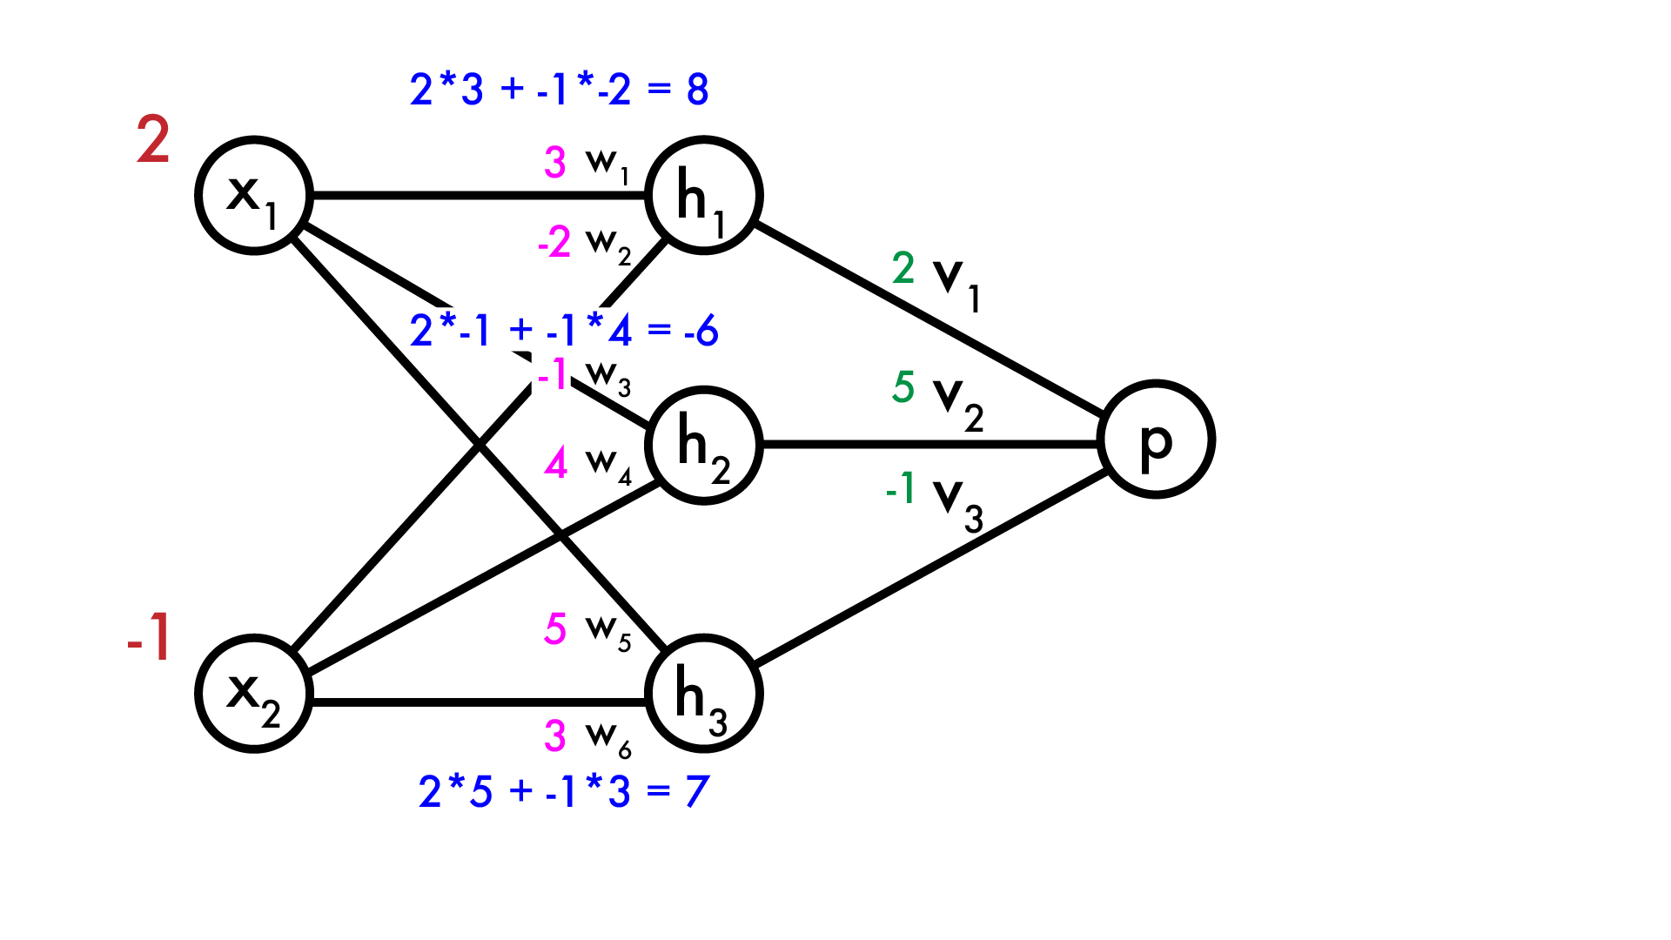
How do we learn it?
Now we have a “real” neural network (using linear activation for simplicity). How do we predict p? Calculate hidden layer neurons

Slide 35
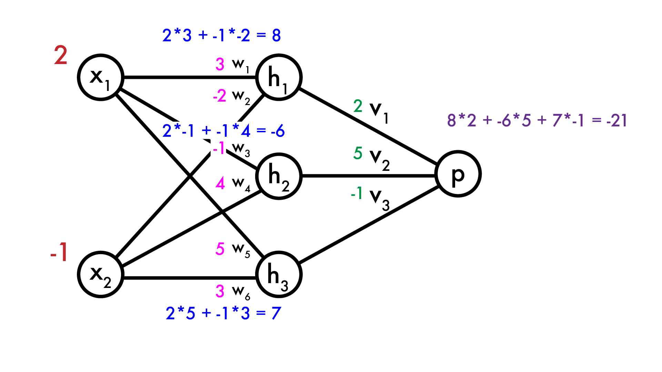
How do we learn it?
Now we have a “real” neural network (using linear activation for simplicity). How do we predict p? Calculate hidden layer neurons Calculate output p

Slide 36
How do we learn it?
Say we want to make p larger. How do we modify the weights? The first layer is easy, same as normal linear model:

Slide 37
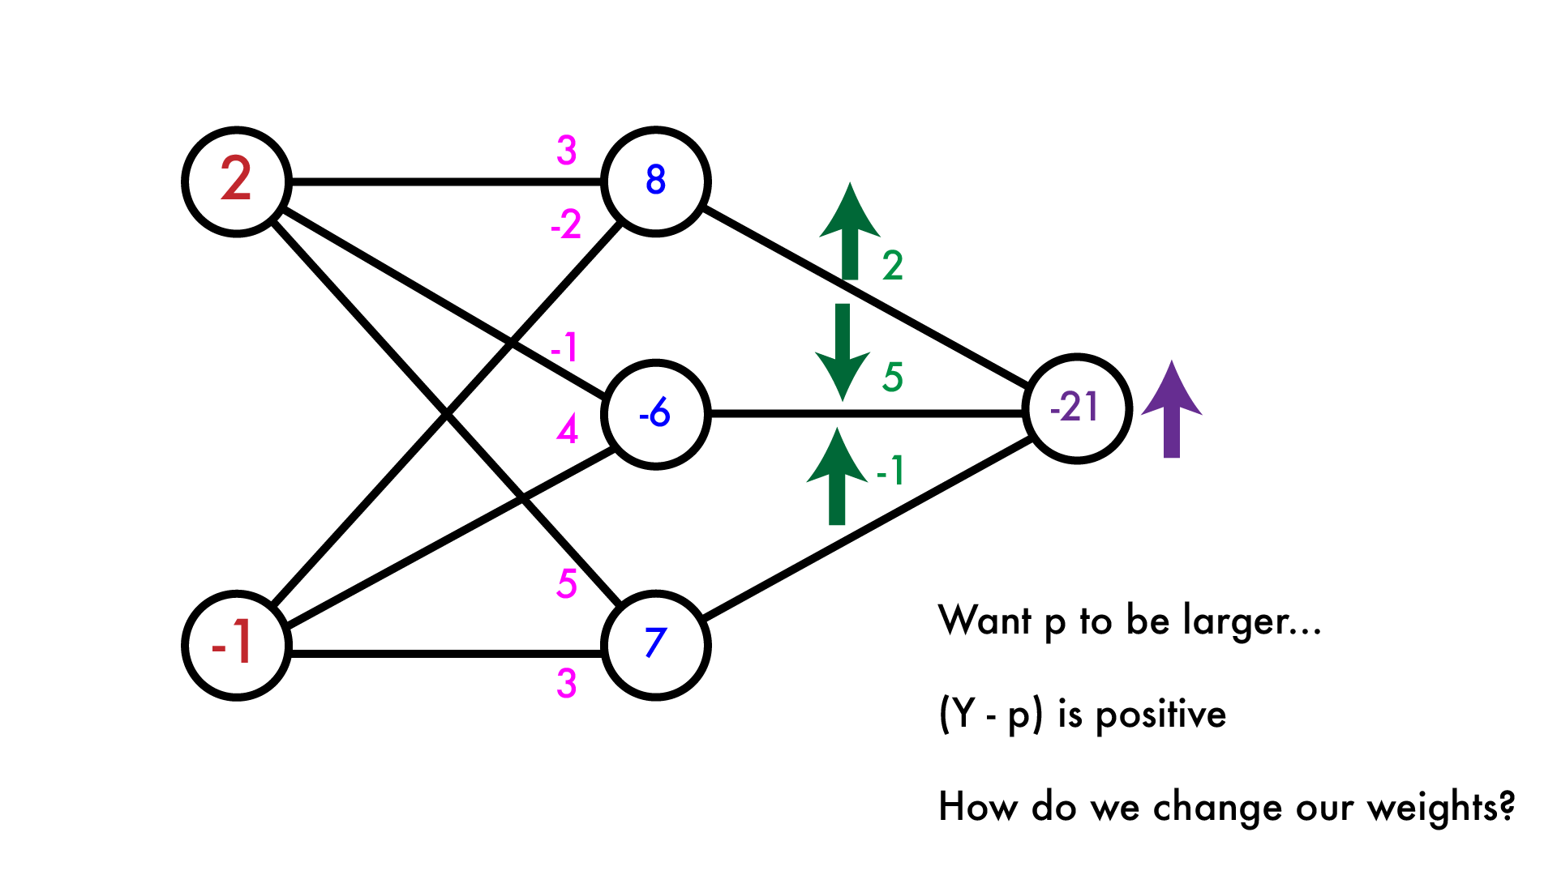
How do we learn it?
Say we want to make p larger. How do we modify the weights? The first layer is easy, same as normal linear model:

Slide 38
How do we learn it?
Now what? Let’s calculate the “error” that the hidden layer makes. We want p to be larger, given current weights how should we adjust the hidden layer output to do that?

Slide 39
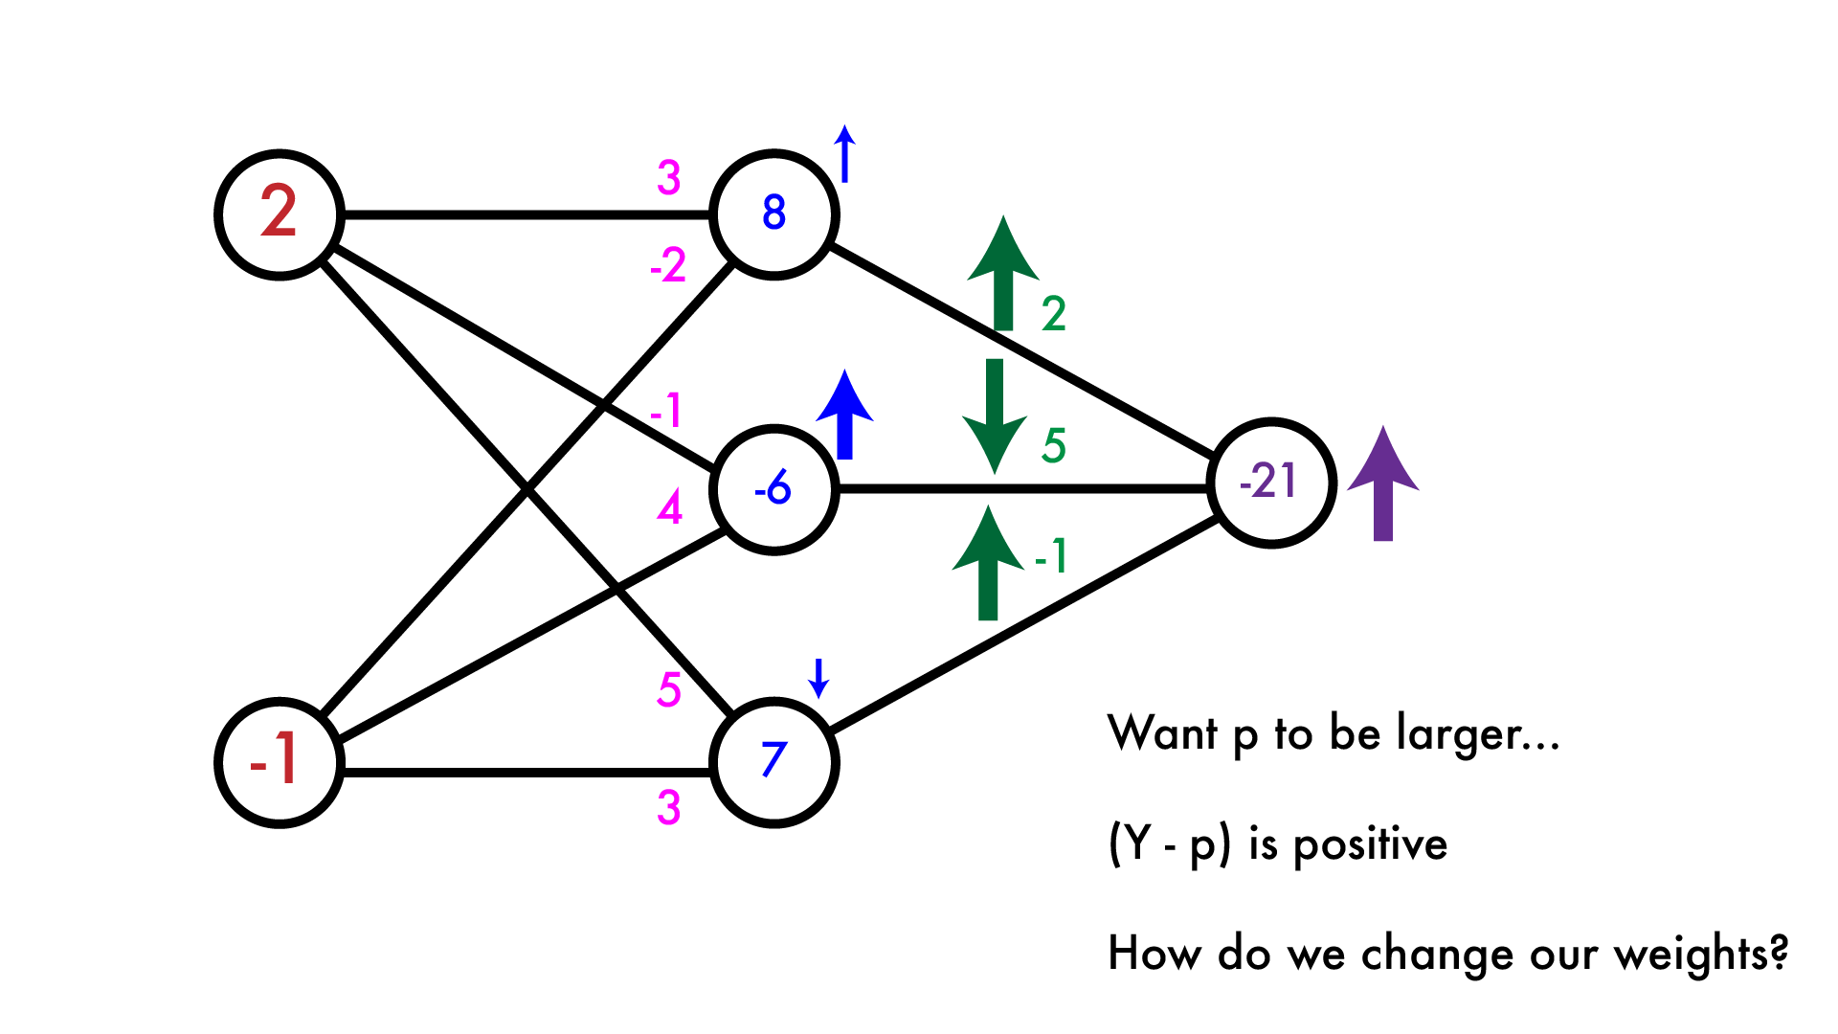
How do we learn it?
Now what? Let’s calculate the “error” that the hidden layer makes. We want p to be larger, given current weights how should we adjust the hidden layer output to do that?

Slide 40
How do we learn it?
Now that we have an “error” in our hidden layer, want to modify the previous weights. Easy again, just like our linear model.

Slide 41
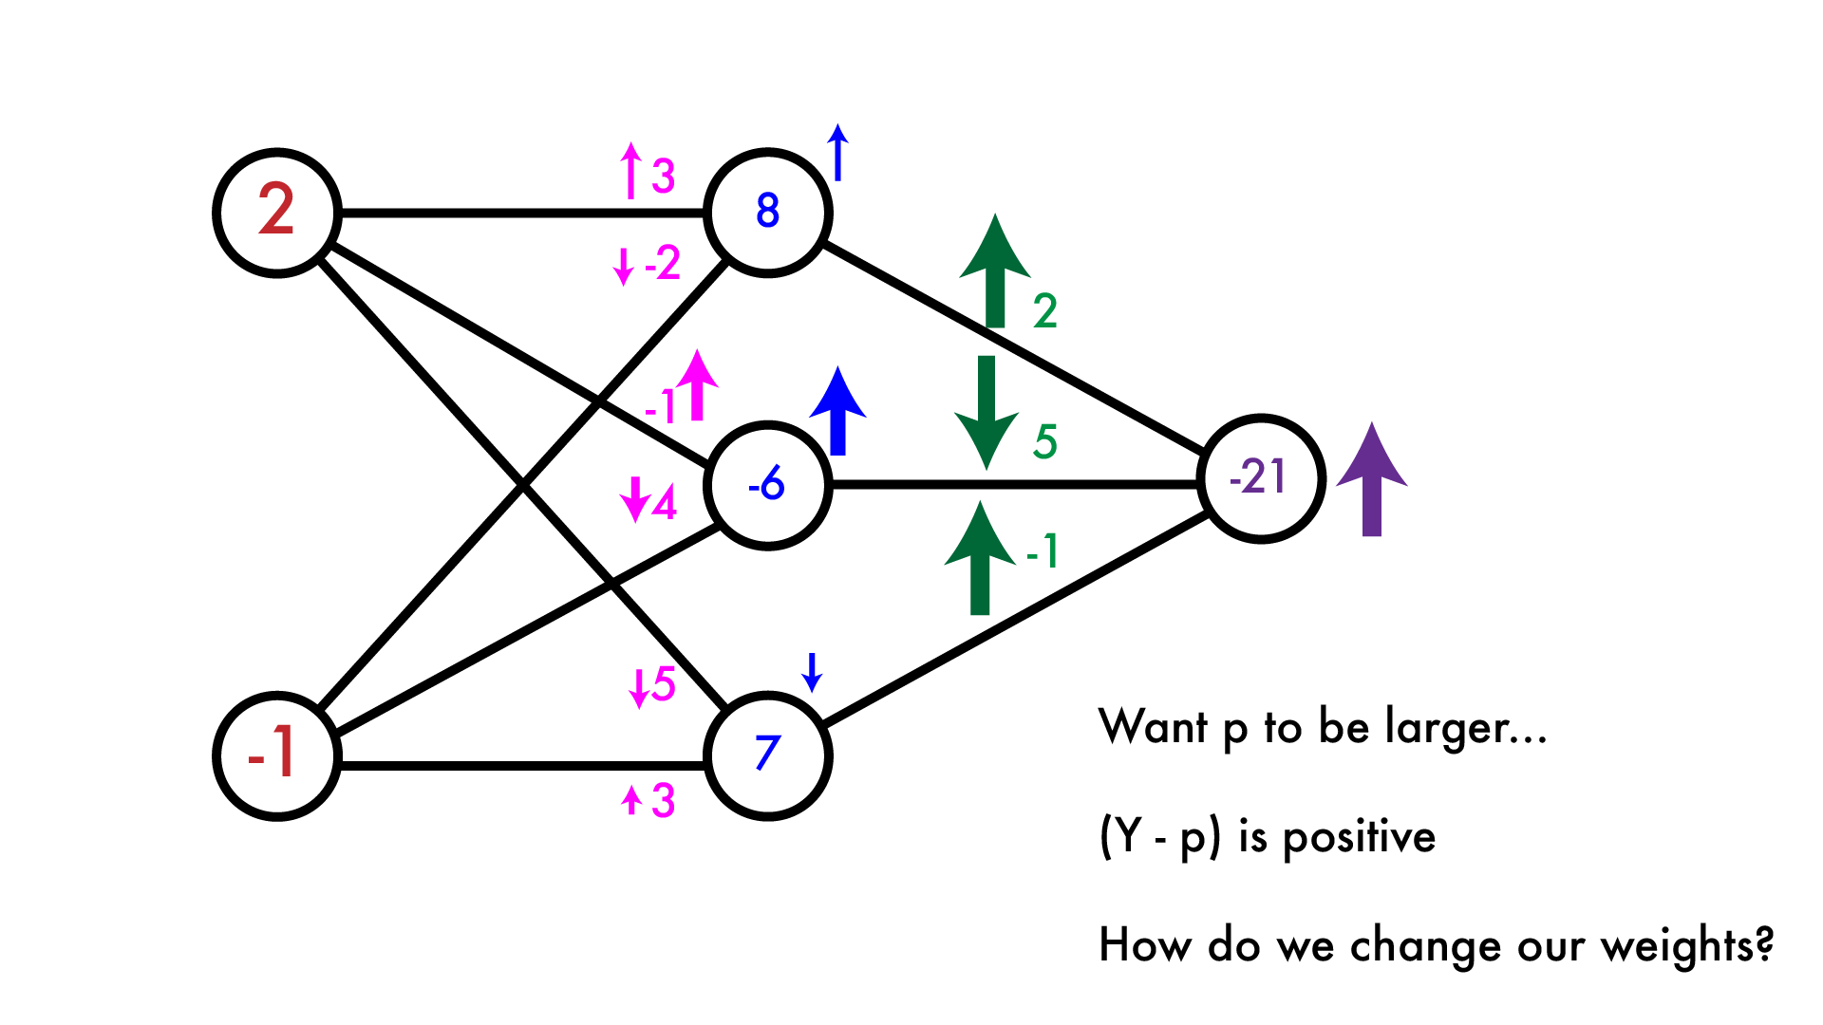
How do we learn it?
Now that we have an “error” in our hidden layer, want to modify the previous weights. Easy again, just like our linear model.

Slide 42
Backpropagation: just taking derivatives
This is the backpropagation algorithm. It’s really just an easy way to calculate partial derivatives in a neural network. We forward-propagate information through the network, calculate our error, then backpropagate that error through network to calculate weight updates.

Slide 43
Backpropagation: just taking derivatives
This was with linear activations but the process is the same for any φ, just have to calculate φ’(x) for that neuron as well.

Slide 44
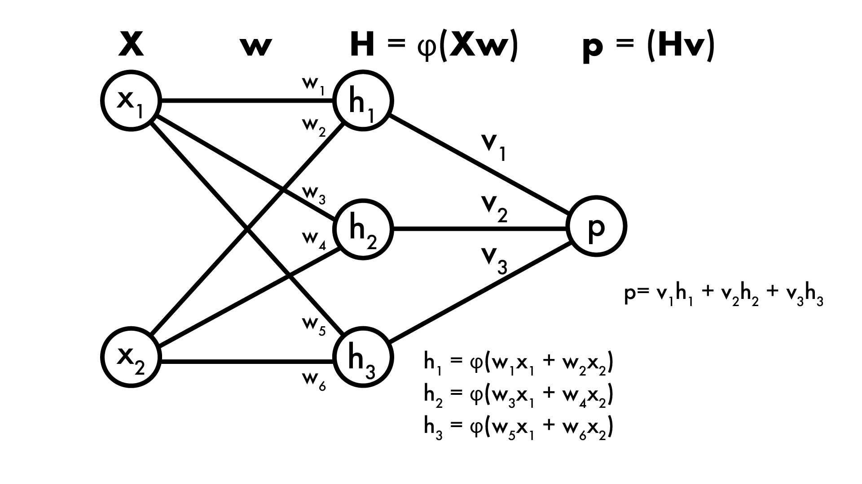
Backpropagation: the math
1-layer NN, sigmoid activation at hidden layer, linear output:
F(X) = φ(Xw)v F(X) = φ(x₁w₁ + x₂w₂)v₁ + φ(x₁w₃ + x₂w₄)v₂ + φ(x₁w₅ + x₂w₆)v₃

Slide 45
Backpropagation: the math
1-layer NN, sigmoid activation at hidden layer, linear output:
F(X) = φ(Xw)v F(X) = φ(x₁w₁ + x₂w₂)v₁ + φ(x₁w₃ + x₂w₄)v₂ + φ(x₁w₅ + x₂w₆)v₃
Say regression, Loss function is ½ L₂ norm, expected output is Y: L_{X,Y}(w,v) = ½(Y - F(X))² = ½(Y - φ(Xw)v)²

Slide 46
Backpropagation: the math
1-layer NN, sigmoid activation at hidden layer, linear output:
F(X) = φ(Xw)v F(X) = φ(x₁w₁ + x₂w₂)v₁ + φ(x₁w₃ + x₂w₄)v₂ + φ(x₁w₅ + x₂w₆)v₃
Say regression, Loss function is ½ L₂ norm, expected output is Y: L_{X,Y}(w,v) = ½(Y - F(X))² = ½(Y - φ(Xw)v)²
Want partial derivative of Loss w.r.t. weights, say v₂: ∂/∂v₂ L_{X,Y}(w,v) = ∂/∂v₂ ½(Y - φ(Xw)v)²

Slide 47
Backpropagation: the math
1-layer NN, sigmoid activation at hidden layer, linear output:
F(X) = φ(Xw)v F(X) = φ(x₁w₁ + x₂w₂)v₁ + φ(x₁w₃ + x₂w₄)v₂ + φ(x₁w₅ + x₂w₆)v₃
Say regression, Loss function is ½ L₂ norm, expected output is Y: L_{X,Y}(w,v) = ½(Y - F(X))² = ½(Y - φ(Xw)v)²
Want partial derivative of Loss w.r.t. weights, say v₂: ∂/∂v₂ L_{X,Y}(w,v) = ∂/∂v₂ ½(Y - φ(Xw)v)² = (Y - φ(Xw)v) * -[∂/∂v₂φ(Xw)v]

Slide 48
Backpropagation: the math
1-layer NN, sigmoid activation at hidden layer, linear output:
F(X) = φ(Xw)v F(X) = φ(x₁w₁ + x₂w₂)v₁ + φ(x₁w₃ + x₂w₄)v₂ + φ(x₁w₅ + x₂w₆)v₃
Say regression, Loss function is ½ L₂ norm, expected output is Y: L_{X,Y}(w,v) = ½(Y - F(X))² = ½(Y - φ(Xw)v)²
Want partial derivative of Loss w.r.t. weights, say v₂: ∂/∂v₂ L_{X,Y}(w,v) = ∂/∂v₂ ½(Y - φ(Xw)v)² = (Y - φ(Xw)v) * -[∂/∂v₂φ(Xw)v] = (Y - φ(Xw)v) * -[∂/∂v₂ φ(x₁w₃ + x₂w₄)v₂]

Slide 49
Backpropagation: the math
1-layer NN, sigmoid activation at hidden layer, linear output:
F(X) = φ(Xw)v F(X) = φ(x₁w₁ + x₂w₂)v₁ + φ(x₁w₃ + x₂w₄)v₂ + φ(x₁w₅ + x₂w₆)v₃
Say regression, Loss function is ½ L₂ norm, expected output is Y: L_{X,Y}(w,v) = ½(Y - F(X))² = ½(Y - φ(Xw)v)²
Want partial derivative of Loss w.r.t. weights, say v₂: ∂/∂v₂ L_{X,Y}(w,v) = ∂/∂v₂ ½(Y - φ(Xw)v)² = (Y - φ(Xw)v) * -[∂/∂v₂φ(Xw)v] = (Y - φ(Xw)v) * -[∂/∂v₂ φ(x₁w₃ + x₂w₄)v₂] = (Y - φ(Xw)v) * -φ(x₁w₃ + x₂w₄)

Slide 50
Backpropagation: the math
Want partial derivative of Loss w.r.t. weights, say v₂: ∂/∂v₂ L_{X,Y}(w,v) = (Y - φ(Xw)v) * -φ(x₁w₃ + x₂w₄)

Slide 51
Backpropagation: the math
Want partial derivative of Loss w.r.t. weights, say v₂: ∂/∂v₂ L_{X,Y}(w,v) = -(Y - φ(Xw)v)*h₂

Slide 52
Backpropagation: the math
Want partial derivative of Loss w.r.t. weights, say v₂: ∂/∂v₂ L_{X,Y}(w,v) = -(Y - φ(Xw)v)*h₂
Weight update rule (remember descend on loss): v₂ = v₂ + η(Y - φ(Xw)v)*h₂

Slide 53
Backpropagation: the math
1-layer NN, sigmoid activation at hidden layer, linear output:
F(X) = φ(Xw)v F(X) = φ(x₁w₁ + x₂w₂)v₁ + φ(x₁w₃ + x₂w₄)v₂ + φ(x₁w₅ + x₂w₆)v₃
Say regression, Loss function is ½ L₂ norm, expected output is Y: L_{X,Y}(w,v) = ½(Y - F(X))² = ½(Y - φ(Xw)v)²
Want partial derivative of Loss w.r.t. weights, say w₂: ∂/∂w₂ L_{X,Y}(w,v) = ∂/∂w₂ ½(Y - φ(Xw)v)² = (Y - φ(Xw)v) * -[∂/∂w₂ φ(Xw)v]

Slide 54
Backpropagation: the math
1-layer NN, sigmoid activation at hidden layer, linear output:
F(X) = φ(Xw)v F(X) = φ(x₁w₁ + x₂w₂)v₁ + φ(x₁w₃ + x₂w₄)v₂ + φ(x₁w₅ + x₂w₆)v₃
Say regression, Loss function is ½ L₂ norm, expected output is Y: L_{X,Y}(w,v) = ½(Y - F(X))² = ½(Y - φ(Xw)v)²
Want partial derivative of Loss w.r.t. weights, say w₂: ∂/∂w₂ L_{X,Y}(w,v) = ∂/∂w₂ ½(Y - φ(Xw)v)² = (Y - φ(Xw)v) * -[∂/∂w₂ φ(Xw)v] = (Y - φ(Xw)v) * -[∂/∂w₂ φ(x₁w₁ + x₂w₂)v₁]

Slide 55
Backpropagation: the math
1-layer NN, sigmoid activation at hidden layer, linear output:
F(X) = φ(Xw)v F(X) = φ(x₁w₁ + x₂w₂)v₁ + φ(x₁w₃ + x₂w₄)v₂ + φ(x₁w₅ + x₂w₆)v₃
Say regression, Loss function is ½ L₂ norm, expected output is Y: L_{X,Y}(w,v) = ½(Y - F(X))² = ½(Y - φ(Xw)v)²
Want partial derivative of Loss w.r.t. weights, say w₂: ∂/∂w₂ L_{X,Y}(w,v) = ∂/∂w₂ ½(Y - φ(Xw)v)² = (Y - φ(Xw)v) * -[∂/∂w₂ φ(Xw)v] = (Y - φ(Xw)v) * -v₁[∂/∂w₂ φ(x₁w₁ + x₂w₂)]

Slide 56
Backpropagation: the math
1-layer NN, sigmoid activation at hidden layer, linear output:
F(X) = φ(Xw)v F(X) = φ(x₁w₁ + x₂w₂)v₁ + φ(x₁w₃ + x₂w₄)v₂ + φ(x₁w₅ + x₂w₆)v₃
Say regression, Loss function is ½ L₂ norm, expected output is Y: L_{X,Y}(w,v) = ½(Y - F(X))² = ½(Y - φ(Xw)v)²
Want partial derivative of Loss w.r.t. weights, say w₂: ∂/∂w₂ L_{X,Y}(w,v) = ∂/∂w₂ ½(Y - φ(Xw)v)² = (Y - φ(Xw)v) * -[∂/∂w₂ φ(Xw)v] = (Y - φ(Xw)v) * -v₁[∂/∂w₂ φ(x₁w₁ + x₂w₂)] = (Y - φ(Xw)v) * -v₁φ’(x₁w₁+x₂w₂)[∂/∂w₂ (x₁w₁ + x₂w₂)]
Chain rule!
If F(x) = f(g(x))
F’(x) = f’(g(x))g’(x)

Slide 57
Backpropagation: the math
1-layer NN, sigmoid activation at hidden layer, linear output:
F(X) = φ(Xw)v F(X) = φ(x₁w₁ + x₂w₂)v₁ + φ(x₁w₃ + x₂w₄)v₂ + φ(x₁w₅ + x₂w₆)v₃
Say regression, Loss function is ½ L₂ norm, expected output is Y: L_{X,Y}(w,v) = ½(Y - F(X))² = ½(Y - φ(Xw)v)²
Want partial derivative of Loss w.r.t. weights, say w₂: ∂/∂w₂ L_{X,Y}(w,v) = ∂/∂w₂ ½(Y - φ(Xw)v)² = (Y - φ(Xw)v) * -[∂/∂w₂ φ(Xw)v] = (Y - φ(Xw)v) * -v₁[∂/∂w₂ φ(x₁w₁ + x₂w₂)] = (Y - φ(Xw)v) * -v₁φ’(x₁w₁+x₂w₂)[∂/∂w₂ (x₁w₁ + x₂w₂)] = (Y - φ(Xw)v) * -v₁φ’(x₁w₁+x₂w₂) * x₂

Slide 58
Backpropagation: the math
Want partial derivative of Loss w.r.t. weights, say w₂: ∂/∂w₂ L_{X,Y}(w,v) = (Y - φ(Xw)v) * -v₁φ’(x₁w₁+x₂w₂) * x₂

Slide 59
Backpropagation: the math
Want partial derivative of Loss w.r.t. weights, say w₂: ∂/∂w₂ L_{X,Y}(w,v) = (Y - φ(Xw)v) * -v₁φ’(x₁w₁+x₂w₂) * x₂
Model error at p

Slide 60
Backpropagation: the math
Want partial derivative of Loss w.r.t. weights, say w₂: ∂/∂w₂ L_{X,Y}(w,v) = (Y - φ(Xw)v) * -v₁φ’(x₁w₁+x₂w₂) * x₂
Model error at p
Backpropagate through v₁

Slide 61
Backpropagation: the math
Want partial derivative of Loss w.r.t. weights, say w₂: ∂/∂w₂ L_{X,Y}(w,v) = (Y - φ(Xw)v) * -v₁φ’(x₁w₁+x₂w₂) * x₂
Model error at p
Model error at h₁
Backpropagate through v₁

Slide 62
Backpropagation: the math
Want partial derivative of Loss w.r.t. weights, say w₂: ∂/∂w₂ L_{X,Y}(w,v) = (Y - φ(Xw)v) * -v₁φ’(x₁w₁+x₂w₂) * x₂
Model error at p
Model error at h₁
Multiply by x₂: gradient w.r.t. w₂
Backpropagate through v₁

Slide 63
Backpropagation: the math
∂h₁/∂(w₁x₁ + w₂x₂)
∂p/∂h₁
∂p/∂v₁
∂(w₁x₁ + w₂x₂)/∂w₂
∂L/∂p

Slide 64
Backpropagation: the math
∂(w₁x₁ + w₂x₂)/∂w₂ = x₂

Slide 65
Backpropagation: the math
∂h₁/∂(w₁x₁ + w₂x₂) = φ’(x₁w₁+x₂w₂)
∂(w₁x₁ + w₂x₂)/∂w₂ = x₂

Slide 66
Backpropagation: the math
∂h₁/∂(w₁x₁ + w₂x₂) = φ’(x₁w₁+x₂w₂)
∂p/∂h₁ = v₁
∂(w₁x₁ + w₂x₂)/∂w₂ = x₂

Slide 67
Backpropagation: the math
∂h₁/∂(w₁x₁ + w₂x₂) = φ’(x₁w₁+x₂w₂)
∂p/∂h₁ = v₁
∂p/∂v₁ = h₁
∂(w₁x₁ + w₂x₂)/∂w₂ = x₂

Slide 68
Backpropagation: the math
∂h₁/∂(w₁x₁ + w₂x₂) = φ’(x₁w₁+x₂w₂)
∂p/∂h₁ = v₁
∂p/∂v₁ = h₁
∂(w₁x₁ + w₂x₂)/∂w₂ = x₂
∂L/∂p = (Y - φ(Xw)v)

Slide 69
Backpropagation: the math
∂h₁/∂(w₁x₁ + w₂x₂) = φ’(x₁w₁+x₂w₂)
∂p/∂h₁ = v₁
∂p/∂v₁ = h₁
∂(w₁x₁ + w₂x₂)/∂w₂ = x₂
∂L/∂p = (Y - φ(Xw)v)
How do we update v₁? ∂L/∂v₁

Slide 70
Backpropagation: the math
∂h₁/∂(w₁x₁ + w₂x₂) = φ’(x₁w₁+x₂w₂)
∂p/∂h₁ = v₁
∂p/∂v₁ = h₁
∂(w₁x₁ + w₂x₂)/∂w₂ = x₂
∂L/∂p = (Y - φ(Xw)v)
How do we update v₁? ∂L/∂v₁ = ∂p/∂v₁ * ∂L/∂p

Slide 71
Backpropagation: the math
∂h₁/∂(w₁x₁ + w₂x₂) = φ’(x₁w₁+x₂w₂)
∂p/∂h₁ = v₁
∂p/∂v₁ = h₁
∂(w₁x₁ + w₂x₂)/∂w₂ = x₂
∂L/∂p = (Y - φ(Xw)v)
How do we update v₁? ∂L/∂v₁ = ∂p/∂v₁ * ∂L/∂p =
H₁

Slide 72
Backpropagation: the math
∂h₁/∂(w₁x₁ + w₂x₂) = φ’(x₁w₁+x₂w₂)
∂p/∂h₁ = v₁
∂p/∂v₁ = h₁
∂(w₁x₁ + w₂x₂)/∂w₂ = x₂
∂L/∂p = (Y - φ(Xw)v)
How do we update v₁? ∂L/∂v₁ = ∂p/∂v₁ * ∂L/∂p =
H₁ * (Y - φ(Xw)v)

Slide 73
Backpropagation: the math
∂h₁/∂(w₁x₁ + w₂x₂) = φ’(x₁w₁+x₂w₂)
∂p/∂h₁ = v₁
∂p/∂v₁ = h₁
∂(w₁x₁ + w₂x₂)/∂w₂ = x₂
∂L/∂p = (Y - φ(Xw)v)
How do we update w₂? ∂L/∂w₂

Slide 74
Backpropagation: the math
∂h₁/∂(w₁x₁ + w₂x₂) = φ’(x₁w₁+x₂w₂)
∂p/∂h₁ = v₁
∂p/∂v₁ = h₁
∂(w₁x₁ + w₂x₂)/∂w₂ = x₂
∂L/∂p = (Y - φ(Xw)v)
How do we update w₂? ∂L/∂w₂ = ∂(w₁x₁ + w₂x₂)/∂w₂ * ∂h₁/∂(w₁x₁ + w₂x₂) * ∂p/∂h₁ * ∂L/∂p

Slide 75
Backpropagation: the math
∂h₁/∂(w₁x₁ + w₂x₂) = φ’(x₁w₁+x₂w₂)
∂p/∂h₁ = v₁
∂p/∂v₁ = h₁
∂(w₁x₁ + w₂x₂)/∂w₂ = x₂
∂L/∂p = (Y - φ(Xw)v)
How do we update w₂? ∂L/∂w₂ = ∂(w₁x₁ + w₂x₂)/∂w₂ * ∂h₁/∂(w₁x₁ + w₂x₂) * ∂p/∂h₁ * ∂L/∂p = x₂

Slide 76
Backpropagation: the math
∂h₁/∂(w₁x₁ + w₂x₂) = φ’(x₁w₁+x₂w₂)
∂p/∂h₁ = v₁
∂p/∂v₁ = h₁
∂(w₁x₁ + w₂x₂)/∂w₂ = x₂
∂L/∂p = (Y - φ(Xw)v)
How do we update w₂? ∂L/∂w₂ = ∂(w₁x₁ + w₂x₂)/∂w₂ * ∂h₁/∂(w₁x₁ + w₂x₂) * ∂p/∂h₁ * ∂L/∂p = x₂ * φ’(x₁w₁+x₂w₂)

Slide 77
Backpropagation: the math
∂h₁/∂(w₁x₁ + w₂x₂) = φ’(x₁w₁+x₂w₂)
∂p/∂h₁ = v₁
∂p/∂v₁ = h₁
∂(w₁x₁ + w₂x₂)/∂w₂ = x₂
∂L/∂p = (Y - φ(Xw)v)
How do we update w₂? ∂L/∂w₂ = ∂(w₁x₁ + w₂x₂)/∂w₂ * ∂h₁/∂(w₁x₁ + w₂x₂) * ∂p/∂h₁ * ∂L/∂p = x₂ * φ’(x₁w₁+x₂w₂) * v₁

Slide 78
Backpropagation: the math
∂h₁/∂(w₁x₁ + w₂x₂) = φ’(x₁w₁+x₂w₂)
∂p/∂h₁ = v₁
∂p/∂v₁ = h₁
∂(w₁x₁ + w₂x₂)/∂w₂ = x₂
∂L/∂p = (Y - φ(Xw)v)
How do we update w₂? ∂L/∂w₂ = ∂(w₁x₁ + w₂x₂)/∂w₂ * ∂h₁/∂(w₁x₁ + w₂x₂) * ∂p/∂h₁ * ∂L/∂p = x₂ * φ’(x₁w₁+x₂w₂) * v₁ * (Y - φ(Xw)v)

Slide 79
Backpropagation: the math
∂L/∂v₁
∂L/∂p

Slide 80
Backpropagation: the math
∂L/∂h₁
∂L/∂p

Slide 81
Backpropagation: the math
∂L/∂(w₁x₁ + w₂x₂)
∂L/∂h₁
φ’(x₁w₁+x₂w₂)

Slide 82
Backpropagation: the math
∂L/∂(w₁x₁ + w₂x₂)
∂L/∂w₂

Slide 83
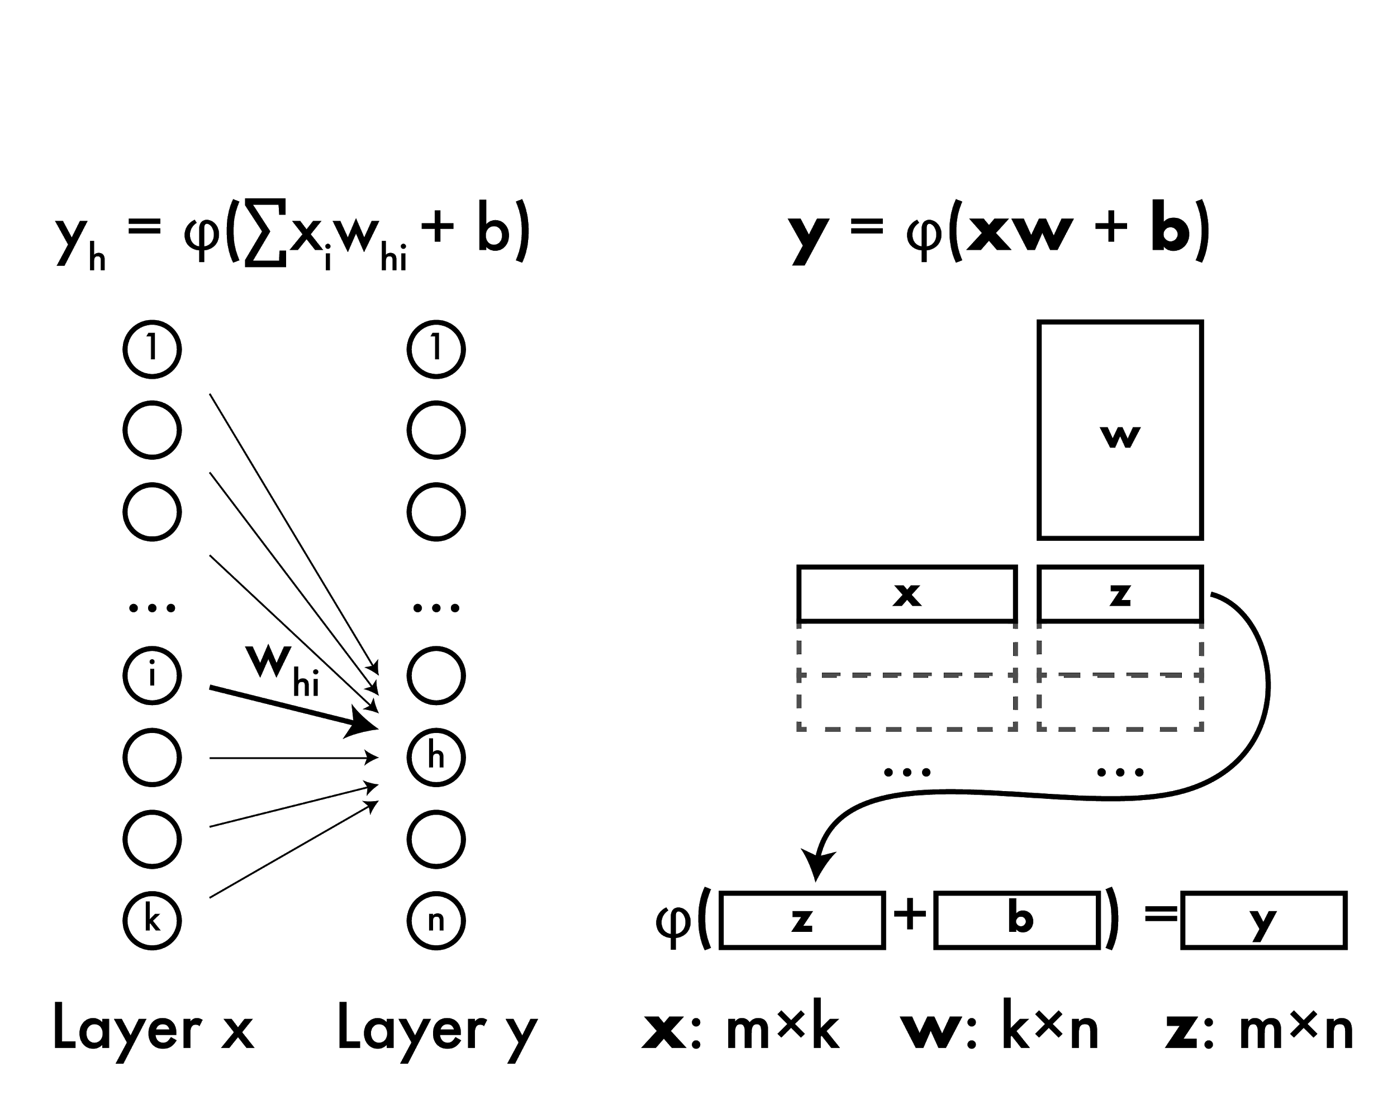
Forward propagation

Slide 84
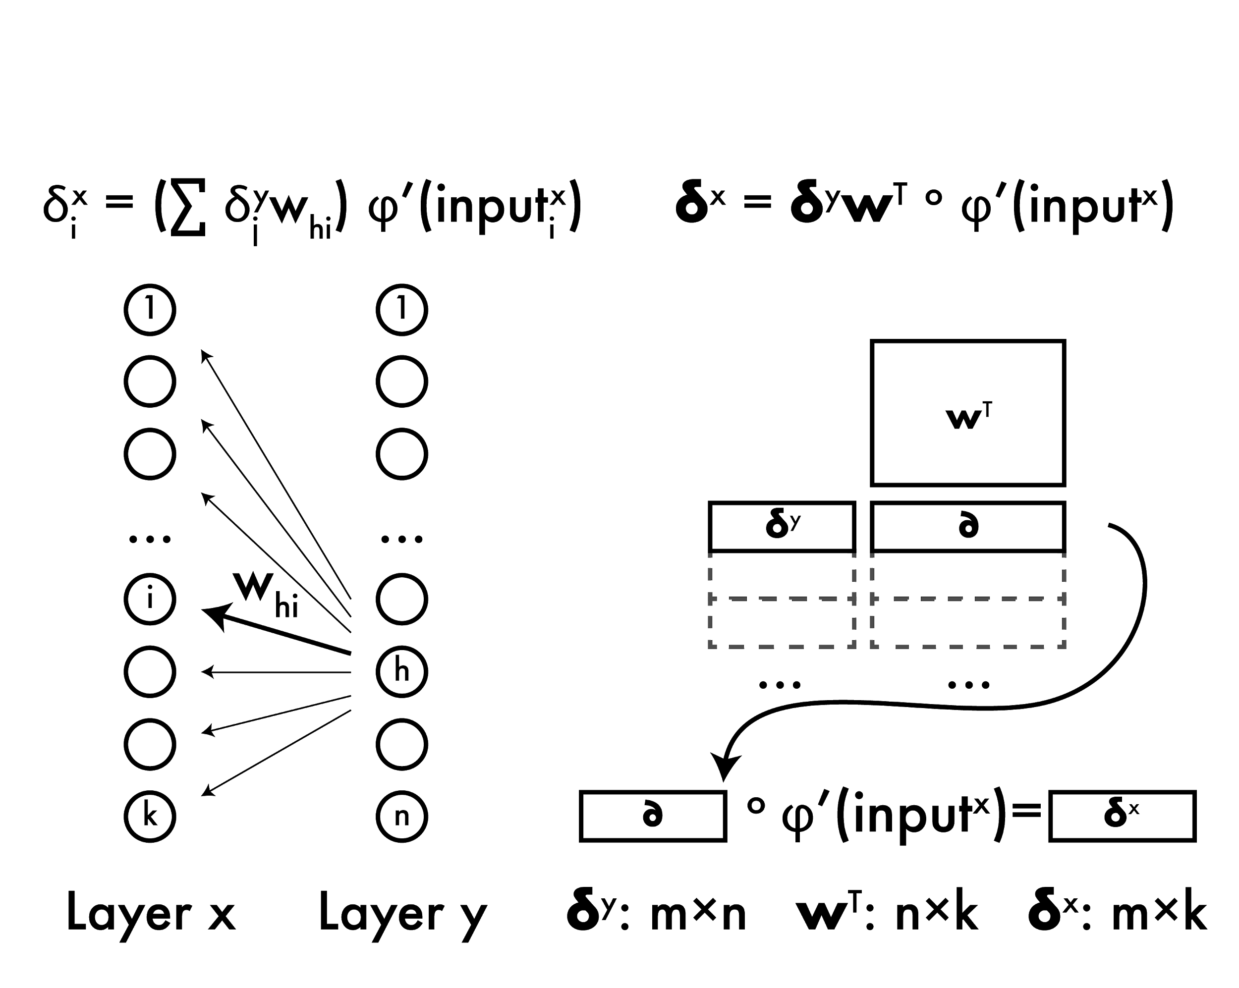
Backward propagation

Slide 85
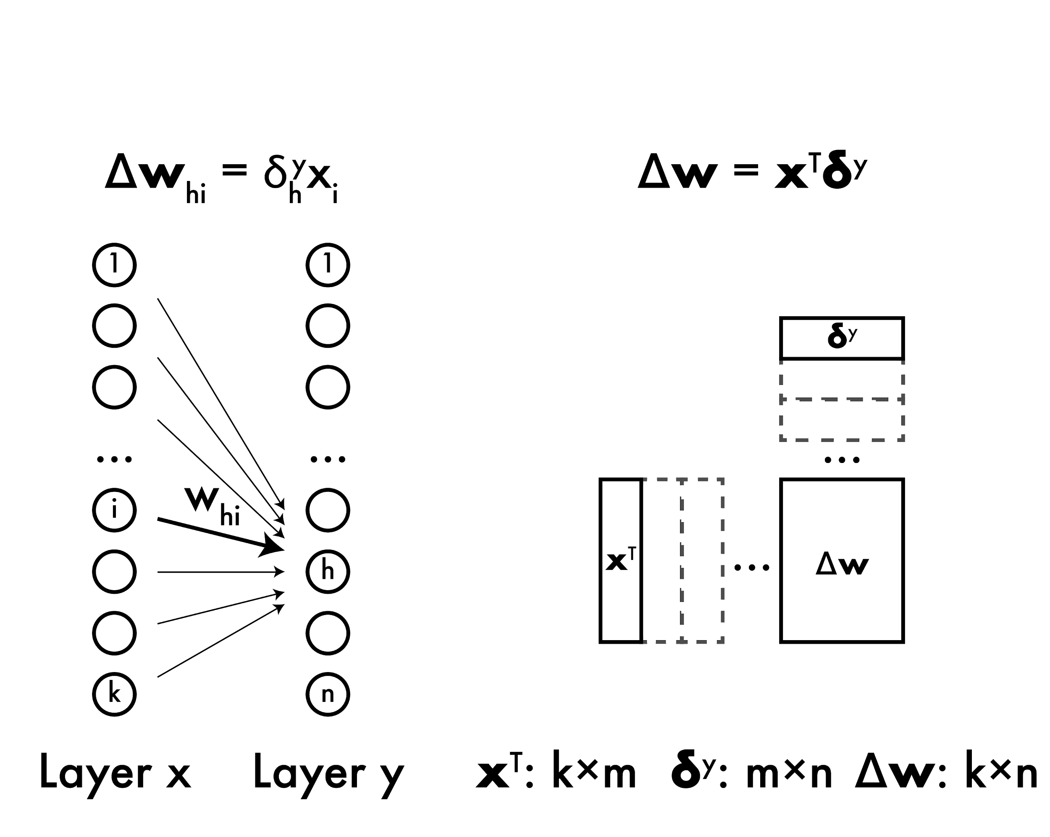
Weight updates

Slide 86
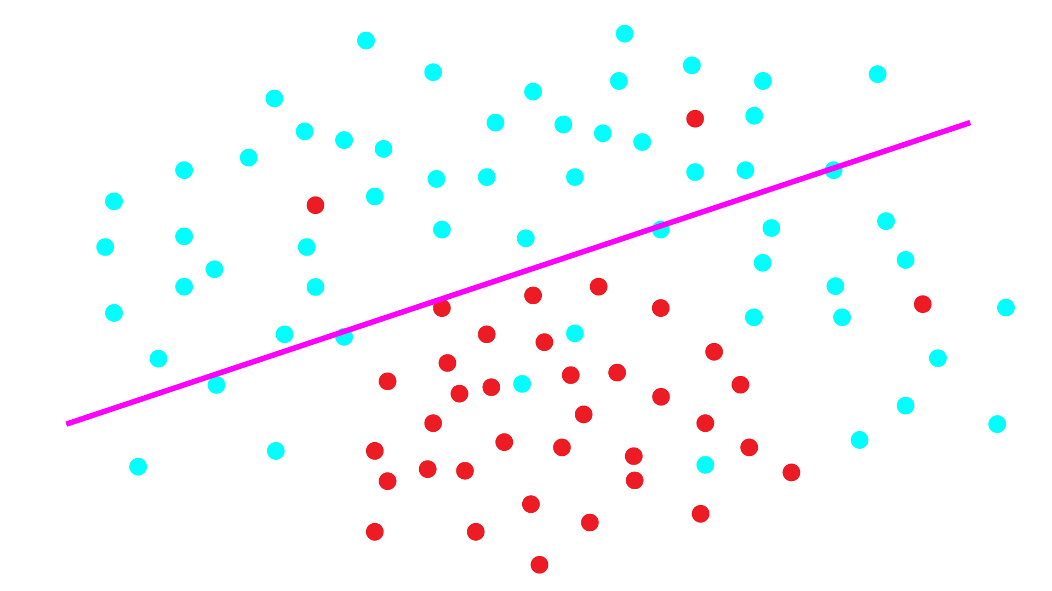
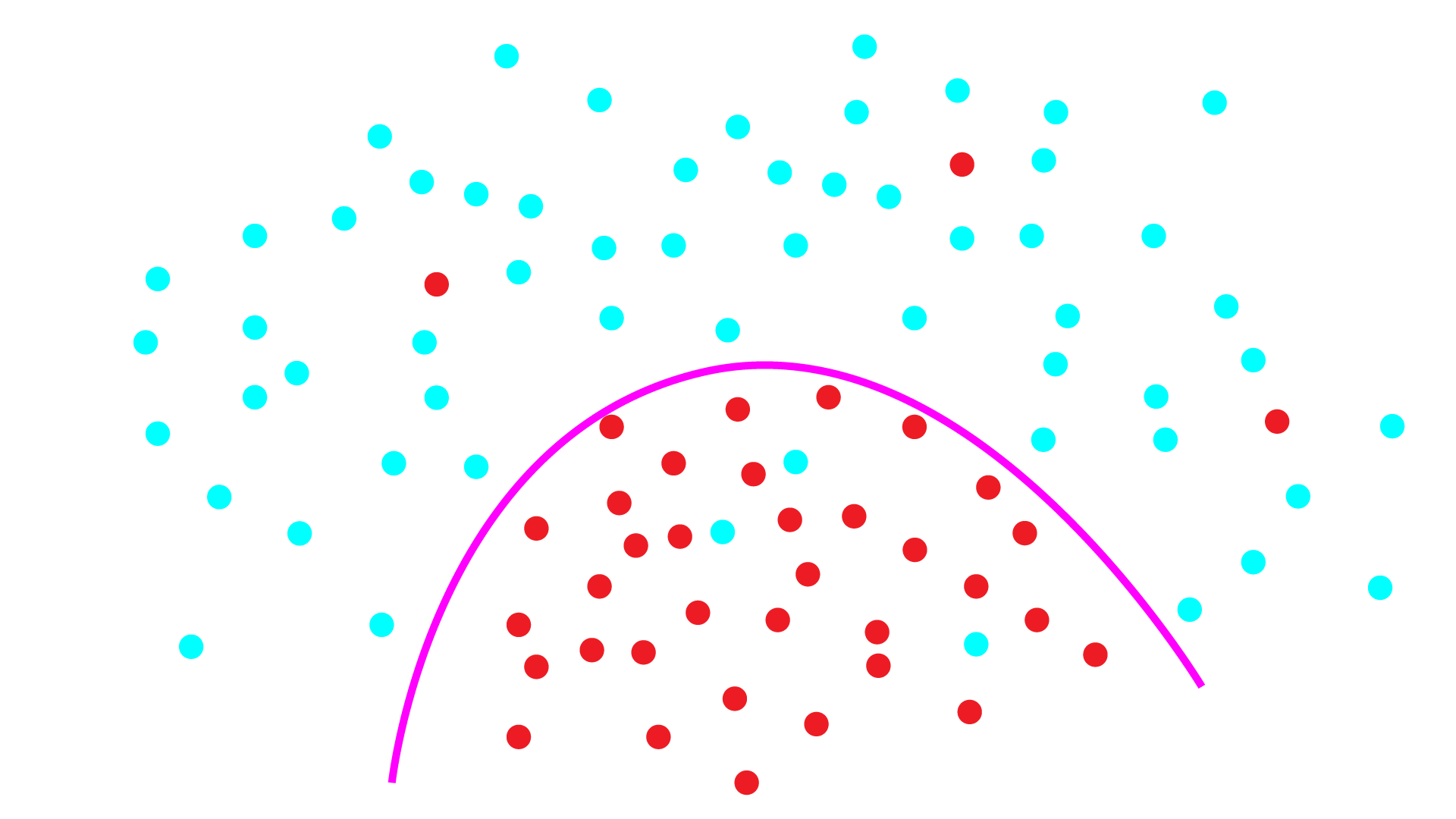
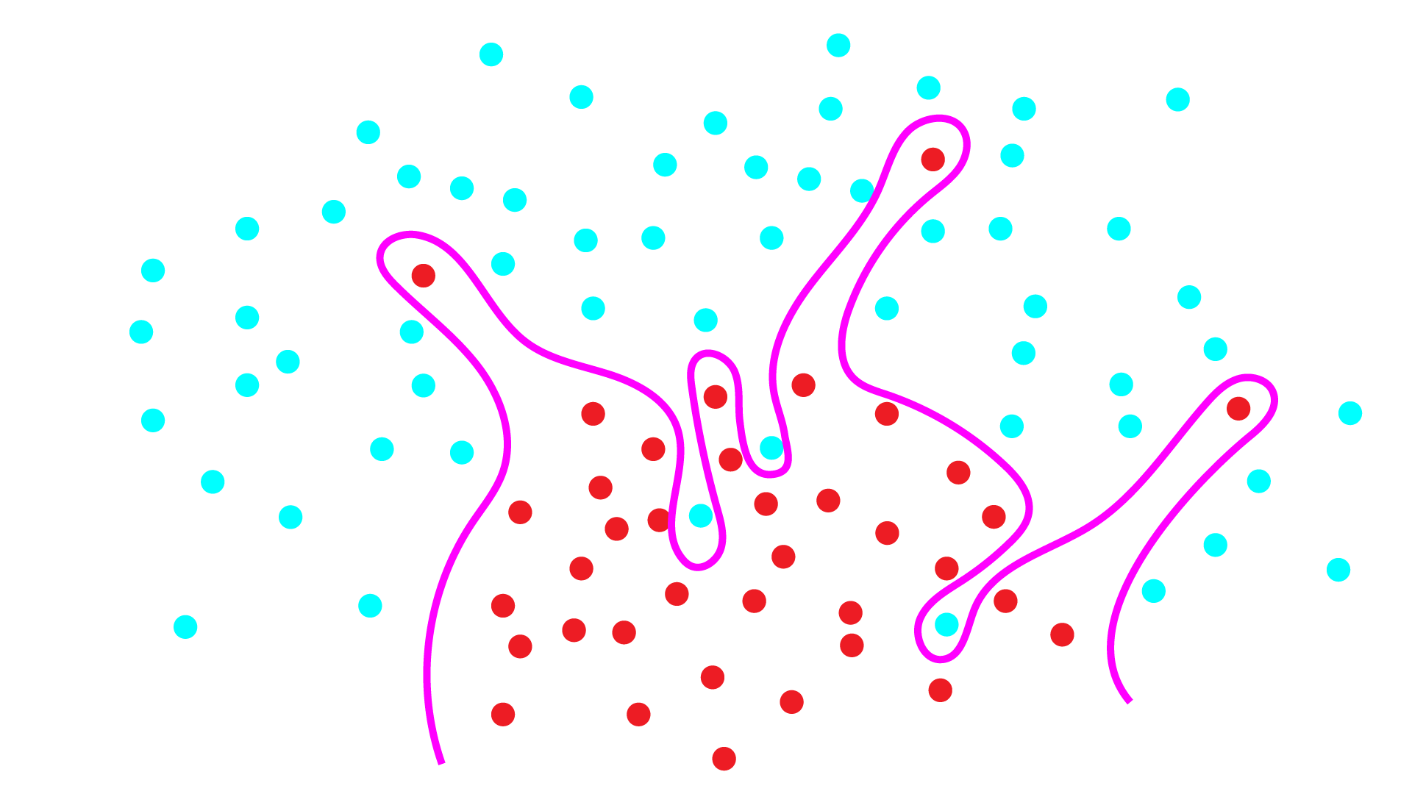
Under and Overfitting
Underfitting: model not powerful enough, too much bias
Overfitting: model too powerful, fits to noise, doesn’t generalize well
Want the happy medium, how?

Slide 87
Under and Overfitting
Want the happy medium, how?
Pick the right model, but very hard to know a priori
Make weak model more powerful: boosting! (or other ways)
Make strong model less likely to overfit: regularization

Slide 88
With great power comes great overfitting
Neural networks are (sort of) all powerful! Which is not necessarily a good thing.

Slide 89
With great power comes great overfitting
Like SVMs, put limits on model that make it generalize better!
SVM: min ||w||₂ s.t. y_{n}(w·x_{n} - b) ≥ 1, n = 1, 2 ..
Neural net: Minimize loss function and weight magnitude Before: argmin_{w} L_{X}(w) Now: argmin_{w} L_{X}(w) + λ ||w||₂

Slide 90
Weight decay: neural network regularization
argmin_{w} L_{X}(w) + λ ||w||₂
λ: regularization parameter Higher: more penalty for large weights, less powerful model Lower: less penalty, more overfitting
Commonly use L₂ norm to regularize, weight decay
Gradient descent update rule: w_{t+1} = w_{t} - η[∂/∂w_{t} L(w_{t}) + λw_{t}]
= w_{t} - η∂/∂w_{t} L(w_{t}) - ηλw_{t}
Subtract a little bit of weight every iteration

Slide 91
Sometimes training is SLOW
With SGD we make LOTS of little steps along the gradient
Sometimes we move in the same direction for a long time… Maybe we should speed up in that direction!

Slide 92
Momentum: speeding up SGD
If we keep moving in same direction we should move further every round
Before: Δw_{t} = -∂/∂w_{t} L(w_{t})
Now: Δw_{t} = -∂/∂w_{t} L(w_{t}) + mΔw_{t-1}
w_{t+1} = w_{t} + ηΔw_{t}
Side effect: smooths out updates if gradient is in different directions

Slide 93
NN updates with weight decay and momentum
Δw_{t} = -∂/∂w_{t} L(w_{t}) - λw_{t} + mΔw_{t-1}
w_{t+1} = w_{t} + ηΔw_{t}

Slide 94
NN updates with weight decay and momentum
Δw_{t} = -∂/∂w_{t} L(w_{t}) - λw_{t} + mΔw_{t-1}
w_{t+1} = w_{t} + ηΔw_{t}
Gradient of loss

Slide 95
NN updates with weight decay and momentum
Δw_{t} = -∂/∂w_{t} L(w_{t}) - λw_{t} + mΔw_{t-1}
w_{t+1} = w_{t} + ηΔw_{t}
Gradient of loss
Weight decay

Slide 96
NN updates with weight decay and momentum
Δw_{t} = -∂/∂w_{t} L(w_{t}) - λw_{t} + mΔw_{t-1}
w_{t+1} = w_{t} + ηΔw_{t}
Gradient of loss
Weight decay
Momentum

Slide 97
NN updates with weight decay and momentum
Δw_{t} = -∂/∂w_{t} L(w_{t}) - λw_{t} + mΔw_{t-1}
w_{t+1} = w_{t} + ηΔw_{t}
Gradient of loss
Weight decay
Momentum
Learning rate

Slide 98
What about our activation functions φ
Many options, want them to be easy to take derivative
UAT holds when bounded, in practice bounds can be problematic

Slide 99
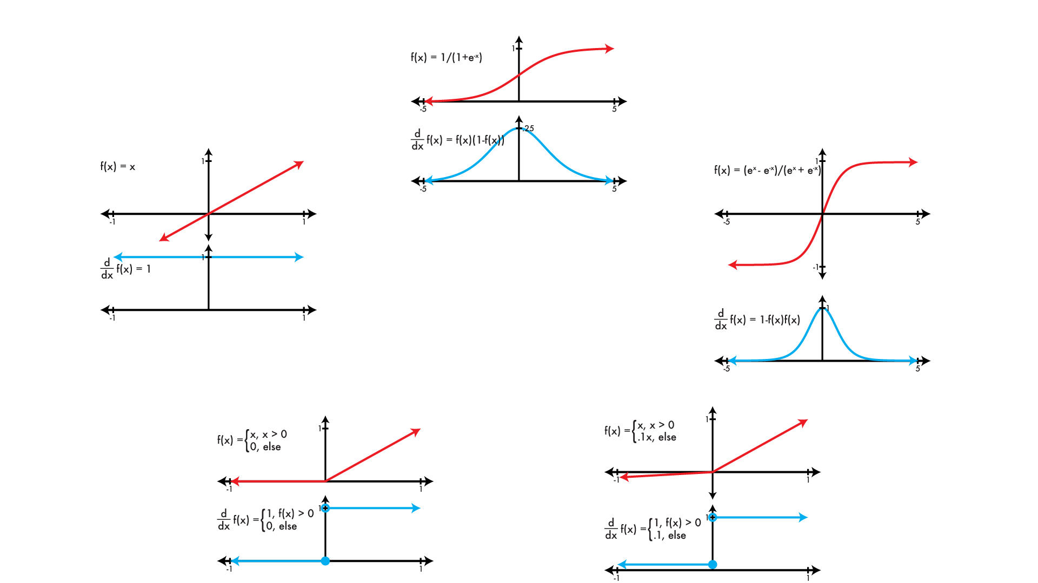
Common activation functions φ
logistic
linear
tanh
REctified Linear Unit (RELU)
Leaky RELU

Slide 100
So many hyper parameters!!
How do we know what to use??

Slide 101
Hyper Parameter Dark Magic
What follows are the one, true, correct, and only set of hyperparameters. Praise be the NetLord!
η = [.0001 - .01]
λ = .0005 m = .9 φ = leaky relu

Slide 103
Neural networks and images
Neural networks are densely connected Each neuron in layer i connected to every neuron in layer i+1
HOG features: 36 features / 8 x 8 patch
Say we want to process images: Input : 256 x 256 x 3 RGB image Hidden : 32 x 32 x 36 feature map? Output : 1000 classes
Input -> hidden is 7.2 billion connections!

Slide 104
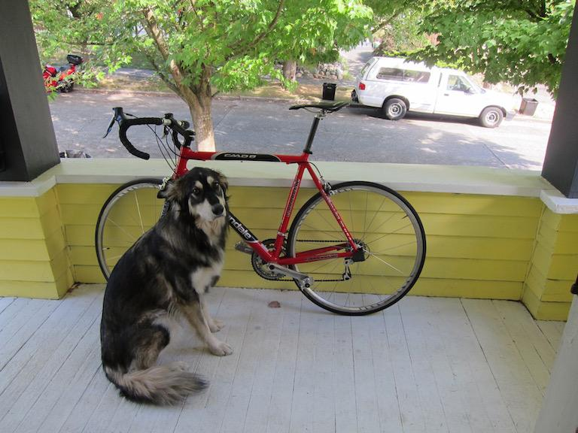
Too many weights!
Neural networks are densely connected
But is this really what we want when processing images?

Slide 105
Too many weights!
Would rather have sparse connections Fewer weights Nearby regions - related Far apart - not related
How can we do this?

Slide 106
Too many weights!
Would rather have sparse connections Fewer weights Nearby regions - related Far apart - not related
Convolutions! Just weighted sums of small areas in image
Weight sharing in different locations in image

Slide 107
Convolutional neural networks
Use convolutions instead of dense connections to process images
Takes advantage of structure in our data!
Imposes an assumption on our model: Nearby pixels are related, far apart ones are less related.
What does this do to our bias/variance??

Slide 108
Convolutional Layer
Input: an image Processing: convolution with multiple filters Output: an image, # channels = # filters
Output still weighted sum of input (w/ activation)

Slide 109
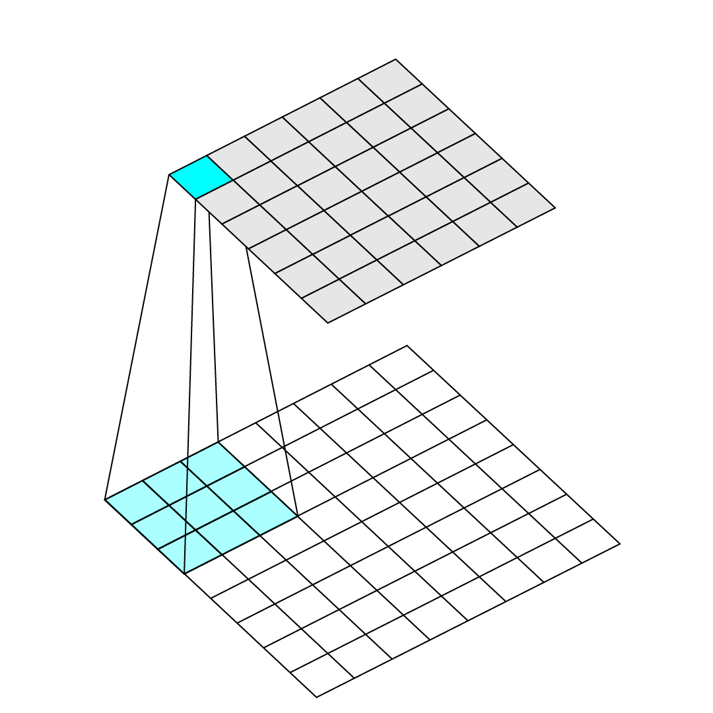
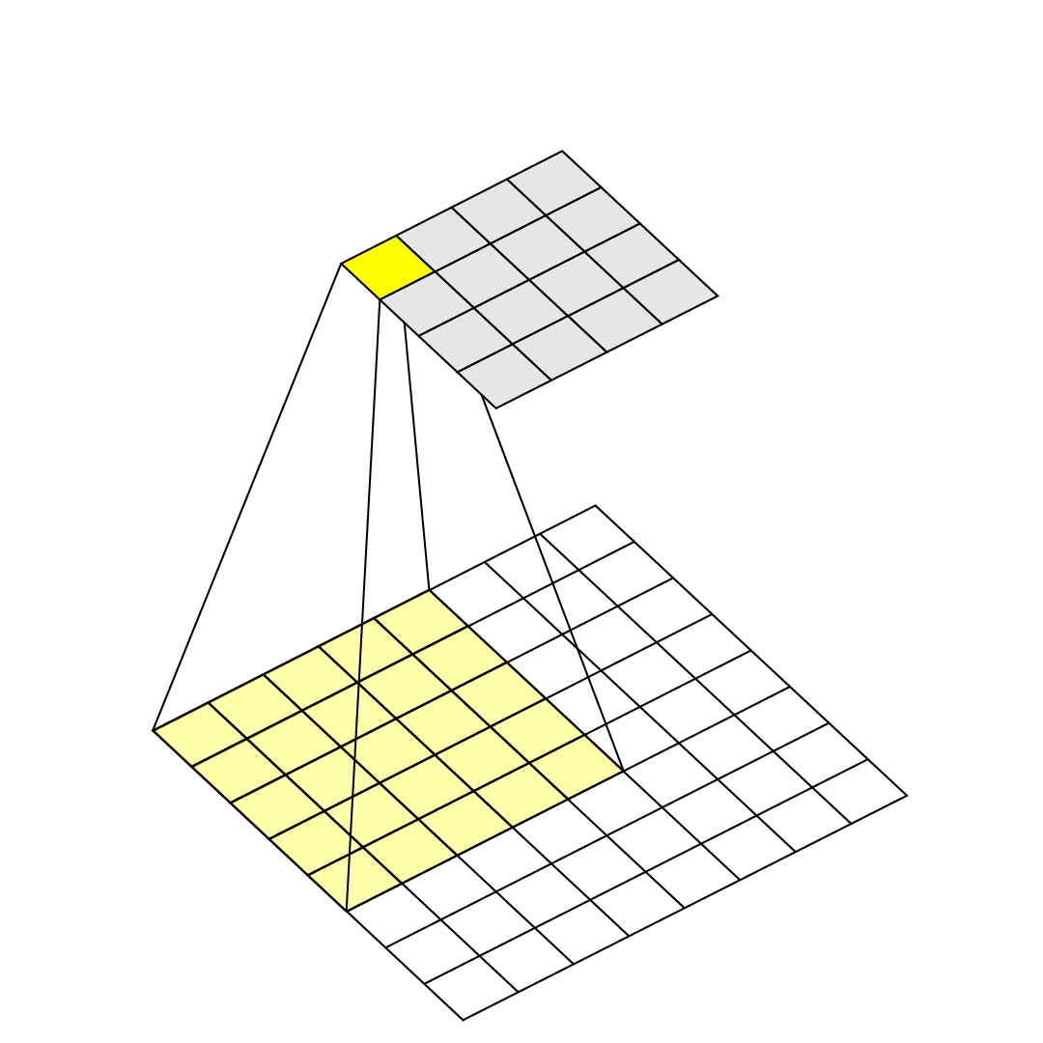
Kernel size
How big the filter for a layer is
Typically 1 x 1 <-> 11 x 11
1 x 1 is just linear combination of channels in previous image (no spatial processing)
Filters usually have same number of channels as input image.

Slide 110
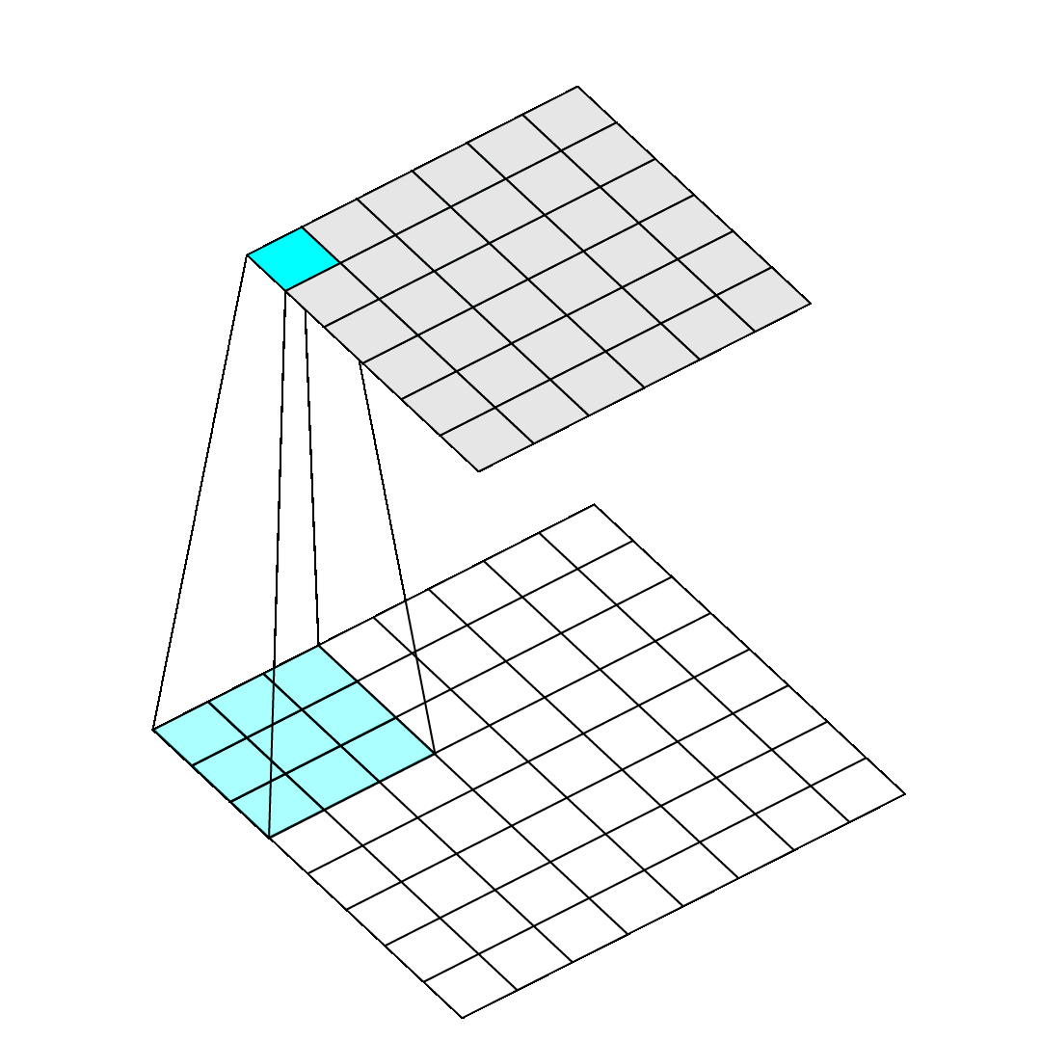
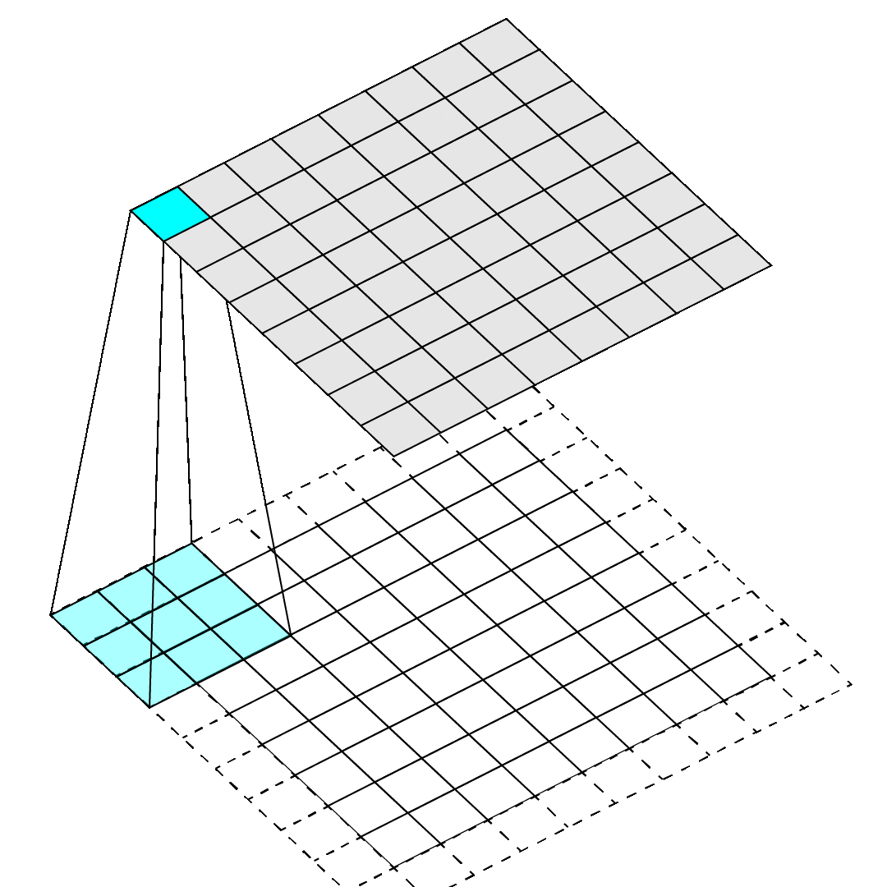
Padding
Convolutions have problems on edges
Do nothing: output a little smaller than input
Pad: add extra pixels on edge

Slide 111
Stride
How far to move filter between applications
We’ve done stride 1 convolutions up until now, approximately preserves image size
Could move filter further, downsample image

Slide 112
Implement using matrices!
We want convolution to be matrix operations because matrices are fast. How?

Slide 113
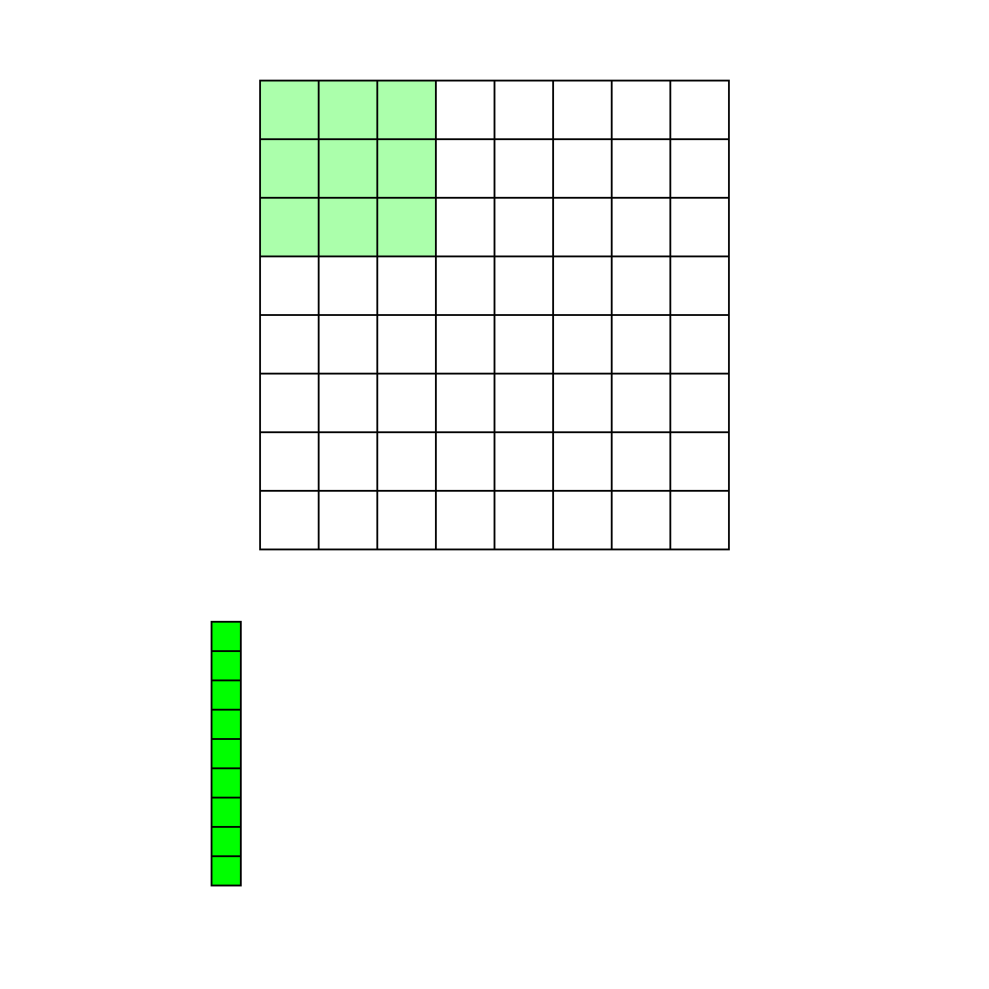
Im2col: rearrange image
Take spatial blocks of image and put them into columns of a matrix.
Im2col handles kernel size, stride, padding, etc.
Makes matrix with all relevant pixels in the image.

Slide 114
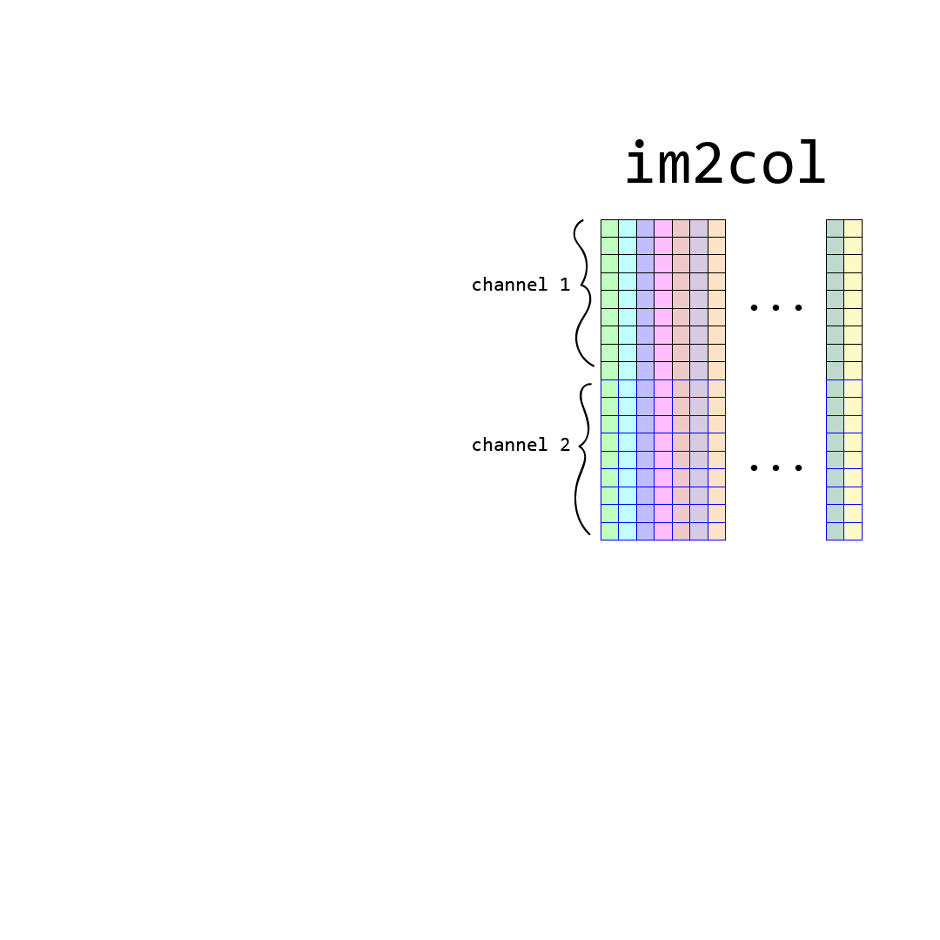
Im2col: rearrange image
Take spatial blocks of image and put them into columns of a matrix.
Im2col handles kernel size, stride, padding, etc.
Makes matrix with all relevant pixels in the image.
Multiple channel image stacked by channel.

Slide 115
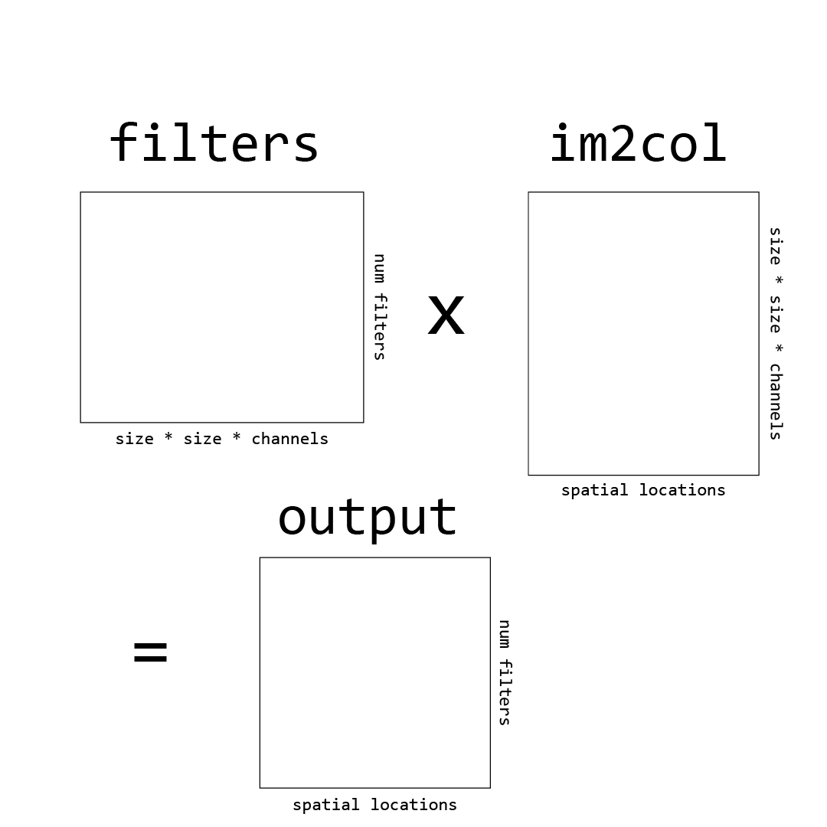
Im2col: rearrange image
Now we just multiply by our filter matrix to do convolutions.

Slide 116
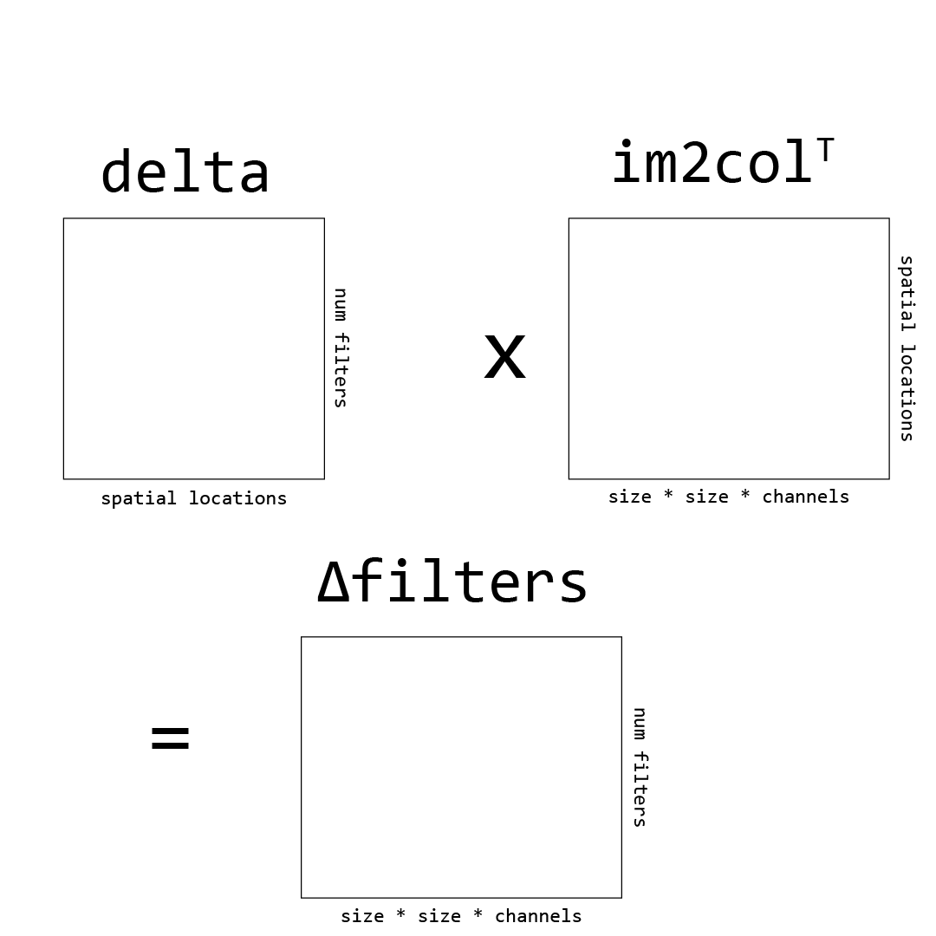
Im2col: rearrange image
Can calculate our weight updates as well by multiplying the delta of a layer by the input.

Slide 117
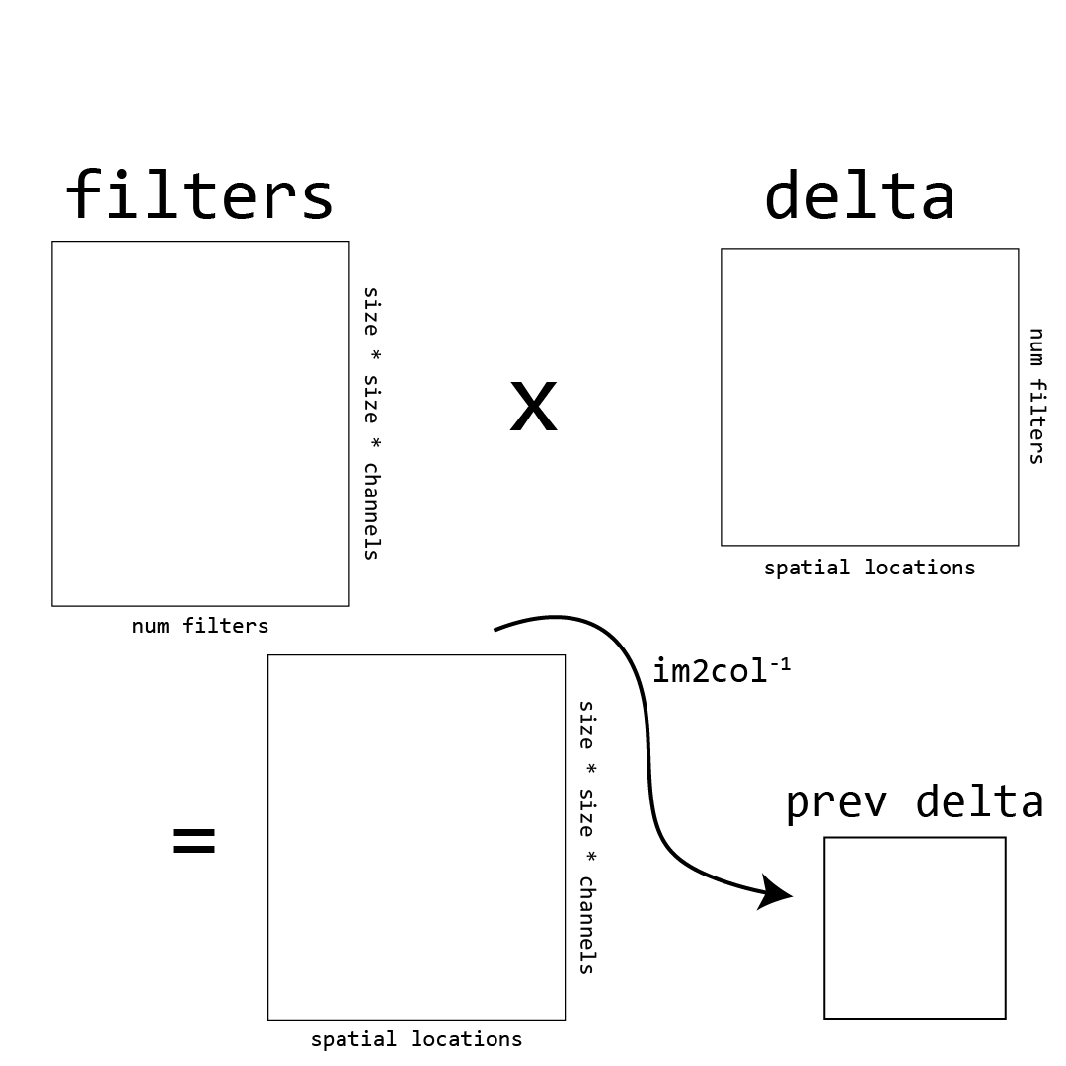
Im2col: rearrange image
Finally, can calculate backpropagated delta by multiplying the current delta by weights and doing the reverse of im2col.

Slide 118
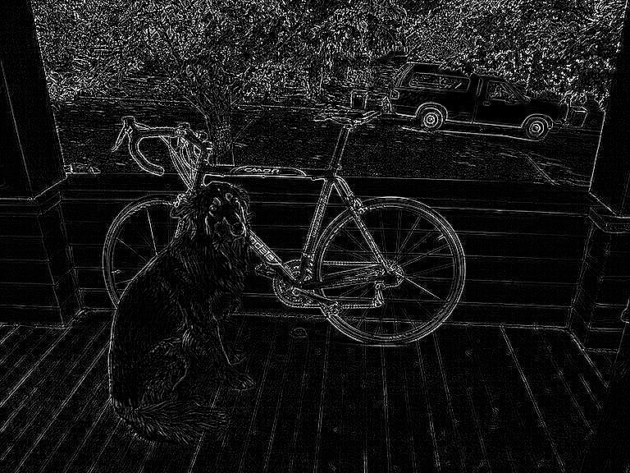
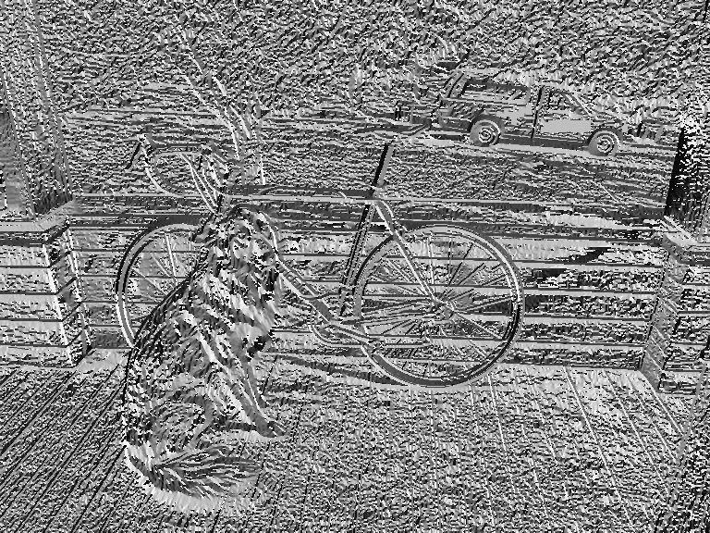
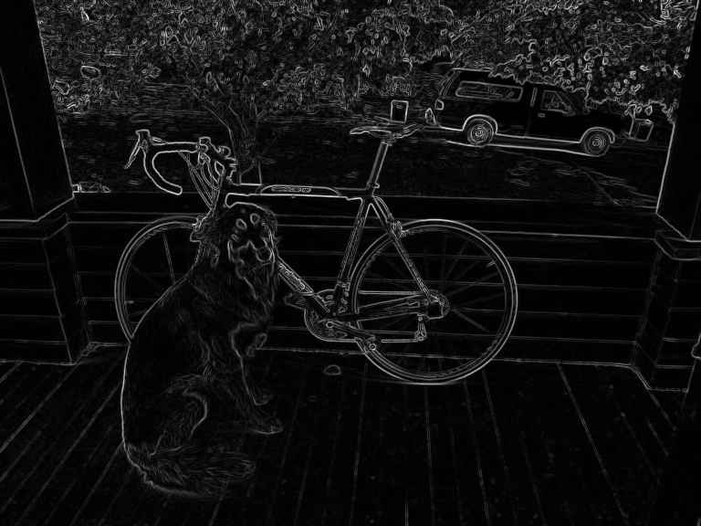
Images are BIG
Even a 256 x 256 images has hundreds of thousands of pixels and that’s considered a small image!
Convolution:
Aggregate information, maybe we don’t need all of the image, can subsample without throwing away useful information

Slide 119
Pooling Layer
Input: an image Processing: pool pixel values over region Output: an image, shrunk by a factor of the stride
Hyperparameters: What kind of pooling? Average, mean, max, min How big of stride? Controls downsampling How big of region? Usually not much bigger than stride
Most common: 2x2 or 3x3 maxpooling, stride of 2

Slide 120
Maxpooling Layer, 2x2 stride 2
-7 | 6 | -1 | 3 | 9 | 9 | 6 | -9
3 | -8 | 0 | 7 | 10 | 8 | -3 | 10
-4 | 2 | -6 | 4 | -7 | 5 | 5 | 7
-3 | -9 | 1 | 8 | -8 | 9 | -1 | -5
-7 | 10 | -9 | -5 | 9 | -8 | -7 | 10
-5 | 5 | 9 | 4 | 10 | -8 | 7 | 6
-3 | 8 | 0 | 2 | 2 | -3 | -2 | 5
4 | -6 | 7 | -3 | 1 | 4 | 10 | 0

Slide 121
Maxpooling Layer, 2x2 stride 2
-7 | 6 | -1 | 3 | 9 | 9 | 6 | -9
3 | -8 | 0 | 7 | 10 | 8 | -3 | 10
-4 | 2 | -6 | 4 | -7 | 5 | 5 | 7
-3 | -9 | 1 | 8 | -8 | 9 | -1 | -5
-7 | 10 | -9 | -5 | 9 | -8 | -7 | 10
-5 | 5 | 9 | 4 | 10 | -8 | 7 | 6
-3 | 8 | 0 | 2 | 2 | -3 | -2 | 5
4 | -6 | 7 | -3 | 1 | 4 | 10 | 0
6

Slide 122
Maxpooling Layer, 2x2 stride 2
-7 | 6 | -1 | 3 | 9 | 9 | 6 | -9
3 | -8 | 0 | 7 | 10 | 8 | -3 | 10
-4 | 2 | -6 | 4 | -7 | 5 | 5 | 7
-3 | -9 | 1 | 8 | -8 | 9 | -1 | -5
-7 | 10 | -9 | -5 | 9 | -8 | -7 | 10
-5 | 5 | 9 | 4 | 10 | -8 | 7 | 6
-3 | 8 | 0 | 2 | 2 | -3 | -2 | 5
4 | -6 | 7 | -3 | 1 | 4 | 10 | 0
6

Slide 123
Maxpooling Layer, 2x2 stride 2
-7 | 6 | -1 | 3 | 9 | 9 | 6 | -9
3 | -8 | 0 | 7 | 10 | 8 | -3 | 10
-4 | 2 | -6 | 4 | -7 | 5 | 5 | 7
-3 | -9 | 1 | 8 | -8 | 9 | -1 | -5
-7 | 10 | -9 | -5 | 9 | -8 | -7 | 10
-5 | 5 | 9 | 4 | 10 | -8 | 7 | 6
-3 | 8 | 0 | 2 | 2 | -3 | -2 | 5
4 | -6 | 7 | -3 | 1 | 4 | 10 | 0
6 | 7

Slide 124
Maxpooling Layer, 2x2 stride 2
-7 | 6 | -1 | 3 | 9 | 9 | 6 | -9
3 | -8 | 0 | 7 | 10 | 8 | -3 | 10
-4 | 2 | -6 | 4 | -7 | 5 | 5 | 7
-3 | -9 | 1 | 8 | -8 | 9 | -1 | -5
-7 | 10 | -9 | -5 | 9 | -8 | -7 | 10
-5 | 5 | 9 | 4 | 10 | -8 | 7 | 6
-3 | 8 | 0 | 2 | 2 | -3 | -2 | 5
4 | -6 | 7 | -3 | 1 | 4 | 10 | 0
6 | 7

Slide 125
Maxpooling Layer, 2x2 stride 2
-7 | 6 | -1 | 3 | 9 | 9 | 6 | -9
3 | -8 | 0 | 7 | 10 | 8 | -3 | 10
-4 | 2 | -6 | 4 | -7 | 5 | 5 | 7
-3 | -9 | 1 | 8 | -8 | 9 | -1 | -5
-7 | 10 | -9 | -5 | 9 | -8 | -7 | 10
-5 | 5 | 9 | 4 | 10 | -8 | 7 | 6
-3 | 8 | 0 | 2 | 2 | -3 | -2 | 5
4 | -6 | 7 | -3 | 1 | 4 | 10 | 0
6 | 7 | 10

Slide 126
Maxpooling Layer, 2x2 stride 2
-7 | 6 | -1 | 3 | 9 | 9 | 6 | -9
3 | -8 | 0 | 7 | 10 | 8 | -3 | 10
-4 | 2 | -6 | 4 | -7 | 5 | 5 | 7
-3 | -9 | 1 | 8 | -8 | 9 | -1 | -5
-7 | 10 | -9 | -5 | 9 | -8 | -7 | 10
-5 | 5 | 9 | 4 | 10 | -8 | 7 | 6
-3 | 8 | 0 | 2 | 2 | -3 | -2 | 5
4 | -6 | 7 | -3 | 1 | 4 | 10 | 0
6 | 7 | 10 | 10

Slide 127
Maxpooling Layer, 2x2 stride 2
-7 | 6 | -1 | 3 | 9 | 9 | 6 | -9
3 | -8 | 0 | 7 | 10 | 8 | -3 | 10
-4 | 2 | -6 | 4 | -7 | 5 | 5 | 7
-3 | -9 | 1 | 8 | -8 | 9 | -1 | -5
-7 | 10 | -9 | -5 | 9 | -8 | -7 | 10
-5 | 5 | 9 | 4 | 10 | -8 | 7 | 6
-3 | 8 | 0 | 2 | 2 | -3 | -2 | 5
4 | -6 | 7 | -3 | 1 | 4 | 10 | 0
6 | 7 | 10 | 10
2

Slide 128
Maxpooling Layer, 2x2 stride 2
-7 | 6 | -1 | 3 | 9 | 9 | 6 | -9
3 | -8 | 0 | 7 | 10 | 8 | -3 | 10
-4 | 2 | -6 | 4 | -7 | 5 | 5 | 7
-3 | -9 | 1 | 8 | -8 | 9 | -1 | -5
-7 | 10 | -9 | -5 | 9 | -8 | -7 | 10
-5 | 5 | 9 | 4 | 10 | -8 | 7 | 6
-3 | 8 | 0 | 2 | 2 | -3 | -2 | 5
4 | -6 | 7 | -3 | 1 | 4 | 10 | 0
6 | 7 | 10 | 10
2 | 8

Slide 129
Maxpooling Layer, 2x2 stride 2
-7 | 6 | -1 | 3 | 9 | 9 | 6 | -9
3 | -8 | 0 | 7 | 10 | 8 | -3 | 10
-4 | 2 | -6 | 4 | -7 | 5 | 5 | 7
-3 | -9 | 1 | 8 | -8 | 9 | -1 | -5
-7 | 10 | -9 | -5 | 9 | -8 | -7 | 10
-5 | 5 | 9 | 4 | 10 | -8 | 7 | 6
-3 | 8 | 0 | 2 | 2 | -3 | -2 | 5
4 | -6 | 7 | -3 | 1 | 4 | 10 | 0
6 | 7 | 10 | 10
2 | 8 | 9 | 7
10 | 9 | 10 | 10
8 | 7 | 4 | 10

Slide 130
(Fully) Connected Layer
The standard neural network layer where every input neuron connects to every output neuron
Often used to go from image feature map -> final output or map image features to a single vector
Eliminates spatial information

Slide 131
Convnet Building Blocks
Convolutional layers: Connections are convolutions Used to extract features
Pooling layers: Used to downsample feature maps, make processing more efficient Most common: maxpool, avgpool sometimes used at end
Connected layers: Often used as last layer, to map image features -> prediction No spatial information Inefficient: lots of weights, no weight sharing

Slide 133
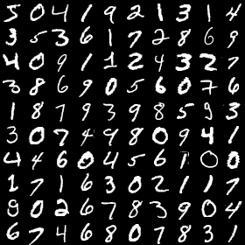
MNIST: Handwriting recognition
50,000 images of handwriting 28 x 28 x 1 (grayscale) Numbers 0-9

Slide 134
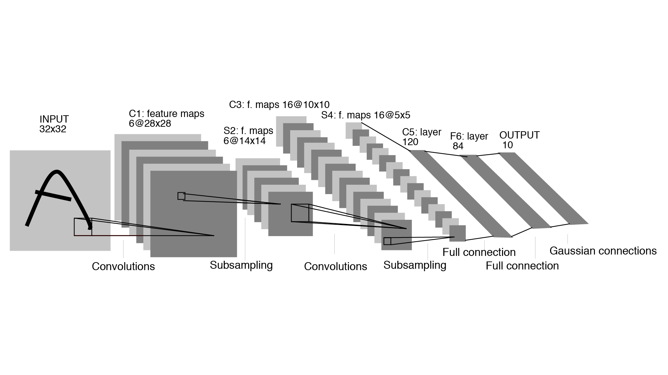
LeNet: First Convnet for Images*
*probably? Maybe neocognitron but not trained w/ backprop Fukushima, Kunihiko (1980). "Neocognitron: A Self-organizing Neural Network Model for a Mechanism of Pattern Recognition Unaffected by Shift in Position" (PDF). Biological Cybernetics. 36 (4): 193–202.
99% accuracy on MNIST (Yann LeCun 1998)
Has all elements of modern convnet Convolutions, maxpooling, fully connected layers Logistic activations after pooling layers (nowadays use RELU) Weight updates through backpropagation

Slide 135
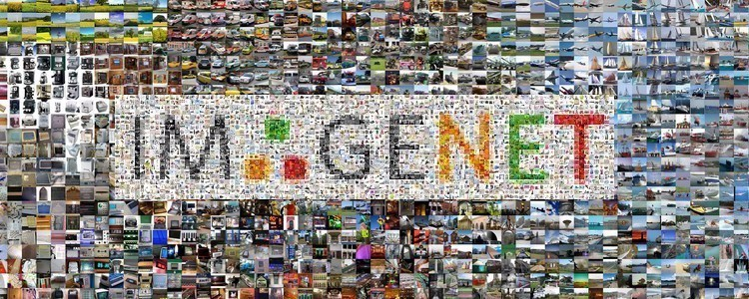
ImageNet: Really big image dataset
Dataset of images and labels from Princeton
14 million images, 22k categories
Challenge subset (most used): 1.2 million images, 1000 categories

Slide 136
ImageNet: Really big image dataset
Labels taken from WordNet, a lexical database of english words and how they relate
Paid workers on AMT to label images with WordNet label or synset (group of words)

Slide 137
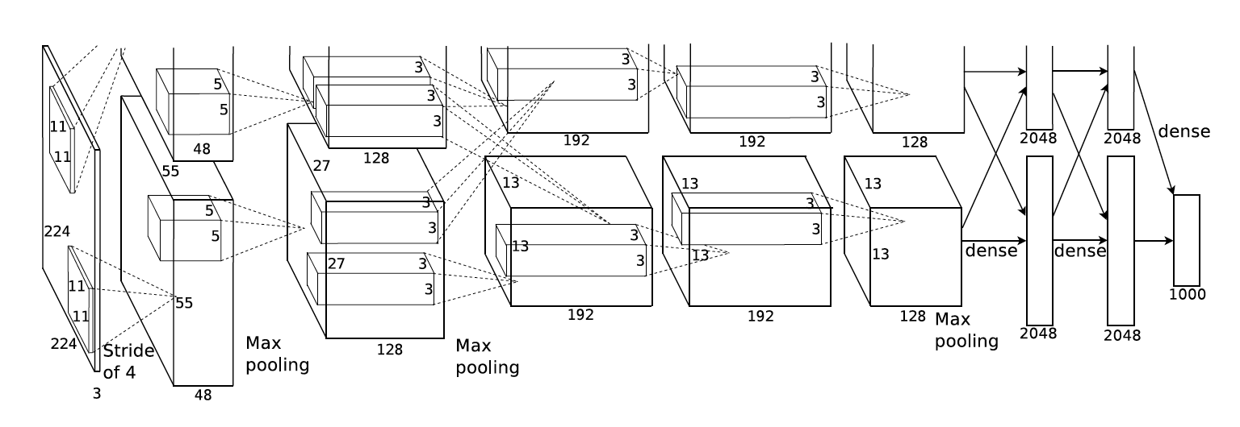
AlexNet: first good network
https://papers.nips.cc/paper/4824-imagenet-classification-with-deep-convolutional-neural-networks.pdf
Entry for ImageNet challenge

Slide 138
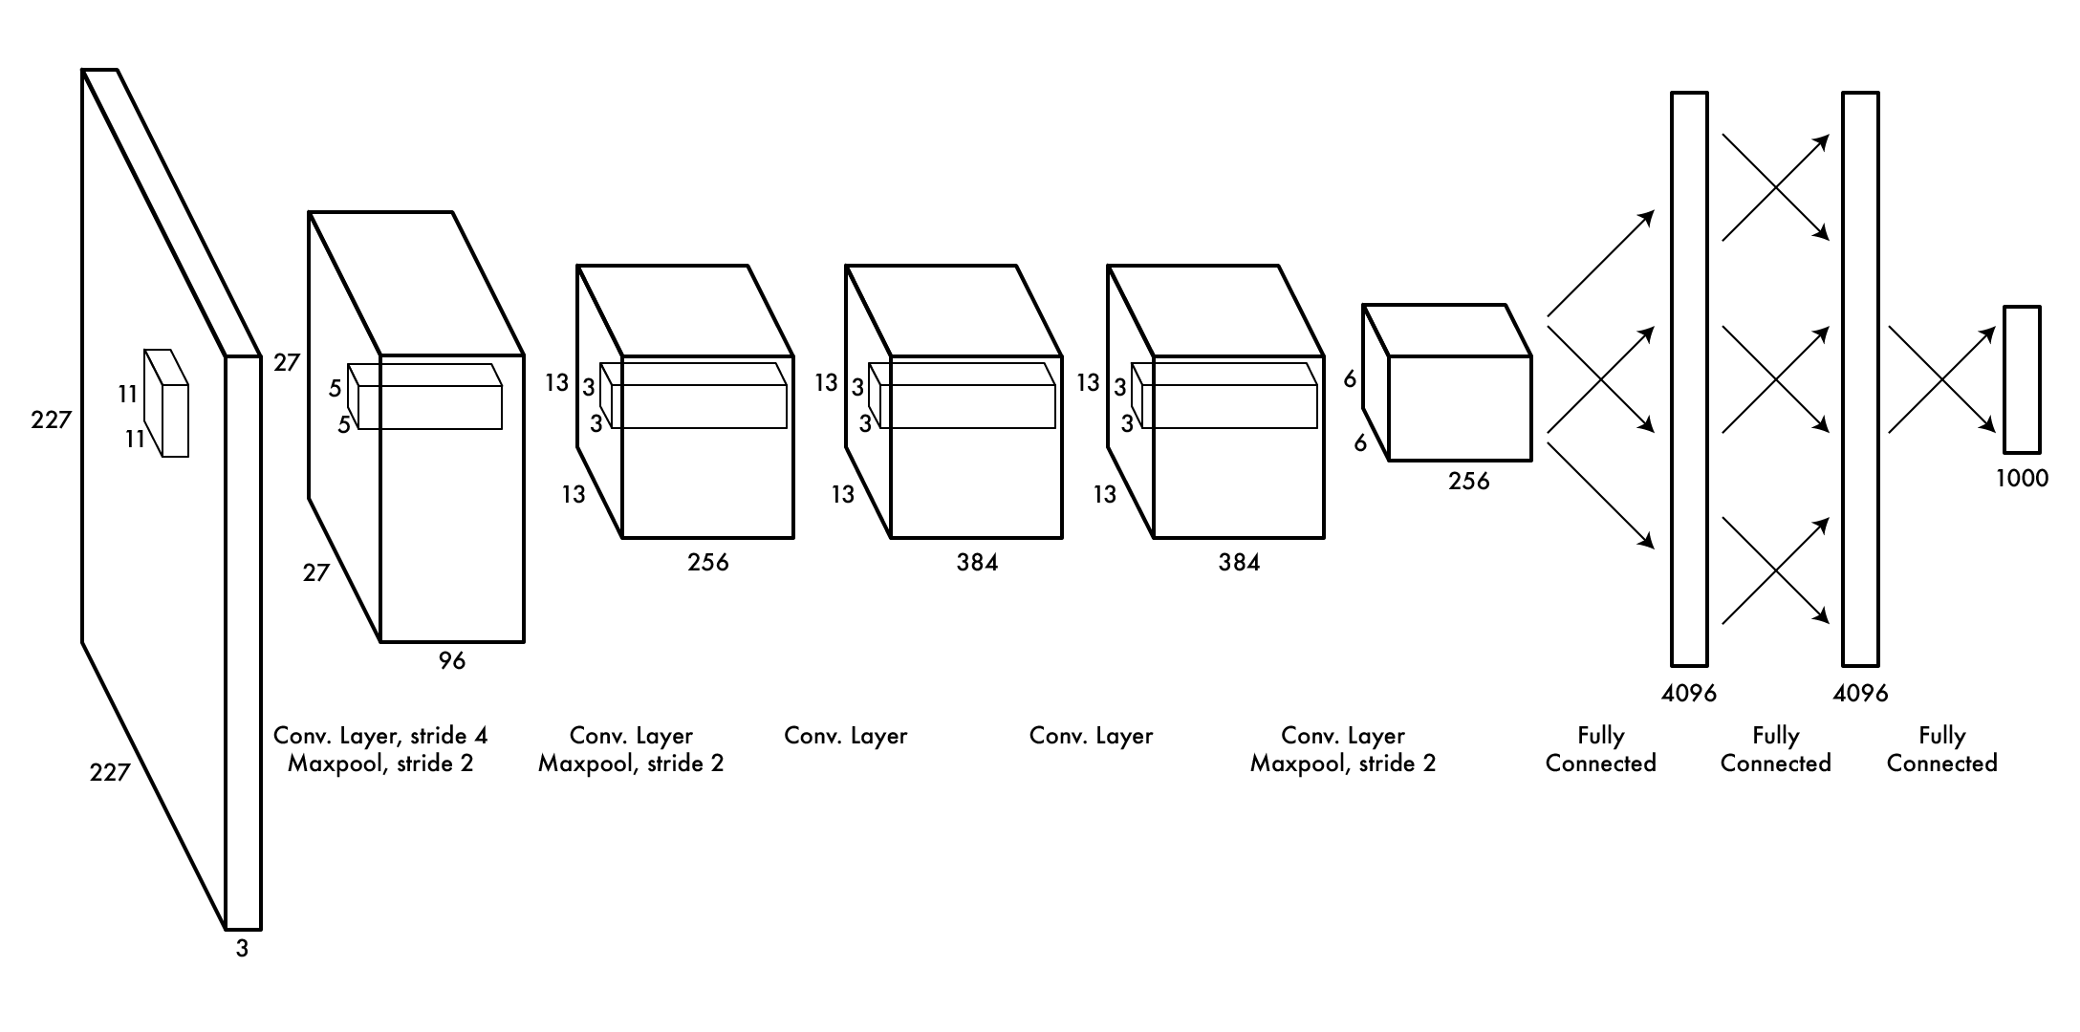
AlexNet: first good network
https://papers.nips.cc/paper/4824-imagenet-classification-with-deep-convolutional-neural-networks.pdf
Entry for ImageNet challenge

Slide 139
AlexNet: first good network
https://papers.nips.cc/paper/4824-imagenet-classification-with-deep-convolutional-neural-networks.pdf
Entry for ImageNet challenge Much higher accuracy than “traditional” methods (SVM on SIFT) Why did it take so long?

Slide 140
GPUs: How modern CNNs are possible
Alex spent a long time implementing the components of a CNN on a GPU, his software Cudaconvnet was the first “modern” neural network framework
GPUs allow >100x speedup compared to CPU, training still took weeks on ImageNet
This idea, CNNs + GPUs started revolution in computer vision just 5 years ago
(check NVIDIAs stock in last 5 years)

Slide 141
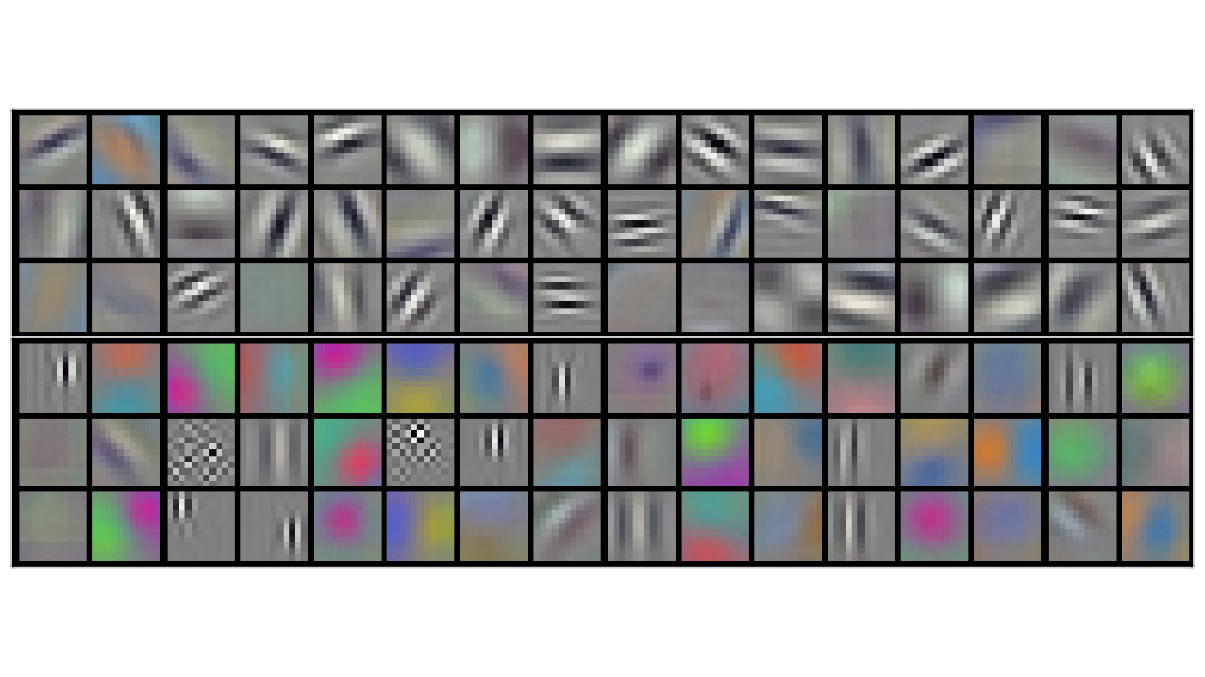
What are these networks learning?
Features! Here’s 1st layer of AlexNet

Slide 142
Later layers harder to visualize
Combinations of lower-level features, not much meaning by themselves
We can try other methods to visualize them, information flow

Slide 143
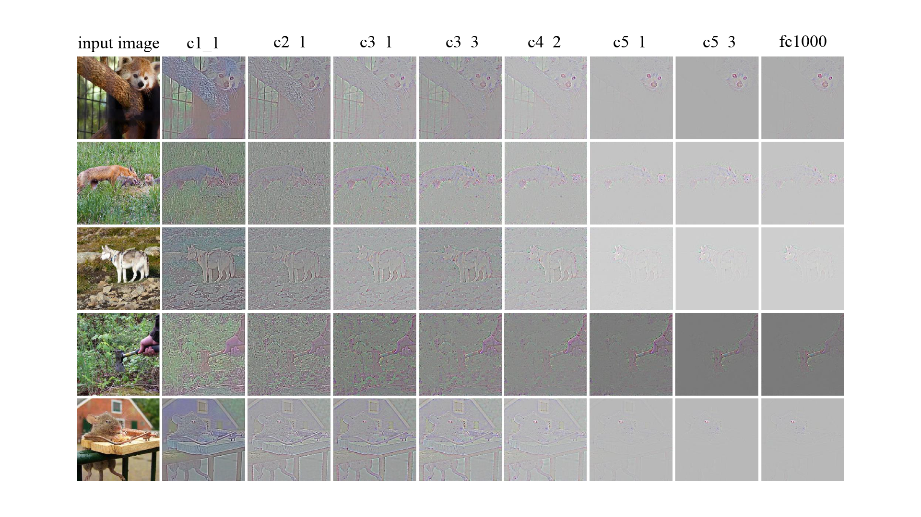
What info goes through the network
https://icmlviz.github.io/icmlviz2016/assets/papers/4.pdf

Slide 144
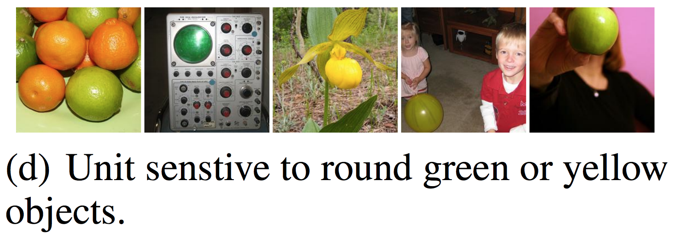
Idea: find interesting images
https://arxiv.org/pdf/1312.6199.pdf
We can feed images into our network and see which ones activate certain neurons

Slide 145
Idea: make interesting images
Instead of optimizing network, we can do gradient descent on the image too
Optimize the image to activate certain neurons or certain layers, then we can learn what those layers or neurons do!
You may have seen this under the name deep dream

Slide 146
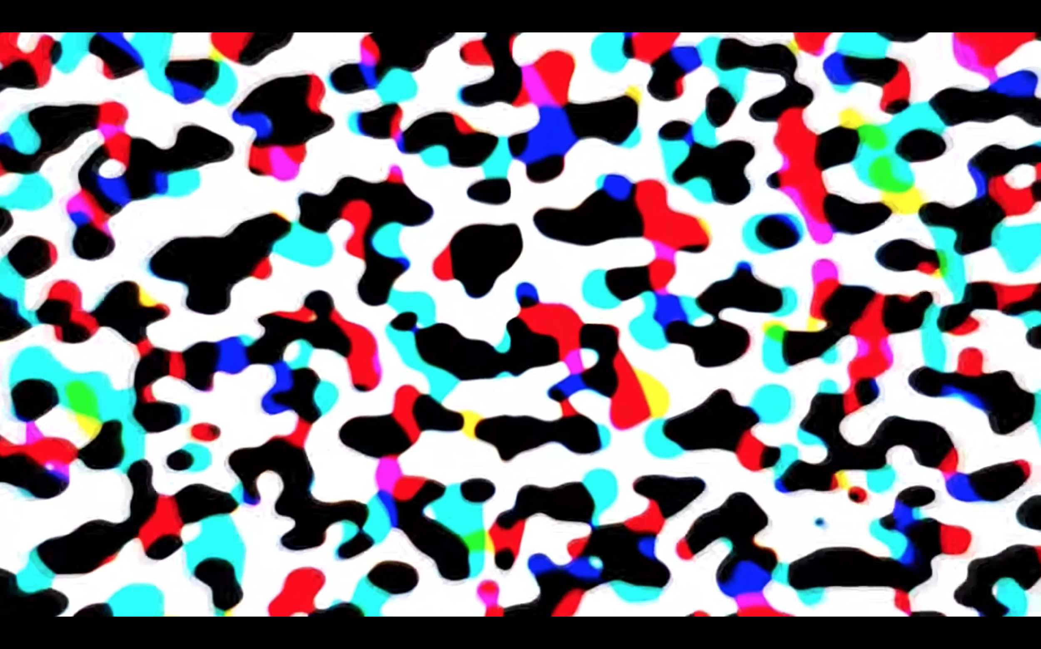
Early layers: blobs
https://www.youtube.com/watch?v=SCE-QeDfXtA
Neurons respond strongly to high contrast

Slide 147
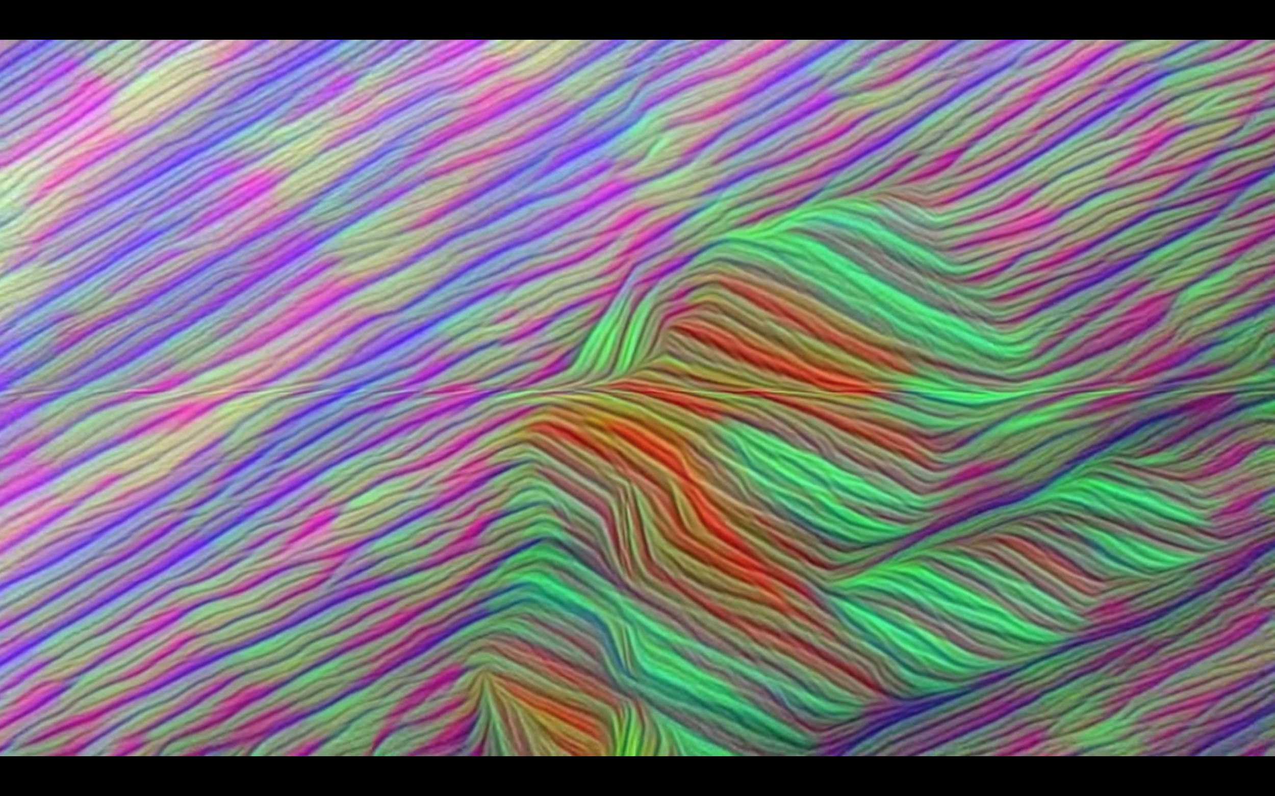
Middle layers: edges, curves, eyes
https://www.youtube.com/watch?v=SCE-QeDfXtA
Neurons respond to simple features and shapes

Slide 148
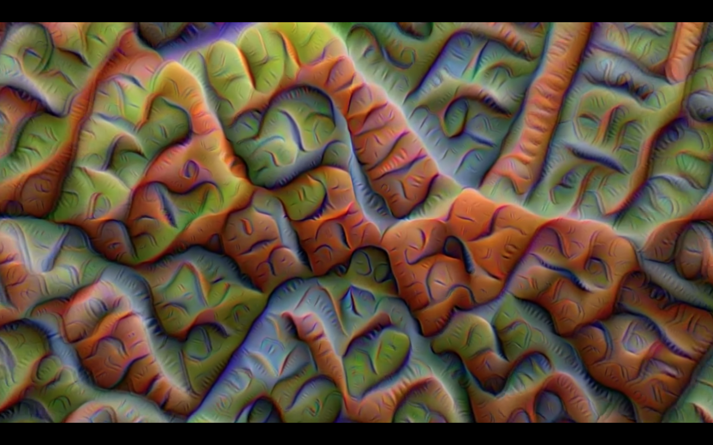
Middle layers: edges, curves, eyes
https://www.youtube.com/watch?v=SCE-QeDfXtA
Neurons respond to simple features and shapes

Slide 149
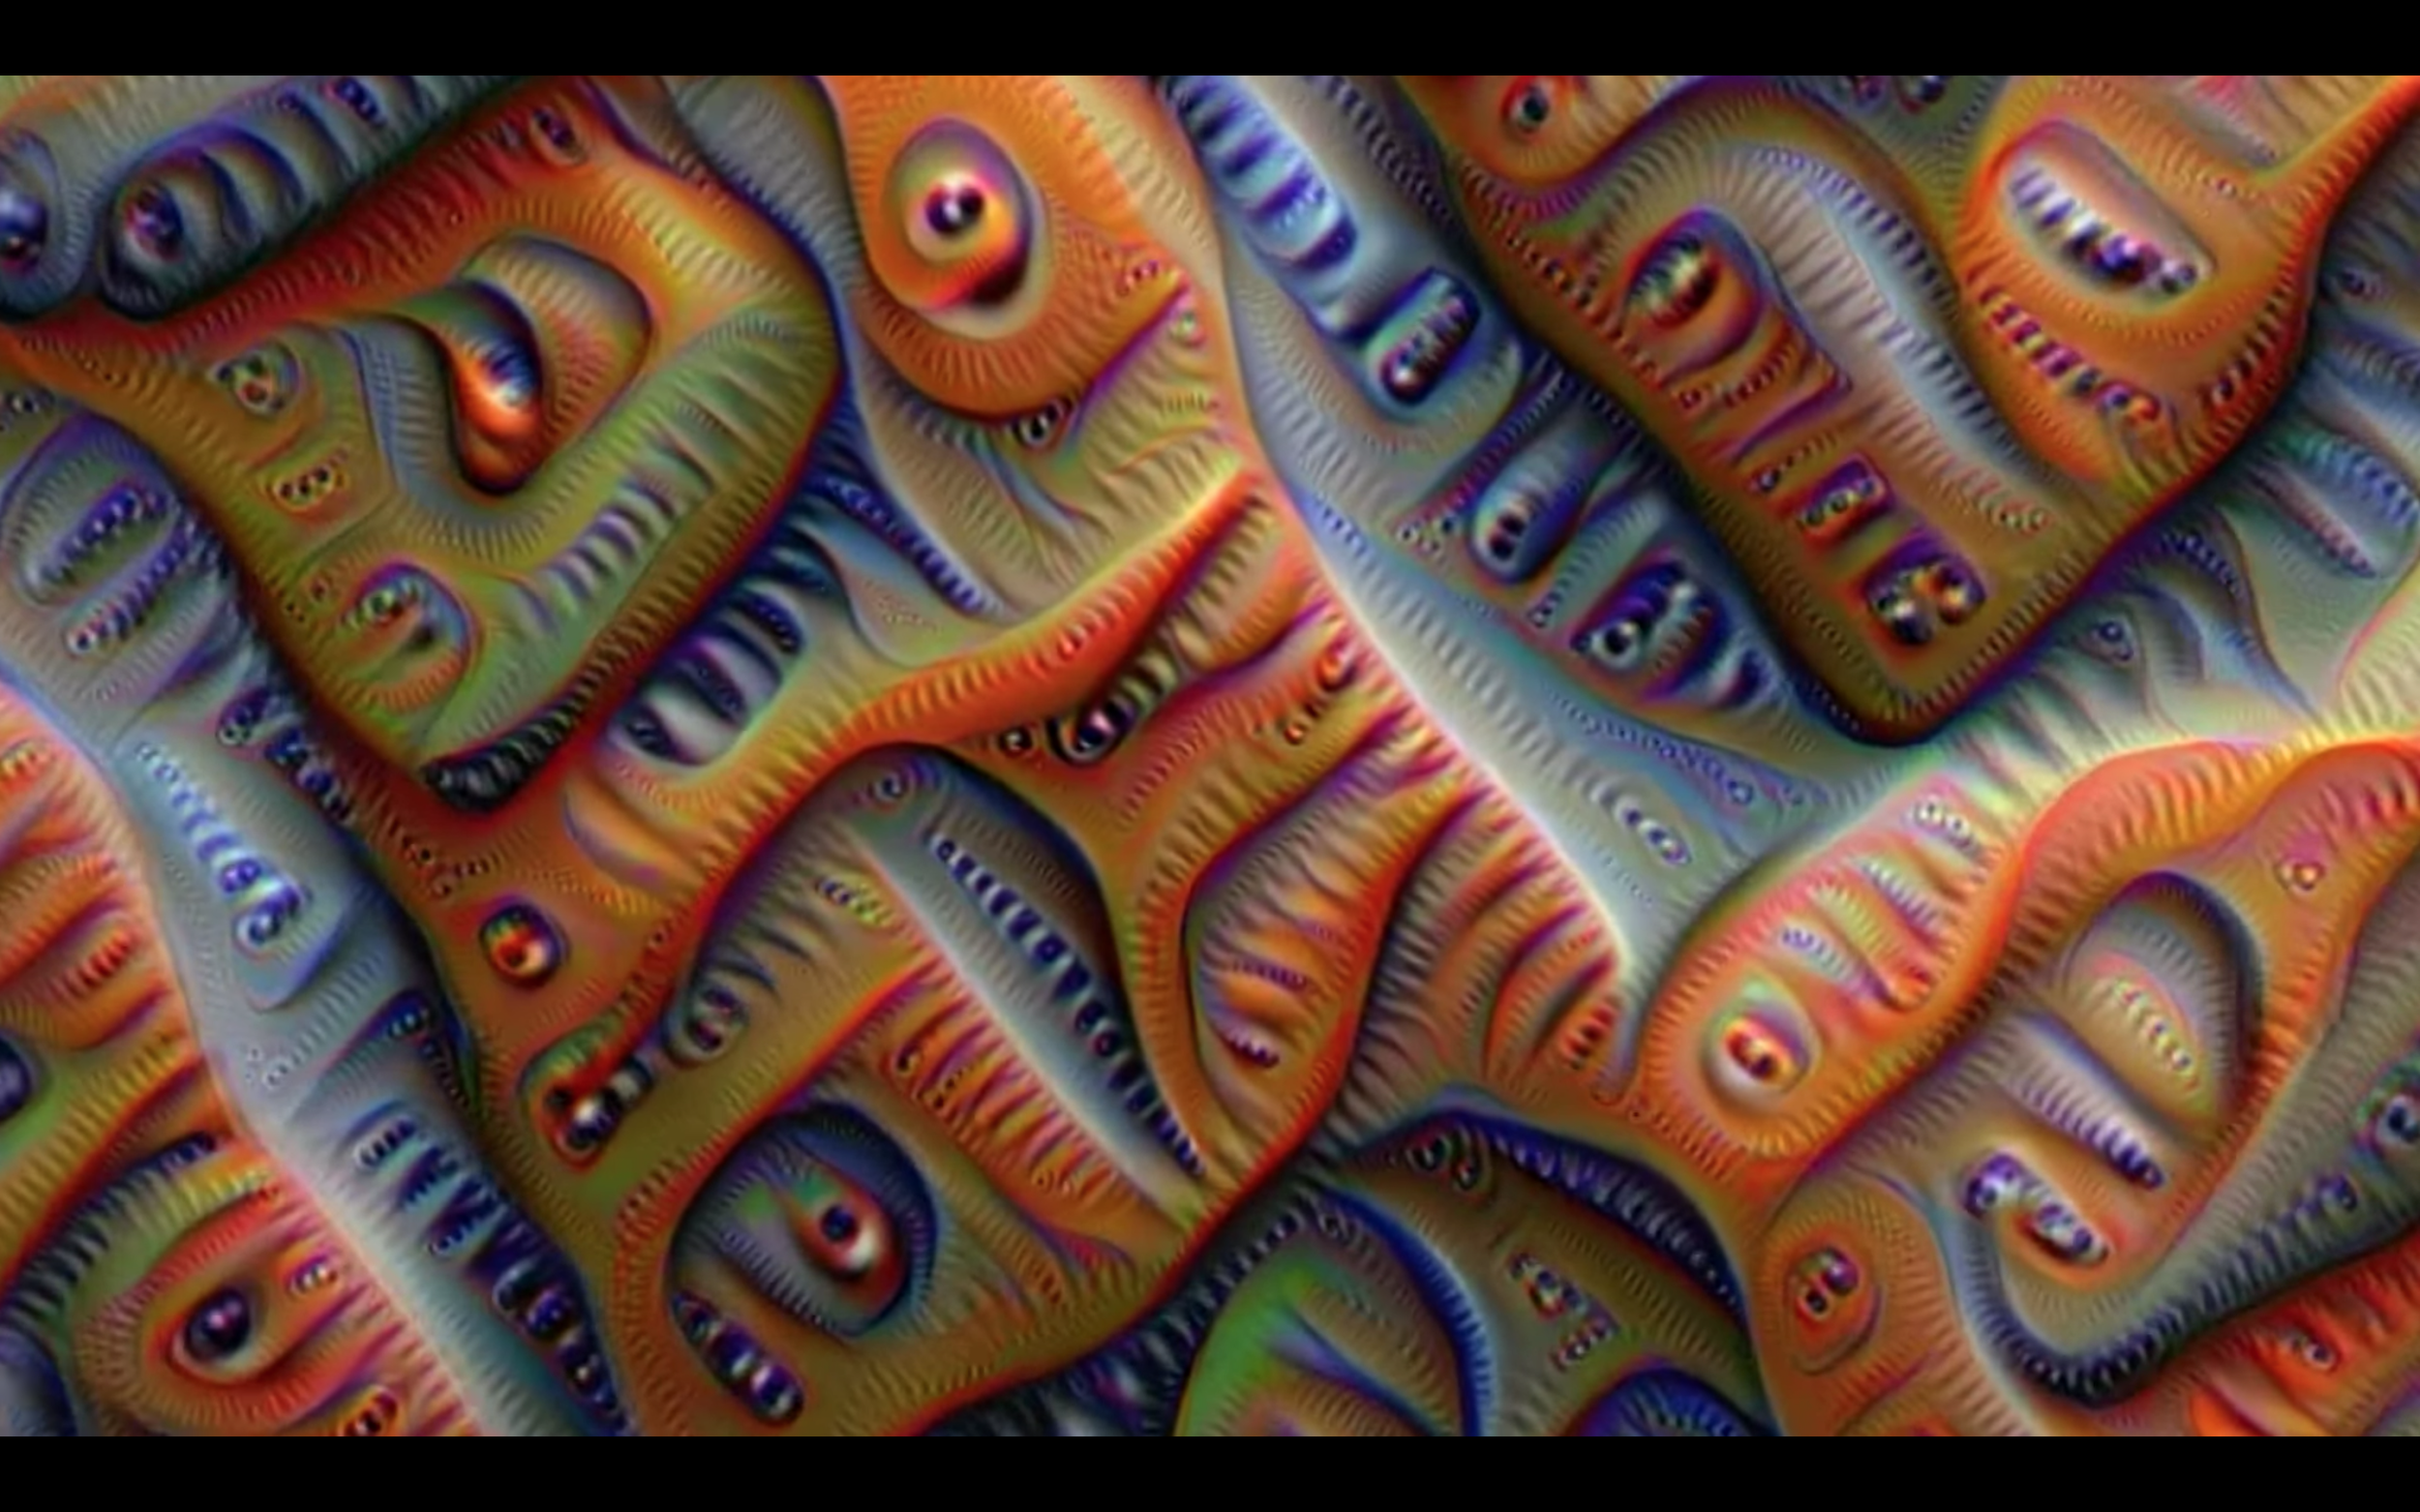
Middle layers: edges, curves, eyes
https://www.youtube.com/watch?v=SCE-QeDfXtA
Neurons respond to simple features and shapes

Slide 150
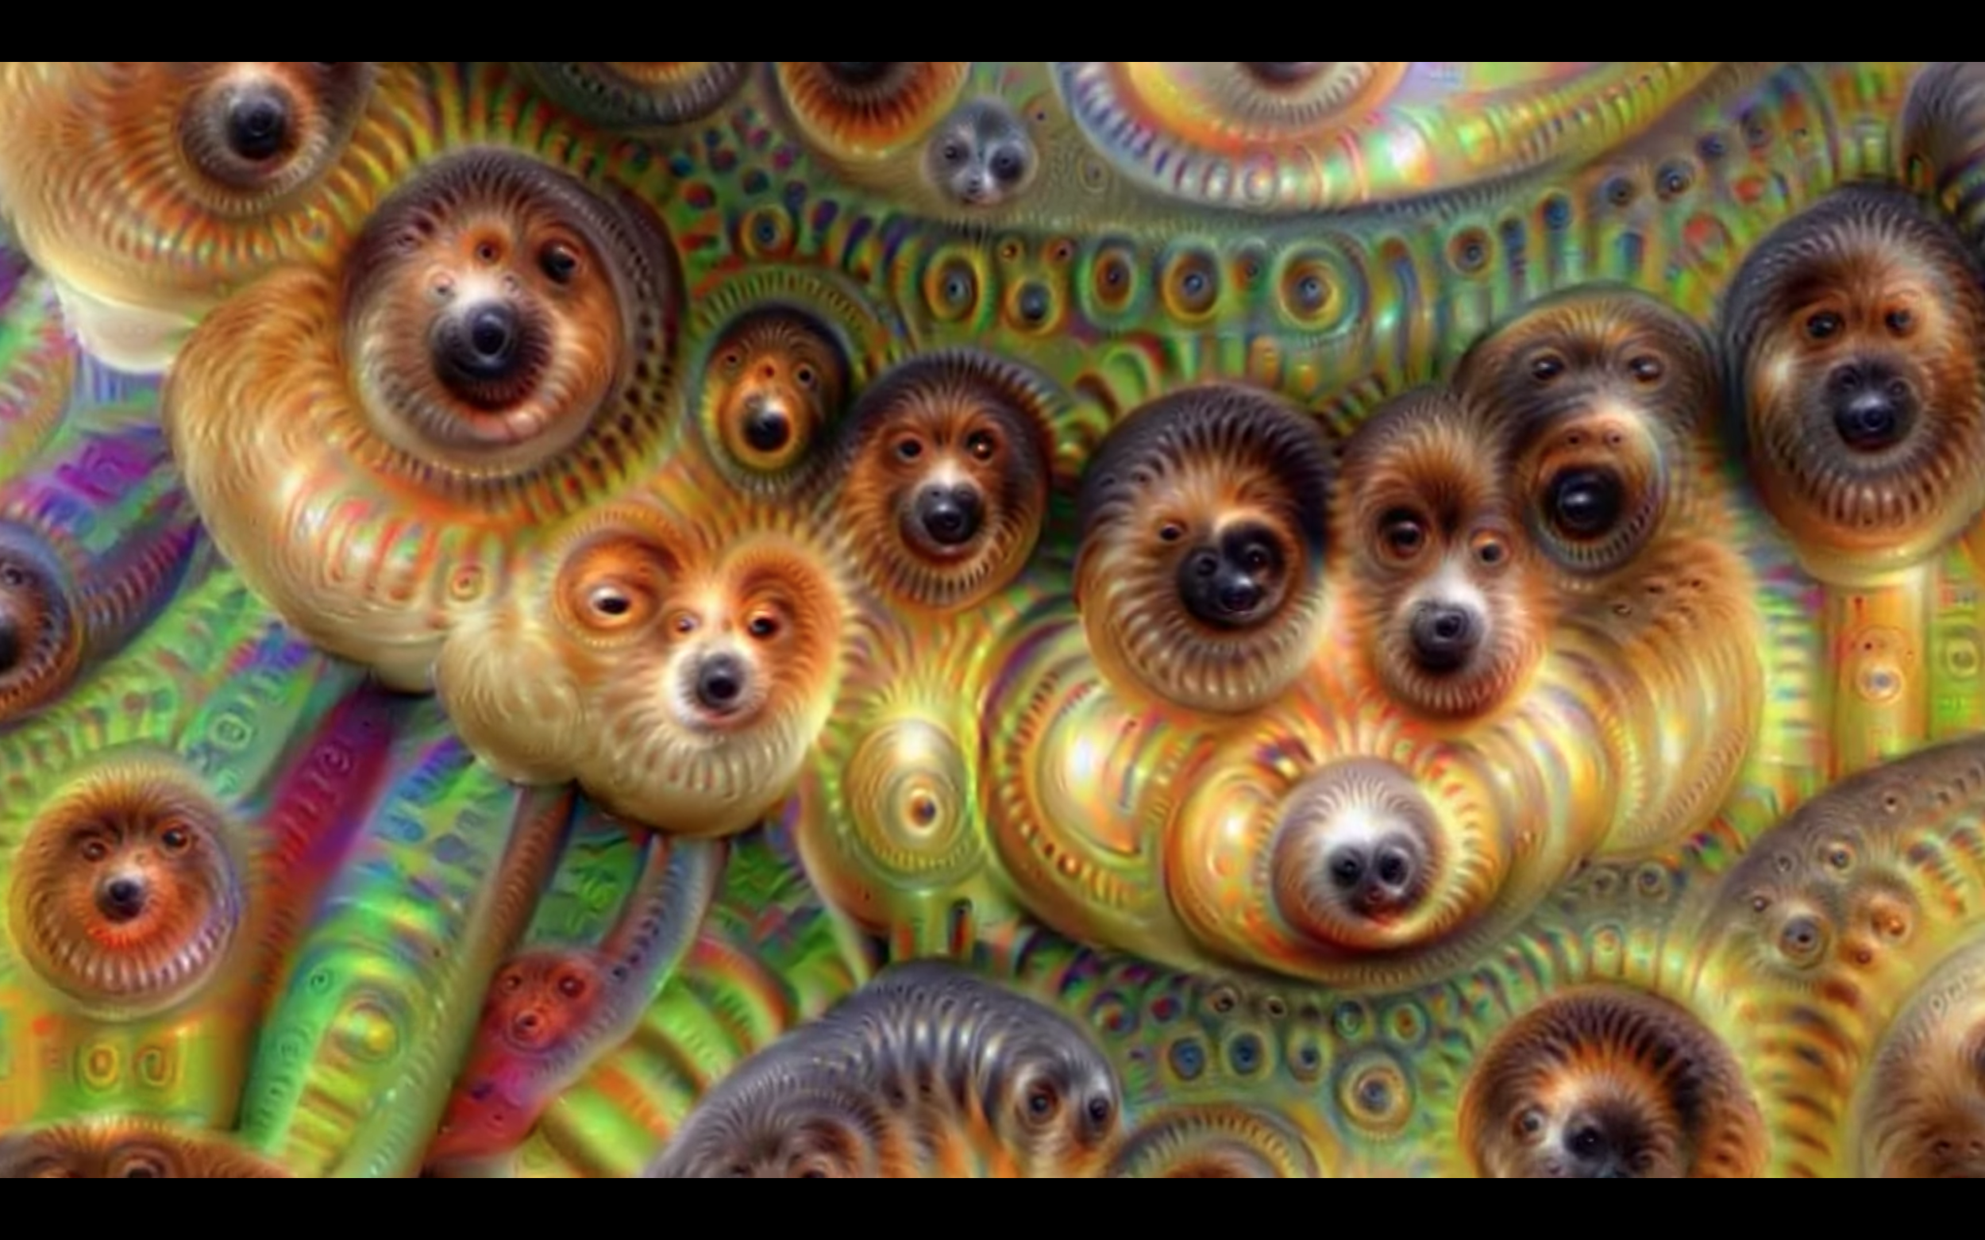
Later layers: eyes, objects, dogs
https://www.youtube.com/watch?v=SCE-QeDfXtA
Neurons respond to arrangements of features

Slide 151
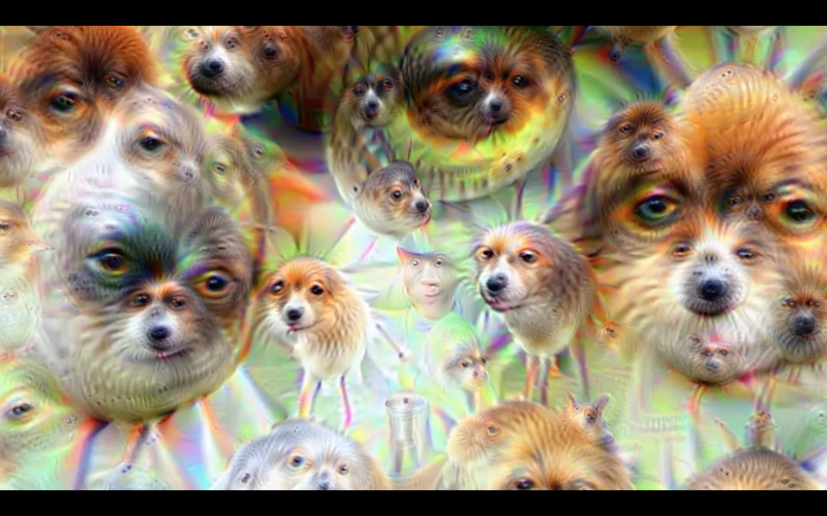
Later layers: eyes, objects, dogs
https://www.youtube.com/watch?v=SCE-QeDfXtA
Neurons respond to arrangements of features

Slide 152
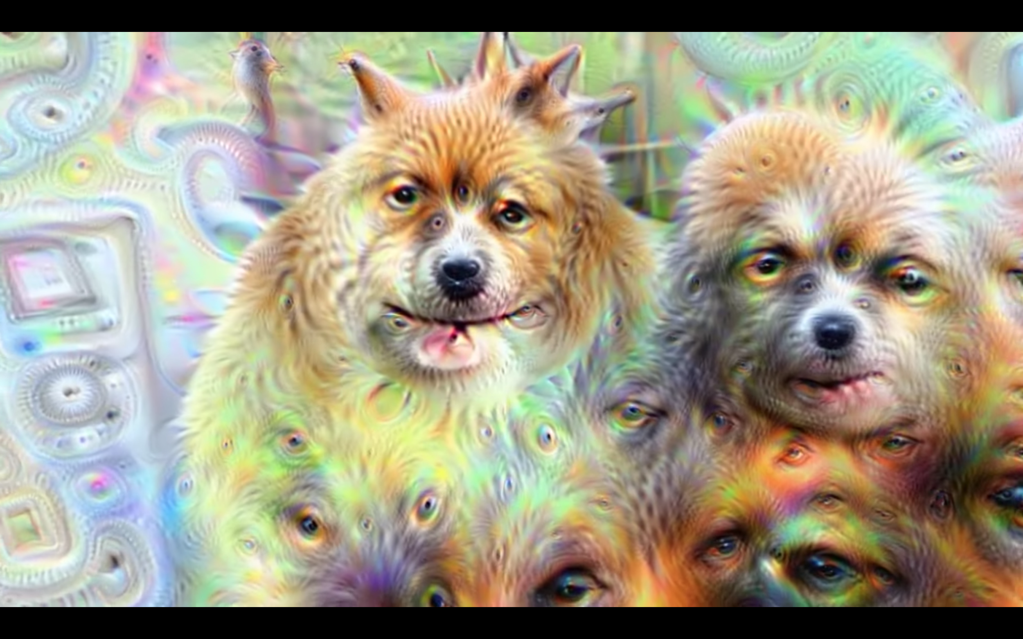
Later layers: eyes, objects, dogs
https://www.youtube.com/watch?v=SCE-QeDfXtA
Neurons respond to arrangements of features

Slide 153
Neural networks work!
At least, seem to do what we want them to
Low-level features Lines, oriented edges
Predictor Process features and predict output
Mid-level features Combine edges: curves, shapes
High-level features Combine shapes: objects, scenes

Slide 154
VGG: networks getting bigger
From the Visual Geometry Group at Oxford Considered “very deep” at the time, 16 - 19 layers VGG-16 is still commonly used as a feature extractor Although really it shouldn’t be, much better alternatives

Slide 155
GoogleNet: networks getting weird
https://www.cs.unc.edu/~wliu/papers/GoogLeNet.pdf
Another way to efficiency: Split layers Not just one size, but many 1x1, 3x3, 5x5
Also use 1x1 convs to compress feature maps
Can make large networks that are still efficient, better than VGG yet smaller and faster.

Slide 156
GoogleNet: networks getting weird
Like… really big
And this is sort of all we do now, try to make networks bigger without making them too expensive

Slide 157
GoogleNet: networks getting weird
Like… really big
And this is sort of all we do now, try to make networks bigger without making them too expensive
Multiple outputs

Slide 158
Gradient explosion / vanishing
With very deep networks, the gradients flow through many layers of weights on their way back
With saturating activation functions like logistic or with small weights gradients can “vanish”
With non-saturating activations or large weights gradients can EXPLODE!
Learning doesn’t scale, what works at 2 levels doesn’t at 20

Slide 159
Batch normalization
https://arxiv.org/pdf/1502.03167.pdf
One way to deal with gradient vanishing: Normalize activations of filters spatially / over the mini-batch
During training, the distribution of network activations changes over time because the parameters (weights) change
Learning is more stable if this change (or internal covariate shift) is reduced
If output is 32 x 32 x 16 image, batch size of 64, normalize activations for each filter across all images in batch: I.e. calculate 16 means and variances Subtract mean, divide by variance both across spatial dimensions and images in the batch

Slide 160
Batch normalization
https://arxiv.org/pdf/1502.03167.pdf
Other benefits:
Output is normalized before activation, mean 0 var 1 means it’s in the “good” domain of most activation functions
Each image is seen relative to others in a batch, introduces a form of regularization because we don’t ever “see” same image twice
Stabilizes training so much larger learning rates can be used

Slide 161
Residual connections
Normally, output of two layers is: f(w*f(vx)) Residual connections: f(w*f(vx) + x)
Learning how to modify x, add some transformed amount Gives delta another path, less vanishing gradient

Slide 162
ResNet

Slide 163
ResNet
3x3 conv blocks or 3x3 and 1x1 conv blocks
Residual connections
VERY deep, 100+ layers

Slide 164
Grouped convolutions
Most filters look at every channel in input Very expensive Maybe not needed? Might only pull info from a few of them
Grouped convolutions: Split up input feature map into groups Run convs on groups independently Recombine

Slide 165
Grouped convolutions
Grouped convolutions: Split up input feature map into groups Run convs on groups independently Recombine
E.g. 3x3 conv layer 32 x 32 x 256 input, 128 filters, 32 groups:
Split input into 32 different feature maps Each is 32 x 32 x 8 Run 4 filters, 3x3x8 on each group Merge 4*32 channels back together, get 32 x 32 x 128 output
Input, output stays same dimensions, less computation

Slide 166
ResNeXt
https://arxiv.org/pdf/1611.05431.pdf
Replace 3x3 blocks with larger grouped convs
“Larger” network but same computational complexity

Slide 167
What’s NeXt?
Starting to saturate ImageNet, fighting over 1-2%

Slide 168
What’s NeXt?
Starting to saturate ImageNet, fighting over 1-2%
But now vision really works, other tasks Other datasets? Segmentation Object detection Captioning …

Slide 169
Training classifiers in wild
Typically you have a much smaller dataset than 1.2 million images and 1,000 classes.
What problems do we encounter with less data, say 10,000 images and 500 classes?

Slide 170
First ImageNet, then the world!
For dealing with smaller datasets where we might overfit, pretraining is key:
First train on ImageNet
Chop off last layer
Keep training on your data

Slide 171
First ImageNet, then the world!
For dealing with smaller datasets where we might overfit, pretraining is key:
First train on ImageNet
Chop off last layer
Keep training on your data

Slide 172
First ImageNet, then the world!
For dealing with smaller datasets where we might overfit, pretraining is key:
First train on ImageNet
Chop off last layer
Keep training on your data

Slide 174
Semantic Segmentation

Slide 175
Semantic Segmentation
https://arxiv.org/pdf/1505.04366.pdf

Slide 176
Semantic Segmentation
https://arxiv.org/pdf/1505.04366.pdf

Slide 177
Semantic Segmentation
https://arxiv.org/pdf/1505.04366.pdf
Encoder

Slide 178
Semantic Segmentation
https://arxiv.org/pdf/1505.04366.pdf
Encoder
Decoder

Slide 179
Semantic Segmentation
https://arxiv.org/pdf/1505.04366.pdf
Coarse features

Slide 180
Semantic Segmentation
https://arxiv.org/pdf/1505.04366.pdf
Fine-grained predictions
Coarse features

Slide 181
U-net/Segnet
https://arxiv.org/pdf/1511.00561.pdf, https://arxiv.org/pdf/1505.04597.pdf

Slide 182
Spatial pyramid pooling
https://arxiv.org/pdf/1612.01105.pdf

Slide 183
Spatial pyramid pooling

Slide 184
DeepLabv3+
https://arxiv.org/pdf/1802.02611.pdf
Atrous convolutions Spaced inputs

Slide 185
DeepLabv3+
https://arxiv.org/pdf/1802.02611.pdf
Atrous convolutions Spaced inputs
Pre-train on ImageNet

Slide 186
DeepLabv3+
https://arxiv.org/pdf/1802.02611.pdf
Atrous convolutions Spaced inputs
Fine-tune on segmentation
Pre-train on ImageNet

Slide 189
Object detection

Slide 190
Deformable parts models

Slide 191
Scoring object detection
Multiple classes, multiple objects per images Can’t just use accuracy
“Correct” bounding box: Intersection / Union > 0.5
Intersection: Ground truth ∩ prediction Union: Ground truth ∪ prediction

Slide 192
Scoring object detection
“Correct” bounding box: Intersection / Union > 0.5
Recall: Correct bounding boxes / total ground-truth boxes
Precision: Correct bounding boxes / total predicted boxes
Only the most confident predictions: High precision, low recall
All the predictions: Low precision, high recall

Slide 193
Scoring object detection
Precision-Recall curve: vary threshold, plot precision and recall
Average precision: Area under PR curve Only for a single class
Take mean of AP across classes: Mean AP (mAP) Standard detection metric Sometimes at particular IOU I.e. mAP@.5 or mAP@.75

Slide 194
PASCAL VOC
One of the first large detection datasets: 20 classes 11,530 training images 27,450 annotated objects
DPM: 33.6% mAP
DPM is pre-neural network, how do we use CNNs for detection?

Slide 195
R-CNN: Regions with CNN features

Slide 196
Selective search: fewer proposals

Slide 197
Lots of post processing, 20 sec/im
Pascal VOC:
AlexNet 53.3% mAP
VGG-16 62.4% mAP

Slide 199
YOLO

Slide 200
Say you have an image...

Slide 201
Split it into a grid

Slide 202
For each cell predicts P(obj)

Slide 203
Also predict a bounding box

Slide 204
Also predict a bounding box

Slide 205
Also class probabilities
Bicycle
Car
Dog
Dining Table

Slide 206
Also class probabilities

Slide 207
Threshold and non-max suppression

Slide 208
Tensor encoding detection

Slide 209
Tensor encoding detection
Can predict multiple boxes, just stack this tensor multiple times

Slide 210
R-CNN is slow
https://dl.dropboxusercontent.com/s/vlyrkgd8nz8gy5l/fast-rcnn.pdf?dl=0
Run convnet independently over every ROI

Slide 211
Fast R-CNN
https://dl.dropboxusercontent.com/s/vlyrkgd8nz8gy5l/fast-rcnn.pdf?dl=0
Run convnet once, extract features using ROI pooling
ROI Pool: Convert variable sized ROI to fixed size output

Slide 212
ROI Align
https://arxiv.org/pdf/1703.06870.pdf
Better than ROI Pool so we’ll talk about it instead
Split ROI into fixed size (say 2x2)
Sample image at multiple points for each cell in ROI (bilinear interp.)
Pool over these samples (max, avg…)

Slide 213
Fast R-CNN
https://dl.dropboxusercontent.com/s/vlyrkgd8nz8gy5l/fast-rcnn.pdf?dl=0
Run convnet once, extract features using ROI pooling
ROI Pool: Convert variable sized ROI to fixed size output
Much faster, no independent network evals (except last linear layer)
Still slow region proposer, selective search takes ~2 sec

Slide 214
Faster R-CNN
https://dl.dropboxusercontent.com/s/vlyrkgd8nz8gy5l/fast-rcnn.pdf?dl=0
Use Convnet to propose regions and generate features
ROI Pool to fix size of ROI features
Additional layers to classify and predict bbox for ROIs

Slide 215
Saturating PASCAL VOC, need new data

Slide 216
Common Objects in COntext (COCO)
http://cocodataset.org/#home
80 objects 117,261 train/val images 902,435 object instances
New detection metric, mAP averaged over IOU [.5 - .95]
Segmentation masks for each instance Originally by Microsoft but they were scared of copyright something something so they spun it off

Slide 217
Performance on COCO
These are Faster R-CNN with new loss

Slide 218
Segmentation vs Detection
Pixel-level labels Category only
Bounding box labels Category + instance

Slide 219
Instance Segmentation
Given an image produce instance-level segmentation Which class does each pixel belong to Also which instance

Slide 220
Mask R-CNN
https://arxiv.org/pdf/1703.06870.pdf
Similar to R-CNN but predict mask instead of box

Slide 221
Mask R-CNN
https://arxiv.org/pdf/1703.06870.pdf
Similar to R-CNN but predict mask as well as box

Slide 222
Mask R-CNN
https://arxiv.org/pdf/1703.06870.pdf
Similar to R-CNN but predict mask as well as box
Faster R-CNN

Slide 223
Mask R-CNN
https://arxiv.org/pdf/1703.06870.pdf
Similar to R-CNN but predict mask as well as box
Faster R-CNN
Mask Prediction

Slide 224
Mask R-CNN on COCO: 41 mAP
Mask R-CNN is over here somewhere

