Slide 1
Bilateral Filtering

Slide 2
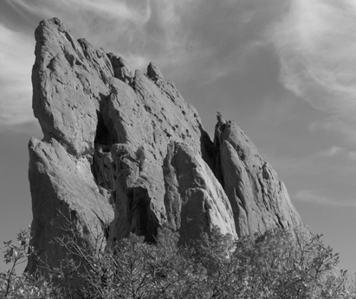
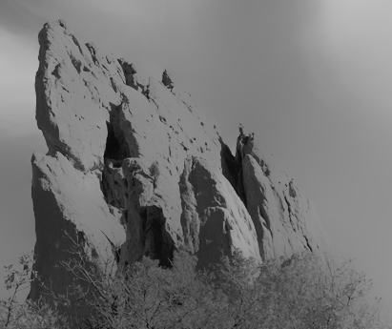
Spatially varying filters
*
input
output
*
*
Bilateral filter: kernel depends on the local image content.
See the Szeliski book for details.
Adapted from Sylvian Paris

Slide 3
Spatially varying filters
*
input
output
*
*
Compare to the result of using the same Gaussian kernel everywhere
Adapted from Sylvian Paris

Slide 4
Acknowledgement
Rest of the slides in this file are taken from:
https://people.csail.mit.edu/sparis/bf_course/
From: A Gentle Introduction to Bilateral Filtering and its Applications

Slide 5
Goal: Image Smoothing
Split an image into:
large-scale features, structure
small-scale features, texture

Slide 6
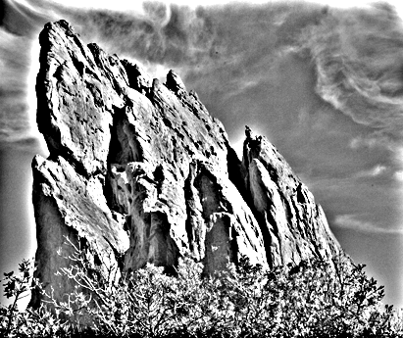
Naïve Approach: Gaussian Blur
BLUR
HALOS
smoothed (structure, large scale)
residual (texture, small scale)
input
Gaussian Convolution

Slide 7
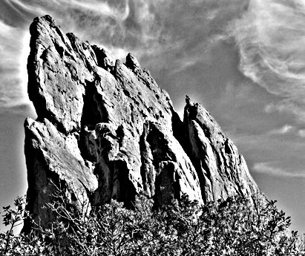
Impact of Blur and Halos
If the decomposition introduces blur and halos, the final result is corrupted.
Sample manipulation: increasing texture (residual × 3)

Slide 8
Bilateral Filter: no Blur, no Halos
smoothed (structure, large scale)
residual (texture, small scale)
input
edge-preserving: Bilateral Filter

Slide 9
input

Slide 10
increasing texture with Gaussian convolution H A L O S

Slide 11
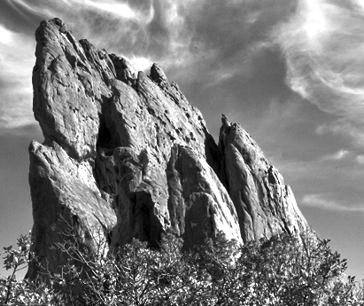
increasing texture with bilateral filter N O H A L O S

Slide 12
Many Other Options
Bilateral filtering is not the only image smoothing filter
Diffusion, wavelets, Bayesian…
We focus on bilateral filtering
Suitable for strong smoothing used in computational photography
Conceptually simple

Slide 13
Notation and Definitions
y
Image = 2D array of pixels
Pixel = intensity (scalar) or color (3D vector)
I_{p} = value of image I at position: p = ( p_{x} , p_{y} )
F [ I ] = output of filter F applied to image I
x

Slide 14
Strategy for Smoothing Images
Images are not smooth because adjacent pixels are different.
Smoothing = making adjacent pixels look more similar.
Smoothing strategy pixel → average of its neighbors

Slide 15
Box Average
square neighborhood
input
output
average

Slide 16
Equation of Box Average
result at pixel p
intensity at pixel q
sum over all pixels q
normalized box function
0

Slide 17
Square Box Generates Defects
Axis-aligned streaks
Blocky results
output
input

Slide 18
Box Profile
pixel weight
pixel position
unrelated
pixels
related
pixels
unrelated
pixels

Slide 19
Strategy to Solve these Problems
Use an isotropic (i.e. circular) window.
Use a window with a smooth falloff.
box window
Gaussian window

Slide 20
Gaussian Blur
per-pixel multiplication
*
input
output
average

Slide 21
input

Slide 22
box average

Slide 23
Gaussian blur

Slide 24
Equation of Gaussian Blur
Same idea: weighted average of pixels.
normalized Gaussian function
1
0

Slide 25
Gaussian Profile
pixel weight
pixel position
unrelated
pixels
uncertain
pixels
related
pixels
uncertain
pixels
unrelated
pixels

Slide 26
Gaussian Filter
5x5 Gaussian filter with sigma=1.0
2-D Gaussian distribution with mean (0,0) and =1
Discrete approximation to Gaussian function with =1.0
Image source: https://homepages.inf.ed.ac.uk/rbf/HIPR2/gsmooth.htm

Slide 27
Spatial Parameter
input
size of the window
small σ
large σ
limited smoothing
strong smoothing

Slide 28
How to set σ
Depends on the application.
Common strategy: proportional to image size
e.g. 2% of the image diagonal
property: independent of image resolution

Slide 29
Properties of Gaussian Blur
Weights independent of spatial location
linear convolution
well-known operation
efficient computation (recursive algorithm, FFT…)

Slide 30
Properties of Gaussian Blur
input
Does smooth images
But smoothes too much: edges are blurred.
Only spatial distance matters
No edge term
output
space

Slide 31
Blur Comes from Averaging across Edges
*
input
output
*
*
Same Gaussian kernel everywhere.

Slide 32
Bilateral Filter: No Averaging across Edges
*
input
output
*
*
The kernel shape depends on the image content.
[Aurich 95, Smith 97, Tomasi 98]

Slide 33
Bilateral Filter Definition: an Additional Edge Term
Same idea: weighted average of pixels.
new
not new
new
normalization factor
space weight
range weight
I

Slide 34
Illustration a 1D Image
1D image = line of pixels
Better visualized as a plot
pixel intensity
pixel position

Slide 35
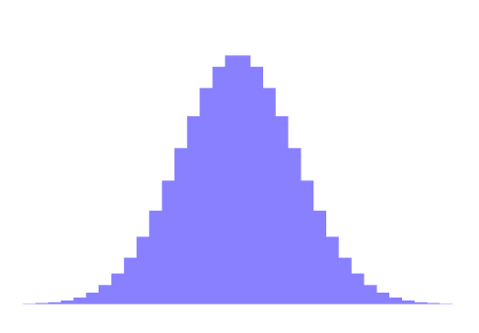
Gaussian Blur and Bilateral Filter
Gaussian blur
p
q
space
space
Bilateral filter [Aurich 95, Smith 97, Tomasi 98]
p
range
q
space
range
normalization
space

Slide 36
Bilateral Filter on a Height Field
output
input
reproduced from [Durand 02]

Slide 37
Space and Range Parameters
space σ_{s} : spatial extent of the kernel, size of the considered neighborhood.
range σ_{r} : “minimum” amplitude of an edge

Slide 38
Influence of Pixels
Only pixels close in space and in range are considered.
space
range
p

Slide 39
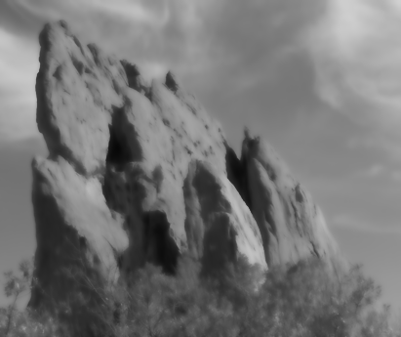
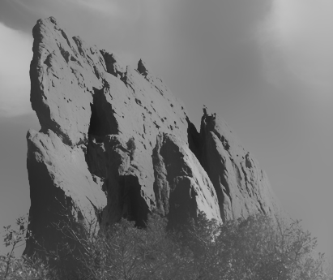
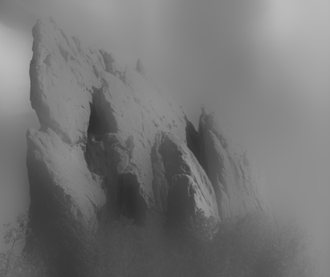
Exploring the Parameter Space
σ_{r} = ∞ (Gaussian blur)
σ_{r} = 0.1
σ_{r} = 0.25
input
σ_{s} = 2
σ_{s} = 6
σ_{s} = 18

Slide 40
Varying the Range Parameter
σ_{r} = ∞ (Gaussian blur)
σ_{r} = 0.1
σ_{r} = 0.25
input
σ_{s} = 2
σ_{s} = 6
σ_{s} = 18

Slide 41
input

Slide 42
σ_{r} = 0.1

Slide 43
σ_{r} = 0.25

Slide 44
σ_{r} = ∞ (Gaussian blur)

Slide 45
Varying the Space Parameter
σ_{r} = ∞ (Gaussian blur)
σ_{r} = 0.1
σ_{r} = 0.25
input
σ_{s} = 2
σ_{s} = 6
σ_{s} = 18

Slide 46
input

Slide 47
σ_{s} = 2

Slide 48
σ_{s} = 6

Slide 49
σ_{s} = 18

Slide 50
How to Set the Parameters
Depends on the application. For instance:
space parameter: proportional to image size
e.g., 2% of image diagonal
range parameter: proportional to edge amplitude
e.g., mean or median of image gradients
independent of resolution and exposure

Slide 51
A Few More Advanced Remarks

Slide 52
Bilateral Filter Crosses Thin Lines
Bilateral filter averages across features thinner than ~2σ_{s}
Desirable for smoothing: more pixels = more robust
Different from diffusion that stops at thin lines
close-up
kernel

Slide 53
Iterating the Bilateral Filter
Generate more piecewise-flat images
Often not needed in computational photo.

Slide 54
input

Slide 55
1 iteration

Slide 56
2 iterations

Slide 57
4 iterations

Slide 58
Bilateral Filtering Color Images
input
For gray-level images
intensity difference
scalar
output
For color images
color difference
3D vector (RGB, Lab)
The bilateral filter is extremely easy to adapt to your need.

Slide 59
Hard to Compute
Nonlinear
Complex, spatially varying kernels
Cannot be precomputed, no FFT…
Brute-force implementation is slow > 10min

