Slide 1
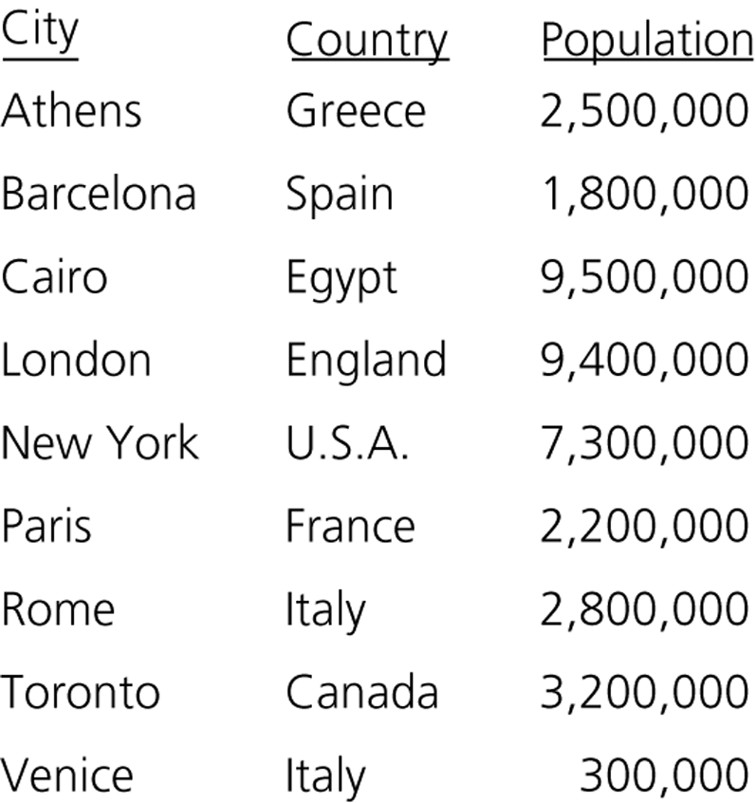
Tables
Appropriate for problems that must manage data by value.
Some important operations of tables:
  Inserting a data item containing the value x.
  Delete a data item containing the value x.
  Retrieve a data item containing the value x.
Various table implementations are possible.
  We have to analyze the possible implementations so that we can make an intelligent choice.
    Some operations are implemented more efficiently in certain implementations.
  An ordinary table of cities

Slide 2
Table Operations
Some of the table operations are possible:
The client may need a subset of these operations or require more
Are keys in the table are unique?
  We will assume that keys in our tables are unique.
  But, some other tables allow duplicate keys.
Create an empty table
Destroy a table
Determine whether a table is empty
Determine the number of items in the table
Insert a new item into a table
Delete the item with a given search key
Retrieve the item with a given search key
Traverse the table

Slide 3
Selecting an Implementation
Since an array or a linked list represents items one after another, these implementations are called linear.
There are four categories of linear implementations:
  Unsorted, array based (an unsorted array)
  Unsorted, pointer based (a simple linked list)
  Sorted (by search key), array based (a sorted array)
  Sorted (by search key), pointer based (a sorted linked list).
We have also nonlinear implementations such as binary search trees.
  Binary search tree implementation offers several advantages over linear implementations.

Slide 4

Sorted Linear Implementations
Array-based implementation
Pointer-based implementation

Slide 5
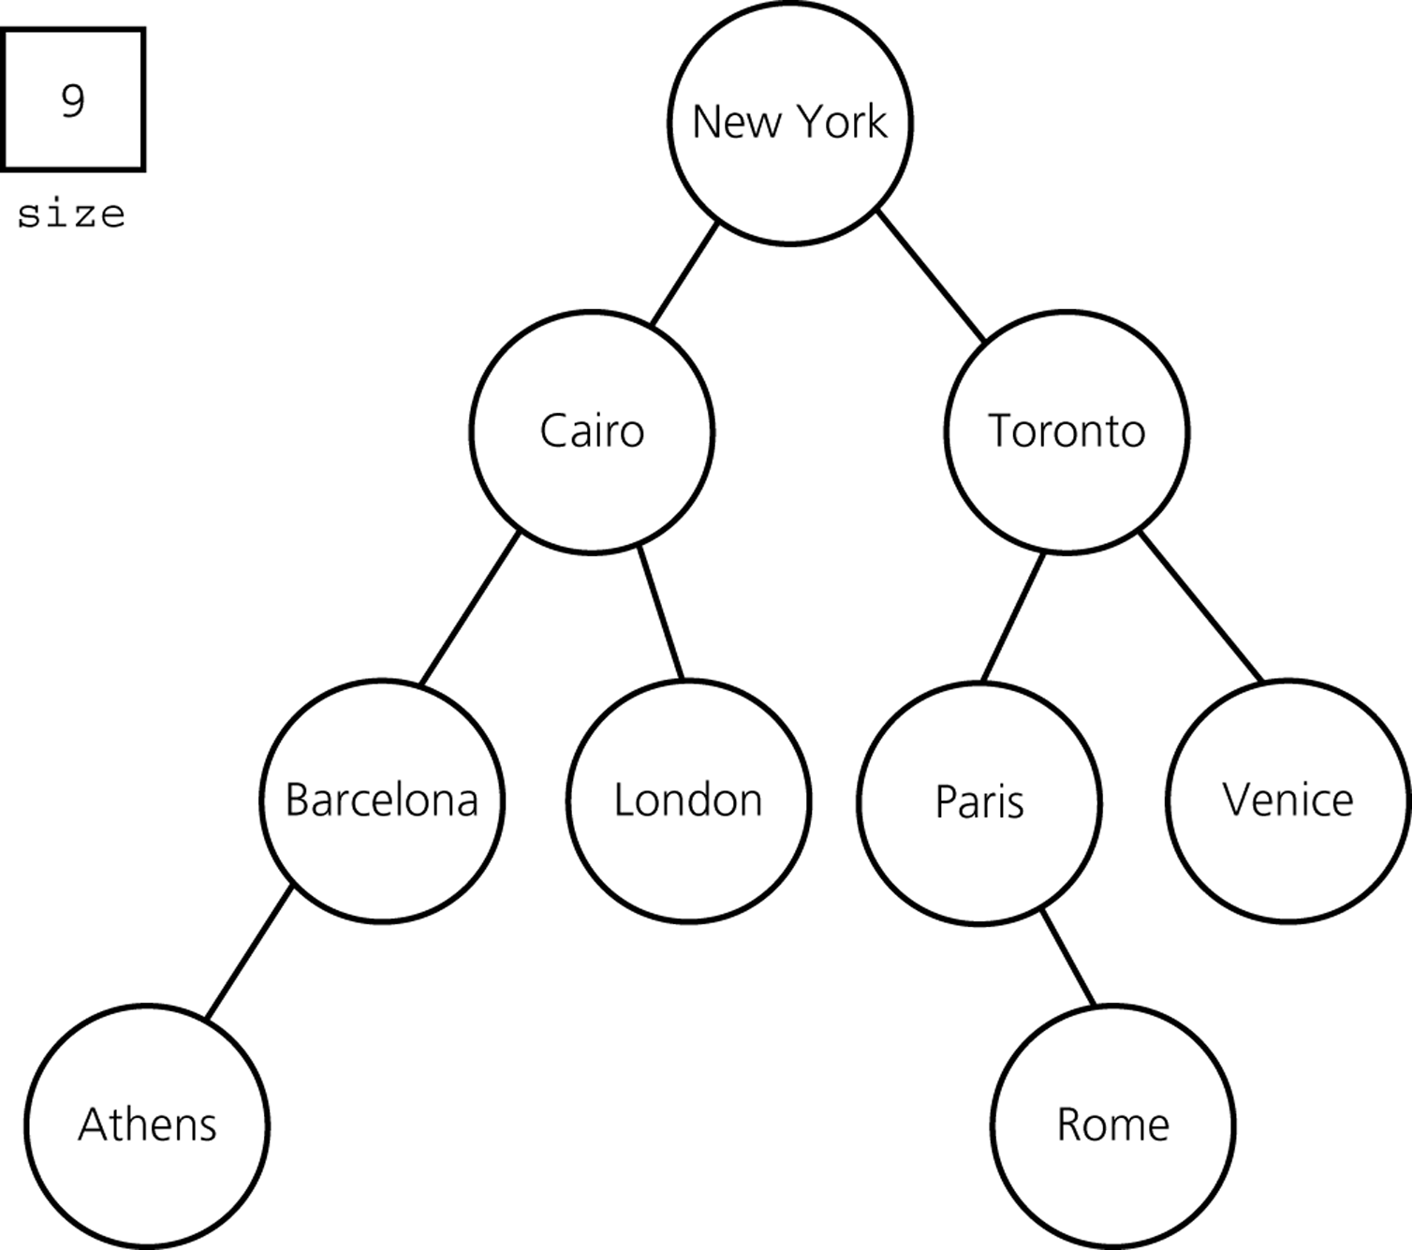
A Nonlinear Implementation
Binary search tree implementation

Slide 6
Which Implementation?
It depends on our application.
Answer the following questions before selecting an implementation.
  What operations are needed?
    Our application may not need all operations.
    Some operations can be implemented more efficiently in one implementation, and some others in another implementation.
  How often is each operation required?
    Some applications may require many occurrences of an operation, but other applications may not.
      For example, some applications may perform many retrievals, but not so many insertions and deletions. On the other hand, other applications may perform many insertions and deletions.

Slide 7
How to Select an Implementation – Scenario A
Scenario A: Let us assume that we have an application:
  Inserts data items into a table.
  After all data items are inserted, traverses this table in no particular order.
  Does not perform any retrieval and deletion operations.
Which implementation is appropriate for this application?
  Keeping the items in a sorted order provides no advantage for this application.
    In fact, it will be more costly for this application.
    ➔ Unsorted implementation is more appropriate.

Slide 8

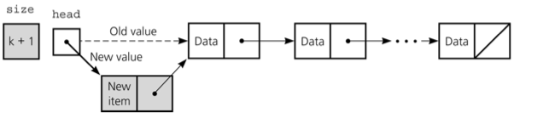
How to Select an Implementation – Scenario A
Which unsorted implementation (array-based, pointer-based)?
  Do we know the maximum size of the table?
    If we know the expected size is close to the maximum size of the table
    ➔an array-based implementation is more appropriate
    (because a pointer-based implementation uses extra space for pointers)
    Otherwise,
    ➔a pointer-based implementation is more appropriate
    (because too many entries will be empty in an array-based implementation)
Time complexity of insertion in an unsorted list: O(1)

Slide 9
How to Select an Implementation – Scenario B
Scenario B: Let us assume that we have an application:
  Performs many retrievals, but few insertions and deletions
    E.g., a thesaurus (to look up synonyms of a word)
For this application, a sorted implementation is more appropriate
  We can use binary search to access data, if we have sorted data.
  A sorted linked-list implementation is not appropriate since binary search is not practical with linked lists.
    If we know the maximum size of the table
    ➔ a sorted array-based implementation is more appropriate for frequent retrievals.
    Otherwise
    ➔ a binary search tree implementation is more appropriate for frequent retrievals.
    (in fact, balanced binary search trees will be used)

Slide 10
How to Select an Implementation – Scenario C
Scenario C: Let us assume that we have an application:
  Performs many retrievals as well as many insertions and deletions.
  ? Sorted Array Implementation
    Retrievals are efficient.
    But insertions and deletions are not efficient.
    a sorted array-based implementation is not appropriate for this application.
  ? Sorted Linked List Implementation
    Retrievals, insertions, and deletions are not efficient.
    a sorted linked-list implementation is not appropriate for this application.
  ?Binary Search Tree Implementation
    Retrieval, insertion, and deletion are efficient in the average case.
    a binary search tree implementation is appropriate for this application.
    (provided that the height of the BST is O(logn))

Slide 11
Which Implementation?
Linear implementations of a table can be appropriate despite its difficulties.
  Linear implementations are easy to understand, easy to implement.
  For small tables, linear implementations can be appropriate.
  For large tables, linear implementations may still be appropriate
  (e.g., for the case that has only insertions to an unsorted table--Scenario A)
In general, a binary search tree implementation is a better choice.
  Worst case: O(n) for most table operations
  Average case: O(log₂n) for most table operations
Balanced binary search trees increase the efficiency.

Slide 12
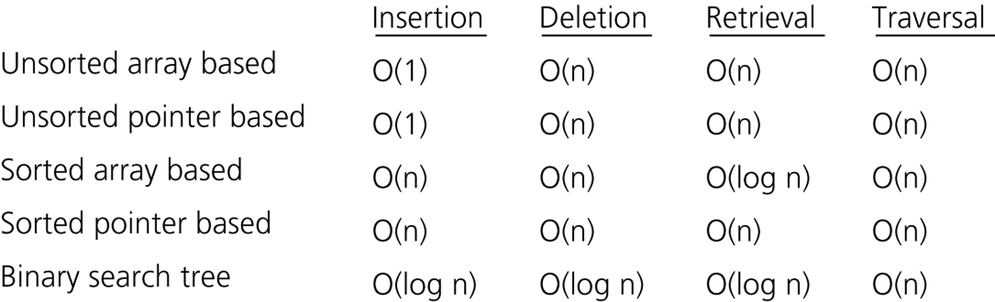
Which Implementation?
  The average-case time complexities of the table operations

Slide 13
Binary Search Tree Implementation – TableB.h
#include "BST.h"// Binary search tree operations
typedef TreeItemType TableItemType;
class Table {
public:
Table(); // default constructor
// copy constructor and destructor are supplied by the compiler
bool tableIsEmpty() const;
int tableLength() const;
void tableInsert(const TableItemType& newItem) throw(TableException);
void tableDelete(KeyType searchKey) throw(TableException);
void tableRetrieve(KeyType searchKey, TableItemType& tableItem) const
throw(TableException);
void traverseTable(FunctionType visit);
protected:
void setSize(int newSize);
private:
BinarySearchTree bst; // BST that contains the table’s items
int size; // Number of items in the table
}

Slide 14
Binary Search Tree Implementation – tableInsert
#include "TableB.h"// header file
void Table::tableInsert(const TableItemType& newItem) throw(TableException) {
try {
bst.searchTreeInsert(newItem);
++size;
}
catch (TreeException e){
throw TableException("Cannot insert item");
}
}

Slide 15
The Priority Queue
Priority queue is a variation of the table.
Each data item in a priority queue has a priority value.
Using a priority queue we prioritize a list of tasks:
  Job scheduling
Major operations:
Insert an item with a priority value into its proper position in the priority queue.
Deletion is not the same as the deletion in the table. We delete the item with the highest priority.

Slide 16
Priority Queue Operations
create – creates an empty priority queue.
destroy – destroys a priority queue.
isEmpty – determines whether a priority queue is empty or not.
insert – inserts a new item (with a priority value) into a priority queue.
delete – retrieves the item in a priority queue with the highest
priority value, and deletes that item from the priority queue.

Slide 17


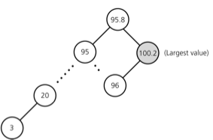
Which Implementations?
Array-based implementation
  Insertion will be O(n)
Linked-list implementation
  Insertion will be O(n)
BST implementation
  Insertion is O(log₂n) in average
  but O(n) in the worst case.
We need a balanced BST so that we can get better performance [O(logn) in the worst case] ➔ HEAP

Slide 18
Heaps
Definition:A heap is a complete binary tree such that
  It is empty, or
  Its root contains a search key greater than or equal to the search key in each of its children, and each of its children is also a heap.
Since the root contains the item with the largest search key, heap in this definition is also known as maxheap.
On the other hand, a heap which places the smallest search key in its root is know as minheap.
We will talk about maxheap as heap in the rest of our discussions.

Slide 19
Differences between a Heap and a BST
A heap is NOT a binary search tree.
  A BST can be seen as sorted, but a heap is ordered in much weaker sense.
    Although it is not sorted, the order of a heap is sufficient for the efficient implementation of priority queue operations.
  A BST has different shapes, but a heap is always complete binary tree.
50
50
50
HEAPS
40
40
45
40
45
30
35
33
50
42
50
NOT HEAPS
40
40
45
40
30
35

Slide 20
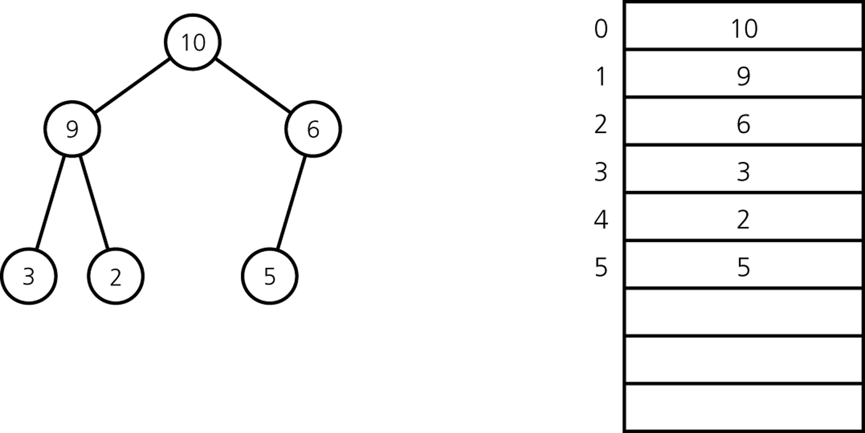
An Array-Based Implementation of a Heap
An array and an integer counter are the data members
for an array-based implementation of a heap.

Slide 21
Major Heap Operations
Two major heap operations are insertion and deletion.
Insertion
  Inserts a new item into a heap.
  After the insertion, the heap must satisfy the heap properties.
Deletion
  Retrieves and deletes the root of the heap.
  After the deletion, the heap must satisfy the heap properties.

Slide 22
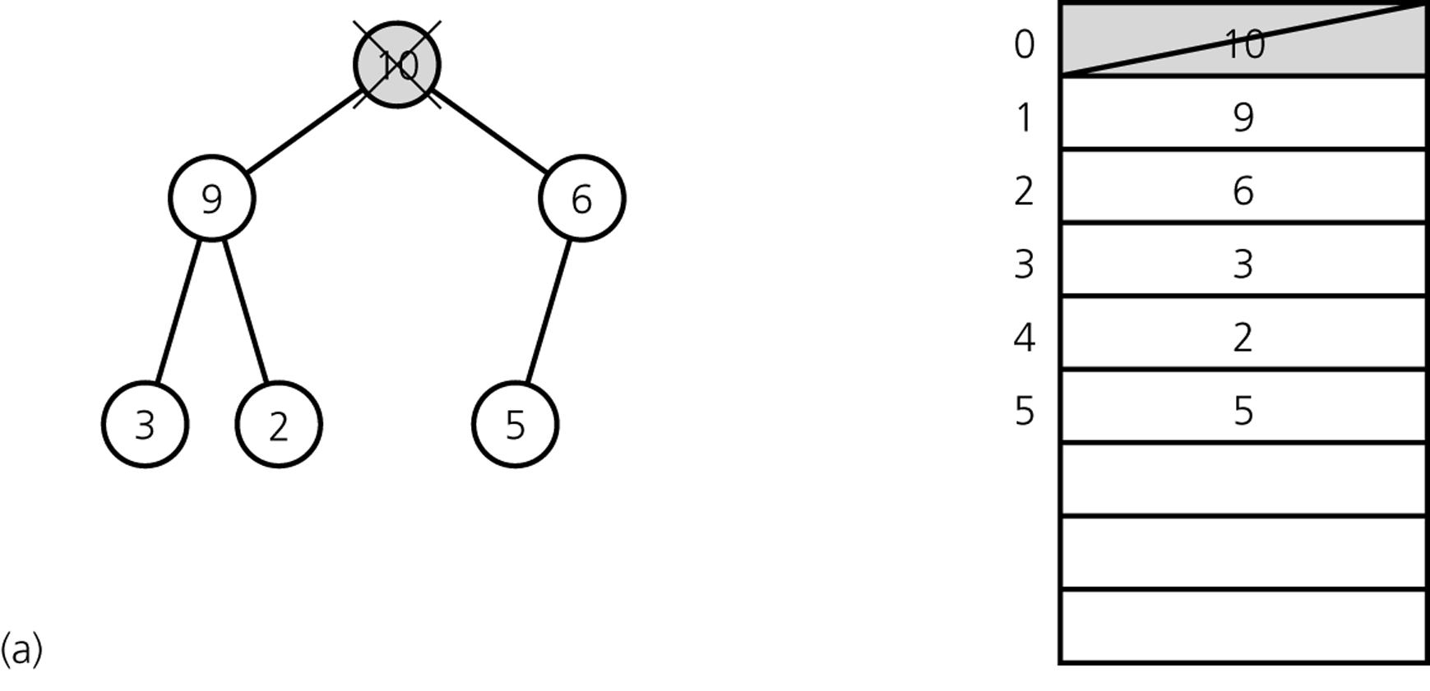
Heap Delete – First Step
The first step of heapDelete is to retrieve and delete the root.
  This creates two disjoint heaps.

Slide 23
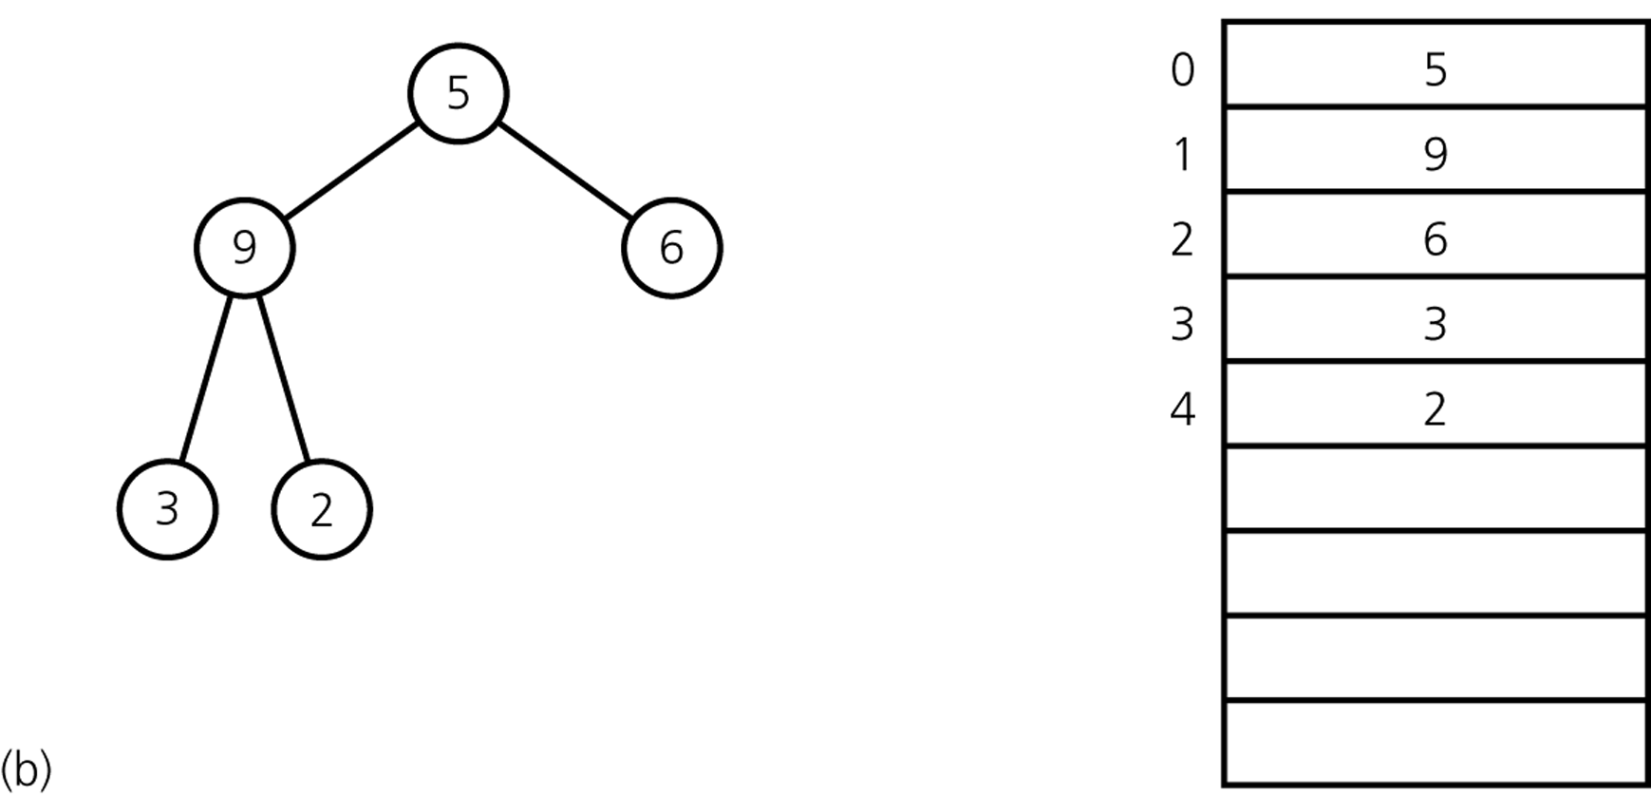
Heap Delete – Second Step
Move the last item into the root.
The resulting structure may not be heap; it is called as semiheap.

Slide 24
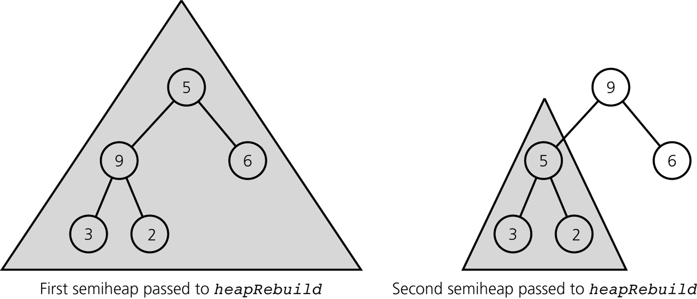
Heap Delete – Last Step
The last step of heapDelete transforms the semiheap into a heap.
Recursive calls to heapRebuild

Slide 25
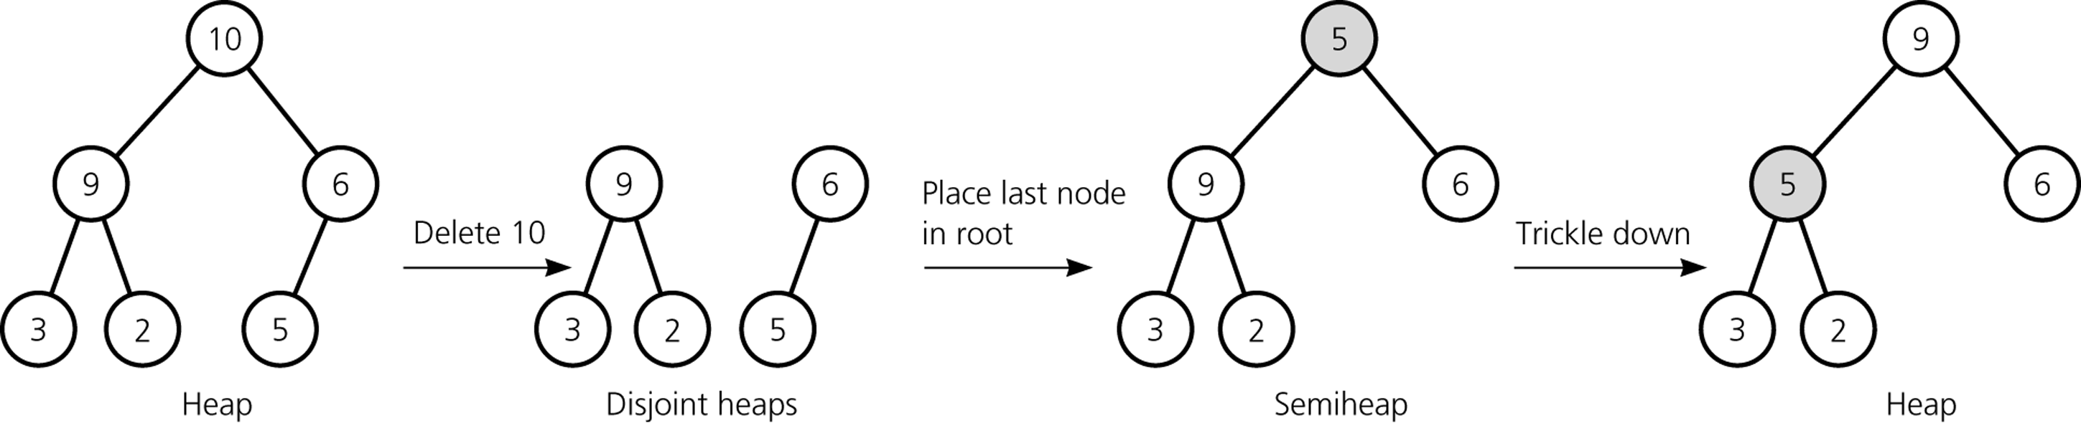
Heap Delete
ANALYSIS
Since the height of a complete binary tree with n nodes is always ⎡ log₂(n+1)⎤
➔ heapDelete is O(log₂n)

Slide 26
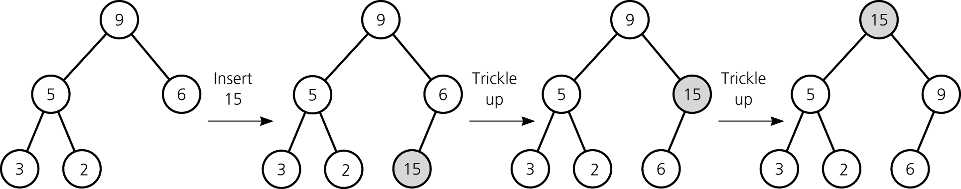
Heap Insert
A new item is inserted at the bottom of the tree,
and it trickles up to its proper place
ANALYSIS
Since the height of a complete binary tree with n nodes is always ⎡ log₂(n+1)⎤
➔ heapInsert is O(log₂n)

Slide 27
Heap Implementation
constint MAX_HEAP = maximum-size-of-heap;
#include "KeyedItem.h"// definition of KeyedItem
typedef KeyedItem HeapItemType;
class Heap {
public:
Heap(); // default constructor
// copy constructor and destructor are supplied by the compiler
bool heapIsEmpty() const;
void heapInsert(const HeapItemType& newItem) throw(HeapException);
void heapDelete(HeapItemType& rootItem) throw(HeapException);
protected:
void heapRebuild(int root); // Converts the semiheap rooted at
// index root into a heap
private:
HeapItemType items[MAX_HEAP]; // array of heap items
int size; // number of heap items
};

Slide 28
Heap Implementation
// Default constructor
Heap::Heap() : size(0) {
}
boolHeap::heapIsEmpty() const {
return (size == 0);
}

Slide 29
Recap

Slide 30
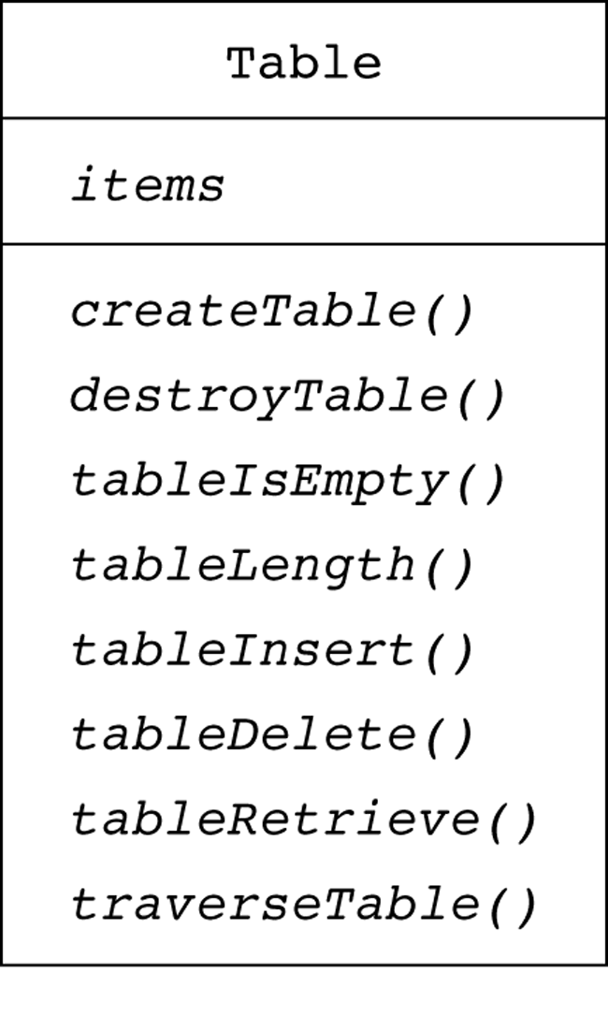
Recap

Slide 31
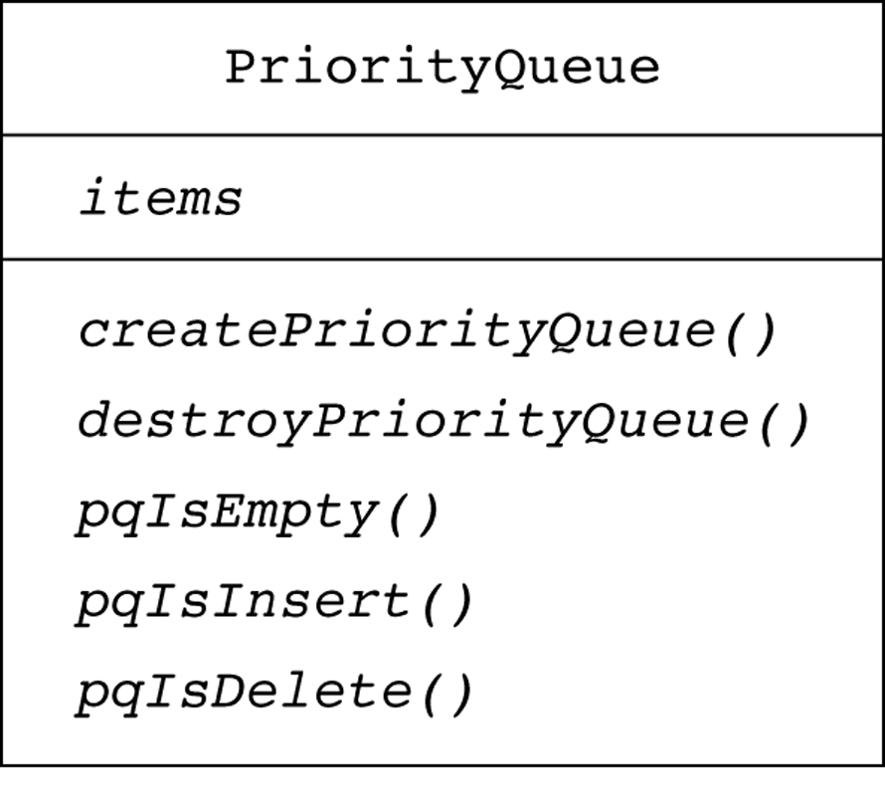
Recap

Slide 32
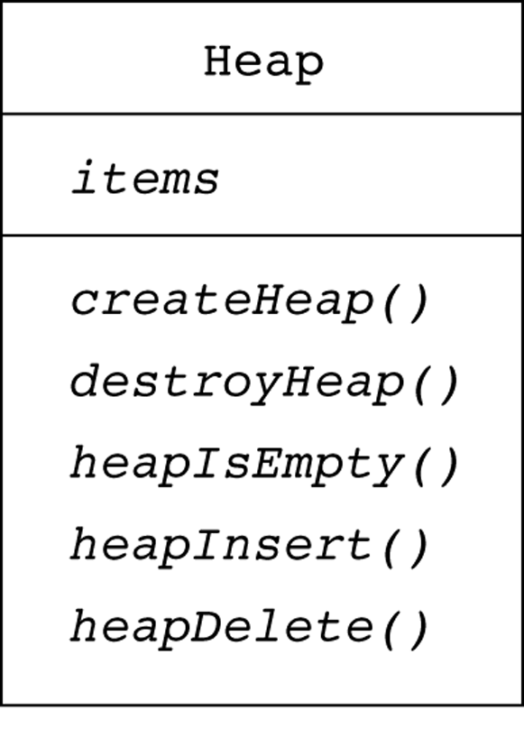
Recap

Slide 33
Recap

Slide 34
Heap Delete – First Step
The first step of heapDelete is to retrieve and delete the root.
  This creates two disjoint heaps.

Slide 35
Heap Delete – Second Step
Move the last item into the root.
The resulting structure may not be heap; it is called as semiheap.

Slide 36
Heap Delete – Last Step
The last step of heapDelete transforms the semiheap into a heap.
Recursive calls to heapRebuild

Slide 37
Heap Delete
ANALYSIS
Since the height of a complete binary tree with n nodes is always ⎡ log₂(n+1)⎤
➔ heapDelete is O(log₂n)

Slide 38
Heap Insert
A new item is inserted at the bottom of the tree,
and it trickles up to its proper place
ANALYSIS
Since the height of a complete binary tree with n nodes is always ⎡ log₂(n+1)⎤
➔ heapInsert is O(log₂n)

Slide 39
Heap Implementation -- heapInsert
void Heap::heapInsert(constHeapItemType&newItem) throw(HeapException) {
if (size >= MAX_HEAP)
throwHeapException("HeapException: Heap full");
// Place the new item at the end of the heap
items[size] = newItem;
// Trickle new item up to its proper position
int place = size;
int parent = (place - 1)/2;
while ( (place >= 0) && (items[place].getKey() >items[parent].getKey()) ) {
HeapItemType temp = items[parent];
items[parent] = items[place];
items[place] = temp;
place = parent;
parent = (place - 1)/2;
}
++size;
}

Slide 40
Heap Implementation -- heapDelete
Void Heap::heapDelete(HeapItemType&rootItem) throw(HeapException) {
if (heapIsEmpty())
throwHeapException("HeapException: Heap empty");
else {
rootItem = items[0];
items[0] = items[--size];
heapRebuild(0);
}
}

Slide 41
Heap Implementation -- heapRebuild
voidHeap::heapRebuild(int root) {
int child = 2 * root + 1; // index of root's left child, if any
if ( child < size ) {
// root is not a leaf so that it has a left child
int rightChild = child + 1; // index of a right child, if any
// If root has right child, find larger child
if ( (rightChild< size) &&
(items[rightChild].getKey() >items[child].getKey()) )
child = rightChild; // index of larger child
// If root’s item is smaller than larger child, swap values
if ( items[root].getKey() <items[child].getKey() ) {
HeapItemType temp = items[root];
items[root] = items[child];
items[child] = temp;
// transform the new subtree into a heap
heapRebuild(child);
}
}

Slide 42
Heap Implementation of PriorityQueue
The heap implementation of the priority queue is straightforward
  Since the heap operations and the priority queue operations are the same.
When we use the heap,
  Insertion and deletion operations of the priority queue will be O(log₂n).

Slide 43
Heap Implementation of PriorityQueue
#include "Heap.h"// ADT heap operations
typedef HeapItemType PQItemType;
class PriorityQueue {
public:
// default constructor, copy constructor, anddestructor
// are supplied by the compiler
// priority-queue operations:
bool pqIsEmpty() const;
void pqInsert(const PQItemType& newItem) throw (PQException);
void pqDelete(PQItemType& priorityItem) throw (PQException);
private:
Heap h;
};

Slide 44
Heap Implementation of PriorityQueue
bool PriorityQueue::pqIsEmpty() const {
return h.heapIsEmpty();
}
void PriorityQueue::pqInsert(const PQItemType& newItem) throw (PQException){
try {
h.heapInsert(newItem);
}
catch (HeapException e) {
throw PQueueException("Priority queue is full");
}
}
void PriorityQueue::pqDelete(PQItemType& priorityItem) throw (PQException) {
try {
h.heapDelete(priorityItem);
}
catch (HeapException e) {
throw PQueueException("Priority queue is empty");
}
}

Slide 45
Heap or Binary Search Tree?

Slide 46
Heapsort
We can make use of a heap to sort an array:
  Create a heap from the given initial array with n items.
  Swap the root of the heap with the last element in the heap.
  Now, we have a semiheap with n-1 items, and a sorted array with one item.
  Using heapRebuild convert this semiheap into a heap. Now we will have a heap with n-1 items.
  Repeat the steps 2-4 as long as the number of items in the heap is more than 1.

Slide 47
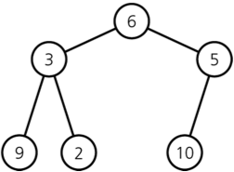

Heapsort -- Building a heap from an array
A heap corresponding to anArray
The initial contents of anArray
for (index = n – 1 ; index >= 0 ; index--) {
// Invariant: the tree rooted at index is a semiheap
heapRebuild(anArray, index, n)
// Assertion: the tree rooted at index is a heap.
}

Slide 48
Heapsort -- Building a heap from an array
A heap corresponding to anArray
The initial contents of anArray
for (index = (n/2) – 1 ; index >= 0 ; index--) { → MORE EFFICIENT
// Invariant: the tree rooted at index is a semiheap
heapRebuild(anArray, index, n)
// Assertion: the tree rooted at index is a heap.
}

Slide 49
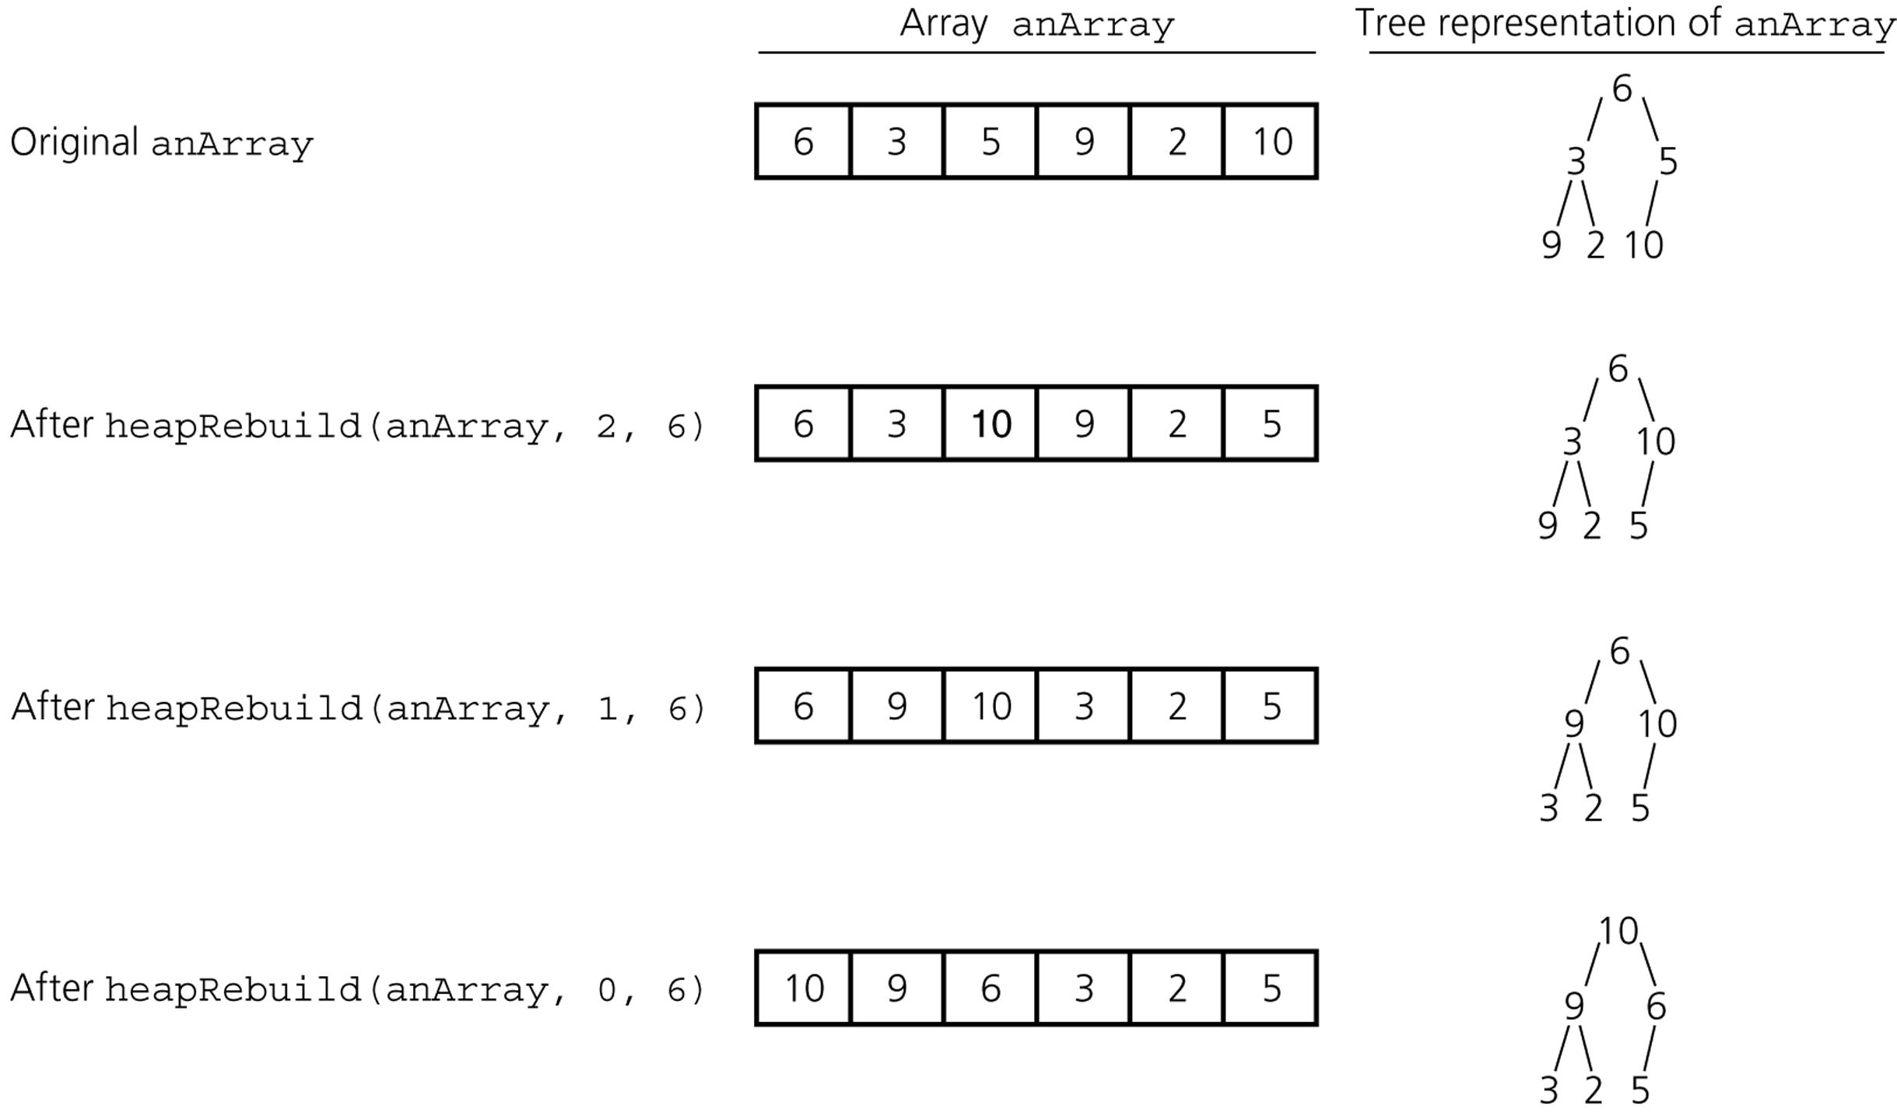
Heapsort -- Building a heap from an array

Slide 50
Heapsort
heapSort(inout anArray:ArrayType, in n:integer) {
// build an initial heap
for (index = (n/2) – 1 ; index >= 0 ; index--)
heapRebuild(anArray, index, n)
for (last = n-1 ; last >0 ; last--) {
// invariant: anArray[0..last] is a heap,
// anArray[last+1..n-1] is sorted and
// contains the largest items of anArray.
swap anArray[0] and anArray[last]
// make the heap region a heap again
heapRebuild(anArray, 0, last)
}
}

Slide 51
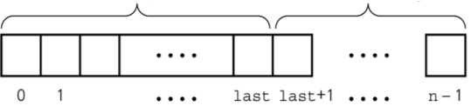
Heapsort
Heapsort partitions an array into two regions.
Each step moves an item from the HeapRegion to SortedRegion.
The invariant of the heapsort algorithm is:
  After the kth step,
  The SortedRegion contains the k largest value and they are in sorted order.
  The items in the HeapRegion form a heap.
HeapRegion
SortedRegion

Slide 52
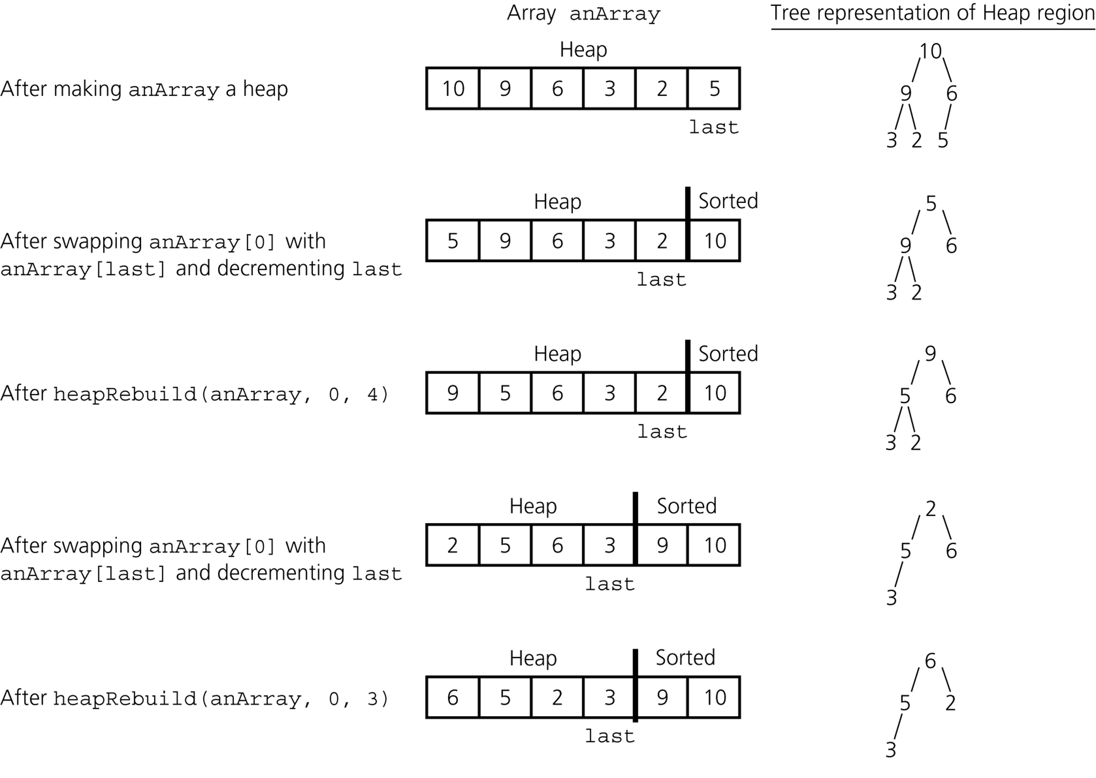
Heapsort -- Trace

Slide 53
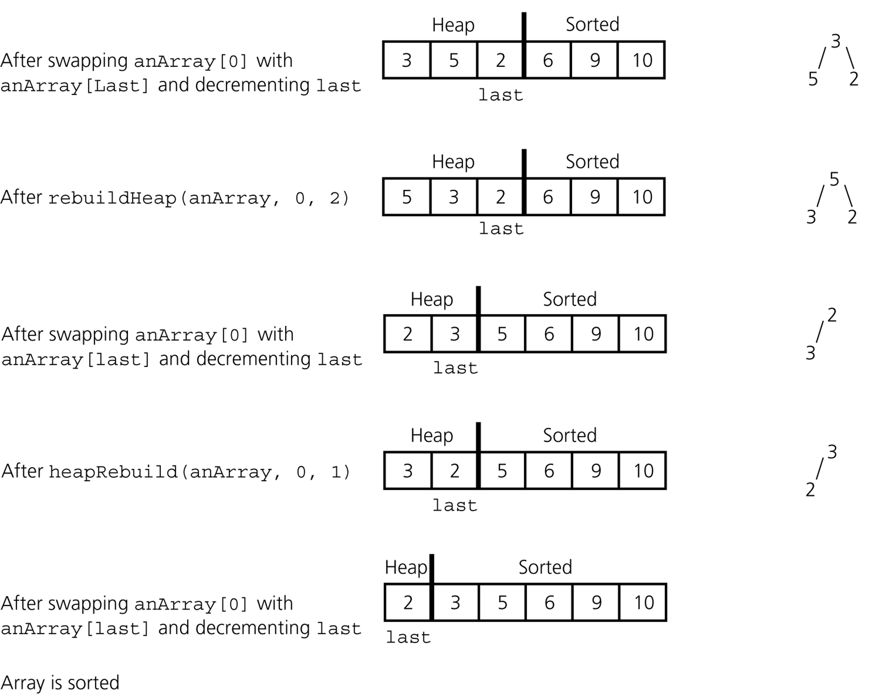
Heapsort -- Trace

Slide 54
Heapsort -- Analysis
Heapsort is
O(n log n) at the average case
O(n log n) at the worst case
Compared against quicksort,
  Heapsort usually takes more time at the average case
  But its worst case is also O(n log n).

